Slide 1

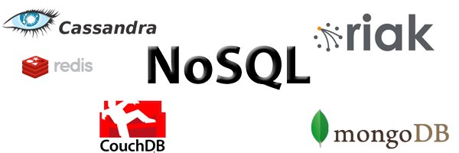
An Open Source NoSQL solution for Internet Access Logs Analysis
A practical case of why, what and how to use a NoSQL Database Management System instead of a relational one
José Manuel Ciges Regueiro <jmanuel@ciges.net> - Student of the V Master on Free Software Projects Development and Management 2011-2012

Slide 2

Author's description
Spanish systems engineer who has been working at PSA Peugeot Citroën for the last 9 years
My department provides support for Open Source servers on Unix
  Apache web server, MySQL, PHP, Tomcat, MediaWiki …
  We work with around 450 servers
The IT department at PSA employs 2.600 people in 26 different countries and has around 10.000 servers including Unix, Windows, z/OS, VMS, Tandem/Guardian …
I'm also:
  Father
  Internet, GNU/Linux & Free Software fan boy
  Always looking for something :-)

Slide 3

Why NoSQL?
The term “NoSQL” exists from 1998 and is used to designate DBMS who don't use SQL
Problems like statistical data analysis, log information, web page indexing, geographical information management ….
  manage huge amounts of data
  use distributed data between very many machines
  distribute also the operations on the data
  need a fault tolerant architecture
  read & write performance are critical. Relations are not really important, it's preferred to duplicate data
  May not give full ACID guarantees
Who uses it? Google, Facebook, Amazon, Twitter ...

Slide 4

Objectives & work plan
Our goals were
  Acquire knowledge on the subject
  Identify what NoSQL technologies could be useful for PSA
  Get one or more tests cases and build a demo
  Offer a NoSQL solution to development team
The work plan has been
  Read, read & read about current Open Source NoSQL solutions
  Choose one for the use case of Internet Access Log management
  Develop a little API, scripts and design a schema to compare NoSQL vs MySQL
  Compare them

Slide 5
Types of NoSQL DBMS
NoSQL databases are categorized according to the way they store the data
“Document-oriented databases” : The element of data is called “document”. Each document can have a different number of fields
    MongoDB, CouchDB
“Key-value databases” : Data is stored as key-value pairs. A value can be of any data type or object.
    Cassandra, Membase, Redis, Riak
“Graph databases” : Oriented towards data whose relations are well represented with a graph-style (social relations, maps, network topologies …)
    Neo4J, FlockDB
“Tabular/Columnar databases” : data is organized in columns. Each row has one or more values for a number of possible columns.
    HBase, Cassandra

Slide 6

Analyse of Internet access logs
Storage and analysis of the logs saved by the proxies who give access to the Internet
Each hit has information like: Date and time of access, user name, accessed URL, size in bytes …
Questions we want to answer:
  Which are the most visited pages?
  And the most visited per month? And last week?
  Which users spend more time online?
  Which are the 100 users whose traffic volume is greater?
  What is the average daily volume of traffic from the corporate network to the Internet?
Volume estimation by month (for 70.000 users)
  Data size: between 150 and 300 GB
  Log entries number: between 650 million and and 1.700 million
In a year we could reach a stored volume of 3.600 GB for 20 billion log entries

Slide 7

Searching for a NoSQL solution
We should be able to answer the following questions:
  What type of data will be handled?
  Can this data be naturally organized in associative Arrays? Or in key-value pairs? Is it data which will fit in a XML or similar structure?
  Do we need transactions?
  Do we need to use “Map Reduce”?
And when reviewing the different options:
  Is the latest version considered stable?
  Does it have commercial support?
  What is the learning curve?
  Is good documentation available? Is there an active community?

Slide 8

Description of our data
Access logs generated by several HTTP proxies:
Two different type of records: records from FTP access and from the rest (mainly HTTP)
  For each FTP access we will save: IP, user, date and time, accessed domain, URI, Size
  For each NonFTP access: IP, user, date and time, HTTP method used, protocol, accessed domain, URI, return code, size
The following statistical reports will be created:
  Number of hits and volume of data transferred by Internet domain, daily and monthly
  Number of hits and volume of data transferred by user, daily and monthly

Slide 9
Definition of our needs
The data:
  data is composed by records with multiple fields
    document-oriented database or tabular
  records are unrelated to each other
  each entry is stored in a log table as it grows indefinitely
  accesses to the database are mostly writing
The reports:
  the list of queries sent by our application is known
  Map Reduce is desired
  each access means a change in daily and monthly access totals by domain and user for having real-time information

Slide 10
Definition of our needs (2)
We don't need:
  master-master replication (proxies in different geographic areas manage accesses from different users)
  support for multiple versions
  real data consistency
  Transactions
Also, the chosen product must be:
  Open Source
  Ready for production environments
  With professional support

Slide 11
Choosing between several NoSQL solutions
If we discard the databases that hold data in memory, as key-value pairs and graphs we are left with: MongoDB, CouchDB, Cassandra, HBase and Riak
At last I have chosen MongoDB
Why not CouchDB:
  We don't need versioning
  It's not very mature (latest version is 1.2.0 and has changes that make it incompatible with the previous versions)
  To exploit the data it is necessary to define views previously
Why not Riak:
  It has two versions, one open source and a commercial one with multi-site replication
Why not Cassandra:
  Too complex
Why not HBase:
  Too complex

Slide 12

Why MongoDB
Meets all the requirements stated at the beginning
document-oriented and very flexible in structuring the data (uses JSON)
has support for Map-Reduce
stable and considered production ready (current version is 2.2)
has a complete website with extensive documentation and comprehensive guides
professionally supported. Support is given by the same company that developed the product, 10gen.
  very active, they are present in many conferences and lectures (FOSDEM 2012, by example)
comparatively this product does not seem too complex
there are native drivers for multiple languages made by 10gen
Open Source, of course :-)

Slide 13

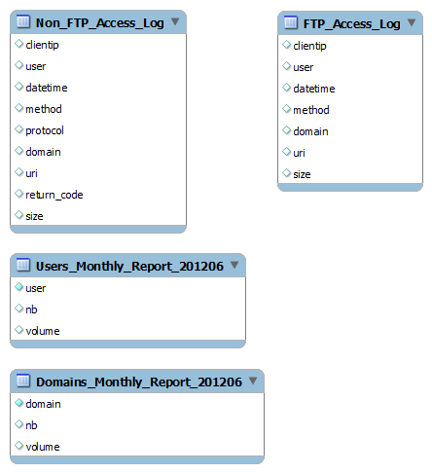
Schema Design for Internet Access Log control
Equivalent MySQL database
Access Logs: FTP connections are stored in a different table than the Non FTP (mostly HTTP)
Two totals are stored per user and domain by month: number of access and volume in bytes downloaded. Then, for each month we have two tables, one with the users information and a second one with domains information.

Slide 14
Schema Design for Internet Access Log control
MongoDB
Data is grouped into “collections” (as tables) and each element of data is called a “document”.
Unlike relational databases there is no need to define an structure. Each document could have a different number of fields, and also contain other documents.
NonFTP_Access_Log
{
"userip": string,
"user": string,
"datetime": MongoDate,
"method": string,
"protocol": string,
"domain": string,
"uri": string,
"return_code": integer,
"size": integer
}
Users_Monthly_Report_201204
{
"_id": "Userid"
"Nb": integer,
"Volume": integer,
"Daily": {
"0": {
"Nb": integer,
"Volume": integer
},
"1": {
"Nb": integer,
"Volume": integer
},
"2": {
"Nb": integer,
"Volume": integer
},
"3": {
"Nb": integer,
"Volume": integer
},
....
"30": {
"Nb": integer,
"Volume": integer
},
},
}
FTP_Access_Log
{
"userip": string,
"user": string,
"datetime": Date,
"method": string,
"domain": string,
"uri": string,
"size": integer
}
MongoDB schema shown as pseudo code

Slide 15
Comparative of a MySQL based solution vs MongoDB
We are going to:
Develop code to fill them with “fake but realistic” data
    70.000 users
    70.000 IPs
    1.300.000 Internet domains
    90.000.000 of Non FTP log entries
    4.500.000 of FTP log entries
Define a battery of tests to compare the performance of both solutions
  MongoDB 2.2.0
  MySQL 5.0.26 with MyISAM tables

Slide 16

PHP classes developed
I have developed three PHP classes:
“RandomElements” class: with functions like getRandomDomain(), getRandomFTPMethod() … which are used to generate the random elements of data
“MongoRandomElements” and “MySQLRandomElements” classes, which are children classes of the previous one and have added functions to work with each database management system.
  The interface for these two classes is the same
  These classes are used by almost all the tests scripts
They have functions to:
Save a random user in the database
Create lists of random domains, IPs and users and save them in tables/collections
Verify if a user exists in the list of random users
Get one random user/domain/IP from the list of created users/domains/IPs
Create a new log entry getting the (random) elements needed and save it into the database
…

Slide 17
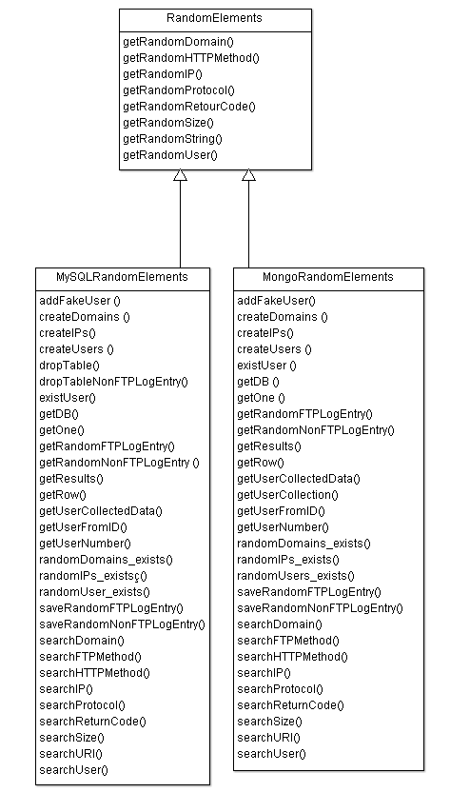
PHP classes developed (2)
Sample code:
$mre = new MongoRandomElements();
$mre->createUsers(70000);
$mre->createIPs(70000);
$mre->createDomains(1300000);
// Example data for April
$start = mktime(0,0,0,4,1,2012);
$end = mktime(23,59,0,4,30,2012);
for ($i = 0; $i < 30000000; $i++) {
$log = $mre->getRandomNonFTPLogEntry($start, $end);
$mre->saveRandomNonFTPLogEntry($log);
}
for ($i = 0; $i < 1500000; $i++) {
$log = $mre->getRandomFTPLogEntry($start, $end);
$mre->saveRandomFTPLogEntry($log);
}
UML diagram

Slide 18

Insertion tests results
We ran 10 tests for inserting data in MongoDB and MySQL (20 PHP scripts)
 | MongoDB | MySQL
70.000 users | 3s | 12s
70.000 IPs | 3s | 12s
1.300.000 domains | 58s | 4m 36s
70.000 unique users with indexes | 23s | 28s
70.000 unique IPs with indexes | 22s | 31s
1.300.000 unique domains with indexes | 8m27s | 14m13s
1.000.000 log entries | 12m7s | 26m14s
5.000.000 log entries | 1h03m53s | 2h10m54s
10.000.000 log entries | 1h59m11s | 3h27m10s
30.000.000 log entries | 5h55m25s | 10h18m46s

Slide 19
Multiuser concurrent tests
These tests will simulate simultaneously accessing users
The request are made to PHP scripts available via web
The load tests were done with the open source tool JMeter and the graphical representation with R
Six scripts were developed, which will perform the following tests for MongoDB and for MySQL
Search and show data for a random user (read test)
Add a random user (write test)
Search and show data for a random user or add a random user (read & write test, 80% of times will read and 20% of times will write)
We will simulate two scenarios
An incrementing load from 0 to 50 users rising by five
A load of 50 users sending all queries from the beginning.

Slide 20
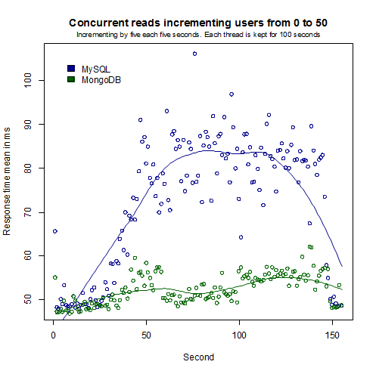
Concurrent reads tests results
Incrementing users from 0 to 50 (each thread will be kept for 100 seconds)
 | Samples | Med | Min | Max | Std. Dev. | Throughput | KB/sec
MongoDB | 112.165 | 48ms | 43ms | 3.090ms | 18,72ms | 728,3 q/s | 184,99 kb/s
MySQL | 81.179 | 67ms | 45ms | 3.140ms | 40,92ms | 528 q/s | 134,08 kb/s

Slide 21
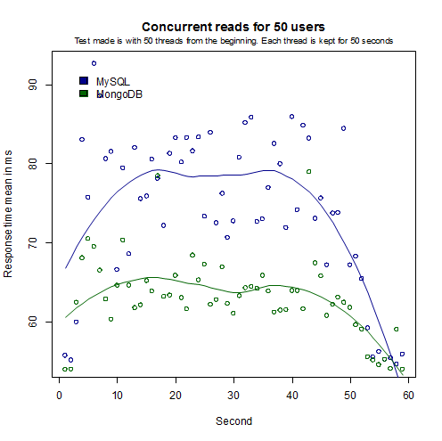
Concurrent reads tests results (2)
50 users from the beginning (each thread will be kept for 50 seconds)
 | Samples | Med | Min | Max | Std. Dev. | Throughput | KB/sec
MongoDB | 37.497 | 54ms | 50ms | 5.419ms | 161,04ms | 635,4 q/s | 122,88 kb/s
MySQL | 32.273 | 62ms | 52ms | 5.136ms | 156,90ms | 547,9 q/s | 114,54 kb/s

Slide 22
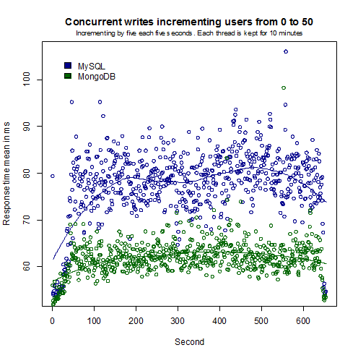
Concurrent writes tests results
Incrementing users from 0 to 50 (each thread will be kept for 10 minutes)
 | Samples | Med | Min | Max | Std. Dev. | Throughput | KB/sec
MongoDB | 464.853 | 54ms | 49ms | 3.105ms | 27,71ms | 710,9 q/s | 148,67 kb/s
MySQL | 383.700 | 70ms | 51ms | 4.105ms | 25,58ms | 586,7 q/s | 122,64 kb/s

Slide 23
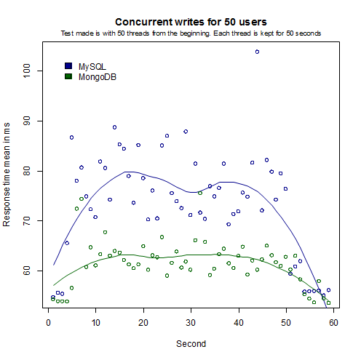
Concurrent writes tests results (2)
50 users from the beginning (each thread will be kept for 50 seconds)
 | Samples | Med | Min | Max | Std. Dev. | Throughput | KB/sec
MongoDB | 37.497 | 54ms | 50ms | 5.419ms | 161,04ms | 635,4 q/s | 132,88 kb/s
MySQL | 32.273 | 62ms | 52ms | 5.136ms | 156,90ms | 547,9 q/s | 114,54 kb/s

Slide 24
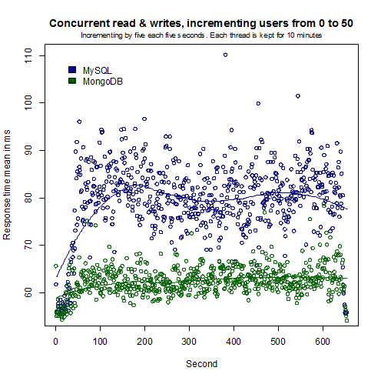
Concurrent reads & writes tests results
Incrementing users from 0 to 50 (each thread will be kept for 10 minutes)
 | Samples | Med | Min | Max | Std. Dev. | Throughput | KB/sec
MongoDB | 462.740 | 55ms | 48ms | 3.111ms | 26,24ms | 707,7 q/s | 173,45 kb/s
MySQL | 373.484 | 71ms | 52ms | 3.152ms | 27,98ms | 571,1 q/s | 139,91 kb/s

Slide 25
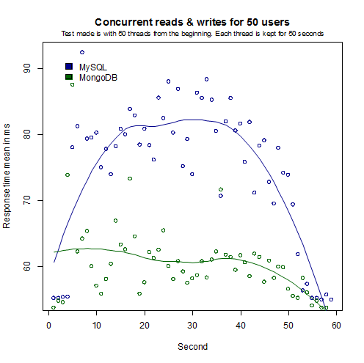
Concurrent reads & writes tests results
50 users from the beginning (each thread will be kept for 50 seconds)
 | Samples | Med | Min | Max | Std. Dev. | Throughput | KB/sec
MongoDB | 39.096 | 54ms | 50ms | 4.753ms | 142,72ms | 665,0 q/s | 162,93 kb/s
MySQL | 31.272 | 64ms | 52ms | 5.964ms | 176,64ms | 530,0 q/s | 129,8 kb/s

Slide 26
Data analyse (aggregation) read tests
This tests are made to compare the aggregation capabilities of both database management systems.
The queries have been done over 90 million of log records
  Which are the 10 most visited domains and how many visits has each one?
  Which are the 10 most visited domains in the second half of June?
  Which are the 10 users that have more Internet accesses?
  What is the average Internet traffic for June?
 | MongoDB | MySQL
10 most visited domains with visit totals | 13m13s | 2m37s
10 most visited domains in the second half of June | 52m39s | 17m43s
10 users with the most Internet accesses | 24m02s | 3m53s
Average Internet traffic for June | 12m05s | 2m42s

Slide 27
Example of MongoDB's aggregation framework
Which are the 10 most visited domains in the second half of June?
First, we get the minimum value of the 10 highest visits per domain
$mre = new MongoRandomElements("mongodb", "mongodb", "localhost", "InternetAccessLog");
$start = new MongoDate(strtotime("2012-06-15 00:00:00"));
$end = new MongoDate(strtotime("2012-06-30 23:59:59"));
$min_value = $mre->getOne(array(
array('$match' => array('datetime' => array( '$gt' => $start, '$lt' => $end ))),
array('$group' => array('_id' => '$domain', 'visits' => array( '$sum' => 1 ))),
array('$group' => array('_id' => '$visits')),
array('$sort' => array('_id' => -1)),
array('$limit' => 10),
array('$sort' => array('_id' => 1)),
array('$limit' => 1),
), "NonFTP_Access_log");
Then, we obtain all the domains with at lest that value for the number of visits
$data = $mre->getResults(array(
array('$match' => array('datetime' => array( '$gt' => $start, '$lt' => $end ))),
array('$group' => array('_id' => '$domain', 'visits' => array( '$sum' => 1 ))),
array('$match' => array('visits' => array( '$gte' => $min_value)))
), "NonFTP_Access_log");
foreach($data as $doc) { print_r($doc); }

Slide 28
Conclusions and last words
Write performance:
MongoDB is faster in pure write performance
For continuous simple writings MongoDB is from 2 to 4 times faster. For high numbers simple writing performance is the double of MySQL
In concurrent writes MongoDB is faster (15% and 30% in our tests)
Read performance:
MongoDB is faster in pure read performance
In concurrent reads MongoDB is faster (15% and 40% in our tests)
Aggregation performance:
Here MySQL wins over MongoDB's aggregation native framework. MySQL is much faster in aggregating data, 3 to 6 times faster for the 4 tests we have done
MongoDB is more scalable, meaning that when the user load increases the response time keeps stable.
For intensive reading and writing data operations MongoDB is a better option that MySQL when no relations nor aggregation queries performance are important and the data reading/writing performance is critical.

Slide 29

Initial planning and actual time spent on each task
The initial estimated work charge was 300 hours. The actual time spent has been of more of 400 hours divided as follows:
Tasks | Time spent
Study of NoSQL articles & books | 65 h
MongoDB installation, configuration, package creation & updates | 58 h
Development of a schema for Internet Access Log | 20 h
Scripts development (PHP, SQL, JavaScript, MySQL stored procedures) | 68 h
Load tests | 75 h
Documentation (memory, posts on ciges.net & presentation) | 93 h
Incidents analyse & resolution | 18 h
Planning, coordination & communication | 43 h
Total | 440 h

Slide 30
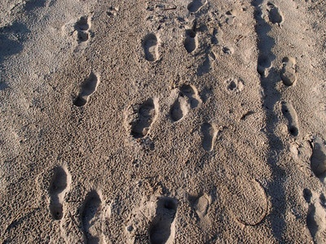
Future work
To complete this work the following should be done
Add tests with a multi-machine configuration using sharding
Also other future lines of work could be:
Test map-reduce operations with Hadoop integration
Test map-reduce operations with V8 JavaScript engine
Repeat the tests with a huge quantity of data

Slide 31

Contributions to the community
The contribution to the community is documentation and source code.
All source code (PHP classes, scripts and configuration files), documentation and detailed instructions to repeat the tests are available on
Github repository “Ciges / internet_access_control_demo”
My personal web page http://www.ciges.net, which has been created and contains a series of posts which summarize this work (in Spanish)
Contributions to the Wikipedia
Rewriting of English articles: “MongoDB”, “CouchDB” and French “MongoDB”
Minor edition on other articles like English “CAP theorem”, “NoSQL”, “Textile (markup language)”, “Apache Cassandra”
Questions opened and answered on Stack Overflow (and also in MongoDB's JIRA)
“Map Reduce with MongoDB really, really slow (30 hours vs 20 minutes in MySQL for an equivalent database)”
“Simple tool for web server benchmarking?”
“Simultaneous users for web load tests in JMeter?”

Slide 32

Technologies used
Technologies used to make this work:
MongoDB and MySQL
PHP, JavaScript, SQL, Stored procedures, Shell
Vim, Notepad++, phpDocumentor
Apache JMeter, R
LibreOffice
Textpattern CMS, GitHub, Slideshare
...

Slide 33

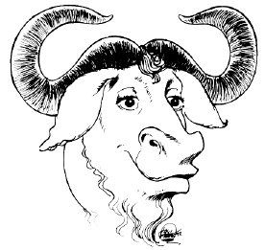
That's all Folks! Any questions?
This presentation, all the articles and documents have the licence Creative Commons Attribution-ShareAlike 3.0 Unported.
The source code has the licence GNU GPL 3.0
Most of clip arts have been taken from Open Clip Art Library web openclipart.org

