Slide 1
Coursera Capstone Project Data Science Specialization
The Idea of Starting Up a Kebab Restaurant in Istanbul
Cihan Ersoy

Slide 2
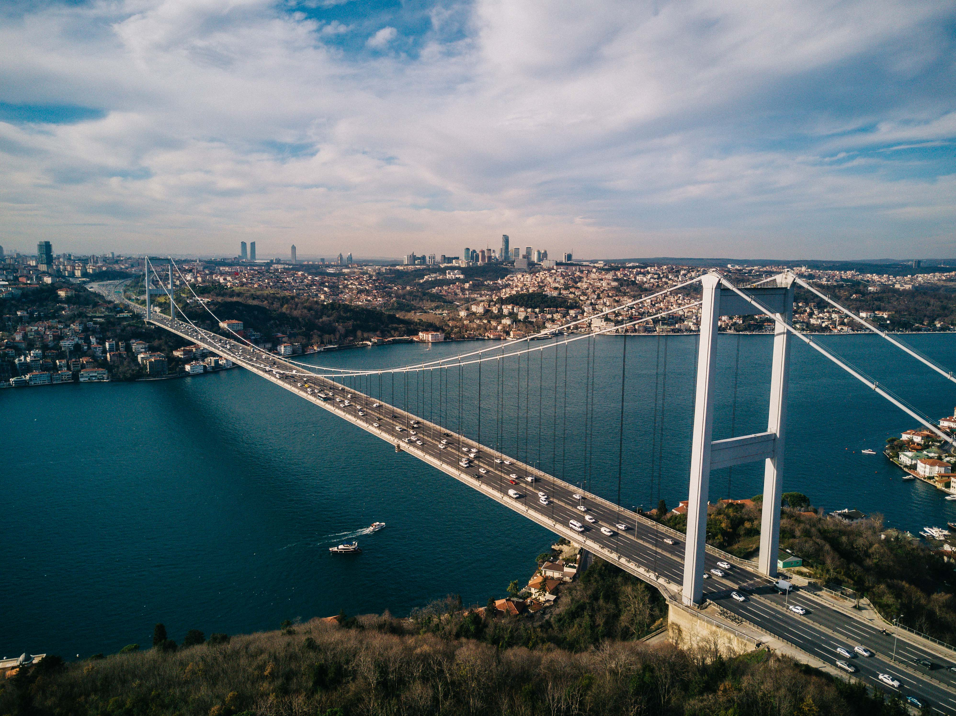
Istanbul, Turkey

Slide 3
Introduction
Turkish cousine is one of the most spectecular things in the world, and kebab is by far the most popular Turkish food of all. Therefore, there are many kebab shops in Istanbul, which is the most populated and most famous city in Turkey. Although restaurant industry is having hard times in 2020 due to pandemic, I believe there will be still room for opportunities after the virus is gone. For this reason, I have decided to make my capstone Project on opening a kebab restaurant in Istanbul. Because the location of a restaurant is a key factor for its success, using data science to determine it will be useful and profitable for our business.

Slide 4
Business Problem
In this project, I am planning to provide an analysis of the location choices for a restaurant in such a big city like Istanbul. The city of Istanbul is full of opportunities only if you know where to look. Emerging technologies help us to use science to make better decisions instead of our gut feeling and instinctions. As a result, I will try to use data science to solve a business problem which is to find most proper location for a restaurant in Istanbul.

Slide 5
Target Audience
Target audience of this project is entrepreneurs, restaurant chefs, and investors who look for a new start-up business to put money in. Also the methods which are used throughout the project may draw technology enthusiasts' attention. Potential stakeholders should keep in mind that this project has been prepared in the year of 2020. Lots of restaurants and other businesses are going bankrupt because of ongoing pandemic. So the conclusion of this project may be irrelevant in coming years.

Slide 6
Data
The data below will be used to solve this problem.
. Neighborhood details of Istanbul. This will be the backbone of the project.
. Geographical details of the neighborhoods. This will help us for visualization.
.Restaurant details will be collected to use for clustering purposes.
.en.wikipedia.org/wiki/List_of_neighbourhoods_of_Istanbul seems to have necessary information.

