Slide 1
Smart Plastic Waste Management using SVM
BTECH
ML COURS/ ASSIGNEMENT
MPWETO CIKURU ELIE/ 25RP20436 - Date

Slide 2
Problem Statement
Manual waste sorting is inefficient, hazardous, and leads to contamination of recyclable streams.
Objective: Develop a low-cost sensor-based SVM system to classify and sort plastic waste automatically.

Slide 3
Dataset Description
Dataset: CSV with sensor readings (sensor1, sensor2, sensor3, sensor4, sensor5, sensor6) and labels (0=Non-Plastic,1=Plastic).
Samples: 100 rows. Format: CSV for ML pipeline.

Slide 4
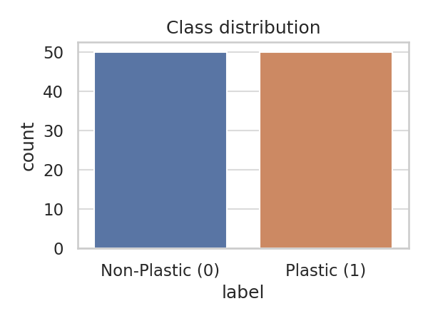
EDA Findings
Key EDA findings:
- Class distribution: {1: 50, 0: 50}
- IR and Capacitive sensors show discriminative patterns.
- Some outliers observed in weight sensor readings.

Slide 5
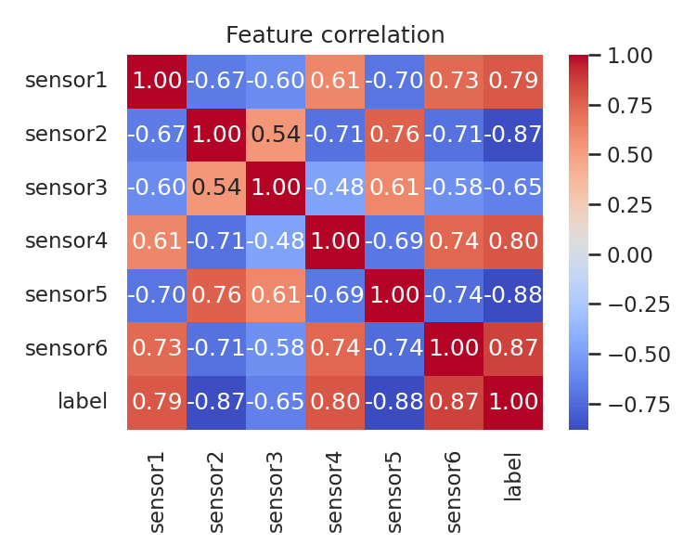
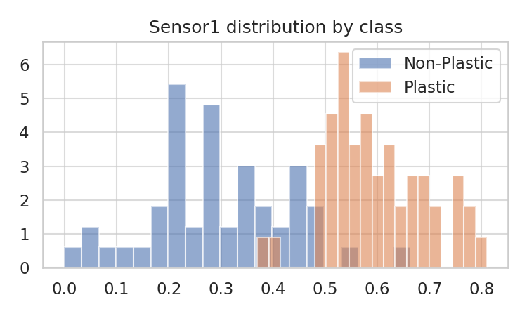
EDA: Correlation & Sensor Distributions

Slide 6
Feature Engineering Steps & Justification
- Impute missing values (median) to handle sensor dropouts.
- Scale features using StandardScaler so SVM performs well.
- Keep all six sensors as features as each adds unique signal.

Slide 7
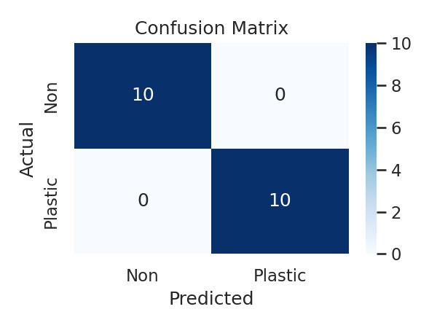
Model Building & Evaluation
- Algorithm: Support Vector Machine (RBF kernel)
- Train/Test split: 80/20
- Metrics: Accuracy=1.000, Precision=1.000, Recall=1.000, F1=1.000

Slide 8
Model Deployment
- Model saved as smart_plastic_sensor_svm.joblib
- Deployed via Streamlit for real-time predictions (input sensor values)
- For public deployment: push repo with requirements.txt to Streamlit Cloud / Heroku

Slide 9
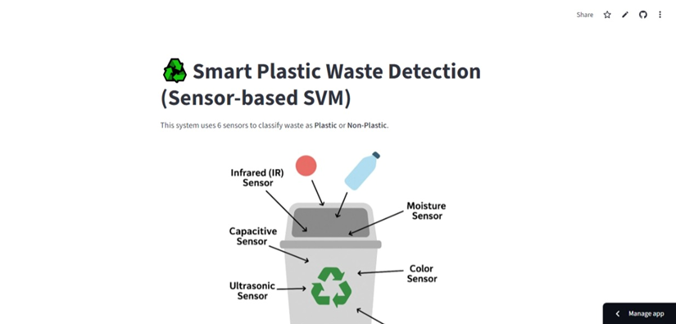
screenshort

Slide 10
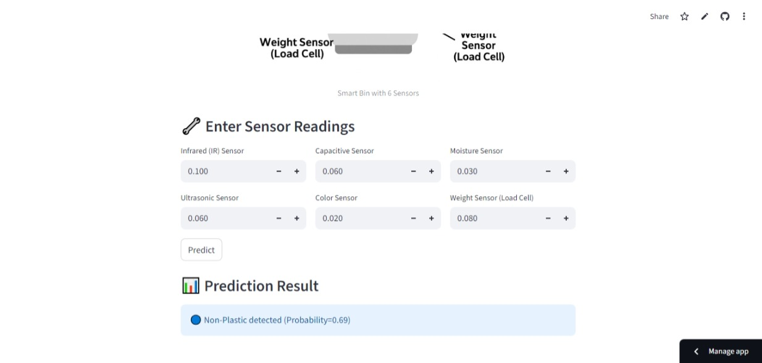
screenshort

Slide 11
Step-by-step Explanation (Short)
1. Collect labeled sensor data from waste samples.
2. Perform EDA and clean data (impute, scale).
3. Train SVM and evaluate with test data.
4. Save model and deploy via Streamlit.

Slide 12
Conclusion & Next Steps
Conclusion: Sensor-based SVM provides a practical, low-cost approach for classifying plastics.
Next steps: collect larger local dataset, field-test prototype, optimize sensors and model.

