Slide 1
Advanced Sequencing Technologies & Applications
http://meetings.cshl.edu/courses.html

Slide 2
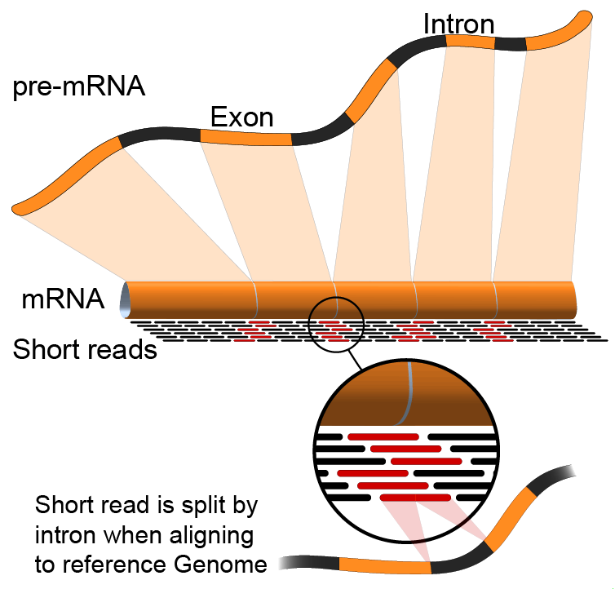
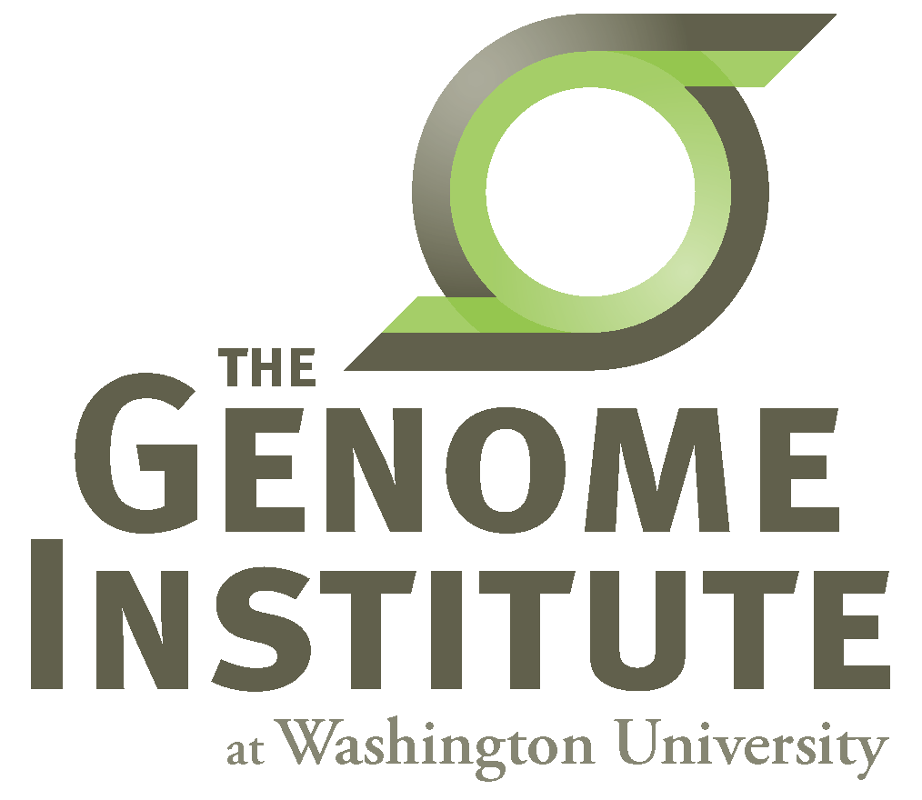
Introduction to Genome Analysis Platforms
Malachi Griffith, Obi Griffith, Jason Walker, Ben Ainscough
Advanced Sequencing Technologies & Applications
November 11-23, 2014

Slide 3
What is a genome analysis ‘platform’?
Means different things to different people…
Many confusion buzzwords!
Pipeline
Cloud computing
‘Private clouds’
‘Public clouds’ - Amazon AWS, Google Cloud, digital ocean, etc.
Hardware
e.g. ‘Dell Genomic Data Analysis Platform’
Virtualization and virtual machines
VirtualBox (vagrant), OpenStack, VMWare
Workflow management systems
Software development kits (SDKs)
Application programming interfaces (APIs)
Distributed storage and processing (e.g. ‘Hadoop’)
Job scheduler. e.g. pbs, lsf, sge, openlava,

Slide 4
List of existing genome analysis platforms
https://docs.google.com/spreadsheets/d/1o8iYwYUy0V7IECmu21Und3XALwQihioj23WGv-w0itk/pubhtml
Genome Modeling System (GMS), Galaxy, bcbio-nextgen, Omics Pipe, Illumina BaseSpace, BINA Genomic Analysis System, SeqWare, DNA Nexus Platform, gkno, NGSANE, Appistry's Ayrris, GATK's Queue, Curoverse's Arvados, CGA's Firehose, Seven Bridges Genomics, MIT STAR, GenomOncology, ga4gh, IBM's PowerGene Orchestrator, etc.

Slide 5
What is a job scheduler?

Slide 6
What is cloud computing?

Slide 7
What is a virtual machine?

Slide 8
What is a workflow management system?

Slide 9
What is a software development kit (SDK)?
E.g. DNA Nexus Platforms provides software development kit with support for several programming languages.

Slide 10
What is an application programming interface (API)
e.g. GA4GH

Slide 11
What is distributed storage and processing (e.g. ‘Hadoop’)?

Slide 12
What is ‘Docker’?

Slide 13
Examples
Assuming you have some NGS data, how should you analyze it?
The informatics spectrum
Build a completely novel process, a custom pipeline, develop algorithms, write software, etc.
Maximum flexibility, performance and scalability are determined by how well you engineer it.
Build on top of someone else genome analysis platform
Don’t have to start from scratch but still have a lot of flexibility.
e.g. GMS, Arvados, DNA Nexus, etc.
Upload data in web browser, use graphical user interface
Sacrifices flexibility for ease of use
Galaxy, Illumina BaseSpace

Slide 14
The Global Alliance for Genomics Health (ga4gh)
An international coalition, formed to enable the sharing of genomic and clinical data.
Work on data models and APIs for Genomic data.
Not yet entirely clear what is available to be used by end users beyond the ‘beacon’ project:
http://genomicsandhealth.org/
http://ga4gh.org/#/
https://github.com/ga4gh
http://ga4gh.org/#/beacon

Slide 15
Galaxy
http://galaxyproject.org/
Open Source academic project.
Example RNA-seq workflow
https://usegalaxy.org/u/mwolfien/w/rnaseq-wolfien-pipeline
A web based interface that allows you to run existing workflows or create custom analyses by combining tools in the Galaxy ‘toolshed’

Slide 16
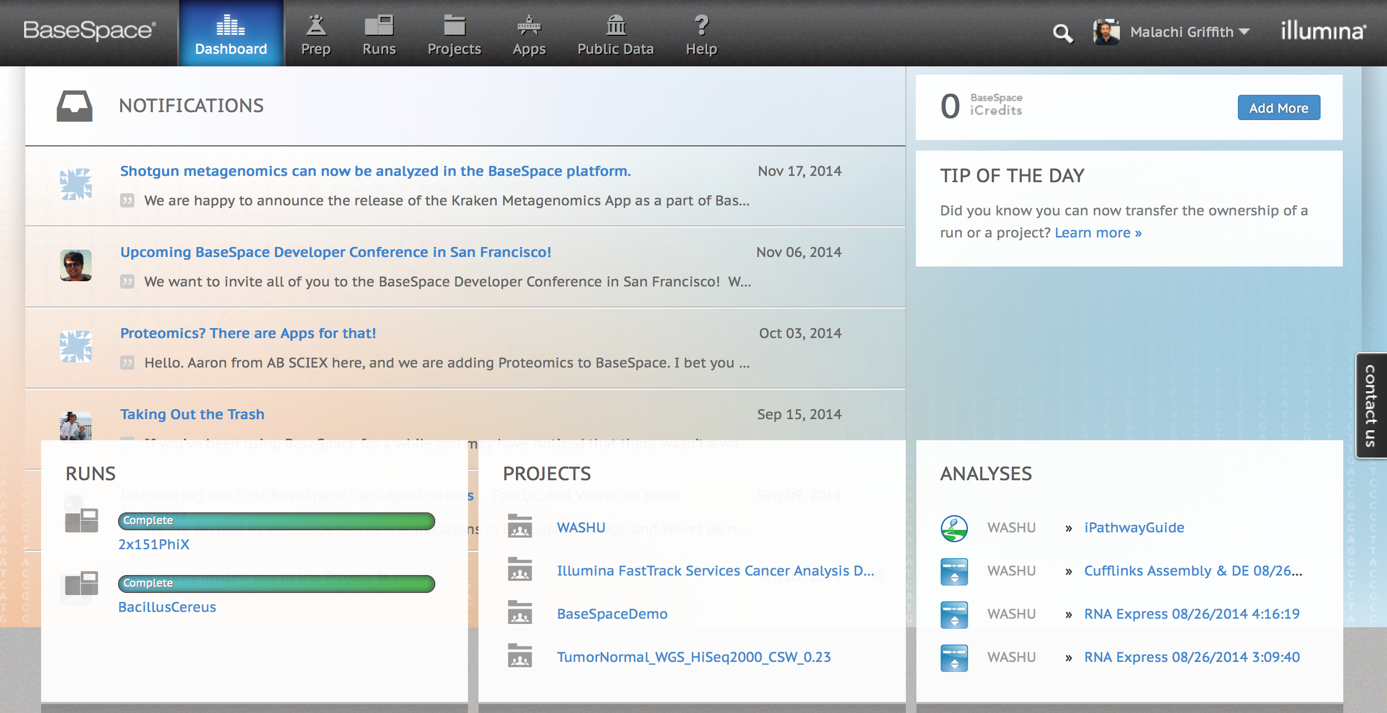
Illumina BaseSpace
Use integrated ‘apps’ and automated pipelines.
Graphical interface
https://basespace.illumina.com

Slide 17
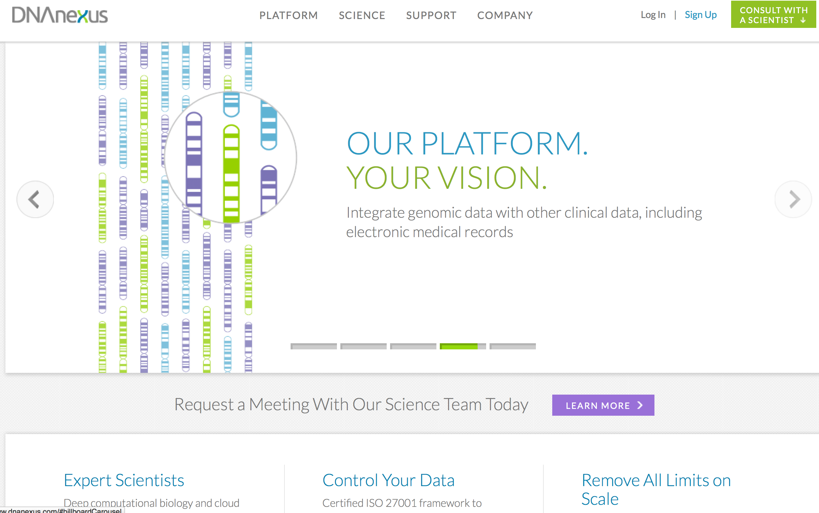
DNA Nexus Platform
Build your own pipeline or use an existing one
DNA Nexus handles cloud deployment, etc. for you
https://www.dnanexus.com/

Slide 18
Other pipeline development platforms to build on top of
Gkno
http://gkno.me/
Genome Modeling System (GMS)
https://github.com/genome/gms
Arvados
https://arvados.org/
Bcbio-nextgen
https://bcbio-nextgen.readthedocs.org/en/latest/

Slide 19
Break

