Slide 1
Canadian Bioinformatics Workshops
www.bioinformatics.ca

Slide 2

Module #: Title of Module
2

Slide 3
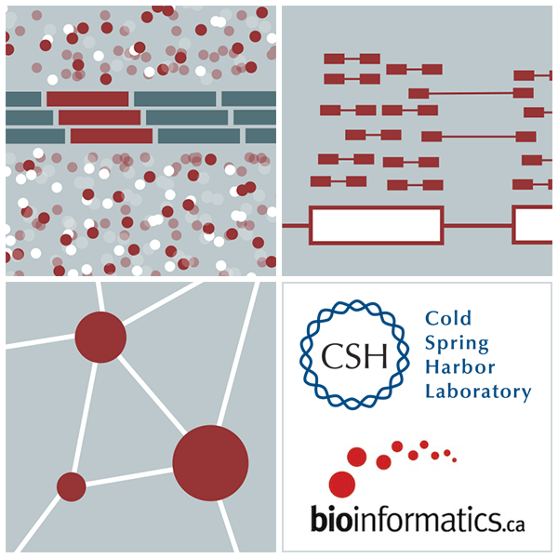

RNA-Seq Module 4 Alignment Free Expression Estimation (lecture)
Malachi Griffith, Obi Griffith
Informatics for RNA-seq Analysis May 28-30, 2018

Slide 4
Learning objectives of the course
Module 0: Introduction to Cloud Computing
Module 1: Introduction to RNA Sequencing
Module 2: Alignment and Visualization
Module 3: Expression and Differential Expression
Module 4: Alignment Free Expression Estimation
Module 5: Isoform Discovery and Alternative Expression
Tutorials
Provide a working example of an RNA-seq analysis pipeline
Run in a ‘reasonable’ amount of time with modest computer resources
Self contained, self explanatory, portable

Slide 5
Learning objectives of module 4

Slide 6
We are on a Coffee Break & Networking Session

