Slide 1

Canadian Bioinformatics Workshops
www.bioinformatics.ca

Slide 2

In collaboration with
Cold Spring Harbor Laboratory
&
New York Genome Center

Slide 3
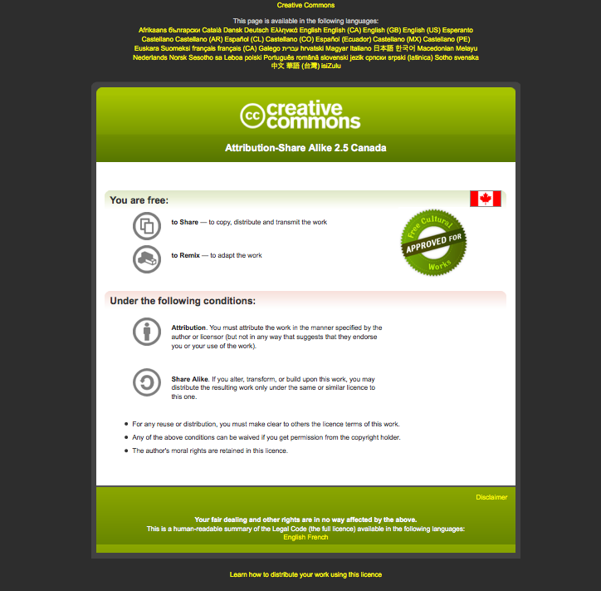
Module #: Title of Module
3

Slide 4
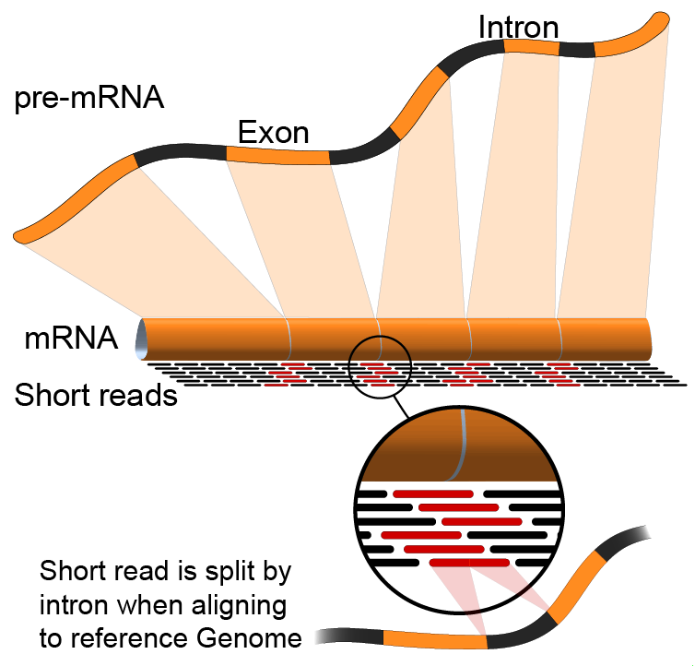
Module 1 Introduction to RNA sequencing (lecture)
Malachi Griffith & Obi Griffith
High-throughput Biology: From Sequence to Networks
April 27-May 3, 2015

Slide 5
Learning objectives of the course
Module 0: Introduction to cloud computing
Module 1: Introduction to RNA sequencing
Module 2: RNA-seq alignment and visualization
Module 3: Expression and Differential Expression
Module 4: Isoform discovery and alternative expression
Tutorials
Provide a working example of an RNA-seq analysis pipeline
Run in a ‘reasonable’ amount of time with modest computer resources
Self contained, self explanatory, portable

Slide 6
Learning objectives of module 2
Introduction to the theory and practice of RNA sequencing (RNA-seq) analysis
Rationale for sequencing RNA
Challenges specific to RNA-seq
General goals and themes of RNA-seq analysis work flows
Common technical questions related to RNA-seq analysis
Getting help outside of this course
Introduction to the RNA-seq hands on tutorial

Slide 7
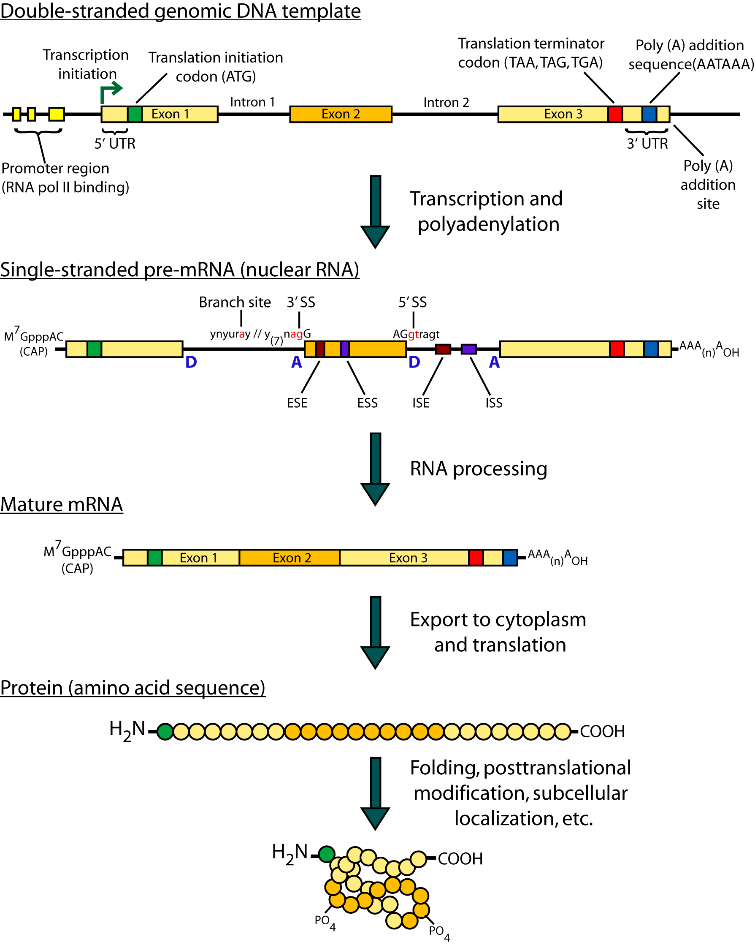
Gene expression

Slide 8
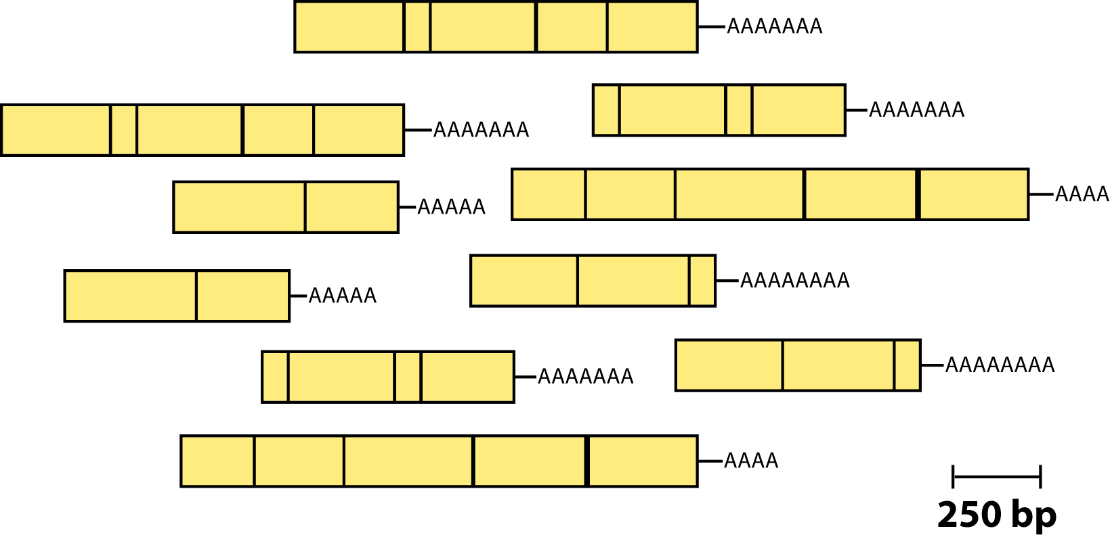
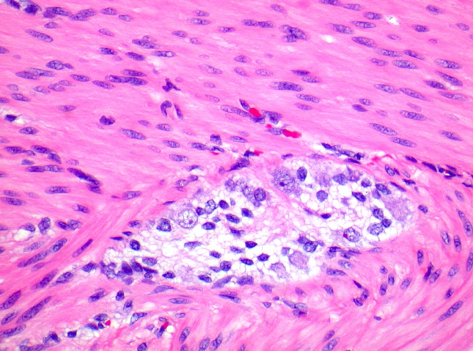
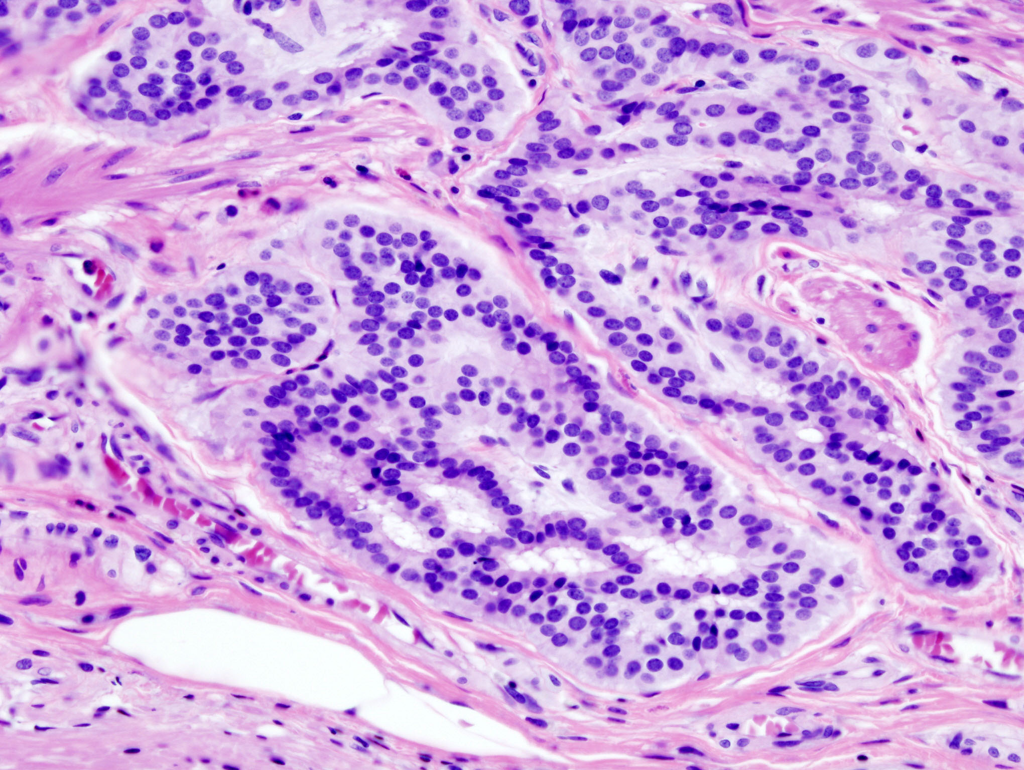
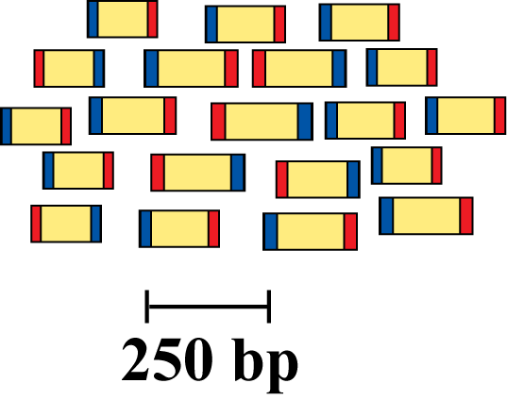
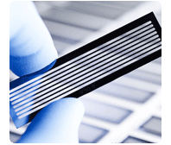
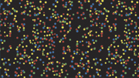
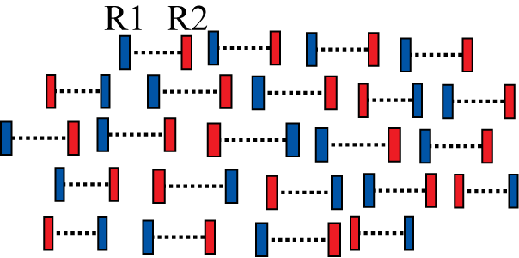
RNA sequencing
Isolate RNAs
Generate cDNA, fragment, size select, add linkers
Samples of interest
Condition 1
(normal colon)
Condition 2
(colon tumor)
Sequence ends
Map to genome, transcriptome, and predicted exon junctions
100s of millions of paired reads
10s of billions bases of sequence
Downstream analysis

Slide 9
Why sequence RNA (versus DNA)?
Functional studies
Genome may be constant but an experimental condition has a pronounced effect on gene expression
e.g. Drug treated vs. untreated cell line
e.g. Wild type versus knock out mice
Predicting transcript sequence from genome sequence is difficult
Gene annotation is revolutionized by RNA-seq
Some molecular features can only be observed at the RNA level
Alternative isoforms, fusion transcripts, RNA editing

Slide 10
Why sequence RNA (versus DNA)?
Interpreting mutations that do not have an obvious effect on protein sequence
‘Regulatory’ mutations that affect what mRNA isoform is expressed and how much
e.g. splice sites, promoters, exonic/intronic splicing motifs, etc.
Prioritizing protein coding somatic mutations (often heterozygous)
If the gene is not expressed, a mutation in that gene would be less interesting
If the gene is expressed but only from the wild type allele, this might suggest loss-of-function (haploinsufficiency)
If the mutant allele itself is expressed, this might suggest a candidate drug target

Slide 11
Challenges
Sample
Purity?, quantity?, quality?
RNAs consist of small exons that may be separated by large introns
Mapping reads to genome is challenging
The relative abundance of RNAs vary wildly
10⁵ – 10⁷ orders of magnitude
Since RNA sequencing works by random sampling, a small fraction of highly expressed genes may consume the majority of reads
Ribosomal and mitochondrial genes
RNAs come in a wide range of sizes
Small RNAs must be captured separately
PolyA selection of large RNAs may result in 3’ end bias
RNA is fragile compared to DNA (easily degraded)

Slide 12
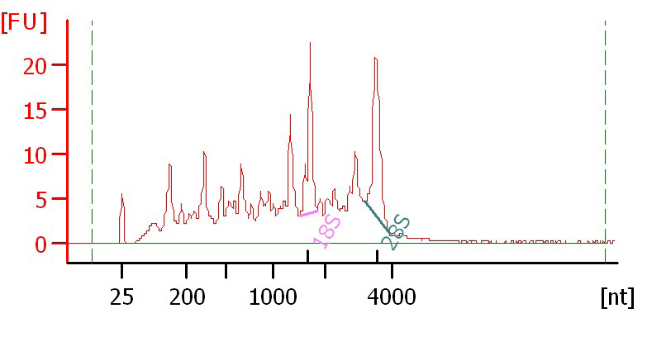
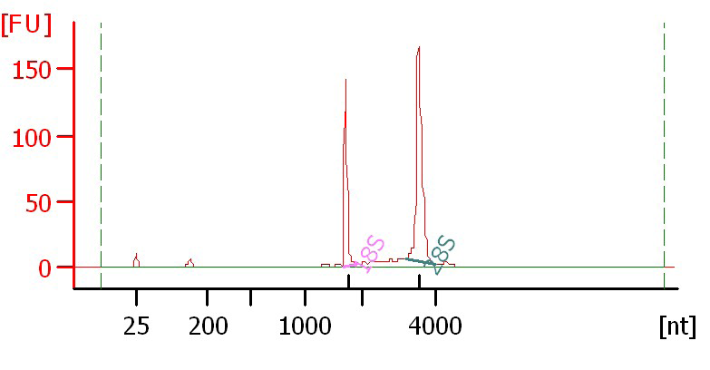
Agilent example / interpretation
https://github.com/griffithlab/rnaseq_tutorial/wiki/Resources/Agilent_Trace_Examples.pdf
‘RIN’ = RNA integrity number
0 (bad) to 10 (good)
RIN = 6.0
RIN = 10

Slide 13
Design considerations
Standards, Guidelines and Best Practices for RNA-seq
The ENCODE Consortium
Download from the Course Wiki
Meta data to supply, replicates, sequencing depth, control experiments, reporting standards, etc.
https://github.com/griffithlab/rnaseq_tutorial/wiki/Resources/ENCODE_RNAseq_standards_v1.0.pdf

Slide 14
There are many RNA-seq library construction strategies
Total RNA versus polyA+ RNA?
Ribo-reduction?
Size selection (before and/or after cDNA synthesis)
Small RNAs (microRNAs) vs. large RNAs?
A narrow fragment size distribution vs. a broad one?
Linear amplification?
Stranded vs. un-stranded libraries
Exome captured vs. un-captured
Library normalization?
These details can affect analysis strategy
Especially comparisons between libraries

Slide 15
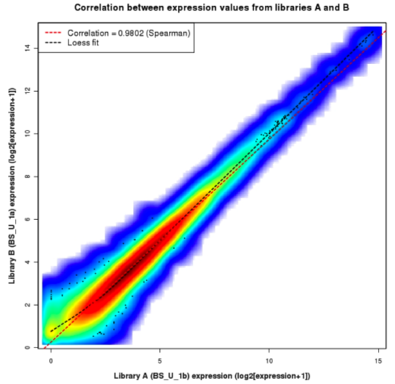
Replicates
Technical Replicate
Multiple instances of sequence generation
Flow Cells, Lanes, Indexes
Biological Replicate
Multiple isolations of cells showing the same phenotype, stage or other experimental condition
Some example concerns/challenges:
Environmental Factors, Growth Conditions, Time
Correlation Coefficient 0.92-0.98

Slide 16
Common analysis goals of RNA-Seq analysis (what can you ask of the data?)
Gene expression and differential expression
Alternative expression analysis
Transcript discovery and annotation
Allele specific expression
Relating to SNPs or mutations
Mutation discovery
Fusion detection
RNA editing

Slide 17
General themes of RNA-seq workflows
Each type of RNA-seq analysis has distinct requirements and challenges but also a common theme:
Obtain raw data (convert format)
Align/assemble reads
Process alignment with a tool specific to the goal
e.g. ‘cufflinks’ for expression analysis, ‘defuse’ for fusion detection, etc.
Post process
Import into downstream software (R, Matlab, Cytoscape, Ingenuity, etc.)
Summarize and visualize
Create gene lists, prioritize candidates for validation, etc.

Slide 18
Tool recommendations
Alignment
BWA (PMID: 20080505)
Align to genome + junction database
Tophat (PMID: 19289445), STAR (PMID: 23104886), MapSplice (PMID: 20802226), hmmSplicer (PMID: 21079731)
Spliced alignment to genome
Expression, differential expression alternative expression
Cufflinks/Cuffdiff (PMID: 20436464), ALEXA-seq (PMID: 20835245), RUM (PMID: 21775302)
Fusion detection
Tophat-fusion (PMID: 21835007), ChimeraScan (PMID: 21840877), Defuse (PMID: 21625565), Comrad (PMID: 21478487)
Transcript assembly
Trinity (PMID: 21572440), Oases (PMID: 22368243), Trans-ABySS (PMID: 20935650)
Visit the ‘SeqAnswers’ or ‘BioStar’ forums for more recommendations and discussion
http://seqanswers.com/
http://www.biostars.org/
Notes:
To find the papers above using their PMID, go to PubMed and enter the ID in the search box
http://www.ncbi.nlm.nih.gov/pubmed

Slide 19
SeqAnswers exercise
Go to:
http://seqanswers.com/
Click the ‘Wiki’ link
http://seqanswers.com/wiki/SEQanswers
Visit the ‘Software Hub’
http://seqanswers.com/wiki/Software
Browse the software that has been added
http://seqanswers.com/wiki/Special:BrowseData
Use the tag cloud to identify tools related to your area of interest. e.g. RNA-seq alignment

Slide 20
Common questions: Should I remove duplicates for RNA-seq?
Maybe… more complicated question than for DNA
Concern.
Duplicates may correspond to biased PCR amplification of particular fragments
For highly expressed, short genes, duplicates are expected even if there is no amplification bias
Removing them may reduce the dynamic range of expression estimates
Assess library complexity and decide…
If you do remove them, assess duplicates at the level of paired-end reads (fragments) not single end reads

Slide 21
Common questions: How much library depth is needed for RNA-seq?
Depends on a number of factors:
Question being asked of the data. Gene expression? Alternative expression? Mutation calling?
Tissue type, RNA preparation, quality of input RNA, library construction method, etc.
Sequencing type: read length, paired vs. unpaired, etc.
Computational approach and resources
Identify publications with similar goals
Pilot experiment
Good news: 1-2 lanes of recent Illumina HiSeq data should be enough for most purposes

Slide 22
Common questions: What mapping strategy should I use for RNA-seq?
Depends on read length
< 50 bp reads
Use aligner like BWA and a genome + junction database
Junction database needs to be tailored to read length
Or you can use a standard junction database for all read lengths and an aligner that allows substring alignments for the junctions only (e.g. BLAST … slow).
Assembly strategy may also work (e.g. Trans-ABySS)
> 50 bp reads
Spliced aligner such as Bowtie/TopHat

Slide 23
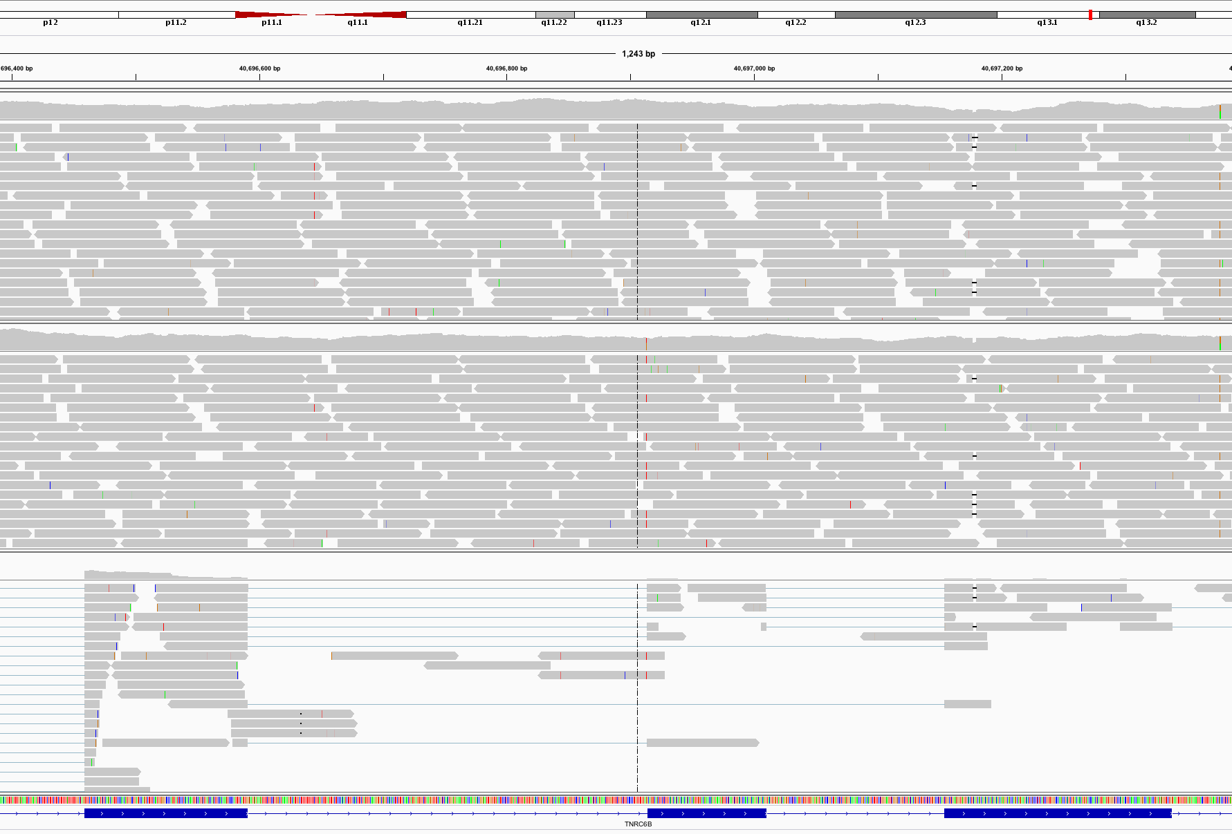
Visualization of spliced alignment of RNA-seq data
Normal WGS
Acceptor site mutation
Tumor WGS
IGV screenshot
Tumor RNA-seq

Slide 24
Common questions: how reliable are expression predictions from RNA-seq?
Are novel exon-exon junctions real?
What proportion validate by RT-PCR and Sanger sequencing?
Are differential/alternative expression changes observed between tissues accurate?
How well do DE values correlate with qPCR?
384 validations
qPCR, RT-PCR, Sanger sequencing
See ALEXA-Seq publication for details:
Also includes comparison to microarrays
Griffith et al. Alternative expression analysis by RNA sequencing. Nature Methods. 2010 Oct;7(10):843-847.

Slide 25
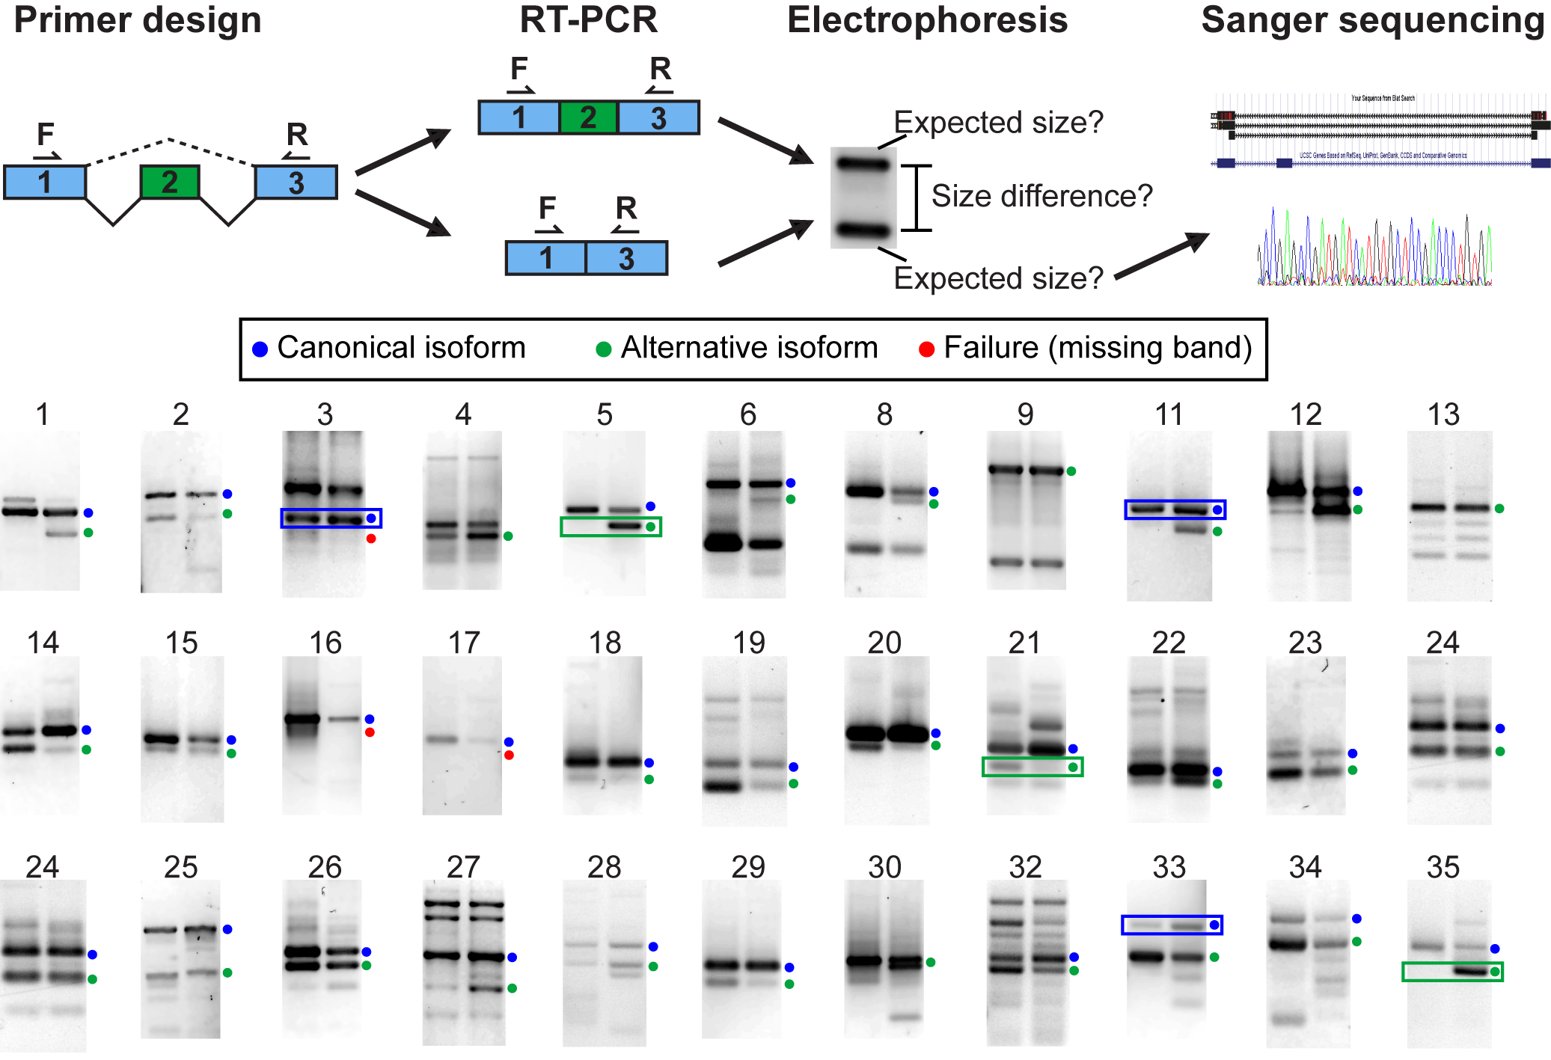
Validation (qualitative)
33 of 192 assays shown. Overall validation rate = 85%

Slide 26
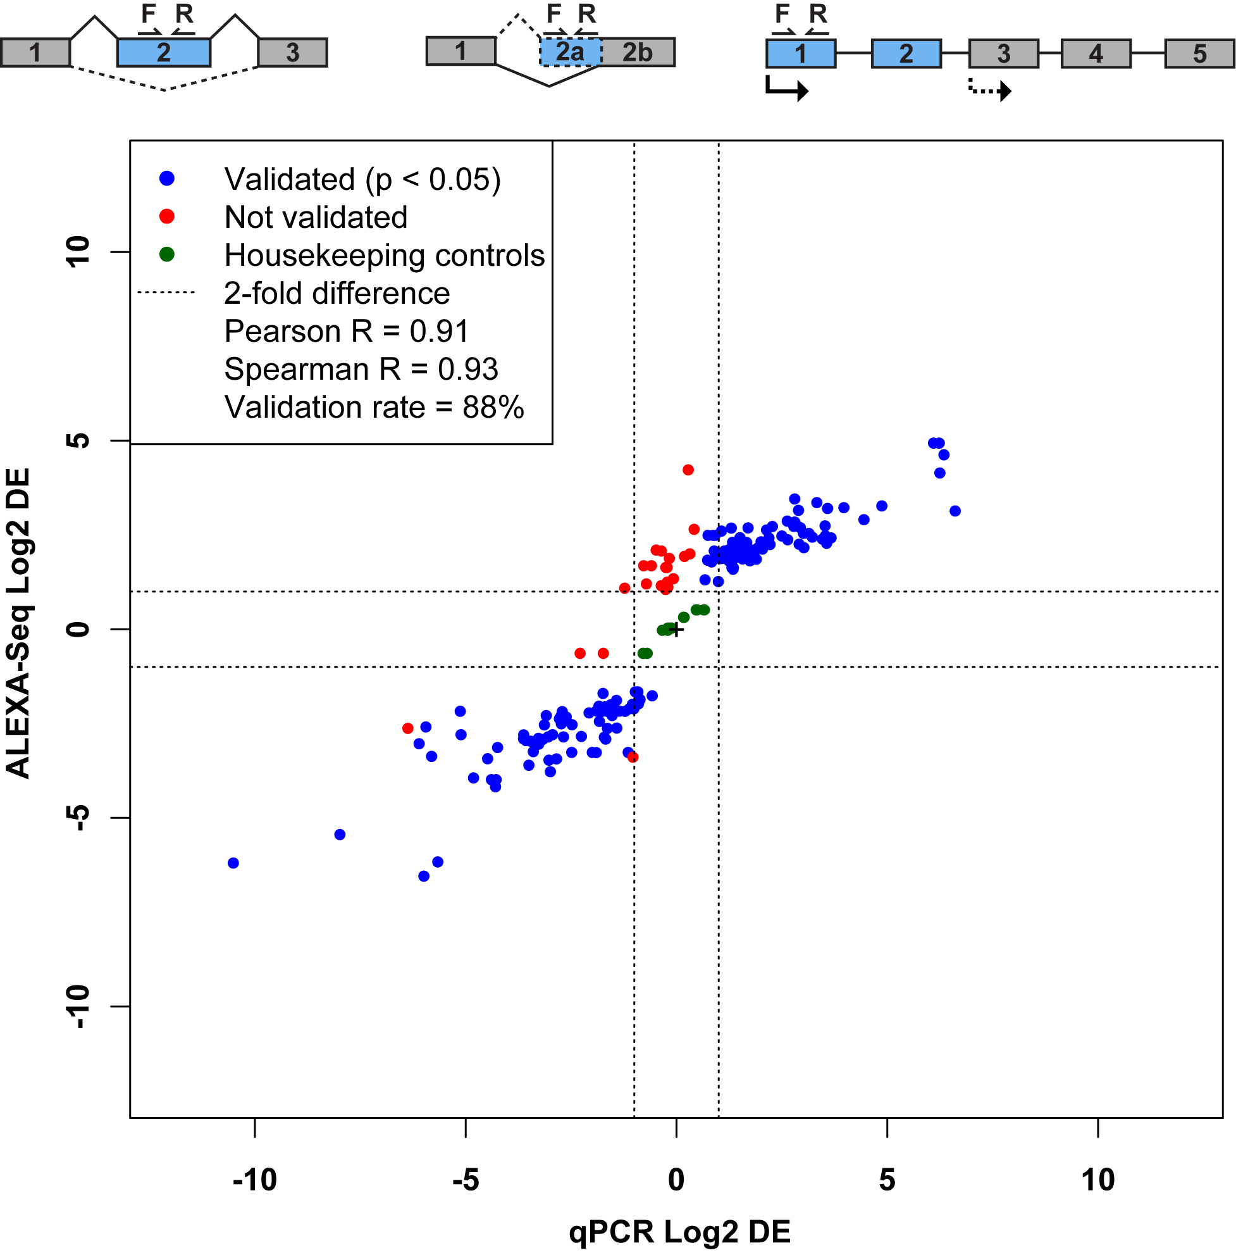
Validation (quantitative)
qPCR of 192 exons identified as alternatively expressed by ALEXA-Seq
Validation rate = 88%

Slide 27
Common questions: What if I don’t have a reference genome for my species?
Have you considered sequencing the genome of your species?
If that is not practical or you simply prefer a transcript discovery approach that does not rely on prior knowledge of the genome or transcriptome there are some tools available ...
Unfortunately de novo transcriptome assembly is beyond the scope of this workshop
The good news is that the skills you learn here will help you figure out how to install and run those tools yourself

Slide 28
BioStar exercise
Go to the BioStar website:
http://www.biostars.org/
If you do not already have an OpenID (e.g. Google, Yahoo, etc.)
Login -> ‘get one’
Login and set up your user profile
Tasks:
Find a question that seems useful and ‘vote it up’
Answer a question [optional]
Search for a topic area of interest and ask a question that has not already been asked [optional]

Slide 29
Introduction to tutorial
(Module 2)

Slide 30
Bowtie/Tophat/Cufflinks/Cuffdiff RNA-seq Pipeline
Sequencing
Read alignment
Transcript compilation
Gene identification
Differential expression
RNA-seq reads (2 x 100 bp)
Bowtie/TopHat alignment (genome)
Cufflinks
Cufflinks (cuffmerge)
Cuffdiff
(A:B comparison)
Raw sequence data
(.fastq files)
Reference genome
(.fa file)
Gene annotation
(.gtf file)
CummRbund
Inputs
Visualization
Module 2

Slide 31
We are on a Coffee Break & Networking Session

