Slide 1
Canadian Bioinformatics Workshops
www.bioinformatics.ca

Slide 2
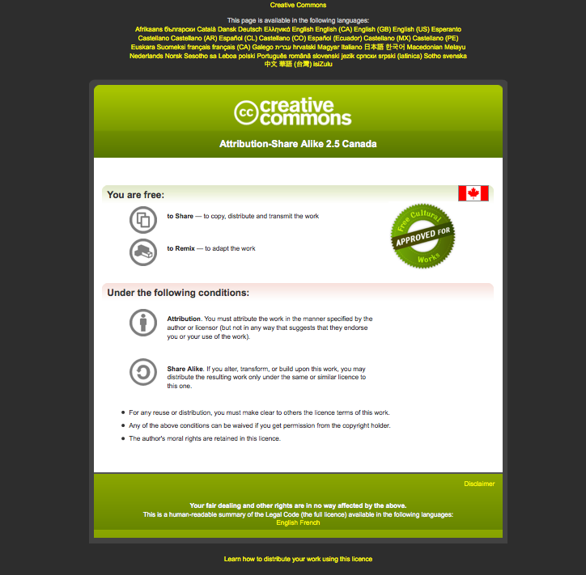
Module #: Title of Module
2

Slide 3
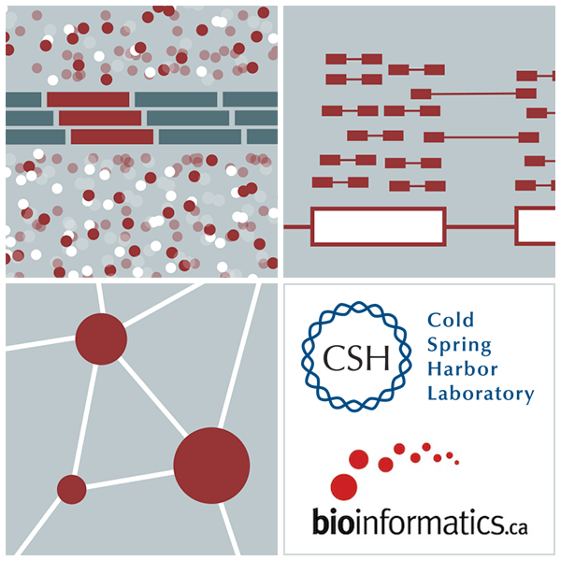

RNA-Seq Module 4 Isoform Discovery and Alternative Expression (tutorial)
Malachi Griffith, Obi Griffith, Fouad Yousif
High-Throughput Biology: From Sequence to Networks
March 20-26, 2017

Slide 4
Learning Objectives of Tutorial
Learn how to run StringTie in ‘reference only’, ‘reference guided’, and ‘de novo’ modes
Learn how to use Cuffmerge to combine transcriptomes from multiple Cufflinks runs and compare assembled transcripts to known transcripts
Learn how to perform differential splicing analysis with Cuffdiff
Examine junctions counts and Cufflinks differential splicing files at the command line
Visualize TopHat junction counts and Cufflinks assembled transcripts in IGV

Slide 5
5-i,ii. Running cuffinks in ‘ref-guided’ and ‘de-novo’ mode
In Module 3 we ran cufflinks in ‘ref-only’ mode. This mode gives us an expression estimate for each known gene/transcript
Now we want to be able to potentially identify novel genes, and novel isoforms of known genes
To accomplish this we will re-run cufflinks in ‘ref-guided’ and ‘de-novo’ modes
In ‘ref-guided’ mode a known transcriptome will be used as a guide
In ‘de-novo’ mode no knowledge of the transcriptome will be used at all

Slide 6
‘-g’, ‘-G’ woe is me...
tophat has a ‘-G’ option
Used to supply a transcriptome GTF file
This will be used to assist the alignment step by allowing alignment to both transcriptome and genome sequences
Coordinates from alignments to transcriptomes will be converted back to genome coordinates
Even though we supply a transcriptome, tophat will not be limited in anyway to known transcripts
tophat also has a ‘-g’ option
Used to specify the maximum number of multiple mappings for a single read
cufflinks has a ‘-G’ option
Used to supply a transcriptome GTF file
If specified, cufflinks will quantitate against reference transcript annotations
We call this the ‘ref-only’ analysis mode
cufflinks also has a ‘-g’ option
Use to supply a transcriptome GTF file
Use reference transcript annotations to guide assembly
We call this ‘reference-guided’ analysis mode
Running cufflinks with neither ‘-G’ or ‘-g’
We call this ‘de-novo’ analysis mode
cuffdiff requires a GTF file but it is not specified with a ‘-G’ or ‘-g’ option, but rather is simply supplied as a file path when you run cuffdiff

Slide 7
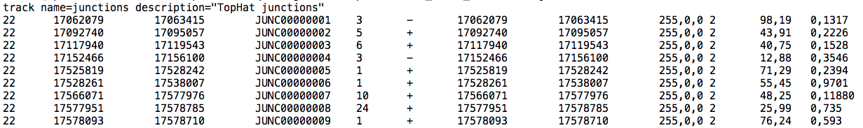
The tophat ‘junctions.bed’ file
After alignment, tophat creates a summary of all reads that support exon-exon junctions
e.g. exon1-exon2 has 5 reads
e.g. exon1-exon3 has 9 reads
This file reports all of the unique exon-exon junctions observed and the read counts for each
In BED format
Junction read count

Slide 8
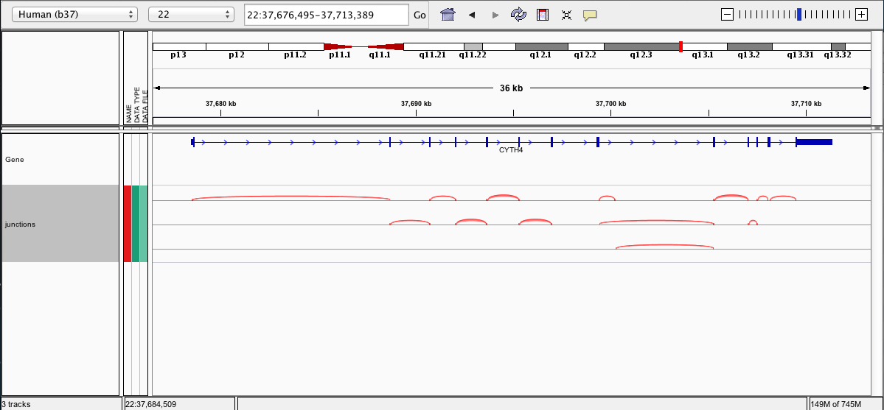
Viewing the junctions.bed in IGV

Slide 9
5-iii,iv. Cuffmerge
http://cufflinks.cbcb.umd.edu/manual.html#cuffmerge
Cuffmerge combines transcripts predicted from multiple RNA-seq data sets into one view of the transcriptome
Do this before running cuffdiff to compare between multiple conditions
Cuffmerge can also simultaneously compare transcripts to the known transcripts GTF file from Ensembl, etc.
http://cufflinks.cbcb.umd.edu/manual.html#class_codes

Slide 10
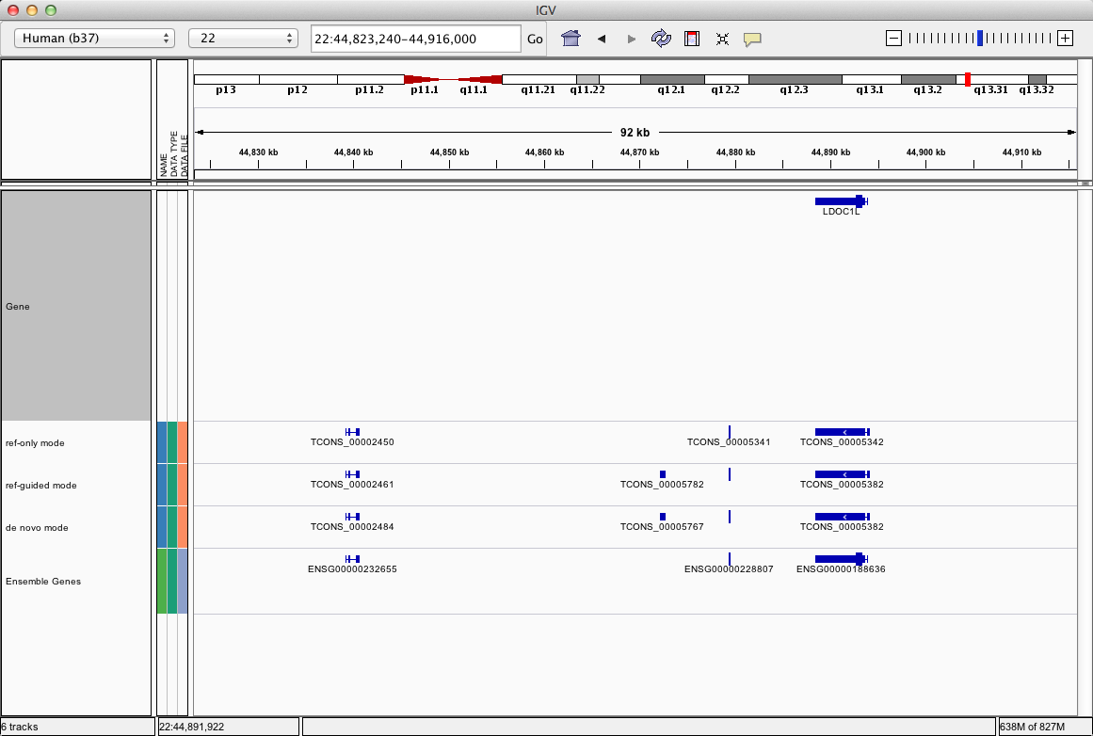
5-v. Comparison of merged GTFs from each cufflinks mode
UCSC genes
ref_only mode
ref_guided mode
de_novo mode
Ensembl genes

Slide 11
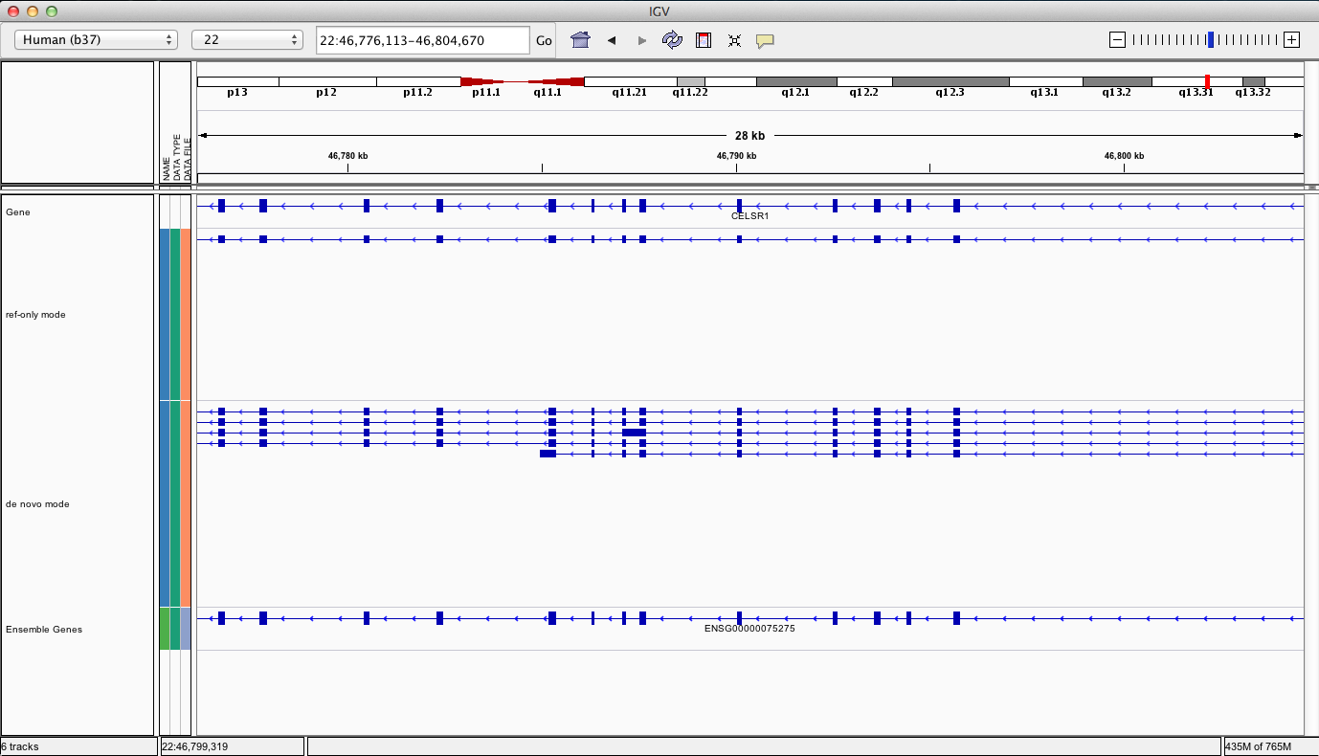
Comparison of merged GTFs from each cufflinks mode
UCSC genes
ref_only mode
de_novo mode
Ensembl genes

Slide 12
What if I return to my lab and can not get this to work on my own data?
Refer to the materials provided with this course for clues
Refer to the Nature Protocols tutorial (Trapnell et al. 2012)
In particular refer to the troubleshooting table (next slide)
Search BioStars, SeqAnswers, and Google
http://www.biostars.org/
http://www.seqanswers.com
If your question is not already answered on BioStars...
Ask it! Then follow up so that others that have the same problem in the future know whether this solution worked

Slide 13
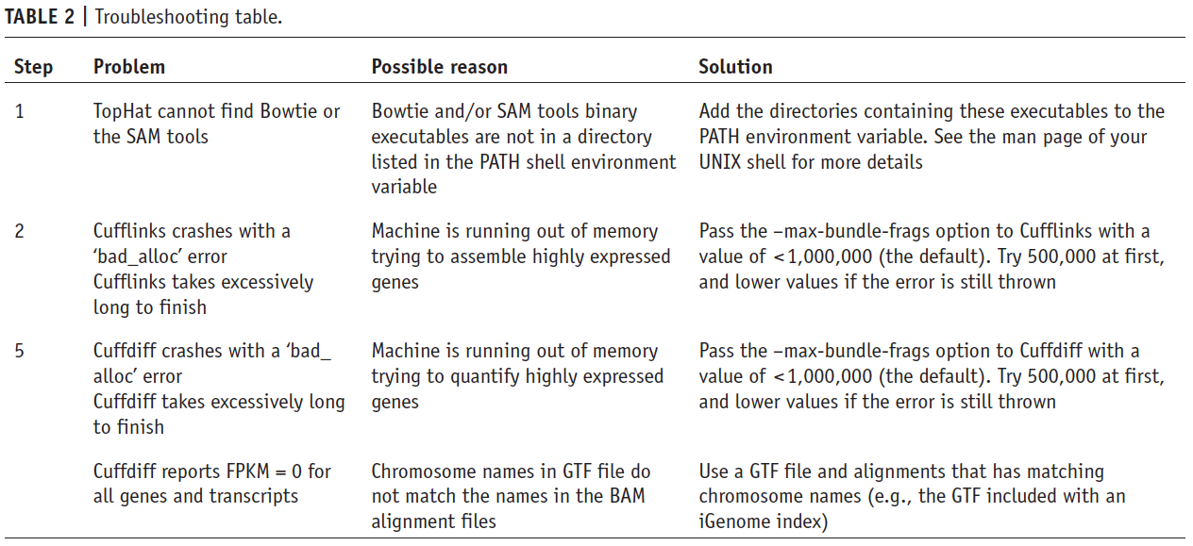
TopHat/Cufflinks/Cuffdiff troubleshooting table

Slide 14
We are on a Coffee Break & Networking Session

