Slide 1

Canadian Bioinformatics Workshops
www.bioinformatics.ca

Slide 2
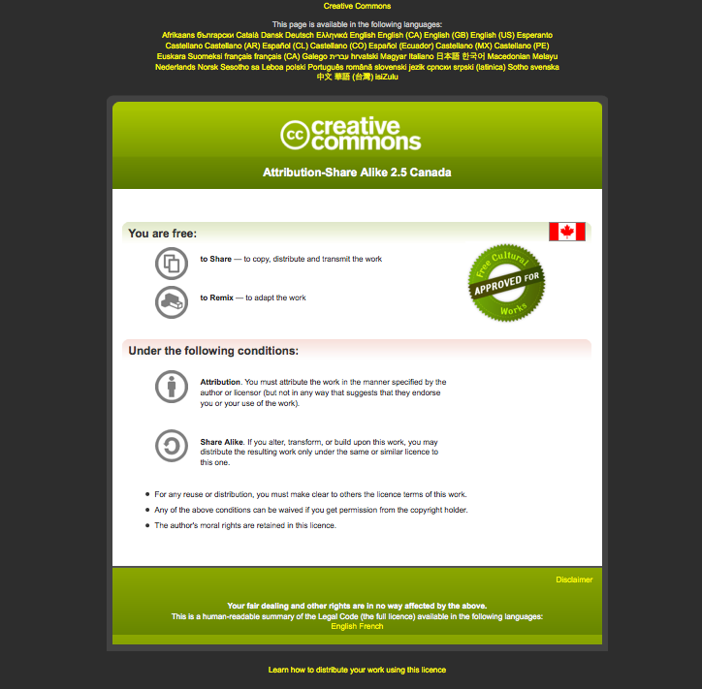
Module #: Title of Module
2

Slide 3
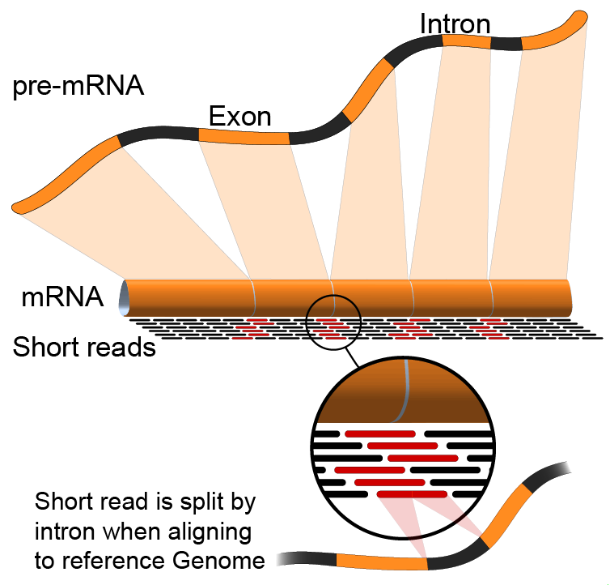
Module 0
Introduction to cloud computing
(slides modified with permission from Francis Ouellette)
Malachi Griffith & Obi Griffith
Informatics for RNA-seq Analysis
June 8-9, 2015

Slide 4
Learning objectives of the course
Module 0: Introduction to cloud computing
Module 1: Introduction to RNA sequencing
Module 2: RNA-seq alignment and visualization
Module 3: Expression and Differential Expression
Module 4: Isoform discovery and alternative expression
Tutorials
Provide a working example of an RNA-seq analysis pipeline
Run in a ‘reasonable’ amount of time with modest computer resources
Self contained, self explanatory, portable

Slide 5
Learning Objectives of module 0
Introduction to cloud computing
Use of the wiki in this workshop
How to log into the cloud

Slide 6
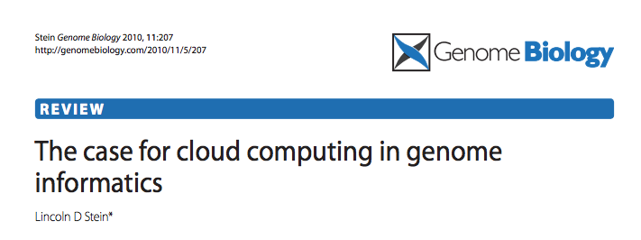
Disk Capacity vs Sequencing Capacity, 1990-2012
Disk Storage
(Mbytes/$)
DNA
Sequencing (bp/$)
1,000,000
1,000,000,000
100,000,000
100,000
10,000,000
10,000
Hard disk storage (MB/$)
Doubling time=14 mo
1,000,000
1,000
100,000
100
10,000
Nextgen sequencing (bp/$)
Doubling time=4 mo0
1,000
10
100
Pre-nextgen sequencing (bp/$)
Doubling time=19 mo
1
10
0
1
1990
1992
1994
1996
1998
2000
2003
2004
2006
2008
2010
2012

Slide 7
About DNA and computers
We'll hit the $1000 genome during 2014-?, then need to think about the $100 genome.
The doubling time of sequencing has been ~5-6 months.
The doubling time of storage and network bandwidth is ~12 months.
The doubling time of CPU speed is ~18 months.
The cost of sequencing a base pair will eventually equal the cost of storing a base pair

Slide 8
What is the general biomedical scientist to do?
Lots of data
Poor IT infrastructure in many labs
Where do they go?
Write more grants?
Get bigger hardware?

Slide 9
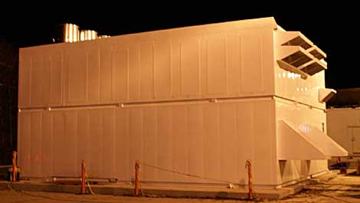

Amazon Web Services (AWS)
Infinite storage (scalable): S3 (simple storage service)
Compute per hour: EC2 (elastic cloud computing)
Ready when you are High Performance Computing
Multiple football fields of HPC throughout the world
HPC are expanded at one container at a time:
http://goo.gl/7PVAl

Slide 10
Some of the challenges of cloud computing:
Not cheap!
Getting files to and from there
Not the best solution for everybody
Standardization
PHI: personal health information & security concerns
In the USA: HIPAA act, PSQIA act, HITECH act, Patriot act, CLIA and CAP programs, etc.
http://www.biostars.org/p/70204/

Slide 11
Some of the advantages of cloud computing:
We received a grant from Amazon, so supported by ‘AWS in Education grant award’.
There are better ways of transferring large files, and now AWS makes it free to upload files.
A number of datasets exist on AWS (e.g. 1000 genome data).
Many useful bioinformatics AMI’s (Amazon Machine Images) exist on AWS: e.g. cloudbiolinux & CloudMan (Galaxy) – now one for this course!
Many flavors of cloud available, not just AWS

Slide 12
In this workshop:
Some tools (data) are
on your computer
on the web
on the cloud.
You will become efficient at traversing these various spaces, and finding resources you need, and using what is best for you.
There are different ways of using the cloud:
Command line (like your own very powerful Unix box)
With a web-browser (e.g. Galaxy): not in this workshop

Slide 13
Things we have set up:
Loaded data files to an ftp server
We brought up an Ubuntu (Linux) instance, and loaded a whole bunch of software for NGS analysis.
We then cloned this, and made separate instances for everybody in the class.
We’ve simplified the security: you basically all have the same login and file access, and opened ports. In your own world you would be more secure.

Slide 14
Amazon AWS Management Console – quick walkthrough
http://aws.amazon.com/console/

Slide 15
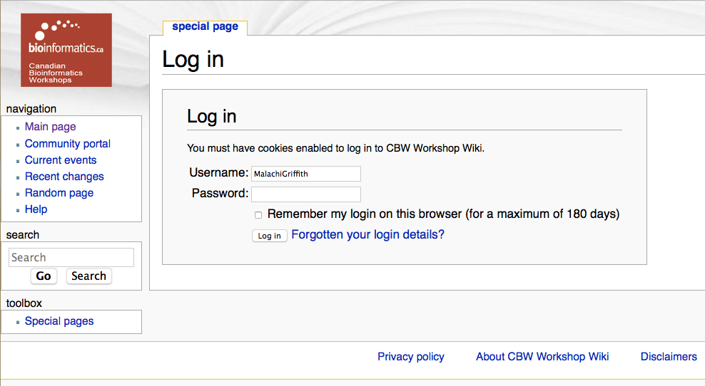
For this workshop: all on Wiki!
http://bioinformatics.ca/workshop_wiki/index.php/
Login: FirstnameLastname
Password: ‘guest’

Slide 16
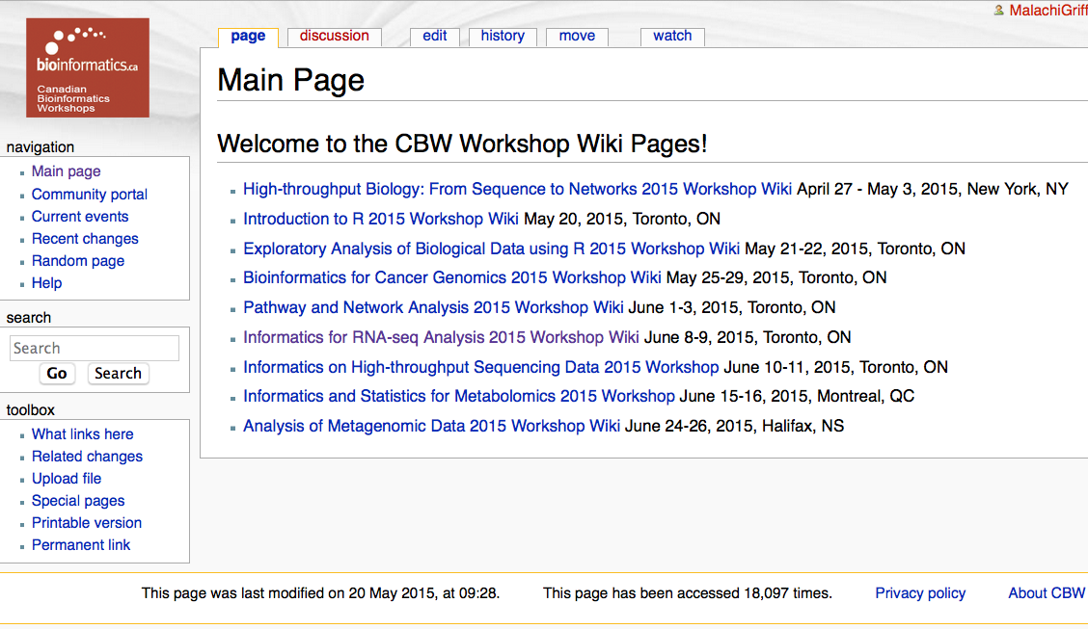
The main CBW Wiki
http://bioinformatics.ca/workshop_wiki/index.php/

Slide 17
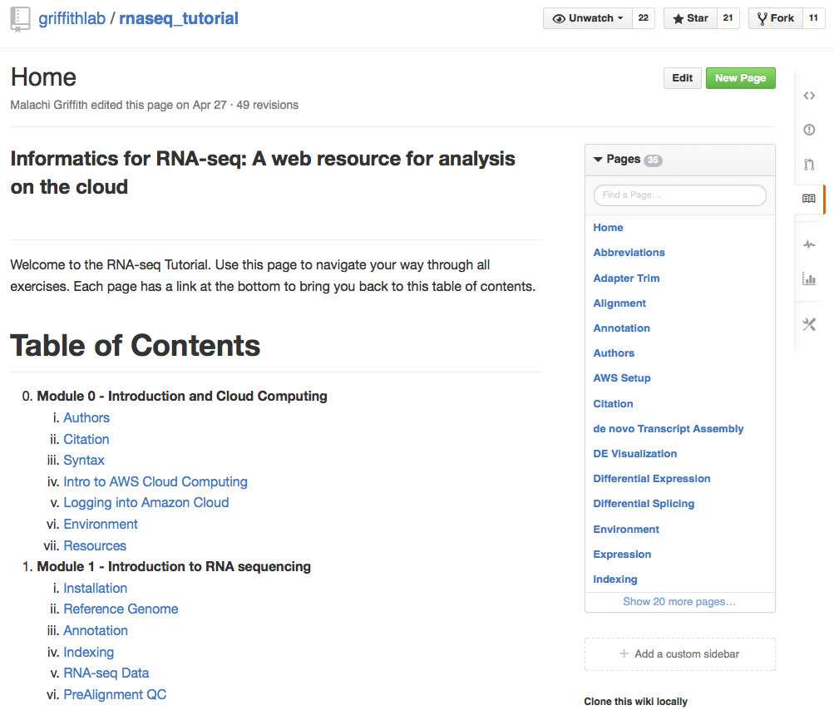
The RNA-seq wiki
http://www.rnaseq.wiki/

Slide 18

Macintosh users

Slide 19
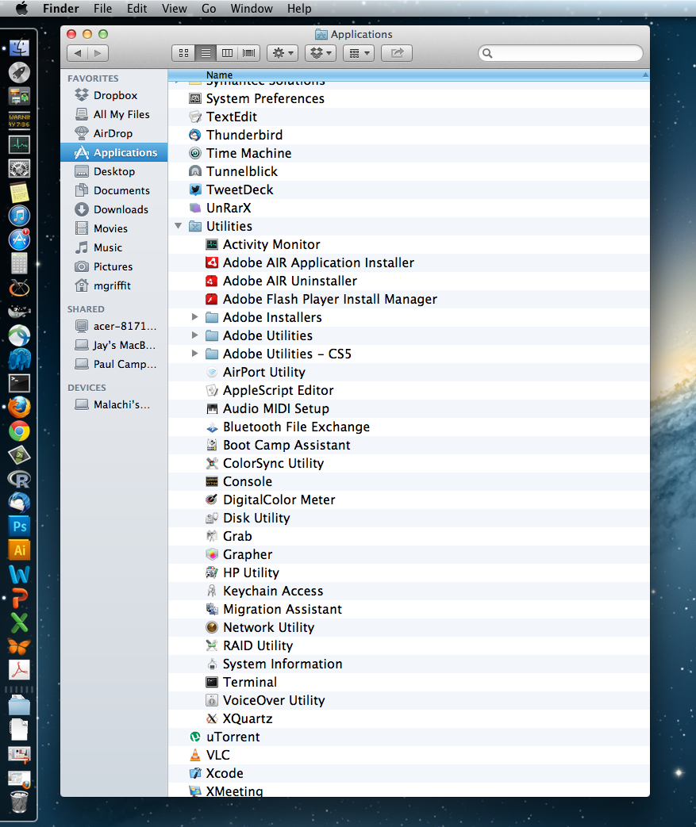

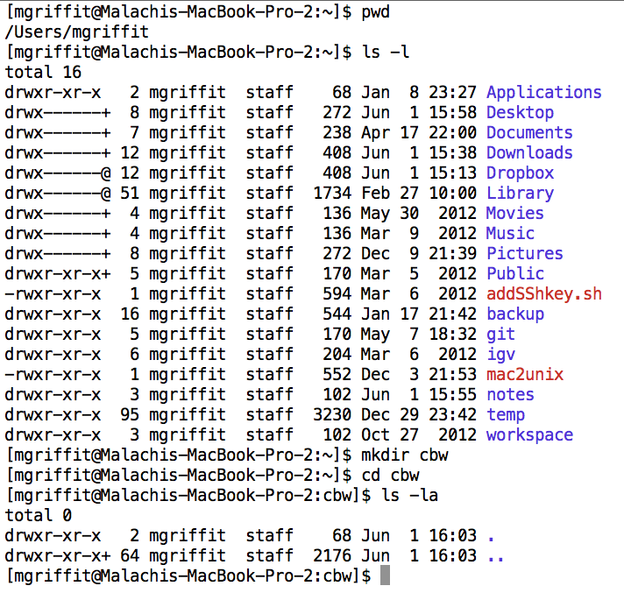
Opening a ‘terminal session’

Slide 20
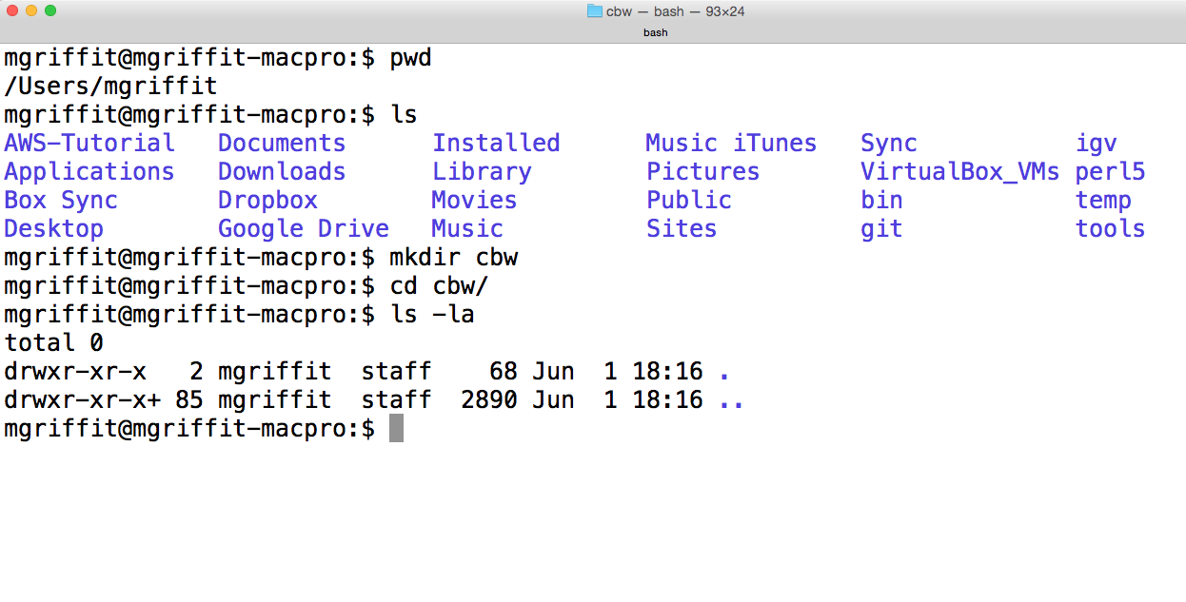
Creating a working directory on your mac

Slide 21
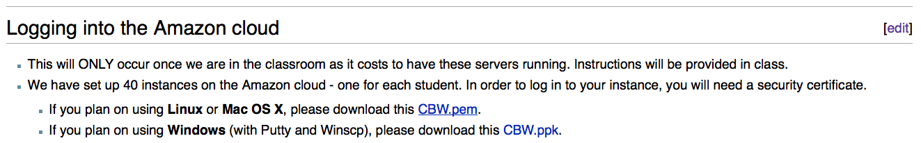
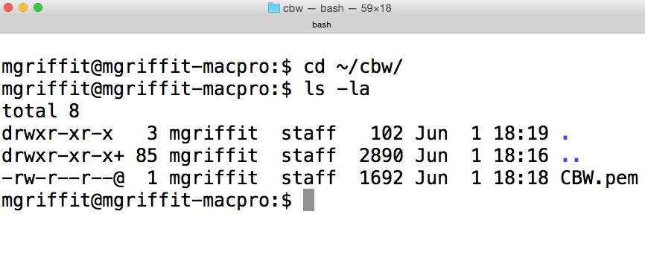
Obtaining your AWS ‘key’ file from the wiki
On Mac: Control+
On Windows
Save key file to your new ‘cbw’ directory

Slide 22
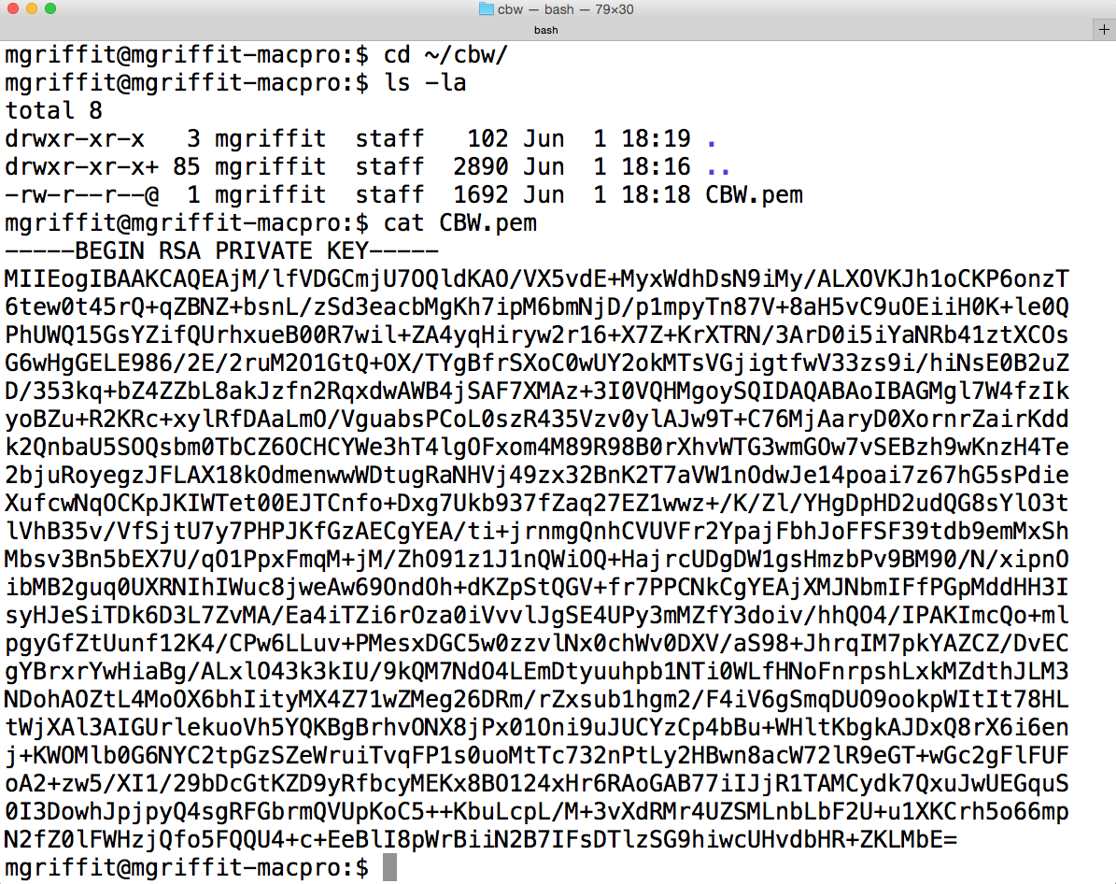
Viewing the ‘key’ file once downloaded

Slide 23
Changing file permissions of your ‘key’ file
ls -l (long listing)
drwx------+ 67 francis staff 2278 22 May 21:25 ../
-rw-r--r--@ 1 francis staff 1696 22 May 21:31 CBW.pem
rwx : owner
rwx : group
rwx: world
r read (4)
w write (2)
x execute (1)
Which ever way you add these 3 numbers, you know which integers
were used (6 is always 4+2, 5 is 4+1, 4 is by itself, 0 is none of them etc …)
So, when you have:
chmod 600 <file name>
It is “rw” for the the file owner only

Slide 24
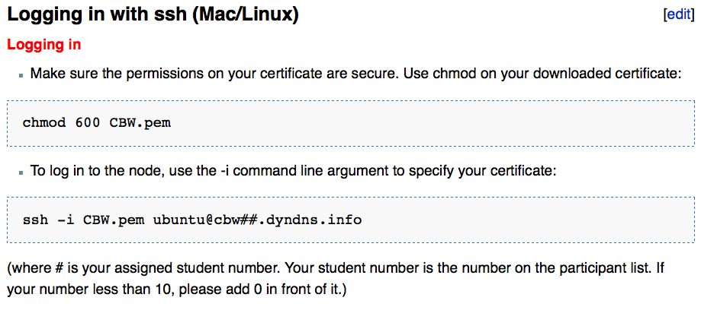
Logging into AWS (Mac)
Use your assigned student #

Slide 25
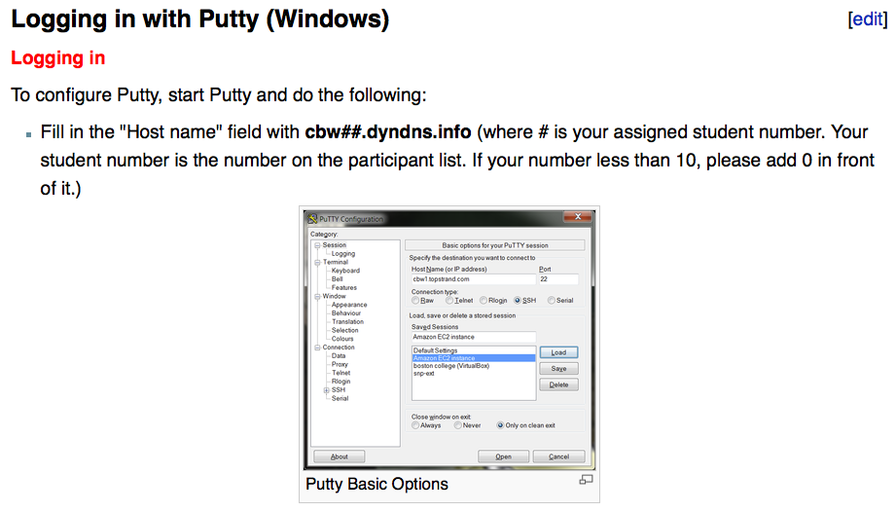
Logging into AWS (Windows)
Follow complete instructions on Wiki:
http://bioinformatics.ca/workshop_wiki/index.php/Informatics_for_RNA-seq_Analysis_2015_Workshop_Wiki

Slide 26
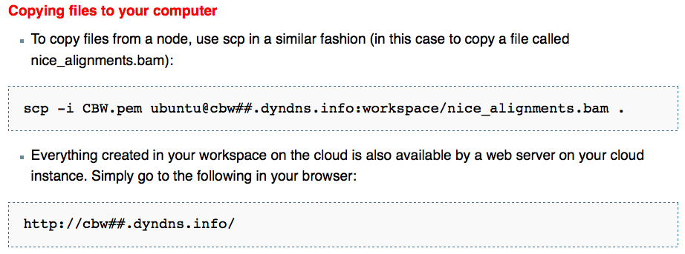
Copying files from AWS to your computer

Slide 27
So, at this point:
Your laptop is ready for the workshop
If it is not, you know where to get the information you need
You know how to use the wiki for this workshop
You know where all of the lectures are
You have read all of the pre-lecture material
If not, you know where the papers are, and you are a speed reader
You know how to login to AWS

Slide 28
A much more detailed tutorial on AWS cloud computing…
https://github.com/griffithlab/rnaseq_tutorial/wiki/Intro-to-AWS-Cloud-Computing

Slide 29
We are on a Coffee Break & Networking Session

