Slide 1
Canadian Bioinformatics Workshops
www.bioinformatics.ca

Slide 2

Module #: Title of Module
2

Slide 3
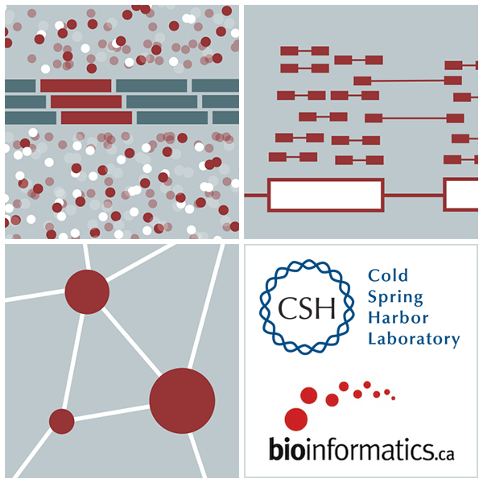

RNA-Seq Module 4 Isoform Discovery and Alternative Expression (tutorial)
Malachi Griffith, Obi Griffith, Fouad Yousif
Informatics for RNA-seq Analysis July 10-12, 2017

Slide 4
Learning Objectives of Tutorial
Learn how to run StringTie in ‘reference only’, ‘reference guided’, and ‘de novo’ modes
Learn how to use Cuffmerge to combine transcriptomes from multiple Cufflinks runs and compare assembled transcripts to known transcripts
Learn how to perform differential splicing analysis with Ballgown
Examine junctions counts with RegTools and StringTie alternative transcript files at the command line
Visualize junction counts and StringTie assembled transcripts in IGV

Slide 5
5-i,ii. Running stringtie in ‘ref-guided’ and ‘de-novo’ mode
In Module 3 we ran StringTie in ‘ref-only’ mode. This mode gives us an expression estimate for each known gene/transcript
Now we want to be able to potentially identify novel genes, and novel isoforms of known genes
To accomplish this we will re-run cufflinks in ‘ref-guided’ and ‘de-novo’ modes
In ‘ref-guided’ mode a known transcriptome will be used as a guide
In ‘de-novo’ mode no knowledge of the transcriptome will be used at all

Slide 6
Options that govern use of existing transcript information
During indexing of the genome with hisat2, transcript information is provided
A transcriptome GTF file is used to extract splice sites and exons
These are supplied during the index step to build a better index
These will be used to assist the alignment step by allowing alignment to both transcriptome and genome sequences
Coordinates from alignments to transcriptomes will be converted back to genome coordinates
Even though we supply transcriptome info, hisat2 will not be limited in to known transcripts or splice sites
Stringtie ‘-G’ option
Used to supply a transcriptome GTF file
If specified, uses the reference annotation file (in GTF or GFF3 format) to guide the assembly process. We call this the ‘ref-guided’ analysis mode
Stringtie ‘-e’ option
Limits the processing of read alignments to only estimate and output the assembled transcripts matching the reference transcripts given with the -G option
We call this ‘reference-only’ analysis mode
Running StringTie with neither ‘-G’ or ‘-e’
We call this ‘de-novo’ analysis mode

Slide 7
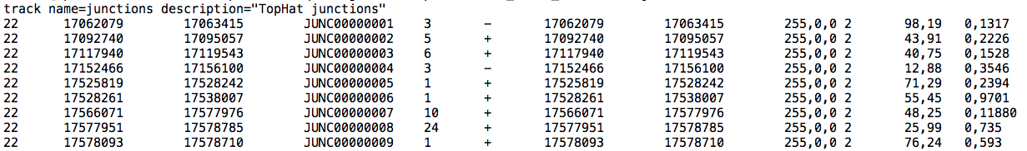
A ‘junctions.bed’ file
After alignment, we can create a summary of all reads that support exon-exon junctions
e.g. exon1-exon2 has 5 reads
e.g. exon1-exon3 has 9 reads
This file reports all of the unique exon-exon junctions observed and the read counts for each
In BED format
Junction read count

Slide 8
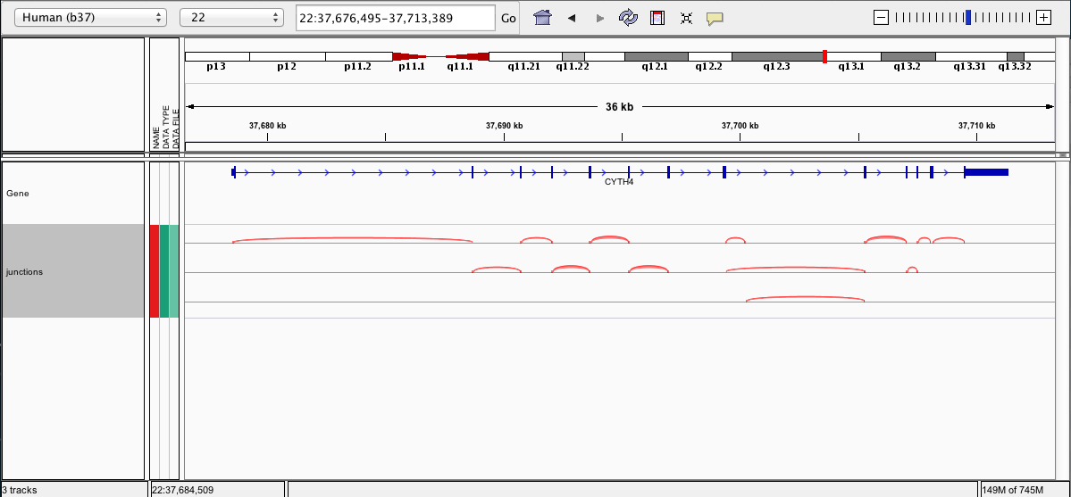
Viewing the junctions.bed in IGV

Slide 9
5-iii,iv. Cuffmerge
http://cufflinks.cbcb.umd.edu/manual.html#cuffmerge
Cuffmerge combines transcripts predicted from multiple RNA-seq data sets into one view of the transcriptome
Do this before running cuffdiff to compare between multiple conditions
Cuffmerge can also simultaneously compare transcripts to the known transcripts GTF file from Ensembl, etc.
http://cufflinks.cbcb.umd.edu/manual.html#class_codes

Slide 10
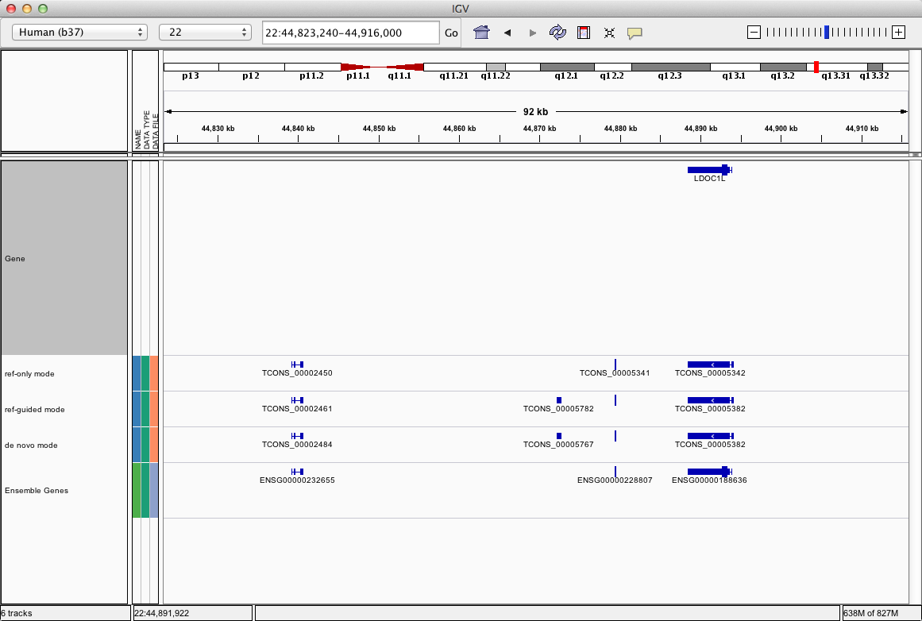
5-v. Comparison of merged GTFs from each StringTie mode
UCSC genes
ref_only mode
ref_guided mode
de_novo mode
Ensembl genes

Slide 11
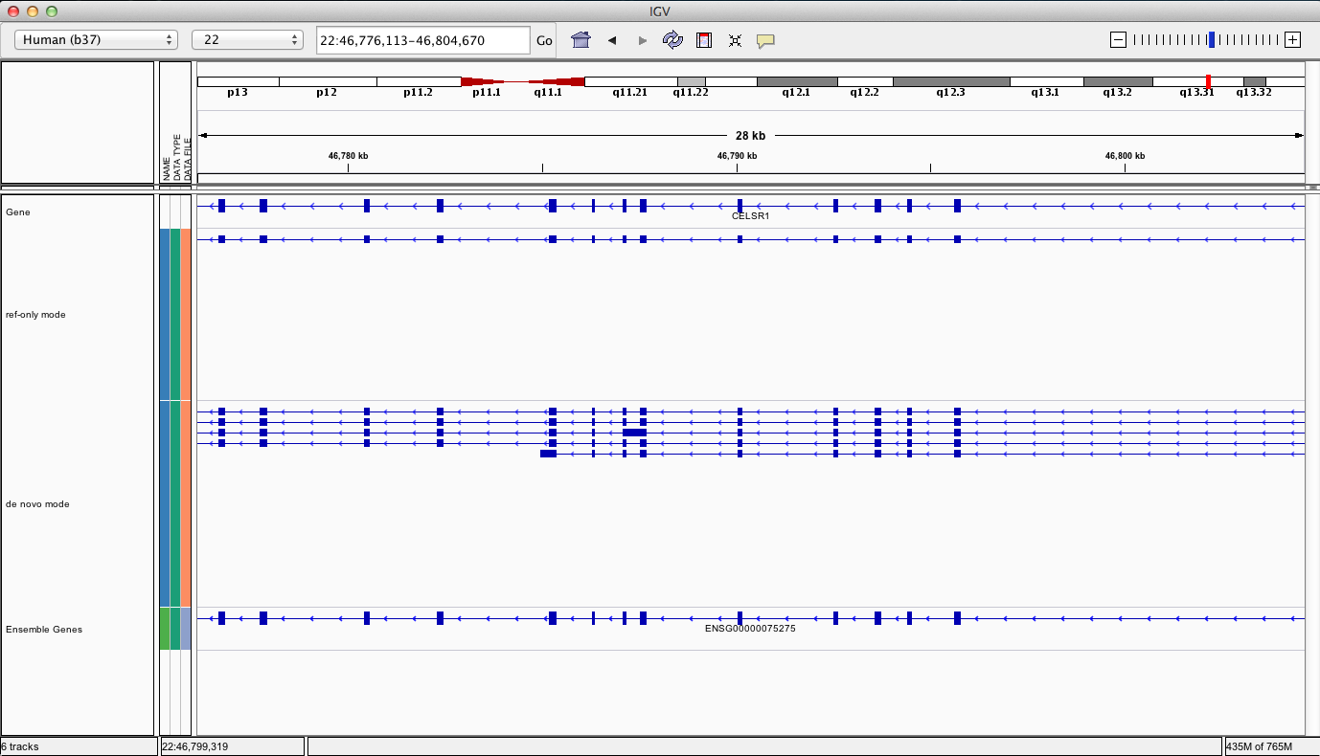
Comparison of merged GTFs from each StringTie mode
UCSC genes
ref_only mode
de_novo mode
Ensembl genes

Slide 12
We are on a Coffee Break & Networking Session

