Slide 1
Right Note Machine
A Keyboard MIDI Controller FPGA Project
by On-Key:
Jon Cili, Xingjian Jiang (Lion), & Raphael Mok

Slide 2
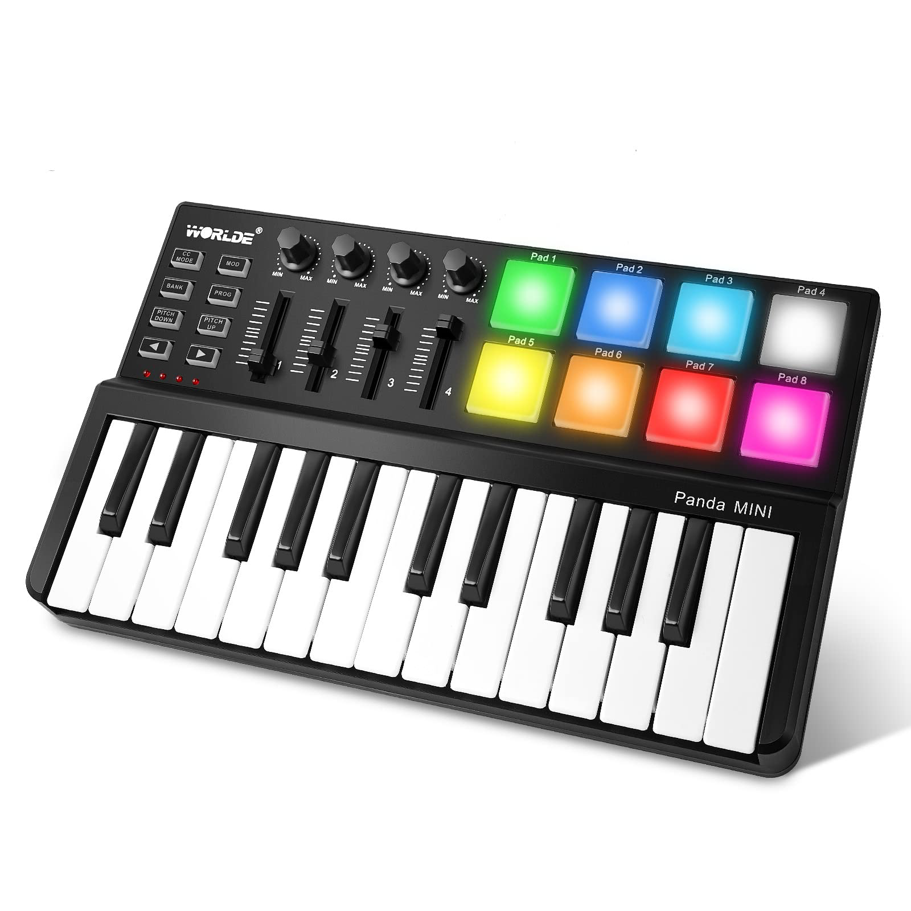
Overview
DIY Synthesizer
Peripheral Device Management
Building off of Existing Code
Music Recorder & Playback

Slide 3
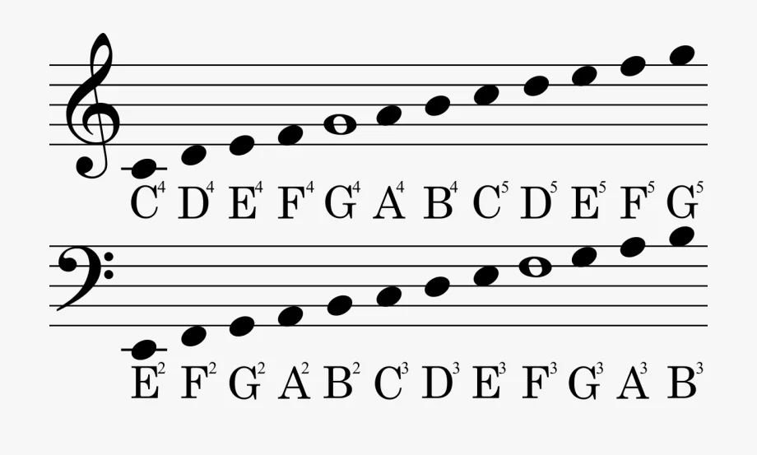
Short Functionality
1) Instant Note Playback
2) Pitch Shifter
3) Recording Controls
Reset Memory
4) Pre-Coded Music

Slide 4
Specifications
Top-Level File
Store at least 10 consecutive Notes
Accessible through Keyboard
Store at least 3 Songs
10 Keys -> 10 Notes
2 Arrow Keys -> Pitch Control
1 Key -> Start Rec.
1 Key -> Stop Rec.
1 Key -> Playback
1 Key -> Reset

Slide 5

Original Code Demonstration

Slide 6
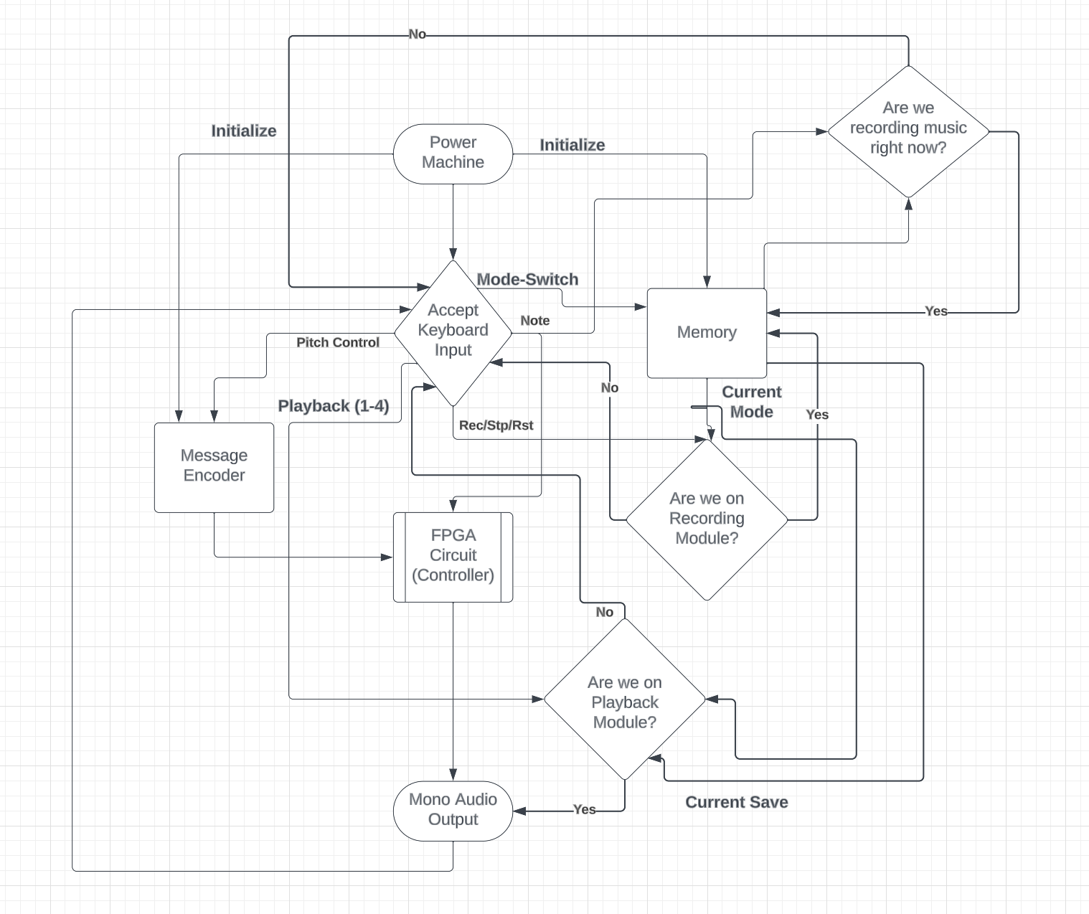
Detailed Block Diagram

Slide 7
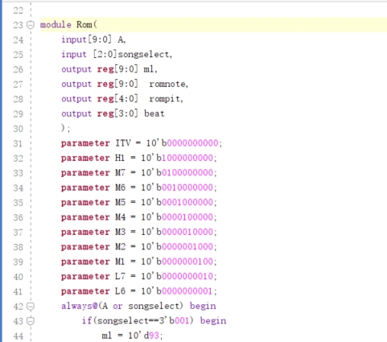
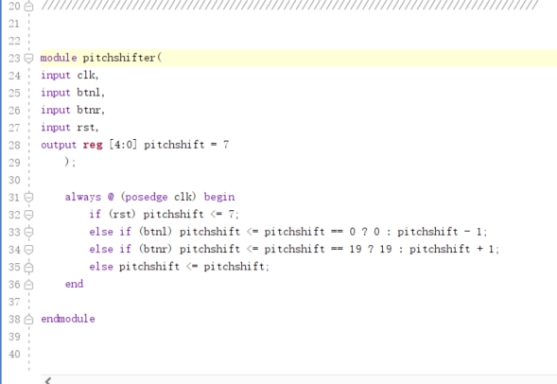
Code Snippets

Slide 8
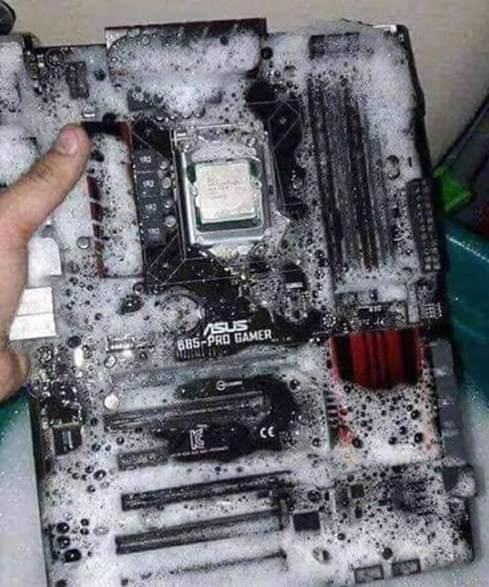
Successes (thus far)
No FPGAs to test on
Selected Necessary Files
-Rom.v
-counter.v
-message_encoder.v
-midi_encoder.v
-controller.v

Slide 9

Potential Failures
Pressing two keys at once.
Max Length of Notes to be Recorded
No VGA -> No Pitch Shift Indication, No Mode Indication

Slide 10
Recap
Online Source | Our Code
Pitch Control on External TouchPad | Pitch Control on Keyboard
Input Notes from Individually Wired Buttons | Input from Keyboard
Pre-Coded Music Activation via FPGA Switches | Pre-Coded Music Activation via Keyboard
Ultrasound Sensor Input | NO Ultrasound Sensor Input (no module)
Author’s Pre-Coded Music Choice | Our Pre-Coded Music Choice
Only implements ROM | Implements RAM & ROM
Terminal Display of Data | VGA Output of Key Letter (TBD)

Slide 11
Questions?

