Slide 1










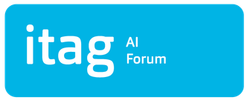

Your paragraph text
AI
AtlanTec Challenge
2026
17th April 2026
Cillian Myles myles.cillian@gmail.com
TEAM NAME:
Tokenizers
CONTACT:
Galway
COUNTY:
PROJECT
OUTCOME
CarePal is a local-first medication coordination app that helps people with high-consequence treatment routines, like transplant patients and their caregivers, stay on top of daily medicines. It combines reminders, calendar management, adherence tracking, and assistant-drafted medication changes with an explicit human review step before anything is applied. The result is a safer bridge between clinical instructions and what actually happens at home, where a missed or misunderstood dose can have serious consequences.
The outcome of this project is a more practical and reliable way to support medication adherence for people whose health depends on getting every dose right. It helps reduce confusion, missed medicines, and unsafe schedule changes by giving patients and families one clear place to manage routines, confirm changes, and track what was actually taken. For transplant care in particular, this kind of tool can be a serious support layer: if it helps prevent even one adherence-related rejection, complication, or death, it has created immeasurable value.

