Slide 1
第3章 敏捷开发
Notes:
Chapter 3 Agile Development

Slide 2
敏捷软件开发的宣言
“我们正在通过亲自实践以及帮助他人实践的方式来揭示更好的软件开发之路，通过这项工作，我们认识到：
  个人和这些人之间的交流胜过了开发过程和工具
  可运行的软件胜过了宽泛的文档
  客户合作胜过了合同谈判
  对变更的良好响应胜过了按部就班地遵循计划
也就是说，虽然上述右边的各项很有价值，但我们认为左边的各项具有更大的价值。”
Kent Beck et al
Notes:
The Manifesto for Agile Software Development
“We are uncovering better ways of developing software by doing it and helping others do it. Through this work we have come to value:
Individuals and interactions over processes and tools
Working software over comprehensive documentation
Customer collaboration over contract negotiation
Responding to change over following a plan
That is, while there is value in the items on the right, we value the items on the left more.”
Kent Beck et al

Slide 3
什么是敏捷？
有效的（快速并适应）响应变更
所有利益相关者中的有效沟通
吸引客户到团队
组织团队使其控制工作执行
产品…
快速、增量交付的软件
Notes:
What is “Agility”?
Effective (rapid and adaptive) response to change
Effective communication among all stakeholders
Drawing the customer onto the team
Organizing a team so that it is in control of the work performed
Yielding …
Rapid, incremental delivery of software

Slide 4

敏捷及变更成本的费用
使用传统软件过程的变更成本
开发成本
使用敏捷过程的变更成本
使用敏捷过程的理想变更成本
开发进度日程

Slide 5
敏捷过程
是由客户对他们需求的描述驱动的（场景）
意识到计划是短期的
着重强调构建活动的软件迭代开发
交付多个软件增量
适应变更的出现
Notes:
An Agile Process
Is driven by customer descriptions of what is required (scenarios)
Recognizes that plans are short-lived
Develops software iteratively with a heavy emphasis on construction activities
Delivers multiple ‘software increments’
Adapts as changes occur

Slide 6
敏捷原则- I
1. 我们最优先要做的是通过尽早、持续地交付有价值的软件来使客户满意。
2. 即使在开发的后期，也欢迎需求的变更。敏捷过程利用变更为客户创造竞争优势。
3. 经常交付可运行软件，交付的间隔可以从几个星期到几个月，交付的时间间隔越短越好。
4. 在整个项目开发期间，业务人员和开发人员必须天天都在一起工作。
5. 围绕有积极性的个人构建项目。给他们提供所需的环境和支持，并且信任他们能够完成工作。
6. 在开发团队内部，最富有效果和效率的信息传递方法是面对面交谈。
Notes:
Agility Principles – I
1. Our highest priority is to satisfy the customer through early and continuous delivery of valuable software.
2. Welcome changing requirements, even late in development. Agile processes harness change for the customer's competitive advantage.
3. Deliver working software frequently, from a couple of weeks to a couple of months, with a preference to the shorter timescale.
4. Business people and developers must work together daily throughout the project.
5. Build projects around motivated individuals. Give them the environment and support they need, and trust them to get the job done.
6. The most efficient and effective method of conveying information to and within a development team is face–to–face conversation.

Slide 7
敏捷原则- II
7. 可运行软件是进步的首要衡量标准。
8. 敏捷过程提倡可持续的开发。责任人、开发者和用户应该能够长期保持步调一致。
9. 不断关注优秀的技能和好的设计会增强敏捷能力。
10. 简单——使不必做的工作最大化的艺术——是必要的。
11. 最好的架构、需求和设计出自于自组织团队。
12. 每隔一定时间，团队会反省如何才能更有效地工作，并相应调整自己的行为。
Notes:
Agility Principles – II
7. Working software is the primary measure of progress.
8. Agile processes promote sustainable development. The sponsors, developers, and users should be able to maintain a constant pace indefinitely.
9. Continuous attention to technical excellence and good design enhances agility.
10. Simplicity – the art of maximizing the amount of work not done – is essential.
11. The best architectures, requirements, and designs emerge from self–organizing teams.
12. At regular intervals, the team reflects on how to become more effective, then tunes and adjusts its behavior accordingly.

Slide 8
人的因素
满足人员及团队需求的过程模型，而非其他过程模型
敏捷开发团队成员及团队本身必须具备的关键特征：
  竞争能力
  共同目标
  精诚合作
  决策能力
  模糊问题解决能力
  相互信任和尊重
  自组织
Notes:
Human Factors
the process molds to the needs of the people and team, not the other way around
key traits must exist among the people on an agile team and the team itself:
Competence.
Common focus.
Collaboration.
Decision-making ability.
Fuzzy problem-solving ability.
Mutual trust and respect.
Self-organization.

Slide 9
极限编程(XP)
使用最广泛的敏捷过程，最初由Kent Beck提出。
XP 策划
  以“用户故事”产生开始
  敏捷团队评估每个故事和分配成本
  将故事分组到一个可交付增量
  承诺交付日期
  在第一个软件增量交付之后，项目速度用于帮助确定后续发行版本的交付日期
Notes:
Extreme Programming (XP)
The most widely used agile process, originally proposed by Kent Beck
XP Planning
Begins with the creation of “user stories”
Agile team assesses each story and assigns a cost
Stories are grouped to for a deliverable increment
A commitment is made on delivery date
After the first increment “project velocity” is used to help define subsequent delivery dates for other increments

Slide 10
极限编程(XP)
XP 设计
  遵循KIS（保持简洁）原则 Keep It Simple！
  鼓励使用CRC卡(参见第5章P.103)
    Class-Responsibility-Collaborator（类-责任-协助者）
  对于困难的设计问题，提出建立“spike解决方案”——一种设计原型 (评估设计原型)
  鼓励“重构”——内部程序设计的迭代改进
XP 编码
  在编码之前，对于每一个软件增量建议构建一个单元测试
  鼓励“结对编程”
XP 测试
  每天执行所有单元测试
  验收测试由客户定义，并由客户执行评估客户可见的功能特征
Notes:
Extreme Programming (XP)
XP Design
Follows the KIS principle
Encourage the use of CRC cards (see Chapter 8)
For difficult design problems, suggests the creation of “spike solutions”—a design prototype
Encourages “refactoring”—an iterative refinement of the internal program design
XP Coding
Recommends the construction of a unit test for a store before coding commences
Encourages “pair programming”
XP Testing
All unit tests are executed daily
“Acceptance tests” are defined by the customer and excuted to assess customer visible functionality

Slide 11

极限编程(XP)
简单设计CRC卡
Spike解决方案原型
用户故事
权值 （优先级）
验收测试准则
迭代计划
设计
策划
编码
重构
测试
结对编程
发布
软件增量
项目速度估算
单元测试
连续集成
验收测试
Notes:
Extreme Programming (XP)

Slide 12
其它敏捷过程模型
（Agile Process Model）
自适应软件开发 （ASD）
Scrum
动态系统开发方法（DSDM）
Crystal
特征驱动开发（FDD）
敏捷建模（AM）
敏捷统一过程（AUP）

Slide 13
自适应软件开发
（Adaptive Software Developmnet）
最初由 Jim Highsmith提出
ASD ——区分特征
  任务驱动规划
  基于组件的焦点
  使用“时间段”
  明确风险考虑
  强调需求收集协作
  强调整个过程的“学习”
Notes:
Adaptive Software Development
Originally proposed by Jim Highsmith
ASD — distinguishing features
Mission-driven planning
Component-based focus
Uses “time-boxing” (See Chapter 24)
Explicit consideration of risks
Emphasizes collaboration for requirements gathering
Emphasizes “learning” throughout the process

Slide 14
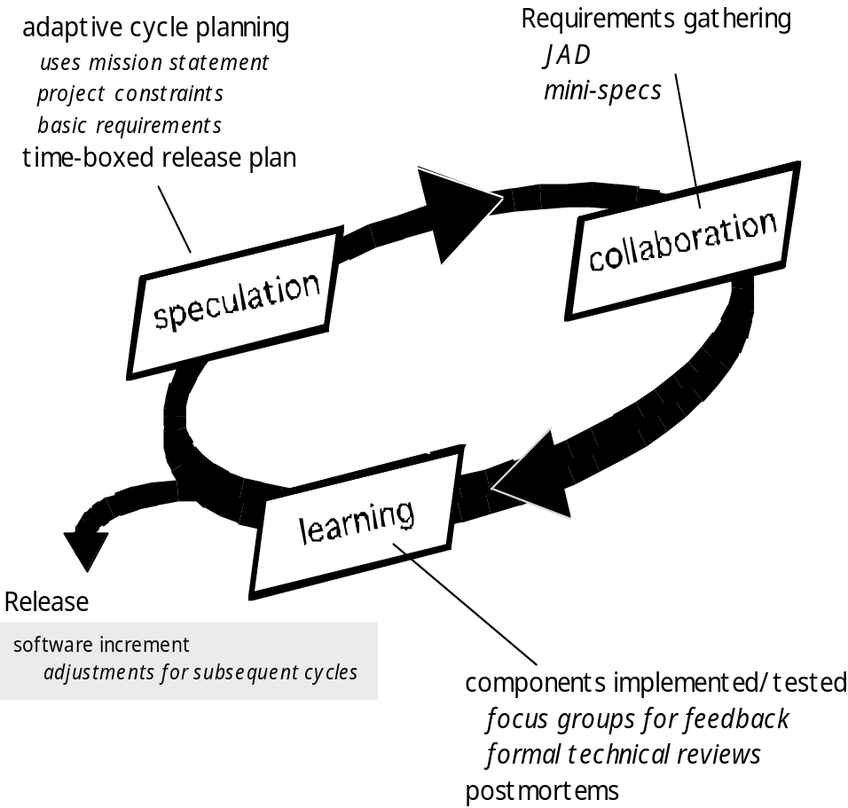
自适应软件开发
自适应循环计划
任务声明
项目约束
基本需求
需求获取
JAD （应用程序开发联席会议）
Joint Application Development
最小规格说明
协作
思考
学习
发布
软件增量
后续循环调整
构件实现/测试
聚焦于反馈分组
正式技术评审
事后剖析
Notes:
Adaptive Software Development

Slide 15
Scrum
最初由Schwaber 和Beedle提出
Scrum——区分特征
  开发工作划分为“包”
  测试和文档在构建产品过程中是持续的
  工作任务称为一个“冲刺sprint”，并来自现有需求的一个“待办项”
  会议非常短暂，甚至有时开会都不用椅子
  演示是在分配的时间段内向客户交付软件增量
Notes:
Scrum
Originally proposed by Schwaber and Beedle
Scrum—distinguishing features
Development work is partitioned into “packets”
Testing and documentation are on-going as the product is constructed
Work occurs in “sprints” and is derived from a “backlog” of existing requirements
Meetings are very short and sometimes conducted without chairs
“demos” are delivered to the customer with the time-box allocated

Slide 16
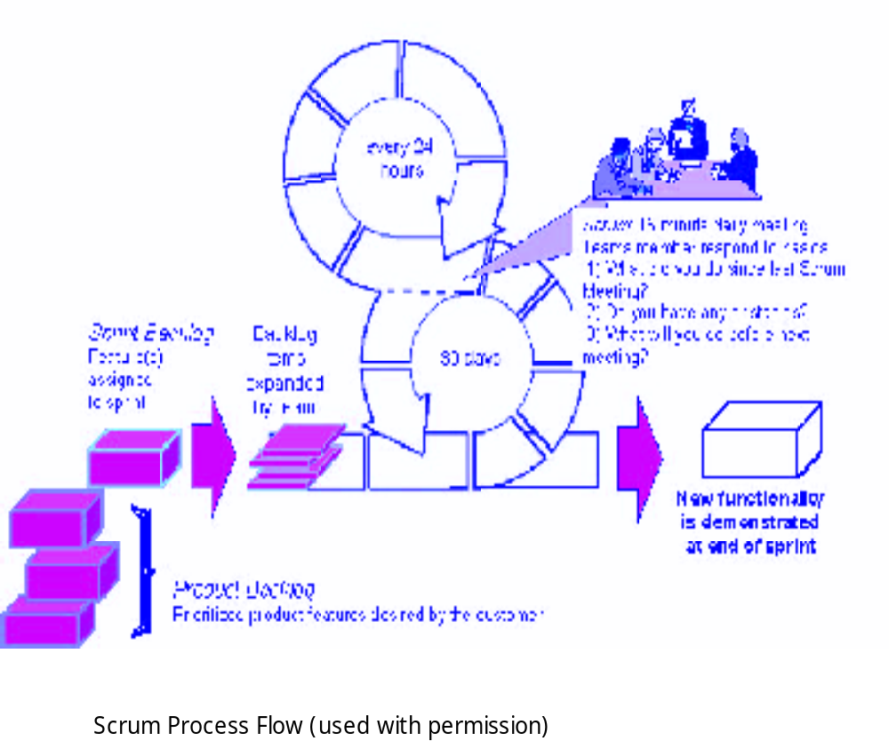
Scrum
每24小时
Scrum:15分钟日例会团队成员基本问题
1、上次例会后做了什么？
2、遇到什么困难？
3、下次例会前做些什么？
团队展开的具体项目
冲刺待定项分配给冲刺的特征
30天
冲刺结束时展示的新功能
产品待定项分优先级的客户急需产品特征
Scrum过程流(使用许可)
Notes:
Scrum

Slide 17
动态系统开发方法
由 DSDM 协会提出 (www.dsdm.org)
DSDM——特征
  在很多方面类似XP或ASD
  九条指导原则
    活跃的用户参与是必不可少的。
    DSDM 团队必须有权作出决定。
    注重多次产品交付。
    适应商业目的是交付产品验收的基本标准。
    迭代和增量开发有必要聚集在一个精确的业务解决方案。
    开发期间所有的变更都是可逆的。
    需求基线是高水准的。
    测试集中在整个生命周期。
Notes:
Adaptive Software Development
Promoted by the DSDM Consortium (www.dsdm.org)
DSDM—distinguishing features
Similar in most respects to XP and/or ASD
Nine guiding principles
Active user involvement is imperative.
DSDM teams must be empowered to make decisions.
The focus is on frequent delivery of products.
Fitness for business purpose is the essential criterion for acceptance of deliverables.
Iterative and incremental development is necessary to converge on an accurate business solution.
All changes during development are reversible.
Requirements are baselined at a high level
Testing is integrated throughout the life-cycle.

Slide 18
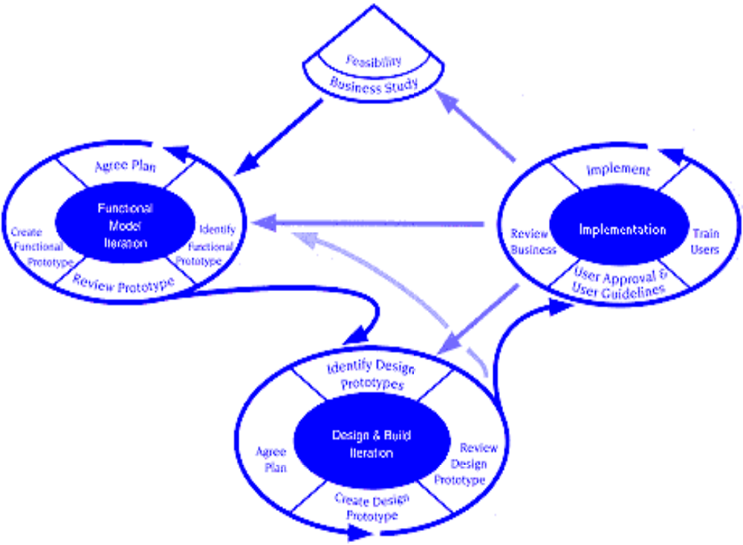
动态系统开发方法
DSDM Life Cycle (with permission of the DSDM consortium)
DSDM生命周期（DSDM协会许可）
Notes:
Dynamic Systems Development Method

Slide 19
Crystal
由 Cockburn 和 Highsmith提出
Crystal——特征
  实际上，一个过程模型的大家庭允许根据问题特点来操作
  强调面对面的沟通
  建议使用“反思研讨会”审查团队的工作习惯
Notes:
Scrum
Proposed by Cockburn and Highsmith
Crystal—distinguishing features
Actually a family of process models that allow “maneuverability” based on problem characteristics
Face-to-face communication is emphasized
Suggests the use of “reflection workshops” to review the work habits of the team

Slide 20
特征驱动开发
最初由Peter Coad及其同事提出
FDD——特征
  强调特征定义
    特征“是可以在2周或更短时间实现的具有客户价值的功能”
  使用特征模版
    <action> the <result> <by | for | of | to> a(n) <object>
  创建一个特征列表并实施“特征计划”
  在FDD中合并设计和构建
Notes:
Feature Driven Development
Originally proposed by Peter Coad et al
FDD—distinguishing features
Emphasis is on defining “features”
a feature “is a client-valued function that can be implemented in two weeks or less.”
Uses a feature template
<action> the <result> <by | for | of | to> a(n) <object>
A features list is created and “plan by feature” is conducted
Design and construction merge in FDD

Slide 21
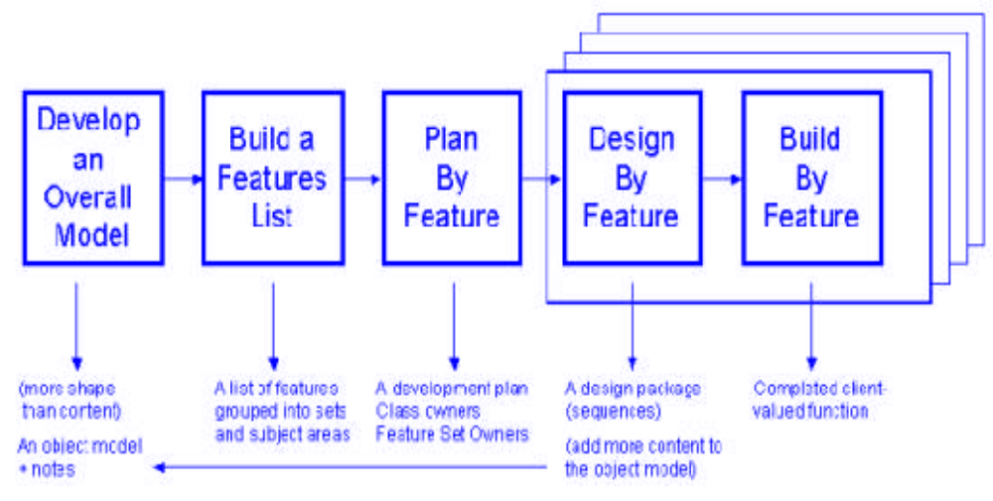
特征驱动开发
开发全局模型
构造特征列表
特征计划
特征设计
特征构建
更多外观而非内容
按照主题
领域划分
开发计划类属性
特征集属性
设计包（序列）
具有客户价值的完整功能
一个对象模型说明
增加更多内容到对象模型
Reprinted with permission of Peter Coad
Notes:
Feature Driven Development

Slide 22
AUP 敏捷统一过程
Agile Unified Process
AUP采用“全局串行”和“局部迭代”构建软件系统
采用经典UP阶段性活动：开始、加工、构建、变迁
与UML结合

Slide 23
敏捷建模
最初由 Scott Ambler提出
提出一系列敏捷建模原则
  有目的的模型
  使用多个模型
  轻装上阵
  内容重于表现形式
  理解模型及构件工具
  适应本地需要
Notes:
Agile Modeling
Originally proposed by Scott Ambler
Suggests a set of agile modeling principles
Model with a purpose
Use multiple models
Travel light
Content is more important than representation
Know the models and the tools you use to create them
Adapt locally

