Slide 1
第5章 理解需求
Notes:
Chapter 5 Understanding Requirements

Slide 2
需求工程-I
起始——询问一系列问题以建立……
  对问题的基本理解
  需要解决方案的人
  所期望解决方案的性质
  项目利益相关者和开发人员之间达成初步交流合作的效果
导出——引出所有利益相关者的需求
精化——创建一个分析模型，用以说明软件的数据、功能和行为等需求
协商——对开发者和客户来说是现实的、达成一致的可交付系统
Notes:
Requirements Engineering-I
Inception—ask a set of questions that establish …
basic understanding of the problem
the people who want a solution
the nature of the solution that is desired, and
the effectiveness of preliminary communication and collaboration between the customer and the developer
Elicitation—elicit requirements from all stakeholders
Elaboration—create an analysis model that identifies data, function and behavioral requirements
Negotiation—agree on a deliverable system that is realistic for developers and customers

Slide 3
需求工程-II
规格说明——可以是以下一项或任意组合：
  一份写好的文档
  一套模型
  一个形式化的数学模型
  一组使用场景（用例）
  一个原型
确认——一种审查机制，即找出：
  内容或解释上的错误
  可能需要进一步解释澄清的地方
  丢失的信息
  不一致性（这是建造大型产品或系统时遇到的主要问题）
  冲突的需求或不可实现的（不能达到的）需求
需求管理
Notes:
Requirements Engineering-II
Specification—can be any one (or more) of the following:
A written document
A set of models
A formal mathematical
A collection of user scenarios (use-cases)
A prototype
Validation—a review mechanism that looks for
errors in content or interpretation
areas where clarification may be required
missing information
inconsistencies (a major problem when large products or systems are engineered)
conflicting or unrealistic (unachievable) requirements.
Requirements management

Slide 4
起始
确认利益相关者
  “你认为我还应该和谁交谈”
识别多重观点
协同合作
首次提问
  谁是这项工作的最初的请求者？
  谁将使用该解决方案
  成功的解决方案将带来什么样的经济效益?
  对于这个解决方案你还需要其他资源吗？
Notes:
Inception
Identify stakeholders
“who else do you think I should talk to?”
Recognize multiple points of view
Work toward collaboration
The first questions
Who is behind the request for this work?
Who will use the solution?
What will be the economic benefit of a successful solution
Is there another source for the solution that you need?

Slide 5
导出需求
会议由软件工程师和利益相关者共同举办和参与
制定筹备和参与会议的规则
建议拟定一个会议议程
由一个“调解人”（可以是客户，开发人员或其他人）控制会议
采用“方案论证手段”（可以是工作表、活动挂图、不干胶贴纸或电子公告牌、聊天室或虚拟论坛）。
目的是
  识别问题
  提出问题解决方案
  协商不同的方法
  确定一套解决需求问题的初步方案
Notes:
Eliciting Requirements
meetings are conducted and attended by both software engineers and customers
rules for preparation and participation are established
an agenda is suggested
a "facilitator" (can be a customer, a developer, or an outsider) controls the meeting
a "definition mechanism" (can be work sheets, flip charts, or wall stickers or an electronic bulletin board, chat room or virtual forum) is used
the goal is
to identify the problem
propose elements of the solution
negotiate different approaches, and
specify a preliminary set of solution requirements

Slide 6
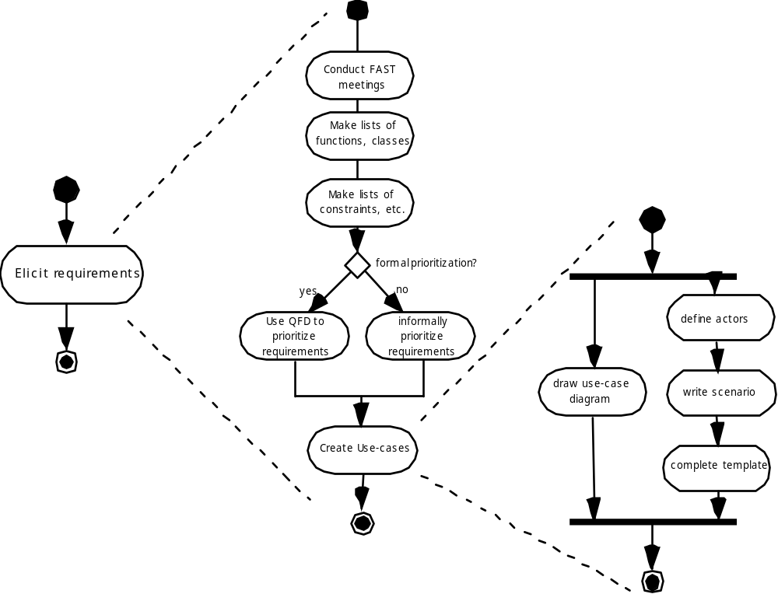
导出需求
召开会议
列出工能、类
列出约束等
形式地划分优先级？
导出需求
使用QFD（质量功能部署）划分需求的优先级
非形式地划分需求的优先级
确定参与者
编写场景
绘制用例图
生成用例
完成模版

Slide 7
质量功能部署（QFD）
功能部署决定系统所需的每一个功能的“价值”（由客户感知）
信息部署确定数据对象和事件
任务部署检查系统行为
价值分析决定需求的相对优先权
Notes:
Quality Function Deployment
Function deployment determines the “value” (as perceived by the customer) of each function required of the system
Information deployment identifies data objects and events
Task deployment examines the behavior of the system
Value analysis determines the relative priority of requirements

Slide 8
导出工作产品
要求和可行性陈述。
系统或产品范围的界限说明。
参与需求导出的客户、用户和其他利益相关者的名单。
系统技术环境的说明。
需求列表（最好按照功能加以组织）以及每个需求使用的领域限制。
一系列使用场景，有助于深入了解系统或产品在不同运行环境下的使用。
任何能够更好地定义需求的原型。
Notes:
Elicitation Work Products
a statement of need and feasibility.
a bounded statement of scope for the system or product.
a list of customers, users, and other stakeholders who participated in requirements elicitation
a description of the system’s technical environment.
a list of requirements (preferably organized by function) and the domain constraints that apply to each.
a set of usage scenarios that provide insight into the use of the system or product under different operating conditions.
any prototypes developed to better define requirements.

Slide 9
构建需求模型
分析模型的元素
  基于场景的元素
    功能说明——处理软件功能的描述
    用例——描述“参与者”和系统之间的交互作用
  基于类的元素
    由场景暗示
  行为元素
    状态图
  面向数据流元素
    数据流图
Notes:
Building the Analysis Model
Elements of the analysis model
Scenario-based elements
Functional—processing narratives for software functions
Use-case—descriptions of the interaction between an “actor” and the system
Class-based elements
Implied by scenarios
Behavioral elements
State diagram
Flow-oriented elements
Data flow diagram

Slide 10
用例
一组用户场景，描述系统的线程使用
从“参与者”的点-视角来描述每一个场景——人或设备以某种方式与软件交互
每一个场景回答以下问题：
  谁是主要参与者、次要参与者？
  参与者的目标是什么？
  故事开始前有什么前提条件？
  参与者完成的主要工作或功能是什么？
  按照故事所描述的还可能需要考虑什么异常？
  参与者的交互中有什么可能的变化？
  参与者将获得、产生或改变哪些系统信息？
  参与者必须通知系统有关外部环境的改变吗？
  参与者希望从系统获取什么信息？
Notes:
Use-Cases
A collection of user scenarios that describe the thread of usage of a system
Each scenario is described from the point-of-view of an “actor”—a person or device that interacts with the software in some way
Each scenario answers the following questions:
Who is the primary actor, the secondary actor (s)?
What are the actor’s goals?
What preconditions should exist before the story begins?
What main tasks or functions are performed by the actor?
What extensions might be considered as the story is described?
What variations in the actor’s interaction are possible?
What system information will the actor acquire, produce, or change?
Will the actor have to inform the system about changes in the external environment?
What information does the actor desire from the system?
Does the actor wish to be informed about unexpected changes?

Slide 11
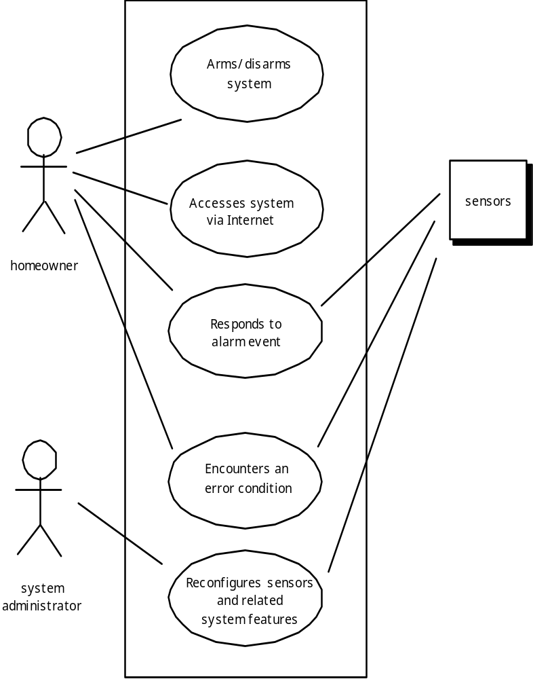
用例图
安装/接触系统
通过因特网访问系统
传感器
房主
报警事件的响应
遇到错误条件
重新配置传感器以及相关的系统特性
系统管理员
Notes:
Use-Case Diagram

Slide 12
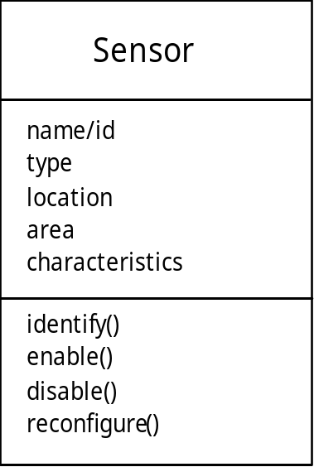
类图
从SafeHome 系统…
传感器
Notes:
Class Diagram

Slide 13
状态图
Reading
Commands
读指令
State name
状态名
System status = “ready”
Display msg = “enter cmd”
Display status = steady
State variables
状态变量
Entry/subsystems ready
Do: poll user input panel
Do: read user input
Do: interpret user input
State activities
状态活动
Notes:
State Diagram

Slide 14
分析模式
  模式名称： 捕获模式本质的描述符。
  目的： 描述该模式实现了或代表什么。
  动机： 说明怎样用模式解决问题的一个场景。
  影响环境： 对外部问题（影响）的描述，即能够影响如何使用模式，并当应用该模式时，影响即将被解决的外部问题。
  解决方案：对如何应用模式来解决强调结构和行为问题的描述。
  效果： 解决了发生在应用模式时和应用过程中存在权衡的问题。
  设计： 通过使用已知的设计模式讨论如何实现该分析模式。
  已知应用: 在实际系统中使用的例子。
  相关模式：与命名模式有关的一个或更多分析模式，因为(1) 与命名模式共同使用；(2) 在结构上，与命名模式相似；(3) 是命名模式的一个变化。
Notes:
Analysis Patterns
Pattern name: A descriptor that captures the essence of the pattern.
Intent: Describes what the pattern accomplishes or represents
Motivation: A scenario that illustrates how the pattern can be used to address the problem.
Forces and context: A description of external issues (forces) that can affect how the pattern is used and also the external issues that will be resolved when the pattern is applied.
Solution: A description of how the pattern is applied to solve the problem with an emphasis on structural and behavioral issues.
Consequences: Addresses what happens when the pattern is applied and what trade-offs exist during its application.
Design: Discusses how the analysis pattern can be achieved through the use of known design patterns.
Known uses: Examples of uses within actual systems.
Related patterns: On e or more analysis patterns that are related to the named pattern because (1) it is commonly used with the named pattern; (2) it is structurally similar to the named pattern; (3) it is a variation of the named pattern.

Slide 15
协商需求
确定关键的利益相关者
  是即将参与协商的人
确定每个利益相关者“赢”的条件
  赢的条件并不总是显而易见的
协商
  致力于导致“双赢”的一组需求
Notes:
Negotiating Requirements
Identify the key stakeholders
These are the people who will be involved in the negotiation
Determine each of the stakeholders “win conditions”
Win conditions are not always obvious
Negotiate
Work toward a set of requirements that lead to “win-win”

Slide 16
确认需求- I
每项需求都和系统或产品的整体目标一致吗？
所有的需求都已经在相应的抽象层上说明了吗？换句话说，是否有一些需求是在技术细节过多的层次上提出的，并不适合当前的阶段。
需求是真正必须的，还是另外加上去的，有可能不是系统目标所必须的特性吗？
每项需求都有界定且无歧义吗？
每项需求都有归属权吗？换句话说，是否每个需求都标记了来源（通常是一个明确的人）？
有需求和其他需求相冲突吗？
Notes:
Validating Requirements – I
Is each requirement consistent with the overall objective for the system/product?
Have all requirements been specified at the proper level of abstraction? That is, do some requirements provide a level of technical detail that is inappropriate at this stage?
Is the requirement really necessary or does it represent an add-on feature that may not be essential to the objective of the system?
Is each requirement bounded and unambiguous?
Does each requirement have attribution? That is, is a source (generally, a specific individual) noted for each requirement?
Do any requirements conflict with other requirements?

Slide 17
确认需求- II
在系统或产品所处的技术环境下每个需求都能够实现吗？
一旦实现后，每项需求是可测试的吗？
需求模型恰当反应了将要构建系统的信息、功能和行为吗？
需求模型是否已经使用合适的方式“分割”，能够逐步地揭示详细的系统信息吗？
已经使用了需求模型简化需求模型吗？所有的模型都已经被恰当地确认了吗？所有的模式都和客户的需求一致吗？
Notes:
Validating Requirements – II
Is each requirement achievable in the technical environment that will house the system or product?
Is each requirement testable, once implemented?
Does the requirements model properly reflect the information, function and behavior of the system to be built.
Has the requirements model been “partitioned” in a way that exposes progressively more detailed information about the system.
Have requirements patterns been used to simplify the requirements model. Have all patterns been properly validated? Are all patterns consistent with customer requirements?

