Slide 1
第6章
需求建模：场景、信息与类分析
Notes:
Chapter 6 Requirements Modeling: Scenarios, Information, and Analysis Classes

Slide 2
需求分析
需求分析
  确定软件的操作特性
  指明软件和其他系统元素的接口
  规定软件必须满足的约束
需求分析让软件工程师（有时这个角色也被称作分析或建模师）：
  细化在前期需求工程任务中建立的基础需求
  建立描述用户场景、功能活动、问题类及它们之间的关系、系统和类行为以及数据流变换时等模型
Notes:
Requirements Analysis
Requirements analysis
specifies software’s operational characteristics
indicates software's interface with other system elements
establishes constraints that software must meet
Requirements analysis allows the software engineer (called an analyst or modeler in this role) to:
elaborate on basic requirements established during earlier requirement engineering tasks
build models that depict user scenarios, functional activities, problem classes and their relationships, system and class behavior, and the flow of data as it is transformed.

Slide 3
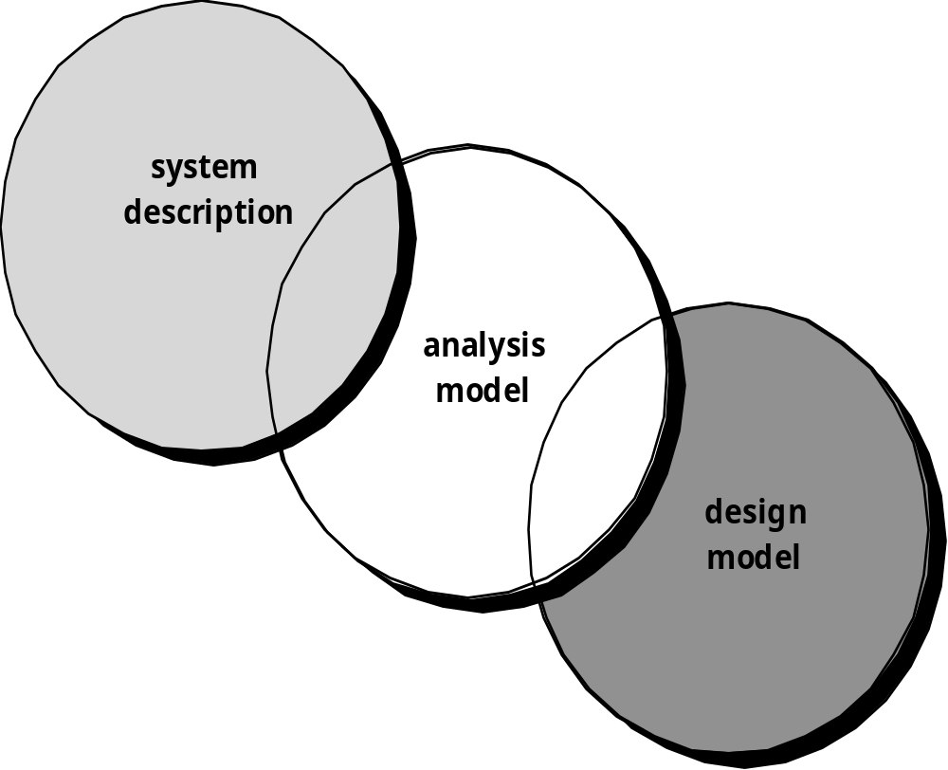
桥接
系统描述
分析模型
设计模型
Notes:
A Bridge

Slide 4
经验原则
模型应关注在问题域或业务域内可见的需求，抽象的级别应该相对高一些。
需求模型的每个元素都应能增加对软件需求的整体理解，并提出对信息域、功能和系统行为的深入理解。
关于基础结构和其他非功能的模型应推延到设计阶段再考虑。
最小化整个系统内的关联。
确认需求模型为所有利益相关者都带来价值。
尽可能保持模型简洁。
Notes:
Rules of Thumb
The model should focus on requirements that are visible within the problem or business domain. The level of abstraction should be relatively high.
Each element of the analysis model should add to an overall understanding of software requirements and provide insight into the information domain, function and behavior of the system.
Delay consideration of infrastructure and other non-functional models until design.
Minimize coupling throughout the system.
Be certain that the analysis model provides value to all stakeholders.
Keep the model as simple as it can be.

Slide 5
域分析
软件域分析是识别、分析和详细说明某个特定应用领域的公共需求，特别是那些在该应用域内被多个项目重复使用的需求……[面向对象的域分析是]在某个特定应用领域，根据通用的对象、类、部件和框架，识别、分析和详细说明公共的、可复用的能力
Donald Firesmith
Notes:
Domain Analysis
Software domain analysis is the identification, analysis, and specification of common requirements from a specific application domain, typically for reuse on multiple projects within that application domain . . . [Object-oriented domain analysis is] the identification, analysis, and specification of common, reusable capabilities within a specific application domain, in terms of common objects, classes, subassemblies, and frameworks . . .

Slide 6
域分析
确定调查的领域。
收集应用领域内的典型例子
分析例子中每一个应用
为对象开发一种分析模型
Notes:
Domain Analysis
Define the domain to be investigated.
Collect a representative sample of applications in the domain.
Analyze each application in the sample.
Develop an analysis model for the objects.

Slide 7
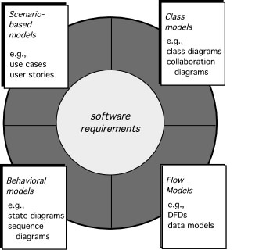
需求分析的元素
基于场景的模型如：
用例
用户故事
类模型如:
类图
协作图
软件需求
行为模型如：
状态图
顺序图
流模型如：
数据流图
数据模型
Notes:
Elements of Requirements Analysis

Slide 8
基于场景模型
“[用例]只是帮助定义系统之外（参与者）存在什么以及系统应完成什么（用例）。”Ivar Jacobson
  (1) 我们应该写什么？
  (2) 我们应该写多少？
  (3) 我们编写说明应该多详细？
  (4) 我们如何组织说明？
Notes:
Scenario-Based Modeling
“[Use-cases] are simply an aid to defining what exists outside the system (actors) and what should be performed by the system (use-cases).” Ivar Jacobson
(1) What should we write about?
(2) How much should we write about it?
(3) How detailed should we make our description?
(4) How should we organize the description?

Slide 9
编写什么？
起始和导出——提供了开始编写用例所需要的信息.。
运用需求收集会议、QFD和其他需求工程机制
  确定利益相关者
  定义问题的范围
  说明整体的运行目标
  建立优先级顺序
  概述所有已知的功能需求
  描述系统将处理的信息(对象)。
开始开发一系列用例时，应列出特定参与者执行的功能活动。
Notes:
What to Write About?
Inception and elicitation—provide you with the information you’ll need to begin writing use cases.
Requirements gathering meetings, QFD, and other requirements engineering mechanisms are used to
identify stakeholders
define the scope of the problem
specify overall operational goals
establish priorities
outline all known functional requirements, and
describe the things (objects) that will be manipulated by the system.
To begin developing a set of use cases, list the functions or activities performed by a specific actor.

Slide 10
编写多少
在与相关利益人进一步会话取得进步后，需求收集团队为每一个功能说明开发用例。
通常以一种非正式的叙述性的方式表达用例。
若要求更正式的方式，则以一种类似于被提及的结构化的格式重写相同的用例。
Notes:
How Much to Write About?
As further conversations with the stakeholders progress, the requirements gathering team develops use cases for each of the functions noted.
In general, use cases are written first in an informal narrative fashion.
If more formality is required, the same use case is rewritten using a structured format similar to the one proposed.

Slide 11
用例
一个场景描述了系统的一个“使用线程”
参与者代表了系统运行时人或设备扮演的角色
用户在给定的场景可以扮演许多不同的角色
Notes:
Use-Cases
a scenario that describes a “thread of usage” for a system
actors represent roles people or devices play as the system functions
users can play a number of different roles for a given scenario

Slide 12
开发用例
参与者完成的主要任务和功能是什么？
参与者将获取、产生或改变哪些系统信息？
参与者必须通知系统有关外部环境的改变吗？
参与者希望从系统获取什么信息？
参与者希望得知会有意料之外的变更吗？
Notes:
Developing a Use-Case
What are the main tasks or functions that are performed by the actor?
What system information will the the actor acquire, produce or change?
Will the actor have to inform the system about changes in the external environment?
What information does the actor desire from the system?
Does the actor wish to be informed about unexpected changes?

Slide 13
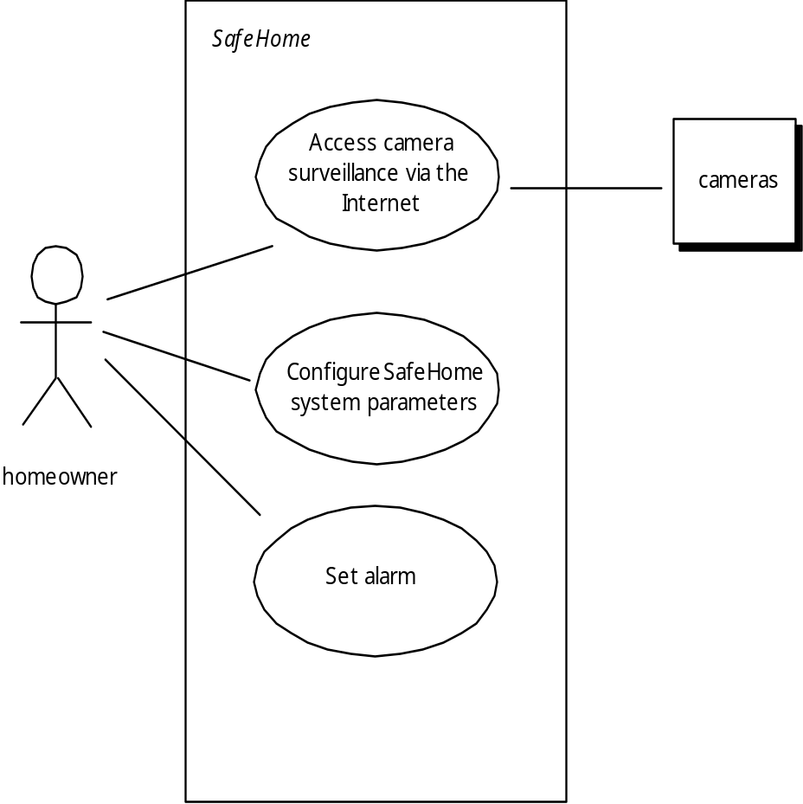
用例图
通过因特网进入摄像机监视
摄像机
配置SafeHome系统参数
房主
设置报警
Notes:
Use-Case Diagram

Slide 14
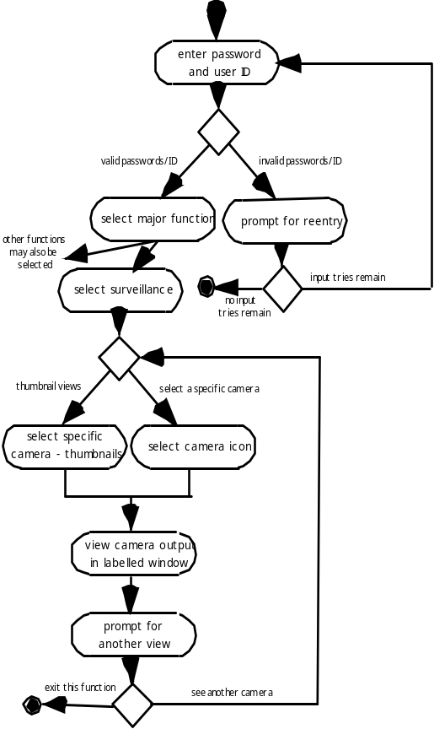
活动图
Supplements the use case by providing a graphical representation of the flow of interaction within a specific scenario
输入密码和用户ID
有效的密码ID
无效的密码/ID
选择主功能
重新输入提示
也可能选择其他功能
继续重试输入
选择监视
结束重试输入
缩略视图
选择某个摄像头
在特定场景内通过提供迭代流的图形化表示类补充用例
选择某个摄像头缩略视图
选择摄像头图标
在标示窗口中查看摄像头输出
查看另一视图提示
退出这个功能
查看另一个摄像头
Notes:
Activity Diagram

Slide 15
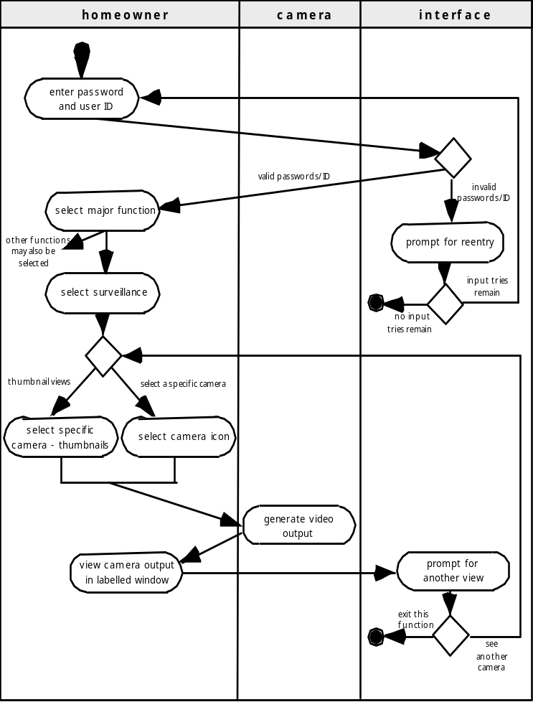
泳道图
Allows the modeler to represent the flow of activities described by the use-case and at the same time indicate which actor (if there are multiple actors involved in a specific use-case) or analysis class has responsibility for the action described by an activity rectangle
房主
摄像机
接口
输入密码和用户ID
选择主功能
无效的密码/ID
有效的密码/ID
提示重新输入提示
也可能选择其他功能
选择监视
继续重试输入
结束重试输入
可让建模人员表示用例所描述的活动流，同时指示哪个参与者（如果在特定用例中涉及了多个参与者）或分析类是由活动矩形所描述的活动来负责。
缩略视图
选择某个摄像头
选择某个摄像头缩略视图
选择摄像头图标
产生视频输出
提示另一视图
在标示窗口中查看摄像头输出
退出这个功能
查看另一个摄像头
Notes:
Swimlane Diagrams

Slide 16
数据建模
检查数据对象的独立处理
注意力集中在数据域
创建客户级抽象的模型
指出数据对象之间的相互联系
Notes:
Data Modeling
examines data objects independently of processing
focuses attention on the data domain
creates a model at the customer’s level of abstraction
indicates how data objects relate to one another

Slide 17
什么是数据对象
数据对象必须由软件理解的复合信息表示。
  复合信息—具有若干不同的特征或属性的事物
可能是外部实体（例如产生或使用信息的任何东西），事物（例如报告或显示），偶发事件（例如电话呼叫）或事件（例如报警），角色（例如销售人员），组织单位（例如财务部），地点（例如仓库）或结构（例如文件）。
描述包括了数据对象及其所有属性。
数据对象只封装数据——在数据对象中没有操作数据的引用
Notes:
What is a Data Object?
a representation of almost any composite information that must be understood by software.
composite information—something that has a number of different properties or attributes
can be an external entity (e.g., anything that produces or consumes information), a thing (e.g., a report or a display), an occurrence (e.g., a telephone call) or event (e.g., an alarm), a role (e.g., salesperson), an organizational unit (e.g., accounting department), a place (e.g., a warehouse), or a structure (e.g., a file).
The description of the data object incorporates the data object and all of its attributes.
A data object encapsulates data only—there is no reference within a data object to operations that act on the data.

Slide 18
数据对象和属性
数据对象包含一组属性，它们充当一个方面、质量、特性或对象的描述
object: automobile
attributes:
make
model
body type
price
options code
Notes:
Data Objects and Attributes
A data object contains a set of attributes that act as an aspect, quality, characteristic, or descriptor of the object

Slide 19
什么是关系
数据对象可以以多种不同的方式与另一个数据对象链接。
  在person和car之间建立联系，因为这两个对象之间是相互联系的。
    人拥有车
    汽车驾车投保人
关系“拥有”和“驾车投保”定义了person和car之间的相关连接。
一个关系中可以存在几个实例
对象之间可以以多种不同的方式联系
Notes:
What is a Relationship?
Data objects are connected to one another in different ways.
A connection is established between person and car because the two objects are related.
A person owns a car
A person is insured to drive a car
The relationships owns and insured to drive define the relevant connections between person and car.
Several instances of a relationship can exist
Objects can be related in many different ways

Slide 20
ERD 符号
One common form:
一种常见形式：
(0, m)
object
relationship
object
1
(1, 1)
2
关系
attribute
属性
Another common form:
另一种常见形式：
object
relationship
object
1
2
(0, m)
关系
(1, 1)
Notes:
ERD Notation

Slide 21
建立ERD
第1层——建模所有数据对象(实体) 和它们与另一个对象的“联系”
第2层——建模所有的实体和关系
第3层——建模所有实体、关系及进一步提供的属性
Notes:
Building an ERD
Level 1—model all data objects (entities) and their “connections” to one another
Level 2—model all entities and relationships
Level 3—model all entities, relationships, and the attributes that provide further depth

Slide 22
The ERD: 举例
request
for service
Customer
places
客户
(1,1)
地点
(1,m)
服务请求
(1,1)
standard
task table
(1,n)
work
order
generates
标准任务表
生成
工作秩序
(1,1)
(1,1)
(1,1)
selected
from
work
tasks
(1,w)
(1,w)
consists
of
工作任务
选择
组成
(1,i)
materials
lists
材料
清单
Notes:
The ERD: An Example

Slide 23
基于类的建模
基于类建模表示：
  系统操作的对象
  应用于对象间能有效控制的操作（也称为方法或服务）
  对象间的关系（某种层级）
  定义出现在类之间的协作
基于类的模型的元素包括类和对象、属性、操作、CRC模型、协作图和包。
Notes:
Class-Based Modeling
Class-based modeling represents:
objects that the system will manipulate
operations (also called methods or services) that will be applied to the objects to effect the manipulation
relationships (some hierarchical) between the objects
collaborations that occur between the classes that are defined.
The elements of a class-based model include classes and objects, attributes, operations, CRC models, collaboration diagrams and packages.

Slide 24
识别分析类
通过检查需求模型开发的使用场景，对系统开发的用例进行“语法解析”[Abb83]
  带有下划线的每个名词或名词词组可以确定为类，并将这些名词输入到一个简单的表中。
  标注同义词。
  如果要求某个类（名词）实现一个解决方案，那么这个类就是解决方案空间的一部分；否则，如果只要求某个类描述一个解决方案，那么这个类就是问题空间的一部分。
不过一旦分离出所有的名词，我们该寻找什么？
Notes:
Identifying Analysis Classes
Examining the usage scenarios developed as part of the requirements model and perform a "grammatical parse" [Abb83]
Classes are determined by underlining each noun or noun phrase and entering it into a simple table.
Synonyms should be noted.
If the class (noun) is required to implement a solution, then it is part of the solution space; otherwise, if a class is necessary only to describe a solution, it is part of the problem space.
But what should we look for once all of the nouns have been isolated?

Slide 25
分析类的证明
分析类表现为如下方式之一：
    外部实体（例如，其他系统、设备、人员），产生或使用基于计算机系统的信息
    事物（例如，报告、显示、字母、信号），问题信息域的一部分
    偶然事件或事件（例如，所有权转移或完成机器人的一组移动动作），在系统操作环境内发生
    角色（例如：经理、工程师、销售人员），由和系统交互的人员扮演
    组织单元（例如，部门、组、团队），和某个应用系统相关
    场地（例如：制造车间或码头），建立问题的环境和系统的整体功能
    结构（例如：传感器、四轮交通工具、计算机），定义了对象的类或与对象相关的类
Notes:
Manifestations of Analysis Classes
Analysis classes manifest themselves in one of the following ways:
External entities (e.g., other systems, devices, people) that produce or consume information
Things (e.g, reports, displays, letters, signals) that are part of the information domain for the problem
Occurrences or events (e.g., a property transfer or the completion of a series of robot movements) that occur within the context of system operation
Roles (e.g., manager, engineer, salesperson) played by people who interact with the system
Organizational units (e.g., division, group, team) that are relevant to an application
Places (e.g., manufacturing floor or loading dock) that establish the context of the problem and the overall function
Structures (e.g., sensors, four-wheeled vehicles, or computers) that define a class of objects or related classes of objects

Slide 26
潜在类
保留信息。 只有记录潜在类的信息才能保证系统正常工作，在这种分析过程中的潜在类是有用的。
所需服务。潜在类必须具有一组可确认的操作，这组操作能用某种方式改变类的属性值。
多个属性。在需求分析过程中，焦点应在于“主”信息；事实上，只有一个属性的类可能在设计中有用，但是在分析活动阶段，最好把它作为另一个类的某个属性。
公共属性。可以为潜在类定义一组属性，这些属性适用于类的所有实例。
公共操作。可以为潜在类定义一组操作，这些操作适用于类的所有实例。
必须需求。在问题空间中出现的外部实体，和任何系统解决方案运行时所必须的生产或消费信息，几乎都被定义为需求模型中的类。
Notes:
Potential Classes
Retained information. The potential class will be useful during analysis only if information about it must be remembered so that the system can function.
Needed services. The potential class must have a set of identifiable operations that can change the value of its attributes in some way.
Multiple attributes. During requirement analysis, the focus should be on "major" information; a class with a single attribute may, in fact, be useful during design, but is probably better represented as an attribute of another class during the analysis activity.
Common attributes. A set of attributes can be defined for the potential class and these attributes apply to all instances of the class.
Common operations. A set of operations can be defined for the potential class and these operations apply to all instances of the class.
Essential requirements. External entities that appear in the problem space and produce or consume information essential to the operation of any solution for the system will almost always be defined as classes in the requirements model.

Slide 27
定义属性
属性描述了已经选择包含在需求模型中的类。
  为一个职业棒球手建立两种不同的类。
    对棒球手的统计软件: 名字、位置、平均击球次数、担任防守百分百，从业年限、比赛次数等相关的。
    对养老基金软件：平均工资、充分享受优惠权后的信用、所选的养老计划、邮件地址等。
Notes:
Defining Attributes
Attributes describe a class that has been selected for inclusion in the analysis model.
build two different classes for professional baseball players
For Playing Statistics software: name, position, batting average, fielding percentage, years played, and games played might be relevant
For Pension Fund software: average salary, credit toward full vesting, pension plan options chosen, mailing address, and the like.

Slide 28
定义操作
做语法解析的处理说明，关注动词
操作可以划分为4种类型：
  （1）以某种方式操作数据（例如：添加、删除、重新格式化、选择）
  （2）执行计算的操作
  （3）请求某个对象的状态的操作
  （4）监视某个对象发生某个控制事件的操作
Notes:
Defining Operations
Do a grammatical parse of a processing narrative and look at the verbs
Operations can be divided into four broad categories:
(1) operations that manipulate data in some way (e.g., adding, deleting, reformatting, selecting)
(2) operations that perform a computation
(3) operations that inquire about the state of an object, and
(4) operations that monitor an object for the occurrence of a controlling event.

Slide 29
CRC模型
类-职责-协作者 (CRC) 建模 [Wir90]提供了一个简单方法，可以识别和组织与系统或产品需求相关的类。Ambler [Amb95] 用如下文字解释CRC建模：
  CRC模型实际上是表示类的标准索引卡的集合。这些卡片分为三部分，顶部写类名，卡片主体左侧部分列出类的职责，右侧部分列出类的协作者。
Notes:
CRC Models
Class-responsibility-collaborator (CRC) modeling [Wir90] provides a simple means for identifying and organizing the classes that are relevant to system or product requirements. Ambler [Amb95] describes CRC modeling in the following way:
A CRC model is really a collection of standard index cards that represent classes. The cards are divided into three sections. Along the top of the card you write the name of the class. In the body of the card you list the class responsibilities on the left and the collaborators on the right.

Slide 30
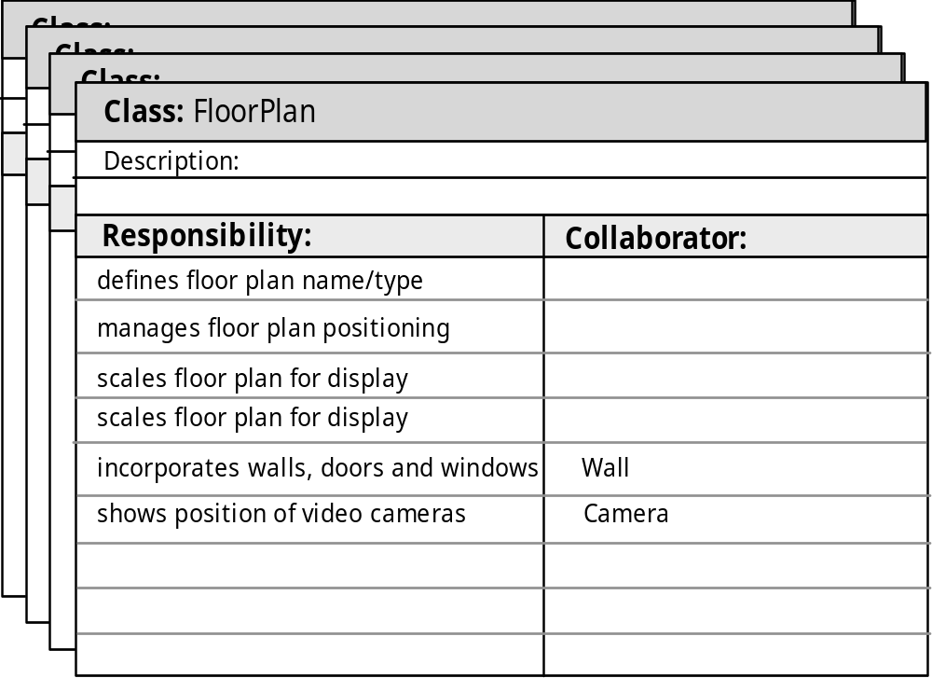
CRC建模
说明
职责
协作者
定义住宅平面图的名称/类型
管理住宅平面图的布局
缩放显示住宅平面
合并墙、门和窗
显示摄像头的位置
Notes:
CRC Modeling

Slide 31
类的类型
实体类，也称作模型或业务类，是从问题说明中直接提取出来的（例如FloorPlan和Senor）。
边界类用于创建用户可见的和在使用软件时交互的接口（如交互屏幕或打印的报表）。
控制类自始至终管理“工作单元” [UML03] 。也就是说，设计控制类可以管理
  实体类的创建或更新；
  当边界类从实体对象获取信息后的实例化；
  对象集合间的复杂通信；
  对象间或用户和应用系统间交换数据的确认。
Notes:
Class Types
Entity classes, also called model or business classes, are extracted directly from the statement of the problem (e.g., FloorPlan and Sensor).
Boundary classes are used to create the interface (e.g., interactive screen or printed reports) that the user sees and interacts with as the software is used.
Controller classes manage a “unit of work” [UML03] from start to finish. That is, controller classes can be designed to manage
the creation or update of entity objects;
the instantiation of boundary objects as they obtain information from entity objects;
complex communication between sets of objects;
validation of data communicated between objects or between the user and the application.

Slide 32
职责
系统智能应用分布在所有类中以求最佳地满足问题的需求。
每个职责的说明应尽可能具有普遍性
信息和与之相关的行为应放在同一个类中
某个事物的信息应局限于一个类中而不要分布在多个类中。
适合时，职责应由相关类共享。
Notes:
Responsibilities
System intelligence should be distributed across classes to best address the needs of the problem
Each responsibility should be stated as generally as possible
Information and the behavior related to it should reside within the same class
Information about one thing should be localized with a single class, not distributed across multiple classes.
Responsibilities should be shared among related classes, when appropriate.

Slide 33
协作
类有一种或两种方法实现其职责：
  类可以使用其自身的操作控制各自的属性，从而实现特定的职责。
  一个类可以和其他类协作。
协作是以客户职责实现的角度表现从客户到服务器的请求
要识别协作可以通过确认类本身是否能够实现自身的每个职责。
类之间三种不同的通用关系[WIR90]:
  is-part-of （是……一部分）关系
  has-knowledge-of （有……知识）关系
  depends-upon （依赖……）关系
Notes:
Collaborations
Classes fulfill their responsibilities in one of two ways:
A class can use its own operations to manipulate its own attributes, thereby fulfilling a particular responsibility, or
a class can collaborate with other classes.
Collaborations identify relationships between classes
Collaborations are identified by determining whether a class can fulfill each responsibility itself
three different generic relationships between classes [WIR90]:
the is-part-of relationship
the has-knowledge-of relationship
the depends-upon relationship

Slide 34

复合聚合类
Notes:
Composite Aggregate Class

Slide 35
关联和依赖
两个分析类以某种方式相互联系着
  在UML中，这些联系被称作关联
  关联可以进一步地指出多样性（术语基数用于数据建模中）
在很多事例中，两个分析类之间存在客户-服务器关系。
  这种情况下，客户类以某种方式依赖于服务器类并且建立了依赖关系
Notes:
Associations and Dependencies
Two analysis classes are often related to one another in some fashion
In UML these relationships are called associations
Associations can be refined by indicating multiplicity (the term cardinality is used in data modeling
In many instances, a client-server relationship exists between two analysis classes.
In such cases, a client-class depends on the server-class in some way and a dependency relationship is established

Slide 36
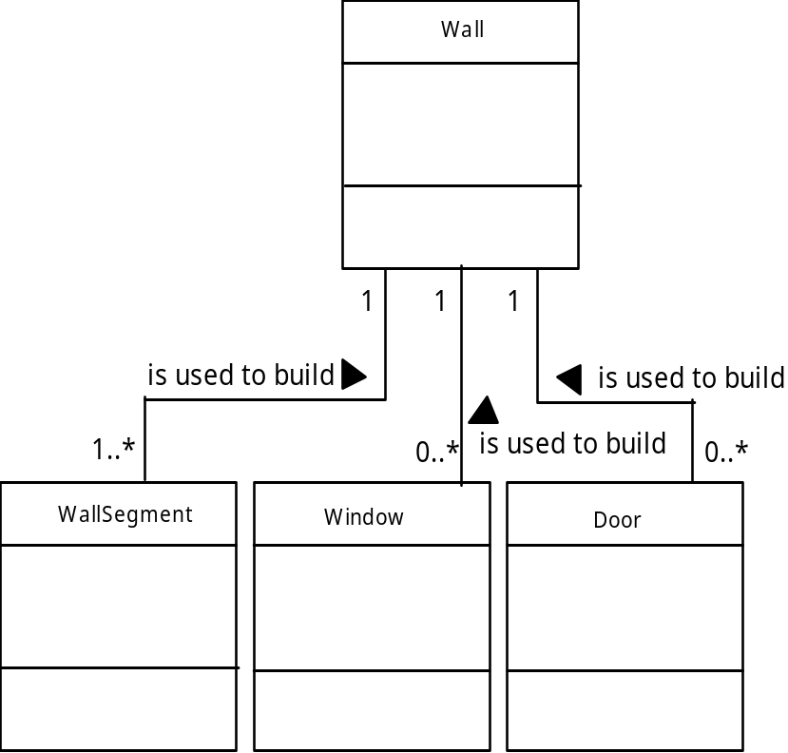
多样性
用于构建
用于构建
用于构建
Notes:
Multiplicity

Slide 37
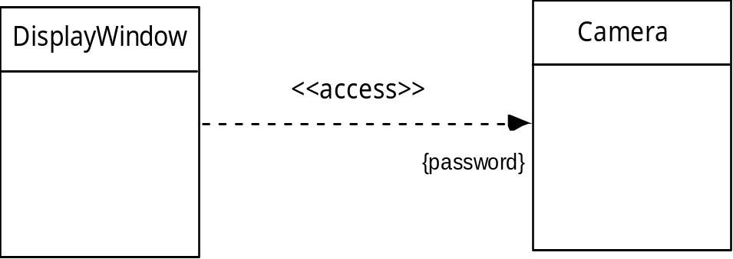
依赖
密码
Notes:
Dependencies

Slide 38
分析包
将分析建模的各种元素（如用例、分析类）以一种方式分类，分组打包后称其为分析包。
每个包中分析类名字前的加号表示该类是公共可见的，因此可以从其他包访问。
包中的任何元素之间可以添加其他符号。负号表示该元素对其他包是隐藏的，#号只能由指定包中的类访问表示该元素。
Notes:
Analysis Packages
Various elements of the analysis model (e.g., use-cases, analysis classes) are categorized in a manner that packages them as a grouping
The plus sign preceding the analysis class name in each package indicates that the classes have public visibility and are therefore accessible from other packages.
Other symbols can precede an element within a package. A minus sign indicates that an element is hidden from all other packages and a # symbol indicates that an element is accessible only to packages contained within a given package.

Slide 39
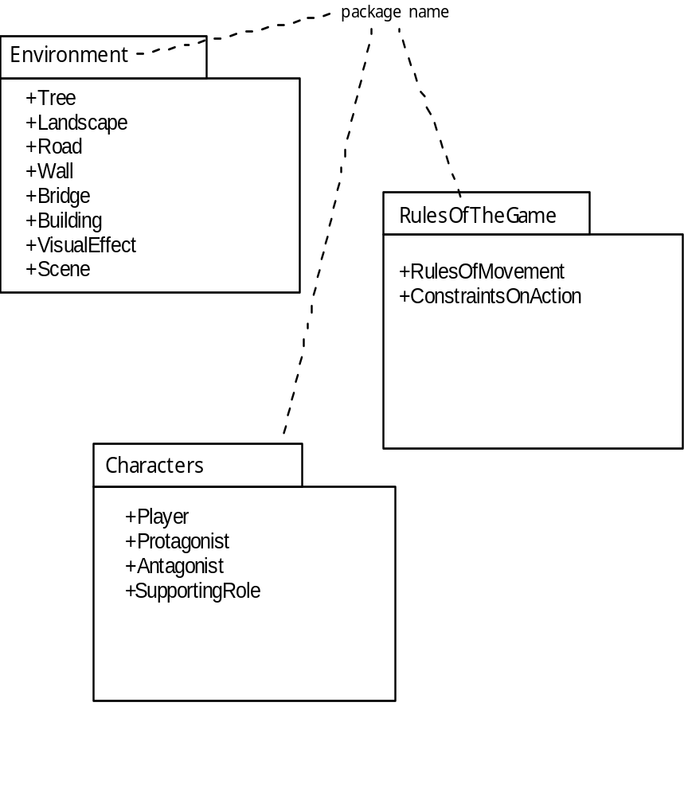
分析包
包名
Notes:
Analysis Packages

Slide 40
评审CRC模型
所有的参与者（CRC模型）评审的人员拿到一部分CRC卡模型索引卡。
  拆分协作卡片（也就是说每个评审员不得有两张存在协作关系的卡片）。
分类管理所有的用例场景（以及相关的用例图）。
评审组长细致地阅读用例。
  当评审组长看到一个已命名的对象时，给拥有相应类索引卡的人员一个令牌。
当令牌传递时，类卡的拥有者需要描述卡上记录的职责。
  评审组确定（一个或多个）职责是否满足用例需求。
如果记录在索引卡上的职责和协作不能满足用例，就需要修改卡片。
  修改可能包括定义新类（和相关的CRC索引卡），或者在已有的卡上说明新的或修改的职责、协作。
Notes:
Reviewing the CRC Model
All participants in the review (of the CRC model) are given a subset of the CRC model index cards.
Cards that collaborate should be separated (i.e., no reviewer should have two cards that collaborate).
All use-case scenarios (and corresponding use-case diagrams) should be organized into categories.
The review leader reads the use-case deliberately.
As the review leader comes to a named object, she passes a token to the person holding the corresponding class index card.
When the token is passed, the holder of the class card is asked to describe the responsibilities noted on the card.
The group determines whether one (or more) of the responsibilities satisfies the use-case requirement.
If the responsibilities and collaborations noted on the index cards cannot accommodate the use-case, modifications are made to the cards.
This may include the definition of new classes (and corresponding CRC index cards) or the specification of new or revised responsibilities or collaborations on existing cards.

