Slide 1
第8章 设计概念
Notes:
Chapter 8 Design Concepts

Slide 2
设计
Mitch Kapor，Lotus 1-2-3的创始人,在 《Dr. Dobbs》杂志上发表了“软件设计宣言”，他说：
  良好的软件设计应该展示：
  坚固：程序应该展示不含任何妨碍其功能的缺陷。
  适用：程序应该符合开发的目标。
  愉悦：使用程序的体验应是愉快的。
Notes:
Design
Mitch Kapor, the creator of Lotus 1-2-3, presented a “software design manifesto” in Dr. Dobbs Journal. He said:
Good software design should exhibit:
Firmness: A program should not have any bugs that inhibit its function.
Commodity: A program should be suitable for the purposes for which it was intended.
Delight: The experience of using the program should be pleasurable one.

Slide 3

分析模型-> 设计模型
面向流的元素
数据流图
控制流图
处理叙述
基于场景的元素
用例文本
用例图
活动图
泳道图
构件级设计
接口设计
分析模型
体系结构设计
基于类的元素
类图
分析包
CRC模型
协作图
数据/类设计
行为元素
状态图
顺序图
设计模型
Notes:
Analysis Model -> Design Model

Slide 4
设计和质量
设计必须实现所有包含在需求模型中的明确需求，而且必须满足利益相关者期望的所有隐含需求。
对于那些生成代码的人和那些进行测试以及随后维护软件的人而言，设计必须是可读的、可理解的指南。
设计必须提软件的全貌，从实现的角度说明数据域、功能域和行为域。
Notes:
Design and Quality
the design must implement all of the explicit requirements contained in the analysis model, and it must accommodate all of the implicit requirements desired by the customer.
the design must be a readable, understandable guide for those who generate code and for those who test and subsequently support the software.
the design should provide a complete picture of the software, addressing the data, functional, and behavioral domains from an implementation perspective.

Slide 5
质量指导原则
设计应该展示出这样一种结构：（a）已经使用可识别的体系结构风格或模式创建；（b）由展示良好设计特征的构建构成；（c）能够以演化的方式实现。
  对于更小的系统，设计有时可以线性开发。
设计应该模块化；也就是说，应将软件逻辑地划分为元素或子系统。
设计应该包含数据、体系结构、接口和构件的清晰表示。
设计应导出数据结构，这些数据结构适用于要实现的类，并从可识别的数据模式提取。
设计应导出显示独立功能特征的构件。
设计应导出接口，这些接口降低了构件之间以及与外部环境连接的复杂性。
设计的导出应根据软件需求分析过程中获取的信息采用可重复的方法进行。
应该用能够有效传达其意义的表示法来表达设计。
Notes:
Quality Guidelines
A design should exhibit an architecture that (1) has been created using recognizable architectural styles or patterns, (2) is composed of components that exhibit good design characteristics and (3) can be implemented in an evolutionary fashion
For smaller systems, design can sometimes be developed linearly.
A design should be modular; that is, the software should be logically partitioned into elements or subsystems
A design should contain distinct representations of data, architecture, interfaces, and components.
A design should lead to data structures that are appropriate for the classes to be implemented and are drawn from recognizable data patterns.
A design should lead to components that exhibit independent functional characteristics.
A design should lead to interfaces that reduce the complexity of connections between components and with the external environment.
A design should be derived using a repeatable method that is driven by information obtained during software requirements analysis.
A design should be represented using a notation that effectively communicates its meaning.

Slide 6
设计原则
设计过程中不要有“井蛙之见”。
设计应起源于分析模型。
设计不要白费力气做重复工作。
在软件和真实世界的问题之间，设计应能“最小化知识距离” [DAV95] 。
设计应表现出一致性和集成性。
设计结构应适应变化。
即使遇到数据、事件或操作条件异常时，设计结构应能温和处理。
设计不是编码，编码不是设计。
创建设计时就应对其质量进行评估，而不是创建之后。
评审设计以最小化概念上的（语义的）错误。
来自 Davis [DAV95]
Notes:
Design Principles
The design process should not suffer from ‘tunnel vision.’
The design should be traceable to the analysis model.
The design should not reinvent the wheel.
The design should “minimize the intellectual distance” [DAV95] between the software and the problem as it exists in the real world.
The design should exhibit uniformity and integration.
The design should be structured to accommodate change.
The design should be structured to degrade gently, even when aberrant data, events, or operating conditions are encountered.
Design is not coding, coding is not design.
The design should be assessed for quality as it is being created, not after the fact.
The design should be reviewed to minimize conceptual (semantic) errors.

Slide 7
基本概念
抽象——数据、过程、控制
体系结构——软件的整个结构
模式——已证实的解决方案的“精髓”
关注点分离——任何复杂问题如果被分解为若干块，该复杂问题更容易地被处理。
模块化——数据和功能的划分
信息隐蔽——控制接口
功能独立——专一的功能和低耦合
求精——所有抽象精化的细节
方面——一种理解全部需求如何影响设计的机制
重构——一种简化设计的重新组织的技术
面向对象设计概念——附录II
设计类——提供设计细节，使分析类得以实现
Notes:
Fundamental Concepts
Abstraction—data, procedure, control
Architecture—the overall structure of the software
Patterns—”conveys the essence” of a proven design solution
Separation of concerns—any complex problem can be more easily handled if it is subdivided into pieces
Modularity—compartmentalization of data and function
Hiding—controlled interfaces
Functional independence—single-minded function and low coupling
Refinement—elaboration of detail for all abstractions
Aspects—a mechanism for understanding how global requirements affect design
Refactoring—a reorganization technique that simplifies the design
OO design concepts—Appendix II
Design Classes—provide design detail that will enable analysis classes to be implemented

Slide 8
数据抽象
door
manufacturer
制造商
model number
模块数
type
类型
swing direction
转动方向
inserts
插入
lights
灯
type
类型
number
数量
weight
重量
opening mechanism
打开机制
implemented as a data structure
实现为一个数据结构
Notes:
Data Abstraction

Slide 9
过程抽象
open
details of enter
进门细节
algorithm
算法
implemented with a "knowledge" of the
object that is associated with enter
实现为一个“知识”对象，与进门有关
Notes:
Procedural Abstraction

Slide 10
体系结构
“软件的整体结构和这种结构为系统提供概念完整性的方式”[SHA95a]
结构特性。体系结构设计表示定义了系统的构件（如模块、对象、过滤器）、构件被封装的方式以及构件之间相互作用的方式。例如，对象封装了数据和过程，过程操纵数据并通过方法调用进行交互。
外部功能特性。体系结构设计描述应当指出设计体系结构如何满足需求，这些需求包括：性能需求、能力需求、可靠性需求、安全性需求、可适应性需求以及其他系统特征需求。
相关系统族。 体系结构应当能抽取出在一类相似系统开发中经常遇到的重复性模式。本质上，设计应当能够重用体系结构构件。
Notes:
Architecture
“The overall structure of the software and the ways in which that structure provides conceptual integrity for a system.” [SHA95a]
Structural properties. This aspect of the architectural design representation defines the components of a system (e.g., modules, objects, filters) and the manner in which those components are packaged and interact with one another. For example, objects are packaged to encapsulate both data and the processing that manipulates the data and interact via the invocation of methods
Extra-functional properties. The architectural design description should address how the design architecture achieves requirements for performance, capacity, reliability, security, adaptability, and other system characteristics.
Families of related systems. The architectural design should draw upon repeatable patterns that are commonly encountered in the design of families of similar systems. In essence, the design should have the ability to reuse architectural building blocks.

Slide 11
模式
设计模式模版
模式名——以简短但富于表现力的名字描述模式的本质
目的——描述模式及其做什么
也称为——列出任何模式的别名
动机——提供问题的实例
适用性——指出模式适用的具体设计解决方案
结构——描述要求实现模式的类
参与者——描述要求实现模式的类的职责
协作——描述参与者如何协作，以完成他们的职责
结构——描述了影响模式的“设计力量”和在实现模式时，必须考虑的潜在权衡
相关模式——相关设计模式的交叉索引
Notes:
Patterns
Design Pattern Template
Pattern name—describes the essence of the pattern in a short but expressive name
Intent—describes the pattern and what it does
Also-known-as—lists any synonyms for the pattern
Motivation—provides an example of the problem
Applicability—notes specific design situations in which the pattern is applicable
Structure—describes the classes that are required to implement the pattern
Participants—describes the responsibilities of the classes that are required to implement the pattern
Collaborations—describes how the participants collaborate to carry out their responsibilities
Consequences—describes the “design forces” that affect the pattern and the potential trade-offs that must be considered when the pattern is implemented
Related patterns—cross-references related design patterns

Slide 12
关注点分离
任何复杂问题如果被分解为可以独立解决和（或）优化的若干块，该复杂问题能够容易地被处理。
一个关注点是一个特征或行为，被指定为软件需求模型的一部分。
通过将关注点分割为更小的关注点，使得解决一个问题需要付出更少的工作量和时间。
Notes:
Separation of Concerns
Any complex problem can be more easily handled if it is subdivided into pieces that can each be solved and/or optimized independently
A concern is a feature or behavior that is specified as part of the requirements model for the software
By separating concerns into smaller, and therefore more manageable pieces, a problem takes less effort and time to solve.

Slide 13
模块化
“模块化是软件的单一属性，它使程序能被智能化地管理”[Mye78]。
软件工程师难以掌握单块软件（即由一个单独模块构成的大程序） 。
  其控制路径的数量、引用的跨度、变量的数量和整体的复杂度使得理解这样的软件几乎是不可能的。
几乎所有的情况下，为了理解更容易，都应当将设计划分成许多模块，这样做的结果，构建软件所需要的成本将会随之降低。
Notes:
Modularity
"modularity is the single attribute of software that allows a program to be intellectually manageable" [Mye78].
Monolithic software (i.e., a large program composed of a single module) cannot be easily grasped by a software engineer.
The number of control paths, span of reference, number of variables, and overall complexity would make understanding close to impossible.
In almost all instances, you should break the design into many modules, hoping to make understanding easier and as a consequence, reduce the cost required to build the software.

Slide 14
模块化： 权衡
What is the "right" number of modules
对特定的软件设计， 什么是“正确”的模块数量？
for a specific software design?
module development cost
模块开发成本
cost of
software
软件成本
module
integration
cost
模块集成成本
optimal number
number of modules
模块的最优数量
模块数
Notes:
Modularity: Trade-offs

Slide 15
信息隐藏
模块
module
• algorithm
算法
controlled
interface
• data structure
数据结构
控制接口
• details of external interface
外部接口信息
• resource allocation policy
资源分配策略
clients
"secret"
客户
“秘密”
a specific design decision
具体的设计决策
Notes:
Information Hiding

Slide 16
为什么要信息隐藏？
减少“负效应”的可能性
限制全局影响局部的设计决策
强调通过控制接口通信
不提倡使用全局数据
导致封装——高质量设计的属性
导致高质量软件
Notes:
Why Information Hiding?
reduces the likelihood of “side effects”
limits the global impact of local design decisions
emphasizes communication through controlled interfaces
discourages the use of global data
leads to encapsulation—an attribute of high quality design
results in higher quality software

Slide 17
逐步求精
一直重复直至门打开
顺时针转动把手；
If 把手不能转动，拿出钥匙；
找到正确的钥匙；
插进锁孔；
endif
open
开门
推/拉门
移动脚步
end 重复
walk to door;
走向门
reach for knob;
伸向把手
open door;
repeat until door opens
打开门；
turn knob clockwise;
walk through;
if knob doesn't turn, then
close door.
take key out;
走进门
find correct key;
关门
insert in lock;
endif
pull/push door
move out of way;
end repeat
Notes:
Stepwise Refinement

Slide 18

测量模型：两种视角
里面是什么？
它多大？
模块
Notes:
Sizing Modules: Two Views

Slide 19
功能独立
通过开发具有“专一”功能和“避免”与其他模块过多的交互的模块，可以实现功能独立。
内聚性显示了某个模块相关功能的强度。
  一个内聚的模块执行一个独立的任务，与程序的其他部分构件只需要很少的交互。简单地说，一个内聚的模块应该（理想情况下）只完成一件事情。
耦合性显示了模块间的相互依赖性。
  耦合性依赖于模块之间的接口复杂性、引用或进入模块所在的点以及什么数据通过接口进行传递。
Notes:
Functional Independence
Functional independence is achieved by developing modules with "single-minded" function and an "aversion" to excessive interaction with other modules.
Cohesion is an indication of the relative functional strength of a module.
A cohesive module performs a single task, requiring little interaction with other components in other parts of a program. Stated simply, a cohesive module should (ideally) do just one thing.
Coupling is an indication of the relative interdependence among modules.
Coupling depends on the interface complexity between modules, the point at which entry or reference is made to a module, and what data pass across the interface.

Slide 20
方面
考虑两个需求，A和B。“如果已经选择了一种软件分解 [精化]，在这种分解中，如果不考虑需求A的话，需求B就不能得到满足” [Ros04] ，那么需求A横切需求B。
方面是一个横切关注点的表示。
Notes:
Aspects
Consider two requirements, A and B. Requirement A crosscuts requirement B “if a software decomposition [refinement] has been chosen in which B cannot be satisfied without taking A into account. [Ros04]
An aspect is a representation of a cross-cutting concern.

Slide 21
方面—举例
考虑SafeHomeAssured.com 网站应用中的两个需求。通过用例Access camera surveillance via the Internet描述需求A，设计求精将集中于那些能够使注册用户通过放置在空间中的相机访问视频的规模。需求B是一个通过的安全需求，要求注册用户在使用SafeHomeAssured.com 之前必须先进行验证，改需求用于Safehome注册用户可使用的所有功能中。当设计求精开始的时候， A*是需求A的一个设计表示， B* 是需求B的一个设计表示。因此，A* 和B* 是关注点的表示，且B* 横切A* 。
方面是一个横切关注点的表示，因此，需求“注册用户在使用SafehomeAssured.com之前必须先进行验证”的设计表示B* 是Safehome网站应用的一个方面。
Notes:
Aspects—An Example
Consider two requirements for the SafeHomeAssured.com WebApp. Requirement A is described via the use-case Access camera surveillance via the Internet. A design refinement would focus on those modules that would enable a registered user to access video from cameras placed throughout a space. Requirement B is a generic security requirement that states that a registered user must be validated prior to using SafeHomeAssured.com. This requirement is applicable for all functions that are available to registered SafeHome users. As design refinement occurs, A* is a design representation for requirement A and B* is a design representation for requirement B. Therefore, A* and B* are representations of concerns, and B* cross-cuts A*.
An aspect is a representation of a cross-cutting concern. Therefore, the design representation, B*, of the requirement, a registered user must be validated prior to using SafeHomeAssured.com, is an aspect of the SafeHome WebApp.

Slide 22
重构
Fowler [FOW99] 用下面的方式定义重构：
  “重构是使用这样一种方式改变软件系统的过程：不改变代码[设计]的外部行为而是改进其内部结构。”
当重构软件时，检查现有设计：
  冗余性
  没有使用的设计元素
  低效的或不必要的算法
  拙劣的或不恰当的数据结构
  其他设计不足，修改这些不足以获取更好的设计。
Notes:
Refactoring
Fowler [FOW99] defines refactoring in the following manner:
"Refactoring is the process of changing a software system in such a way that it does not alter the external behavior of the code [design] yet improves its internal structure.”
When software is refactored, the existing design is examined for
redundancy
unused design elements
inefficient or unnecessary algorithms
poorly constructed or inappropriate data structures
or any other design failure that can be corrected to yield a better design.

Slide 23
OO 设计概念
设计类
  实体类
  边界类
  控制类
继承——超类的所有特点立即被所有子类继承。
消息——刺激接收对象产生某种行为
多态——一种可以显著减少扩展已存在的设计的特性
Notes:
OO Design Concepts
Design classes
Entity classes
Boundary classes
Controller classes
Inheritance—all responsibilities of a superclass is immediately inherited by all subclasses
Messages—stimulate some behavior to occur in the receiving object
Polymorphism—a characteristic that greatly reduces the effort required to extend the design

Slide 24
设计类
在设计时，分析类被精化变为实体类
边界类是在设计中创建接口被开发的（例如：交互式屏幕或打印报表），用户看到并与使用的软件交互。
  边界类的设计，其职责管理将实体对象呈现给用户的方式。
控制类被设计用来管理
  实体对象的创建和更新；
  边界对象的实例化，因为它们获得来自实体对象的信息；
  对象集之间的复杂通信；
  验证对象之间或用户与应用程序之间的数据通信。
Notes:
Design Classes
Analysis classes are refined during design to become entity classes
Boundary classes are developed during design to create the interface (e.g., interactive screen or printed reports) that the user sees and interacts with as the software is used.
Boundary classes are designed with the responsibility of managing the way entity objects are represented to users.
Controller classes are designed to manage
the creation or update of entity objects;
the instantiation of boundary objects as they obtain information from entity objects;
complex communication between sets of objects;
validation of data communicated between objects or between the user and the application.

Slide 25

设计模型
类图
分析包
CRC模型
协作图
数据流图
控制流图
处理过程描述
状态图
顺序图
用例—文本
用例图
活动图
泳道图
协作图
状态图
顺序图
高
类图
分析包
CRC模型
协作图
数据流图
控制流图
处理过程描述
分析模型
需求
约束
交互操作
目标和配置
抽象维度
构件图
设计类
活动图
顺序图
设计类实现
子系统
协作图
设计类实现
子系统
协作图
构件图
设计类
活动图
顺序图
设计模型
技术接口设计
导航设计
图形用户界面设计
求精：
构件图
设计类
活动图
顺序图
求精：
设计类的实现
子系统
协作图
低
部署图
系统结构元素
接口元素
构件级元素
部署级元素
过程维度
Notes:
The Design Model

Slide 26
设计模型元素
数据元素
  数据模型--> 数据结构
  数据模型--> 数据库体系结构
体系结构元素
  应用领域
  分析类、它们的关系、协作和行为被转换设计实现
  模式和“风格”(第9章和第12章)
接口元素
  用户界面(UI)
  与其他系统的外部接口、设备、网络或其他生产者或信息使用者
  不同设计构件间的内部接口
构件元素
部署元素
Notes:
Design Model Elements
Data elements
Data model --> data structures
Data model --> database architecture
Architectural elements
Application domain
Analysis classes, their relationships, collaborations and behaviors are transformed into design realizations
Patterns and “styles” (Chapters 9 and 12)
Interface elements
the user interface (UI)
external interfaces to other systems, devices, networks or other producers or consumers of information
internal interfaces between various design components.
Component elements
Deployment elements

Slide 27
体系结构元素
体系结构模型[Sha96] 从以下3个来源获得：
  关于将要构件的软件的应用领域信息；
  特定的需求模型元素，如数据流图或分析类，现有问题中它们的关系和协作；
  体系结构模式（第9章）和风格（第12章）的可获得性。
Notes:
Architectural Elements
The architectural model [Sha96] is derived from three sources:
information about the application domain for the software to be built;
specific requirements model elements such as data flow diagrams or analysis classes, their relationships and collaborations for the problem at hand, and
the availability of architectural patterns (Chapter 12) and styles (Chapter 9).

Slide 28
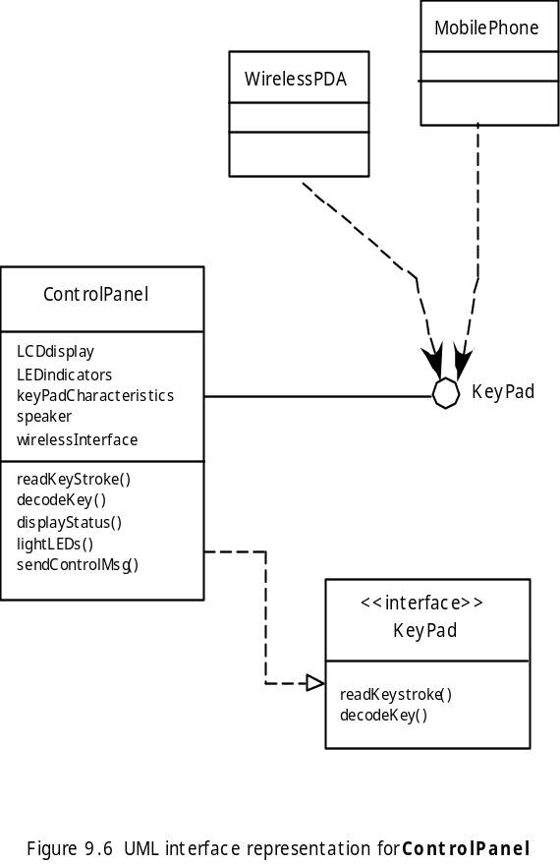
接口元素
Notes:
Interface Elements

Slide 29
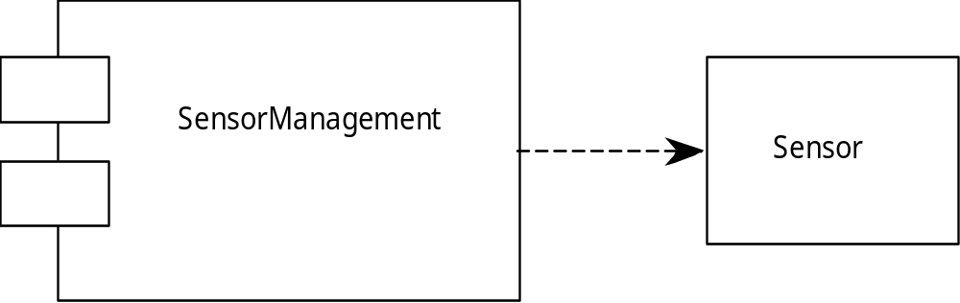
构件元素
Notes:
Component Elements

Slide 30
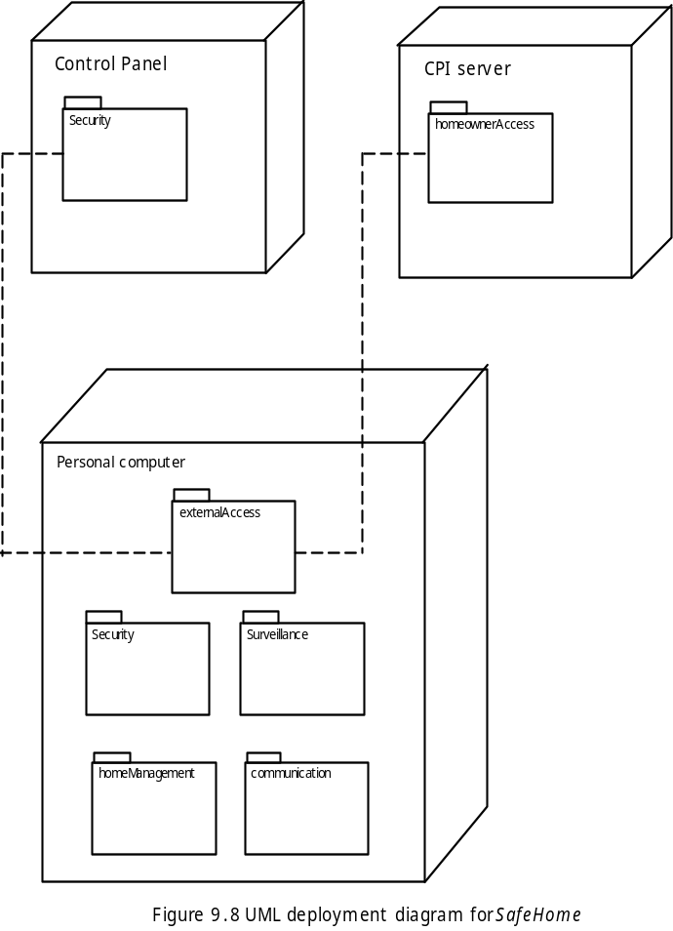
部署元素
控制面板
CPI服务器
安全
户主访问
个人计算机
外部访问
安全
监视
住宅管理
通信
Notes:
Deployment Elements

