Slide 1
第10章 构件级设计
Notes:
Chapter 10 Component-Level Design

Slide 2
什么是构件？
OMG 统一建模语言规范[OMG01] 是这样定义构件的：
  “系统模块化的、可部署的和可替换的部件，该部件封装了实现并暴露一组接口。””
OO 观点：构件包含一组协作的类
传统观点：一个构件包含处理逻辑，实现处理逻辑所需的内部数据结构以及能保证构件被调用和实现数据传递的接口。
Notes:
What is a Component?
OMG Unified Modeling Language Specification [OMG01] defines a component as
“… a modular, deployable, and replaceable part of a system that encapsulates implementation and exposes a set of interfaces.””
OO view: a component contains a set of collaborating classes
Conventional view: a component contains processing logic, the internal data structures that are required to implement the processing logic, and an interface that enables the component to be invoked and data to be passed to it.

Slide 3
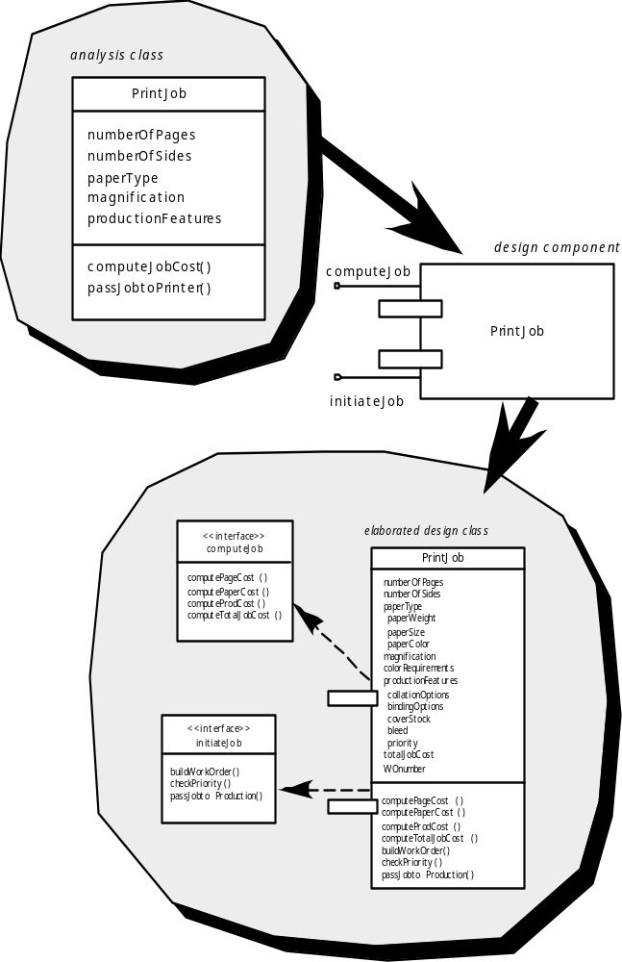
OO 构件
分析类
设计构件
细化后的设计类
Notes:
OO Component

Slide 4
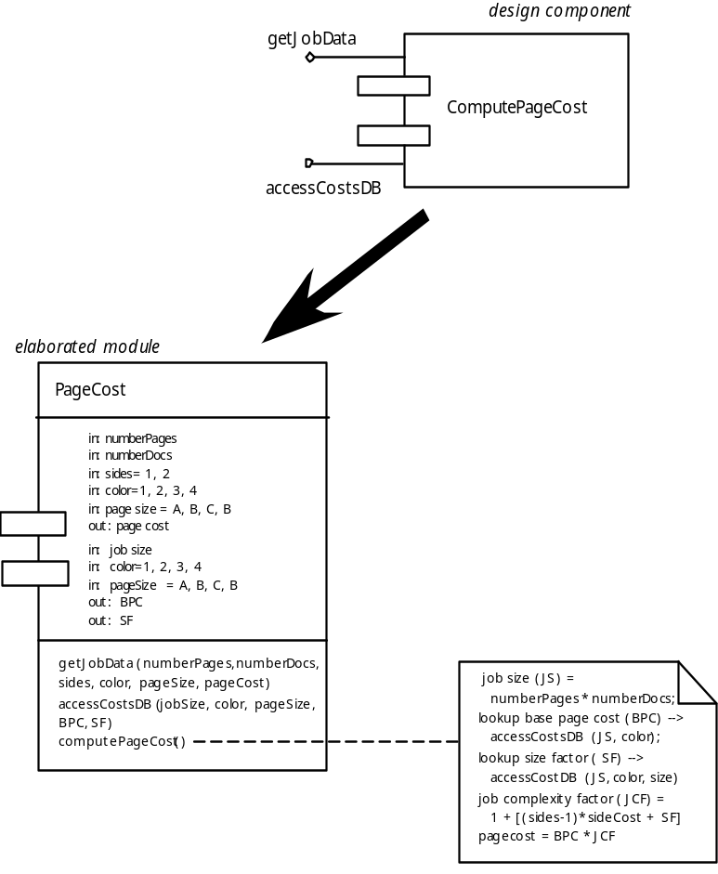
传统构件
设计构件
细化后的模块
Notes:
Conventional Component

Slide 5
基本设计原则
构建级设计基本原则：
开闭原则(OCP)。“模块[构件]应该对外延具有开放性，对修改具有封闭性”。
Liskov 替换原则(LSP)。“子类可以替换它们的基类”。
依赖倒置原则(DIP)。“依赖于抽象，而非具体实现”。
接口分离原则(ISP)。“多个客户专用接口比一个通用接口要好”。
构件打包原则：
发布复用等价性原则(REP)。“复用的粒度就是发布的粒度”。
共同封装原则(CCP)。“一同变更的类应该合在一起”。
共同复用原则(CRP).。“不能一起复用的类不能被分到一组”。
Notes:
Basic Design Principles
The Open-Closed Principle (OCP). “A module [component] should be open for extension but closed for modification.
The Liskov Substitution Principle (LSP). “Subclasses should be substitutable for their base classes.
Dependency Inversion Principle (DIP). “Depend on abstractions. Do not depend on concretions.”
The Interface Segregation Principle (ISP). “Many client-specific interfaces are better than one general purpose interface.
The Release Reuse Equivalency Principle (REP). “The granule of reuse is the granule of release.”
The Common Closure Principle (CCP). “Classes that change together belong together.”
The Common Reuse Principle (CRP). “Classes that aren’t reused together should not be grouped together.”

Slide 6
设计指导方针
构件
  对那些已经被确定为体系结构模型一部分的构件应该建立命名约定，并对其做进一步的细化和精华，使其成为构件级模型的一部分。
接口
  接口提供关于通信和协作的重要信息(也可以帮助我们实现OCP)。
依赖与继承
  这种方法很好，模型依赖关系是自左向右，继承关系是自底（导出类）向上(基类)。
Notes:
Design Guidelines
Components
Naming conventions should be established for components that are specified as part of the architectural model and then refined and elaborated as part of the component-level model
Interfaces
Interfaces provide important information about communication and collaboration (as well as helping us to achieve the OPC)
OPC全称是OLE for Process Control，它的出现为基于Windows的应用程序和现场过程控制应用建立了桥梁。
Dependencies and Inheritance
it is a good idea to model dependencies from left to right and inheritance from bottom (derived classes) to top (base classes).

Slide 7
内聚性
传统观点：
  模块的专一性
OO 观点:：
  内聚性意味着构件或者类只封装那些相互关联密切，以及与构件或类自身有密切关系的属性和操作。
内聚分类
  功能的
  分层的
  通信的
  有序的
  过程的
  暂时的
  实用的
Notes:
Cohesion
Conventional view:
the “single-mindedness” of a module
OO view:
cohesion implies that a component or class encapsulates only attributes and operations that are closely related to one another and to the class or component itself
Levels of cohesion
Functional
Layer
Communicational
Sequential
Procedural
Temporal
utility

Slide 8
耦合性
传统观点
  构件之间彼此联系、构件和外部世界联系程度的一种度量
OO观点：
  类之间彼此联系程度的一种定性度量
耦合分类
  内容
  共用
  控制
  标记
  数据
  历程调用
  类型使用
  包含或者导入
  外部
Notes:
Coupling
Conventional view:
The degree to which a component is connected to other components and to the external world
OO view:
a qualitative measure of the degree to which classes are connected to one another
Level of coupling
Content
Common
Control
Stamp
Data
Routine call
Type use
Inclusion or import
External

Slide 9
构件级设计-I
步骤1：标识出所有与问题域相对应的设计类。
步骤2：确定所有与基础设施域相对应的设计类。
步骤3：细化所有不需要作为可复用构件的设计类。
步骤3a：在类或构件协作时说明消息的细节。
步骤3b：为每个构件确定适当的接口。
Notes:
Component Level Design-I
Step 1. Identify all design classes that correspond to the problem domain.
Step 2. Identify all design classes that correspond to the infrastructure domain.
Step 3. Elaborate all design classes that are not acquired as reusable components.
Step 3a. Specify message details when classes or component collaborate.
Step 3b. Identify appropriate interfaces for each component.

Slide 10
构件级设计-II
步骤3c： 细化属性，并且定义实现属性所需要的数据类型和数据结构。
步骤3d：详细描述每个操作的处理流。
步骤4：说明持久数据源(数据库和文件)并确定管理数据源所需要的类。
步骤5：开发并且细化类或构件的行为表示。
步骤6：细化部署图以提供额外的实现细节。
步骤7：考虑每个构件级设计表示，并且时刻考虑其他可选方案。
Notes:
Component-Level Design-II
Step 3c. Elaborate attributes and define data types and data structures required to implement them.
Step 3d. Describe processing flow within each operation in detail.
Step 4. Describe persistent data sources (databases and files) and identify the classes required to manage them.
Step 5. Develop and elaborate behavioral representations for a class or component.
Step 6. Elaborate deployment diagrams to provide additional implementation detail.
Step 7. Factor every component-level design representation and always consider alternatives.

Slide 11
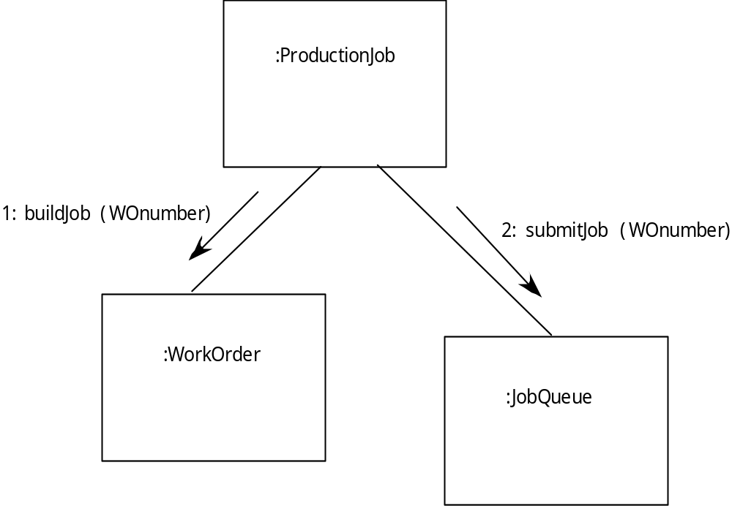
协作图
Notes:
Collaboration Diagram

Slide 12
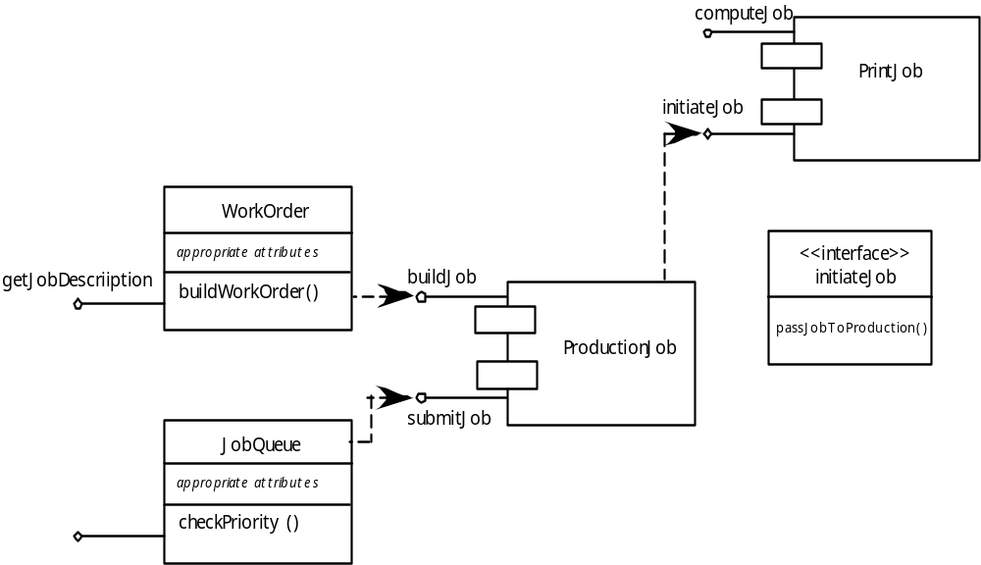
重构
Notes:
Refactoring

Slide 13
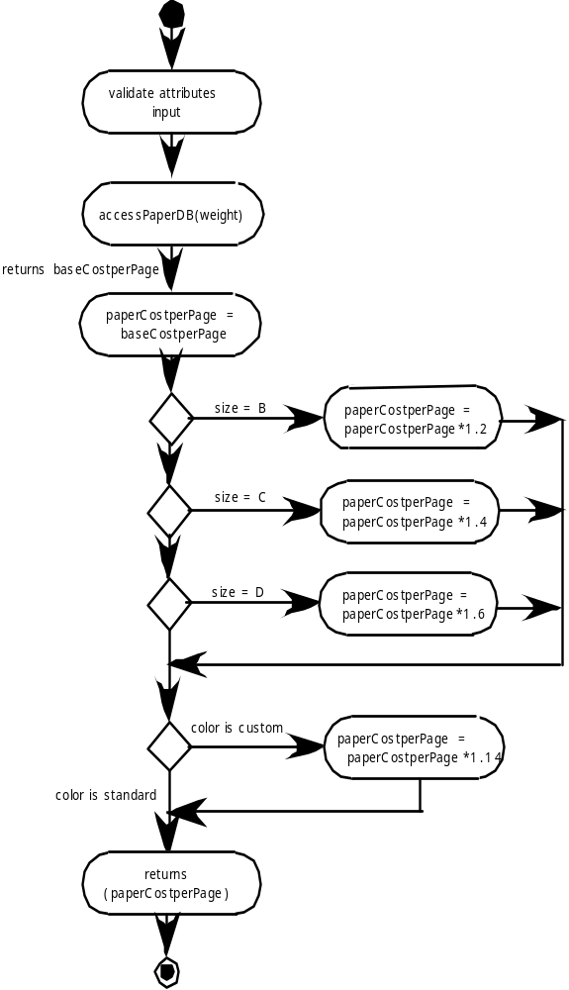
活动图
Notes:
Activity Diagram

Slide 14
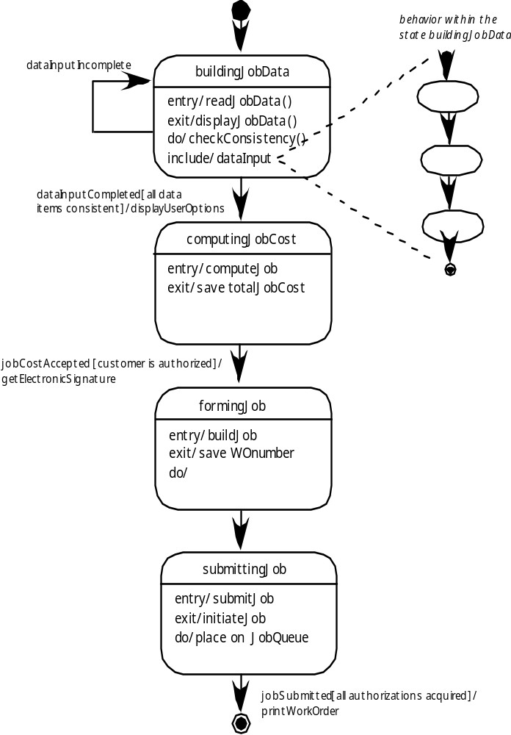
状态图
Notes:
Statechart

Slide 15
设计传统构件
处理逻辑的设计是由算法设计的基本原则和结构化编程支配
数据结构的设计由系统开发的数据模型定义
接口的设计是由协作支配的，协作受构件的影响
Notes:
Designing Conventional Components
The design of processing logic is governed by the basic principles of algorithm design and structured programming
The design of data structures is defined by the data model developed for the system
The design of interfaces is governed by the collaborations that a component must effect

Slide 16
算法设计
最接近编码的设计活动
方法：
  审查构件的设计说明
  使用逐步求精开发算法
  使用结构化程序实现程序逻辑
  使用“形式化方法”证明逻辑
Notes:
Algorithm Design
the closest design activity to coding
the approach:
review the design description for the component
use stepwise refinement to develop algorithm
use structured programming to implement procedural logic
use ‘formal methods’ to prove logic

Slide 17
逐步求精
一直重复直至门打开
顺时针转动把手；
If 把手不能转动，拿出钥匙；
open
开门
找到正确的钥匙；
插进锁孔；
endif
推/拉门
移动脚步
walk to door;
reach for knob;
end 重复
open door;
repeat until door opens
turn knob clockwise;
walk through;
if knob doesn't turn, then
close door.
take key out;
find correct key;
insert in lock;
走向门；
endif
伸向把手；
pull/push door
move out of way;
打开门；
end repeat
走进门
关门
Notes:
Stepwise Refinement

Slide 18
算法设计模型
以细节的层次表示算法，它能对质量进行评审
选择：
  图解 (例如：流程图、盒图)
  伪代码(例如：PDL) ... 很多选择
  编程语言
  决策表
Notes:
Algorithm Design Model
represents the algorithm at a level of detail that can be reviewed for quality
options:
graphical (e.g. flowchart, box diagram)
pseudocode (e.g., PDL) ... choice of many
programming language
decision table

Slide 19
结构化程序设计
使用一组有限的逻辑结构：
顺序
条件句
— if-then-else, select-case
循环
— do-while, repeat until
导致更高的可读性、可测试的代码
可以结合“正确性证明”使用
对实现高品质目标很重要，但是还不够
Notes:
Structured Programming
uses a limited set of logical constructs:
sequence
conditional — if-then-else, select-case
loops — do-while, repeat until
leads to more readable, testable code
can be used in conjunction with ‘proof of correctness’
important for achieving high quality,
but not enough

Slide 20
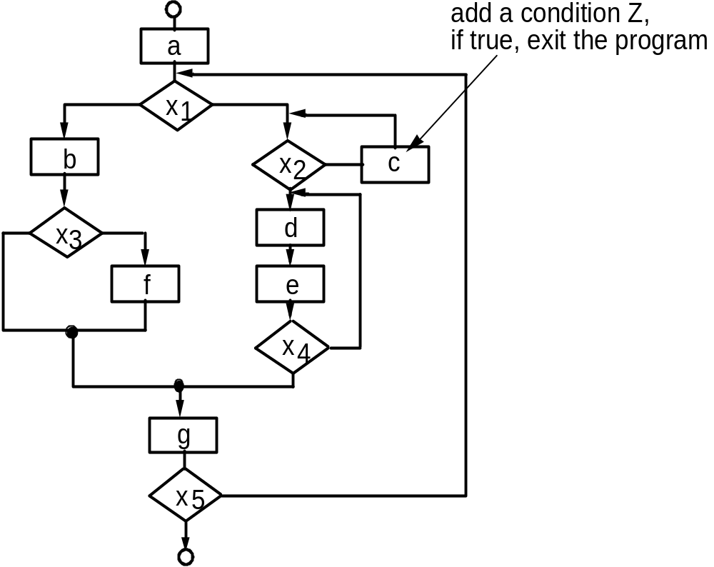
结构化程序设计
增加一个条件Z，如果为真，退出程序
Notes:
A Structured Procedural Design

Slide 21
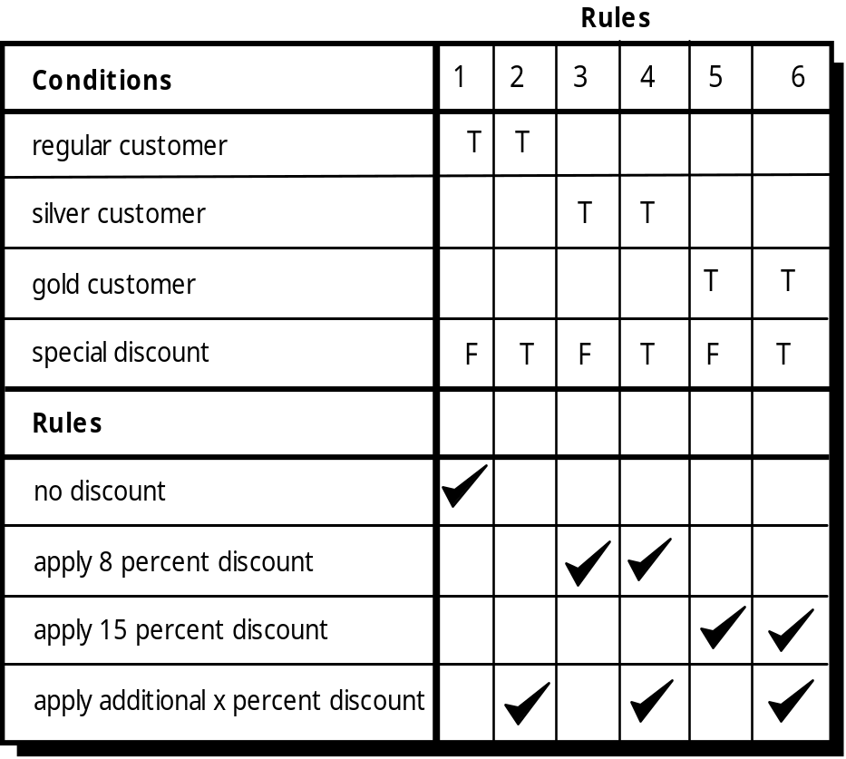
决策表
规则
条件
普通会员
白金会员
黄金会员
特别折扣
动作
无折扣
8%折扣
15%折扣
额外的x%的优惠
Notes:
表驱动算法，决策表Decision Table：左上部列出所有条件；左下部分列出所有动作，右半部分构成一个矩阵，该矩阵表示在特定的组合下，满足条件组合将触发相应的动作。矩阵的每一列构成一条处理规则。

Slide 22
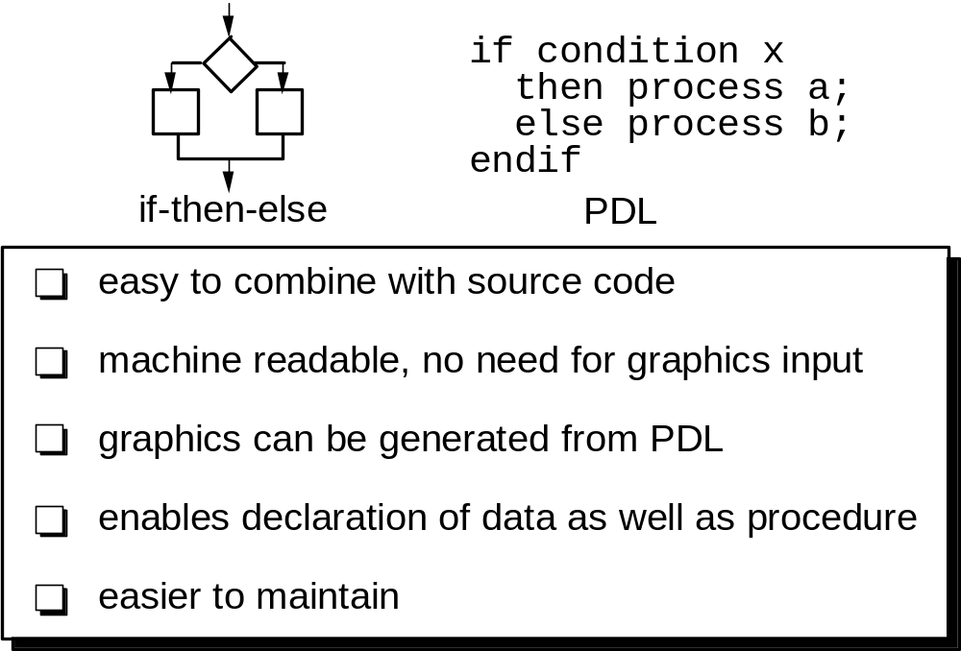
程序设计语言(PDL)
if 条件 x
then 过程a；
else 过程b；
endif
容易结合源代码
机器可读，不需要图形输入
由PDL可以生成图形
允许数据及过程的声明
易于维护
Notes:
Program Design Language (PDL)

Slide 23
基于构件的开发
当面对重用的可能，软件团队会问：
  商业成品构件（COTS）对实现需求是可用的吗？
  内部开发的可复用构件可实现需求吗？
  可复用构件的接口兼容待建系统的体系结构吗？
与此同时，重用时他们会遇到以下障碍……
Notes:
Component-Based Development
When faced with the possibility of reuse, the software team asks:
Are commercial off-the-shelf (COTS) components available to implement the requirement?
Are internally-developed reusable components available to implement the requirement?
Are the interfaces for available components compatible within the architecture of the system to be built?
At the same time, they are faced with the following impediments to reuse ...

Slide 24
重用困难
很少有企业和组织有任何甚至略微相似的一个全面的软件可重用计划。
虽然越来越多的软件厂商目前销售的工具或构件为软件重用提供直接援助，但大多软件开发者都不用他们。
相对较少的训练是可以帮助软件工程师和管理者理解并应用重用。
许多软件从业者仍然认为，“相比其价值，重用的麻烦更多。”
许多公司继续鼓励软件开发方法，而不促进重用。
很少有公司提供生产可重用的程序组件的激励措施。
Notes:
Impediments to Reuse
Few companies and organizations have anything that even slightly resembles a comprehensive software reusability plan.
Although an increasing number of software vendors currently sell tools or components that provide direct assistance for software reuse, the majority of software developers do not use them.
Relatively little training is available to help software engineers and managers understand and apply reuse.
Many software practitioners continue to believe that reuse is “more trouble than it’s worth.”
Many companies continue to encourage of software development methodologies which do not facilitate reuse
Few companies provide an incentives to produce reusable program components.

Slide 25
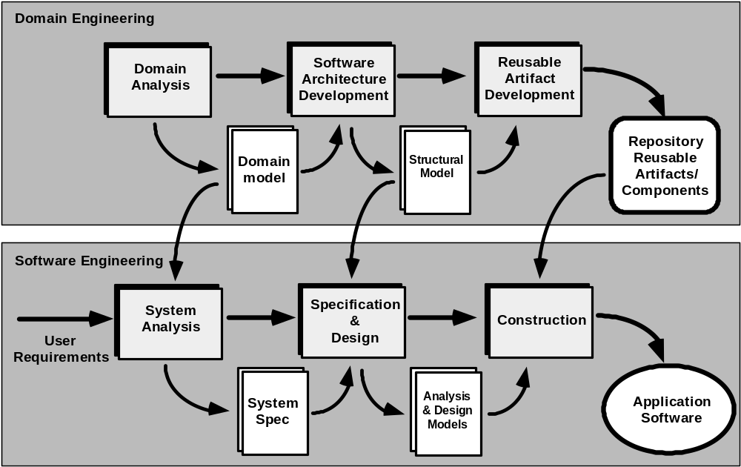
CBSE 过程
软件体系结构开发
重用构件开发
领域工程
领域分析
存储库可重用构件/组件
领域模型
结构模型
软件工程
规格说明和设计
系统分析
构建
用户需求
系统规格说明
应用系统软件
分析和设计模型
Notes:
The CBSE Process

Slide 26
领域工程
1. 定义待研究的领域。
2. 把从领域中提取的项进行分类。
收集领域中有代表性的应用系统样本。
4. 分析样本中的每个应用系统。
5. 为这些对象开发需求模型。
Notes:
Domain Engineering
1. Define the domain to be investigated.
2. Categorize the items extracted from the domain.
3. Collect a representative sample of applications in the domain.
4. Analyze each application in the sample.
5. Develop an analysis model for the objects.

Slide 27
确定可复用构件
• 组件功能需要在未来实现吗？
• 领域内组件的功能有多普遍？
• 领域内组件功能有重复的吗？
• 组件依赖于硬件吗?
• 在实现时，硬件保持不变吗？
• 硬件细节能被远离另一个组件吗？
• 最优设计对接下来的实现足够吗？
• 我们能参数化一个不可重用的组件使其变为可重用的吗？
• 在许多仅有一点改变的实现中，组件可重用吗？
• 通过修改使重用可行吗?
• 一个不可重用的组件能被分解生成可重用的组件吗？
• 组件如何被有效分解成可重用的？
Notes:
Identifying Reusable Components
• Is component functionality required on future implementations?
• How common is the component's function within the domain?
• Is there duplication of the component's function within the domain?
• Is the component hardware-dependent?
• Does the hardware remain unchanged between implementations?
• Can the hardware specifics be removed to another component?
• Is the design optimized enough for the next implementation?
• Can we parameterize a non-reusable component so that it becomes reusable?
• Is the component reusable in many implementations with only minor changes?
• Is reuse through modification feasible?
• Can a non-reusable component be decomposed to yield reusable components?
• How valid is component decomposition for reuse?

Slide 28
基于构件的 CBSE
库中的构件必须是可供使用的
构件应该有一致的结构
存在标准，例如：
  OMG/CORBA
  Microsoft COM
  Sun JavaBeans
Notes:
Component-Based SE
a library of components must be available
components should have a consistent structure
a standard should exist, e.g.,
OMG/CORBA
Microsoft COM
Sun JavaBeans

Slide 29
CBSE 活动
构件合格检验
构件适应性修改
构件组装
构件更新
Notes:
CBSE Activities
Component qualification
Component adaptation
Component composition
Component update

Slide 30
合格检验
在使用构件之前，必须考虑到：
• 应用系统的编程接口(API)
• 构件所需的开发工具与集成工具
• 运行时需求，包括资源使用(例如：内存或外存储器)、时间或速度以及网络协议
• 服务需求，包括操作系统接口和其他构件的支持
• 安全特性，包括访问控制和身份验证协议
• 嵌入式设计假定，包括特定的数值或非数值算法的使用
• 异常处理
Notes:
Qualification
• application programming interface (API)
• development and integration tools required by the component
• run-time requirements including resource usage (e.g., memory or storage), timing or speed, and network protocol
• service requirements including operating system interfaces and support from other components
• security features including access controls and authentication protocol
• embedded design assumptions including the use of specific numerical or non-numerical algorithms
• exception handling

Slide 31
适应性修改
“容易集成”的含义是：
(1) 对于库中的所有构件，都已经实现了一致的资源管理方法；
(2) 所有的构件都存在诸如数据管理等公共活动
(3) 已经以一致的方式实现了体系结构的内部接口与外部环境的接口
Notes:
Adaptation
The implication of “easy integration” is:
(1) that consistent methods of resource management have been implemented for all components in the library;
(2) that common activities such as data management exist for all components, and
(3) that interfaces within the architecture and with the external environment have been implemented in a consistent manner.

Slide 32
组装
必须建立一个基础设施以将构件绑定到一起
体系结构组装成分包括：
  数据交换模型
  自动化
  结构化存储
  基础对象模型
Notes:
Composition
An infrastructure must be established to bind components together
Architectural ingredients for composition include:
Data exchange model
Automation
Structured storage
Underlying object model

Slide 33
OMG/ CORBA
对象管理组织发布了公共对象请求代理体系结构(OMG/CORBA)。
对象请求代理(ORB)提供了多种服务，使得可复用构件（对象）可以与其他构件通信，而不管这些构件在系统中的位置如何。
如果为每一个构件创建一个接口定义语言（IDL）接口，系统内CORBA构件集成（没有修正）得以保证。
在客户应用端，对象从ORB服务器请求一个或更多服务。请求通过IDL或在动态运行时得到响应。
一个接口库包含所有关于服务的请求和响应格式的必要信息。
Notes:
OMG/ CORBA
The Object Management Group has published a common object request broker architecture (OMG/CORBA).
An object request broker (ORB) provides services that enable reusable components (objects) to communicate with other components, regardless of their location within a system.
Integration of CORBA components (without modification) within a system is assured if an interface definition language (IDL) interface is created for every component.
Objects within the client application request one or more services from the ORB server. Requests are made via an IDL or dynamically at run time.
An interface repository contains all necessary information about the service’s request and response formats.

Slide 34
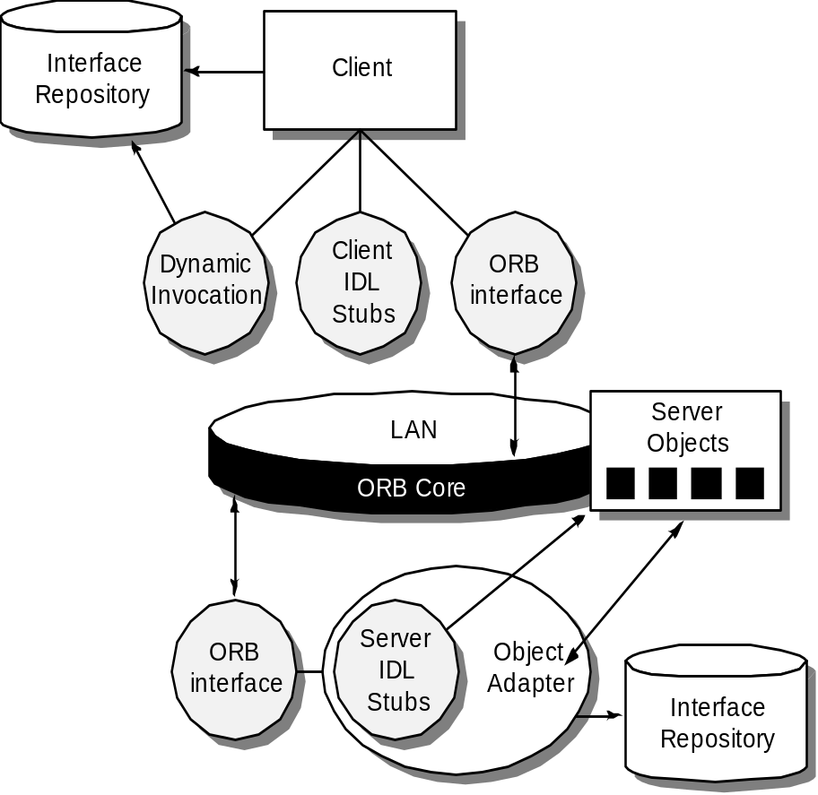
ORB 体系架构
接口库
客户端
客户端IDL存根
动态调用
ORB接口
服务器对象
ORB核
接口库
服务器IDL存根
对象适配器
ORB接口
Notes:
ORB Architecture

Slide 35
Microsoft COM
构件对象模型(COM) 提供了在Windows操作系统上运行的单个应用系统内使用构件的规格说明，这些构件可以是不同厂商生产的。
  .NET 涵盖了COM
COM 包含两个元素：
  COM 接口(作为COM 对象实现)
  为在COM接口间注册并传递消息的一组机制
Notes:
Microsoft COM
The component object model (COM) provides a specification for using components produced by various vendors within a single application running under the Windows operating system.
COM encompasses two elements:
COM interfaces (implemented as COM objects)
a set of mechanisms for registering and passing messages between COM interfaces.

Slide 36
Sun JavaBeans
JavaBeans 构件系统是一个可移植的、平台独立的CBSE基础设施，是使用Java程序设计语言开发的。
JavaBeans 构件系统包括一组工具，称为Bean开发工具箱(BDK)， 它允许开发者做以下工作：
  分析现有的Bean（构件）如何工作
  定制它们的行为和外观
  建立协作及通信机制
  开发在特定应用中使用的定制Bean
  测试和评估Bean的行为。
Notes:
Sun JavaBeans
The JavaBeans component system is a portable, platform independent CBSE infrastructure developed using the Java programming language.
The JavaBeans component system encompasses a set of tools, called the Bean Development Kit (BDK), that allows developers to
analyze how existing Beans (components) work
customize their behavior and appearance
establish mechanisms for coordination and communication
develop custom Beans for use in a specific application
test and evaluate Bean behavior.

