Slide 1
第11章 用户界面设计
Notes:
Chapter 11 User Interface Design

Slide 2

界面设计
Easy to learn?
易学？
Easy to use?
易用？
Easy to understand?
易理解？
Notes:
Interface Design

Slide 3

界面设计
典型设计错误
缺乏一致性
太多的记忆
没有指导/帮助
没有上下文敏感
响应不及时
神秘/不友好
Notes:
Interface Design
Typical Design Errors
lack of consistency
too much memorization
no guidance / help
no context sensitivity
poor response
Arcane/unfriendly

Slide 4
黄金规则
用户操纵控制
减少用户的记忆负担
保持界面一致
Notes:
Golden Rules
Place the user in control
Reduce the user’s memory load
Make the interface consistent

Slide 5
用户操作控制
以不强迫用户进入不必要的或不希望的动作的方式来定义交互模式。
提供灵活的交互。
允许用户交互被中断和撤销。
当技能级别增长时可以使交互流线化并允许定制交互。
使用户与内部技术细节隔离开来。
设计应允许用户与出现在屏幕上的对象直接交互。
Notes:
Place the User in Control
Define interaction modes in a way that does not force a user into unnecessary or undesired actions.
Provide for flexible interaction.
Allow user interaction to be interruptible and undoable.
Streamline interaction as skill levels advance and allow the interaction to be customized.
Hide technical internals from the casual user.
Design for direct interaction with objects that appear on the screen.

Slide 6
减轻用户记忆负担
减少对短期记忆的要求。
建立有意义的缺省。
定义直观的快捷方式。
界面的视觉布局应该基于真实世界的象征。
以不断进展的方式揭示信息。
Notes:
Reduce the User’s Memory Load
Reduce demand on short-term memory.
Establish meaningful defaults.
Define shortcuts that are intuitive.
The visual layout of the interface should be based on a real world metaphor.
Disclose information in a progressive fashion.

Slide 7
保持界面一致
允许用户将当前任务放入有意义的环境中。
在应用系统家族内保持一致性。
如果过去的交互模型已经建立起了用户期望，除非有不得已的理由，否则不要改变它。
Notes:
Make the Interface Consistent
Allow the user to put the current task into a meaningful context.
Maintain consistency across a family of applications.
If past interactive models have created user expectations, do not make changes unless there is a compelling reason to do so.

Slide 8
用户界面设计模型
用户模型 ——系统所有最终用户的轮廓
设计模型——实现用户模型的设计
心里模型(系统感觉) ——用户脑海里对界面的想象
实现模型——界面（“看和感觉”）结合了用来描述系统语法和语义的支撑信息
Notes:
User Interface Design Models
User model — a profile of all end users of the system
Design model — a design realization of the user model
Mental model (system perception) — the user’s mental image of what the interface is
Implementation model — the interface “look and feel” coupled with supporting information that describe interface syntax and semantics

Slide 9

用户界面设计过程
界面确认
界面分析和建模
界面构造
界面设计
Notes:
User Interface Design Process

Slide 10
界面分析
界面分析意味着了解
  (1) 通过界面和系统交互的人(最终用户)
  (2) 最终用户为完成工作要执行的任务
  (3) 作为界面的一部分而显示的内容
  (4) 任务处理的环境
Notes:
Interface Analysis
Interface analysis means understanding
(1) the people (end-users) who will interact with the system through the interface;
(2) the tasks that end-users must perform to do their work,
(3) the content that is presented as part of the interface
(4) the environment in which these tasks will be conducted.

Slide 11
用户分析
用户是经过的训练的专业人员、技术员、办事员，还是制造业工人？
用户平均正规教育水平如何？
用户是否具有学习书面资料的能力或者是否渴望接受集中培训？
用户是否是专业录入人员还是键盘恐惧者？
用户群体的年龄范围如何？
是否需要考虑用户的性别差异？
如何为用户完成的工作提供报酬？
用户是否在正常的办公时间内工作或者一直干到工作完成？
软件是用户所完成工作中的一个集成部分，还是偶尔使用一次？
用户群中使用的主要交流语言是什么？
如果用户在使用软件的过程中出错，结果会怎么样？
用户是否是系统所解决问题领域的专家？
用户是否想了解界面背后的技术？
Notes:
User Analysis
Are users trained professionals, technician, clerical, or manufacturing workers?
What level of formal education does the average user have?
Are the users capable of learning from written materials or have they expressed a desire for classroom training?
Are users expert typists or keyboard phobic?
What is the age range of the user community?
Will the users be represented predominately by one gender?
How are users compensated for the work they perform?
Do users work normal office hours or do they work until the job is done?
Is the software to be an integral part of the work users do or will it be used only occasionally?
What is the primary spoken language among users?
What are the consequences if a user makes a mistake using the system?
Are users experts in the subject matter that is addressed by the system?
Do users want to know about the technology the sits behind the interface?

Slide 12
任务分析和建模
回答以下问题…
  在指定环境下用户将完成什么工作？
  当用户工作时将完成什么任务和子任务？
  在工作中用户将处理什么特殊的问题域对象？
  工作任务的顺序（工作流）如何？
  任务的层次关系如何？
用例确定基本的交互作用
任务细化精化交互任务
对象细化确定界面对象(类)
工作流分析确定在涉及多个成员（角色）时，工作过程是如何完成的。
Notes:
Task Analysis and Modeling
Answers the following questions …
What work will the user perform in specific circumstances?
What tasks and subtasks will be performed as the user does the work?
What specific problem domain objects will the user manipulate as work is performed?
What is the sequence of work tasks—the workflow?
What is the hierarchy of tasks?
Use-cases define basic interaction
Task elaboration refines interactive tasks
Object elaboration identifies interface objects (classes)
Workflow analysis defines how a work process is completed when several people (and roles) are involved

Slide 13
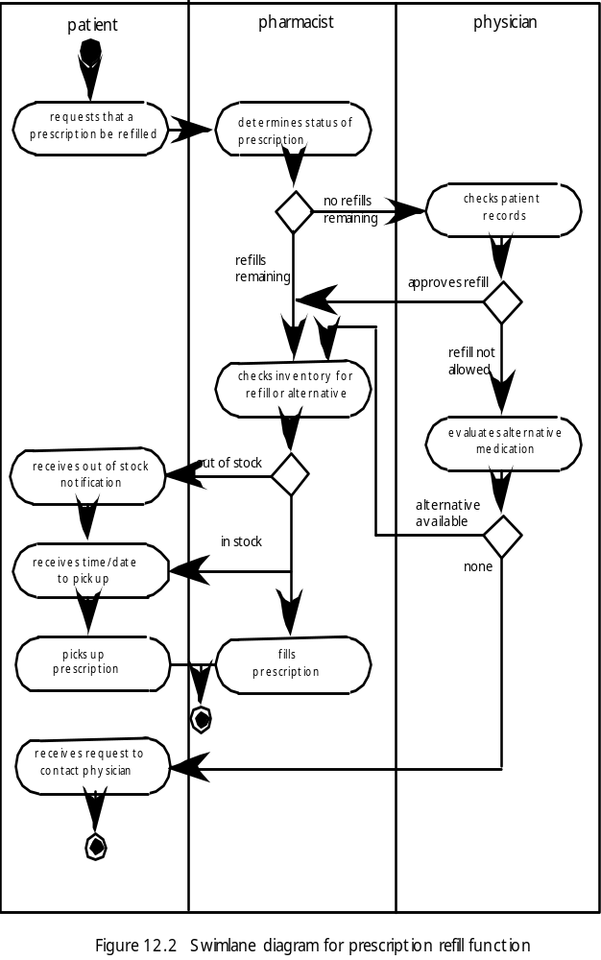
泳道图
病人
药剂师
医生
确定处方的状态
重填处方请求
检查患者记录
有新补充的药
没有新补充的药
批准重填处方
检查库存查找新补充的药或替换药
不允许
评估可替换的药物
接到缺货通知单
无存货
有可替换
接收供选择的时间/日期
有存货
没有
选择处方
填写处方
接收联系医生的请求
处方重填功能的泳道图
Notes:
Swimlane Diagram

Slide 14
显示内容分析
不同类型的数据是否要放置到屏幕上固定的位置（例如，照片一般显示在右上角）？
用户能否定制内容的屏幕位置？
是否对所有的内容赋予适当的屏幕标识？
为了便于理解，应如何划分长篇报告？
对于大集合的数据，是否存在直接移动到摘要信息的机制？
输出图形的大小是否需要适合所使用显示设备的限制？
如何使用颜色来曾强理解？
出错信息和警告应如何呈现给用户？
Notes:
Analysis of Display Content
Are different types of data assigned to consistent geographic locations on the screen (e.g., photos always appear in the upper right hand corner)?
Can the user customize the screen location for content?
Is proper on-screen identification assigned to all content?
If a large report is to be presented, how should it be partitioned for ease of understanding?
Will mechanisms be available for moving directly to summary information for large collections of data.
Will graphical output be scaled to fit within the bounds of the display device that is used?
How will color to be used to enhance understanding?
How will error messages and warning be presented to the user?

Slide 15
界面设计步骤
使用界面分析中获得的信息，定义界面对象和动作（操作）。
定义那些导致用户界面状态发生变化的事件（用户动作），并对行为建模。
描述每个界面状态，就像最终用户实际看到的那样。
简要说明用户如何从界面提供的界面信息来解释系统状态。
Notes:
Interface Design Steps
Using information developed during interface analysis, define interface objects and actions (operations).
Define events (user actions) that will cause the state of the user interface to change. Model this behavior.
Depict each interface state as it will actually look to the end-user.
Indicate how the user interprets the state of the system from information provided through the interface.

Slide 16
设计问题
响应时间
帮助设施
错误处理
菜单和命令标识
应用系统的可访问性
国际化
Notes:
Design Issues
Response time
Help facilities
Error handling
Menu and command labeling
Application accessibility
Internationalization

Slide 17
WebApp 界面设计
我在哪里？ 界面应该：
  为访问过的WebApp提供指示
  提示用户当前在内容层次中所处的位置
我现在能做什么？ 界面应该总是能够帮助用户理解当前的选项
  哪些功能可以使用？
  哪些链接是可用的？
  哪些内容是相关的？
我去过哪里？我将去哪里？界面必须能够辅助导航。
  提供一张“地图”（以容易理解的方式实现），这张地图显示了用户在WebApp中去过哪里，还能沿着哪些路径去WebApp的其他地方。
Notes:
WebApp Interface Design
Where am I? The interface should
provide an indication of the WebApp that has been accessed
inform the user of her location in the content hierarchy.
What can I do now? The interface should always help the user understand his current options
what functions are available?
what links are live?
what content is relevant?
Where have I been, where am I going? The interface must facilitate navigation.
Provide a “map” (implemented in a way that is easy to understand) of where the user has been and what paths may be taken to move elsewhere within the WebApp.

Slide 18
有效的WebApp 界面
Bruce Tognozzi [TOG01] 提出……
  有效的界面在视觉效果上是明显的、宽容的，并且慢慢地给用户灌输控制感。用户能够很快地看到他们的选择范围，领会怎样达到他们的目标，然后做他们的工作。
  有效的界面使用户不必关心系统的内部操作。工作被谨慎而连续地保存，从而使用户有充分的选择余地，可以在任何时刻取消任何活动。
  有效的应用和服务从用户那里要求最少的信息，而完成最多的工作。
Notes:
Effective WebApp Interfaces
Bruce Tognozzi [TOG01] suggests…
Effective interfaces are visually apparent and forgiving, instilling in their users a sense of control. Users quickly see the breadth of their options, grasp how to achieve their goals, and do their work.
Effective interfaces do not concern the user with the inner workings of the system. Work is carefully and continuously saved, with full option for the user to undo any activity at any time.
Effective applications and services perform a maximum of work, while requiring a minimum of information from users.

Slide 19
界面设计原则-I
预测——对WebApp进行设计，使其能够预测出用户的下一个步骤。
传达——界面应该能够传达由用户启动的任何活动的状态。
一致——导航控制、菜单、图标和美学风格（例如，颜色、形状和布局）。
自律——界面应该辅助用户在整个WebApp中移动，但是应该坚持使用已经为应用系统建立起来的导航习惯，以这样的方式来辅助用户。
效率—— WebApp的设计和界面应该优化用户的工作效率，而不是优化设计与构造WebApp的Web工程师的效率，也不是优化运行WebApp的客户/服务器环境的效率。
Notes:
Interface Design Principles-I
Anticipation—A WebApp should be designed so that it anticipates the use’s next move.
Communication—The interface should communicate the status of any activity initiated by the user
Consistency—The use of navigation controls, menus, icons, and aesthetics (e.g., color, shape, layout)
Controlled autonomy—The interface should facilitate user movement throughout the WebApp, but it should do so in a manner that enforces navigation conventions that have been established for the application.
Efficiency—The design of the WebApp and its interface should optimize the user’s work efficiency, not the efficiency of the Web engineer who designs and builds it or the client-server environment that executes it.

Slide 20
界面设计原则-II
关注点—— WebApp界面（及界面表示的内容）应该关注在用户正完成的任务上。
Fitt规则——“到达目标所用的时间是到达目标的距离和目标规模的函数。”
人机界面对象——对于WebApp，已经开发了大量可复用的人机界面对象库。
缩短等待时间—— WebApp应该利用多任务处理方式，从而使用户继续他的处理工作，看起就像前面的操作已经完成一样。
学习能力——应该设计WebApp的界面，将学习时间减到最少，并且一旦已经学习过了，当再次访问此WebApp时，将所需要的再学习时间减到最少。
Notes:
Interface Design Principles-II
Focus—The WebApp interface (and the content it presents) should stay focused on the user task(s) at hand.
Fitt’s Law—“The time to acquire a target is a function of the distance to and size of the target.”
Human interface objects—A vast library of reusable human interface objects has been developed for WebApps.
Latency reduction—The WebApp should use multi-tasking in a way that lets the user proceed with work as if the operation has been completed.
Learnability— A WebApp interface should be designed to minimize learning time, and once learned, to minimize relearning required when the WebApp is revisited.

Slide 21
界面设计原则-III
保持工作产品的完整性——工作产品（例如用户填写的表单，用户专用数据清单）必须自动保存，使得在有错误发生时数据不会丢失。
易读性——界面展示的所有信息对于老人和年轻人都应该是易读的。
跟踪状态——在合适的时候，应该跟踪和保存用户状态，使得用户能够退出系统，稍后返回系统时又能回到退出的地方。
可见的导航——设计合理的WebApp界面提供了这样的设想，“即用户呆在同一个地方，工作被带到他们面前”。
Notes:
Interface Design Principles-III
Maintain work product integrity—A work product (e.g., a form completed by the user, a user specified list) must be automatically saved so that it will not be lost if an error occurs.
Readability—All information presented through the interface should be readable by young and old.
Track state—When appropriate, the state of the user interaction should be tracked and stored so that a user can logoff and return later to pick up where she left off.
Visible navigation—A well-designed WebApp interface provides “the illusion that users are in the same place, with the work brought to them.”

Slide 22
界面设计工作流-I
对需求模型中的信息进行评审，并根据需要进行优化。
开发WebApp界面布局的草图。
将用户目标映射到特定的界面行为。
定义与每个行为相关的一组用户任务。
为每个界面行为设计情节故事板屏像。
利用从美学设计中的输入来优化界面布局和情节故事板。
Notes:
Interface Design Workflow-I
Review information contained in the analysis model and refine as required.
Develop a rough sketch of the WebApp interface layout.
Map user objectives into specific interface actions.
Define a set of user tasks that are associated with each action.
Storyboard screen images for each interface action.
Refine interface layout and storyboards using input from aesthetic design.

Slide 23
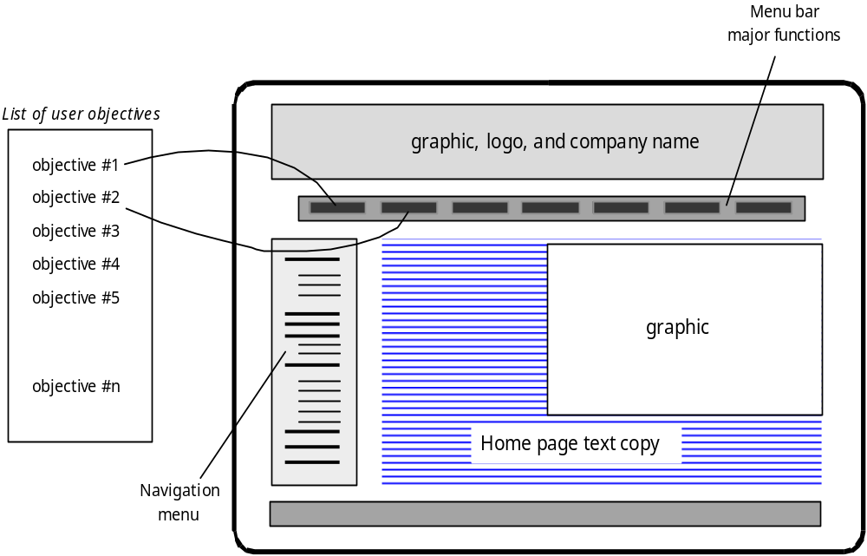
映射用户目标
主要功能菜单条
用户目标列表
图像 徽标和公司名称
目标#1
目标#2
目标#3
目标#4
目标#5
图像
目标#n
主页文本拷贝
导航菜单
Notes:
Mapping User Objectives

Slide 24
界面设计工作流-II
明确实现界面功能的界面对象。
开发用户与界面交互的过程表示。
开发界面的行为表示法。
描述每种状态的界面布局。
优化和评审界面设计模型。
Notes:
Interface Design Workflow-II
Identify user interface objects that are required to implement the interface.
Develop a procedural representation of the user’s interaction with the interface.
Develop a behavioral representation of the interface.
Describe the interface layout for each state.
Refine and review the interface design model.

Slide 25
美学设计
不要担心留下空白。
重视内容。
按照从左上到右下的顺序组织布局元素。
在页面内按导航、内容和功能安排布局。
不需要通过滚动条扩展空间。
在设计布局时，考虑分辨率和浏览器窗口的尺寸。
Notes:
Aesthetic Design
Don’t be afraid of white space.
Emphasize content.
Organize layout elements from top-left to bottom right.
Group navigation, content, and function geographically within the page.
Don’t extend your real estate with the scrolling bar.
Consider resolution and browser window size when designing layout.

Slide 26
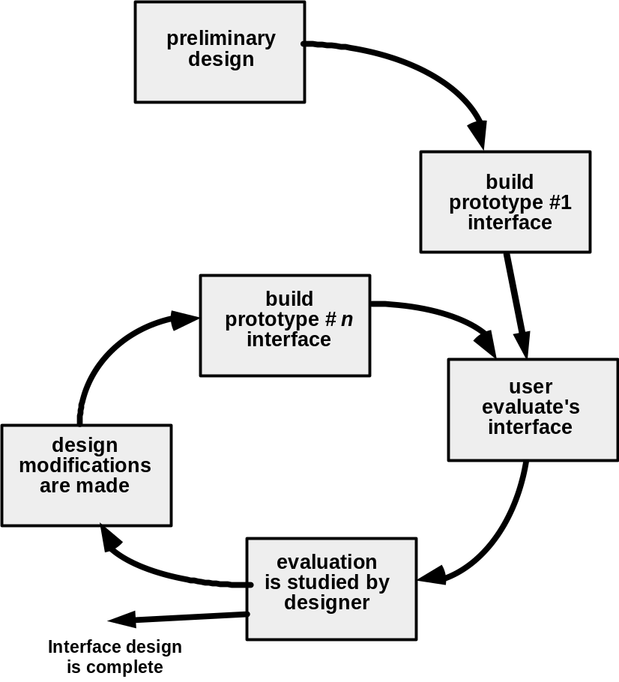
设计评估循环
初步设计
建立第一级原型界面
建立第n级原型界面
用户评估界面
对设计进行修改
设计者研究评估
界面设计完成
Notes:
Design Evaluation Cycle

