Slide 1
第13章 WebApp 设计
Notes:
Chapter 13 WebApp Design

Slide 2
设计 & WebApps
“本质上，设计有两种基本的途径：表达你自己的艺术设想和为客户解决问题的工程设想。”
Jakob Nielsen
我们应该何时强调WebApp设计？
  何时内容和功能是复杂的？
  何时Web应用的规模包含数百内容对象、功能和分析类？
  何时Web应用的成功会对商业的成功有直接影响？
Notes:
Design & WebApps
“There are essentially two basic approaches to design: the artistic ideal of expressing yourself and the engineering ideal of solving a problem for a customer.”
Jakob Nielsen
When should we emphasize WebApp design?
when content and function are complex
when the size of the WebApp encompasses hundreds of content objects, functions, and analysis classes
when the success of the WebApp will have a direct impact on the success of the business

Slide 3
设计 & Web应用质量
安全性
  阻挡外部攻击
  拒绝非授权访问
  确保用户/客户的隐私
可用性
  对WebApp的可用时间占总时间的百分比的一种度量
可伸缩性
  WebApp和为其提供接口的系统能不能承受访问数量上的巨大波动
投放市场时间
Notes:
Design & WebApp Quality
Security
Rebuff external attacks
Exclude unauthorized access
Ensure the privacy of users/customers
Availability
the measure of the percentage of time that a WebApp is available for use
Scalability
Can the WebApp and the systems with which it is interfaced handle significant variation in user or transaction volume
Time to Market

Slide 4
对最终用户的质量维度
时间
  自从上一次升级后，网站改变了多少？
  怎样突出已经被改变的部分？
结构
  怎样使网站的所有部分很好的结合在一起？
  网站所有的内部链接和外部链接是否都能正常工作？
  所有的图片都正常吗？
  网站中有不能被连接的部分吗？
内容
  关键页面的内容是否与支持它的内容匹配？
  关键短语是否持续存在在多变的网页中？
  关键页面是否保持质量，当内容从一个版本更新到另一个版本？
  对动态生成的HTML网页该怎么办？
Notes:
Quality Dimensions for End-Users
Time
How much has a Web site changed since the last upgrade?
How do you highlight the parts that have changed?
Structural
How well do all of the parts of the Web site hold together.
Are all links inside and outside the Web site working?
Do all of the images work?
Are there parts of the Web site that are not connected?
Content
Does the content of critical pages match what is supposed to be there?
Do key phrases exist continually in highly-changeable pages?
Do critical pages maintain quality content from version to version?
What about dynamically generated HTML pages?

Slide 5
对最终用户的质量维度
精确性和一致性
  今天下载网页的副本是否与昨天的一样？非常接近吗？
  提供的数据足够精确吗？你怎样知道的？
响应时间和延迟
  网站服务器是在特定的范围内响应浏览器请求的吗？
  在电子商务环境中，在提交请求之后，端到端的响应时间是怎样的？
  是否有一部分网站响应如此缓慢以致用户拒绝继续访问？
性能
  浏览器到Web、Web到Web站点、Web站点到浏览器等的连接足够快吗？
  随着时间、负载和使用的变化，性能怎样？
  性能适合电子商务应用系统吗？
Notes:
Quality Dimensions for End-Users
Accuracy and Consistency
Are today's copies of the pages downloaded the same as yesterday's? Close enough?
Is the data presented accurate enough? How do you know?
Response Time and Latency
Does the Web site server respond to a browser request within certain parameters?
In an E-commerce context, how is the end to end response time after a SUBMIT?
Are there parts of a site that are so slow the user declines to continue working on it?
Performance
Is the Browser-Web-Web site-Web-Browser connection quick enough?
How does the performance vary by time of day, by load and usage?
Is performance adequate for E-commerce applications?

Slide 6
WebApp设计目标
一致性
  内容构造应该一致
  图形设计（美学）应在WebApp的各部分有统一的外观
  体系结构设计应建立一个能够产生一致的超媒体结构的模版
  界面设计应确定交互、导航和内容显示的模式一致
  所有的WebApp元素中应一致地使用导航机制
Notes:
WebApp Design Goals
Consistency
Content should be constructed consistently
Graphic design (aesthetics) should present a consistent look across all parts of the WebApp
Architectural design should establish templates that lead to a consistent hypermedia structure
Interface design should define consistent modes of interaction, navigation and content display
Navigation mechanisms should be used consistently across all WebApp elements

Slide 7
WebApp 设计目标
符合性
  建立一个与业务目的相符的“身份”
健壮性
  用户期待与他们的要求相关的健壮的内容和功能
导航性
  以直观的和可预测的方式来设计
视觉吸引
  内容的外观、界面布局、颜色协调、正文布局是否匀称、图片和其他媒体、导航机制等必定吸引最终用户
兼容性
  兼容所有适合的环境和配置
Notes:
WebApp Design Goals
Identity
Establish an “identity” that is appropriate for the business purpose
Robustness
The user expects robust content and functions that are relevant to the user’s needs
Navigability
designed in a manner that is intuitive and predictable
Visual appeal
the look and feel of content, interface layout, color coordination, the balance of text, graphics and other media, navigation mechanisms must appeal to end-users
Compatibility
With all appropriate environments and configurations

Slide 8
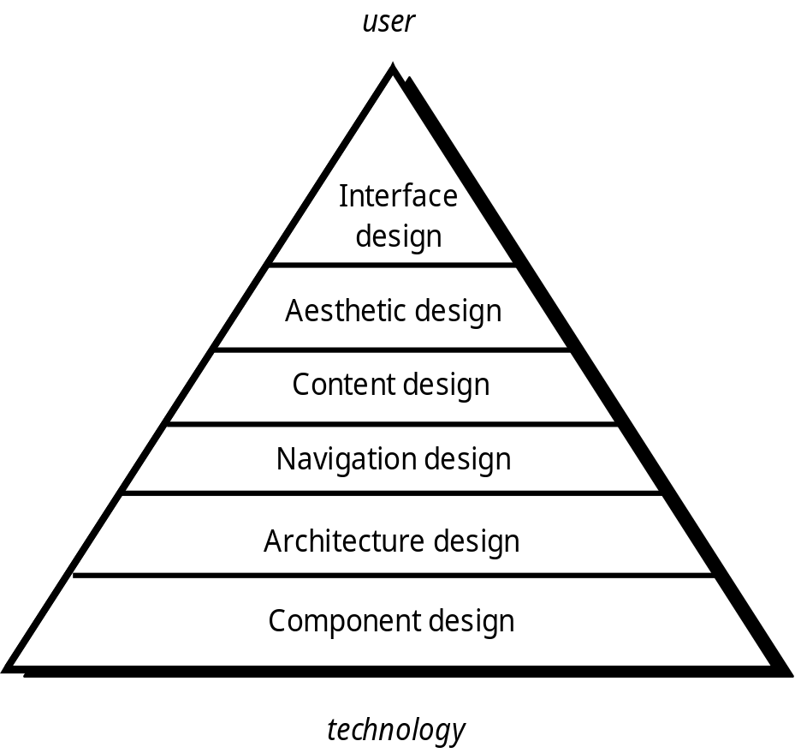
WebApp 设计金字塔
用户
界面设计
美学设计
内容设计
导航设计
体系结构设计
构件设计
技术
Notes:
WebE Design Pyramid

Slide 9
WebApp界面设计
我在哪里？ 界面应该：
  为访问的WebApp提供指示
  提示用户当前在内容层次中所处的位置
我现在能做什么？ 界面应该总是能够帮助用户理解当前的选项
  哪些功能可以使用？
  哪些链接是可用的？
  哪些内容是相关的？
我去过哪里？我将去哪里？界面必须能够辅助导航
  提供一张“地图”（以容易理解的方式实现），这张地图显示了用户在WebApp中去过哪里，还能沿着哪些路径去WebApp的其他地方。
Notes:
WebApp Interface Design
Where am I? The interface should
provide an indication of the WebApp that has been accessed
inform the user of her location in the content hierarchy.
What can I do now? The interface should always help the user understand his current options
what functions are available?
what links are live?
what content is relevant?
Where have I been, where am I going? The interface must facilitate navigation.
Provide a “map” (implemented in a way that is easy to understand) of where the user has been and what paths may be taken to move elsewhere within the WebApp.

Slide 10
有效的 WebApp 界面
Bruce Tognozzi [TOG01] 提出……
  有效的界面在视觉效果上是明显的、宽容的，并且慢慢地给用户灌输控制感。用户能够很快地看到他们的选择范围，领会怎样达到他们的目标，然后做他们的工作。
  有效的界面使用户不必关心系统的内部操作。工作被谨慎而连续地保存，从而使用户有充分的选择余地，可以在任何时刻取消任何活动。
  有效的应用和服务从用户那里要求最少的信息，而完成最多的工作。
Notes:
Effective WebApp Interfaces
Bruce Tognozzi [TOG01] suggests…
Effective interfaces are visually apparent and forgiving, instilling in their users a sense of control. Users quickly see the breadth of their options, grasp how to achieve their goals, and do their work.
Effective interfaces do not concern the user with the inner workings of the system. Work is carefully and continuously saved, with full option for the user to undo any activity at any time.
Effective applications and services perform a maximum of work, while requiring a minimum of information from users.

Slide 11
界面设计原则-I
预测——对WebApp进行设计，使其能够预测出用户的下一个步骤。
传达——界面应该能够传达由用户启动的任何活动的状态。
一致——导航控制、菜单、图标和美学风格（例如，颜色、形状和布局）。
自律——界面应该辅助用户在整个WebApp中移动，但是应该坚持使用已经为应用系统建立起来的导航习惯，以这样的方式来辅助用户。
效率—— WebApp的设计和界面应该优化用户的工作效率，而不是优化设计与构造WebApp的Web工程师的效率，也不是优化运行WebApp的客户/服务器环境的效率。
Notes:
Interface Design Principles-I
Anticipation—A WebApp should be designed so that it anticipates the use’s next move.
Communication—The interface should communicate the status of any activity initiated by the user
Consistency—The use of navigation controls, menus, icons, and aesthetics (e.g., color, shape, layout)
Controlled autonomy—The interface should facilitate user movement throughout the WebApp, but it should do so in a manner that enforces navigation conventions that have been established for the application.
Efficiency—The design of the WebApp and its interface should optimize the user’s work efficiency, not the efficiency of the Web engineer who designs and builds it or the client-server environment that executes it.

Slide 12
界面设计原则-II
关注点—— WebApp界面（及界面表示的内容）应该关注在用户正完成的任务上。
Fitt规则——“到达目标所用的时间是到达目标的距离和目标规模的函数”。
人机界面对象——对于WebApp，已经开发了大量可复用的人机界面对象库。
缩短等待时间—— WebApp应该利用多任务处理方式，从而使用户继续他的处理工作，看起就像前面的操作已经完成一样。
学习能力——应该设计WebApp的界面，将学习时间减到最少，并且一旦已经学习过了，当再次访问此WebApp时，将所需要的再学习时间减到最少。
Notes:
Interface Design Principles-II
Focus—The WebApp interface (and the content it presents) should stay focused on the user task(s) at hand.
Fitt’s Law—“The time to acquire a target is a function of the distance to and size of the target.”
Human interface objects—A vast library of reusable human interface objects has been developed for WebApps.
Latency reduction—The WebApp should use multi-tasking in a way that lets the user proceed with work as if the operation has been completed.
Learnability— A WebApp interface should be designed to minimize learning time, and once learned, to minimize relearning required when the WebApp is revisited.

Slide 13
界面设计原则-III
保持工作产品的完整性——工作产品（例如用户填写的表单，用户专用数据清单）必须自动保存，使得在有错误发生时数据不会丢失。
易读性——界面展示的所有信息对于老人和年轻人都应该是易读的。
跟踪状态——在合适的时候，应该跟踪和保存用户状态，使得用户能够退出系统，稍后返回系统时又能回到退出的地方。
可见的导航——设计合理的WebApp界面提供了这样的设想，“即用户呆在同一个地方，工作被带到他们面前”。
Notes:
Interface Design Principles-III
Maintain work product integrity—A work product (e.g., a form completed by the user, a user specified list) must be automatically saved so that it will not be lost if an error occurs.
Readability—All information presented through the interface should be readable by young and old.
Track state—When appropriate, the state of the user interaction should be tracked and stored so that a user can logoff and return later to pick up where she left off.
Visible navigation—A well-designed WebApp interface provides “the illusion that users are in the same place, with the work brought to them.”

Slide 14
美学设计
不要担心留下空白。
重视内容。
按照从左上到右下的顺序组织布局元素。
在页面内按导航、内容和功能安排布局。
不需要通过滚动条扩展空间。
在设计布局时，考虑分辨率和浏览器窗口的尺寸。
Notes:
Aesthetic Design
Don’t be afraid of white space.
Emphasize content.
Organize layout elements from top-left to bottom right.
Group navigation, content, and function geographically within the page.
Don’t extend your real estate with the scrolling bar.
Consider resolution and browser window size when designing layout.

Slide 15
内容设计
为内容对象开发一种设计表示
  在WebApp设计环境中，内容对象与传统软件中的数据对象关系更加紧密
代表机制需要实例化它们之间的关系
  类似于在第11章描述的分析类和设计构件之间的关系
内容对象具有的属性，包括特定的内容信息的属性和指定为设计成分的实现属性
Notes:
Content Design
Develops a design representation for content objects
For WebApps, a content object is more closely aligned with a data object for conventional software
Represents the mechanisms required to instantiate their relationships to one another.
analogous to the relationship between analysis classes and design components described in Chapter 11
A content object has attributes that include content-specific information and implementation-specific attributes that are specified as part of design

Slide 16
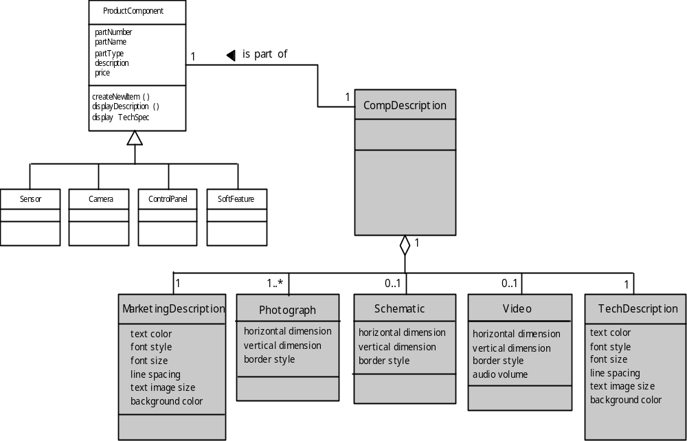
内容对象的设计
Notes:
Design of Content Objects

Slide 17
体系结构设计
内容体系结构的设计着重于内容对象（诸如网页的组成对象）的表现和导航的组织方式。
  术语信息体系结构也用于表示结构，使得能够更好地组织、标识、导航及搜索内容对象。
WebApp体系结构描述应用系统将以什么方式来管理用户交互、操纵内部处理任务、实现导航及展示内容。
体系结构设计与界面设计、美学设计和内容设计并行进行。
Notes:
Architecture Design
Content architecture focuses on the manner in which content objects (or composite objects such as Web pages) are structured for presentation and navigation.
The term information architecture is also used to connote structures that lead to better organization, labeling, navigation, and searching of content objects.
WebApp architecture addresses the manner in which the application is structured to manage user interaction, handle internal processing tasks, effect navigation, and present content.
Architecture design is conducted in parallel with interface design, aesthetic design and content design.

Slide 18
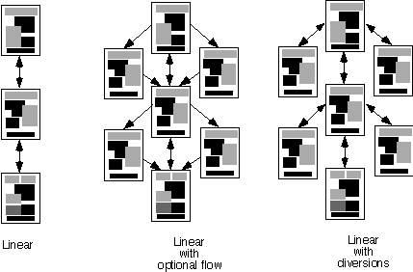
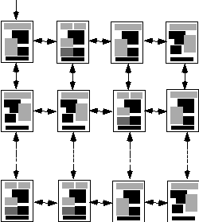
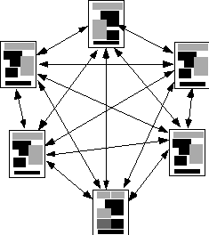
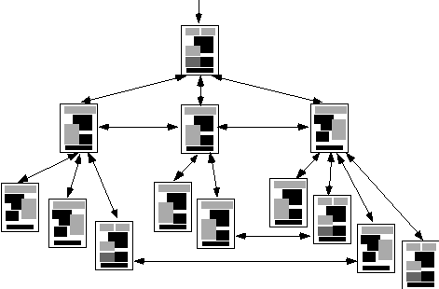
内容体系结构
Linear
structure
线性结构
网格结构
带有选择流的线性结构
带有转向的线性结构
Network
structure
网格结构
分层结构
Notes:
Content Architecture

Slide 19
MVC 体系结构
模型包括应用系统的所有详细内容和处理逻辑，包括
  所有的内容对象
  对外数据或信息源的访问
  应用系统的特定处理功能
视图包括所有界面的特定功能，并能够
  表示内容和处理逻辑
  对外数据或信息源的访问
  最终用户所需要的所有处理功能
控制器管理对模型和视图的访问，并协调两者间的数据流。
Notes:
MVC Architecture
The model contains all application specific content and processing logic, including
all content objects
access to external data/information sources,
all processing functionality that are application specific
The view contains all interface specific functions and enables
the presentation of content and processing logic
access to external data/information sources,
all processing functionality required by the end-user.
The controller manages access to the model and the view and coordinates the flow of data between them.

Slide 20
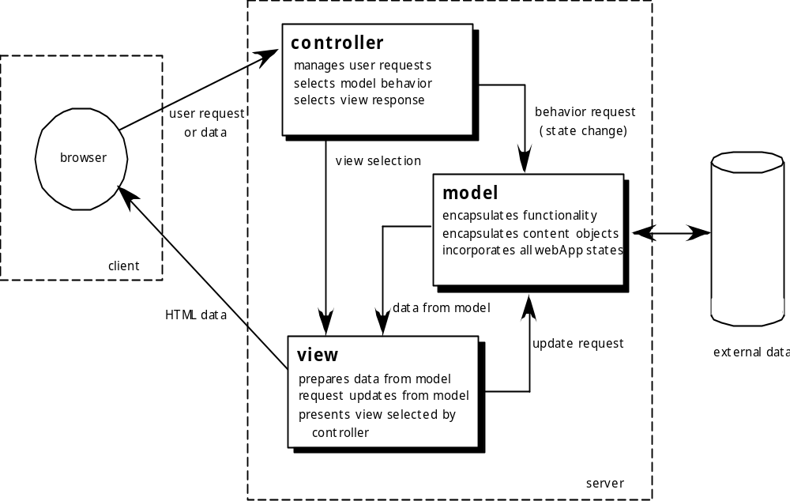
MVC 体系结构
控制器
管理用户请求
选择模型行为
选择视图响应
行为请求
（状态改变）
用户请求或数据
模型
封装功能
封装内容
合并所有的WebApp状态
浏览器
视图选择
客户
HTML数据
来自模型的数据
更新请求
外部数据
视图
准备雷子模型的数据
请求模型梗系
显示控制器所选择的视图
服务器
Notes:
MVC Architecture

Slide 21
导航设计
首先考虑用户层次和相关用例
  每一类角色使用WebApp的方式或多或少会有所区别，因而会有不同的导航要求
当每一个用户和WebApp进行交互时，会遇到一系列的导航语义单元(NSUs)
  NSU——“信息和相关的导航结构的集合，它们相互协作共同完成相关的用户请求的一部分”
Notes:
Navigation Design
Begins with a consideration of the user hierarchy and related use-cases
Each actor may use the WebApp somewhat differently and therefore have different navigation requirements
As each user interacts with the WebApp, she encounters a series of navigation semantic units (NSUs)
NSU—“a set of information and related navigation structures that collaborate in the fulfillment of a subset of related user requirements”

Slide 22
导航语义单元
导航语义单元
  导航方式(WoN)—对特定用户来说，为了到达他们期望的目标或子目标，WoN展示最佳的导航路径。由一组…
    导航节点(NN)组成，这些导航节点通过导航链接连接起来
link₁₂
NN₂
link₂₄
NN₁
NN₄
NSU
link₁₃
NN₃
link₃₄
Notes:
Navigation Semantic Units
Navigation semantic unit
Ways of navigation (WoN)—represents the best navigation way or path for users with certain profiles to achieve their desired goal or sub-goal. Composed of …
Navigation nodes (NN) connected by Navigation links

Slide 23
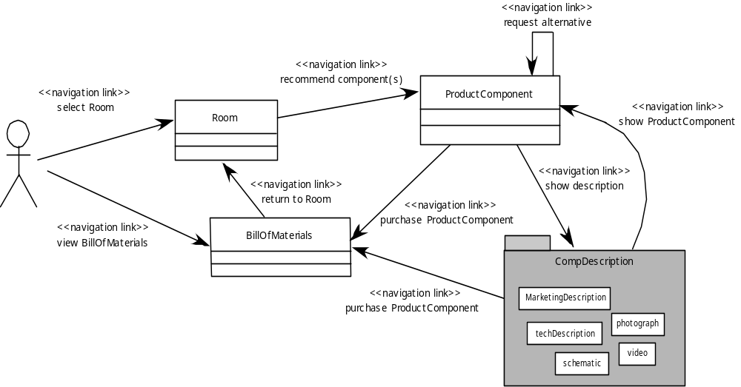
创建一个NSU
请求选择
推荐部件
选择房间
显示产品部件
返回房间
显示描述
购买产品部件
浏览材料清单
购买产品部件
Notes:
Creating an NSU

Slide 24
导航语法
单独的导航链接——基于文本的链接、图标、按钮、开关及图形隐喻.
水平导航条——列出主要重要的内容或功能类别，一般列出4~7类。
垂直导航列
  列出重要的内容和功能类别
  列出WebApp中几乎所有的重要内容对象
标签——作为一种隐喻，其实标签只是导航条和导航列的变种，代表内容或功能类别，在需要链接时作为标签页被选中。
网站地图——向WebApp中的所有内容对象和功能提供完整的导航内容表格。
Notes:
Navigation Syntax
Individual navigation link—text-based links, icons, buttons and switches, and graphical metaphors..
Horizontal navigation bar—lists major content or functional categories in a bar containing appropriate links. In general, between 4 and 7 categories are listed.
Vertical navigation column
lists major content or functional categories
lists virtually all major content objects within the WebApp.
Tabs—a metaphor that is nothing more than a variation of the navigation bar or column, representing content or functional categories as tab sheets that are selected when a link is required.
Site maps—provide an all-inclusive tab of contents for navigation to all content objects and functionality contained within the WebApp.

Slide 25
构件级设计
WebApp 构件实现以下功能
  执行本地化的处理，从而动态地产生内容和导航能力
  提供了适于WebApp业务领域的计算或数据处理能力
  提供了高级的数据库查询和访问
  建立了与外部协作系统的数据接口
Notes:
Component-Level Design
WebApp components implement the following functionality
perform localized processing to generate content and navigation capability in a dynamic fashion
provide computation or data processing capability that are appropriate for the WebApp’s business domain
provide sophisticated database query and access
establish data interfaces with external corporate systems.

Slide 26
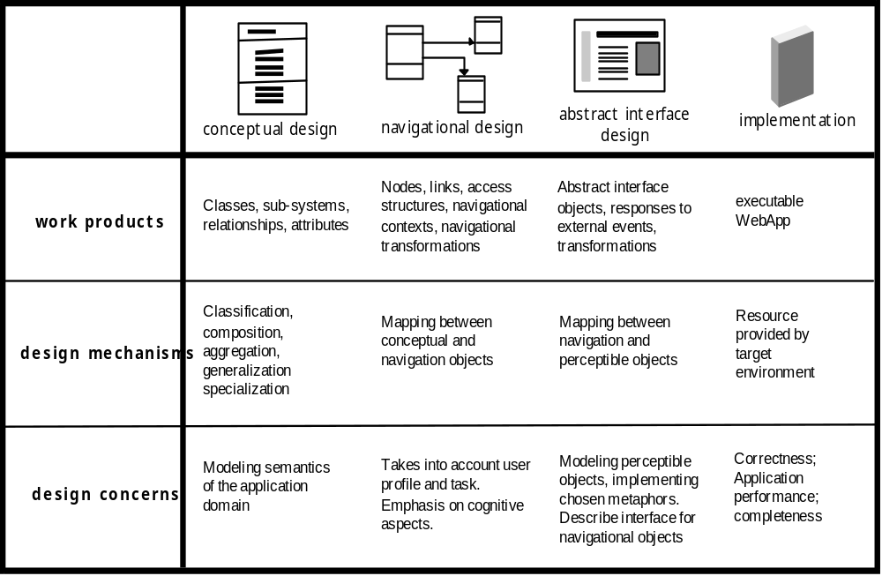
OOHDM
面向对象超媒体设计方法(OOHDM)
概念设计
导航设计
抽象界面设计
实现
共走产品
类、子系统、关系、属性
可执行的WebApp
节点链接、访问结构、导航环境、导航变换
抽象的界面对象、响应外部事件、变换
设计机制
建立概念对象和导航对象之间的映射
建立导航对象和可感知对象之间的影身
目标环境提供的资源
分类、组合、聚合、泛化、特殊化
设计问题
应用领域的建模语义
考虑用户描述和任务，侧重于可感知的方面
可感知对象建模，实现选择的隐喻，描述导航对象的界面
正确性；应用层序的性能；完整性
Notes:
OOHDM
Object-Oriented Hypermedia Design Method (OOHDM)

Slide 27
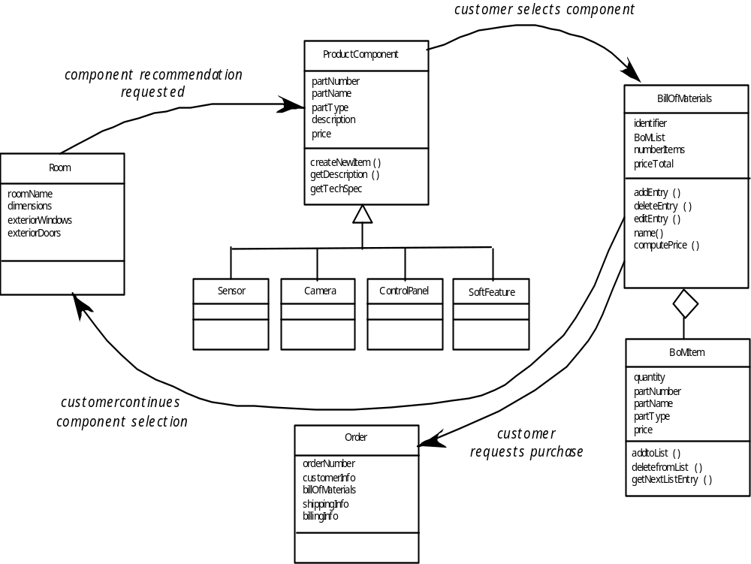
概念模式
客户选择部件
部件推荐请求
客户继续选择部件
客户请求购买
Notes:
Conceptual Schema

