Slide 1
第18章 测试传统的应用系统
Notes:
Chapter 18 Testing Conventional Applications

Slide 2
可测试性
可操作性——有效地操作
可观察性——每个测试用例的结果都是易观察的
可控制性——测试能被自动化执行和优化的程度
可分解性——有针对的测试
简单性——减少复杂的体系结构和逻辑以简化测试
稳定性——测试过程需求变更不经常发生
易理解性——对设计的较好理解
Notes:
Testability
Operability—it operates cleanly
Observability—the results of each test case are readily observed
Controllability—the degree to which testing can be automated and optimized
Decomposability—testing can be targeted
Simplicity—reduce complex architecture and logic to simplify tests
Stability—few changes are requested during testing
Understandability—of the design

Slide 3
什么是“好”的测试
好的测试有较高的发现错误的可能性
好的测试是不冗余的
好的测试应该是“最佳品种”
好的测试应该既不简单也不太复杂
Notes:
What is a “Good” Test?
A good test has a high probability of finding an error
A good test is not redundant.
A good test should be “best of breed”
A good test should be neither too simple nor too complex

Slide 4
内部视角和外部视角
任何工程化的产品（以及大多数其他东西）都可以采用以下两种方式之一进行测试：
  了解已设计的产品要完成的指定功能，可以执行测试以显示每个功能是可操作的，同时，查找在每个功能中的错误；
  了解产品的内部工作情况，可以执行测试以确保“所有的齿轮吻合”——即内部操作依据规格说明执行，而且对所有的内部结构已进行了充分测试。
Notes:
Internal and External Views
Any engineered product (and most other things) can be tested in one of two ways:
Knowing the specified function that a product has been designed to perform, tests can be conducted that demonstrate each function is fully operational while at the same time searching for errors in each function;
Knowing the internal workings of a product, tests can be conducted to ensure that "all gears mesh," that is, internal operations are performed according to specifications and all internal components have been adequately exercised.

Slide 5
测试用例设计
"Bugs lurk in corners
and congregate at
boundaries ..."
“Bugs 潜伏在角落及在边界处聚集…
Boris Beizer
OBJECTIVE
to uncover errors
发现错误
目标
CRITERIA
in a complete manner
以一个完整的方式
准则
CONSTRAINT
with a minimum of effort and time
限制
用最少的工作量和时间
Notes:
Test Case Design

Slide 6
穷举设计
loop < 20 X
循环 < 20 次
There are 10 possible paths! If we execute one
test per millisecond, it would take 3,170 years to
test this program!!
大约有10¹⁴ 个可能的路径！如果我们1毫秒内执行一个测试
用例，则测试这个程序要工作3170年！！
Notes:
Exhaustive Testing

Slide 7
选择测试
Selected path
选择路径
loop < 20 X
循环 < 20 次

Slide 8
软件测试
white-box
methods
black-box
methods
白盒方法
黑盒方法
Methods
方法
Strategies
策略
Notes:
Software Testing

Slide 9

白盒测试
…我们的目标是确保程序中的每一条语句和条件都至少被执行一次…
Notes:
White-Box Testing
... our goal is to ensure that all
statements and conditions have
been executed at least once ...

Slide 10
为什么要覆盖？
逻辑错误和错误的假定与路径的可能执行是成反比的
我们总是认为那条路径不可能被执行；事实上，
现实总是与直觉相反
印刷错误是随机的；很可能包含一些未经测试的
路径
Notes:
Why Cover?
logic errors and incorrect assumptions
are inversely proportional to a path's
execution probability
we often believe that a path is not
likely to be executed; in fact, reality is
often counter intuitive
typographical errors are random; it's
likely that untested paths will contain
some

Slide 11
基本路径测试
首先，我们计算出环复杂性：
简单决策数+ 1
或
封闭区域数+ 1
在这个例子中， V(G) = 4
Notes:
Basis Path Testing
First, we compute the cyclomatic complexity:
number of simple decisions + 1
or
number of enclosed areas + 1
In this case, V(G) = 4

Slide 12
环复杂性
许多企业研究表明，V(G)越高，其错误的概率就越高
A number of industry studies have indicated
that the higher V(G), the higher the probability
or errors.
modules
模块
V(G)
modules in this range are
more error prone
模块在这个范围内易发生更多错误
Notes:
Cyclomatic Complexity
A number of industry studies have indicated
that the higher V(G), the higher the probability
or errors.

Slide 13
基本路径测试
1
Next, we derive the
下一步，我们导出独立路径
independent paths:
2
Since V(G) = 4,
因为 V(G) = 4,
there are four paths
有4条路径
3
Path 1: 1,2,3,6,7,8
路径1: 1,2,3,6,7,8
4
Path 2: 1,2,3,5,7,8
路径2: 1,2,3,5,7,8
5
6
Path 3: 1,2,4,7,8
路径3: 1,2,4,7,8
Path 4: 1,2,4,7,2,4,...7,8
路径4: 1,2,4,7,2,4,...7,8
Finally, we derive test
最后，我们导出测试用例执行这些路径
7
cases to exercise these
paths.
8
Notes:
Basis Path Testing

Slide 14
基本路径测试说明
我们不需要画流图，但是，当追踪程序路
径时这幅图能帮助我们
计算每一个简单逻辑测试，当有两个或更
多时，复合测试计算
基本路径测试应应用到关键模型
Notes:
Basis Path Testing Notes
you don't need a flow chart,
but the picture will help when
you trace program paths
count each simple logical test,
compound tests count as 2 or
more
basis path testing should be
applied to critical modules

Slide 15
导出测试用例
总结
  以设计或源码为基础，画出相应的流图。
  确定所得流图的环复杂性。
  确定线性独立路径的基本集合。
  准备测试用例，强制执行基本集合中的每条路径。
Notes:
Deriving Test Cases
Summarizing:
Using the design or code as a foundation, draw a corresponding flow graph.
Determine the cyclomatic complexity of the resultant flow graph.
Determine a basis set of linearly independent paths.
Prepare test cases that will force execution of each path in the basis set.

Slide 16
图矩阵
图矩阵是一种方阵，其大小（即行与列的数量）等于流图的结点数。
每行和每列都对应于已标识的结点，矩阵中的项对应于结点间的连接（边）。
通过将每个矩阵项加入一个连接权值，图矩阵成为测试期间评估程序控制结构的一个强有力的工具。
Notes:
Graph Matrices
A graph matrix is a square matrix whose size (i.e., number of rows and columns) is equal to the number of nodes on a flow graph
Each row and column corresponds to an identified node, and matrix entries correspond to connections (an edge) between nodes.
By adding a link weight to each matrix entry, the graph matrix can become a powerful tool for evaluating program control structure during testing

Slide 17
控制结构测试
条件测试——通过检查程序模块中包含的逻辑条件进行测试用例设计的方法
数据流测试——根据变量的定义和使用位置来选择程序测试路径
Notes:
Control Structure Testing
Condition testing — a test case design method that exercises the logical conditions contained in a program module
Data flow testing — selects test paths of a program according to the locations of definitions and uses of variables in the program

Slide 18
数据流测试
数据流测试方法[Fra93] 就是根据变量的定义和使用位置来选择程序测试路径。
  假设程序的每条语句都赋予了独特的语句号，而且每个函数都不改变其参数或全局参量。对于语句号为S的语句
    DEF(S) = {X |语句S 包含X的定义}
    USE(S) = {X | 语句S 包含X的使用}
  变量X的定义-使用链（或称DU链）的形式为[X，S， S' ]，其中S 和S'为语句号，X 在DEF(S) 和USE(S' )中，且在语句S中定义的X在语句S'中有效。
Notes:
Data Flow Testing
The data flow testing method [Fra93] selects test paths of a program according to the locations of definitions and uses of variables in the program.
Assume that each statement in a program is assigned a unique statement number and that each function does not modify its parameters or global variables. For a statement with S as its statement number
DEF(S) = {X | statement S contains a definition of X}
USE(S) = {X | statement S contains a use of X}
A definition-use (DU) chain of variable X is of the form [X, S, S'], where S and S' are statement numbers, X is in DEF(S) and USE(S'), and the definition of X in statement S is live at statement S'

Slide 19
循环测试
Simple
loop
简单循环
Nested
Loops
Concatenated
Loops
嵌套循环
Unstructured
串接循环
Loops
非结构化循环

Slide 20
循环测试：简单循环
最少条件—简单循环
1. 跳过整个循环
2. 只有一次通过循环
3. 两次通过循环
4. m次通过循环，其中m < n
5. (n-1), n, 和 (n+1) 次通过循环
其中n是允许通过的最大次数
Notes:
Loop Testing: Simple Loops
Minimum conditions—Simple Loops
1. skip the loop entirely
2. only one pass through the loop
3. two passes through the loop
4. m passes through the loop m < n
5. (n-1), n, and (n+1) passes through
the loop
where n is the maximum number
of allowable passes

Slide 21
循环测试：嵌套循环
嵌套循环
从最内层循环开始，将其他循环设置为最小迭代参量值。
测试min+1、典型的、max1-1和内层循环的最大值，而使外
层循环的迭代参数值最小。
由内向外构造下一个循环并按步骤2设置，使所有其他循环为
典型值。继续这一步直至最外层循环被测试
串接循环
If 串接循环的每个循环彼此独立
then 可以使用简单循环测试方法
else 使用嵌套循环测试方法
Endif
例如，第1个循环的最后循环计数值为第2个循环的初始值。
Notes:
Loop Testing: Nested Loops
Nested Loops
Start at the innermost loop. Set all outer loops to their
minimum iteration parameter values.
Test the min+1, typical, max-1 and max for the
innermost loop, while holding the outer loops at their
minimum values.
Move out one loop and set it up as in step 2, holding all
other loops at typical values. Continue this step until
the outermost loop has been tested.
Concatenated Loops
If the loops are independent of one another
then treat each as a simple loop
else* treat as nested loops
endif*
for example, the final loop counter value of loop 1 is
used to initialize loop 2.

Slide 22
黑盒测试
requirements
需求
output
输出
input
输入
events
事件

Slide 23
黑盒测试
如何测试功能的有效性？
如何测试系统的行为和性能？
哪种类型的输入会产生好的测试用例？
系统是否对特定的输入值特别敏感？
如何分离数据类的边界？
系统能承受什么样的数据速率和数据量？
特定类型的数据组合会对系统运行产生什么样的影响？
Notes:
Black-Box Testing
How is functional validity tested?
How is system behavior and performance tested?
What classes of input will make good test cases?
Is the system particularly sensitive to certain input values?
How are the boundaries of a data class isolated?
What data rates and data volume can the system tolerate?
What effect will specific combinations of data have on system operation?

Slide 24
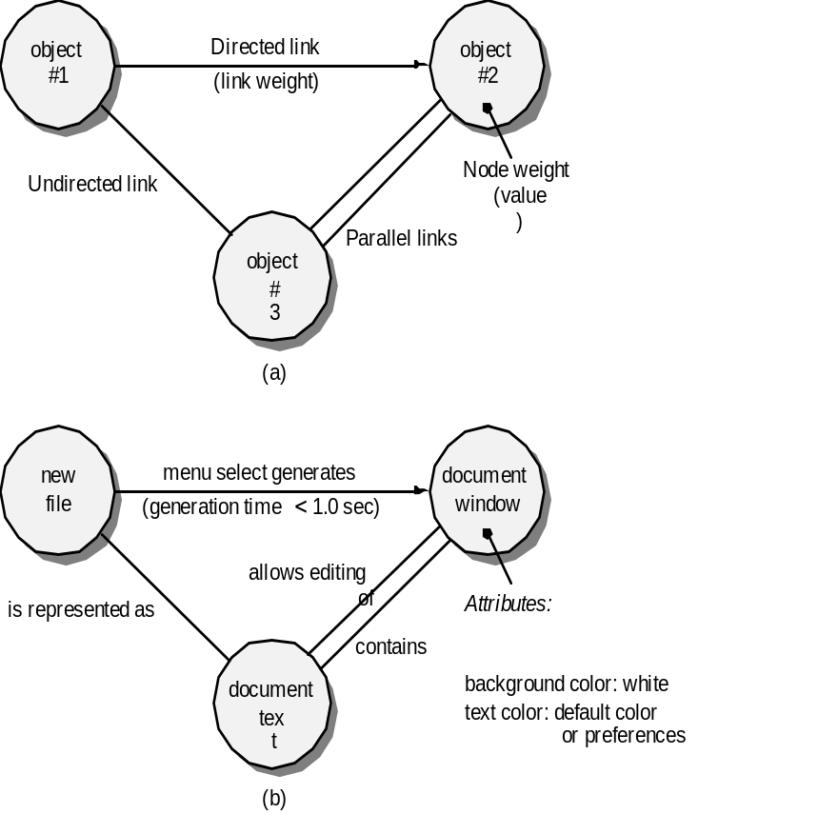
基于图的测试方法
理解软件对象建模和连接这些对象的关系
这里，我们在最广泛的环境中考虑术语“对象”。它包括数据对象、传统的构件（模块）以及计算机软件的面向对象元素
对象#1
有向连接
对象#2
连接权值
结点权值
无向连接
对象#3
并行连接
新建文件
菜单选择生成
文档
窗口
生成时间<1.0 sec
实现编辑
表示为
属性：
包含
文档
文本
起始维：缺省设置或偏爱的
背景颜色：白色
文本颜色：缺省颜色或偏爱颜色
Notes:
Graph-Based Methods
To understand the objects that are modeled in software and the relationships that connect these objects
In this context, we consider the term “objects” in the broadest possible context. It encompasses data objects, traditional components (modules), and object-oriented elements of computer software.

Slide 25
等价类划分
user
queries
output
formats
FK
input
用户问题
mouse
picks
data
输出格式
prompts
FK
输入
鼠标选择
数据
提示
Notes:
Equivalence Partitioning

Slide 26
等价类样本
有效数据
用户提供命令
响应系统提示符
文件名
计算数据
物理参数
边界值
初始值
输出数据格式
响应错误消息
图解数据（例如，鼠标选择）
无效数据
程序边界范围外的数据
物理上不可能的数据
在错误的地点提供适当的值
Notes:
Sample Equivalence Classes
Valid data
user supplied commands
responses to system prompts
file names
computational data
physical parameters
bounding values
initiation values
output data formatting
responses to error messages
graphical data (e.g., mouse picks)
Invalid data
data outside bounds of the program
physically impossible data
proper value supplied in wrong place

Slide 27
边界值分析
user
queries
output
formats
FK
input
用户问题
mouse
picks
data
输出格式
prompts
FK
输入
鼠标选择
数据
提示
output
domain
input domain
输入域
输出域
Notes:
Boundary Value Analysis

Slide 28
对比测试
仅在这种情况下使用，即软件的可靠性是绝对关键的（例如，与人相关的系统）
  独立的软件工程团队使用相同的规格说明独立开发应用系统的版本
  可以使用相同的测试数据测试每一个版本，以确保所有的版本有确定的输出
  然后，并行执行所有的版本，实时比较结果，以确保一致性。
Notes:
Comparison Testing
Used only in situations in which the reliability of software is absolutely critical (e.g., human-rated systems)
Separate software engineering teams develop independent versions of an application using the same specification
Each version can be tested with the same test data to ensure that all provide identical output
Then all versions are executed in parallel with real-time comparison of results to ensure consistency

Slide 29
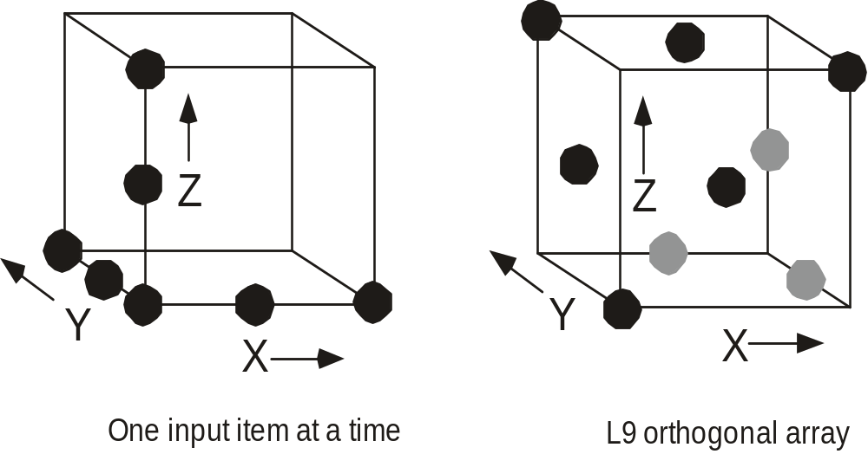
正交数组测试
当输入参数的数量不多，且每个参数可取的值有明确的界定时使用
一次一个输入项
L9正交数组
Notes:
Orthogonal Array Testing
Used when the number of input parameters is small and the values that each of the parameters may take are clearly bounded

Slide 30
基于模型的测试
分析软件的已有行为模型或创建一个行为模型。
  回忆一下，行为模型指明软件是如何响应外部事件或刺激的。
遍历行为模型，并标明促使软件状态之间进行转换的输入。
  输入将触发事件，使转换发生。
评估行为模型，并标注当软件在状态之间转换时所期望的输出。
运行测试用例。
比较实际结果和期望结果，并根据需要进行调整。
Notes:
Model-Based Testing
Analyze an existing behavioral model for the software or create one.
Recall that a behavioral model indicates how software will respond to external events or stimuli.
Traverse the behavioral model and specify the inputs that will force the software to make the transition from state to state.
The inputs will trigger events that will cause the transition to occur.
Review the behavioral model and note the expected outputs as the software makes the transition from state to state.
Execute the test cases.
Compare actual and expected results and take corrective action as required.

Slide 31
软件测试模式
测试模式可以采用与设计模式（第12章）同样的描述方式。
举例：
    模式名称：场景测试
    摘要：一旦已经执行了单元测试，就需要确定软件是否以让用户满意的方式执行。场景测试描述一种从用户的角度测试软件的技术。在这个层次上的失败表明软件不能满足用户的可见需求。[Kan01]
Notes:
Software Testing Patterns
Testing patterns are described in much the same way as design patterns (Chapter 12).
Example:
Pattern name: ScenarioTesting
Abstract: Once unit and integration tests have been conducted, there is a need to determine whether the software will perform in a manner that satisfies users. The ScenarioTesting pattern describes a technique for exercising the software from the user’s point of view. A failure at this level indicates that the software has failed to meet a user visible requirement. [Kan01]

