Slide 1
第19章
测试面向对象的应用系统
Notes:
Chapter 19 Testing Object-Oriented Applications

Slide 2
OO 测试
为了充分测试面向对象的系统，必须做3件事：
  对测试的定义进行扩展，使其包括应用于面向对象分析和设计模型的错误发现技术
  单元测试和集成测试策略必须彻底改变
  测试用例设计必须考虑面向对象软件的独特性质
Notes:
OO Testing
To adequately test OO systems, three things must be done:
the definition of testing must be broadened to include error discovery techniques applied to object-oriented analysis and design models
the strategy for unit and integration testing must change significantly, and
the design of test cases must account for the unique characteristics of OO software.

Slide 3
‘测试’OO 模型
面向对象分析和设计模型的评审非常有用，因为相同的语义结构（例如，类、属性、操作、消息）出现在分析、设计和代码层次。
因此，在分析期间所发现的类属性的定义问题会防止副作用的发生。如果问题直到设计或编码阶段（或者是分析的下一轮迭代）还没有出现，副作用就会发生。
Notes:
‘Testing’ OO Models
The review of OO analysis and design models is especially useful because the same semantic constructs (e.g., classes, attributes, operations, messages) appear at the analysis, design, and code level
Therefore, a problem in the definition of class attributes that is uncovered during analysis will circumvent side affects that might occur if the problem were not discovered until design or code (or even the next iteration of analysis).

Slide 4
OO 模型的正确性
在分析和设计期间，可以根据模型是否符合真实世界的问题域来评估模型的语义正确性。
如果模型准确地反应了真实世界（详细程度与模型被评审的开发阶段相适应），则在语义上是正确的。
实际上，为了确定模型是否反应了真实世界的需求，应该将其介绍给问题领域的专家，由专家检查类定义和层次中遗漏和不清楚的地方。
要对类关系（实例连接）进行评估，确定这些关系是否准确地反应了真实世界的对象连接。
Notes:
Correctness of OO Models
During analysis and design, semantic correctness can be asesssed based on the model’s conformance to the real world problem domain.
If the model accurately reflects the real world (to a level of detail that is appropriate to the stage of development at which the model is reviewed) then it is semantically correct.
To determine whether the model does, in fact, reflect real world requirements, it should be presented to problem domain experts who will examine the class definitions and hierarchy for omissions and ambiguity.
Class relationships (instance connections) are evaluated to determine whether they accurately reflect real-world object connections.

Slide 5
类模型的一致性
检查CRC模型和对象-关系模型。
检查每一张CRC索引卡片的描述以确定委托责任是定义协作者的一部分。
反转连接，确保每个提供服务的协作者都从合理的地方收到请求。
使用前一步骤中反转后的连接，确定是否真正需要其他类，或者责任类之间的组织是否合适。
确定是否可以将广泛请求的多个责任组合为一个责任。
Notes:
Class Model Consistency
Revisit the CRC model and the object-relationship model.
Inspect the description of each CRC index card to determine if a delegated responsibility is part of the collaborator’s definition.
Invert the connection to ensure that each collaborator that is asked for service is receiving requests from a reasonable source.
Using the inverted connections examined in the preceding step, determine whether other classes might be required or whether responsibilities are properly grouped among the classes.
Determine whether widely requested responsibilities might be combined into a single responsibility.

Slide 6
OO 测试决策
单元测试
  单元的概念发生了改变
  最小的测试单元是封装了的类
  已经不可能再独立地测试单一的操作了（独立地测试单一的操作是单元测试的传统观点），而是作为类的一部分进行测试
集成测试
  基于线程的测试，将响应系统的一个输入或事件所需的一组类集成到一起
  基于使用的测试，通过测试很少使用服务类（如果有的话）的那些类（称之为独立类）开始构造系统
  簇测试[McG94] 通过设计试图发现协作错误的测试用例，对一簇协作类（通过检查CRC和对象-关系模型来确定）进行测试
Notes:
OO Testing Strategies
Unit testing
the concept of the unit changes
the smallest testable unit is the encapsulated class
a single operation can no longer be tested in isolation (the conventional view of unit testing) but rather, as part of a class
Integration Testing
Thread-based testing integrates the set of classes required to respond to one input or event for the system
Use-based testing begins the construction of the system by testing those classes (called independent classes) that use very few (if any) of server classes. After the independent classes are tested, the next layer of classes, called dependent classes
Cluster testing [McG94] defines a cluster of collaborating classes (determined by examining the CRC and object-relationship model) is exercised by designing test cases that attempt to uncover errors in the collaborations.

Slide 7
OO 测试策略
确认测试
  类连接的细节消失了
  利用用例（第5章和第6章），它是需求模型的一部分
  传统的黑盒测试方法（第18章）可以用于驱动确认测试
Notes:
OO Testing Strategies
Validation Testing
details of class connections disappear
draw upon use cases (Chapters 5 and 6) that are part of the requirements model
Conventional black-box testing methods (Chapter 18) can be used to drive validation tests

Slide 8
OOT 方法
Berard [Ber93]提出了以下方法：
1. 每个测试用例都应该唯一地标识，并明确地与被测试的类相关联
2. 应该叙述测试的目的
3. 应该为每个测试开发测试步骤，并包含以下内容[BER94]：
  a. 将要测试的类的指定状态列表
b. 作为测试结果要进行检查的消息和操作列表
c. 对类进行测试时可能 发生异常列表
d. 外部条件列表（即软件外部环境的变更，为了正确地进行测试，这种环境必须存在）
e. 有助于理解或实现测试的补充信息
Notes:
OOT Methods
1. Each test case should be uniquely identified and should be explicitly associated with the class to be tested,
2. The purpose of the test should be stated,
3. A list of testing steps should be developed for each test and should contain [BER94]:
a. a list of specified states for the object that is to be tested
b. a list of messages and operations that will be exercised as a consequence of the test
c. a list of exceptions that may occur as the object is tested
d. a list of external conditions (i.e., changes in the environment external to the software that must exist in order to properly conduct the test)
e. supplementary information that will aid in understanding or implementing the test.

Slide 9
测试方法
基于故障的测试
  测试人员查找似然故障（即系统的实现有可能产生错误的方面）。为了确定这些故障是否存在，需要设计测试用例以检查设计或代码
类测试与类层次
  继承并不能排除对所有派生类进行全面测试的需要。事实上，它确实使测试过程更复杂。
基于场景的测试设计
  基于场景的测试关心用户做什么，而不是产品做什么。这意味着捕获用户必须完成的任务（通过用例），然后在测试时使用它们及其变体。
Notes:
Testing Methods
Fault-based testing
The tester looks for plausible faults (i.e., aspects of the implementation of the system that may result in defects). To determine whether these faults exist, test cases are designed to exercise the design or code.
Class Testing and the Class Hierarchy
Inheritance does not obviate the need for thorough testing of all derived classes. In fact, it can actually complicate the testing process.
Scenario-Based Test Design
Scenario-based testing concentrates on what the user does, not what the product does. This means capturing the tasks (via use-cases) that the user has to perform, then applying them and their variants as tests.

Slide 10
OOT 方法：随机测试
随机测试
  确定适用于类的操作
  定义约束它们的使用
  确定最小测试序列
    操作序列定义了类的最小生命历时
  随机产生（但是有效）一些不同的测试序列
    检查其他类实例（更复杂的）的生命历时
Notes:
OOT Methods: Partition Testing
Partition Testing
reduces the number of test cases required to test a class in much the same way as equivalence partitioning for conventional software
state-based partitioning
categorize and test operations based on their ability to change the state of a class
attribute-based partitioning
categorize and test operations based on the attributes that they use
category-based partitioning
categorize and test operations based on the generic function each performs

Slide 11
OOT 方法：划分测试
划分测试
  与传统软件的等价划分基本相似，划分测试减少测试特定类所需的测试用例数量
  基于状态划分
    根据它们改变类的状态的能力对类操作进行分类
  基于属性划分
    根据它们所使用的属性对类操作进行分类
  基于类别划分
    根据每个操作所完成的一般功能对类操作进行分类
Notes:
OOT Methods: Partition Testing
Partition Testing
reduces the number of test cases required to test a class in much the same way as equivalence partitioning for conventional software
state-based partitioning
categorize and test operations based on their ability to change the state of a class
attribute-based partitioning
categorize and test operations based on the attributes that they use
category-based partitioning
categorize and test operations based on the generic function each performs

Slide 12
OOT 方法：类间测试
类间测试
  对每个客户类，使用类操作列表来生成一系列随机测试序列。这些操作将向其他服务类发送消息。
  对生成的每个消息，确定协作类和服务对象中的相应操作。
  对服务对象中的每个操作（已被来自客户对象的消息停用），确定它传送的消息。
  对每个消息，确定下一层被调用的操作，并将其引入到测试序列中。
Notes:
OOT Methods: Inter-Class Testing
Inter-class testing
For each client class, use the list of class operators to generate a series of random test sequences. The operators will send messages to other server classes.
For each message that is generated, determine the collaborator class and the corresponding operator in the server object.
For each operator in the server object (that has been invoked by messages sent from the client object), determine the messages that it transmits.
For each of the messages, determine the next level of operators that are invoked and incorporate these into the test sequence

Slide 13
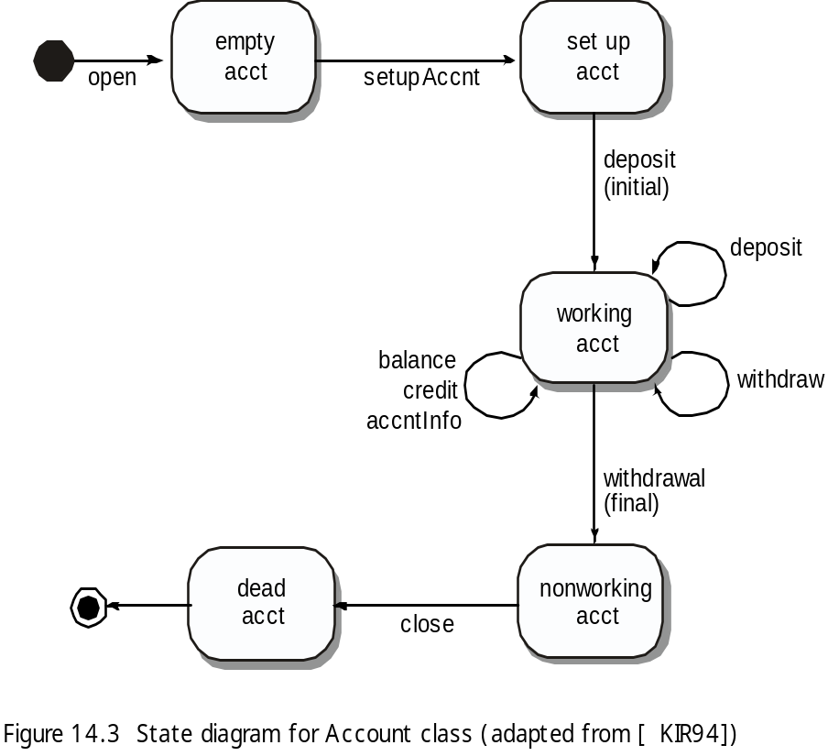
OOT 方法：行为测试
将要设计的测试应该覆盖所有的状态[KIR94]，也就是说，操作序列应该使Account类能够向所有可允许的状态转换
Notes:
OOT Methods: Behavior Testing
The tests to be designed should achieve all state coverage [KIR94]. That is, the operation sequences should cause the Account class to make transition through all allowable states

