Slide 1
第31章 软件工程的新趋势
Notes:
Chapter 31 Emerging Trends in Software Engineering

Slide 2
趋势
当我们面临挑战时，试图分离出这些有意义的技术趋势
  什么因素决定趋势的成功？
  趋势遵循什么样的生命周期？
  一个成功的趋势怎样能做到早期认识？
  演变的哪些方面是可控的？
Ray Kurzweil [Kur06]认为技术的发展，类似于生物进化，但其增长速度却比生物进化快几个数量级。
  演进（不管是生物或技术）作为正反馈的结果出现 ——“从进化过程的一个阶段所产生的更好方法可用于创建下一个阶段”[Kur06]。
Notes:
Trends
Challenges we face when trying to isolate meaningful technology trends:
What Factors Determine the Success of a Trend?
What Lifecycle Does a Trend Follow?
How Early Can a Successful Trend be Identified?
What Aspects of Evolution are Controllable?
Ray Kurzweil [Kur06] argues that technological evolution is similar to biological evolution, but occurs at a rate that is orders of magnitude faster.
Evolution (whether biological or technological) occurs as a result of positive feedback—“the more capable methods resulting from one stage of evolutionary progress are used to create the next stage.” [Kur06]

Slide 3
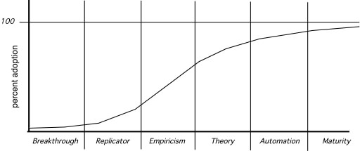
技术演变生命周期
采用的百分比
突破
复制
经验
理论
自动化
成熟
Notes:
Technology Innovation Lifecycle

Slide 4
观察SE 的趋势
Barry Boehm [Boe08]认为：“软件工程师[将]经常面对令人生畏的挑战，处理快速的变化、不确定性和突发事件、可信性、多样性以及相互依赖等问题，但他们还有机会做得更好”。
然而，今后几年我们面对这些挑战的趋势是什么呢？
Notes:
Observing SE Trends
Barry Boehm [Boe08] suggests that “software engineers [will] face the often formidable challenges of dealing with rapid change, uncertainty and emergence, dependability, diversity, and interdependence, but they also have opportunities to make significant contributions that will make a difference for the better.”
But what of more modest, short-term innovations, tools, and methods?

Slide 5
新型技术的趋势周期
技术触发——研究有所突破或创新推出了新产品，吸引了媒体的报道和公众的热情
膨胀期望的顶点——基于有限的但广为人知的成功产生的过度热情和对于影响过于乐观的预测
幻灭——对影响过于乐观的预测没有达到，批评家开始抨击，该技术在专家中已不再流行
启蒙倾斜——大量公司不断增长的使用使得对该技术的真正潜力有了更好的认识，出现了支持该技术的成熟方法和工具
生产力的稳定期——这时，该技术给现实世界带来的益处已经很明显了，其使用占据了潜在市场的很大比例
Gartner Group [Gar08]
Notes:
The Hype Cycle
technology trigger—a research breakthrough or launch of an innovative new product that leads to media coverage and public enthusiasm
peak of inflated expectations—over-enthusiasm and overly optimistic projections of impact based on limited, but well-publicized successes
disillusionment— overly optimistic projections of impact are not met and critics begin the drumbeat; the technology becomes unfashionable among the cognoscenti
slope of enlightenment—growing usage by a wide variety of companies leads to a better understanding of the technology’s true potential; off the shelf methods and tools emerge to support the technology
plateau of productivity—real world benefits are now obvious and usage penetrates a significant percentage of the potential market

Slide 6
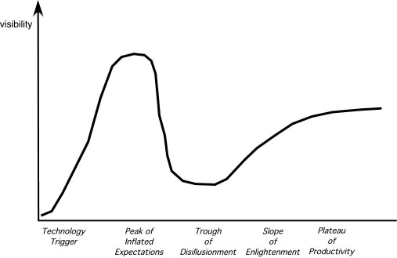
新型技术的趋势周期
可见度
技术触发
膨胀期望的顶点
幻灭
启蒙倾斜
生产力的稳定期
Notes:
The Hype Cycle

Slide 7
软趋势
连接和协作（通过高带宽通信做到）可以使软件团队不占用同样的物理空间（实现远程交换和当地条件下的兼职工作）。
全球化导致了多种多样的劳动力（在语言、文化、问题求解、管理观念、交流偏好以及个人间的相互影响方面都存在差异）。
人口老化意味着许多经验丰富的软件工程师和管理员在未来十年会离开这个领域。软件工程界必须采取切实可行的机制保留住这些上了年纪的管理人员和技术人员所具有的知识。
消费者的支出在新型经济体将增加一倍，超过9亿万美元。 [Pet06] 毫无疑问的是，这个非同一般的支出比例将适用于那些由数码组件构成的产品和服务——这些都是基于软件或软件驱动的。
Notes:
Soft Trends
Connectivity and collaboration (enabled by high bandwidth communication) has already led to a software teams that do not occupy the same physical space (telecommuting and part-time employment in a local context).
Globalization leads to a diverse workforce (in terms of language, culture, problem resolution, management philosophy, communication priorities, and person-to-person interaction).
An aging population implies that many experienced software engineers and managers will be leaving the field over the coming decade. The software engineering community must respond with viable mechanisms that capture the knowledge of these aging managers and technologists
Consumer spending in emerging economies will double to well over $9 trillion. [Pet06] There is little doubt that a non-trivial percentage of this spending will be applied to products and services that have a digital component—that are software-based or software-driven.

Slide 8
管理复杂性
在不久的将来，需要超过1亿行代码的系统将开始出现。
  考虑具有10亿行代码的系统的接口
    既要连接外部的世界
    其他互操作的系统
    互联网（或其继承者）
    连接内部几百万个必须共同工作的构件，使得这个计算巨人成功运行。
  有没有一个可靠的方法，以确保所有这些连接都允许信息正确流动呢？
  考虑项目本身。
  考虑工作人员的人数（和他们的工作地点）。
  考虑工程的挑战。
  考虑质量保证的挑战。
Notes:
Managing Complexity
In the relatively near future, systems requiring over 1 billion LOC will begin to emerge
Consider the interfaces for a billion LOC system
both to the outside world
to other interoperable systems
to the Internet (or its successor), and
to the millions of internal components that must all work together to make this computing monster operate successfully.
Is there a reliable way to ensure that all of these connections will allow information to flow properly?
Consider the project itself.
Consider the number of people (and their locations) who will be doing the work
Consider the engineering challenge.
Consider the challenge of quality assurance.

Slide 9
开放世界的软件
诸如情景智能，上下文敏感应用以及普适计算机等这些概念——所有都将集中在把基于软件的系统集成到比任何其他数字设备广泛得多的环境中
“开放世界的软件”——被设计成“通过自组织结构和自适应行为”适应不断变化的环境。 [Bar06]
Notes:
Open-World Software
Concepts such as ambient intelligence, context-aware applications, and pervasive/ubiquitous computing—all focus on integrating software-based systems into an environment far broader than anything to date
“open-world software”—software that is designed to adapt to a continually changing environment ‘by self-organizing its structure and self-adapting its behavior.” [Bar06]

Slide 10
意外需求
由于系统变得越来越复杂，随着每个参与复杂系统的工程设计和建设的人对系统本身、系统所处的环境和与系统交互的用户具有了更多的了解，需求就出现了。
这一现实暗示了很多软件工程的趋势。
  过程模型的设计必须包含变更，并采取敏捷哲学的基本原理（第3章）。
  必须明智地使用产生工程模型的方法（例如，需求模型和设计模型），因为这些模型随着更多知识的获取将不断地改变。
  支持过程和方法的工具必须很容易适应和改变。
Notes:
Emergent Requirements
As systems become more complex, requirements will emerge as everyone involved in the engineering and construction of a complex system learns more about it, the environment in which it is to reside, and the users who will interact with it.
This reality implies a number of software engineering trends.
process models must be designed to embrace change and adopt the basic tenets of the agile philosophy (Chapter 3).
methods that yield engineering models (e.g., requirements and design models) must be used judiciously because those models will change repeatedly as more knowledge about the system is acquired
tools that support both process and methods must make adaptation and change easy.

Slide 11
软件构造块
软件工程界试图捕获过去的知识以及重复使用可靠的解决方案，但是当今制造的软件很大一部分仍然是“从零开始”。
  部分原因是（利益相关者和软件工程人员）对“独特解决方案”的持续渴望。
“商业软件”——专为独特的应用领域 (例如，VoIP 设备)设计的软件构造块。
Notes:
Software Building Blocks
the software engineering community attempts to capture past knowledge and reuse proven solutions, but a significant percentage of the software that is built today continues to be built “from scratch.”
Part of the reason for this is a continuing desire (by stakeholders and software engineering practitioners) for “unique solutions.”
“merchant software”—software building blocks designed specifically for a unique application domain (e.g., VoIP devices).

Slide 12
开源
“开源是一种软件开发方法，运用了分布的同行审查的力量和过程的透明性。开放源码的承诺是更好的质量，更高的可靠性，更大的灵活，更低的成本，而起也是垄断性厂商的坟墓”。[OSO08]
开源这个术语应用到计算机软件，意味着对于软件工程的工作产品（模型、源代码、测试套件）都是公开的，任何感兴趣并得到允许的人都可以（有控制地）对其评审和扩展。
Notes:
Open Source
“Open source is a development method for software that harnesses the power of distributed peer review and transparency of process. The promise of open source is better quality, higher reliability, more flexibility, lower cost, and an end to predatory vendor lock-in.” [OSO08]
The term open source when applied to computer software, implies that software engineering work products (models, source code, test suites) are open to the public and can be reviewed and extended (with controls) by anyone with interest and permission.

Slide 13
过程趋势
随着SPI框架的发展，他们将强调“关注目标定位和产品创新的策略” [Con02]。
因为软件工程师对一个过程中哪里存在弱点是比较清楚的，过程改变一般应按他们的要求驱动，并且应该自底向上进行。
自动的软件过程技术（SPI）将不去做全局性过程管理（整个软件过程的广泛支持），而是侧重于软件开发过程中从自动化中最受益的那些方面。
更强调SPI活动的投资收益率。
随着时间的推移，软件界可能逐渐认识到，如其他技术性更强的学科一样，社会学和人类学的专业知识对于成功的SPI有很多或更多的事情可做。
学习的新模式可能有助于向更有效的软件过程转变。
Notes:
Process Trends
As SPI frameworks evolve, they will emphasize “strategies that focus on goal orientation and product innovation.” [Con02]
Because software engineers have a good sense of where the process is weak, process changes should generally be driven by their needs and should start form the bottom up.
Automated software process technology (SPT) will move away from global process management (broad-based support of the entire software process) to focus on those aspects of the software process that can best benefit from automation.
Greater emphasis will be placed on the return-on-investment of SPI activities.
As time passes, the software community may come to understand that expertise in sociology and anthropology may have as much of more to do with successful SPI as other, more technical disciplines.
New modes of learning may facilitate the transition to a more effective software process.

Slide 14
巨大的挑战
有一个趋势是不可否认的——毋庸置疑，随着时间的推移，基于软件的系统将变得越来越大，越来越复杂。
正是这些大型、复杂的系统工程，无论交付平台还是应用领域，都构成了对软件工程师“巨大挑战” [Bro06]
关键方法：
  更有效的分布式和协作软件工程的理念
  更好的需求工程方法
  更健壮的模型驱动的开发方法
  更好的软件工具
Notes:
The Grand Challenge
There is one trend that is undeniable—software-based systems will undoubtedly become bigger and more complex as time passes.
It is the engineering of these large, complex systems, regardless of delivery platform or application domain, the poses the “grand challenge” [Bro06] for software engineers.
Key approaches:
more effective distributed and collaborative software engineering philosophy
better requirements engineering approaches
a more robust approach to model-driven development, and
better software tools

Slide 15
协同开发
今天，软件工程师可以跨越时区和国界进行合作，他们中的每个人都共享信息。
未来十年的挑战是开发有助于协作的方法和工具。
关键成功因素：
  共享目标
  共享文化
  共享过程
  共享责任
Notes:
Collaborative Development
Today, software engineers collaborate across time zones and international boundaries, and every one of them must share information.
The challenge over the next decade is to develop methods and tools that facilitate that collaboration.
Critical success factors:
Shared goals
Shared culture
Shared process
Shared responsibility

Slide 16
需求工程
为了改善需求定义的方式，当执行RE时，软件工程界会实施3种不同的子过程[Gli07]：
  改善知识获取和知识共享，使得更完善地理解应用领域的限制和利益相关者的需求
  在定义需求时，更加强调迭代
  更有效的沟通和协调工具，所有的利益相关者进行有效的合作
Notes:
Requirements Engineering
To improve the manner in which requirements are defined, the software engineering community will likely implement three distinct sub-processes as RE is conducted [Gli07]:
improved knowledge acquisition and knowledge sharing that allows more complete understanding of application domain constraints and stakeholder needs
greater emphasis on iteration as requirements are defined
more effective communication and coordination tools that enable all stakeholders to collaborate effectively.

Slide 17
模型驱动的开发
将特定领域的建模语言与转换引擎和产生器相结合，有助于对较高层次抽象的表示，并将其转换成较低层次的表示[Sch06]。
特定领域建模语言 (DSMLs)
  描述“应用程序结构、行为和特定应用领域的需求”
  使用元模型进行描述，元模型“定义在领域中概念之间的关系，准确地描述关键语义以及与这些领域概念相关的约束”[Sch06]。
Notes:
Model-Driven Development
couples domain-specific modeling languages with transformation engines and generators in a way that facilitates the representation of abstraction at high levels and then transforms it into lower levels [Sch06]
Domain-specific modeling languages (DSMLs)
represent “application structure, behavior and requirements within particular application domains”
described with metamodels that “define the relationships among concepts in the domain and precisely specify the key semantics and constraints associated with these domain concepts.” [Sch06]

Slide 18
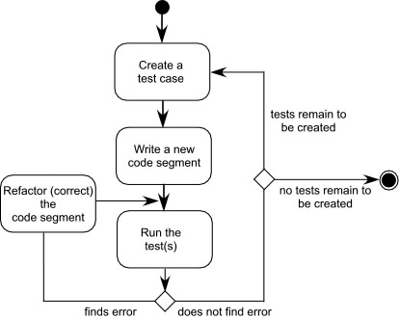
测试驱动的开发
在测试驱动的开发(TDD)中，将软件构件的需求作为生成一组测试用例的基础，以测试用例检查接口，并试图找到数据结构中和构件提供的功能中的错误。
TDD并不是一种真正的新技术，而是一个趋势，它强调生成源码之前测试用例的设计。继续强调软件体系结构的重要性。
创建一个测试用例
编写一段
新代码
继续创建测试
重构（纠正）
代码段
不再创建测试
运行测试
发现错误
没有发现错误
Notes:
Test-Driven Development
In test-driven development (TDD), requirements for a software component serve as the basis for the creation of a series of test cases that exercise the interface and attempt to find errors in the data structures and functionality delivered by the component.
TDD is not really a new technology but rather a trend that emphasizes the design of test cases before the creation of source code.continue to emphasize the importance of software architecture

Slide 19
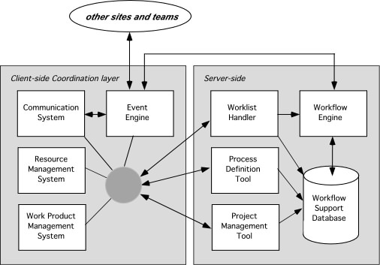
工具趋势—SEE（软件工程环境）
其他工作场所和团队
客户端协作层
服务器端
工作流管理系统
事件引擎
工作表处理程序
工作流引擎
资源管理系统
过程定义工具
工作流支持数据库
工作产品管理系统
项目管理工具
Notes:
Tools Trends—SEE

