Slide 1
第7章
需求建模：流程、行为、模式和Web应用
Notes:
Chapter 7 Requirements Modeling: Flow, Behavior, Patterns, and WebApps

Slide 2
需求建模策略
一种考虑数据和处理的需求建模方法被称为结构化分析，其中数据作为独立实体转换。
  数据对象模型的方式定义了它们的属性和关系。
  操作数据对象的建模过程表明当数据对象通过系统时如何转换数据。
分析建模的第二种方法称做面向对象分析，这种方法关注于
  定义类
  影响客户需求的类之间的协作方式
Notes:
Requirements Modeling Strategies
One view of requirements modeling, called structured analysis, considers data and the processes that transform the data as separate entities.
Data objects are modeled in a way that defines their attributes and relationships.
Processes that manipulate data objects are modeled in a manner that shows how they transform data as data objects flow through the system.
A second approach to analysis modeled, called object-oriented analysis, focuses on
the definition of classes and
the manner in which they collaborate with one another to effect customer requirements.

Slide 3
面向流建模
表示当数据对象在系统中移动时是如何转变的
数据流图是使用图解的形式
被许多人认为是一种“保守派”的方法，但仍提供系统独特的观点——它应该用来补充其他分析模型元素
Notes:
Flow-Oriented Modeling
Represents how data objects are transformed at they move through the system
data flow diagram (DFD) is the diagrammatic form that is used
Considered by many to be an “old school” approach, but continues to provide a view of the system that is unique—it should be used to supplement other analysis model elements

Slide 4
流模型
每一个计算机系统是一个信息转化....
computer
based
system
input
output
输入
输出
计算机系统
Notes:
The Flow Model
Every computer-based system is an
information transform ....

Slide 5
流模型符号
external entity
外部实体
process
过程
数据流
data flow
data store
数据存数
Notes:
Flow Modeling Notation

Slide 6
外部实体
生产者或数据使用者
举例: 人、设备、传感器
另一个例子：计算机系统
数据总是起源某个地方并传送一些信息
Notes:
External Entity
A producer or consumer of data
Examples: a person, a device, a sensor
Another example: computer-based
system
Data must always originate somewhere
and must always be sent to something

Slide 7
过程
数据转换（改变输入到输出）
举例: 计算税费, 确定面积,
格式报表, 显示图标
数据总是以某种方式被处理以达到系统功能
Notes:
Process
A data transformer (changes input
to output)
Examples: compute taxes, determine area,
format report, display graph
Data must always be processed in some
way to achieve system function

Slide 8
数据流
Data flows through a system, beginning
as input and transformed into output.
通过系统的数据流，以输入开始，并转换成输出
base
底
compute
triangle
area
area
面积
高
height
计算三角形面积
Notes:
Data Flow

Slide 9
数据存储
Data is often stored for later use.
数据通常存储供以后使用
sensor #
传感器#
sensor #, type,
location, age
look-up
sensor
data
传感器#，类型，位置，年龄
report required
报告要求
查找传感器数据
type,
location, age
sensor number
类型，位置，年龄
传感器数
sensor data
传感器数据

Slide 10
数据流图：原则
所有图标必须标注有意义的名称
DFD通过一些细化的数字级别来演变
总是以一个上下文分层图开始（也称为0层）
总是在第0层显示外部实体
总是标注数据流箭头
并不代表程序逻辑
Notes:
Data Flow Diagramming: Guidelines
all icons must be labeled with meaningful names
the DFD evolves through a number of levels of detail
always begin with a context level diagram (also called level 0)
always show external entities at level 0
always label data flow arrows
do not represent procedural logic

Slide 11
创建数据流图-I
审查用户场景和（或）数据模型以分离数据对象并从语法解析上确定“操作”
确定外部实体（生产者和数据使用者）
创建第0层数据流图
Notes:
Constructing a DFD—I
review user scenarios and/or the data model to isolate data objects and use a grammatical parse to determine “operations”
determine external entities (producers and consumers of data)
create a level 0 DFD

Slide 12
第0层数据流图举例
user
processing
request
requested
video
signal
用户
处理请求
digital
video
processor
monitor
请求视频信号
监视器
video
source
数字视频处理器
NTSC
video signal
视频源
NTSC
视频信号
Notes:
Level 0 DFD Example

Slide 13
创建数据流图-II
写一个转换的叙述性描述
从语法上解析确定下一个层的转换
“平衡”流以维持数据流持续性
开发第1层DFD
使用1:5（大约）的膨胀比
Notes:
Constructing a DFD—II
write a narrative describing the transform
parse to determine next level transforms
“balance” the flow to maintain data flow continuity
develop a level 1 DFD
use a 1:5 (approx.) expansion ratio

Slide 14
数据流层次
a
b
x
P
y
level 0
第0层
a
c
p2
f
p1
p4
b
d
5
p3
e
g
level 1
第1层
Notes:
The Data Flow Hierarchy

Slide 15
流建模说明
每一个泡泡被精化只做一件事
当层数增加时，膨胀比减小
大多数系统需要3到7层为一个合适的流模型
当层数增加时（数据字典提供信息），可能会扩展单一的数据流项（箭头）
Notes:
Flow Modeling Notes
each bubble is refined until it does just one thing
the expansion ratio decreases as the number of levels increase
most systems require between 3 and 7 levels for an adequate flow model
a single data flow item (arrow) may be expanded as levels increase (data dictionary provides information)

Slide 16
过程规格说明书（ PSPEC ）
泡泡
PSPEC
叙述的
伪代码 (PDL)
方程式
表格
图和/或图表
Notes:
Process Specification (PSPEC)
Narrative
pseudocode (PDL)
equations
tables
diagrams and/or charts

Slide 17
DFDs: 前瞻
analysis model
Maps into
分析模型
映射为
design model
设计模型
Notes:
DFDs: A Look Ahead

Slide 18
控制流建模
代表“事件”和管理事件的过程
确定一个“事件”是布尔条件，通过：
    列出所有被软件“读”的传感器。
    列出所有的中断条件。
    列出操作人员能够启动的所有“开关”。
    列出所有的数据条件。
    回顾对处理叙述所进行的名词或动词的语法解释，考察所有可能作为控制规格说明输入/输出的“控制项”。
Notes:
Control Flow Modeling
Represents “events” and the processes that manage events
An “event” is a Boolean condition that can be ascertained by:
listing all sensors that are "read" by the software.
listing all interrupt conditions.
listing all "switches" that are actuated by an operator.
listing all data conditions.
recalling the noun/verb parse that was applied to the processing narrative, review all "control items" as possible CSPEC inputs/outputs.

Slide 19
控制规格说明(CSPEC)
CSPEC 包含：
state diagram
状态图
(sequential spec)
（序列说明）
state transition table
状态转换表
combinatorial spec
组合说明
decision tables
决策表
activation tables
激活表
Notes:
Control Specification (CSPEC)

Slide 20
行为建模
行为模型显示了软件如何对外部事件或激励作出响应。要生成模型，分析师必须按照如下步骤进行：
    评估所有的用例，以保证完全理解系统内的交互顺序。
    识别驱动交互顺序的事件，并理解这些事情如何与特定的对象相互联系。
    为每个用例生成序列。
    创建系统状态图。
    评审行为模型以验证准确性和一致性。
Notes:
Behavioral Modeling
The behavioral model indicates how software will respond to external events or stimuli. To create the model, the analyst must perform the following steps:
Evaluate all use-cases to fully understand the sequence of interaction within the system.
Identify events that drive the interaction sequence and understand how these events relate to specific objects.
Create a sequence for each use-case.
Build a state diagram for the system.
Review the behavioral model to verify accuracy and consistency.

Slide 21
状态表现
在行为建模的场合下，必须考虑两种不同的状态描述：
  系统执行其功能时每个类的状态
  系统执行其功能时从外部观察到的系统状态
类状态具有被动和主动两种特征[CHA93]。
  被动状态只是某个对象所有属性的当前状态。
  一个对象的主动状态指的是对象进行持续变换或处理时的当前状态。
Notes:
State Representations
In the context of behavioral modeling, two different characterizations of states must be considered:
the state of each class as the system performs its function and
the state of the system as observed from the outside as the system performs its function
The state of a class takes on both passive and active characteristics [CHA93].
A passive state is simply the current status of all of an object’s attributes.
The active state of an object indicates the current status of the object as it undergoes a continuing transformation or processing.

Slide 22
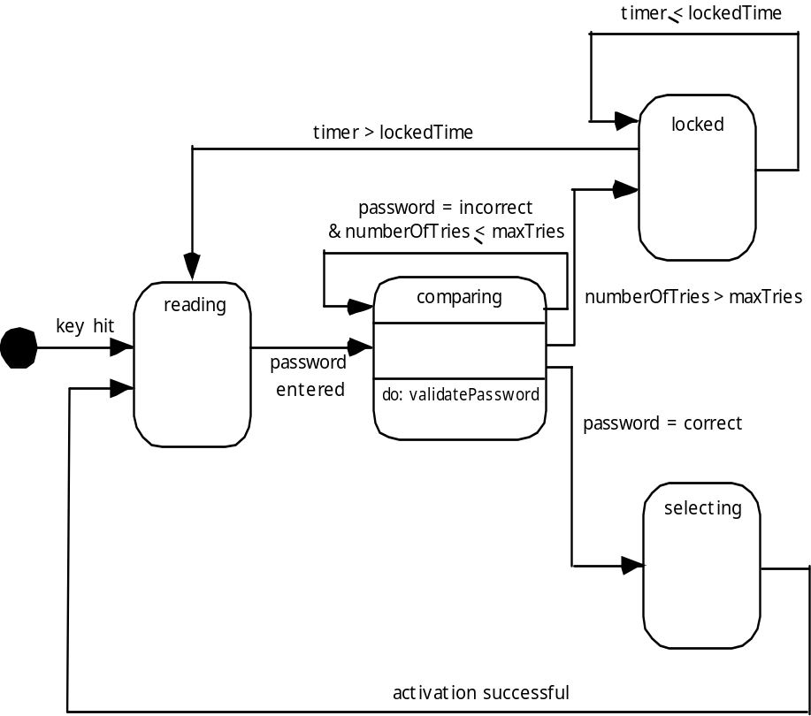
ControlPanel类的状态图
计时器≦锁定时间
计时器>锁定时间
密码不正确并且重试输入的次数<允许重试最多次数
敲击键盘
重试输入的次数>允许重试的最多次数
输入密码
密码正确
成功激活
Notes:
State Diagram for the ControlPanel Class

Slide 23
系统状态
状态——在给定的时间内，观察到的一组系统行为特征的情况
状态转换——从一个状态到另一个状态的运动
事件——能导致系统表现出一些可预测的行为方式的发生
活动——以作出转变结果形式出现的过程
Notes:
The States of a System
state—a set of observable circum-stances that characterizes the behavior of a system at a given time
state transition—the movement from one state to another
event—an occurrence that causes the system to exhibit some predictable form of behavior
action—process that occurs as a consequence of making a transition

Slide 24
行为建模
列出不同的系统状态（系统如何表现？）
表明系统如何从一个状态转变为另一个状态（系统怎样改变状态？）
  指出事件
  指出活动
画状态图或顺序图
Notes:
Behavioral Modeling
make a list of the different states of a system (How does the system behave?)
indicate how the system makes a transition from one state to another (How does the system change state?)
indicate event
indicate action
draw a state diagram or a sequence diagram

Slide 25
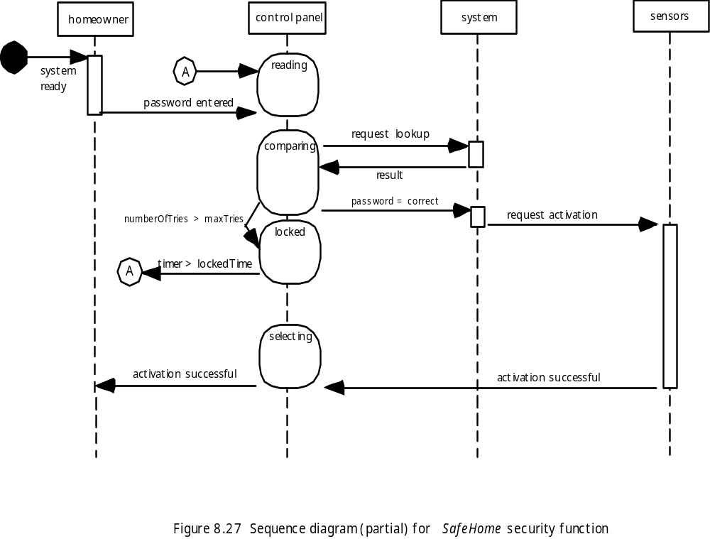
顺序图
输入密码
系统就绪
查找请求
重试输入的次数>允许重试最多的次数
结果密码正确
激活请求
计时器>锁定时间
成功激活
成功请求
Notes:
Sequence Diagram

Slide 26
写软件规格说明书
直到有人将它写下来，每个人都应该明确的知道做什么！
Notes:
Writing the Software Specification
Everyone knew exactly what had to be done until someone wrote it down!

Slide 27
需求建模的模式
软件模式是获取领域知识的一种机制从而遇到新问题时可以反复使用。
  领域知识在同一应用领域中用于解决新问题
  通过模式获取的领域知识可借助模拟用于完全不同的应用领域
分析模型最初的创作者没有“创建”模式。
一旦发现模式则记载。
Notes:
Patterns for Requirements Modeling
Software patterns are a mechanism for capturing domain knowledge in a way that allows it to be reapplied when a new problem is encountered
domain knowledge can be applied to a new problem within the same application domain
the domain knowledge captured by a pattern can be applied by analogy to a completely different application domain.
The original author of an analysis pattern does not “create” the pattern, but rather, discovers it as requirements engineering work is being conducted.
Once the pattern has been discovered, it is documented

Slide 28
发现分析模式
在需求模型的描述中最基本的元素是用例。
一套连贯用例可以成为服务于发现一个活多个分析模式的基础。
语义分析模式（SAP）“是描述了一小套连贯用例，这些用例一起描述了通用应用的基础”[Fer00]
Notes:
Discovering Analysis Patterns
The most basic element in the description of a requirements model is the use case.
A coherent set of use cases may serve as the basis for discovering one or more analysis patterns.
A semantic analysis pattern (SAP) “is a pattern that describes a small set of coherent use cases that together describe a basic generic application.” [Fer00]

Slide 29
举例
考虑下面要求控制和监控“实时查看摄像机”和汽车临近传感器的初步软件用例：
    用例：监控反向运动
    描述： 当车辆安装了反向齿轮，控制软件就能从后向视频摄像机将一段视频输入到仪表显示器上。控制软件在仪表显示器上叠加各种各样距离和方向的线，以便车辆向后运动时驾驶员能保持方向。控制软件还能监控临近传感器，以判定在车后方10英尺内是否有物体存在。如果临近传感器检测到某个物体在车后方3英尺内就会让车自动停止。
    .
Notes:
An Example
Consider the following preliminary use case for software required to control and monitor a real-view camera and proximity sensor for an automobile:
Use case: Monitor reverse motion
Description: When the vehicle is placed in reverse gear, the control software enables a video feed from a rear-placed video camera to the dashboard display. The control software superimposes a variety of distance and orientation lines on the dashboard display so that the vehicle operator can maintain orientation as the vehicle moves in reverse. The control software also monitors a proximity sensor to determine whether an object is inside 10 feet of the rear of the vehicle. It will automatically break the vehicle if the proximity sensor indicates an object within 3 feet of the rear of the vehicle.

Slide 30
举例
在需求收集和建模阶段，本用例包含（在一套连贯用例中）各种将要精练和详细阐述的功能。
无论完成的如何精练，建议用例要简单，但还要广泛地适用于SAP，即具有基于软件的监控和在一个物理系统中对传感器和执行器的控制。
在本例中，“传感器”提供临近信息和视频信息。“执行器”用于车辆的停止系统（如果一个物体离车辆很近就会调用它）。
但是更常见的情况是发现大量的应用模式。
Notes:
An Example
This use case implies a variety of functionality that would be refined and elaborated (into a coherent set of use cases) during requirements gathering and modeling.
Regardless of how much elaboration is accomplished, the use case(s) suggest(s) a simple, yet widely applicable SAP—the software-based monitoring and control of sensors and actuators in a physical system.
In this case, the “sensors” provide information about proximity and video information. The “actuator” is the breaking system of the vehicle (invoked if an object is very close to the vehicle.
But in a more general case, a widely applicable pattern is discovered --> Actuator-Sensor

Slide 31
执行器-传感器 模式—I
模式名：执行器-传感器
目的：详细说明在嵌入系统中的各种传感器和执行器。
动机：嵌入式系统常有各种传感器和执行器。这些传感器和执行器都直接或间接连接到一个控制单元。虽然许多传感器和执行器看上去十分不同，但它们的行为是相似的，足以让它们构成一个模式。这个模式显示了如何为一个系统指定传感器和执行器，包括属性和操作。执行器-传感器模式为被动式传感器使用“拉机制”（对消息的显示要求），为主动传感器使用“推机制”（消息广播）。
约束：
每个被动传感器必须有某种方法读取传感器的输入和表示传感器值得属性。
每个主动传感器必须能在其值发生变更时广播更新消息。
每个主动传感器应该能发送一个生命刻度，即在特定时间帧中发布状态信息，以便检测出错误动作。
每个执行者必须有某种方法调用ComputingComponent计算构件决定的适当应答。
每个传感器和执行器能测试接受值或发送值得有效性，并且当值超过指定边界时能设定其操作状态。
Notes:
Actuator-Sensor Pattern—I
Pattern Name: Actuator-Sensor
Intent: Specify various kinds of sensors and actuators in an embedded system.
Motivation: Embedded systems usually have various kinds of sensors and actuators. These sensors and actuators are all either directly or indirectly connected to a control unit. Although many of the sensors and actuators look quite different, their behavior is similar enough to structure them into a pattern. The pattern shows how to specify the sensors and actuators for a system, including attributes and operations. The Actuator-Sensor pattern uses a pull mechanism (explicit request for information) for PassiveSensors and a push mechanism (broadcast of information) for the ActiveSensors.
Constraints:
Each passive sensor must have some method to read sensor input and attributes that represent the sensor value.
Each active sensor must have capabilities to broadcast update messages when its value changes.
Each active sensor should send a life tick, a status message issued within a specified time frame, to detect malfunctions.
Each actuator must have some method to invoke the appropriate response determined by the ComputingComponent.
Each sensor and actuator should have a function implemented to check its own operation state.
Each sensor and actuator should be able to test the validity of the values received or sent and set its operation state if the values are outside of the specifications.

Slide 32
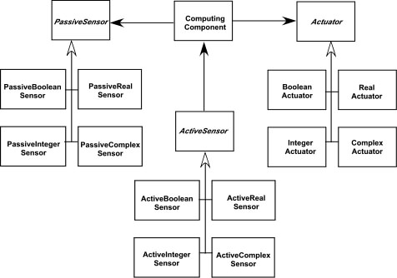
执行器-传感器 模式—II
适用性：对有多个传感器和执行器的任何系统都是非常有用的。
结构体：下图显示了执行器-传感器模式的UML类图，执行器、被动传感器和主动传感器是抽象类。这个模式中有四种不同的传感器和执行器。传感器和执行器的常见类型为Boolean、Integer、和Real。就基本数据类型而言，复杂类是不能用值简单表示的，例如雷达设备。虽然如此但是这些设备还应该继承来自抽象类的接口，因为它们应该具备基本的功能如查询操作状态。
被动传感器
计算构件
执行器
被动布尔型传感器
被动实型传感器
布尔型执行器
实型执行器
主动传感器
被动整型传感器
被动复合型传感器
整型传感器
复合型传感器
主动布尔型传感器
主动实型传感器
主动整型传感器
主动复合型传感器
Notes:
Actuator-Sensor Pattern—II
Applicability: Useful in any system in which multiple sensors and actuators are present.
Structure: A UML class diagram for the Actuator-Sensor Pattern is shown in Figure 7.8. Actuator, PassiveSensor and ActiveSensor are abstract classes and denoted in italics. There are four different types of sensors and actuators in this pattern. The Boolean, integer, and real classes represent the most common types of sensors and actuators. The complex classes are sensors or actuators that use values that cannot be easily represented in terms of primitive data types, such as a radar device. Nonetheless, these devices should still inherit the interface from the abstract classes since they should have basic functionalities such as querying the operation states.

Slide 33
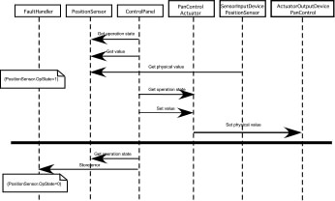
执行器-传感器 模式—III
行为：下图描述了执行器-传感器例子的UML顺序图。这个例子可以应用于SafeHome功能，用以控制安全摄像机的调整（例如遥摄、聚焦）。这里在读取或设置一个值时，ControlPanel需要一个传感器（被动传感器）和一个执行器（遥摄控制器）进行以诊断为目的核查操作状态。名Set Physcal Value 和Get Physical Value的消息不是对象间的信息，相反它们描述了系统物理设备和相关软件对应项之间的交互活动。在图的下部即在水平线以下，PositionSensor报告操作状态为零。接着ComputingComponent发送位置传感器失败的错误代码给FaultHandler错误处理程序，它将决定这些错误如何影响系统，并需要采取什么措施。从传感器获得的数据经过计算得到执行器所需的应答。
获得操作状态
获得值
获得物理值
获得操作状态
设定值
设定 物理值
获得操作状态
存储错误
Notes:
Actuator-Sensor Pattern—III
Behavior: Figure 7.9 presents a UML sequence diagram for an example of the Actuator-Sensor Pattern as it might be applied for the SafeHome function that controls the positioning (e.g., pan, zoom) of a security camera. Here, the ControlPanel queries a sensor (a passive position sensor) and an actuator (pan control) to check the operation state for diagnostic purposes before reading or setting a value. The messages Set Physical Value and Get Physical Value are not messages between objects. Instead, they describe the interaction between the physical devices of the system and their software counterparts. In the lower part of the diagram, below the horizontal line, the PositionSensor reports that the operation state is zero. The ComputingComponent then sends the error code for a position sensor failure to the FaultHandler that will decide how this error affects the system and what actions are required. it gets the data from the sensors and computes the required response for the actuators.

Slide 34
执行器-传感器 模式—III
参见 SEPA（软件工程实践者的研究方法）第7版关于下面更多的信息：
  参与者
  协作者
  结果
Notes:
Actuator-Sensor Pattern—III
See SEPA, 7/e for additional information on:
Participants
Collaborations
Consequences

Slide 35
Web应用系统的需求模型
内容分析。给出由Web应用系统提供的全部系列内容 。内容包括文本、图标和图像、视频和音频数据。数据建模用来确定和描述每一个数据对象。
交互分析。详细描述了用户与Web应用系统采用了哪种交互方式。开发用例提供这种交互方式的详细描述。
功能分析。作为交互分析一部分创建的使用场景（用例）定义了将用于Web应用系统内容并描述其他处理功能的操作。所有的操作和功能都被详细的描述。
配置分析。详细描述Web应用系统驻留的环境和基础设施。
Notes:
Requirements Modeling for WebApps
Content Analysis. The full spectrum of content to be provided by the WebApp is identified, including text, graphics and images, video, and audio data. Data modeling can be used to identify and describe each of the data objects.
Interaction Analysis. The manner in which the user interacts with the WebApp is described in detail. Use-cases can be developed to provide detailed descriptions of this interaction.
Functional Analysis. The usage scenarios (use-cases) created as part of interaction analysis define the operations that will be applied to WebApp content and imply other processing functions. All operations and functions are described in detail.
Configuration Analysis. The environment and infrastructure in which the WebApp resides are described in detail.

Slide 36
什么时候完成分析？
在有些WebE 情况下，归并分析和设计。但是，有一个明确的分析活动出现，当：
  所建Web应用的规模大且（或者）复杂度增加
  相关利益者的人数之多
  Web 应用团队人数之多
  Web应用的目标和宗旨（在规划时决定的）将影响商业底线
  Web应用的成功将对商业成功有很大的压力
Notes:
When Do We Perform Analysis?
In some WebE situations, analysis and design merge. However, an explicit analysis activity occurs when …
the WebApp to be built is large and/or complex
the number of stakeholders is large
the number of Web engineers and other contributors is large
the goals and objectives (determined during formulation) for the WebApp will effect the business’ bottom line
the success of the WebApp will have a strong bearing on the success of the business

Slide 37
内容模型
内容对象是从用例中提取
  通过检查直接或间接引用的内容的场景的描述
每一个内容对象的属性都是确定的
内容对象间的关系和（或者）Web应用系统维护的内容层次
  关系——实体-关系图或 UML
  层次——数据树或UML
Notes:
The Content Model
Content objects are extracted from use-cases
examine the scenario description for direct and indirect references to content
Attributes of each content object are identified
The relationships among content objects and/or the hierarchy of content maintained by a WebApp
Relationships—entity-relationship diagram or UML
Hierarchy—data tree or UML

Slide 38
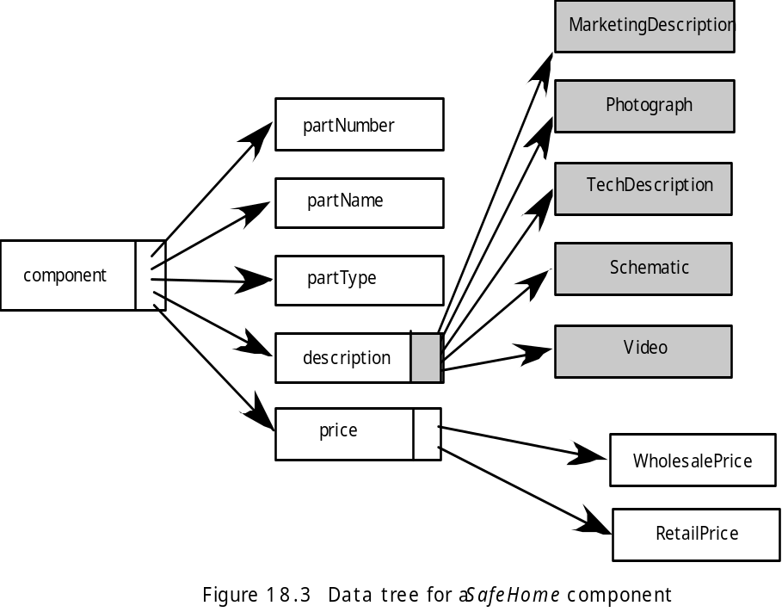
数据树
营销描述
部件编号
照片
部件名称
技术描述
部件类型
原理图
构件
视频
描述说明
价格
批发价格
零售价格
Notes:
Data Tree

Slide 39
交互模型
由四个元素组成
  用例
  顺序图
  状态图
  用户界面原型
这些元素中的每一个都是重要的UML符号并在附录I中有描述
Notes:
The Interaction Model
Composed of four elements:
use-cases
sequence diagrams
state diagrams
a user interface prototype
Each of these is an important UML notation and is described in Appendix I

Slide 40
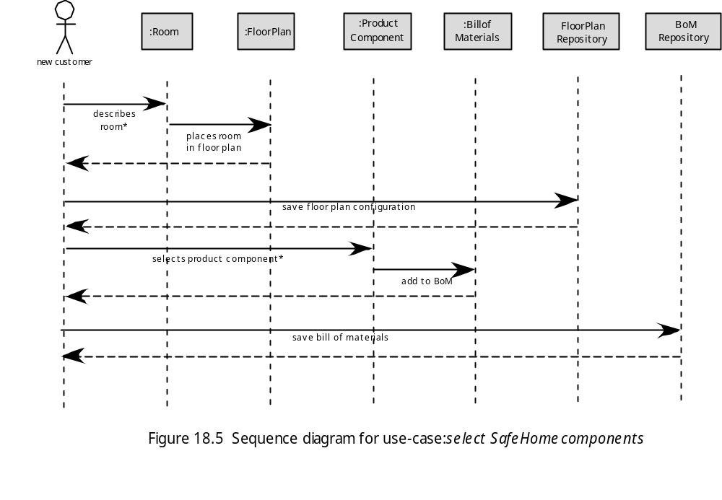
顺序图
Notes:
Sequence Diagram

Slide 41
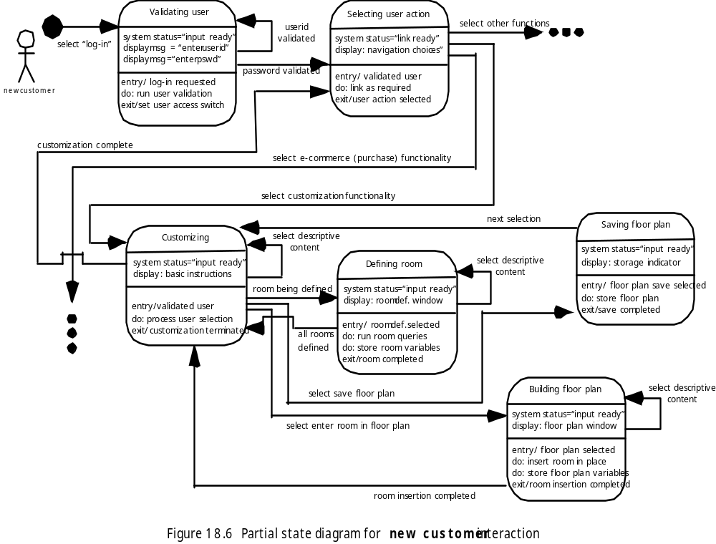
状态图
Notes:
State Diagram

Slide 42
功能模型
功能模型描述Web应用系统的两个处理元素
  用户可观察到的功能是由Web应用系统传递给最终用户的
  分析类中的操作实现与类相关的行为
一个活动图能用来表示过程流
Notes:
The Functional Model
The functional model addresses two processing elements of the WebApp
user observable functionality that is delivered by the WebApp to end-users
the operations contained within analysis classes that implement behaviors associated with the class.
An activity diagram can be used to represent processing flow

Slide 43
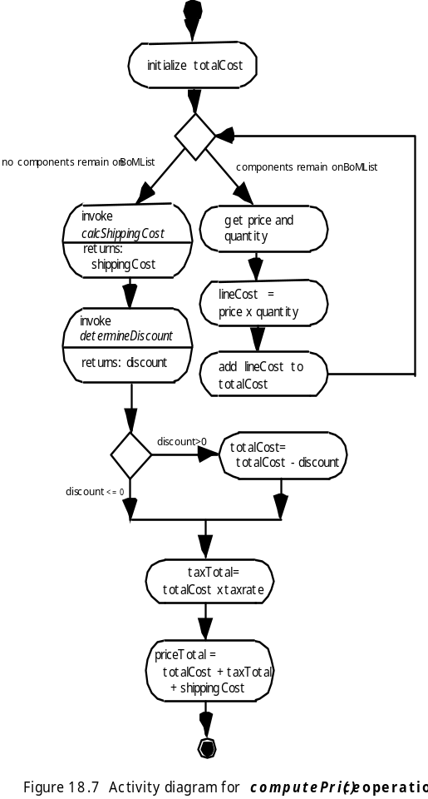
活动图
Notes:
Activity Diagram

Slide 44
配置模型
服务器端
  必须说明服务器硬件和操作系统环境
  必须考虑服务器端的互操作性
  必须说明相应的接口、通信协议及相关合作信息
  客户端
  必须确定浏览器的配置问题
  应确定测试要求
Notes:
The Configuration Model
Server-side
Server hardware and operating system environment must be specified
Interoperability considerations on the server-side must be considered
Appropriate interfaces, communication protocols and related collaborative information must be specified
Client-side
Browser configuration issues must be identified
Testing requirements should be defined

Slide 45
导航建模-I
某些元素比其他元素更容易到吗？（即需要更少的导航步骤）？表示的优先级别是什么？
为了促使用户以他们自己的方向导航，应该强调某些元素吗？
应该怎样处理导航错误？
导航到相关元素组的优先权应该高于导航到某个特定元素的优先权吗？
应该通过链接的方式、基于搜索的访问方式还是其他方式来实现导航？
根据前面的导航行为，某些确定的元素应该展现给用户吗？
应该为用户维护导航日志吗？
Notes:
Navigation Modeling-I
Should certain elements be easier to reach (require fewer navigation steps) than others? What is the priority for presentation?
Should certain elements be emphasized to force users to navigate in their direction?
How should navigation errors be handled?
Should navigation to related groups of elements be given priority over navigation to a specific element.
Should navigation be accomplished via links, via search-based access, or by some other means?
Should certain elements be presented to users based on the context of previous navigation actions?
Should a navigation log be maintained for users?

Slide 46
导航建模-II
在用户交互的每一点处，（与单个“返回”链接或有方向的指针相比）一个完整的导航地图或菜单都可用吗？
导航设计应该由大多数普遍期望的用户行为来驱动，还是由已定义的Web应用系统元素可感知的重要性来驱动？
为了促进将来使用快捷，一个用户能否“存储”他以前对Web应用的导航？
应该为哪类用户设计最佳导航？
应该如何处理Web应用系统外部的链接？应该覆盖现有的浏览器窗口吗？能否作为一个新的浏览器窗口，还是作为一个单独的框架？
Notes:
Navigation Modeling-II
Should a full navigation map or menu (as opposed to a single “back” link or directed pointer) be available at every point in a user’s interaction?
Should navigation design be driven by the most commonly expected user behaviors or by the perceived importance of the defined WebApp elements?
Can a user “store” his previous navigation through the WebApp to expedite future usage?
For which user category should optimal navigation be designed?
How should links external to the WebApp be handled? overlaying the existing browser window? as a new browser window? as a separate frame?

