Slide 1
第20章 测试Web应用系统
Notes:
Chapter 20 Testing Web Applications

Slide 2
测试质量维度-1
内容：在语法及语义层对内容进行评估。
  语法层——对基于文本的文档进行拼写、标点及文法方面的评估 。
  语义层——(所表示信息的)正确性、(整个内容对象及相关对象的)一致性及清晰性都要评估。
功能： 测试功能的正确性、不稳定性及相应的实现标准(例如，Java或AJAX语言标准)的总体符合程度。
结构：对结构进行评估，以保证它
  正确地表示WebApp 的内容及功能
  是可扩展的
  支持新内容、新功能的增加
Notes:
Testing Quality Dimensions-I
Content is evaluated at both a syntactic and semantic level.
syntactic level—spelling, punctuation and grammar are assessed for text-based documents.
semantic level—correctness (of information presented), consistency (across the entire content object and related objects) and lack of ambiguity are all assessed.
Function is tested for correctness, instability, and general conformance to appropriate implementation standards (e.g.,Java or XML language standards).
Structure is assessed to ensure that it
properly delivers WebApp content and function
is extensible
can be supported as new content or functionality is added.

Slide 3
测试质量维度-2
可用性：对可用性进行测试，以保证各种类型的用户
  提供接口支持
  能够学会及使用所有需要的导航语法及语义
导航性： 对导航性进行测试，以保证
  检查所有的导航语言及语义，发现任何导航错误 (例如，死链接、不合适的链接、错误链接)。
性能： 在各种不同的操作条件、配置及负载下，对性能进行测试，以保证
  系统响应用户的交互
  在没有出现操作上不可接受的性能降低的情况下，系统处理极端的负载情况
Notes:
Testing Quality Dimensions-II
Usability is tested to ensure that each category of user
is supported by the interface
can learn and apply all required navigation syntax and semantics
Navigability is tested to ensure that
all navigation syntax and semantics are exercised to uncover any navigation errors (e.g., dead links, improper links, erroneous links).
Performance is tested under a variety of operating conditions, configurations, and loading to ensure that
the system is responsive to user interaction
the system handles extreme loading without unacceptable operational degradation

Slide 4
测试质量维度-3
兼容性： 在客户端及服务器端，在各种不同的主机配置下通过运行 WebApp 对兼容性进行测试。
  目的是发现针对特定主机配置的错误。
互操作性：对互操作性进行测试，以保证WebApp与其他应用系统和(或)数据库有正确接口。
安全性： 对安全性进行测试，通过评定可能存在的弱点，试图对每个弱点进行攻击。
  任何成功的突破尝试都被认为是一个安全漏洞。
Notes:
Testing Quality Dimensions-III
Compatibility is tested by executing the WebApp in a variety of different host configurations on both the client and server sides.
The intent is to find errors that are specific to a unique host configuration.
Interoperability is tested to ensure that the WebApp properly interfaces with other applications and/or databases.
Security is tested by assessing potential vulnerabilities and attempting to exploit each.
Any successful penetration attempt is deemed a security failure.

Slide 5
WebApp环境中的错误
由于WebApp测试发现的很多类型的错误都首先表现在客户端的问题，你经常是看到了错误的征兆，而不是错误本身。
由于WebApp是在很多不同的配置及不同的环境中实现的, 要在最初遇到错误的环境之外再现错误，可能是很困难的，或是不可能的。
虽然许多错误是不正确的设计或不合适的HTML (或其他程序设计语言)编码的结果, 许多错误的原因都能够追溯到WebApp配置。
由于WebApps位于客户/服务器体系结构中, 在三层体系结构中追踪错误是很困难的: 客户、服务器或网络本身。
某些错误应归于静态的操作环境 (即进行测试的特定配置), 而另外一些错误可归于动态的操作环境 (即瞬间的资源负载或时间相关的错误)。
Notes:
Errors in a WebApp
Because many types of WebApp tests uncover problems that are first evidenced on the client side, you often see a symptom of the error, not the error itself.
Because a WebApp is implemented in a number of different configurations and within different environments, it may be difficult or impossible to reproduce an error outside the environment in which the error was originally encountered.
Although some errors are the result of incorrect design or improper HTML (or other programming language) coding, many errors can be traced to the WebApp configuration.
Because WebApps reside within a client/server architecture, errors can be difficult to trace across three architectural layers: the client, the server, or the network itself.
Some errors are due to the static operating environment (i.e., the specific configuration in which testing is conducted), while others are attributable to the dynamic operating environment (i.e., instantaneous resource loading or time-related errors).

Slide 6
WebApp测试策略-1
对WebApp的内容模型进行评审，以发现错误。
对接口模型进行评审，保证适合所有的用例。
评审WebApp的设计模型，发现导航错误。
测试用户界面，发现表现机制和(或)导航机制中的错误。
对功能构件进行单元测试。
Notes:
WebApp Testing Strategy-I
The content model for the WebApp is reviewed to uncover errors.
The interface model is reviewed to ensure that all use-cases can be accommodated.
The design model for the WebApp is reviewed to uncover navigation errors.
The user interface is tested to uncover errors in presentation and/or navigation mechanics.
Selected functional components are unit tested.

Slide 7
WebApp测试策略-2
对贯穿体系结构的导航进行测试。
在各种不同的环境配置下，实现WebApp，并测试WebApp对于每一种配置的兼容性。
进行安全性测试，试图攻击WebApp或其所处环境的弱点。
进行性能测试。
通过可监控的最终用户群对WebApp进行测试
  对他们与系统的交互结果进行以下方面的评估，包括内容和导航错误、可用性、兼容性、WebApp的安全性、可靠性及性能等方面的评估。
Notes:
WebApp Testing Strategy-II
Navigation throughout the architecture is tested.
The WebApp is implemented in a variety of different environmental configurations and is tested for compatibility with each configuration.
Security tests are conducted in an attempt to exploit vulnerabilities in the WebApp or within its environment.
Performance tests are conducted.
The WebApp is tested by a controlled and monitored population of end-users
the results of their interaction with the system are evaluated for content and navigation errors, usability concerns, compatibility concerns, and WebApp reliability and performance.

Slide 8
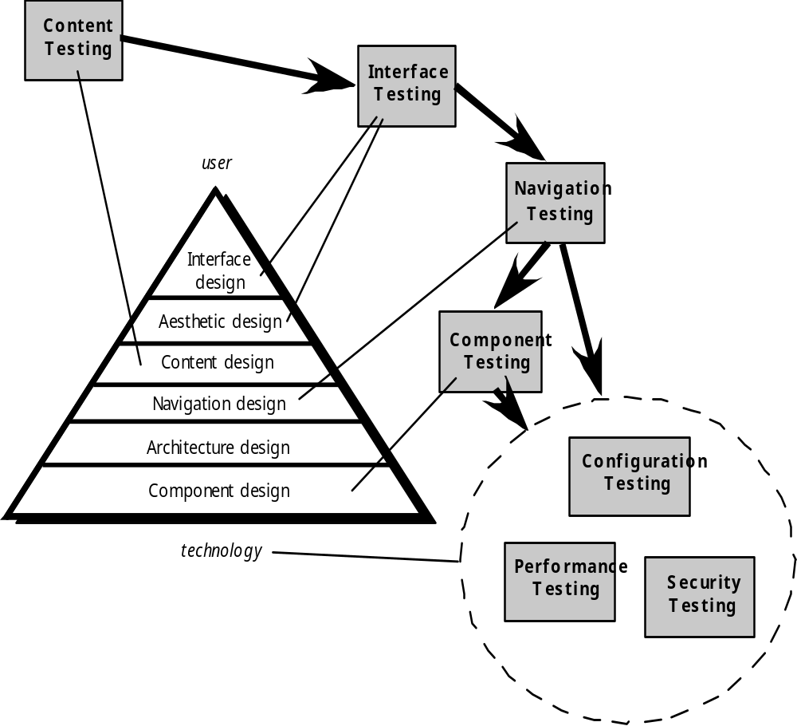
测试过程
内容测试
界面测试
用户
导航测试
界面设计
美学设计
内容设计
构件测试
导航设计
体系结构设计
构件设计
配置测试
技术
性能测试
安全测试

Slide 9
内容测试
内容测试具有3个重要的目标：
  发现基于文本的文档、图形表示和其他媒体中的语法错误(例如，打字错误、文法错误)；
  发现当导航发生时所展现的任何内容对象中的语义错误(即信息的准确性和完备性方面的错误)；
  发现展示给最终用户的内容的组织或结构方面的错误。
Notes:
Content Testing
Content testing has three important objectives:
to uncover syntactic errors (e.g., typos, grammar mistakes) in text-based documents, graphical representations, and other media
to uncover semantic errors (i.e., errors in the accuracy or completeness of information) in any content object presented as navigation occurs, and
to find errors in the organization or structure of content that is presented to the end-user.

Slide 10
内容语义的评估
信息确实准确吗?
信息简明扼要吗?
内容对象的布局对于用户来说容易理解吗?
嵌入在内容对象中的信息易于被发现吗?
对于从其他地方导出的所有信息，是否提供了合适的引用?
显示的信息是否是内部一致的?与其他内容对象中所显示的信息是否一致?
内容是否具有攻击性?是否容易误解? 或者是否会引起诉讼?
内容是否侵犯了现有的版权或商标?
内容是否包括补充现有内容的内部链接?链接正确吗?
内容的美学风格是否与界面的美学风格相矛盾?
Notes:
Assessing Content Semantics
Is the information factually accurate?
Is the information concise and to the point?
Is the layout of the content object easy for the user to understand?
Can information embedded within a content object be found easily?
Have proper references been provided for all information derived from other sources?
Is the information presented consistent internally and consistent with information presented in other content objects?
Is the content offensive, misleading, or does it open the door to litigation?
Does the content infringe on existing copyrights or trademarks?
Does the content contain internal links that supplement existing content? Are the links correct?
Does the aesthetic style of the content conflict with the aesthetic style of the interface?

Slide 11
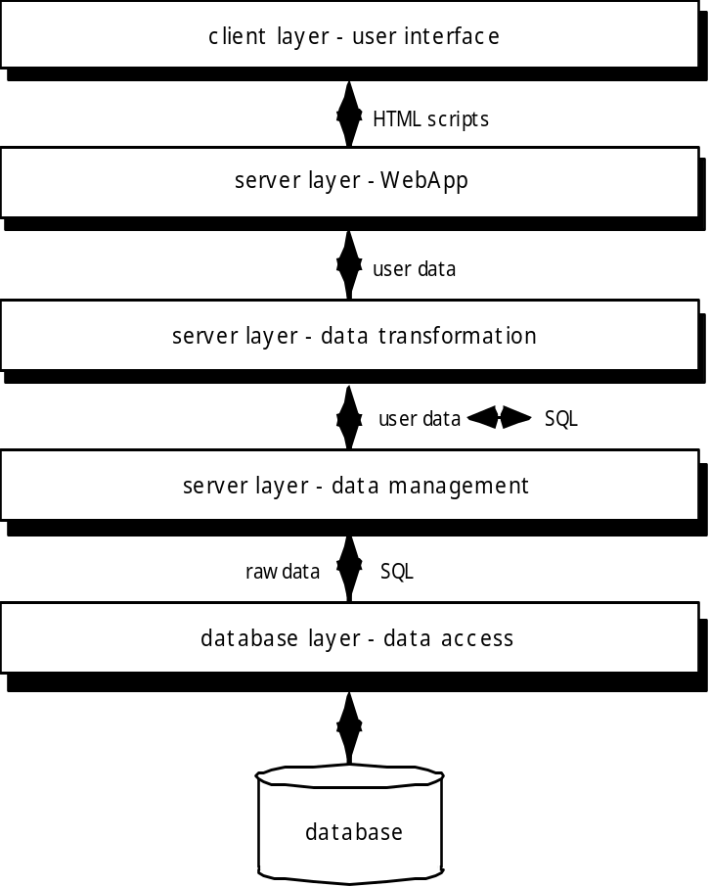
数据库测试
客户层-用户界面
HTML脚本
服务器层-WebApp
测试为每一层都做了定义
用户数据
服务器层-数据转换
用户数据
服务器层-数据管理
原始数据
数据库层-数据访问
数据库

Slide 12
用户界面测试
对界面要素进行测试，确保设计规则、美学和相关的可视化内容对用户有效，且没有错误。
采用与单元测试类似的方式测试单个界面机制。
对于特殊的用户类，在用例或导航语义单元NSU的环境中测试每一种界面机制。
与选择用例及NSU有所不同，此方法要对所有界面进行测试，发现界面的语义错误。
在多种环境(例如，浏览器)中对界面进行测试，确保其兼容性。
Notes:
User Interface Testing
Interface features are tested to ensure that design rules, aesthetics, and related visual content is available for the user without error.
Individual interface mechanisms are tested in a manner that is analogous to unit testing.
Each interface mechanism is tested within the context of a use-case or NSU for a specific user category.
The complete interface is tested against selected use-cases and NSUs to uncover errors in the semantics of the interface.
The interface is tested within a variety of environments (e.g., browsers) to ensure that it will be compatible.

Slide 13
测试界面机制-1
链接——导航机制将用户链接到其他一些内容对象或功能。
表单——一个结构化文档，其中包含空白字段供用户填写。字段中包含的数据用来作为一个或多个WebApp功能的输入。
客户端脚本——脚本语言(例如， Javascript)中一系列编程命令处理来自表单输入或其他用户交互的信息。
动态HTML—— 导致在客户端使用的脚本或层叠样式表(CSS)操作的内容对象。
客户端弹出窗口 ——弹出一个没有用户交互的小型窗口。这些窗口可以面向内容，并可能需要某种形式的用户交互。
Notes:
Testing Interface Mechanisms-I
Links—navigation mechanisms that link the user to some other content object or function.
Forms—a structured document containing blank fields that are filled in by the user. The data contained in the fields are used as input to one or more WebApp functions.
Client-side scripting—a list of programmed commands in a scripting language (e.g., Javascript) that handle information input via forms or other user interactions
Dynamic HTML—leads to content objects that are manipulated on the client side using scripting or cascading style sheets (CSS).
Client-side pop-up windows—small windows that pop-up without user interaction. These windows can be content-oriented and may require some form of user interaction.

Slide 14
测试界面机制-2
CGI脚本——一个公共网关接口 (CGI) 脚本实现了一种标准方法，它允许Web服务器与用户动态交互(例如，一个包含表单的WebApp可以使用CGI脚本来处理由用户提交的表单数据)。
流内容 ——不是一直等待客户端请求，内容对象会自动从服务器端下载。由于是服务器将数据推送到客户端，所以该方法有时被叫做“推”技术。
Cookies—— 服务器发送的一个数据块，该数据块会被浏览器作为特定用户交互的结果进行存储。数据内容是web应用程序特定的(例如，用户标识数据或一个用户选择购买的项目列表)。
特定应用系统的界面机制 ——包含一个或多个“宏”界面机制，例如购物车，信用卡的处理或运费计算器。
Notes:
Testing Interface Mechanisms-II
CGI scripts—a common gateway interface (CGI) script implements a standard method that allows a Web server to interact dynamically with users (e.g., a WebApp that contains forms may use a CGI script to process the data contained in the form once it is submitted by the user).
Streaming content—rather than waiting for a request from the client-side, content objects are downloaded automatically from the server side. This approach is sometimes called “push” technology because the server pushes data to the client.
Cookies—a block of data sent by the server and stored by a browser as a consequence of a specific user interaction. The content of the data is WebApp-specific (e.g., user identification data or a list of items that have been selected for purchase by the user).
Application specific interface mechanisms—include one or more “macro” interface mechanisms such as a shopping cart, credit card processing, or a shipping cost calculator.

Slide 15
可用性测试
由WebE团队设计，由最终用户执行
测试步骤 ……
  定义一组可用性测试类别，并确定每类测试的目标。
  设计测试，使其能够评估每个目标。
  选择将执行测试的参与者。
  当进行测试时，指导参与者与 WebApp 的交互。
  开发一种机制来评估 WebApp的可用性。
不同的抽象级别:
  对特定的界面机制(例如，表单)的可用性进行评估；
  对所有网页(包括界面机制、数据对象及相关的功能)的可用性进行评估；
  考虑整个WebApp的可用性。
Notes:
Usability Tests
Design by WebE team … executed by end-users
Testing sequence …
Define a set of usability testing categories and identify goals for each.
Design tests that will enable each goal to be evaluated.
Select participants who will conduct the tests.
Instrument participants’ interaction with the WebApp while testing is conducted.
Develop a mechanism for assessing the usability of the WebApp
different levels of abstraction:
the usability of a specific interface mechanism (e.g., a form) can be assessed
the usability of a complete Web page (encompassing interface mechanisms, data objects and related functions) can be evaluated
the usability of the complete WebApp can be considered.

Slide 16
兼容性测试
兼容性测试是定义一组“通常遇到”的客户端计算配置和它们的变型。
创建一种树结构标识
  每一种计算平台
  典型的显示设备
  此平台支持的操作系统
  可用的浏览器
  可靠地Internet连接速度
  类似信息
导出一系列兼容性确认测试
  从现有的界面测试、导航测试、性能测试和安全性测试中导出
  这些测试的目的是发现由于配置差异所导致的错误和运行问题
Notes:
Compatibility Testing
Compatibility testing is to define a set of “commonly encountered” client side computing configurations and their variants
Create a tree structure identifying
each computing platform
typical display devices
the operating systems supported on the platform
the browsers available
likely Internet connection speeds
similar information.
Derive a series of compatibility validation tests
derived from existing interface tests, navigation tests, performance tests, and security tests.
intent of these tests is to uncover errors or execution problems that can be traced to configuration differences.

Slide 17
构件级测试
集中于一组试图发现WebApp功能方面的错误测试。
可以使用传统的黑盒和白盒测试用例设计方法。
数据库测试通常是构件测试领域中不可或缺的一部分。
Notes:
Component-Level Testing
Focuses on a set of tests that attempt to uncover errors in WebApp functions
Conventional black-box and white-box test case design methods can be used
Database testing is often an integral part of the component-testing regime

Slide 18
导航测试
以下的每个导航机制应该进行测试：
  导航链接 ——这些机制包括WebApp中的内部链接，到其他
  WebApp的外部链接和特定网页中的锚。
  重定向——当用户请求一个不存在的URL，选择的目标地址已经被
  移走或者名字被改变的链接时，就会用到这些重定向的链接。
  书签——虽然书签是浏览器功能，还是应该对WebApp进行测试，
  确保当创建一个书签时，能够抽取出有意义的页标题。
  框架和框架集 ——对内容的正确性、合适的布局和大小、下载性能
  和浏览器兼容性方面进行测试。
  站点地图 ——每个站点地图的入口必须进行测试，以确保链接引导
  用户到达合适的内容或功能。
  内部搜索引擎 ——搜索引擎测试确认搜索的准确性和完备性、搜索引擎的错误处理特性及高级的搜索特性。
Notes:
Navigation Testing
The following navigation mechanisms should be tested:
Navigation links—these mechanisms include internal links within the WebApp, external links to other WebApps, and anchors within a specific Web page.
Redirects—these links come into play when a user requests a non-existent URL or selects a link whose destination has been removed or whose name has changed.
Bookmarks—although bookmarks are a browser function, the WebApp should be tested to ensure that a meaningful page title can be extracted as the bookmark is created.
Frames and framesets—tested for correct content, proper layout and sizing, download performance, and browser compatibility
Site maps—Each site map entry should be tested to ensure that the link takes the user to the proper content or functionality.
Internal search engines—Search engine testing validates the accuracy and completeness of the search, the error-handling properties of the search engine, and advanced search features

Slide 19
测试导航语义-1
此 NSU 是否没有错误地全部完成了?
在为此 NSU定义的导航路径的上下文中，(为一个 NSU定义的) 每个导航节点是否都是可达的?
如果使用多条导航路径都能完成此 NSU， 每条相关的路径是否都已经被测试?
如果使用用户界面提供的指导来帮助导航，当导航进行时，方向正确并可理解吗?
是否具有返回到前一个导航节点及导航路径开始位置的机制 (不同于浏览器的“回退”箭头) ?
大型导航节点 (即一个长的网页) 中的导航机制工作正常吗?
如果一个功能在一个结点上运行，并且用户选择不提供输入，NSU的剩余部分能完成吗?
Notes:
Testing Navigation Semantics-I
Is the NSU achieved in its entirety without error?
Is every navigation node (defined for a NSU) reachable within the context of the navigation paths defined for the NSU?
If the NSU can be achieved using more than one navigation path, has every relevant path been tested?
If guidance is provided by the user interface to assist in navigation, are directions correct and understandable as navigation proceeds?
Is there a mechanism (other than the browser ‘back’ arrow) for returning to the preceding navigation node and to the beginning of the navigation path.
Do mechanisms for navigation within a large navigation node (i.e., a long web page) work properly?
If a function is to be executed at a node and the user chooses not to provide input, can the remainder of the NSU be completed?

Slide 20
导航测试语义-2
如果一个功能在一个结点上运行，并且在功能处理时发生了一个错误，NSU能完成吗?
在到达所有节点之前，是否有办法终止导航? 然后又能返回到导航被终止的地方，并从那里继续?
从站点地图可以到达每个节点吗? 节点的名字对最终用户有意义吗?
如果可以从某外部的信息源到达NSU中的一个节点，推移到导航路径的下一个节点可能吗?返回到导航路径的前一个节点可能吗?
当运行NSU时，用户知道他在内容体系结构中所处的位置吗?
Notes:
Testing Navigation Semantics-II
If a function is executed at a node and an error in function processing occurs, can the NSU be completed?
Is there a way to discontinue the navigation before all nodes have been reached, but then return to where the navigation was discontinued and proceed from there?
Is every node reachable from the site map? Are node names meaningful to end-users?
If a node within an NSU is reached from some external source, is it possible to process to the next node on the navigation path. Is it possible to return to the previous node on the navigation path?
Does the user understand his location within the content architecture as the NSU is executed?

Slide 21
配置测试
服务器端
  WebApp与服务器操作系统完全兼容吗?
  当WebApp运行时，系统文件、目录和相关的系统数据是否正确创建?
  系统安全措施 (例如，防火墙或加密) 允许WebApp运行，并对用户提供服务，而不发生冲突或性能下降吗?
  是否已经利用所选择的分布式服务器配置(如果存在一种配置) 对WebApp 进行了测试?
  此WebApp 是否与数据库软件进行了适当的集成? 是否对数据库的不同版本敏感?
  服务器端的WebApp脚本运行正常吗?
  系统管理员错误对WebApp运行的影响是否已经得到检查?
  如果使用了代理服务器，在站点测试时，是否已经明确这些代理服务器在配置方面的差异?
Notes:
Configuration Testing
Server-side
Is the WebApp fully compatible with the server OS?
Are system files, directories, and related system data created correctly when the WebApp is operational?
Do system security measures (e.g., firewalls or encryption) allow the WebApp to execute and service users without interference or performance degradation?
Has the WebApp been tested with the distributed server configuration (if one exists) that has been chosen?
Is the WebApp properly integrated with database software? Is the WebApp sensitive to different versions of database software?
Do server-side WebApp scripts execute properly?
Have system administrator errors been examined for their affect on WebApp operations?
If proxy servers are used, have differences in their configuration been addressed with on-site testing?

Slide 22
配置测试
客户端
  硬件——CPU、内存、存储器和打印设备
  操作系统 —— Linux、Macintosh操作系统、Microsoft Windows、 基于移动的操作系统
  浏览器软件 —— Internet Explorer、Mozilla/Netscape、Opera、 Safari及其他浏览器
  用户界面构件 —Active X, Java applets 及其他构件
  插件—— QuickTime, RealPlayer及很多其他插件
  连通——电缆、 DSL、常规的调制解调器、 T1
配置变量的数量必须减少到可管理的数目
Notes:
Configuration Testing
Client-side
Hardware—CPU, memory, storage and printing devices
Operating systems—Linux, Macintosh OS, Microsoft Windows, a mobile-based OS
Browser software—Internet Explorer, Mozilla/Netscape, Opera, Safari, and others
User interface components—Active X, Java applets and others
Plug-ins—QuickTime, RealPlayer, and many others
Connectivity—cable, DSL, regular modem, T1
The number of configuration variables must be reduced to a manageable number

Slide 23
安全性测试
应该设计安全性测试去探查某些方面所存在的弱点，比如客户端环境，当数据从客户端传到服务器并从服务器再传回客户端时发生的网络通信以及服务器环境
在客户端，弱点通常可以追溯到早已存在于浏览器、电子邮件程序、或通信软件中的缺陷。
在服务器端, 薄弱环节包括拒绝服务攻击和恶意脚本，这些恶意脚本可以传送到客户端，或者用来使服务器操作丧失能力。
Notes:
Security Testing
Designed to probe vulnerabilities of the client-side environment, the network communications that occur as data are passed from client to server and back again, and the server-side environment
On the client-side, vulnerabilities can often be traced to pre-existing bugs in browsers, e-mail programs, or communication software.
On the server-side, vulnerabilities include denial-of-service attacks and malicious scripts that can be passed along to the client-side or used to disable server operations

Slide 24
性能测试
服务器响应时间是否降到了值得注意或不可接受的程度?
在什么情况下 (就用户、事务或数据负载来说) ，性能变得不可接受?
那些系统构件应对性能下降负责?
在多种负载条件下，对用户的平均响应时间是多少?
性能下降是否影响系统的安全性?
当系统的负载增加时，WebApp 的可靠性和准确性是否会受影响?
当负载大于服务器容量的最大值时，会发生什么情况?
Notes:
Performance Testing
Does the server response time degrade to a point where it is noticeable and unacceptable?
At what point (in terms of users, transactions or data loading) does performance become unacceptable?
What system components are responsible for performance degradation?
What is the average response time for users under a variety of loading conditions?
Does performance degradation have an impact on system security?
Is WebApp reliability or accuracy affected as the load on the system grows?
What happens when loads that are greater than maximum server capacity are applied?

Slide 25
负载测试
目的是确定WebApp和其服务器环境如何响应不同的负载条件
  N，并发用户的数量
  T，每单位时间的在线事务数量
  D，每次事务服务器处理的数据负载
总的吞吐量，P，按照以下的方式计算：
    P = N x T x D
Notes:
Load Testing
The intent is to determine how the WebApp and its server-side environment will respond to various loading conditions
N, the number of concurrent users
T, the number of on-line transactions per unit of time
D, the data load processed by the server per transaction
Overall throughput, P, is computed in the following manner:
P = N x T x D

Slide 26
压力测试
系统“逐渐”降级? 或者，当容量超出时，服务器停机吗?
服务器软件会给出“服务器不可用”的提示信息吗? 更一般说，用户知道他们不能访问服务器吗?
服务器队列请求增加资源吗? 一旦容量要求减少，会释放队列所占用的资源吗?
当容量超过时，事务会丢失吗?
当容量超过时，数据完整性会受到影响吗?
N、T和D的哪些值迫使服务器环境失效? 如何证明失效? 自动通知会被发送到位于服务器站点的技术支持人员那里吗?
如果系统失效，需要多长时间才能回到在线状态?
当容量达到80%或90%时，某些WebApp功能 (例如，计算密集的功能、数据流动功能) 会被停止吗?
Notes:
Stress Testing
Does the system degrade ‘gently’ or does the server shut down as capacity is exceeded?
Does server software generate “server not available” messages? More generally, are users aware that they cannot reach the server?
Does the server queue requests for resources and empty the queue once capacity demands diminish?
Are transactions lost as capacity is exceeded?
Is data integrity affected as capacity is exceeded?
What values of N, T, and D force the server environment to fail? How does failure manifest itself? Are automated notifications sent to technical support staff at the server site?
If the system does fail, how long will it take to come back on-line?
Are certain WebApp functions (e.g., compute intensive functionality, data streaming capabilities) discontinued as capacity reaches the 80 or 90 percent level?

