Slide 1
第21章 形式化建模与验证
Notes:
Chapter 21 Formal Modeling and Verification

Slide 2
形式化建模与验证
净室软件工程 和形式化方法
  两种方法都要求特殊的规格说明方法，并且每种方法都适合于一种独特的验证方法。
  两种方法都非常严格，都没有被软件工程团体广泛使用。
如果你要构造出非常健壮(子弹打不穿) 的软件， 这些方法给你的帮助会是巨大的。
Notes:
Formal Modeling and Verification
Cleanroom software engineering and formal methods
Both demand a specialized specification approach and each applies a unique verification method.
Both are quite rigorous and neither is used widely by the software engineering community.
If you must build “bullet-proof” software, these methods can help immeasurably.

Slide 3
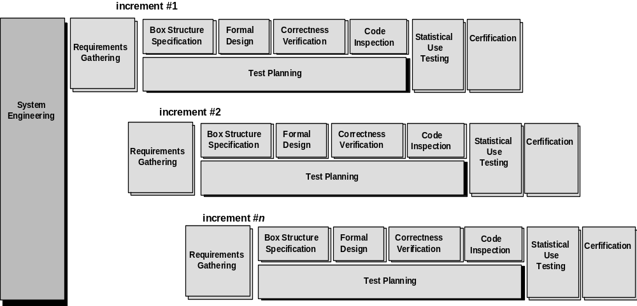
净室过程模型
增量1
形式化设计
正确性验证
代码检查
统计使用测试
盒结构规格说明
认证
需求收集
测试策划
形式化设计
正确性验证
代码检查
统计使用测试
增量2
系统工程
认证
需求收集
盒结构规格说明
测试策划
形式化设计
正确性验证
代码检查
统计使用测试
增量n
盒结构规格说明
认证
需求收集
测试策划

Slide 4
净室策略-1
增量策划 ——采用增量策略
需求收集 ——开发更详细的客户级需求描述 (为每个增量)
盒结构规格说明 ——描述功能规格说明
形式化设计 ——对规格说明 (称为黑盒) 进行迭代求精 (在一个增量内) 类似于体系结构设计和构件级设计 (分别称为状态盒和清晰盒)。
正确性验证 ——验证从最高层次的盒结构(规格说明)开始，然后移向设计细节和代码。正确性验证的第一层次通过应用一组“正确性问题”来进行，如果这些不能证明规格说明是正确的，则使用更形式化的(数学的)验证方法。
代码生成、检查和验证 ——将某种专门语言表示的盒结构规格说明翻译为适当的程序设计语言。
Notes:
The Cleanroom Strategy-I
Increment Planning—adopts the incremental strategy
Requirements Gathering—defines a description of customer level requirements (for each increment)
Box Structure Specification—describes the functional specification
Formal Design—specifications (called “black boxes”) are iteratively refined (with an increment) to become analogous to architectural and procedural designs (called “state boxes” and “clear boxes,” respectively).
Correctness Verification—verification begins with the highest level box structure (specification) and moves toward design detail and code using a set of “correctness questions.” If these do not demonstrate that the specification is correct, more formal (mathematical) methods for verification are used.
Code Generation, Inspection and Verification—the box structure specifications, represented in a specialized language, are transmitted into the appropriate programming language.

Slide 5
净室策略-2
统计测试策划 ——策划并设计一组测试用例，以测试使用情况的“概率分布”。
统计使用策划 ——统计使用技术执行由统计样本(上面提到的概率
分布)导出的一系列测试，这里的统计样本是从来自目标人群的所有用户对程序的所有可能执行中抽取的。
认证——一旦完成验证、检查和使用测试 (并且所有错误被改正)，
则对增量进行集成前的认证工作。
Notes:
The Cleanroom Strategy-II
Statistical Test Planning—a suite of test cases that exercise of “probability distribution” of usage are planned and designed
Statistical Usage Testing—execute a series of tests derived from a statistical sample (the probability distribution noted above) of all possible program executions by all users from a targeted population
Certification—once verification, inspection and usage testing have been completed (and all errors are corrected) the increment is certified as ready for integration.

Slide 6
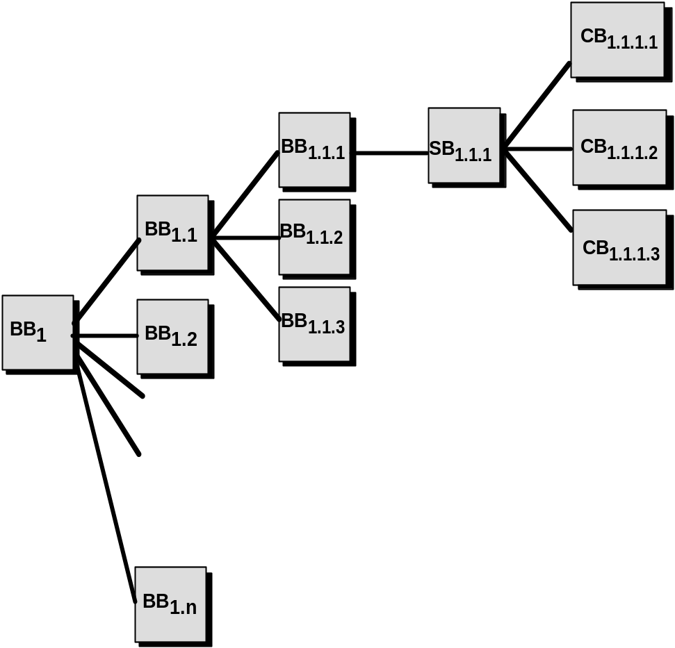
盒结构规格说明
黑盒
清晰盒
状态盒

Slide 7
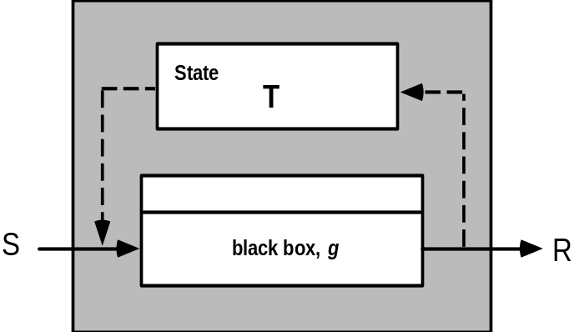
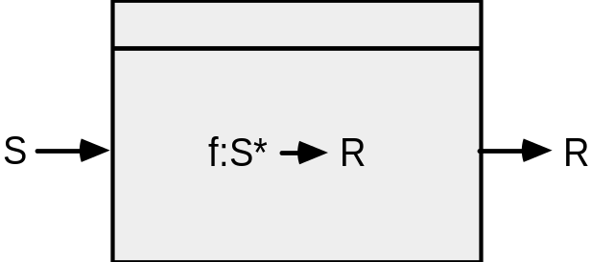
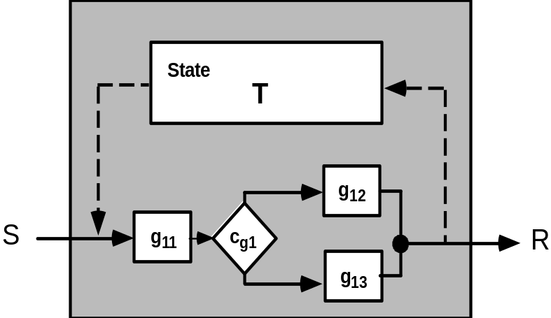
盒结构
黑盒
状态盒
清晰盒

Slide 8
设计细化和验证
如果函数f被扩展为序列g和h，则f所有输入的正确性条件是：
• 执行g 之后再执行 h 能完成 f 的功能吗?
如果一个函数 f 被细化为形如 (if-then-else)的条件形式，则对f的所有输入的正确性条件：
• 只要条件 <c> 为真，g 能完成 f 的功能吗? 只要条件<c> 为假，h 能完成 f 的功能?
如果函数 f 被细化为循环， 则对 f 的所有输入的正确性条件是：
• 能够保证循环终止吗?
• 只要 <c> 为真，循环执行 g 之后能完成 f 的功能吗?只要 <c> 为假，退出循环仍能完成 f 的功能吗?
Notes:
Design Refinement & Verification
If a function f is expanded into a sequence g and h, the correctness condition for all input to f is:
• Does g followed by h do f?
When a function f is refined into a conditional (if-then-else), the correctness condition for all input to f is:
• Whenever condition <c> is true does g do f and whenever <c> is false, does h do f?
When function f is refined as a loop, the correctness conditions for all input to f is:
• Is termination guaranteed?
• Whenever <c> is true does g followed by f do f, and whenever <c> is false, does skipping the loop still do f?

Slide 9
设计验证的优势
它将验证降低为一个有限的过程。
它让净室团队验证设计和代码的每一行。
它使设计达到一个接近于零缺陷级别。
它的使用范围逐渐扩大。
它产生的代码比单元测试的好。
Notes:
Advantages of Design Verification
It reduces verification to a finite process.
It lets cleanroom teams verify every line of design and code.
It results in a near zero defect level.
It scales up.
It produces better code than unit testing.

Slide 10
净室测试
统计使用测试
  测试程序的实际使用情况
确定一个 “使用概率分布”
  分析规格说明来定义一组触发
  触发引起软件改变其行为
  创建使用场景
  为每个触发分配一个使用概率
  按照使用概率分布为每个触发生成测试用例
Notes:
Cleanroom Testing
statistical use testing
tests the actual usage of the program
determine a “usage probability distribution”
analyze the specification to identify a set of stimuli
stimuli cause software to change behavior
create usage scenarios
assign probability of use to each stimuli
test cases are generated for each stimuli according to the usage probability distribution

Slide 11
认证
1. 必须创建使用场景。
2. 指定使用概貌。
3. 从概貌中生成测试用例。
4. 执行测试，记录并分析失效数据。
5. 计算并认证可靠性。
Notes:
Certification
1. Usage scenarios must be created.
2. A usage profile is specified.
3. Test cases are generated from the profile.
4. Tests are executed and failure data are recorded and analyzed.
5. Reliability is computed and certified.

Slide 12
认证模型
取样模型。软件测试执行m个随机测试用例，如果没有错误发生或只有少于指定数量的错误发生，则通过认证。用数学方法导出m值，以保证能够获得需要的可靠性。
构件模型。对由n个构件组成的系统进行认证，构件模型使得分析员能够确定构件i在完成前失效的概率。
认证模型。 设计并认证系统的整体可靠性。
Notes:
Certification Models
Sampling model. Software testing executes m random test cases and is certified if no failures or a specified numbers of failures occur. The value of m is derived mathematically to ensure that required reliability is achieved.
Component model. A system composed of n components is to be certified. The component model enables the analyst to determine the probability that component i will fail prior to completion.
Certification model. The overall reliability of the system is projected and certified.

Slide 13
形式化方法
“在开发计算机系统中使用的形式化方法是描述系统特性的基于数学的技术。这种形式化方法提供了框架，在这些框架内，人们能够以系统的方式而不是随意的方式来说明、开发和验证系统。”
The Encyclopedia of Software Engineering [Mar01]
传统规格说明的问题:
  矛盾性
  二义性
  模糊性
  不完整性
  混合的抽象级别
Notes:
Formal Methods
“Formal methods used in developing computer systems are mathematically based techniques for describing system properties. Such formal methods provide frameworks within which people can specify, develop, and verify systems in a systematic, rather than ad hoc manner.”
The Encyclopedia of Software Engineering [Mar01]
The Problem with conventional specs:
contradictions
ambiguities
vagueness
incompleteness
mixed levels of abstraction

Slide 14
形式化规格说明
期望特性——一致性、完整性及无歧义性——是所有规格说明方法的目标
规格说明语言的形式化语法使得能够唯一地解释需求或设计，从而排除了读者解释自然语言(如英语)或图形表示时经常产生的歧义性。
  集合论和逻辑符号的描述工具使得可以清晰地陈述事实（需求）。
一致性是通过数学证明将初始事实形式化地映射 (使用推理规则) 到后面的规格说明中的陈述来保证的。
Notes:
Formal Specification
Desired properties—consistency, completeness, and lack of ambiguity—are the objectives of all specification methods
The formal syntax of a specification language enables requirements or design to be interpreted in only one way, eliminating ambiguity that often occurs when a natural language (e.g., English) or a graphical notation must be interpreted
The descriptive facilities of set theory and logic notation enable clear statement of facts (requirements).
Consistency is ensured by mathematically proving that initial facts can be formally mapped (using inference rules) into later statements within the specification.

Slide 15
形式化方法的概念
数据不变式 ——一个条件，在包含一组数据的系统的执行过程中总保持为真。
状态
  许多形式化语言，如OCL（28.5节），使用第7章和第8章中所讨论的状态概念，也就是说，系统可能处于多种状态之一，每一种状态都表示外部可观察到的行为模式。
  在Z语言中（28.6节），系统的访问和改变状态由系统的存储数据来表示。
操作——系统发生的读写数据的动作
  前置条件 定义一个特定操作有效的环境
  后置条件 定义当操作完成动作后保证什么为真
Notes:
Formal Methods Concepts
data invariant—a condition that is true throughout the execution of the system that contains a collection of data
state
Many formal languages, such as OCL (Section 28.5) , use the notion of states as they were discussed in Chapters 7 and 8, that is, a system can be in one of several states, each representing an externally observable mode of behavior.
The Z language (Section 28.6)defines a state as the stored data which a system accesses and alters
operation—an action that takes place in a system and reads or writes data to a state
precondition defines the circumstances in which a particular operation is valid
postcondition defines what happens when an operation has completed its action

Slide 16
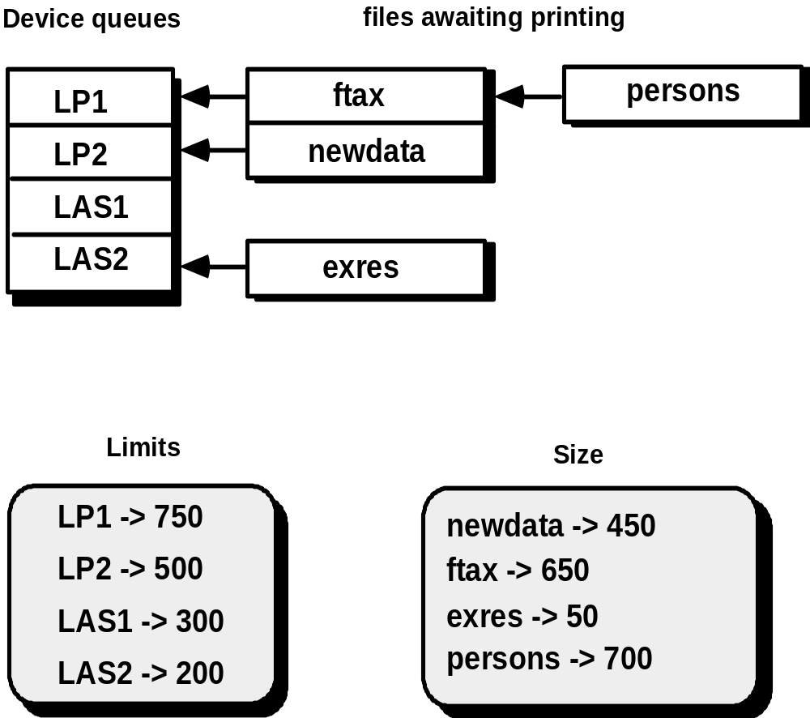
一个例子 — Print Spooler
设备序列
等待打印文件
限制
大小

Slide 17
状态和数据不变式
打印程序的状态由四个组件所表现，分别是序列、输出设备、限制和大小。
数据不变式有五个组件:
• 每个输出设备都关联一个打印行数的上限。
• 每个输出设备都关联一个等待打印文件的可能非空队列
• 每个文件都有大小
• 每个序列关联一个含有文件的输出设备，文件的大小小于该输出设备的上限。
• 打印程序只能管理不超过 MaxDevs 的输出设备
Notes:
States and Data Invariant
The state of the spooler is represented by the four components Queues, OutputDevices, Limits, and Sizes.
The data invariant has five components:
• Each output device is associated with an upper limit of print lines
• Each output device is associated with a possibly nonempty queue of files awaiting printing
• Each file is associated with a size
• Each queue associated with an output device contains files that have a size less than the upper limit of the output device
• There will be no more than MaxDevs output devices administered by the spooler

Slide 18
操作
将一个新的输出设备添加到后台处理程序，并保证没有超过打印数量的限制的操作。
将一个文件从其相关联的特定输出设备的序列中移除的操作。
将一个文件添加到其相关联的特定输出设备的序列的操作。
为一个特定输出设备修改打印上限的操作。
将一个文件从一个输出设备的序列中移到另一个输出设备的序列的操作。
Notes:
Operations
An operation which adds a new output device to the spooler together with its associated print limit
An operation which removes a file from the queue associated with a particular output device
An operation which adds a file to the queue associated with a particular output device
An operation which alters the upper limit of print lines for a particular output device
An operation which moves a file from a queue associated with an output device to another queue associated with a second output device

Slide 19
前置和后置条件
对于第一个操作 (根据后台打印程序的打印限制来添加一个新的输出设备到后台打印程序中):
前置条件: 此输出设备的名字不能与现有输出设备重复，并且当前后台打印程序中的输出设备没有超过最大数MaxDevs
后置条件: 新设备的名称添加到现有设备名称的集合中，然后形成一个新的没有序列的条目，并且为该设备设定打印限制。
Notes:
Pre- & Postconditions
For the first operation (adds a new output device to the spooler together with its associated print limit):
Precondition: the output device name does not already exist and that there are currently less than MaxDevs output devices known to the spooler
Postcondition: the name of the new device is added to the collection of existing device names, a new entry is formed for the device with no files being associated with its queue, and the device is associated with its print limit.

Slide 20
数学概念*
集合和构建集合说明
集合运算符
逻辑运算符
  例如， i, j: • i > j i² => j²
  该表达式说明，对于自然数集合中的任何一对数值，只要 i 大于 j,那么 i² 就大于 j²。
序列
*对集合和构建集合说明的讨论（幻灯片20—24）不包含在书SEPA第7版中，但是幻灯片中还包含一些不熟悉的基本概念。
Notes:
Mathematical Concepts*
sets and constructive set specification
set operators
logic operators
e.g., i, j: • i > j i² => j²
which states that, for every pair of values in the set of natural numbers, if i is greater than j, then i² is greater than j².
sequences

Slide 21
集合和构建说明
集合是对象或元素的总和，并作为形式化方法的基础。
  举例
    {C++, Pascal, Ada, COBOL, Java}
    #{C++, Pascal, Ada, COBOL, Java} 包含 基数= 5
  集合描述法更偏向于枚举，因为它能够为一个很大的集合给出一个简洁的定义。
    {x, y : N | x + y = 10 (x, y²)}
Notes:
Sets and Constructive Specification
A set is a collection of objects or elements and is used as a cornerstone of formal methods.
Enumeration
{C++, Pascal, Ada, COBOL, Java}
#{C++, Pascal, Ada, COBOL, Java} implies cardinality = 5
Constructive set specification is preferable to enumeration because it enables a succinct definition of large sets.
{x, y : N | x + y = 10 (x, y²)}

Slide 22
集合运算符
一套特殊的符号用来描述集合和逻辑运算符。
  例子
    P运算符是用来表示集合的成员。例如，表达式为
      x P X
    , ,运算符和#使用集合来作为它们的操作数。 谓词公式为
      A , B
    当集合A中的所有元素都包含在集合B中，则该表示式的值为真，否则该表达式的值为假。
  联合运算符, <, 是将两个集合合并为一个集合，并将集合中重复的元素去除。
    {File1, File2, Tax, Compiler} < {NewTax, D2, D3, File2} 的结果是集合
    {Filel, File2, Tax, Compiler, NewTax, D2, D3}
Notes:
Set Operators
A specialized set of symbology is used to represent set and logic operations.
Examples
The P operator is used to indicate membership of a set. For example, the expression
x P X
The operators , , and # take sets as their operands. The predicate
A , B
has the value true if the members of the set A are contained in the set B and has the value false otherwise.
The union operator, <, takes two sets and forms a set that contains all the elements in the set with duplicates eliminated.
{File1, File2, Tax, Compiler} < {NewTax, D2, D3, File2} is the set
{Filel, File2, Tax, Compiler, NewTax, D2, D3}

Slide 23
逻辑运算符
形式化方法的另一个重要构成成分是逻辑：代数true和false表达式。
  例子:
    V 或
    ¬ 非
    => 蕴含
全称量词是一种根据集合中某些为真元素来推断集合中的每个元素的方法。全称量词的符号是=> ，一个使用例子：
    i, j : N i > j => i² > j²
该表达式说明自然数集合中的任何一对数，只要 i 大于 j，那么 i² 就大于 j²。
Notes:
Logic Operators
Another important component of a formal method is logic: the algebra of true and false expressions.
Examples:
V or
¬ not
=> implies
Universal quantification is a way of making a statement about the elements of a set that is true for every member of the set. Universal quantification uses the symbol, . An example of its use is
i, j : N i > j => i² > j²
which states that for every pair of values in the set of natural numbers, if i is greater than j, then i² is greater than j².

Slide 24
序列
序列使用尖括号来表示。 例如，以前的序列会写成这种形式
  k Jones, Wilson, Shapiro, Estavezl
连接符 X 是一个二元运算符，该运算符是将第二个操作数添加到第一个操作数的后面组成一个新的序列。 例如，
    k 2, 3, 34, 1l X k12, 33, 34, 200 l = k 2, 3, 34, 1, 12, 33, 34, 200 l
其他一些可以在序列中使用的运算符有head, tail, front, 和 last.
    head k 2, 3, 34, 1, 99, 101 l = 2
    tail k 2, 3, 34, 1, 99, 101 l = 73, 34, 1,99, 1018
    last k 2, 3, 34, 1, 99, 101 l = 101
    front k 2, 3, 34, 1, 99, 101 l = 72, 3, 34, 1, 998
Notes:
Sequences
Sequences are designated using angle brackets. For example, the preceding sequence would normally be written as
k Jones, Wilson, Shapiro, Estavezl
Catenation, X, is a binary operator that forms a sequence constructed by adding its second operand to the end of its first operand. For example,
k 2, 3, 34, 1l X k12, 33, 34, 200 l = k 2, 3, 34, 1, 12, 33, 34, 200 l
Other operators that can be applied to sequences are head, tail, front, and last.
head k 2, 3, 34, 1, 99, 101 l = 2
tail k 2, 3, 34, 1, 99, 101 l = 73, 34, 1,99, 1018
last k 2, 3, 34, 1, 99, 101 l = 101
front k 2, 3, 34, 1, 99, 101 l = 72, 3, 34, 1, 998

Slide 25
形式化规格说明
块处理器
  块处理器维持一个未用(空闲)块池，并保持对当前使用块的跟踪。 当块从被删除文件释放时，它们通常被加入到块队列中以等待进入未用块池。
    状态
      used, free: P BLOCKS
      BlockQueue: seq P BLOCKS
    数据不变式
      used > free = \
      used < free = AllBlocks
      i: dom BlockQueue BlockQueue i # used
      i, j : dom BlockQueue i ≠ j => BlockQueue i > BlockQueue j = \
    前置条件
      #BlockQueue > 0
    后置条件
      used' = used \ head BlockQueue
      free’ = free < head BlockQueue
      BlockQueue' = tail BlockQueue
Notes:
Formal Specification
The block handler
The block handler maintains a reservoir of unused blocks and will also keep track of blocks that are currently in use. When blocks are released from a deleted file they are normally added to a queue of blocks waiting to be added to the reservoir of unused blocks.
The state
used, free: P BLOCKS
BlockQueue: seq P BLOCKS
Data Invariant
used > free = \
used < free = AllBlocks
i: dom BlockQueue BlockQueue i # used
i, j : dom BlockQueue i ≠ j => BlockQueue i > BlockQueue j = \
Precondition
#BlockQueue > 0
Postcondition
used' = used \ head BlockQueue
free’ = free < head BlockQueue
BlockQueue' = tail BlockQueue

Slide 26
形式化规格说明语言
形式化规格说明语言通常由三个主要成分构成：
  语法，定义用于表示规格说明的特定表示方法
  语义，帮助定义用于描述系统的“对象的全域”[WIN90]
  一组关系，定义确定哪个对象真正满足规格说明的规则
形式化规格说明语言的语法域通常基于从标准集合论表示法和谓词演算导出的语法。
规格说明语言的语义域指出语言如何表示系统需求。
Notes:
Formal Specification Languages
A formal specification language is usually composed of three primary components:
a syntax that defines the specific notation with which the specification is represented
semantics to help define a "universe of objects" [WIN90] that will be used to describe the system
a set of relations that define the rules that indicate which objects properly satisfy the specification
The syntactic domain of a formal specification language is often based on a syntax that is derived from standard set theory notation and predicate calculus.
The semantic domain of a specification language indicates how the language represents system requirements.

Slide 27
对象约束语言 (OCL)
成熟的形式化表示法，UML的使用者可以向他们的规格说明中加入更精确的内容。
OCL具有逻辑数学及离散数学的所有优势。
然而，OCL的设计者决定在OCL语言中只能使用ASCII字符(而不能使用传统的数学表示方法) 。
Notes:
Object Constraint Language (OCL)
a formal notation developed so that users of UML can add more precision to their specifications
All of the power of logic and discrete mathematics is available in the language
However the designers of OCL decided that only ASCII characters (rather than conventional mathematical notation) should be used in OCL statements.

Slide 28
OCL概述
如面向对象程序设计语言一样，OCL表达式包括操作对象的操作符。
然而，完整表达式的结果总是一个布尔值，即其值为true或false。
对象可以是OCL Collection 类的实例，Set和 Sequence 是OCL Collection 类的两个子类。
参见表28.1，OCL符号总结
Notes:
OCL Overview
Like an object-oriented programming language, an OCL expression involves operators operating on objects.
However, the result of a complete expression must always be a Boolean, i.e. true or false.
The objects can be instances of the OCL Collection class, of which Set and Sequence are two subclasses.
See Table 28.1 for summary of OCL notation

Slide 29
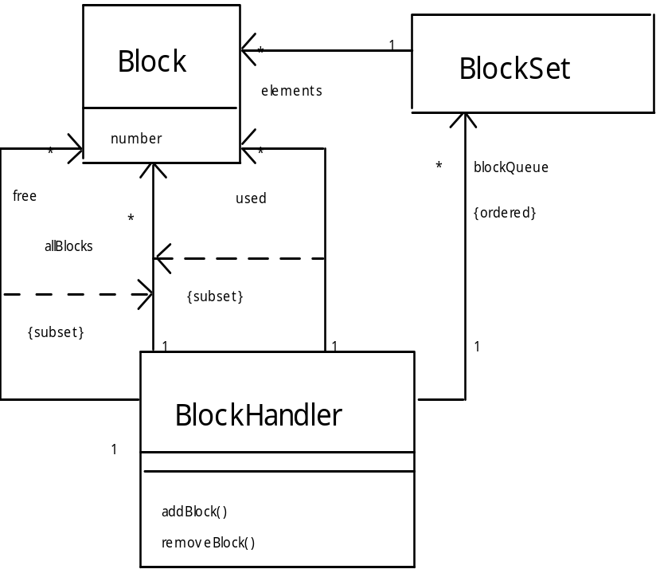
使用UML的块处理器

Slide 30
OCL中的块处理器
块不会同时被标记为未用和已用。
    context BlockHandler inv:
    (self.used->intersection(self.free)) ->isEmpty()
所有在队列中的块集合都将是当前已用块集合的子集。
    context BlockHandler inv:
    blockQueue->forAll(aBlockSet | used->includesAll(aBlockSet ))
队列元素不包含相同的块号。
    context BlockHandler inv:
    blockQueue->forAll(blockSet1, blockSet2 |
    blockSet1 <> blockSet2 implies
    blockSet1.elements.number->excludesAll(blockSet2.elements.number))
    The expression before implies is needed to ensure we ignore pairs where both elements are the same Block.
已用块和未用块的集合将是组成文件的块的总和。
    context BlockHandler inv:
    allBlocks = used->union(free)
未用块集合中没有重复的块号。
    context BlockHandler inv:
    free->isUnique(aBlock | aBlock.number)
已用块集合中没有重复的块号。
    context BlockHandler inv:
    used->isUnique(aBlock | aBlock.number)
Notes:
BlockHandler in OCL
No block will be marked as both unused and used.
context BlockHandler inv:
(self.used->intersection(self.free)) ->isEmpty()
All the sets of blocks held in the queue will be subsets of the collection of currently used blocks.
context BlockHandler inv:
blockQueue->forAll(aBlockSet | used->includesAll(aBlockSet ))
No elements of the queue will contain the same block numbers.
context BlockHandler inv:
blockQueue->forAll(blockSet1, blockSet2 |
blockSet1 <> blockSet2 implies
blockSet1.elements.number->excludesAll(blockSet2.elements.number))
The expression before implies is needed to ensure we ignore pairs where both elements are the same Block.
The collection of used blocks and blocks that are unused will be the total collection of blocks that make up files.
context BlockHandler inv:
allBlocks = used->union(free)
The collection of unused blocks will have no duplicate block numbers.
context BlockHandler inv:
free->isUnique(aBlock | aBlock.number)
The collection of used blocks will have no duplicate block numbers.
context BlockHandler inv:
used->isUnique(aBlock | aBlock.number)

Slide 31
Z语言
组织为一组schema
  定义变量
  为这些变量之间建立关系
  类似于传统语言中的“模块”
符号描述如表21.2
Notes:
The Z Language
organized into schemas
defines variables
establishes relationships between variables
the analog for a “module” in conventional languages
notation described in Table 21.2

Slide 32
Z语言中块处理器
下面 schema 的例子描述了块处理器的状态和数据不变式:
———BlockHandler——————————————
used, free : P BLOCKS
BlockQueue : seq P BLOCKS
———————————————————————
used > free = \
used < free = AllBlocks
i: dom BlockQueue BlockQueue i # used
i, j : dom BlockQueue i ≠ j => BlockQueue i > BlockQueue j = \
————————————————————————
更详细的说明解释参见21.7.2 节
Notes:
BlockHandler in Z
The following example of a schema describes the state of the block handler and the data invariant:
———BlockHandler——————————————
used, free : P BLOCKS
BlockQueue : seq P BLOCKS
———————————————————————
used > free = \
used < free = AllBlocks
i: dom BlockQueue BlockQueue i # used
i, j : dom BlockQueue i ≠ j => BlockQueue i > BlockQueue j = \
————————————————————————
See Section 21.7.2 for further expansion of the specification

