Slide 1
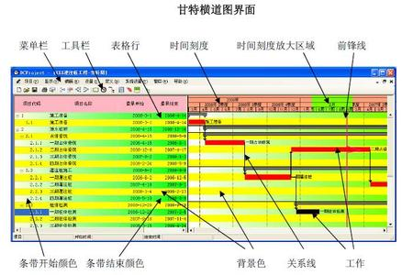
第27章 项目进度安排
Notes:
Chapter 27 Project Scheduling

Slide 2
为什么软件会延期交付?
由软件开发团队以外的某个人制定的不切实际的项目结束期限。
客户需求发生变更，而这种变更没有在项目变更进度表上预先安排。
对完成该工作所需的工作量和(或)资源数量估计不足。
在项目开始时，没有考虑到可预测的和(或)不可预测的风险。
出现了事先无法预计的技术难题。
出现了事先无法预计的人力问题;
由于项目团队成员之间的交流不畅而导致的延期。
项目管理者未能发现项目进度拖后，也未能采取措施来解决这一问题。
Notes:
Why Are Projects Late?
an unrealistic deadline established by someone outside the software development group
changing customer requirements that are not reflected in schedule changes;
an honest underestimate of the amount of effort and/or the number of resources that will be required to do the job;
predictable and/or unpredictable risks that were not considered when the project commenced;
technical difficulties that could not have been foreseen in advance;
human difficulties that could not have been foreseen in advance;
miscommunication among project staff that results in delays;
a failure by project management to recognize that the project is falling behind schedule and a lack of action to correct the problem

Slide 3
项目进度安排基本原则
划分——划分不同的任务
相互依赖性——明确任务之间的相互依赖关系
工作量确认——确保资源是可用的
确定责任 ——每个任务都应该指定特定的团队成员来负责
明确输出结果 ——每个任务都应该有一个明确的输出结果
确定里程碑 ——质量评审
Notes:
Scheduling Principles
compartmentalization—define distinct tasks
interdependency—indicate task interrelationship
effort validation—be sure resources are available
defined responsibilities—people must be assigned
defined outcomes—each task must have an output
defined milestones—review for quality

Slide 4
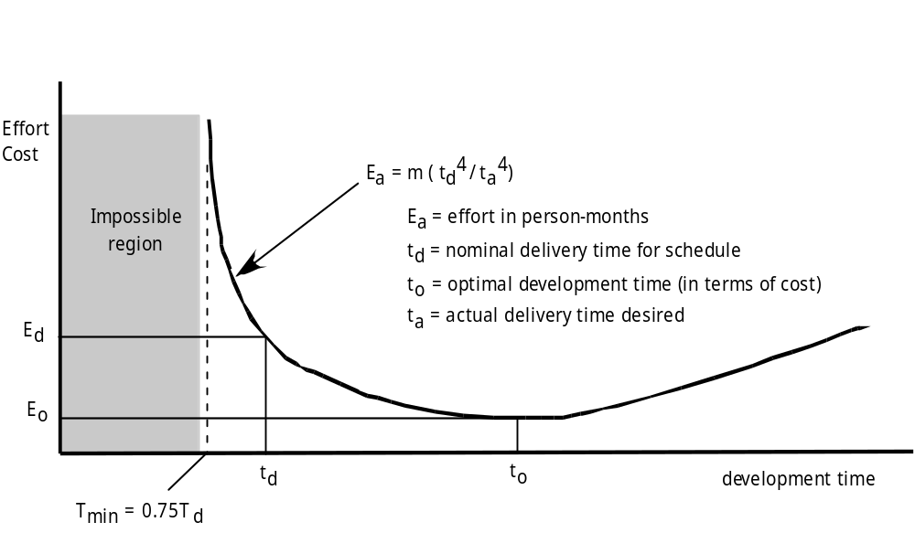
工作量和交付时间
工作量成本
不可能的区域
以人月为单位的工作量
按进度的正常交付时间
理想的开发时间(依据成本)
实际想达到的交付时间
开发时间

Slide 5
工作量分配
“前期” 活动
  客户交流
  需求分析
  软件设计
  审查和修改
编码工作
  编码或代码生成
测试和安装
  单元测试，集成测试
  白盒测试，黑盒测试
  回归分析
40-50%
15-20%
30-40%
Notes:
Effort Allocation
“front end” activities
customer communication
analysis
design
review and modification
construction activities
coding or code generation
testing and installation
unit, integration
white-box, black box
regression

Slide 6
定义任务集
决定项目类型
明确严格要求的程度
确定合适的标准
选择合适的软件工程任务
Notes:
Defining Task Sets
determine type of project
assess the degree of rigor required
identify adaptation criteria
select appropriate software engineering tasks

Slide 7
任务集分解
1.1 确定项目的整体概念范围。
任务定义: 行动 1.1 确定概念范围
1.1.1 确定需求、效益和潜在的客户；
1.1.2 确定所希望的输出/控制和驱动应用程序的输入事件；
开始任务 1.1.2
1.1.2.1 FTR: 评审需求的书面描述；
  FTR 表示需要进行一次技术评审（第26章）。
1.1.2.2 导出客户可见的输出/输入列表；
1.1.2.3 FTR：与客户一起评审输出/输入，并在需要时进行修改；
结束任务 1.1.2
1.1.3 为每个主要功能定义功能/行为 ；
开始任务 1.1.3
1.1.3.1 FTR: 评审在任务1.1.2 中得到的输出和输入数据对象；
1.1.3.2 导出功能/行为模型；
1.1.3.3 FTR: 与客户一起评审功能/行为模型，并在需要时进行修改；
结束任务 1.1.3
1.1.4 把需要在软件中实现的技术要素分离出来；
1.1.5 研究现有软件的可用性；
1.1.6 确定技术可行性；
1.1.7 对系统规模进行快速估算；
1.1.8 创建“范围定义”；
结束行动1.1的任务定义
被分解为
Notes:
Task Set Refinement
1.1 Concept scoping determines the overall scope of the project.
Task definition: Task 1.1 Concept Scoping
1.1.1 Identify need, benefits and potential customers;
1.1.2 Define desired output/control and input events that drive the application;
Begin Task 1.1.2
1.1.2.1 FTR: Review written description of need
FTR indicates that a formal technical review (Chapter 26) is to be conducted.
1.1.2.2 Derive a list of customer visible outputs/inputs
1.1.2.3 FTR: Review outputs/inputs with customer and revise as required;
endtask Task 1.1.2
1.1.3 Define the functionality/behavior for each major function;
Begin Task 1.1.3
1.1.3.1 FTR: Review output and input data objects derived in task 1.1.2;
1.1.3.2 Derive a model of functions/behaviors;
1.1.3.3 FTR: Review functions/behaviors with customer and revise as required;
endtask Task 1.1.3
1.1.4 Isolate those elements of the technology to be implemented in software;
1.1.5 Research availability of existing software;
1.1.6 Define technical feasibility;
1.1.7 Make quick estimate of size;
1.1.8 Create a Scope Definition;
endTask definition: Task 1.1

Slide 8
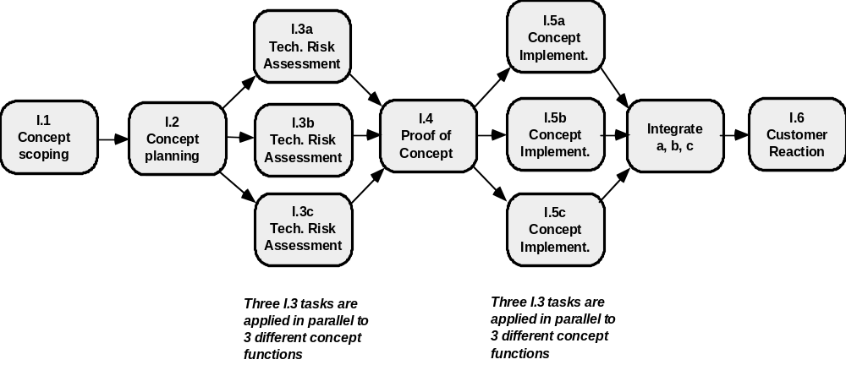
定义任务网络
1.3a 技术风险评估
1.5a 概念实现
1.1 确定概念范围
1.2 概念策划
1.4 概念证明
集成a,b,c
1.6 客户反映
将3个“任务1.3”并行应用于3中不同的概念功能
将3个“任务1.5”并行应用于3中不同的概念功能

Slide 9
时序图
任务 第一周 第二周 第三周 第四周 第n周
Tasks
Week 1
Week 2
Week 3
Week 4
Week n
任务1
任务2
任务3
任务4
任务5
任务6
任务7
任务8
任务9
任务10
任务11
任务12
Task 1
Task 2
Task 3
Task 4
Task 5
Task 6
Task 7
Task 8
Task 9
Task 10
Task 11
Task 12

Slide 10
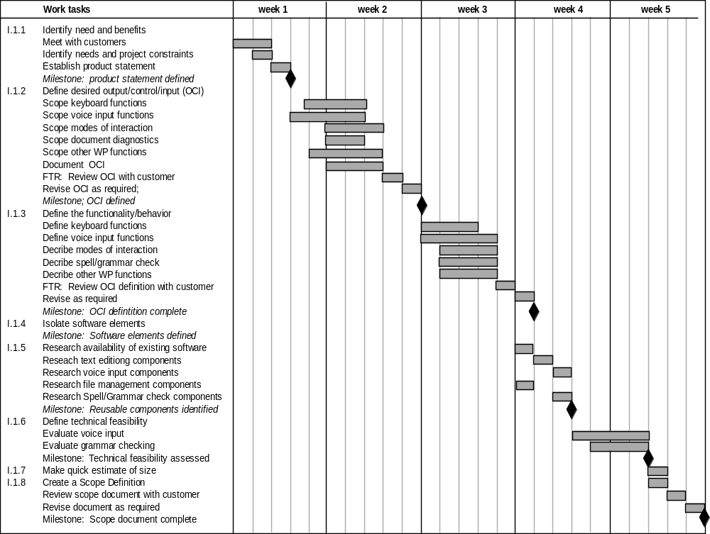
使用自动化工具导出时序图
工作任务 第一周 第二周 第三周 第四周 第5周
1.1.1 明确要求和效益
会见客户
明确要求和项目约束
编写产品说明
里程碑：完成产品说明
1.1.2 确定期望的输出/控制/输入
确定键盘功能
确定语音输入功能
确定交互模式
确定诊断文档
确定其他WP功能
将OCI形成文档
FTR：与客户一起评审OCI
必要时修改OCI
里程碑：形成OCI文档
1.1.3 定义功能/行为
定义键盘功能
定义语音输入功能
描述交互模式
描述诊断文档
描述其他WP功能
FTR：与客户一起评审OCI定义
必要时修改OCI
里程碑：完成OCI定义
1.1.4 分离软件要素
里程碑：确定软件要素
1.1.5 研究现有软件的可用性
研究文本编辑构件
研究语音输入构件
研究文件管理构件
研究拼写/语法检查构件
里程碑：确定可复用的构件
1.1.6 确定技术可行性
评估语音输入
评估语法检查
里程碑：完成技术可行性评估
1.1.7 快速估算规模
1.1.8 创建范围定义
与客户一起评审范围文档
必要时修改文档
里程碑：完成范围文档

Slide 11
跟踪进度
  定期举行项目状态会议，由项目团队中的各个成员分别报告进度和存在的问题。
  评估在软件工程过程中所进行的所有评审的结果。
  判断正式的项目里程碑 (图27.3中的菱形) 是否在预定日期内完成。
  比较项目表 (图 27.4)中列出的各项任务的实际开始日期与计划开始日期。
  与开发人员进行非正式会谈，获取他们对项目进展及可能出现的问题的客观评估。
  通过挣值分析 (第27.6节) 来定量地评估项目进展。
Notes:
Schedule Tracking
conduct periodic project status meetings in which each team member reports progress and problems.
evaluate the results of all reviews conducted throughout the software engineering process.
determine whether formal project milestones (the diamonds shown in Figure 27.3) have been accomplished by the scheduled date.
compare actual start-date to planned start-date for each project task listed in the resource table (Figure 27.4).
meet informally with practitioners to obtain their subjective assessment of progress to date and problems on the horizon.
use earned value analysis (Section 27.6) to assess progress quantitatively.

Slide 12
跟踪OO项目的进展-1
技术里程碑：OO 分析完成
    已经定义和评审了所有的类和类层次。
    已经定义和评审了与每一类相关的属性和操作。
    已经定义和评审了各类之间的关系(第8章) 。
    已经定义和评审了行为模型(第8章) 。
    已经确定可复用的类。
技术里程碑：OO 设计完成
    已经确定和评审了子系统集合(第9章)。
    各类已经分配给相应的子系统，并且已经通过评审。
    已经建立和评审了任务分配。
    已经明确责任和协作（第9章）。
    已经设计和评审了属性和操作。
    已经创建和评审了通信模型。
Notes:
Progress on an OO Project-I
Technical milestone: OO analysis completed
All classes and the class hierarchy have been defined and reviewed.
Class attributes and operations associated with a class have been defined and reviewed.
Class relationships (Chapter 8) have been established and reviewed.
A behavioral model (Chapter 8) has been created and reviewed.
Reusable classes have been noted.
Technical milestone: OO design completed
The set of subsystems (Chapter 9) has been defined and reviewed.
Classes are allocated to subsystems and reviewed.
Task allocation has been established and reviewed.
Responsibilities and collaborations (Chapter 9) have been identified.
Attributes and operations have been designed and reviewed.
The communication model has been created and reviewed.

Slide 13
跟踪OO项目的进展-2
技术里程碑：OO 程序设计完成
    按照设计模型，每一个新类都已经编码实现。
    (从可复用库中) 提取的类已经实现。
    已经构建了原型或增量。
技术里程碑：OO 测试
    已经评审了OO分析和设计模型的正确性和完整性。
    已经建立和评审了类-责任-协作网络 (CRC) 。
    已经设计了测试用例，并且已经对每个类进行了类级测试 (第19章) 。
    已经设计了测试用例，并且已经完成簇测试 (第19章) ，已经完成类的集成。
    已经完成系统级测试。
Notes:
Progress on an OO Project-II
Technical milestone: OO programming completed
Each new class has been implemented in code from the design model.
Extracted classes (from a reuse library) have been implemented.
Prototype or increment has been built.
Technical milestone: OO testing
The correctness and completeness of OO analysis and design models has been reviewed.
A class-responsibility-collaboration network (Chapter 6) has been developed and reviewed.
Test cases are designed and class-level tests (Chapter 19) have been conducted for each class.
Test cases are designed and cluster testing (Chapter 19) is completed and the classes are integrated.
System level tests have been completed.

Slide 14
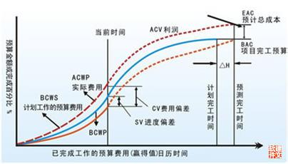
挣值分析 (EVA)
挣值
  对项目进展的测量
  它使得计划者不依赖于感觉，而是采用定量的分析方法来评估一个项目的“完成百分比”。
  “早在项目进展的前15%就提供了精确而可靠地性能数据。” [Fle98]
Notes:
Earned Value Analysis (EVA)
Earned value
is a measure of progress
enables us to assess the “percent of completeness” of a project using quantitative analysis rather than rely on a gut feeling
“provides accurate and reliable readings of performance from as early as 15 percent into the project.” [Fle98]

Slide 15
计算挣值-1
为进度表中的每个工作任务确定其预计工作的预算成本 (BCWS) 。
  BCWS_{i} 是指工作任务 i的计划工作量。
  为了确定在项目进度表中某特定时间点的项目进展状况， BCWS 的值是在项目进度表中该时间点应该完成的所有工作任务的BCWS_{i} 值之和。
所有工作任务的BCWS值加起来，可计算出完成工作的预算，BAC。 因此，
对所有的任务k，BAC = ∑ (BCWS_{k})
Notes:
Computing Earned Value-I
The budgeted cost of work scheduled (BCWS) is determined for each work task represented in the schedule.
BCWS_{i} is the effort planned for work task i.
To determine progress at a given point along the project schedule, the value of BCWS is the sum of the BCWS_{i} values for all work tasks that should have been completed by that point in time on the project schedule.
The BCWS values for all work tasks are summed to derive the budget at completion, BAC. Hence,
BAC = ∑ (BCWS_{k}) for all tasks k

Slide 16
计算挣值-2
接着，计算已完成工作的预算成本 (BCWP) 的值。
  BCWP的值是在项目进度表中该时间点已经实际完成的所有工作任务的BCWS的值。
“BCWS和BCWP的不同点是，前者表示计划将完成的工作的预算，而后者表示已实际完成的工作的预算。” [Wil99]
给定BCWS、BAC和BCWP的值，就可以得出相关的项目进展指标：
    进度表执行指标SPI = BCWP/BCWS
    进度表偏差 SV = BCWP – BCWS
    其中，SPI是效率指标，指出项目使用预定资源的效率。
Notes:
Computing Earned Value-II
Next, the value for budgeted cost of work performed (BCWP) is computed.
The value for BCWP is the sum of the BCWS values for all work tasks that have actually been completed by a point in time on the project schedule.
“the distinction between the BCWS and the BCWP is that the former represents the budget of the activities that were planned to be completed and the latter represents the budget of the activities that actually were completed.” [Wil99]
Given values for BCWS, BAC, and BCWP, important progress indicators can be computed:
Schedule performance index, SPI = BCWP/BCWS
Schedule variance, SV = BCWP – BCWS
SPI is an indication of the efficiency with which the project is utilizing scheduled resources.

Slide 17
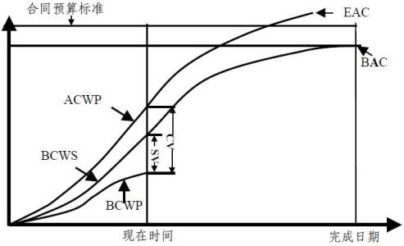
计算挣值-3
预定完成百分比 = BCWS/BAC 表示在时间点 t应该完成工作的百分比值。
完成百分比 = BCWP/BAC 表示在特定时间点 t实际完成工作的百分比值。
已完成工作的实际成本 ACWP，是在项目进度表中某时间点已经完成的工作任务的实际工作量之和。然后，再计算：
    成本执行指标 CPI = BCWP/ACWP
    成本偏差 CV = BCWP – ACWP
Notes:
Computing Earned Value-III
Percent scheduled for completion = BCWS/BAC
provides an indication of the percentage of work that should have been completed by time t.
Percent complete = BCWP/BAC
provides a quantitative indication of the percent of completeness of the project at a given point in time, t.
Actual cost of work performed, ACWP, is the sum of the effort actually expended on work tasks that have been completed by a point in time on the project schedule. It is then possible to compute
Cost performance index, CPI = BCWP/ACWP
Cost variance, CV = BCWP – ACWP

Slide 18
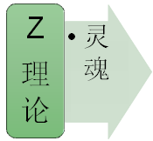
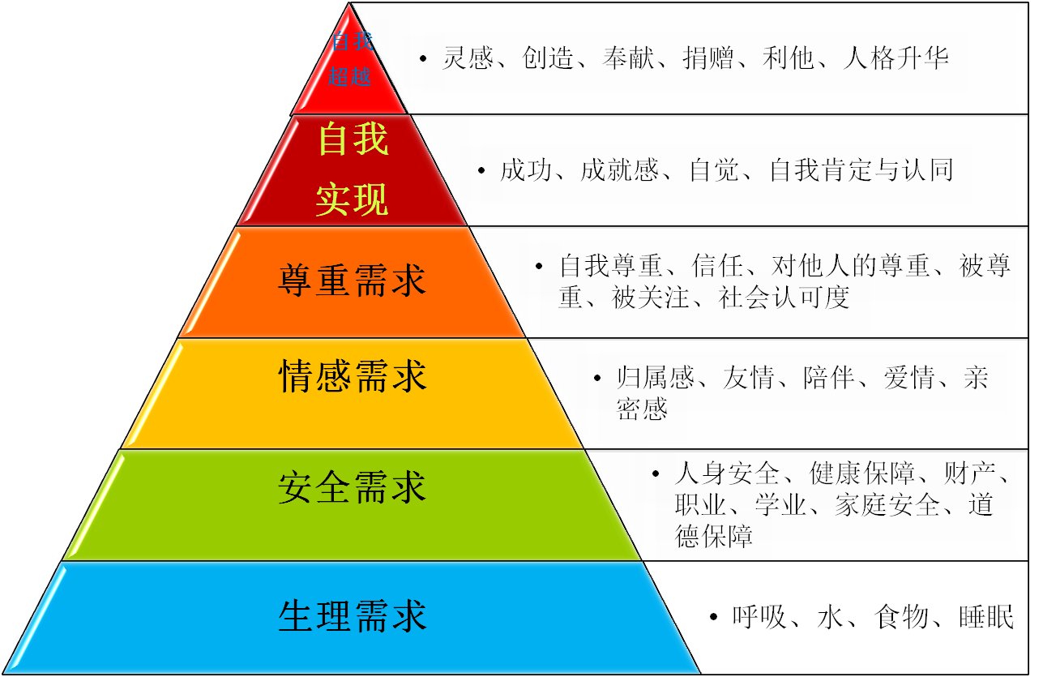
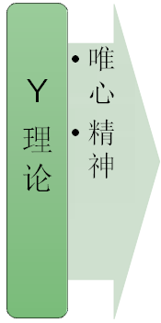
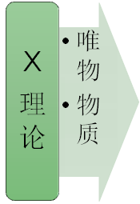
结束语 马斯洛人类需求模型

