Slide 1
第29章 维护和再工程
Notes:
Chapter 29 Maintenance and Reengineering

Slide 2
软件维护
软件交付给最终用户，
  几天之内，缺陷报告就有可能送到软件工程组织。
  几周之内，某类用户就可能会提出必须修改软件以适应他们所处环境的特殊要求。
  几个月之内，另一个公司集团在软件发布时认为他们与这个软件毫不相干，但现在意识到该软件可能会给他们带来意想不到的好处，因此他们需要做些改进，使软件可以用于他们的环境。
所有这些工作都是软件维护
Notes:
Software Maintenance
Software is released to end-users, and
within days, bug reports filter back to the software engineering organization.
within weeks, one class of users indicates that the software must be changed so that it can accommodate the special needs of their environment.
within months, another corporate group who wanted nothing to do with the software when it was released, now recognizes that it may provide them with unexpected benefit. They’ll need a few enhancements to make it work in their world.
All of this work is software maintenance

Slide 3
软件维护
可维护的软件表现为有效的模块性
它采用易于理解的设计模式
采用了明确定义的编码标准及约定建造可维护的软件，导致源代码能够自身文档化且易于理解
它应用了大量质量保证技术，在软件交付之前就已经找出了潜在的维护问题
创建它的软件工程师们已经意识到，实施变更时他们可能已经离开了
  因此，软件的设计与实现必须对实施变更的人员“有帮助”
Notes:
Maintainable Software
Maintainable software exhibits effective modularity
It makes use of design patterns that allow ease of understanding.
It has been constructed using well-defined coding standards and conventions, leading to source code that is self-documenting and understandable.
It has undergone a variety of quality assurance techniques that have uncovered potential maintenance problems before the software is released.
It has been created by software engineers who recognize that they may not be around when changes must be made.
Therefore, the design and implementation of the software must “assist” the person who is making the change

Slide 4
软件可支持性
“在软件系统的整个产品生命周期内支持软件系统的能力。
  这意味着不仅需要满足所有必要的要求或需求，而且还要能够供应装置、支持基础设施、附加软件、工具、人力、或所需要的任何资源以维护软件的运行并满足软件的功能。”[SSO08]
当在运行环境中出现缺陷时（没有错误，但会有缺陷），该软件应该具有协助支持人员进行处理的工具。
支持人员应该能够访问到记录已经出现的所有缺陷的数据库——获得各个缺陷的特征、起因以及补救措施。
Notes:
Software Supportability
“the capability of supporting a software system over its whole product life.
This implies satisfying any necessary needs or requirements, but also the provision of equipment, support infrastructure, additional software, facilities, manpower, or any other resource required to maintain the software operational and capable of satisfying its function.” [SSO08]
The software should contain facilities to assist support personnel when a defect is encountered in the operational environment (and make no mistake, defects will be encountered).
Support personnel should have access to a database that contains records of all defects that have already been encountered—their characteristics, cause, and cure.

Slide 5
再工程
Business
processes
业务过程
IT
systems
Software
applications
Reengineering
IT
系统
再工程
软件应用系统
Notes:
Reengineering

Slide 6
业务过程再工程
业务定义。在4个关键的驱动因子范畴内指定业务目标：降低成本、缩短时间、提高质量、人力开发以及授权。
过程识别。识别对业务定义中所制定的业务目标起关键作用的所有过程。
过程评估。对现有过程进行透彻的分析和测量。
过程规格说明及设计。根据从上面3个BRP活动中获得信息，为每个即将被重新设计的过程准备用例。
原型开发。在将重新设计的业务过程完全集成到整个业务之前，必须将其原型化。
求精及实例化。根据来自原型的反馈信息对业务过程进行求精，然后在业务系统中实例化。
Notes:
Business Process Reengineering
Business definition. Business goals are identified within the context of four key drivers: cost reduction, time reduction, quality improvement, and personnel development and empowerment.
Process identification. Processes that are critical to achieving the goals defined in the business definition are identified.
Process evaluation. The existing process is thoroughly analyzed and measured.
Process specification and design. Based on information obtained during the first three BPR activities, use-cases are prepared for each process that is to be redesigned.
Prototyping. A redesigned business process must be prototyped before it is fully integrated into the business.
Refinement and instantiation. Based on feedback from the prototype, the business process is refined and then instantiated within a business system.

Slide 7
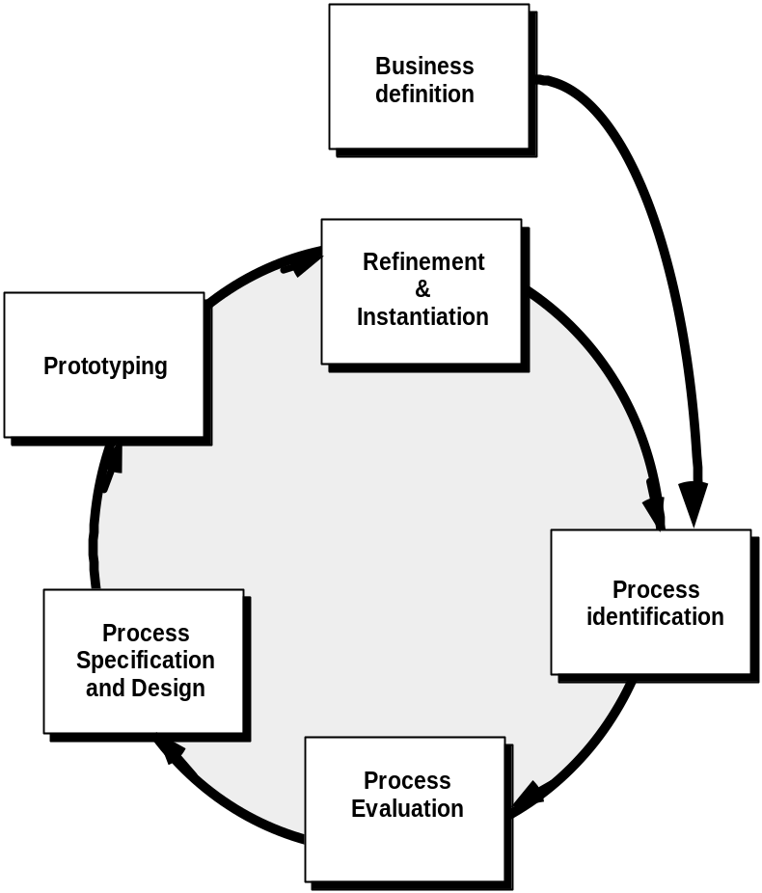
业务过程再工程
业务定义
求精及实例化
原型开发
过程规格说明设计
过程识别
过程评估
Notes:
Business Process Reengineering

Slide 8
BPR 原则
组织周围的结果,而不是任务。
使那些使用过程输出结果的人执行过程。
将信息处理工作合并到产生原始信息的实际工作中。
对待地理上分散的资源就好像它们是集中的。
链接并行活动，而不是当不同时，集成它们的结果。
把决策点放在执行任务的位置，并在过程中构建控制。
在它的源头捕捉数据一次。
Notes:
BPR Principles
Organize around outcomes, not tasks.
Have those who use the output of the process perform the process.
Incorporate information processing work into the real work that produces the raw information.
Treat geographically dispersed resources as though they were centralized.
Link parallel activities instead of integrated their results. When different
Put the decision point where the work is performed, and build control into the process.
Capture data once, at its source.

Slide 9
软件再工程
Forward
engineering
inventory
analysis
正向工程
库存目录分析
Data
restructuring
document
restructuring
数据重构
文档重构
code
restructuring
reverse
engineering
逆向工程
代码重构
Notes:
Software Reengineering

Slide 10
库存目录分析
构建一张包含所有应用系统的表
建立一个标准列表， 例如，
  应用系统的名字
  最初创建时间
  所做实质性变更的数量
  使这些变更得以应用的总得工作量
  上一个实质性变更的日期
  使上一个变更得以应用的工作量
  它驻留的系统
  应用程序接口……
分析并优化选择再工程的候选系统
Notes:
Inventory Analysis
build a table that contains all applications
establish a list of criteria, e.g.,
name of the application
year it was originally created
number of substantive changes made to it
total effort applied to make these changes
date of last substantive change
effort applied to make the last change
system(s) in which it resides
applications to which it interfaces, ...
analyze and prioritize to select candidates for reengineering

Slide 11
文档重构
拙劣的文档是很多遗留系统的特点。
但是，对此能做些什么呢？如何进行选择？
选项……
  建立文档是非常耗费时间的。如果系统正常运作，可以选择保持现状。在某些情况下，这是一个正确的做法。
  文档必须更新，但是资源有限。我们可以采取“使用时再建立文档”的方法。不需要重构应用系统的全部文档。
  系统是业务关键的，而且必须完全地重构文档。即使出现这种情况，也最好是设法将文档精简到最少。
Notes:
Document Restructuring
Weak documentation is the trademark of many legacy systems.
But what do we do about it? What are our options?
Options …
Creating documentation is far too time consuming. If the system works, we’ll live with what we have. In some cases, this is the correct approach.
Documentation must be updated, but we have limited resources. We’ll use a “document when touched” approach. It may not be necessary to fully redocument an application.
The system is business critical and must be fully redocumented. Even in this case, an intelligent approach is to pare documentation to an essential minimum.

Slide 12
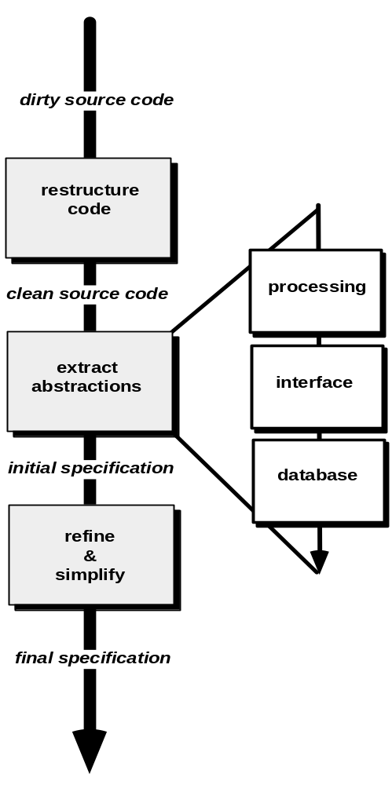
逆向工程
脏的源代码
重构代码
干净的源代码
处理
抽取抽象
界面
初始的规格说明书
数据库
求精和简化
最终的规格说明书
Notes:
Reverse Engineering

Slide 13
代码重构
使用重构工具去分析源代码。
对糟糕设计的代码段进行重新设计。
将与结构化程序设计概念相违背的部分标注出来，然后对代码进行重构（此工作可以自动进行）。
对生成的重构代码进行评审和测试，以确保没有引入不规则的代码。
更新内部的代码文档。
Notes:
Code Restructuring
Source code is analyzed using a restructuring tool.
Poorly design code segments are redesigned
Violations of structured programming constructs are noted and code is then restructured (this can be done automatically)
The resultant restructured code is reviewed and tested to ensure that no anomalies have been introduced
Internal code documentation is updated.

Slide 14
数据重构
与抽象层次较低的代码重构不同，数据重构是一种全范围的再工程活动。
在多数情况下，数据重构开始于逆向工程活动。
  对当前的数据体系结构进行分解，并定义必要的数据模型（第9章）。
  标识数据对象和属性，并对现有的数据结构进行质量评审。
  当数据结构较差时（例如，通常采用平面文件实现，而关系型方法可以大大地简化处理），应该对数据进行再工程。
由于数据体系结构对程序体系结构及其算法有很强的影响，所以对数据的变更总会导致体系结构或代码层的变更。
Notes:
Data Restructuring
Unlike code restructuring, which occurs at a relatively low level of abstraction, data structuring is a full-scale reengineering activity
In most cases, data restructuring begins with a reverse engineering activity.
Current data architecture is dissected and necessary data models are defined (Chapter 9).
Data objects and attributes are identified, and existing data structures are reviewed for quality.
When data structure is weak (e.g., flat files are currently implemented, when a relational approach would greatly simplify processing), the data are reengineered.
Because data architecture has a strong influence on program architecture and the algorithms that populate it, changes to the data will invariably result in either architectural or code-level changes.

Slide 15
正向工程
1. 维护一行源代码的成本可能是该行代码初始开发成本20~40倍。
2. 采用现代设计概念重新设计软件体系结构（程序和/或数据结构）可以大大地方便于未来的维护。
3. 由于软件的原型已经存在，开发生产率将远高于平均水平。
4. 用户现在已对该软件有使用经验，因此，可以很容易地确定新的需求和变更的方向。
5. 再工程的CASE工具可以自动化部分工作。
6. 预防性维护的完成将产生完整的软件配置（文档、程序和数据）。
Notes:
Forward Engineering
1. The cost to maintain one line of source code may be 20 to 40 times the cost of initial development of that line.
2. Redesign of the software architecture (program and/or data structure), using modern design concepts, can greatly facilitate future maintenance.
3. Because a prototype of the software already exists, development productivity should be much higher than average.
4. The user now has experience with the software. Therefore, new requirements and the direction of change can be ascertained with greater ease.
5. CASE tools for reengineering will automate some parts of the job.
6. A complete software configuration (documents, programs and data) will exist upon completion of preventive maintenance.

Slide 16
再工程经济学-I
Sneed [Sne95]提出了再工程的成本——效益分析模型， 其中定义了9个参数：
    P₁ = 应用系统当前的年度维护成本。
    P₂ = 应用系统当前的年度运作成本。
    P₃ = 应用系统当前的年度业务价值。
    P₄ = 再工程后预期的年度维护成本。
    P₅ = 再工程后预期的年度运作成本。
    P₆ =再工程后预期的年度业务价值。
    P₇ = 估计的再工程成本。
    P₈ = 估计的再工程日程。
    P₉ = 再工程风险因子(P₉ = 1.0为额定值)。
    L = 期望的系统生命期
Notes:
Economics of Reengineering-I
A cost/benefit analysis model for reengineering has been proposed by Sneed [Sne95]. Nine parameters are defined:
P₁ = current annual maintenance cost for an application.
P₂ = current annual operation cost for an application.
P₃ = current annual business value of an application.
P₄ = predicted annual maintenance cost after reengineering.
P₅ = predicted annual operations cost after reengineering.
P₆ = predicted annual business value after reengineering.
P₇ = estimated reengineering costs.
P₈ = estimated reengineering calendar time.
P₉ = reengineering risk factor (P₉ = 1.0 is nominal).
L = expected life of the system.

Slide 17
再工程经济学-II
与某候选应用系统（即，未执行再工程的应用系统）的持续维护相关的成本可以定义为：
C_{维护} = [P₃ - (P₁ + P₂)] x L
与再工程相关的成本用下面的关系定义：
C_{再工程} = [P₆ - (P₄ + P₅) x (L - P₈) - (P₇ x P₉)] `
方程式中利用上述计算出的成本，可以计算出再工程的整体效益：
成本效益= C_{再工程} - C_{维护}
Notes:
Economics of Reengineering-II
The cost associated with continuing maintenance of a candidate application (i.e., reengineering is not performed) can be defined as
C_{maint} = [P₃ - (P₁ + P₂)] x L
The costs associated with reengineering are defined using the following relationship:
C_{reeng} = [P₆ - (P₄ + P₅) x (L - P₈) - (P₇ x P₉)] `
Using the costs presented in equations above, the overall benefit of reengineering can be computed as
cost benefit = C_{reeng} - C_{maint}

