Slide 1
第32章 结束语
Notes:
Chapter 32 Concluding Comments

Slide 2
再论软件的重要性
在第1章中，软件被描述为区分器。
  交付的软件可分区为产品、系统和服务，它提供了市场竞争力。
但是，软件并不仅仅是区分器 。
程序、文档和数据是软件工程的工作产品产生了任何个人、商业或政府都能获取的最重要的日用品——信息。
Notes:
Importance of Software-Revisited
In Chapter 1, software was characterized as a differentiator.
The function delivered by software differentiates products, systems, and services and provides competitive advantage in the marketplace.
But software is more that a differentiator.
The programs, documents, and data that are software help to generate the most important commodity that any individual, business, or government can acquire—information.

Slide 3
人员构造系统
交流方式一直在变
  例如，视频会议
工作模式一直在变
  例如，智能代理
获取知识的方式一直在变
  例如，数据挖掘、网络
Notes:
People - Building Systems
Communication is changing
e.g., video conferencing
Work patterns are changing
e.g., intelligent agents
Knowledge acquisition is changing
e.g., data mining, the Web

Slide 4
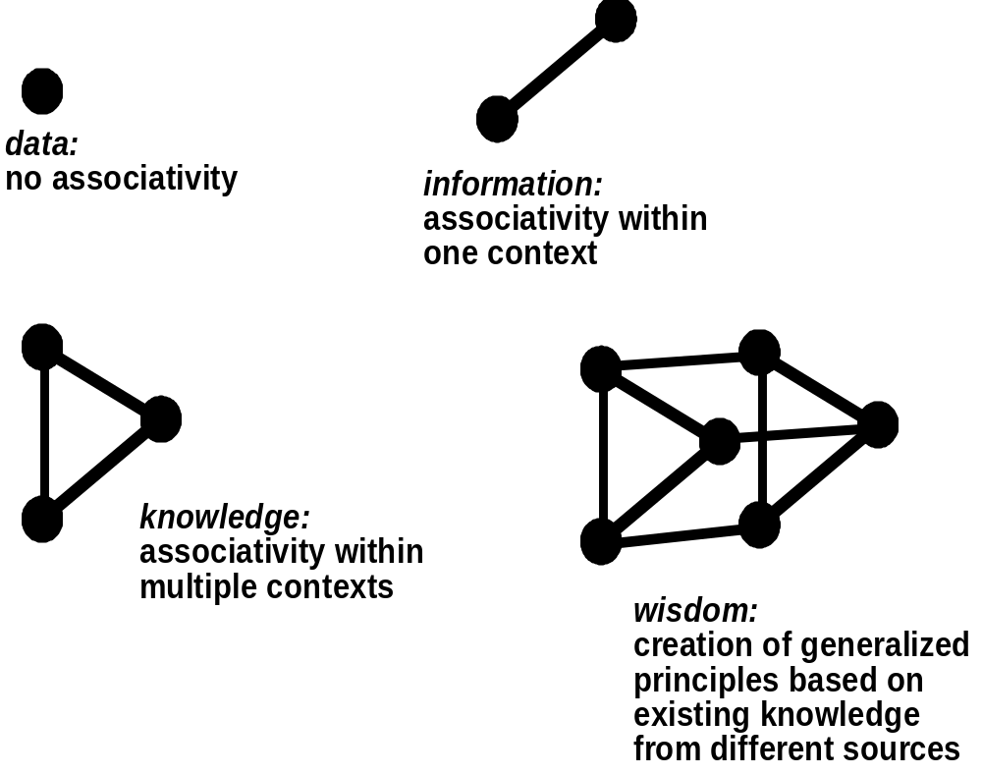
信息谱系
信息：
在一个环境内相联系
数据：没有联系
知识：
在多个环境内相联系
智慧：
基于不同源中存在
的知识创建一般性
原理
Notes:
An Information Spectrum

Slide 5
远景
两种对立的观点：
  Ray Kurzweil——数字理想国和不朽
  Bill Joy——数字非理想化和灭绝
详细的讨论，请参见2008年6月杂志IEEE Spectrum的一个特殊的问题
  Geeks的爱好者
Notes:
The Long View
Two conflicting views:
Ray Kurzweil—digital utopia and immortality
Bill Joy—digital distopia and extinction
For a thorough discussion, see a special issue of IEEE Spectrum, June, 2008
The Rapture of the Geeks

Slide 6
软件工程道德-I
ACM/IEEE-CS 联合工作组已经提出了《 Software Engineering Code of Ethics and Professional Practices 》（软件工程师职业道德规范和职业实践要求）(5.1版)，该规范 [ACM98] 规定：
  软件工程师应该履行其承诺，使软件的分析、规格说明、设计、开发、测试和维护成为一项有益和受人尊重的职业。依照他们对公众健康、安全和利益的承诺，软件工程师应当坚持以下八项原则：
Notes:
Software Engineering Ethics-I
An ACM/IEEE-CS Joint Task Force has produced a Software Engineering Code of Ethics and Professional Practices (Version 5.1). The code [ACM98] states:
Software engineers shall commit themselves to making the analysis, specification, design, development, testing and maintenance of software a beneficial and respected profession. In accordance with their commitment to the health, safety and welfare of the public, software engineers shall adhere to the following Eight Principles:

Slide 7
软件工程道德-II
1. 公众——软件工程师的行为应符合公众利益。
2. 客户和雇主——在保持与公众利益一致的原则下，软件工程师的行为应使他们的客户和雇主获得最大利益。
3. 产品——软件工程师应该确保他们的产品和相关的修改符合最高的专业标准。
4. 判断——软件工程师应当维护他们职业判断的完整性和独立性。
5. 管理——软件工程师经理和领导应赞成和促进对软件开发和维护进行合乎道德规范的管理。
6. 专业——在与公众利益一致的原则下，软件工程师应当推进其专业的完整性和声誉。
7. 同事——软件工程师对其同事应持平等和支持的态度。
8. 自我——软件工程师应当参与终生职业实践的学习，并促进合乎道德的职业实践方法。
Notes:
Software Engineering Ethics-II
1. PUBLIC - Software engineers shall act consistently with the public interest.
2. CLIENT AND EMPLOYER - Software engineers shall act in a manner that is in the best interests of their client and employer consistent with the public interest.
3. PRODUCT - Software engineers shall ensure that their products and related modifications meet the highest professional standards possible.
4. JUDGMENT - Software engineers shall maintain integrity and independence in their professional judgment.
5. MANAGEMENT - Software engineering managers and leaders shall subscribe to and promote an ethical approach to the management of software development and maintenance.
6. PROFESSION - Software engineers shall advance the integrity and reputation of the profession consistent with the public interest.
7. COLLEAGUES - Software engineers shall be fair to and supportive of their colleagues.
8. SELF - Software engineers shall participate in lifelong learning regarding the practice of their profession and shall promote an ethical approach to the practice of the profession.

Slide 8
道德-个人层面上的
决不将数据据为己有。
决不散步或出售在软件项目中工作时所获得的私有信息。
决不恶意毁坏或修改别人的程序、文件或数据。
决不侵犯个人、小组或组织的隐私。
决不闯入一个系统胡闹或牟取利益。
决不制造或传播计算机病毒。
决不使用计算技术去助长偏见或制造麻烦。
Notes:
Ethics-On a Personal Level
Never steal data for personal gain.
Never distribute or sell proprietary information obtained as part of your work on a software project.
Never maliciously destroy or modify another person’s programs, files, or data.
Never violate the privacy of an individual, a group, or an organization.
Never hack into a system for sport or profit.
Never create or promulgate a computer virus or worm.
Never use computing technology to facilitate discrimination or harassment.

