Slide 1
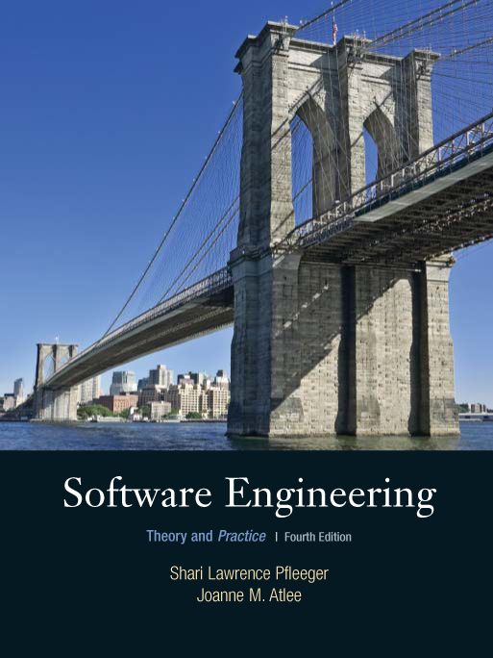
第四章
获取需求
Shari L. Pfleeger
Joanne M. Atlee
4th Edition
﻿An Equal Opportunity University

Slide 2
提纲
需求分析的概念和任务
获取需求的方法
需求规格说明
建模表示方法

Slide 3
软件需求分析概述
从开发工作的流程来看，需求分析是软件计划的下一工作步骤，它为软件设计阶段提供一个软件需求规格说明书。
软件功能
成本、资源估算
软件计划
需求分析
软件作用范围
软件规格说明
软件开发工作流程

Slide 4
软件需求分析概述
1、需求的概念
比较权威的定义是IEEE（The Institute of Electrical and Electronics Engineers 电气与电子工程师学会 美国）软件工程标准词汇表中的需求定义：
⑴用户解决问题或达到目标所需的条件或权能(Capability)。
⑵系统或系统部件要满足合同、标准、规范或其它正式规定文档所需具有的条件或权能。
⑶一种反映上面(1)或(2)所描述的条件或权能的文档说明。

Slide 5
软件需求分析概述
2、需求的层次
需求可分解为4个层次：业务需求、用户需求、功能需求和非功能需求。
⑴业务需求：业务需求是反映组织机构或客户对软件高层次的目标要求。这项需求是用户高层领导机构决定的，它确定了系统的目标、规模和范围。
⑵用户需求：用户需求是用户使用该软件要完成的任务。
⑶功能需求：功能需求定义了软件必须实现的功能。
⑷非功能需求：非功能需求是对功能需求的补充。

Slide 6
软件需求分析概述
3、需求分析的目标和任务
需求分析的目标
构造一个完全地、精致 地目标系统逻辑模型；
确定设计约束和定义软件有效性要求。
软件规格说明

Slide 7
软件需求分析概述
3、需求分析的目标和任务
需求分析的任务
需求分析阶段研究的对象是软件项目的用户要求，其任务是借助当前系统的逻辑模型， 调查研究、分析综合，并通过抽象思维、逻辑推理导出目标系统的逻辑模型，解决系统“作什么”的问题，并将结果准确表达。

Slide 8
软件需求分析概述
实现步骤：
(1)分析现实世界，充分理解当前系统，并用一个具体模型描述，获得当前系统的物理模型。
(2)在理解当前系统“怎么做”的基础上，抽取“作什么”的本质，抽象出系统的逻辑模型。
(3)分析目标系统与当前系统逻辑上的差别，导出目标系统的逻辑模型。
(4)对目标系统逻辑模型进行补充，以求完整地描述。

Slide 9
软件需求分析概述
怎么做
做什么
模型化
抽象化
理解需求
当前系统
物理模型
逻辑模型
导出
表达需求
目标系统
具体化
物理模型
实例化
逻辑模型
由当前系统建立目标系统模型过程

Slide 10
软件需求分析概述
需求分析的过程
需求分析阶段的工作有以下四个方面：
引发
分析
编制需求分析阶段文档-规格说明
确认

Slide 11
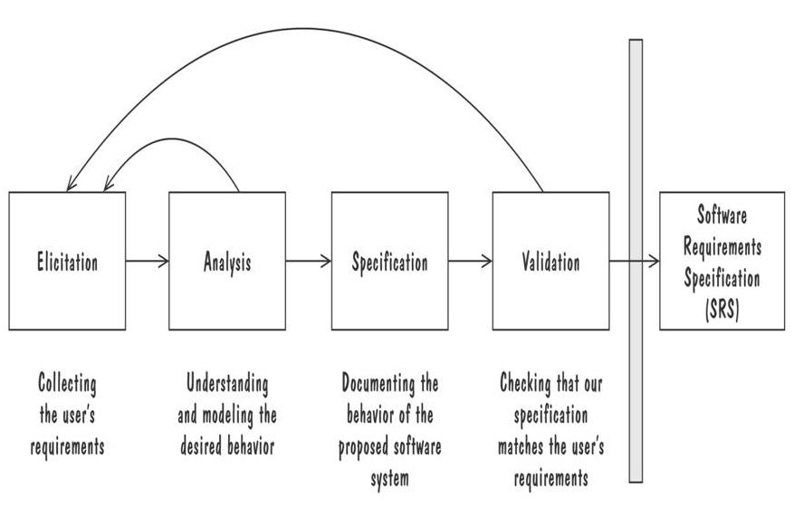
获取需求的过程

Slide 12
软件需求分析概述
引发：
功能要求
性能要求
运行和扩充要求
维护要求
系统文档规格要求
收集用户需求

Slide 13
软件需求分析概述
编写需求规格说明
（1）需求规格说明包含对目标软件系统的外部行为的完整描述、需求验证标准以及用户在性能、质量、可维护性等方面的要求。
（2）用户手册包括用户界面描述以及有关目标系统使用方法的初步构想。
（3）在需求分析中确立测试标准，作为系统开发目标是否完成的验收依据。
（4）修改的项目开发计划是根据新的分析结果，对可行性分析和软件计划阶段中制订的初步的项目开发计划作必要的修改、补充和完善。

Slide 14
软件需求分析概述
需求确认和验证
由专家、分析人员、开发人员、用户组成评审组，对需求分析所得的结果进行评审。
⑴完整性
⑵正确性
⑶一致性
⑷可理解性
⑸无歧义性
⑹可验证性
⑺可修改性

Slide 15
获取需求的方法
需求分析至今仍是公认为的软件开发中最为困难、亟待解决的一个问题。软件项目中40%~60%的问题都是在需求阶段埋下的祸根！
1、存在问题
(1)对需求的理解问题。
(2)分析人员与用户的通信问题。
(3)用户需求的可变性问题。
⑷分析方法和分析工具问题。

Slide 16
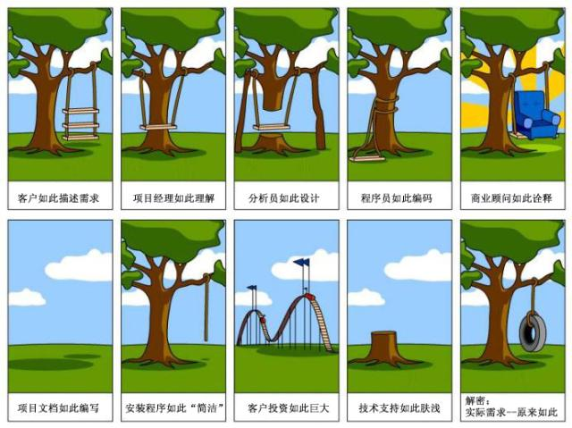
需求获取的主要困难

Slide 17
需求引发
相关人员Stakeholders
Clients 委托人: pay for the software to be developed
Customers 客户: buy the software after it is developed
Users 用户: use the system
Domain experts 领域专家: familiar with the problem that the software must automate
Market Researchers 市场研究人员: conduct surveys to determine future trends and potential customers
Lawyers or auditors 律师或审计人员: familiar with government, safety, or legal requirements
Software engineers 软件工程师：or other technology experts

Slide 18
用“观点集”来管理不一致性
No need to resolve inconsitencies early in the requirements process (Easterbrook and Nuseibah, 1996)
Stakeholders‘ views documented and maintained as separate Viewpoints（视点） through the software development process
  The requirements analyst defines consistency rules that should apply between Viewpoints
  The Viewpoints are analyzed to see if they conform to the consistency requirements
Inconsistencies are highlighted but not adressed until there is sufficient information to make informed decision

Slide 19
获取需求的方法
常用方法
（1）评审可用文档
（2）观察当前系统
（3）做用户的学徒
（4）以小组的方式和风险承担者进行交谈，以便相互启发
（5）与当前的和潜在的用户一起进行集体讨论

Slide 20
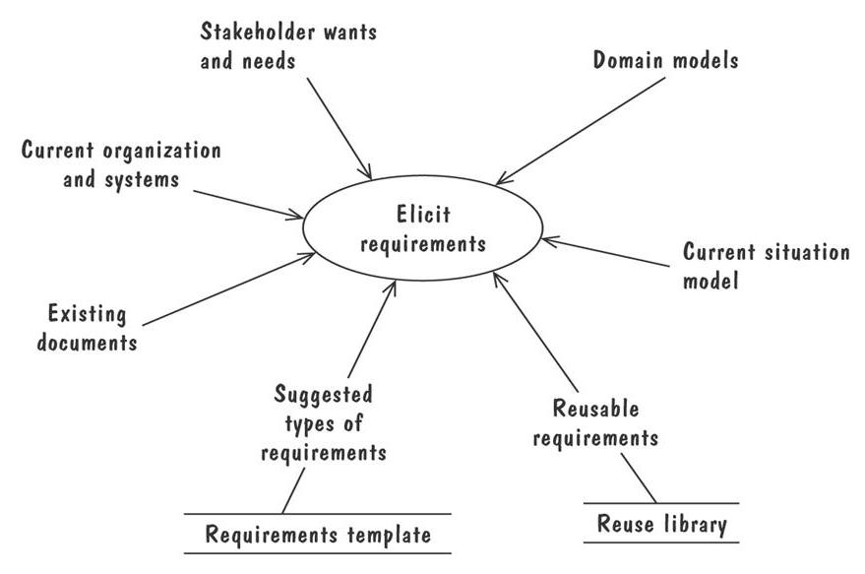
Volere 需求过程模型—需求源

Slide 21
获取需求的方法
需求分析的原则
（1）解决逻辑问题
需求分析是对问题的识别和说明过程，分析员要回答的是“系统必须做什么”的问题，而不是“系统应该怎么做”的问题。
（2）以运行环境为基础
需求分析工作应以具体的运行环境为基础，实事求是 。
（3）用户参与的原则
需求分析工作是系统分析人员同用户不断交互的过程。
（4）构造高质量的需求规格说明
需求规格说明是需求分析工作重要的完成标志。

Slide 22
获取需求的方法
需求分析方法概述
需求分析及描述的方法有很多，不管采用哪种方法进行需求分析，都应满足如下基本要求。
⑴必须能理解问题的数据域和功能域
数据域一般描述为：数据内容、数据结构和数据流。其中，数据内容就是数据项，数据结构就是数据项的组织形式，数据流是数据通过系统时的变化方式。
对数据进行的一系列的转换即系统应实现的功能和子功能。两个功能之间的数据传递就确定了功能之间的接口。

Slide 23
获取需求的方法
⑵必须能按自顶向下、逐层分解的方式对问题进行分解和不断细化
分解是将求解的复杂问题，分解为若干相对简单问题求解的组合。分解的目的是为了降低问题求解的复杂性，将复杂问题分解成一些小的、容易控制和理解的子问题不仅便于理解，还可以将子问题划分给不同的开发小组，分别完成，然后再装配起来形成一个完整的系统。更重要的是可以促进软件开发走向构件开发的道路。

Slide 24
获取需求的方法
⑶要给出系统的逻辑视图和物理视图
软件需求的逻辑视图描述的是软件要达到的功能和要处理的信息之间的关系，但没有描述实现的细节。
软件需求的物理视图给出的是处理功能和信息结构的实际表现形式，需考虑实际的环境和具体的设备。

Slide 25
需求的类型
功能需求: describes required behavior in terms of required activities
质量需求or 非功能需求: describes some quality characteristic that the software must posses
设计约束: a design decision such as choice of platform or interface components
过程约束: a restriction on the techniques or resources that can be used to build the system

Slide 26
使需求可测试
Fit criteria form objective standards for judging whether a proposed solution satisfies the requirements
  It is easy to set fit criteria for quantifyable requirements
  It is hard for subjective quality requirements
Three ways to help make requirements testable
  指定每个副词和形容词的定量描述
  用特定实体的名称替换代名词
  在确保需求文档的某个地方，准确定义每个名词

Slide 27
解决冲突
Different stakeholder has different set of requirements
  potential conflicting ideas
Need to prioritize requirements 优先级划分
Prioritization might separate requirements into three categories
  Essential 必须的: absolutely must be met
  Desirable 值得要的: highly desirable but not necessary
  Optional 可要可不要的: possible but could be eliminated

Slide 28
两种需求文档
Requirements definition 需求定义: 客户想要的每一件事情的完整列表
  Describing the entities in the environment where the system will be installed
Requirements specification 需求规格说明: 将需求重新陈述为关于要构建的系统如何运转的说明

Slide 29
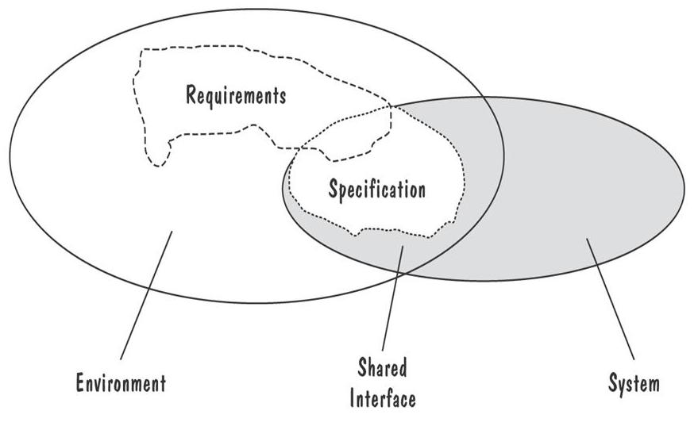
Requirements defined anywhwere within the environment's domain, including the system's interface
Specification restricted only to the intersection between environment and system domain

Slide 30
需求规格说明书
1、需求规格书明书的主体内容：
1）概述：软件需求的简要说明
2）界面描述：软件系统的实现环境
3）模型分析：系统模型的形式规定、限制和说明
4）质量评审要求
5）其他

Slide 31
需求规格说明书
2、需求规格书明书的基本要求：
1）完整：考虑细致
2）一致：前后内容一致
3）精确：数据、任务要精确
4）无二义性：不提模棱两可的问题
5）符合标准：按国家、国际标准书写
6）易维护：应便于修改

Slide 32
需求规格说明书
3、主要负责人：分析员
1）资历较高：要有概括能力、分析能力和社交活动能力。
2）熟悉计算机技术：要有一定的计算机硬件和软件系统的开发经验。
3）对用户的相关业务了解：要能理解用户提出的要求。
4）发挥中间人的作用：要善于在用户和软件开发机构之间进行良好的联系工作。

Slide 33
需求特性
Correct 正确
Consistent 一致
Unambigious 无二义
Complete 完备
Feasible 可行
Relevant 相关
Testable 可测试
Traceable 可追踪

Slide 34
需求规格说明语言
统一建模语言 (UML)
静态建模
  用例图 (一种高层的 DFD)
  类图 (一种ER 图)
  动态建模
  时序图 (一种事件跟踪) 活动图 泳道图
  协作图 (一种事件跟踪)
  状态图 (一种状态机模型)

Slide 35
建模表示法--实体联系图
A popular graphical notational paradigm for representing conceptual models
Has three core constructs
  An entity 实体: depicted as a rectangle, represents a collection of real-world objects that have common properties and behaviors
  A relationship 联系: depicted as an edge between two entities, with diamond in the middle of the edge specifying the type of relationship
  An attribute 属性: an annotation on an entity that describes data or properties associated with the entity

Slide 36
建模表示法--实体联系图
Aggregate association 聚合关联 is an association that represents interaction, or events that involve objects in the associated (marked with white diamond)
  “has-a” relationship
Composition association 组装关联 is a special type of aggregation, in which instances of the compound class are physically constructed from instances of component classes (marked with black diamond)

Slide 37
建模表示法—状态机
A path 路径: 起始于状态机初始状态，沿着从状态到状态的转移
  A trace of observable events in the environment
  Coin, push, rotated, coin, push, rotated….
Deterministic 确定的 state machine: 对每一个状态和事件都有一个唯一的响应

Slide 38
建模表示法—UML状态图
State hierarchy 状态层次结构：
  有公共转移的状态合并为超状态
A superstate 超状态 can actually comprise multiple concurrent submachines, separated by dashed line
  The submachines are said to operate concurrently

Slide 39
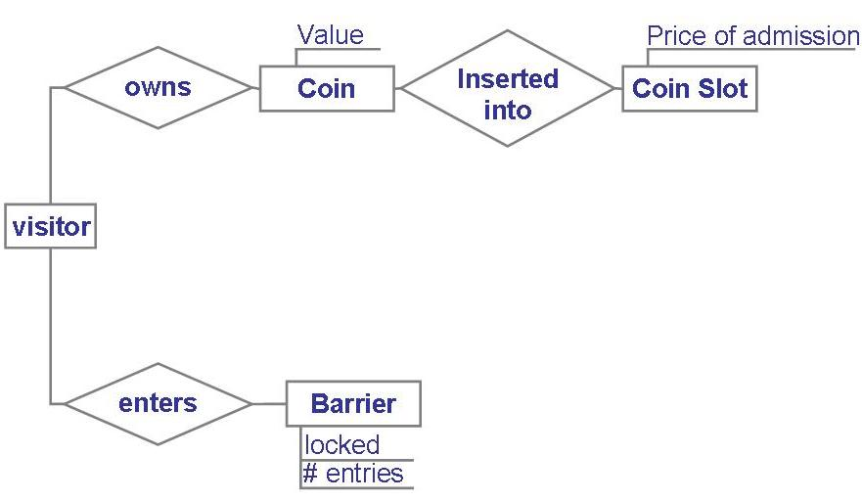
建模表示法--实体联系图
Entity diagram of turnstile (十字转门) problem

Slide 40
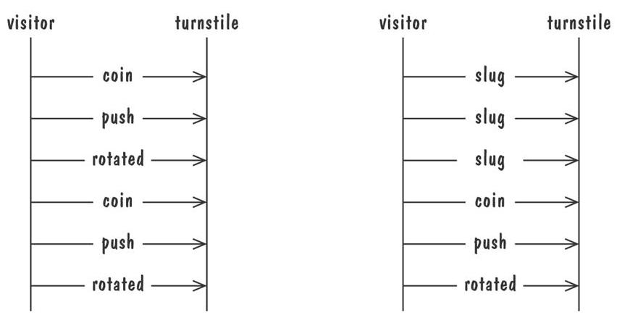
建模表示法—事件追踪
例：典型的行为和异常行为的追踪表示

Slide 41
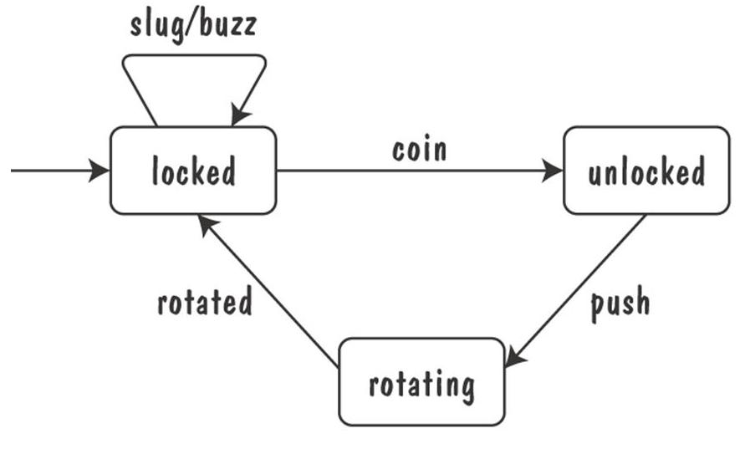
建模表示法—状态机 （客体：+转门）
Finite state machine model of the tunstile problem

Slide 42
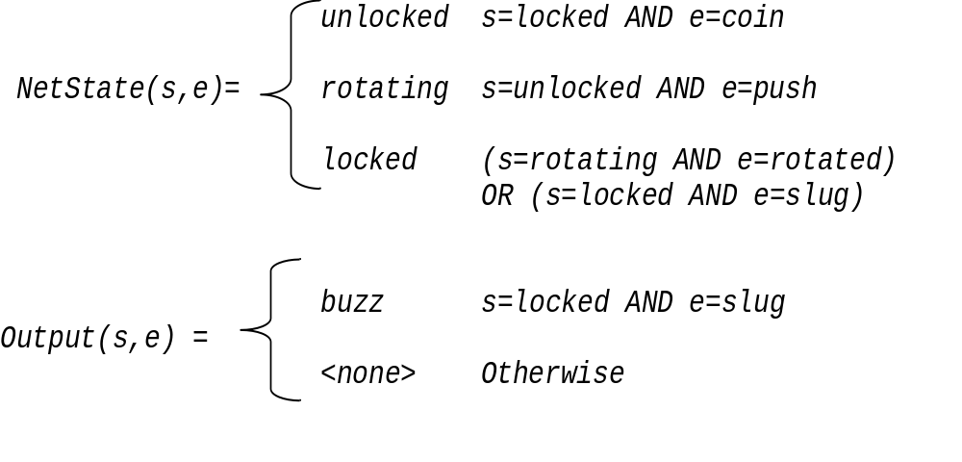
Example: representing turnstile problem（十字转门系统） using two functions
  跟踪转门状态
  基于当前状态和输入，指定十字转门的输出

Slide 43
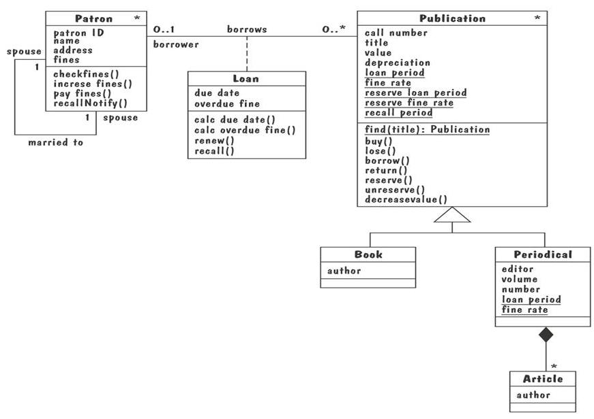
建模表示法—UML类图（图书馆）
∗
∗
Notes:
Patron : 赞助人,资助人，顾客
Spouse : 配偶

Slide 44
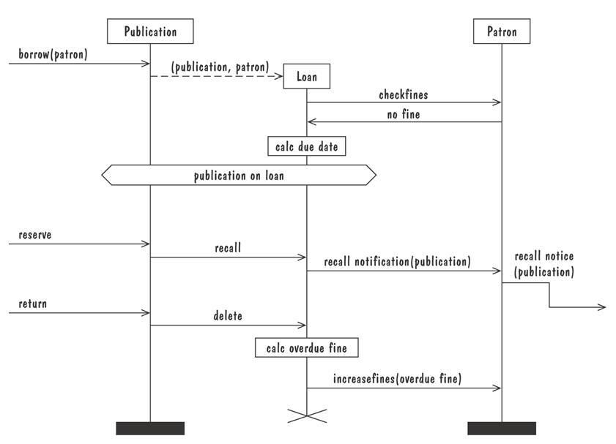
建模表示法—消息时序图
Message sequence chart for library loan transaction

Slide 45
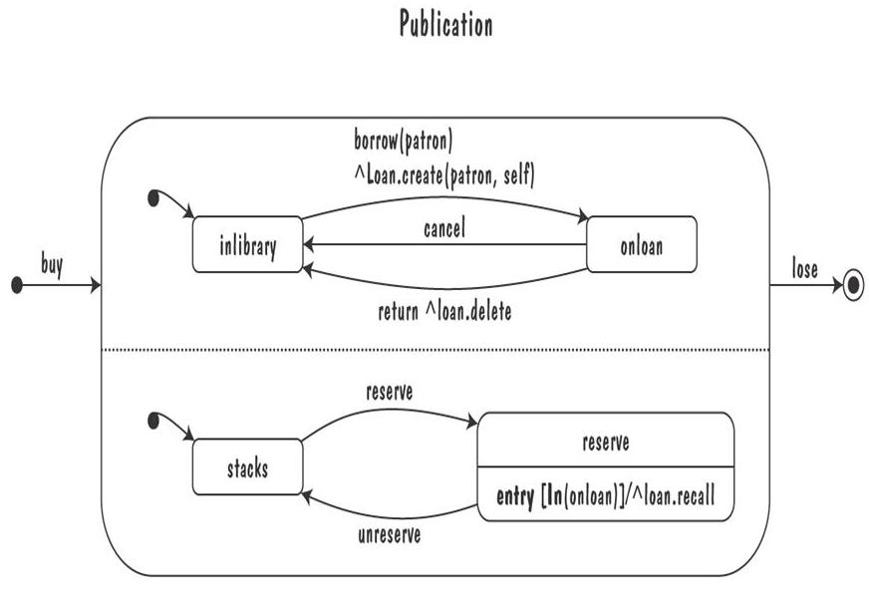
建模表示法—UML状态图（客体：书）

Slide 46
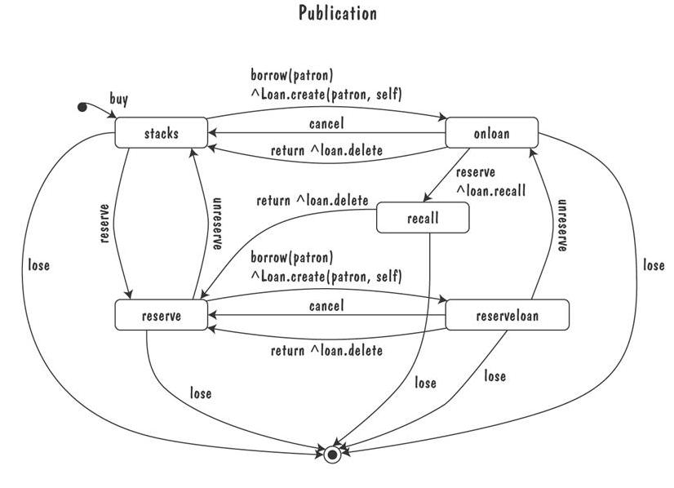
An equivalent statechart

Slide 47
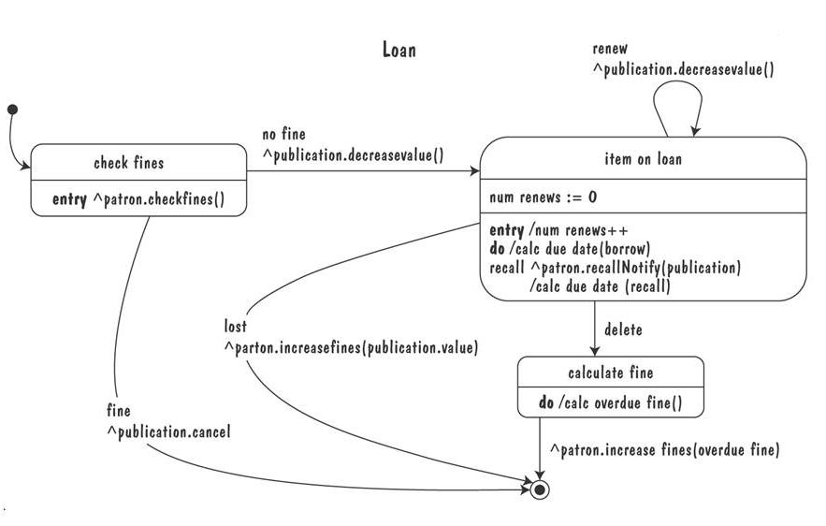
Loan类的状态图

Slide 48
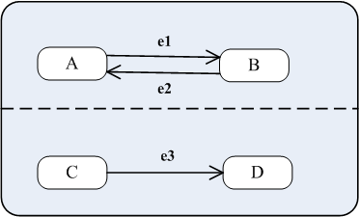
思考题
下述并行状态机的等价顺序状态机？

Slide 49
建模表示法—Petri网
A form or state-transition notation that is used to model concurrent activities and their interaction
  Circles (places) 位置：represent activities or conditions
  Bars represents transitions 变迁
  Arcs connect a transition with its input places and its ouput places
  The places are populated with tokens 令牌, which act as enabling conditions for the transitions
  Each arc can be assigned a weight 权重 that specifies how many tokens are removed from arc's input place, when the transition fires

Slide 50
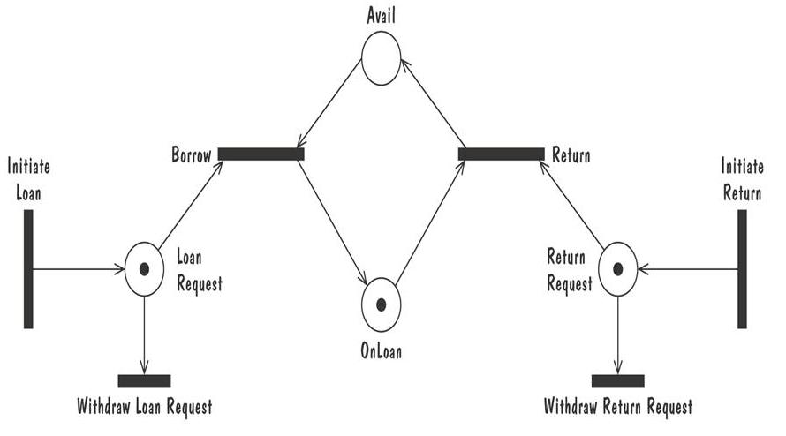
Petri net of book loan

Slide 51
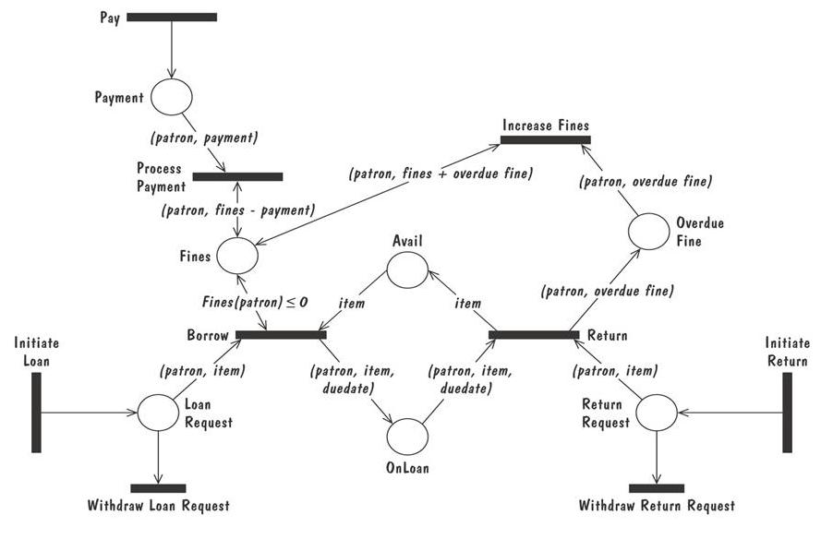

Slide 52
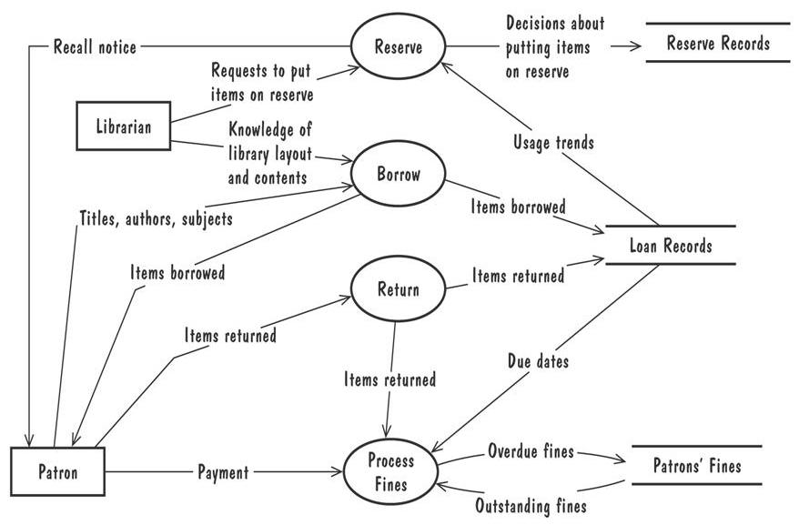
建模表示法—数据流图

Slide 53
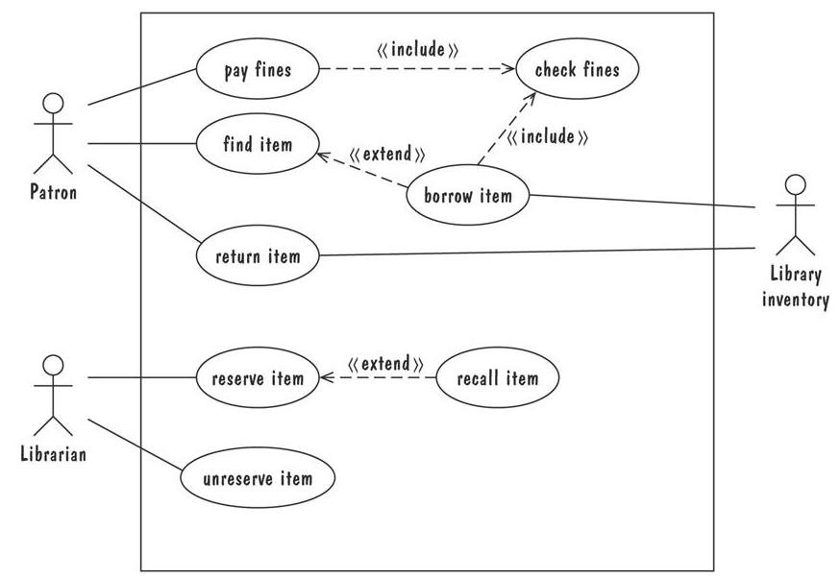
建模表示法—用例图
Notes:
Library inventory: 图书馆存货清单（管理员）

Slide 54
建模表示法—函数和关系
形式化方法: (基于数学)mathematically based specification and design techniques
Formal methods model requirements or software behavior as a collection of mathematical functions 函数 or relations 关系
  Functions specify the state of the system‘s execution, and output（一个输入对应一个输出）
  A relation is used whenever an input value maps more than one ouput value （一个输入可能对应多个输出值）
Functional method is consistent and complete

Slide 55
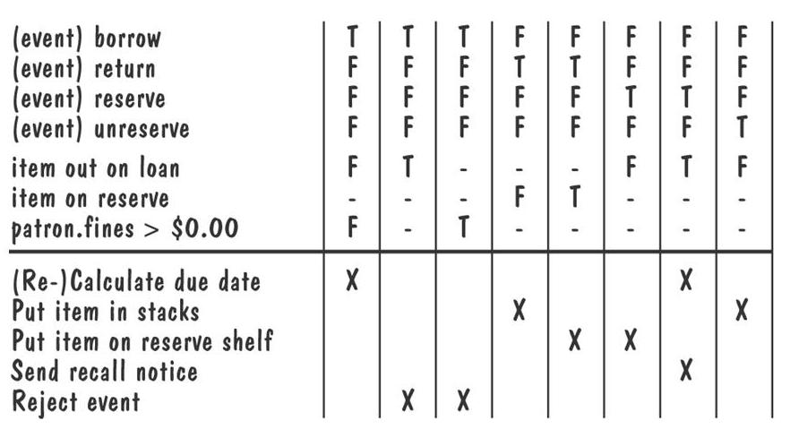
建模表示法—判定表
Decision table for library functions borrow, return, reserve, and unreserve

Slide 56
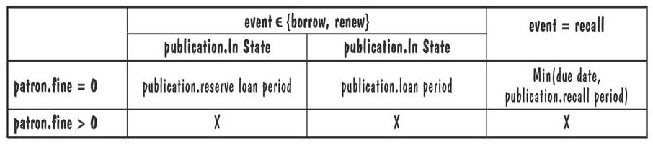
建模表示法—Parnas表
Tabular representations of mathematical functions or relations
  An entry “X” either could be invalid under the specified conditions or the combindation of conditions is infeasible
操作calc due date 的Parnas表

Slide 57
建模表示法—逻辑
An operational notation 操作性表示法 ：对于一个特定的情况，期望的响应是什么
  Model of case-based behavior 基于情况的行为模型
  Examples: state machine 状态机, data-flow diagram 数据流图, functional method 函数方法
A descriptive notation 描述性表示法 ：根据问题或提议的解决方案的性质或者不变行为来进行描述
  Example: logic 逻辑

Slide 58
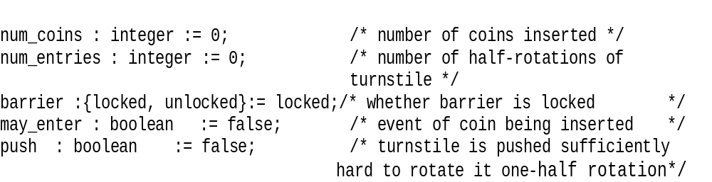
Consider the following variables of turnstile problem（十字转门模型）, with their initial value
The first-order logic expressions
num_coins > num_entries
(num_coins > num_entries ⬄ (barrier = unlocked)
(barrier = locked ) ⬄ ¬may_enter

Slide 59
建模表示法—时态逻辑
Temporal logic时态逻辑 introduces additional logical connectives for constraining how variables can change value over time
  □f Ξ f 现在以及整个后面的执行过程永远为真
  ⋄f Ξ f 现在或者执行过程中将来的某个时刻为真
  ○f Ξ f 执行的下一时刻为真
  f W g Ξ f 直到g为真的那一刻才为真，但是g可能永远不会为真
Turnstile properties expressed in temporal logic
  □(insert_coin => ○ (may_enter W push))
  □(∀n(insert_coin ∧ num_coins=n) => ○(num_coins=n+1))

Slide 60
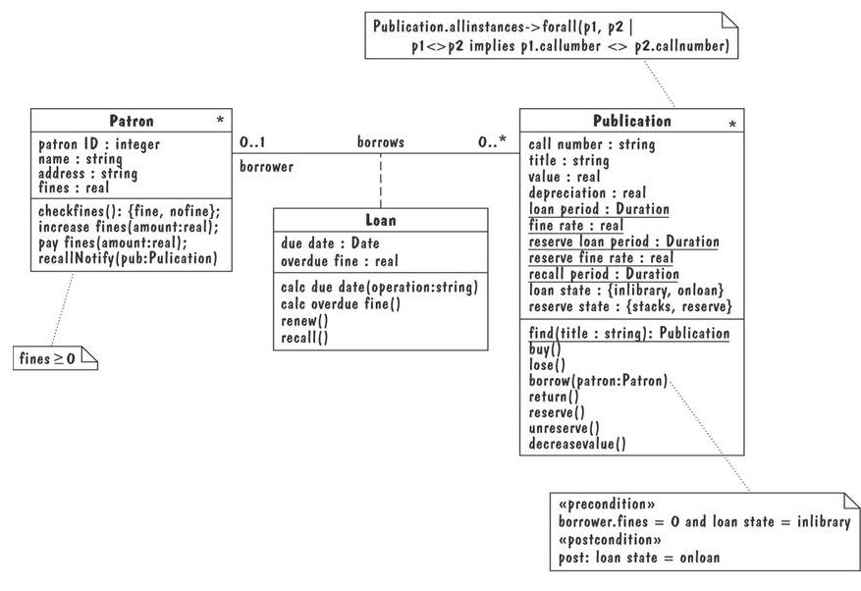
建模表示法—对象约束语言OCL

Slide 61
建模表示法—Z语言
A formal requirements-specification language that
  structures set-theoretic definitions of variables into a complete abstract-data-type model of problem
  uses logic to express the pre- and post-conditions for each operation
Method of abstractions are used to decompose a specification into manageable sized modules, called schemas （模式）

Slide 62
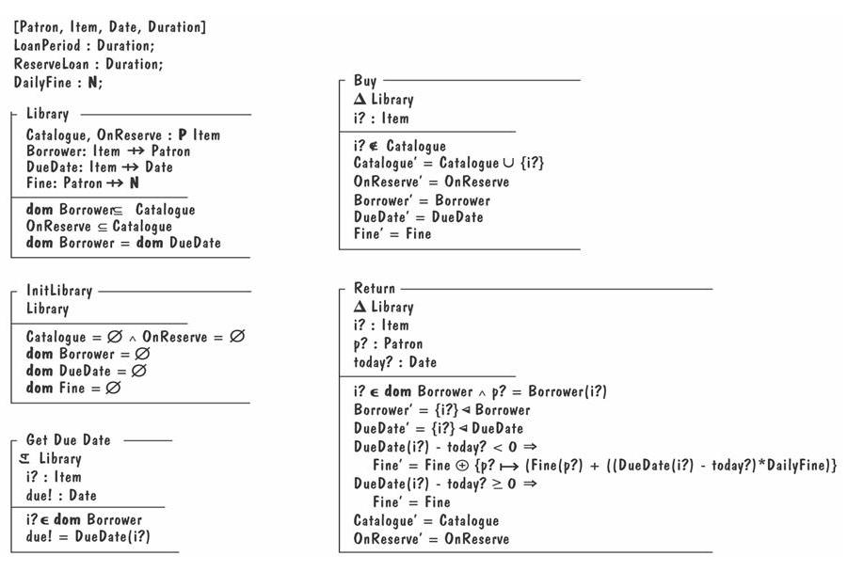

Slide 63
建模表示法—代数规格说明
To specify the behavior of operations by specifying interactions between pairs of operations rather than modeling individual operations
It is hard to define a set of axioms that is complete and consistent and that reflects the desired behavior

Slide 64
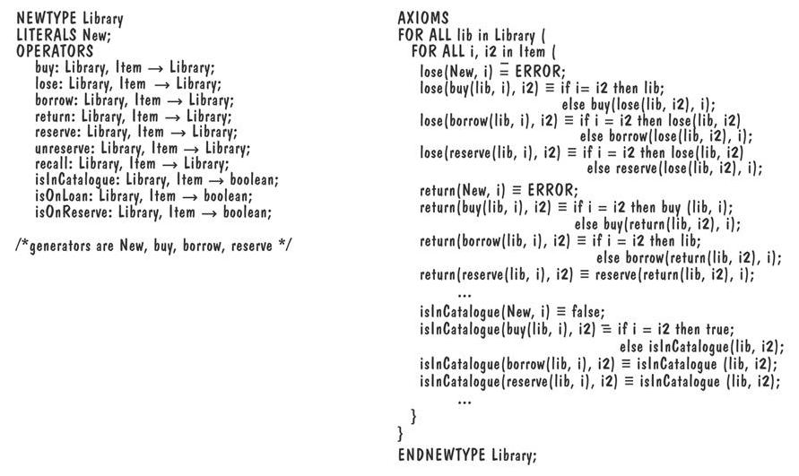
规格说明和描述语言 SDL

Slide 65
建模表示法—统一建模语言UML
Combines multiple notation paradigms
Eight graphical modeling notations, and the OCL constrain language, including
  Use-case diagram 用例图 (a high-level DFD)
  Class diagram 类图 (an ER diagram)
  Sequence diagram 时序图 (an event trace)
  Collaboration diagram 合作图 (an event trace)
  Statechart diagram 状态图(a state-machine model)
  OCL properties OCL特性 逻辑(logic)

Slide 66
规格说明和描述语言—SDL
Standardized by the International Telecommunication Union
Specifies the behavior of real-time, concurrent, distributed processes that communicate with each other via unbounded message queues: 用于说明实时、并发、分布的进程，通过消息队列进行通讯
Comprises
  SDL system diagram (a DFD): 系统图
  SDL block diagram (a DFD)： 方框图
  SDL process diagram (a state-machine model)：进程图
  SDL data type (algebraic specification)： 数据类型
Often accompanied by a set of Message Sequence Chart (MSC)

Slide 67
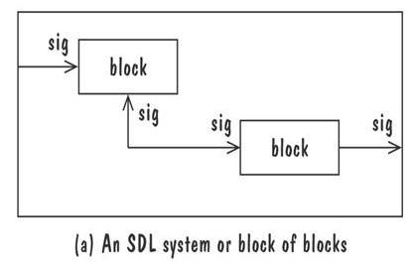
规格说明和描述语言—SDL
SDL系统图（一种DFD）
The top-level blocks of the specification and communication channels that connect the blocks
Channels 信道 are directional and are labelled with the type of signals
Message is asynchronous （异步）

Slide 68
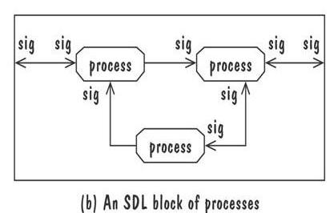
规格说明和描述语言—SDL
SDL 方框图（一种DFD）
SDL block diagram Models a lower-level collection of blocks and the message-delaying channels that interconnect them
Figure depicts a collection of lowest-level processes that communicate via signal routes
Signal routes 信号路由 pass messages synchronously（同步）

Slide 69
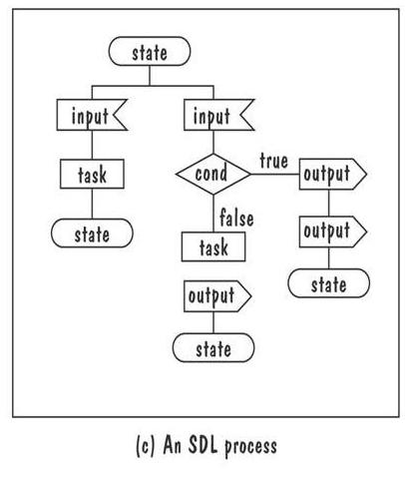
SDL进程图（一种状态机模型）It is a state-machine whose transitions are sequences of language constructs (input, decisions, tasks, outputs) that start and end at state constructs

Slide 70
软件成本降低SCR
Collection of techniques that were designed to encourage software developers to employ good software-engineering design principles
Models software requirements as a mathematical function 数学模型 REQ, that maps monitored variables to controlled variables （变量间映射）
  monitored variables 监控变量: environmental variables that are sensed by the system
  controlled variables 控制变量: environmental variables that are set by the system
The function REQ is decomposed into a collection of tabular functions 表格式函数 类似Parnas表，每一个函数负责设置一个控制变量的值或者一个项的值

Slide 71
REQ is the result of composing the tabular functions 函数表 into network (a DFD) as shown in the picture.
Edges reflect the data dependecies among the functions： 边表示函数之间的依赖关系
变量值的变化通过网络进行传递
Execution steps start with a change in the value of one monitored variable, then propagate through the network, in a single syncronized step
A
B
C
D
Mode
Condition
Mode
Condition
Mode
Condition
Mode
Condition
Off
True
X
Off
True
X
Off
True
X
Off
True
X
Heat, Maintain
Temp < 175
Temp ≥ 175
Heat, Maintain
Temp < 175
Temp ≥ 175
Heat, Maintain
Temp < 175
Temp ≥ 175
Heat, Maintain
Temp < 175
Temp ≥ 175
Warning’ =
off
on
Warning’ =
off
on
Warning’ =
off
on
Warning’ =
off
on
E
F
Mode
Condition
Mode
Condition
Off
True
X
Off
True
X
Heat, Maintain
Temp < 175
Temp ≥ 175
Heat, Maintain
Temp < 175
Temp ≥ 175
Warning’ =
off
on
Warning’ =
off
on

Slide 72
原型化需求
To elicit the details of proposed system
To solicit feedback from potential users about
  what aspects they would like to see improve
  which features are not so useful
  what functionality is missing
Determine whether the customer's problem has a feasible solution
Assist in exploring options for otimizing quality requirements

Slide 73
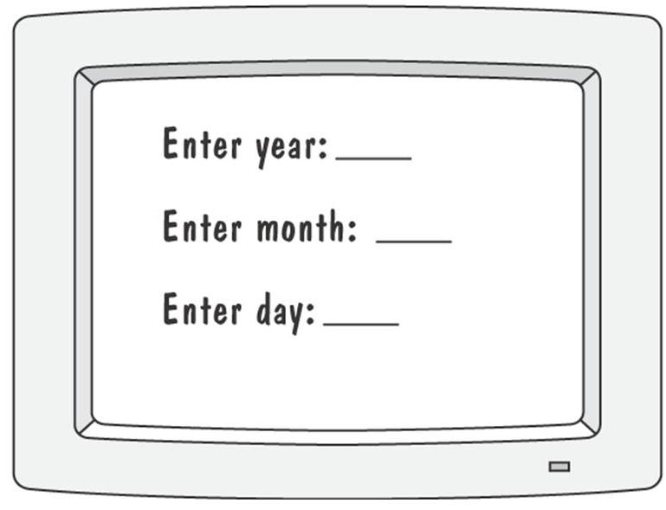
原型化需求—原型
Prototype for building a tool to track how much a user exercises each day
Graphical respresentation of first prototype, in which the user must type the day, month and year

Slide 74
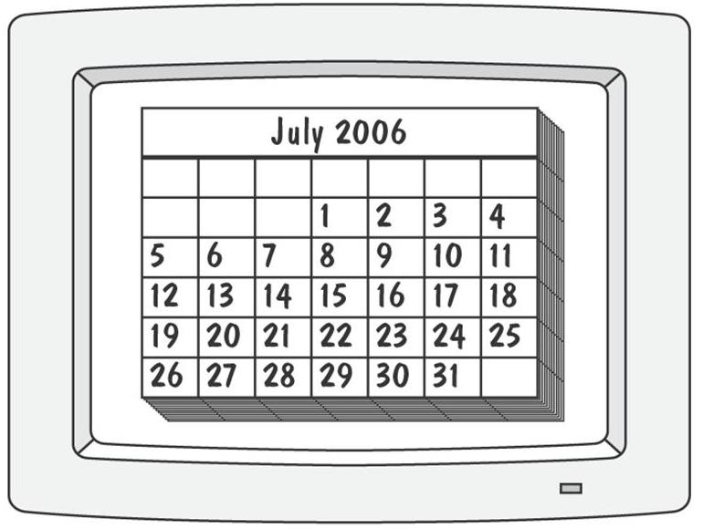
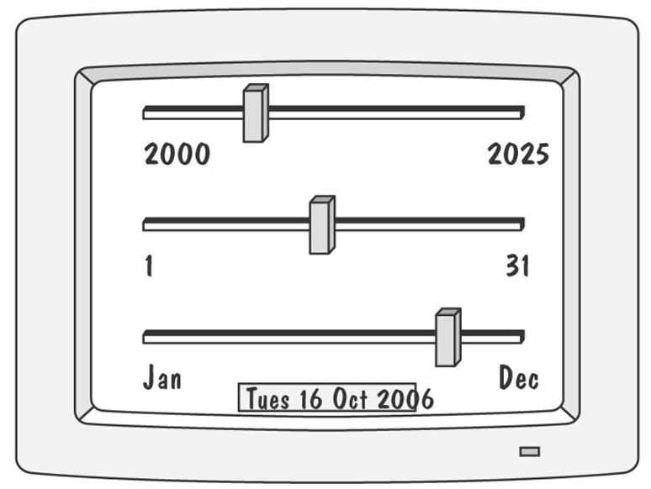
原型

Slide 75
原型化需求—原型
Throwaway approach：抛弃型原型
  Developed to learn more about a problem or a proposed solution, and that is never intended to be part of the delivered software
  Allow us to write “quick-and-dirty”
Evolutionary approach：演化型原型
  Developed not only to help us answer questions but also to be incorporated into the final product
  Prototype has to eventually exhibit the quality requirements of the final product, and these qualities cannot be retrofitted
Both techniques are sometimes called rapid prototyping 快速原型化

Slide 76
需求定义
Outline the general purpose and scope of the system, including relevant benefits, objectives, and goals
Describe the background and the rationale behind proposal for new system
Describe the essential characteristics of an accepatable solution
Describe the environment in which the system will operate
Outline a description of the proposal, if the customer has a proposal for solving the problem
List any assumptions we make about how the environment behaves

Slide 77
需求规格说明
详细描述所有的输入和输出
  the sources of inputs
  the destinations of ouputs,
  the value ranges
  data format of inputs and output data
  data protocols
  window formats and organizations
  timing constraint
根据接口的输入和输出重新陈述要求的功能
对每一个客户的质量需求，设计适配标准，以便于能够最后证明我们的系统满足了这些质量需求

Slide 78
Intodruction to the Document
  1.1 Purpose of the Product
  1.2 Scope of the Product
  1.3 Acronyms, Abbreviations, Definitions
  1.4 References
  1.5 Outline of the rest of the SRS
General Description of Product
  2.1 Context of Product
  2.2 Product Functions
  2.3 User Characteristics
  2.4 Constraints
  2.5 Assumptions and Dependencies
Specific Requirements
  3.1 External Interface Requirements
    3.1.1 User Interfaces
    3.1.2 Hardware Interfaces
    3.1.3 Software Interfaces
    3.1.4 Communications Interfaces
  3.2 Functional Requirements
    3.2.1 Class 1
    3.2.2 Class 2
    …
  3.3 Performance Requirements
  3.4 Design Constraints
  3.5 Quality Requirements
  3.6 Other Requirements
Appendices
需求规格说明标准

Slide 79
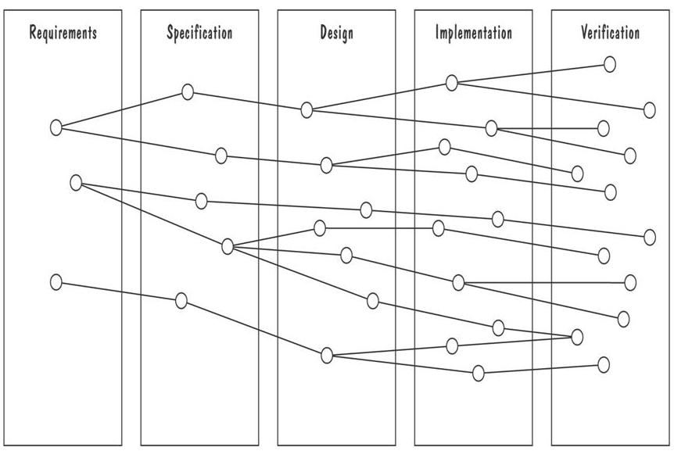
过程管理和需求的可追踪性

Slide 80
确认和验证
In requirements validation 需求确认, we check that our requirements definition accurately reflects the customer's needs
In verification 验证, we check that one document or artifact conforms to another
Verification ensures that we build the system right, whereas validation ensures that we build the right system

Slide 81
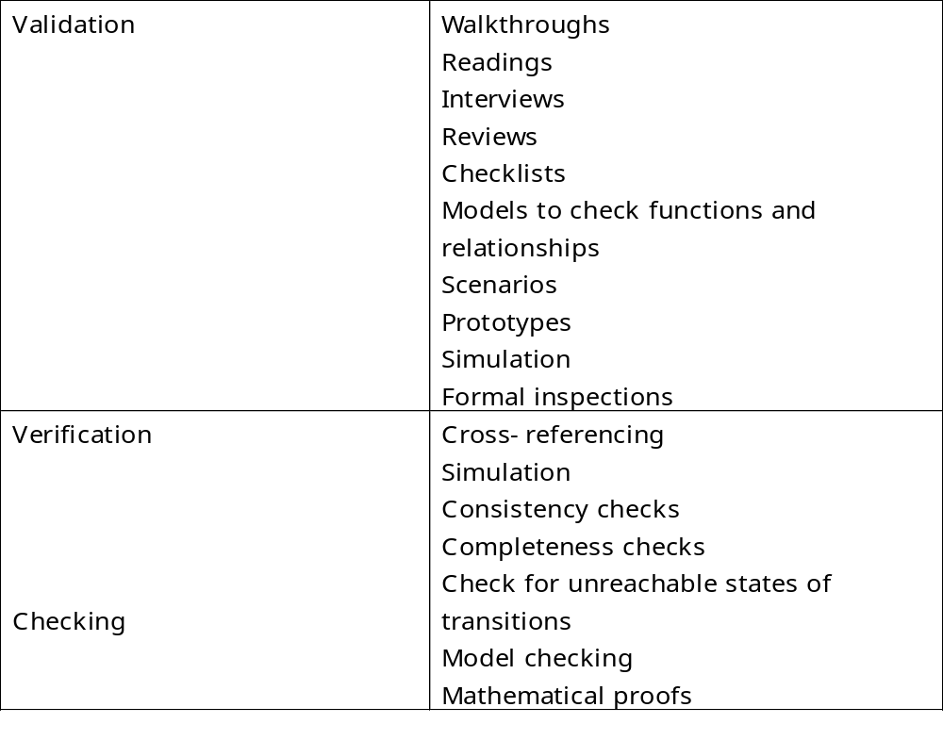
需求确认和验证技术

Slide 82
需求评审
Review the stated goals and objectives of the system
Compare the requirements with the goals and objectives
Review the environment in which the system is to operate
Review the information flow and proposed functions
Assess and document the risk, discuss and compare alternatives
Testing the system: how the requirements will be revalidated as the requirements grow and change

Slide 83
验证
Check that the requirements-specification document corresponds to the requirements-definition 检查需求规格说明文档是否对应于需求定义文档
Make sure that if we implement a system that meets the specification, then the system will satisfy the customer's requirements
Ensure that each requirement in the definition document is traceable to the specification

Slide 84
验证
Model checking 模型检查 is an exhaustive search for a specification's execution space, to determine whether some temporal-logic property holds of the execution
  Atlee (1996) used the SMV model checker to verify five properties of an SCR specification of the A-7 naval aircraft
A theorem prover 定理证明器 uses a collection of built-in theories, inference rules, and decision procedures for determining whether a set of asserted facts logically entails some unasserted fact
  Dutertre and Stavridou (1997) used theorem prover PVS to verify some of the functional and safety requirements of an avionic system

Slide 85
测量需求评分1-5
You understand this requirement completely, have designed systems from similar requirements, and have no trouble developing a design from this requirement
Some elements of this requirement are new, but they are not radically different from requirements that have been successfully designed in the past
Some elements of this requirement are very different from requirements in the past, but you understand the requirement and can develop a good design from it
You cannot understand some parts of this requirement, and are not sure that you can develop a good design
You do not understand this requirement at all, and can not develop a design

Slide 86
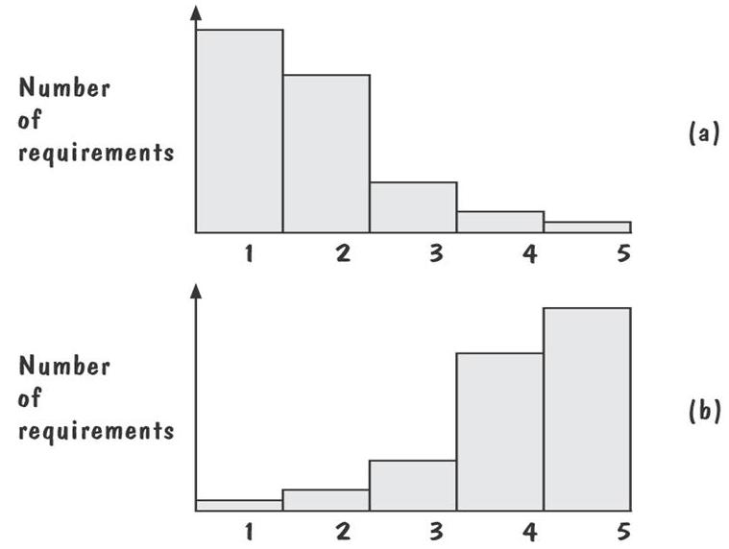
Figure (a) shows profiles with mostly 1s and 2s
  The requirements are in good shape （1,2分多）
Figure (b) shows profiles with mostly 4s and 5s
  The requirements should be revised（4,5分多）

Slide 87
选择规格说明技术特性
适用性
可实现性
可测试性/模拟
可检查性
可维护性
模块化
抽象层次/可表达性
合理性
可验证性
运行时安全性
工具成熟度
宽松性
学习曲线
技术成熟度
数据建模
纪律性

Slide 88
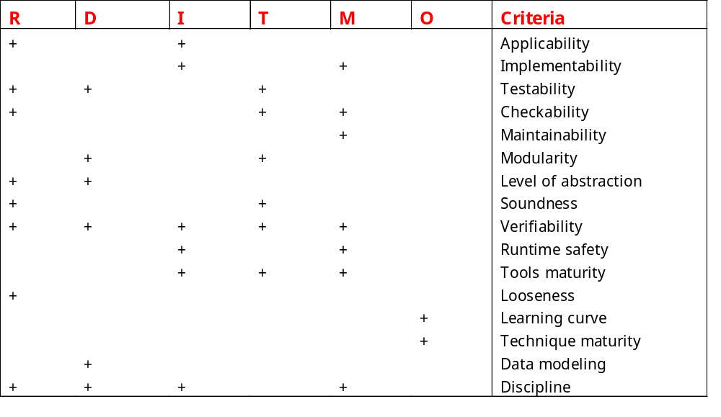
系统生命期中规格说明标准的重要性
R=Requirements, D=Design, I=Implementation, T=Testing, M=Maintenance, O=Other

Slide 89
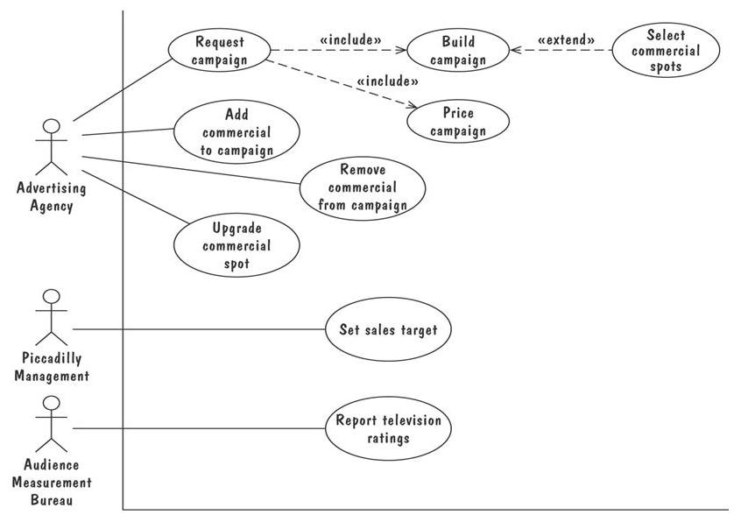
信息系统例子-皮卡地里电视广告

Slide 90
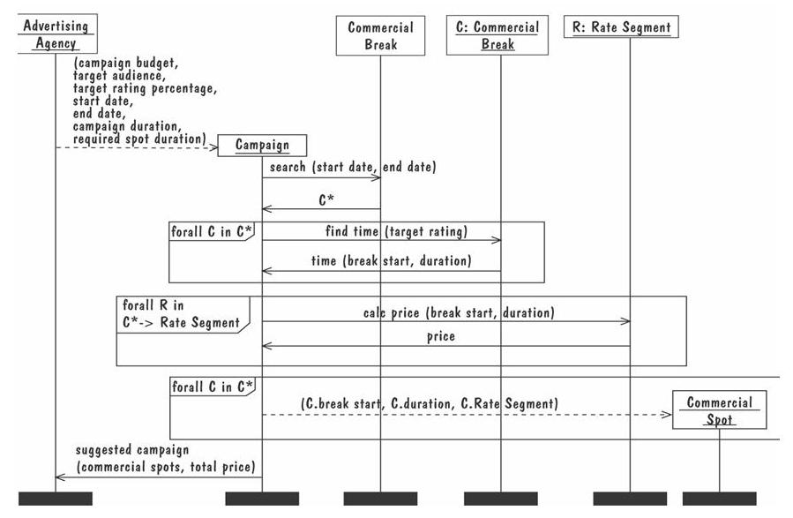

Slide 91
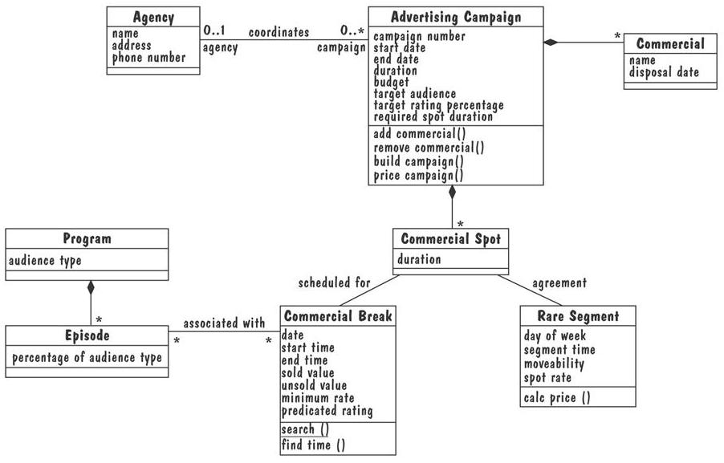

Slide 92
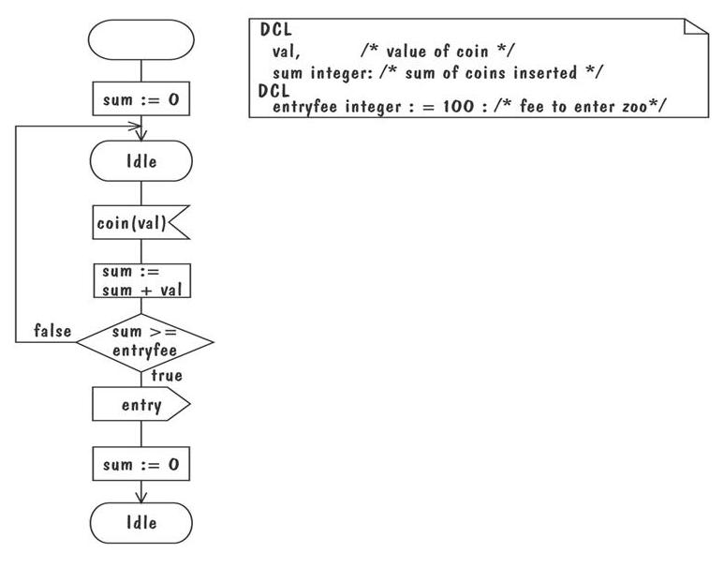
实时系统例子-SDL模型

