Slide 1

TDA for the user
Seminar 1
10/01/23
Eduardo Paluzo-Hidalgo

Slide 2
Steps:
Data manipulation
Persistent homology
2.1 Filtration
2.2 Vectorization
Machine Learning

Slide 3




(https://www.anaconda.com/)
First: environment
Second:
Terminal
Notebook
Coding

Slide 4
Library installation
https://github.com/Cimagroup/vectorization-maps
In the downloaded folder:
pip install –r requirements.txt
pip install .

Slide 5
Steps:
Data manipulation
Libraries:
numpy (https://numpy.org/doc/stable/)
pandas (https://pandas.pydata.org/)

Slide 6
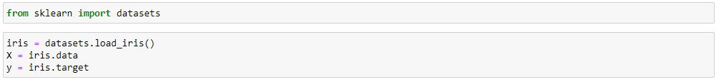
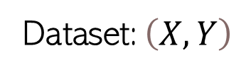
Steps:
Data manipulation
Libraries:
numpy (https://numpy.org/doc/stable/)
pandas (https://pandas.pydata.org/)
Dataset: $\left(X,Y\right)$

Slide 7
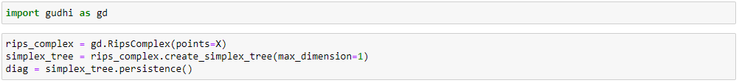
Persistent homology
2.1 Filtration
ripser
Gudhi
Giotto-tda (pip install giotto-tda)

Slide 8
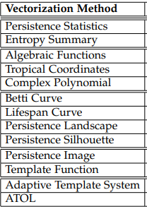
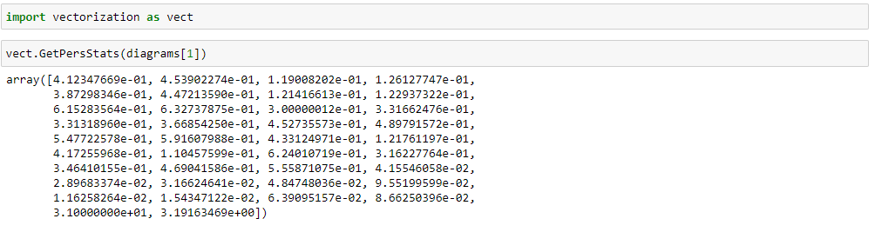
Persistent homology
2.2 Vectorization

Slide 9
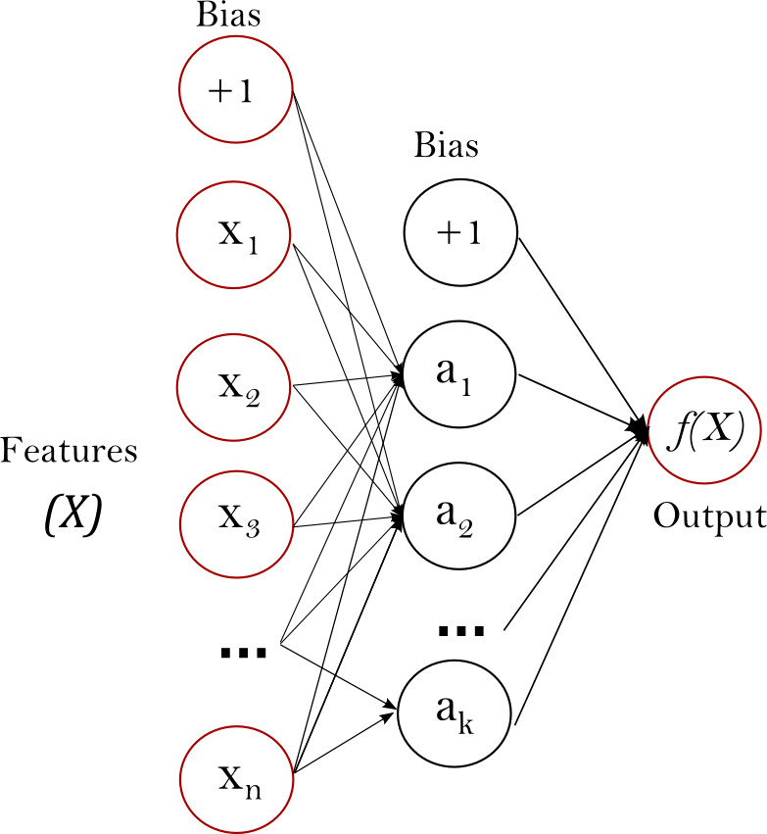
3. Machine Learning
Split the dataset in training, (validation), and test
Fit machine learning model using the vectorization method as input
Evaluate on test set

Slide 10
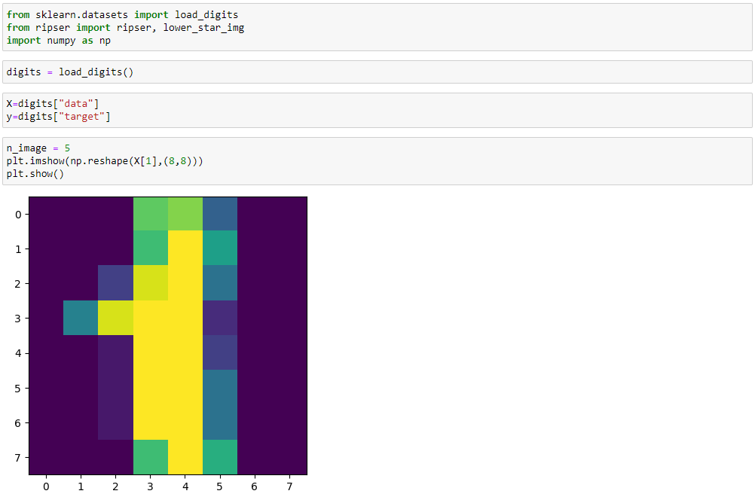
Example

Slide 11
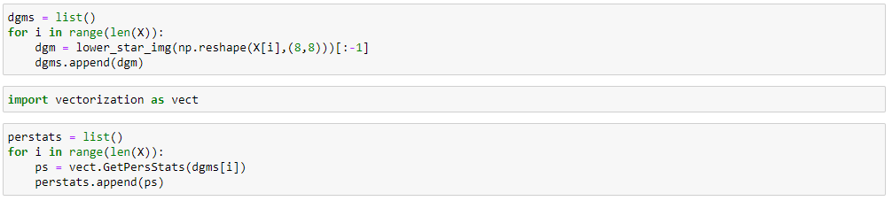
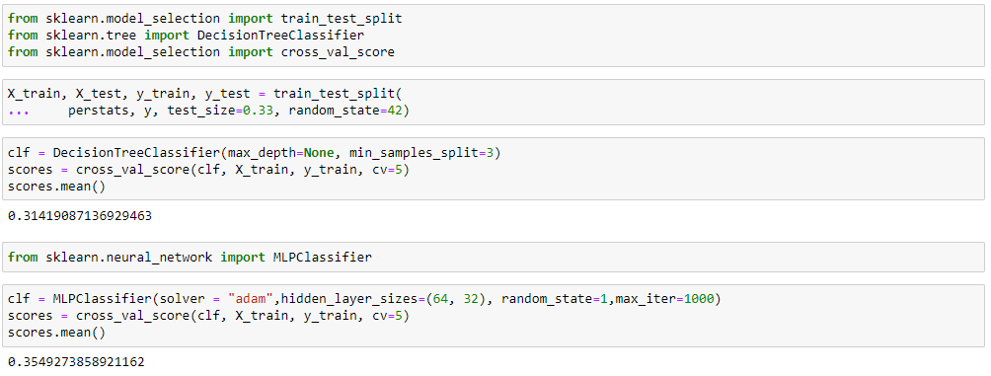
Example

Slide 12
Example
Gracias

