Slide 1
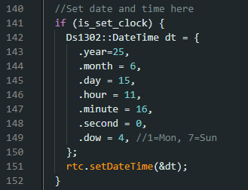
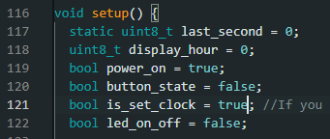

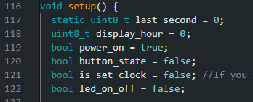
CelesDial Set clock
Adjust date and time
is_set_clock = true;
Upload to Arduino
Run it around 1 mins to
check if correct date/time
is_set_clock = false;
Upload to Arduino
Finish

