Slide 1
Spring-WS
Adam Kohring
Mar 28, 2013

Slide 2
Agenda
What is Spring Web Services?
Writing Contract-First Web Services
Publishing the WSDL
Handling Exceptions
Intercepting Requests
Server-Side Testing
Spring-WS Security

Slide 3
Why Spring-WS?
Powerful mappings
Reuses your Spring expertise
Supports WS-Security
Built by Maven
Apache license

Slide 4
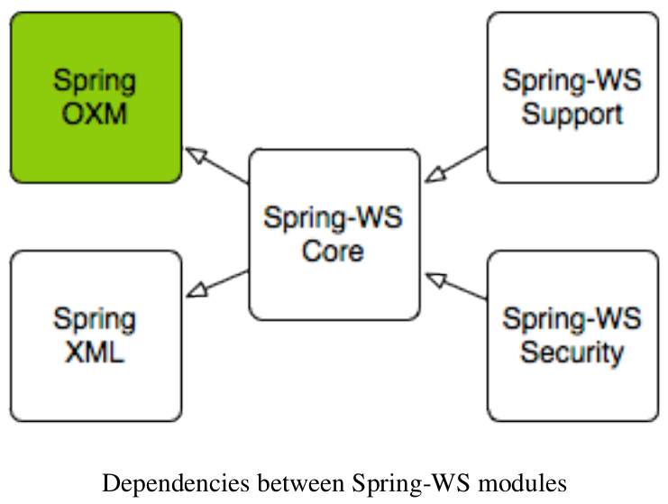
Runtime Environment
Requires Java 1.5 or higher Runtime Environment
Requires Spring 3.0 or higher

Slide 5
The Contracts
Service Contract
  Web Service Definition Language (WSDL)
Data Contract
  XML Schema (XSD)
  DTDs
  RELAX NG
  Schematron

Slide 6
Why Contract First?
This is an interview question!
Spring-WS ONLY supports the contract-first development style. Why?
What are the pitfalls of contract-last?

Slide 7
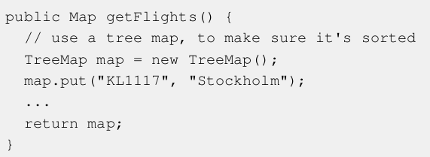
Unportable Types
Web Services should be interoperable.

Slide 8
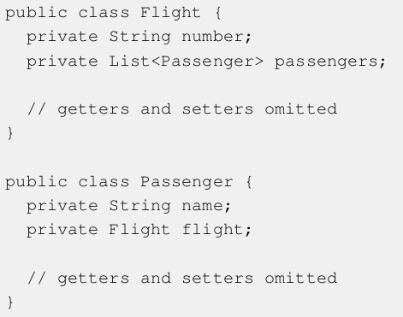
What happens when this is converted to XML?

Slide 9
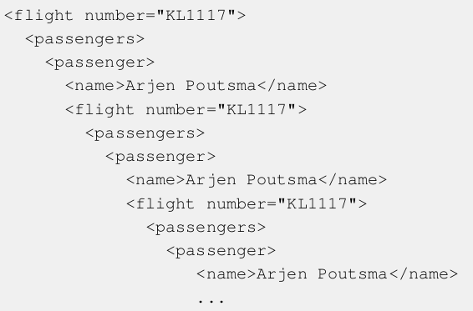
Cyclic Graphs

Slide 10
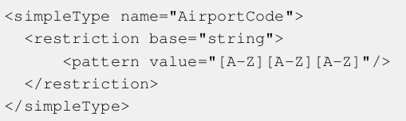
XSD Extensions
In Java, the only way to change the behavior of a class is to subclass it, adding the new behavior to that subclass.
In XSD, you can extend a data type by restricting it: that is, constraining the valid values for the elements and attributes.

Slide 11
Versioning
In order for a contract to be useful, it must remain constant for as long as possible.
If using contract-first, we can have a looser coupling between contract and implementation.

Slide 12
Contract
Demo

Slide 13
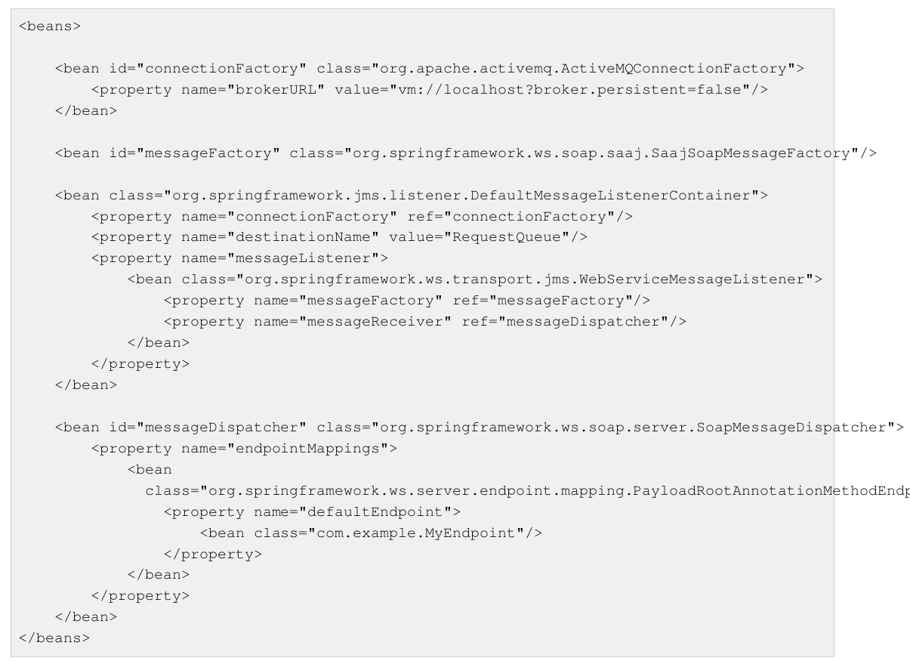
JMS Transport

Slide 14
spring-ws.xml
Demo

Slide 15
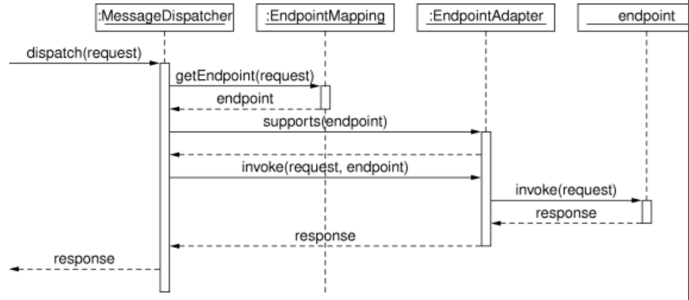
Message Dispatcher

Slide 16
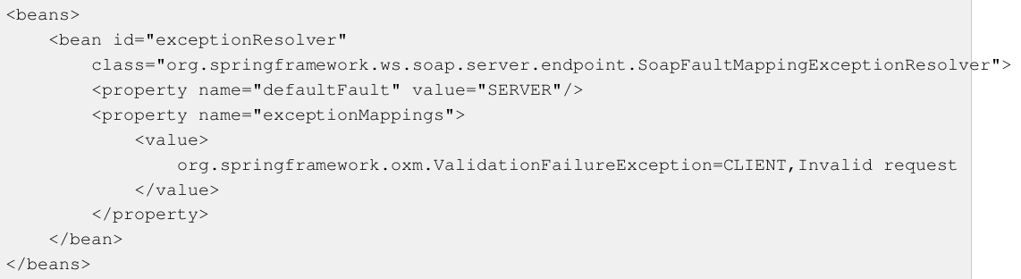
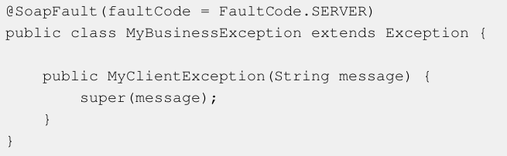
EndpointExceptionResolver
SimpleSoapExceptionResolver

Slide 17
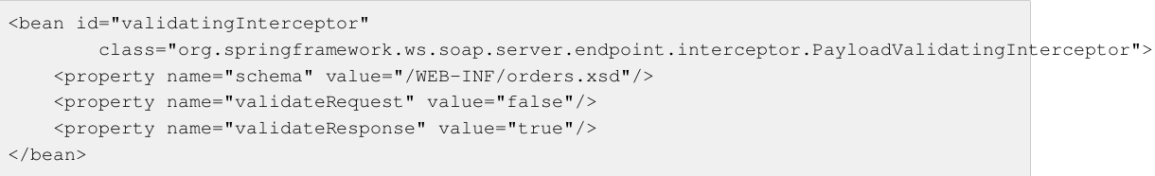
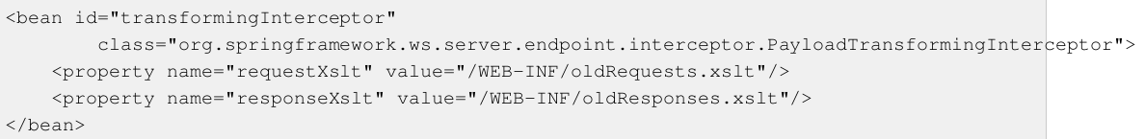
EndpointInterceptor

Slide 18
Server-Side Testing
Write Unit Tests, where you provide (mock) arguments for your endpoint to consume.
The advantage of this approach is that it's quite easy to accomplish (especially for classes annotated with @Endpoint); the disadvantage is that you are not really testing the exact content of the XML messages that are sent over the wire.
Write Integrations Tests, which do test the contents of the message.

Slide 19
WS-Security
Authentication
Digital signatures
Encryption and Decryption
Note that WS-Security (especially encryption and signing) requires substantial amounts of memory, and will also decrease performance. If performance is important to you, you might want to consider not using WS-Security, or simply use HTTP-based security.
All of these three areas are implemented using the XwsSecurityInterceptor or Wss4jSecurityInterceptor

Slide 20
WS-Security
XwsSecurityInterceptor vs. Wss4jSecurityInterceptor
XWSS requires both a SUN 1.5 JDK and the SUN SAAJ reference implementation. The WSS4J interceptor does not have these requirements.
If you are planning to use Axiom message factory or JDK 1.4 for instance, you will have to go for WSS4J.
As for the configuration, XWSS uses its own xml file whereas WSS4J's configuration is property-based.
Both solutions are functionally equivalent and implemented as endpoint interceptors so you could switch from one to another at a later point without impacting the design of your services.

Slide 21
ws-security
Demo

Slide 22

References
http://www.springsource.org/documentation
https://github.com/SpringSource

