Slide 1
HW2 MIDTRM PRE
Group5
Huang Hongnan, Li Zhengguang, Wu Gefei

Slide 2
CONTENTS
02
Code Construction and Model Evaluation
01
Anomaly Detection Model Construction

Slide 3
01
Anomaly Detection Model Construction

Slide 4
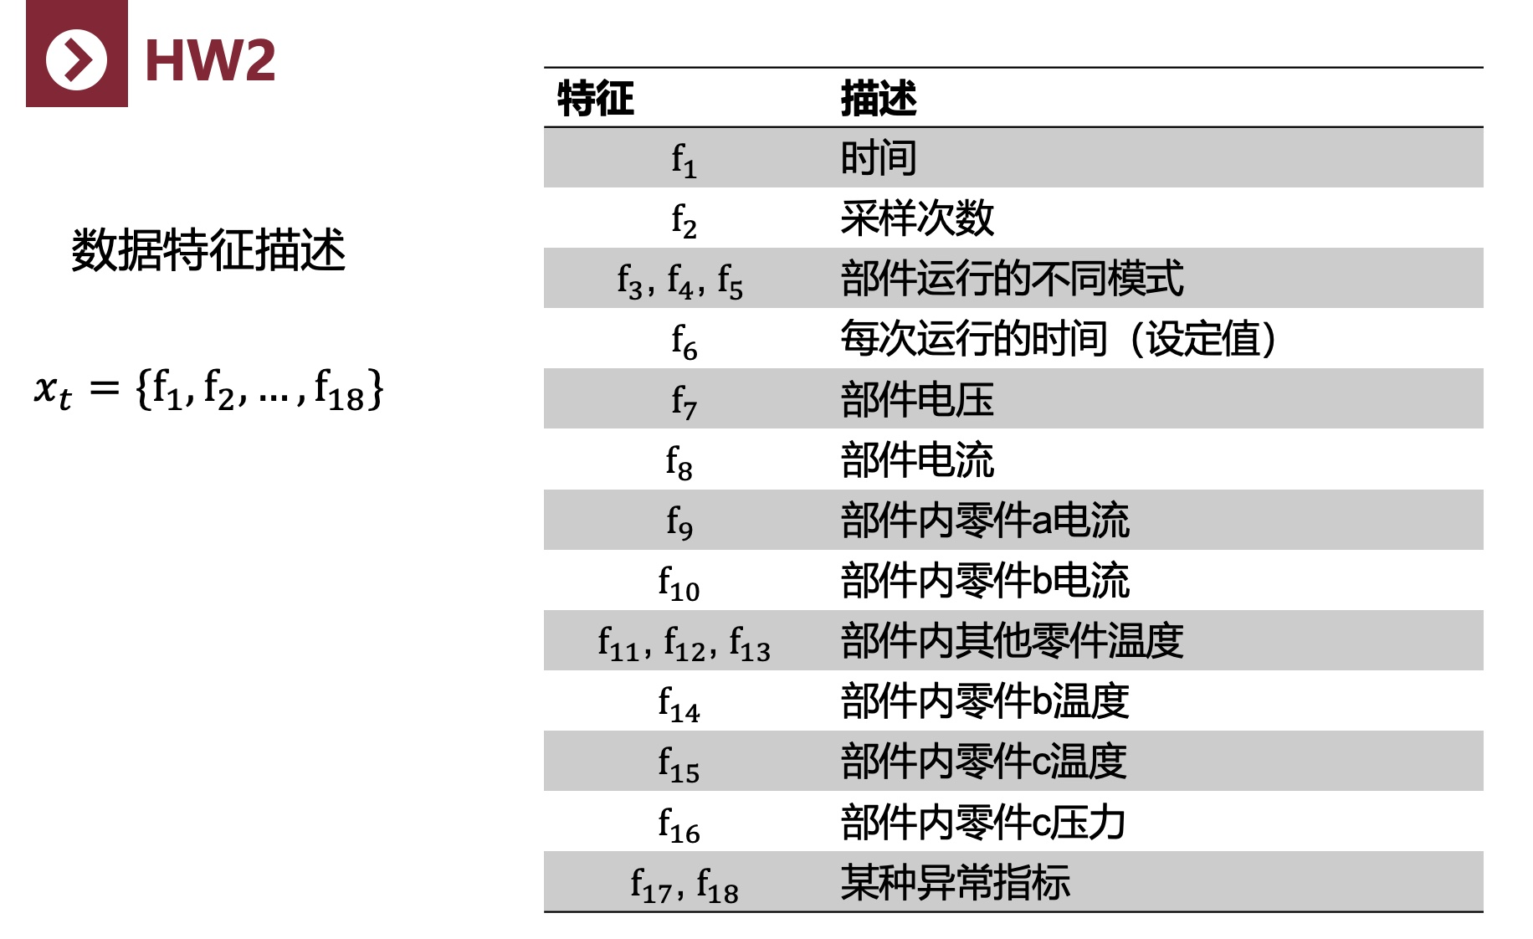
Preliminary Model Development
According to the requirements of HW 2, the table below shows that f17 and f18 are indicators used to define anomalies. Additionally, based on the tube.csv file, we can determine that if either f17 or f18 is nonzero, the device is considered faulty.

Slide 5

LET’S HAVE A LOOK
However, even if we extract the abnormal indicators from f17 and f18 in the five tubes, we only obtain 99 abnormal features. Therefore, it is still necessary to define additional parameter indicators to achieve more optimal fault detection results, which will require support from relevant literature.

Slide 6
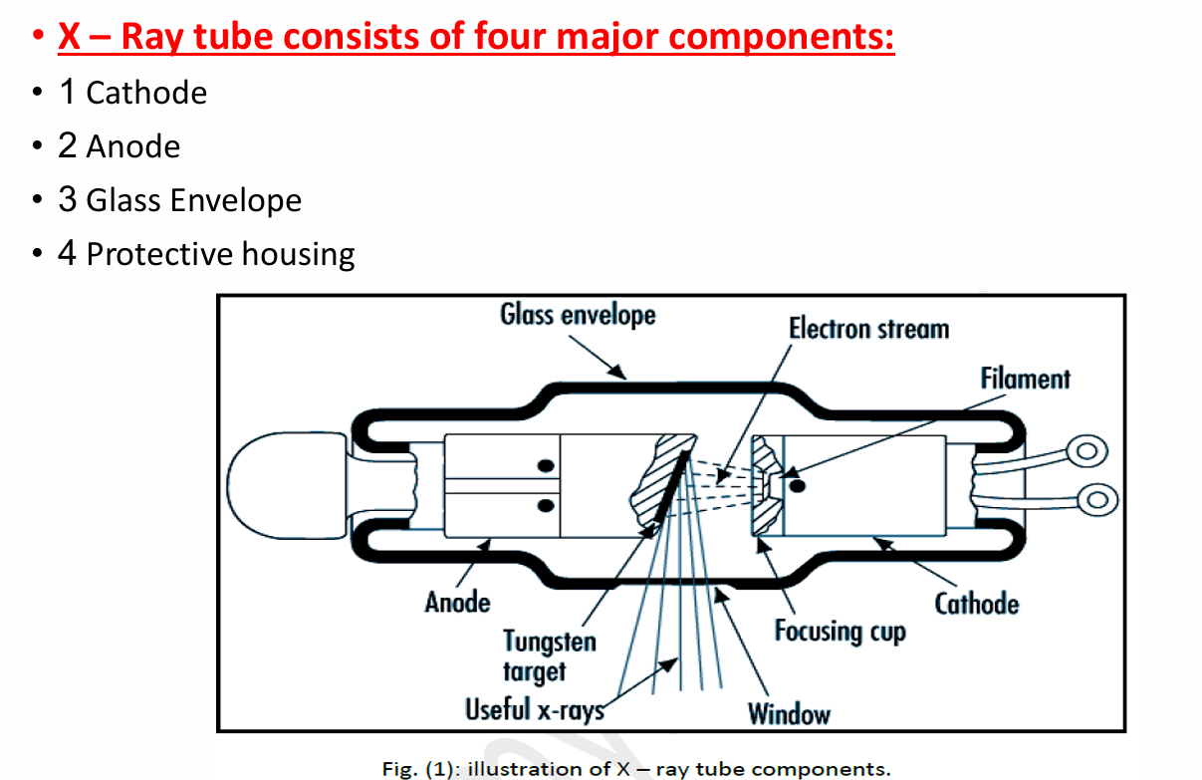
Paper Assistance
Christensen's Physics of Diagnostic Radiology - Thomas S. Curry, James E. Dowdey, Robert C. Murry - Google 图书
I. X-ray Machine
The voltage range for diagnostic X-ray machines is typically 25–150 kVp, with a tube current range of 100–1200 mA.
- Cathode
- Filament: When heated, the filament emits electrons via thermionic emission. It is usually made of thoriated tungsten, which has a high melting point (3410°C) and low evaporation rate.
- Focusing Cup: Applies a negative voltage to focus the electron beam onto the anode’s focal spot.
- Anode
- Anodes are classified as either stationary or rotating.
- The typical rotational speed for rotating anodes is 3200–5000 rpm, which helps distribute heat and prevent localized overheating.
- Focal Spot
- This is the area on the anode where electrons strike and X-rays are produced. Common focal spot sizes are 1.0 and 0.6 mm.
- Glass Envelope
- Modern X-ray tubes may use a metal envelope design to avoid arcing issues caused by tungsten vapor deposition.
- The tube window is a thin glass area of about 5 cm², through which useful X-rays are emitted.
- Protective Housing
- The housing is lined with lead to shield against unnecessary radiation and prevent electric shock.
- It typically contains insulating oil for cooling and electrical insulation; some designs also use fans to enhance heat dissipation.

Slide 7
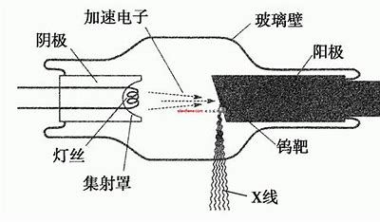
Typical Failures and Damage:
Failure to rotate the anode may cause localized overheating, resulting in cracks or ablation.
Slow rotation or overloading can also damage the anode surface and shorten its lifespan.

Slide 8
Drawing on our expertise in equipment systems, we have engineered several new features with practical significance based on raw signals, flow rate, voltage, current, temperature, and other variables, as detailed below:
02
01
03
Thermal Effect Feature for Component B (q_b):
By multiplying the square of current f10 with temperature f14, this feature models rapid fluctuations in heat generated within component B under load conditions, helping to detect abnormal heating.
Arrhenius Feature for Component C (arrhenius_c): Using a modified Arrhenius equation—combining the logarithm of pressure f16 with the reciprocal of temperature f15—this feature captures changes in the activation state at complex reaction sites.
Power Feature (power): Calculated by multiplying flow rate f7 and voltage f8, this feature reflects changes in the energy input to the device.

Slide 9
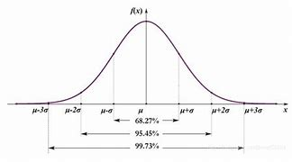
Further Model Development
For these new features, we employed statistical methods to define outlier detection intervals (using mean ± 0.5 standard deviation as the threshold, to tighten the criteria and reduce false positives by only labeling the most anomalous samples), and marked anomalies for each feature individually.

Slide 10

This approach not only enhances the physical reliability of the labels but also enables our model to capture subtle anomalous signals more effectively. Ultimately, by using all original and newly constructed features as inputs for machine learning, we built a fault detection model that maximizes the use of multidimensional operational data from the equipment, achieving more practically meaningful and engineering-relevant anomaly detection.

Slide 11
02
Code Construction and Model Evaluation

Slide 12
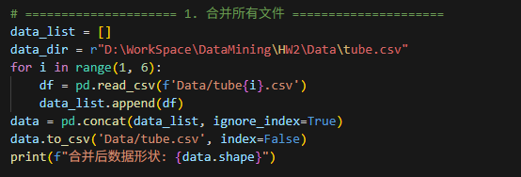
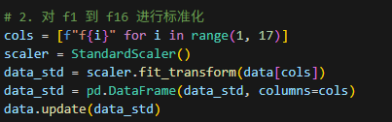
Merge the tube.csv file and standardlize the data

Slide 13
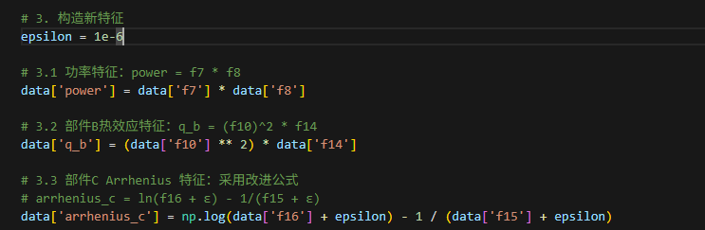
Construct new features

Slide 14
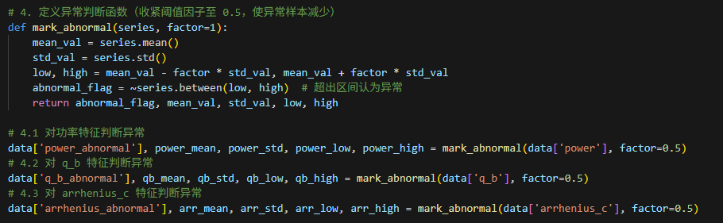
Define the exception function and perform three kinds of exception feature judgment

Slide 15
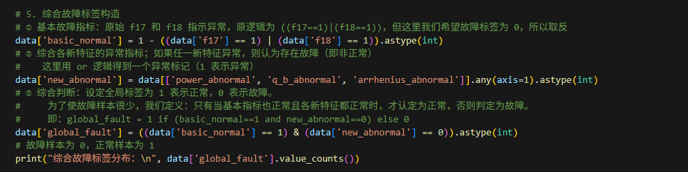
Comprehensive Anomaly Detection Structure

Slide 16

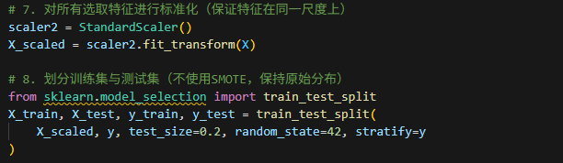

Slide 17
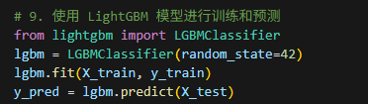

Slide 18


Results

Slide 19
THANKS!

