Slide 1
GifLang
Universal translation and sentiment detection for the English language

Slide 2
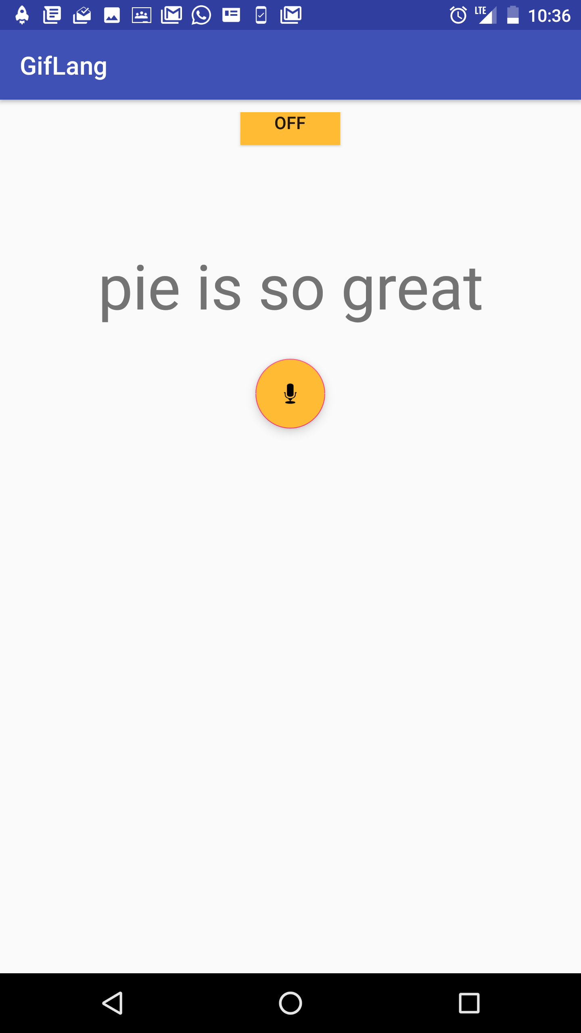
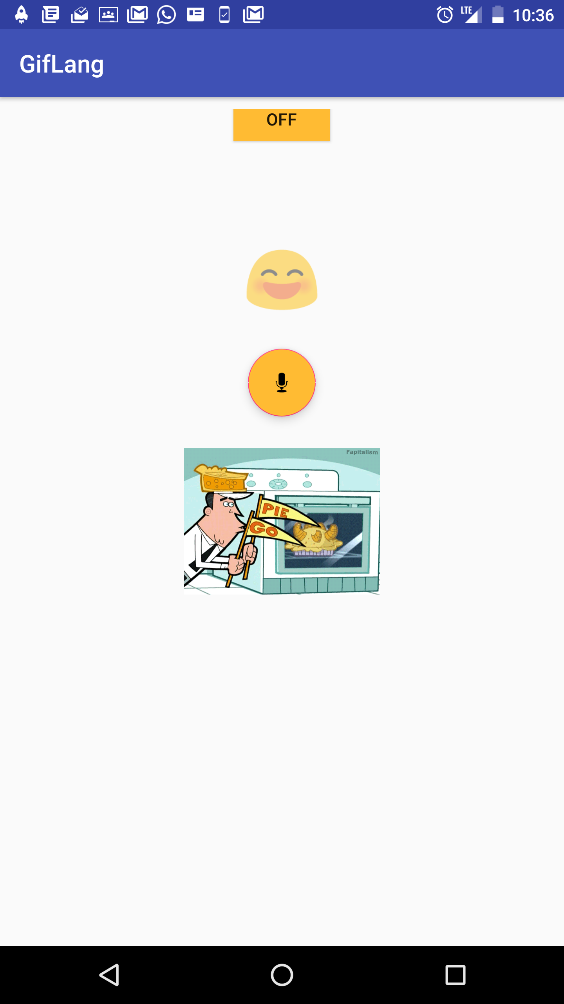
Try it out now!

Slide 3
On/Off Switch™
Entity Analysis by Natural Language API on GCP™
Sentiment Analysis by Google Cloud Platform™
Translation into universally understood images from Giphy™

