Slide 1
Tensor Calculus Introduction

Slide 2
Tensor Calculus Introduction
What is Tensor Calculus?
Why would you want to study it?
What do I need to start?

Slide 3
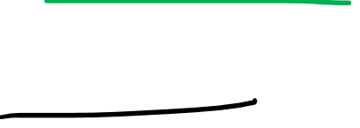
Tensor Calculus = study of how tensors change over space

Slide 4
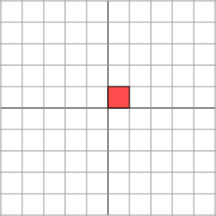
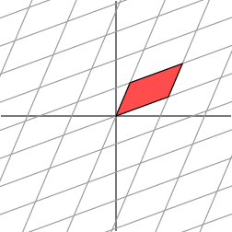
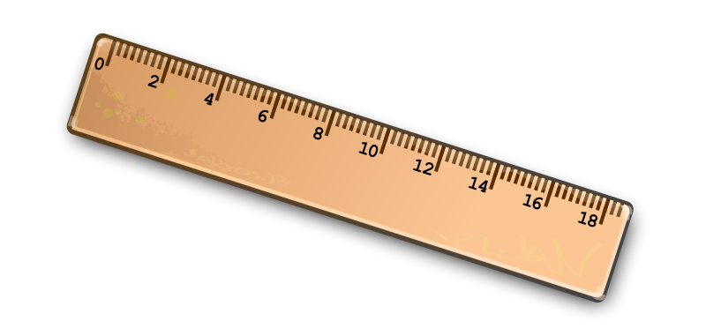
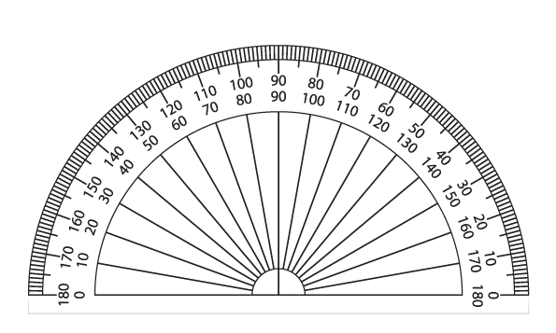
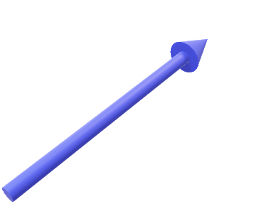

From my “Tensors for Beginners” series…
2D
3D
Vectors
Linear Maps
2D
3D
Covectors
Metric Tensors

Slide 5

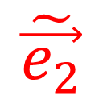
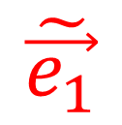
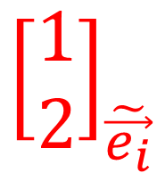

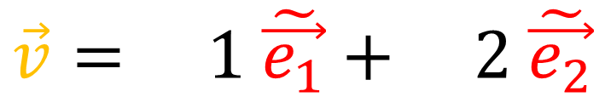

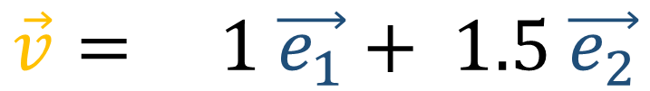

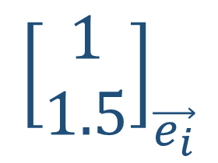
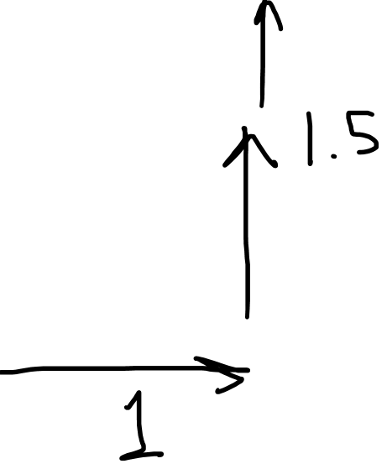
Vector Components
$$\vec{v}= 1 \vec{e_{1}}+ 1.5 \vec{e_{2}}$$
$$\vec{v}$$
$$\vec{e_{2}}$$
$${\left[\begin{matrix}1 \\ 1.5\end{matrix}\right]}_{\vec{e_{i}}}$$
$$\tilde{\vec{e_{1}}}$$
$$\tilde{\vec{e_{2}}}$$
$$\vec{v}= 1 \tilde{\vec{e_{1}}}+ \text{2 }\tilde{\vec{e_{2}}}$$
$$\vec{e_{1}}$$
$${\left[\begin{matrix}1 \\ 2\end{matrix}\right]}_{\tilde{\vec{e_{i}}}}$$

Slide 6
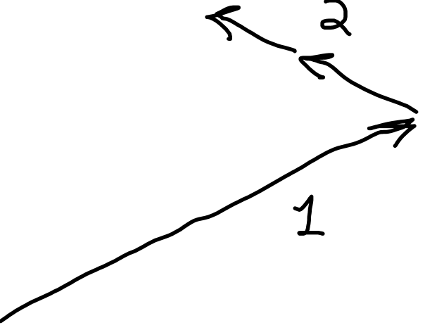
Vector Components
$$\vec{v}= 1 \vec{e_{1}}+ 1.5 \vec{e_{2}}$$
$$\vec{v}$$
$$\vec{e_{2}}$$
$${\left[\begin{matrix}1 \\ 1.5\end{matrix}\right]}_{\vec{e_{i}}}$$
$$\tilde{\vec{e_{1}}}$$
$$\tilde{\vec{e_{2}}}$$
$$\vec{v}= 1 \tilde{\vec{e_{1}}}+ \text{2 }\tilde{\vec{e_{2}}}$$
$$\vec{e_{1}}$$
$${\left[\begin{matrix}1 \\ 2\end{matrix}\right]}_{\tilde{\vec{e_{i}}}}$$

Slide 7
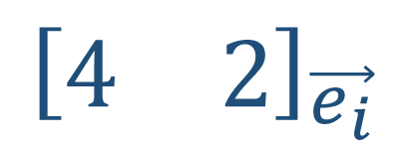
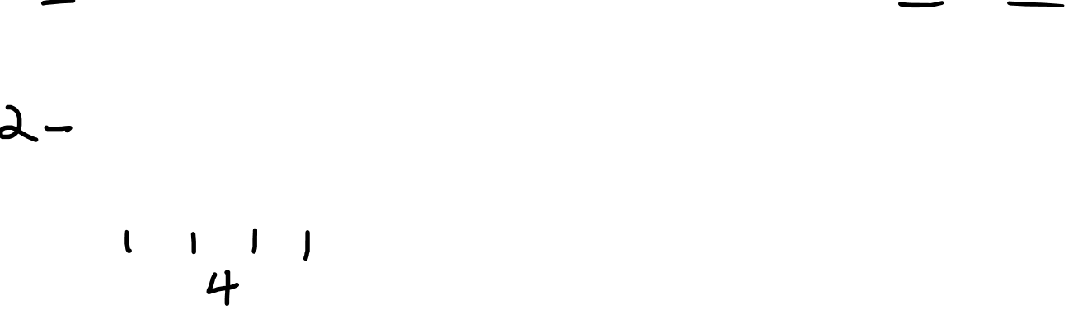




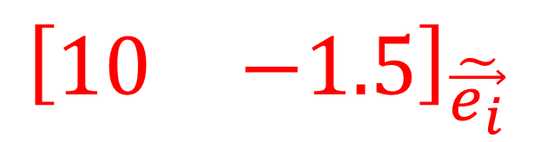
Covector Components
$$\vec{e_{2}}$$
$${\left[\begin{matrix}4 & 2\end{matrix}\right]}_{\vec{e_{i}}}$$
$$\tilde{\vec{e_{1}}}$$
$$\tilde{\vec{e_{2}}}$$
$$\vec{e_{1}}$$
$${\left[\begin{matrix}10 & −1.5\end{matrix}\right]}_{\tilde{\vec{e_{i}}}}$$

Slide 8





Linear Map Components
$$\vec{e_{2}}$$
$$\vec{w}$$
$$\vec{e_{1}}$$
$$\vec{v}$$

Slide 11

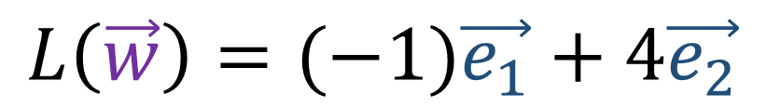
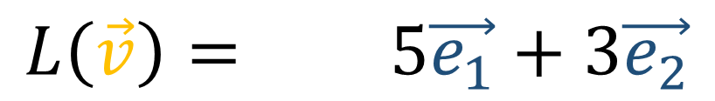
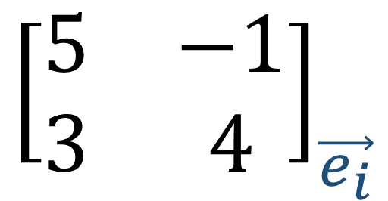

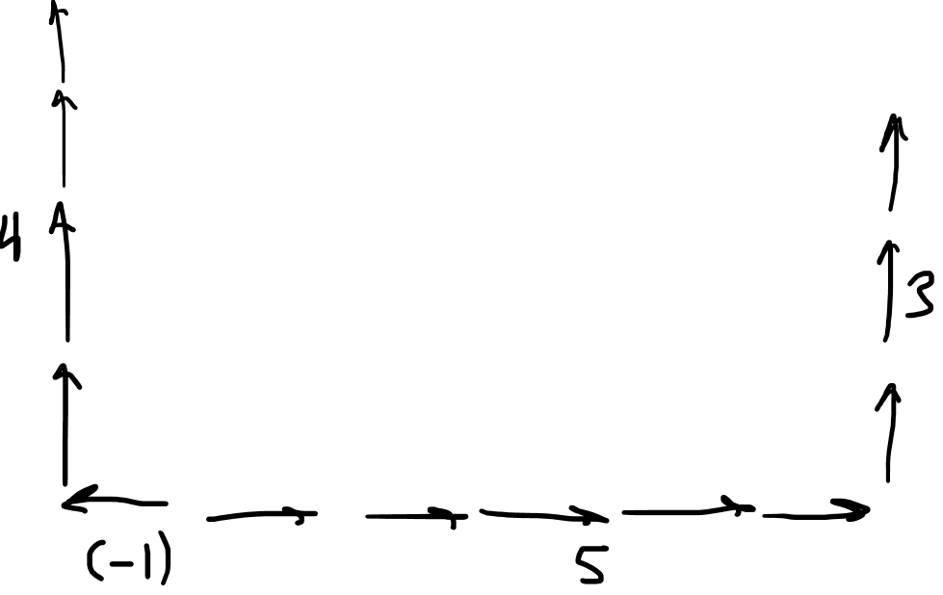
Linear Map Components
$$L\left(\vec{w}\right)$$
$$L\left(\vec{v}\right)= 5\vec{e_{1}}+3\vec{e_{2}}$$
$$L\left(\vec{v}\right)$$
$$L\left(\vec{w}\right)=(−1)\vec{e_{1}}+4\vec{e_{2}}$$
$${\left[\begin{matrix}5 & −1 \\ 3 & 4\end{matrix}\right]}_{\vec{e_{i}}}$$
$$\vec{e_{2}}$$
$$\vec{w}$$
$$\vec{e_{1}}$$
$$\vec{v}$$

Slide 12


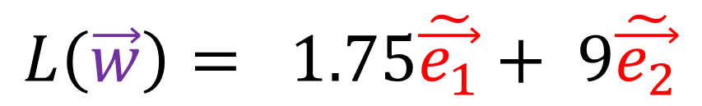
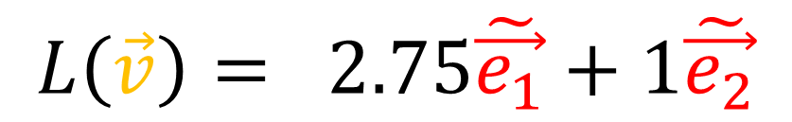
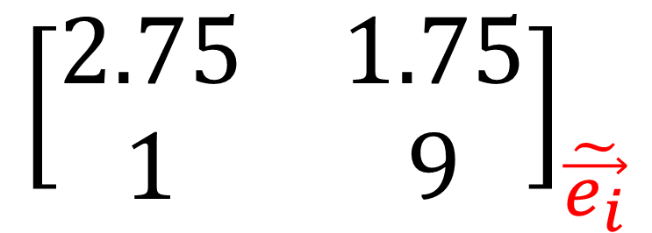


Linear Map Components
$$L\left(\vec{w}\right)$$
$$L\left(\vec{v}\right)= 2.75\tilde{\vec{e_{1}}}+1\tilde{\vec{e_{2}}}$$
$$L\left(\vec{v}\right)$$
$$L\left(\vec{w}\right)= 1.75\tilde{\vec{e_{1}}}+ 9\tilde{\vec{e_{2}}}$$
$${\left[\begin{matrix}2.75 & 1.75 \\ 1 & 9\end{matrix}\right]}_{\tilde{\vec{e_{i}}}}$$
$$\tilde{\vec{e_{1}}}$$
$$\tilde{\vec{e_{2}}}$$
$$\vec{v}$$
$$\vec{w}$$

Slide 13

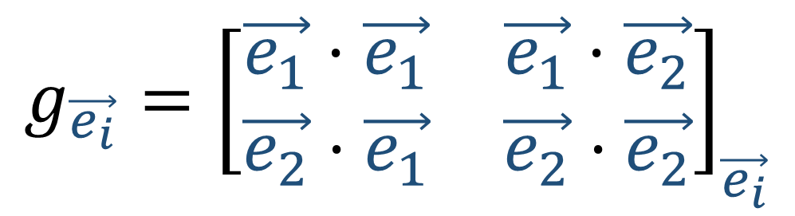
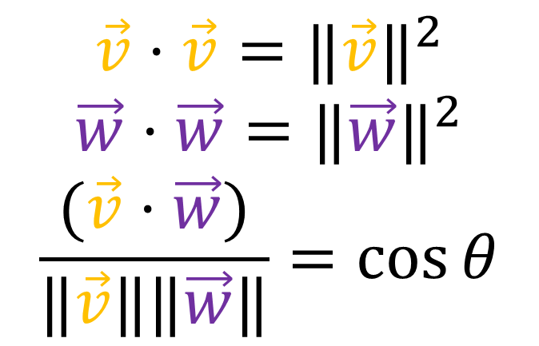
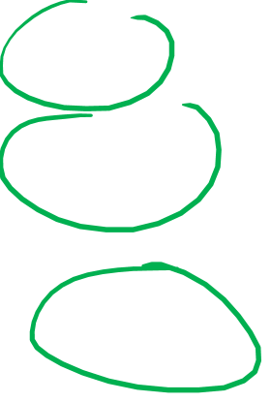
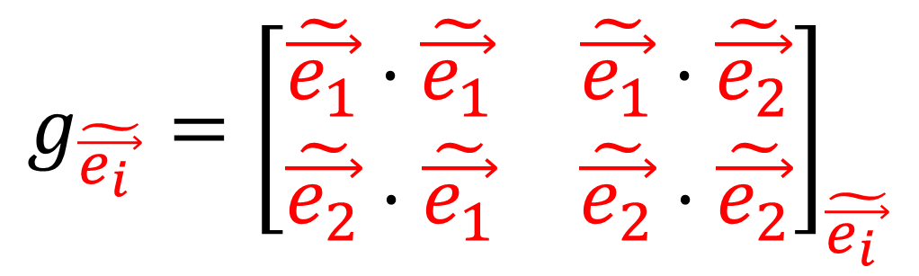
Metric Tensor Components
$$\vec{v}⋅\vec{w}=g(\vec{v},\vec{w})$$
$${g_{\vec{e_{i}}}=\left[\begin{matrix}\vec{e_{1}}⋅\vec{e_{1}} & \vec{e_{1}}⋅\vec{e_{2}} \\ \vec{e_{2}}⋅\vec{e_{1}} & \vec{e_{2}}⋅\vec{e_{2}}\end{matrix}\right]}_{\vec{e_{i}}}$$
$$g_{\tilde{\vec{e_{i }}}}={\left[\begin{matrix}\tilde{\vec{e_{1}}}⋅\tilde{\vec{e_{1}}} & \tilde{\vec{e_{1}}}⋅\tilde{\vec{e_{2}}} \\ \tilde{\vec{e_{2}}}⋅\tilde{\vec{e_{1}}} & \tilde{\vec{e_{2}}}⋅\tilde{\vec{e_{2}}}\end{matrix}\right]}_{\tilde{\vec{e_{i }}}}$$
$$\vec{v}⋅\vec{v}={‖\vec{v}‖}^{2}$$
$$\vec{w}⋅\vec{w}={‖\vec{w}‖}^{2}$$
$$\frac{(\vec{v}⋅\vec{w})}{‖\vec{v}‖‖\vec{w}‖}=\cos{θ}$$

Slide 14
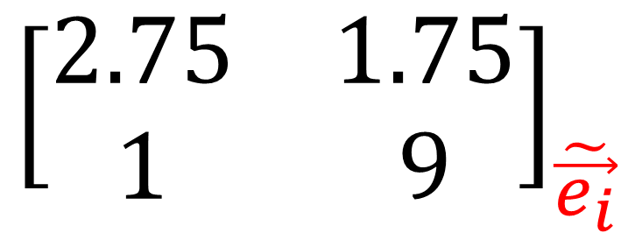

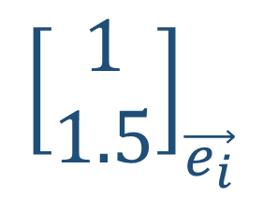
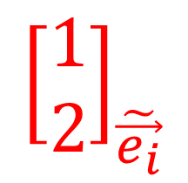

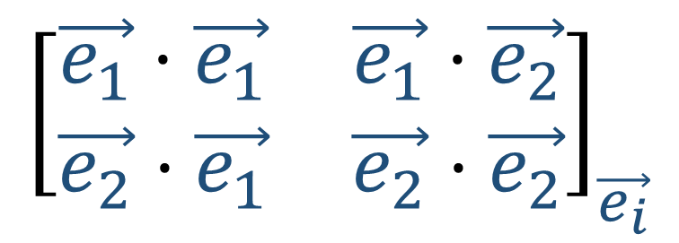

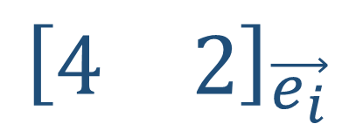
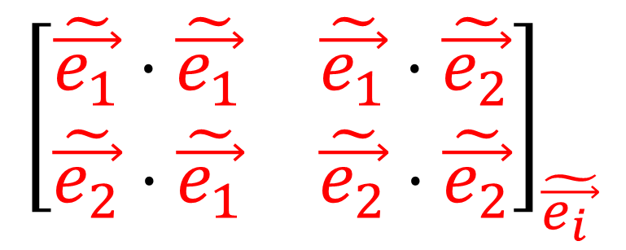
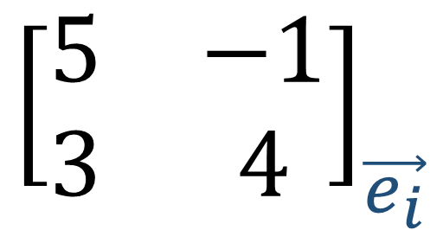
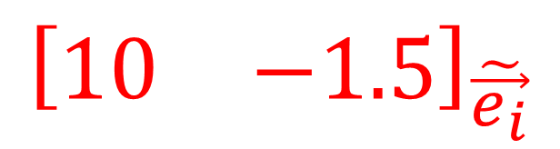

$$\vec{e_{2}}$$
$$\tilde{\vec{e_{1}}}$$
$${\left[\begin{matrix}1 \\ 1.5\end{matrix}\right]}_{\vec{e_{i}}}$$
$$\tilde{\vec{e_{2}}}$$
$${\left[\begin{matrix}1 \\ 2\end{matrix}\right]}_{\tilde{\vec{e_{i}}}}$$
$$\vec{e_{1}}$$
$${\left[\begin{matrix}4 & 2\end{matrix}\right]}_{\vec{e_{i}}}$$
$${\left[\begin{matrix}10 & −1.5\end{matrix}\right]}_{\tilde{\vec{e_{i}}}}$$
$${\left[\begin{matrix}5 & −1 \\ 3 & 4\end{matrix}\right]}_{\vec{e_{i}}}$$
$${\left[\begin{matrix}2.75 & 1.75 \\ 1 & 9\end{matrix}\right]}_{\tilde{\vec{e_{i}}}}$$
$${\left[\begin{matrix}\vec{e_{1}}⋅\vec{e_{1}} & \vec{e_{1}}⋅\vec{e_{2}} \\ \vec{e_{2}}⋅\vec{e_{1}} & \vec{e_{2}}⋅\vec{e_{2}}\end{matrix}\right]}_{\vec{e_{i}}}$$
$${\left[\begin{matrix}\tilde{\vec{e_{1}}}⋅\tilde{\vec{e_{1}}} & \tilde{\vec{e_{1}}}⋅\tilde{\vec{e_{2}}} \\ \tilde{\vec{e_{2}}}⋅\tilde{\vec{e_{1}}} & \tilde{\vec{e_{2}}}⋅\tilde{\vec{e_{2}}}\end{matrix}\right]}_{\tilde{\vec{e_{i }}}}$$

Slide 15
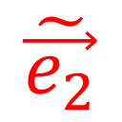
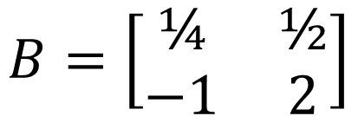
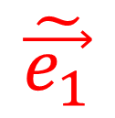
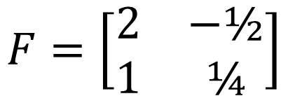

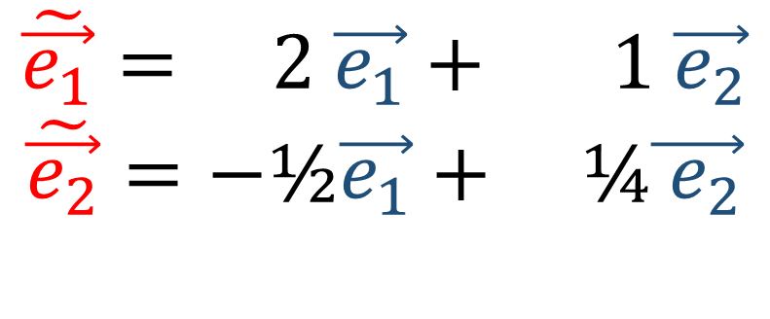




Forward + Backward Transformations
$$\tilde{\vec{e_{1}}}= 2 \vec{e_{1}}+ 1 \vec{e_{2}}$$
$$\tilde{\vec{e_{2}}}=−\text{½}\vec{e_{1}}+ \text{¼}\vec{{ e}_{2}}$$
Old Basis: $\{\vec{e_{1}},\vec{e_{2}}\}$
New Basis: $\{\tilde{\vec{e_{1}}},\tilde{\vec{e_{2}}}\}$
$$F=\left[\begin{matrix}2 & −\text{½} \\ 1 & \text{¼}\end{matrix}\right]$$
$$\vec{e_{2}}$$
$$\tilde{\vec{e_{1}}}$$
$$\vec{e_{1}}= \text{¼} \tilde{\vec{e_{1}}}+ \left(−\text{1}\right)\tilde{\vec{e_{2}}} \\ \vec{e_{2}}= \text{½} \tilde{\vec{e_{1}}}+ \text{2} \tilde{\vec{e_{2}}}$$
$$\tilde{\vec{e_{2}}}$$
$$\vec{e_{1}}$$
$$B=\left[\begin{matrix}\text{¼} & \text{½} \\ −\text{1} & \text{2}\end{matrix}\right]$$

Slide 16



Forward + Backward
Transformations
$$\tilde{\vec{e_{j}}}=F_{j}^{i}\vec{e_{i}}$$
$$\vec{e_{j}}=B_{j}^{i}\tilde{\vec{e_{i}}}$$
Implied sums over $i$
(Einstein summation convention)

Slide 17









Forward + Backward
Transformations
$$\tilde{\vec{e_{j}}}=F_{j}^{i}\vec{e_{i}}$$
$$\vec{e_{j}}=B_{j}^{i}\tilde{\vec{e_{i}}}$$
Vectors
Linear Maps
$$\tilde{v^{i}}=B_{j}^{i}v^{j}$$
$$\tilde{L_{j}^{i}}=B_{k}^{i}L_{l}^{k}F_{j}^{l}$$
$$v^{i}=F_{j}^{i}\tilde{v^{j}}$$
$$L_{j}^{i}=F_{k}^{i}\tilde{L_{l}^{k}}B_{j}^{l}$$
Covectors
Metric Tensor/Bilinear Forms
$$\tilde{α_{j}}=F_{j}^{i}α_{i}$$
$$\tilde{ℬ_{ij}}=F_{i}^{k}F_{j}^{l}ℬ_{kl}$$
$$ℬ_{ij}=B_{i}^{k}B_{j}^{l}\tilde{ℬ_{kl}}$$
$$α_{j}=B_{j}^{i}\tilde{α_{i}}$$

Slide 18
Forward + Backward
Transformations
$$\tilde{\vec{e_{j}}}=F_{j}^{i}\vec{e_{i}}$$
$$\vec{e_{j}}=B_{j}^{i}\tilde{\vec{e_{i}}}$$
Vectors
(1,0)
Linear Maps
(1,1)
$$\tilde{v^{i}}=B_{j}^{i}v^{j}$$
$$\tilde{L_{j}^{i}}=B_{k}^{i}L_{l}^{k}F_{j}^{l}$$
$$v^{i}=F_{j}^{i}\tilde{v^{j}}$$
$$L_{j}^{i}=F_{k}^{i}\tilde{L_{l}^{k}}B_{j}^{l}$$
Covectors
(0,1)
Metric Tensor/Bilinear Forms
(0,2)
$$\tilde{α_{j}}=F_{j}^{i}α_{i}$$
$$\tilde{ℬ_{ij}}=F_{i}^{k}F_{j}^{l}ℬ_{kl}$$
$$ℬ_{ij}=B_{i}^{k}B_{j}^{l}\tilde{ℬ_{kl}}$$
$$α_{j}=B_{j}^{i}\tilde{α_{i}}$$

Slide 19







Tensor Algebra
Tensor Calculus
$$θ$$
$$g$$
Scalar Field
$$\vec{v}$$
$$\vec{w}$$
$$\cos{θ}=\frac{(\vec{v}⋅\vec{w})}{‖\vec{v}‖‖\vec{w}‖}$$
$$=\frac{g(\vec{v},\vec{w})}{\sqrt{g\left(\vec{v},\vec{v}\right)}\sqrt{g\left(\vec{w},\vec{w}\right)}}$$
Vector Field

Slide 20




$$+5$$
$$0$$
$$−2$$
Scalars
Temperature
Voltage
Scalar Field

Slide 21
Vector
Vector Field
Electric Field
Gravitation Field (Newtonian)

Slide 22





Directional Derivative
Rate of change of $f$ in the direction of $\vec{v}$
$$f$$
$$\vec{v}$$
$∇_{\vec{v}}f$

Slide 23

Covector
Covector Field
(Differential Form/1-Form)

Slide 24


Metric Tensor
Metric Tensor Field

Slide 25









$$y$$
$$x$$
$$\vec{e_{2}}$$
$$\tilde{\vec{e_{1}}}$$
$$\tilde{\vec{e_{2}}}$$
$$θ$$
$$\vec{e_{1}}$$
$$r$$
Forward + Backward Transform
F+B Transform Field

Slide 26
Tensor Calculus
$$y$$
$$x$$
Scalar Field
Covector Field
$$θ$$
$$r$$
Vector Field
Metric Tensor Field
Basis Vector “Field”

Slide 27





Why Learn Tensor Calculus?
Faraday Tensor $F$
Electric Field $\vec{E}$
Magnetic field $\vec{B}$
$$\left[\begin{matrix}\begin{matrix}\begin{aligned}0 \\ −E_{x}/c \\ −E_{y}/c \\ −E_{z}/c\end{aligned} & \begin{aligned}E_{x}/c \\ 0 \\ B_{z} \\ {−B}_{y}\end{aligned}\end{matrix} & \begin{matrix}\begin{aligned}E_{y}/c \\ {−B}_{z} \\ 0 \\ B_{x}\end{aligned} & \begin{aligned}E_{z}/c \\ B_{y} \\ {−B}_{x} \\ 0\end{aligned}\end{matrix}\end{matrix}\right]$$
Maxwell’s Equations:
$$∇⋅\vec{E}=\frac{ρ}{ε_{0}}$$
$$∇⋅\vec{B}=0$$
$$∇×\vec{E}=−\frac{∂\vec{B}}{∂t}$$
$$∇×\vec{B}=μ_{0}\left(\vec{J}+ε_{0}\frac{∂\vec{E}}{∂t}\right)$$
Maxwell’s Equations:
$$∂_{α}F^{αβ}=μ_{0}J^{β}$$
$$∂_{α}\left(\frac{1}{2}ε^{αβγδ}F_{γδ}\right)=0$$

Slide 28

Why Learn Tensor Calculus?
Faraday Tensor $F$
Electric Field $\vec{E}$
Magnetic field $\vec{B}$
$$\left[\begin{matrix}\begin{matrix}\begin{aligned}0 \\ −E_{x}/c \\ −E_{y}/c \\ −E_{z}/c\end{aligned} & \begin{aligned}E_{x}/c \\ 0 \\ B_{z} \\ {−B}_{y}\end{aligned}\end{matrix} & \begin{matrix}\begin{aligned}E_{y}/c \\ {−B}_{z} \\ 0 \\ B_{x}\end{aligned} & \begin{aligned}E_{z}/c \\ B_{y} \\ {−B}_{x} \\ 0\end{aligned}\end{matrix}\end{matrix}\right]$$
Maxwell’s Equations:
$$∇⋅\vec{E}=\frac{ρ}{ε_{0}}$$
$$∇⋅\vec{B}=0$$
$$∇×\vec{E}=−\frac{∂\vec{B}}{∂t}$$
$$∇×\vec{B}=μ_{0}\left(\vec{J}+ε_{0}\frac{∂\vec{E}}{∂t}\right)$$
Maxwell’s Equations:
$$∂_{α}F^{αβ}=μ_{0}J^{β}$$
$$∂_{α}\left(\frac{1}{2}ε^{αβγδ}F_{γδ}\right)=0$$

Slide 29






Why Learn Tensor Calculus?
Cauchy Stress Tensor $T$ (or $σ$)
$$\left[\begin{matrix}T_{xx} & T_{xy} & T_{xz} \\ T_{yz} & T_{yy} & T_{yz} \\ T_{zx} & T_{zy} & T_{zz}\end{matrix}\right]=\left[\begin{matrix}σ_{x} & τ_{xy} & τ_{xz} \\ τ_{yz} & σ_{y} & τ_{yz} \\ τ_{zx} & τ_{zy} & σ_{z}\end{matrix}\right]$$
$T_{ij}$= force on face $i$ in direction $j$
$σ_{i}$ = normal stress
$τ_{ij}$ = shear stress

Slide 30



Why Learn Tensor Calculus?
Space-time is curved
Universe is expanding
Notes:
If you’re read or watched some popular science articles or videos, you’ve probably heard about how spacetimes is curved. Another thing… universe is expanding? What do either of these things even mean? In order to understand these ideas mathematically, not just intuitively, we need tensors. Gonna throw up an equation…. Einstein’s field equations… this tells us how spacetime is curve and why the universe is expanding It uses tensors. These are all 4x4 rank 2 tensors. Matrices. The most important on is this term here… the metric tensor. It tells us how to measure distances in weird geometries.
I’m going to talk about the metric tensor in video 7 or 8. I’m not going to say you’ll understand relativity, but you’ll understand what the metric tensor does and the first steps to how it might be used in relatvitity.

Slide 31


Why Learn Tensor Calculus?
$$R_{μν}−\frac{1}{2}Rg_{μν}+Λg_{μν}=\frac{8πG}{c^{4}}T_{μν}$$
Physics
Geometry
Energy-Momentum Tensor $T_{μν}$
Reimann Curvature Tensor $R_{μβν}^{α}$
Ricci Curvature Tensor $R_{μν}$
Metric Tensor $g_{μν}$

