Slide 1
Lie Bracket, Flow Curves and Torsion
(Also see Videos 17-20: Covariant Derivative)
(Links in the description)

Slide 2
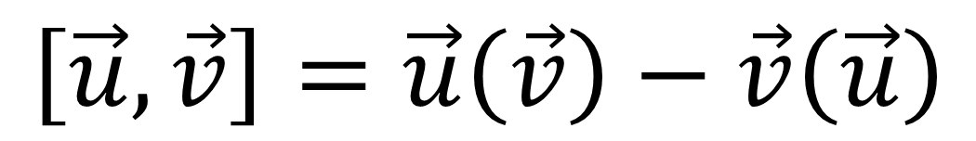
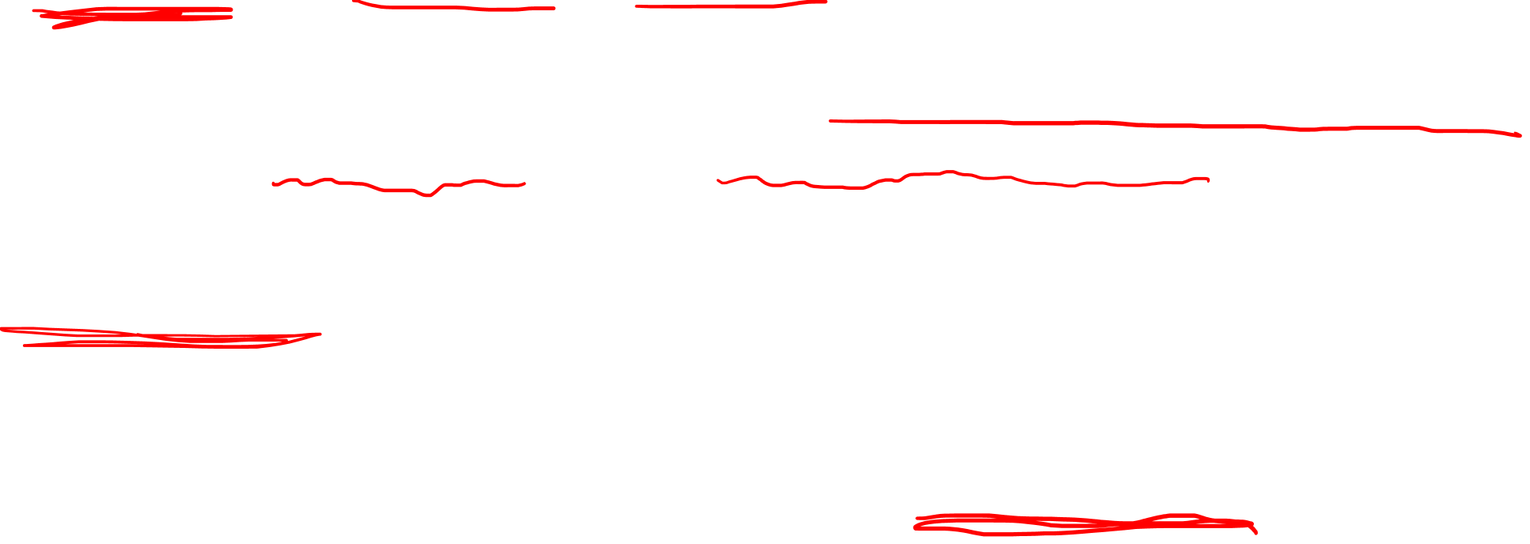
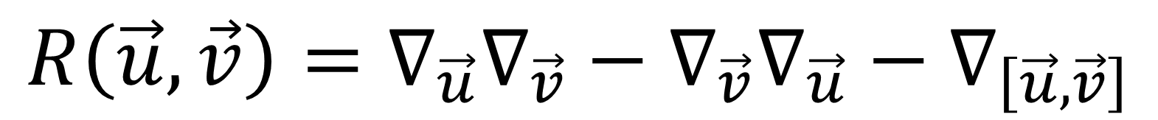
Lie Bracket (Commutator) of Vector Fields
$$\left[\vec{u},\vec{v}\right]=\vec{u}\left(\vec{v}\right)−\vec{v}\left(\vec{u}\right)$$
Required for understanding Riemann Curvature Tensor
(Related Ricci Tensor is in the Einstein Field Equations)
$$R\left(\vec{u},\vec{v}\right)=∇_{\vec{u}}∇_{\vec{v}}−∇_{\vec{v}}∇_{\vec{u}}−∇_{\left[\vec{u},\vec{v}\right]}$$
2. Get a better understanding of “Torsion Free”

Slide 3
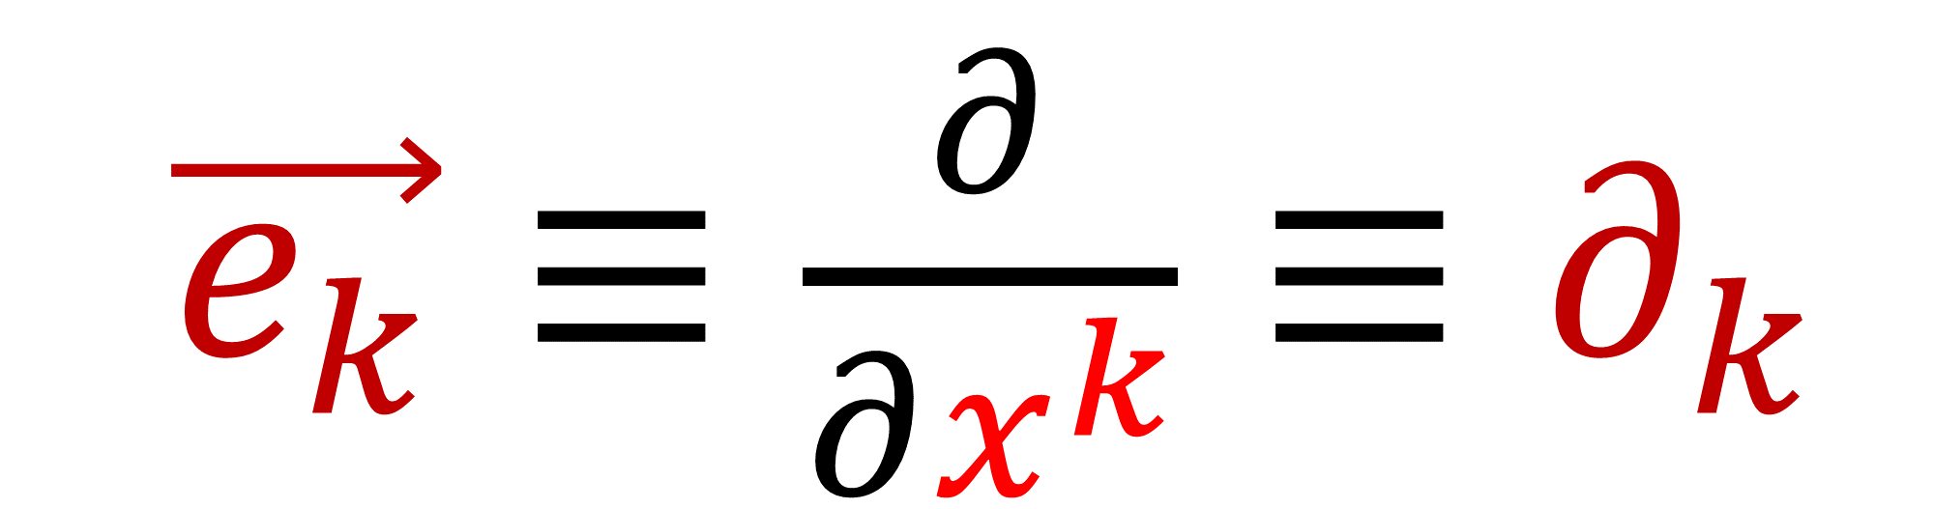
Basis vectors
$\vec{e_{k}}≡\frac{∂}{∂x^{k}}≡∂_{k}$

Slide 4
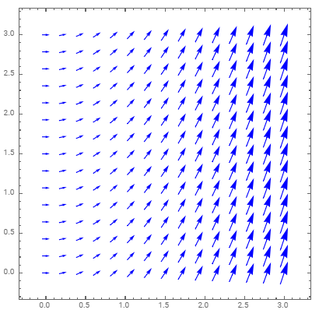
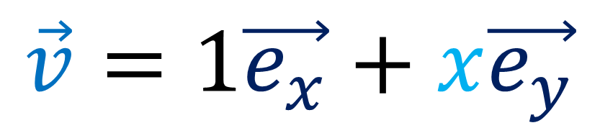
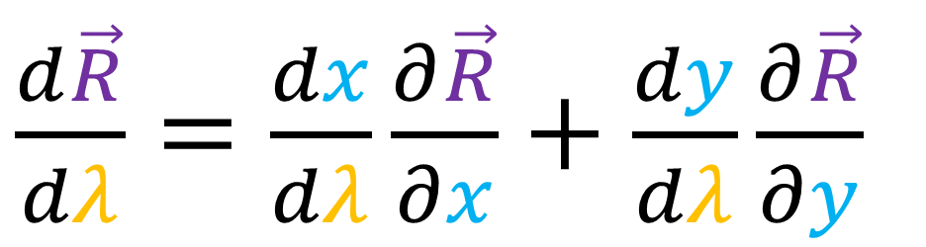
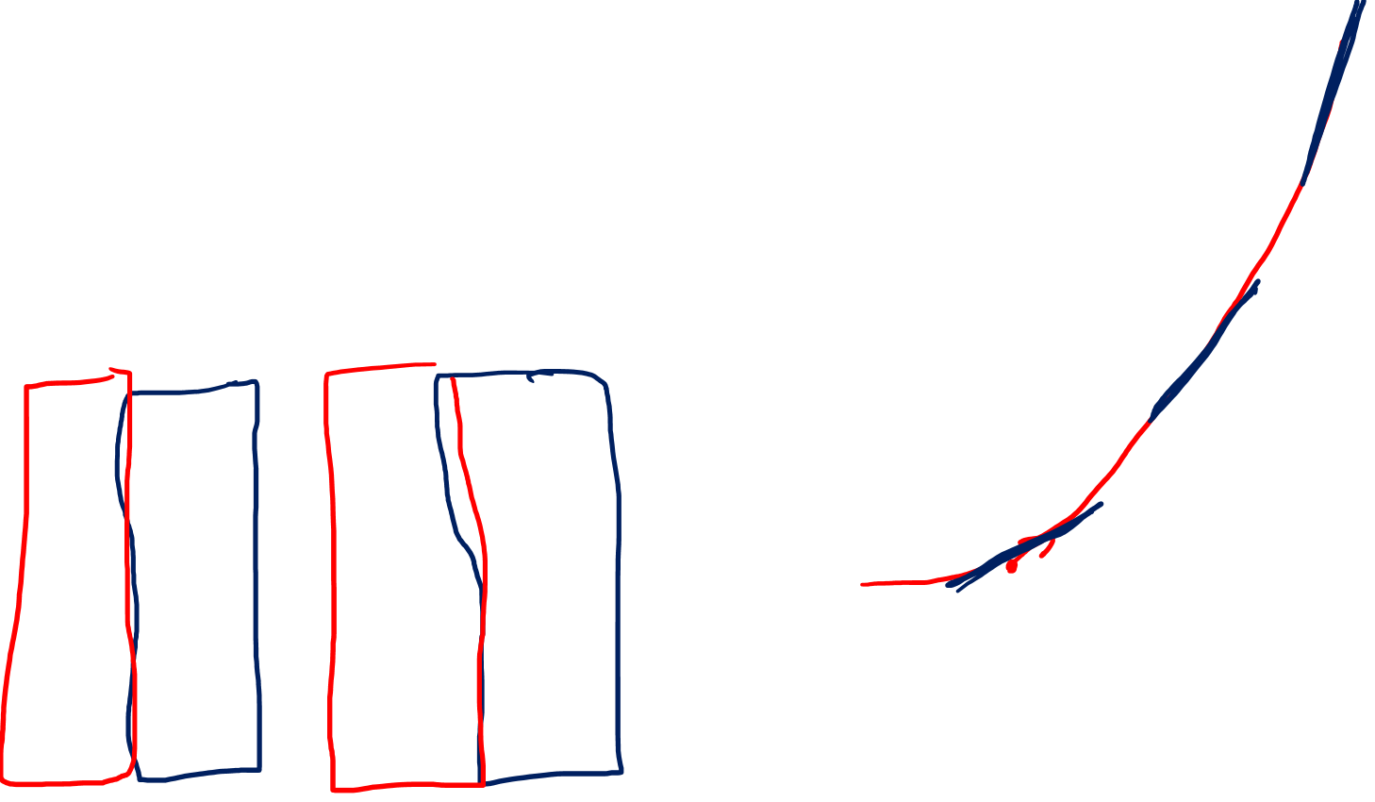
What does it mean to “Travel Along” a vector field?
Flow-Field:
Vector arrows tell you velocity
$$\vec{v}=1\vec{e_{x}}+x\vec{e_{y}}$$
$\frac{d\vec{R}}{dλ}=\frac{dx}{dλ}\frac{∂\vec{R}}{∂x}+\frac{dy}{dλ}\frac{∂\vec{R}}{∂y}$

Slide 5
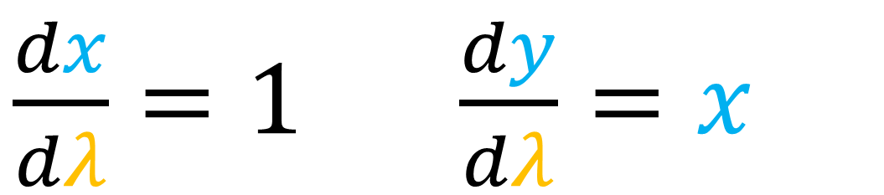
What does it mean to “Travel Along” a vector field?
$\frac{dx}{dλ}=1 \frac{dy}{dλ}=x$
$$\vec{v}=1\vec{e_{x}}+x\vec{e_{y}}$$
$\frac{d\vec{R}}{dλ}=\frac{dx}{dλ}\frac{∂\vec{R}}{∂x}+\frac{dy}{dλ}\frac{∂\vec{R}}{∂y}$

Slide 6
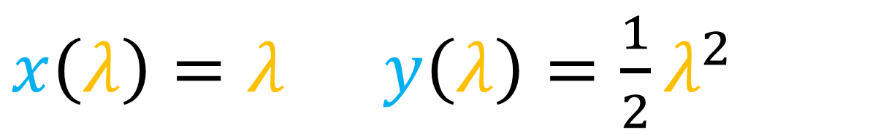
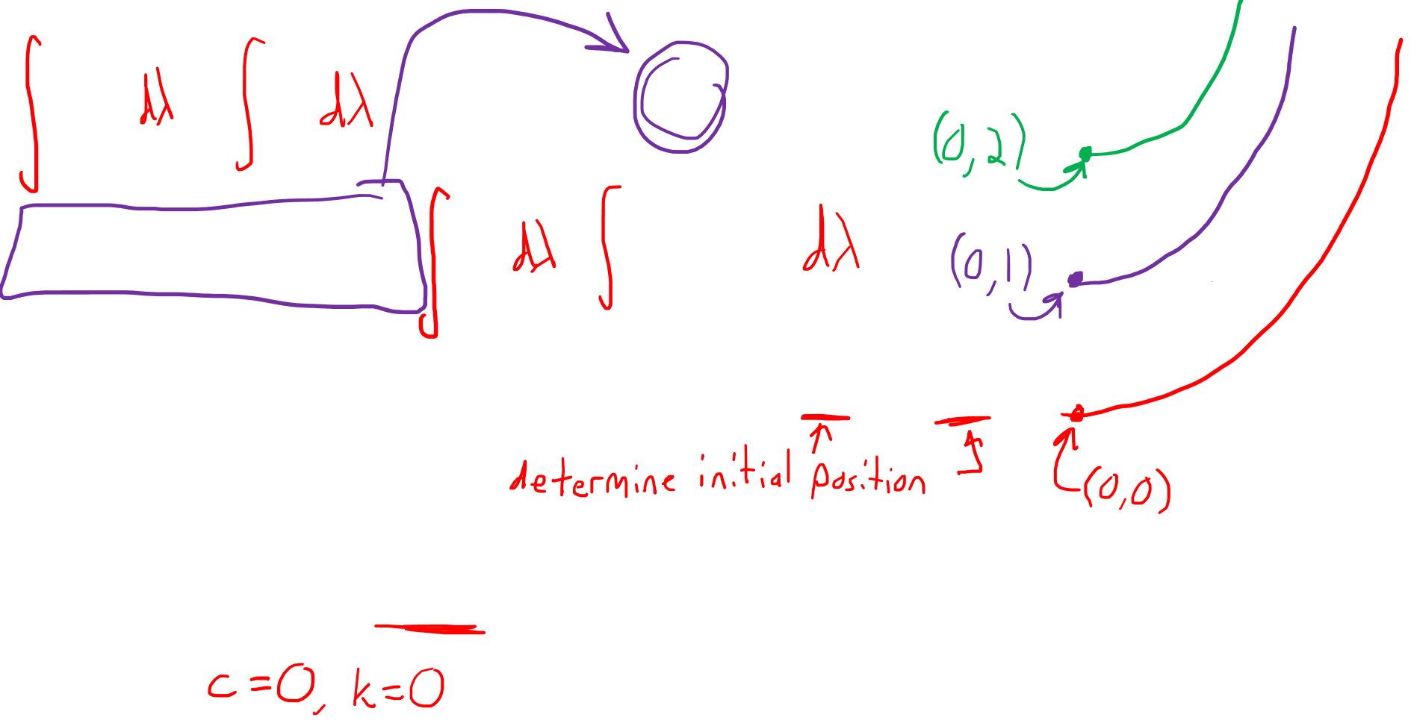
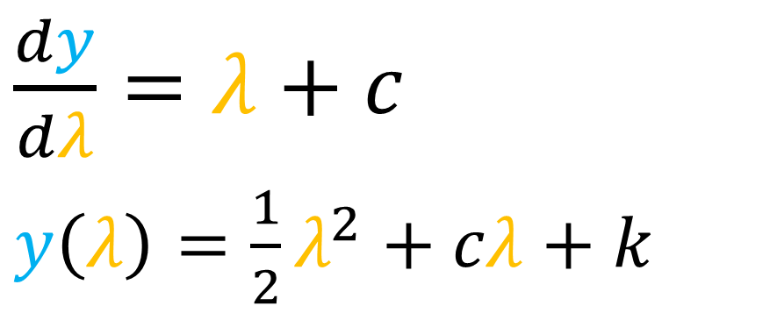
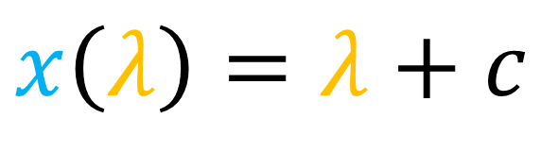
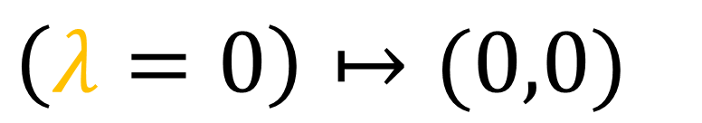
What does it mean to “Travel Along” a vector field?
$\frac{dx}{dλ}=1 \frac{dy}{dλ}=x$
$\frac{dy}{dλ}=λ+c$
$y\left(λ\right)=\frac{1}{2}λ^{2}+cλ+k$
$$x\left(λ\right)=λ+c$$
$\left(λ=0\right)↦(0,0)$
$x\left(λ\right)=λ y\left(λ\right)=\frac{1}{2}λ^{2}$

Slide 7
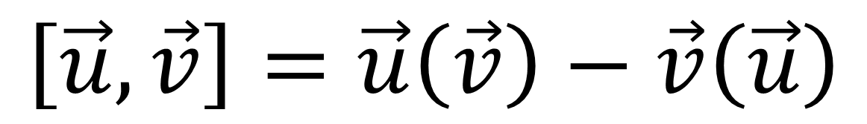
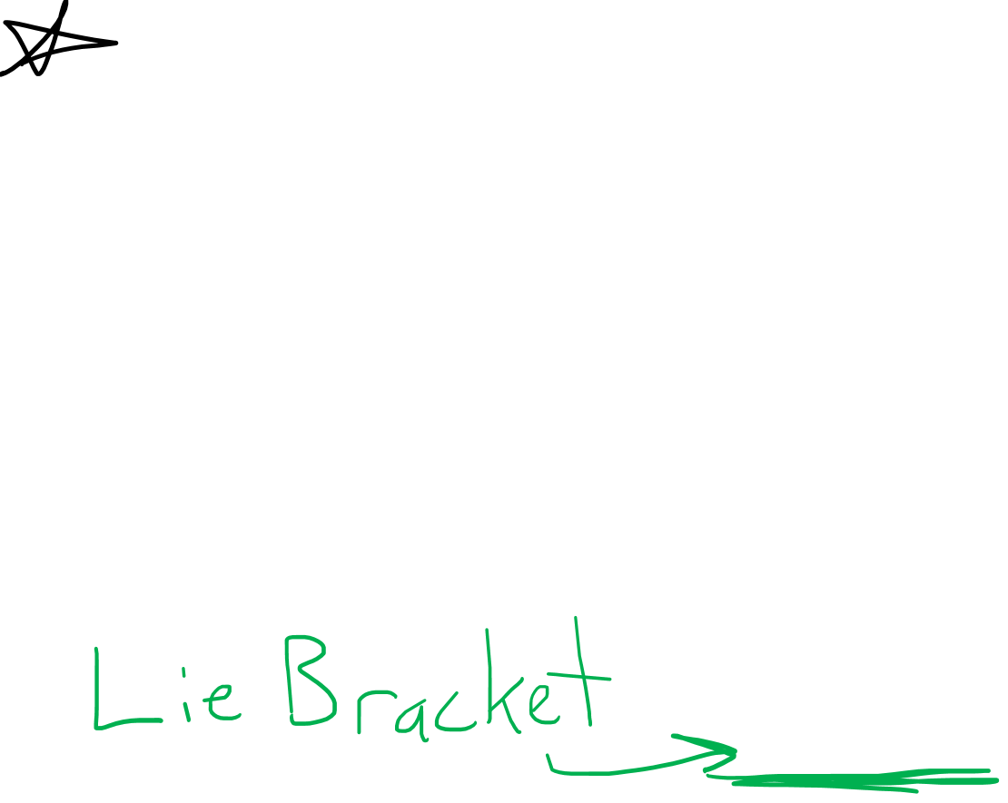
Flow curve / Integral Curve =
a curve that is tangent
to all vectors in a vector field
$$\left[\vec{u},\vec{v}\right]=\vec{u}\left(\vec{v}\right)−\vec{v}\left(\vec{u}\right)$$

Slide 8
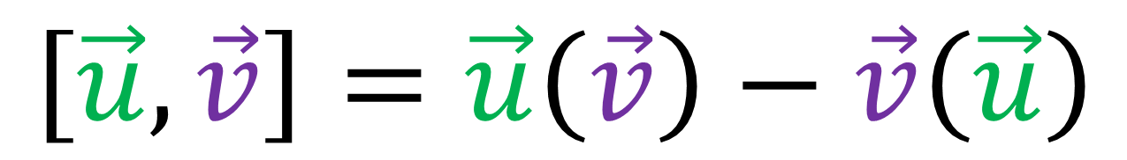
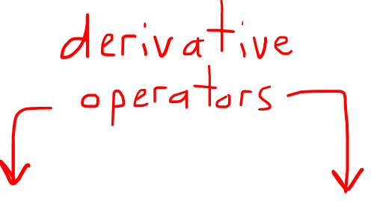
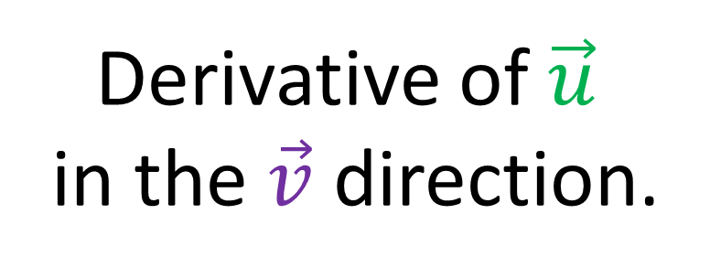
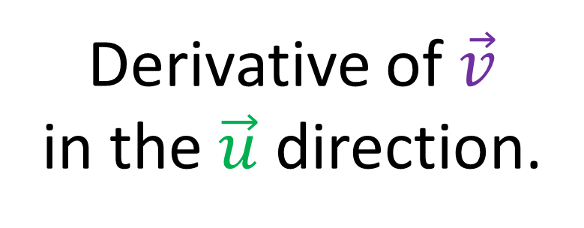
Lie Bracket
$$\left[\vec{u},\vec{v}\right]=\vec{u}\left(\vec{v}\right)−\vec{v}\left(\vec{u}\right)$$
Derivative of $\vec{v}$
in the $\vec{u}$ direction.
Derivative of $\vec{u}$
in the $\vec{v}$ direction.

Slide 9
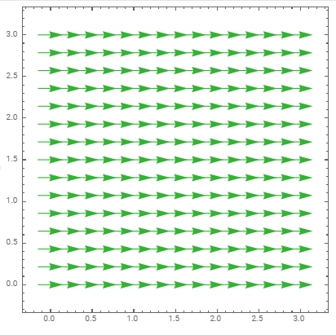
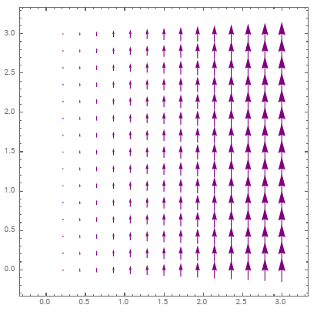
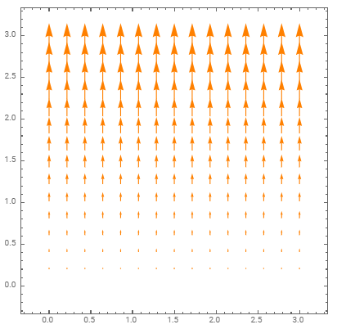
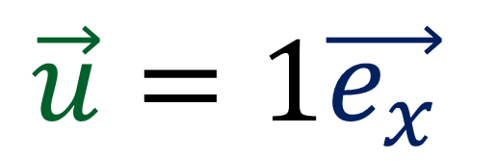
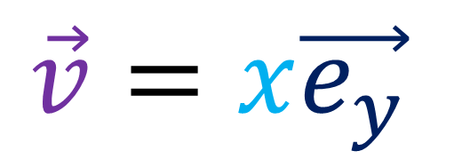
Finding change of one vector field along another vector field
$$\vec{u}=1\vec{e_{x}}$$
$$\vec{v}=x\vec{e_{y}}$$

Slide 10
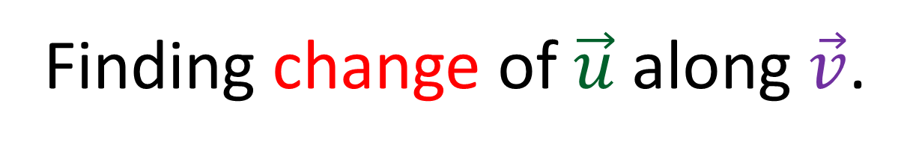
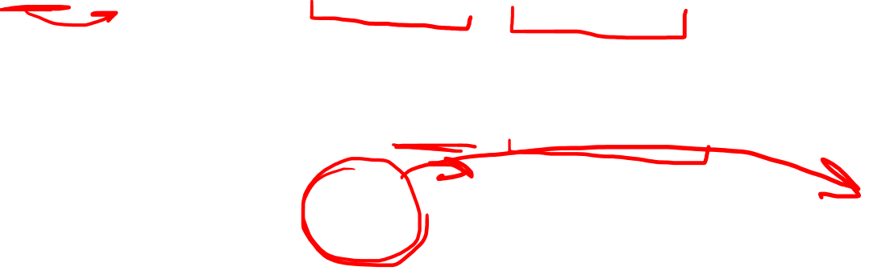
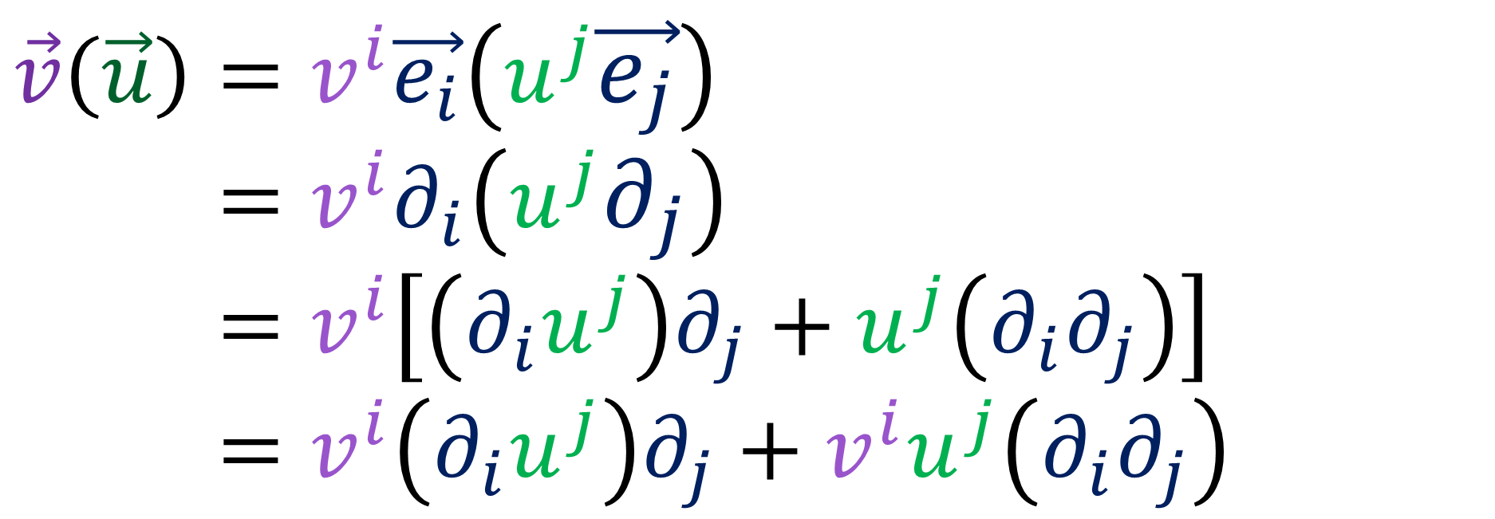
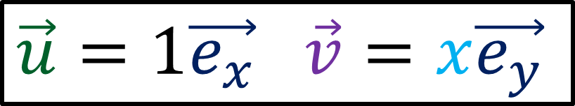
Finding change of $\vec{u}$along $\vec{v}$.
$\vec{u}=1\vec{e_{x}}$ $\vec{v}=x\vec{e_{y}}$
$$\vec{v}\left(\vec{u}\right)=v^{i}\vec{e_{i}}\left(u^{j}\vec{e_{j}}\right)$$
$$\vec{u}\left(\vec{v}\right)=v^{i}∂_{i}\left(u^{j}∂_{j}\right)$$
$$\vec{u}\left(\vec{v}\right)=v^{i}\left[\left(∂_{i}u^{j}\right)∂_{j}+u^{j}\left(∂_{i}∂_{j}\right)\right]$$
$$\vec{u}\left(\vec{v}\right)=v^{i}\left(∂_{i}u^{j}\right)∂_{j}+v^{i}u^{j}\left(∂_{i}∂_{j}\right)$$

Slide 11

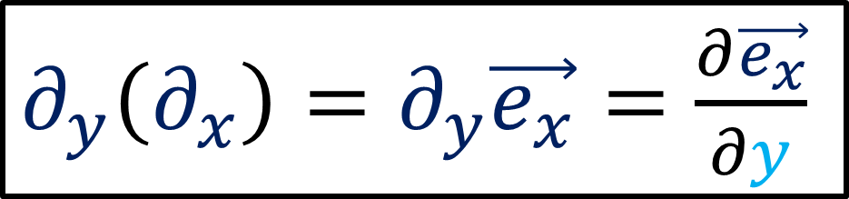
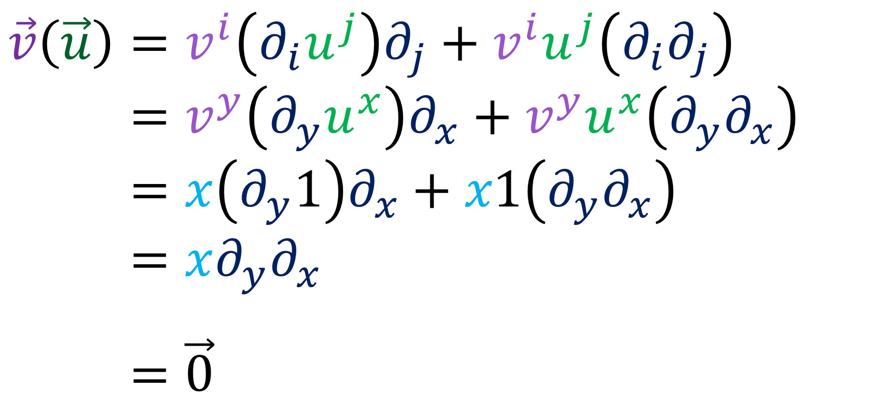
Finding change of $\vec{u}$along $\vec{v}$.
$\vec{u}=1\vec{e_{x}}$ $\vec{v}=x\vec{e_{y}}$
$$\vec{v}\left(\vec{u}\right)=v^{i}\left(∂_{i}u^{j}\right)∂_{j}+v^{i}u^{j}\left(∂_{i}∂_{j}\right)$$
$$\vec{u}\left(\vec{v}\right)=v^{y}\left(∂_{y}u^{x}\right)∂_{x}+v^{y}u^{x}\left(∂_{y}∂_{x}\right)$$
$$\vec{u}\left(\vec{v}\right)=x\left(∂_{y}1\right)∂_{x}+x1\left(∂_{y}∂_{x}\right)$$
$$\vec{u}\left(\vec{v}\right)=x∂_{y}∂_{x}$$
$$\vec{u}\left(\vec{v}\right)=\vec{0}$$
$∂_{y}\left(∂_{x}\right)=∂_{y}\vec{e_{x}}=\frac{∂\vec{e_{x}}}{∂y}$

Slide 12
Finding change of $\vec{u}$along $\vec{v}$.
$\vec{u}=1\vec{e_{x}}$ $\vec{v}=x\vec{e_{y}}$
$$\vec{v}\left(\vec{u}\right)=v^{i}\left(∂_{i}u^{j}\right)∂_{j}+v^{i}u^{j}\left(∂_{i}∂_{j}\right)$$
$$\vec{u}\left(\vec{v}\right)=v^{y}\left(∂_{y}u^{x}\right)∂_{x}+v^{y}u^{x}\left(∂_{y}∂_{x}\right)$$
$$\vec{u}\left(\vec{v}\right)=x\left(∂_{y}1\right)∂_{x}+x1\left(∂_{y}∂_{x}\right)$$
$$\vec{u}\left(\vec{v}\right)=x∂_{y}∂_{x}$$
$$\vec{u}\left(\vec{v}\right)=\vec{0}$$
$∂_{y}\left(∂_{x}\right)=∂_{y}\vec{e_{x}}=\frac{∂\vec{e_{x}}}{∂y}$

Slide 13
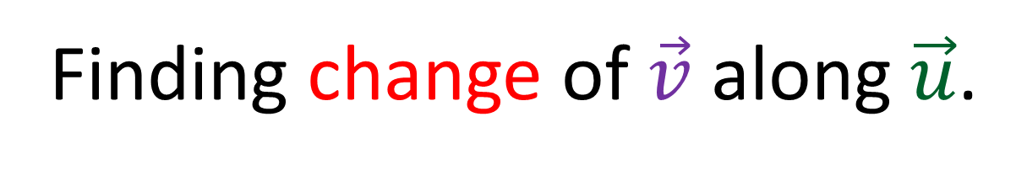
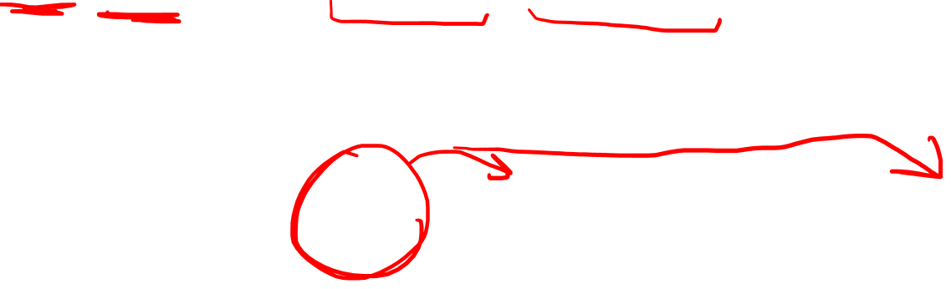
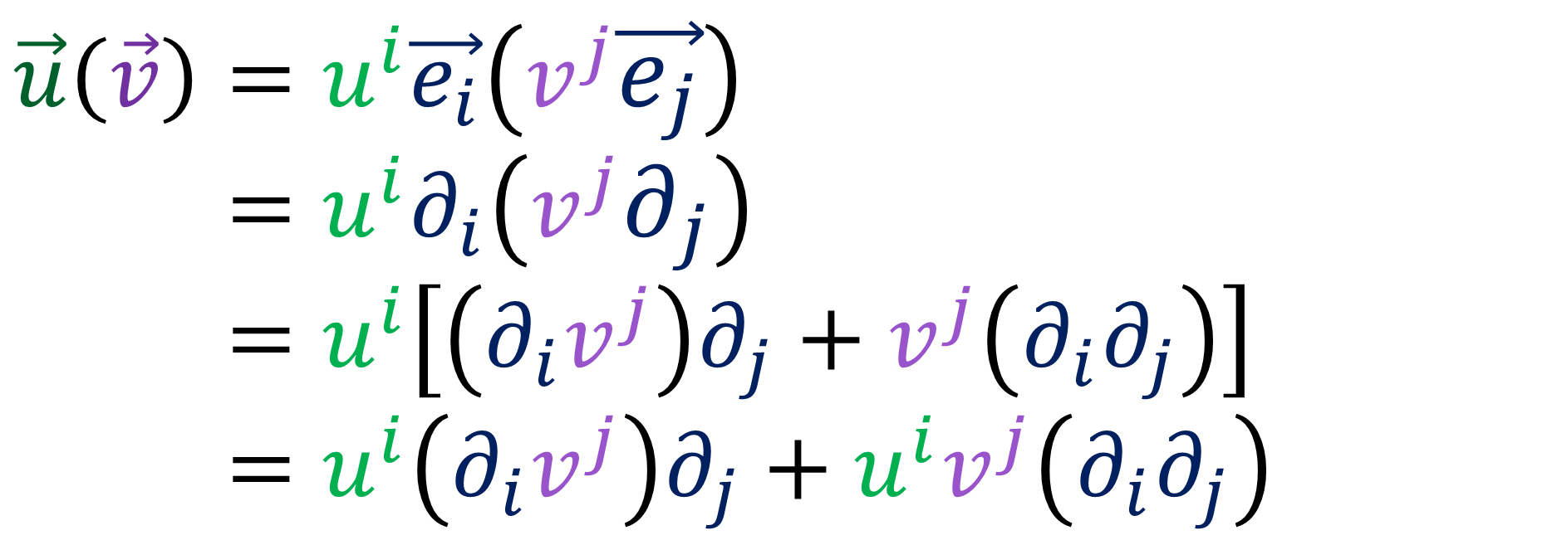
Finding change of $\vec{v}$along $\vec{u}$.
$\vec{u}=1\vec{e_{x}}$ $\vec{v}=x\vec{e_{y}}$
$$\vec{u}\left(\vec{v}\right)=u^{i}\vec{e_{i}}\left(v^{j}\vec{e_{j}}\right)$$
$$\vec{u}\left(\vec{v}\right)=u^{i}∂_{i}\left(v^{j}∂_{j}\right)$$
$$\vec{u}\left(\vec{v}\right)=u^{i}\left[\left(∂_{i}v^{j}\right)∂_{j}+v^{j}\left(∂_{i}∂_{j}\right)\right]$$
$$\vec{u}\left(\vec{v}\right)=u^{i}\left(∂_{i}v^{j}\right)∂_{j}+u^{i}v^{j}\left(∂_{i}∂_{j}\right)$$

Slide 14
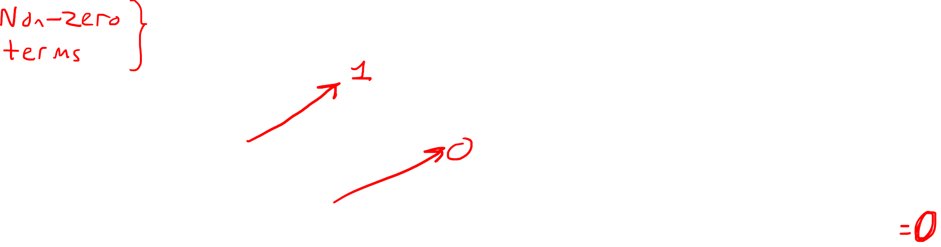
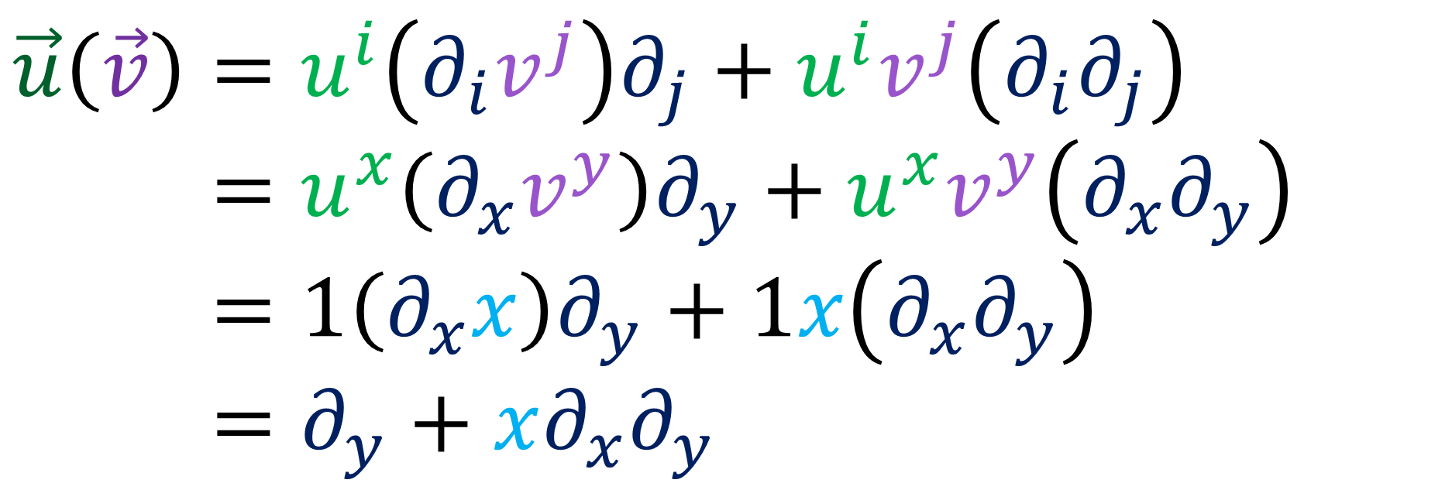
Finding change of $\vec{v}$along $\vec{u}$.
$\vec{u}=1\vec{e_{x}}$ $\vec{v}=x\vec{e_{y}}$
$$\vec{u}\left(\vec{v}\right)=u^{i}\left(∂_{i}v^{j}\right)∂_{j}+u^{i}v^{j}\left(∂_{i}∂_{j}\right)$$
$$\vec{u}\left(\vec{v}\right)=u^{x}\left(∂_{x}v^{y}\right)∂_{y}+u^{x}v^{y}\left(∂_{x}∂_{y}\right)$$
$$\vec{u}\left(\vec{v}\right)=1\left(∂_{x}x\right)∂_{y}+1x\left(∂_{x}∂_{y}\right)$$
$$\vec{u}\left(\vec{v}\right)=∂_{y}+x∂_{x}∂_{y}$$

Slide 15
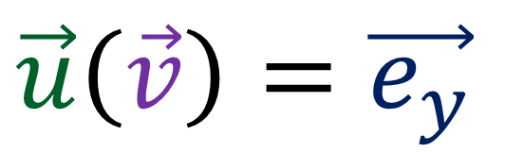
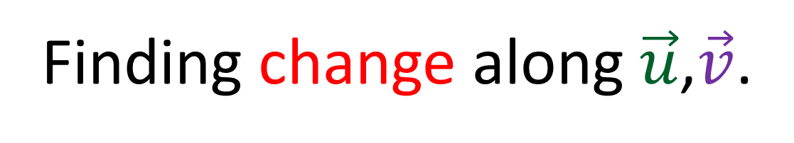
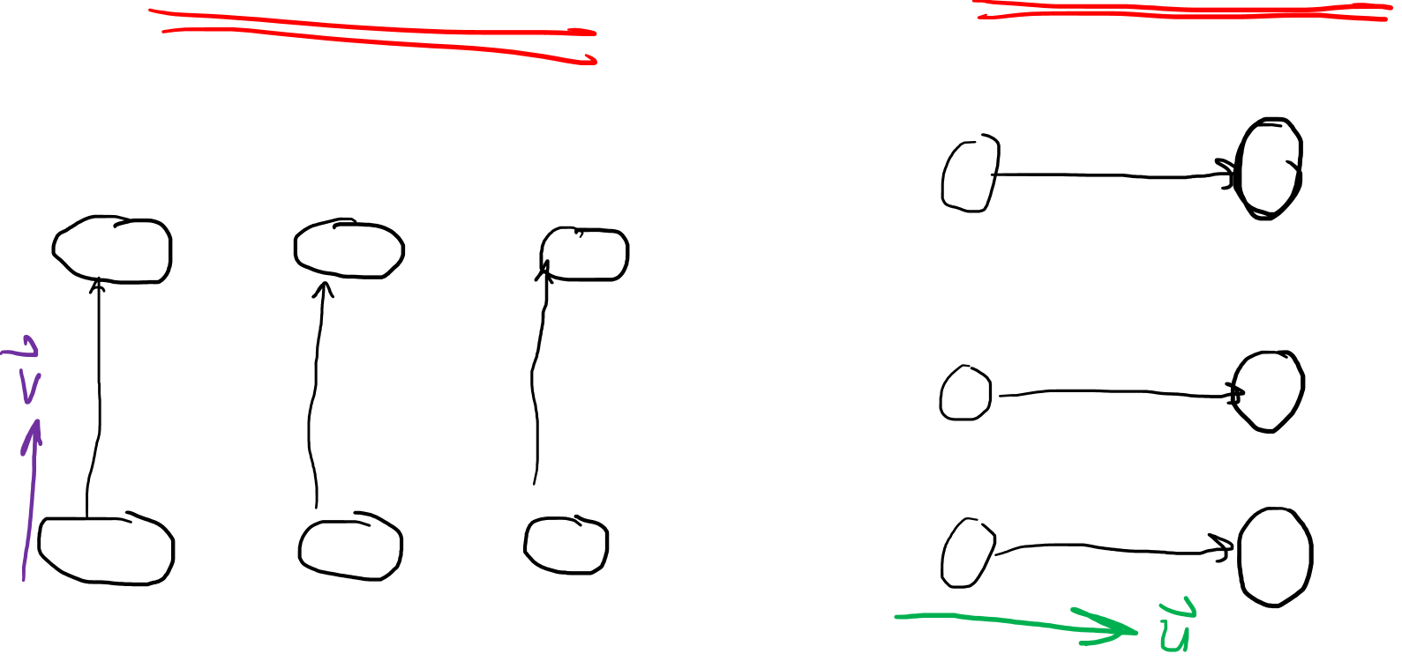
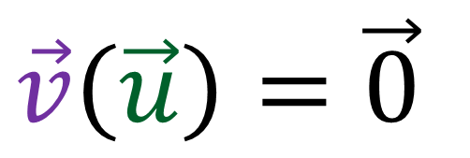
Finding change along $\vec{u}$,$\vec{v}$.
$\vec{u}=1\vec{e_{x}}$ $\vec{v}=x\vec{e_{y}}$
$$\vec{v}\left(\vec{u}\right)=\vec{0}$$
$$\vec{u}\left(\vec{v}\right)=\vec{e_{y}}$$

Slide 16
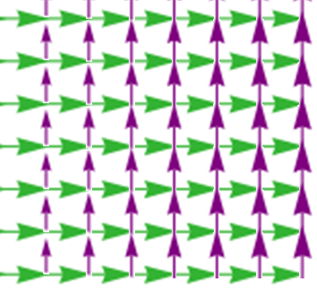
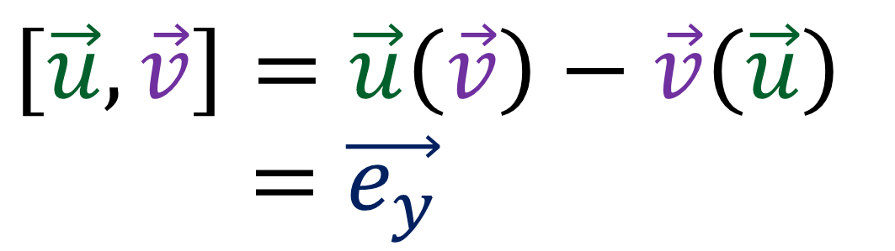
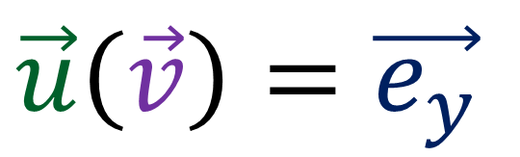
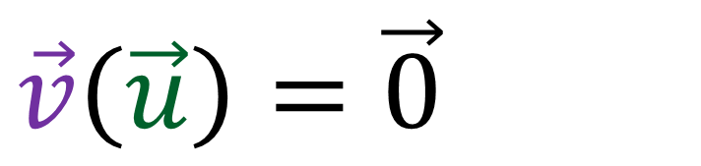
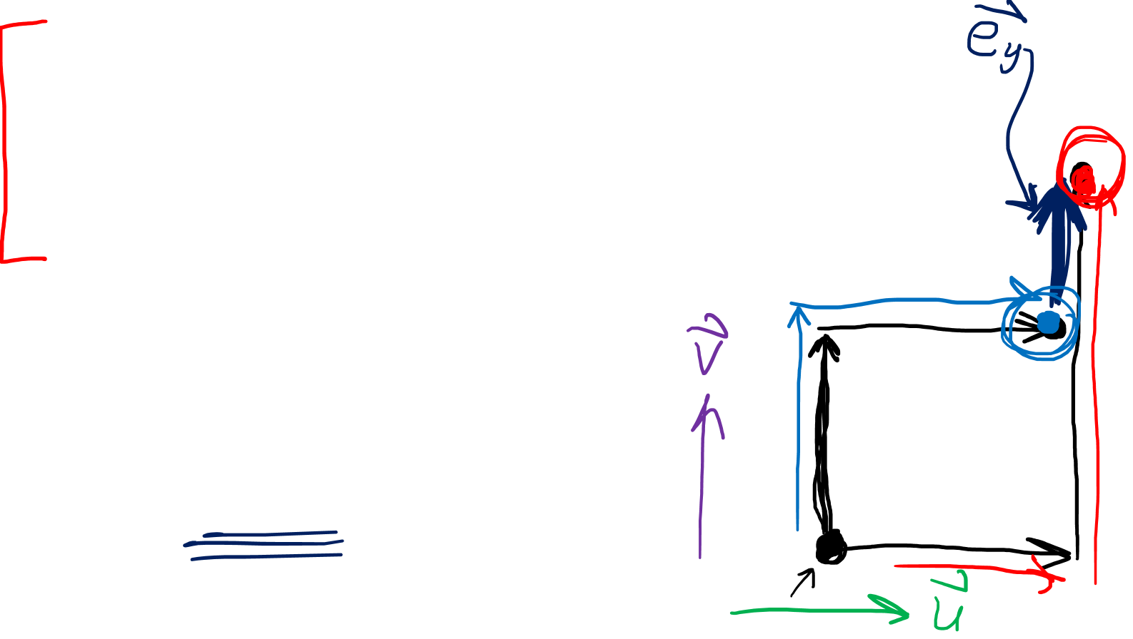
Finding change along $\vec{u}$,$\vec{v}$.
$\vec{u}=1\vec{e_{x}}$ $\vec{v}=x\vec{e_{y}}$
$$\vec{v}\left(\vec{u}\right)=\vec{0}$$
$$\vec{u}\left(\vec{v}\right)=\vec{e_{y}}$$
$$\left[\vec{u},\vec{v}\right]=\vec{u}\left(\vec{v}\right)−\vec{v}\left(\vec{u}\right)$$
$=\vec{e_{y}}$

Slide 17
Finding change of one vector field along another vector field
$$\vec{u}=1\vec{e_{x}}$$
$$\vec{v}=x\vec{e_{y}}$$

Slide 18
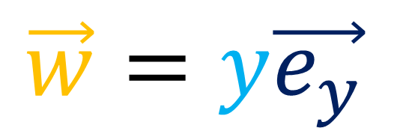
Finding change of one vector field along another vector field
$$\vec{u}=1\vec{e_{x}}$$
$$\vec{w}=y\vec{e_{y}}$$

Slide 19
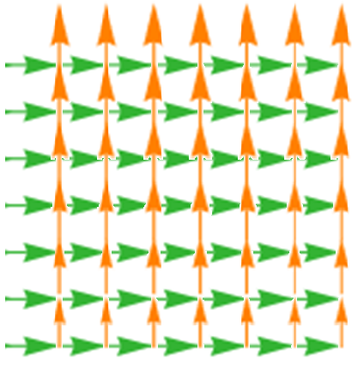
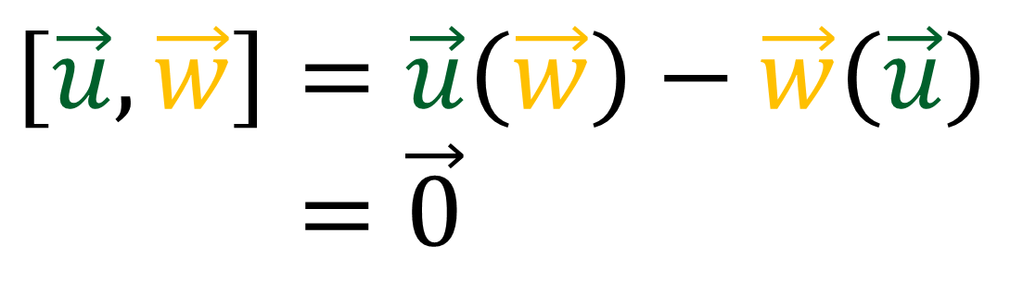
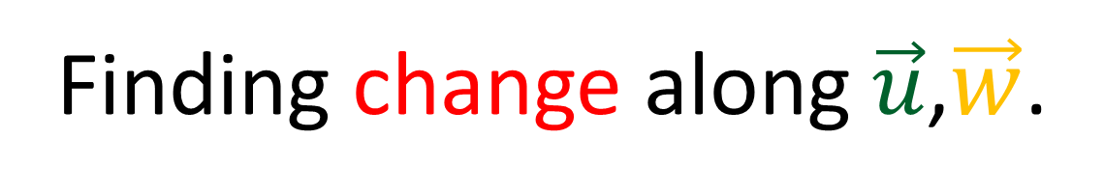




Finding change along $\vec{u}$,$\vec{w}$.
$\vec{u}=1\vec{e_{x}}$ $\vec{w}=y\vec{e_{y}}$
$$\vec{w}\left(\vec{u}\right)=\vec{0}$$
$$\vec{u}\left(\vec{w}\right)=\vec{0}$$
$$\left[\vec{u},\vec{w}\right]=\vec{u}\left(\vec{w}\right)−\vec{w}\left(\vec{u}\right)$$
$=\vec{0}$

Slide 20



$$[\vec{u},\vec{w}]=\vec{0}$$
$$[\vec{u},\vec{v}]=\vec{e_{y}}$$

Slide 21







$$[\vec{u},\vec{v}]$$
$$\vec{u}\left(\vec{v}\right)$$
$$\vec{v}\left(\vec{u}\right)$$
$$\vec{u}$$
$$\vec{u}$$
$$\vec{v}$$
$$\vec{v}$$

Slide 22

Coordinate lines
are just flows curves
along basis vectors.
$$[\vec{e_{i}},\vec{e_{j}}]=\vec{0}$$
$$[∂_{i},∂_{j}]=\vec{0}$$
$$y$$
$$p$$
$$θ$$
$$q$$
$$x$$
$$r$$

Slide 23












$$∂_{r}$$
$$∂_{r}= \cos{θ}∂_{x}+ \sin{θ}∂_{y}$$
$$∂_{θ}=−r\sin{θ}∂_{x}+r\cos{θ}∂_{y}$$
$$∂_{θ}$$
$$θ$$
$$∂_{r}$$
$$∂_{r}\left(∂_{θ}\right)=∂_{r}\left(−r\sin{θ}∂_{x}+r\cos{θ}∂_{y}\right)$$
$∂_{r}\left(∂_{θ}\right)=$ $−\sin{θ}∂_{x}+\cos{θ}∂_{y}$
$∂_{r}\left(∂_{θ}\right)=$ $\frac{1}{r}∂_{θ}$
$$∂_{θ}$$
$$r$$
$$∂_{θ}$$
$$∂_{r}$$
$$\left[∂_{r},∂_{θ}\right]$$
$$=∂_{r}\left(∂_{θ}\right)−∂_{θ}\left(∂_{r}\right)$$
$=\frac{1}{r}∂_{θ}−\frac{1}{r}∂_{θ}$
$=\vec{0}$
$$∂_{θ}\left(∂_{r}\right)=∂_{θ}\left(\cos{θ}∂_{x}+\sin{θ}∂_{y}\right)$$
$∂_{r}\left(∂_{θ}\right)=$ $−\sin{θ}∂_{x}+\cos{θ}∂_{y}$
$∂_{r}\left(∂_{θ}\right)=\frac{1}{r}∂_{θ}$

Slide 24
Lie Bracket / Commutator =
measures how much
vector field flow curves
fail to close.

Slide 25



Lie Bracket
$\left[\vec{u},\vec{v}\right]=$ $\vec{u}\left(\vec{v}\right)−\vec{v}\left(\vec{u}\right)$
Defining the Torsion Tensor…
$$∇_{\vec{u}}\vec{v}−∇_{\vec{v}}\vec{u}$$
Connection
(defined by $Γ_{ij}^{k}$)
Vector Fields

Slide 26


Review Definition of Covariant Derivative
$$∇_{\vec{u}}\vec{v}==∇_{u^{i}∂_{i}}\left(v^{j}∂_{j}\right)$$
$∇_{\frac{∂}{∂u^{i}}}\vec{v}=u^{i}∇_{∂_{i}}\left(v^{j}∂_{j}\right)$
$∇_{\frac{∂}{∂u^{i}}}\vec{v}=u^{i}\left[∇_{∂_{i}}\left(v^{j}\right)∂_{j}+v^{j}∇_{∂_{i}}∂_{j}\right]$
$∇_{\frac{∂}{∂u^{i}}}\vec{v}=u^{i}\left[\left(∂_{i}v^{j}\right)∂_{j}+v^{j}Γ_{ij}^{k}∂_{k}\right]$
$∇_{\frac{∂}{∂u^{i}}}\vec{v}=u^{i}\left(∂_{i}v^{k}+v^{j}Γ_{ij}^{k}\right)∂_{k}$
$$∇_{∂_{i}}∂_{j}=Γ_{ij}^{k}∂_{k}$$
(see videos 17-20
for more info)

Slide 27




Review Definition of Covariant Derivative
$$∇_{\vec{u}}\vec{v} =u^{i}\left(∂_{i}v^{k}+v^{j}Γ_{ij}^{k}\right)∂_{k}$$
$$∇_{∂_{i}}∂_{j}=Γ_{ij}^{k}∂_{k}$$
Levi-Civita Connection
$$Γ_{ij}^{k}=\frac{1}{2}𝔤^{mk}\left(∂_{j}g_{mi}+∂_{i}g_{jm}−∂_{m}g_{ij}\right)$$
Parallel Transport $∇_{\vec{u}}\vec{v} =\vec{0}$

Slide 28






Levi-Civita Connection
Boring Connection
$Γ_{jk}^{m}=\frac{1}{2}𝔤^{im}\left(∂_{k}g_{ij}+∂_{j}g_{ki}−∂_{i}g_{jk}\right)$
$$\tilde{Γ_{ij}^{k}}=0$$
$$\vec{v}$$
$$\vec{v}$$
$$∇_{\frac{d}{dλ}}\vec{v}=\vec{0}$$
$${\tilde{∇}}_{\frac{d}{dλ}}\vec{v}=\vec{0}$$

Slide 29









The connection defines what
“parallel transport” means.
$$\vec{u}$$
$$\vec{u}$$
$$\vec{u}$$
$$\vec{v}$$
$$\vec{v}$$
$$\vec{v}$$
$$∇$$
$$\tilde{∇}$$
$$\overset{⃛}{∇}$$

Slide 30






Parallel Transport in Polar Coordinates
$$Γ_{ij}^{k}=\frac{1}{2}𝔤^{mk}\left(∂_{j}g_{mi}+∂_{i}g_{jm}−∂_{m}g_{ij}\right)$$
$$\tilde{Γ_{ij}^{k}}=0$$
$$θ$$
$$θ$$
$$r$$
$$r$$

Slide 31




$$∇_{\vec{u}}\left(\vec{v}\right)=\vec{0}$$
$$∇_{\vec{v}}\left(\vec{u}\right)=\vec{0}$$
$$\vec{u}$$
$$\vec{v}$$

Slide 32






$$∇_{\vec{u}}\left(\vec{v}\right)$$
Torsion Tensor
$$[\vec{u},\vec{v}]$$
$$T\left(\vec{u},\vec{v}\right)$$
$$T(\vec{u},\vec{v})$$
$$∇_{\vec{v}}\left(\vec{u}\right)$$
$$\vec{u}$$
Separation between parallel transported vectors lines.
$$\vec{v}$$
$$T\left(\vec{u},\vec{v}\right)=∇_{\vec{u}}\vec{v}−\left[\vec{u},\vec{v}\right]−∇_{\vec{v}}\vec{u}$$

Slide 33



$$T\left(\vec{u},\vec{v}\right)=∇_{\vec{u}}\vec{v}−∇_{\vec{v}}\vec{u}−\left[\vec{u},\vec{v}\right]=0$$
$$T\left(\vec{u},\vec{v}\right)=∇_{\vec{u}}\vec{v}−∇_{\vec{v}}\vec{u}=\left[\vec{u},\vec{v}\right]$$
$$\vec{u}$$
$$\vec{v}$$

Slide 34



$$T\left(\vec{u},\vec{v}\right)=∇_{\vec{u}}\vec{v}−∇_{\vec{v}}\vec{u}−\left[\vec{u},\vec{v}\right]=0$$
$$T\left(\vec{u},\vec{v}\right)=∇_{\vec{u}}\vec{v}−∇_{\vec{v}}\vec{u}=\left[\vec{u},\vec{v}\right]$$
$$∇_{\vec{u}}\left(\vec{v}\right)$$
$$[\vec{u},\vec{v}]$$
“Torsion-Free” means parallel-transported vectors close properly.
$$\vec{u}$$
$$∇_{\vec{v}}\left(\vec{u}\right)$$
$$\vec{v}$$

Slide 35


Torsion Tensor
$$T\left(\vec{u},\vec{v}\right)=∇_{\vec{u}}\vec{v}−∇_{\vec{v}}\vec{u}−\left[\vec{u},\vec{v}\right]$$
$$T\left(\vec{u},\vec{v}\right)=∇_{\vec{u}}\vec{v}−∇_{\vec{v}}\vec{u}−\left(\vec{u}\left(\vec{v}\right)−\vec{v}\left(\vec{u}\right)\right)$$
$$=u^{i}\left(∂_{i}v^{k}+v^{j}Γ_{ij}^{k}\right)∂_{k}−v^{i}\left(∂_{i}u^{k}+u^{j}Γ_{ij}^{k}\right)∂_{k}$$
$$−\left[\left[u^{i}∂_{i}\left(v^{j}∂_{j}\right)\right] −\left[v^{i}∂_{i}\left(u^{j}∂_{j}\right)\right]\right]$$

Slide 36

Torsion Tensor
$$T\left(\vec{u},\vec{v}\right)=∇_{\vec{u}}\vec{v}−∇_{\vec{v}}\vec{u}−\left[\vec{u},\vec{v}\right]$$
$$T\left(\vec{u},\vec{v}\right)=∇_{\vec{u}}\vec{v}−∇_{\vec{v}}\vec{u}−\left(\vec{u}\left(\vec{v}\right)−\vec{v}\left(\vec{u}\right)\right)$$
$$=u^{i}\left(∂_{i}v^{k}+v^{j}Γ_{ij}^{k}\right)∂_{k}−v^{i}\left(∂_{i}u^{k}+u^{j}Γ_{ij}^{k}\right)∂_{k}$$
$$−\left[\left[u^{i}\left(∂_{i}v^{j}\right)∂_{j}+u^{i}v^{j}\left(∂_{i}∂_{j}\right)\right]−\left[v^{i}\left(∂_{i}u^{j}\right)∂_{j}+v^{i}u^{j}\left(∂_{i}∂_{j}\right)\right]\right]$$
$$v^{i}u^{j}\left(∂_{i}∂_{j}\right)=v^{j}u^{i}\left(∂_{j}∂_{i}\right)=u^{i}v^{j}\left(∂_{i}∂_{j}\right)$$

Slide 37

Torsion Tensor
$$T\left(\vec{u},\vec{v}\right)=∇_{\vec{u}}\vec{v}−∇_{\vec{v}}\vec{u}−\left[\vec{u},\vec{v}\right]$$
$$T\left(\vec{u},\vec{v}\right)=∇_{\vec{u}}\vec{v}−∇_{\vec{v}}\vec{u}−\left(\vec{u}\left(\vec{v}\right)−\vec{v}\left(\vec{u}\right)\right)$$
$$=u^{i}\left(∂_{i}v^{k}+v^{j}Γ_{ij}^{k}\right)∂_{k}−v^{i}\left(∂_{i}u^{k}+u^{j}Γ_{ij}^{k}\right)∂_{k}$$
$$−\left[u^{i}\left(∂_{i}v^{j}\right)∂_{j} −v^{i}\left(∂_{i}u^{j}\right)∂_{j}\right]$$

Slide 38

Torsion Tensor
$$T\left(\vec{u},\vec{v}\right)=∇_{\vec{u}}\vec{v}−∇_{\vec{v}}\vec{u}−\left[\vec{u},\vec{v}\right]$$
$$T\left(\vec{u},\vec{v}\right)=∇_{\vec{u}}\vec{v}−∇_{\vec{v}}\vec{u}−\left(\vec{u}\left(\vec{v}\right)−\vec{v}\left(\vec{u}\right)\right)$$
$$=\left(u^{i}\left(∂_{i}v^{k}\right)∂_{k}+u^{i}v^{j}Γ_{ij}^{k}∂_{k}\right)−\left(v^{i}\left(∂_{i}u^{k}\right)∂_{k}+v^{i}u^{j}Γ_{ij}^{k}∂_{k}\right)$$
$$−\left[u^{i}\left(∂_{i}v^{j}\right)∂_{j} −v^{i}\left(∂_{i}u^{j}\right)∂_{j}\right]$$

Slide 39

Torsion Tensor
$$T\left(\vec{u},\vec{v}\right)=∇_{\vec{u}}\vec{v}−∇_{\vec{v}}\vec{u}−\left[\vec{u},\vec{v}\right]$$
$$T\left(\vec{u},\vec{v}\right)=∇_{\vec{u}}\vec{v}−∇_{\vec{v}}\vec{u}−\left(\vec{u}\left(\vec{v}\right)−\vec{v}\left(\vec{u}\right)\right)$$
$$=\left(u^{i}\left(∂_{i}v^{k}\right)∂_{k}+u^{i}v^{j}Γ_{ij}^{k}∂_{k}\right)−\left(v^{i}\left(∂_{i}u^{k}\right)∂_{k}+v^{i}u^{j}Γ_{ij}^{k}∂_{k}\right)$$
$$−\left[u^{i}\left(∂_{i}v^{k}\right)∂_{k} −v^{i}\left(∂_{i}u^{k}\right)∂_{k}\right]$$

Slide 40

Torsion Tensor
$$T\left(\vec{u},\vec{v}\right)=∇_{\vec{u}}\vec{v}−∇_{\vec{v}}\vec{u}−\left[\vec{u},\vec{v}\right]$$
$$T\left(\vec{u},\vec{v}\right)=∇_{\vec{u}}\vec{v}−∇_{\vec{v}}\vec{u}−\left(\vec{u}\left(\vec{v}\right)−\vec{v}\left(\vec{u}\right)\right)$$
$$=u^{i}v^{j}Γ_{ij}^{k}∂_{k}−v^{i}u^{j}Γ_{ij}^{k}∂_{k}$$
$$=u^{i}v^{j}Γ_{ij}^{k}∂_{k}−v^{j}u^{i}Γ_{ji}^{k}∂_{k}$$
$$=u^{i}v^{j}\left(Γ_{ij}^{k}−Γ_{ji}^{k}\right)∂_{k}$$

Slide 41


Torsion Tensor
$$T\left(\vec{u},\vec{v}\right)=∇_{\vec{u}}\vec{v}−∇_{\vec{v}}\vec{u}−\left[\vec{u},\vec{v}\right]$$
$$T\left(\vec{u},\vec{v}\right)=∇_{\vec{u}}\vec{v}−∇_{\vec{v}}\vec{u}−\left(\vec{u}\left(\vec{v}\right)−\vec{v}\left(\vec{u}\right)\right)$$
$=u^{i}v^{j}\left(Γ_{ij}^{k}−Γ_{ji}^{k}\right)∂_{k}$
$T_{ij}^{k}$ $=Γ_{ij}^{k}−Γ_{ji}^{k}$

Slide 42


Torsion-Free connection $∇$
$$T\left(\vec{u},\vec{v}\right)=∇_{\vec{u}}\vec{v}−∇_{\vec{v}}\vec{u}−\left[\vec{u},\vec{v}\right]=0$$
$$∇_{\vec{u}}\vec{v}−∇_{\vec{v}}\vec{u}=\left[\vec{u},\vec{v}\right]=\vec{u}\left(\vec{v}\right)−\vec{v}\left(\vec{u}\right)$$
$$T_{ij}^{k}=Γ_{ij}^{k}−Γ_{ji}^{k}=0$$
$Γ_{ij}^{k}=Γ_{ji}^{k}$

Slide 43
Summary
Flow curves:
Vector arrows tell you velocity

Slide 44

Summary – Lie Bracket
$$\left[\vec{u},\vec{v}\right]=\vec{u}\left(\vec{v}\right)−\vec{v}\left(\vec{u}\right)$$
$$[\vec{u},\vec{v}]$$
$$\vec{u}\left(\vec{v}\right)$$
$$\vec{v}\left(\vec{u}\right)$$
$$\vec{u}$$
$$\vec{v}$$

Slide 45









Summary – Torsion
$$T\left(\vec{u},\vec{v}\right)=∇_{\vec{u}}\vec{v}−∇_{\vec{v}}\vec{u}−\left[\vec{u},\vec{v}\right]$$
$$∇_{\vec{u}}\vec{v}$$
$$[\vec{u},\vec{v}]$$
$$T\left(\vec{u},\vec{v}\right)=u^{i}v^{j}T_{ij}^{k}∂_{k}$$
$$T(\vec{u},\vec{v})$$
$$∇_{\vec{v}}\vec{u}$$
$$\vec{u}$$
$$T_{ij}^{k}=Γ_{ij}^{k}−Γ_{ji}^{k}$$
$$\vec{v}$$

Slide 46


But what happens if I set my basis to the vector fields where the Lie bracket doesn’t commute???
Remember… $∇_{\vec{u}}\vec{v}=0$ means we are parallel transporting $\vec{v}$ along the $\vec{u}$ direction. If this fails to be zero, it means that there is some “twisting” in the vector field that is not due to parallel transport.
So $∇_{\vec{u}}\vec{v}$ is basically the “deviation from parallel transport”.

