Slide 1

$$R_{ abc}^{d}$$
Riemann Curvature Tensor

Slide 2
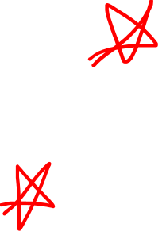
Riemann Curvature Tensor
(Also see Videos 17-20: Covariant Derivative)
(Also see Video 21: Lie Bracket)
(Links in the description)

Slide 3
This video:
abstract formula, geometry, intuition
$$R\left(\vec{u},\vec{v}\right)\vec{w}=∇_{\vec{u}}∇_{\vec{v}}\vec{w}−∇_{\vec{v}}∇_{\vec{u}}\vec{w}−∇_{\left[\vec{u},\vec{v}\right]}\vec{w}$$
Next video:
components, symmetries
$R_{ cab}^{d}=∂_{a}\left(Γ_{bc}^{d}\right)−∂_{b}\left(Γ_{ac}^{d}\right)+Γ_{bc}^{i}Γ_{ai}^{d}−Γ_{ac}^{j}Γ_{bj}^{d}$

Slide 4
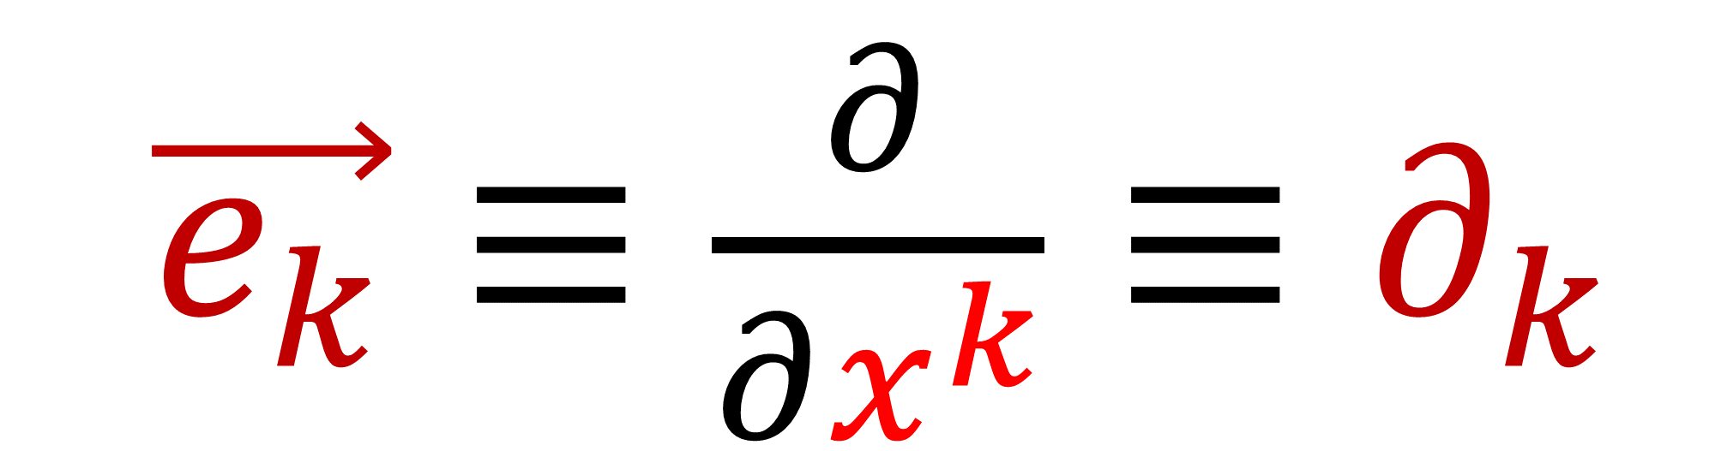
Basis vectors
$\vec{e_{k}}≡\frac{∂}{∂x^{k}}≡∂_{k}$

Slide 5
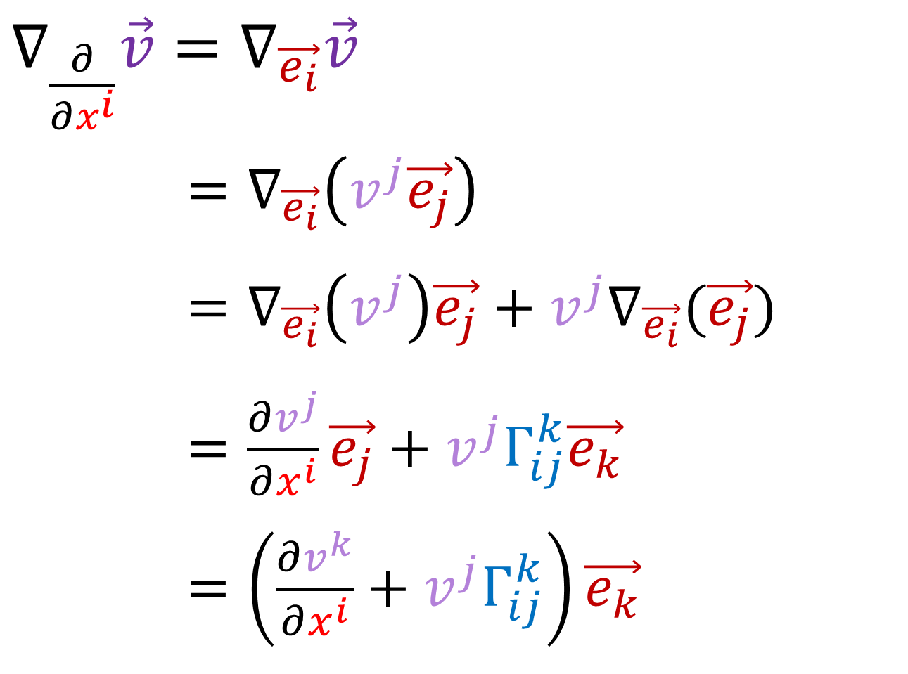
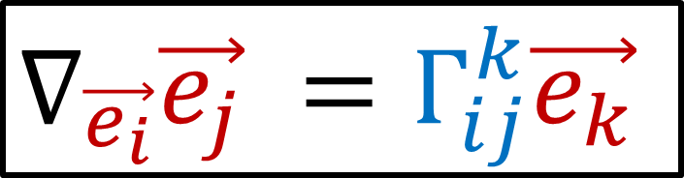
Review Definition of Covariant Derivative
$∇_{\frac{∂}{∂x^{i}}}\vec{v}=∇_{\vec{e_{i}}}\vec{v}$
$∇_{\frac{∂}{∂u^{i}}}\vec{v}=∇_{\vec{e_{i}}}\left(v^{j}\vec{e_{j}}\right)$
$∇_{\frac{∂}{∂u^{i}}}\vec{v}=∇_{\vec{e_{i}}}\left(v^{j}\right)\vec{e_{j}}+v^{j}∇_{\vec{e_{i}}}(\vec{e_{j}})$
$∇_{\frac{∂}{∂u^{i}}}\vec{v}=\frac{∂v^{j}}{∂x^{i}}\vec{e_{j}}+v^{j}Γ_{ij}^{k}\vec{e_{k}}$
$∇_{\frac{∂}{∂u^{i}}}\vec{v}=\left(\frac{∂v^{k}}{∂x^{i}}+v^{j}Γ_{ij}^{k}\right)\vec{e_{k}}$
$∇_{\vec{e_{i}}}\vec{e_{j}} =Γ_{ij}^{k}\vec{e_{k}}$
(see videos 17-20
for more info)

Slide 6
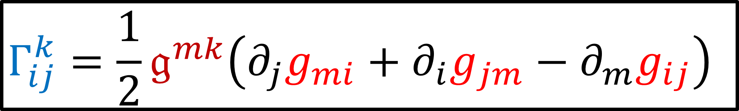
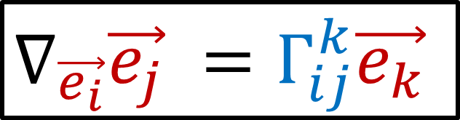
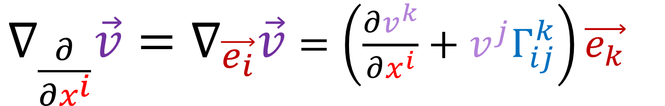
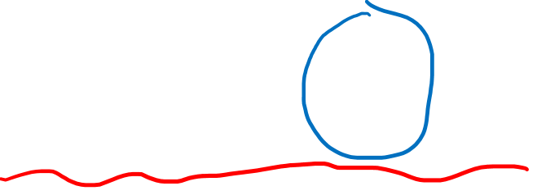
Review Definition of Covariant Derivative
$∇_{\frac{∂}{∂x^{i}}}\vec{v}=∇_{\vec{e_{i}}}\vec{v}$ $=\left(\frac{∂v^{k}}{∂x^{i}}+v^{j}Γ_{ij}^{k}\right)\vec{e_{k}}$
$∇_{\vec{e_{i}}}\vec{e_{j}} =Γ_{ij}^{k}\vec{e_{k}}$
Levi-Civita Connection (Video 20)
$$Γ_{ij}^{k}=\frac{1}{2}𝔤^{mk}\left(∂_{j}g_{mi}+∂_{i}g_{jm}−∂_{m}g_{ij}\right)$$

Slide 7
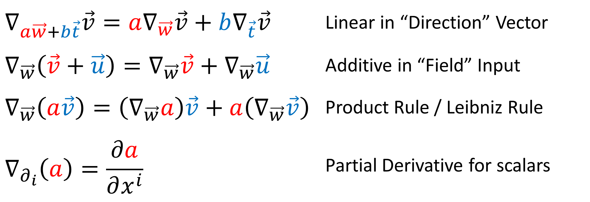
Review Definition of Covariant Derivative
$$∇_{a\vec{w}+b\vec{t}}\vec{v}=a∇_{\vec{w}}\vec{v}+b∇_{\vec{t}}\vec{v}$$ | Linear in “Direction” Vector
$$∇_{\vec{w}}\left(\vec{v}+\vec{u}\right)=∇_{\vec{w}}\vec{v}+∇_{\vec{w}}\vec{u}$$ | Additive in “Field” Input
$$∇_{\vec{w}}\left(a\vec{v}\right)=\left(∇_{\vec{w}}a\right)\vec{v}+a\left(∇_{\vec{w}}\vec{v}\right)$$ | Product Rule / Leibniz Rule
$$∇_{∂_{i}}\left(a\right)=\frac{∂a}{∂x^{i}}$$ | Partial Derivative for scalars

Slide 8
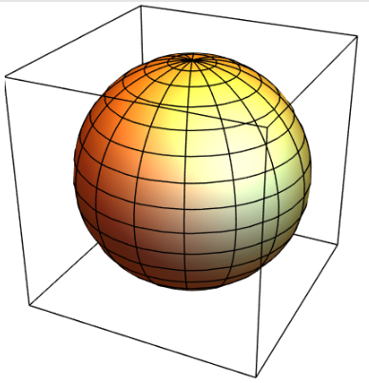
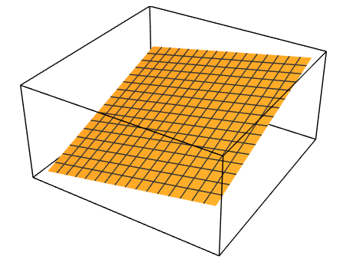
How can we tell if a space is curved or flat?
Curved Surface
Flat Surface

Slide 9

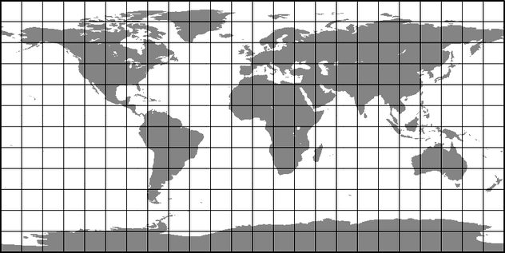


How can we tell if a space is curved or flat?
$$u^{2}$$
$$u^{1}$$

Slide 10

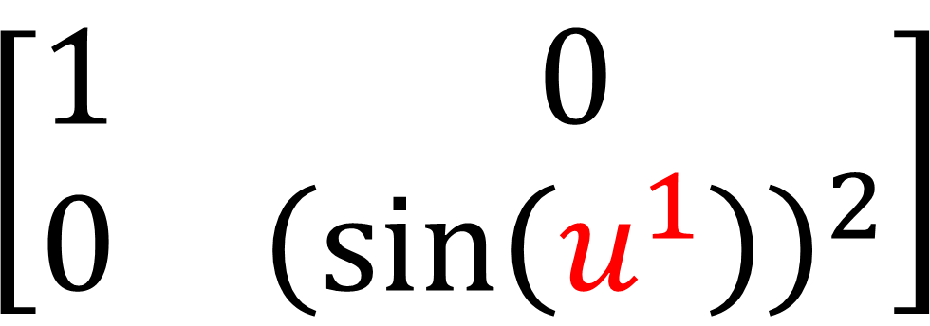
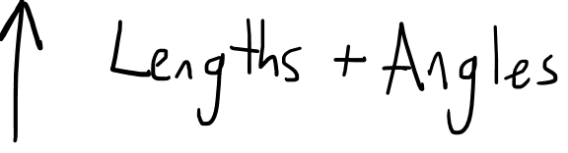
How can we tell if a space is curved or flat?
$$\left[\begin{matrix}1 & 0 \\ 0 & {\left(\sin\left(u^{1}\right)\right)}^{2}\end{matrix}\right]$$
$$u^{2}$$
$$u^{1}$$
Metric Tensor $g_{ij}$

Slide 11
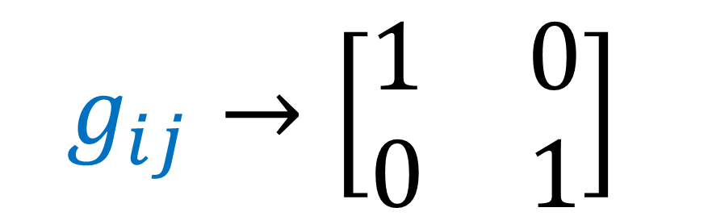
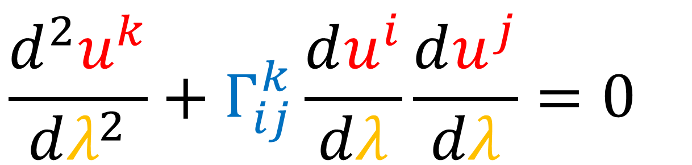
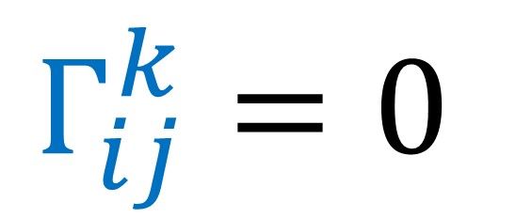
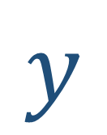

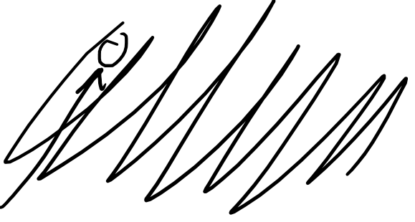
How can we tell if a space is curved or flat?
$$g_{ij}→\left[\begin{matrix}1 & 0 \\ 0 & 1\end{matrix}\right]$$
2D Cartesian Coords
$$y$$
$$Γ_{ij}^{k}=0$$
Geodesic Equation:
$$x$$
$$\frac{d^{2}u^{k}}{dλ^{2}}+Γ_{ij}^{k}\frac{du^{i}}{dλ}\frac{du^{j}}{dλ}=0$$

Slide 12
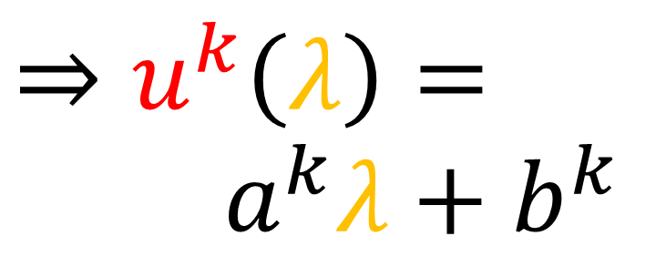
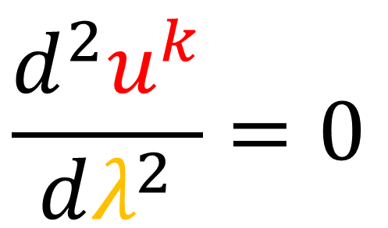
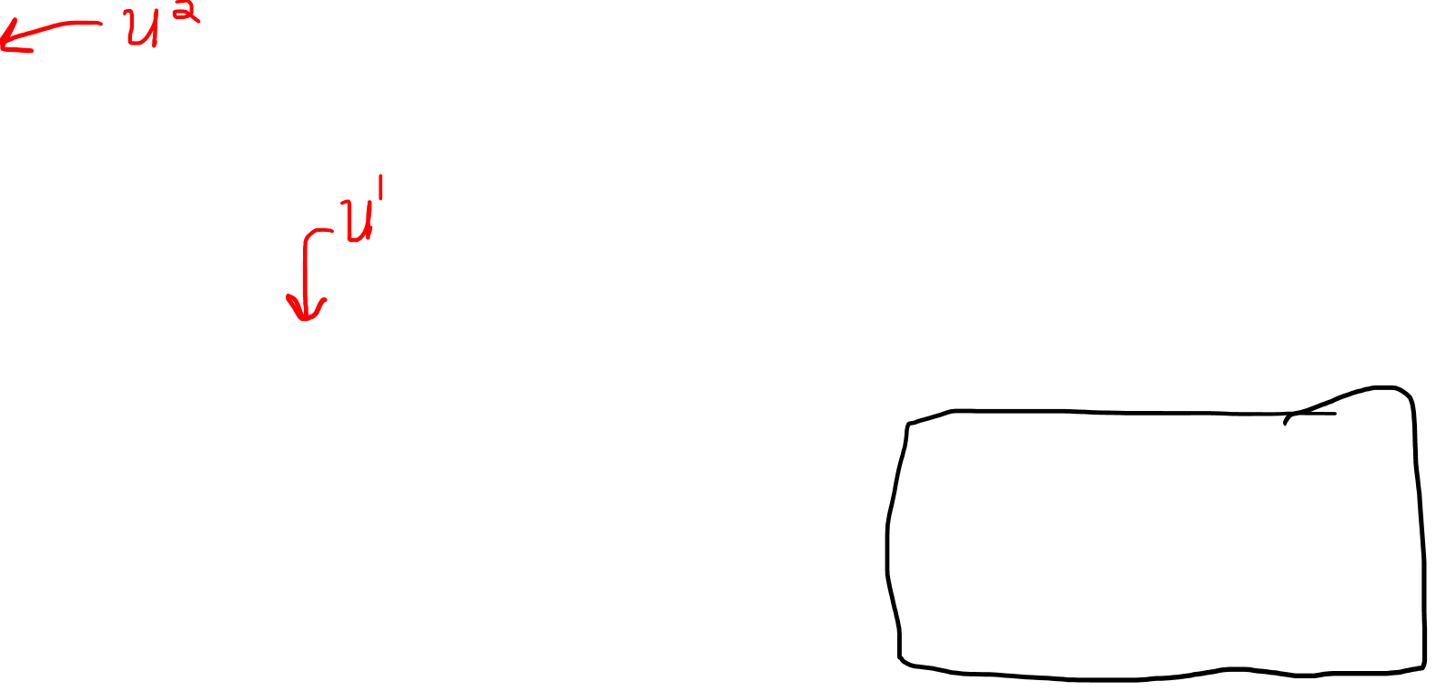
How can we tell if a space is curved or flat?
$$g_{ij}→\left[\begin{matrix}1 & 0 \\ 0 & 1\end{matrix}\right]$$
2D Cartesian Coords
$$y$$
$$Γ_{ij}^{k}=0$$
Geodesic Equation:
$$x$$
$$\frac{d^{2}u^{k}}{dλ^{2}}=0$$
$$⇒u^{k}\left(λ\right)=$$
$a^{k}λ+b^{k}$

Slide 13
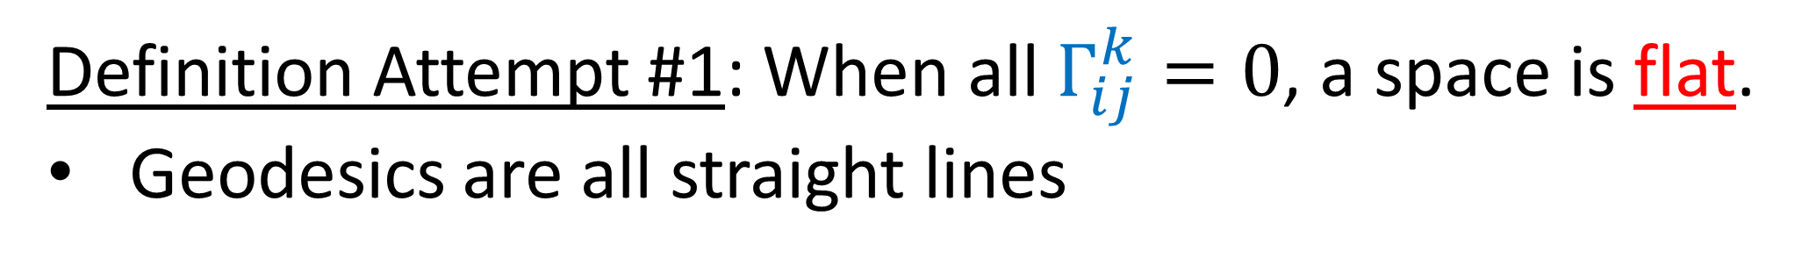
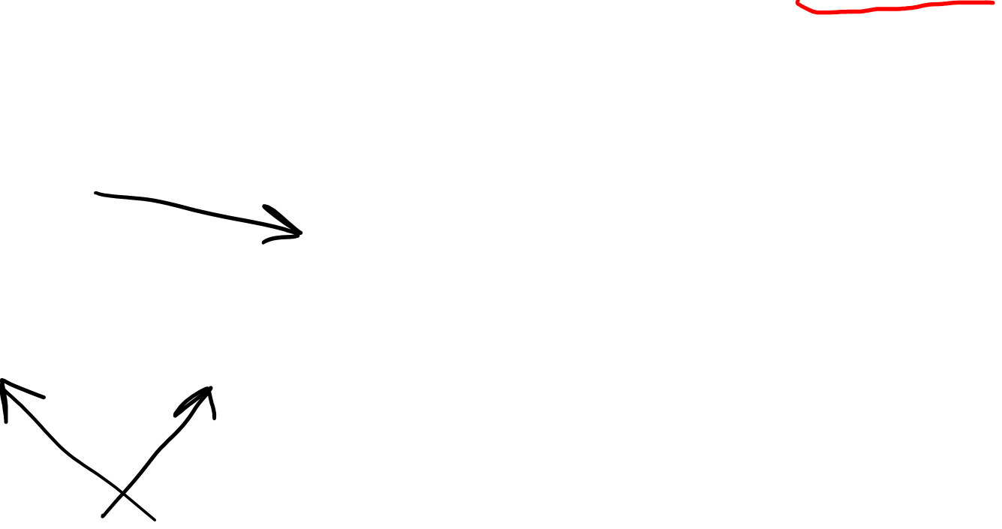
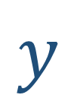

How can we tell if a space is curved or flat?
Definition Attempt #1: When all $Γ_{ij}^{k}=0$, a space is flat.
Geodesics are all straight lines
$$y$$
It’s not that easy!
$$x$$

Slide 14

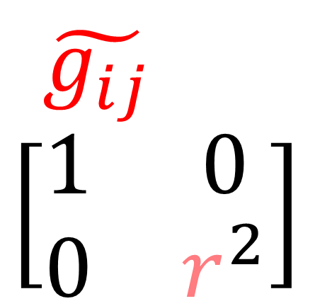
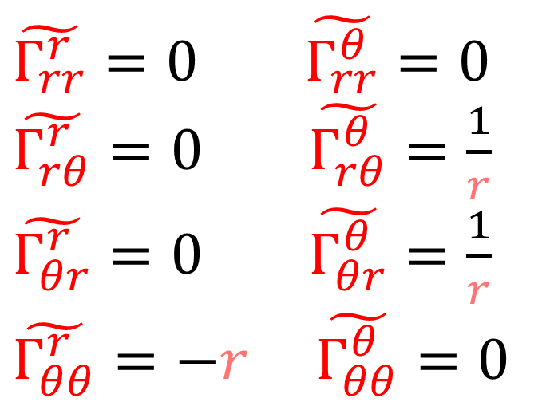



How can we tell if a space is curved or flat?
Definition Attempt #1: When all $Γ_{ij}^{k}=0$, a space is flat.
Geodesics are all straight lines
$$θ$$
$$\tilde{g_{ij}}$$
$$\left[\begin{matrix}1 & 0 \\ 0 & r^{2}\end{matrix}\right]$$
$\tilde{Γ_{rr}^{r}}=0$ $\tilde{Γ_{rr}^{θ}}=0$
$\tilde{Γ_{rθ}^{r}}=0$ $\tilde{Γ_{rθ}^{θ}}=\frac{1}{r}$
$\tilde{Γ_{θr}^{r}}=0$ $\tilde{Γ_{θr}^{θ}}=\frac{1}{r}$
$$\tilde{Γ_{θθ}^{r}}=−r \tilde{Γ_{θθ}^{θ}}=0$$
$$↱$$
$$r$$
Polar Coords (flat)

Slide 15
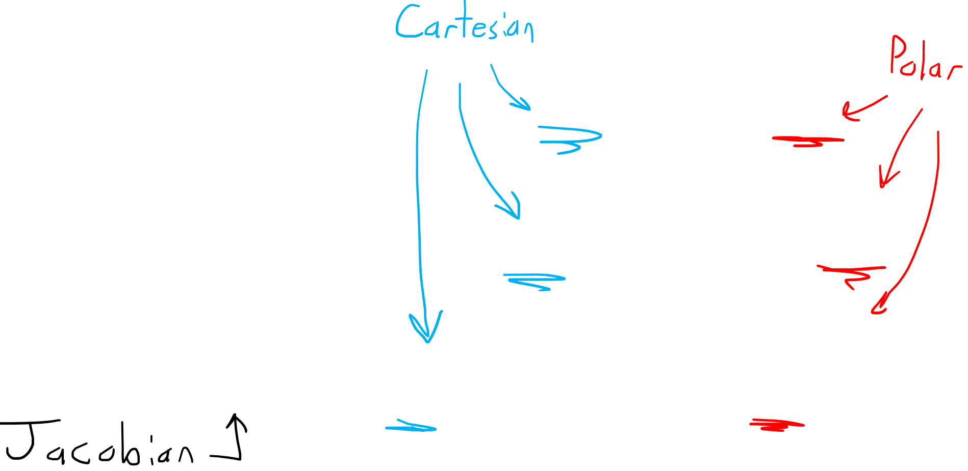
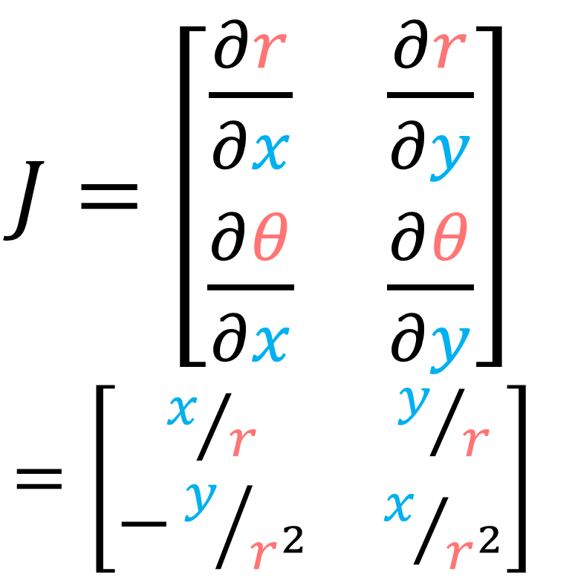
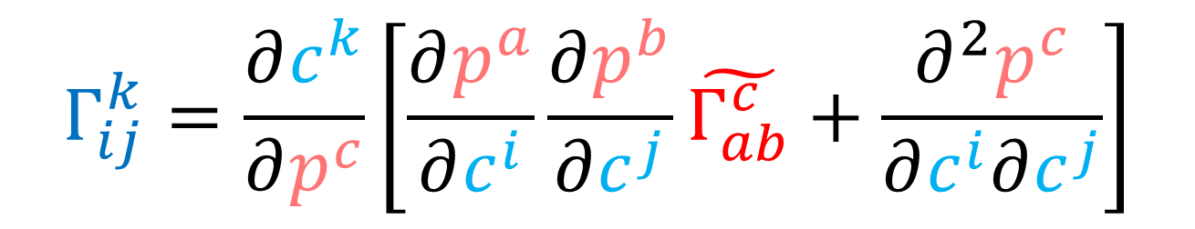
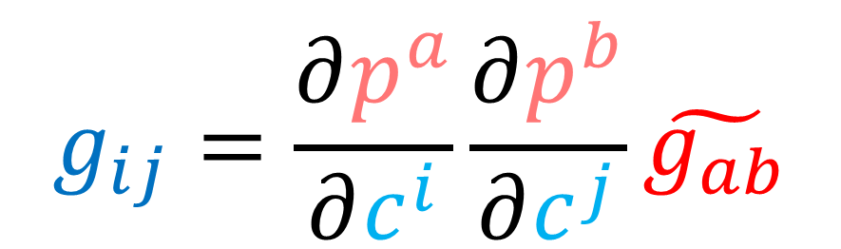
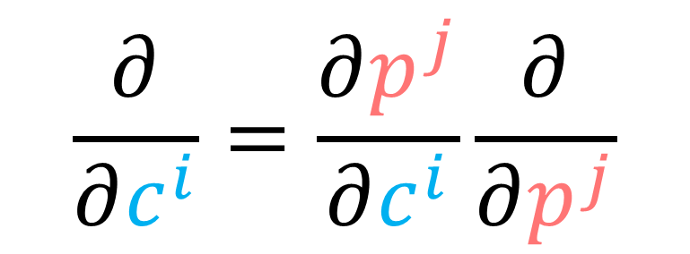
How can we tell if a space is curved or flat?
$$\frac{∂}{∂c^{i}}=\frac{∂p^{j}}{∂c^{i}}\frac{∂}{∂p^{j}}$$
$J=\left[\begin{matrix}\frac{∂r}{∂x} & \frac{∂r}{∂y} \\ \frac{∂θ}{∂x} & \frac{∂θ}{∂y}\end{matrix}\right]$
$=\left[\begin{matrix}x/r & y/r \\ −y/{r^{2}} & x/{r^{2}}\end{matrix}\right]$
$$g_{ij}=\frac{∂p^{a}}{∂c^{i}}\frac{∂p^{b}}{∂c^{j}}\tilde{g_{ab}}$$
$$Γ_{ij}^{k}=\frac{∂c^{k}}{∂p^{c}}\left[\frac{∂p^{a}}{∂c^{i}}\frac{∂p^{b}}{∂c^{j}}\tilde{Γ_{ab}^{c}}+\frac{∂^{2}p^{c}}{∂c^{i}∂c^{j}}\right]$$

Slide 16

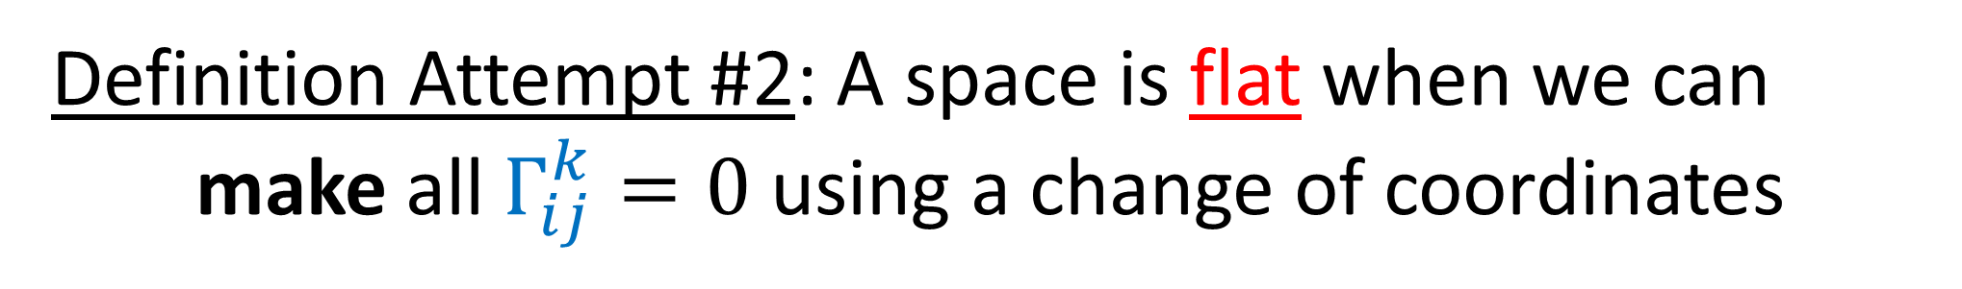

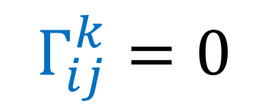
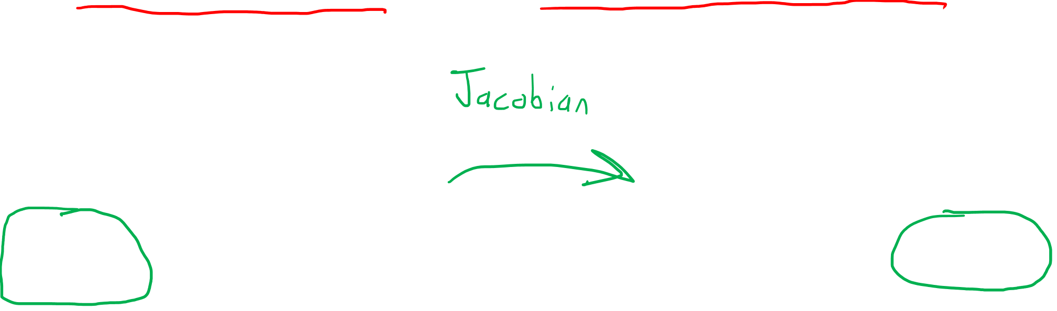


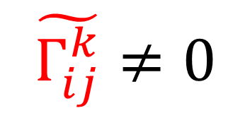
How can we tell if a space is curved or flat?
Definition Attempt #2: A space is flat when we can make all $Γ_{ij}^{k}=0$ using a change of coordinates
$$y$$
$$θ$$
$$r$$
$$x$$
$$\tilde{Γ_{ij}^{k}}≠0$$
$$Γ_{ij}^{k}=0$$
Polar Coords (flat)
Cartesian Coords (flat)

Slide 17

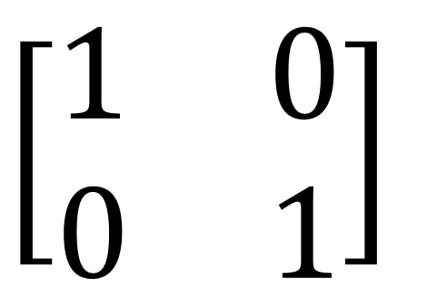

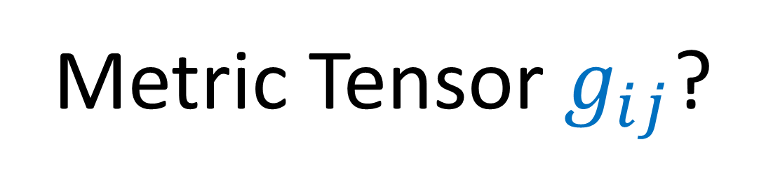


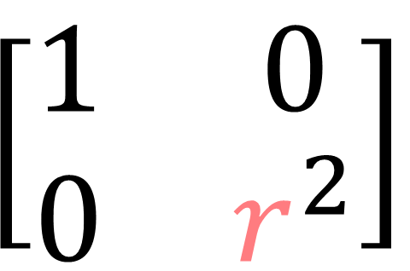
How can we tell if a space is curved or flat?
Metric Tensor $g_{ij}$?
$$y$$
$$θ$$
$$\left[\begin{matrix}1 & 0 \\ 0 & 1\end{matrix}\right]$$
$$\left[\begin{matrix}1 & 0 \\ 0 & r^{2}\end{matrix}\right]$$
$$x$$
$$r$$
(Tensor Calculus Video 9)

Slide 18
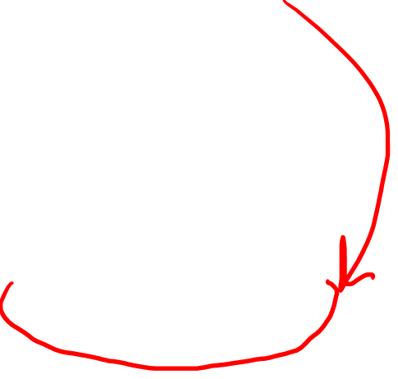
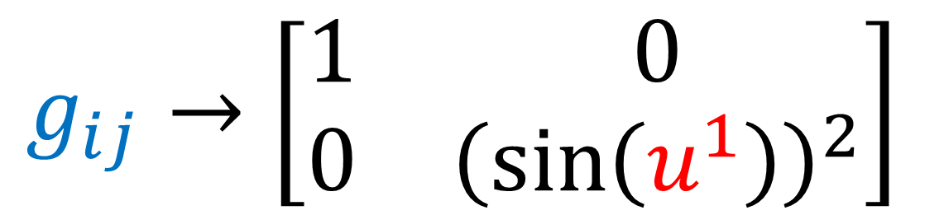
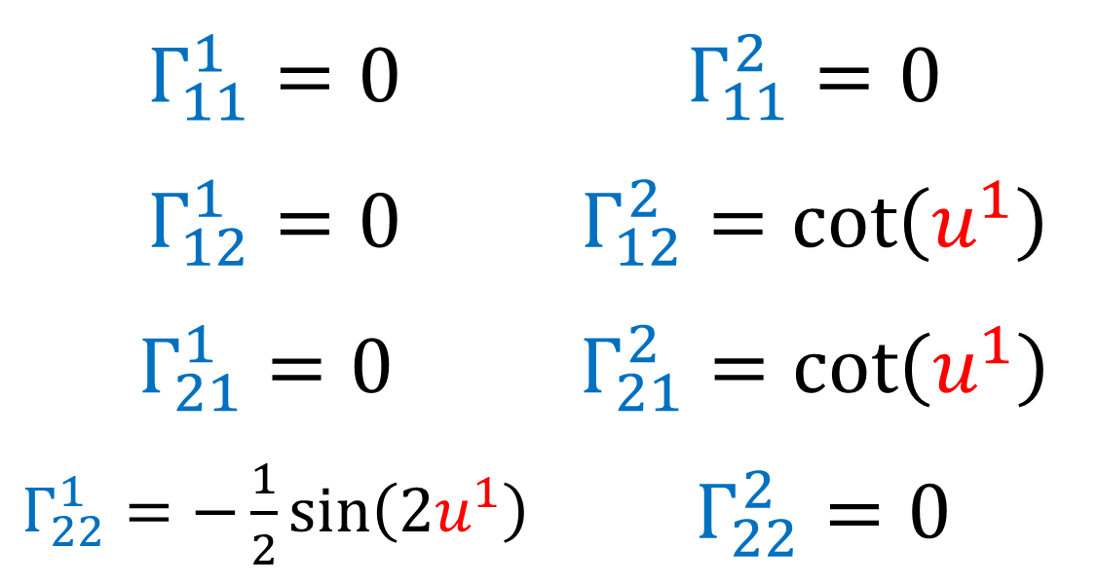
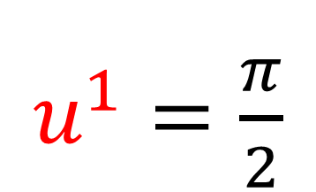
How can we tell if a space is curved or flat?
$u^{1}=\frac{π}{2}$
$$g_{ij}→\left[\begin{matrix}1 & 0 \\ 0 & {\left(\sin\left(u^{1}\right)\right)}^{2}\end{matrix}\right]$$
$Γ_{11}^{1}=0$ | $$Γ_{11}^{2}=0$$
$Γ_{12}^{1}=0$ | $$Γ_{12}^{2}=\cot\left(u^{1}\right)$$
$$Γ_{21}^{1}=0$$ | $$Γ_{21}^{2}=\cot\left(u^{1}\right)$$
$Γ_{22}^{1}=−\frac{1}{2}\sin\left(2u^{1}\right)$ | $Γ_{22}^{2}=0$
Sphere (radius=1)

Slide 19

How can we tell if a space is curved or flat?
$u^{1}=\frac{π}{2}$
$$g_{ij}→\left[\begin{matrix}1 & 0 \\ 0 & 1\end{matrix}\right]$$
$Γ_{11}^{1}=0$ | $$Γ_{11}^{2}=0$$
$Γ_{12}^{1}=0$ | $$Γ_{12}^{2}=\cot\left(u^{1}\right)$$
$$Γ_{21}^{1}=0$$ | $$Γ_{21}^{2}=\cot\left(u^{1}\right)$$
$Γ_{22}^{1}=−\frac{1}{2}\sin\left(2u^{1}\right)$ | $Γ_{22}^{2}=0$
Sphere (radius=1)

Slide 20
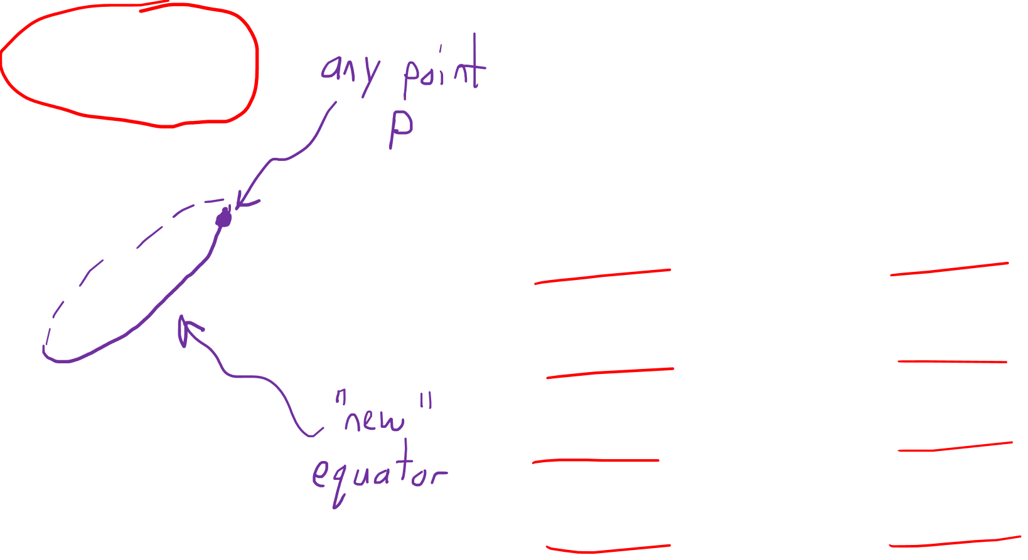
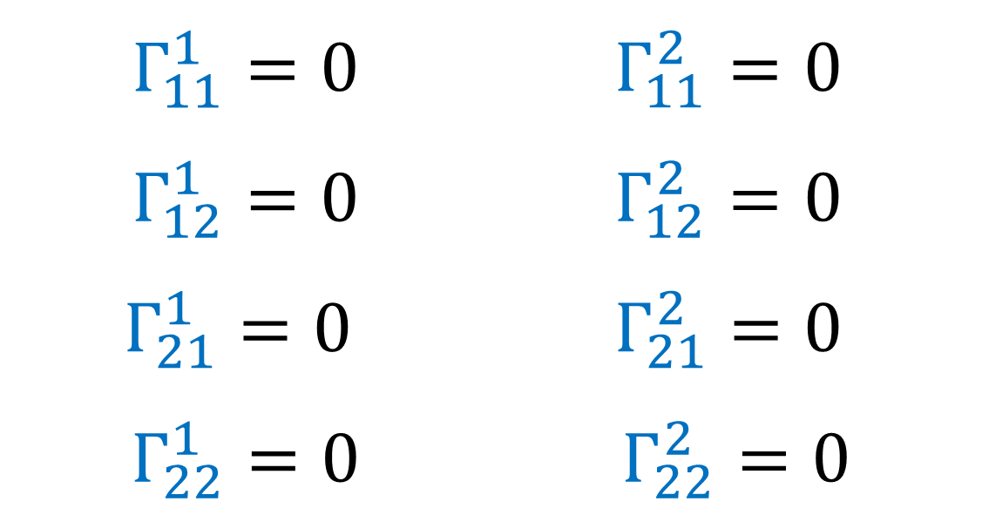
How can we tell if a space is curved or flat?
$u^{1}=\frac{π}{2}$
$$g_{ij}→\left[\begin{matrix}1 & 0 \\ 0 & 1\end{matrix}\right]$$
$Γ_{11}^{1}=0$ | $$Γ_{11}^{2}=0$$
$Γ_{12}^{1}=0$ | $$Γ_{12}^{2}=0$$
$$Γ_{21}^{1}=0$$ | $$Γ_{21}^{2}=0$$
$Γ_{22}^{1}=0$ | $Γ_{22}^{2}=0$
Sphere (radius=1)

Slide 21
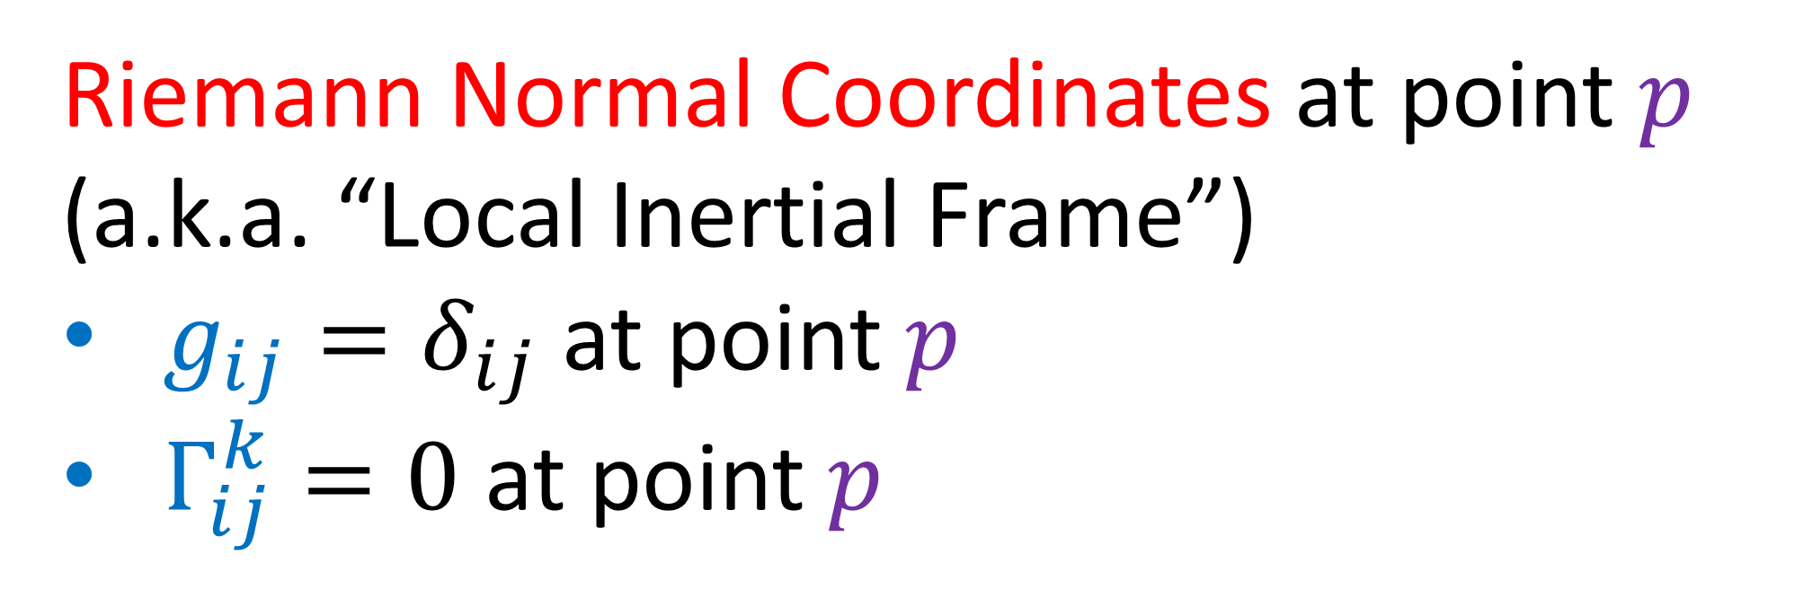
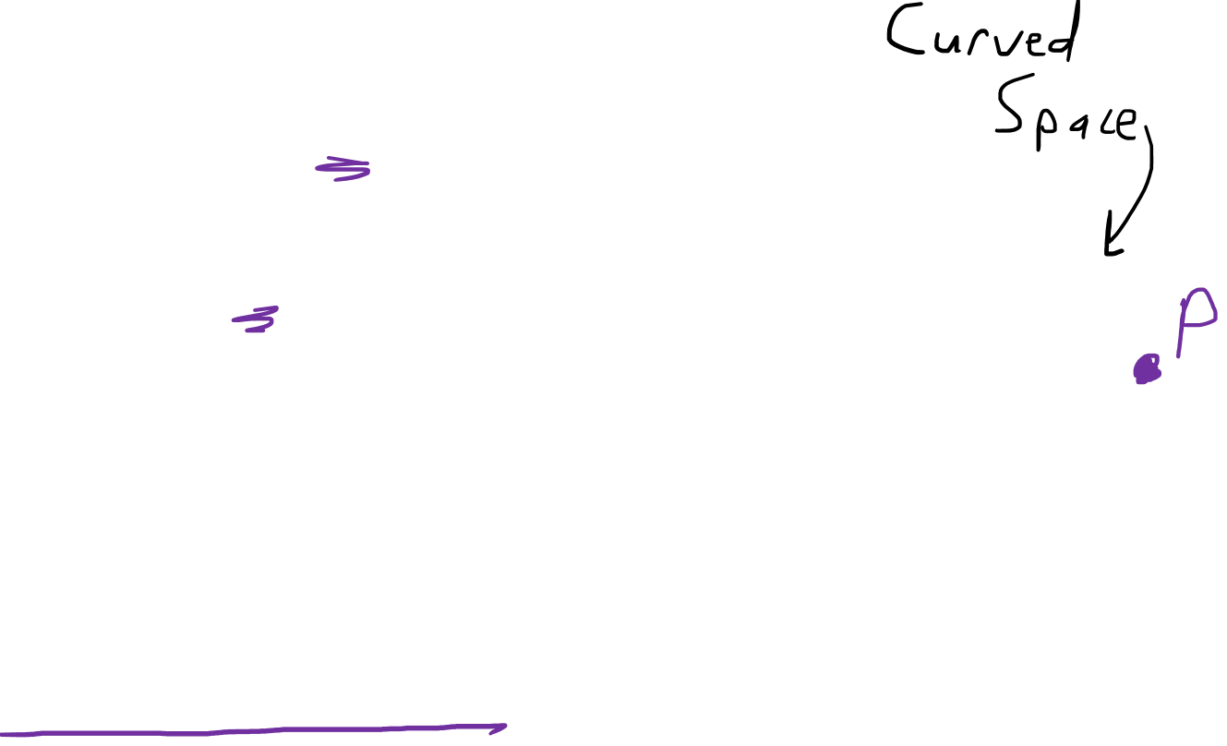

Riemann Normal Coordinates at point $p$
(a.k.a. “Local Inertial Frame”)
$g_{ij}=δ_{ij}$ at point $p$
$Γ_{ij}^{k}=0$ at point $p$
We can always change coordinates to make
$Γ_{ij}^{k}=0$ at a given point $p$.

Slide 22







How can we tell if a space is curved or flat?
Christoffel Symbols $Γ_{ij}^{k}$?
$$y$$
$\tilde{Γ_{rr}^{r}}=0$ $\tilde{Γ_{rr}^{θ}}=0$
$\tilde{Γ_{rθ}^{r}}=0$ $\tilde{Γ_{rθ}^{θ}}=\frac{1}{r}$
$\tilde{Γ_{θr}^{r}}=0$ $\tilde{Γ_{θr}^{θ}}=\frac{1}{r}$
$$\tilde{Γ_{θθ}^{r}}=−r \tilde{Γ_{θθ}^{θ}}=0$$
$$θ$$
$$Γ_{ij}^{k}=0$$
$$x$$
$$r$$
(Tensor Calculus Video 17)

Slide 23







How can we tell if a space is curved or flat?
Christoffel Symbols $Γ_{ij}^{k}$?
$$\tilde{\vec{e_{θ}}}$$
$$\tilde{\vec{e_{r}}}$$
$∇_{\vec{e_{i}}}\vec{e_{j}} =Γ_{ij}^{k}\vec{e_{k}}$
$\tilde{Γ_{rr}^{r}}=0$ $\tilde{Γ_{rr}^{θ}}=0$
$\tilde{Γ_{rθ}^{r}}=0$ $\tilde{Γ_{rθ}^{θ}}=\frac{1}{r}$
$\tilde{Γ_{θr}^{r}}=0$ $\tilde{Γ_{θr}^{θ}}=\frac{1}{r}$
$$\tilde{Γ_{θθ}^{r}}=−r \tilde{Γ_{θθ}^{θ}}=0$$
$$θ$$
$$\tilde{\vec{e_{r}}}$$
$$\tilde{\vec{e_{θ}}}$$
Christoffel Symbols
are about basis vectors changing.
$$r$$
$$\tilde{\vec{e_{θ}}}$$
$$\tilde{\vec{e_{r}}}$$

Slide 24


How can we tell if a space is curved or flat?
Riemann Curvature Tensor $R_{ abc}^{d}$
(1 contra, 3 co)-Tensor
Two main ways to detect curvature:
holonomy
geodesic deviation

Slide 25


Parallel Transport keeps vectors “as constant as possible”, as we move step-by-step.
(Video 18)

Slide 26

Parallel Transport keeps vectors “as constant as possible”, as we move step-by-step.

Slide 27

Flat space
Curved space

Slide 28

Curved spaces

Slide 29

Parallel Transport doesn’t keep vectors “constant”.
It’s impossible to defined a “constant” vector field on a curved surface.
Parallel Transport keeps vectors “as constant as possible”, as we move step-by-step.

Slide 30








Assume
$$\left[\vec{u},\vec{v}\right]=0$$
$$\left(r,s\right)$$
$$\left(0,s\right)$$
$$\vec{v}$$
$$\vec{u}$$
$$\left(r,0\right)$$
$$\left(0,0\right)$$

Slide 31





$$\vec{w}−DCBA\vec{w}$$
$$\left(r,s\right)$$
$$\left(0,s\right)$$
$$\vec{v}$$
$$\vec{u}$$
$$\left(r,0\right)$$
$$\vec{w}$$
$$\left(0,0\right)$$

Slide 32













$$\left(r,s\right)$$
$$\left(0,s\right)$$
$$DCBA\vec{w}$$
$$\vec{v}$$
$$\vec{u}$$
$$\left(r,0\right)$$
$$\vec{w}$$
$$\left(0,0\right)$$
$$\frac{}{ rs }$$
$$\vec{w}−DCBA\vec{w}$$
$$\lim_{r,s→0}{}$$
$$R\left(\vec{u},\vec{v}\right)\vec{w}=$$

Slide 33




Riemann Curvature Tensor Definition
$$R\left(\vec{u},\vec{v}\right)\vec{w}=∇_{\vec{u}}∇_{\vec{v}}\vec{w}−∇_{\vec{v}}∇_{\vec{u}}\vec{w}−∇_{\left[\vec{u},\vec{v}\right]}\vec{w}$$
$$R\left(\vec{u},\vec{v}\right)\vec{w}$$
$$\vec{v}$$
$$\vec{u}$$
$$\vec{w}$$

Slide 34


Riemann Curvature Tensor Definition
$$R\left(\vec{u},\vec{v}\right)\vec{w}=∇_{\vec{u}}∇_{\vec{v}}\vec{w}−∇_{\vec{v}}∇_{\vec{u}}\vec{w}$$
$\vec{w}↦R\left(\vec{u},\vec{v}\right)\vec{w}$ is a linear map.
$$R\left(\vec{u},\vec{v}\right)\vec{w}$$
$$\vec{v}$$
$$\vec{u}$$
$$\vec{w}$$

Slide 35




Riemann Curvature Tensor Definition
$$R\left(\vec{u},\vec{v}\right)\vec{w}=∇_{\vec{u}}∇_{\vec{v}}\vec{w}−∇_{\vec{v}}∇_{\vec{u}}\vec{w}$$
$$R\left(\vec{u},\vec{v}\right)\vec{w}=\vec{0}$$
$$\vec{v}$$
Space is flat!
$$\vec{u}$$
$$\vec{w}$$

Slide 36




Riemann Curvature Tensor Definition
$$R\left(\vec{u},\vec{v}\right)\vec{w}=∇_{\vec{u}}∇_{\vec{v}}\vec{w}−∇_{\vec{v}}∇_{\vec{u}}\vec{w}$$
$$R\left(\vec{u},\vec{v}\right)\vec{w}≠\vec{0}$$
$$\vec{v}$$
Space is curved!
$$\vec{u}$$
$$\vec{w}$$

Slide 37



Riemann Curvature Tensor Definition
$R\left(\vec{u},\vec{v}\right)\vec{w}=\lim_{r,s→0}{\frac{1}{rs}\left(\vec{w}−DCBA\vec{w}\right)}$
$R\left(\vec{u},\vec{v}\right)\vec{w}=\lim_{r,s→0}{\frac{1}{rs}\left(DCC^{−1}D^{−1}\vec{w}−DCBA\vec{w}\right)}$
$R\left(\vec{u},\vec{v}\right)\vec{w}=\lim_{r,s→0}{\frac{1}{rs}DC\left(C^{−1}D^{−1}\vec{w}−BA\vec{w}\right)}$
$$\left(C^{−1}D^{−1}\vec{w}−C^{−1}\vec{w}+C^{−1}\vec{w}−\vec{w}\right)$$
$$+ \left( −BA\vec{w}+ B\vec{w}− B\vec{w}+\vec{w}\right)$$

Slide 38








$$\vec{v}$$
$$C$$
$$B$$
$$D$$
$$A$$
$$\vec{u}$$
Riemann Curvature Tensor Definition
$R\left(\vec{u},\vec{v}\right)\vec{w}=\lim_{r,s→0}{\frac{1}{rs}\left(\vec{w}−DCBA\vec{w}\right)}$
$R\left(\vec{u},\vec{v}\right)\vec{w}=\lim_{r,s→0}{\frac{1}{rs}\left(DCC^{−1}D^{−1}\vec{w}−DCBA\vec{w}\right)}$
$R\left(\vec{u},\vec{v}\right)\vec{w}=\lim_{r,s→0}{\frac{1}{rs}DC\left(C^{−1}D^{−1}\vec{w}−BA\vec{w}\right)}$
$$\left(C^{−1}D^{−1}\vec{w}−C^{−1}\vec{w}+C^{−1}\vec{w}−\vec{w}\right)$$
$$− \left( BA\vec{w}− B\vec{w}+ B\vec{w}−\vec{w}\right)$$

Slide 39


Riemann Curvature Tensor Definition
$R\left(\vec{u},\vec{v}\right)\vec{w}=\lim_{r,s→0}{\frac{1}{rs}\left(\vec{w}−DCBA\vec{w}\right)}$
$R\left(\vec{u},\vec{v}\right)\vec{w}=\lim_{r,s→0}{\frac{1}{rs}\left(DCC^{−1}D^{−1}\vec{w}−DCBA\vec{w}\right)}$
$R\left(\vec{u},\vec{v}\right)\vec{w}=\lim_{r,s→0}{\frac{1}{rs}DC\left(C^{−1}D^{−1}\vec{w}−BA\vec{w}\right)}$
$$\left(C^{−1}\left(D^{−1}\vec{w}−\vec{w}\right)+\left(C^{−1}\vec{w}−\vec{w}\right)\right)$$
$$− \left( B\left(A\vec{w}−\vec{w}\right)+\left(B\vec{w}−\vec{w}\right)\right)$$

Slide 40








Riemann Curvature Tensor Definition
$R\left(\vec{u},\vec{v}\right)\vec{w}=\lim_{r,s→0}{DC\frac{1}{rs}\left(C^{−1}D^{−1}\vec{w}−BA\vec{w}\right)}$
$\frac{1}{rs} \left(C^{−1}\left(D^{−1}\vec{w}−\vec{w}\right)+\left(C^{−1}\vec{w}−\vec{w}\right)\right)$
$−\frac{1}{rs}\left( B\left(A\vec{w}−\vec{w}\right)+\left(B\vec{w}−\vec{w}\right)\right)$
$$\left(r,s\right)$$
$$\left(0,s\right)$$
$$\vec{v}$$
$$A\vec{w}$$
$$\vec{u}$$
$$\left(r,0\right)$$
$$\vec{w}$$
$$\left(0,0\right)$$

Slide 41











Riemann Curvature Tensor Definition
$$\left(r,s\right)$$
$$\left(r,s\right)$$
$$\left(0,s\right)$$
$$\left(0,s\right)$$
$$\vec{v}$$
$$\vec{v}$$
$$A\vec{w}$$
$$\left(r,0\right)$$
$$\left(r,0\right)$$
$$\vec{w}$$
$$\vec{u}$$
$$\vec{u}$$
$$\left(0,0\right)$$
$$\left(0,0\right)$$
$${\vec{w}}^{\left(field\right)}$$

Slide 42


Riemann Curvature Tensor Definition
$R\left(\vec{u},\vec{v}\right)\vec{w}=\lim_{r,s→0}{DC\frac{1}{rs}\left(C^{−1}D^{−1}\vec{w}−BA\vec{w}\right)}$
$\frac{1}{rs}\left(C^{−1}\left(D^{−1}\vec{w}−\vec{w}\right)+\left(C^{−1}\vec{w}−\vec{w}\right)\right)$
$−\frac{1}{rs}\left( B \left(A\vec{w}−\vec{w}\right) + \left(B\vec{w}−\vec{w}\right)\right)$

Slide 43












Riemann Curvature Tensor Definition
$$C$$
$$\vec{v}$$
$$B$$
$R\left(\vec{u},\vec{v}\right)\vec{w}=\lim_{r,s→0}{DC\frac{1}{rs}\left(C^{−1}D^{−1}\vec{w}−BA\vec{w}\right)}$
$$D$$
$$A$$
$$\vec{u}$$
$\left(\frac{C^{−1}}{r}\frac{\left(D^{−1}\vec{w}−\vec{w}\right)}{s}+\frac{1}{s}\frac{\left(C^{−1}\vec{w}−\vec{w}\right)}{r}\right)$
$−\left( \frac{B}{s} \frac{\left(A\vec{w}−\vec{w}\right)}{r} +\frac{1}{r} \frac{\left(B\vec{w}−\vec{w}\right)}{s}\right)$
$$∇_{\vec{v}} \vec{w}$$
$$∇_{\vec{u}} \vec{w}$$
$$∇_{\vec{u}} \vec{w}$$
$$∇_{\vec{v}} \vec{w}$$

Slide 44


Riemann Curvature Tensor Definition
$$C$$
$$\vec{v}$$
$$B$$
$R\left(\vec{u},\vec{v}\right)\vec{w}=\lim_{r,s→0}{DC\frac{1}{rs}\left(C^{−1}D^{−1}\vec{w}−BA\vec{w}\right)}$
$$D$$
$$A$$
$$\vec{u}$$
$\left(\frac{C^{−1}}{r}∇_{\vec{v}} \vec{w}+\frac{1}{s}∇_{\vec{u}} \vec{w}\right)− \left( \frac{B}{s}∇_{\vec{u}} \vec{w}+\frac{1}{r}∇_{\vec{v}} \vec{w}\right)$

Slide 45









Riemann Curvature Tensor Definition
$$R\left(\vec{u},\vec{v}\right)\vec{w}$$
$=\lim_{r,s→0}{DC\left[\frac{C^{−1}}{r}\left(∇_{\vec{v}} \vec{w}\right)+\frac{1}{s}∇_{\vec{u}} \vec{w}−\frac{B}{s}\left(∇_{\vec{u}} \vec{w}\right)−\frac{1}{r}∇_{\vec{v}} \vec{w}\right]}$
$=\lim_{r,s→0}{DC\left[\frac{C^{−1}∇_{\vec{v}} \vec{w}−∇_{\vec{v}} \vec{w}}{r}−\frac{B∇_{\vec{u}} \vec{w}−∇_{\vec{u}} \vec{w}}{s}\right]}$
$$=\lim_{r,s→0}{DC\left[∇_{\vec{u}}∇_{\vec{v}} \vec{w}−∇_{\vec{v}}∇_{\vec{u}} \vec{w}\right]}$$
$$=∇_{\vec{u}}∇_{\vec{v}} \vec{w}−∇_{\vec{v}}∇_{\vec{u}} \vec{w}$$
$$\vec{v}$$
$$C$$
$$B$$
$$D$$
$$A$$
$$\vec{u}$$
Applies for $\left[\vec{u},\vec{v}\right]=0$ only!

Slide 46


Riemann Curvature Tensor Definition
$$R\left(\vec{u},\vec{v}\right)\vec{w}=∇_{\vec{u}}∇_{\vec{v}}\vec{w}−∇_{\vec{v}}∇_{\vec{u}}\vec{w}$$
Applies for $\left[\vec{u},\vec{v}\right]=0$ only!

Slide 47
Riemann Curvature Tensor Definition
$$R\left(\vec{u},\vec{v}\right)\vec{w}=∇_{\vec{u}}∇_{\vec{v}}\vec{w}−∇_{\vec{v}}∇_{\vec{u}}\vec{w}−∇_{\left[\vec{u},\vec{v}\right]}\vec{w}$$
Reasons:
Takes care of the “Parallelogram Gap”?
Required to make 𝑅 a Tensor (multilinear map)

Slide 48







Riemann Curvature Tensor Definition
$$R\left(\vec{u},\vec{v}\right)\vec{w}=∇_{\vec{u}}∇_{\vec{v}}\vec{w}−∇_{\vec{v}}∇_{\vec{u}}\vec{w}−∇_{\left[\vec{u},\vec{v}\right]}\vec{w}$$
1. Takes care of the “Parallelogram Gap”?
$$u$$
$$\left[u,v\right]≠0$$
$$v$$
$$v$$
$$u$$
Section 11.4

Slide 49


Riemann Curvature Tensor Definition
$$R\left(\vec{u},\vec{v}\right)\vec{w}=∇_{\vec{u}}∇_{\vec{v}}\vec{w}−∇_{\vec{v}}∇_{\vec{u}}\vec{w}−∇_{\left[\vec{u},\vec{v}\right]}\vec{w}$$
2. Required to make $R$ a Tensor
Linear
Linearity Definition:
$$f\left(ax,y\right) =af\left(x,y\right)$$
$$f\left(x+b,y\right)=f\left(x,y\right)+f(b,y)$$

Slide 50


$$R\left(\vec{u},\vec{v}\right)\vec{w}=R\left(u^{i}\vec{e_{i}},\vec{v}\right)\vec{w}=u^{i}R\left(\vec{e_{i}},\vec{v}\right)\vec{w}$$
$$R\left(\vec{u},\vec{v}\right)\vec{w}=R\left(\vec{u},v^{j}\vec{e_{j}}\right)\vec{w}=v^{j}R\left(\vec{u},\vec{e_{j}}\right)\vec{w}$$
$R\left(\vec{u},\vec{v}\right)\vec{w}=$ $R\left(\vec{u},\vec{v}\right)\left(w^{k}\vec{e_{k}}\right)$ $=w^{k}R\left(\vec{u},\vec{v}\right)\vec{e_{k}}$
Linear for all Inputs
$$R\left(\vec{u},\vec{v}\right)\vec{w}=u^{i}v^{j}w^{k}R\left(\vec{e_{i}},\vec{e_{j}}\right)\vec{e_{k}}$$

Slide 51



Lie Bracket is NOT Linear for each input
$$\left[a\vec{r},\vec{s}\right]≠a[\vec{r},\vec{s}]$$
$$\left[a\vec{r},\vec{s}\right]=a\vec{r}\left(\vec{s}\right)−\vec{s}(a\vec{r})$$
$$\left[a\vec{r},\vec{s}\right]=a\vec{r}\left(\vec{s}\right)−\vec{s}\left(a\right)\vec{r}−a\vec{s}(\vec{r})$$
$$\left[a\vec{r},\vec{s}\right]=a\left(\vec{r}\left(\vec{s}\right)−\vec{s}\left(\vec{r}\right)\right)−\vec{s}\left(a\right)\vec{r}$$
$$\left[a\vec{r},\vec{s}\right]=a[\vec{r},\vec{s}]−\vec{s}\left(a\right)\vec{r}$$
$$\left[a\vec{r},\vec{s}\right]=a[\vec{r},\vec{s}]−\vec{s}\left(a\right)\vec{r}$$

Slide 52


$$R\left(\vec{u},\vec{v}\right)\vec{w}=∇_{\vec{u}}∇_{\vec{v}}\vec{w}−∇_{\vec{v}}∇_{\vec{u}}\vec{w}−∇_{\left[\vec{u},\vec{v}\right]}\vec{w}$$
$$=∇_{u^{i}\vec{e_{i}}}∇_{\vec{v}}\vec{w}−∇_{\vec{v}}∇_{u^{i}\vec{e_{i}}}\vec{w}−∇_{\left[u^{i}\vec{e_{i}},\vec{v}\right]}\vec{w}$$
$$=∇_{u^{i}\vec{e_{i}}}∇_{\vec{v}}\vec{w}−∇_{\vec{v}}∇_{u^{i}\vec{e_{i}}}\vec{w}−\left(∇_{u^{i}\left[\vec{e_{i}},\vec{v}\right]−\vec{v}\left(u^{i}\right)\vec{e_{i}}}\vec{w}\right)$$
$$=u^{i}∇_{\vec{e_{i}}}∇_{\vec{v}}\vec{w}−∇_{\vec{v}}\left(u^{i}∇_{\vec{e_{i}}}\vec{w}\right)$$
$−u^{i}∇_{\left[\vec{e_{i}},\vec{v}\right]}\vec{w}+\vec{v}(u^{i})∇_{\vec{e_{i}}}\vec{w}$
$$\left[a\vec{r},\vec{s}\right]=a[\vec{r},\vec{s}]−\vec{s}\left(a\right)\vec{r}$$

Slide 53

$$R\left(\vec{u},\vec{v}\right)\vec{w}=u^{i}∇_{\vec{e_{i}}}∇_{\vec{v}}\vec{w}−∇_{\vec{v}}\left(u^{i}∇_{\vec{e_{i}}}\vec{w}\right)$$
$$−u^{i}∇_{\left[\vec{e_{i}},\vec{v}\right]}\vec{w}+\vec{v}(u^{i})∇_{\vec{e_{i}}}\vec{w}$$
$$=u^{i}∇_{\vec{e_{i}}}∇_{\vec{v}}\vec{w}−\left(∇_{\vec{v}}u^{i}\right)\left(∇_{\vec{e_{i}}}\vec{w}\right)−u^{i}\left(∇_{\vec{v}}∇_{\vec{e_{i}}}\vec{w}\right)$$
$−u^{i}∇_{\left[\vec{e_{i}},\vec{v}\right]}\vec{w}+\vec{v}(u^{i})∇_{\vec{e_{i}}}\vec{w}$

Slide 54


$$R\left(\vec{u},\vec{v}\right)\vec{w}=u^{i}∇_{\vec{e_{i}}}∇_{\vec{v}}\vec{w}−∇_{\vec{v}}\left(u^{i}∇_{\vec{e_{i}}}\vec{w}\right)$$
$$−u^{i}∇_{\left[\vec{e_{i}},\vec{v}\right]}\vec{w}+\vec{v}(u^{i})∇_{\vec{e_{i}}}\vec{w}$$
$$=u^{i}∇_{\vec{e_{i}}}∇_{\vec{v}}\vec{w}−\vec{v}(u^{i})\left(∇_{\vec{e_{i}}}\vec{w}\right)−u^{i}\left(∇_{\vec{v}}∇_{\vec{e_{i}}}\vec{w}\right)$$
$−u^{i}∇_{\left[\vec{e_{i}},\vec{v}\right]}\vec{w}+\vec{v}(u^{i})∇_{\vec{e_{i}}}\vec{w}$
$$=u^{i}\left(∇_{\vec{e_{i}}}∇_{\vec{v}}\vec{w}−∇_{\vec{v}}∇_{\vec{e_{i}}}\vec{w}−∇_{\left[\vec{e_{i}},\vec{v}\right]}\vec{w}\right)$$
$$=u^{i}R\left(\vec{e_{i}},\vec{v}\right)\vec{w}$$
$$R\left(\vec{u},\vec{v}\right)\vec{w}=v^{i}R\left(\vec{u},\vec{e_{i}}\right)\vec{w}$$

Slide 55

$$R\left(\vec{u},\vec{v}\right)\vec{w}=∇_{\vec{u}}∇_{\vec{v}}\vec{w}−∇_{\vec{v}}∇_{\vec{u}}\vec{w}−∇_{\left[\vec{u},\vec{v}\right]}\vec{w}$$
$$∇_{\vec{u}}∇_{\vec{v}}\left(w^{i}\vec{e_{i}}\right)−∇_{\vec{v}}∇_{\vec{u}}\left(w^{i}\vec{e_{i}}\right)$$
$$=∇_{\vec{u}}\left[\left(∇_{\vec{v}}w^{i}\right)\vec{e_{i}}+w^{i}\left(∇_{\vec{v}}\vec{e_{i}}\right)\right]−∇_{\vec{v}}\left[\left(∇_{\vec{u}}w^{i}\right)\vec{e_{i}}+w^{i}\left(∇_{\vec{u}}\vec{e_{i}}\right)\right]$$
$$=\left(∇_{\vec{u}}∇_{\vec{v}}w^{i}\right)\vec{e_{i}}+\left(∇_{\vec{v}}w^{i}\right)\left(∇_{\vec{u}}\vec{e_{i}}\right)+\left(∇_{\vec{u}}w^{i}\right)\left(∇_{\vec{v}}\vec{e_{i}}\right)+w^{i}\left(∇_{\vec{u}}∇_{\vec{v}}\vec{e_{i}}\right)$$
$$−\left(∇_{\vec{v}}∇_{\vec{u}}w^{i}\right)\vec{e_{i}}−\left(∇_{\vec{u}}w^{i}\right)\left(∇_{\vec{v}}\vec{e_{i}}\right)−\left(∇_{\vec{v}}w^{i}\right)\left(∇_{\vec{u}}\vec{e_{i}}\right)−w^{i}\left(∇_{\vec{v}}∇_{\vec{u}}\vec{e_{i}}\right)$$
$$=\left(∇_{\vec{u}}∇_{\vec{v}}w^{i}\right)\vec{e_{i}}−\left(∇_{\vec{v}}∇_{\vec{u}}w^{i}\right)\vec{e_{i}}+w^{i}\left(∇_{\vec{u}}∇_{\vec{v}}\vec{e_{i}}\right)−w^{i}\left(∇_{\vec{v}}∇_{\vec{u}}\vec{e_{i}}\right)$$

Slide 56




$$R\left(\vec{u},\vec{v}\right)\vec{w}=∇_{\vec{u}}∇_{\vec{v}}\vec{w}−∇_{\vec{v}}∇_{\vec{u}}\vec{w}−∇_{\left[\vec{u},\vec{v}\right]}\vec{w}$$
$$=∇_{\vec{u}}∇_{\vec{v}}\left(w^{i}\vec{e_{i}}\right)−∇_{\vec{v}}∇_{\vec{u}}\left(w^{i}\vec{e_{i}}\right) −∇_{\left[\vec{u},\vec{v}\right]}\left(w^{i}\vec{e_{i}}\right)$$
$$=\left(∇_{\vec{u}}∇_{\vec{v}}w^{i}\right)\vec{e_{i}}−\left(∇_{\vec{v}}∇_{\vec{u}}w^{i}\right)\vec{e_{i}}$$
$$+ w^{i}\left(∇_{\vec{u}}∇_{\vec{v}}\vec{e_{i}}\right)−w^{i}\left(∇_{\vec{v}}∇_{\vec{u}}\vec{e_{i}}\right)$$
$$−\left(∇_{\left[\vec{u},\vec{v}\right]}w^{i}\right)\vec{e_{i}}$$
$$− w^{i}\left(∇_{\left[\vec{u},\vec{v}\right]}\vec{e_{i}}\right)$$
$∇_{\vec{u}}∇_{\vec{v}}s−∇_{\vec{v}}∇_{\vec{u}}s=∇_{\left[\vec{u},\vec{v}\right]}s$ for a scalar $s$
$$\vec{u}\left(\vec{v}\left(s\right)\right)−\vec{v}\left(\vec{u}\left(s\right)\right)=\left[\vec{u},\vec{v}\right]s$$

Slide 57

$$R\left(\vec{u},\vec{v}\right)\vec{w}=∇_{\vec{u}}∇_{\vec{v}}\vec{w}−∇_{\vec{v}}∇_{\vec{u}}\vec{w}−∇_{\left[\vec{u},\vec{v}\right]}\vec{w}$$
$$=∇_{\vec{u}}∇_{\vec{v}}\left(w^{i}\vec{e_{i}}\right)−∇_{\vec{v}}∇_{\vec{u}}\left(w^{i}\vec{e_{i}}\right) −∇_{\left[\vec{u},\vec{v}\right]}\left(w^{i}\vec{e_{i}}\right)$$
$$=\left(∇_{\vec{u}}∇_{\vec{v}}w^{i}\right)\vec{e_{i}}−\left(∇_{\vec{v}}∇_{\vec{u}}w^{i}\right)\vec{e_{i}}$$
$$+ w^{i}\left(∇_{\vec{u}}∇_{\vec{v}}\vec{e_{i}}\right)−w^{i}\left(∇_{\vec{v}}∇_{\vec{u}}\vec{e_{i}}\right)$$
$$−\left(∇_{\left[\vec{u},\vec{v}\right]}w^{i}\right)\vec{e_{i}}$$
$$− w^{i}\left(∇_{\left[\vec{u},\vec{v}\right]}\vec{e_{i}}\right)$$
$$=w^{i}\left(∇_{\vec{u}}∇_{\vec{v}}\vec{e_{i}}−∇_{\vec{v}}∇_{\vec{u}}\vec{e_{i}}−∇_{\left[\vec{u},\vec{v}\right]}\right)$$
$=w^{i}R\left(\vec{u},\vec{v}\right)$ $\vec{e_{i}}$

Slide 58

$$R\left(\vec{u},\vec{v}\right)\vec{w}=R\left(u^{i}\vec{e_{i}},\vec{v}\right)\vec{w}=u^{i}R\left(\vec{e_{i}},\vec{v}\right)\vec{w}$$
$$R\left(\vec{u},\vec{v}\right)\vec{w}=R\left(\vec{u},v^{j}\vec{e_{j}}\right)\vec{w}=v^{j}R\left(\vec{u},\vec{e_{j}}\right)\vec{w}$$
$R\left(\vec{u},\vec{v}\right)\vec{w}=$ $R\left(\vec{u},\vec{v}\right)\left(w^{k}\vec{e_{k}}\right)$ $=w^{k}R\left(\vec{u},\vec{v}\right)\vec{e_{k}}$
Linear for all Inputs
$$R\left(\vec{u},\vec{v}\right)\vec{w}=u^{i}v^{j}w^{k}R\left(\vec{e_{i}},\vec{e_{j}}\right)\vec{e_{k}}$$

Slide 59

Summary
Riemann Normal Coordinates at point $p$
(a.k.a. “Local Inertial Frame”)
$g_{ij}=δ_{ij}$ at point $p$
$Γ_{ij}^{k}=0$ at point $p$
Riemann Curvature Tensor
$$R\left(\vec{u},\vec{v}\right)\vec{w}=∇_{\vec{u}}∇_{\vec{v}}\vec{w}−∇_{\vec{v}}∇_{\vec{u}}\vec{w}−∇_{\left[\vec{u},\vec{v}\right]}\vec{w}$$

Slide 60




Summary
$$R\left(\vec{u},\vec{v}\right)\vec{w}=∇_{\vec{u}}∇_{\vec{v}}\vec{w}−∇_{\vec{v}}∇_{\vec{u}}\vec{w}−∇_{\left[\vec{u},\vec{v}\right]}\vec{w}$$
$$\left(r,s\right)$$
Linear for all Inputs
$$\left(0,s\right)$$
$$R\left(\vec{u},\vec{v}\right)\vec{w}=$$
$$u^{i}v^{j}w^{k}R\left(\vec{e_{i}},\vec{e_{j}}\right)\vec{e_{k}}$$
$$\vec{v}$$
$$\vec{u}$$
$$\left(r,0\right)$$
$$\vec{w}$$
$$\left(0,0\right)$$

Slide 61
Geodesic Deviation
Flat Surface
Curved Surface

Slide 62


Geodesic Deviation
$$p$$
$$p$$
Flat Surface
Curved Surface

Slide 63




Recall: Geodesic Deviation
Geodesic
$$∇_{y}∇_{\vec{v}}\vec{v}=0$$
$$∇_{\vec{s}}∇_{\vec{v}}\vec{v}=0$$
$$\vec{s}$$
$$\vec{v}$$
$$∇_{\vec{s}}∇_{\vec{v}}\vec{v}−∇_{\vec{v}}∇_{\vec{s}}\vec{v}+∇_{\vec{v}}∇_{\vec{s}}\vec{v}=0$$
$R\left(\vec{s},\vec{v}\right)\vec{v} +∇_{\vec{v}}∇_{\vec{v}}\vec{s}=0$
$∇_{\vec{v}}∇_{\vec{v}}\vec{s}=−R\left(\vec{s},\vec{v}\right)\vec{v}$
Torsion- Free

Slide 64



Geodesic Deviation
$$∇_{\vec{v}}∇_{\vec{v}}\vec{s}$$
Torsion-Free
$$∇_{\vec{v}}\vec{s}−∇_{\vec{s}}\vec{v}=[\vec{v},\vec{s}]$$
$$∇_{\vec{v}}\vec{s}=∇_{\vec{s}}\vec{v}$$
$$p$$

Slide 65
Sectional Curvature
Geodesic
$$∇_{y}∇_{\vec{v}}\vec{v}=0$$
$$∇_{\vec{s}}∇_{\vec{v}}\vec{v}=0$$
$$\vec{s}$$
$$\vec{v}$$
$$∇_{\vec{s}}∇_{\vec{v}}\vec{v}−∇_{\vec{v}}∇_{\vec{s}}\vec{v}+∇_{\vec{v}}∇_{\vec{s}}\vec{v}=0$$
$R\left(\vec{s},\vec{v}\right)\vec{v} +∇_{\vec{v}}∇_{\vec{v}}\vec{s}=0$
$∇_{\vec{v}}∇_{\vec{v}}\vec{s}=−R\left(\vec{s},\vec{v}\right)\vec{v}$
Torsion- Free
$$p$$

