Slide 1
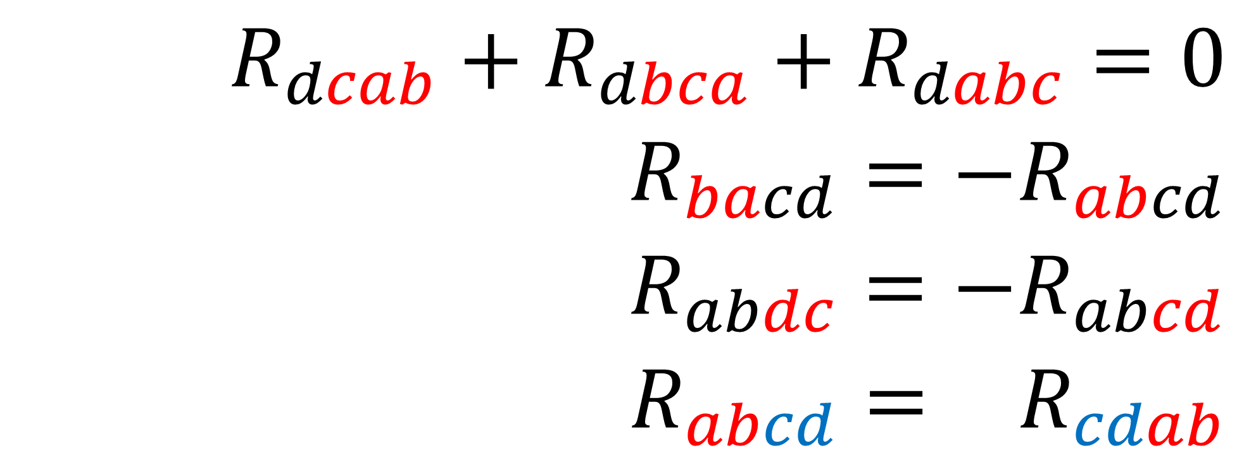
$$R_{dcab}+R_{dbca}+R_{dabc}=0$$
$$R_{bacd}=−R_{abcd}$$
$$R_{abdc}=−R_{abcd}$$
$$R_{abcd}=−R_{cdab}$$
Riemann Tensor
Symmetries

Slide 2
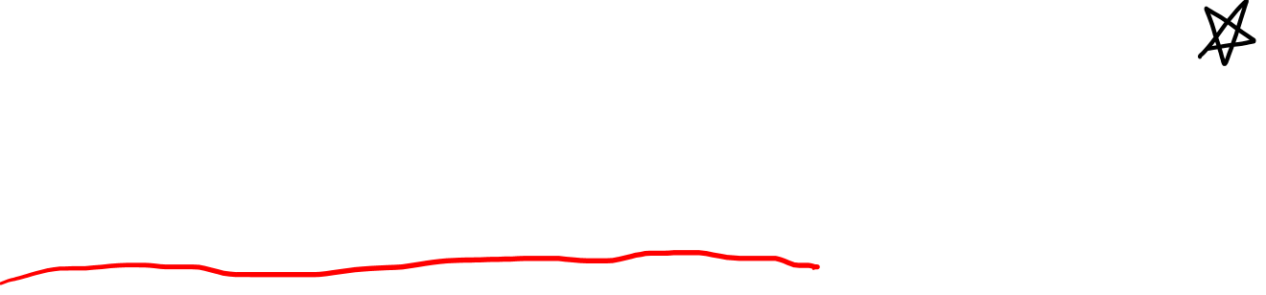
Riemann Curvature Tensor Components + Symmetries
(Also see Video 22: Riemann Tensor Derivation)
(Links in the description)

Slide 3




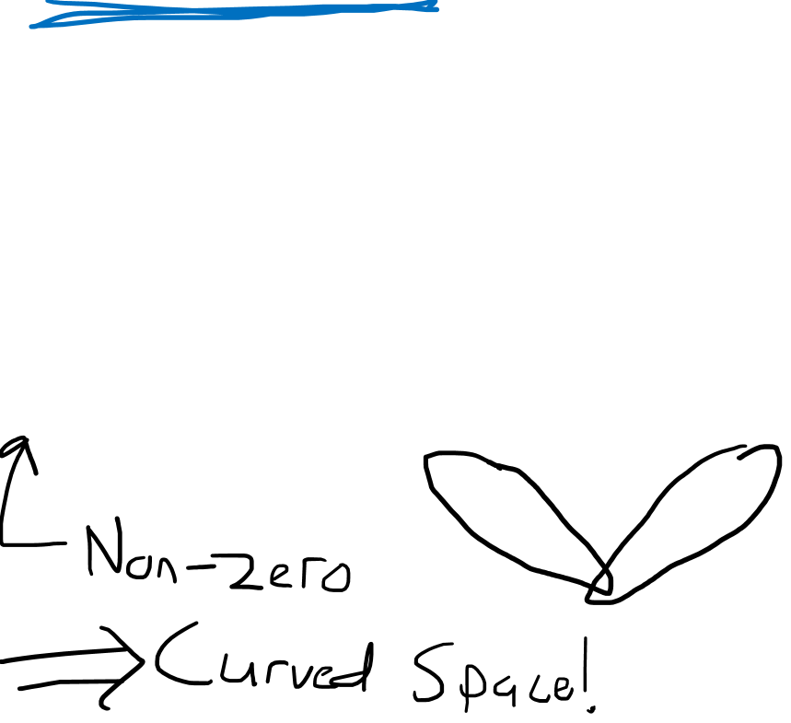
Riemann Curvature Tensor Definition
$$R\left(\vec{u},\vec{v}\right)\vec{w}=∇_{\vec{u}}∇_{\vec{v}}\vec{w}−∇_{\vec{v}}∇_{\vec{u}}\vec{w}−∇_{\left[\vec{u},\vec{v}\right]}\vec{w}$$
$$R\left(\vec{u},\vec{v}\right)\vec{w}$$
$$\vec{v}$$
$$\vec{u}$$
$$\vec{w}$$

Slide 4
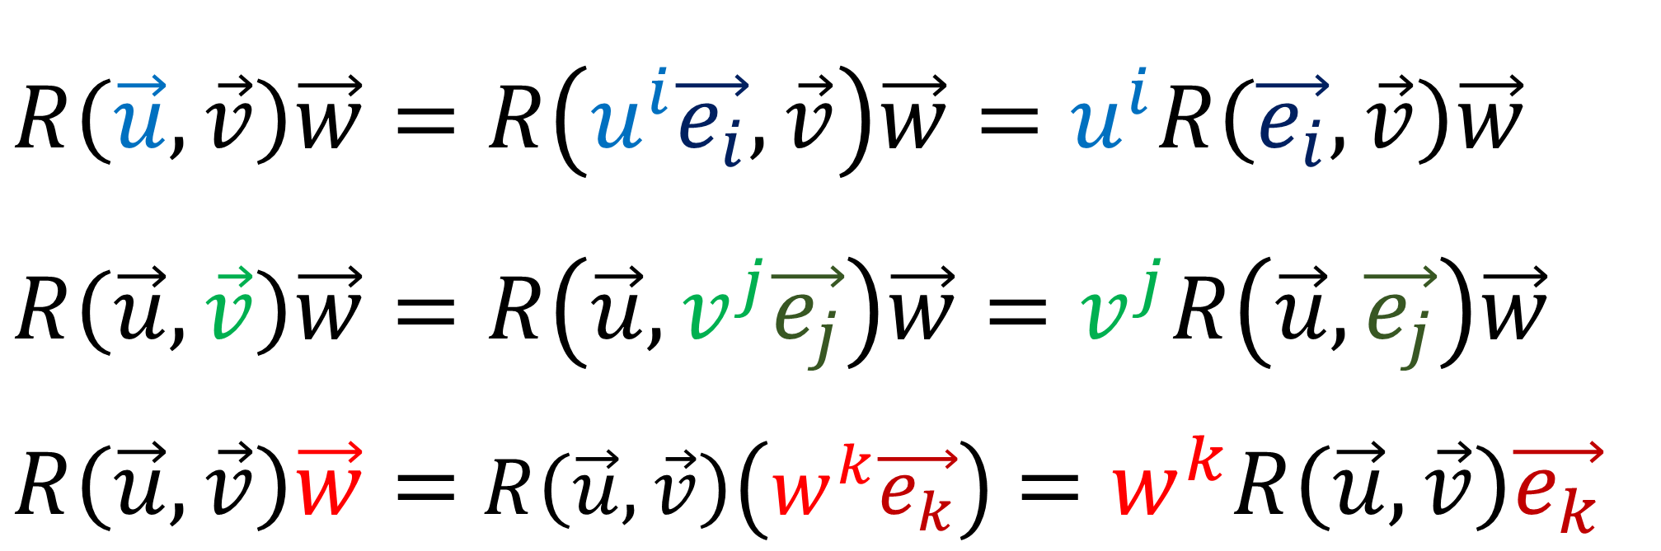
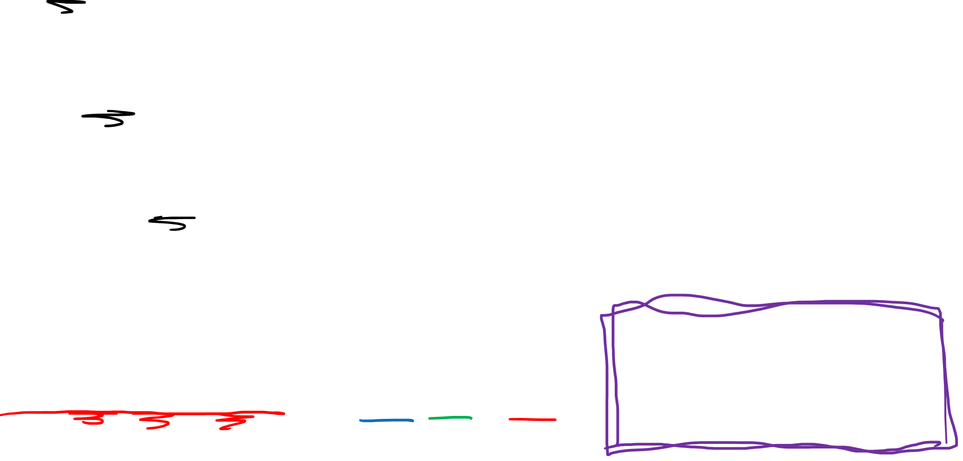
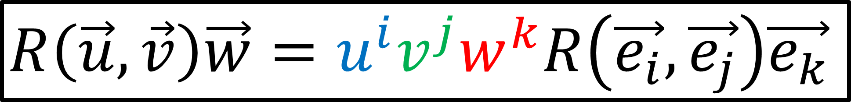
$$R\left(\vec{u},\vec{v}\right)\vec{w}=R\left(u^{i}\vec{e_{i}},\vec{v}\right)\vec{w}=u^{i}R\left(\vec{e_{i}},\vec{v}\right)\vec{w}$$
$$R\left(\vec{u},\vec{v}\right)\vec{w}=R\left(\vec{u},v^{j}\vec{e_{j}}\right)\vec{w}=v^{j}R\left(\vec{u},\vec{e_{j}}\right)\vec{w}$$
$R\left(\vec{u},\vec{v}\right)\vec{w}=$ $R\left(\vec{u},\vec{v}\right)\left(w^{k}\vec{e_{k}}\right)$ $=w^{k}R\left(\vec{u},\vec{v}\right)\vec{e_{k}}$
Linear for all Inputs
$$R\left(\vec{u},\vec{v}\right)\vec{w}=u^{i}v^{j}w^{k}R\left(\vec{e_{i}},\vec{e_{j}}\right)\vec{e_{k}}$$

Slide 5
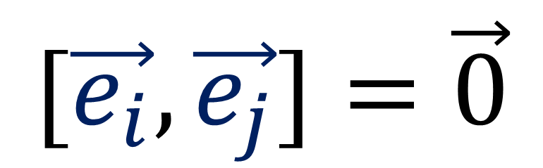
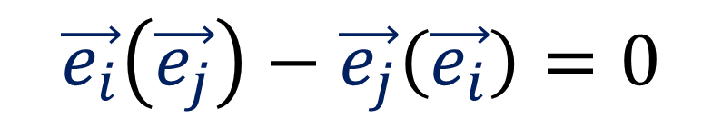

$$R\left(\vec{e_{a}},\vec{e_{b}}\right)\vec{e_{c}}=∇_{\vec{e_{a}}}∇_{\vec{e_{b}}}\vec{e_{c}}−∇_{\vec{e_{b}}}∇_{\vec{e_{a}}}\vec{e_{c}}−∇_{\left[\vec{e_{a}},\vec{e_{b}}\right]}\vec{e_{c}}$$
$$[\vec{e_{i}},\vec{e_{j}}]=\vec{0}$$
$$\vec{e_{i}}\left(\vec{e_{j}}\right)−\vec{e_{j}}\left(\vec{e_{i}}\right)=0$$

Slide 6
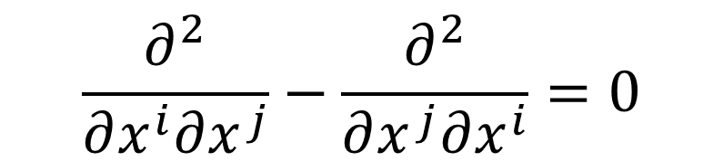
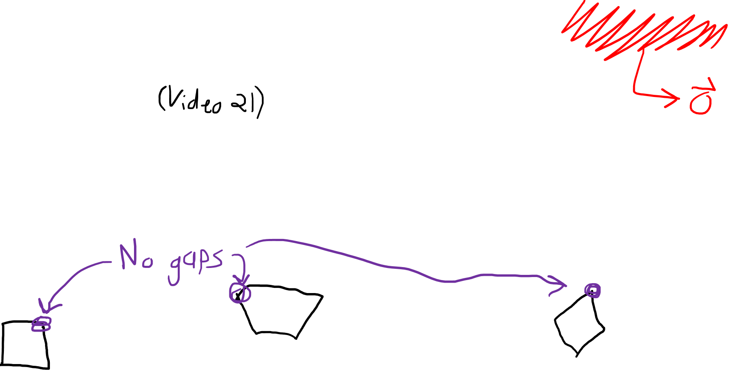
$$R\left(\vec{e_{a}},\vec{e_{b}}\right)\vec{e_{c}}=∇_{\vec{e_{a}}}∇_{\vec{e_{b}}}\vec{e_{c}}−∇_{\vec{e_{b}}}∇_{\vec{e_{a}}}\vec{e_{c}}−∇_{\left[\vec{e_{a}},\vec{e_{b}}\right]}\vec{e_{c}}$$
Coordinate lines
are just flows curves
along basis vectors.
$$[\vec{e_{i}},\vec{e_{j}}]=\vec{0}$$
$$\frac{∂^{2}}{∂x^{i}∂x^{j}}−\frac{∂^{2}}{∂x^{j}∂x^{i}}=0$$
$$y$$
$$p$$
$$θ$$
$$q$$
$$x$$
$$r$$

Slide 7
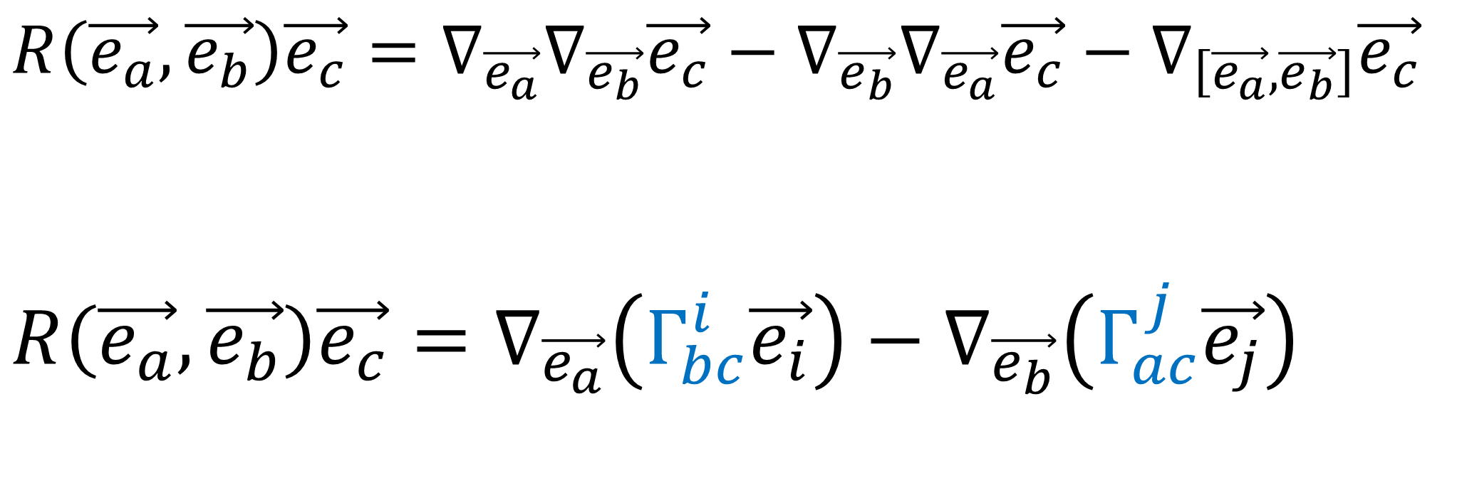
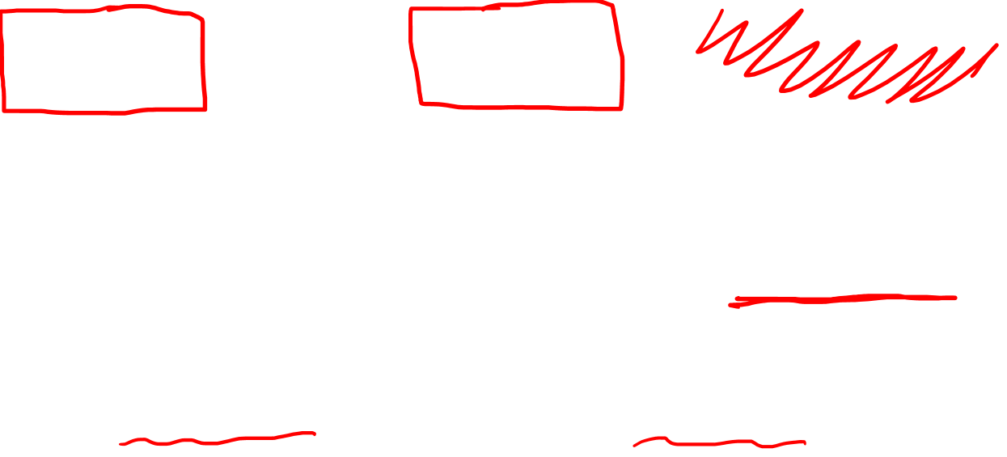
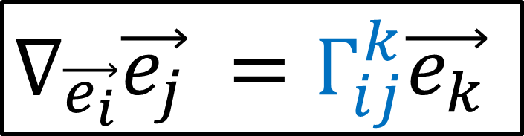
$$R\left(\vec{e_{a}},\vec{e_{b}}\right)\vec{e_{c}}=∇_{\vec{e_{a}}}∇_{\vec{e_{b}}}\vec{e_{c}}−∇_{\vec{e_{b}}}∇_{\vec{e_{a}}}\vec{e_{c}}−∇_{\left[\vec{e_{a}},\vec{e_{b}}\right]}\vec{e_{c}}$$
$$R\left(\vec{e_{a}},\vec{e_{b}}\right)\vec{e_{c}}=∇_{\vec{e_{a}}}\left(Γ_{bc}^{i}\vec{e_{i}}\right)−∇_{\vec{e_{b}}}\left(Γ_{ac}^{j}\vec{e_{j}}\right)$$
$∇_{\vec{e_{i}}}\vec{e_{j}} =Γ_{ij}^{k}\vec{e_{k}}$

Slide 8
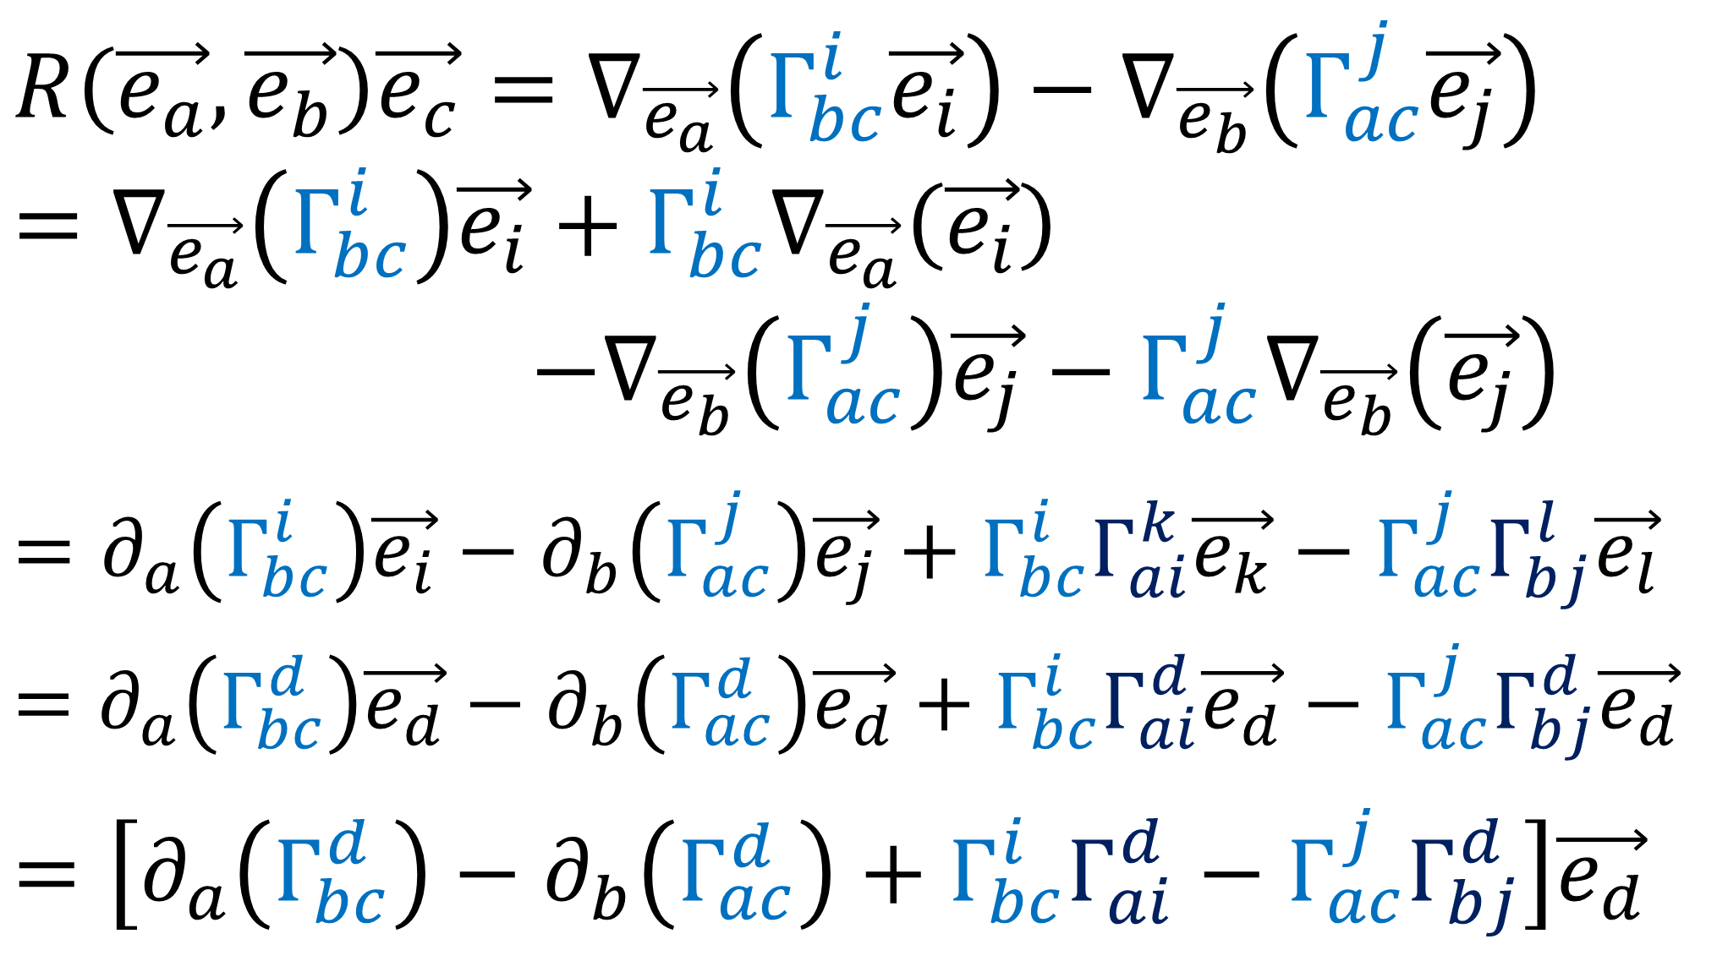
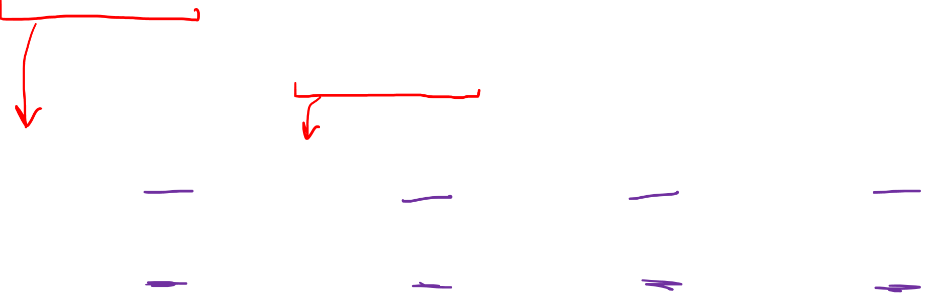
$$R\left(\vec{e_{a}},\vec{e_{b}}\right)\vec{e_{c}}=∇_{\vec{e_{a}}}\left(Γ_{bc}^{i}\vec{e_{i}}\right)−∇_{\vec{e_{b}}}\left(Γ_{ac}^{j}\vec{e_{j}}\right)$$
$$=∇_{\vec{e_{a}}}\left(Γ_{bc}^{i}\right)\vec{e_{i}}+Γ_{bc}^{i}∇_{\vec{e_{a}}}\left(\vec{e_{i}}\right)$$
$−∇_{\vec{e_{b}}}\left(Γ_{ac}^{j}\right)\vec{e_{j}}−Γ_{ac}^{j}∇_{\vec{e_{b}}}\left(\vec{e_{j}}\right)$
$$=∂_{a}\left(Γ_{bc}^{i}\right)\vec{e_{i}}−∂_{b}\left(Γ_{ac}^{j}\right)\vec{e_{j}}+Γ_{bc}^{i}Γ_{ai}^{k}\vec{e_{k}}−Γ_{ac}^{j}Γ_{bj}^{l}\vec{e_{l}}$$
$$=∂_{a}\left(Γ_{bc}^{d}\right)\vec{e_{d}}−∂_{b}\left(Γ_{ac}^{d}\right)\vec{e_{d}}+Γ_{bc}^{i}Γ_{ai}^{d}\vec{e_{d}}−Γ_{ac}^{j}Γ_{bj}^{d}\vec{e_{d}}$$
$$=\left[∂_{a}\left(Γ_{bc}^{d}\right)−∂_{b}\left(Γ_{ac}^{d}\right)+Γ_{bc}^{i}Γ_{ai}^{d}−Γ_{ac}^{j}Γ_{bj}^{d}\right]\vec{e_{d}}$$

Slide 9
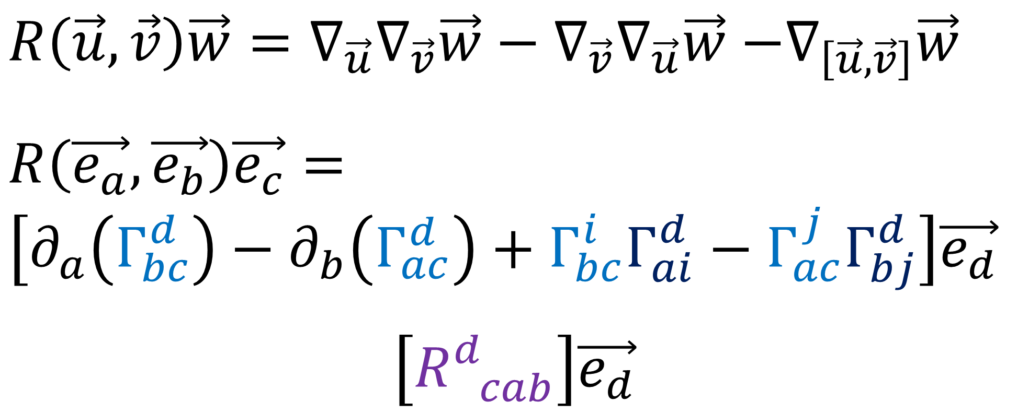
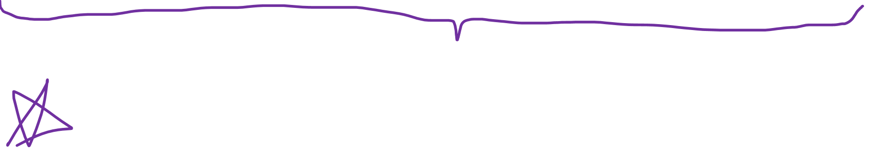
$R\left(\vec{u},\vec{v}\right)\vec{w}=∇_{\vec{u}}∇_{\vec{v}}\vec{w}−∇_{\vec{v}}∇_{\vec{u}}\vec{w}$ $−∇_{\left[\vec{u},\vec{v}\right]}\vec{w}$
$$R\left(\vec{e_{a}},\vec{e_{b}}\right)\vec{e_{c}}=$$
$$\left[∂_{a}\left(Γ_{bc}^{d}\right)−∂_{b}\left(Γ_{ac}^{d}\right)+Γ_{bc}^{i}Γ_{ai}^{d}−Γ_{ac}^{j}Γ_{bj}^{d}\right]\vec{e_{d}}$$
$$\left[R_{ cab}^{d}\right]\vec{e_{d}}$$
$R_{ cab}^{d}=∂_{a}\left(Γ_{bc}^{d}\right)−∂_{b}\left(Γ_{ac}^{d}\right)+Γ_{bc}^{i}Γ_{ai}^{d}−Γ_{ac}^{j}Γ_{bj}^{d}$

Slide 10
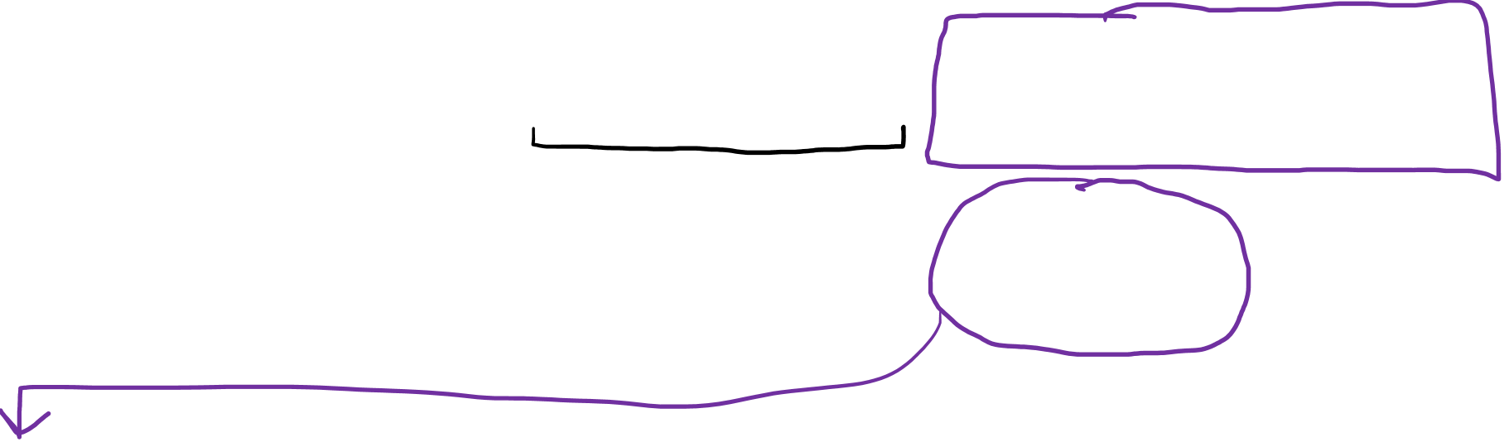
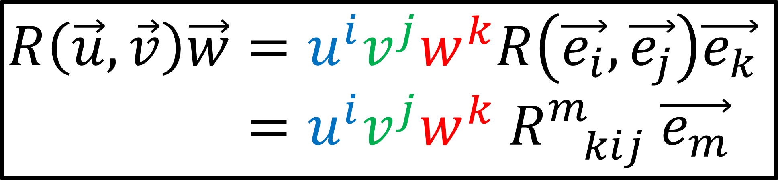
$R\left(\vec{u},\vec{v}\right)\vec{w}=∇_{\vec{u}}∇_{\vec{v}}\vec{w}−∇_{\vec{v}}∇_{\vec{u}}\vec{w}$ $−∇_{\left[\vec{u},\vec{v}\right]}\vec{w}$
Linear for all Inputs
$$R\left(\vec{u},\vec{v}\right)\vec{w}=u^{i}v^{j}w^{k}R\left(\vec{e_{i}},\vec{e_{j}}\right)\vec{e_{k}}$$
$$R\left(\vec{u},\vec{v}\right)\vec{w}=u^{i}v^{j}w^{k} R_{ kij}^{m} \vec{e_{m}}$$
$R_{ cab}^{d}=∂_{a}\left(Γ_{bc}^{d}\right)−∂_{b}\left(Γ_{ac}^{d}\right)+Γ_{bc}^{i}Γ_{ai}^{d}−Γ_{ac}^{j}Γ_{bj}^{d}$

Slide 11

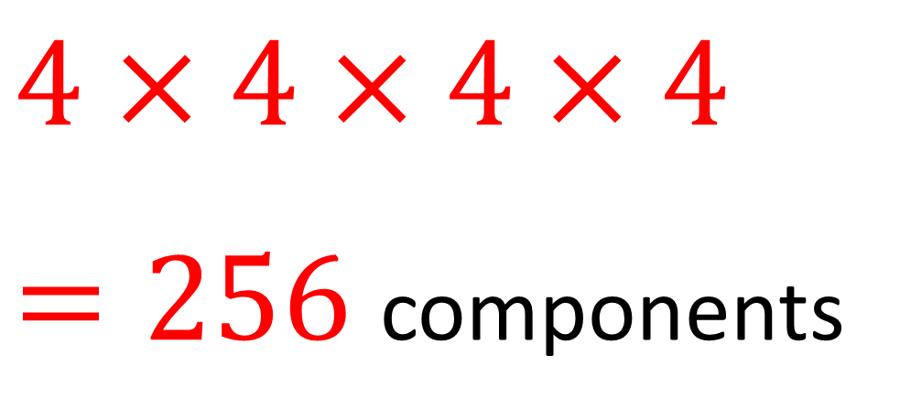
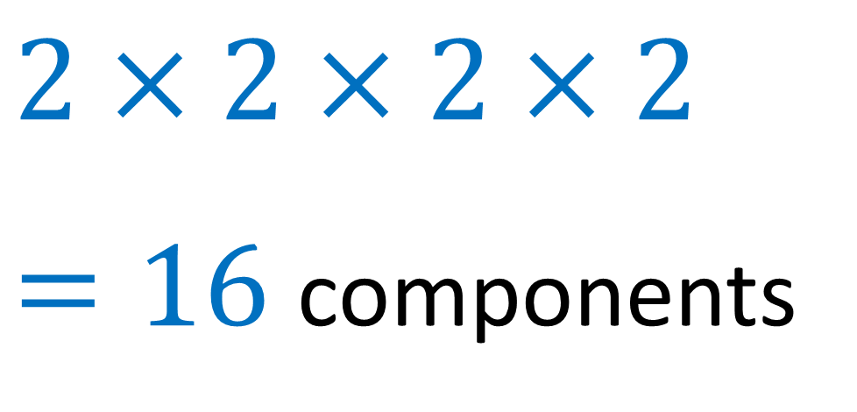
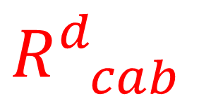

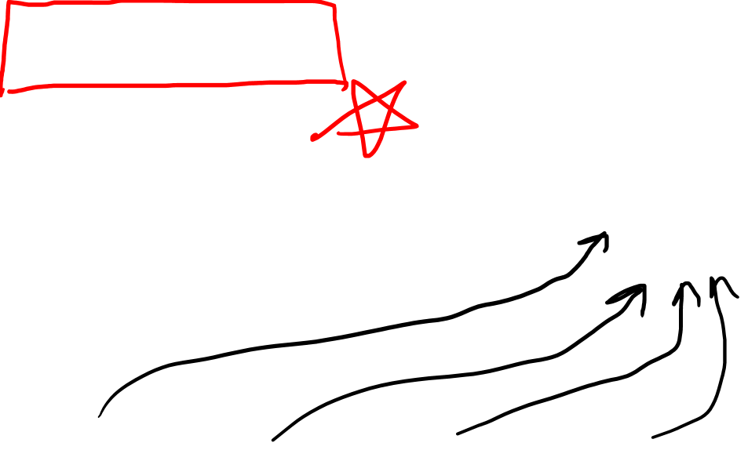
$$R_{ cab}^{d}$$
Symmetries of the Riemann Curvature Tensor
2 Dimensions
$$R_{ cab}^{d}$$
4 Dimensions
(spacetime)
$$R_{ cab}^{d}$$
$$2×2×2×2$$
$=16$ components
$$4×4×4×4$$
$=256$ components

Slide 12
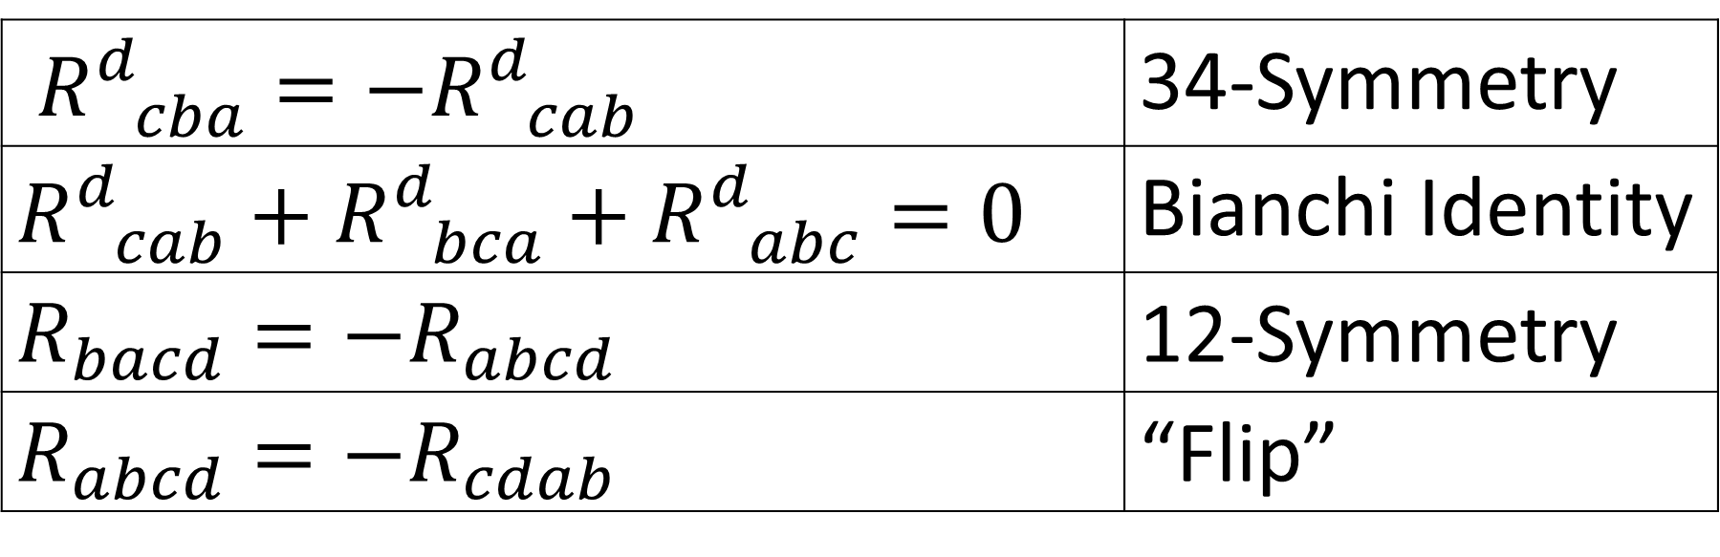
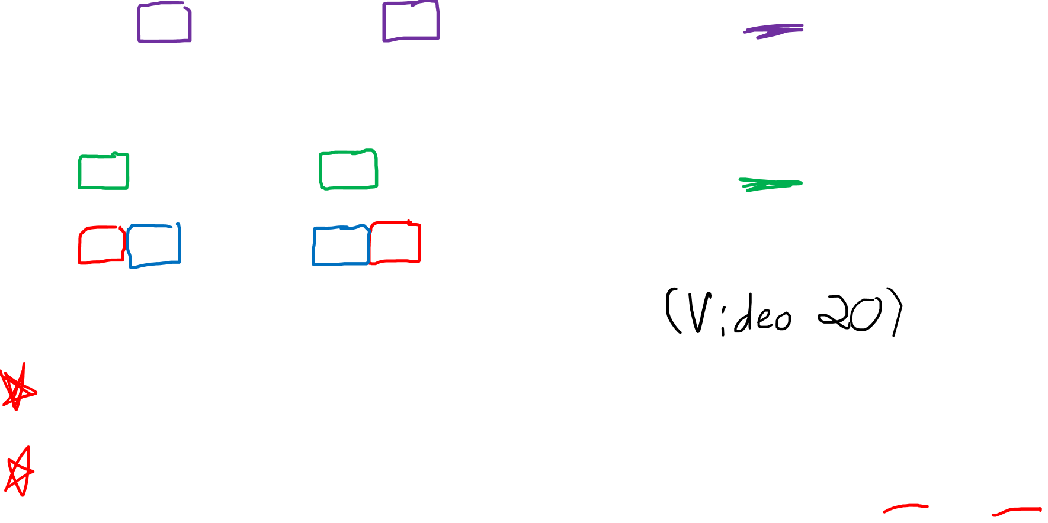
Symmetries of the Riemann Curvature Tensor
$R_{ cba}^{d}=−R_{ cab}^{d}$ | 34-Symmetry
$$R_{ cab}^{d}+R_{ bca}^{d}+R_{ abc}^{d}=0$$ | Bianchi Identity
$$R_{bacd}=−R_{abcd}$$ | 12-Symmetry
$$R_{abcd}=−R_{cdab}$$ | “Flip”
Assume Levi-Civita Connection
Metric Compatible: $∇_{\vec{z}}\left(\vec{u}⋅\vec{v}\right)=\left(∇_{\vec{z}}\vec{u}\right)⋅\vec{v}+\vec{u}⋅(∇_{\vec{z}}\vec{v})$
Torsion-Free: $∇_{\vec{e_{i}}}\vec{e_{j}}=∇_{\vec{e_{j}}}\vec{e_{i}}$ $Γ_{ij}^{k}=Γ_{ji}^{k}$

Slide 13
Symmetries of the Riemann Curvature Tensor
$R\left(\vec{u},\vec{v}\right)\vec{w}=∇_{\vec{u}}∇_{\vec{v}}\vec{w}−∇_{\vec{v}}∇_{\vec{u}}\vec{w}$ $−∇_{\left[\vec{u},\vec{v}\right]}\vec{w}$

Slide 14
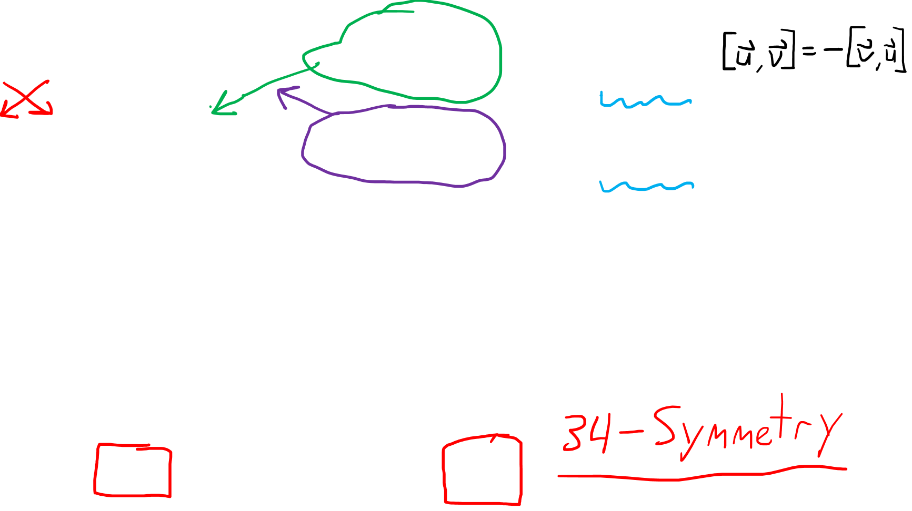
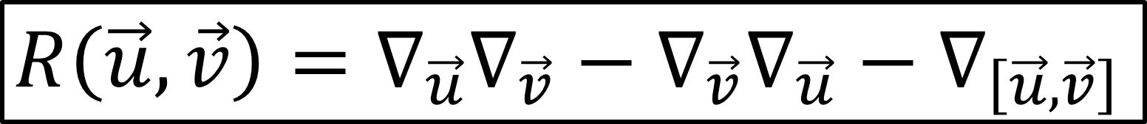

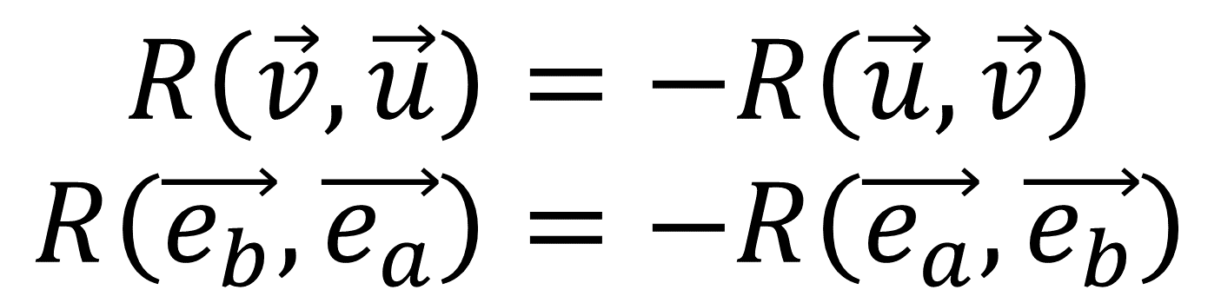
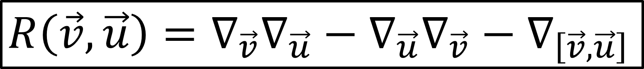
Symmetries of the Riemann Curvature Tensor
$$R\left(\vec{u},\vec{v}\right)=∇_{\vec{u}}∇_{\vec{v}}−∇_{\vec{v}}∇_{\vec{u}}−∇_{\left[\vec{u},\vec{v}\right]}$$
$$R\left(\vec{v},\vec{u}\right)=∇_{\vec{v}}∇_{\vec{u}}−∇_{\vec{u}}∇_{\vec{v}}−∇_{\left[\vec{v},\vec{u}\right]}$$
$$R\left(\vec{v},\vec{u}\right)=−R\left(\vec{u},\vec{v}\right)$$
$$R\left(\vec{e_{b}},\vec{e_{a}}\right)=−R\left(\vec{e_{a}},\vec{e_{b}}\right)$$
$R_{ cba}^{d}=−R_{ cab}^{d}$

Slide 15
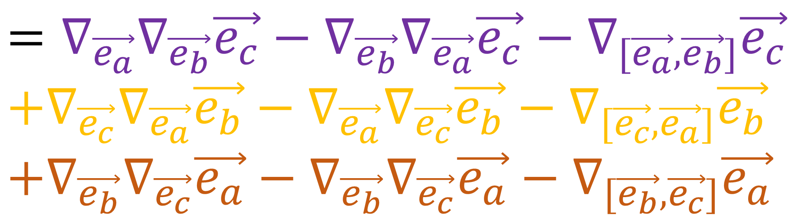
Symmetries of the Riemann Curvature Tensor
$$R\left(\vec{e_{a}},\vec{e_{b}}\right)\vec{e_{c}}+R\left(\vec{e_{c}},\vec{e_{a}}\right)\vec{e_{b}}+R\left(\vec{e_{b}},\vec{e_{c}}\right)\vec{e_{a}}$$
$$=∇_{\vec{e_{a}}}∇_{\vec{e_{b}}}\vec{e_{c}}−∇_{\vec{e_{b}}}∇_{\vec{e_{a}}}\vec{e_{c}}−∇_{[\vec{e_{a}},\vec{e_{b}}]}\vec{e_{c}}$$
$$+∇_{\vec{e_{c}}}∇_{\vec{e_{a}}}\vec{e_{b}}−∇_{\vec{e_{a}}}∇_{\vec{e_{c}}}\vec{e_{b}}−∇_{[\vec{e_{c}},\vec{e_{a}}]}\vec{e_{b}}$$
$$+∇_{\vec{e_{b}}}∇_{\vec{e_{c}}}\vec{e_{a}}−∇_{\vec{e_{b}}}∇_{\vec{e_{c}}}\vec{e_{a}}−∇_{[\vec{e_{b}},\vec{e_{c}}]}\vec{e_{a}}$$

Slide 16

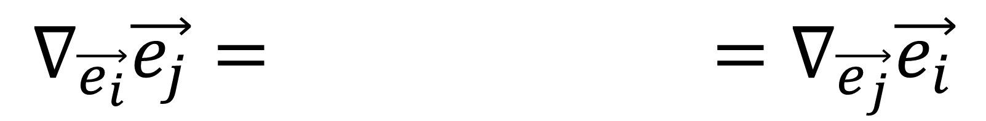

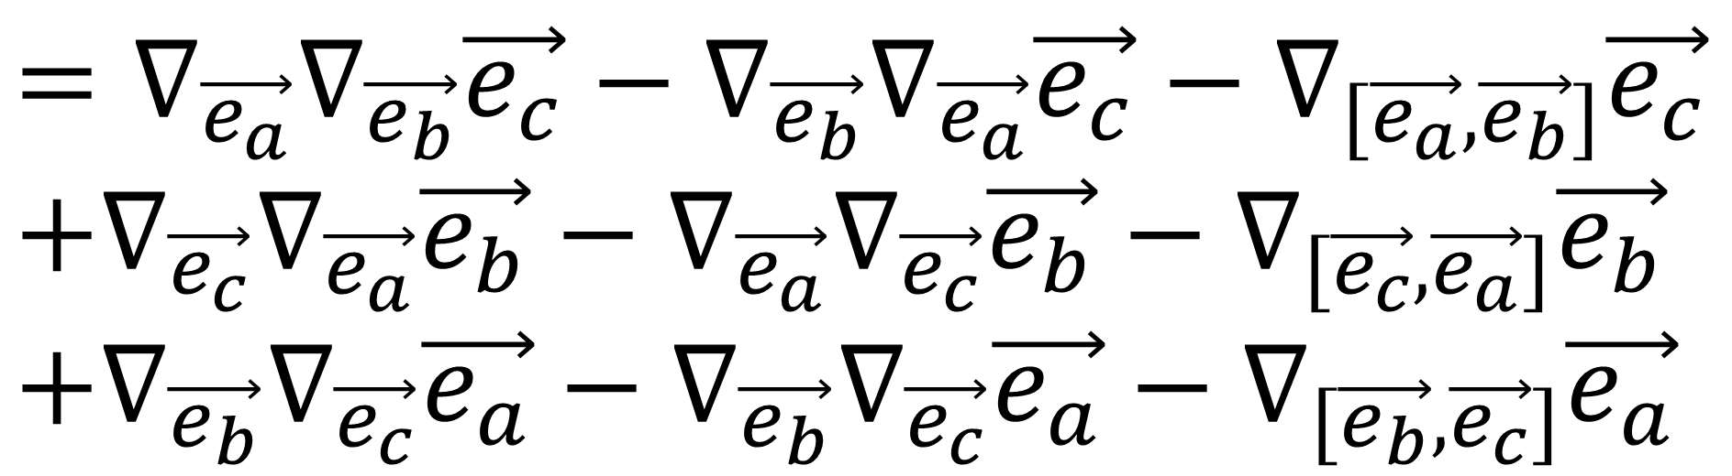
Symmetries of the Riemann Curvature Tensor
$$R\left(\vec{e_{a}},\vec{e_{b}}\right)\vec{e_{c}}+R\left(\vec{e_{c}},\vec{e_{a}}\right)\vec{e_{b}}+R\left(\vec{e_{b}},\vec{e_{c}}\right)\vec{e_{a}}$$
$$=∇_{\vec{e_{a}}}∇_{\vec{e_{b}}}\vec{e_{c}}−∇_{\vec{e_{b}}}∇_{\vec{e_{a}}}\vec{e_{c}}−∇_{[\vec{e_{a}},\vec{e_{b}}]}\vec{e_{c}}$$
$$+∇_{\vec{e_{c}}}∇_{\vec{e_{a}}}\vec{e_{b}}−∇_{\vec{e_{a}}}∇_{\vec{e_{c}}}\vec{e_{b}}−∇_{[\vec{e_{c}},\vec{e_{a}}]}\vec{e_{b}}$$
$$+∇_{\vec{e_{b}}}∇_{\vec{e_{c}}}\vec{e_{a}}−∇_{\vec{e_{b}}}∇_{\vec{e_{c}}}\vec{e_{a}}−∇_{[\vec{e_{b}},\vec{e_{c}}]}\vec{e_{a}}$$
Torsion -Free
$$∇_{\vec{e_{i}}}\vec{e_{j}}= =∇_{\vec{e_{j}}}\vec{e_{i}}$$
$$Γ_{ij}^{k}\vec{e_{k}}=Γ_{ji}^{k}\vec{e_{k}}$$

Slide 17
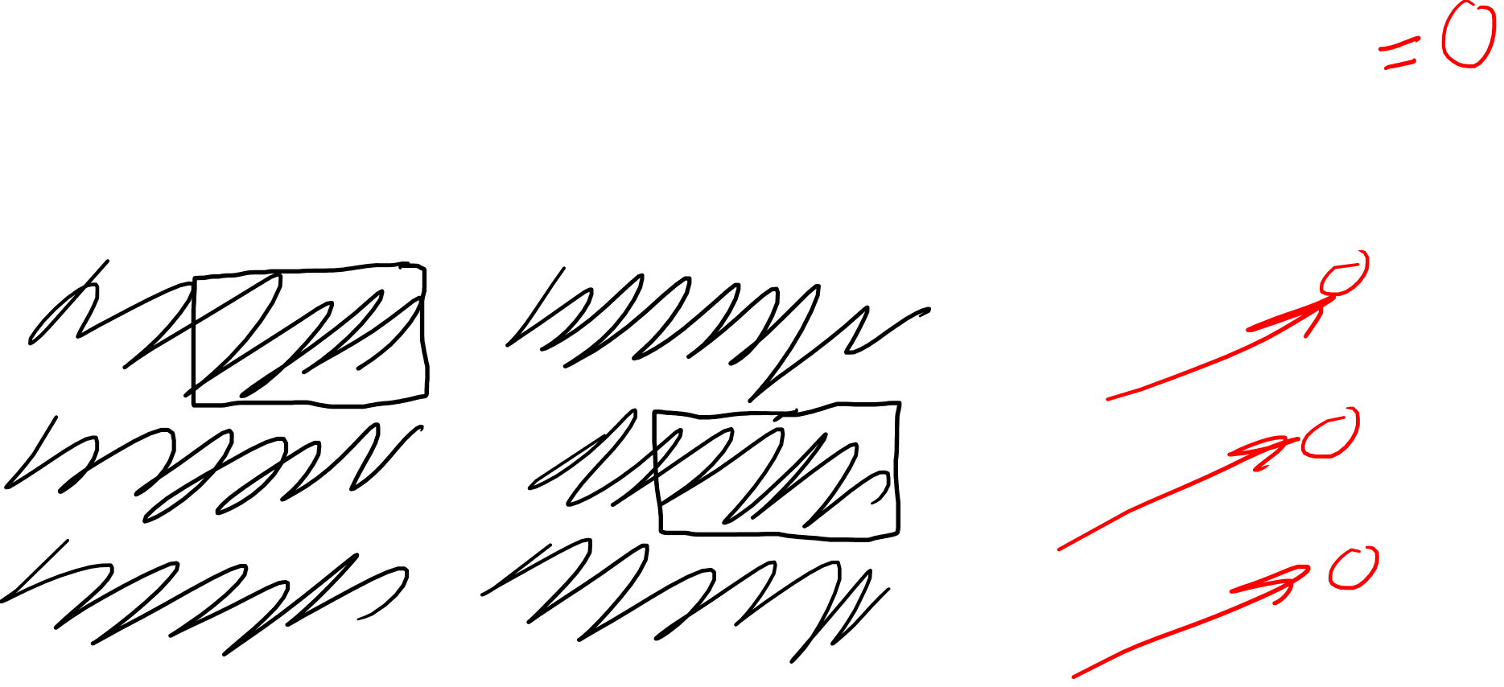
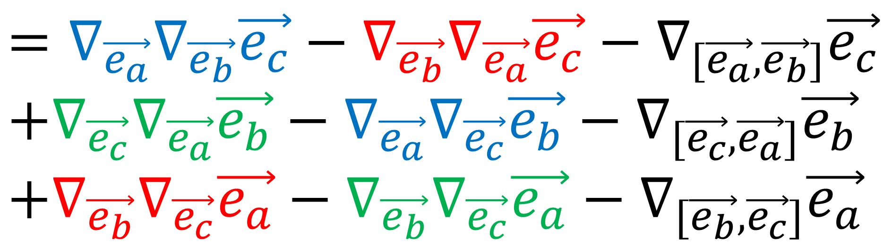
Symmetries of the Riemann Curvature Tensor
$$R\left(\vec{e_{a}},\vec{e_{b}}\right)\vec{e_{c}}+R\left(\vec{e_{c}},\vec{e_{a}}\right)\vec{e_{b}}+R\left(\vec{e_{b}},\vec{e_{c}}\right)\vec{e_{a}}$$
$$=∇_{\vec{e_{a}}}∇_{\vec{e_{b}}}\vec{e_{c}}−∇_{\vec{e_{b}}}∇_{\vec{e_{a}}}\vec{e_{c}}−∇_{[\vec{e_{a}},\vec{e_{b}}]}\vec{e_{c}}$$
$$+∇_{\vec{e_{c}}}∇_{\vec{e_{a}}}\vec{e_{b}}−∇_{\vec{e_{a}}}∇_{\vec{e_{c}}}\vec{e_{b}}−∇_{[\vec{e_{c}},\vec{e_{a}}]}\vec{e_{b}}$$
$$+∇_{\vec{e_{b}}}∇_{\vec{e_{c}}}\vec{e_{a}}−∇_{\vec{e_{b}}}∇_{\vec{e_{c}}}\vec{e_{a}}−∇_{[\vec{e_{b}},\vec{e_{c}}]}\vec{e_{a}}$$
Torsion -Free
$$∇_{\vec{e_{i}}}\vec{e_{j}}= =∇_{\vec{e_{j}}}\vec{e_{i}}$$
$$Γ_{ij}^{k}\vec{e_{k}}=Γ_{ji}^{k}\vec{e_{k}}$$

Slide 18
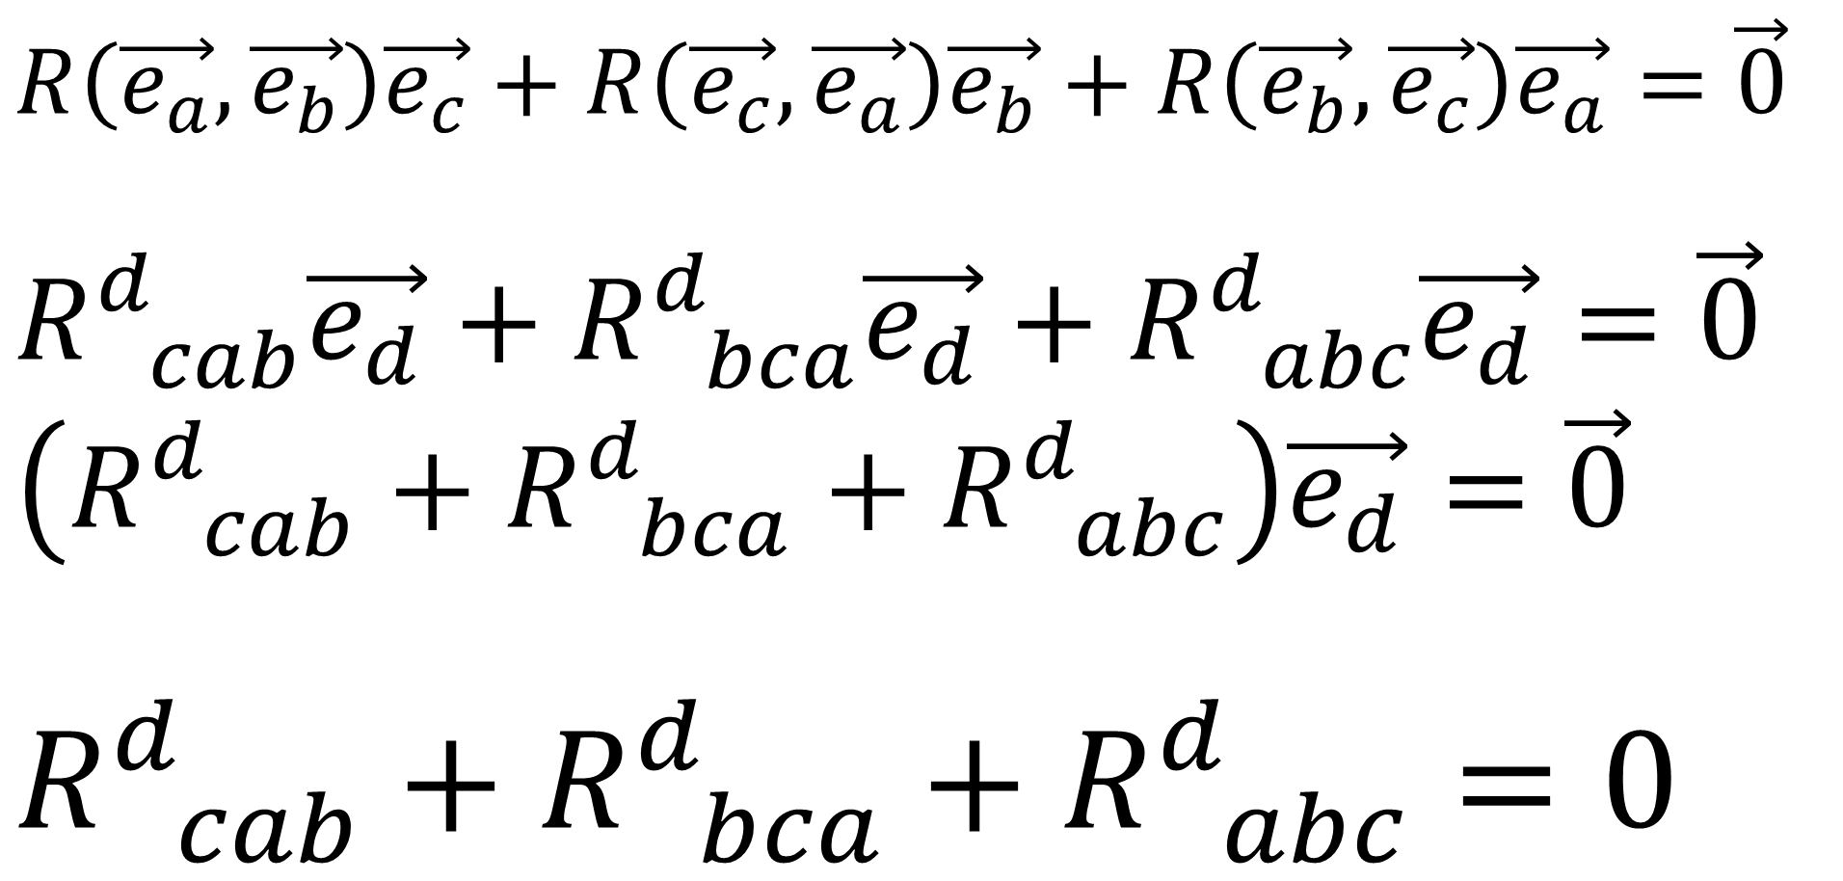
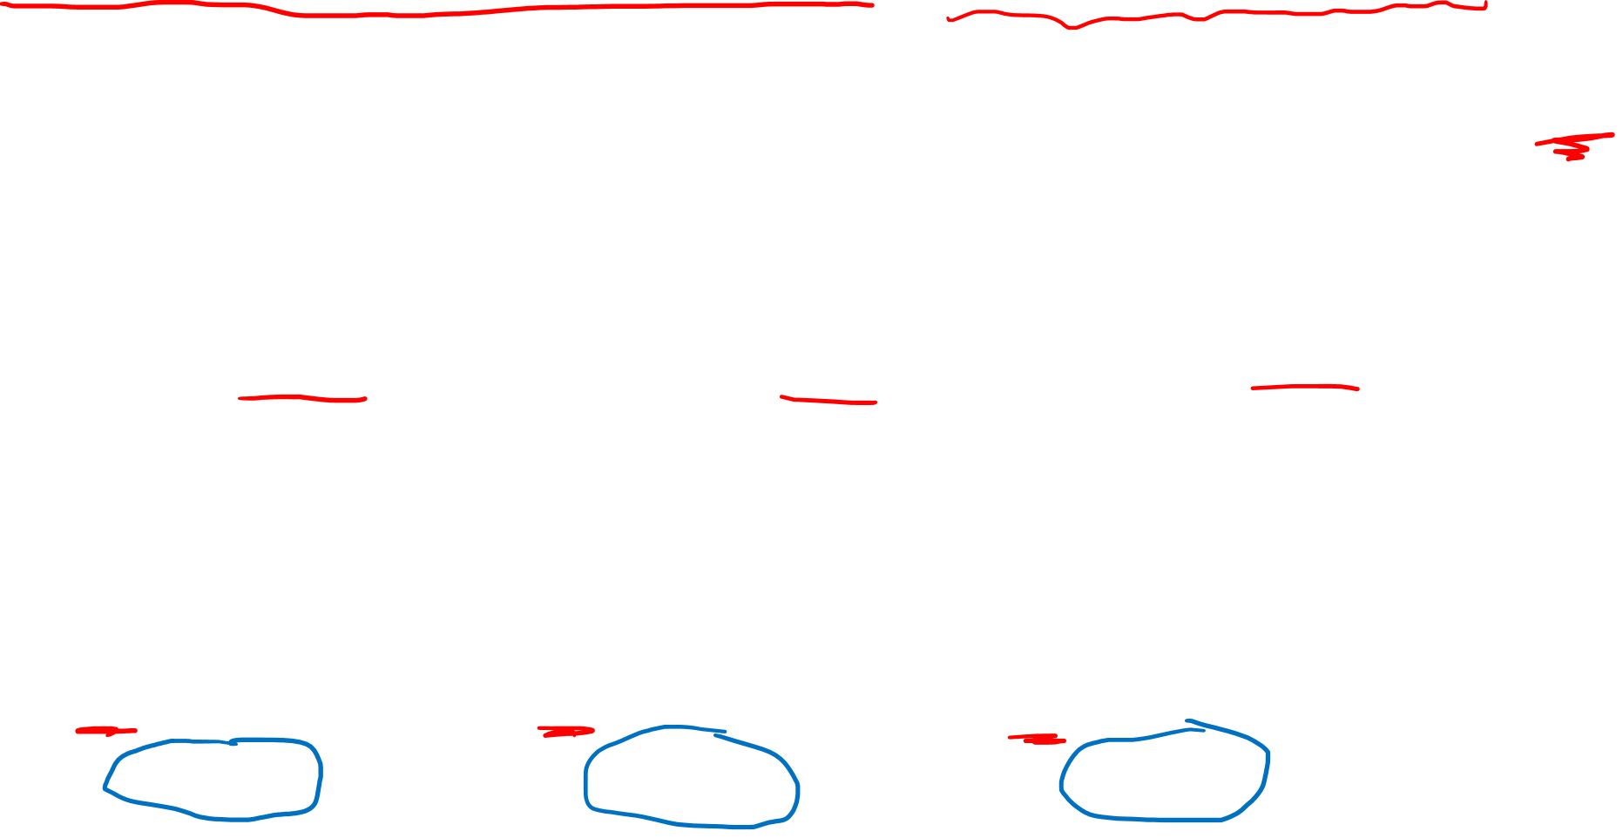
First Bianchi Identity (Torsion-Free)
$$R\left(\vec{e_{a}},\vec{e_{b}}\right)\vec{e_{c}}+R\left(\vec{e_{c}},\vec{e_{a}}\right)\vec{e_{b}}+R\left(\vec{e_{b}},\vec{e_{c}}\right)\vec{e_{a}}=\vec{0}$$
$$R_{ cab}^{d}\vec{e_{d}}+R_{ bca}^{d}\vec{e_{d}}+R_{ abc}^{d}\vec{e_{d}}=\vec{0}$$
$$\left(R_{ cab}^{d}+R_{ bca}^{d}+R_{ abc}^{d}\right)\vec{e_{d}}=\vec{0}$$
$$R_{ cab}^{d}+R_{ bca}^{d}+R_{ abc}^{d}=0$$

Slide 19
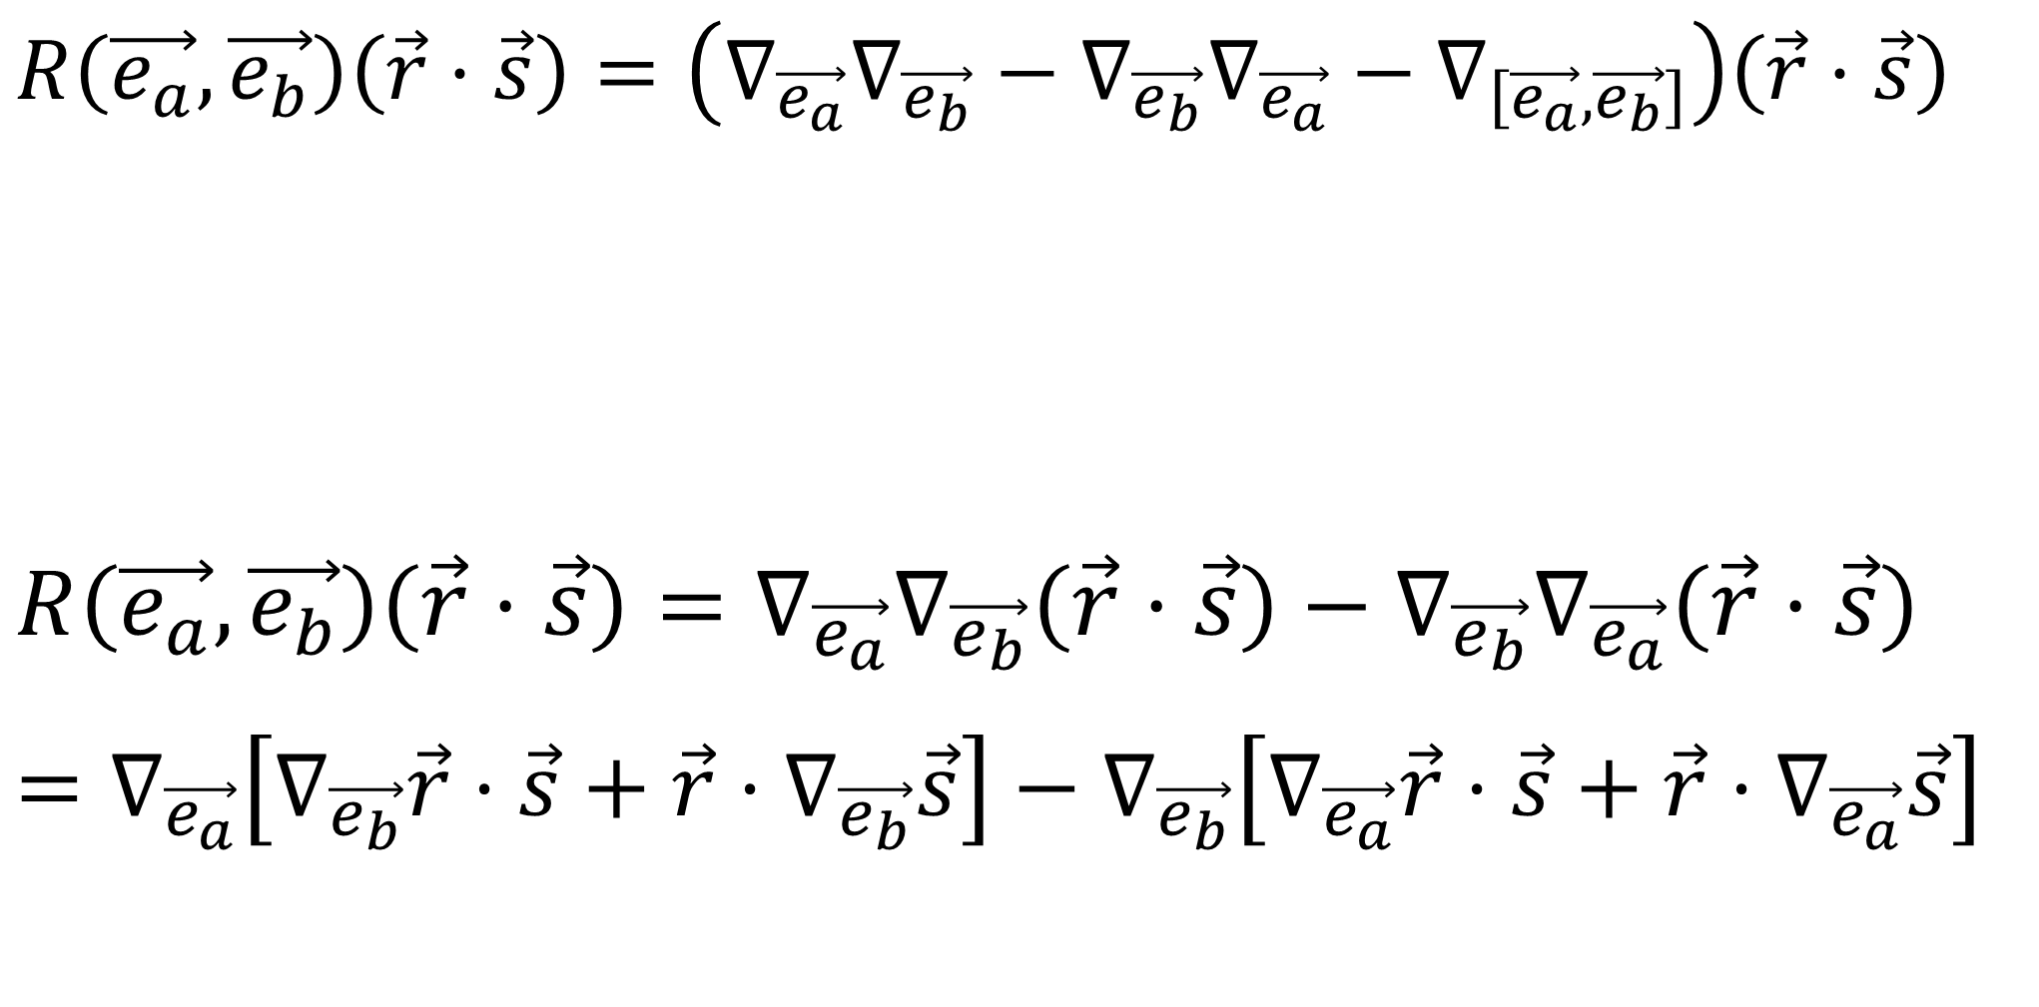
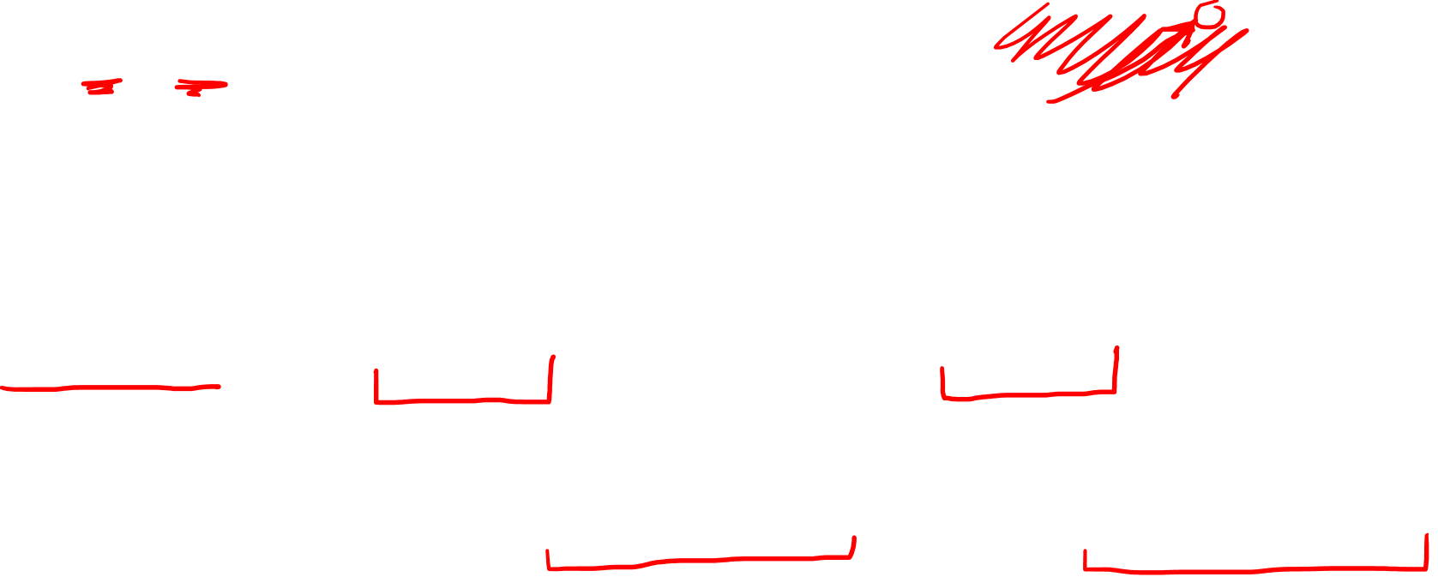
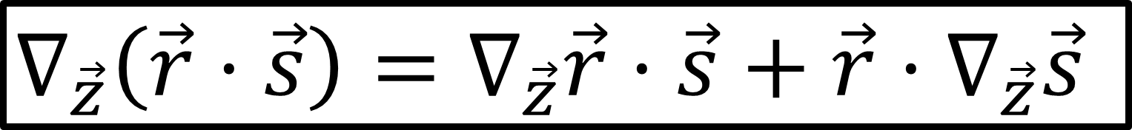
Symmetries of the Riemann Curvature Tensor
$$R\left(\vec{e_{a}},\vec{e_{b}}\right)\left(\vec{r}⋅\vec{s}\right)=\left(∇_{\vec{e_{a}}}∇_{\vec{e_{b}}}−∇_{\vec{e_{b}}}∇_{\vec{e_{a}}}−∇_{\left[\vec{e_{a}},\vec{e_{b}}\right]}\right)\left(\vec{r}⋅\vec{s}\right)$$
$$R\left(\vec{e_{a}},\vec{e_{b}}\right)\left(\vec{r}⋅\vec{s}\right)=∇_{\vec{e_{a}}}∇_{\vec{e_{b}}}\left(\vec{r}⋅\vec{s}\right)−∇_{\vec{e_{b}}}∇_{\vec{e_{a}}}\left(\vec{r}⋅\vec{s}\right)$$
$$=∇_{\vec{e_{a}}}\left[∇_{\vec{e_{b}}}\vec{r}⋅\vec{s}+\vec{r}⋅∇_{\vec{e_{b}}}\vec{s}\right]−∇_{\vec{e_{b}}}\left[∇_{\vec{e_{a}}}\vec{r}⋅\vec{s}+\vec{r}⋅∇_{\vec{e_{a}}}\vec{s}\right]$$
Metric Compatibility (Tensor Calc Video 20)
$$∇_{\vec{z}}\left(\vec{r}⋅\vec{s}\right)=∇_{\vec{z}}\vec{r}⋅\vec{s}+\vec{r}⋅∇_{\vec{z}}\vec{s}$$

Slide 20
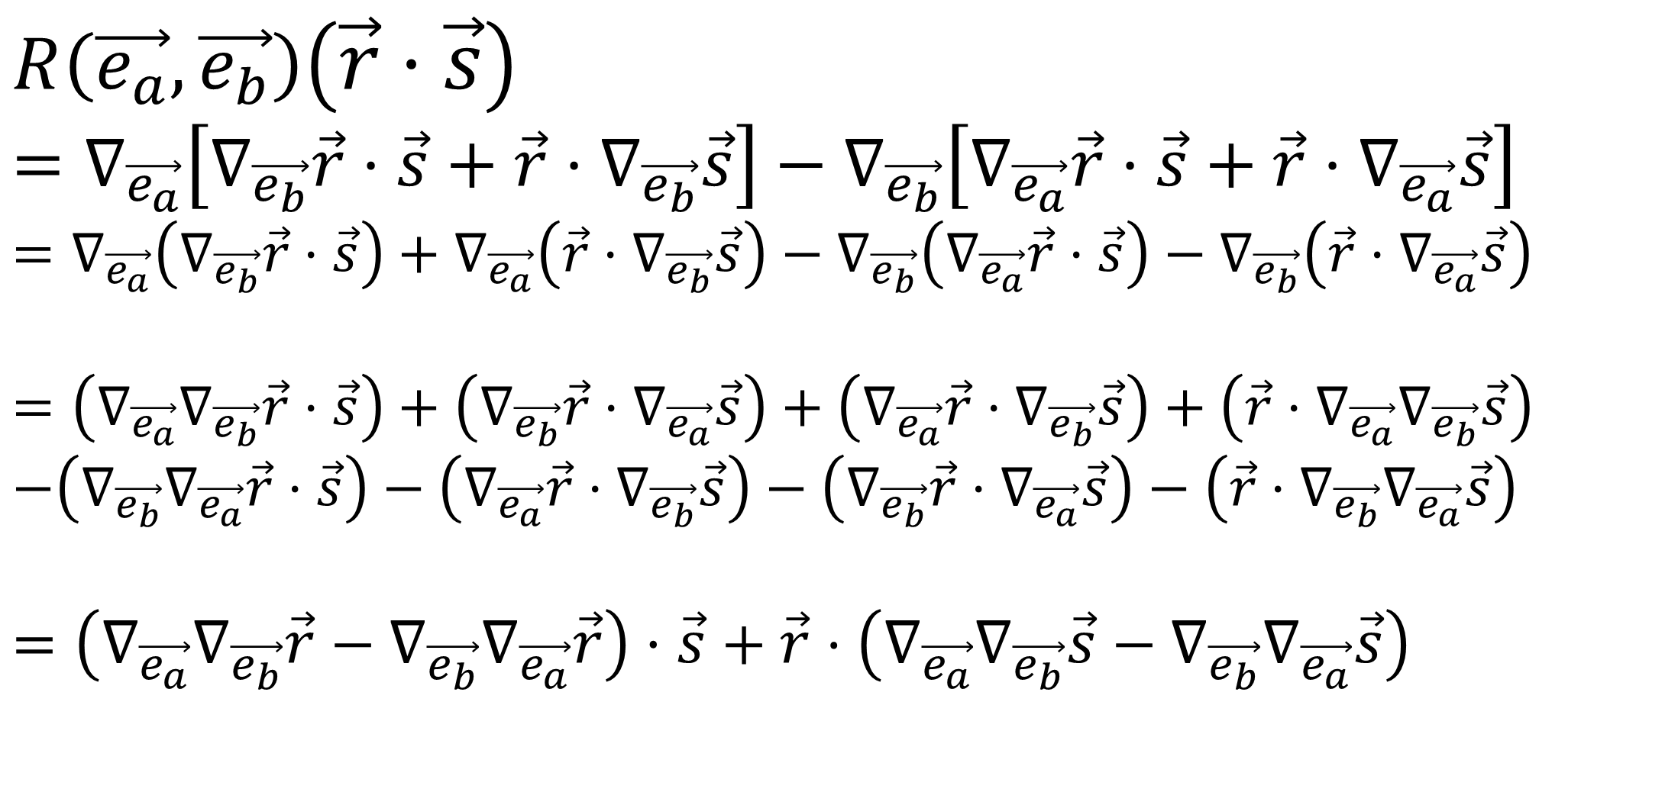
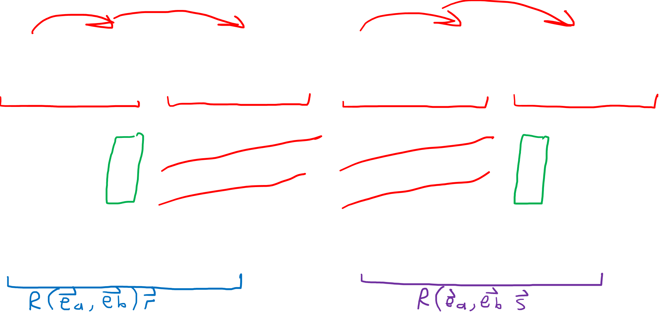
Symmetries of the Riemann Curvature Tensor
$$R\left(\vec{e_{a}},\vec{e_{b}}\right)\left(\vec{r}⋅\vec{s}\right)$$
$$=∇_{\vec{e_{a}}}\left[∇_{\vec{e_{b}}}\vec{r}⋅\vec{s}+\vec{r}⋅∇_{\vec{e_{b}}}\vec{s}\right]−∇_{\vec{e_{b}}}\left[∇_{\vec{e_{a}}}\vec{r}⋅\vec{s}+\vec{r}⋅∇_{\vec{e_{a}}}\vec{s}\right]$$
$$=∇_{\vec{e_{a}}}\left(∇_{\vec{e_{b}}}\vec{r}⋅\vec{s}\right)+∇_{\vec{e_{a}}}\left(\vec{r}⋅∇_{\vec{e_{b}}}\vec{s}\right)−∇_{\vec{e_{b}}}\left(∇_{\vec{e_{a}}}\vec{r}⋅\vec{s}\right)−∇_{\vec{e_{b}}}\left(\vec{r}⋅∇_{\vec{e_{a}}}\vec{s}\right)$$
$$=\left(∇_{\vec{e_{a}}}∇_{\vec{e_{b}}}\vec{r}⋅\vec{s}\right)+\left(∇_{\vec{e_{b}}}\vec{r}⋅∇_{\vec{e_{a}}}\vec{s}\right)+\left(∇_{\vec{e_{a}}}\vec{r}⋅∇_{\vec{e_{b}}}\vec{s}\right)+\left(\vec{r}⋅∇_{\vec{e_{a}}}∇_{\vec{e_{b}}}\vec{s}\right)$$
$$−\left(∇_{\vec{e_{b}}}∇_{\vec{e_{a}}}\vec{r}⋅\vec{s}\right)−\left(∇_{\vec{e_{a}}}\vec{r}⋅∇_{\vec{e_{b}}}\vec{s}\right)−\left(∇_{\vec{e_{b}}}\vec{r}⋅∇_{\vec{e_{a}}}\vec{s}\right)−\left(\vec{r}⋅∇_{\vec{e_{b}}}∇_{\vec{e_{a}}}\vec{s}\right)$$
$$=\left(∇_{\vec{e_{a}}}∇_{\vec{e_{b}}}\vec{r}−∇_{\vec{e_{b}}}∇_{\vec{e_{a}}}\vec{r}\right)⋅\vec{s}+\vec{r}⋅\left(∇_{\vec{e_{a}}}∇_{\vec{e_{b}}}\vec{s}−∇_{\vec{e_{b}}}∇_{\vec{e_{a}}}\vec{s}\right)$$

Slide 21
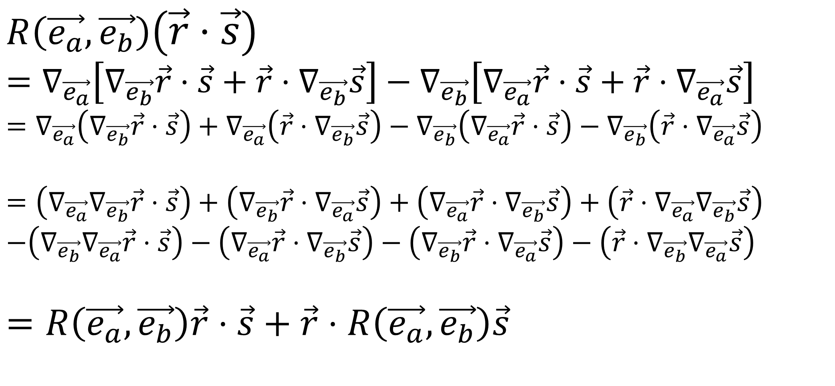
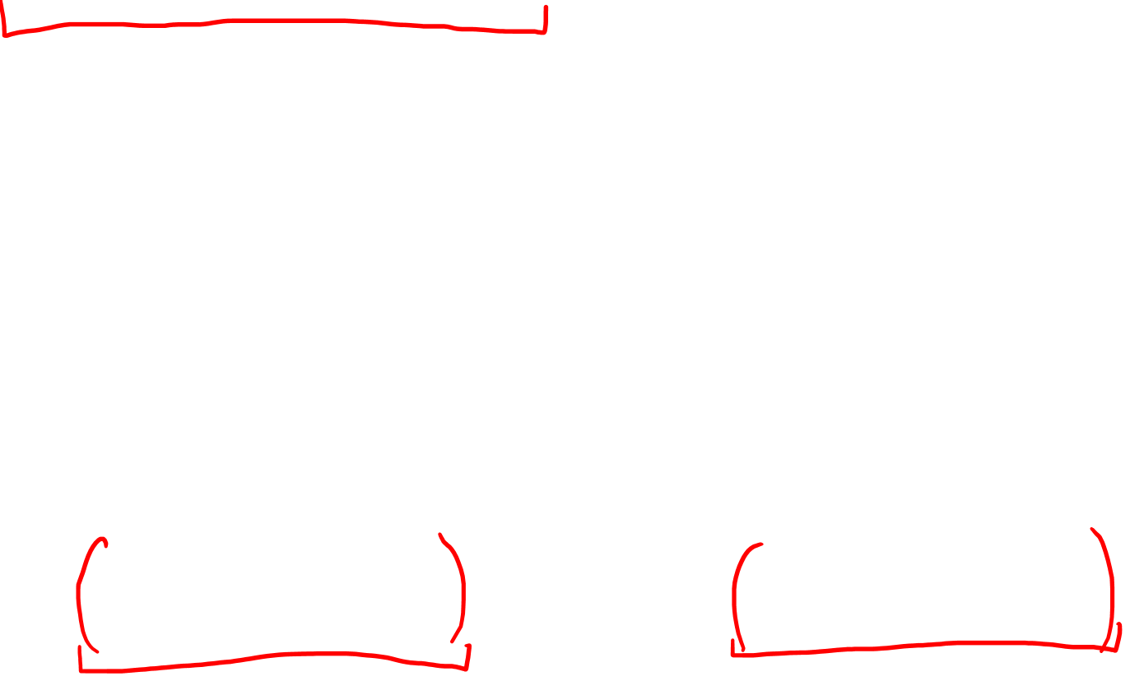
Symmetries of the Riemann Curvature Tensor
$$R\left(\vec{e_{a}},\vec{e_{b}}\right)\left(\vec{r}⋅\vec{s}\right)$$
$$=∇_{\vec{e_{a}}}\left[∇_{\vec{e_{b}}}\vec{r}⋅\vec{s}+\vec{r}⋅∇_{\vec{e_{b}}}\vec{s}\right]−∇_{\vec{e_{b}}}\left[∇_{\vec{e_{a}}}\vec{r}⋅\vec{s}+\vec{r}⋅∇_{\vec{e_{a}}}\vec{s}\right]$$
$$=∇_{\vec{e_{a}}}\left(∇_{\vec{e_{b}}}\vec{r}⋅\vec{s}\right)+∇_{\vec{e_{a}}}\left(\vec{r}⋅∇_{\vec{e_{b}}}\vec{s}\right)−∇_{\vec{e_{b}}}\left(∇_{\vec{e_{a}}}\vec{r}⋅\vec{s}\right)−∇_{\vec{e_{b}}}\left(\vec{r}⋅∇_{\vec{e_{a}}}\vec{s}\right)$$
$$=\left(∇_{\vec{e_{a}}}∇_{\vec{e_{b}}}\vec{r}⋅\vec{s}\right)+\left(∇_{\vec{e_{b}}}\vec{r}⋅∇_{\vec{e_{a}}}\vec{s}\right)+\left(∇_{\vec{e_{a}}}\vec{r}⋅∇_{\vec{e_{b}}}\vec{s}\right)+\left(\vec{r}⋅∇_{\vec{e_{a}}}∇_{\vec{e_{b}}}\vec{s}\right)$$
$$−\left(∇_{\vec{e_{b}}}∇_{\vec{e_{a}}}\vec{r}⋅\vec{s}\right)−\left(∇_{\vec{e_{a}}}\vec{r}⋅∇_{\vec{e_{b}}}\vec{s}\right)−\left(∇_{\vec{e_{b}}}\vec{r}⋅∇_{\vec{e_{a}}}\vec{s}\right)−\left(\vec{r}⋅∇_{\vec{e_{b}}}∇_{\vec{e_{a}}}\vec{s}\right)$$
$$=R\left(\vec{e_{a}},\vec{e_{b}}\right)\vec{r}⋅\vec{s}+\vec{r}⋅R\left(\vec{e_{a}},\vec{e_{b}}\right)\vec{s}$$

Slide 22
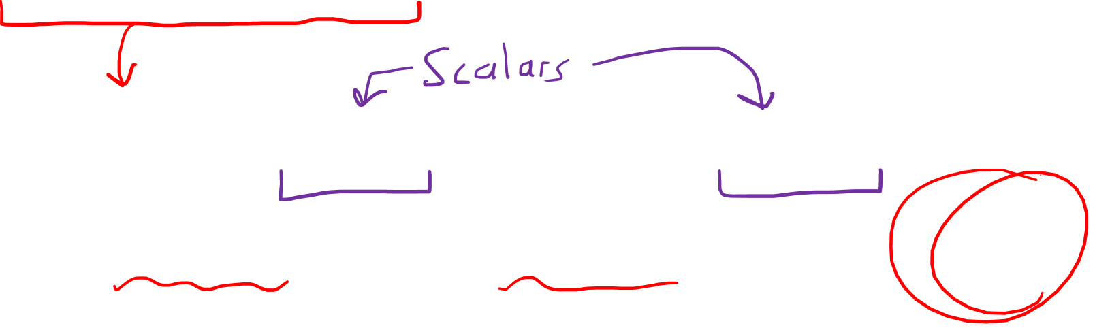
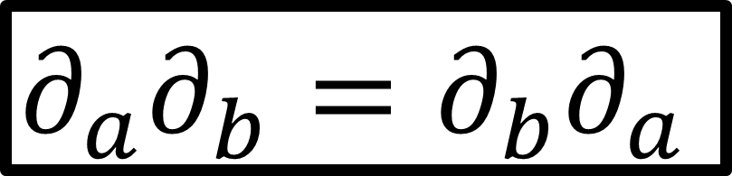
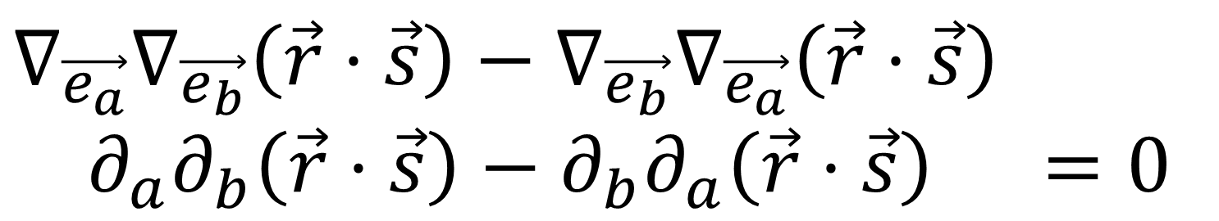
Symmetries of the Riemann Curvature Tensor
$$R\left(\vec{e_{a}},\vec{e_{b}}\right)\left(\vec{r}⋅\vec{s}\right)=R\left(\vec{e_{a}},\vec{e_{b}}\right)\vec{r}⋅\vec{s}+\vec{r}⋅R\left(\vec{e_{a}},\vec{e_{b}}\right)\vec{s}$$
$$∇_{\vec{e_{a}}}∇_{\vec{e_{b}}}\left(\vec{r}⋅\vec{s}\right)−∇_{\vec{e_{b}}}∇_{\vec{e_{a}}}\left(\vec{r}⋅\vec{s}\right)$$
$∂_{a}∂_{b}\left(\vec{r}⋅\vec{s}\right)−∂_{b}∂_{a}\left(\vec{r}⋅\vec{s}\right)$ $=0$
$$∂_{a}∂_{b}=∂_{b}∂_{a}$$

Slide 23
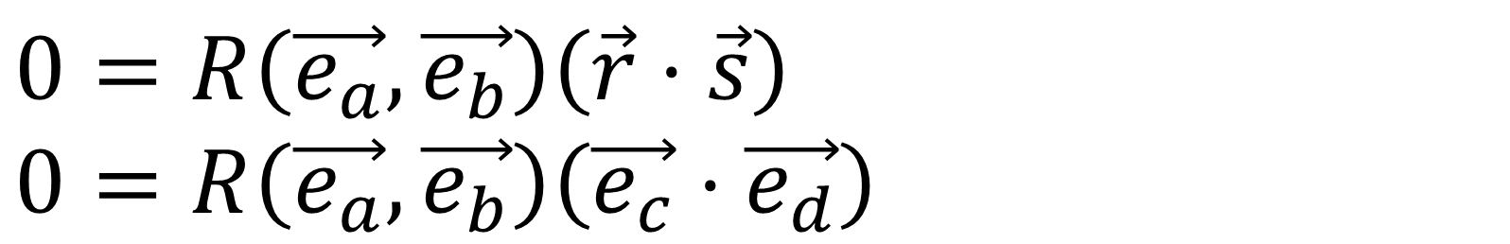


Symmetries of the Riemann Curvature Tensor
$$0=R\left(\vec{e_{a}},\vec{e_{b}}\right)\left(\vec{r}⋅\vec{s}\right)$$
$$0=R\left(\vec{e_{a}},\vec{e_{b}}\right)\left(\vec{e_{c}}⋅\vec{e_{d}}\right)$$
$$0=\left(R\left(\vec{e_{a}},\vec{e_{b}}\right)\vec{e_{c}}\right)⋅\vec{e_{d}}+\vec{e_{c}}⋅\left(R\left(\vec{e_{a}},\vec{e_{b}}\right)\vec{e_{d}}\right)$$
$$0=\left(R_{ cab }^{i}\vec{e_{i}}\right)⋅\vec{e_{d}}+\vec{e_{c}}⋅\left(R_{ dab }^{i}\vec{e_{i}}\right)$$
$$0=\vec{e_{i}}⋅\vec{e_{d}}\left(R_{ cab }^{i}\right)+\vec{e_{c}}⋅\vec{e_{i}}\left(R_{ dab }^{i}\right)$$
$$0=g_{id}\left(R_{ cab }^{i}\right)+g_{ci}\left(R_{ dab }^{i}\right)$$
$$0=R_{dcab}+R_{cdab}$$
$$R_{dcab}=−R_{cdab}$$

Slide 24


Symmetries of the Riemann Curvature Tensor
34-S | $$R_{ bdc}^{i}=−R_{ bcd}^{i}$$
BI | $$R_{ bcd}^{i}+R_{ dbc}^{i}+R_{ cdb}^{i}=0$$
12-S | $$R_{bacd}=−R_{abcd}$$

Slide 25



Symmetries of the Riemann Curvature Tensor
34-S | $$R_{abdc}=−R_{abcd}$$
BI | $$R_{abcd}+R_{adbc}+R_{acdb}=0$$
12-S | $$R_{bacd}=−R_{abcd}$$
$$R_{abcd}=−R_{adbc}−R_{acdb}$$

Slide 26



$$R_{abcd}=−R_{adbc}−R_{acdb}$$
$$R_{abcd}=R_{dabc}+R_{cadb}$$
$$R_{abcd}=−R_{dcab}−R_{dbca}−R_{cbad}−R_{cdba}$$
$$R_{abcd}=2R_{cdab}+R_{bdca}+R_{bcad}$$
$$R_{abcd}=2R_{cdab}−R_{badc}$$
$$R_{abcd}=2R_{cdab}−R_{abcd}$$
$$2R_{abcd}=2R_{cdab}$$
$$R_{abcd}=R_{cdab}$$
BI | $$R_{dcab}+R_{dbca}+R_{dabc}=0$$
12-S | $$R_{bacd}=−R_{abcd}$$
34-S | $$R_{abdc}=−R_{abcd}$$

Slide 27



BI | $$R_{dcab}+R_{dbca}+R_{dabc}=0$$
12-S | $$R_{bacd}=−R_{abcd}$$
34-S | $$R_{abdc}=−R_{abcd}$$
Flip | $$R_{abcd}=−R_{cdab}$$
Torsion-Free
Metric Compatibility
From BI, 12-S, 34-S
$$R_{11cd}=−R_{11cd}$$
$$⇒R_{11cd}=0$$

Slide 28



BI | $$R_{dcab}+R_{dbca}+R_{dabc}=0$$
12-S | $$R_{bacd}=−R_{abcd}$$
34-S | $$R_{abdc}=−R_{abcd}$$
Flip | $$R_{abcd}=−R_{cdab}$$
Torsion-Free
Metric Compatibility
From BI, 12-S, 34-S
$$R_{1111}=0, ,R_{2222}=0,,R_{1122}=−R_{2211}=0$$
$$R_{1112}=−R_{1121}=R_{2111}=−R_{1211}=0$$
$$R_{2221}=−R_{2212}=R_{1222}=−R_{2122}=0$$
$$R_{1212}=−R_{1221}=R_{2121}=−R_{2112}$$

Slide 29



In 2 Dimensions, the Riemann Curvature Tensor
only has one free parameter: $R_{1212}$
This is called the Gaussian Curvature $K=R_{1212}$
$$R_{1111}=0, ,R_{2222}=0,,R_{1122}=−R_{2211}=0$$
$$R_{1112}=−R_{1121}=R_{2111}=−R_{1211}=0$$
$$R_{2221}=−R_{2212}=R_{1222}=−R_{2122}=0$$
$$R_{1212}=−R_{1221}=R_{2121}=−R_{2112}$$

Slide 30


Riemann Curvature Tensor for Polar Coords
$$Γ_{ij}^{k}=Γ_{ji}^{k}$$
$R_{ cab}^{d}=∂_{a}\left(Γ_{bc}^{d}\right)−∂_{b}\left(Γ_{ac}^{d}\right)+Γ_{bc}^{i}Γ_{ai}^{d}−Γ_{ac}^{j}Γ_{bj}^{d}$
From Video 17:
$\tilde{Γ_{rr}^{r}}=0$ $\tilde{Γ_{rr}^{θ}}=0$
$\tilde{Γ_{rθ}^{r}}=0$ $\tilde{Γ_{rθ}^{θ}}=\frac{1}{r}$
$\tilde{Γ_{θr}^{r}}=0$ $\tilde{Γ_{θr}^{θ}}=\frac{1}{r}$
$$\tilde{Γ_{θθ}^{r}}=−r \tilde{Γ_{θθ}^{θ}}=0$$

Slide 31



Riemann Curvature Tensor for Polar Coords
$$Γ_{ij}^{k}=Γ_{ji}^{k}$$
$R_{ θrθ}^{r}=∂_{r}\left(Γ_{θθ}^{r}\right)−∂_{θ}\left(Γ_{rθ}^{r}\right)+Γ_{θθ}^{i}Γ_{ri}^{r}−Γ_{rθ}^{j}Γ_{θj}^{r}$
$$R_{ θrθ}^{r}=∂_{r}\left(Γ_{θθ}^{r}\right)−Γ_{rθ}^{θ}Γ_{θθ}^{r}$$
$R_{ θrθ}^{r}=∂_{r}\left(−r\right)−\left(−r\right)\left(\frac{1}{r}\right)$
$$R_{ θrθ}^{r}=−1+1$$
$$R_{ θrθ}^{r}=0$$
From Video 17:
$\tilde{Γ_{rr}^{r}}=0$ $\tilde{Γ_{rr}^{θ}}=0$
$\tilde{Γ_{rθ}^{r}}=0$ $\tilde{Γ_{rθ}^{θ}}=\frac{1}{r}$
$\tilde{Γ_{θr}^{r}}=0$ $\tilde{Γ_{θr}^{θ}}=\frac{1}{r}$
$$\tilde{Γ_{θθ}^{r}}=−r \tilde{Γ_{θθ}^{θ}}=0$$

Slide 32






Riemann Curvature Tensor for Sphere
$R_{ cab}^{d}=∂_{a}\left(Γ_{bc}^{d}\right)−∂_{b}\left(Γ_{ac}^{d}\right)+Γ_{bc}^{i}Γ_{ai}^{d}−Γ_{ac}^{j}Γ_{bj}^{d}$
$$X=\cos\left(u^{2}\right)\sin\left(u^{1}\right)$$
$$Y=\sin\left(u^{2}\right)\sin\left(u^{1}\right)$$
$$Z=\cos\left(u^{1}\right)$$
From Video 18:
$Γ_{11}^{1}=0$ | $$Γ_{11}^{2}=0$$
$Γ_{12}^{1}=0$ | $$Γ_{12}^{2}=\cot\left(u^{1}\right)$$
$$Γ_{21}^{1}=0$$ | $$Γ_{21}^{2}=\cot\left(u^{1}\right)$$
$Γ_{22}^{1}=−\frac{1}{2}\sin\left(2u^{1}\right)$ | $Γ_{22}^{2}=0$
$$Z$$
$$Y$$
$$X$$

Slide 33




Riemann Curvature Tensor for Sphere
$R_{ 212}^{1}=∂_{1}\left(Γ_{22}^{1}\right)−∂_{2}\left(Γ_{12}^{1}\right)+Γ_{22}^{i}Γ_{1i}^{1}−Γ_{12}^{j}Γ_{2j}^{1}$
$R_{ 212}^{1}=∂_{1}\left(Γ_{22}^{1}\right)$ $+Γ_{22}^{1}Γ_{11}^{1}+Γ_{22}^{2}Γ_{12}^{1}−Γ_{12}^{1}Γ_{21}^{1}−Γ_{12}^{2}Γ_{22}^{1}$
$R_{ 212}^{1}=∂_{1}\left(Γ_{22}^{1}\right)−Γ_{12}^{2}Γ_{22}^{1}$
$Γ_{11}^{1}=0$ | $$Γ_{11}^{2}=0$$
$Γ_{12}^{1}=0$ | $$Γ_{12}^{2}=\cot\left(u^{1}\right)$$
$$Γ_{21}^{1}=0$$ | $$Γ_{21}^{2}=\cot\left(u^{1}\right)$$
$Γ_{22}^{1}=−\frac{1}{2}\sin\left(2u^{1}\right)$ | $Γ_{22}^{2}=0$
$R_{ 212}^{1}=\frac{∂}{∂u^{1}}\left(−\frac{1}{2}\sin\left(2u^{1}\right)\right)$
$$−(\cot\left(u^{1}\right))(−\frac{1}{2}\sin\left(2u^{1}\right))$$

Slide 34


Riemann Curvature Tensor for Sphere
$R_{ 212}^{1}=\frac{∂}{∂u^{1}}\left(−\frac{1}{2}\sin\left(2u^{1}\right)\right)−(\cot\left(u^{1}\right))(−\frac{1}{2}\sin\left(2u^{1}\right))$
$R_{ 212}^{1}=−\frac{1}{2}2cos\left(2u^{1}\right)+\left(\frac{\cos\left(u^{1}\right)}{\sin\left(u^{1}\right)}\right)(\cos\left(u^{1}\right)\sin\left(u^{1}\right))$
$R_{ 212}^{1}=−\cos\left(2u^{1}\right)+{\left(\cos\left(u^{1}\right)\right)}^{2}$
$R_{ 212}^{1}=−\left[{\left(\cos\left(u^{1}\right)\right)}^{2}−{\left(\sin\left(u^{1}\right)\right)}^{2}\right]+{\left(\cos\left(u^{1}\right)\right)}^{2}$
$$R_{ 212}^{1}={\left(\sin\left(u^{1}\right)\right)}^{2}$$

Slide 35




Riemann Curvature Tensor for…
2D Polar Coordinates
2-Sphere
$R_{ 212}^{1}=0$
$R_{ 212}^{1}={\left(\sin\left(u^{1}\right)\right)}^{2}$
$$θ$$
$$r$$

Slide 36





Summary
$$R\left(\vec{u},\vec{v}\right)\vec{w}$$
$$\vec{v}$$
$$\vec{u}$$
$$\vec{w}$$
Riemann Curvature Tensor Definition
$$R\left(\vec{u},\vec{v}\right)\vec{w}=∇_{\vec{u}}∇_{\vec{v}}\vec{w}−∇_{\vec{v}}∇_{\vec{u}}\vec{w}−∇_{\left[\vec{u},\vec{v}\right]}\vec{w}$$

Slide 37


Summary
$R\left(\vec{u},\vec{v}\right)\vec{w}=∇_{\vec{u}}∇_{\vec{v}}\vec{w}−∇_{\vec{v}}∇_{\vec{u}}\vec{w}$ $−∇_{\left[\vec{u},\vec{v}\right]}\vec{w}$
Linear for all Inputs
$$R\left(\vec{u},\vec{v}\right)\vec{w}=u^{i}v^{j}w^{k}R\left(\vec{e_{i}},\vec{e_{j}}\right)\vec{e_{k}}$$
$$R\left(\vec{u},\vec{v}\right)\vec{w}=u^{i}v^{j}w^{k} R_{ kij}^{m} \vec{e_{m}}$$
$R_{ cab}^{d}=∂_{a}\left(Γ_{bc}^{d}\right)−∂_{b}\left(Γ_{ac}^{d}\right)+Γ_{bc}^{i}Γ_{ai}^{d}−Γ_{ac}^{j}Γ_{bj}^{d}$

Slide 38

BI | $$R_{dcab}+R_{dbca}+R_{dabc}=0$$
12-S | $$R_{bacd}=−R_{abcd}$$
34-S | $$R_{abdc}=−R_{abcd}$$
Flip | $$R_{abcd}=−R_{cdab}$$
Torsion-Free
Metric Compatibility
From BI, 12-S, 34-S
$$R_{1111}=0, ,R_{2222}=0,,R_{1122}=−R_{2211}=0$$
$$R_{1112}=−R_{1121}=R_{2111}=−R_{1211}=0$$
$$R_{2221}=−R_{2212}=R_{1222}=−R_{2122}=0$$
$$R_{1212}=−R_{1221}=R_{2121}=−R_{2112}$$

Slide 39





$$R_{ cab}^{d}$$
Symmetries of the Riemann Curvature Tensor
2 Dimensions
$$R_{ cab}^{d}$$
4 Dimensions
(spacetime)
$$R_{ cab}^{d}$$
$$2×2×2×2$$
$=16$ components
$$4×4×4×4$$
$=256$ components
$$1$$
independent
component
$$20$$
independent
components

Slide 40



Next Video: Ricci Curvature Tensor
$$R_{ab}=R_{ aib}^{i}$$
$R_{μν}−\frac{1}{2}Rg_{μν}+Λg_{μν}=\frac{8πG}{c^{4}}T_{μν}$

Slide 41
Additional Sources on Geodesic Deviation:
https://www.physicsforums.com/threads/intuitive-description-of-what-the-ricci-tensor-scalar-represent.734876/
http://math.ucr.edu/home/baez/gr/outline2.html
http://math.ucr.edu/home/baez/gr/geodesic.deviation.html
Geodesic Deviation Equation = Jacobi Equation
http://www.phys.uniroma1.it/DipWeb/web_disp/d3/dispense/ferrari/CAP14_Geodesic_Deviation.pdf

