Slide 1
Geometric Meaning of Ricci Curvature Tensor and Ricci Scalar
https://arxiv.org/pdf/gr-qc/0401099.pdf
(Video 24: Ricci Tensor)
(Videos 22,23: Riemann Curvature Tensor)
(Link in the description)

Slide 2
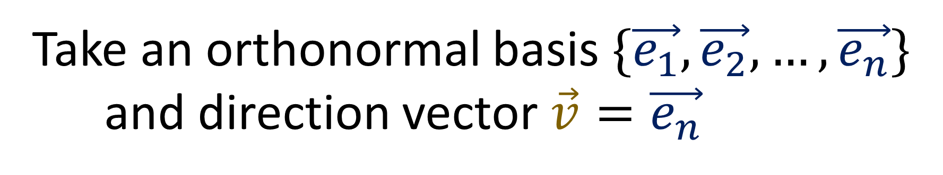
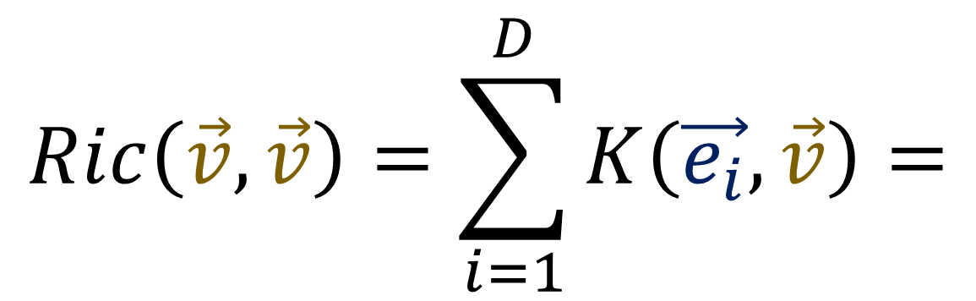
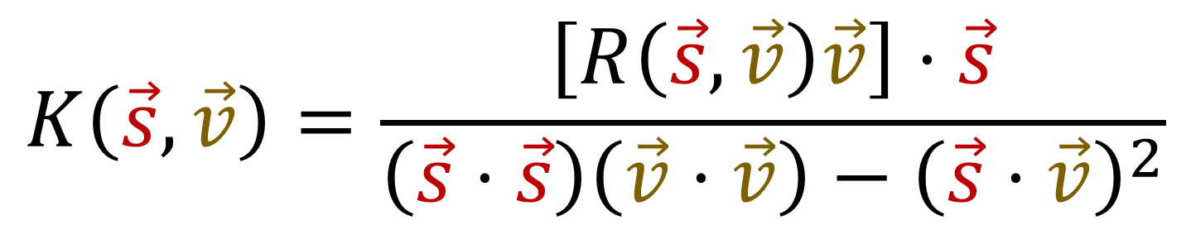


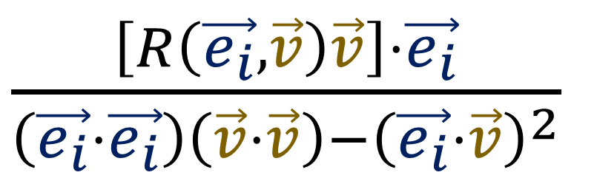
http://www.math.ucsd.edu/~benchow/250-11-19.pdf
$$\vec{v}$$
$$K\left(\vec{s},\vec{v}\right)=\frac{\left[R\left(\vec{s},\vec{v}\right)\vec{v}\right]⋅\vec{s}}{\left(\vec{s}⋅\vec{s}\right)\left(\vec{v}⋅\vec{v}\right)−{\left(\vec{s}⋅\vec{v}\right)}^{2}}$$
$$\vec{s}$$
Take an orthonormal basis $\{\vec{e_{1}},\vec{e_{2}},…,\vec{e_{n}}\}$
and direction vector $\vec{v}=\vec{e_{n}}$
$$Ric\left(\vec{v},\vec{v}\right)=\sum_{i=1}^{D}{K\left(\vec{e_{i}},\vec{v}\right)}=$$
$\frac{\left[R\left(\vec{e_{i}},\vec{v}\right)\vec{v}\right]⋅\vec{e_{i}}}{\left(\vec{e_{i}}⋅\vec{e_{i}}\right)\left(\vec{v}⋅\vec{v}\right)−{\left(\vec{e_{i}}⋅\vec{v}\right)}^{2}}$

Slide 3
Ricci Tensor: Track “volume change” along geodesics
Sectional Curvature
Volume element derivative
Orthonormal
Basis Only!
Any Basis!

Slide 4

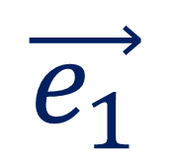
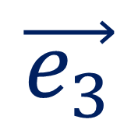
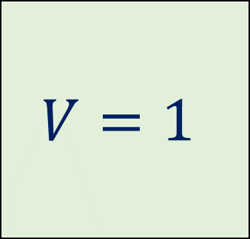
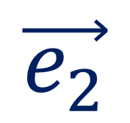
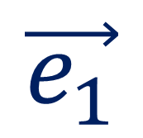
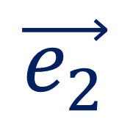
“Volume” created by orthonormal basis
$$\vec{e_{2}}$$
$$\vec{e_{2}}$$
$$V=1$$
$$\vec{e_{1}}$$
$$\vec{e_{1}}$$
$$V=1$$
$$\vec{e_{3}}$$

Slide 5
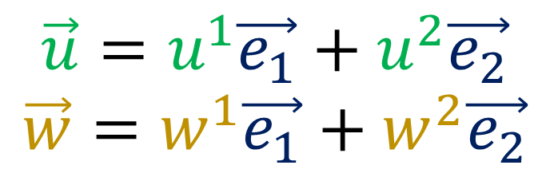
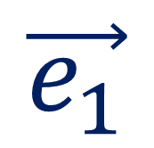

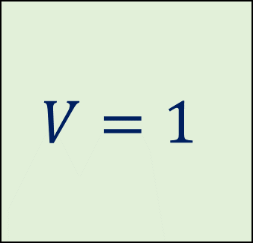

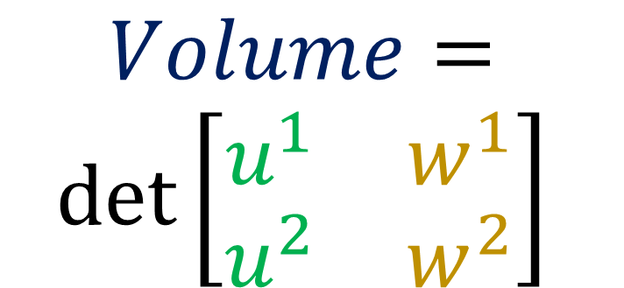
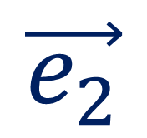
“Volume” created by vectors on O.N. basis
$$\vec{w}$$
$$\vec{e_{2}}$$
$$V=1$$
$$\vec{u}$$
$$Volume=$$
$$\det\left[\begin{matrix}u^{1} & w^{1} \\ u^{2} & w^{2}\end{matrix}\right]$$
$$\vec{e_{1}}$$
$$\vec{u}=u^{1}\vec{e_{1}}+u^{2}\vec{e_{2}}$$
$$\vec{w}=w^{1}\vec{e_{1}}+w^{2}\vec{e_{2}}$$

Slide 6

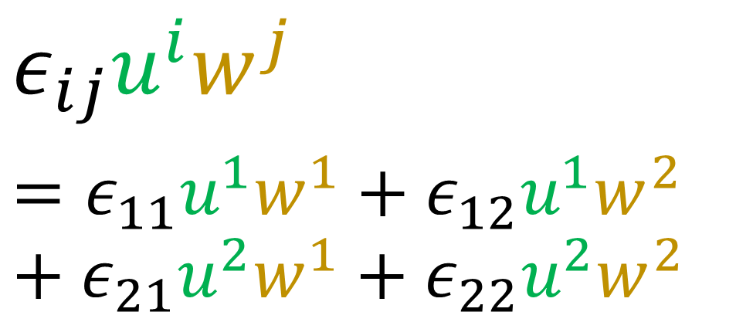

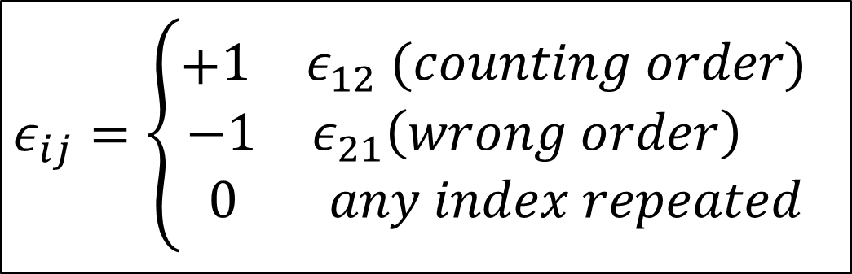


“Volume” created by vectors in O.N. basis
$$\vec{w}$$
$$\vec{u}=u^{1}\vec{e_{1}}+u^{2}\vec{e_{2}}$$
$$\vec{w}=w^{1}\vec{e_{1}}+w^{2}\vec{e_{2}}$$
$$\vec{u}$$
$$Volume=\det\left[\begin{matrix}u^{1} & w^{1} \\ u^{2} & w^{2}\end{matrix}\right]=u^{1}w^{2}−u^{2}w^{1}$$
Levi-Civita Symbol
$$ε_{ij}u^{i}w^{j}$$
$$=ε_{11}u^{1}w^{1}+ε_{12}u^{1}w^{2}+ε_{21}u^{2}w^{1}+ε_{22}u^{2}w^{2}$$
$$ε_{ij}=\left\{\begin{aligned}+\begin{matrix}1 & ε_{12} (counting order)\end{matrix} \\ \begin{matrix}−1 & ε_{21}\left(wrong order\right) \end{matrix} \\ \begin{matrix} 0 & any index repeated\end{matrix}\end{aligned}\right.$$

Slide 7
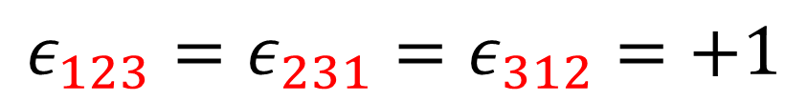

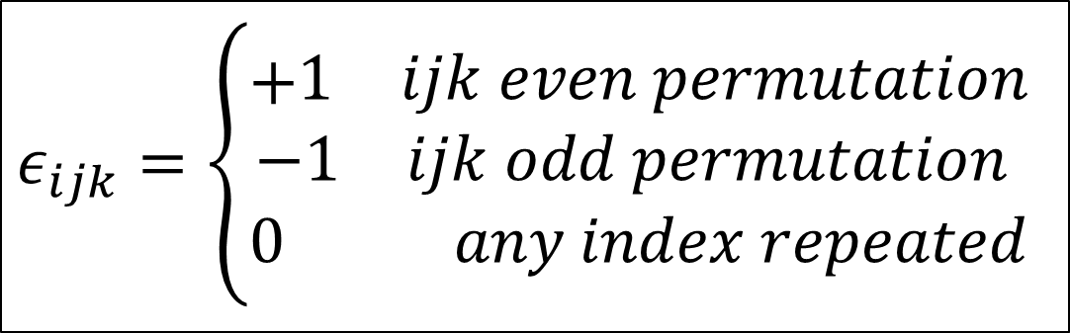
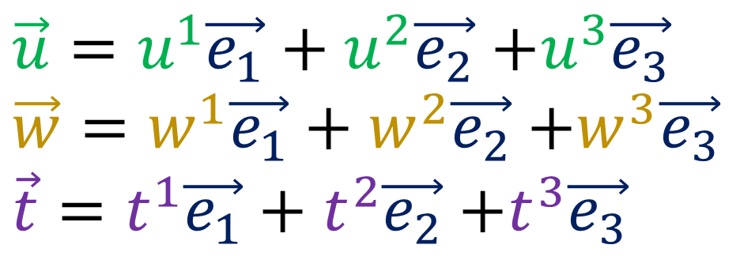


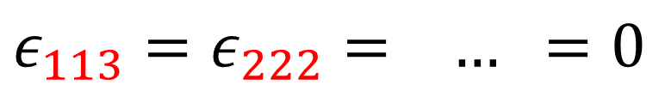

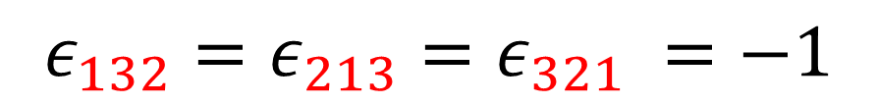
“Volume” created by vectors in O.N. basis
$$\vec{w}$$
$\vec{u}=u^{1}\vec{e_{1}}+u^{2}\vec{e_{2}}$ $+u^{3}\vec{e_{3}}$
$\vec{w}=w^{1}\vec{e_{1}}+w^{2}\vec{e_{2}}$ $+w^{3}\vec{e_{3}}$
$\vec{t}=t^{1}\vec{e_{1}}+t^{2}\vec{e_{2}}$ $+t^{3}\vec{e_{3}}$
$$\vec{u}$$
$$\vec{t}$$
$$Volume=\det\left[\begin{matrix}u^{1} & w^{1} & t^{1} \\ u^{2} & w^{2} & t^{2} \\ u^{3} & w^{3} & t^{3}\end{matrix}\right]=ε_{ijk}u^{i}w^{j}t^{k}$$
Levi-Civita Symbol
$$ε_{123}=ε_{231}=ε_{312}=+1$$
$$ε_{ijk}=\left\{\begin{aligned}+\begin{matrix}1 & ijk even permutation\end{matrix} \\ \begin{matrix}−1 & ijk odd permutation\end{matrix} \\ \begin{matrix}0 & any index repeated\end{matrix}\end{aligned}\right.$$
$$ε_{132}=ε_{213}=ε_{321} =−1$$
$ε_{113}=ε_{222}= …$ $=0$

Slide 8
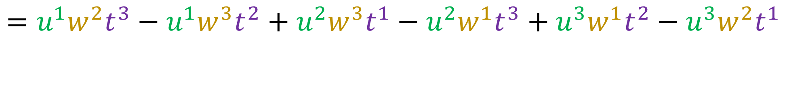
“Volume” created by vectors in O.N. basis
$$\vec{w}$$
$\vec{u}=u^{1}\vec{e_{1}}+u^{2}\vec{e_{2}}$ $+u^{3}\vec{e_{3}}$
$\vec{w}=w^{1}\vec{e_{1}}+w^{2}\vec{e_{2}}$ $+w^{3}\vec{e_{3}}$
$\vec{t}=t^{1}\vec{e_{1}}+t^{2}\vec{e_{2}}$ $+t^{3}\vec{e_{3}}$
$$\vec{u}$$
$$\vec{t}$$
$$Volume=\det\left[\begin{matrix}u^{1} & w^{1} & t^{1} \\ u^{2} & w^{2} & t^{2} \\ u^{3} & w^{3} & t^{3}\end{matrix}\right]=ε_{ijk}u^{i}w^{j}t^{k}$$
$$=u^{1}w^{2}t^{3}−u^{1}w^{3}t^{2}+u^{2}w^{3}t^{1}−u^{2}w^{1}t^{3}+u^{3}w^{1}t^{2}−u^{3}w^{2}t^{1}$$

Slide 9
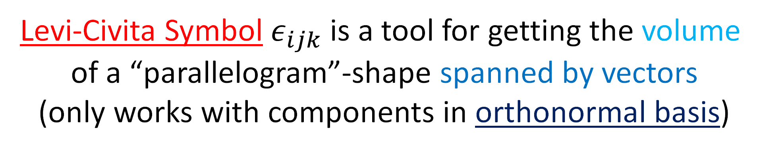
“Volume” created by vectors in O.N. basis
$$\vec{w}$$
$\vec{u}=u^{1}\vec{e_{1}}+u^{2}\vec{e_{2}}$ $+u^{3}\vec{e_{3}}$
$\vec{w}=w^{1}\vec{e_{1}}+w^{2}\vec{e_{2}}$ $+w^{3}\vec{e_{3}}$
$\vec{t}=t^{1}\vec{e_{1}}+t^{2}\vec{e_{2}}$ $+t^{3}\vec{e_{3}}$
$$\vec{u}$$
$$\vec{t}$$
$$Volume=\det\left[\begin{matrix}u^{1} & w^{1} & t^{1} \\ u^{2} & w^{2} & t^{2} \\ u^{3} & w^{3} & t^{3}\end{matrix}\right]=ε_{ijk}u^{i}w^{j}t^{k}$$
Levi-Civita Symbol $ε_{ijk}$is a tool for getting the volume
of a “parallelogram”-shape spanned by vectors
(only works with components in orthonormal basis)

Slide 10
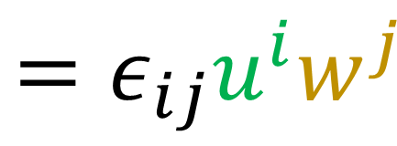
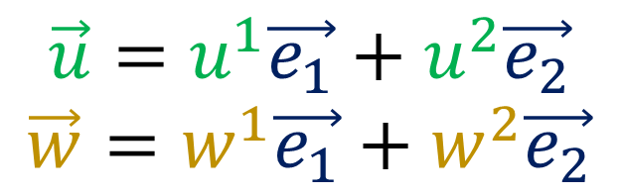
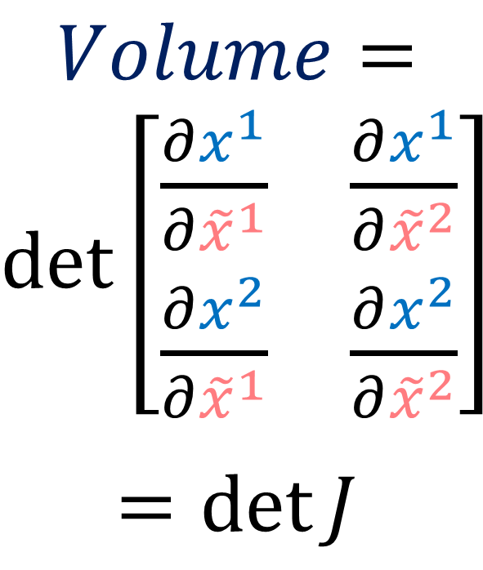
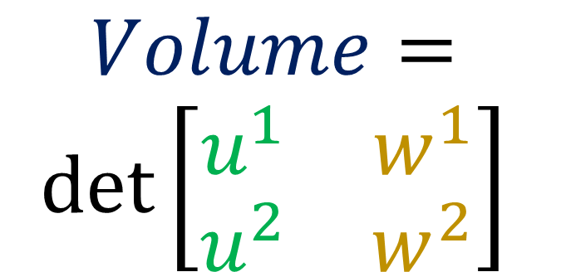
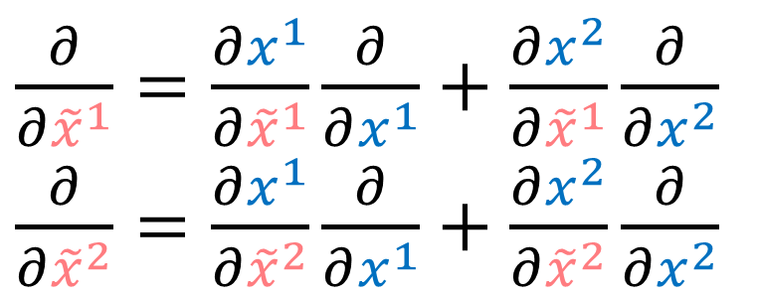
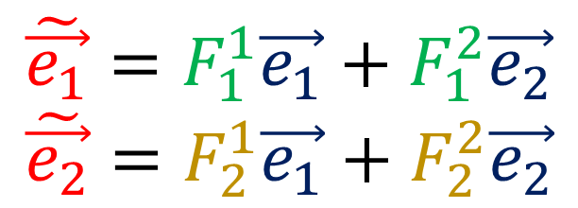
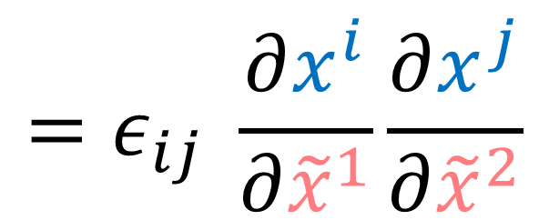
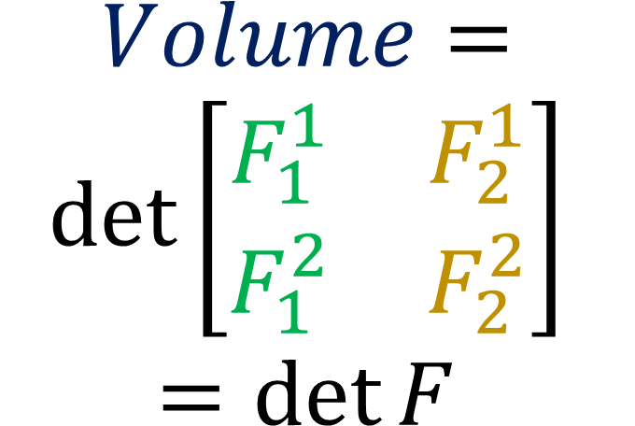
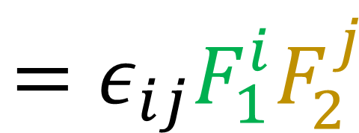
“Volume” created by vectors in O.N. basis
$\frac{∂}{∂{\tilde{x}}^{1}}=\frac{∂x^{1}}{∂{\tilde{x}}^{1}}\frac{∂}{∂x^{1}}+\frac{∂x^{2}}{∂{\tilde{x}}^{1}}\frac{∂}{∂x^{2}}$
$\frac{∂}{∂{\tilde{x}}^{2}}=\frac{∂x^{1}}{∂{\tilde{x}}^{2}}\frac{∂}{∂x^{1}}+\frac{∂x^{2}}{∂{\tilde{x}}^{2}}\frac{∂}{∂x^{2}}$
$$\vec{u}=u^{1}\vec{e_{1}}+u^{2}\vec{e_{2}}$$
$$\vec{w}=w^{1}\vec{e_{1}}+w^{2}\vec{e_{2}}$$
$$\tilde{\vec{e_{1}}}=F_{1}^{1}\vec{e_{1}}+F_{1}^{2}\vec{e_{2}}$$
$$\tilde{\vec{e_{2}}}=F_{2}^{1}\vec{e_{1}}+F_{2}^{2}\vec{e_{2}}$$
$$Volume=$$
$$\det\left[\begin{matrix}u^{1} & w^{1} \\ u^{2} & w^{2}\end{matrix}\right]$$
$$Volume=$$
$\det\left[\begin{matrix}\frac{∂x^{1}}{∂{\tilde{x}}^{1}} & \frac{∂x^{1}}{∂{\tilde{x}}^{2}} \\ \frac{∂x^{2}}{∂{\tilde{x}}^{1}} & \frac{∂x^{2}}{∂{\tilde{x}}^{2}}\end{matrix}\right]$
$$=\det{J}$$
$$Volume=$$
$$\det\left[\begin{matrix}F_{1}^{1} & F_{2}^{1} \\ F_{1}^{2} & F_{2}^{2}\end{matrix}\right]$$
$$=\det{F}$$
$$=ε_{ij}u^{i}w^{j}$$
$$=ε_{ij}F_{1}^{i}F_{2}^{j}$$
$$=ε_{ij} \frac{∂x^{i}}{∂{\tilde{x}}^{1}}\frac{∂x^{j}}{∂{\tilde{x}}^{2}}$$

Slide 11
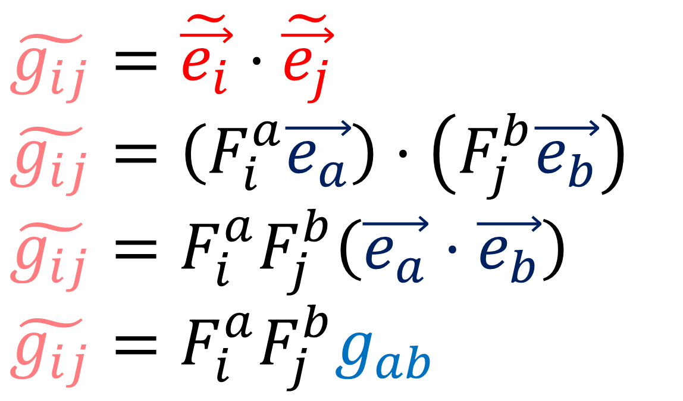

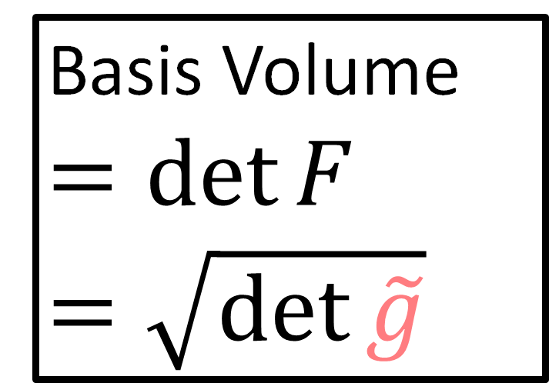
$$g_{ij}=\vec{e_{i}}⋅\vec{e_{j}}$$
“Volume” created by arbitrary basis
$$\tilde{g_{ij}}=\tilde{\vec{e_{i}}}⋅\tilde{\vec{e_{j}}}$$
$\tilde{g_{ij}}=\left(F_{i}^{a}\vec{e_{a}}\right)⋅\left(F_{j}^{b}\vec{e_{b}}\right)$
$\tilde{g_{ij}}=F_{i}^{a}F_{j}^{b}\left(\vec{e_{a}}⋅\vec{e_{b}}\right)$
$\tilde{g_{ij}}=F_{i}^{a}F_{j}^{b}g_{ab}$
Basis Volume
$$=\det{F}$$
$$=\sqrt{\det{\tilde{g}}}$$
$$\det{\tilde{g}}=\left(\det{F}\right)\left(\det{F}\right)\left(\det{g}\right)={\left(\det{F}\right)}^{2}$$

Slide 12
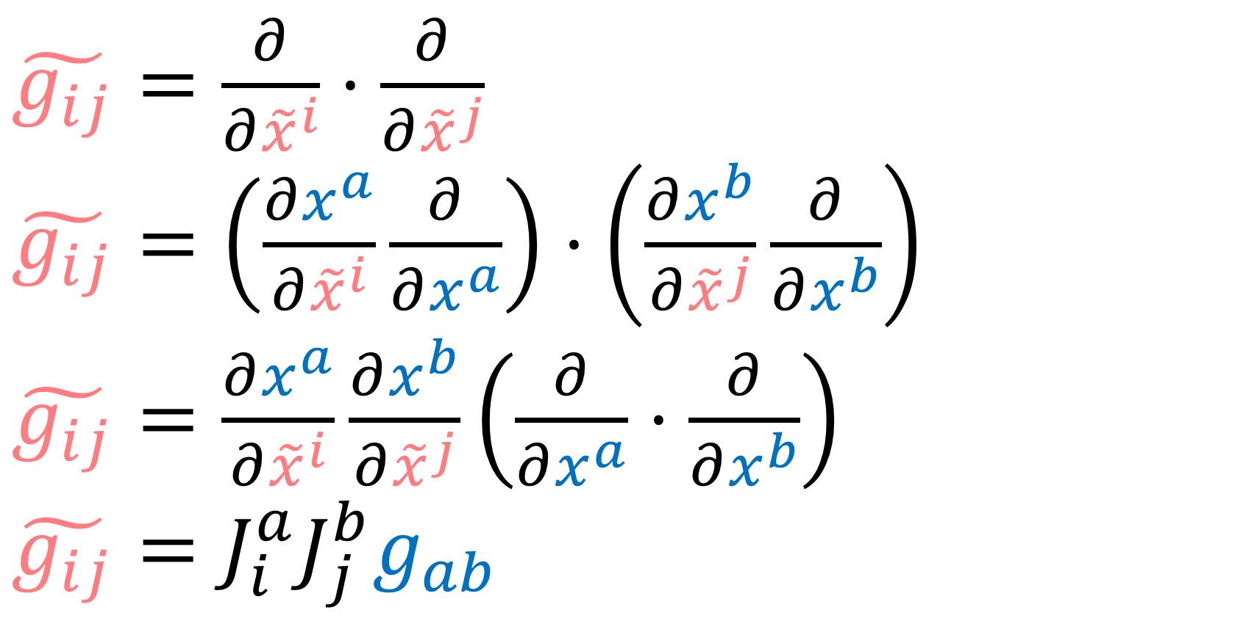


$$g_{ij}=\vec{e_{i}}⋅\vec{e_{j}}$$
“Volume” created by arbitrary basis
$\tilde{g_{ij}}=\frac{∂}{∂{\tilde{x}}^{i}}⋅\frac{∂}{∂{\tilde{x}}^{j}}$
$\tilde{g_{ij}}=\left(\frac{∂x^{a}}{∂{\tilde{x}}^{i}}\frac{∂}{∂x^{a}}\right)⋅\left(\frac{∂x^{b}}{∂{\tilde{x}}^{j}}\frac{∂}{∂x^{b}}\right)$
$\tilde{g_{ij}}=\frac{∂x^{a}}{∂{\tilde{x}}^{i}}\frac{∂x^{b}}{∂{\tilde{x}}^{j}}\left(\frac{∂}{∂x^{a}}⋅\frac{∂}{∂x^{b}}\right)$
$\tilde{g_{ij}}=J_{i}^{a}J_{j}^{b}g_{ab}$
Basis Volume
$$=\det{J}$$
$$=\sqrt{\det{\tilde{g}}}$$
$$\det{\tilde{g}}={\left(\det{J}\right)}^{2}\left(\det{g}\right)$$

Slide 13
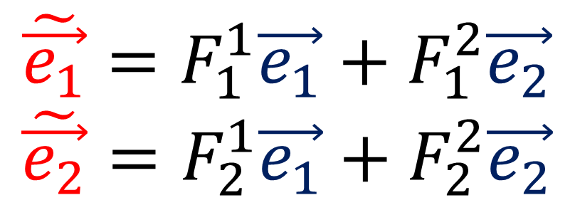
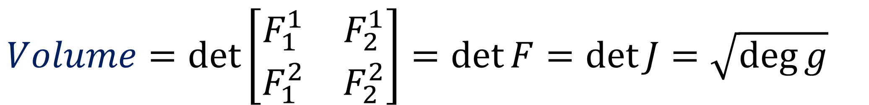
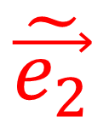
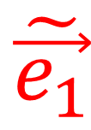
“Volume” created by arbitrary basis
$$\tilde{\vec{e_{2}}}$$
$$\tilde{\vec{e_{1}}}=F_{1}^{1}\vec{e_{1}}+F_{1}^{2}\vec{e_{2}}$$
$$\tilde{\vec{e_{2}}}=F_{2}^{1}\vec{e_{1}}+F_{2}^{2}\vec{e_{2}}$$
$$\tilde{\vec{e_{1}}}$$
$$Volume=\det\left[\begin{matrix}F_{1}^{1} & F_{2}^{1} \\ F_{1}^{2} & F_{2}^{2}\end{matrix}\right]=\det{F}=\det{J}=\sqrt{\deg{g}}$$

Slide 14

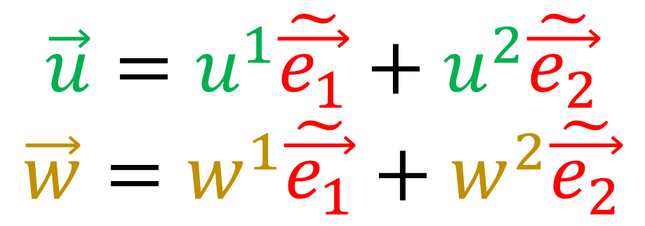


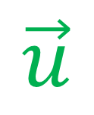


“Volume” created by arbitrary basis
$$\vec{w}$$
$$\vec{u}=u^{1}\tilde{\vec{e_{1}}}+u^{2}\tilde{\vec{e_{2}}}$$
$$\vec{w}=w^{1}\tilde{\vec{e_{1}}}+w^{2}\tilde{\vec{e_{2}}}$$
$$\tilde{\vec{e_{2}}}$$
$$\vec{u}$$
$$\tilde{\vec{e_{1}}}$$
$$Volume=\sqrt{\deg{g}}⋅\det\left[\begin{matrix}u^{1} & w^{1} \\ u^{2} & w^{2}\end{matrix}\right]$$
$$Volume=ε_{ij}u^{i}w^{j}$$

Slide 15

“Volume” created by arbitrary basis
$$\vec{w}$$
$$\vec{u}=u^{1}\tilde{\vec{e_{1}}}+u^{2}\tilde{\vec{e_{2}}}$$
$$\vec{w}=w^{1}\tilde{\vec{e_{1}}}+w^{2}\tilde{\vec{e_{2}}}$$
$$\tilde{\vec{e_{2}}}$$
$$\vec{u}$$
$$\tilde{\vec{e_{1}}}$$
$$Volume=\sqrt{\deg{g}}ε_{ij}u^{i}w^{j}$$
“Volume Form” components
$$Volume=ε_{ij}u^{i}w^{j}$$

Slide 16
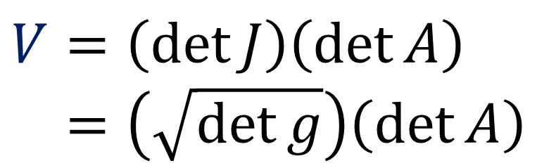









“Volume” created by arbitrary vectors
$$\tilde{\vec{e_{2}}}$$
$$\vec{e_{2}}$$
$$\tilde{\vec{e_{2}}}$$
$$\tilde{\vec{e_{1}}}$$
$$\tilde{\vec{e_{1}}}$$
$$\vec{e_{1}}$$
$$\vec{u}=a_{1}^{1}\tilde{\vec{e_{1}}}+a_{1}^{2}\tilde{\vec{e_{2}}}$$
$$\vec{w}=a_{2}^{1}\tilde{\vec{e_{1}}}+a_{2}^{2}\tilde{\vec{e_{2}}}$$
$$V=\det{J}$$
$$V=\sqrt{\det{g}}$$
$$V=1$$
$$V=\left(\det{J}\right)\left(\det{A}\right)$$
$$V=\left(\sqrt{\det{g}}\right)\left(\det{A}\right)$$

Slide 17





2nd Derivative of Volume spanned by vectors
$$\vec{w}$$
$$V=\sqrt{\deg{g}}ε_{ijk}u^{i}w^{j}t^{k}$$
$$\vec{u}$$
$$\vec{v}$$
$$\vec{t}$$

Slide 18





2nd Derivative of Volume spanned by vectors
$$\vec{s_{2}}$$
$$V= \sqrt{\deg{g}} ε_{ijk} s_{1}^{i}s_{2}^{j}s_{3}^{k}$$
$V=\sqrt{\deg{g}}ε_{μ_{1}…μ_{D}}\left(\prod_{i=1}^{D}{s_{i}^{μ_{i}}}\right)$
$$\vec{s_{1}}$$
$$\vec{v}$$
$$\vec{s_{3}}$$
$∇_{\vec{v}}∇_{\vec{v}} V$ $=\frac{d^{2}}{dλ^{2}}V=\frac{d}{dλ}\frac{d}{dλ}\left[\sqrt{\deg{g}}ε_{μ_{1}…μ_{D}}\left(\prod_{i=1}^{D}{s_{i}^{μ_{i}}}\right)\right]$

Slide 19


https://arxiv.org/pdf/gr-qc/0401099.pdf
Volume form is invariant
$$\frac{d^{2}V}{dλ^{2}}=\frac{d}{dλ}\frac{d}{dλ}\left[\left(\prod_{i=1}^{D}{s_{i}^{μ_{i}}}\right)\sqrt{\deg{g}}ε_{μ_{1}…μ_{D}}\right]$$
$$\frac{d^{2}V}{dλ^{2}}=\frac{d}{dλ}\left({\dot{s}}_{j}^{μ_{j}}\prod_{\begin{aligned}i=1 \\ i≠j\end{aligned}}^{D}{s_{i}^{μ_{i}}}\right)\sqrt{\deg{g}}ε_{μ_{1}…μ_{D}}$$
$$\frac{d^{2}V}{dλ^{2}}=\left({\ddot{s}}_{j}^{μ_{j}}\prod_{\begin{aligned}i=1 \\ i≠j\end{aligned}}^{D}{s_{i}^{μ_{i}}}\right)\sqrt{\deg{g}}ε_{μ_{1}…μ_{D}}+\left({\dot{s}}_{j}^{μ_{j}}{\dot{s}}_{k}^{μ_{k}}\prod_{\begin{aligned}i=1 \\ i≠j,k\end{aligned}}^{D}{s_{i}^{μ_{i}}}\right)\sqrt{\deg{g}}ε_{μ_{1}…μ_{D}}$$
$${\ddot{s}}_{j}^{μ_{j}}=−R_{xyz}^{μ_{j}}v^{x}s_{j}^{y}v^{z}$$
$$∇_{\vec{v}}∇_{\vec{v}}\vec{s}=−R\left(\vec{s},\vec{v}\right)\vec{v}$$

Slide 20


https://arxiv.org/pdf/gr-qc/0401099.pdf
$$\frac{d^{2}V}{dλ^{2}}=\left(−R_{xyz}^{μ_{j}}v^{x}s_{j}^{y}v^{z}\prod_{\begin{aligned}i=1 \\ i≠j\end{aligned}}^{D}{s_{i}^{μ_{i}}}\right)\sqrt{\deg{g}}ε_{μ_{1}…μ_{D}}+\left({\dot{s}}_{j}^{μ_{j}}{\dot{s}}_{k}^{μ_{k}}\prod_{\begin{aligned}i=1 \\ i≠j,k\end{aligned}}^{D}{s_{i}^{μ_{i}}}\right)\sqrt{\deg{g}}ε_{μ_{1}…μ_{D}}$$
$$\frac{d^{2}V}{dλ^{2}}=\left(−R_{xμ_{j}z}^{μ_{j}}v^{x}s_{j}^{μ_{j}}v^{z}\prod_{\begin{aligned}i=1 \\ i≠j\end{aligned}}^{D}{s_{i}^{μ_{i}}}\right)\sqrt{\deg{g}}ε_{μ_{1}…μ_{D}}+\left({\dot{s}}_{j}^{μ_{j}}{\dot{s}}_{k}^{μ_{k}}\prod_{\begin{aligned}i=1 \\ i≠j,k\end{aligned}}^{D}{s_{i}^{μ_{i}}}\right)\sqrt{\deg{g}}ε_{μ_{1}…μ_{D}}$$
$$\frac{d^{2}V}{dλ^{2}}=−R_{xμ_{j}z}^{μ_{j}}v^{x}v^{z}\left(\prod_{i=1}^{D}{s_{i}^{μ_{i}}}\right)\sqrt{\deg{g}}ε_{μ_{1}…μ_{D}}+\left({\dot{s}}_{j}^{μ_{j}}{\dot{s}}_{k}^{μ_{k}}\prod_{\begin{aligned}i=1 \\ i≠j,k\end{aligned}}^{D}{s_{i}^{μ_{i}}}\right)\sqrt{\deg{g}}ε_{μ_{1}…μ_{D}}$$
Every index except $μ_{j}$ is used

Slide 21

https://arxiv.org/pdf/gr-qc/0401099.pdf
$$\frac{d^{2}V}{dλ^{2}}=−R_{xμ_{j}z}^{μ_{j}}v^{x}v^{z}\left(\prod_{i=1}^{D}{s_{i}^{μ_{i}}}\right)\sqrt{\deg{g}}ε_{μ_{1}…μ_{D}}+\left({\dot{s}}_{j}^{μ_{j}}{\dot{s}}_{k}^{μ_{k}}\prod_{\begin{aligned}i=1 \\ i≠j,k\end{aligned}}^{D}{s_{i}^{μ_{i}}}\right)\sqrt{\deg{g}}ε_{μ_{1}…μ_{D}}$$
$\frac{d^{2}V}{dλ^{2}}=−R_{xz}v^{x}v^{z}\left(V\right)$ $+\left({\dot{s}}_{j}^{μ_{j}}{\dot{s}}_{k}^{μ_{k}}\prod_{\begin{aligned}i=1 \\ i≠j,k\end{aligned}}^{D}{s_{i}^{μ_{i}}}\right)\sqrt{\deg{g}}ε_{μ_{1}…μ_{D}}$
Conclusion: Ricci Tensor tells us how volumes change as we move around in space

Slide 22





https://arxiv.org/pdf/gr-qc/0401099.pdf
$\frac{d^{2}V}{dλ^{2}}=−R_{xz}v^{x}v^{z}\left(V\right)$ $+\left({\dot{s}}_{j}^{μ_{j}}{\dot{s}}_{k}^{μ_{k}}\prod_{\begin{aligned}i=1 \\ i≠j,k\end{aligned}}^{D}{s_{i}^{μ_{i}}}\right)\sqrt{\deg{g}}ε_{μ_{1}…μ_{D}}$
$$\vec{s}$$
$$\vec{s}$$
$$\vec{v}$$
$$\vec{v}$$
Curved Space
Flat Space
Conclusion: Ricci Tensor tells us how volumes change due to the curvature of the space we’ere in

Slide 23



https://arxiv.org/pdf/gr-qc/0401099.pdf
$$\det{A}=a_{i}^{1}a_{j}^{2}a_{k}^{3}ε^{ijk}$$
$$\det{A}=a_{μ_{1}}^{1}a_{μ_{2}}^{2}a_{μ_{3}}^{3}ε^{μ_{1}μ_{2}μ_{3}}$$
$$\det{A}=\left(\prod_{i=1}^{D}{a_{μ_{i}}^{i}}\right)ε^{μ_{1}…μ_{D}}$$
Second Derivative of Volume Element
$$∇_{\vec{v}}∇_{\vec{v}}\det{V}$$
$$=\frac{d^{2}}{dλ^{2}}\det{V}=\frac{d}{dλ}\frac{d}{dλ}\left(\prod_{i=1}^{D}{a_{μ_{i}}^{i}}\right)\sqrt{\det{g}}ε^{μ_{1}…μ_{D}}$$
$$=\frac{d}{dλ}\left({\dot{a}}_{μ_{j}}^{j}\prod_{\begin{aligned}i=1 \\ i≠j\end{aligned}}^{D}{a_{μ_{i}}^{i}}\right)\sqrt{\det{g}}ε^{μ_{1}…μ_{D}}$$
$$V=\left(\sqrt{\det{g}}\right)\left(\det{A}\right)$$
$\left(\sqrt{\det{g}}\right)\left(\prod_{i=1}^{D}{a_{μ_{i}}^{i}}\right)ε^{μ_{1}…μ_{D}}$

Slide 24
https://arxiv.org/pdf/gr-qc/0401099.pdf
$$\det{A}=a_{i}^{1}a_{j}^{2}a_{k}^{3}ε^{ijk}$$
$$\det{A}=a_{μ_{1}}^{1}a_{μ_{2}}^{2}a_{μ_{3}}^{3}ε^{μ_{1}μ_{2}μ_{3}}$$
$$\det{A}=\left(\prod_{i=1}^{D}{a_{μ_{i}}^{i}}\right)ε^{μ_{1}…μ_{D}}$$
Second Derivative of Volume Element
$$∇_{\vec{v}}∇_{\vec{v}}\det{V}$$
$$=\frac{d^{2}}{dλ^{2}}\det{V}=\frac{d}{dλ}\frac{d}{dλ}\left(\prod_{i=1}^{D}{a_{μ_{i}}^{i}}\right)\sqrt{\det{g}}ε^{μ_{1}…μ_{D}}$$
$$=\frac{d}{dλ}\left({\dot{a}}_{μ_{j}}^{j}\prod_{\begin{aligned}i=1 \\ i≠j\end{aligned}}^{D}{a_{μ_{i}}^{i}}\right)\sqrt{\det{g}}ε^{μ_{1}…μ_{D}}$$
$$V=\left(\sqrt{\det{g}}\right)\left(\det{A}\right)$$
$\left(\sqrt{\det{g}}\right)\left(\prod_{i=1}^{D}{a_{μ_{i}}^{i}}\right)ε^{μ_{1}…μ_{D}}$

Slide 25


https://arxiv.org/pdf/gr-qc/0401099.pdf
$$\frac{d^{2}V}{dλ^{2}}=\frac{d}{dλ}\left({\dot{a}}_{μ_{j}}^{j}\prod_{\begin{aligned}i=1 \\ i≠j\end{aligned}}^{D}{a_{μ_{i}}^{i}}\right)\sqrt{\det{g}}ε^{μ_{1}…μ_{D}}$$
$$\frac{d^{2}V}{dλ^{2}}=\left({\ddot{a}}_{μ_{j}}^{j}\prod_{\begin{aligned}i=1 \\ i≠j\end{aligned}}^{D}{a_{μ_{i}}^{i}}\right)\sqrt{\det{g}}ε^{μ_{1}…μ_{D}}+\left({{\dot{a}}_{μ_{k}}^{k}\dot{a}}_{μ_{j}}^{j}\prod_{\begin{aligned}i=1 \\ i≠j,k\end{aligned}}^{D}{a_{μ_{i}}^{i}}\right)\sqrt{\det{g}}ε^{μ_{1}…μ_{D}}$$
$${\ddot{a}}_{μ_{j}}^{j}=−R_{xyz}^{j}v^{x}a_{μ_{j}}^{y}v^{z}$$
$$∇_{\vec{v}}∇_{\vec{v}}\vec{s}=−R\left(\vec{s},\vec{v}\right)\vec{v}$$

Slide 26

https://arxiv.org/pdf/gr-qc/0401099.pdf
$$\frac{d^{2}V}{dλ^{2}}=\left(−R_{xyz}^{j}v^{x}a_{μ_{j}}^{y}v^{z}\prod_{\begin{aligned}i=1 \\ i≠j\end{aligned}}^{D}{a_{μ_{i}}^{i}}\right)\sqrt{\det{g}}ε^{μ_{1}…μ_{D}}+\left({{\dot{a}}_{μ_{k}}^{k}\dot{a}}_{μ_{j}}^{j}\prod_{\begin{aligned}i=1 \\ i≠j,k\end{aligned}}^{D}{a_{μ_{i}}^{i}}\right)\sqrt{\det{g}}ε^{μ_{1}…μ_{D}}$$
$$\frac{d^{2}V}{dλ^{2}}=\left(−R_{xjz}^{j}v^{x}a_{μ_{j}}^{j}v^{z}\prod_{\begin{aligned}i=1 \\ i≠j\end{aligned}}^{D}{a_{μ_{i}}^{i}}\right)\sqrt{\det{g}}ε^{μ_{1}…μ_{D}}+\left({{\dot{a}}_{μ_{k}}^{k}\dot{a}}_{μ_{j}}^{j}\prod_{\begin{aligned}i=1 \\ i≠j,k\end{aligned}}^{D}{a_{μ_{i}}^{i}}\right)\sqrt{\det{g}}ε^{μ_{1}…μ_{D}}$$
$$\frac{d^{2}V}{dλ^{2}}=−R_{xjz}^{j}v^{z}\left(\prod_{i=1}^{D}{a_{μ_{i}}^{i}}\right)\sqrt{\det{g}}ε^{μ_{1}…μ_{D}}+\left({{\dot{a}}_{μ_{k}}^{k}\dot{a}}_{μ_{j}}^{j}\prod_{\begin{aligned}i=1 \\ i≠j,k\end{aligned}}^{D}{a_{μ_{i}}^{i}}\right)\sqrt{\det{g}}ε^{μ_{1}…μ_{D}}$$

Slide 27

https://arxiv.org/pdf/gr-qc/0401099.pdf
$$\frac{d^{2}V}{dλ^{2}}=−R_{xjz}^{j}v^{x}v^{z}\left(\prod_{i=1}^{D}{a_{μ_{i}}^{i}}\right)\sqrt{\det{g}}ε^{μ_{1}…μ_{D}}+\left({{\dot{a}}_{μ_{k}}^{k}\dot{a}}_{μ_{j}}^{j}\prod_{\begin{aligned}i=1 \\ i≠j,k\end{aligned}}^{D}{a_{μ_{i}}^{i}}\right)\sqrt{\det{g}}ε^{μ_{1}…μ_{D}}$$
$\frac{d^{2}V}{dλ^{2}}=−R_{xz}v^{x}v^{z}\left(V\right)$ $+\left({{\dot{a}}_{μ_{k}}^{k}\dot{a}}_{μ_{j}}^{j}\prod_{\begin{aligned}i=1 \\ i≠j,k\end{aligned}}^{D}{a_{μ_{i}}^{i}}\right)\sqrt{\det{g}}ε^{μ_{1}…μ_{D}}$

Slide 28



$$g_{ij}=\vec{e_{i}}⋅\vec{e_{j}}$$
“Volume” created by basis vectors
$\tilde{g_{ij}}=\frac{∂}{∂{\tilde{x}}^{i} }⋅\frac{∂}{∂{\tilde{x}}^{j} }$
$\tilde{g_{ij}}=\left(\frac{∂x^{a}}{∂{\tilde{x}}^{i} }\frac{∂}{∂x^{a}}\right)⋅\left(\frac{∂x^{b}}{∂{\tilde{x}}^{j} }\frac{∂}{∂x^{b}}\right)$
$\tilde{g_{ij}}=\frac{∂x^{a}}{∂{\tilde{x}}^{i} }\frac{∂x^{b}}{∂{\tilde{x}}^{j} }\left(\frac{∂}{∂x^{a}}⋅\frac{∂}{∂x^{b}}\right)$
$\tilde{g_{ij}}=J_{i}^{a}J_{j}^{b}g_{ab}$
Volume change
$$=\det{J}$$
$$=\sqrt{\det{\tilde{g}}}$$
$$\det{\tilde{g}}={\left(\det{J}\right)}^{2}\left(\det{g}\right)$$

Slide 29



“Volume” created by basis vectors
$$g_{ij}\left(x\right)=δ_{ij}+\frac{1}{3}R_{iklj}x^{k}x^{l}+O\left({\left|x\right|}^{3}\right)$$
I don't know what $x$ is in this case… or why this formula is true…
Long explanation here: https://studylib.net/doc/13872779/the-taylor-expansion-of-a-riemannian-metric
Series expansion of the square root of the metric tensor: http://pi.math.cornell.edu/files/Research/SeniorTheses/rudeliusThesis.pdf

Slide 30


Taylor Series Expansion
$$f\left(x\right)=f\left(0\right)+f^{′}\left(0\right)x+\frac{1}{2}f^{′′}\left(0\right)x^{2}+\frac{1}{6}f^{′′′}\left(0\right)x^{3}+…$$
$$f\left(x\right)=\sum_{n=0}^{∞}{\frac{1}{n!}f^{\left(n\right)}\left(0\right)x^{n}}$$
$$f\left(x,y\right)=f\left(0\right)+f^{′}\left(0\right)x+f^{′}\left(0\right)y+\frac{1}{2}f^{′′}\left(0\right)x^{2}+\frac{1}{2}f^{′′}\left(0\right)xy+\frac{1}{2}f^{′′}\left(0\right)yx+\frac{1}{2}f^{′′}\left(0\right)y^{2}+…$$
$$f\left(x\right)=\sum_{n=0}^{∞}{\frac{1}{n!}f^{\left(n\right)}\left(0\right)x^{n}}$$

Slide 31

Taylor Series Expansion
$$f\left(x\right)=f\left(0\right)+f^{′}\left(0\right)x+\frac{1}{2}f^{′′}\left(0\right)x^{2}+\frac{1}{6}f^{′′′}\left(0\right)x^{3}+…$$
$$f\left(x\right)=\sum_{n=0}^{∞}{\frac{1}{n!}f^{\left(n\right)}\left(0\right)x^{n}}$$
$$f\left(x,y\right)=f\left(0\right)+f^{′}\left(0\right)x+f^{′}\left(0\right)y$$
$f\left(x,y\right)$ $+\frac{1}{2}f^{′′}\left(0\right)x^{2}+\frac{1}{2}f^{′′}\left(0\right)xy+\frac{1}{2}f^{′′}\left(0\right)yx+\frac{1}{2}f^{′′}\left(0\right)y^{2}$
$$+…$$
$$f\left(x\right)=\sum_{n=0}^{∞}{\frac{1}{n!}f^{\left(n\right)}\left(0\right)x^{n}}$$

Slide 32



Taylor Series Expansion of the metric
$$g_{ij}\left(x\right)=g_{ij}{\left.​\right|}_{p}+∂_{k}g_{ij}{\left.​\right|}_{p}x^{k}+\frac{1}{2}∂_{l}∂_{k}g_{ij}{\left.​\right|}_{p}x^{k}x^{l}+\frac{1}{6}∂_{m}∂_{l}∂_{k}g_{ij}{\left.​\right|}_{p}x^{k}x^{l}x^{m}+…$$
Riemann Normal
Coordinates
$$=δ_{ij}+ 0 −\frac{1}{3}R_{ikjl}{\left.​\right|}_{p}x^{k}x^{l}+O\left(x^{3}\right)+…$$
$$\frac{1}{2}∂_{l}∂_{k}g_{ij}{\left.​\right|}_{p}=−\frac{1}{3}R_{ikjl}{\left.​\right|}_{p}$$

