Slide 1

Ricci Tensor & Scalar Properties
(Watch Videos 22,23: Riemann Tensor)
(Watch Video 24: Geometric Meaning of Ricci)
(Link in the description)

Slide 2
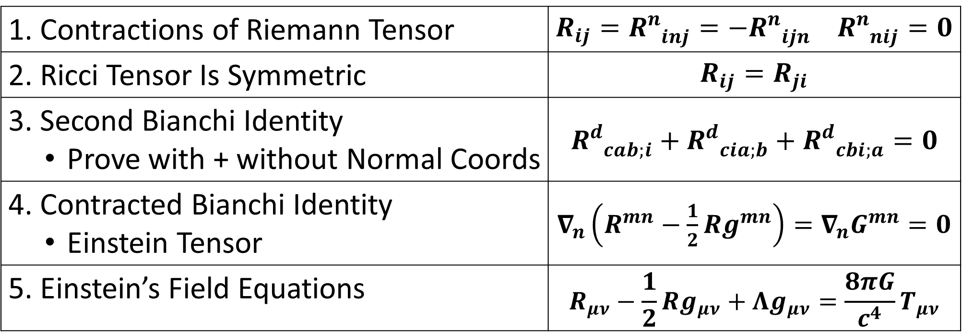
Stuff we’ll cover…
1. Contractions of Riemann Tensor | $R_{ij}=R_{ inj}^{n}=−R_{ ijn}^{n}$ $R_{ nij}^{n}=0$
2. Ricci Tensor Is Symmetric | $$R_{ij}=R_{ji}$$
3. Second Bianchi Identity Prove with + without Normal Coords | $$R_{ cab;i}^{d}+R_{ cia;b}^{d}+R_{ cbi;a}^{d}=0$$
4. Contracted Bianchi Identity Einstein Tensor | $∇_{n}\left(R^{mn}−\frac{1}{2}Rg^{mn}\right)=∇_{n}G^{mn}=0$
5. Einstein’s Field Equations | $$R_{μν}−\frac{1}{2}Rg_{μν}+Λg_{μν}=\frac{8πG}{c^{4}}T_{μν}$$

Slide 3
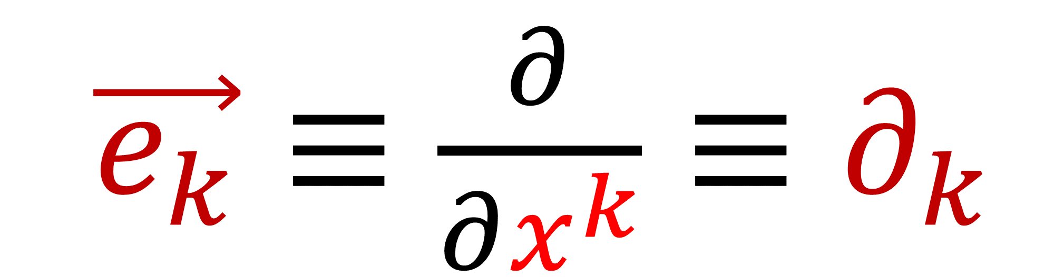
Basis vectors
$\vec{e_{k}}≡\frac{∂}{∂x^{k}}≡∂_{k}$

Slide 4
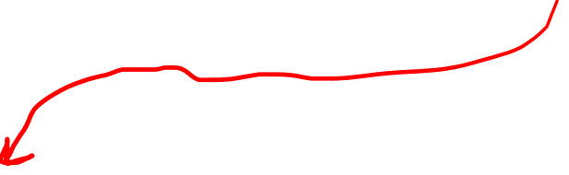
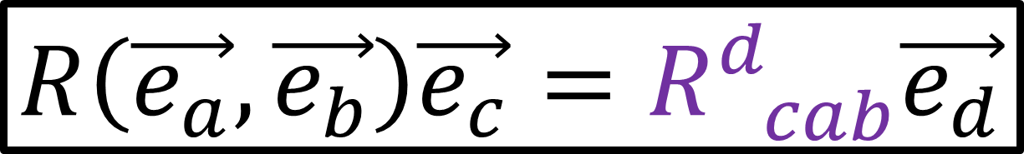
Riemann Curvature Tensor formulas:
$$R\left(\vec{u},\vec{v}\right)\vec{w}=∇_{\vec{u}}∇_{\vec{v}}\vec{w}−∇_{\vec{v}}∇_{\vec{u}}\vec{w}−∇_{\left[\vec{u},\vec{v}\right]}\vec{w}$$
$$R\left(\vec{e_{a}},\vec{e_{b}}\right)\vec{e_{c}}=R_{ cab}^{d}\vec{e_{d}}$$
$R_{ cab}^{d}=∂_{a}\left(Γ_{bc}^{d}\right)−∂_{b}\left(Γ_{ac}^{d}\right)+Γ_{bc}^{i}Γ_{ai}^{d}−Γ_{ac}^{j}Γ_{bj}^{d}$

Slide 5
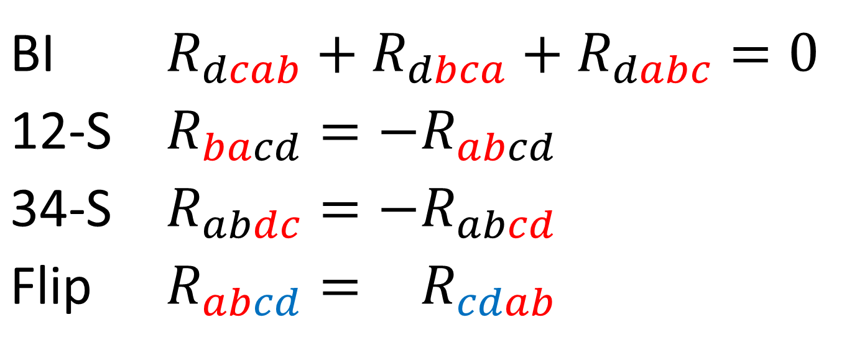
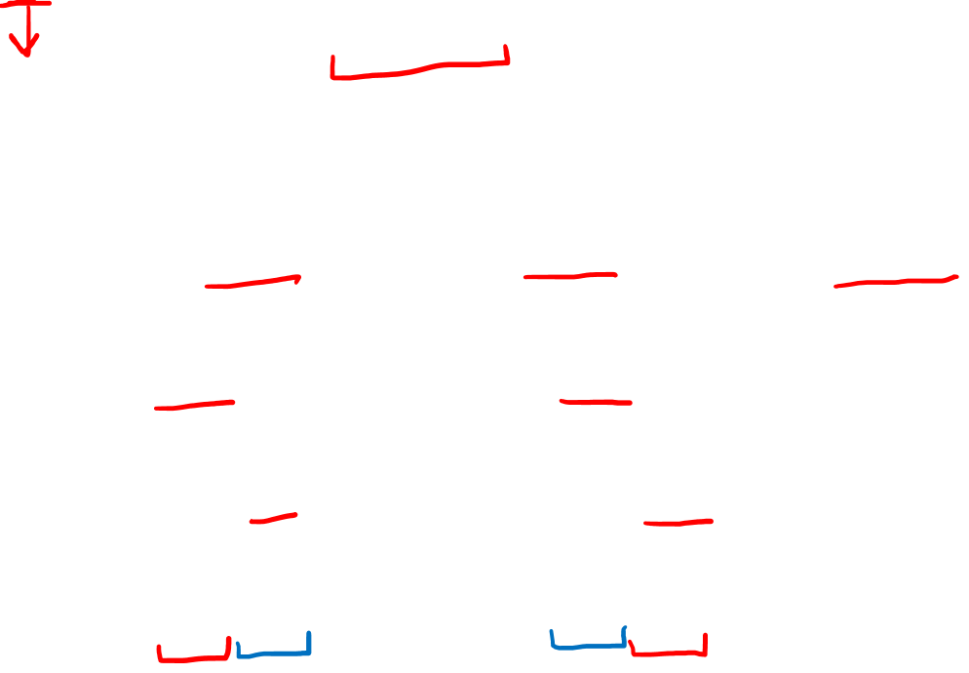
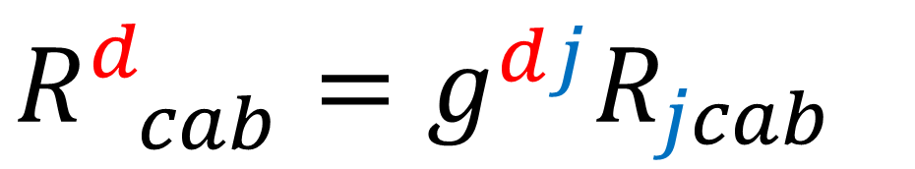
Riemann Curvature Tensor Symmetries:
$$R_{ cab}^{d}=g^{dj}R_{jcab}$$
Index-Lowering
BI | $$R_{dcab}+R_{dbca}+R_{dabc}=0$$
12-S | $$R_{bacd}=−R_{abcd}$$
34-S | $$R_{abdc}=−R_{abcd}$$
Flip | $$R_{abcd}=−R_{cdab}$$
Torsion-Free
Metric Compatibility
From BI, 12-S, 34-S

Slide 6


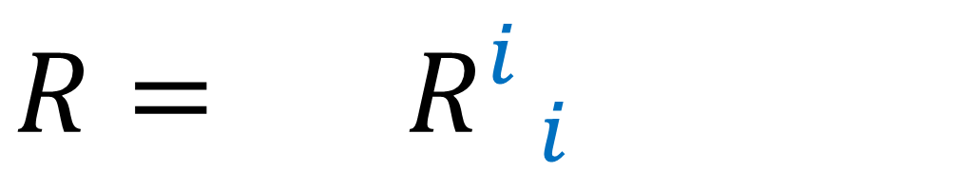

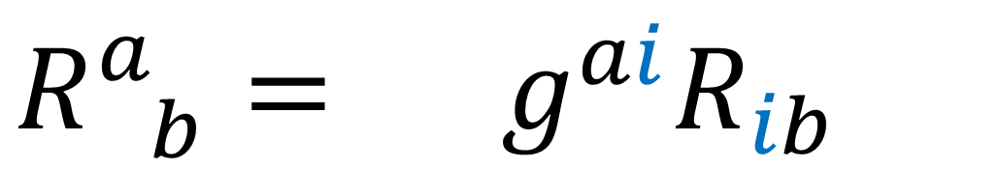
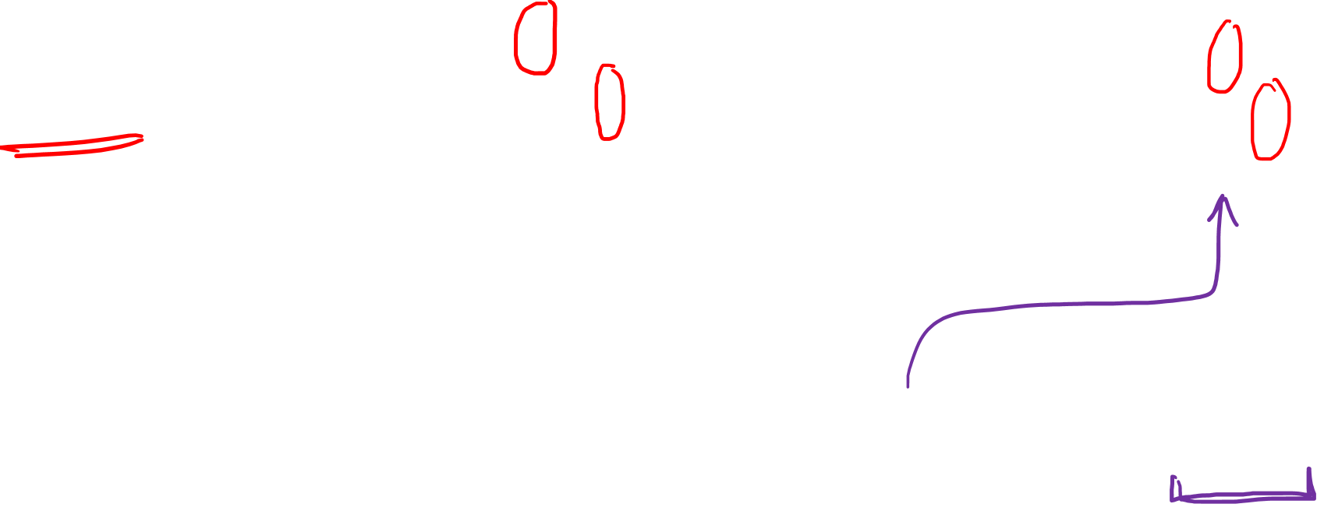

Ricci Tensor formula:
Ricci Scalar formula:
$$\sum_{i}{}$$
$$\sum_{i}{}$$
$$R_{ab}= R_{ aib}^{i}$$
$$R= R_{ i}^{i}$$
$$\sum_{i}{}$$
$$R_{ b}^{a}= {g^{ai}R}_{ib}$$

Slide 7



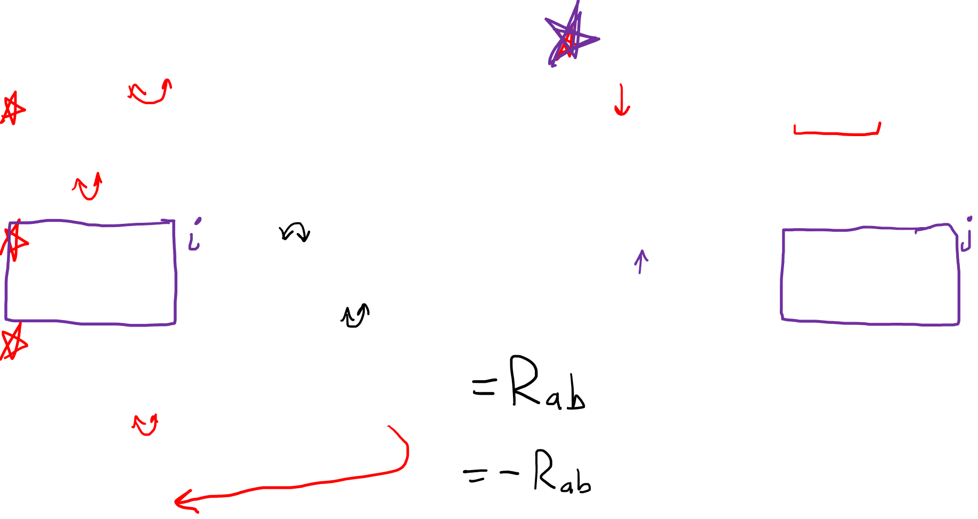
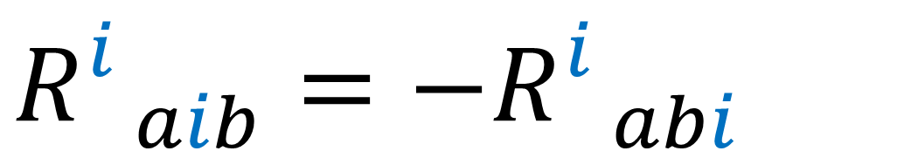

1. Are there any other “contractions” of $Riemann$?
$$R_{ cab}^{d}=−R_{ cba}^{d}$$
$$R_{ cab}^{d}=g^{dj}R_{jcab}$$
$$R_{dcab}=−R_{cdab}$$
$R_{ iab}^{i}$ $=g^{ij}R_{jiab}=−g^{ji}R_{ijab}=−R_{ jab}^{j}=0$
$$R_{ aib}^{i}=−R_{ abi}^{i}$$
Ricci Tensor is the only interesting contraction of the Riemann Tensor
$$R_{ abi}^{i}$$

Slide 8
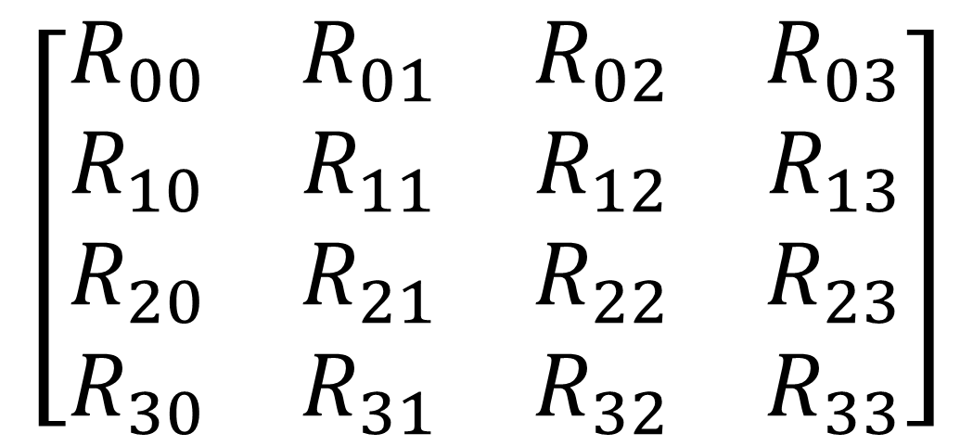
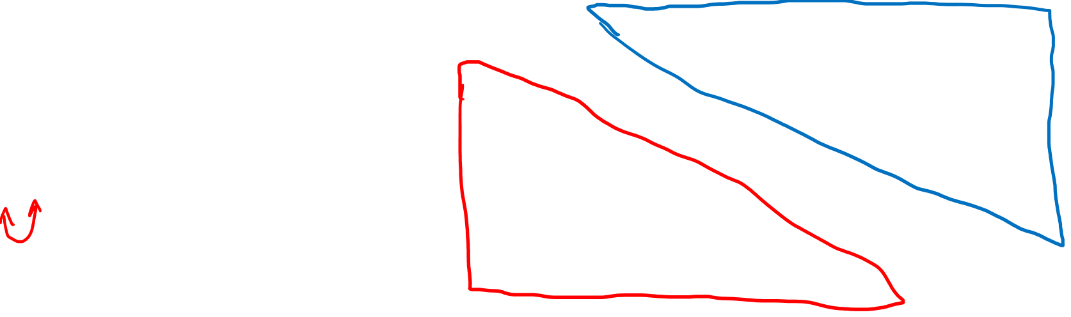
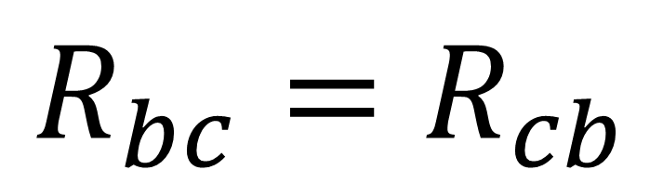
2. The Ricci Tensor is Symmetric
$$\left[\begin{matrix}\begin{matrix}R_{00} & R_{01} \\ R_{10} & R_{11}\end{matrix} & \begin{matrix}R_{02} & R_{03} \\ R_{12} & R_{13}\end{matrix} \\ \begin{matrix}R_{20} & R_{21} \\ R_{30} & R_{31}\end{matrix} & \begin{matrix}R_{22} & R_{23} \\ R_{32} & R_{33}\end{matrix}\end{matrix}\right]$$
$$R_{bc}=R_{cb}$$

Slide 9
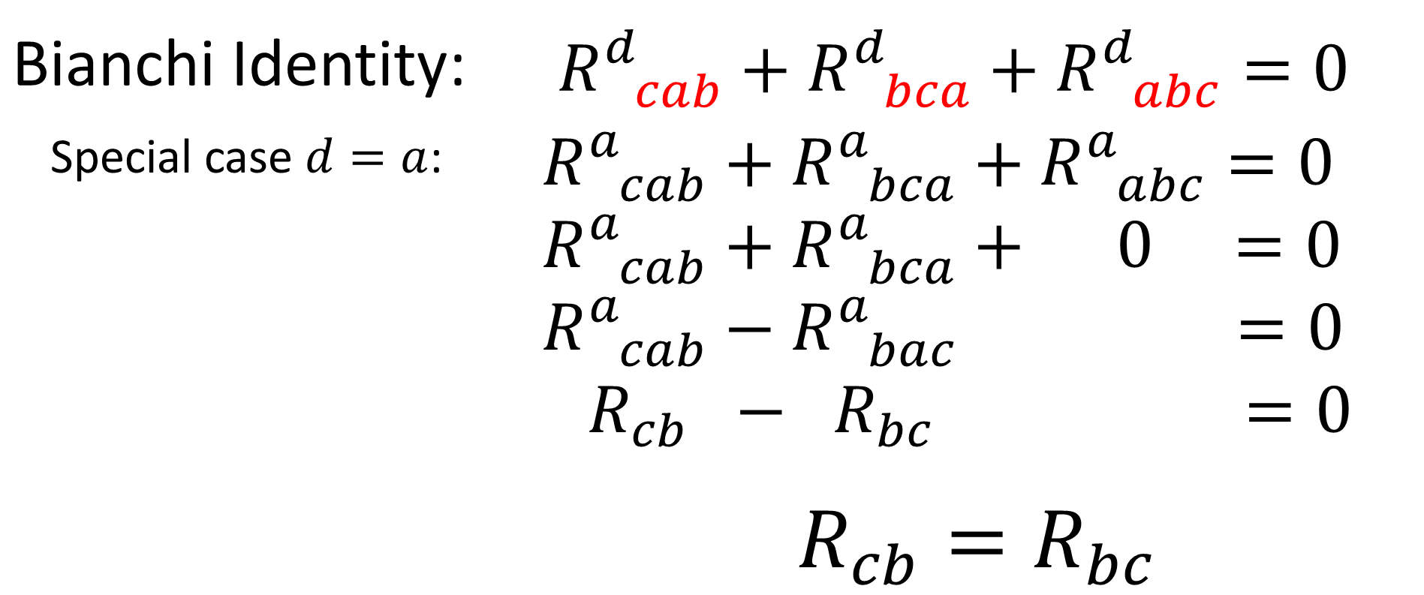
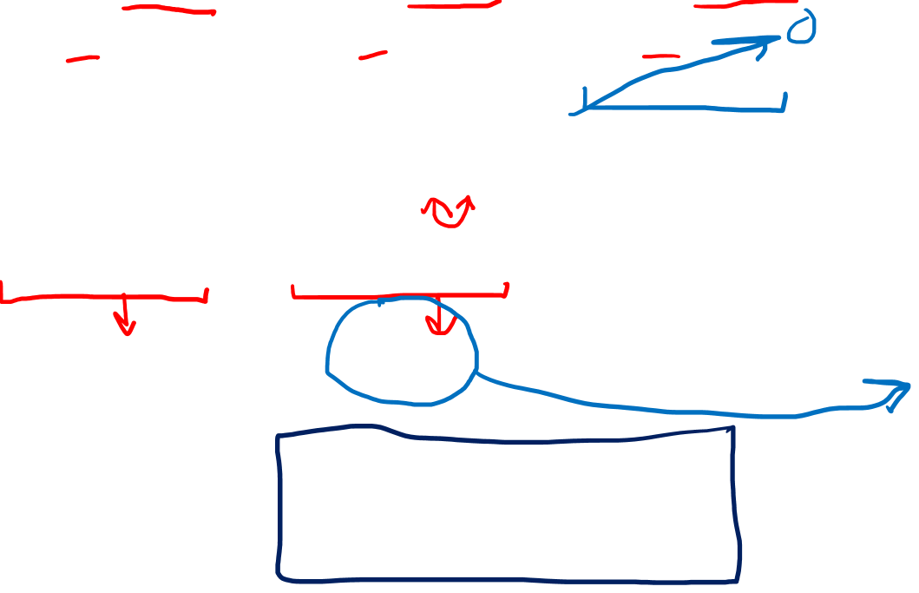
2. The Ricci Tensor is Symmetric
Bianchi Identity: | $R_{ cab}^{d}+R_{ bca}^{d}+R_{ abc}^{d}=0$
Special case $d=a$: | $$R_{ cab}^{a}+R_{ bca}^{a}+R_{ abc}^{a}=0$$ $$R_{ cab}^{a}+R_{ bca}^{a}+ 0 =0$$ $$R_{ cab}^{a}−R_{ bac}^{a} =0$$ $$R_{cb} − R_{bc} =0$$ $$R_{cb}=R_{bc}$$

Slide 10
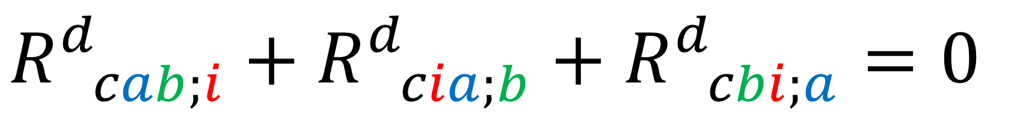
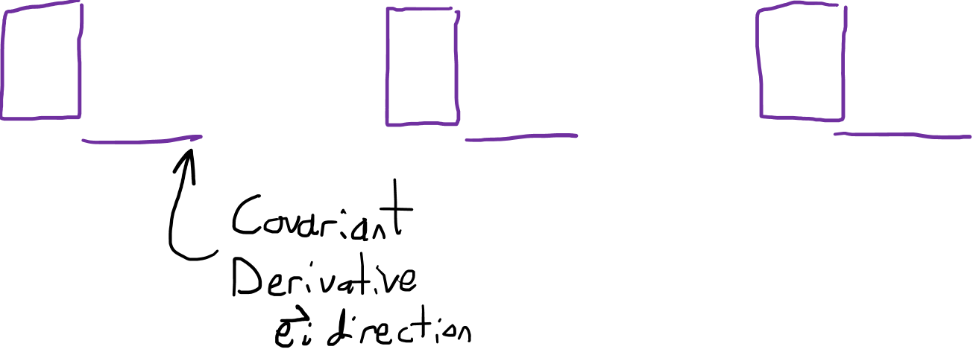
3. Second Bianchi Identity
$$\left(∇_{\vec{z}}R\right)\left(\vec{u},\vec{v}\right)+\left(∇_{\vec{v}}R\right)\left(\vec{z},\vec{u}\right)+\left(∇_{\vec{u}}R\right)\left(\vec{v}, \vec{z}\right)=0$$
$$R_{ cab;i}^{d}+R_{ cia;b}^{d}+R_{ cbi;a}^{d}=0$$

Slide 11
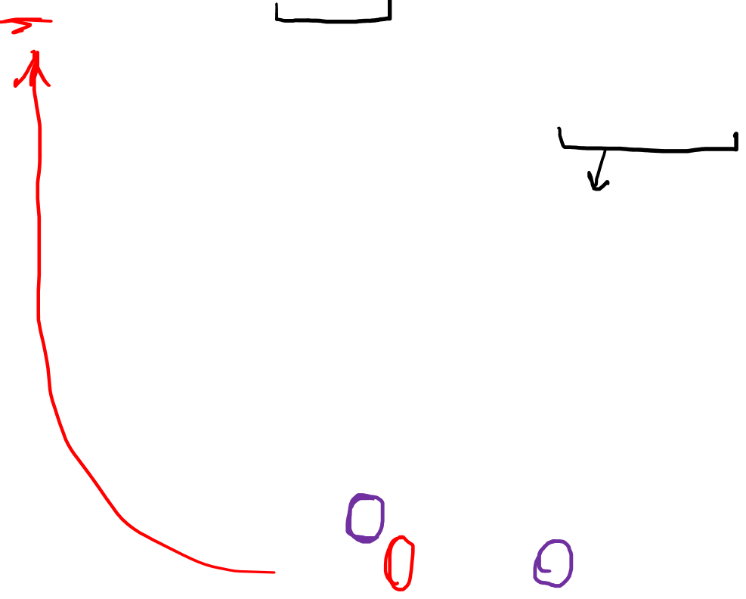
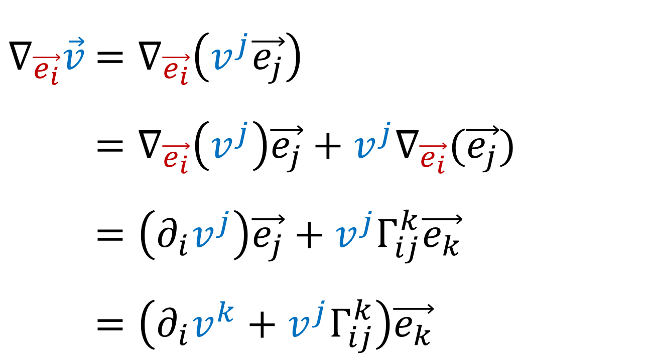
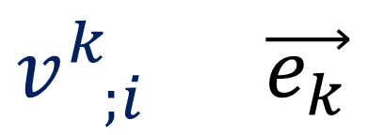
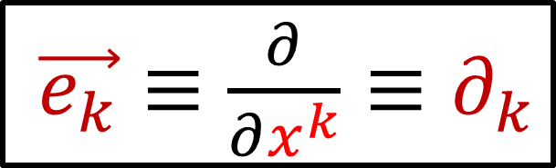
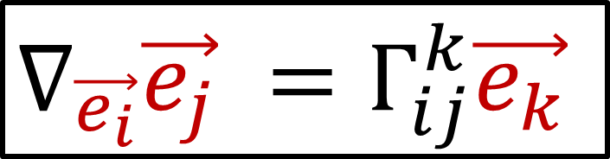
Review Definition of Covariant Derivative
$∇_{\vec{e_{i}}}\vec{v}$ $=∇_{\vec{e_{i}}}\left(v^{j}\vec{e_{j}}\right)$
$∇_{\vec{e_{i}}}\vec{v}$ $=∇_{\vec{e_{i}}}\left(v^{j}\right)\vec{e_{j}}+v^{j}∇_{\vec{e_{i}}}(\vec{e_{j}})$
$∇_{\vec{e_{i}}}\vec{v}$ $=\left(∂_{i}v^{j}\right)\vec{e_{j}}+v^{j}Γ_{ij}^{k}\vec{e_{k}}$
$∇_{\vec{e_{i}}}\vec{v}$ $=\left(∂_{i}v^{k}+v^{j}Γ_{ij}^{k}\right)\vec{e_{k}}$
$\vec{e_{k}}≡\frac{∂}{∂x^{k}}≡∂_{k}$
$∇_{\vec{e_{i}}}\vec{e_{j}} =Γ_{ij}^{k}\vec{e_{k}}$
$v_{ ;i}^{k}$ $\vec{e_{k}}$

Slide 12




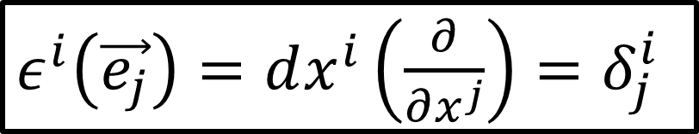
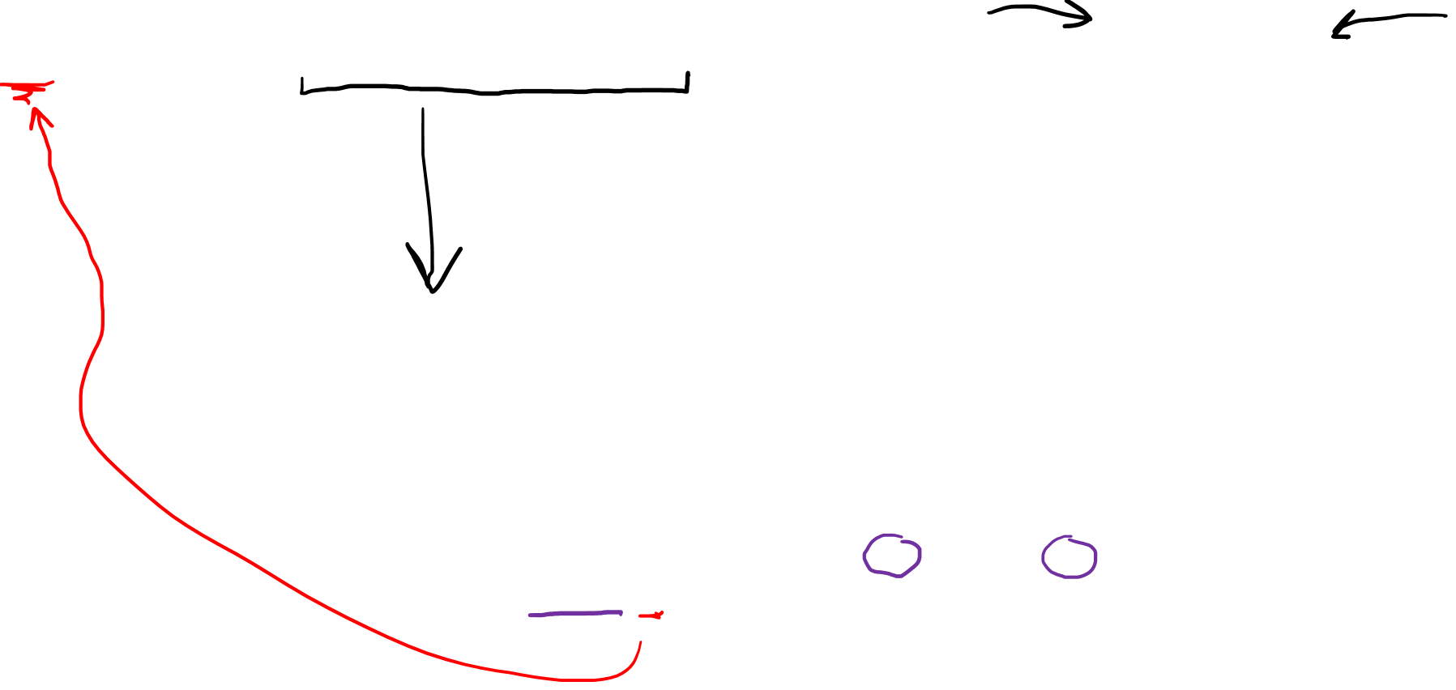
Review Definition of Covariant Derivative
$∇_{\vec{e_{i}}}g=∇_{\vec{e_{i}}}\left(g_{mn} ε^{m}⊗ε^{n}\right)$
$∇_{\vec{e_{i}}}\vec{v}$ $=\left(∂_{i}g_{mn}−g_{mx}Γ_{in}^{x}−g_{xn}Γ_{im}^{x}\right)ε^{m}⊗ε^{n}$
$$ε^{i}≡dx^{i}$$
$ε^{i}\left(\vec{e_{j}}\right)=dx^{i}\left(\frac{∂}{∂x^{j}}\right)=δ_{j}^{i}$
$$ε^{m}⊗ε^{n}$$
$$g_{mn;i}$$

Slide 13

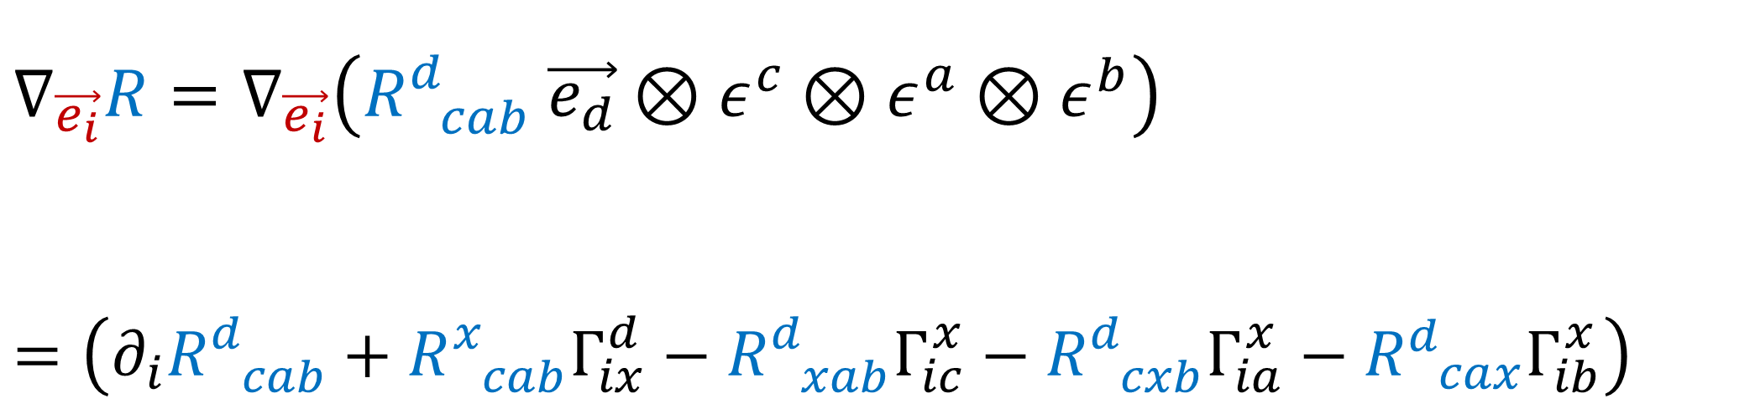


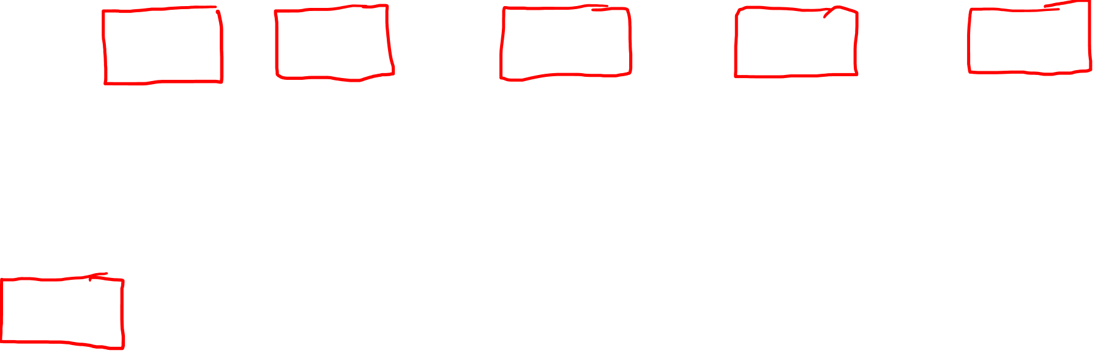
Review Definition of Covariant Derivative
$∇_{\vec{e_{i}}}R=∇_{\vec{e_{i}}}\left(R_{ cab}^{d} \vec{e_{d}}⊗ε^{c}⊗ε^{a}⊗ε^{b}\right)$
$$=\left(∂_{i}R_{ cab}^{d}+R_{ cab}^{x}Γ_{ix}^{d}−R_{ xab}^{d}Γ_{ic}^{x}−R_{ cxb}^{d}Γ_{ia}^{x}−R_{ cax}^{d}Γ_{ib}^{x}\right)$$
$$\vec{e_{d}}⊗ε^{c}⊗ε^{a}⊗ε^{b}$$
$$R_{ cab;i}^{d}$$
$R_{ cab}^{d}=∂_{a}\left(Γ_{bc}^{d}\right)−∂_{b}\left(Γ_{ac}^{d}\right)+Γ_{bc}^{k}Γ_{ak}^{d}−Γ_{ac}^{j}Γ_{bj}^{d}$

Slide 14
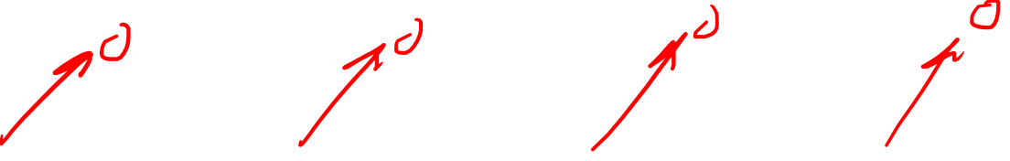
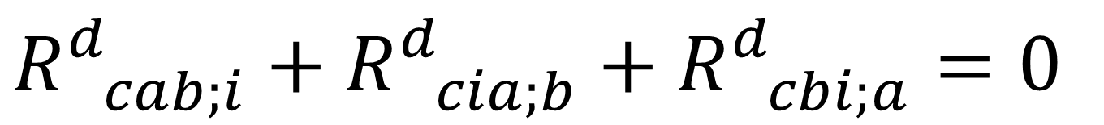
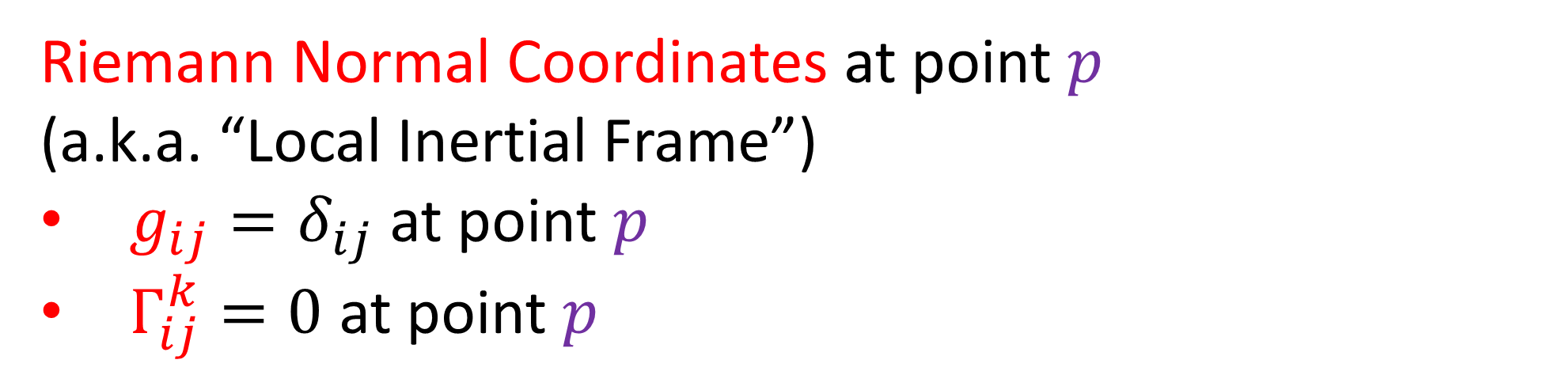
3a. 2nd Bianchi Identity (Normal Coords)
$$R_{ cab;i}^{d}+R_{ cia;b}^{d}+R_{ cbi;a}^{d}=0$$
$$R_{ cab;i}^{d}=∂_{i}R_{ cab}^{d}+R_{ cab}^{x}Γ_{ix}^{d}−R_{ xab}^{d}Γ_{ic}^{x}−R_{ cxb}^{d}Γ_{ia}^{x}−R_{ cax}^{d}Γ_{ib}^{x}$$
$R_{ cab}^{d}=∂_{a}\left(Γ_{bc}^{d}\right)−∂_{b}\left(Γ_{ac}^{d}\right)+Γ_{bc}^{k}Γ_{ak}^{d}−Γ_{ac}^{j}Γ_{bj}^{d}$
Riemann Normal Coordinates at point $p$
(a.k.a. “Local Inertial Frame”)
$g_{ij}=δ_{ij}$ at point $p$
$Γ_{ij}^{k}=0$ at point $p$

Slide 15
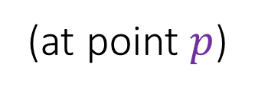

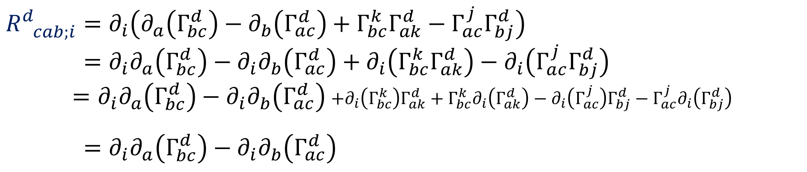
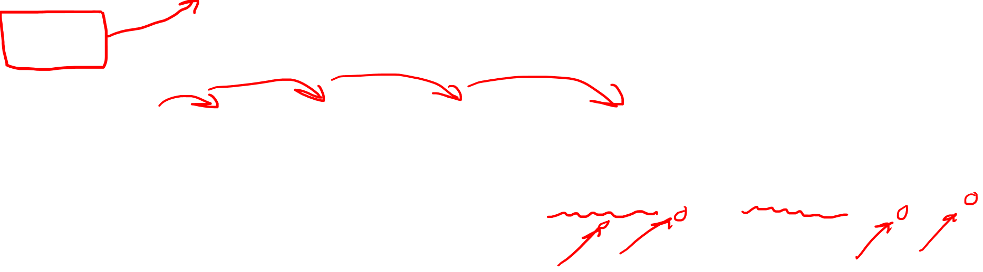

3a. 2nd Bianchi Identity (Normal Coords)
$$R_{ cab;i}^{d}+R_{ cia;b}^{d}+R_{ cbi;a}^{d}=0$$
$$R_{ cab;i}^{d}=∂_{i}R_{ cab}^{d}$$
(at point $p$)
$R_{ cab}^{d}=∂_{a}\left(Γ_{bc}^{d}\right)−∂_{b}\left(Γ_{ac}^{d}\right)+Γ_{bc}^{k}Γ_{ak}^{d}−Γ_{ac}^{j}Γ_{bj}^{d}$
$$R_{ cab;i}^{d}=∂_{i}\left(∂_{a}\left(Γ_{bc}^{d}\right)−∂_{b}\left(Γ_{ac}^{d}\right)+Γ_{bc}^{k}Γ_{ak}^{d}−Γ_{ac}^{j}Γ_{bj}^{d}\right)$$
$$R_{ cab;i}^{d}=∂_{i}∂_{a}\left(Γ_{bc}^{d}\right)−∂_{i}∂_{b}\left(Γ_{ac}^{d}\right)+∂_{i}\left(Γ_{bc}^{k}Γ_{ak}^{d}\right)−∂_{i}\left(Γ_{ac}^{j}Γ_{bj}^{d}\right)$$
$=∂_{i}∂_{a}\left(Γ_{bc}^{d}\right)−∂_{i}∂_{b}\left(Γ_{ac}^{d}\right)$ $+∂_{i}\left(Γ_{bc}^{k}\right)Γ_{ak}^{d}+Γ_{bc}^{k}∂_{i}\left(Γ_{ak}^{d}\right)−∂_{i}\left(Γ_{ac}^{j}\right)Γ_{bj}^{d}−Γ_{ac}^{j}∂_{i}\left(Γ_{bj}^{d}\right)$
$$R_{ cab;i}^{d}=∂_{i}∂_{a}\left(Γ_{bc}^{d}\right)−∂_{i}∂_{b}\left(Γ_{ac}^{d}\right)$$
(at point $p$)

Slide 16
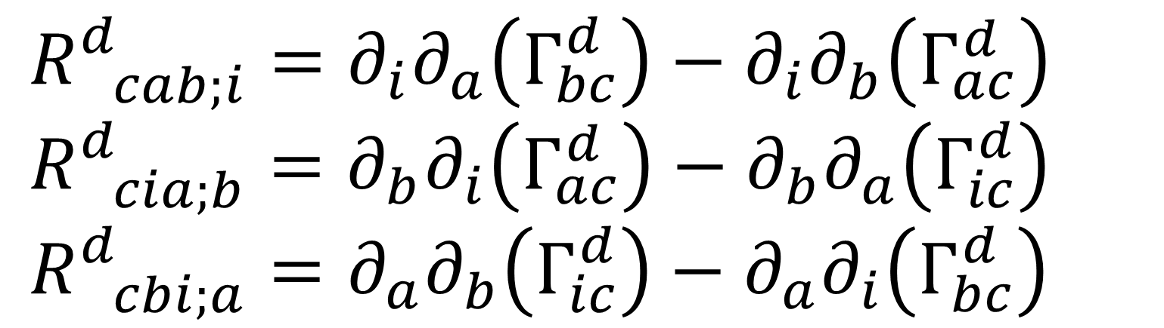

3a. 2nd Bianchi Identity (Normal Coords)
$$R_{ cab;i}^{d}+R_{ cia;b}^{d}+R_{ cbi;a}^{d}=0$$
$R_{ cab;i}^{d}=∂_{i}∂_{a}\left(Γ_{bc}^{d}\right)−∂_{i}∂_{b}\left(Γ_{ac}^{d}\right)$
$R_{ cia;b}^{d}=∂_{b}∂_{i}\left(Γ_{ac}^{d}\right)−∂_{b}∂_{a}\left(Γ_{ic}^{d}\right)$
$R_{ cbi;a}^{d}=∂_{a}∂_{b}\left(Γ_{ic}^{d}\right)−∂_{a}∂_{i}\left(Γ_{bc}^{d}\right)$

Slide 17
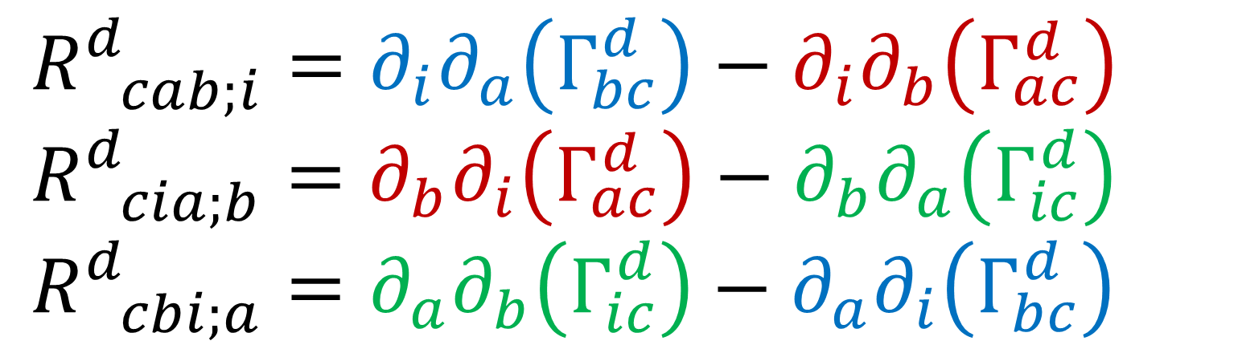
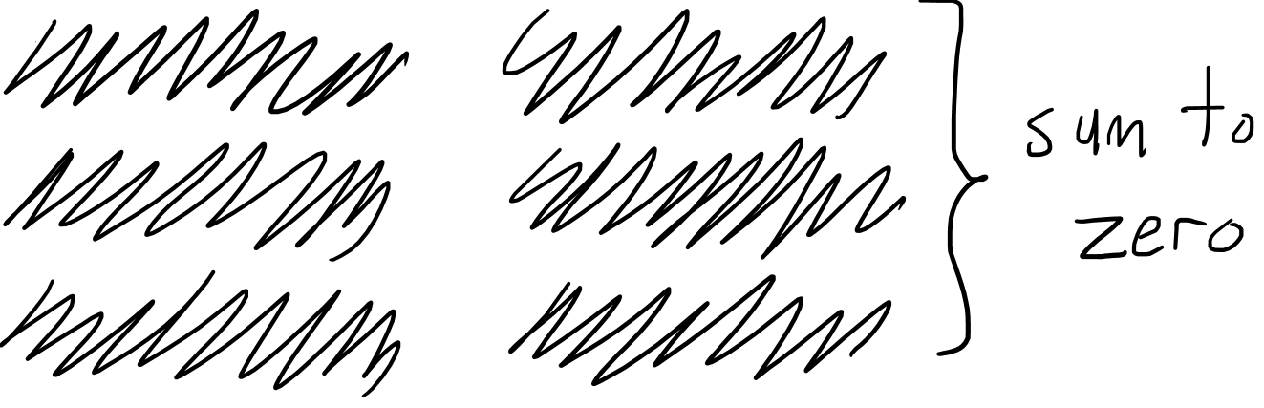
http://astro.dur.ac.uk/~done/gr/l11.pdf
3a. 2nd Bianchi Identity (Normal Coords)
$$R_{ cab;i}^{d}+R_{ cia;b}^{d}+R_{ cbi;a}^{d}=0$$
$R_{ cab;i}^{d}=∂_{i}∂_{a}\left(Γ_{bc}^{d}\right)−∂_{i}∂_{b}\left(Γ_{ac}^{d}\right)$
$R_{ cia;b}^{d}=∂_{b}∂_{i}\left(Γ_{ac}^{d}\right)−∂_{b}∂_{a}\left(Γ_{ic}^{d}\right)$
$R_{ cbi;a}^{d}=∂_{a}∂_{b}\left(Γ_{ic}^{d}\right)−∂_{a}∂_{i}\left(Γ_{bc}^{d}\right)$

Slide 18

3b. 2nd Bianchi Identity (General)
$$\left(∇_{\vec{z}}R\right)\left(\vec{u},\vec{v}\right)+\left(∇_{\vec{v}}R\right)\left(\vec{z},\vec{u}\right)+\left(∇_{\vec{u}}R\right)\left(\vec{v}, \vec{z}\right)=0$$
This proof sucks.

Slide 19
3b. 2nd Bianchi Identity (General)
$$\left(∇_{\vec{z}}R\right)\left(\vec{u},\vec{v}\right)\vec{w}+\left(∇_{\vec{v}}R\right)\left(\vec{z},\vec{u}\right)+\left(∇_{\vec{u}}R\right)\left(\vec{v}, \vec{z}\right)=0$$
Proof involves “product rule”….
$$∇_{\vec{z}}\left[L\left(\vec{v}\right)\right]=\left(∇_{\vec{z}}L\right)\left(\vec{v}\right)+L\left(∇_{\vec{z}}\vec{v}\right)$$

Slide 20

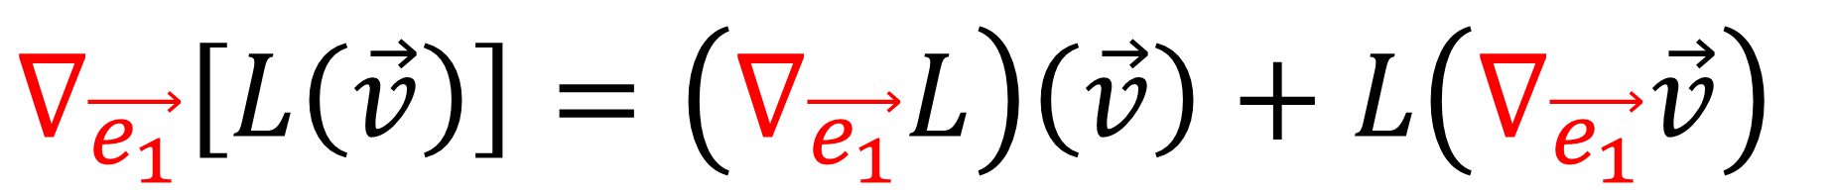
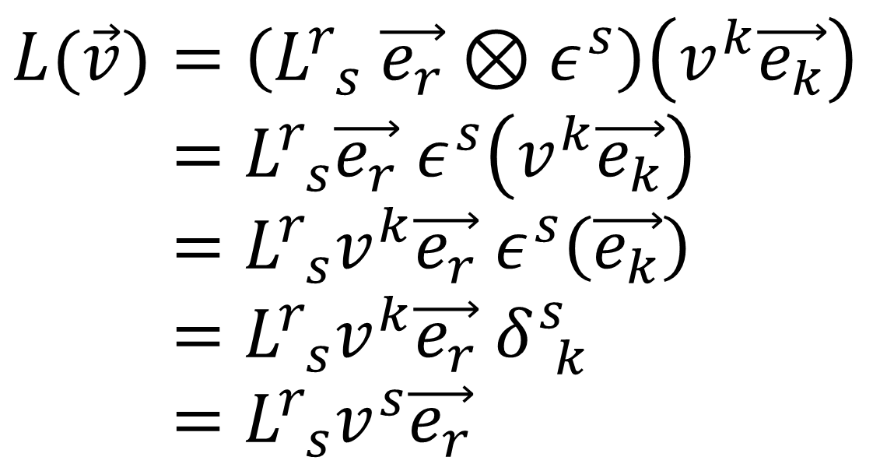
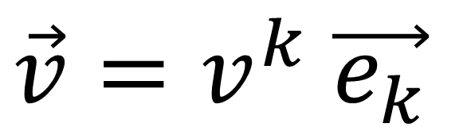
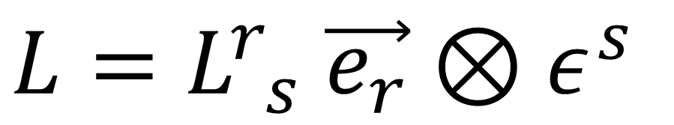
Proof involves “product rule”….
$$∇_{\vec{e_{1}}}\left[L\left(\vec{v}\right)\right]=\left(∇_{\vec{e_{1}}}L\right)\left(\vec{v}\right)+L\left(∇_{\vec{e_{1}}}\vec{v}\right)$$
$$L=L_{ s}^{r} \vec{e_{r}}⊗ε^{s}$$
$$L(\vec{v})=\left(L_{ s}^{r} \vec{e_{r}}⊗ε^{s}\right)\left(v^{k}\vec{e_{k}}\right)$$
$$L\left(\vec{v}\right)=L_{ s}^{r}\vec{e_{r}} ε^{s}\left(v^{k}\vec{e_{k}}\right)$$
$$L\left(\vec{v}\right)=L_{ s}^{r}v^{k}\vec{e_{r}} ε^{s}\left(\vec{e_{k}}\right)$$
$$L\left(\vec{v}\right)=L_{ s}^{r}v^{k}\vec{e_{r}} δ_{ k}^{s}$$
$$L\left(\vec{v}\right)=L_{ s}^{r}v^{s}\vec{e_{r}}$$
$$\vec{v}=v^{k} \vec{e_{k}}$$

Slide 21
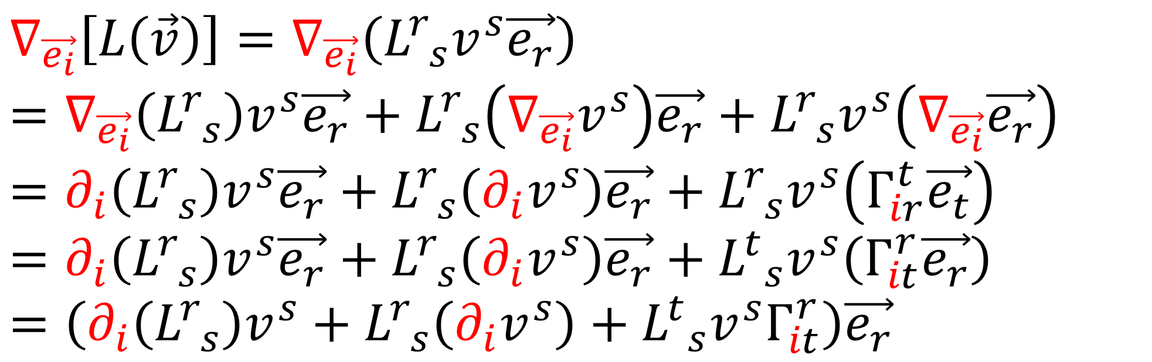
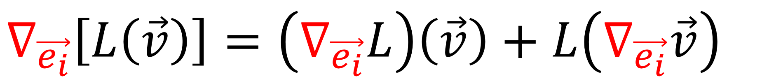
Proof involves “product rule”….
$$∇_{\vec{e_{i}}}\left[L\left(\vec{v}\right)\right]=\left(∇_{\vec{e_{i}}}L\right)\left(\vec{v}\right)+L\left(∇_{\vec{e_{i}}}\vec{v}\right)$$
$$∇_{\vec{e_{i}}}\left[L\left(\vec{v}\right)\right]=∇_{\vec{e_{i}}}\left(L_{ s}^{r}v^{s}\vec{e_{r}}\right)$$
$$=∇_{\vec{e_{i}}}\left(L_{ s}^{r}\right)v^{s}\vec{e_{r}}+L_{ s}^{r}\left(∇_{\vec{e_{i}}}v^{s}\right)\vec{e_{r}}+L_{ s}^{r}v^{s}\left(∇_{\vec{e_{i}}}\vec{e_{r}}\right)$$
$$=∂_{i}\left(L_{ s}^{r}\right)v^{s}\vec{e_{r}}+L_{ s}^{r}\left(∂_{i}v^{s}\right)\vec{e_{r}}+L_{ s}^{r}v^{s}\left(Γ_{ir}^{t}\vec{e_{t}}\right)$$
$$=∂_{i}\left(L_{ s}^{r}\right)v^{s}\vec{e_{r}}+L_{ s}^{r}\left(∂_{i}v^{s}\right)\vec{e_{r}}+L_{ s}^{t}v^{s}\left(Γ_{it}^{r}\vec{e_{r}}\right)$$
$$=\left(∂_{i}\left(L_{ s}^{r}\right)v^{s}+L_{ s}^{r}\left(∂_{i}v^{s}\right)+L_{ s}^{t}v^{s}Γ_{it}^{r}\right)\vec{e_{r}}$$

Slide 22
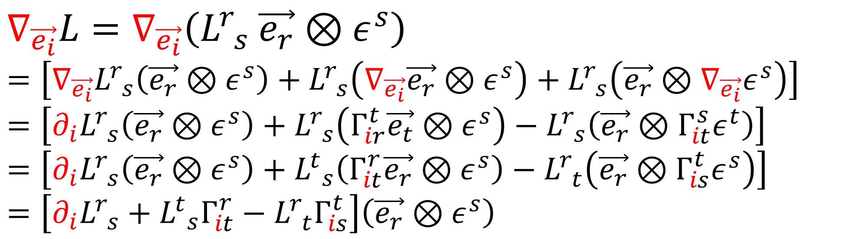
Proof involves “product rule”….
$$∇_{\vec{e_{i}}}\left[L\left(\vec{v}\right)\right]=\left(∇_{\vec{e_{i}}}L\right)\left(\vec{v}\right)+L\left(∇_{\vec{e_{i}}}\vec{v}\right)$$
$$∇_{\vec{e_{i}}}L=∇_{\vec{e_{i}}}\left(L_{ s}^{r} \vec{e_{r}}⊗ε^{s}\right)$$
$$=\left[∇_{\vec{e_{i}}}L_{ s}^{r}\left(\vec{e_{r}}⊗ε^{s}\right)+L_{ s}^{r}\left(∇_{\vec{e_{i}}}\vec{e_{r}}⊗ε^{s}\right)+L_{ s}^{r}\left(\vec{e_{r}}⊗∇_{\vec{e_{i}}}ε^{s}\right)\right]$$
$$=\left[∂_{i}L_{ s}^{r}\left(\vec{e_{r}}⊗ε^{s}\right)+L_{ s}^{r}\left(Γ_{ir}^{t}\vec{e_{t}}⊗ε^{s}\right)−L_{ s}^{r}\left(\vec{e_{r}}⊗Γ_{it}^{s}ε^{t}\right)\right]$$
$$=\left[∂_{i}L_{ s}^{r}\left(\vec{e_{r}}⊗ε^{s}\right)+L_{ s}^{t}\left(Γ_{it}^{r}\vec{e_{r}}⊗ε^{s}\right)−L_{ t}^{r}\left(\vec{e_{r}}⊗Γ_{is}^{t}ε^{s}\right)\right]$$
$$=\left[∂_{i}L_{ s}^{r}+L_{ s}^{t}Γ_{it}^{r}−L_{ t}^{r}Γ_{is}^{t}\right]\left(\vec{e_{r}}⊗ε^{s}\right)$$

Slide 23
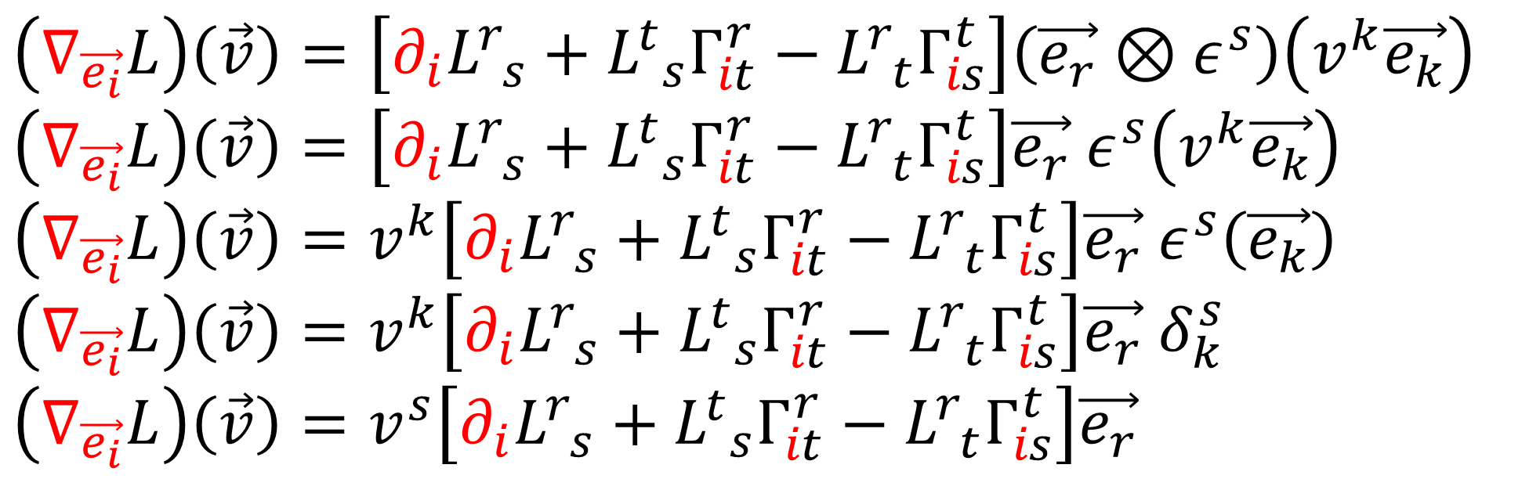
Proof involves “product rule”….
$$∇_{\vec{e_{i}}}\left[L\left(\vec{v}\right)\right]=\left(∇_{\vec{e_{i}}}L\right)\left(\vec{v}\right)+L\left(∇_{\vec{e_{i}}}\vec{v}\right)$$
$$\left(∇_{\vec{e_{i}}}L\right)\left(\vec{v}\right)=\left[∂_{i}L_{ s}^{r}+L_{ s}^{t}Γ_{it}^{r}−L_{ t}^{r}Γ_{is}^{t}\right]\left(\vec{e_{r}}⊗ε^{s}\right)\left(v^{k}\vec{e_{k}}\right)$$
$$\left(∇_{\vec{e_{i}}}L\right)\left(\vec{v}\right)=\left[∂_{i}L_{ s}^{r}+L_{ s}^{t}Γ_{it}^{r}−L_{ t}^{r}Γ_{is}^{t}\right]\vec{e_{r}} ε^{s}\left(v^{k}\vec{e_{k}}\right)$$
$$\left(∇_{\vec{e_{i}}}L\right)\left(\vec{v}\right)=v^{k}\left[∂_{i}L_{ s}^{r}+L_{ s}^{t}Γ_{it}^{r}−L_{ t}^{r}Γ_{is}^{t}\right]\vec{e_{r}} ε^{s}\left(\vec{e_{k}}\right)$$
$$\left(∇_{\vec{e_{i}}}L\right)\left(\vec{v}\right)=v^{k}\left[∂_{i}L_{ s}^{r}+L_{ s}^{t}Γ_{it}^{r}−L_{ t}^{r}Γ_{is}^{t}\right]\vec{e_{r}} δ_{k}^{s}$$
$$\left(∇_{\vec{e_{i}}}L\right)\left(\vec{v}\right)=v^{s}\left[∂_{i}L_{ s}^{r}+L_{ s}^{t}Γ_{it}^{r}−L_{ t}^{r}Γ_{is}^{t}\right]\vec{e_{r}}$$

Slide 24
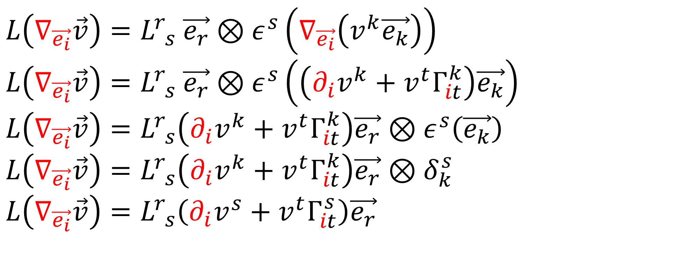
Proof involves “product rule”….
$$∇_{\vec{e_{i}}}\left[L\left(\vec{v}\right)\right]=\left(∇_{\vec{e_{i}}}L\right)\left(\vec{v}\right)+L\left(∇_{\vec{e_{i}}}\vec{v}\right)$$
$$L\left(∇_{\vec{e_{i}}}\vec{v}\right)=L_{ s}^{r} \vec{e_{r}}⊗ε^{s}\left(∇_{\vec{e_{i}}}\left(v^{k}\vec{e_{k}}\right)\right)$$
$$L\left(∇_{\vec{e_{i}}}\vec{v}\right)=L_{ s}^{r} \vec{e_{r}}⊗ε^{s}\left(\left(∂_{i}v^{k}+v^{t}Γ_{it}^{k}\right)\vec{e_{k}}\right)$$
$$L\left(∇_{\vec{e_{i}}}\vec{v}\right)=L_{ s}^{r}\left(∂_{i}v^{k}+v^{t}Γ_{it}^{k}\right)\vec{e_{r}}⊗ε^{s}\left(\vec{e_{k}}\right)$$
$$L\left(∇_{\vec{e_{i}}}\vec{v}\right)=L_{ s}^{r}\left(∂_{i}v^{k}+v^{t}Γ_{it}^{k}\right)\vec{e_{r}}⊗δ_{k}^{s}$$
$$L\left(∇_{\vec{e_{i}}}\vec{v}\right)=L_{ s}^{r}\left(∂_{i}v^{s}+v^{t}Γ_{it}^{s}\right)\vec{e_{r}}$$

Slide 25

Proof involves “product rule”….
$$∇_{\vec{e_{i}}}\left[L\left(\vec{v}\right)\right]=\left(∇_{\vec{e_{i}}}L\right)\left(\vec{v}\right)+L\left(∇_{\vec{e_{i}}}\vec{v}\right)$$
$$∇_{\vec{e_{i}}}\left[L\left(\vec{v}\right)\right]=\left(∂_{i}\left(L_{ s}^{r}\right)v^{s}+L_{ s}^{r}\left(∂_{i}v^{s}\right)+L_{ s}^{t}v^{s}Γ_{it}^{r}\right)\vec{e_{r}}$$
$$\left(∇_{\vec{e_{i}}}L\right)\left(\vec{v}\right)=\left(∂_{i}\left(L_{ s}^{r}\right)v^{s}+L_{ s}^{t}v^{s}Γ_{it}^{r}−L_{ t}^{r}v^{s}Γ_{is}^{t}\right)\vec{e_{r}}$$
$$L\left(∇_{\vec{e_{i}}}\vec{v}\right)=\left(L_{ s}^{r}\left(∂_{i}v^{s}\right)+L_{ s}^{r}v^{t}Γ_{it}^{s}\right)\vec{e_{r}}$$

Slide 26



3b. 2nd Bianchi Identity (General)
$$∇_{\vec{z}}\left[R\left(\vec{u},\vec{v}\right)\vec{w}\right]=$$
$$\left(∇_{\vec{z}}R\right)\left(\vec{u},\vec{v}\right)\vec{w}+R\left(∇_{\vec{z}}\vec{u},\vec{v}\right)\vec{w}+R\left(\vec{u},∇_{\vec{z}}\vec{v}\right)\vec{w}+R\left(\vec{u},\vec{v}\right)∇_{\vec{z}}\vec{w}$$
$$\left(∇_{\vec{z}}R\right)\left(\vec{u},\vec{v}\right)\vec{w}=$$
$$∇_{\vec{z}}\left[R\left(\vec{u},\vec{v}\right)\vec{w}\right]−R\left(∇_{\vec{z}}\vec{u},\vec{v}\right)\vec{w}−R\left(\vec{u},∇_{\vec{z}}\vec{v}\right)\vec{w}−R\left(\vec{u},\vec{v}\right)∇_{\vec{z}}\vec{w}$$
$$\left(∇_{\vec{z}}R\right)\left(\vec{u},\vec{v}\right)\vec{w}+\left(∇_{\vec{v}}R\right)\left(\vec{z},\vec{u}\right)\vec{w}+\left(∇_{\vec{u}}R\right)\left(\vec{v}, \vec{z}\right)\vec{w}=0$$

Slide 27



3b. 2nd Bianchi Identity (General)
$$\left(∇_{\vec{z}}R\right)\left(\vec{u},\vec{v}\right)\vec{w}=$$
$$∇_{\vec{z}}\left[R\left(\vec{u},\vec{v}\right)\vec{w}\right]−R\left(∇_{\vec{z}}\vec{u},\vec{v}\right)\vec{w}−R\left(\vec{u},∇_{\vec{z}}\vec{v}\right)\vec{w}−R\left(\vec{u},\vec{v}\right)∇_{\vec{z}}\vec{w}$$
$$\left(∇_{\vec{z}}R\right)\left(\vec{u},\vec{v}\right)\vec{w}+\left(∇_{\vec{v}}R\right)\left(\vec{z},\vec{u}\right)\vec{w}+\left(∇_{\vec{u}}R\right)\left(\vec{v}, \vec{z}\right)\vec{w}=$$
$$∇_{\vec{z}}\left[R\left(\vec{u},\vec{v}\right)\vec{w}\right]−R\left(∇_{\vec{z}}\vec{u},\vec{v}\right)\vec{w}−R\left(\vec{u},∇_{\vec{z}}\vec{v}\right)\vec{w}−R\left(\vec{u},\vec{v}\right)∇_{\vec{z}}\vec{w}$$
$$∇_{\vec{v}}\left[R\left(\vec{z},\vec{u}\right)\vec{w}\right]−R\left(∇_{\vec{v}}\vec{z},\vec{u}\right)\vec{w}−R\left(\vec{z},∇_{\vec{v}}\vec{u}\right)\vec{w}−R\left(\vec{z},\vec{u}\right)∇_{\vec{v}}\vec{w}$$
$$∇_{\vec{u}}\left[R\left(\vec{v}, \vec{z}\right)\vec{w}\right]−R\left(∇_{\vec{u}}\vec{v}, \vec{z}\right)\vec{w}−R\left(\vec{v},∇_{\vec{u}}\vec{z}\right)\vec{w}−R\left(\vec{v}, \vec{z}\right)∇_{\vec{u}}\vec{w}$$

Slide 28


$$\left(∇_{\vec{z}}R\right)\left(\vec{u},\vec{v}\right)\vec{w}+\left(∇_{\vec{v}}R\right)\left(\vec{z},\vec{u}\right)\vec{w}+\left(∇_{\vec{u}}R\right)\left(\vec{v}, \vec{z}\right)\vec{w}=$$
$$∇_{\vec{z}}\left[R\left(\vec{u},\vec{v}\right)\vec{w}\right]−R\left(∇_{\vec{z}}\vec{u},\vec{v}\right)\vec{w}−R\left(\vec{u},∇_{\vec{z}}\vec{v}\right)\vec{w}−R\left(\vec{u},\vec{v}\right)∇_{\vec{z}}\vec{w}$$
$$∇_{\vec{v}}\left[R\left(\vec{z},\vec{u}\right)\vec{w}\right]−R\left(∇_{\vec{v}}\vec{z},\vec{u}\right)\vec{w}−R\left(\vec{z},∇_{\vec{v}}\vec{u}\right)\vec{w}−R\left(\vec{z},\vec{u}\right)∇_{\vec{v}}\vec{w}$$
$$∇_{\vec{u}}\left[R\left(\vec{v}, \vec{z}\right)\vec{w}\right]−R\left(∇_{\vec{u}}\vec{v}, \vec{z}\right)\vec{w}−R\left(\vec{v},∇_{\vec{u}}\vec{z}\right)\vec{w}−R\left(\vec{v}, \vec{z}\right)∇_{\vec{u}}\vec{w}$$

Slide 29


$$\left(∇_{\vec{z}}R\right)\left(\vec{u},\vec{v}\right)\vec{w}+\left(∇_{\vec{v}}R\right)\left(\vec{z},\vec{u}\right)\vec{w}+\left(∇_{\vec{u}}R\right)\left(\vec{v}, \vec{z}\right)\vec{w}=$$
$$∇_{\vec{z}}\left[R\left(\vec{u},\vec{v}\right)\vec{w}\right]+R\left(\vec{v},∇_{\vec{z}}\vec{u}\right)\vec{w}−R\left(\vec{u},∇_{\vec{z}}\vec{v}\right)\vec{w}−R\left(\vec{u},\vec{v}\right)∇_{\vec{z}}\vec{w}$$
$$∇_{\vec{v}}\left[R\left(\vec{z},\vec{u}\right)\vec{w}\right]+R\left({\vec{u},∇}_{\vec{v}}\vec{z}\right)\vec{w}−R\left(\vec{z},∇_{\vec{v}}\vec{u}\right)\vec{w}−R\left(\vec{z},\vec{u}\right)∇_{\vec{v}}\vec{w}$$
$$∇_{\vec{u}}\left[R\left(\vec{v}, \vec{z}\right)\vec{w}\right]+R\left(\vec{z},∇_{\vec{u}}\vec{v}\right)\vec{w}−R\left(\vec{v},∇_{\vec{u}}\vec{z}\right)\vec{w}−R\left(\vec{v}, \vec{z}\right)∇_{\vec{u}}\vec{w}$$
Tensors are multilinear maps:
$$R\left(\vec{v},∇_{\vec{z}}\vec{u}\right)\vec{w}−R\left(\vec{v},∇_{\vec{u}}\vec{z}\right)\vec{w}=R\left(\vec{v},∇_{\vec{z}}\vec{u}−∇_{\vec{u}}\vec{z}\right)\vec{w}$$

Slide 30



$$\left(∇_{\vec{z}}R\right)\left(\vec{u},\vec{v}\right)\vec{w}+\left(∇_{\vec{v}}R\right)\left(\vec{z},\vec{u}\right)\vec{w}+\left(∇_{\vec{u}}R\right)\left(\vec{v}, \vec{z}\right)\vec{w}=$$
$$+ ∇_{\vec{z}}\left[R\left(\vec{u},\vec{v}\right)\vec{w}\right]+R\left(\vec{v},∇_{\vec{z}}\vec{u}−∇_{\vec{u}}\vec{z}\right)\vec{w}−R\left(\vec{u},\vec{v}\right)∇_{\vec{z}}\vec{w}$$
$$+ ∇_{\vec{v}}\left[R\left(\vec{z},\vec{u}\right)\vec{w}\right]+R\left({\vec{u},∇}_{\vec{v}}\vec{z}−∇_{\vec{z}}\vec{v}\right)\vec{w}−R\left(\vec{z},\vec{u}\right)∇_{\vec{v}}\vec{w}$$
$$+ ∇_{\vec{u}}\left[R\left(\vec{v}, \vec{z}\right)\vec{w}\right]+R\left(\vec{z},∇_{\vec{u}}\vec{v}−∇_{\vec{v}}\vec{u}\right)\vec{w}−R\left(\vec{v}, \vec{z}\right)∇_{\vec{u}}\vec{w}$$
$$∇_{\vec{z}}\left[R\left(\vec{u},\vec{v}\right)\vec{w}\right]=∇_{\vec{z}}\left[∇_{\vec{u}}∇_{\vec{v}}\vec{w}−∇_{\vec{v}}∇_{\vec{u}}\vec{w}−∇_{\left[\vec{u},\vec{v}\right]}\vec{w}\right]$$
$$∇_{\vec{v}}\left[R\left(\vec{z},\vec{u}\right)\vec{w}\right]=∇_{\vec{v}}\left[∇_{\vec{z}}∇_{\vec{u}}\vec{w}−∇_{\vec{u}}∇_{\vec{z}}\vec{w}−∇_{\left[\vec{z},\vec{u}\right]}\vec{w}\right]$$
$$∇_{\vec{u}}\left[R\left(\vec{v}, \vec{z}\right)\vec{w}\right]=∇_{\vec{u}}\left[∇_{\vec{v}}∇_{\vec{z}}\vec{w}−∇_{\vec{z}}∇_{\vec{v}}\vec{w}−∇_{\left[\vec{v},\vec{z}\right]}\vec{w}\right]$$

Slide 31

$$\left(∇_{\vec{z}}R\right)\left(\vec{u},\vec{v}\right)\vec{w}+\left(∇_{\vec{v}}R\right)\left(\vec{z},\vec{u}\right)\vec{w}+\left(∇_{\vec{u}}R\right)\left(\vec{v}, \vec{z}\right)\vec{w}=$$
$$+ ∇_{\vec{z}}\left[R\left(\vec{u},\vec{v}\right)\vec{w}\right]+R\left(\vec{v},∇_{\vec{z}}\vec{u}−∇_{\vec{u}}\vec{z}\right)\vec{w}−R\left(\vec{u},\vec{v}\right)∇_{\vec{z}}\vec{w}$$
$$+ ∇_{\vec{v}}\left[R\left(\vec{z},\vec{u}\right)\vec{w}\right]+R\left({\vec{u},∇}_{\vec{v}}\vec{z}−∇_{\vec{z}}\vec{v}\right)\vec{w}−R\left(\vec{z},\vec{u}\right)∇_{\vec{v}}\vec{w}$$
$$+ ∇_{\vec{u}}\left[R\left(\vec{v}, \vec{z}\right)\vec{w}\right]+R\left(\vec{z},∇_{\vec{u}}\vec{v}−∇_{\vec{v}}\vec{u}\right)\vec{w}−R\left(\vec{v}, \vec{z}\right)∇_{\vec{u}}\vec{w}$$
$$∇_{\vec{z}}\left[R\left(\vec{u},\vec{v}\right)\vec{w}\right]=\left[∇_{\vec{z}}∇_{\vec{u}}∇_{\vec{v}}\vec{w}−∇_{\vec{z}}∇_{\vec{v}}∇_{\vec{u}}\vec{w}−∇_{\vec{z}}∇_{\left[\vec{u},\vec{v}\right]}\vec{w}\right]$$
$$∇_{\vec{v}}\left[R\left(\vec{z},\vec{u}\right)\vec{w}\right]=\left[∇_{\vec{v}}∇_{\vec{z}}∇_{\vec{u}}\vec{w}−∇_{\vec{v}}∇_{\vec{u}}∇_{\vec{z}}\vec{w}−∇_{\vec{v}}∇_{\left[\vec{z},\vec{u}\right]}\vec{w}\right]$$
$$∇_{\vec{u}}\left[R\left(\vec{v}, \vec{z}\right)\vec{w}\right]=\left[∇_{\vec{u}}∇_{\vec{v}}∇_{\vec{z}}\vec{w}−∇_{\vec{u}}∇_{\vec{z}}∇_{\vec{v}}\vec{w}−∇_{\vec{u}}∇_{\left[\vec{v},\vec{z}\right]}\vec{w}\right]$$

Slide 32

3b. 2nd Bianchi Identity (General)
$$+∇_{\vec{z}}\left[R\left(\vec{u},\vec{v}\right)\vec{w}\right]+∇_{\vec{v}}\left[R\left(\vec{z},\vec{u}\right)\vec{w}\right]+∇_{\vec{u}}\left[R\left(\vec{v}, \vec{z}\right)\vec{w}\right]$$
$$=∇_{\vec{z}}∇_{\vec{u}}∇_{\vec{v}}\vec{w}−∇_{\vec{z}}∇_{\vec{v}}∇_{\vec{u}}\vec{w}−∇_{\vec{z}}∇_{\left[\vec{u},\vec{v}\right]}\vec{w}$$
$$+∇_{\vec{v}}∇_{\vec{z}}∇_{\vec{u}}\vec{w}−∇_{\vec{v}}∇_{\vec{u}}∇_{\vec{z}}\vec{w}−∇_{\vec{v}}∇_{\left[\vec{z},\vec{u}\right]}\vec{w}$$
$$+∇_{\vec{u}}∇_{\vec{v}}∇_{\vec{z}}\vec{w}−∇_{\vec{u}}∇_{\vec{z}}∇_{\vec{v}}\vec{w}−∇_{\vec{u}}∇_{\left[\vec{v},\vec{z}\right]}\vec{w}$$

Slide 33


3b. 2nd Bianchi Identity (General)
$$+∇_{\vec{z}}\left[R\left(\vec{u},\vec{v}\right)\vec{w}\right]+∇_{\vec{v}}\left[R\left(\vec{z},\vec{u}\right)\vec{w}\right]+∇_{\vec{u}}\left[R\left(\vec{v}, \vec{z}\right)\vec{w}\right]$$
$$=∇_{\vec{z}}∇_{\vec{u}}∇_{\vec{v}}\vec{w}−∇_{\vec{u}}∇_{\vec{z}}∇_{\vec{v}}\vec{w}$$
$$+∇_{\vec{v}}∇_{\vec{z}}∇_{\vec{u}}\vec{w}−∇_{\vec{z}}∇_{\vec{v}}∇_{\vec{u}}\vec{w}$$
$$+∇_{\vec{u}}∇_{\vec{v}}∇_{\vec{z}}\vec{w}−∇_{\vec{v}}∇_{\vec{u}}∇_{\vec{z}}\vec{w}$$
$$−∇_{\vec{z}}∇_{\left[\vec{u},\vec{v}\right]}\vec{w}−∇_{\vec{v}}∇_{\left[\vec{z},\vec{u}\right]}\vec{w}−∇_{\vec{u}}∇_{\left[\vec{v},\vec{z}\right]}\vec{w}$$
$$R\left(\vec{z},\vec{u}\right)\left(∇_{\vec{v}}\vec{w}\right)=∇_{\vec{z}}∇_{\vec{u}}\left(∇_{\vec{v}}\vec{w}\right)−∇_{\vec{u}}∇_{\vec{z}}\left(∇_{\vec{v}}\vec{w}\right)−∇_{\left[\vec{z},\vec{u}\right]}\left(∇_{\vec{v}}\vec{w}\right)$$
$$R\left(\vec{z},\vec{u}\right)\left(∇_{\vec{v}}\vec{w}\right)+∇_{\left[\vec{z},\vec{u}\right]}\left(∇_{\vec{v}}\vec{w}\right)=∇_{\vec{z}}∇_{\vec{u}}\left(∇_{\vec{v}}\vec{w}\right)−∇_{\vec{u}}∇_{\vec{z}}\left(∇_{\vec{v}}\vec{w}\right)$$

Slide 34


3b. 2nd Bianchi Identity (General)
$$+∇_{\vec{z}}\left[R\left(\vec{u},\vec{v}\right)\vec{w}\right]+∇_{\vec{v}}\left[R\left(\vec{z},\vec{u}\right)\vec{w}\right]+∇_{\vec{u}}\left[R\left(\vec{v}, \vec{z}\right)\vec{w}\right]$$
$$=R\left(\vec{z},\vec{u}\right)\left(∇_{\vec{v}}\vec{w}\right)+∇_{\left[\vec{z},\vec{u}\right]}\left(∇_{\vec{v}}\vec{w}\right)−∇_{\vec{v}}∇_{\left[\vec{z},\vec{u}\right]}\vec{w}$$
$$+R\left(\vec{v}, \vec{z}\right)\left(∇_{\vec{u}}\vec{w}\right)+∇_{\left[\vec{v},\vec{z}\right]}\left(∇_{\vec{u}}\vec{w}\right)−∇_{\vec{u}}∇_{\left[\vec{v},\vec{z}\right]}\vec{w}$$
$$+R\left(\vec{u},\vec{v}\right)\left(∇_{\vec{z}}\vec{w}\right)+∇_{\left[\vec{u},\vec{v}\right]}\left(∇_{\vec{z}}\vec{w}\right)−∇_{\vec{z}}∇_{\left[\vec{u},\vec{v}\right]}\vec{w}$$
$$R\left(\left[\vec{z},\vec{u}\right],\vec{v}\right)\vec{w}=∇_{\left[\vec{z},\vec{u}\right]}\left(∇_{\vec{v}}\vec{w}\right)−∇_{\vec{v}}∇_{\left[\vec{z},\vec{u}\right]}\vec{w}−∇_{\left[\vec{v},\left[\vec{z},\vec{u}\right]\right]}\vec{w}$$
$$R\left(\left[\vec{z},\vec{u}\right],\vec{v}\right)\vec{w}+∇_{\left[\vec{v},\left[\vec{z},\vec{u}\right]\right]}\vec{w}=∇_{\left[\vec{z},\vec{u}\right]}\left(∇_{\vec{v}}\vec{w}\right)−∇_{\vec{v}}∇_{\left[\vec{z},\vec{u}\right]}\vec{w}$$

Slide 35


3b. 2nd Bianchi Identity (General)
$$+∇_{\vec{z}}\left[R\left(\vec{u},\vec{v}\right)\vec{w}\right]+∇_{\vec{v}}\left[R\left(\vec{z},\vec{u}\right)\vec{w}\right]+∇_{\vec{u}}\left[R\left(\vec{v}, \vec{z}\right)\vec{w}\right]$$
$$=R\left(\vec{z},\vec{u}\right)\left(∇_{\vec{v}}\vec{w}\right)+R\left(\left[\vec{z},\vec{u}\right],\vec{v}\right)\vec{w}+∇_{\left[\vec{v},\left[\vec{z},\vec{u}\right]\right]}\vec{w}$$
$$+R\left(\vec{v}, \vec{z}\right)\left(∇_{\vec{u}}\vec{w}\right)+R\left(\left[\vec{v},\vec{z}\right],\vec{u}\right)\vec{w}+∇_{\left[\vec{u},\left[\vec{v},\vec{z}\right]\right]}\vec{w}$$
$$+R\left(\vec{u},\vec{v}\right)\left(∇_{\vec{z}}\vec{w}\right)+R\left(\left[\vec{u},\vec{v}\right],\vec{z}\right)\vec{w}+∇_{\left[\vec{z},\left[\vec{u},\vec{v}\right]\right]}\vec{w}$$
$$∇_{\left[\vec{v},\left[\vec{z},\vec{u}\right]\right]+\left[\vec{u},\left[\vec{v},\vec{z}\right]\right]+\left[\vec{z},\left[\vec{u},\vec{v}\right]\right]}\vec{w} =∇_{\vec{0}}\vec{w}$$

Slide 36


3b. 2nd Bianchi Identity (General)
$$+∇_{\vec{z}}\left[R\left(\vec{u},\vec{v}\right)\vec{w}\right]+∇_{\vec{v}}\left[R\left(\vec{z},\vec{u}\right)\vec{w}\right]+∇_{\vec{u}}\left[R\left(\vec{v}, \vec{z}\right)\vec{w}\right]$$
$$=R\left(\vec{z},\vec{u}\right)\left(∇_{\vec{v}}\vec{w}\right)+R\left(\left[\vec{z},\vec{u}\right],\vec{v}\right)\vec{w}$$
$$+R\left(\vec{v}, \vec{z}\right)\left(∇_{\vec{u}}\vec{w}\right)+R\left(\left[\vec{v},\vec{z}\right],\vec{u}\right)\vec{w}$$
$$+R\left(\vec{u},\vec{v}\right)\left(∇_{\vec{z}}\vec{w}\right)+R\left(\left[\vec{u},\vec{v}\right],\vec{z}\right)\vec{w}$$

Slide 37











3b. 2nd Bianchi Identity (General)
$$∇_{\vec{z}}\left[R\left(\vec{u},\vec{v}\right)\vec{w}\right]$$
$$∇_{\vec{v}}\left[R\left(\vec{z},\vec{u}\right)\vec{w}\right]$$
$$∇_{\vec{u}}\left[R\left(\vec{v}, \vec{z}\right)\vec{w}\right]$$
$$R\left(\vec{z},\vec{u}\right)\left(∇_{\vec{v}}\vec{w}\right)$$
$$R\left(\vec{v}, \vec{z}\right)\left(∇_{\vec{u}}\vec{w}\right)$$
$$R\left(\vec{u},\vec{v}\right)\left(∇_{\vec{z}}\vec{w}\right)$$
$$R\left(\left[\vec{z},\vec{u}\right],\vec{v}\right)\vec{w}$$
$$R\left(\left[\vec{v},\vec{z}\right],\vec{u}\right)\vec{w}$$
$$R\left(\left[\vec{u},\vec{v}\right],\vec{z}\right)\vec{w}$$
$$=$$
$$+$$
$$∇_{\vec{z}}\left[R\left(\vec{u},\vec{v}\right)\vec{w}\right]$$
$$∇_{\vec{v}}\left[R\left(\vec{z},\vec{u}\right)\vec{w}\right]$$
$$∇_{\vec{u}}\left[R\left(\vec{v}, \vec{z}\right)\vec{w}\right]$$
$$R\left(\vec{z},\vec{u}\right)\left(∇_{\vec{v}}\vec{w}\right)$$
$$R\left(\vec{v}, \vec{z}\right)\left(∇_{\vec{u}}\vec{w}\right)$$
$$R\left(\vec{u},\vec{v}\right)\left(∇_{\vec{z}}\vec{w}\right)$$
$$R\left(\left[\vec{z},\vec{u}\right],\vec{v}\right)\vec{w}$$
$$R\left(\left[\vec{v},\vec{z}\right],\vec{u}\right)\vec{w}$$
$$R\left(\left[\vec{u},\vec{v}\right],\vec{z}\right)\vec{w}$$
$$−$$
$$=$$

Slide 38


3b. 2nd Bianchi Identity (General)
$$\left(∇_{\vec{z}}R\right)\left(\vec{u},\vec{v}\right)\vec{w}+\left(∇_{\vec{v}}R\right)\left(\vec{z},\vec{u}\right)\vec{w}+\left(∇_{\vec{u}}R\right)\left(\vec{v}, \vec{z}\right)\vec{w}$$
$$=∇_{\vec{z}}\left[R\left(\vec{u},\vec{v}\right)\vec{w}\right]+R\left(\vec{v},∇_{\vec{z}}\vec{u}−∇_{\vec{u}}\vec{z}\right)\vec{w}−R\left(\vec{u},\vec{v}\right)∇_{\vec{z}}\vec{w}$$
$$+ ∇_{\vec{v}}\left[R\left(\vec{z},\vec{u}\right)\vec{w}\right]+R\left({\vec{u},∇}_{\vec{v}}\vec{z}−∇_{\vec{z}}\vec{v}\right)\vec{w}−R\left(\vec{z},\vec{u}\right)∇_{\vec{v}}\vec{w}$$
$$+ ∇_{\vec{u}}\left[R\left(\vec{v}, \vec{z}\right)\vec{w}\right]+R\left(\vec{z},∇_{\vec{u}}\vec{v}−∇_{\vec{v}}\vec{u}\right)\vec{w}−R\left(\vec{v}, \vec{z}\right)∇_{\vec{u}}\vec{w}$$
$$∇_{\vec{z}}\left[R\left(\vec{u},\vec{v}\right)\vec{w}\right]$$
$$∇_{\vec{v}}\left[R\left(\vec{z},\vec{u}\right)\vec{w}\right]$$
$$∇_{\vec{u}}\left[R\left(\vec{v}, \vec{z}\right)\vec{w}\right]$$
$$R\left(\vec{z},\vec{u}\right)\left(∇_{\vec{v}}\vec{w}\right)$$
$$R\left(\vec{v}, \vec{z}\right)\left(∇_{\vec{u}}\vec{w}\right)$$
$$R\left(\vec{u},\vec{v}\right)\left(∇_{\vec{z}}\vec{w}\right)$$
$$R\left(\left[\vec{z},\vec{u}\right],\vec{v}\right)\vec{w}$$
$$R\left(\left[\vec{v},\vec{z}\right],\vec{u}\right)\vec{w}$$
$$R\left(\left[\vec{u},\vec{v}\right],\vec{z}\right)\vec{w}$$
$$−$$
$$=$$

Slide 39


3b. 2nd Bianchi Identity (General)
$$\left(∇_{\vec{z}}R\right)\left(\vec{u},\vec{v}\right)\vec{w}+\left(∇_{\vec{v}}R\right)\left(\vec{z},\vec{u}\right)\vec{w}+\left(∇_{\vec{u}}R\right)\left(\vec{v}, \vec{z}\right)\vec{w}$$
$$=R\left(\vec{v},∇_{\vec{z}}\vec{u}−∇_{\vec{u}}\vec{z}\right)\vec{w}+R\left(\left[\vec{z},\vec{u}\right],\vec{v}\right)\vec{w}$$
$$+ R\left({\vec{u},∇}_{\vec{v}}\vec{z}−∇_{\vec{z}}\vec{v}\right)\vec{w}+R\left(\left[\vec{v},\vec{z}\right],\vec{u}\right)\vec{w}$$
$$+ R\left(\vec{z},∇_{\vec{u}}\vec{v}−∇_{\vec{v}}\vec{u}\right)\vec{w}+R\left(\left[\vec{u},\vec{v}\right],\vec{z}\right)\vec{w}$$

Slide 40


3b. 2nd Bianchi Identity (General)
$$\left(∇_{\vec{z}}R\right)\left(\vec{u},\vec{v}\right)\vec{w}+\left(∇_{\vec{v}}R\right)\left(\vec{z},\vec{u}\right)\vec{w}+\left(∇_{\vec{u}}R\right)\left(\vec{v}, \vec{z}\right)\vec{w}$$
$$=R\left(\vec{v},∇_{\vec{z}}\vec{u}−∇_{\vec{u}}\vec{z}\right)\vec{w}−R\left(\vec{v},\left[\vec{z},\vec{u}\right]\right)\vec{w}$$
$$+ R\left({\vec{u},∇}_{\vec{v}}\vec{z}−∇_{\vec{z}}\vec{v}\right)\vec{w}−R\left(\vec{u},\left[\vec{v},\vec{z}\right]\right)\vec{w}$$
$$+ R\left(\vec{z},∇_{\vec{u}}\vec{v}−∇_{\vec{v}}\vec{u}\right)\vec{w}−R\left(\vec{z},\left[\vec{u},\vec{v}\right]\right)\vec{w}$$

Slide 41



3b. 2nd Bianchi Identity (General)
$$\left(∇_{\vec{z}}R\right)\left(\vec{u},\vec{v}\right)\vec{w}+\left(∇_{\vec{v}}R\right)\left(\vec{z},\vec{u}\right)\vec{w}+\left(∇_{\vec{u}}R\right)\left(\vec{v}, \vec{z}\right)\vec{w}$$
$$=R\left(\vec{v},∇_{\vec{z}}\vec{u}−∇_{\vec{u}}\vec{z}−\left[\vec{z},\vec{u}\right]\right)\vec{w}$$
$$+ R\left({\vec{u},∇}_{\vec{v}}\vec{z}−∇_{\vec{z}}\vec{v}−\left[\vec{v},\vec{z}\right]\right)\vec{w}$$
$$+ R\left(\vec{z},∇_{\vec{u}}\vec{v}−∇_{\vec{v}}\vec{u}−\left[\vec{u},\vec{v}\right]\right)\vec{w}$$
Torsion-Free Property:
$$T\left(\vec{z},\vec{u}\right)=∇_{\vec{z}}\vec{u}−∇_{\vec{u}}\vec{z}−\left[\vec{z},\vec{u}\right]=0$$

Slide 42

3. Second Bianchi Identity
$$\left(∇_{\vec{z}}R\right)\left(\vec{u},\vec{v}\right)\vec{w}+\left(∇_{\vec{v}}R\right)\left(\vec{z},\vec{u}\right)+\left(∇_{\vec{u}}R\right)\left(\vec{v}, \vec{z}\right)=0$$
$$R_{ cab;i}^{d}+R_{ cia;b}^{d}+R_{ cbi;a}^{d}=0$$

Slide 43




4. Contracted Bianchi Identity
$R_{abmn;l}+R_{ablm;n}+R_{abnl;m} =0$
$$g^{bn}g^{am}\left(R_{abmn;l}+R_{ablm;n}+R_{abnl;m}\right)=0$$
$$g^{bn} \left(R_{ bmn;l}^{m}+R_{ blm;n}^{m}+g^{am}R_{abnl;m}\right)=0$$
$$∇_{\vec{e_{i}}}\left(g\left(R\right)\right)=\left(∇_{\vec{e_{i}}}g\right)\left(R\right)+g(∇_{\vec{e_{i}}}R)$$
$$∇_{\vec{w}}\left(\vec{v}⋅\vec{u}\right)=\left(∇_{\vec{w}}\vec{v}\right)⋅\vec{u}+\vec{v}⋅\left(∇_{\vec{w}}\vec{u}\right)$$
$∂_{k}g_{ij}=Γ_{ik}^{l}g_{jl}+Γ_{kj}^{l}g_{il}$
$∇g=0$
Metric
Compatibility

Slide 44

4. Contracted Bianchi Identity
$R_{ ;n}^{mn}−\frac{1}{2}g^{mn}R_{;n}=0$

Slide 45




4. Contracted Bianchi Identity
$R_{abmn;l}+R_{ablm;n}+R_{abnl;m} =0$
$$g^{bn}g^{am}\left(R_{abmn;l}+R_{ablm;n}+R_{abnl;m}\right)=0$$
$$g^{bn} \left(R_{ bmn;l}^{m}+R_{ blm;n}^{m}+g^{am}R_{abnl;m}\right)=0$$
$$∇_{\vec{e_{i}}}\left(g\left(R\right)\right)=g(∇_{\vec{e_{i}}}R)$$
$${\left(g^{am}R_{abcd}\right)}_{;i}=g^{am}\left(R_{abcd;i}\right)$$
$${ \left(R_{ bcd}^{m}\right)}_{;i} =g^{am}(R_{abcd;i})$$

Slide 46


4. Contracted Bianchi Identity
$R_{abmn;l}+R_{ablm;n}+R_{abnl;m} =0$
$$g^{bn}g^{am}\left(R_{abmn;l}+R_{ablm;n}+R_{abnl;m}\right)=0$$
$$g^{bn} \left(R_{ bmn;l}^{m}+R_{ blm;n}^{m}+g^{am}R_{abnl;m}\right)=0$$
$g^{bn} \left(R_{ bmn;l}^{m}−R_{ bml;n}^{m}−g^{am}R_{banl;m}\right)=0$
$g^{bn} \left( R_{bn;l} − R_{bl;n} −g^{am}R_{banl;m}\right)=0$
$$\left( R_{ n;l}^{n} − R_{ l;n}^{n} −g^{am}R_{ anl;m}^{n}\right)=0$$
$\left( R_{ n;l}^{n} − R_{ l;n}^{n} −g^{am}R_{al;m}\right)=0$
$$\left( R_{ n;l}^{n} − R_{ l;n}^{n} − R_{ l;m}^{m} \right)=0$$

Slide 47



4. Contracted Bianchi Identity
$$R_{ n;l}^{n}−R_{ l;n}^{n}−R_{ l;m}^{m}=0$$
$$R_{;l} −R_{ l;n}^{n}−R_{ l;n}^{n}=0$$
$R_{;l} − 2R_{ l;n}^{n}=0$
$\frac{1}{2}R_{;l} − R_{ l;n}^{n}=0$
$\frac{1}{2}δ_{ l}^{n}R_{;n} − R_{ l;n}^{n}=0$
$\frac{1}{2}g^{ml}δ_{ l}^{n}R_{;n}−g^{ml}R_{ l;n}^{n}=0$
$\frac{1}{2}g^{mn}R_{;n} − R_{ ;n}^{nm}=0$
Metric
Compatibility
$$∇g=0$$

Slide 48

4. Contracted Bianchi Identity
$$R_{ n;l}^{n}−R_{ l;n}^{n}−R_{ l;m}^{m}=0$$
$$R_{;l} −R_{ l;n}^{n}−R_{ l;n}^{n}=0$$
$R_{;l} − 2R_{ l;n}^{n}=0$
$\frac{1}{2}R_{;l} − R_{ l;n}^{n}=0$
$\frac{1}{2}δ_{ l}^{n}R_{;n} − R_{ l;n}^{n}=0$
$\frac{1}{2}g^{ml}δ_{ l}^{n}R_{;n}−g^{ml}R_{ l;n}^{n}=0$
$\frac{1}{2}g^{mn}R_{;n} − R_{ ;n}^{mn}=0$
Metric
Compatibility
$$∇g=0$$

Slide 49




4. Contracted Bianchi Identity
$R_{ ;n}^{mn}−\frac{1}{2}g^{mn}R_{;n}=0$
${\left(R_{ }^{mn}\right)}_{;n}≠0$
${\left(R_{ }^{mn}−\frac{1}{2}g^{mn}R\right)}_{;n}=0$

Slide 50



4. Contracted Bianchi Identity
$R_{ ;n}^{mn}−\frac{1}{2}g^{mn}R_{;n}=0$
$∇_{\vec{e_{n}}}\left(R^{mn}\left(\vec{e_{m}}⊗\vec{e_{n}}\right)−\frac{1}{2}g^{mn}\left(\vec{e_{m}}⊗\vec{e_{n}}\right)R\right)=0$
$∇_{n}\left(R^{mn}−\frac{1}{2}g^{mn}R\right)=0$
$$G^{mn}$$
Einstein Tensor

Slide 51



4. Contracted Bianchi Identity
$$G_{ ;n}^{mn}=0$$
$$G^{mn}=R^{mn}−\frac{1}{2}g^{mn}R$$

Slide 52


5. Einstein Field Equations
$$T^{mn}$$ | Energy-Momentum Tensor
$${∇_{n}T}^{mn}=0$$ | Conservation of Energy-Momentum
$$Spacetime Curvature≈EnergyMomentum$$

Slide 53



5. Einstein Field Equations
$$T^{mn}$$ | Energy-Momentum Tensor
$${∇_{n}T}^{mn}=0$$ | Conservation of Energy-Momentum
$$Spacetime Curvature≈T^{mn}$$
Einstein Tensor
$∇_{n}\left(R^{mn}−\frac{1}{2}g^{mn}R\right)=∇_{n}G^{mn}=0$

Slide 54

5. Einstein Field Equations
$$T^{mn}$$ | Energy-Momentum Tensor
$${∇_{n}T}^{mn}=0$$ | Conservation of Energy-Momentum
$$G^{mn}≈T^{mn}$$
Einstein Tensor
$∇_{n}\left(R^{mn}−\frac{1}{2}g^{mn}R\right)=∇_{n}G^{mn}=0$

Slide 55


5. Einstein Field Equations
$$T^{mn}$$ | Energy-Momentum Tensor
$${∇_{n}T}^{mn}=0$$ | Conservation of Energy-Momentum
$G^{mn}=\frac{8πG}{c^{4}}T^{mn}$
Einstein Tensor
$∇_{n}\left(R^{mn}−\frac{1}{2}g^{mn}R\right)=∇_{n}G^{mn}=0$

Slide 56





5. Einstein Field Equations
Metric
Compatibility
$G^{mn}=\frac{8πG}{c^{4}}T^{mn}$
$$∇g=0$$
$R^{mn}−\frac{1}{2}g^{mn}R=\frac{8πG}{c^{4}}T^{mn}$
$R^{mn}−\frac{1}{2}g^{mn}R+Λg^{mn}=\frac{8πG}{c^{4}}T^{mn}$
Cosmological Constant (expansion of the universe)

Slide 57

Summary
1. Contractions of Riemann Tensor | $R_{ij}=R_{ inj}^{n}=−R_{ ijn}^{n}$ $R_{ nij}^{n}=0$
2. Ricci Tensor Is Symmetric | $$R_{ij}=R_{ji}$$
3. Second Bianchi Identity Prove with + without Normal Coords | $$R_{ cab;i}^{d}+R_{ cia;b}^{d}+R_{ cbi;a}^{d}=0$$
4. Contracted Bianchi Identity Einstein Tensor | $∇_{n}\left(R^{mn}−\frac{1}{2}Rg^{mn}\right)=∇_{n}G^{mn}=0$
5. Einstein’s Field Equations | $$R_{μν}−\frac{1}{2}Rg_{μν}+Λg_{μν}=\frac{8πG}{c^{4}}T_{μν}$$

Slide 58

To Be Continued in…..
General Relativity Series!
$R^{μν}−\frac{1}{2}g^{μν}R+Λg^{μν}=\frac{8πG}{c^{4}}T^{μν}$

