Slide 1
Quick Review of
Multivariable Calculus

Slide 2
Multi-Variable Calculus Review Help
Khan Academy Videos
Paul’s Online Math Notes
Massive Open Online Courses (“MOOCs”)
Coursera
Edx
MIT Open Courseware
Wolfram MathWorld
Wikipedia (not always great…)

Slide 3

Topics to Review
Single-Variable Calculus
Derivatives
Chain Rule
Integrals
Differentials (change of variable)
Multi-Variable Calculus
Partial derivatives
Chain Rule
Gradient of a function
Directional Derivatives
Integrals
Differentials
Arc length
Velocity Vector Tangent to Curve

Slide 4
Derivatives
(Single-Variable)

Slide 5
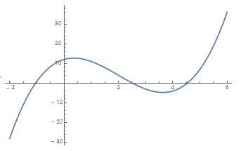



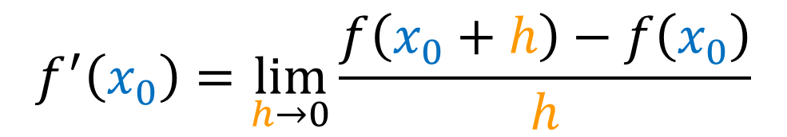

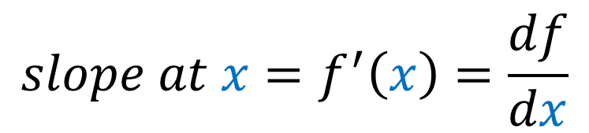



Derivatives (single-variable)
$$f(x)$$
$$slope at x=f^{′}\left(x\right)=\frac{df}{dx}$$
$$f\left(x_{0}\right)$$
$$f\left(x_{0}+h\right)$$
$$x$$
$$f^{′}\left(x_{0}\right)=\lim_{h→0}{\frac{f\left(x_{0}+h\right)−f\left(x_{0}\right)}{h}}$$
$$x_{0}$$
$$x_{0}+h$$
$$f(x)=x^{3} − 6x^{2} + 4x + 12$$

Slide 6
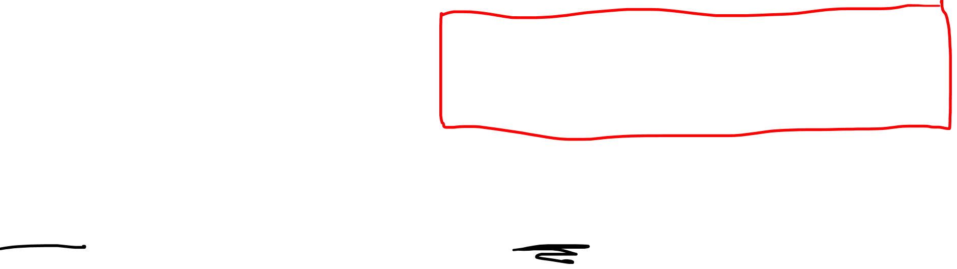

Derivatives (single-variable)
$$f(x)$$
$$slope at x=f^{′}\left(x\right)=\frac{df}{dx}$$
$$f\left(x_{0}\right)$$
$$x$$
$$f^{′}\left(x_{0}\right)=\lim_{h→0}{\frac{f\left(x_{0}+h\right)−f\left(x_{0}\right)}{h}}$$
$$x_{0}$$
$$f(x)=x^{3} − 6x^{2} + 4x + 12$$
$$f′(x)={3x}^{2} −12x+ 4$$

Slide 7
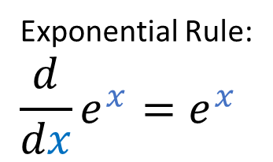
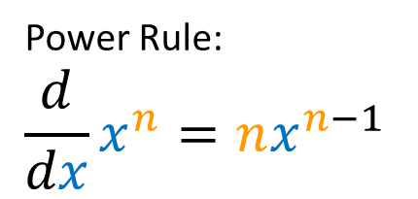
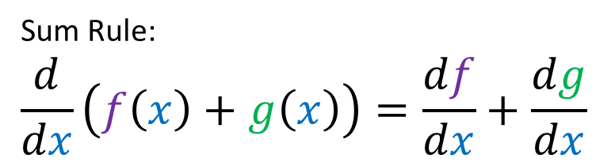

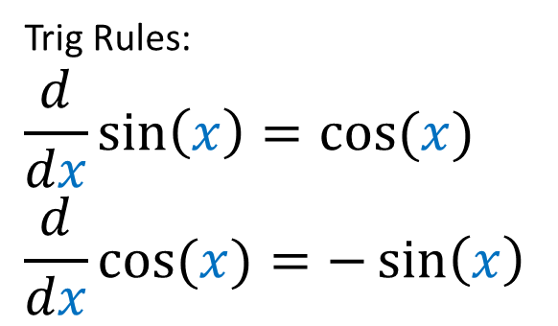
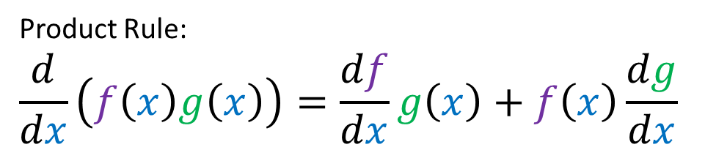
Derivatives (single-variable)
Power Rule:
$$\frac{d}{dx}x^{n}=nx^{n−1}$$
Sum Rule:
$$\frac{d}{dx}\left(f\left(x\right)+g\left(x\right)\right)=\frac{df}{dx}+\frac{dg}{dx}$$
Exponential Rule:
$$\frac{d}{dx}e^{x}=e^{x}$$
Product Rule:
$$\frac{d}{dx}\left(f\left(x\right)g\left(x\right)\right)=\frac{df}{dx}g\left(x\right)+f\left(x\right)\frac{dg}{dx}$$
Trig Rules:
$$\frac{d}{dx}\sin\left(x\right)=\cos{(x)}$$
$$\frac{d}{dx}\cos{(x)}=−\sin\left(x\right)$$
Chain Rule:
$$\frac{d}{dx}\left(f\left(g\left(x\right)\right)\right)=\frac{df}{dg}\frac{dg}{dx}$$

Slide 8
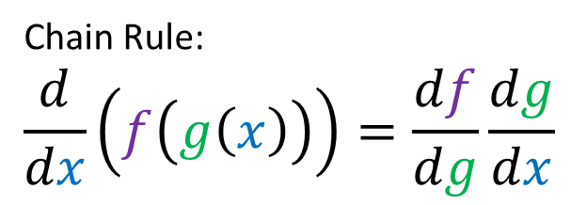
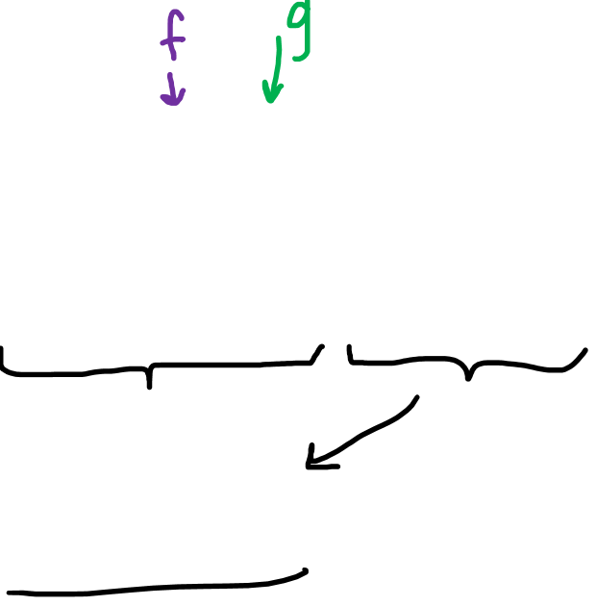
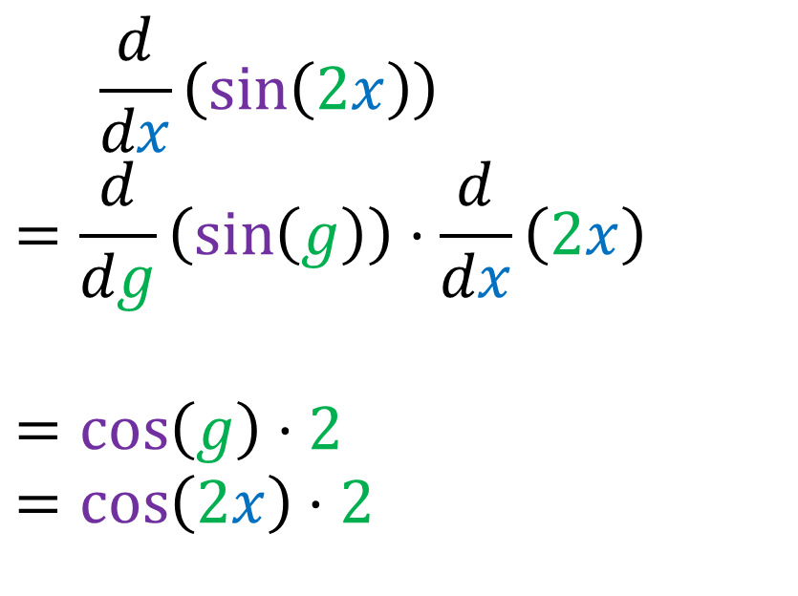
Derivatives (single-variable)
Chain Rule:
$$\frac{d}{dx}\left(f\left(g\left(x\right)\right)\right)=\frac{df}{dg}\frac{dg}{dx}$$
$$\frac{d}{dx}\left(\sin\left(2x\right)\right)$$
$$=\frac{d}{dg}\left(\sin\left(g\right)\right)⋅\frac{d}{dx}\left(2x\right)$$
$$=\cos\left(g\right)⋅2$$
$$=\cos\left(2x\right)⋅2$$

Slide 9
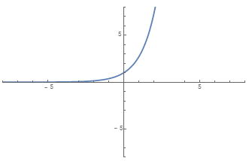
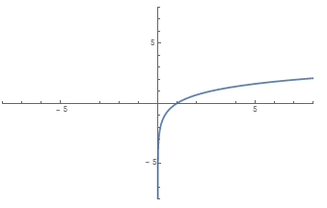



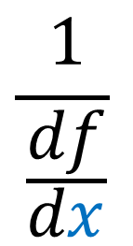
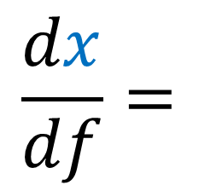
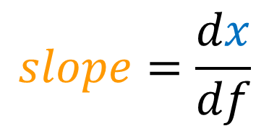


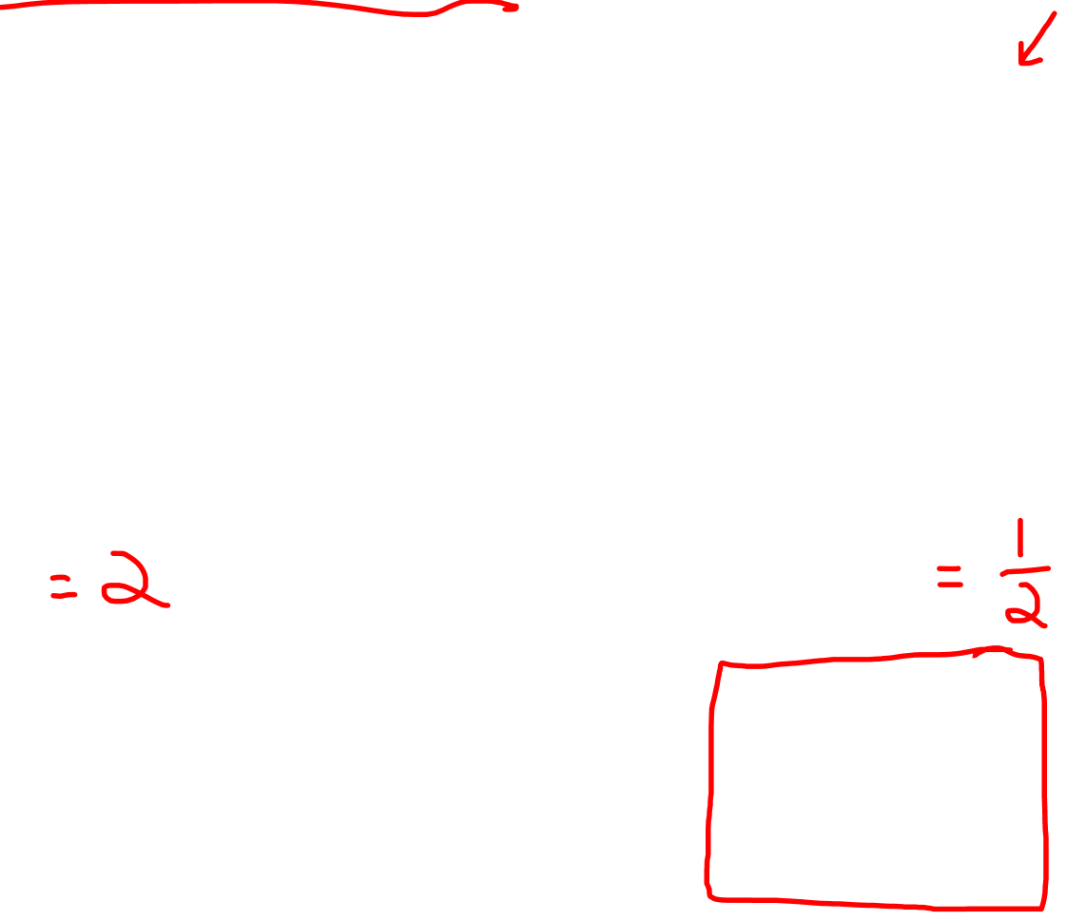
Derivatives (single-variable)
$$f(x)$$
$$x$$
$$x$$
$$f(x)$$
$$slope=\frac{df}{dx}$$
$$slope=\frac{dx}{df}$$
$$\frac{dx}{df}=$$
$$\frac{1}{\frac{df}{dx}}$$

Slide 10
Integrals
(Single-Variable)

Slide 11
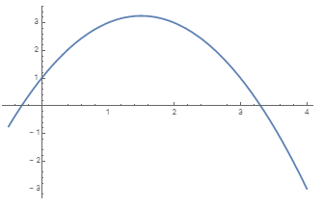





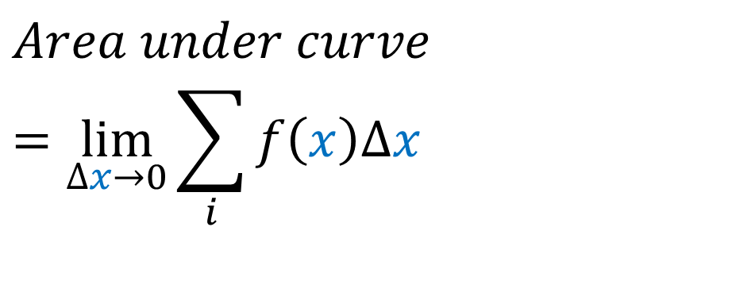
Integrals (single-variable)
$$f(x)$$
$$Δx$$
$$Area under curve \\ =\lim_{Δx→0}{\sum_{i}{f\left(x\right)Δx}}$$
$$x$$
$$a=1$$
$$b=3$$
$$f(x)=− x^{2} +3x +1$$

Slide 12
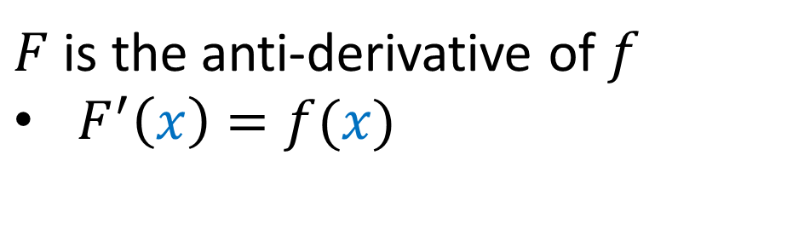
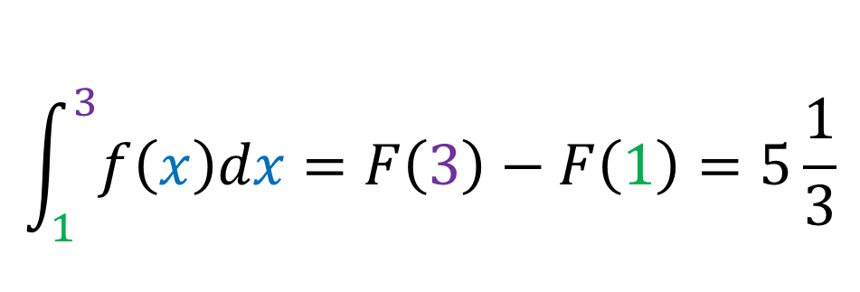
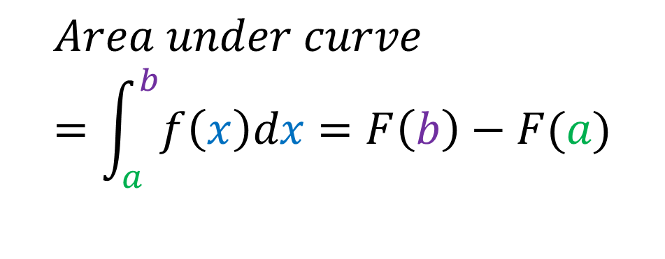
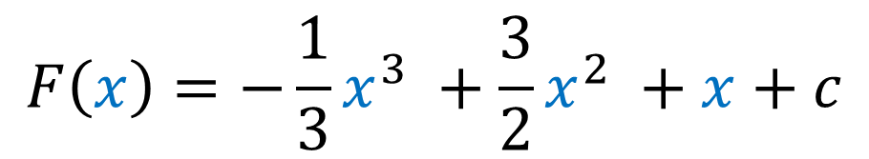

Integrals (single-variable)
$$f(x)$$
$$Δx$$
$$Area under curve \\ =\int_{a}^{b}{f\left(x\right)dx}=F\left(b\right)−F(a)$$
$$x$$
$F$ is the anti-derivative of $f$
$F^{′}\left(x\right)=f(x)$
$$a=1$$
$$b=3$$
$$F\left(x\right)=−\frac{1}{3}x^{3} +\frac{3}{2}x^{2} +x+c$$
$$f(x)=− x^{2} +3x +1$$
$$\int_{1}^{3}{f\left(x\right)dx}=F\left(3\right)−F\left(1\right)=5\frac{1}{3}$$

Slide 13
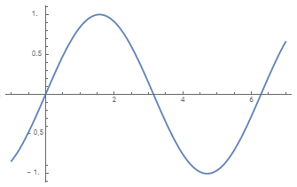
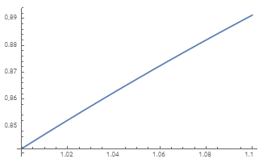
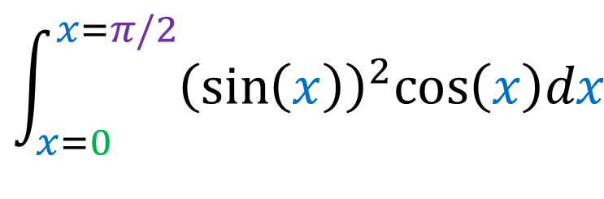
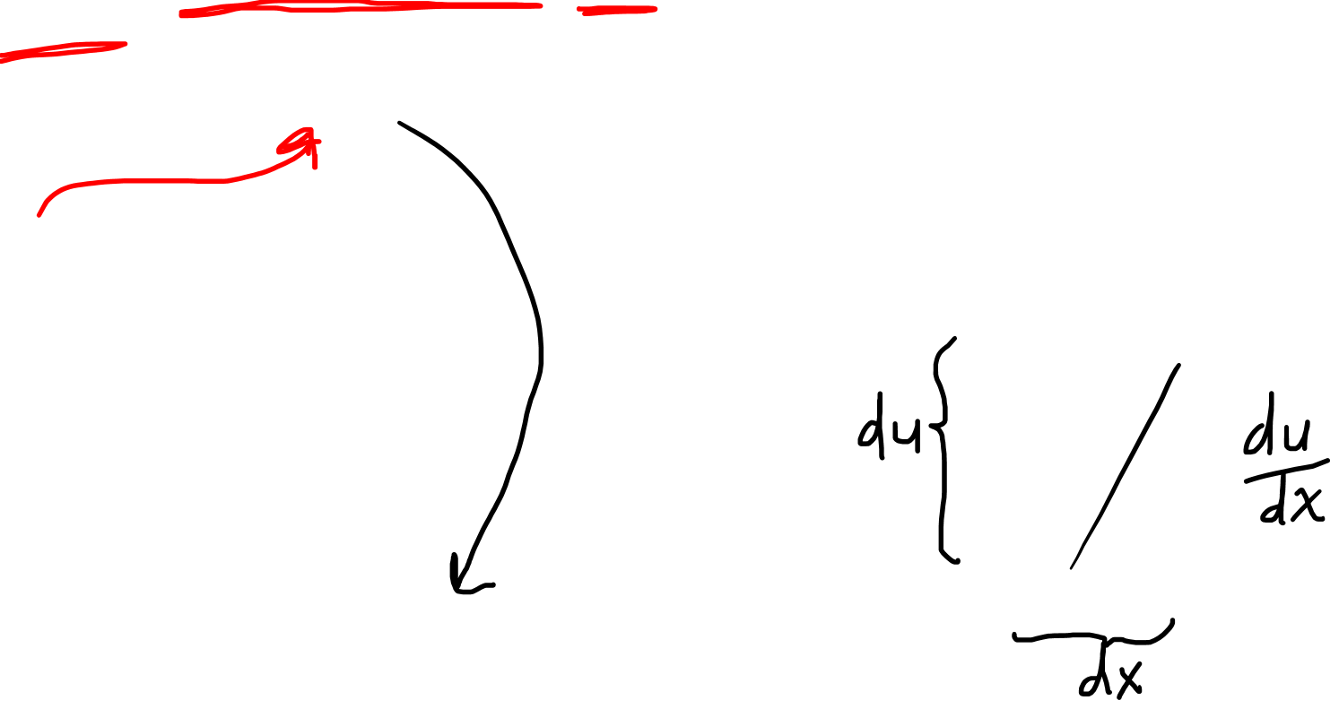
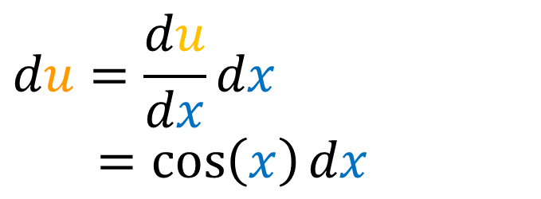
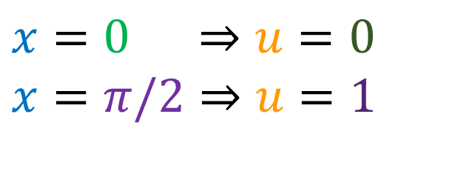

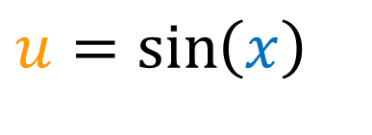

Integrals (single-variable)
$$u$$
$$\int_{x=0}^{x=π/2}{{\left(\sin\left(x\right)\right)}^{2}cos\left(x\right)dx}$$
$$x$$
$$u=\sin\left(x\right)$$
$$x=0 ⇒u=0$$
$$x=π/2⇒u=1$$
$$du=\frac{du}{dx}{dx}$$
$=cos\left(x\right){dx}$

Slide 14
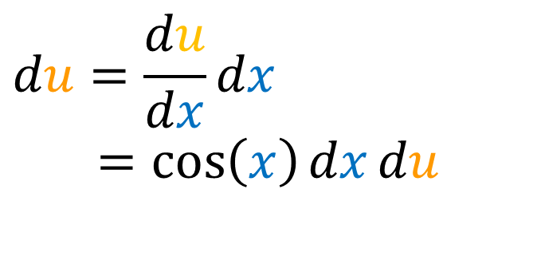
Integrals (single-variable)
$$\int_{x=0}^{x=π/2}{{\left(\sin\left(x\right)\right)}^{2}cos\left(x\right)dx}$$
$$u=\sin\left(x\right)$$
$$x=0 ⇒u=0$$
$$x=π/2⇒u=1$$
$$du=\frac{du}{dx}{dx}$$
$=cos\left(x\right){dx}du$

Slide 15
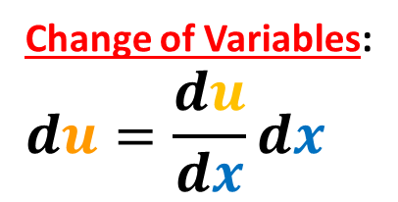
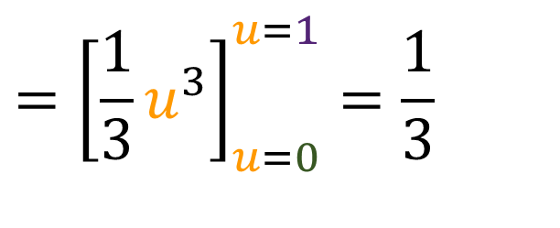
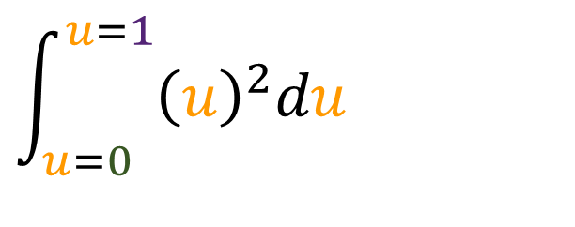
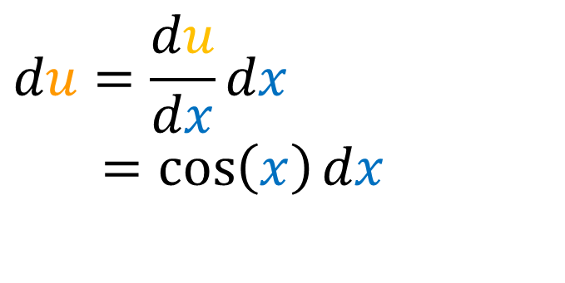
Integrals (single-variable)
$$\int_{x=0}^{x=π/2}{{\left(\sin\left(x\right)\right)}^{2}cos\left(x\right)dx}$$
$$\int_{u=0 }^{u=1}{{\left(u\right)}^{2}du}$$
$$u=\sin\left(x\right)$$
$$={\left[\frac{1}{3}u^{3}\right]}_{u=0}^{u=1}=\frac{1}{3}$$
$$x=0 ⇒u=0$$
$$x=π/2⇒u=1$$
Change of Variables:
$$du=\frac{du}{dx}{dx}$$
$$du=\frac{du}{dx}{dx}$$
$=cos\left(x\right){dx}$

Slide 16
Partial Derivatives
(Multi-Variable)

Slide 17
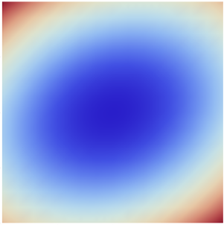
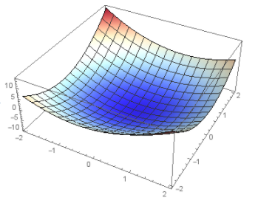
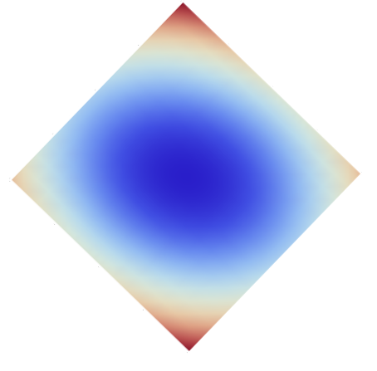
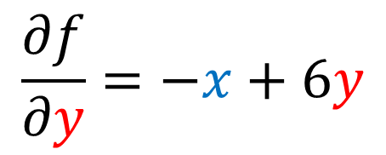


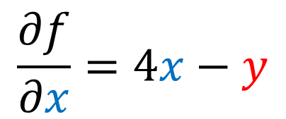



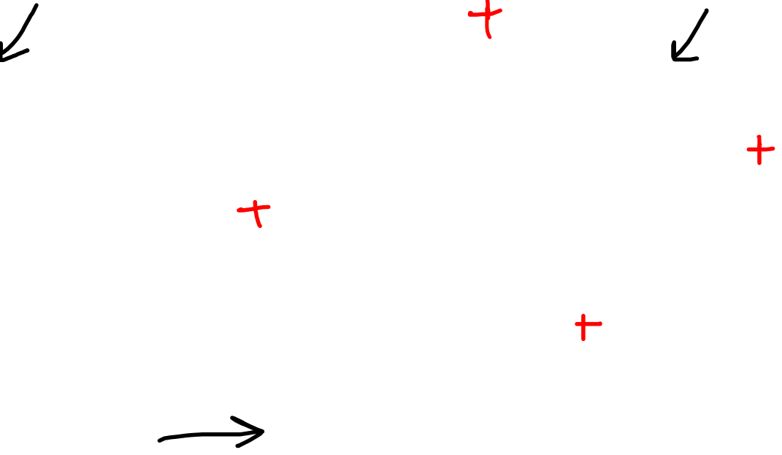

Derivatives (multi-variable)
$$f(x,y)$$
$$y$$
$$y$$
$$x$$
$$x$$
$$\frac{∂f}{∂x}=4x−y$$
$$f\left(x,y\right)=2x^{2}−xy+3y^{2}−10$$
$$\frac{∂f}{∂y}=−x+6y$$

Slide 18

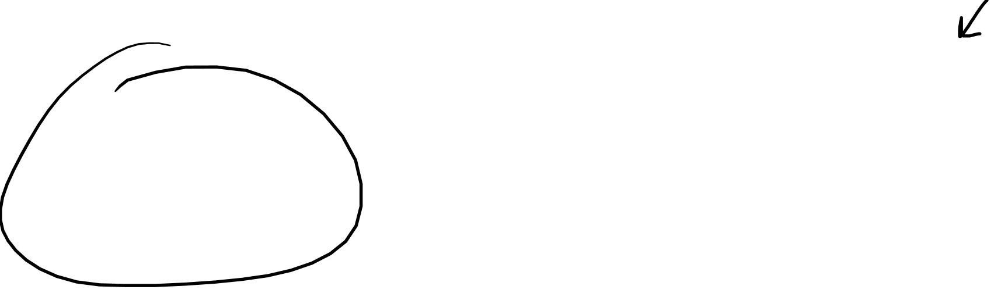
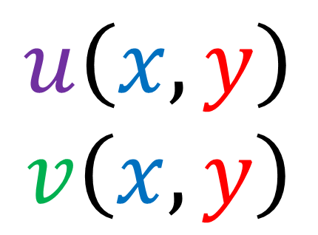

Derivatives (multi-variable)
$$\frac{∂x}{∂u}≠$$
$$\frac{1}{\frac{∂u}{∂x}}$$
$$u\left(x,y\right)$$
$$v\left(x,y\right)$$
Need the Jacobian Matrix
(next 2 videos)

Slide 19
Chain Rule
(Multi-Variable)

Slide 20
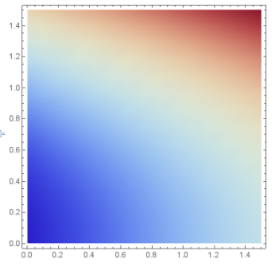




Chain Rule (multi-variable)
A. Temperature as a function of (2D) position
$$T\left(x,y\right)=y^{2}+x−\text{½}$$
$$y$$
$$x$$

Slide 21


Chain Rule (multi-variable)
A. Temperature as a function of (2D) position
B. Position (2D) as a function of time
$$\left(x(t),y(t)\right)=\left(t+1,t^{2}−t+\text{¼}\right)$$
$$T\left(x,y\right)=y^{2}+x−\text{½}$$
$$y$$
$$x$$

Slide 22





Chain Rule (multi-variable)
C. Temperature as a function of time
$T\left(x,y\right)=y^{2}+x−\text{½}$ $$\left(x(t),y(t)\right)=\left(t,t^{2}−t+\text{¼} \right)$$
$$T(t)={\left(t^{2}−t+\text{¼}\right)}^{2}+\left(t\right)−\text{½}$$
$$\frac{dT}{dt}=2\left(t^{2}−t+\text{¼}\right)\left(2t−1\right)+1$$
$$y$$
$$x$$

Slide 23


Chain Rule (multi-variable)
C. Temperature as a function of time
$T\left(x,y\right)=y^{2}+x−\text{½}$ $$\left(x(t),y(t)\right)=\left(t,t^{2}−t+\text{¼} \right)$$
$$\frac{dT}{dt}=\frac{∂T}{∂x}\frac{dx}{dt}+\frac{∂T}{∂y}\frac{dy}{dt}$$
$$=(1)(1)+\left(2y\right)(2t−1)$$
$= 1+\left(2(t^{2}−t+\text{¼})\right)(2t−1)$
$$=2\left(t^{2}−t+\text{¼}\right)\left(2t−1\right)+1$$
$$y$$
$$x$$

Slide 24



Chain Rule (multi-variable)
$$\frac{dT}{dt}=\frac{∂T}{∂x}\frac{dx}{dt}+\frac{∂T}{∂y}\frac{dy}{dt}$$
$$\frac{dT}{dt}=\sum_{i}{\frac{∂T}{∂q^{i}}\frac{dq^{i}}{dt}}=\frac{∂T}{∂q^{i}}\frac{dq^{i}}{dt}$$
Einstein
summation
notation

Slide 25
Gradient of a Function

Slide 26






Gradient of a Function
Gradient takes a function (i.e. scalar field) and produces a vector field
Vector points in direction of greatest increase
Vector magnitude is proportional to steepness (rate of increase)
$$f$$
$$∇f$$
$$∇$$

Slide 27


Gradient of a Function

Slide 28








Gradient of a Function
$$f$$
$$∇f$$
$$∇$$
$$f\left(x,y\right)=y^{2}+x−\text{½}$$
$∇f=$ $\left[\begin{aligned}\frac{∂}{∂x} \\ \frac{∂}{∂y}\end{aligned}\right]$ $\left(y^{2}+x−\text{½}\right)$
$=$ $\left[\begin{aligned}\frac{∂}{∂x}\left(y^{2}+x−\text{½}\right) \\ \frac{∂}{∂y}\left(y^{2}+x−\text{½}\right)\end{aligned}\right]=\left[\begin{aligned}1 \\ 2y\end{aligned}\right]$
$$∇=\left[\begin{aligned}\frac{∂}{∂x} \\ \frac{∂}{∂y}\end{aligned}\right]$$
Cartesian Only!!

Slide 29
Directional Derivative

Slide 30








Directional Derivative
Partial derivatives give us the rate of change in the $x$ and $y$ directions
The directional derivative gives us the rate of change in any direction $\vec{v}$
$∇_{\vec{v}}f=D_{\vec{v}}f=\frac{∂f}{∂\vec{v}}$
$$∇_{\vec{v}}f\left(x,y\right)≡\lim_{h→0}{\frac{f\left(x+hv_{x},y+hv_{y}\right)−f\left(x,y\right)}{h}}$$
$$f$$
$∇_{\vec{v}}f=\vec{v}⋅∇f$
$$=\left[\begin{aligned}\text{½} \\ 1\end{aligned}\right]⋅\left[\begin{aligned}1 \\ 2y\end{aligned}\right]$$
$=\text{½}+2y$
$$\vec{v}$$

Slide 31

Directional Derivative
$$∇_{\vec{v}}f\left(x,y\right)≡\lim_{h→0}{\frac{f\left(x+hv_{x},y+hv_{y}\right)−f\left(x,y\right)}{h}}$$
$$=\lim_{h→0}{\frac{f\left(x+hv_{x},y+hv_{y}\right)−f\left(x,y+hv_{y}\right)+f\left(x,y+hv_{y}\right)−f\left(x,y\right)}{h}}$$
$$=\lim_{h→0}{\frac{f\left(x+hv_{x},y+hv_{y}\right)−f\left(x,y+hv_{y}\right)}{h}+\lim_{h→0}{\frac{f\left(x,y+hv_{y}\right)−f\left(x,y\right)}{h}}}$$
Assume that in a small region, $f$ is “flat” like a line…
$f\left(x+hv_{x},\sim \right)=f\left(x,\sim \right)+hv_{x}\frac{∂f}{∂x}\left(x,\sim \right)$
$f\left(\sim ,y+hv_{y}\right)=f\left(\sim ,y\right)+hv_{x}\frac{∂f}{∂y}\left(\sim ,y\right)$

Slide 32

$$=\lim_{h→0}{\frac{f\left(x+hv_{x},\sim \right)−f\left(x,\sim \right)}{h}+\lim_{h→0}{\frac{f\left(x,y+hv_{y}\right)−f\left(x,y\right)}{h}}}$$
Assume that in a small region, $f$ is “flat” like a line…
$f\left(x+hv_{x},\sim \right)=f\left(x,\sim \right)+hv_{x}\frac{∂f}{∂x}\left(x,\sim \right)$
$f\left(\sim ,y+hv_{y}\right)=f\left(\sim ,y\right)+hv_{x}\frac{∂f}{∂y}\left(\sim ,y\right)$
$$=\lim_{h→0}{\frac{f\left(x,\sim \right)+hv_{x}\frac{∂f}{∂x}\left(x,\sim \right)−f\left(x,\sim \right)}{h}+\lim_{h→0}{\frac{f\left(x,y\right)+hv_{x}\frac{∂f}{∂y}\left(x,y\right)−f\left(x,y\right)}{h}}}$$
$$=\lim_{h→0}{\frac{hv_{x}\frac{∂f}{∂x}\left(x,y+hv_{y}\right)}{h}+\lim_{h→0}{\frac{hv_{x}\frac{∂f}{∂y}\left(x,y\right)}{h}}}$$
$$=v_{x}\frac{∂f}{∂x}\left(x,y\right)+v_{x}\frac{∂f}{∂y}\left(x,y\right)$$
$$=\vec{v}⋅∇f\left(x,y\right)$$

Slide 33
Differentials
(Multi-Variable)

Slide 34








Differentials (multi-variable)
Change of Variables:
$$du=\frac{du}{dx}{dx}$$
$$du=\frac{du}{dx}{dx}$$
$=cos\left(x\right){dx}$
$$u=\sin\left(x\right)$$
$$u$$
$$x$$
$$\int_{x=0}^{x=π/2}{{\left(\sin\left(x\right)\right)}^{2}cos\left(x\right)dx}$$
$$\int_{u=0 }^{u=1}{{\left(u\right)}^{2}du}$$

Slide 35







Differentials (multi-variable)
Differentials:
$$df=\frac{∂f}{∂x}{dx}+\frac{∂f}{∂y}{dy}$$
$$df=\frac{∂f}{∂x}{dx}+\frac{∂f}{∂y}{dy}$$
$$df=\left(cos\left(x\right)sin\left(y\right)\right){dx}+\left(sin\left(x\right)cos\left(y\right)\right){dy}$$
$$f\left(x,y\right)=sin\left(x\right)sin\left(y\right)$$

Slide 36



Differentials (multi-variable)
$$df=\frac{∂f}{∂x}{dx}+\frac{∂f}{∂y}{dy}$$
$$df=\sum_{i}{\frac{∂f}{∂q^{i}}{dq^{i}}}=\frac{∂f}{∂q^{i}}{dq^{i}}$$
Einstein
summation
notation

Slide 37
Calculating
Length of a Curve

Slide 38


Arc Length
Integrals help us calculate the length of curves (arc length)
Done by breaking a line into small segments and summing them up
$$arc length≈\sum_{i}{‖\vec{R}\left(t_{i+1 }\right)−\vec{R}\left(t_{i}\right)‖}$$
$$arc length=\lim_{Δt→0}{\sum_{i}{\left\|\vec{R}\left(t_{i+1 }\right)−\vec{R}\left(t_{i}\right)\right\|}}$$
$$arc length=\lim_{Δt→0}{\sum_{i}{\left\|\vec{R}\left(t_{i+1 }\right)−\vec{R}\left(t_{i}\right)\right\|}}\left(\frac{Δt}{Δt}\right)$$
$$arc length=\lim_{Δt→0}{\sum_{i}{\frac{\left\|\vec{R}\left(t_{i+1 }\right)−\vec{R}\left(t_{i}\right)\right\|}{Δt}Δt}}$$
$$arc length=\int{\left\|\frac{d\vec{R}}{dt}\right\|dt}$$

Slide 39

Arc Length
Integrals help us calculate the length of curves (arc length)
Done by breaking a line into small segments and summing them up
$$arc length≈\sum_{i}{‖\vec{R}\left(t_{i+1 }\right)−\vec{R}\left(t_{i}\right)‖}$$
$$arc length=\lim_{Δt→0}{\sum_{i}{\left\|\vec{R}\left(t_{i+1 }\right)−\vec{R}\left(t_{i}\right)\right\|}}$$
$$arc length=\lim_{Δt→0}{\sum_{i}{\left\|\vec{R}\left(t_{i+1 }\right)−\vec{R}\left(t_{i}\right)\right\|}}\left(\frac{Δt}{Δt}\right)$$
$$arc length=\lim_{Δt→0}{\sum_{i}{\frac{\left\|\vec{R}\left(t_{i+1 }\right)−\vec{R}\left(t_{i}\right)\right\|}{Δt}Δt}}$$
$$arc length=\int{\left\|\frac{d\vec{R}}{dt}\right\|dt}$$

Slide 40

Arc Length
Lines Integrals help us calculate the length of curves
Done by breaking a line into small segments and summing them up
$$arc length=\int{\left\|\frac{d\vec{R}}{dt}\right\|dt}=\int{\sqrt{\frac{d\vec{R}}{dt}⋅\frac{d\vec{R}}{dt}}dt}$$
$$=\int{\sqrt{\left(\frac{∂\vec{R}}{∂x}\frac{dx}{dt}+\frac{∂\vec{R}}{∂y}\frac{dy}{dt}\right)⋅\left(\frac{∂\vec{R}}{∂x}\frac{dx}{dt}+\frac{∂\vec{R}}{∂y}\frac{dy}{dt}\right)}dt}$$
$$=\int{\sqrt{{\left(\frac{dx}{dt}\right)}^{2}\left(\frac{∂\vec{R}}{∂x}⋅\frac{∂\vec{R}}{∂x}\right)+2\frac{dx}{dt}\frac{dy}{dt}\left(\frac{∂\vec{R}}{∂x}⋅\frac{∂\vec{R}}{∂y}\right)+{\left(\frac{dy}{dt}\right)}^{2}\left(\frac{∂\vec{R}}{∂y}⋅\frac{∂\vec{R}}{∂y}\right)}dt}$$

Slide 41



Arc Length
$$\left\|\frac{d\vec{R}}{dt}\right\|=\sqrt{{\left(\frac{dx}{dt}\right)}^{2}\left(\frac{∂\vec{R}}{∂x}⋅\frac{∂\vec{R}}{∂x}\right)+2\frac{dx}{dt}\frac{dy}{dt}\left(\frac{∂\vec{R}}{∂x}⋅\frac{∂\vec{R}}{∂y}\right)+{\left(\frac{dy}{dt}\right)}^{2}\left(\frac{∂\vec{R}}{∂y}⋅\frac{∂\vec{R}}{∂y}\right)}$$
$$=\sqrt{{\left(\frac{dx}{dt}\right)}^{2}+{\left(\frac{dy}{dt}\right)}^{2}}$$
$$=\sqrt{{\left(1\right)}^{2}+{\left(2t\right)}^{2}}$$
$$=\sqrt{1+4t^{2}}$$
$$\vec{R}\left(t\right)=\left(x\left(t\right)y\left(t\right)\right)=\left(t,t^{2}\right)$$
$$\frac{d\vec{R}}{dt}=\left(1,2t\right)=\left[\begin{aligned}1 \\ 2t\end{aligned}\right]$$
$$\left\|\frac{d\vec{R}}{dt}\right\|=\sqrt{\frac{d\vec{R}}{dt}⋅\frac{d\vec{R}}{dt}}$$
$$=\sqrt{\left[\begin{aligned}1 \\ 2t\end{aligned}\right]⋅\left[\begin{aligned}1 \\ 2t\end{aligned}\right]}$$
$$=\sqrt{1+4t^{2}}$$
$$arc length=\int{\left\|\frac{d\vec{R}}{dt}\right\|dt}=\int{\sqrt{1+4t^{2}}dt}$$

Slide 42


Arc Length
$$\left\|\frac{d\vec{R}}{dt}\right\|=\sqrt{{\left(\frac{dx}{dt}\right)}^{2}\left(\frac{∂\vec{R}}{∂x}⋅\frac{∂\vec{R}}{∂x}\right)+2\frac{dx}{dt}\frac{dy}{dt}\left(\frac{∂\vec{R}}{∂x}⋅\frac{∂\vec{R}}{∂y}\right)+{\left(\frac{dy}{dt}\right)}^{2}\left(\frac{∂\vec{R}}{∂y}⋅\frac{∂\vec{R}}{∂y}\right)}$$
$$=\sqrt{{\left(\frac{dx}{dt}\right)}^{2}+{\left(\frac{dy}{dt}\right)}^{2}}$$
$$=\sqrt{{\left(1\right)}^{2}+{\left(2t\right)}^{2}}$$
$$=\sqrt{1+4t^{2}}$$
$$\vec{R}\left(t\right)=\left(x\left(t\right)y\left(t\right)\right)=\left(t,t^{2}\right)$$
$$\frac{d\vec{R}}{dt}=\left(1,2t\right)=\left[\begin{aligned}1 \\ 2t\end{aligned}\right]$$
$$\left\|\frac{d\vec{R}}{dt}\right\|=\sqrt{\frac{d\vec{R}}{dt}⋅\frac{d\vec{R}}{dt}}$$
$$=\sqrt{\left[\begin{aligned}1 \\ 2t\end{aligned}\right]⋅\left[\begin{aligned}1 \\ 2t\end{aligned}\right]}$$
$$=\sqrt{1+4t^{2}}$$
$$arc length=\int{\left\|\frac{d\vec{R}}{dt}\right\|dt}=\int{\sqrt{1+4t^{2}}dt}$$

Slide 43




Arc Length
$$arc length=\int{\left\|\frac{d\vec{R}}{dt}\right\|dt}$$
$$\left\|\frac{d\vec{R}}{dt}\right\|=\sqrt{{\left(\frac{dx}{dt}\right)}^{2}\left(\frac{∂\vec{R}}{∂x}⋅\frac{∂\vec{R}}{∂x}\right)+2\frac{dx}{dt}\frac{dy}{dt}\left(\frac{∂\vec{R}}{∂x}⋅\frac{∂\vec{R}}{∂y}\right)+{\left(\frac{dy}{dt}\right)}^{2}\left(\frac{∂\vec{R}}{∂y}⋅\frac{∂\vec{R}}{∂y}\right)}$$
$\left\|\frac{d\vec{R}}{dt}\right\|=\sqrt{\sum_{i}{\sum_{j}{\frac{dq^{i}}{dt}\frac{dq^{j}}{dt}}}\left(\frac{∂\vec{R}}{∂q^{i}}⋅\frac{∂\vec{R}}{∂q^{j}}\right)}=\sqrt{\frac{dq^{i}}{dt}\frac{dq^{j}}{dt}\left(\frac{∂\vec{R}}{∂q^{i}}⋅\frac{∂\vec{R}}{∂q^{j}}\right)}$
Einstein
summation
notation

Slide 44



Main Take-aways
$$\frac{df}{dt}=\sum_{i}{\frac{∂f}{∂q^{i}}\frac{dq^{i}}{dt}}=\frac{∂f}{∂q^{i}}\frac{dq^{i}}{dt}$$
Multi-Variable Chain Rule:
$$df=\sum_{i}{\frac{∂f}{∂q^{i}}{dq^{i}}}=\frac{∂f}{∂q^{i}}{dq^{i}}$$
Total Differential Formula:
Velocity vector tangent to a Curve (magnitude):
$\left\|\frac{d\vec{R}}{dt}\right\|=\sqrt{\sum_{i}{\sum_{j}{\frac{dq^{i}}{dt}\frac{dq^{j}}{dt}}}\left(\frac{∂\vec{R}}{∂q^{i}}⋅\frac{∂\vec{R}}{∂q^{j}}\right)}=\sqrt{\frac{dq^{i}}{dt}\frac{dq^{j}}{dt}\left(\frac{∂\vec{R}}{∂q^{i}}⋅\frac{∂\vec{R}}{∂q^{j}}\right)}$

