Slide 1
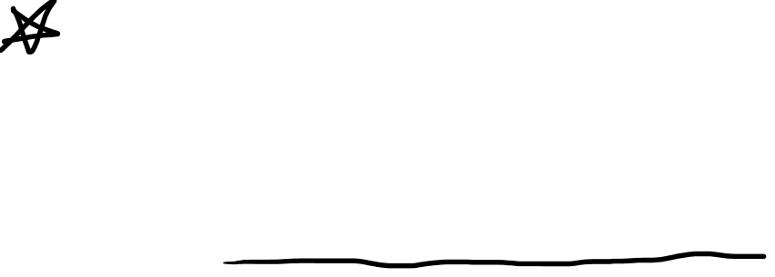
Differentials are Covectors
(See “Tensors for Beginners:
What are Covectors” Video)
(Link in Description)

Slide 2
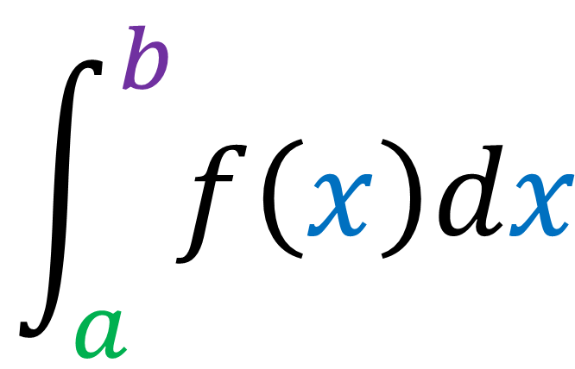
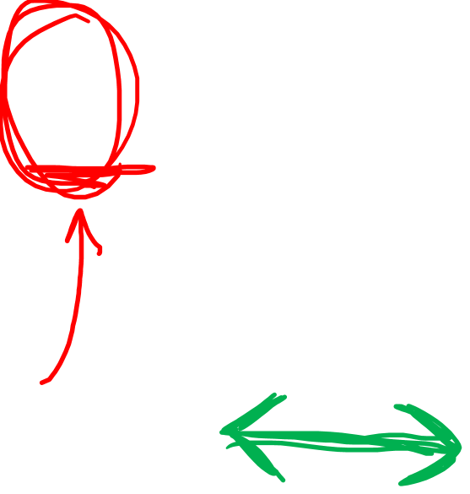
$$\int_{a}^{b}{f\left(x\right)dx}$$
Differential
Covector

Slide 3
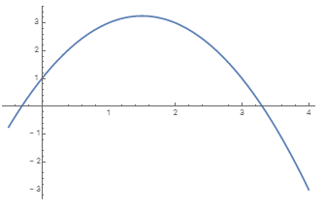








Integrals (single-variable)
$$f(x)$$
$$Δx$$
$$Area under curve \\ =\lim_{Δx→0}{\sum_{i}{f\left(x\right)Δx}}$$
$$= \int_{a}^{b}{f\left(x\right)dx}$$
$$x$$
$$a=1$$
$$b=3$$
$$f(x)=− x^{2} +3x +1$$

Slide 4
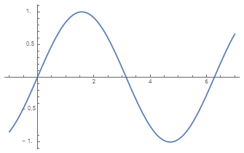
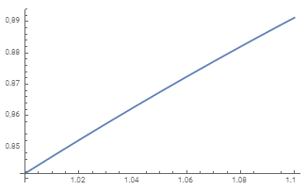
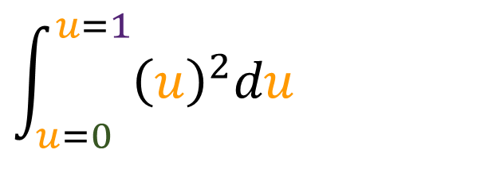
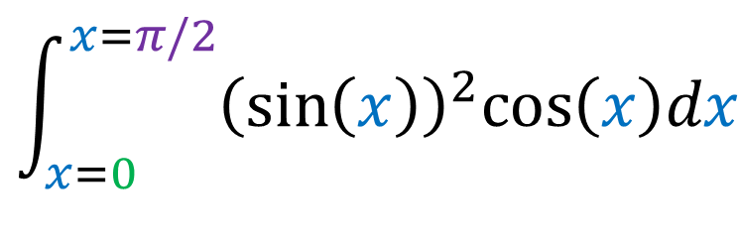



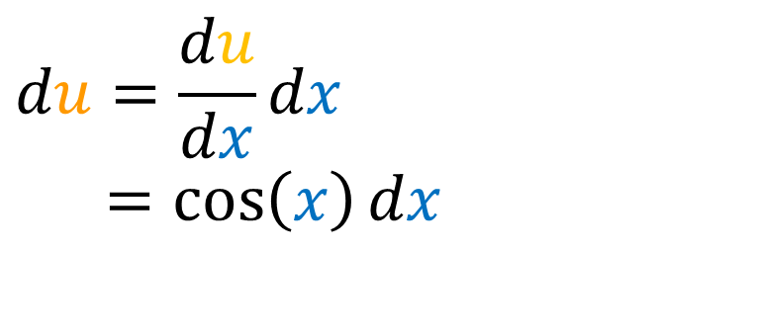
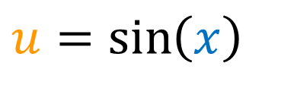
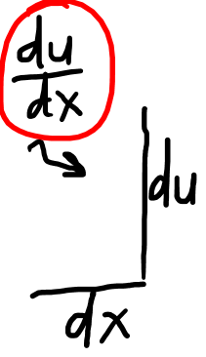
Integrals (single-variable)
Change of Variables:
$$du=\frac{du}{dx}{dx}$$
$$du=\frac{du}{dx}{dx}$$
$=cos\left(x\right){dx}$
$$u=\sin\left(x\right)$$
$$u$$
$$x$$
$$\int_{x=0}^{x=π/2}{{\left(\sin\left(x\right)\right)}^{2}cos\left(x\right)dx}$$
$$\int_{u=0 }^{u=1}{{\left(u\right)}^{2}du}$$

Slide 5
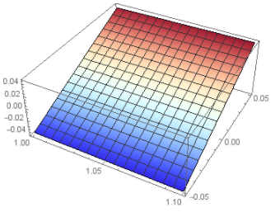
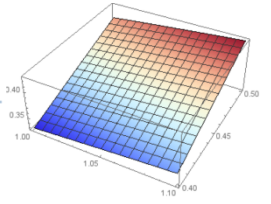
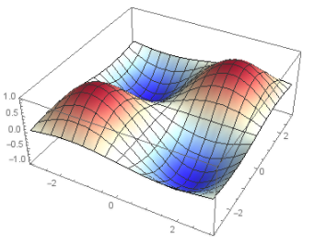
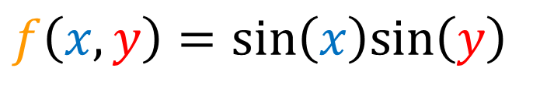
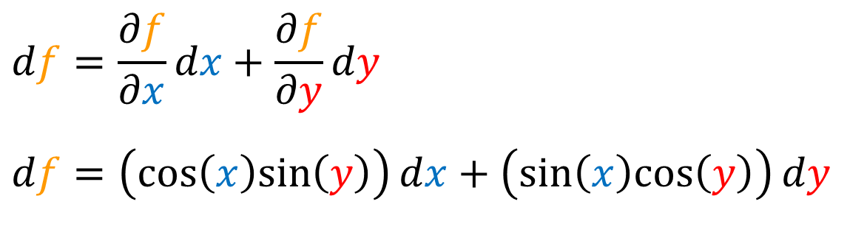
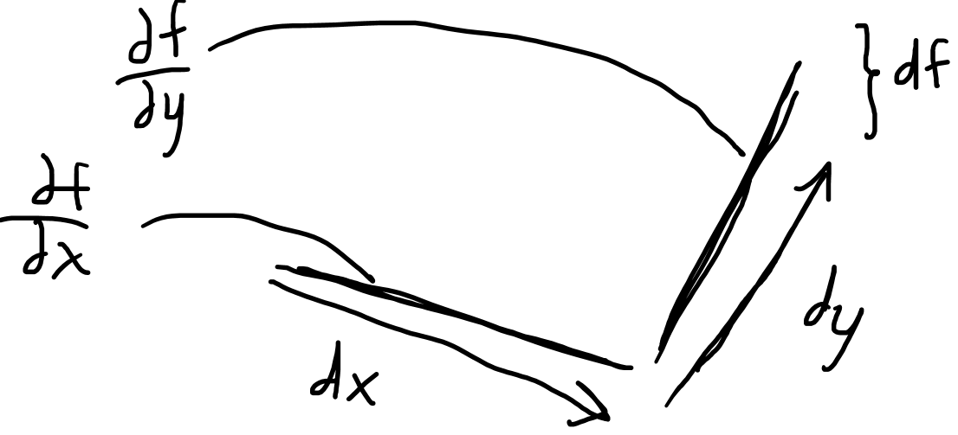

Differentials (multi-variable)
Differentials:
$$df=\frac{∂f}{∂x}{dx}+\frac{∂f}{∂y}{dy}$$
$$df=\frac{∂f}{∂x}{dx}+\frac{∂f}{∂y}{dy}$$
$$df=\left(cos\left(x\right)sin\left(y\right)\right){dx}+\left(sin\left(x\right)cos\left(y\right)\right){dy}$$
$$f\left(x,y\right)=sin\left(x\right)sin\left(y\right)$$

Slide 6

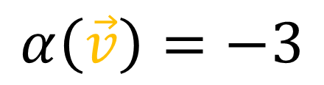


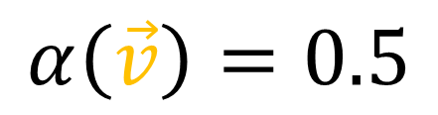
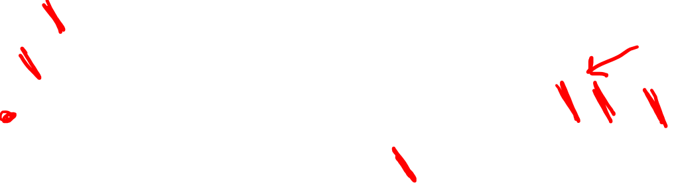

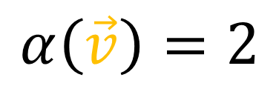




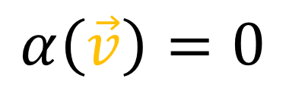
Covectors
$$α$$
$$α$$
$$α$$
$$α$$
$$\vec{v}$$
$$\vec{v}$$
$$\vec{v}$$
$$\vec{v}$$
$$α\left(\vec{v}\right)=2$$
$$α\left(\vec{v}\right)=0.5$$
$$α\left(\vec{v}\right)=−3$$
$$α\left(\vec{v}\right)=0$$

Slide 7

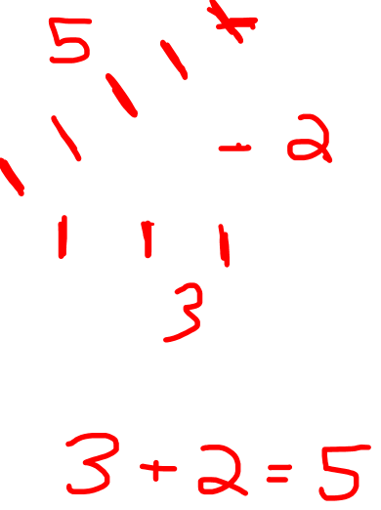
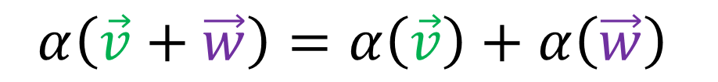
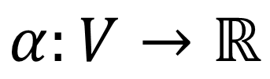
Covectors
$$α$$
$$α:V→ℝ$$
$$α\left(\vec{v}+\vec{w}\right)=α\left(\vec{v}\right)+α\left(\vec{w}\right)$$

Slide 8
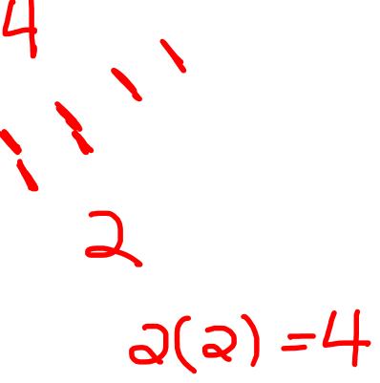
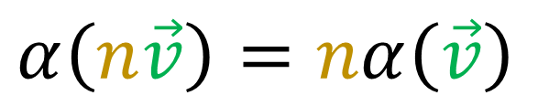
Covectors
$$α$$
$$α:V→ℝ$$
$$α\left(\vec{v}+\vec{w}\right)=α\left(\vec{v}\right)+α\left(\vec{w}\right)$$
$$α\left(n\vec{v}\right)=nα\left(\vec{v}\right)$$

Slide 9

2D
3D

Slide 10

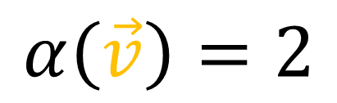

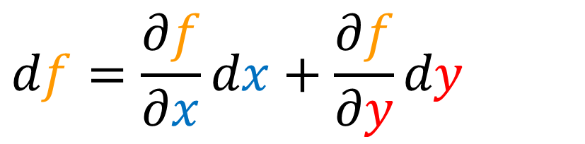
Differentials are Covectors?
$$α$$
$$\vec{v}$$
$$df=\frac{∂f}{∂x}{dx}+\frac{∂f}{∂y}{dy}$$
$$α\left(\vec{v}\right)=2$$

Slide 11
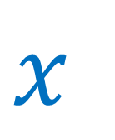

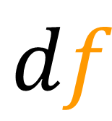
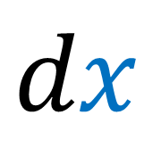

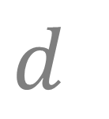
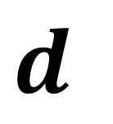

Re-interpret the $d$ symbol…
$$d$$
“Small change”
in Variable
Old:
Variable
$$x$$
$$dx$$
$$d$$
NEW:
Scalar Field
Covector Field
$$f$$
$$df$$

Slide 12
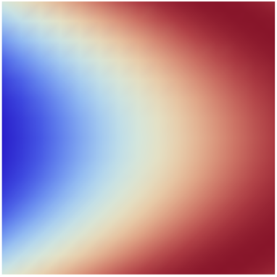
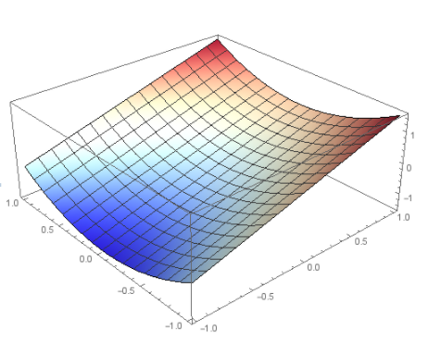
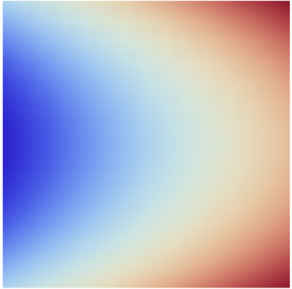
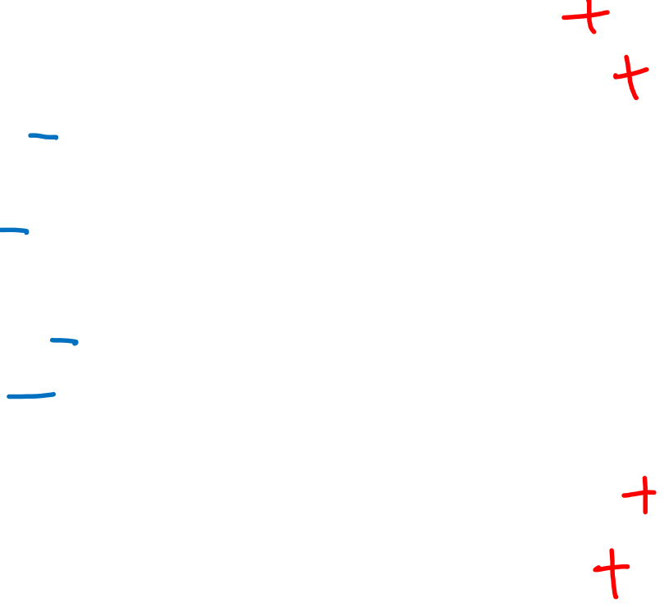

Scalar Field
$$f$$

Slide 13
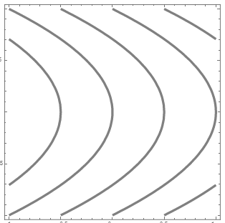
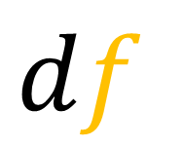
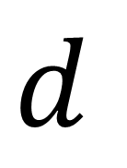
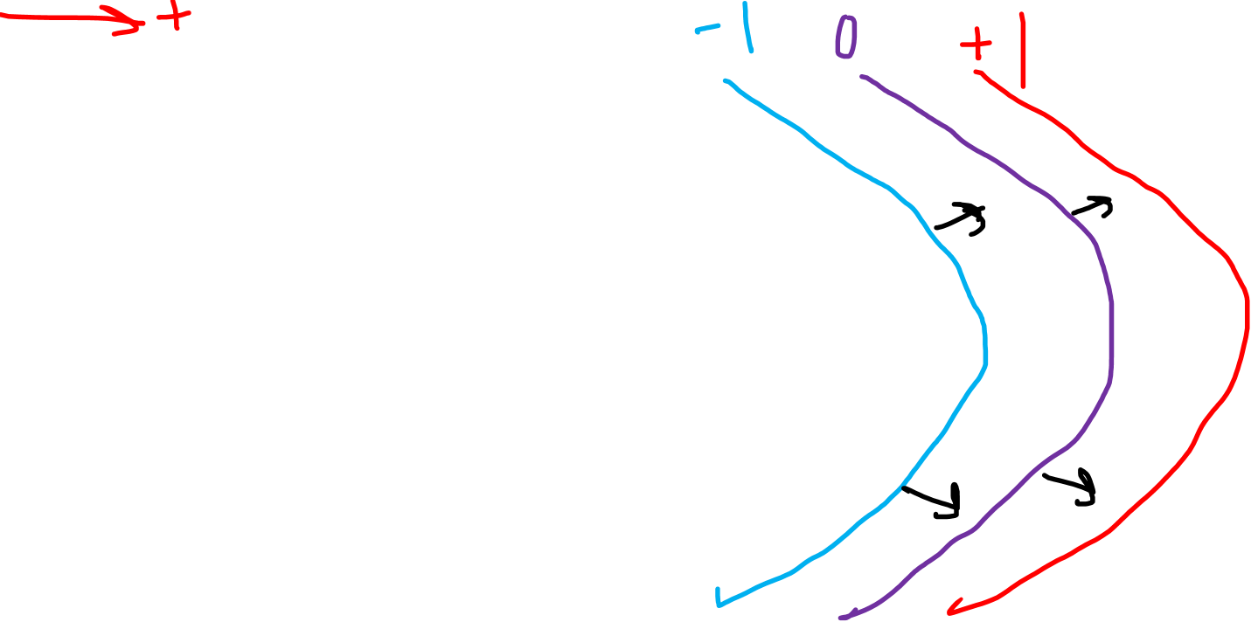
$$d$$
Scalar Field
Covector Field
$$f$$
$$df$$

Slide 14
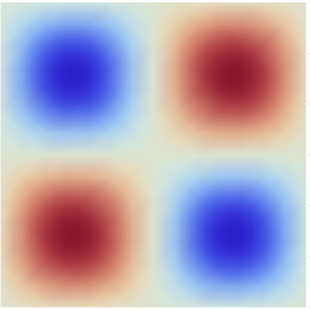

$$f\left(x,y\right)=\sin\left(x\right)sin⁡(y)$$
Scalar Field
$$f$$

Slide 15
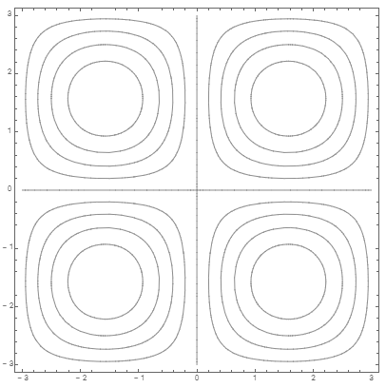
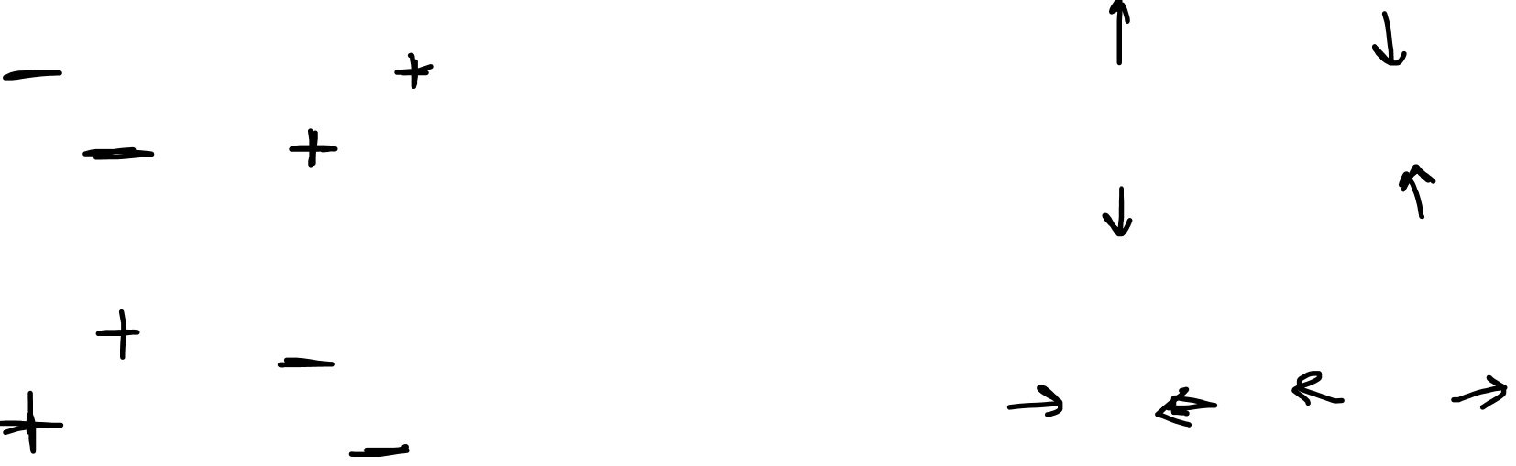
$$f\left(x,y\right)=\sin\left(x\right)sin⁡(y)$$
$$d$$
Scalar Field
Covector Field
$$f$$
$$df$$

Slide 16




$$d$$
Scalar Field
Covector Field
“function”
“level sets”
0-form
1-form
$$f$$
$$df$$

Slide 17












$dx$ and $dy$
$$y$$
$$x$$
$$dx$$
$$dx$$
$$x$$
$$dy$$
$$y$$
$$dy$$

Slide 18












$dr$ and$dθ$
$$θ$$
$$r$$
$$dr$$
$$r$$
$$θ$$
$$dθ$$

Slide 19




$$dx$$
$$dy$$
$$dr$$
$$dθ$$

Slide 20









$$p$$
$$p$$
$$\vec{v}$$
$$\vec{v}$$
$$df\left(\vec{v}\right)=5$$
$$df$$
$df$ (at point $p$)

Slide 21








$$df\left(\vec{u}\right)=−1$$
$$\vec{u}$$
$$\vec{u}$$
$$p$$
$$q$$
$$df$$
$df$ (at point $q$)

Slide 22





$$df$$
$$df\left(\vec{v}+\vec{w}\right)=df\left(\vec{v}\right)+df\left(\vec{w}\right)$$
$$α\left(\vec{v}+\vec{w}\right)=α\left(\vec{v}\right)+α\left(\vec{w}\right)$$
$$α\left(n\vec{v}\right)=nα\left(\vec{v}\right)$$
$$\vec{v}$$

Slide 23


$$df$$
$$df\left(\vec{v}+\vec{w}\right)=df\left(\vec{v}\right)+df\left(\vec{w}\right)$$
$$df\left(n\vec{v}\right)=n\left(df\left(\vec{v}\right)\right)$$
$$α\left(\vec{v}+\vec{w}\right)=α\left(\vec{v}\right)+α\left(\vec{w}\right)$$
$$α\left(n\vec{v}\right)=nα\left(\vec{v}\right)$$
$$\vec{v}$$

Slide 24

What is the
geometrical meaning of $df\left(\vec{v}\right)$ ?

Slide 25



$df$ is just the level sets of a function.

Slide 26







$$df\left(\vec{v}\right)=8000$$
$$\vec{v}$$
$$\vec{w}$$
$$df\left(\vec{w}\right)=4000$$
$df\left(\vec{v}\right)$is proportional to the steepness of $f$
in the direction of $\vec{v}$
$$df$$

Slide 27




$$df\left(\vec{v}\right)=8000$$
$$\vec{v}$$
$$df\left(\vec{u}\right)=4000$$
$$\vec{u}$$
$df\left(\vec{v}\right)$is proportional
to the length of $\vec{v}$
$$df$$

Slide 28






$$df$$
$df$ tells us how quickly
the function $f$ is changing.
$$\vec{v}$$
Vectors like $\vec{v}$ and $\vec{u}$
give us a direction (and speed).
$$\vec{u}$$
$df\left(\vec{v}\right)$ tells us the rate of change of $f$ when moving at velocity $\vec{v}$.

Slide 29




$df\left(\vec{v}\right)$is proportional to the steepness of $f$
in the direction of $\vec{v}$
$df\left(\vec{v}\right)$is proportional
to the length of $\vec{v}$
$df\left(\vec{v}\right)$ tells us the rate of change of $f$ when moving at velocity $\vec{v}$.

Slide 30





$df\left(\vec{v}\right)$ tells us the rate of change of $f$ when moving at velocity $\vec{v}$.
$df\left(\vec{v}\right)$ is the directional derivative.
$$df\left(\vec{v}\right)$$
$= ∇_{\vec{v}}f=D_{\vec{v}}f=\frac{∂f}{∂\vec{v}}$

Slide 31


$df\left(\vec{v}\right)$ is the
directional derivative
of $f$ in direction $\vec{v}$.

Slide 32








Summary…
$$df$$
$$d$$
Scalar Field
Covector Field
$$f$$
$$df$$
$df\left(\vec{v}\right)$ is the directional derivative
$$df\left(\vec{v}\right)=∇_{\vec{v}}f$$
$$df\left(\vec{v}+\vec{w}\right)=df\left(\vec{v}\right)+df\left(\vec{w}\right)$$
$$df\left(n\vec{v}\right)=n\left(df\left(\vec{v}\right)\right)$$

Slide 33



$$\int_{a}^{b}{g\left(x\right)dx}$$
$$df$$

