Slide 1

Differential Form Components
(See “Tensors for Beginners:
Covector Components” Video)
(Link in Description)

Slide 2
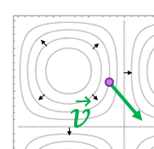
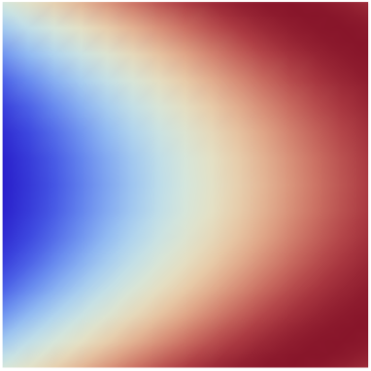
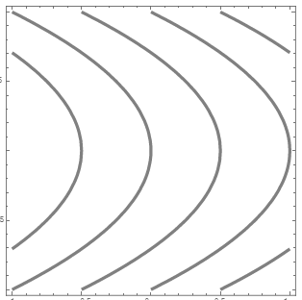
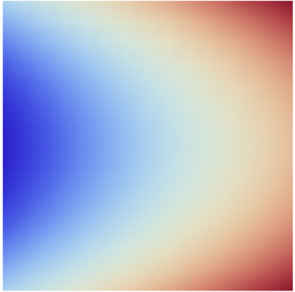
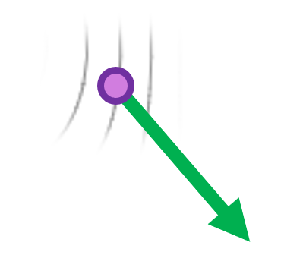



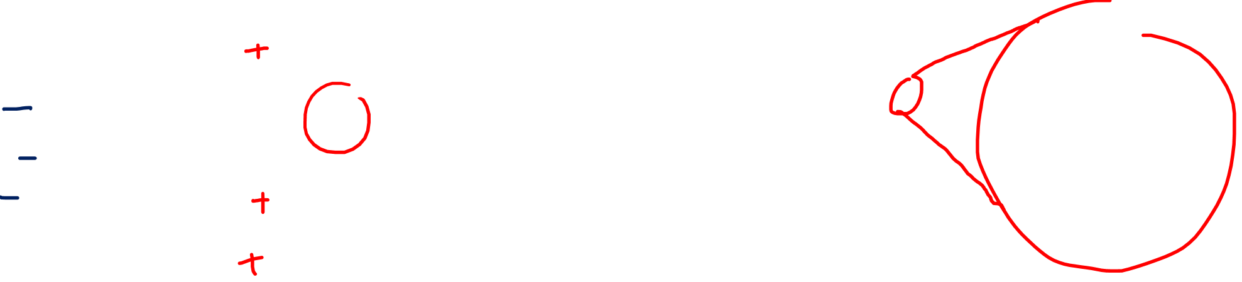


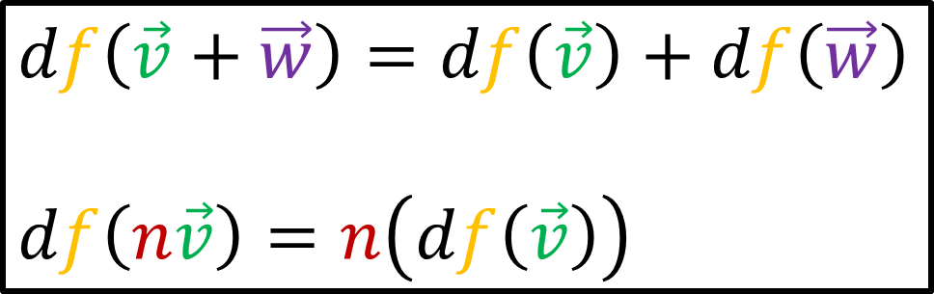
Summary…
$$df$$
$$d$$
Scalar Field
Covector Field
$$f$$
$$df$$
$df\left(\vec{v}\right)$ is the directional derivative
$$df\left(\vec{v}\right)=∇_{\vec{v}}f$$
$$df\left(\vec{v}+\vec{w}\right)=df\left(\vec{v}\right)+df\left(\vec{w}\right)$$
$$df\left(n\vec{v}\right)=n\left(df\left(\vec{v}\right)\right)$$

Slide 3
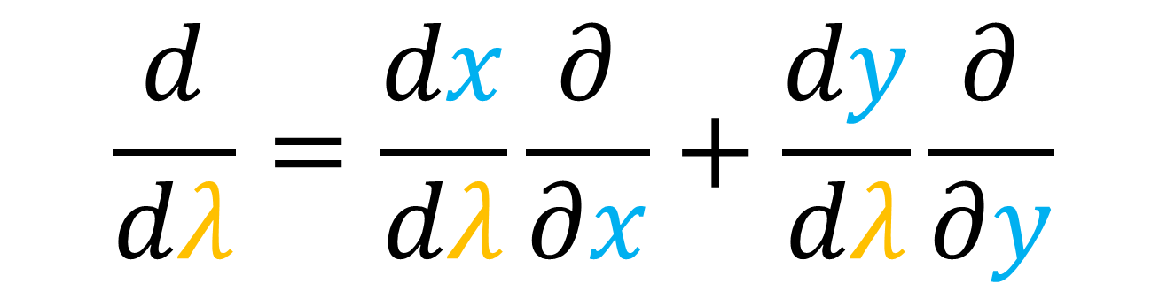
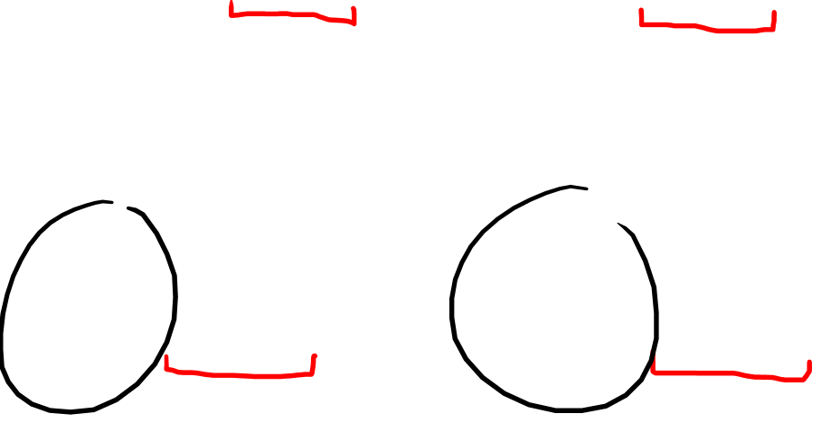

$$\frac{d}{dλ}=\frac{dx}{dλ}\frac{∂}{∂x}+\frac{dy}{dλ}\frac{∂}{∂y}$$
$$df=A dx+B dy$$

Slide 4




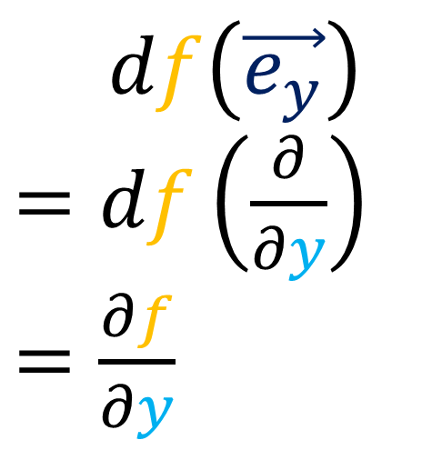

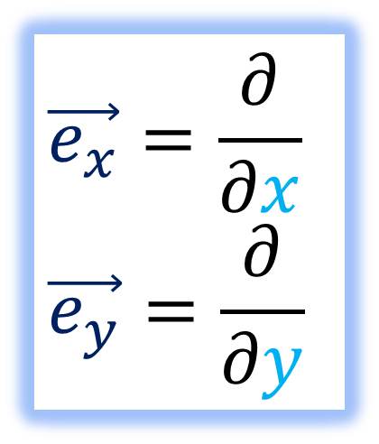
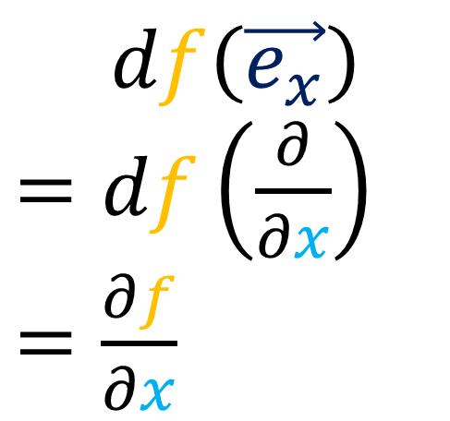
$$f$$
$$df$$
$$\vec{e_{x}}=\frac{∂}{∂x}$$
$$\vec{e_{y}}=\frac{∂}{∂y}$$
$$\vec{e_{y}}$$
$$d$$
$$\vec{e_{x}}$$
$df\left(\vec{e_{x}}\right)$
$=df\left(\frac{∂}{∂x}\right)$
$=\frac{∂f}{∂x}$
$df\left(\vec{e_{y}}\right)$
$=df\left(\frac{∂}{∂y}\right)$
$=\frac{∂f}{∂y}$

Slide 5
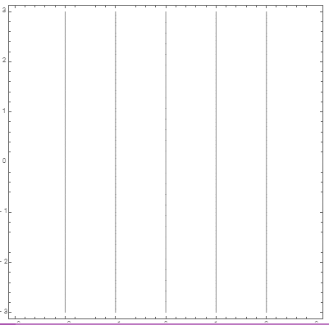
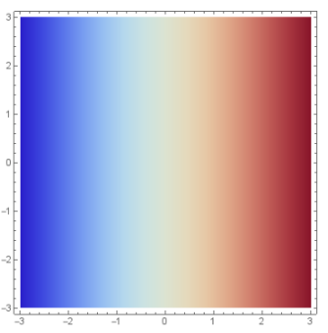
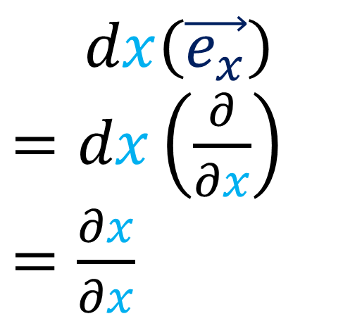



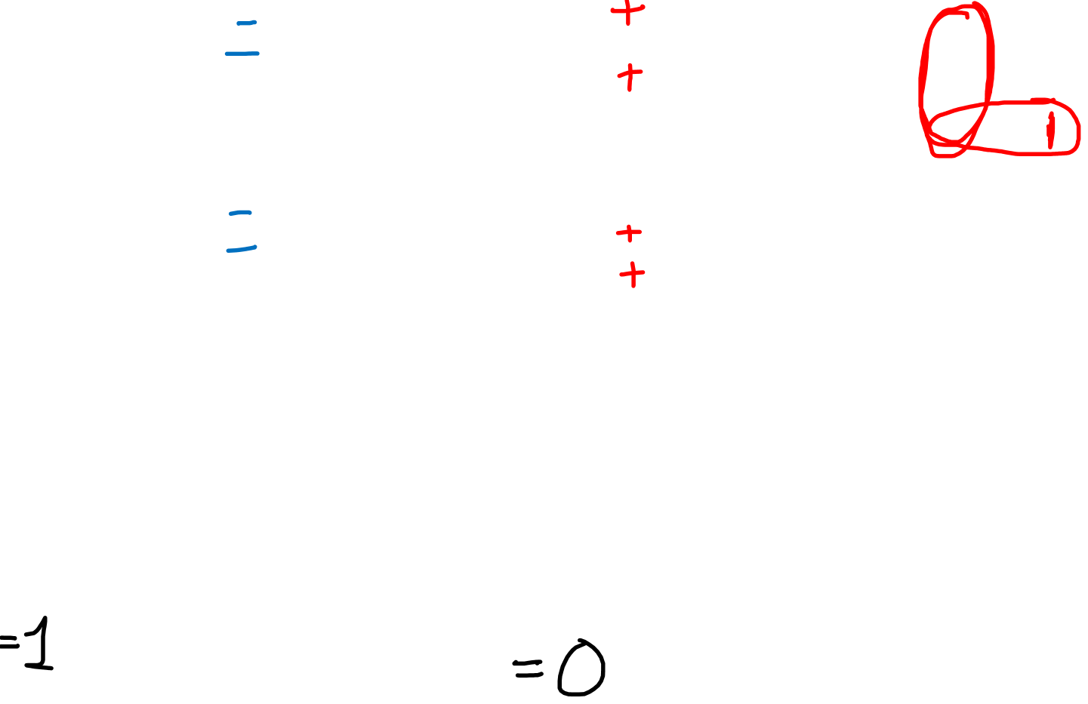

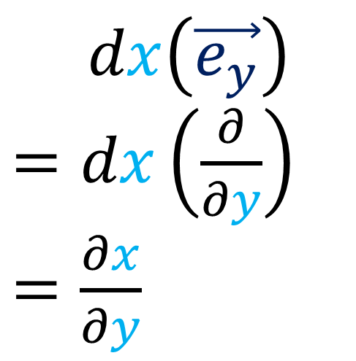
$$x$$
$$dx$$
$$\vec{e_{y}}$$
$$\vec{e_{x}}=\frac{∂}{∂x}$$
$$\vec{e_{y}}=\frac{∂}{∂y}$$
$$d$$
$$\vec{e_{x}}$$
$dx\left(\vec{e_{x}}\right)$
$=dx\left(\frac{∂}{∂x}\right)$
$=\frac{∂x}{∂x}$
$dx\left(\vec{e_{y}}\right)$
$=dx\left(\frac{∂}{∂y}\right)$
$=\frac{∂x}{∂y}$

Slide 6

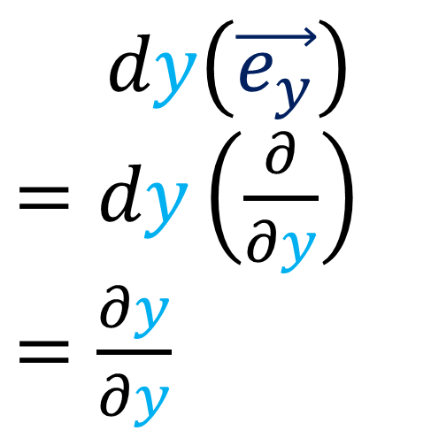

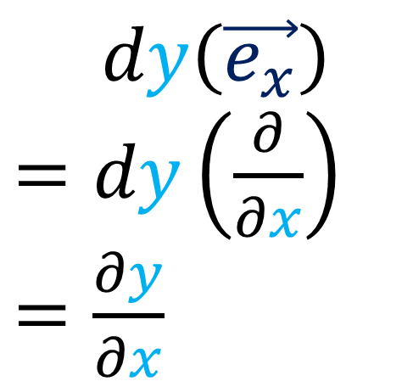
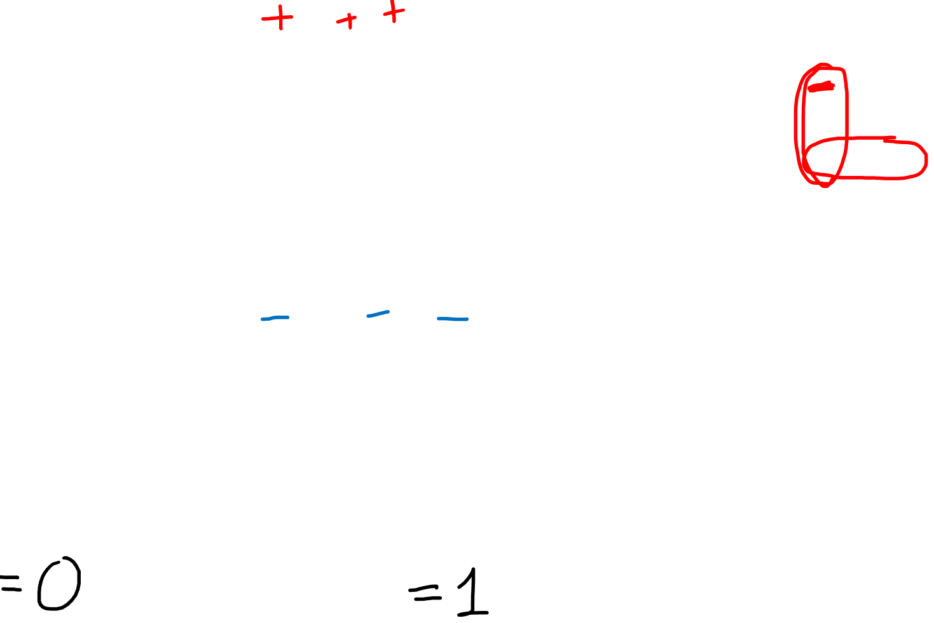


$$y$$
$$dy$$
$$\vec{e_{x}}=\frac{∂}{∂x}$$
$$\vec{e_{y}}=\frac{∂}{∂y}$$
$$\vec{e_{y}}$$
$$d$$
$$\vec{e_{x}}$$
$dy\left(\vec{e_{x}}\right)$
$=dy\left(\frac{∂}{∂x}\right)$
$=\frac{∂y}{∂x}$
$dy\left(\vec{e_{y}}\right)$
$=dy\left(\frac{∂}{∂y}\right)$
$=\frac{∂y}{∂y}$

Slide 7
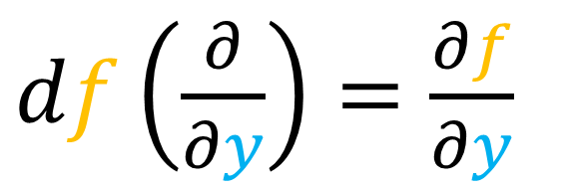
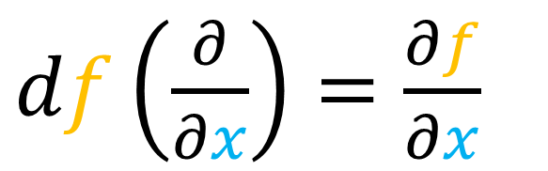
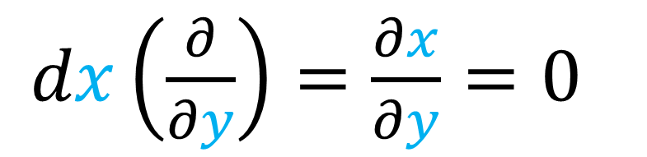
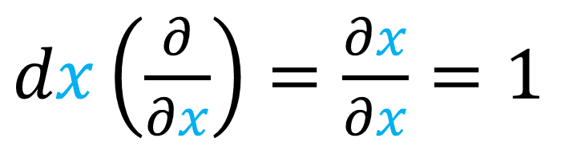
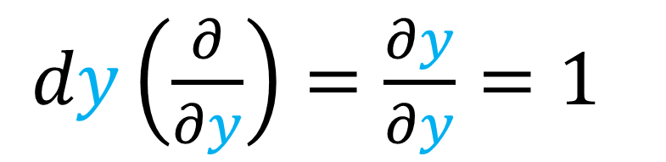
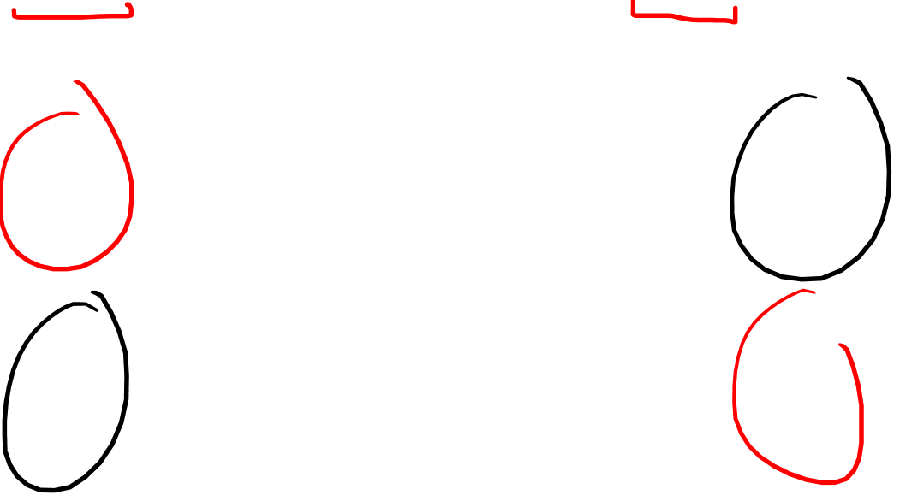
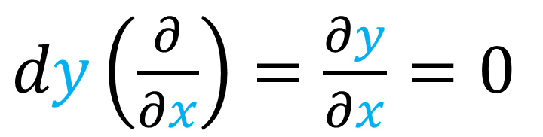
$df\left(\frac{∂}{∂x}\right)=\frac{∂f}{∂x}$
$df\left(\frac{∂}{∂y}\right)=\frac{∂f}{∂y}$
$dx\left(\frac{∂}{∂x}\right)=\frac{∂x}{∂x}=1$
$dx\left(\frac{∂}{∂y}\right)=\frac{∂x}{∂y}=0$
$dy\left(\frac{∂}{∂x}\right)=\frac{∂y}{∂x}=0$
$dy\left(\frac{∂}{∂y}\right)=\frac{∂y}{∂y}=1$

Slide 8
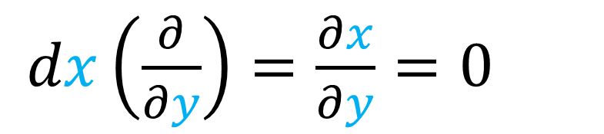
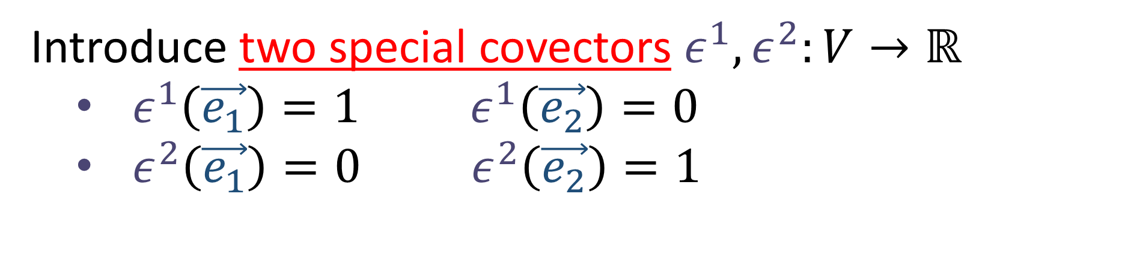
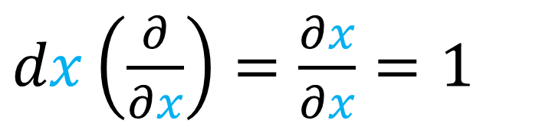
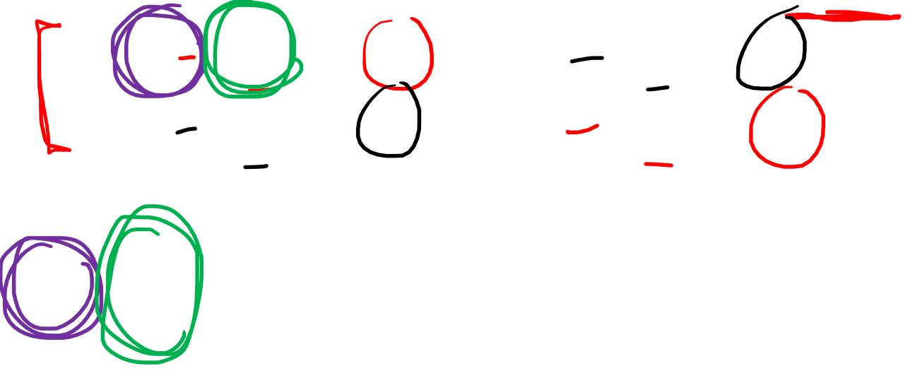
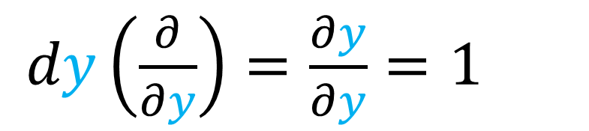
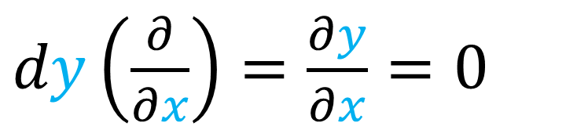

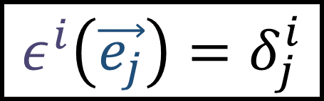
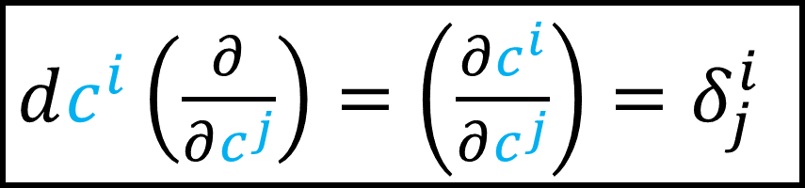
Introduce two special covectors $ε^{1},ε^{2}:V→ℝ$
$ε^{1}\left(\vec{e_{1}}\right)=1 ε^{1}\left(\vec{e_{2}}\right)=0$
$ε^{2}\left(\vec{e_{1}}\right)=0 ε^{2}\left(\vec{e_{2}}\right)=1$
$$ε^{i}\left(\vec{e_{j}}\right)=δ_{j}^{i}$$
$dx\left(\frac{∂}{∂x}\right)=\frac{∂x}{∂x}=1$
$dx\left(\frac{∂}{∂y}\right)=\frac{∂x}{∂y}=0$
$dy\left(\frac{∂}{∂x}\right)=\frac{∂y}{∂x}=0$
$dy\left(\frac{∂}{∂y}\right)=\frac{∂y}{∂y}=1$
$dc^{i}\left(\frac{∂}{∂c^{j}}\right)=\left(\frac{∂c^{i}}{∂c^{j}}\right)=δ_{j}^{i}$
$c^{1}=x, c^{2}=y$ $⇒$

Slide 9
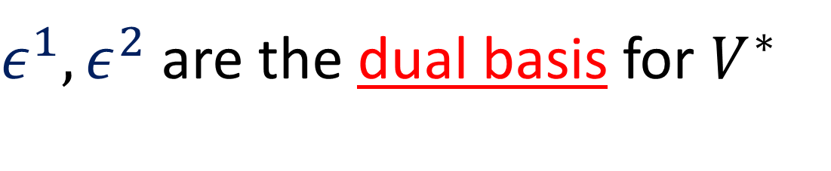





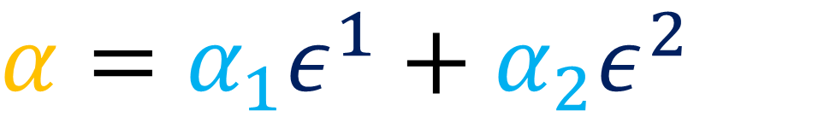
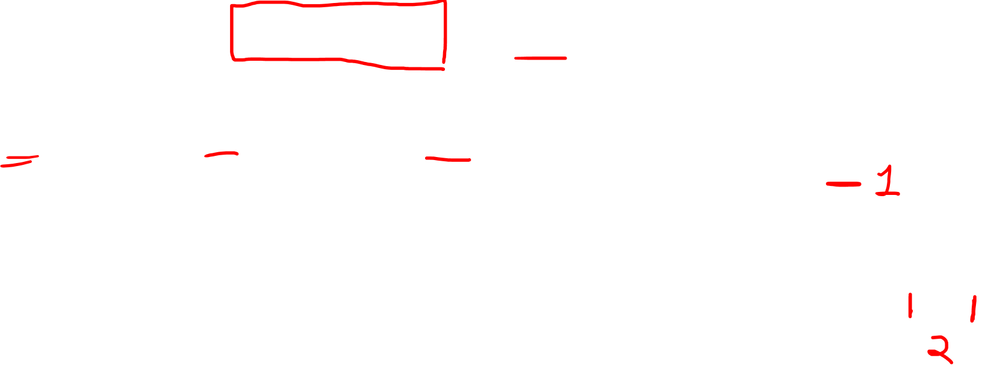
$ε^{1},ε^{2}$are the dual basis for $V^{∗}$
$$α$$
$$α=α_{1}ε^{1}+α_{2}ε^{2}$$
$$\vec{e_{2}}$$
$$α_{1}=α\left(\vec{e_{1}}\right) α_{2}=α\left(\vec{e_{2}}\right)$$
$$\vec{e_{1}}$$
$${\left[\begin{matrix}2 & 1\end{matrix}\right]}_{ε^{i}}$$

Slide 10






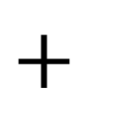
$ε^{1},ε^{2}$are the dual basis for $V^{∗}$
$$α=α_{1}ε^{1}+α_{2}ε^{2}$$
$$α_{1}=α\left(\vec{e_{1}}\right) α_{2}=α\left(\vec{e_{2}}\right)$$
$$=$$
$$α_{1}$$
$$+$$
$$α_{2}$$
$$α$$
$$ε^{1}$$
$$ε^{2}$$

Slide 11



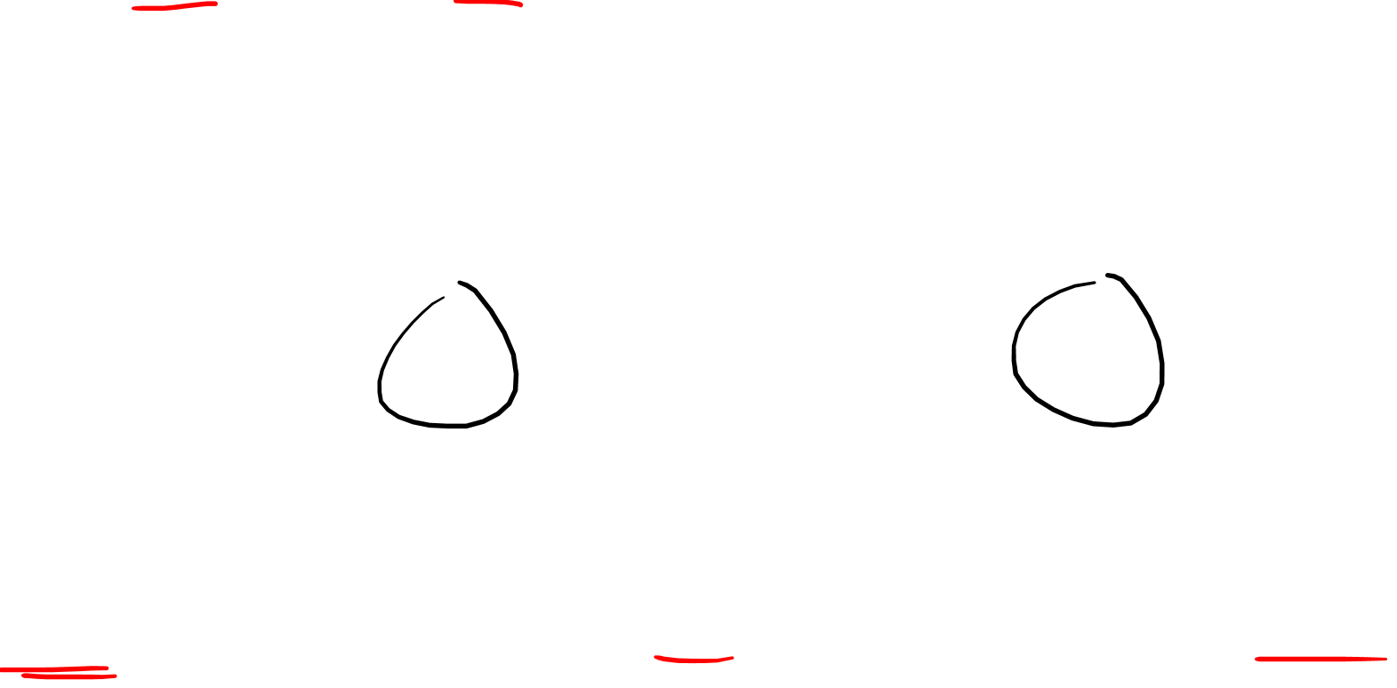


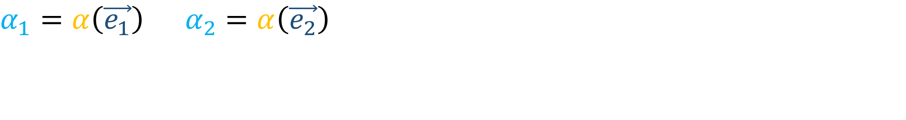


$$α_{1}=α\left(\vec{e_{1}}\right) α_{2}=α\left(\vec{e_{2}}\right)$$
$dx,dy$ are the dual basis for differential forms
$$df=Adx+Bdy$$
$$=$$
$$A$$
$$+$$
$$B$$
$$df$$
$$dx$$
$$dy$$

Slide 12

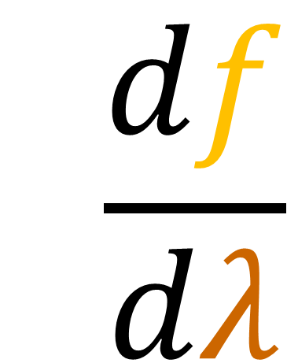


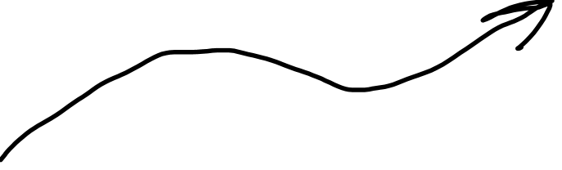

$$f\left(x,y\right)$$
$$y$$
$\frac{d}{dλ}$
$$\frac{df}{dλ}$$
$$x$$

Slide 13
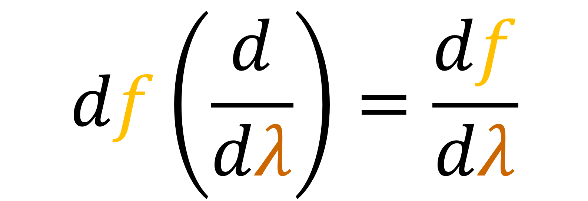

$$df\left(\frac{d}{dλ}\right)=\frac{df}{dλ}$$

Slide 14
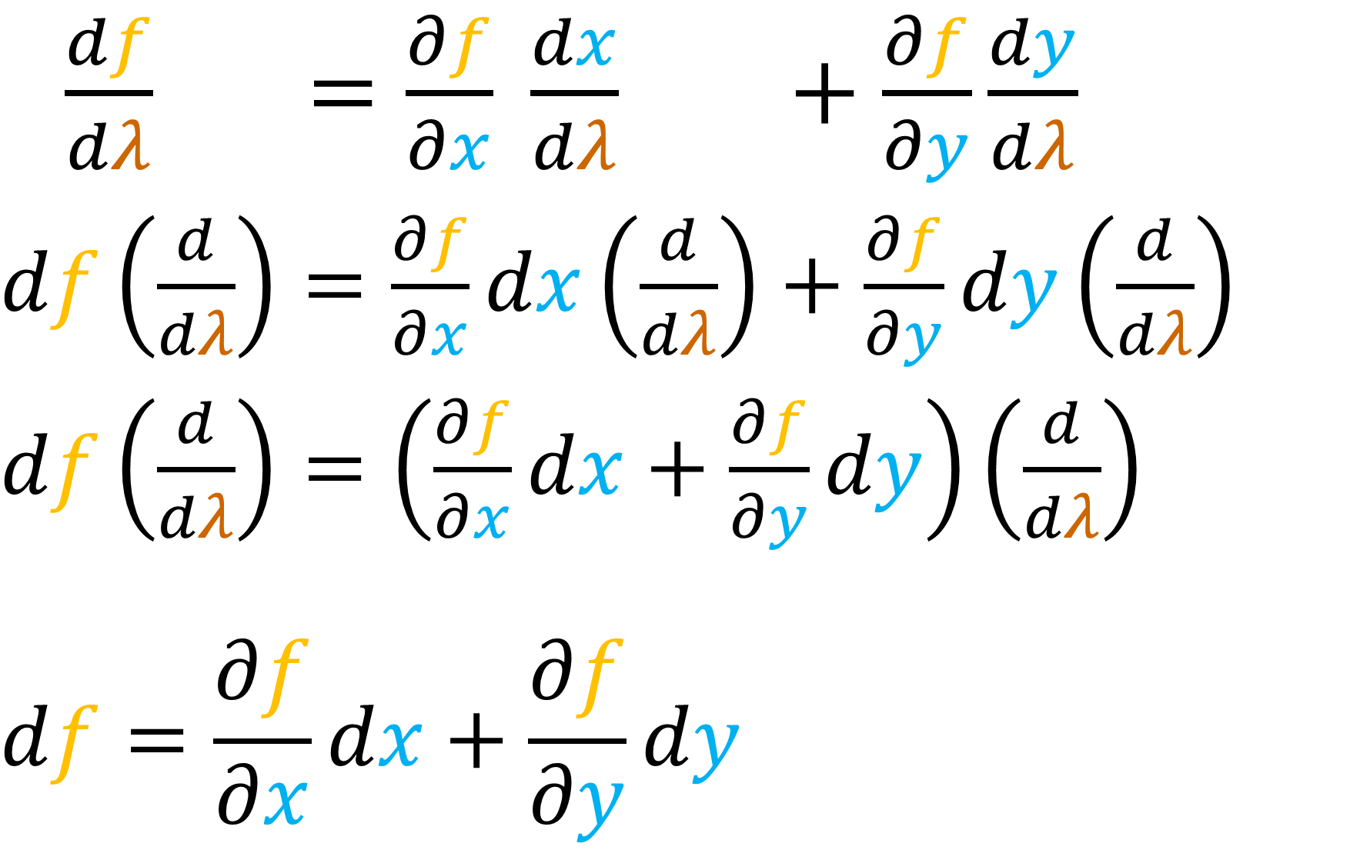


$$α_{1}=α\left(\vec{e_{1}}\right) α_{2}=α\left(\vec{e_{2}}\right)$$
$\frac{df}{dλ} =\frac{∂f}{∂x} \frac{dx}{dλ} +\frac{∂f}{∂y}\frac{dy}{dλ}$
$df\left(\frac{d}{dλ}\right)=\frac{∂f}{∂x}dx\left(\frac{d}{dλ}\right)+\frac{∂f}{∂y}dy\left(\frac{d}{dλ}\right)$
$df\left(\frac{d}{dλ}\right)=\left(\frac{∂f}{∂x}dx+\frac{∂f}{∂y}dy\right)\left(\frac{d}{dλ}\right)$
$$df=\frac{∂f}{∂x}dx+\frac{∂f}{∂y}dy$$

Slide 15
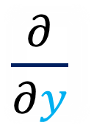
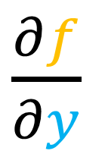
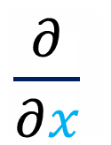



$$α_{1}=α\left(\vec{e_{1}}\right) α_{2}=α\left(\vec{e_{2}}\right)$$
$dx,dy$ are the dual basis for differential forms
$\frac{∂}{∂y}$
$df=\frac{∂f}{∂x}dx+\frac{∂f}{∂y}dy$
$\frac{∂}{∂x}$
$\frac{∂f}{∂x}$
$\frac{∂f}{∂y}$
$$=$$
$$+$$
$$df$$
$$dx$$
$$dy$$

Slide 16









$\frac{∂}{∂y}$
$\frac{∂}{∂x}$
$$\vec{e_{2}}$$
$$\vec{e_{1}}$$
$dx$
$$ε^{2}$$
$dy$
$$ε^{1}$$

Slide 17

$df=\frac{∂f}{∂x}dx+\frac{∂f}{∂y}dy$

Slide 18















$$f$$
$$y$$
$$f\left(x,y\right)=y^{2}+x−\text{½}$$
$$df=\frac{∂f}{∂x}dx+\frac{∂f}{∂y}dy$$
$$x$$
$$\frac{∂f}{∂x}=1$$
$$\frac{∂f}{∂y}=2y$$
$$=$$
$$1$$
$$+$$
$$2y$$
$$df$$
$$dx$$
$$dy$$

Slide 19








$$=$$
$$1$$
$$+$$
$$2y$$
$$dx$$
$$dy$$
$$df$$

Slide 20

$$=$$
$$1$$
$$+$$
$$2y$$
$$dx$$
$$dy$$
$$df$$

Slide 21

$$=$$
$$1$$
$$+$$
$$2y$$
$$dx$$
$$dy$$
$$df$$

Slide 22





$$y$$
$$f\left(x,y\right)=y^{2}+x−\text{½}$$
$$x$$
$$x=r\cos{θ}$$
$$y=r\sin{θ}$$
$$θ$$
$$r$$
$$f\left(r,θ\right)=r^{2}{\left(\sin{θ}\right)}^{2}+r\cos{θ}−\text{½}$$

Slide 23











$$f$$
$$f\left(r,θ\right)=r^{2}{\left(\sin{θ}\right)}^{2}+r\cos{θ}−\text{½}$$
$$θ$$
$$df=\frac{∂f}{∂r}dr+\frac{∂f}{∂θ}dθ$$
$$r$$
$$\frac{∂f}{∂r}={2r\left(\sin{θ}\right)}^{2}+\cos{θ}$$
$$\frac{∂f}{∂θ}=2r^{2}\sin{θ}\cos{θ}−r\sin{θ}$$
$$\frac{∂f}{∂r}$$
$$\frac{∂f}{∂θ}$$
$$=$$
$$+$$
$$df$$
$$dr$$
$$dθ$$

Slide 24











$$\frac{∂f}{∂r}$$
$$\frac{∂f}{∂θ}$$
$$=$$
$$+$$
$$df$$
$$dr$$
$$dθ$$
$$\frac{∂f}{∂r}=1$$
$$\frac{∂f}{∂θ}=0$$
$$\frac{∂f}{∂r}={2r\left(\sin{θ}\right)}^{2}+\cos{θ}$$
$$\frac{∂f}{∂θ}=2r^{2}\sin{θ}\cos{θ}−r\sin{θ}$$
$$θ =0$$

Slide 25





$$=$$
$$1$$
$$+$$
$$0$$
$$dr$$
$$dθ$$
For
$θ =0$
only
$$df$$

Slide 26



$$\frac{∂f}{∂r}$$
$$\frac{∂f}{∂θ}$$
$$=$$
$$+$$
$$df$$
$$dr$$
$$dθ$$
$$\frac{∂f}{∂r}=2r$$
$$\frac{∂f}{∂θ}=(−r)$$
$$\frac{∂f}{∂r}={2r\left(\sin{θ}\right)}^{2}+\cos{θ}$$
$$\frac{∂f}{∂θ}=2r^{2}\sin{θ}\cos{θ}−r\sin{θ}$$
$$θ =π/2$$

Slide 27





$$=$$
$$2r$$
$$−$$
$$r$$
$$dr$$
$$dθ$$
For
$θ =π/2$
only
$$df$$

Slide 28

$$=$$
$$2r$$
$$−$$
$$r$$
$$dr$$
$$dθ$$
$$df$$

Slide 29







$\frac{∂f}{∂r}$
$\frac{∂f}{∂θ}$
$$=$$
$$−$$
$$dr$$
$$dθ$$
$$\frac{∂f}{∂r}={2r\left(\sin{θ}\right)}^{2}+\cos{θ}$$
$$\frac{∂f}{∂θ}=2r^{2}\sin{θ}\cos{θ}−r\sin{θ}$$
$$df$$

Slide 30
$$f$$
$$f\left(r,θ\right)=r^{2}{\left(\sin{θ}\right)}^{2}+r\cos{θ}−\text{½}$$
$$θ$$
$$df=\frac{∂f}{∂r}dr+\frac{∂f}{∂θ}dθ$$
$$r$$
$$\frac{∂f}{∂r}={2r\left(\sin{θ}\right)}^{2}+\cos{θ}$$
$$\frac{∂f}{∂θ}=2r^{2}\sin{θ}\cos{θ}−r\sin{θ}$$
$$\frac{∂f}{∂r}$$
$$\frac{∂f}{∂θ}$$
$$=$$
$$+$$
$$df$$
$$dr$$
$$dθ$$

Slide 31



$$α=α_{1}ε^{1}+α_{2}ε^{2}=\tilde{α_{1}}\tilde{ε^{1}}+\tilde{α_{2}}\tilde{ε^{1}}$$
$$df=\frac{∂f}{∂x}dx+\frac{∂f}{∂y}dy=\frac{∂f}{∂r}dr+\frac{∂f}{∂θ}dθ$$

Slide 32




$$α= α_{i} ε^{i} = \tilde{α_{i}} \tilde{ε^{i}}$$
$df=\frac{∂f}{∂c^{i}}dc^{i}=\frac{∂f}{∂p^{i}}dp^{i}$
$$c^{1}=x c^{2}=y$$
$$p^{1}=r p^{2}=θ$$

Slide 33










Differentials:
$$df=\frac{∂f}{∂x}{dx}+\frac{∂f}{∂y}{dy}$$
Covector Fields:
$$df=\frac{∂f}{∂x}{dx}+\frac{∂f}{∂y}{dy}$$
$=\frac{∂f}{∂x}$
$+\frac{∂f}{∂y}$
$$df$$
$$dx$$
$$dy$$

Slide 34

$$α= α_{i} ε^{i} = \tilde{α_{i}} \tilde{ε^{i}}$$
$df=\frac{∂f}{∂c^{i}}dc^{i}=\frac{∂f}{∂p^{i}}dp^{i}$
$$c^{1}=x c^{2}=y$$
$$p^{1}=r p^{2}=θ$$

