Slide 1

Differential Form Transformation Rules
(See “Tensors for Beginners:
Covector Transformation Rules” Video)
(Link in Description)

Slide 2
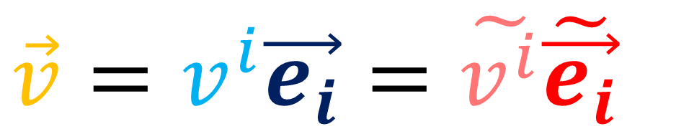
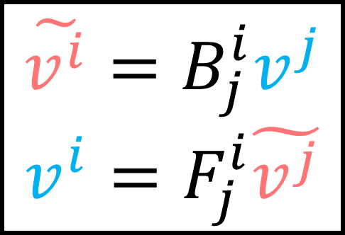
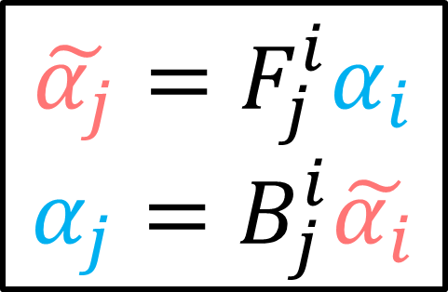
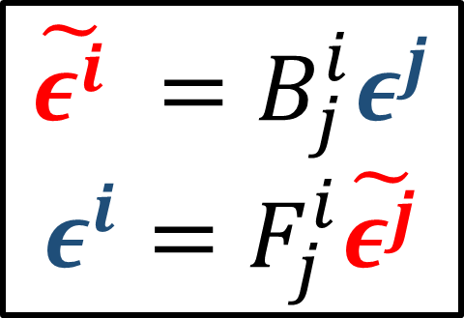
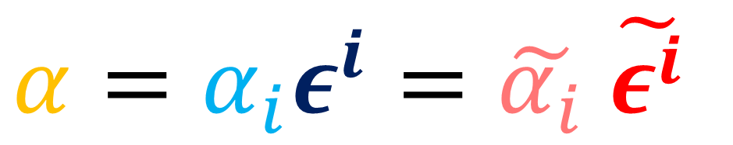
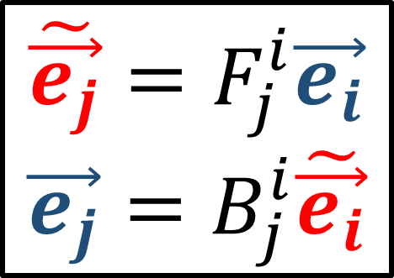
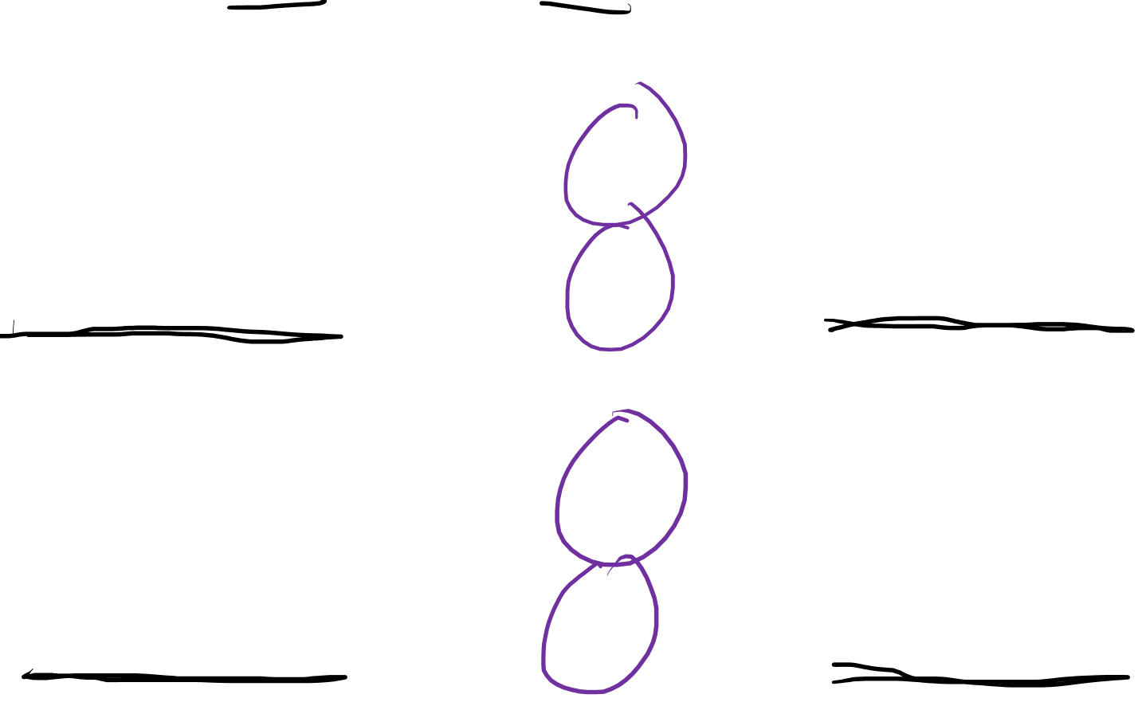
$$\vec{v}=v^{i}\vec{e_{i}}=\tilde{v^{i}}\tilde{\vec{e_{i}}}$$
$$α=α_{i}ε^{i}=\tilde{α_{i}} \tilde{ε^{i}}$$
Basis Vectors
$$\tilde{\vec{e_{j}}}=F_{j}^{i}\vec{e_{i}}$$
$$\vec{e_{j}}=B_{j}^{i}\tilde{\vec{e_{i}}}$$
$$\tilde{ε^{i}} =B_{j}^{i}ε^{j}$$
$$ε^{i}=F_{j}^{i}\tilde{ε^{j}}$$
Basis Covectors
Covariant
Contravariant
Vector
Components
$$\tilde{v^{i}}=B_{j}^{i}v^{j}$$
$$v^{i}=F_{j}^{i}\tilde{v^{j}}$$
Covector
Components
$$\tilde{α_{j}}=F_{j}^{i}α_{i}$$
$$α_{j}=B_{j}^{i}\tilde{α_{i}}$$
Covariant
Contravariant

Slide 3
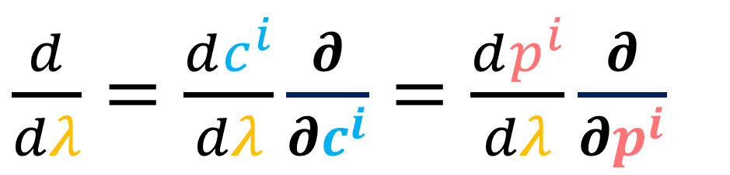
$\frac{d}{dλ}=\frac{dc^{i}}{dλ}\frac{∂}{∂c^{i}}=\frac{dp^{i}}{dλ}\frac{∂}{∂p^{i}}$
$$α=α_{i}ε^{i}=\tilde{α_{i}} \tilde{ε^{i}}$$
Basis Vectors
$$\tilde{\vec{e_{j}}}=F_{j}^{i}\vec{e_{i}}$$
$$\vec{e_{j}}=B_{j}^{i}\tilde{\vec{e_{i}}}$$
$$\tilde{ε^{i}} =B_{j}^{i}ε^{j}$$
$$ε^{i}=F_{j}^{i}\tilde{ε^{j}}$$
Basis Covectors
Covariant
Contravariant
Vector
Components
$$\tilde{v^{i}}=B_{j}^{i}v^{j}$$
$$v^{i}=F_{j}^{i}\tilde{v^{j}}$$
Covector
Components
$$\tilde{α_{j}}=F_{j}^{i}α_{i}$$
$$α_{j}=B_{j}^{i}\tilde{α_{i}}$$
Covariant
Contravariant

Slide 4
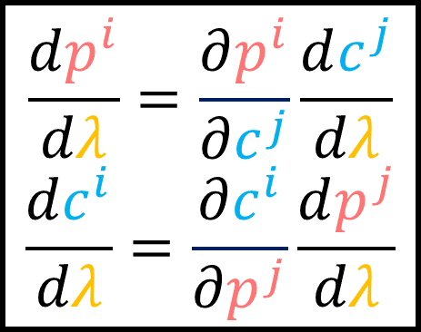
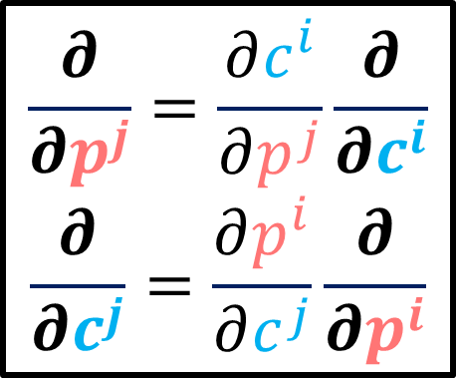
$\frac{d}{dλ}=\frac{dc^{i}}{dλ}\frac{∂}{∂c^{i}}=\frac{dp^{i}}{dλ}\frac{∂}{∂p^{i}}$
$$α=α_{i}ε^{i}=\tilde{α_{i}} \tilde{ε^{i}}$$
Basis Vectors
$$\frac{∂}{∂p^{j}}=\frac{∂c^{i}}{∂p^{j}}\frac{∂}{∂c^{i}}$$
$$\frac{∂}{∂c^{j}}=\frac{∂p^{i}}{∂c^{j}}\frac{∂}{∂p^{i}}$$
$$\tilde{ε^{i}} =B_{j}^{i}ε^{j}$$
$$ε^{i}=F_{j}^{i}\tilde{ε^{j}}$$
Basis Covectors
Covariant
Contravariant
Vector
Components
$$\frac{dp^{i}}{dλ}=\frac{∂p^{i}}{∂c^{j}}\frac{dc^{j}}{dλ}$$
$$\frac{dc^{i}}{dλ}=\frac{∂c^{i}}{∂p^{j}}\frac{dp^{j}}{dλ}$$
Covector
Components
$$\tilde{α_{j}}=F_{j}^{i}α_{i}$$
$$α_{j}=B_{j}^{i}\tilde{α_{i}}$$
Covariant
Contravariant

Slide 5
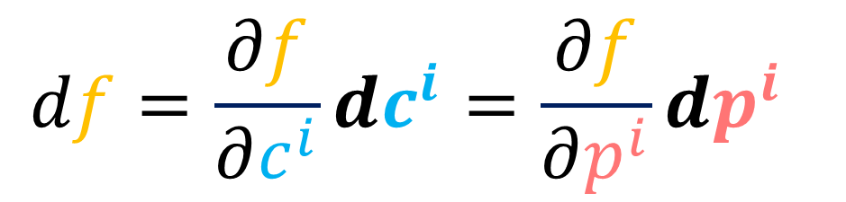
$\frac{d}{dλ}=\frac{dc^{i}}{dλ}\frac{∂}{∂c^{i}}=\frac{dp^{i}}{dλ}\frac{∂}{∂p^{i}}$
$$df=\frac{∂f}{∂c^{i}}dc^{i}=\frac{∂f}{∂p^{i}}dp^{i}$$
Basis Vectors
$$\frac{∂}{∂p^{j}}=\frac{∂c^{i}}{∂p^{j}}\frac{∂}{∂c^{i}}$$
$$\frac{∂}{∂c^{j}}=\frac{∂p^{i}}{∂c^{j}}\frac{∂}{∂p^{i}}$$
$$\tilde{ε^{i}} =B_{j}^{i}ε^{j}$$
$$ε^{i}=F_{j}^{i}\tilde{ε^{j}}$$
Basis Covectors
Covariant
Contravariant
Vector
Components
$$\frac{dp^{i}}{dλ}=\frac{∂p^{i}}{∂c^{j}}\frac{dc^{j}}{dλ}$$
$$\frac{dc^{i}}{dλ}=\frac{∂c^{i}}{∂p^{j}}\frac{dp^{j}}{dλ}$$
Covector
Components
$$\tilde{α_{j}}=F_{j}^{i}α_{i}$$
$$α_{j}=B_{j}^{i}\tilde{α_{i}}$$
Covariant
Contravariant

Slide 6


$\frac{d}{dλ}=\frac{dc^{i}}{dλ}\frac{∂}{∂c^{i}}=\frac{dp^{i}}{dλ}\frac{∂}{∂p^{i}}$
$$df=\frac{∂f}{∂c^{i}}dc^{i}=\frac{∂f}{∂p^{i}}dp^{i}$$
$$\frac{∂}{∂p^{j}}=\frac{∂c^{i}}{∂p^{j}}\frac{∂}{∂c^{i}}$$
$$\frac{∂}{∂c^{j}}=\frac{∂p^{i}}{∂c^{j}}\frac{∂}{∂p^{i}}$$
?
Basis Vectors
Basis Covectors
$$\tilde{ε^{i}} =B_{j}^{i}ε^{j}$$
$$ε^{i}=F_{j}^{i}\tilde{ε^{j}}$$
Covariant
$$\frac{dp^{i}}{dλ}=\frac{∂p^{i}}{∂c^{j}}\frac{dc^{j}}{dλ}$$
$$\frac{dc^{i}}{dλ}=\frac{∂c^{i}}{∂p^{j}}\frac{dp^{j}}{dλ}$$
?
Vector
Components
Covector
Components
$$\tilde{α_{j}}=F_{j}^{i}α_{i}$$
$$α_{j}=B_{j}^{i}\tilde{α_{i}}$$
Contravariant

Slide 7
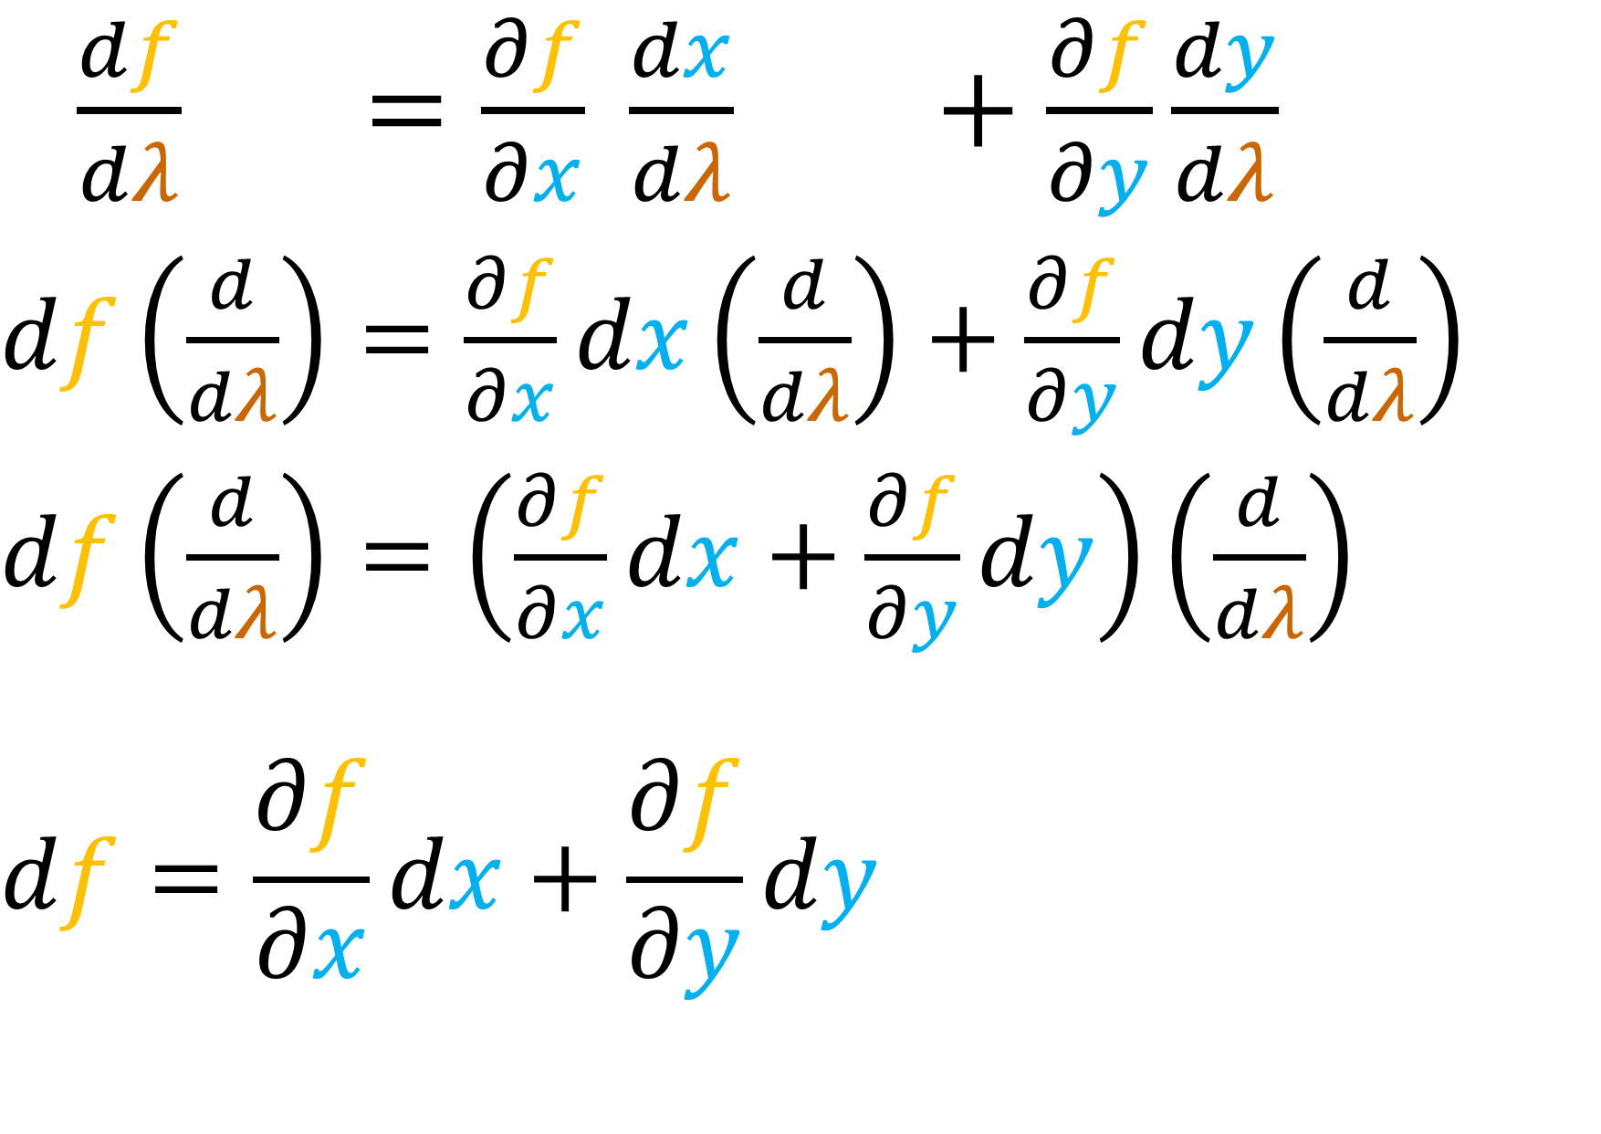

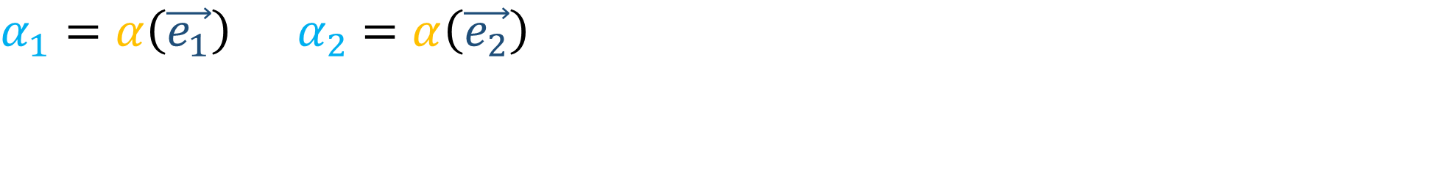
$$α_{1}=α\left(\vec{e_{1}}\right) α_{2}=α\left(\vec{e_{2}}\right)$$
$\frac{df}{dλ} =\frac{∂f}{∂x} \frac{dx}{dλ} +\frac{∂f}{∂y}\frac{dy}{dλ}$
$df\left(\frac{d}{dλ}\right)=\frac{∂f}{∂x}dx\left(\frac{d}{dλ}\right)+\frac{∂f}{∂y}dy\left(\frac{d}{dλ}\right)$
$df\left(\frac{d}{dλ}\right)=\left(\frac{∂f}{∂x}dx+\frac{∂f}{∂y}dy\right)\left(\frac{d}{dλ}\right)$
$$df=\frac{∂f}{∂x}dx+\frac{∂f}{∂y}dy$$

Slide 8

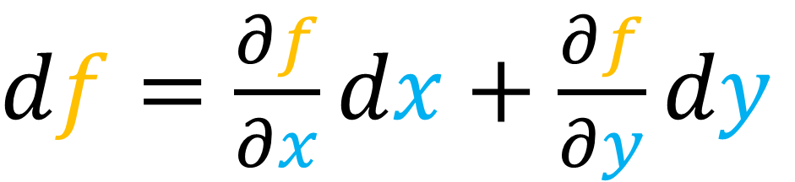
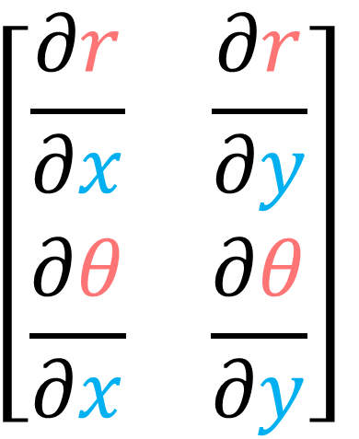
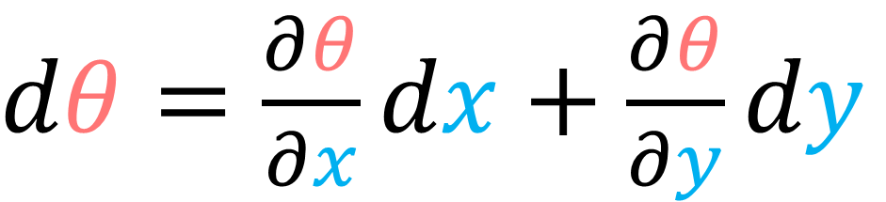
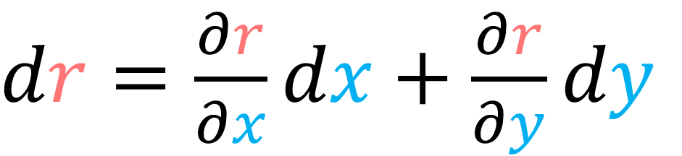

$$α_{1}=α\left(\vec{e_{1}}\right) α_{2}=α\left(\vec{e_{2}}\right)$$
$df=\frac{∂f}{∂x}dx+\frac{∂f}{∂y}dy$
Inverse Jacobian $J^{−1}$
(Backward Transform $B$)
$dr=\frac{∂r}{∂x}dx+\frac{∂r}{∂y}dy$
$$\left[\begin{matrix}\frac{∂r}{∂x} & \frac{∂r}{∂y} \\ \frac{∂θ}{∂x} & \frac{∂θ}{∂y}\end{matrix}\right]$$
$dθ=\frac{∂θ}{∂x}dx+\frac{∂θ}{∂y}dy$

Slide 9
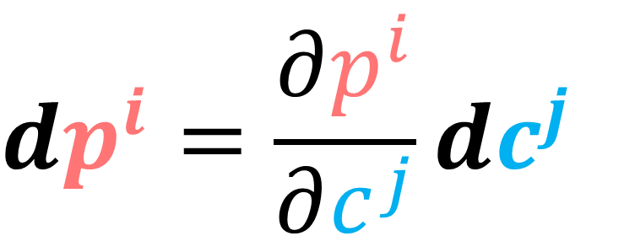

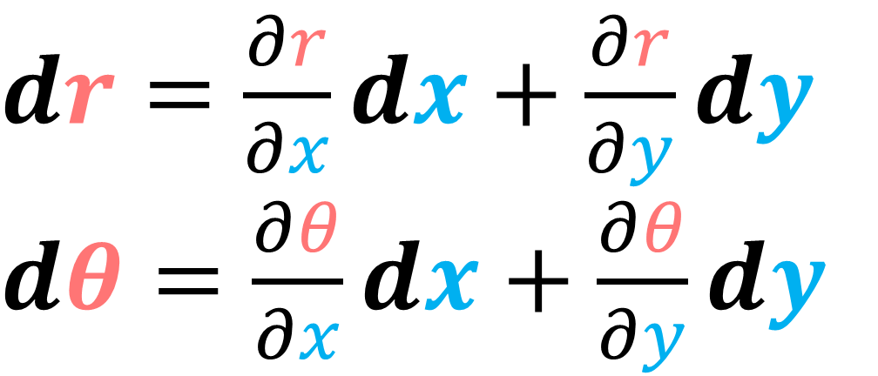
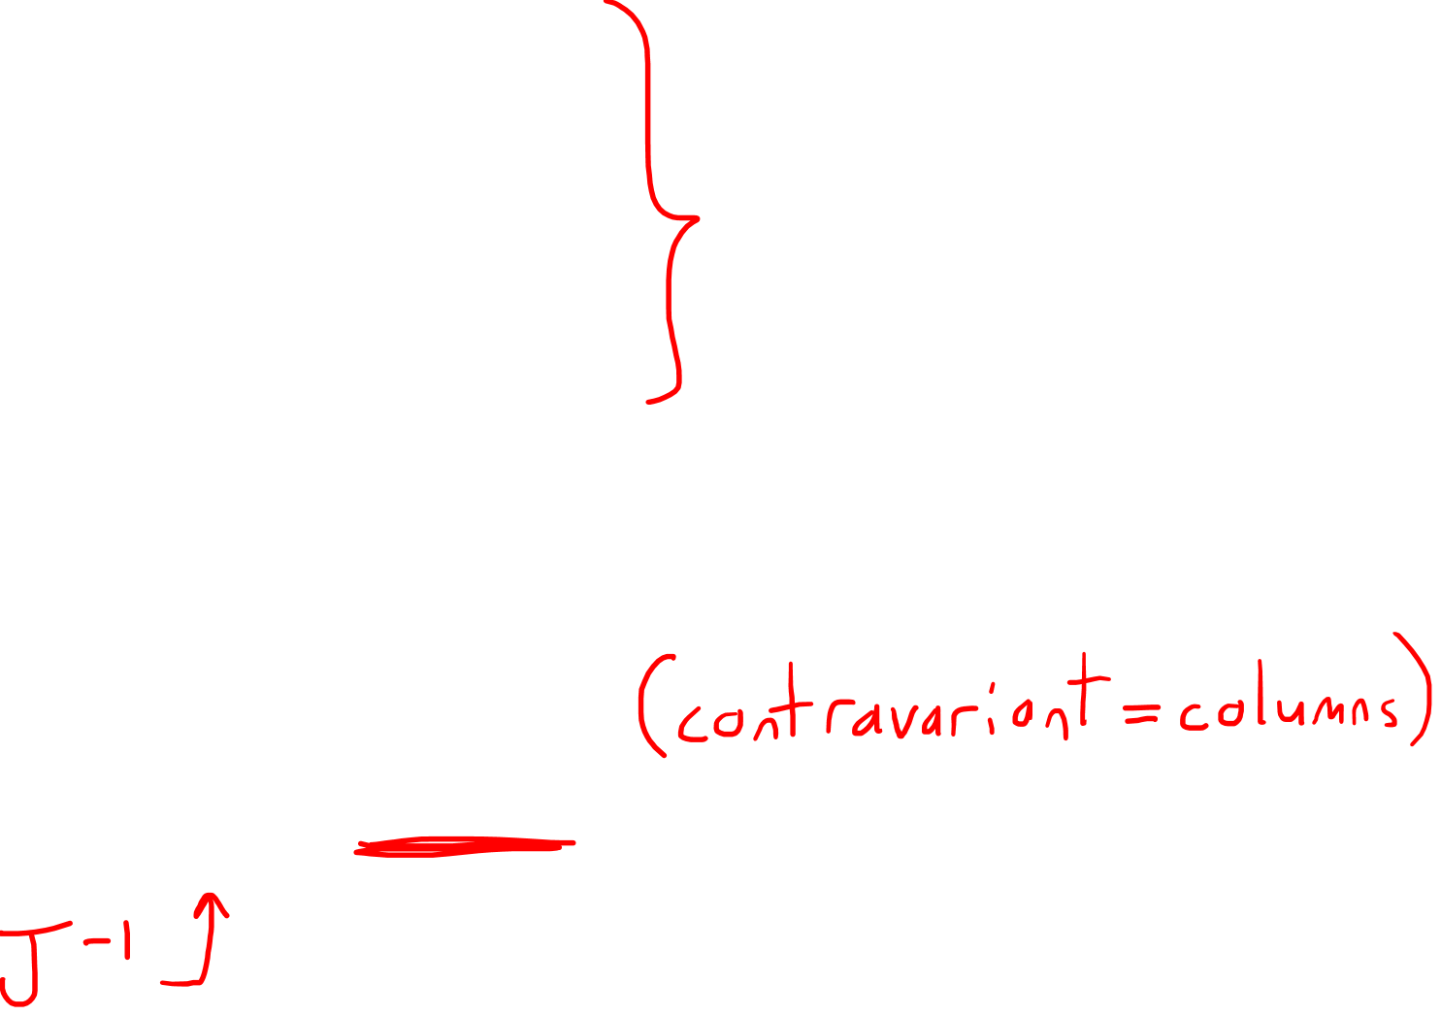
$$α_{1}=α\left(\vec{e_{1}}\right) α_{2}=α\left(\vec{e_{2}}\right)$$
$dr=\frac{∂r}{∂x}dx+\frac{∂r}{∂y}dy$
$dθ=\frac{∂θ}{∂x}dx+\frac{∂θ}{∂y}dy$
$$dp^{i}=\frac{∂p^{i}}{∂c^{j}}dc^{j}$$
$\left[\begin{aligned}dr \\ dθ\end{aligned}\right]$ $=\left[\begin{matrix}\frac{∂r}{∂x} & \frac{∂r}{∂y} \\ \frac{∂θ}{∂x} & \frac{∂θ}{∂y}\end{matrix}\right]$ $\left[\begin{aligned}dx \\ dy\end{aligned}\right]$

Slide 10
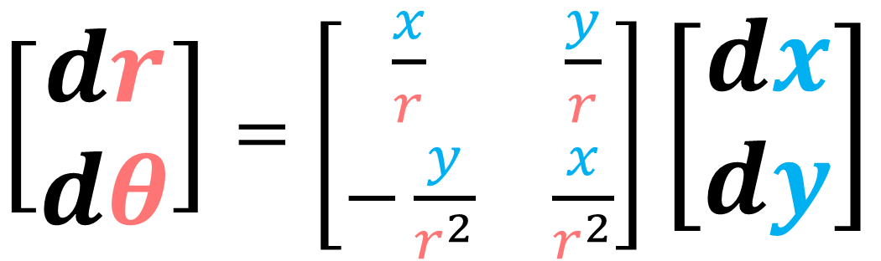
$$α_{1}=α\left(\vec{e_{1}}\right) α_{2}=α\left(\vec{e_{2}}\right)$$
$dr=\frac{∂r}{∂x}dx+\frac{∂r}{∂y}dy$
$dθ=\frac{∂θ}{∂x}dx+\frac{∂θ}{∂y}dy$
$$dp^{i}=\frac{∂p^{i}}{∂c^{j}}dc^{j}$$
$\left[\begin{aligned}dr \\ dθ\end{aligned}\right]$ $=\left[\begin{matrix}\frac{x}{r} & \frac{y}{r} \\ −\frac{y}{r^{2}} & \frac{x}{r^{2}}\end{matrix}\right]$ $\left[\begin{aligned}dx \\ dy\end{aligned}\right]$

Slide 11
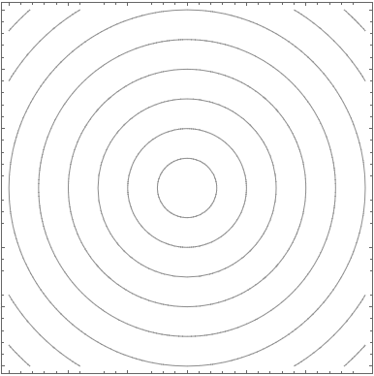


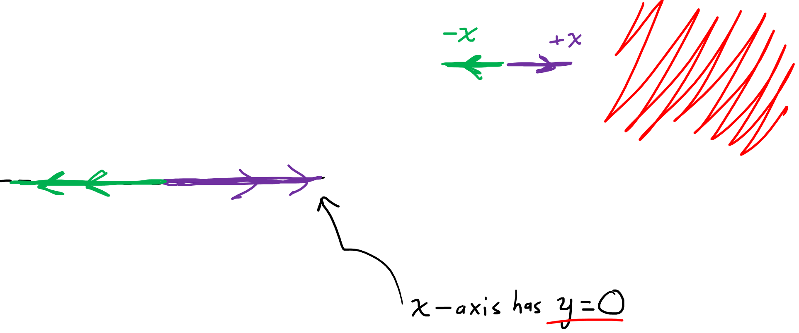






$$=$$
$\frac{x}{r}$
$$+$$
$\frac{y}{r}$
$$dx$$
$$dy$$
$$dr$$

Slide 12
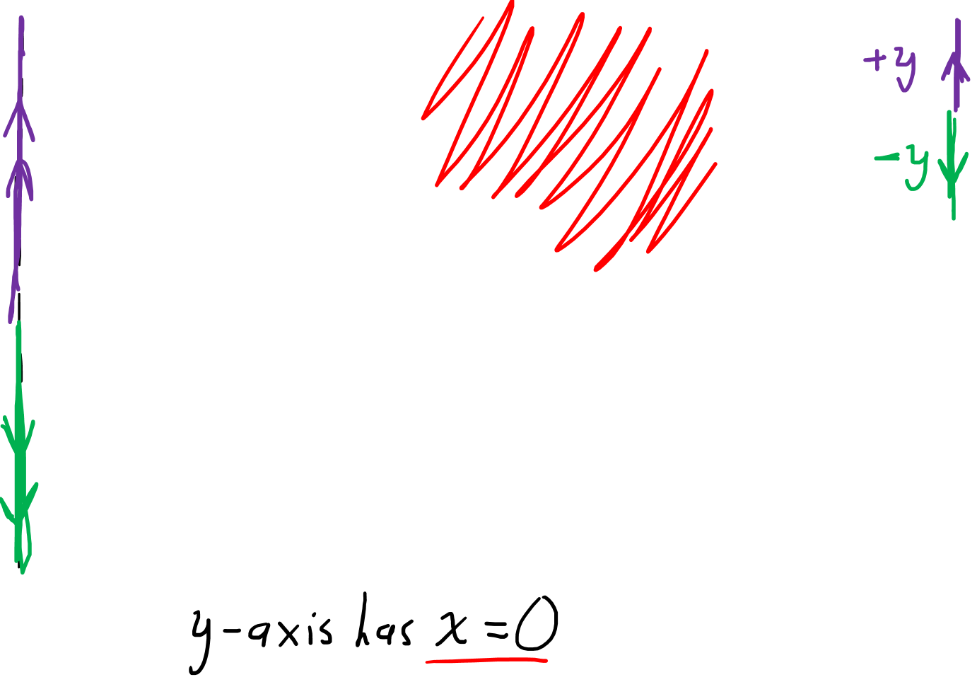
$$=$$
$\frac{x}{r}$
$$+$$
$\frac{y}{r}$
$$dx$$
$$dy$$
$$dr$$

Slide 13
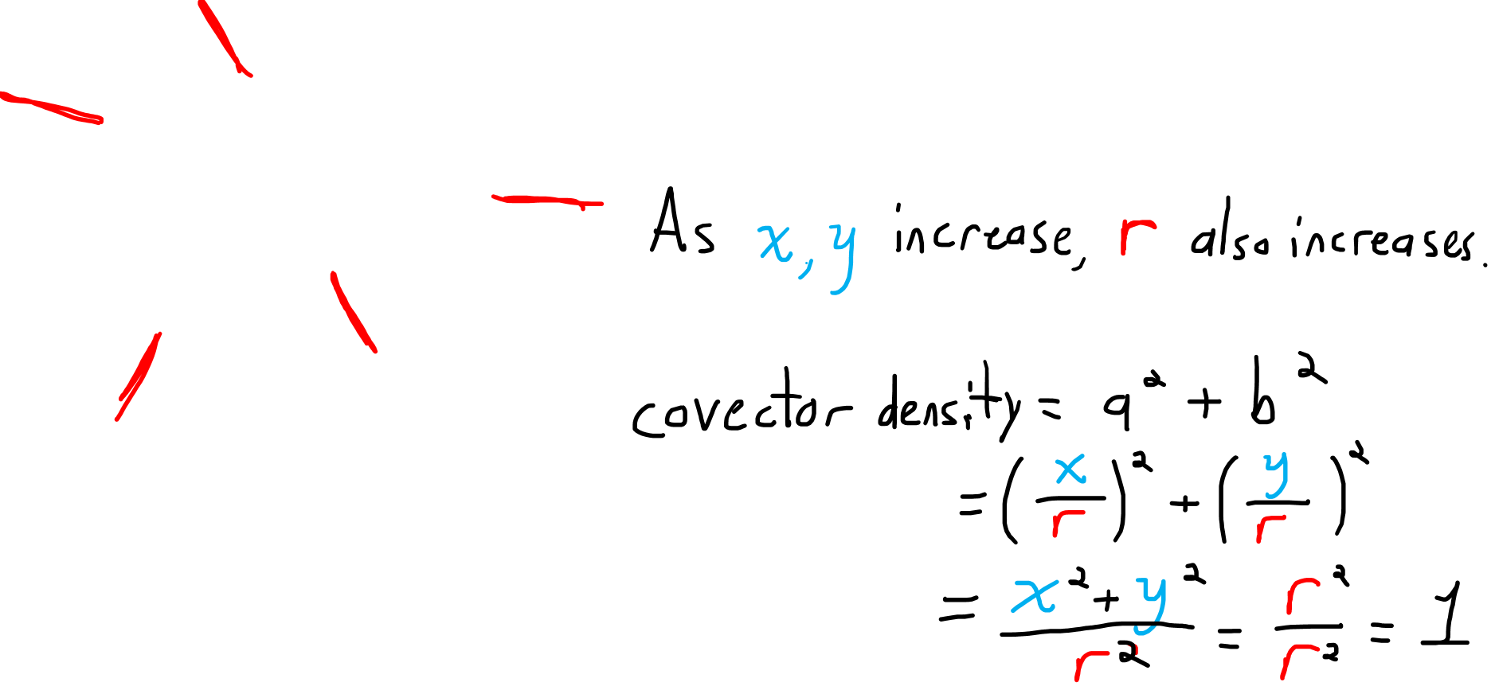
$$=$$
$\frac{x}{r}$
$$+$$
$\frac{y}{r}$
$$dx$$
$$dy$$
$$dr$$

Slide 14
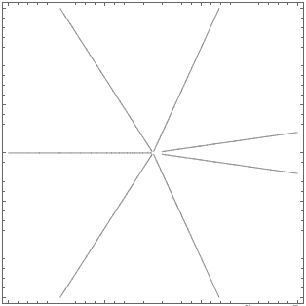
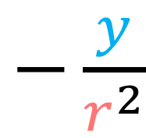
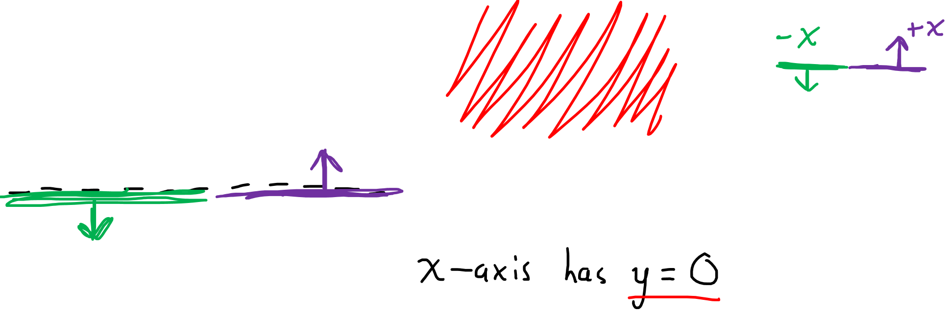



$$=$$
$−\frac{y}{r^{2}}$
$$+$$
$\frac{x}{r^{2}}$
$$dx$$
$$dy$$
$$dθ$$

Slide 15
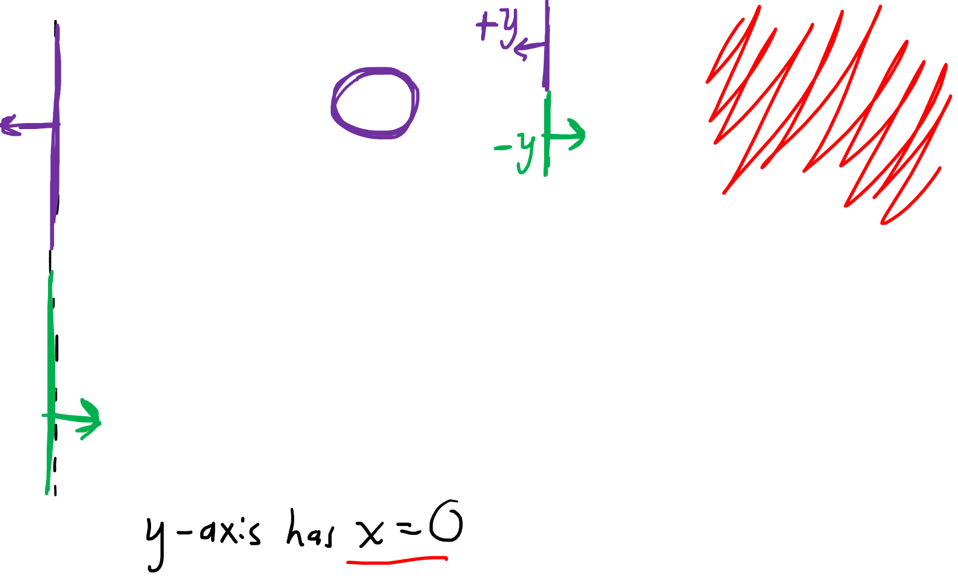
$$=$$
$−\frac{y}{r^{2}}$
$$+$$
$\frac{x}{r^{2}}$
$$dx$$
$$dy$$
$$dθ$$

Slide 16

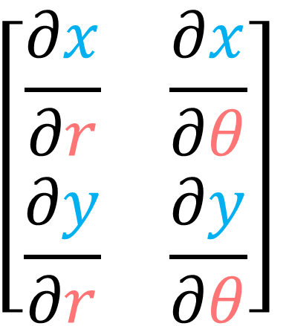

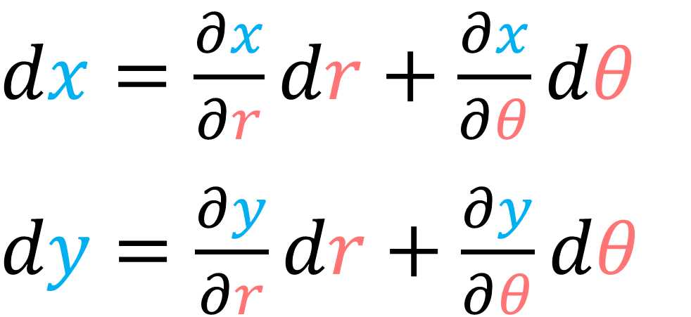
$$α_{1}=α\left(\vec{e_{1}}\right) α_{2}=α\left(\vec{e_{2}}\right)$$
$df=\frac{∂f}{∂x}dx+\frac{∂f}{∂y}dy$
Jacobian $J^{}$
(Forward Transform $F$)
$dx=\frac{∂x}{∂r}dr+\frac{∂x}{∂θ}dθ$
$dy=\frac{∂y}{∂r}dr+\frac{∂y}{∂θ}dθ$
$$\left[\begin{matrix}\frac{∂x}{∂r} & \frac{∂x}{∂θ} \\ \frac{∂y}{∂r} & \frac{∂y}{∂θ}\end{matrix}\right]$$

Slide 17
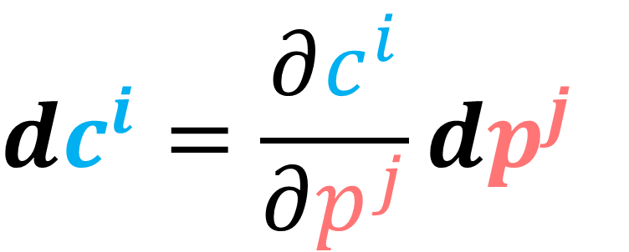

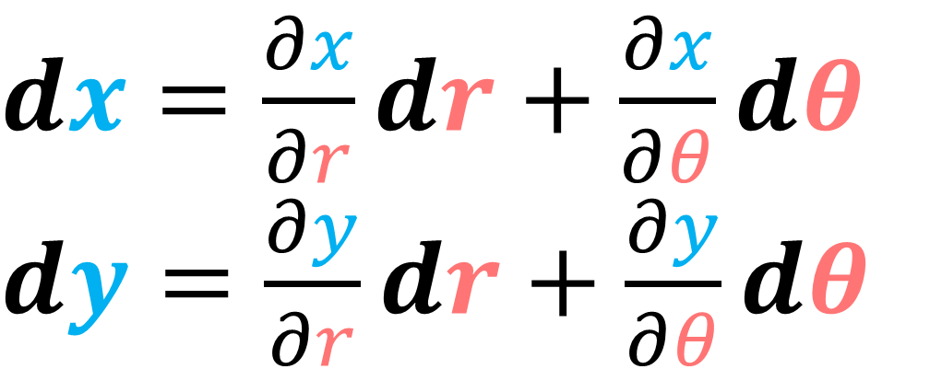
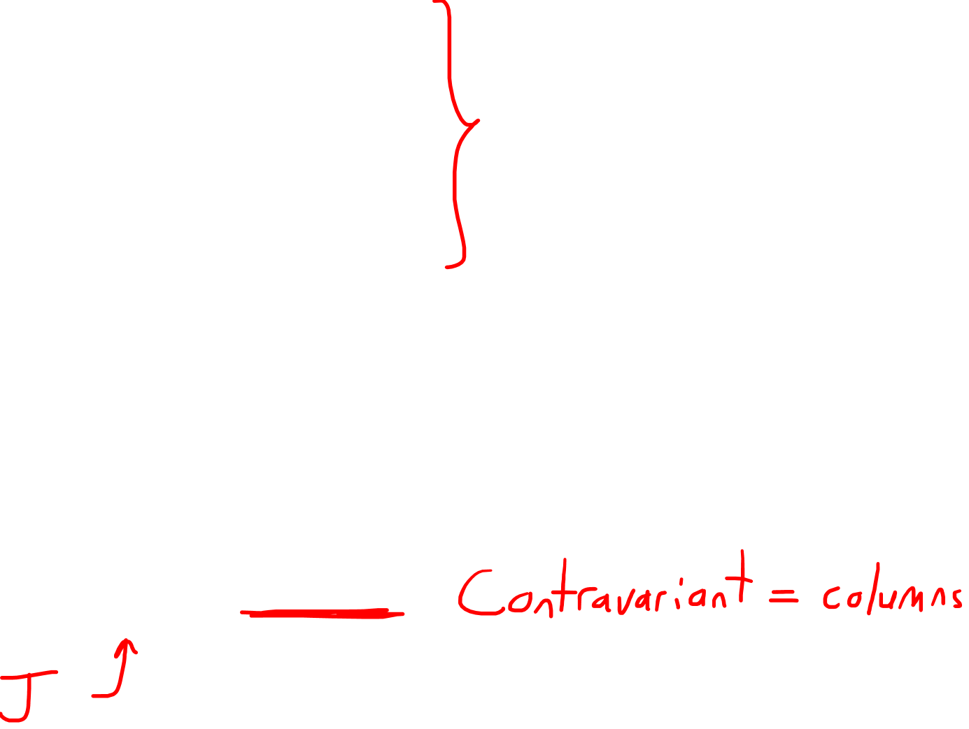
$$α_{1}=α\left(\vec{e_{1}}\right) α_{2}=α\left(\vec{e_{2}}\right)$$
$dx=\frac{∂x}{∂r}dr+\frac{∂x}{∂θ}dθ$
$dy=\frac{∂y}{∂r}dr+\frac{∂y}{∂θ}dθ$
$$dc^{i}=\frac{∂c^{i}}{∂p^{j}}dp^{j}$$
$\left[\begin{aligned}dx \\ dy\end{aligned}\right]$ $=\left[\begin{matrix}\frac{∂x}{∂r} & \frac{∂x}{∂θ} \\ \frac{∂y}{∂r} & \frac{∂y}{∂θ}\end{matrix}\right]\left[\begin{aligned}dr \\ dθ\end{aligned}\right]$

Slide 18

$$α_{1}=α\left(\vec{e_{1}}\right) α_{2}=α\left(\vec{e_{2}}\right)$$
$dx=\frac{∂x}{∂r}dr+\frac{∂x}{∂θ}dθ$
$dy=\frac{∂y}{∂r}dr+\frac{∂y}{∂θ}dθ$
$$dc^{i}=\frac{∂c^{i}}{∂p^{j}}dp^{j}$$
$\left[\begin{aligned}dx \\ dy\end{aligned}\right]$ $=\left[\begin{matrix}x/r & −y \\ y/r & x\end{matrix}\right]\left[\begin{aligned}dr \\ dθ\end{aligned}\right]$

Slide 19

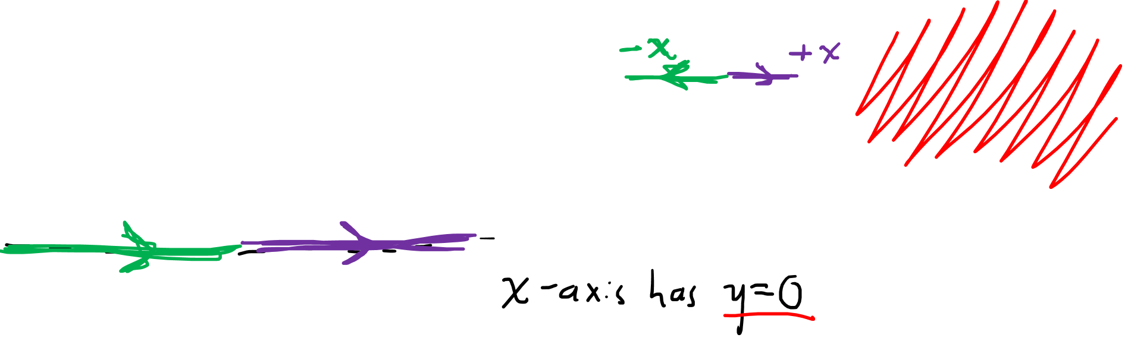





$\frac{x}{r}$
$$=$$
$$−$$
$$y$$
$$dr$$
$$dθ$$
$$dx$$

Slide 20
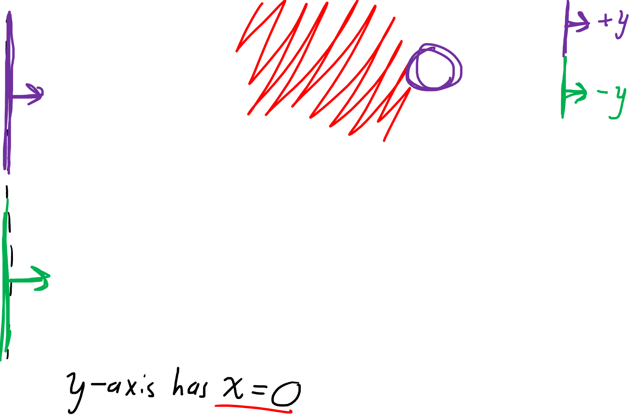
$\frac{x}{r}$
$$=$$
$$−$$
$$y$$
$$dr$$
$$dθ$$
$$dx$$

Slide 21
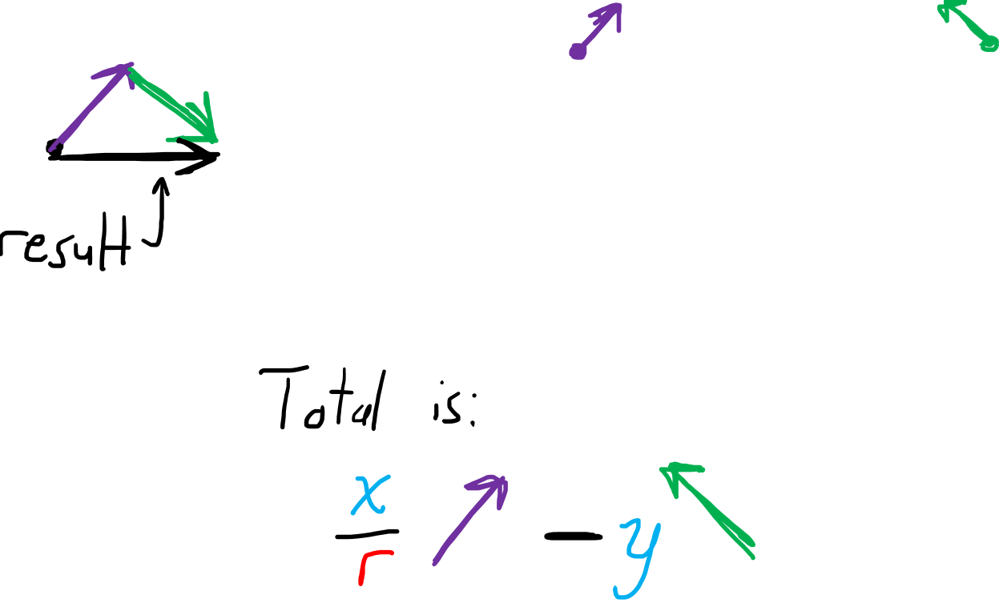
$\frac{x}{r}$
$$=$$
$$−$$
$$y$$
$$dr$$
$$dθ$$
$$dx$$

Slide 22

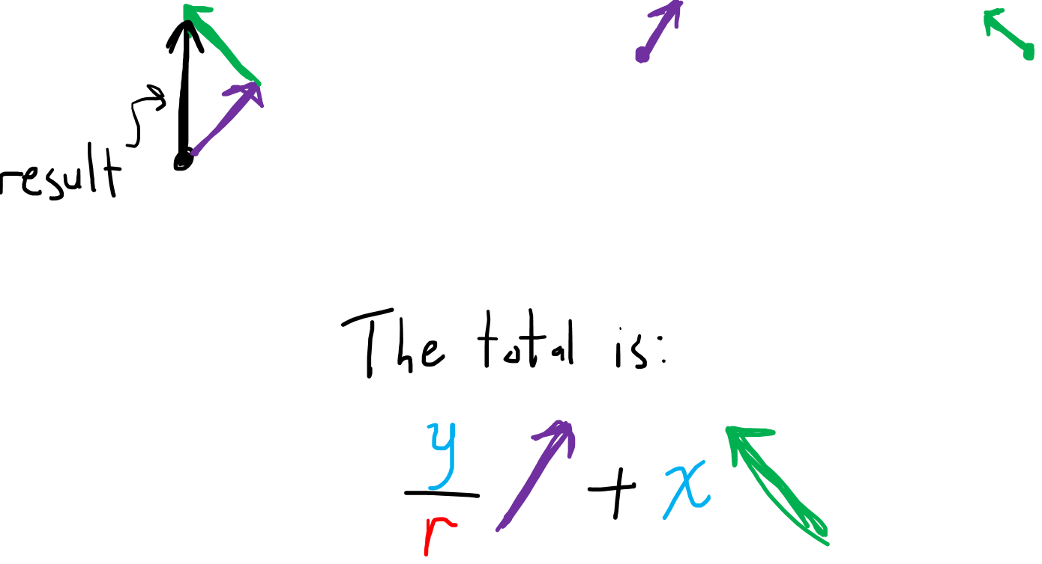



$\frac{y}{r}$
$$=$$
$$+$$
$$x$$
$$dr$$
$$dθ$$
$$dy$$

Slide 23
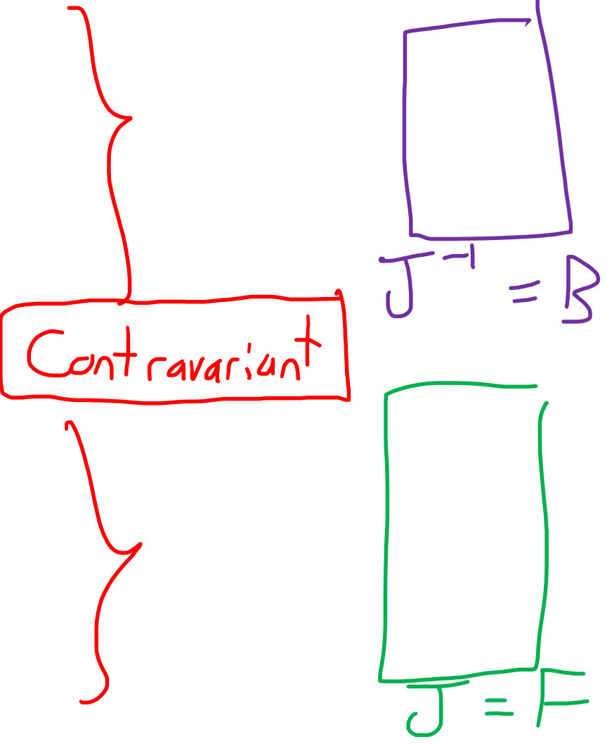


$dr=\frac{∂r}{∂x}dx+\frac{∂r}{∂y}dy$
$dθ=\frac{∂θ}{∂x}dx+\frac{∂θ}{∂y}dy$
$$dp^{i}=\frac{∂p^{i}}{∂c^{j}}dc^{j}$$
$dx=\frac{∂x}{∂r}dr+\frac{∂x}{∂θ}dθ$
$dy=\frac{∂y}{∂r}dr+\frac{∂y}{∂θ}dθ$
$$dc^{i}=\frac{∂c^{i}}{∂p^{j}}dp^{j}$$

Slide 24



$\frac{d}{dλ}=\frac{dc^{i}}{dλ}\frac{∂}{∂c^{i}}=\frac{dp^{i}}{dλ}\frac{∂}{∂p^{i}}$
$$df=\frac{∂f}{∂c^{i}}dc^{i}=\frac{∂f}{∂p^{i}}dp^{i}$$
$$\frac{∂}{∂p^{j}}=\frac{∂c^{i}}{∂p^{j}}\frac{∂}{∂c^{i}}$$
$$\frac{∂}{∂c^{j}}=\frac{∂p^{i}}{∂c^{j}}\frac{∂}{∂p^{i}}$$
$$dp^{i}=\frac{∂p^{i}}{∂c^{j}}dc^{j}$$
$$dc^{i}=\frac{∂c^{i}}{∂p^{j}}dp^{j}$$
Basis Vectors
Basis Covectors
?
Covariant
Vector
Components
$$\frac{dp^{i}}{dλ}=\frac{∂p^{i}}{∂c^{j}}\frac{dc^{j}}{dλ}$$
$$\frac{dc^{i}}{dλ}=\frac{∂c^{i}}{∂p^{j}}\frac{dp^{j}}{dλ}$$
Covector
Components
$$\frac{∂f}{∂p^{j}}=\frac{∂c^{i}}{∂p^{j}}\frac{∂f}{∂c^{i}}$$
$$\frac{∂f}{∂c^{j}}=\frac{∂p^{i}}{∂c^{j}}\frac{∂f}{∂p^{i}}$$
?
Contravariant

Slide 25
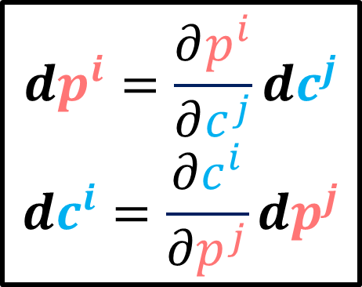
$\frac{d}{dλ}=\frac{dc^{i}}{dλ}\frac{∂}{∂c^{i}}=\frac{dp^{i}}{dλ}\frac{∂}{∂p^{i}}$
$$df=\frac{∂f}{∂c^{i}}dc^{i}=\frac{∂f}{∂p^{i}}dp^{i}$$
Basis Vectors
$$\frac{∂}{∂p^{j}}=\frac{∂c^{i}}{∂p^{j}}\frac{∂}{∂c^{i}}$$
$$\frac{∂}{∂c^{j}}=\frac{∂p^{i}}{∂c^{j}}\frac{∂}{∂p^{i}}$$
$$dp^{i}=\frac{∂p^{i}}{∂c^{j}}dc^{j}$$
$$dc^{i}=\frac{∂c^{i}}{∂p^{j}}dp^{j}$$
Basis Covectors
Covariant
Contravariant
Vector
Components
$$\frac{dp^{i}}{dλ}=\frac{∂p^{i}}{∂c^{j}}\frac{dc^{j}}{dλ}$$
$$\frac{dc^{i}}{dλ}=\frac{∂c^{i}}{∂p^{j}}\frac{dp^{j}}{dλ}$$
Covector
Components
$$\frac{∂f}{∂p^{j}}=\frac{∂c^{i}}{∂p^{j}}\frac{∂f}{∂c^{i}}$$
$$\frac{∂f}{∂c^{j}}=\frac{∂p^{i}}{∂c^{j}}\frac{∂f}{∂p^{i}}$$
?
Contravariant

Slide 26
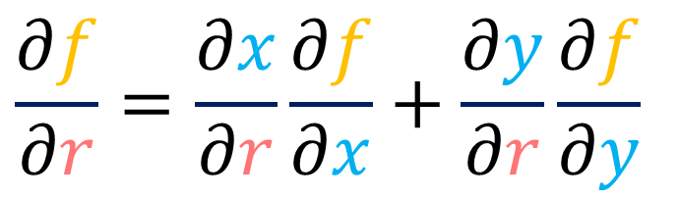
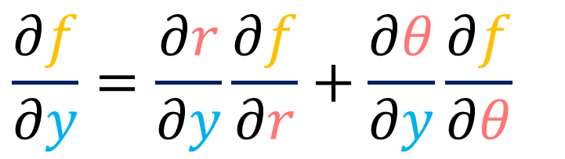
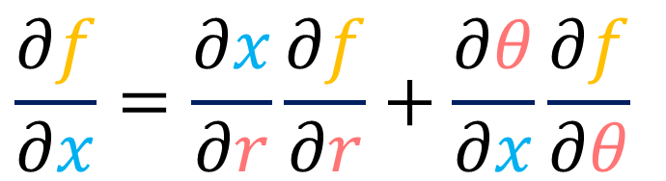

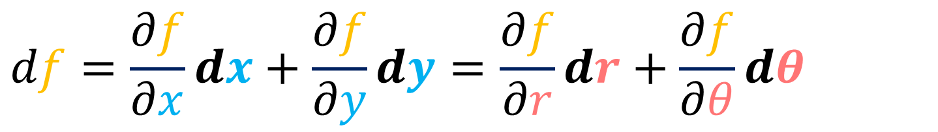

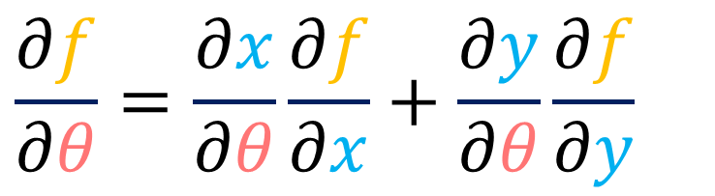
$$df=\frac{∂f}{∂x}dx+\frac{∂f}{∂y}dy=\frac{∂f}{∂r}dr+\frac{∂f}{∂θ}dθ$$
$$\frac{∂f}{∂r}=\frac{∂x}{∂r}\frac{∂f}{∂x}+\frac{∂y}{∂r}\frac{∂f}{∂y}$$
$$\frac{∂f}{∂x}=\frac{∂x}{∂r}\frac{∂f}{∂r}+\frac{∂θ}{∂x}\frac{∂f}{∂θ}$$
$$\frac{∂f}{∂θ}=\frac{∂x}{∂θ}\frac{∂f}{∂x}+\frac{∂y}{∂θ}\frac{∂f}{∂y}$$
$$\frac{∂f}{∂y}=\frac{∂r}{∂y}\frac{∂f}{∂r}+\frac{∂θ}{∂y}\frac{∂f}{∂θ}$$
$$\frac{∂f}{∂p^{j}}=\frac{∂c^{i}}{∂p^{j}}\frac{∂f}{∂c^{i}}$$
$$\frac{∂f}{∂c^{j}}=\frac{∂p^{i}}{∂c^{j}}\frac{∂f}{∂p^{i}}$$

Slide 27
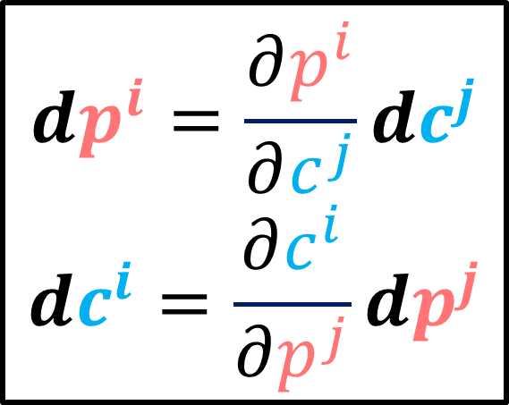

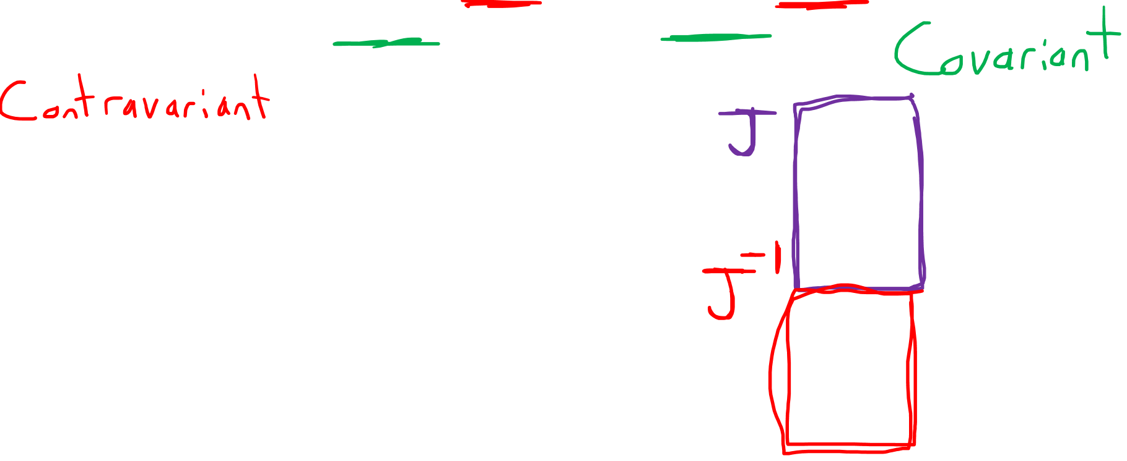
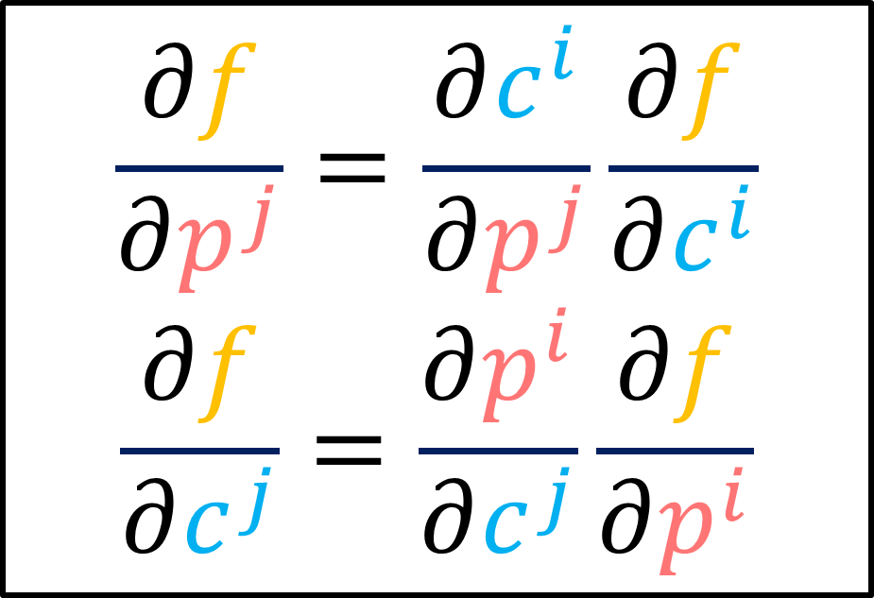
$df=\frac{∂f}{∂c^{i}}dc^{i}=\frac{∂f}{∂p^{i}}dp^{i}$
$$\frac{∂f}{∂p^{j}}=\frac{∂c^{i}}{∂p^{j}}\frac{∂f}{∂c^{i}}$$
$$\frac{∂f}{∂c^{j}}=\frac{∂p^{i}}{∂c^{j}}\frac{∂f}{∂p^{i}}$$
$$dp^{i}=\frac{∂p^{i}}{∂c^{j}}dc^{j}$$
$$dc^{i}=\frac{∂c^{i}}{∂p^{j}}dp^{j}$$

Slide 28
$$\tilde{\vec{e_{2}}}$$
$$\vec{e_{2}}$$
$$\vec{e_{1}}$$
$$\tilde{\vec{e_{1}}}$$

Slide 29

$$\tilde{\vec{e_{2}}}$$
$$\vec{e_{2}}$$
$$\vec{e_{1}}$$
$$\tilde{\vec{e_{1}}}$$

Slide 30
$$\tilde{\vec{e_{2}}}$$
$$\vec{e_{2}}$$
$$\vec{e_{1}}$$
$$\tilde{\vec{e_{1}}}$$
COVARIANT

Slide 31








$$y$$
$$f\left(x,y\right)=y^{2}+x−\text{½}$$
$$x$$
$$x=r\cos{θ}$$
$$y=r\sin{θ}$$
$$θ$$
$$r$$
$$f\left(r,θ\right)=r^{2}{\left(\sin{θ}\right)}^{2}+r\cos{θ}−\text{½}$$

Slide 32





$$df=\frac{∂f}{∂x}dx+\frac{∂f}{∂y}dy=\frac{∂f}{∂r}dr+\frac{∂f}{∂θ}dθ$$
$$\frac{∂f}{∂x}=1$$
$$\frac{∂f}{∂y}=2y$$
$$\frac{∂f}{∂r}={2r\left(\sin{θ}\right)}^{2}+\cos{θ}$$
$$\frac{∂f}{∂θ}=2r^{2}\sin{θ}\cos{θ}−r\sin{θ}$$
$$\frac{∂f}{∂p^{j}}=\frac{∂c^{i}}{∂p^{j}}\frac{∂f}{∂c^{i}}$$

Slide 33



$$\frac{∂f}{∂p^{j}}=\frac{∂c^{i}}{∂p^{j}}\frac{∂f}{∂c^{i}}$$
$$=\left[\begin{matrix}\frac{∂f}{∂c^{1}} & \frac{∂f}{∂c^{2}}\end{matrix}\right]\left[\begin{matrix}\frac{∂c^{1}}{∂p^{1}} & \frac{∂c^{1}}{∂p^{2}} \\ \frac{∂c^{2}}{∂p^{1}} & \frac{∂c^{2}}{∂p^{2}}\end{matrix}\right]$$
$$=\left[\begin{matrix}\frac{∂f}{∂x} & \frac{∂f}{∂y}\end{matrix}\right]\left[\begin{matrix}\frac{∂x}{∂r} & \frac{∂x}{∂θ} \\ \frac{∂y}{∂r} & \frac{∂y}{∂θ}\end{matrix}\right]$$
$$=\left[\begin{matrix}1 & 2y\end{matrix}\right]\left[\begin{matrix}x/r & −y \\ y/r & x\end{matrix}\right]$$
$$=\left[\begin{matrix}1 & 2r\sin{θ}\end{matrix}\right]\left[\begin{matrix}\cos{θ} & −r\sin{θ} \\ \sin{θ} & r\cos{θ}\end{matrix}\right]$$

Slide 34





$$\frac{∂f}{∂p^{j}}=\frac{∂c^{i}}{∂p^{j}}\frac{∂f}{∂c^{i}}$$
$$=\left[\begin{matrix}1 & 2r\sin{θ}\end{matrix}\right]\left[\begin{matrix}\cos{θ} & −r\sin{θ} \\ \sin{θ} & r\cos{θ}\end{matrix}\right]$$
$$=\left[\begin{matrix}\cos{θ}+{2r\left(\sin{θ}\right)}^{2} & −r\sin{θ}+2r^{2}\sin{θ}\cos{θ}\end{matrix}\right]$$
$$=\left[\begin{matrix}{2r\left(\sin{θ}\right)}^{2}+\cos{θ} & 2r^{2}\sin{θ}\cos{θ}−r\sin{θ}\end{matrix}\right]$$
$$\frac{∂f}{∂r}$$
$$\frac{∂f}{∂θ}$$

Slide 35
$$=\left[\begin{matrix}\frac{∂f}{∂p^{1}} & \frac{∂f}{∂p^{2}}\end{matrix}\right]\left[\begin{matrix}\frac{∂p^{1}}{∂c^{1}} & \frac{∂p^{1}}{∂c^{2}} \\ \frac{∂p^{2}}{∂c^{1}} & \frac{∂p^{2}}{∂c^{2}}\end{matrix}\right]$$
$$=\left[\begin{matrix}\frac{∂f}{∂r} & \frac{∂f}{∂θ}\end{matrix}\right]\left[\begin{matrix}\frac{∂r}{∂x} & \frac{∂r}{∂y} \\ \frac{∂θ}{∂x} & \frac{∂θ}{∂y}\end{matrix}\right]$$
$$\frac{∂f}{∂c^{j}}=\frac{∂p^{i}}{∂c^{j}}\frac{∂f}{∂p^{i}}$$
$=\left[\begin{matrix}{2r\left(\sin{θ}\right)}^{2}+\cos{θ} & 2r^{2}\sin{θ}\cos{θ}−r\sin{θ}\end{matrix}\right]$ $\left[\begin{matrix}\frac{x}{r} & \frac{y}{r} \\ −\frac{y}{r^{2}} & \frac{x}{r^{2}}\end{matrix}\right]$
$=\left[\begin{matrix}2\frac{y^{2}}{r}+\frac{x}{r} & 2yx−y\end{matrix}\right]$ $\left[\begin{matrix}\frac{x}{r} & \frac{y}{r} \\ −\frac{y}{r^{2}} & \frac{x}{r^{2}}\end{matrix}\right]$

Slide 36
$$\frac{∂f}{∂c^{j}}=\frac{∂p^{i}}{∂c^{j}}\frac{∂f}{∂p^{i}}$$
$$=\left[\begin{matrix}2\frac{y^{2}}{r}+\frac{x}{r} & 2yx−y\end{matrix}\right]\left[\begin{matrix}\frac{x}{r} & \frac{y}{r} \\ −\frac{y}{r^{2}} & \frac{x}{r^{2}}\end{matrix}\right]$$
$$=\left[\begin{matrix}\left(2\frac{y^{2}}{r}+\frac{x}{r}\right)\frac{x}{r}−\left(2yx−y\right)\frac{y}{r^{2}} & \left(2\frac{y^{2}}{r}+\frac{x}{r}\right)\frac{y}{r}+\left(2yx−y\right)\end{matrix}\frac{x}{r^{2}}\right]$$
$$=\left[\begin{matrix}2\frac{xy^{2}}{r^{2}}+\frac{x^{2}}{r^{2}}−2\frac{xy^{2}}{r^{2}}+\frac{y^{2}}{r^{2}} & 2\frac{y^{3}}{r^{2}}+\frac{xy}{r^{2}}+2\frac{x^{2}y}{r^{2}}−\frac{xy}{r^{2}}\end{matrix}\right]$$
$$=\left[\begin{matrix}\frac{x^{2}+y^{2}}{r^{2}} & 2y\left(\frac{x^{2}+y^{2}}{r^{2}}\right)\end{matrix}\right]$$
$$=\left[\begin{matrix}1 & 2y\end{matrix}\right]$$

Slide 37
$df=\frac{∂f}{∂c^{i}}dc^{i}=\frac{∂f}{∂p^{i}}dp^{i}$
$$\frac{∂f}{∂p^{j}}=\frac{∂c^{i}}{∂p^{j}}\frac{∂f}{∂c^{i}}$$
$$\frac{∂f}{∂c^{j}}=\frac{∂p^{i}}{∂c^{j}}\frac{∂f}{∂p^{i}}$$
$$dp^{i}=\frac{∂p^{i}}{∂c^{j}}dc^{j}$$
$$dc^{i}=\frac{∂c^{i}}{∂p^{j}}dp^{j}$$

Slide 38
$\frac{d}{dλ}=\frac{dc^{i}}{dλ}\frac{∂}{∂c^{i}}=\frac{dp^{i}}{dλ}\frac{∂}{∂p^{i}}$
$$df=\frac{∂f}{∂c^{i}}dc^{i}=\frac{∂f}{∂p^{i}}dp^{i}$$
Basis Vectors
$$\frac{∂}{∂p^{j}}=\frac{∂c^{i}}{∂p^{j}}\frac{∂}{∂c^{i}}$$
$$\frac{∂}{∂c^{j}}=\frac{∂p^{i}}{∂c^{j}}\frac{∂}{∂p^{i}}$$
$$dp^{i}=\frac{∂p^{i}}{∂c^{j}}dc^{j}$$
$$dc^{i}=\frac{∂c^{i}}{∂p^{j}}dp^{j}$$
Basis Covectors
Covariant
Contravariant
Vector
Components
$$\frac{dp^{i}}{dλ}=\frac{∂p^{i}}{∂c^{j}}\frac{dc^{j}}{dλ}$$
$$\frac{dc^{i}}{dλ}=\frac{∂c^{i}}{∂p^{j}}\frac{dp^{j}}{dλ}$$
Covector
Components
$$\frac{∂f}{∂p^{j}}=\frac{∂c^{i}}{∂p^{j}}\frac{∂f}{∂c^{i}}$$
$$\frac{∂f}{∂c^{j}}=\frac{∂p^{i}}{∂c^{j}}\frac{∂f}{∂p^{i}}$$
?
Contravariant

Slide 39
$\frac{d}{dλ}=\frac{dc^{i}}{dλ}\frac{∂}{∂c^{i}}=\frac{dp^{i}}{dλ}\frac{∂}{∂p^{i}}$
$$df=\frac{∂f}{∂c^{i}}dc^{i}=\frac{∂f}{∂p^{i}}dp^{i}$$
Basis Vectors
$$\frac{∂}{∂p^{j}}=\frac{∂c^{i}}{∂p^{j}}\frac{∂}{∂c^{i}}$$
$$\frac{∂}{∂c^{j}}=\frac{∂p^{i}}{∂c^{j}}\frac{∂}{∂p^{i}}$$
$$dp^{i}=\frac{∂p^{i}}{∂c^{j}}dc^{j}$$
$$dc^{i}=\frac{∂c^{i}}{∂p^{j}}dp^{j}$$
Basis Covectors
Covariant
Contravariant
Vector
Components
$$\frac{dp^{i}}{dλ}=\frac{∂p^{i}}{∂c^{j}}\frac{dc^{j}}{dλ}$$
$$\frac{dc^{i}}{dλ}=\frac{∂c^{i}}{∂p^{j}}\frac{dp^{j}}{dλ}$$
Covector
Components
$$\frac{∂f}{∂p^{j}}=\frac{∂c^{i}}{∂p^{j}}\frac{∂f}{∂c^{i}}$$
$$\frac{∂f}{∂c^{j}}=\frac{∂p^{i}}{∂c^{j}}\frac{∂f}{∂p^{i}}$$
Covariant
Contravariant

Slide 40

$$\int_{a}^{b}{f\left(x\right)dx}$$
Differential
Covector

