Slide 1
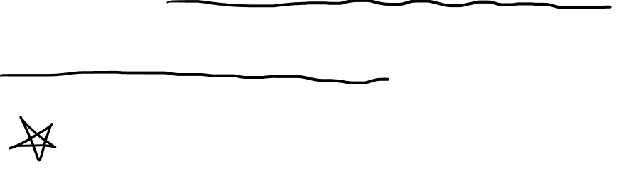
The Metric Tensor and Arc Length
(See “Tensors for Beginners:
The Metric Tensor” Video First)
(See Link in Description)

Slide 2
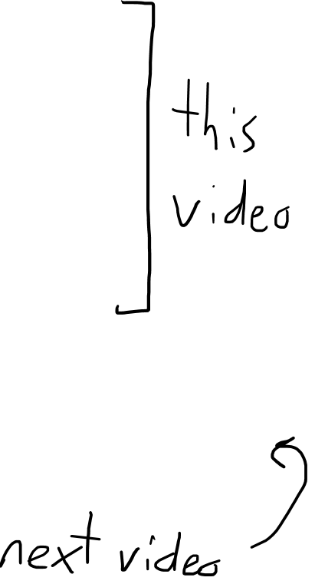
The Metric Tensor for…
Vector Length (review)
Arc Length (flat space)
Arc Length (curved space)

Slide 3
The Metric Tensor for… 1. Vector Length

Slide 4






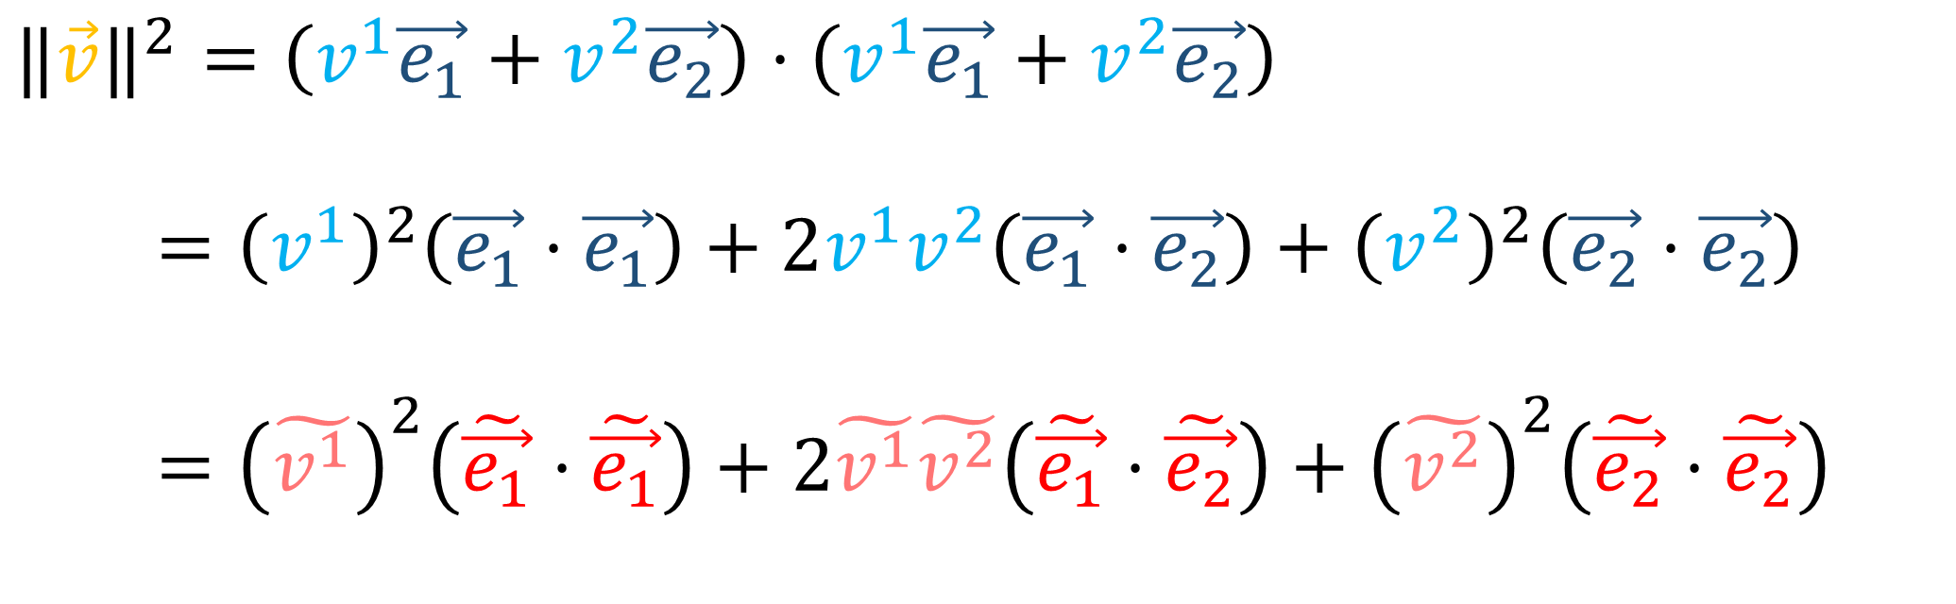

$$\vec{v}$$
How do you get the length of a vector?
$$\vec{e_{2}}$$
$$\tilde{\vec{e_{1}}}$$
$${‖\vec{v}‖}^{2}=\vec{v}⋅\vec{v}$$
$$\tilde{\vec{e_{2}}}$$
$$\vec{e_{1}}$$
$${‖\vec{v}‖}^{2}=\left(v^{1}\vec{e_{1}}+v^{2}\vec{e_{2}}\right)⋅\left(v^{1}\vec{e_{1}}+v^{2}\vec{e_{2}}\right)$$
$={\left(v^{1}\right)}^{2}\left(\vec{e_{1}}⋅\vec{e_{1}}\right)+2v^{1}v^{2}\left(\vec{e_{1}}⋅\vec{e_{2}}\right)+{\left(v^{2}\right)}^{2}\left(\vec{e_{2}}⋅\vec{e_{2}}\right)$
$={\left(\tilde{v^{1}}\right)}^{2}\left(\tilde{\vec{e_{1}}}⋅\tilde{\vec{e_{1}}}\right)+2\tilde{v^{1}}\tilde{v^{2}}\left(\tilde{\vec{e_{1}}}⋅\tilde{\vec{e_{2}}}\right)+{\left(\tilde{v^{2}}\right)}^{2}\left(\tilde{\vec{e_{2}}}⋅\tilde{\vec{e_{2}}}\right)$

Slide 5

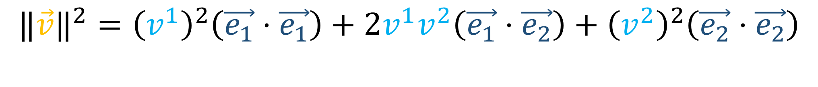


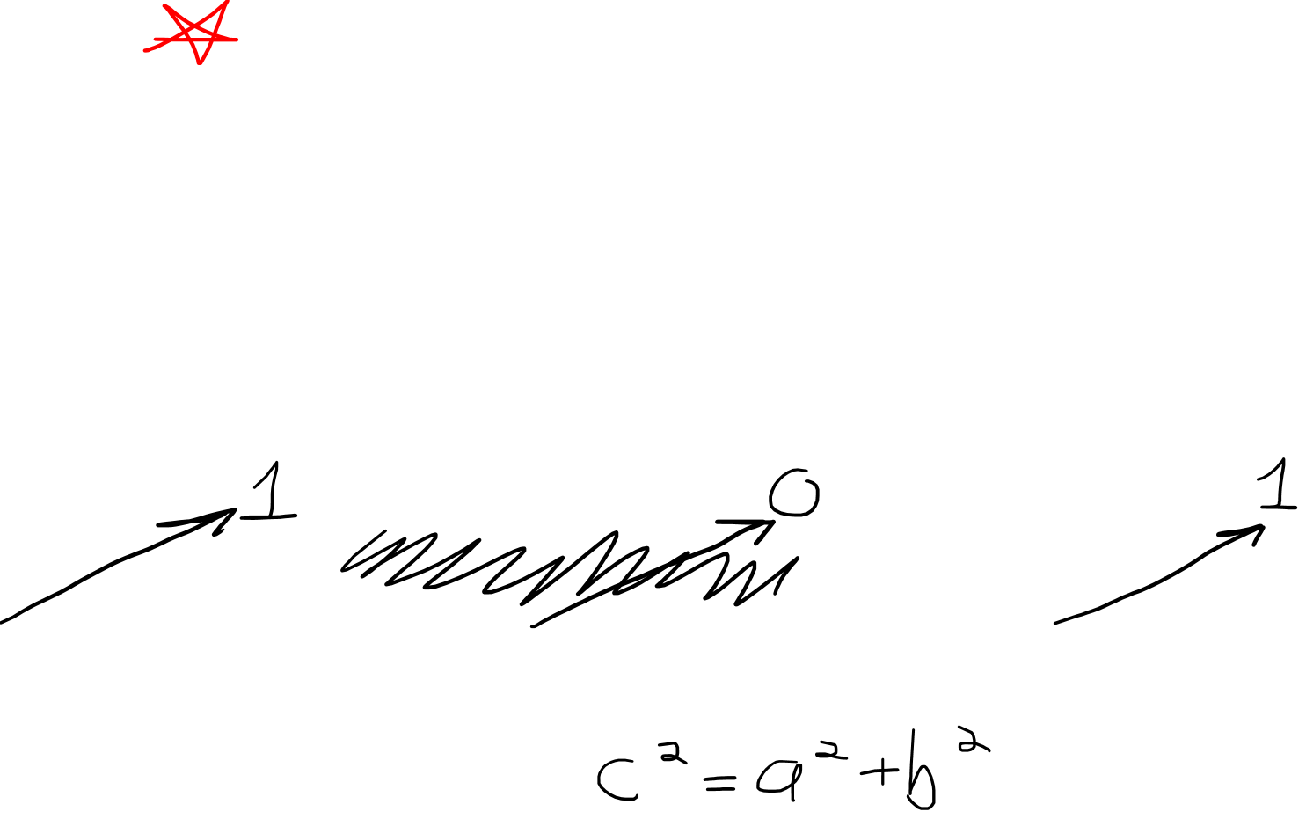

$$\vec{e_{1}}⋅\vec{e_{1}}=1$$
$$\vec{e_{1}}⋅\vec{e_{2}}=0$$
$$\vec{e_{2}}⋅\vec{e_{2}}=1$$
$$\vec{e_{2}}$$
$$\vec{e_{1}}$$
$${‖\vec{v}‖}^{2}={\left(v^{1}\right)}^{2}\left(\vec{e_{1}}⋅\vec{e_{1}}\right)+2v^{1}v^{2}\left(\vec{e_{1}}⋅\vec{e_{2}}\right)+{\left(v^{2}\right)}^{2}\left(\vec{e_{2}}⋅\vec{e_{2}}\right)$$
$${‖\vec{v}‖}^{2}={\left(v^{1}\right)}^{2}+{\left(v^{2}\right)}^{2}$$

Slide 6
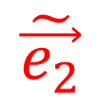
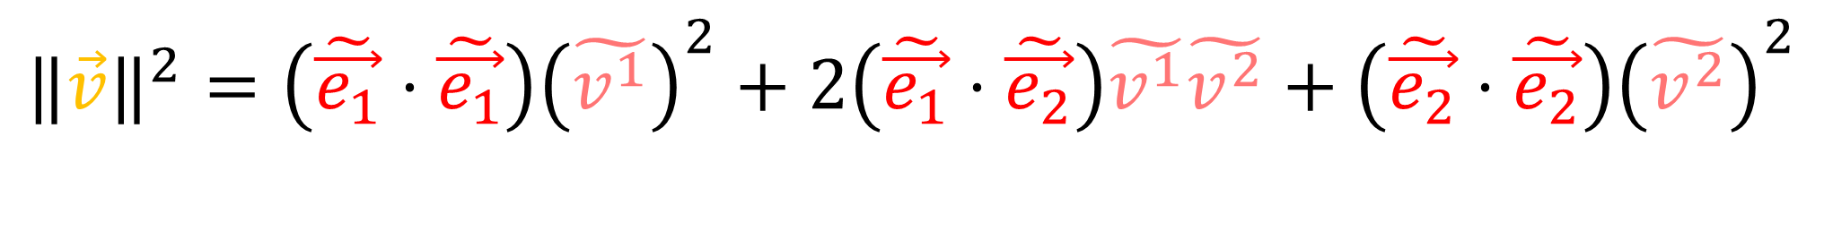
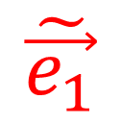
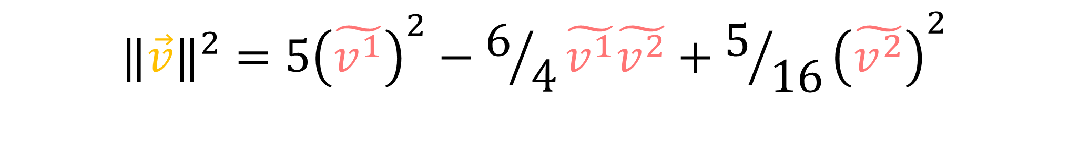
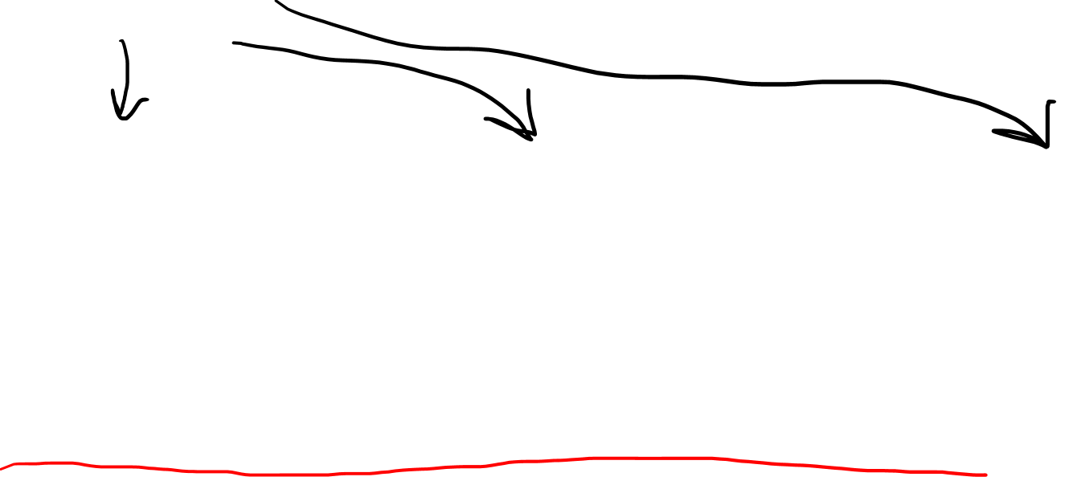

$$\tilde{\vec{e_{1}}}⋅\tilde{\vec{e_{1}}}=5$$
$$\tilde{\vec{e_{1}}}⋅\tilde{\vec{e_{2}}}=−3/4$$
$$\tilde{\vec{e_{2}}}⋅\tilde{\vec{e_{2}}}=5/{16}$$
$$\tilde{\vec{e_{1}}}$$
$$\tilde{\vec{e_{2}}}$$
$${‖\vec{v}‖}^{2}={\left(\tilde{\vec{e_{1}}}⋅\tilde{\vec{e_{1}}}\right)\left(\tilde{v^{1}}\right)}^{2}+2\left(\tilde{\vec{e_{1}}}⋅\tilde{\vec{e_{2}}}\right)\tilde{v^{1}}\tilde{v^{2}}+{\left(\tilde{\vec{e_{2}}}⋅\tilde{\vec{e_{2}}}\right)\left(\tilde{v^{2}}\right)}^{2}$$
$${‖\vec{v}‖}^{2}={5\left(\tilde{v^{1}}\right)}^{2}−6/4\tilde{v^{1}}\tilde{v^{2}}+{5/{16}\left(\tilde{v^{2}}\right)}^{2}$$

Slide 7
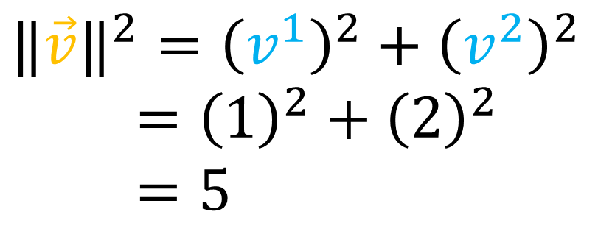
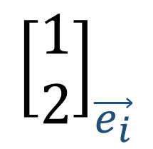
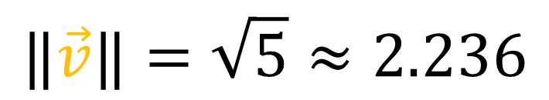
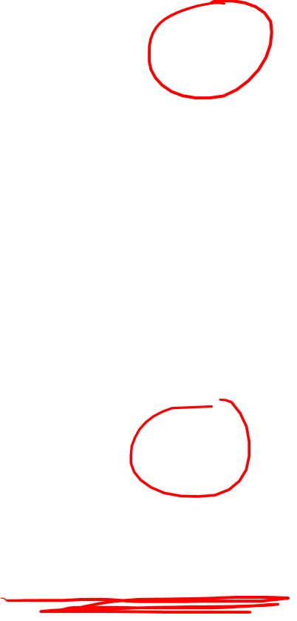
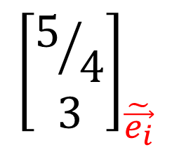
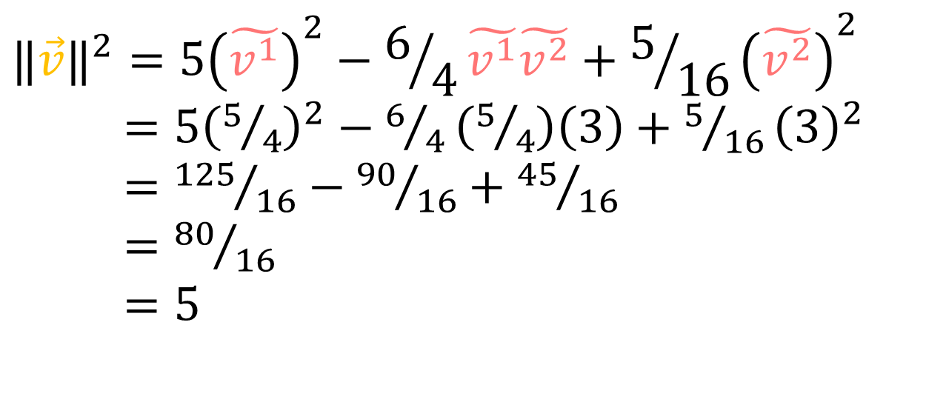
$${\left[\begin{aligned}\text{1} \\ 2\end{aligned}\right]}_{\vec{e_{i}}}$$
$${‖\vec{v}‖}^{2}={\left(v^{1}\right)}^{2}+{\left(v^{2}\right)}^{2}$$
$={\left(1\right)}^{2}+{\left(2\right)}^{2}$
$=5$
$$\vec{v}$$
$$\vec{e_{2}}$$
$$\tilde{\vec{e_{1}}}$$
$$\tilde{\vec{e_{2}}}$$
$${\left[\begin{aligned}5/4 \\ 3\end{aligned}\right]}_{\tilde{\vec{e_{i}}}}$$
$${‖\vec{v}‖}^{2}={5\left(\tilde{v^{1}}\right)}^{2}−6/4\tilde{v^{1}}\tilde{v^{2}}+{5/{16}\left(\tilde{v^{2}}\right)}^{2}$$
$={5\left(5/4\right)}^{2}−6/4\left(5/4\right)\left(3\right)+{5/{16}\left(3\right)}^{2}$
$={125}/{16}−{90}/{16}+{45}/{16}$
$={80}/{16}$
$=5$
$$\vec{e_{1}}$$
$$‖\vec{v}‖=\sqrt{5}≈2.236$$

Slide 8

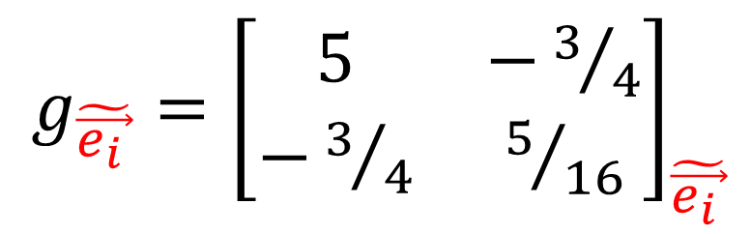
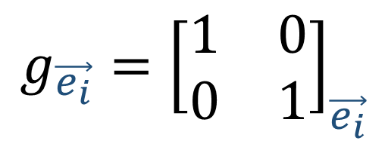
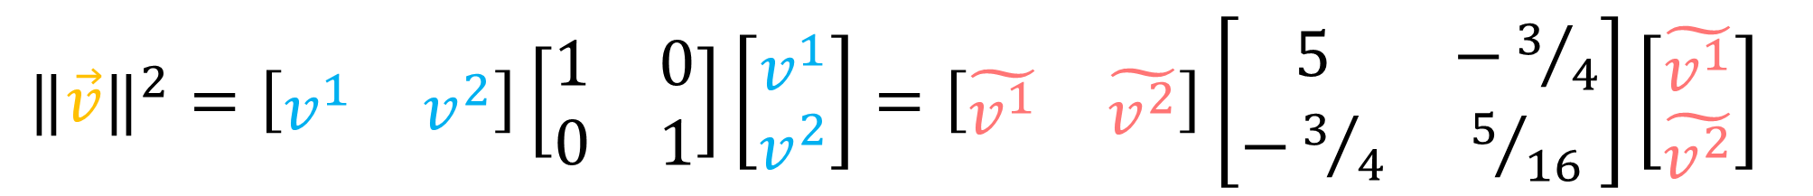
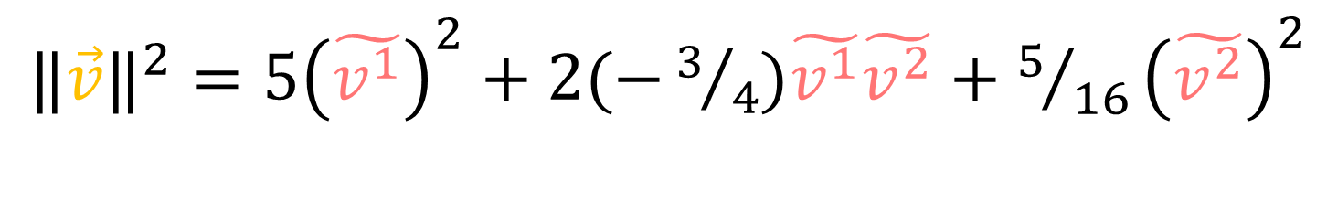
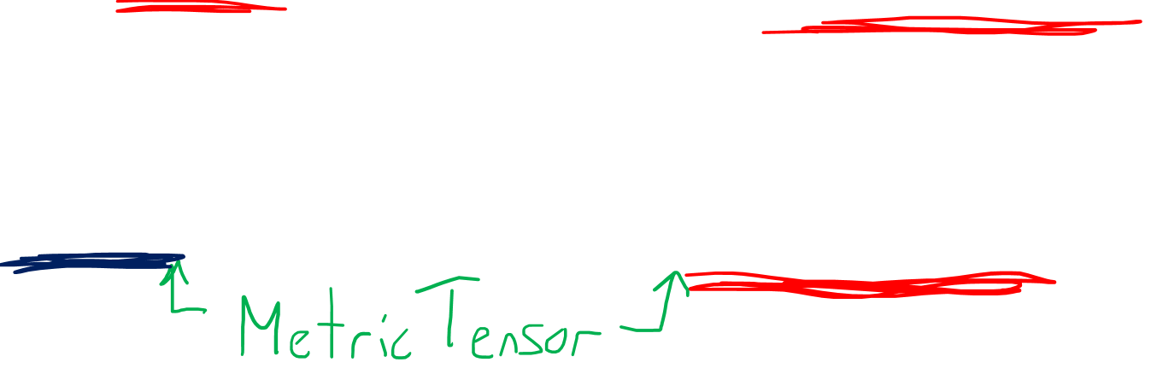
$${‖\vec{v}‖}^{2}={ \left(v^{1}\right)}^{2}+ {\left(v^{2}\right)}^{2}$$
${‖\vec{v}‖}^{2}={5\left(\tilde{v^{1}}\right)}^{2}+2(−3/4)\tilde{v^{1}}\tilde{v^{2}}+{5/{16}\left(\tilde{v^{2}}\right)}^{2}$
${‖\vec{v}‖}^{2}=\left[\begin{matrix}v^{1} & v^{2}\end{matrix}\right]\left[\begin{matrix}1 & 0 \\ 0 & 1\end{matrix}\right]\left[\begin{aligned}v^{1} \\ v^{2}\end{aligned}\right]=\left[\begin{matrix}\tilde{v^{1}} & \tilde{v^{2}}\end{matrix}\right]\left[\begin{matrix}5 & −3/4 \\ −3/4 & 5/{16}\end{matrix}\right]\left[\begin{aligned}\tilde{v^{1}} \\ \tilde{v^{2}}\end{aligned}\right]$
$g_{\tilde{\vec{e_{i }}}}={\left[\begin{matrix}5 & −3/4 \\ −3/4 & 5/{16}\end{matrix}\right]}_{\tilde{\vec{e_{i }}}}$
$${g_{\vec{e_{i}}}=\left[\begin{matrix}1 & 0 \\ 0 & 1\end{matrix}\right]}_{\vec{e_{i}}}$$

Slide 9

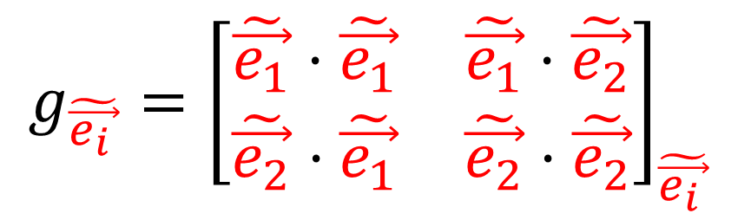
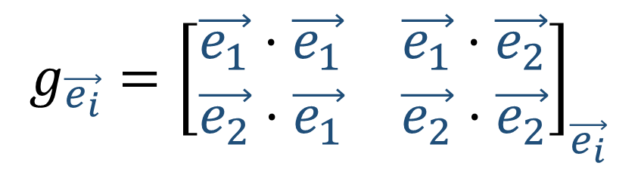

$${‖\vec{v}‖}^{2}={\left(v^{1}\right)}^{2}\left(\vec{e_{1}}⋅\vec{e_{1}}\right)+2v^{1}v^{2}\left(\vec{e_{1}}⋅\vec{e_{2}}\right)+{\left(v^{2}\right)}^{2}\left(\vec{e_{2}}⋅\vec{e_{2}}\right)$$
$${‖\vec{v}‖}^{2}={\left(\tilde{v^{1}}\right)}^{2}\left(\tilde{\vec{e_{1}}}⋅\tilde{\vec{e_{1}}}\right)+2\tilde{v^{1}}\tilde{v^{2}}\left(\tilde{\vec{e_{1}}}⋅\tilde{\vec{e_{2}}}\right)+{\left(\tilde{v^{2}}\right)}^{2}\left(\tilde{\vec{e_{2}}}⋅\tilde{\vec{e_{2}}}\right)$$
$${g_{\vec{e_{i}}}=\left[\begin{matrix}\vec{e_{1}}⋅\vec{e_{1}} & \vec{e_{1}}⋅\vec{e_{2}} \\ \vec{e_{2}}⋅\vec{e_{1}} & \vec{e_{2}}⋅\vec{e_{2}}\end{matrix}\right]}_{\vec{e_{i}}}$$
$g_{\tilde{\vec{e_{i }}}}={\left[\begin{matrix}\tilde{\vec{e_{1}}}⋅\tilde{\vec{e_{1}}} & \tilde{\vec{e_{1}}}⋅\tilde{\vec{e_{2}}} \\ \tilde{\vec{e_{2}}}⋅\tilde{\vec{e_{1}}} & \tilde{\vec{e_{2}}}⋅\tilde{\vec{e_{2}}}\end{matrix}\right]}_{\tilde{\vec{e_{i }}}}$
$$g_{ij}=\left(\vec{e_{i}}⋅\vec{e_{j}}\right)$$
$$\tilde{g_{ij}}=\left(\tilde{\vec{e_{i}}}⋅\tilde{\vec{e_{j}}}\right)$$

Slide 10





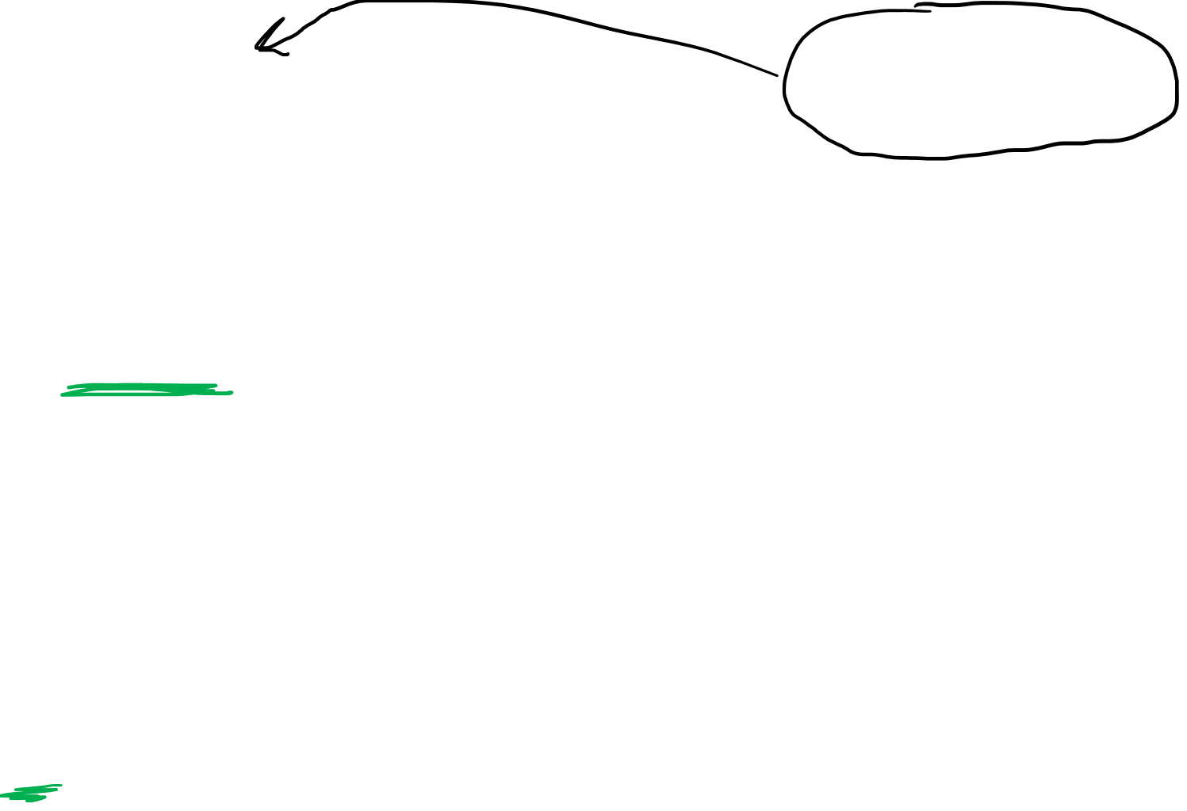
$$\tilde{g_{ij}}=\tilde{\vec{e_{i}}}⋅\tilde{\vec{e_{j}}}$$
$=\left(F_{i}^{k}\vec{e_{k}}\right)⋅\left(F_{j}^{l}\vec{e_{l}}\right)$
$$=F_{i}^{k}F_{j}^{l}\left(\vec{e_{k}}⋅\vec{e_{l}}\right)$$
$=F_{i}^{k}F_{j}^{l}g_{kl}$
$$\tilde{\vec{e_{j}}}=F_{j}^{i}\vec{e_{i}}$$
$$\vec{e_{j}}=B_{j}^{i}\tilde{\vec{e_{i}}}$$
$$\tilde{g_{ij}}=F_{i}^{k}F_{j}^{l}g_{kl}$$
$$g_{kl}=B_{k}^{i}B_{l}^{j}\tilde{g_{ij}}$$
(0,2)-Tensor

Slide 11
The Metric Tensor for… 2. Arc Length (flat space)

Slide 12
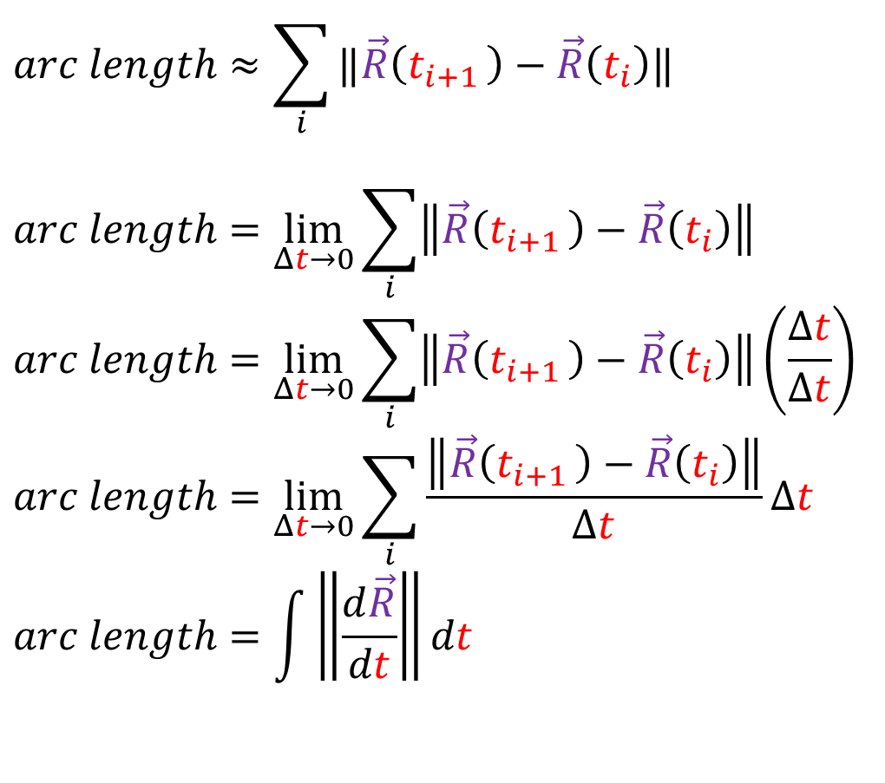
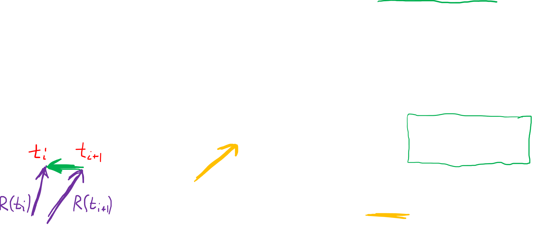


Arc Length
Integrals help us calculate the length of curves (arc length)
Done by breaking a line into small segments and summing them up
$$arc length≈\sum_{i}{‖\vec{R}\left(t_{i+1 }\right)−\vec{R}\left(t_{i}\right)‖}$$
$$arc length=\lim_{Δt→0}{\sum_{i}{\left\|\vec{R}\left(t_{i+1 }\right)−\vec{R}\left(t_{i}\right)\right\|}}$$
$$arc length=\lim_{Δt→0}{\sum_{i}{\left\|\vec{R}\left(t_{i+1 }\right)−\vec{R}\left(t_{i}\right)\right\|}}\left(\frac{Δt}{Δt}\right)$$
$$arc length=\lim_{Δt→0}{\sum_{i}{\frac{\left\|\vec{R}\left(t_{i+1 }\right)−\vec{R}\left(t_{i}\right)\right\|}{Δt}Δt}}$$
$$arc length=\int{\left\|\frac{d\vec{R}}{dt}\right\|dt}$$
$$=\int{\left\|\frac{d\vec{R}}{dλ}\right\|dλ}$$

Slide 13
Arc Length
Integrals help us calculate the length of curves (arc length)
Done by breaking a line into small segments and summing them up
$$arc length≈\sum_{i}{‖\vec{R}\left(t_{i+1 }\right)−\vec{R}\left(t_{i}\right)‖}$$
$$arc length=\lim_{Δt→0}{\sum_{i}{\left\|\vec{R}\left(t_{i+1 }\right)−\vec{R}\left(t_{i}\right)\right\|}}$$
$$arc length=\lim_{Δt→0}{\sum_{i}{\left\|\vec{R}\left(t_{i+1 }\right)−\vec{R}\left(t_{i}\right)\right\|}}\left(\frac{Δt}{Δt}\right)$$
$$arc length=\lim_{Δt→0}{\sum_{i}{\frac{\left\|\vec{R}\left(t_{i+1 }\right)−\vec{R}\left(t_{i}\right)\right\|}{Δt}Δt}}$$
$$arc length=\int{\left\|\frac{d\vec{R}}{dt}\right\|dt}$$
$$=\int{\left\|\frac{d\vec{R}}{dλ}\right\|dλ}$$

Slide 14
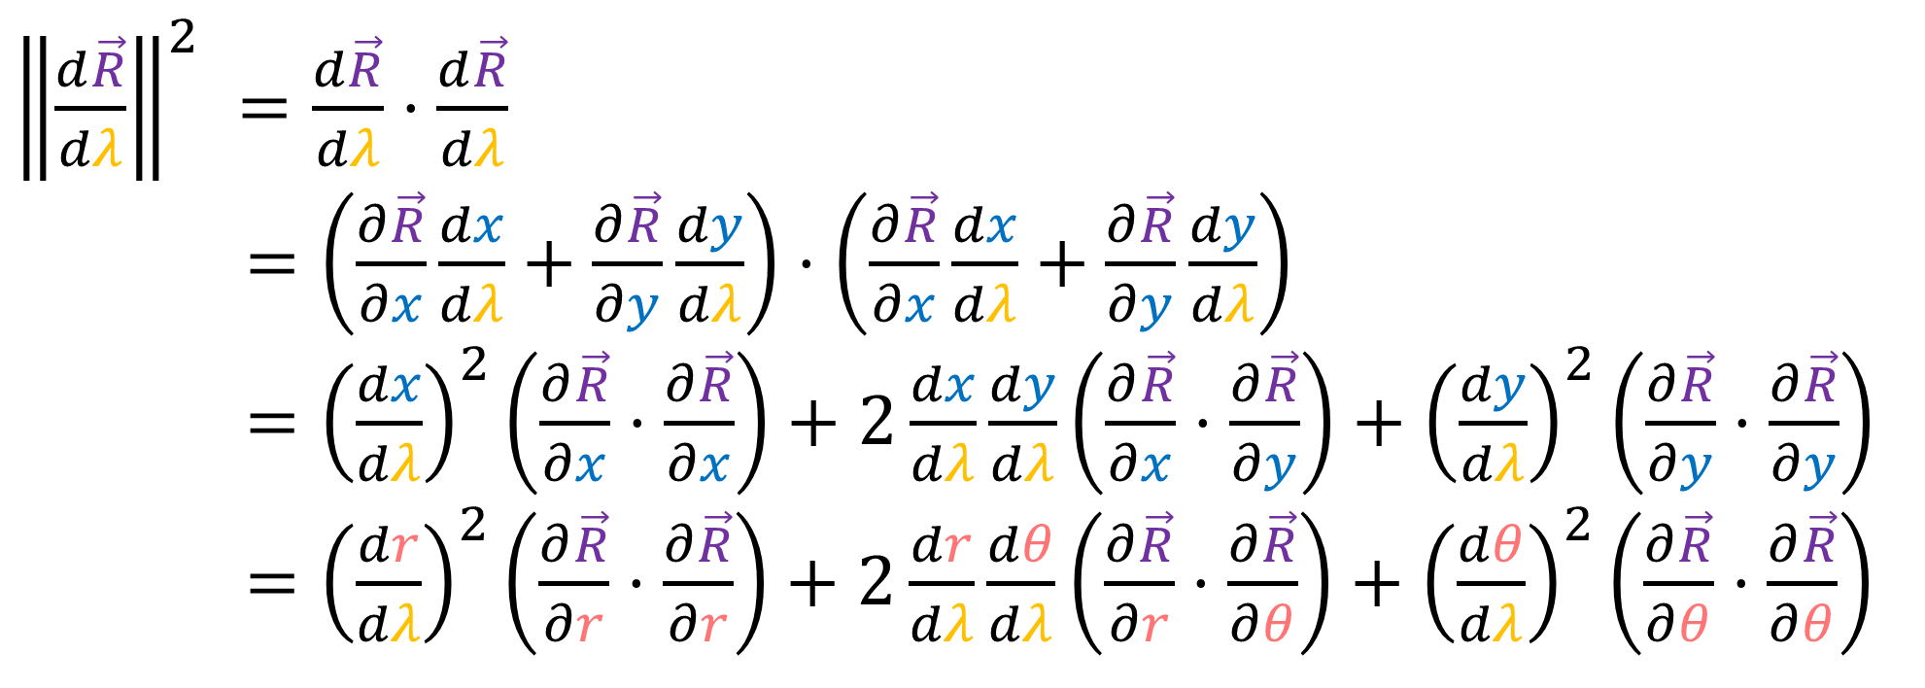

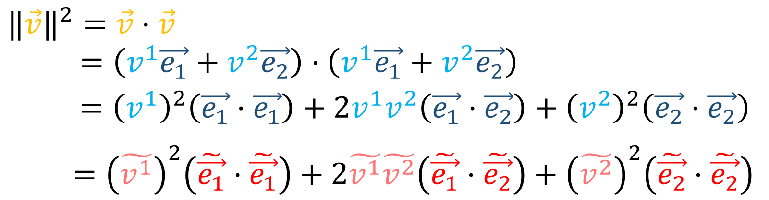
$${‖\vec{v}‖}^{2}=\vec{v}⋅\vec{v}$$
$=\left(v^{1}\vec{e_{1}}+v^{2}\vec{e_{2}}\right)⋅\left(v^{1}\vec{e_{1}}+v^{2}\vec{e_{2}}\right)$
$={\left(v^{1}\right)}^{2}\left(\vec{e_{1}}⋅\vec{e_{1}}\right)+2v^{1}v^{2}\left(\vec{e_{1}}⋅\vec{e_{2}}\right)+{\left(v^{2}\right)}^{2}\left(\vec{e_{2}}⋅\vec{e_{2}}\right)$
$={\left(\tilde{v^{1}}\right)}^{2}\left(\tilde{\vec{e_{1}}}⋅\tilde{\vec{e_{1}}}\right)+2\tilde{v^{1}}\tilde{v^{2}}\left(\tilde{\vec{e_{1}}}⋅\tilde{\vec{e_{2}}}\right)+{\left(\tilde{v^{2}}\right)}^{2}\left(\tilde{\vec{e_{2}}}⋅\tilde{\vec{e_{2}}}\right)$
${\left\|\frac{d\vec{R}}{dλ}\right\|}^{2} =\frac{d\vec{R}}{dλ}⋅\frac{d\vec{R}}{dλ}$
$=\left(\frac{∂\vec{R}}{∂x}\frac{dx}{dλ}+\frac{∂\vec{R}}{∂y}\frac{dy}{dλ}\right)⋅\left(\frac{∂\vec{R}}{∂x}\frac{dx}{dλ}+\frac{∂\vec{R}}{∂y}\frac{dy}{dλ}\right)$
$={\left(\frac{dx}{dλ}\right)}^{2}\left(\frac{∂\vec{R}}{∂x}⋅\frac{∂\vec{R}}{∂x}\right)+2\frac{dx}{dλ}\frac{dy}{dλ}\left(\frac{∂\vec{R}}{∂x}⋅\frac{∂\vec{R}}{∂y}\right)+{\left(\frac{dy}{dλ}\right)}^{2}\left(\frac{∂\vec{R}}{∂y}⋅\frac{∂\vec{R}}{∂y}\right)$
$={\left(\frac{dr}{dλ}\right)}^{2}\left(\frac{∂\vec{R}}{∂r}⋅\frac{∂\vec{R}}{∂r}\right)+2\frac{dr}{dλ}\frac{dθ}{dλ}\left(\frac{∂\vec{R}}{∂r}⋅\frac{∂\vec{R}}{∂θ}\right)+{\left(\frac{dθ}{dλ}\right)}^{2}\left(\frac{∂\vec{R}}{∂θ}⋅\frac{∂\vec{R}}{∂θ}\right)$

Slide 15
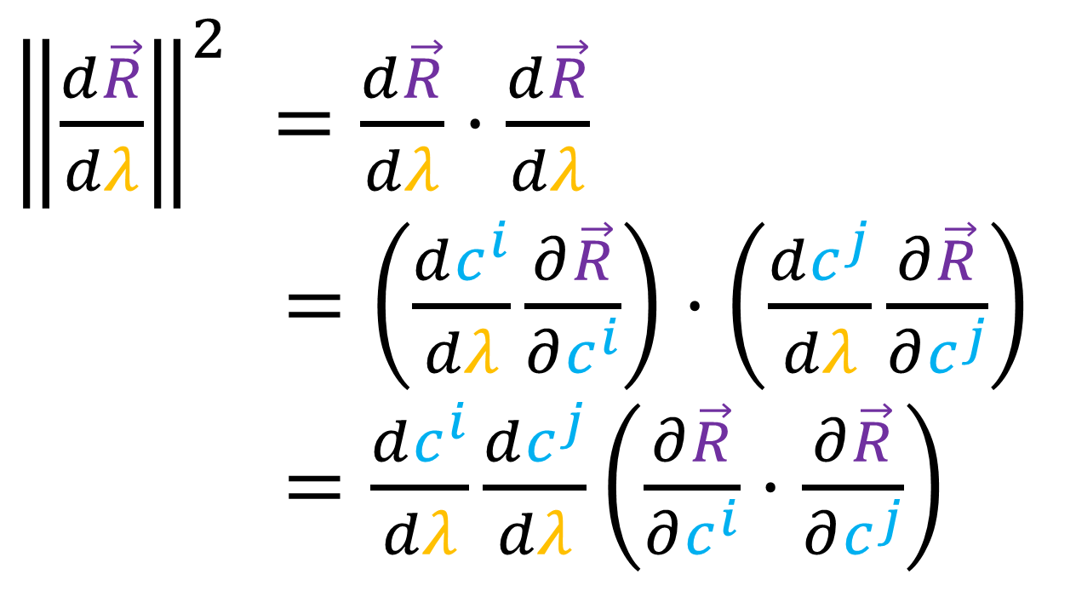
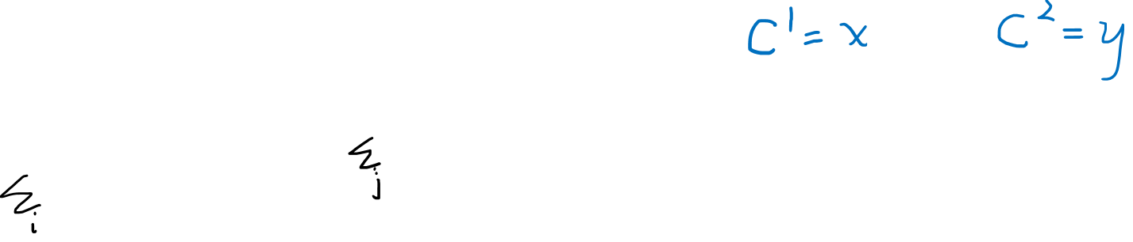
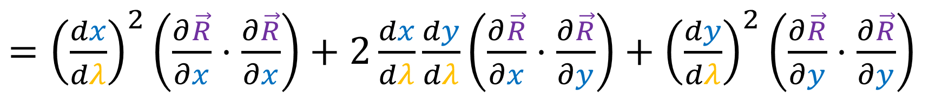
${\left\|\frac{d\vec{R}}{dλ}\right\|}^{2} =\frac{d\vec{R}}{dλ}⋅\frac{d\vec{R}}{dλ}$
$=\left(\frac{dc^{i}}{dλ}\frac{∂\vec{R}}{∂c^{i}}\right)⋅\left(\frac{dc^{j}}{dλ}\frac{∂\vec{R}}{∂c^{j}}\right)$
$=\frac{dc^{i}}{dλ}\frac{dc^{j}}{dλ}\left(\frac{∂\vec{R}}{∂c^{i}}⋅\frac{∂\vec{R}}{∂c^{j}}\right)$
$={\left(\frac{dx}{dλ}\right)}^{2}\left(\frac{∂\vec{R}}{∂x}⋅\frac{∂\vec{R}}{∂x}\right)+2\frac{dx}{dλ}\frac{dy}{dλ}\left(\frac{∂\vec{R}}{∂x}⋅\frac{∂\vec{R}}{∂y}\right)+{\left(\frac{dy}{dλ}\right)}^{2}\left(\frac{∂\vec{R}}{∂y}⋅\frac{∂\vec{R}}{∂y}\right)$

Slide 16
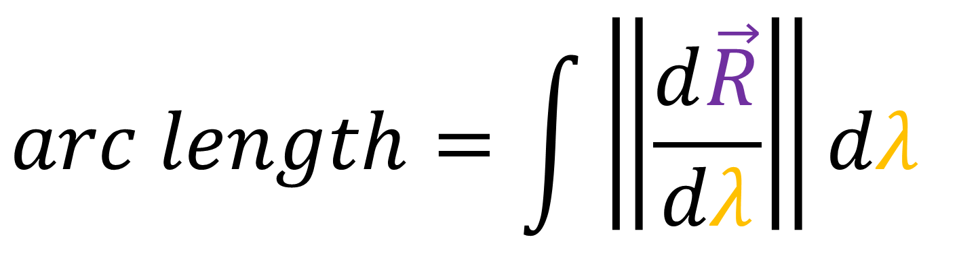

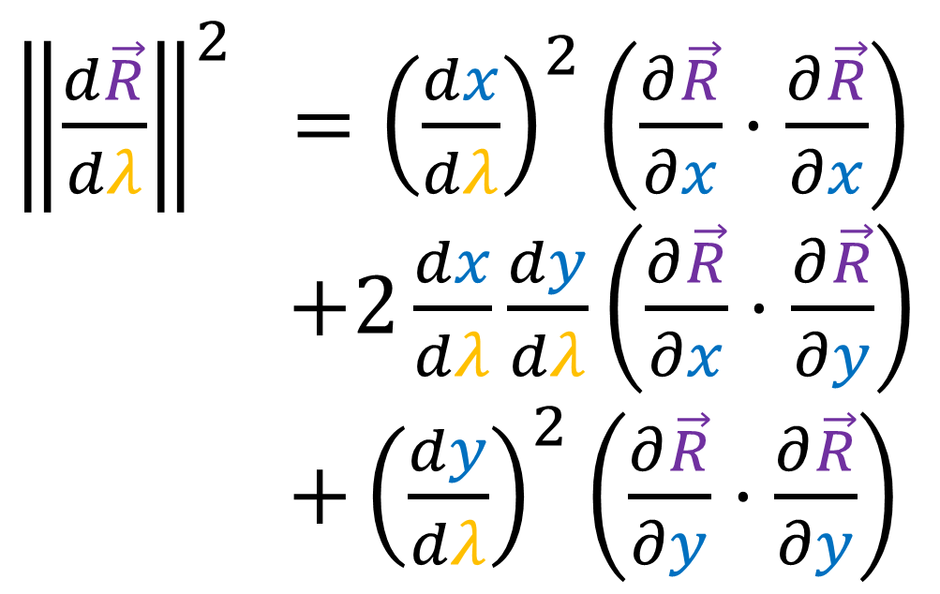
$$arc length=\int{\left\|\frac{d\vec{R}}{dλ}\right\|dλ}$$
${\left\|\frac{d\vec{R}}{dλ}\right\|}^{2}$ $={\left(\frac{dx}{dλ}\right)}^{2}\left(\frac{∂\vec{R}}{∂x}⋅\frac{∂\vec{R}}{∂x}\right)$
$+2\frac{dx}{dλ}\frac{dy}{dλ}\left(\frac{∂\vec{R}}{∂x}⋅\frac{∂\vec{R}}{∂y}\right)$
$+{\left(\frac{dy}{dλ}\right)}^{2}\left(\frac{∂\vec{R}}{∂y}⋅\frac{∂\vec{R}}{∂y}\right)$

Slide 17


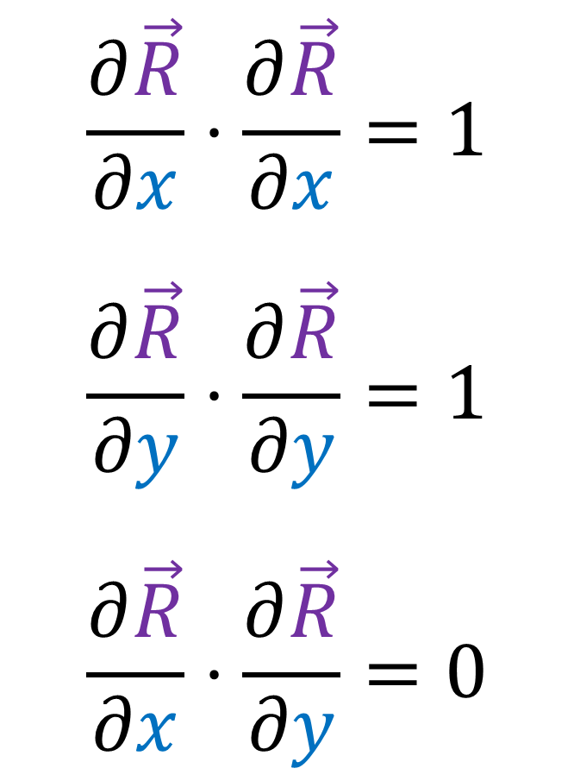






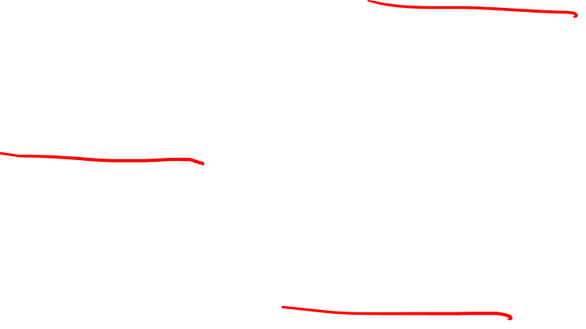
${\left\|\frac{d\vec{R}}{dλ}\right\|}^{2}$ $={\left(\frac{dx}{dλ}\right)}^{2}\left(\frac{∂\vec{R}}{∂x}⋅\frac{∂\vec{R}}{∂x}\right)+2\frac{dx}{dλ}\frac{dy}{dλ}\left(\frac{∂\vec{R}}{∂x}⋅\frac{∂\vec{R}}{∂y}\right)+{\left(\frac{dy}{dλ}\right)}^{2}\left(\frac{∂\vec{R}}{∂y}⋅\frac{∂\vec{R}}{∂y}\right)$
$$\vec{e_{y}}$$
$$y$$
$$\frac{∂\vec{R}}{∂x}⋅\frac{∂\vec{R}}{∂x}=1$$
$$\frac{∂\vec{R}}{∂y}⋅\frac{∂\vec{R}}{∂y}=1$$
$$\frac{∂\vec{R}}{∂x}⋅\frac{∂\vec{R}}{∂y}=0$$
$$\vec{e_{x}}$$
$$\vec{e_{y}}$$
$$\vec{e_{x}}$$
$$\vec{e_{y}}$$
$$x$$
$$\vec{e_{x}}$$

Slide 18

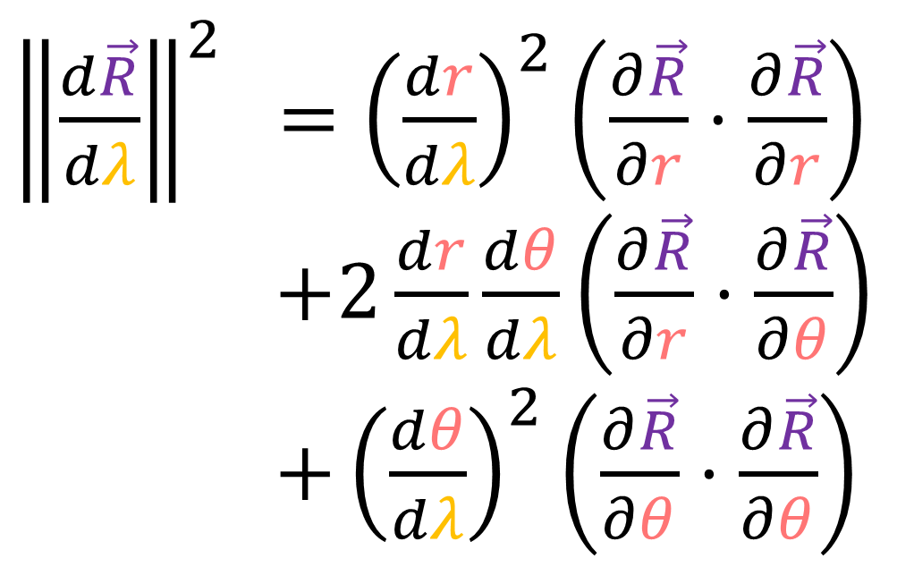
$$arc length=\int{\left\|\frac{d\vec{R}}{dλ}\right\|dλ}$$
${\left\|\frac{d\vec{R}}{dλ}\right\|}^{2}$ $={\left(\frac{dr}{dλ}\right)}^{2}\left(\frac{∂\vec{R}}{∂r}⋅\frac{∂\vec{R}}{∂r}\right)$
$+2\frac{dr}{dλ}\frac{dθ}{dλ}\left(\frac{∂\vec{R}}{∂r}⋅\frac{∂\vec{R}}{∂θ}\right)$
$+{\left(\frac{dθ}{dλ}\right)}^{2}\left(\frac{∂\vec{R}}{∂θ}⋅\frac{∂\vec{R}}{∂θ}\right)$

Slide 19
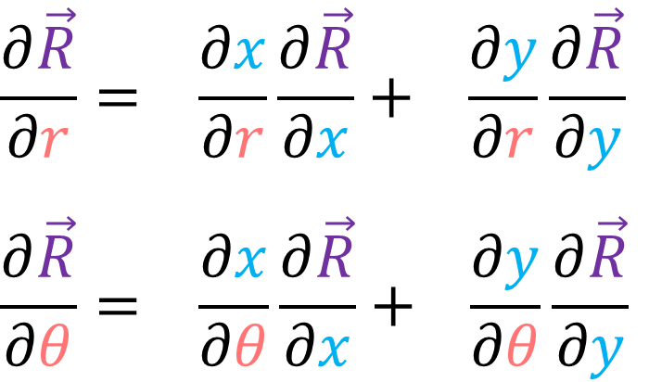
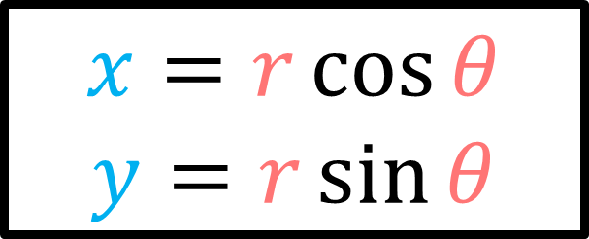
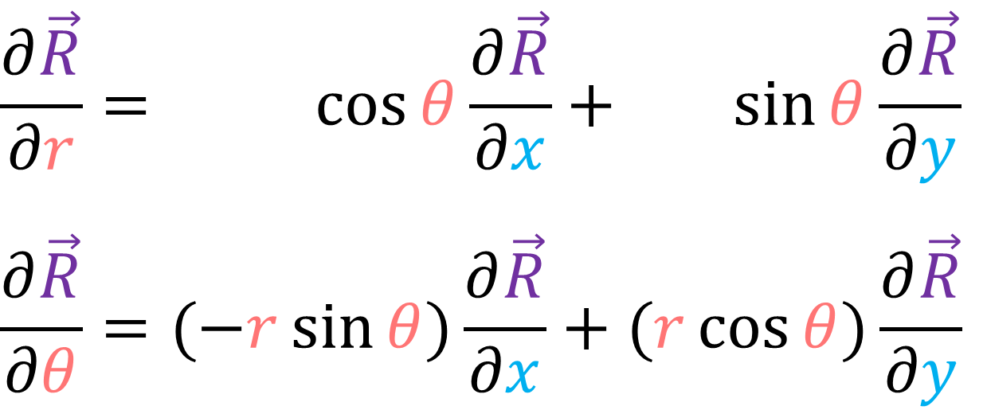
$$\frac{∂\vec{R}}{∂r}= \frac{∂x}{∂r}\frac{∂\vec{R}}{∂x}+ \frac{∂y}{∂r}\frac{∂\vec{R}}{∂y}$$
$$\frac{∂\vec{R}}{∂θ}= \frac{∂x}{∂θ}\frac{∂\vec{R}}{∂x}+ \frac{∂y}{∂θ}\frac{∂\vec{R}}{∂y}$$
$$x=r\cos{θ}$$
$$y=r\sin{θ}$$
$$\frac{∂\vec{R}}{∂r}= \cos{θ}\frac{∂\vec{R}}{∂x}+ \sin{θ}\frac{∂\vec{R}}{∂y}$$
$$\frac{∂\vec{R}}{∂θ}=(−r\sin{θ})\frac{∂\vec{R}}{∂x}+(r\cos{θ})\frac{∂\vec{R}}{∂y}$$

Slide 20

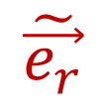











$\frac{∂\vec{R}}{∂r}= \cos{θ}\frac{∂\vec{R}}{∂x}+ \sin{θ}\frac{∂\vec{R}}{∂y}$
$\frac{∂\vec{R}}{∂θ}=(−r\sin{θ})\frac{∂\vec{R}}{∂x}+(r\cos{θ})\frac{∂\vec{R}}{∂y}$
$$\tilde{\vec{e_{θ}}}$$
$$\tilde{\vec{e_{r}}}$$
$$θ$$
$$\tilde{\vec{e_{r}}}$$
$$\tilde{\vec{e_{θ}}}$$
$$r$$
$\frac{∂\vec{R}}{∂r}⋅\frac{∂\vec{R}}{∂r}$
$=\left(\cos{θ}\frac{∂\vec{R}}{∂x}+\sin{θ}\frac{∂\vec{R}}{∂y}\right)⋅\left(\cos{θ}\frac{∂\vec{R}}{∂x}+\sin{θ}\frac{∂\vec{R}}{∂y}\right)$
$={\left(\cos{θ}\right)}^{2}\left(\frac{∂\vec{R}}{∂x}⋅\frac{∂\vec{R}}{∂x}\right)+{\left(\sin{θ}\right)}^{2}\left(\frac{∂\vec{R}}{∂y}⋅\frac{∂\vec{R}}{∂y}\right)+2\left(\cos{θ}\sin{θ}\right)\left(\frac{∂\vec{R}}{∂x}⋅\frac{∂\vec{R}}{∂y}\right)$
$$={\left(\cos{θ}\right)}^{2}+{\left(\sin{θ}\right)}^{2}$$
$$=1$$
$$\tilde{\vec{e_{θ}}}$$
$$\tilde{\vec{e_{r}}}$$
$$\vec{e_{y}}$$
$$\vec{e_{x}}$$

Slide 21


$\frac{∂\vec{R}}{∂r}= \cos{θ}\frac{∂\vec{R}}{∂x}+ \sin{θ}\frac{∂\vec{R}}{∂y}$
$\frac{∂\vec{R}}{∂θ}=(−r\sin{θ})\frac{∂\vec{R}}{∂x}+(r\cos{θ})\frac{∂\vec{R}}{∂y}$
$$\tilde{\vec{e_{θ}}}$$
$$\tilde{\vec{e_{r}}}$$
$$θ$$
$$\tilde{\vec{e_{r}}}$$
$$\tilde{\vec{e_{θ}}}$$
$$r$$
$\frac{∂\vec{R}}{∂θ}⋅\frac{∂\vec{R}}{∂θ}$
$=\left((−r\sin{θ})\frac{∂\vec{R}}{∂x}+(r\cos{θ})\frac{∂\vec{R}}{∂y}\right)⋅\left((−r\sin{θ})\frac{∂\vec{R}}{∂x}+(r\cos{θ})\frac{∂\vec{R}}{∂y}\right)$
$={r^{2}\left(\sin{θ}\right)}^{2}\left(\frac{∂\vec{R}}{∂x}⋅\frac{∂\vec{R}}{∂x}\right)+r^{2}{\left(\cos{θ}\right)}^{2}\left(\frac{∂\vec{R}}{∂y}⋅\frac{∂\vec{R}}{∂y}\right)+ 2r\left(\cos{θ}\sin{θ}\right)\left(\frac{∂\vec{R}}{∂x}⋅\frac{∂\vec{R}}{∂y}\right)$
$$={r^{2}\left(\sin{θ}\right)}^{2}+r^{2}{\left(\cos{θ}\right)}^{2}$$
$$=r^{2} [{\left(\sin{θ}\right)}^{2}+{\left(\cos{θ}\right)}^{2}]$$
$$=r^{2}$$
$$\tilde{\vec{e_{θ}}}$$
$$\tilde{\vec{e_{r}}}$$
$$\vec{e_{y}}$$
$$\vec{e_{x}}$$

Slide 22


$\frac{∂\vec{R}}{∂r}= \cos{θ}\frac{∂\vec{R}}{∂x}+ \sin{θ}\frac{∂\vec{R}}{∂y}$
$\frac{∂\vec{R}}{∂θ}=(−r\sin{θ})\frac{∂\vec{R}}{∂x}+(r\cos{θ})\frac{∂\vec{R}}{∂y}$
$$\tilde{\vec{e_{θ}}}$$
$$\tilde{\vec{e_{r}}}$$
$$θ$$
$$\tilde{\vec{e_{r}}}$$
$$\tilde{\vec{e_{θ}}}$$
$$r$$
$\frac{∂\vec{R}}{∂r}⋅\frac{∂\vec{R}}{∂θ}$
$=\left(\cos{θ}\frac{∂\vec{R}}{∂x}+\sin{θ}\frac{∂\vec{R}}{∂y}\right)⋅\left((−r\sin{θ})\frac{∂\vec{R}}{∂x}+(r\cos{θ})\frac{∂\vec{R}}{∂y}\right)$
$=\left(−r\cos{θ}\sin{θ}\right)\left(\frac{∂\vec{R}}{∂x}⋅\frac{∂\vec{R}}{∂x}\right)+\left(r\cos{θ}\sin{θ}\right)\left(\frac{∂\vec{R}}{∂y}⋅\frac{∂\vec{R}}{∂y}\right)$
$+r{\left(\cos{θ}\right)}^{2}\left(\frac{∂\vec{R}}{∂x}⋅\frac{∂\vec{R}}{∂y}\right)−r{\left(\sin{θ}\right)}^{2}\left(\frac{∂\vec{R}}{∂y}⋅\frac{∂\vec{R}}{∂x}\right)$
$$=0$$
$$\tilde{\vec{e_{θ}}}$$
$$\tilde{\vec{e_{r}}}$$
$$\vec{e_{y}}$$
$$\vec{e_{x}}$$

Slide 23





$\frac{∂\vec{R}}{∂x}⋅\frac{∂\vec{R}}{∂x}=1$ $\frac{∂\vec{R}}{∂x}⋅\frac{∂\vec{R}}{∂y}=0$ $\frac{∂\vec{R}}{∂y}⋅\frac{∂\vec{R}}{∂y}=1$
${\left\|\frac{d\vec{R}}{dλ}\right\|}^{2}$ $={\left(\frac{dx}{dλ}\right)}^{2}\left(\frac{∂\vec{R}}{∂x}⋅\frac{∂\vec{R}}{∂x}\right)+2\frac{dx}{dλ}\frac{dy}{dλ}\left(\frac{∂\vec{R}}{∂x}⋅\frac{∂\vec{R}}{∂y}\right)+{\left(\frac{dy}{dλ}\right)}^{2}\left(\frac{∂\vec{R}}{∂y}⋅\frac{∂\vec{R}}{∂y}\right)$
$={\left(\frac{dx}{dλ}\right)}^{2}+{\left(\frac{dy}{dλ}\right)}^{2}$
$\frac{∂\vec{R}}{∂r}⋅\frac{∂\vec{R}}{∂r}=1$ $\frac{∂\vec{R}}{∂r}⋅\frac{∂\vec{R}}{∂θ}=0$ $\frac{∂\vec{R}}{∂θ}⋅\frac{∂\vec{R}}{∂θ}=r^{2}$
${\left\|\frac{d\vec{R}}{dλ}\right\|}^{2}$ $={\left(\frac{dr}{dλ}\right)}^{2}\left(\frac{∂\vec{R}}{∂r}⋅\frac{∂\vec{R}}{∂r}\right)+2\frac{dr}{dλ}\frac{dθ}{dλ}\left(\frac{∂\vec{R}}{∂r}⋅\frac{∂\vec{R}}{∂θ}\right)+{\left(\frac{dθ}{dλ}\right)}^{2}\left(\frac{∂\vec{R}}{∂θ}⋅\frac{∂\vec{R}}{∂θ}\right)$
$={\left(\frac{dr}{dλ}\right)}^{2}+r^{2}{\left(\frac{dθ}{dλ}\right)}^{2}$

Slide 24



















$$y$$
$$\vec{e_{y}}$$
$$\tilde{\vec{e_{θ}}}$$
$$\tilde{\vec{e_{r}}}$$
$$\vec{e_{y}}$$
$$\vec{e_{x}}$$
$$θ$$
$$\vec{e_{x}}$$
$$\vec{e_{y}}$$
$$x$$
$$\tilde{\vec{e_{r}}}$$
$$\vec{e_{x}}$$
$$\tilde{\vec{e_{θ}}}$$
$$r$$
$$\tilde{\vec{e_{θ}}}$$
$$\tilde{\vec{e_{r}}}$$
$$\left[\begin{matrix}\frac{∂\vec{R}}{∂x}⋅\frac{∂\vec{R}}{∂x} & \frac{∂\vec{R}}{∂y}⋅\frac{∂\vec{R}}{∂x} \\ \frac{∂\vec{R}}{∂x}⋅\frac{∂\vec{R}}{∂y} & \frac{∂\vec{R}}{∂y}⋅\frac{∂\vec{R}}{∂y}\end{matrix}\right]$$
$$\left[\begin{matrix}\frac{∂\vec{R}}{∂r}⋅\frac{∂\vec{R}}{∂r} & \frac{∂\vec{R}}{∂θ}⋅\frac{∂\vec{R}}{∂r} \\ \frac{∂\vec{R}}{∂r}⋅\frac{∂\vec{R}}{∂θ} & \frac{∂\vec{R}}{∂θ}⋅\frac{∂\vec{R}}{∂θ}\end{matrix}\right]$$

Slide 25




$$y$$
$$\vec{e_{y}}$$
$$\tilde{\vec{e_{θ}}}$$
$$\tilde{\vec{e_{r}}}$$
$$\vec{e_{y}}$$
$$\vec{e_{x}}$$
$$θ$$
$\tilde{\vec{e_{θ}}}=\frac{∂\vec{R}}{∂θ}$ is
NOT NORMALIZED.
$$\vec{e_{x}}$$
$$\vec{e_{y}}$$
$$x$$
$$\tilde{\vec{e_{r}}}$$
$$\vec{e_{x}}$$
$$\tilde{\vec{e_{θ}}}$$
$$r$$
$$\tilde{\vec{e_{θ}}}$$
$$\tilde{\vec{e_{r}}}$$
$$\left[\begin{matrix}1 & 0 \\ 0 & 1\end{matrix}\right]$$
$$\left[\begin{matrix}1 & 0 \\ 0 & r^{2}\end{matrix}\right]$$

Slide 26



$$y$$
$$\vec{e_{y}}$$
$$\tilde{\vec{e_{θ}}}$$
$$\tilde{\vec{e_{r}}}$$
$$\vec{e_{y}}$$
$$\vec{e_{x}}$$
$$θ$$
$\tilde{\vec{e_{θ}}}=\frac{∂\vec{R}}{∂θ}$ is
NOT NORMALIZED.
$$\vec{e_{x}}$$
$$\vec{e_{y}}$$
$$x$$
$$\tilde{\vec{e_{r}}}$$
$$\vec{e_{x}}$$
$$\tilde{\vec{e_{θ}}}$$
$$r$$
$$\tilde{\vec{e_{θ}}}$$
$$\tilde{\vec{e_{r}}}$$
$${\tilde{\vec{e_{θ}}}}_{normalized}=\frac{∂\vec{R}}{∂θ}\frac{1}{r}$$
$$\left[\begin{matrix}1 & 0 \\ 0 & 1\end{matrix}\right]$$
$$\left[\begin{matrix}1 & 0 \\ 0 & r^{2}\end{matrix}\right]$$

Slide 27







$$y$$
$$y$$
$$\vec{R}\left(λ\right)=\left(x\left(λ\right),y\left(λ\right)\right)=(2\cos\left(λ\right),2\sin\left(λ\right))$$
$\frac{dx}{dλ}=\frac{d}{dλ}2cos\left(λ\right)=−2sin\left(λ\right)$
$\frac{dy}{dλ}=\frac{d}{dλ}2sin\left(λ\right)= 2cos\left(λ\right)$
$$x$$
$$x$$
$${\left\|\frac{d\vec{R}}{dλ}\right\|}^{2}={\left(\frac{dx}{dλ}\right)}^{2}+{\left(\frac{dy}{dλ}\right)}^{2}$$
$$={\left(−2sin\left(λ\right)\right)}^{2}+{\left(2cos\left(λ\right)\right)}^{2}$$
$=4[{\left(\sin\left(λ\right)\right)}^{2}+{\left(\cos\left(λ\right)\right)}^{2}]$
$=4$

Slide 28



$$arc length=\int_{0}^{2π}{\left\|\frac{d\vec{R}}{dλ}\right\|dλ}$$
$$=\int_{0}^{2π}{2dλ}$$
$$=2\int_{0}^{2π}{dλ}$$
$=2{\left[λ\right]}_{0}^{2π}$
$=2(2π−0)$
$=4π$
$${\left\|\frac{d\vec{R}}{dλ}\right\|}^{2}=4$$

Slide 29





$$\vec{R}\left(λ\right)=\left(r\left(λ\right),θ\left(λ\right)\right)=(2,λ)$$
$$θ$$
$\frac{dr}{dλ}=\frac{d}{dλ}(2)=0$
$\frac{dθ}{dλ}=\frac{d}{dλ}\left(λ\right)=1$
$$r$$
$${\left\|\frac{d\vec{R}}{dλ}\right\|}^{2}={\left(\frac{dr}{dλ}\right)}^{2}+r^{2}{\left(\frac{dθ}{dλ}\right)}^{2}$$
$={\left(0\right)}^{2}+{\left(2\right)}^{2}{\left(1\right)}^{2}$
$=4$

Slide 30

$$arc length=\int_{0}^{2π}{\left\|\frac{d\vec{R}}{dλ}\right\|dλ}$$
$$=\int_{0}^{2π}{2dλ}$$
$$=2\int_{0}^{2π}{dλ}$$
$=2{\left[λ\right]}_{0}^{2π}$
$=2(2π−0)$
$=4π$
$${\left\|\frac{d\vec{R}}{dλ}\right\|}^{2}=4$$

Slide 31
$$\tilde{g_{ij}}=\tilde{\vec{e_{i}}}⋅\tilde{\vec{e_{j}}}$$
$=\left(F_{i}^{k}\vec{e_{k}}\right)⋅\left(F_{j}^{l}\vec{e_{l}}\right)$
$$=F_{i}^{k}F_{j}^{l}\left(\vec{e_{k}}⋅\vec{e_{l}}\right)$$
$=F_{i}^{k}F_{j}^{l}g_{kl}$
$$\tilde{\vec{e_{j}}}=F_{j}^{i}\vec{e_{i}}$$
$$\vec{e_{j}}=B_{j}^{i}\tilde{\vec{e_{i}}}$$
$$\tilde{g_{ij}}=F_{i}^{k}F_{j}^{l}g_{kl}$$
$$g_{kl}=B_{k}^{i}B_{l}^{j}\tilde{g_{ij}}$$
(0,2)-Tensor

Slide 32





$$\tilde{g_{ij}}=\frac{∂\vec{R}}{∂p^{i}}⋅\frac{∂\vec{R}}{∂p^{j}}$$
$=\left(\frac{∂c^{k}}{∂p^{i}}\frac{∂\vec{R}}{∂c^{k}}\right)⋅\left(\frac{∂c^{l}}{∂p^{j}}\frac{∂\vec{R}}{∂c^{l}}\right)$
$=\frac{∂c^{k}}{∂p^{i}}\frac{∂c^{l}}{∂p^{j}}\left(\frac{∂\vec{R}}{∂c^{k}}⋅\frac{∂\vec{R}}{∂c^{l}}\right)$
$=\frac{∂c^{k}}{∂p^{i}}\frac{∂c^{l}}{∂p^{j}}g_{kl}$
$$\frac{∂\vec{R}}{∂p^{j}}=\frac{∂c^{i}}{∂p^{j}}\frac{∂\vec{R}}{∂c^{i}}$$
$$\frac{∂\vec{R}}{∂c^{j}}=\frac{∂p^{i}}{∂c^{j}}\frac{∂\vec{R}}{∂p^{i}}$$
(0,2)-Tensor
$$\tilde{g_{ij}}=\frac{∂c^{k}}{∂p^{i}}\frac{∂c^{l}}{∂p^{j}}g_{kl}$$
$$g_{kl}=\frac{∂p^{i}}{∂c^{k}}\frac{∂p^{j}}{∂c^{l}}\tilde{g_{ij}}$$

Slide 33




$$\tilde{g_{ij}}=\tilde{\vec{e_{i}}}⋅\tilde{\vec{e_{j}}}$$
$=\left(F_{i}^{k}\vec{e_{k}}\right)⋅\left(F_{j}^{l}\vec{e_{l}}\right)$
$$=F_{i}^{k}F_{j}^{l}\left(\vec{e_{k}}⋅\vec{e_{l}}\right)$$
$=F_{i}^{k}F_{j}^{l}g_{kl}$
$$\tilde{g_{ij}}=\frac{∂\vec{R}}{∂p^{i}}⋅\frac{∂\vec{R}}{∂p^{j}}$$
$=\left(\frac{∂c^{k}}{∂p^{i}}\frac{∂\vec{R}}{∂c^{k}}\right)⋅\left(\frac{∂c^{l}}{∂p^{j}}\frac{∂\vec{R}}{∂c^{l}}\right)$
$=\frac{∂c^{k}}{∂p^{i}}\frac{∂c^{l}}{∂p^{j}}\left(\frac{∂\vec{R}}{∂c^{k}}⋅\frac{∂\vec{R}}{∂c^{l}}\right)$
$=\frac{∂c^{k}}{∂p^{i}}\frac{∂c^{l}}{∂p^{j}}g_{kl}$
$$\tilde{g_{ij}}=\frac{∂c^{k}}{∂p^{i}}\frac{∂c^{l}}{∂p^{j}}g_{kl}$$
$$\tilde{g_{ij}}=F_{i}^{k}F_{j}^{l}g_{kl}$$

Slide 34






$$\frac{∂c^{k}}{∂p^{i}}→\left[\begin{matrix}\frac{∂c^{1}}{∂p^{1}} & \frac{∂c^{1}}{∂p^{2}} \\ \frac{∂c^{2}}{∂p^{1}} & \frac{∂c^{2}}{∂p^{2}}\end{matrix}\right]=\left[\begin{matrix}x/r & −y \\ y/r & x\end{matrix}\right]$$
$$\tilde{g_{ij}}=\frac{∂c^{k}}{∂p^{i}}\frac{∂c^{l}}{∂p^{j}}g_{kl}$$
$$\left[\begin{matrix}1 & 0 \\ 0 & r^{2}\end{matrix}\right]$$
$${\left[\begin{matrix}x/r & −y \\ y/r & x\end{matrix}\right]}^{T}\left[\begin{matrix}1 & 0 \\ 0 & 1\end{matrix}\right]\left[\begin{matrix}x/r & −y \\ y/r & x\end{matrix}\right]$$
$$=\left[\begin{matrix}x/r & y/r \\ −y & x\end{matrix}\right]\left[\begin{matrix}x/r & −y \\ y/r & x\end{matrix}\right]$$
$$=\left[\begin{matrix}\frac{x^{2}+y^{2}}{r^{2}} & \frac{−xy+yx}{r} \\ \frac{−yx−xy}{r} & y^{2}+x^{2}\end{matrix}\right]$$
$$=\left[\begin{matrix}1 & 0 \\ 0 & r^{2}\end{matrix}\right]$$

Slide 35



$$arc length=\int{\left\|\frac{d\vec{R}}{dλ}\right\|dλ}$$
${\left\|\frac{d\vec{R}}{dλ}\right\|}^{2} =\frac{d\vec{R}}{dλ}⋅\frac{d\vec{R}}{dλ}$
$=\frac{dc^{i}}{dλ}\frac{dc^{j}}{dλ}\left(\frac{∂\vec{R}}{∂c^{i}}⋅\frac{∂\vec{R}}{∂c^{j}}\right)$
$=\frac{dp^{i}}{dλ}\frac{dp^{j}}{dλ}\left(\frac{∂\vec{R}}{∂p^{i}}⋅\frac{∂\vec{R}}{∂p^{j}}\right)$

Slide 36



$$arc length=\int{\left\|\frac{d\vec{R}}{dλ}\right\|dλ}$$
(0,2)-Tensor
${\left\|\frac{d\vec{R}}{dλ}\right\|}^{2} =\frac{d\vec{R}}{dλ}⋅\frac{d\vec{R}}{dλ}$
$=\frac{dc^{i}}{dλ}\frac{dc^{j}}{dλ}g_{ij}$
$=\frac{dp^{i}}{dλ}\frac{dp^{j}}{dλ}\tilde{g_{ij}}$
$$\tilde{g_{ij}}=\frac{∂c^{k}}{∂p^{i}}\frac{∂c^{l}}{∂p^{j}}g_{kl}$$
$$g_{kl}=\frac{∂p^{i}}{∂c^{k}}\frac{∂p^{j}}{∂c^{l}}\tilde{g_{ij}}$$

Slide 37
The Metric Tensor for… 3. Arc Length (curved space)

