Slide 1
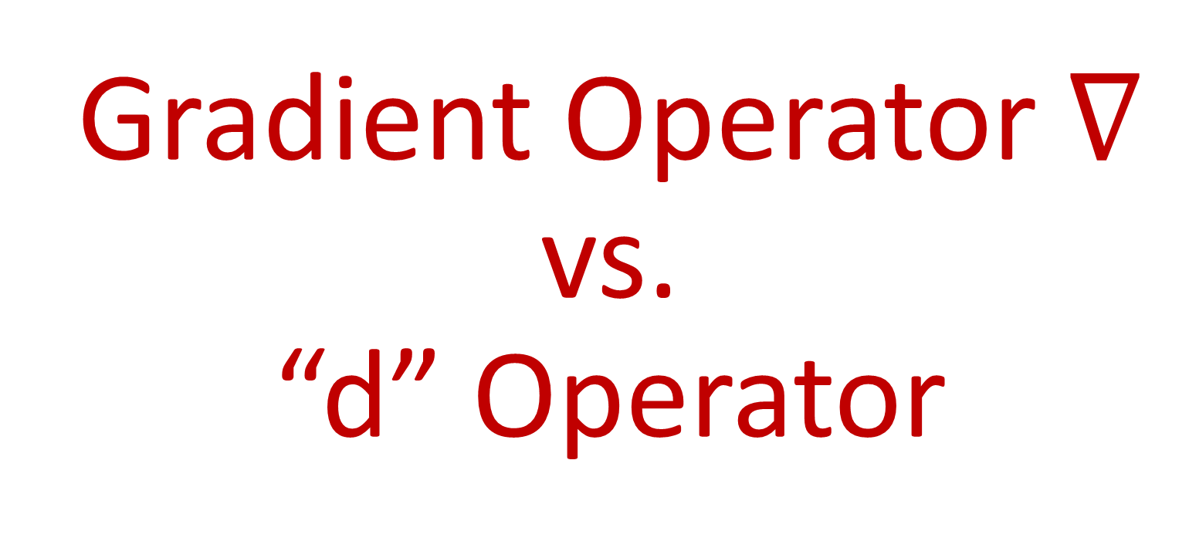
Gradient Operator $∇$ vs. “d” Operator
(see links in description to learn about raising/lowering indexes with metric tensor)

Slide 2



$$∇f$$
$$df$$
vs.

Slide 3
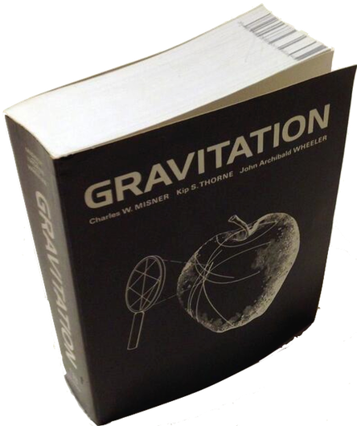
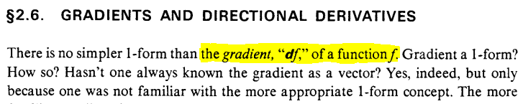




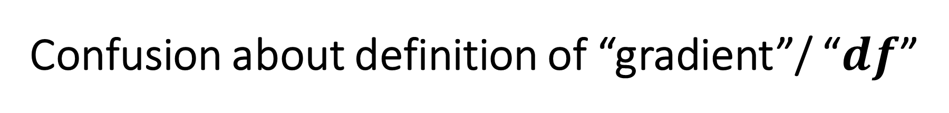

Confusion about definition of “gradient”/ “$df$”
From “Gravitation”, by Misner, Thorne and Wheeler

Slide 4





Confusion about definition of “gradient”/ “$df$”

Slide 5
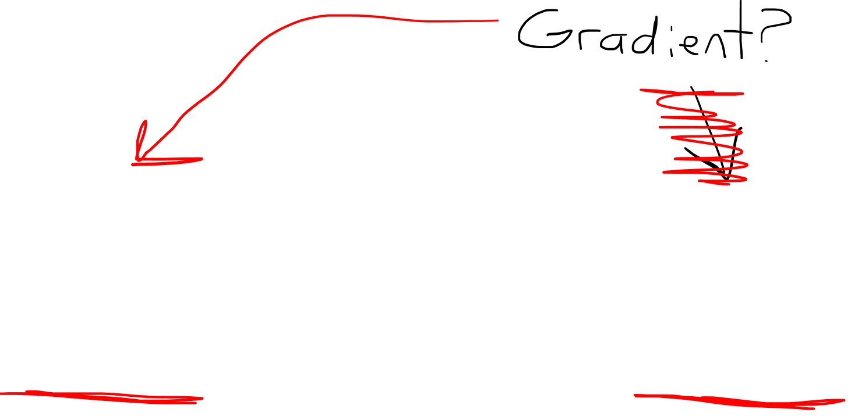
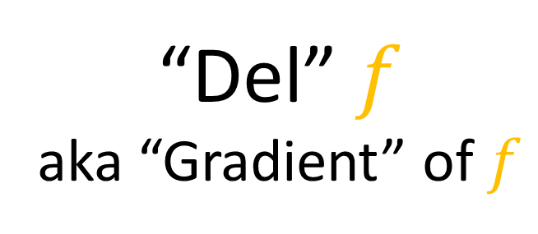
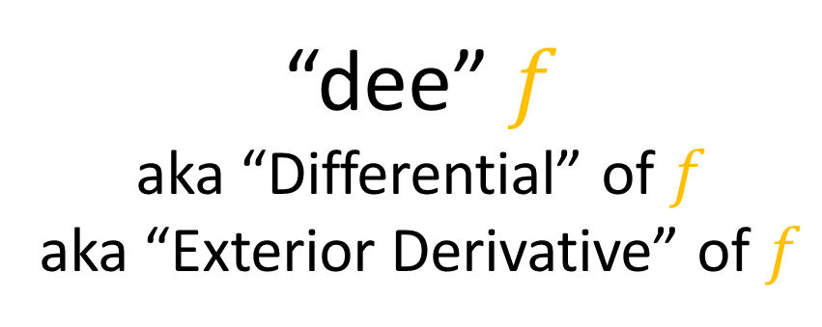
$$∇f$$
$$df$$
vs.
“Del” $f$
aka “Gradient” of $f$
“dee” $f$
aka “Differential” of $f$
aka “Exterior Derivative” of $f$

Slide 6
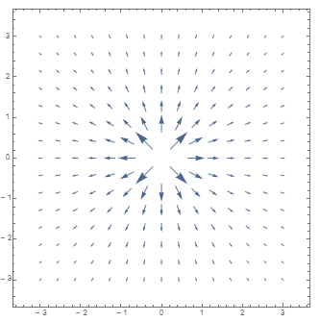
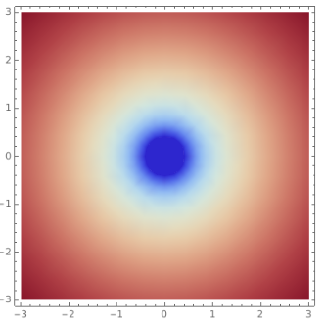
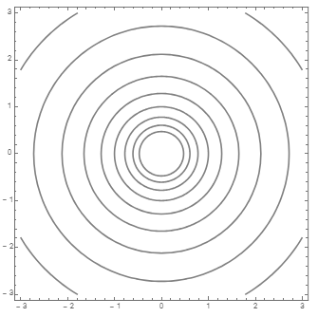

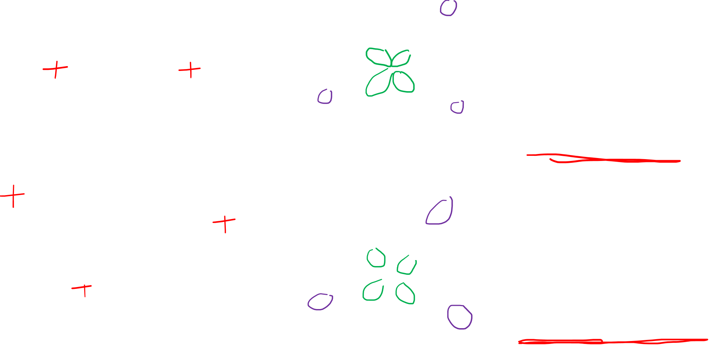


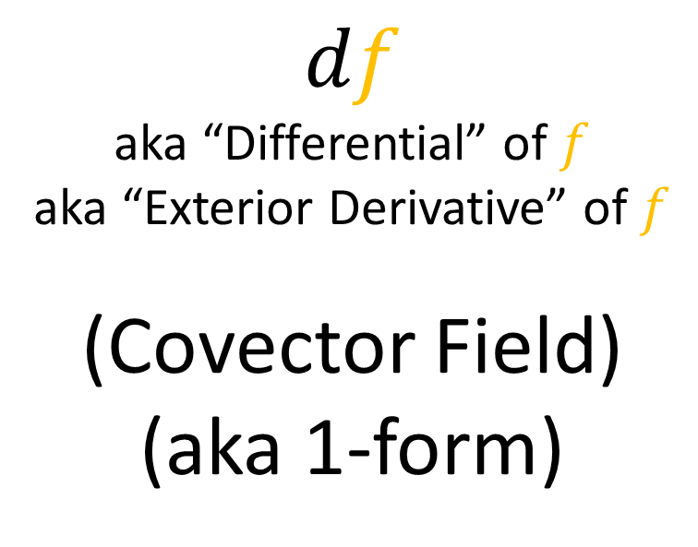
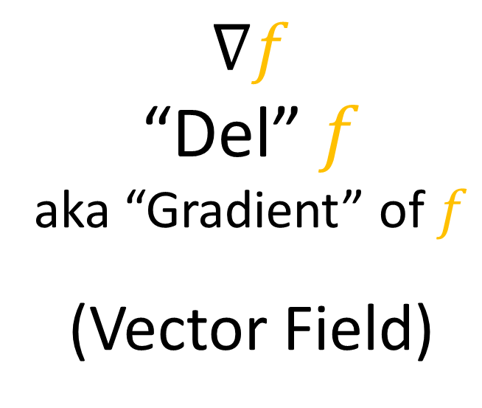
$$∇f$$
“Del” $f$
aka “Gradient” of $f$
(Vector Field)
$$∇f$$
$$f$$
$$df$$
aka “Differential” of $f$
aka “Exterior Derivative” of $f$
(Covector Field)
(aka 1-form)
$$df$$

Slide 7
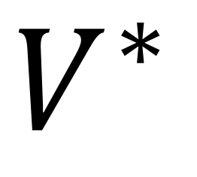
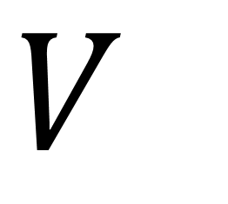

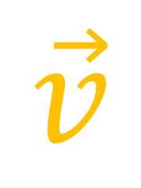
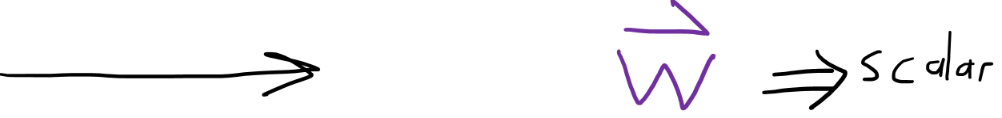
Vector Space
(vectors)
Dual Space
(covectors)
$$V$$
$$V^{∗}$$
$$\vec{v}⋅___$$
$$\vec{v}$$

Slide 8
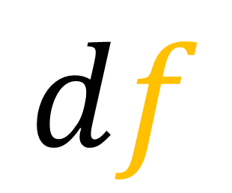
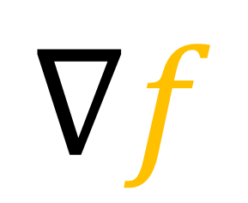
Vector Space
(vectors)
Dual Space
(covectors)
$$V$$
$$V^{∗}$$
$$∇f$$
$$df$$

Slide 9
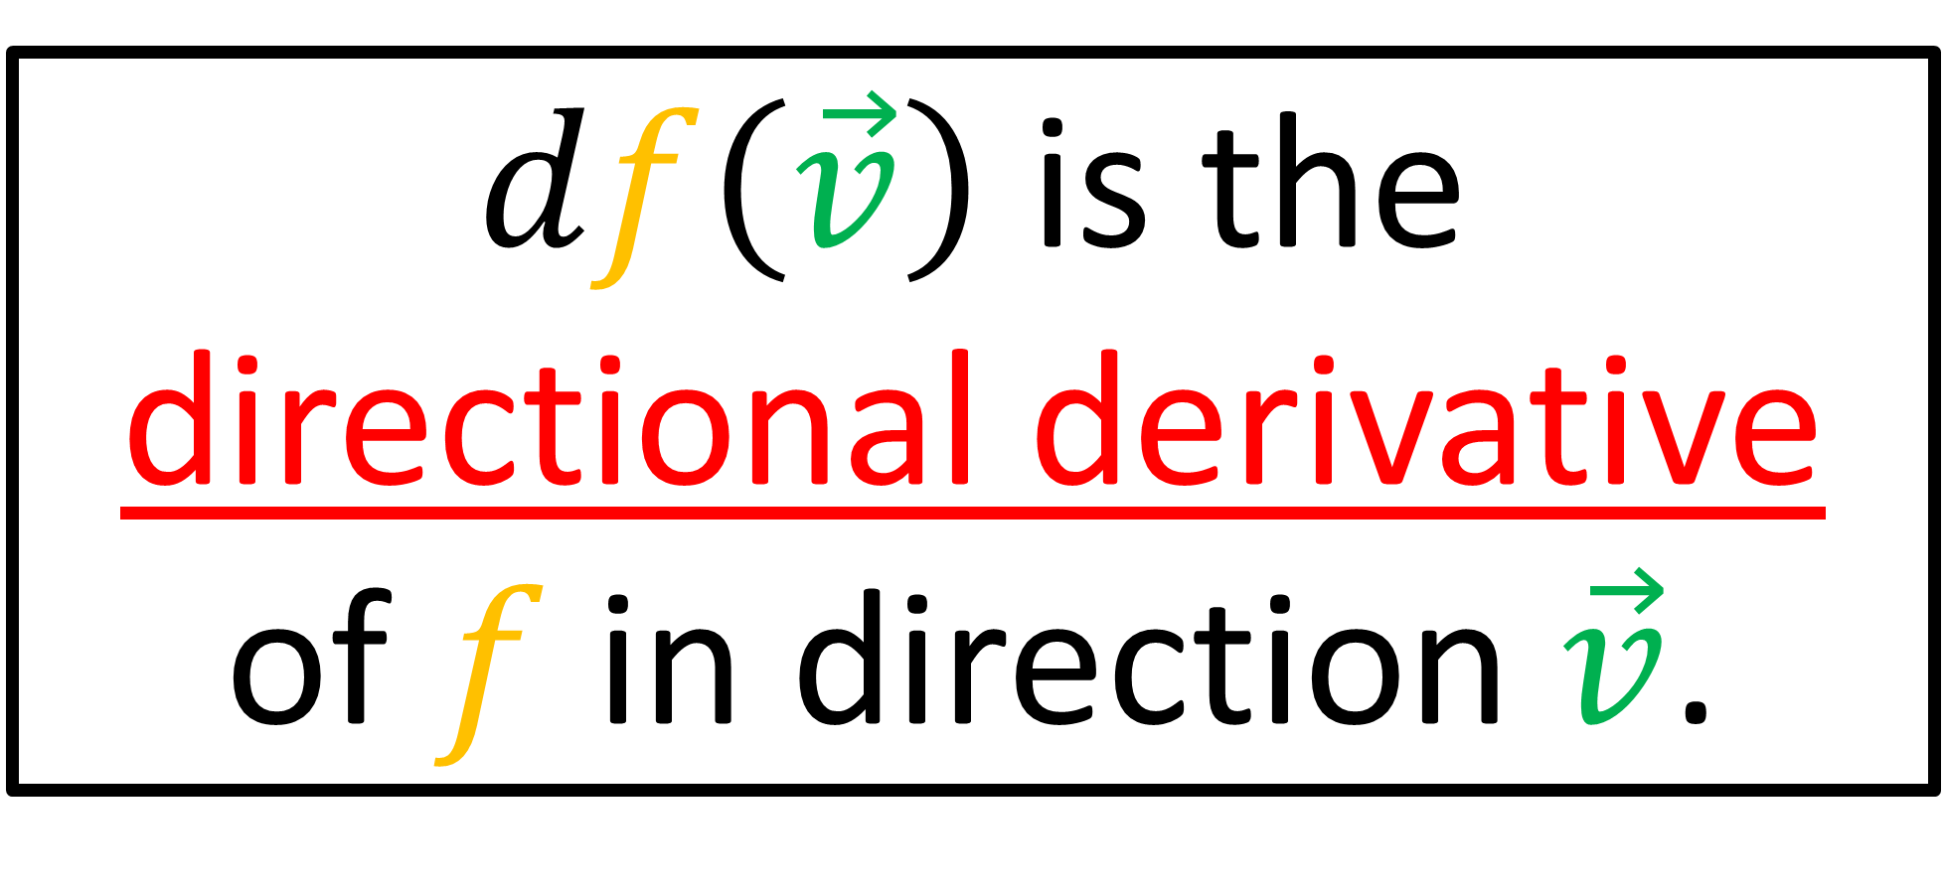
$df\left(\vec{v}\right)$ is the
directional derivative
of $f$ in direction $\vec{v}$.

Slide 10
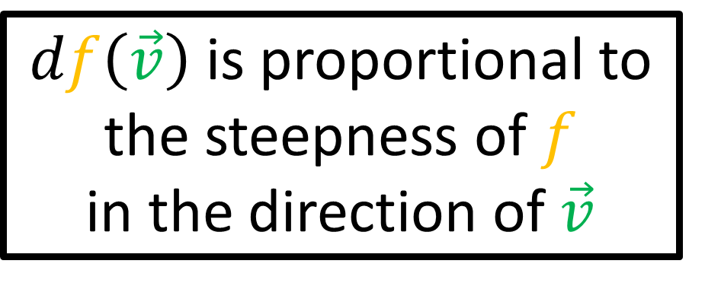

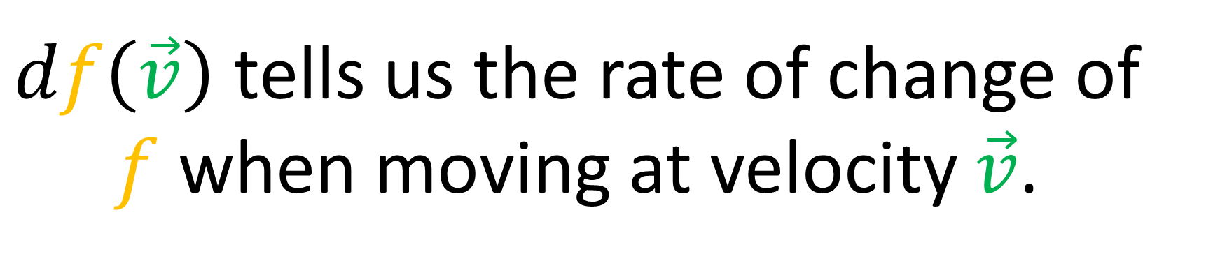
$df\left(\vec{v}\right)$is proportional to the steepness of $f$
in the direction of $\vec{v}$
$df\left(\vec{v}\right)$is proportional
to the length of $\vec{v}$
$df\left(\vec{v}\right)$ tells us the rate of change of $f$ when moving at velocity $\vec{v}$.

Slide 11

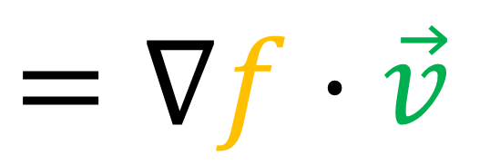

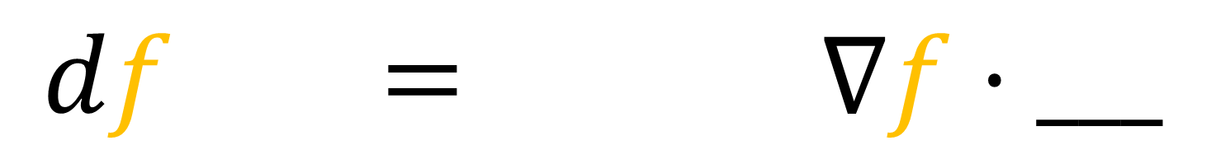

$df\left(\vec{v}\right)$ is the
directional derivative
of $f$ in direction $\vec{v}$.
$$df\left(\vec{v}\right)$$
$$=∇_{\vec{v}}f$$
$$=∇f⋅\vec{v}$$
$$df = ∇f⋅___$$

Slide 12
$df\left(\vec{v}\right)$ is the
directional derivative
of $f$ in direction $\vec{v}$.
$$df\left(\vec{v}\right)$$
$$=∇_{\vec{v}}f$$
$$=∇f⋅\vec{v}$$
$$df = ∇f⋅___$$

Slide 13

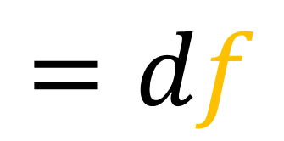
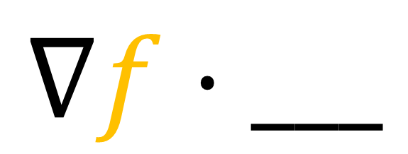
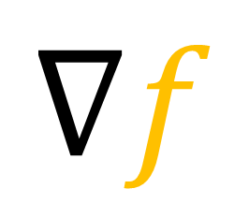


Vector Space
(vectors)
Dual Space
(covectors)
$$\vec{v}$$
$$\vec{v}⋅___$$
$$∇f$$
$$∇f⋅___$$
$$=df$$

Slide 14
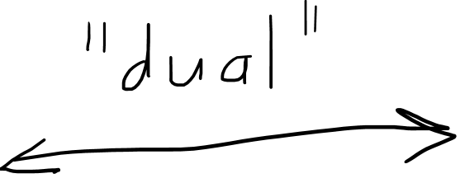
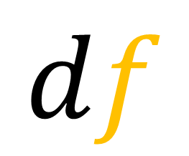
Vector Space
(vectors)
Dual Space
(covectors)
$$\vec{v}$$
$$\vec{v}⋅___$$
$$∇f$$
$$df$$

Slide 15






Metric Tensor
(covariant metric tensor)
Vectors
Covectors
$$\vec{v}$$
$$g$$
$$\vec{v}⋅___$$
$$𝔤$$
Inverse Metric Tensor
(contravariant metric tensor)
$$g_{ij}𝔤^{jk}=δ_{i}^{k}$$

Slide 16

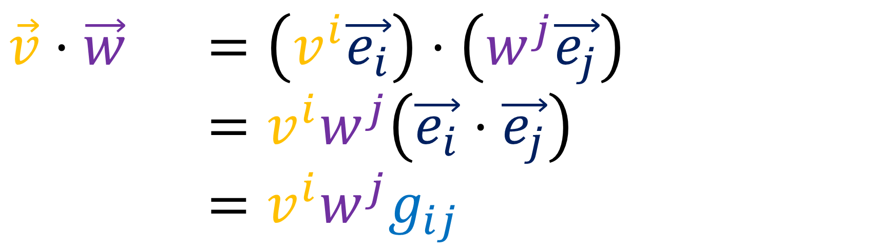
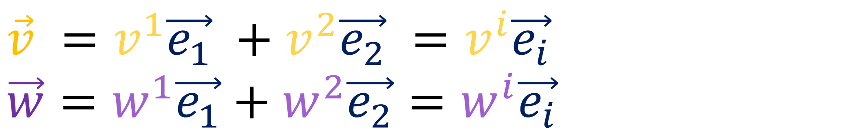
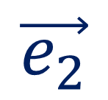
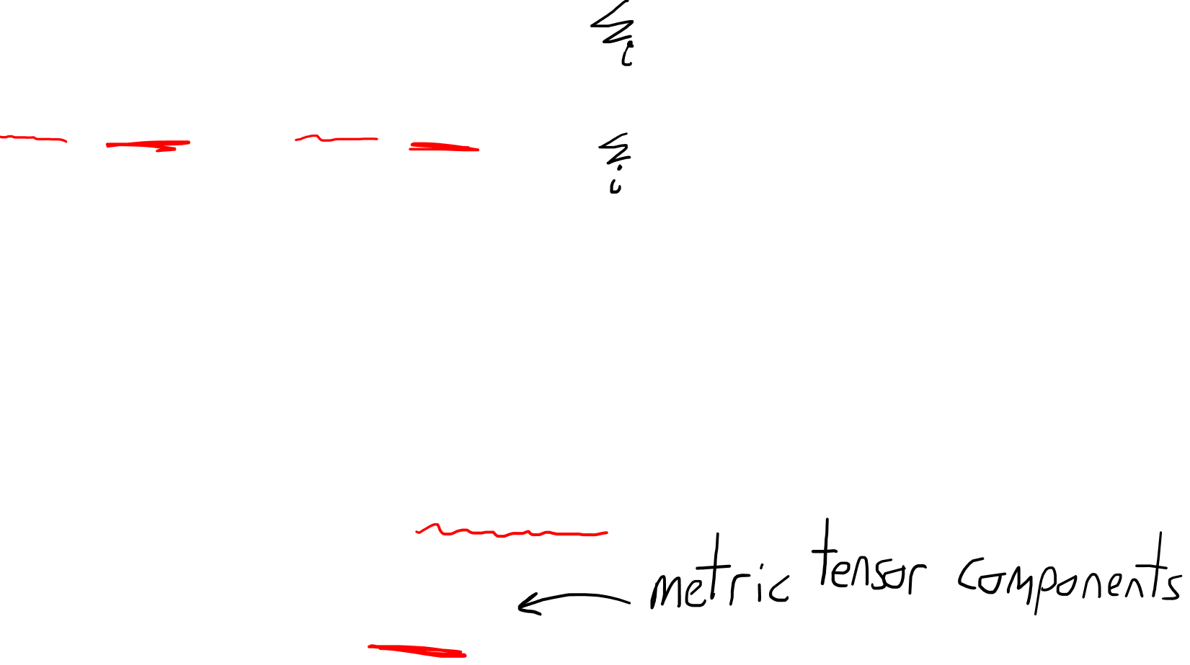

$$\vec{v}⋅\vec{w} ?$$
$$\vec{e_{2}}$$
$$\vec{v} =v^{1}\vec{e_{1}} +v^{2}\vec{e_{2}} =v^{i}\vec{e_{i}}$$
$$\vec{w}=w^{1}\vec{e_{1}}+w^{2}\vec{e_{2}}=w^{i}\vec{e_{i}}$$
$$\vec{e_{1}}$$
$$\vec{v}⋅\vec{w} =\left(v^{i}\vec{e_{i}}\right)⋅\left(w^{j}\vec{e_{j}}\right)$$
$$\vec{v}⋅\vec{w} =v^{i}w^{j}\left(\vec{e_{i}}⋅\vec{e_{j}}\right)$$
$$\vec{v}⋅\vec{w} =v^{i}w^{j}g_{ij}$$

Slide 17
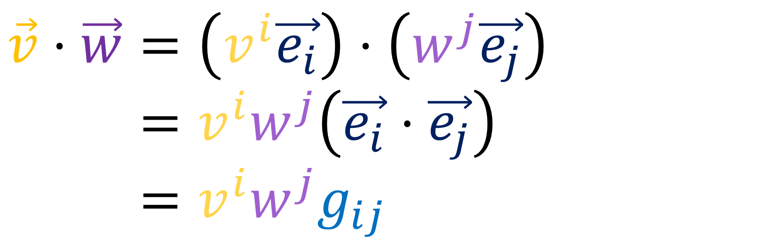
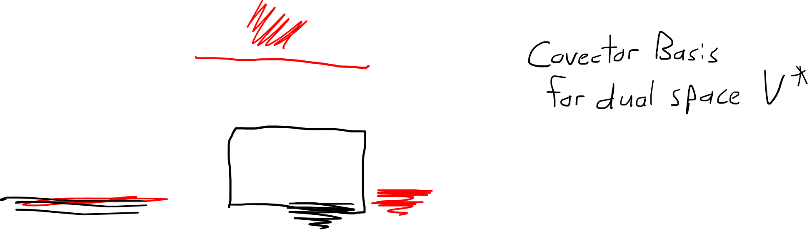


$$\vec{v}⋅\vec{w}=\left(v^{i}\vec{e_{i}}\right)⋅\left(w^{j}\vec{e_{j}}\right)$$
$$\vec{v}⋅\vec{w}=v^{i}w^{j}\left(\vec{e_{i}}⋅\vec{e_{j}}\right)$$
$$\vec{v}⋅\vec{w}=v^{i}w^{j}g_{ij}$$
$$\vec{v}⋅__=v^{i}g_{ij} ε^{j}$$
$$ε^{j}\left(\vec{e_{i}}\right)=δ_{i}^{j}$$
(See “Tensors for Beginners 16” video for full explanation)

Slide 18

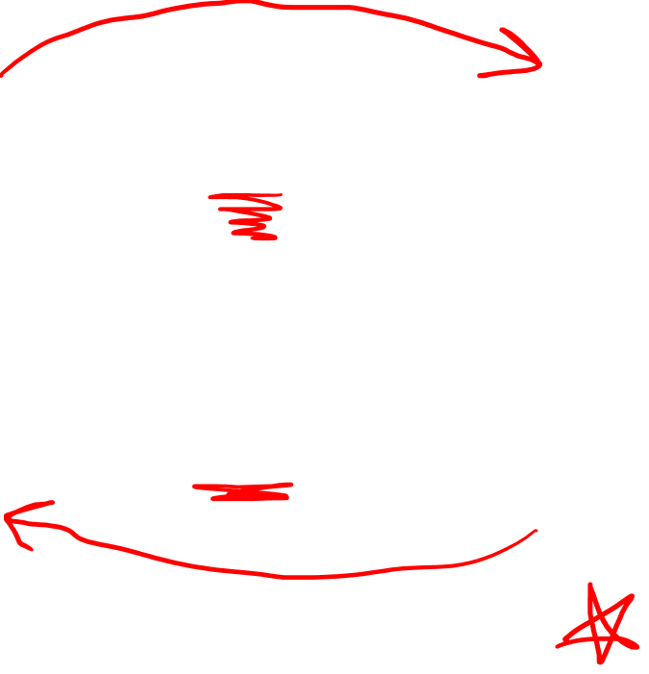


Metric Tensor
(covariant metric tensor)
Vectors
Covectors
$$\vec{v}$$
$$g$$
$$\vec{v}⋅___$$
$$∇f$$
$$df$$
$$𝔤$$
$$∇f⋅___$$
Inverse Metric Tensor
(contravariant metric tensor)
$$g_{ij}𝔤^{jk}=δ_{i}^{k}$$

Slide 19
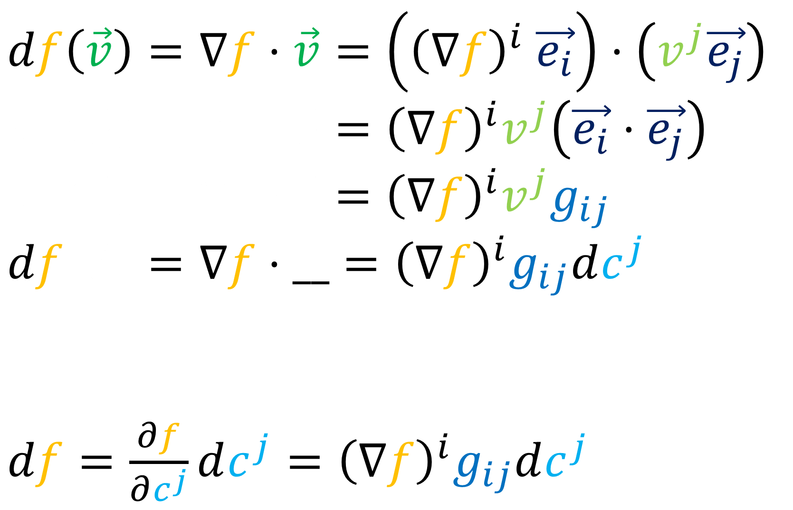
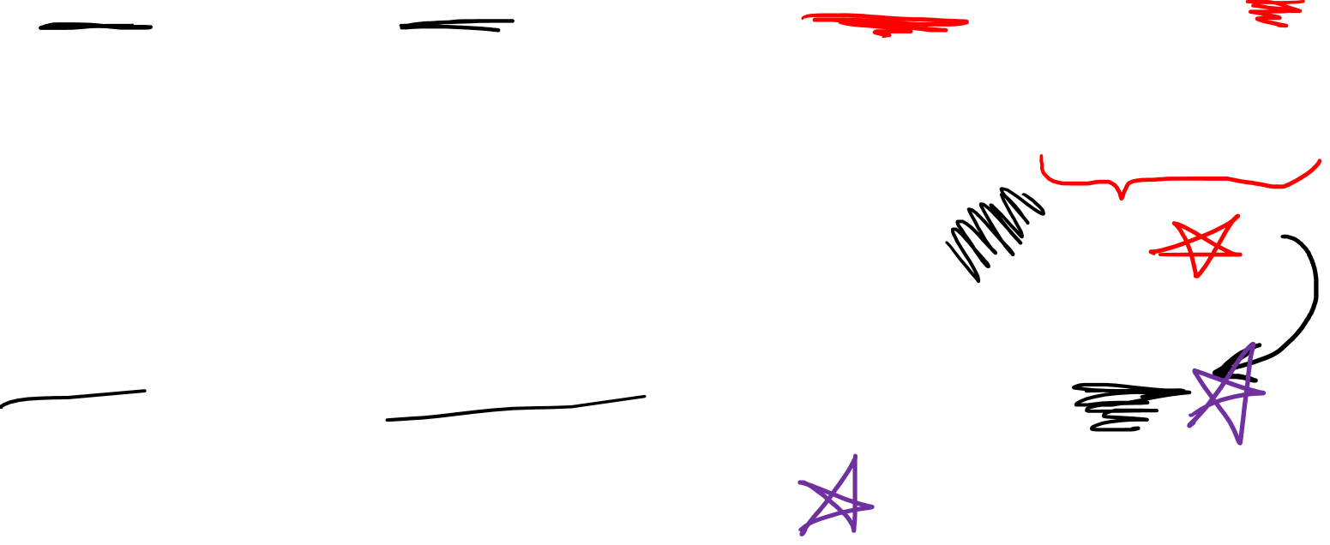
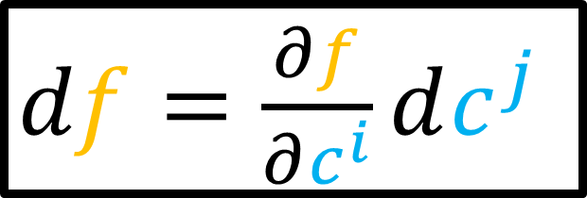
$$df\left(\vec{v}\right)=∇f⋅\vec{v}=\left({\left(∇f\right)}^{i} \vec{e_{i}}\right)⋅\left(v^{j}\vec{e_{j}}\right)$$
$$df\left(\vec{v}\right)=∇f⋅\vec{v}={\left(∇f\right)}^{i}v^{j}\left(\vec{e_{i}}⋅\vec{e_{j}}\right)$$
$$df\left(\vec{v}\right)=∇f⋅\vec{v}={\left(∇f\right)}^{i}v^{j}g_{ij}$$
$$df\left(\vec{v}\right)=∇f⋅__={\left(∇f\right)}^{i}g_{ij}dc^{j}$$
$df=\frac{∂f}{∂c^{j}}dc^{j}={\left(∇f\right)}^{i}g_{ij}dc^{j}$
$df=\frac{∂f}{∂c^{i}}dc^{j}$

Slide 20
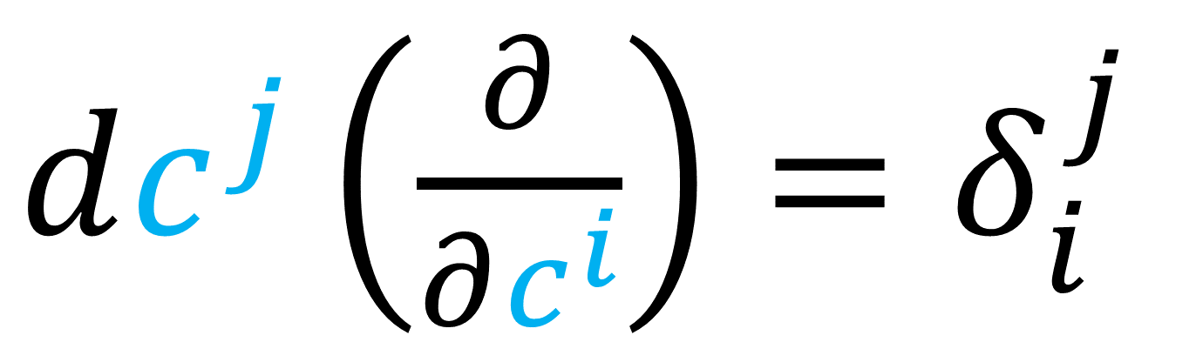
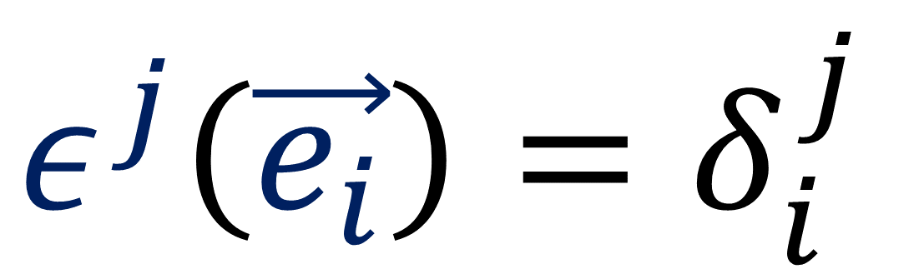
$dc^{j}\left(\frac{∂}{∂c^{i}}\right)=δ_{i}^{j}$
$$ε^{j}\left(\vec{e_{i}}\right)=δ_{i}^{j}$$

Slide 21
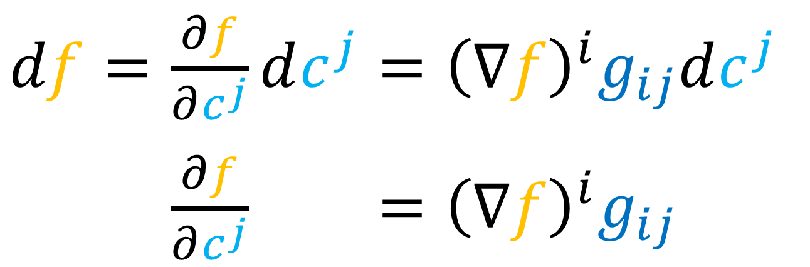
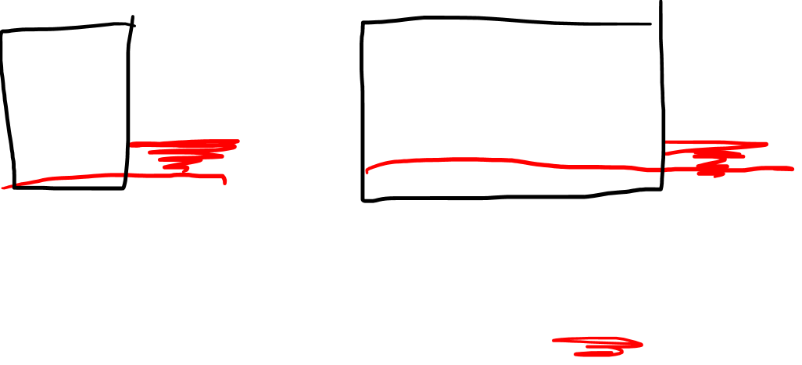
$df=\frac{∂f}{∂c^{j}}dc^{j}={\left(∇f\right)}^{i}g_{ij}dc^{j}$
$df=\frac{∂f}{∂c^{j}}dc^{j}={\left(∇f\right)}^{i}g_{ij}dc^{j}$

Slide 22






$${\left(∇f\right)}^{i}g_{ij}=\frac{∂f}{∂c^{j}}$$
$$g$$
$$∇f$$
$$df$$
$$𝔤$$

Slide 23



$df=\frac{∂f}{∂c^{j}}dc^{j}={\left(∇f\right)}^{i}g_{ij}dc^{j}$
$df=\frac{∂f}{∂c^{j}}dc^{j}={\left(∇f\right)}^{i}g_{ij}dc^{j}$
$df=\frac{∂f}{∂c^{j}}𝔤^{jk} ={\left(∇f\right)}^{i}g_{ij}𝔤^{jk}$
$df=\frac{∂f}{∂c^{j}}𝔤^{jk} ={\left(∇f\right)}^{i}δ_{i}^{k}$
$df=\frac{∂f}{∂c^{j}}𝔤^{jk} ={\left(∇f\right)}^{k}$
$$g_{ij}𝔤^{jk}=δ_{i}^{k}$$

Slide 24







$${\left(∇f\right)}^{i}g_{ij}=\frac{∂f}{∂c^{j}}$$
$$g$$
$$∇f$$
$$df$$
$$𝔤$$
$${\left(∇f\right)}^{k}=𝔤^{jk}\frac{∂f}{∂c^{j}}$$

Slide 25



$${\left(∇f\right)}^{k}=𝔤^{jk}\frac{∂f}{∂c^{j}}$$
$$∇f={\left(∇f\right)}^{k}\frac{∂}{∂c^{k}}=𝔤^{jk}\frac{∂f}{∂c^{j}}\frac{∂}{∂c^{k}}$$
$$∇f={\left(∇f\right)}^{k} \vec{e_{k}} = 𝔤^{jk}\frac{∂f}{∂c^{j}}\vec{e_{k}}$$

Slide 26





$$∇f = 𝔤^{jk}\frac{∂f}{∂c^{j}}\vec{e_{k}}$$
$$∇f =δ^{jk}\frac{∂f}{∂c^{j}}\vec{e_{k}}$$
$$∇f = \frac{∂f}{∂c^{k}}\vec{e_{k}}$$
Cartesian Basis
$$g_{ij}=δ_{ij}→\left[\begin{matrix}1 & 0 \\ 0 & 1\end{matrix}\right]$$
$$𝔤^{jk}=δ^{jk}→\left[\begin{matrix}1 & 0 \\ 0 & 1\end{matrix}\right]$$
$∇f=\frac{∂f}{∂x}\vec{e_{x}}+\frac{∂f}{∂y}\vec{e_{y}}$

Slide 27





$$∇f =\tilde{𝔤^{ij}}\frac{∂f}{∂p^{j}}\tilde{\vec{e_{i}}}$$
$∇f=\tilde{𝔤^{rr}}\frac{∂f}{∂r}\tilde{\vec{e_{r}}}+\tilde{𝔤^{θθ}}\frac{∂f}{∂θ}\tilde{\vec{e_{θ}}}$
$∇f= \frac{∂f}{∂r}\tilde{\vec{e_{r}}} + \frac{1}{r^{2}} \frac{∂f}{∂θ}\tilde{\vec{e_{θ}}}$
Polar Basis
$$\tilde{g_{ij}}→\left[\begin{matrix}1 & 0 \\ 0 & r^{2}\end{matrix}\right]$$
$$\tilde{𝔤^{ij}}→\left[\begin{matrix}1 & 0 \\ 0 & 1/r^{2}\end{matrix}\right]$$
$∇f=\frac{∂f}{∂r}\tilde{\vec{e_{r}}}+\frac{1}{r^{2}}\frac{∂f}{∂θ}\tilde{\vec{e_{θ}}}$

Slide 28












$$\tilde{\vec{e_{r}}}$$
$∇f=\frac{∂f}{∂r}\tilde{\vec{e_{r}}}+\frac{1}{r^{2}}\frac{∂f}{∂θ}\tilde{\vec{e_{θ}}}$
$$\tilde{\vec{e_{θ}}}$$
$$θ$$
${\tilde{\vec{e_{θ}}}}_{textbook}=\frac{1}{r}\tilde{\vec{e_{θ}}}$
$\tilde{\vec{e_{θ}}}=r{\tilde{\vec{e_{θ}}}}_{textbook}$
$$\tilde{\vec{e_{r}}}$$
$$\tilde{\vec{e_{θ}}}$$
$$r$$
$$\tilde{\vec{e_{θ}}}$$
$$\tilde{\vec{e_{r}}}$$
$∇f=\frac{∂f}{∂r}\tilde{\vec{e_{r}}}+\frac{1}{r}\frac{∂f}{∂θ}{\tilde{\vec{e_{θ}}}}_{textbook}$

Slide 29


$∇f=\frac{∂f}{∂x}\vec{e_{x}}+ \frac{∂f}{∂y}\vec{e_{y}}$
$∇f=\frac{∂f}{∂r}\tilde{\vec{e_{r}}}+\frac{1}{r^{2}}\frac{∂f}{∂θ}\tilde{\vec{e_{θ}}}$

Slide 30



$∇f=\frac{∂f}{∂x}\vec{e_{x}}+ \frac{∂f}{∂y}\vec{e_{y}}$
$∇f=\frac{∂f}{∂r}\tilde{\vec{e_{r}}}+\frac{1}{r^{2}}\frac{∂f}{∂θ}\tilde{\vec{e_{θ}}}$
$${\left(∇f\right)}^{k}=𝔤^{jk}\frac{∂f}{∂c^{j}}$$
$$\tilde{{\left(∇f\right)}^{k}}=\tilde{𝔤^{jk}}\frac{∂f}{∂p^{j}}$$

Slide 31


Cartesian basis only!
$∇f= \frac{∂f}{∂x}\vec{e_{x}}+\frac{∂f}{∂y}\vec{e_{y}}$
$df=\frac{∂f}{∂x}dx+\frac{∂f}{∂y}dy$

Slide 32


Polar basis
$∇f= \frac{∂f}{∂r}\vec{e_{r}}+\frac{1}{r^{2}}\frac{∂f}{∂θ}\vec{e_{θ}}$
$df=\frac{∂f}{∂r}dr+ \frac{∂f}{∂θ}dθ$

Slide 33




$∇f=\frac{∂f}{∂r}\vec{e_{r}}+\frac{1}{r^{2}}\frac{∂f}{∂θ}\vec{e_{θ}}+$ $\frac{1}{r^{2}{\left(\sin{θ}\right)}^{2}}$ $\frac{∂f}{∂φ}\vec{e_{φ}}$
$$𝔤^{ij}=\left[\begin{matrix}1 & 0 & 0 \\ 0 & \frac{1}{r^{2}} & 0 \\ 0 & 0 & \frac{1}{r^{2}{\left(\sin{θ}\right)}^{2}}\end{matrix}\right]$$
https://en.wikipedia.org/wiki/ Spherical_coordinate_system

Slide 34



Summary
$$∇f$$
“Del” $f$
aka “Gradient” of $f$
(Vector Field)
$$∇f$$
$$f$$
$$df$$
aka “Differential” of $f$
aka “Exterior Derivative” of $f$
(Covector Field)
(aka 1-form)
$$df$$

Slide 35

Vector Space
(vectors)
Dual Space
(covectors)
$$\vec{v}$$
$$\vec{v}⋅___$$
$$∇f$$
$$∇f⋅___$$
$$=df$$

Slide 36

Metric Tensor
(covariant metric tensor)
Vectors
Covectors
$$\vec{v}$$
$$g$$
$$\vec{v}⋅___$$
$$∇f$$
$$df$$
$$𝔤$$
Inverse Metric Tensor
(contravariant metric tensor)
$$g_{ij}𝔤^{jk}=δ_{i}^{k}$$

Slide 37

$${\left(∇f\right)}^{i}g_{ij}=\frac{∂f}{∂c^{j}}$$
$$g$$
$$∇f$$
$$df$$
$$𝔤$$
$${\left(∇f\right)}^{k}=𝔤^{jk}\frac{∂f}{∂c^{j}}$$

Slide 38






$${\left(∇f\right)}^{i}g_{ij}=\frac{∂f}{∂c^{j}}$$
$$\text{♭}\left(∇f\right)=df$$
$${\left(∇f\right)}^{k}=𝔤^{jk}\frac{∂f}{∂c^{j}}$$
$$\text{♯}\left(df\right)=∇f$$
Components
of $∇f$
Components
of $df$

Slide 39


Next Video:
Proof of
$$df\left(\vec{v}\right)=∇f⋅__={\left(∇f\right)}^{i}g_{ij}dc^{j}$$
and examples of computing $∇f$.

