Slide 1


$∇$ vs. d Explanation + Examples
(see link in description to original video)

Slide 2


$$∇f$$
$$df$$
vs.

Slide 3
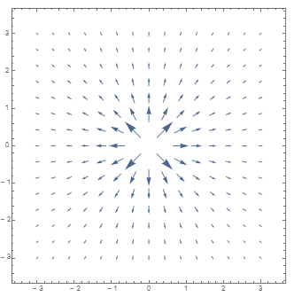
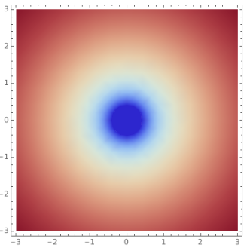
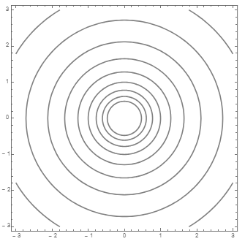


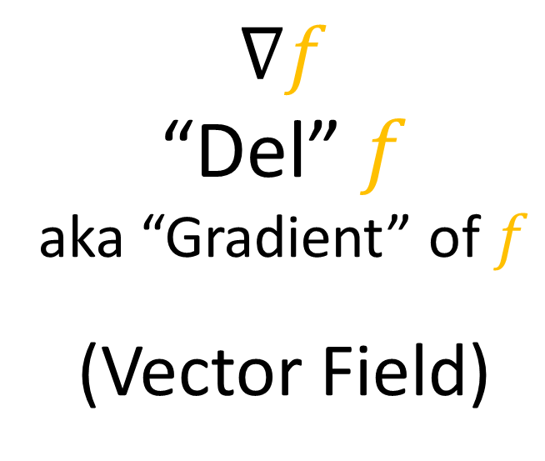
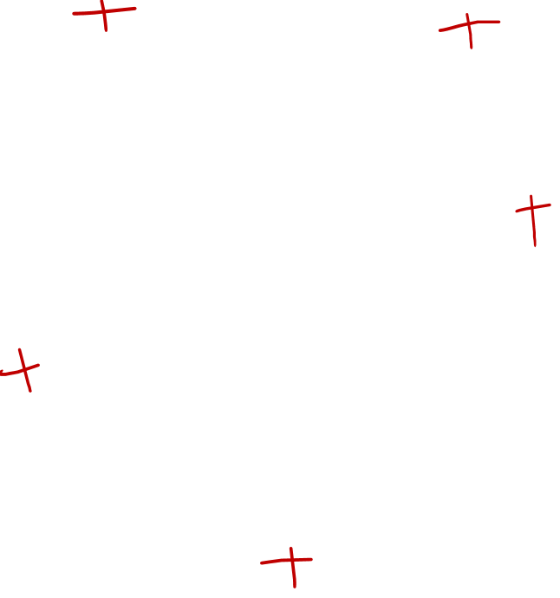

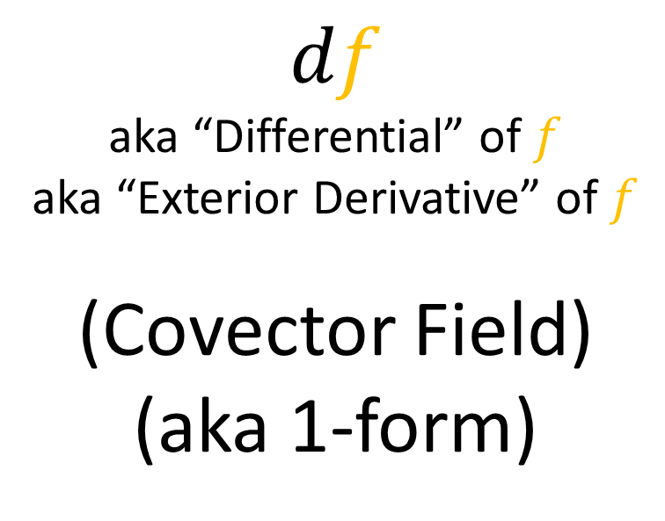
$$∇f$$
“Del” $f$
aka “Gradient” of $f$
(Vector Field)
$$∇f$$
$$f$$
$$df$$
aka “Differential” of $f$
aka “Exterior Derivative” of $f$
(Covector Field)
(aka 1-form)
$$df$$

Slide 4
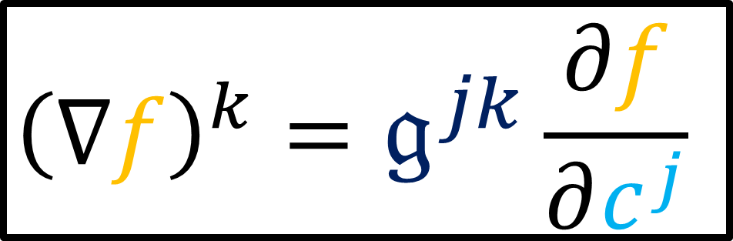
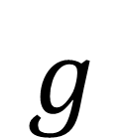
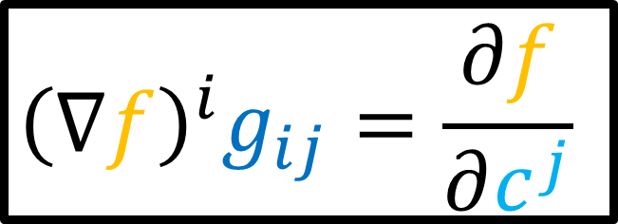




$${\left(∇f\right)}^{i}g_{ij}=\frac{∂f}{∂c^{j}}$$
$$g$$
$$∇f$$
$$df$$
$$𝔤$$
$${\left(∇f\right)}^{k}=𝔤^{jk}\frac{∂f}{∂c^{j}}$$

Slide 5
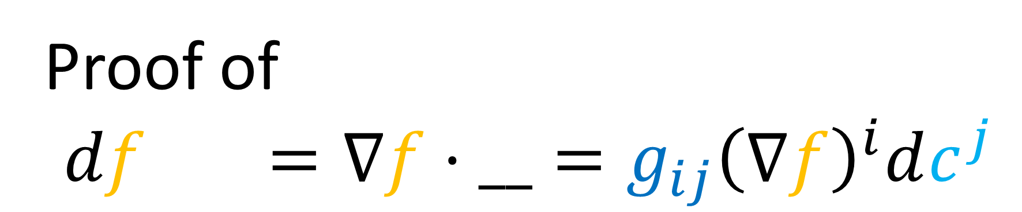


This Video:
Proof of
$$df\left(\vec{v}\right)=∇f⋅__=g_{ij}{\left(∇f\right)}^{i}dc^{j}$$
and examples of computing $∇f$.

Slide 6
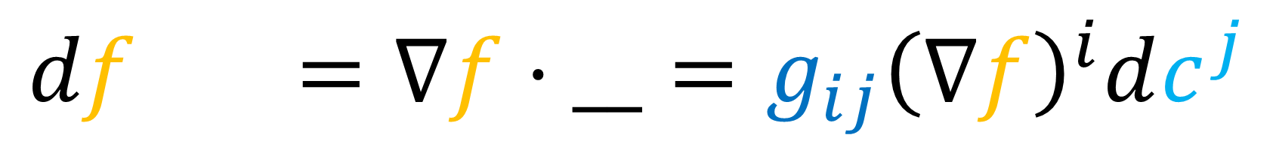
1. A Deeper Explanation
$$df\left(\vec{v}\right)=∇f⋅__=g_{ij}{\left(∇f\right)}^{i}dc^{j}$$

Slide 7


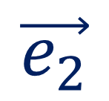

The Tensor Product:
$$ε^{1}⊗ε^{2}$$
$$\vec{e_{2}}$$
$$ε^{j}\left(\vec{e_{i}}\right)=δ_{i}^{j}$$
$$\vec{e_{1}}$$

Slide 8
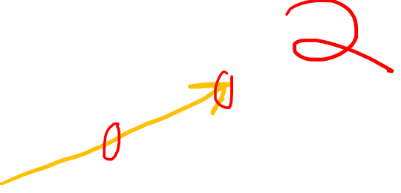

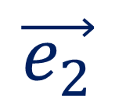


$$\vec{e_{2}}$$
$$\vec{e_{1}}$$
$$ε^{2}$$
$$ε^{1}$$

Slide 9
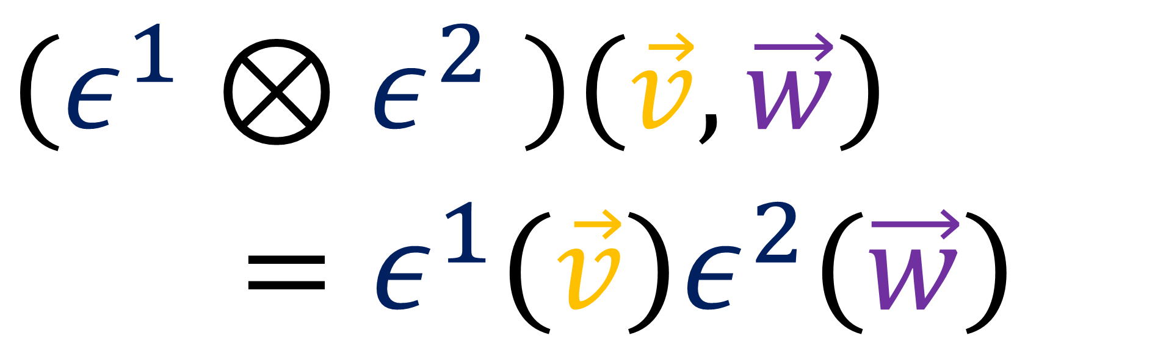
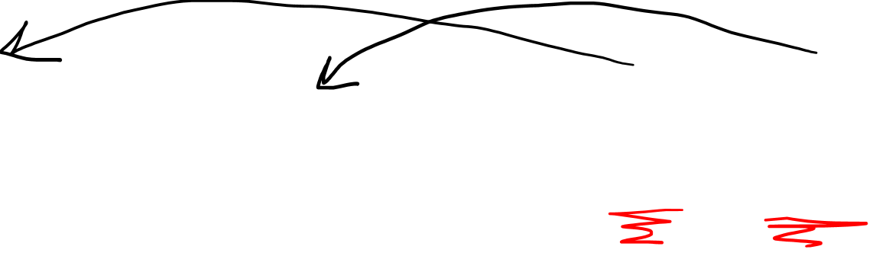
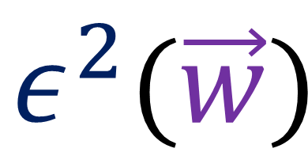
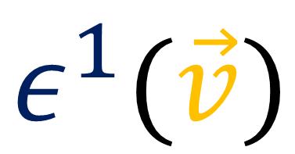
The Tensor Product:
$$ε^{1}(\vec{v})$$
$$ε^{2}(\vec{w})$$
$$\left(ε^{1}⊗ε^{2} \right)\left(\vec{v},\vec{w}\right)$$
$=ε^{1}\left(\vec{v}\right)ε^{2}\left(\vec{w}\right)$

Slide 10
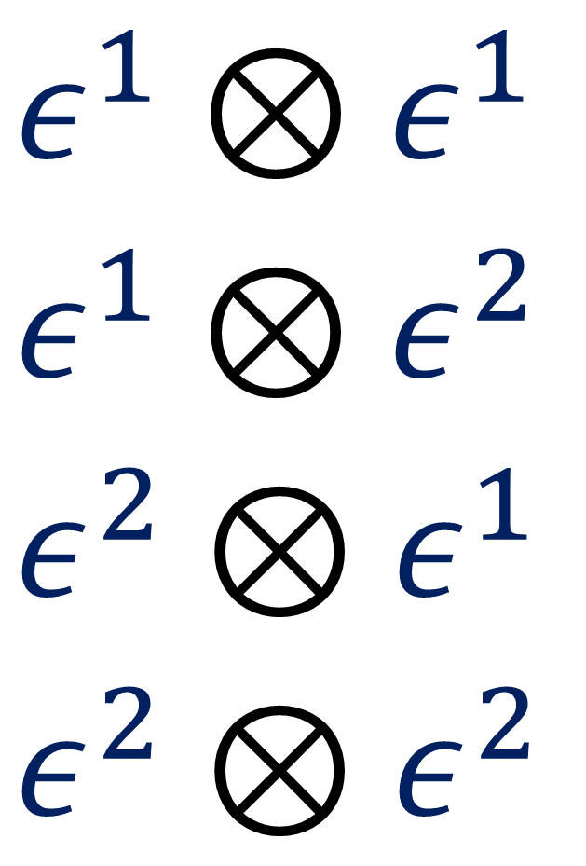
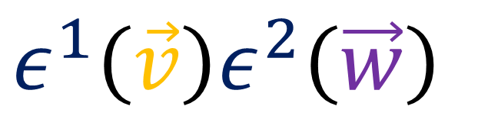
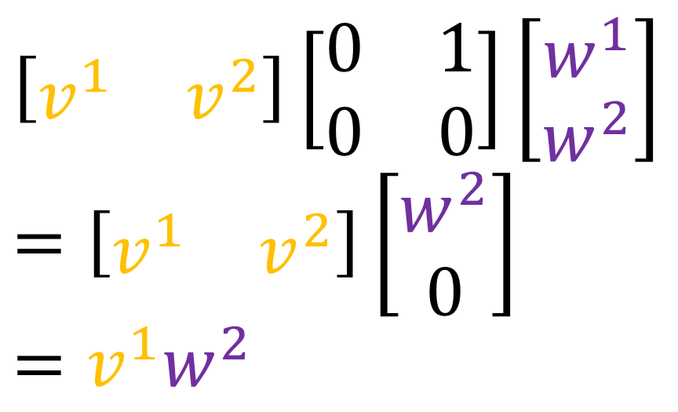
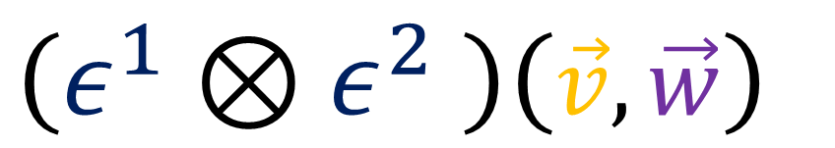
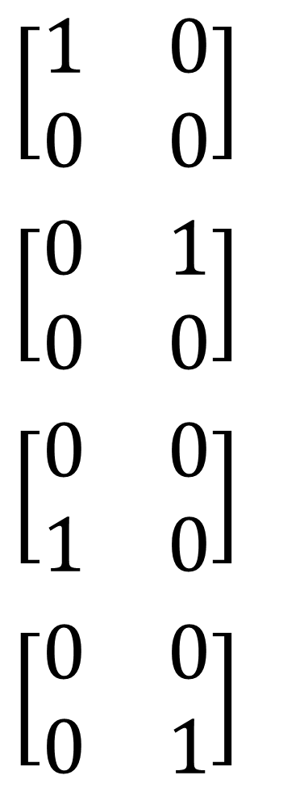
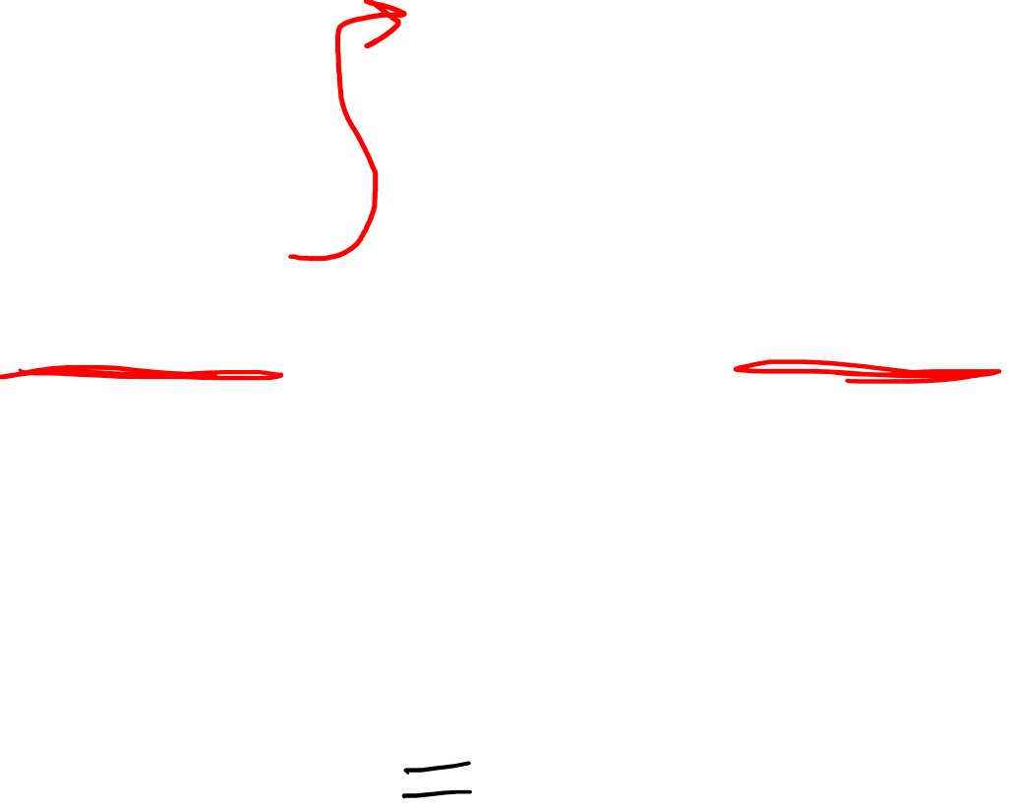
The Tensor Product:
$$\left[\begin{matrix}1 & 0 \\ 0 & 0\end{matrix}\right]$$
$$\left[\begin{matrix}0 & 1 \\ 0 & 0\end{matrix}\right]$$
$$\left[\begin{matrix}0 & 0 \\ 1 & 0\end{matrix}\right]$$
$$\left[\begin{matrix}0 & 0 \\ 0 & 1\end{matrix}\right]$$
$$ε^{1}⊗ε^{1}$$
$$ε^{1}⊗ε^{2}$$
$$ε^{2}⊗ε^{1}$$
$$ε^{2}⊗ε^{2}$$
$$\left(ε^{1}⊗ε^{2} \right)\left(\vec{v},\vec{w}\right)$$
$$\left[\begin{matrix}v^{1} & v^{2}\end{matrix}\right]\left[\begin{matrix}0 & 1 \\ 0 & 0\end{matrix}\right]\left[\begin{aligned}w^{1} \\ w^{2}\end{aligned}\right]$$
$$=\left[\begin{matrix}v^{1} & v^{2}\end{matrix}\right]\left[\begin{aligned}w^{2} \\ 0\end{aligned}\right]$$
$$=v^{1}w^{2}$$
$$ε^{1}\left(\vec{v}\right)ε^{2}\left(\vec{w}\right)$$

Slide 11
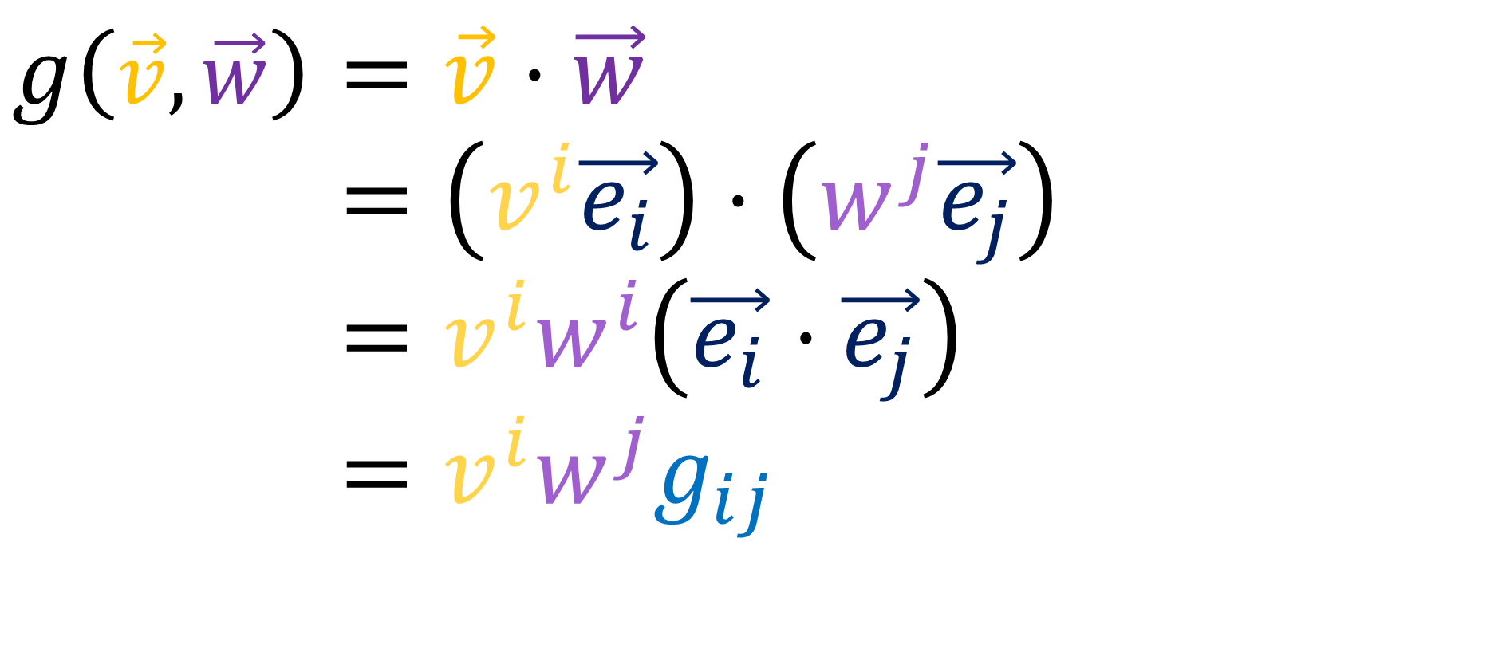
The Metric Tensor
$$g\left(\vec{v},\vec{w}\right)=\vec{v}⋅\vec{w}$$
$$g\left(\vec{v},\vec{w}\right)=\left(v^{i}\vec{e_{i}}\right)⋅\left(w^{j}\vec{e_{j}}\right)$$
$$g\left(\vec{v},\vec{w}\right)=v^{i}w^{i}\left(\vec{e_{i}}⋅\vec{e_{j}}\right)$$
$$g\left(\vec{v},\vec{w}\right)=v^{i}w^{j}g_{ij}$$

Slide 12
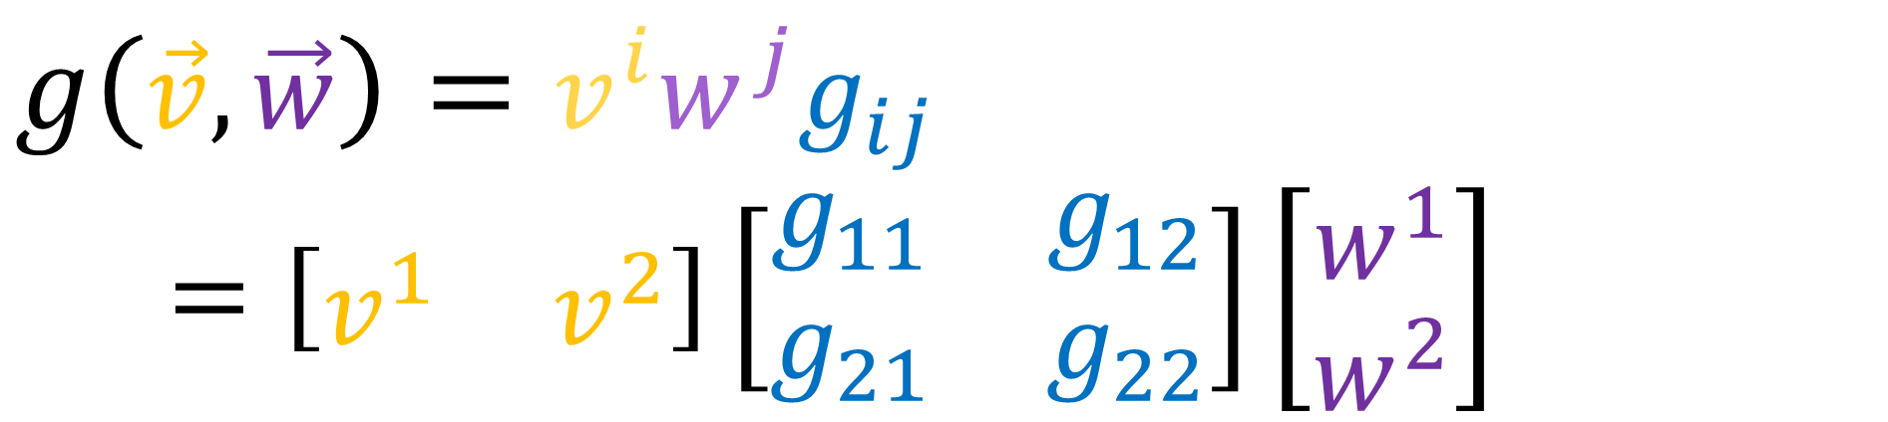

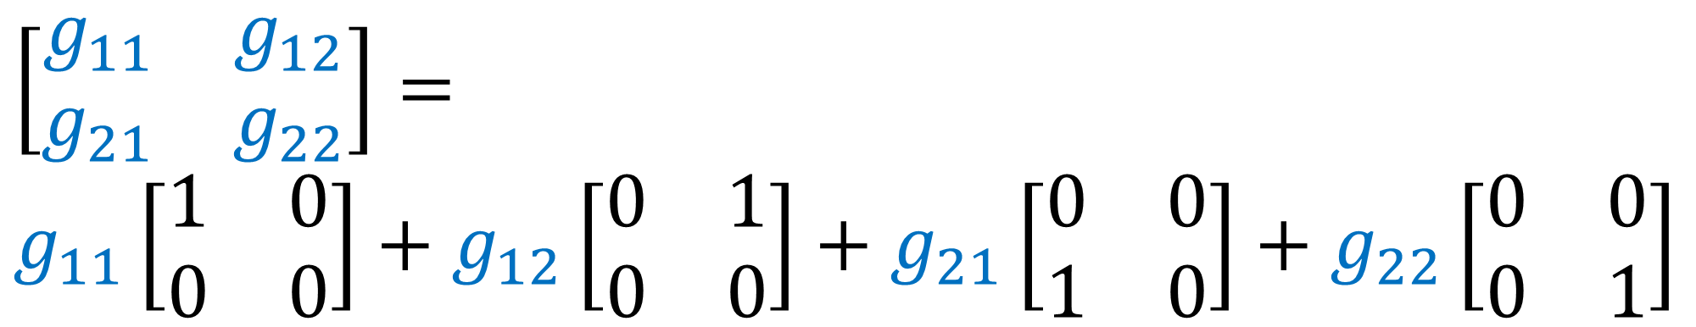
The Metric Tensor
$$g\left(\vec{v},\vec{w}\right)=v^{i}w^{j}g_{ij}$$
$=\left[\begin{matrix}v^{1} & v^{2}\end{matrix}\right]\left[\begin{matrix}g_{11} & g_{12} \\ g_{21} & g_{22}\end{matrix}\right]\left[\begin{aligned}w^{1} \\ w^{2}\end{aligned}\right]$
$$\left[\begin{matrix}g_{11} & g_{12} \\ g_{21} & g_{22}\end{matrix}\right]=$$
$$g_{11}\left[\begin{matrix}1 & 0 \\ 0 & 0\end{matrix}\right]+g_{12}\left[\begin{matrix}0 & 1 \\ 0 & 0\end{matrix}\right]+g_{21}\left[\begin{matrix}0 & 0 \\ 1 & 0\end{matrix}\right]+g_{22}\left[\begin{matrix}0 & 0 \\ 0 & 1\end{matrix}\right]$$

Slide 13

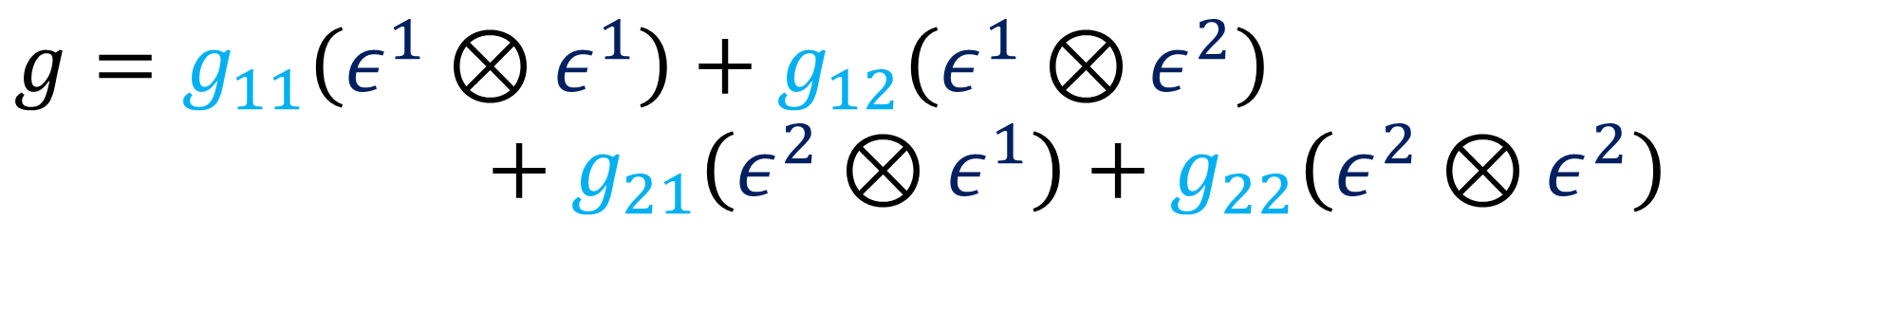
The Metric Tensor
$$g\left(\vec{v},\vec{w}\right)=v^{i}w^{j}g_{ij}$$
$=\left[\begin{matrix}v^{1} & v^{2}\end{matrix}\right]\left[\begin{matrix}g_{11} & g_{12} \\ g_{21} & g_{22}\end{matrix}\right]\left[\begin{aligned}w^{1} \\ w^{2}\end{aligned}\right]$
$$g=g_{11}\left(ε^{1}⊗ε^{1}\right)+g_{12}\left(ε^{1}⊗ε^{2}\right)$$
$$+g_{21}\left(ε^{2}⊗ε^{1}\right)+g_{22}\left(ε^{2}⊗ε^{2}\right)$$

Slide 14
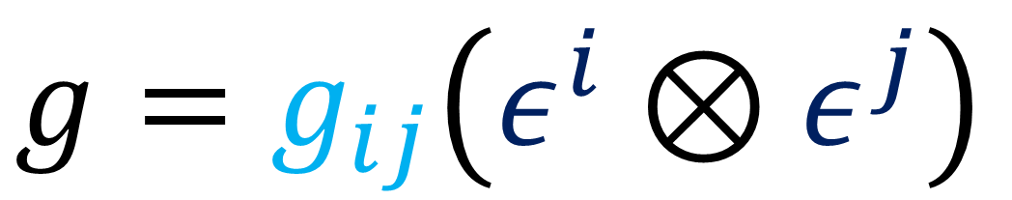
The Metric Tensor
$$g\left(\vec{v},\vec{w}\right)=v^{i}w^{j}g_{ij}$$
$=\left[\begin{matrix}v^{1} & v^{2}\end{matrix}\right]\left[\begin{matrix}g_{11} & g_{12} \\ g_{21} & g_{22}\end{matrix}\right]\left[\begin{aligned}w^{1} \\ w^{2}\end{aligned}\right]$
$$g=g_{ij}\left(ε^{i}⊗ε^{j}\right)$$

Slide 15

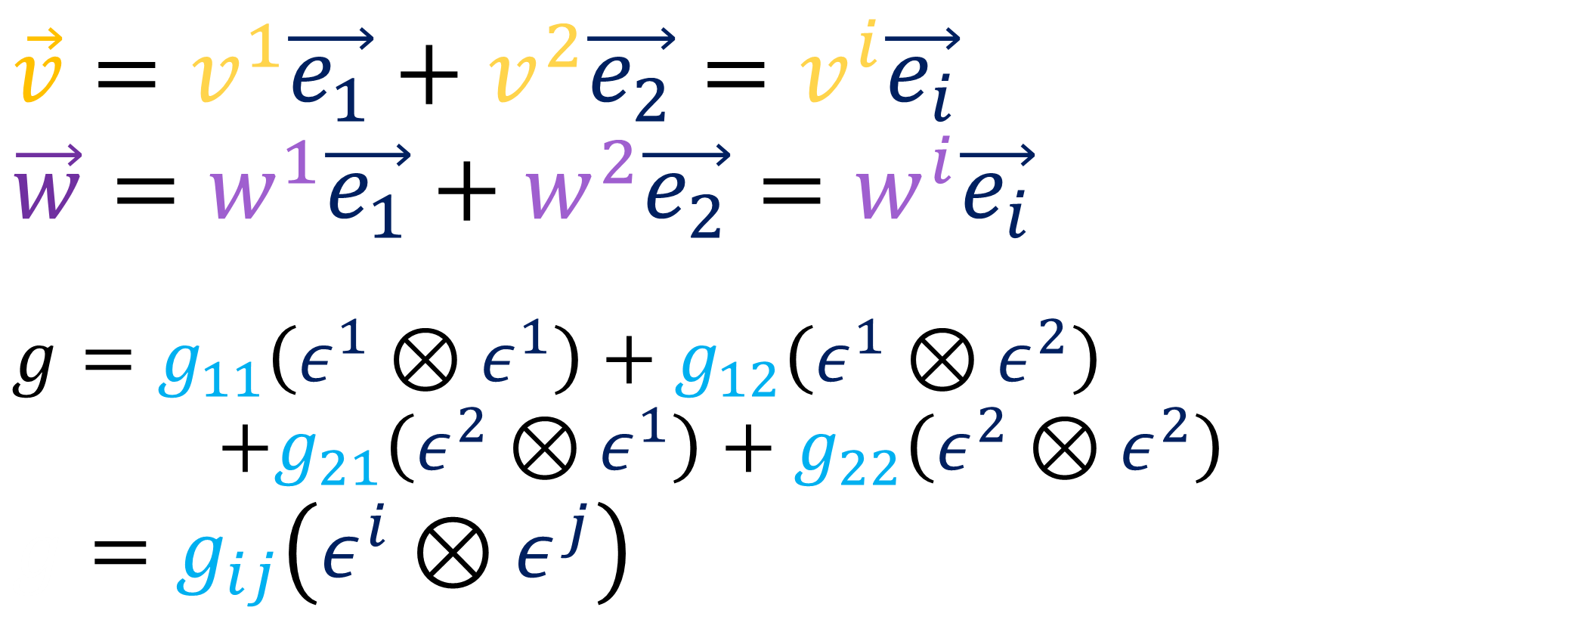

The Tensor Product:
$$\vec{e_{2}}$$
$$\vec{v}=v^{1}\vec{e_{1}}+v^{2}\vec{e_{2}}=v^{i}\vec{e_{i}}$$
$$\vec{w}=w^{1}\vec{e_{1}}+w^{2}\vec{e_{2}}=w^{i}\vec{e_{i}}$$
$$g=g_{11}\left(ε^{1}⊗ε^{1}\right)+g_{12}\left(ε^{1}⊗ε^{2}\right)$$
$+g_{21}\left(ε^{2}⊗ε^{1}\right)+g_{22}\left(ε^{2}⊗ε^{2}\right)$
$$g=g_{ij}\left(ε^{i}⊗ε^{j}\right)$$
$$\vec{e_{1}}$$
$$ε^{j}\left(\vec{e_{i}}\right)=δ_{i}^{j}$$

Slide 16

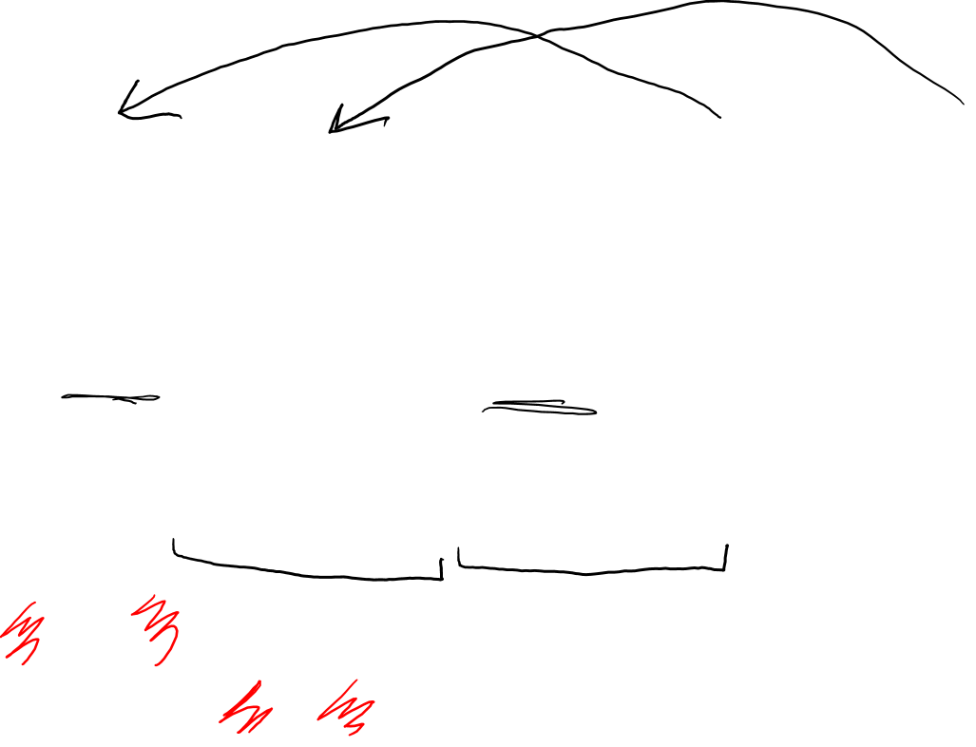
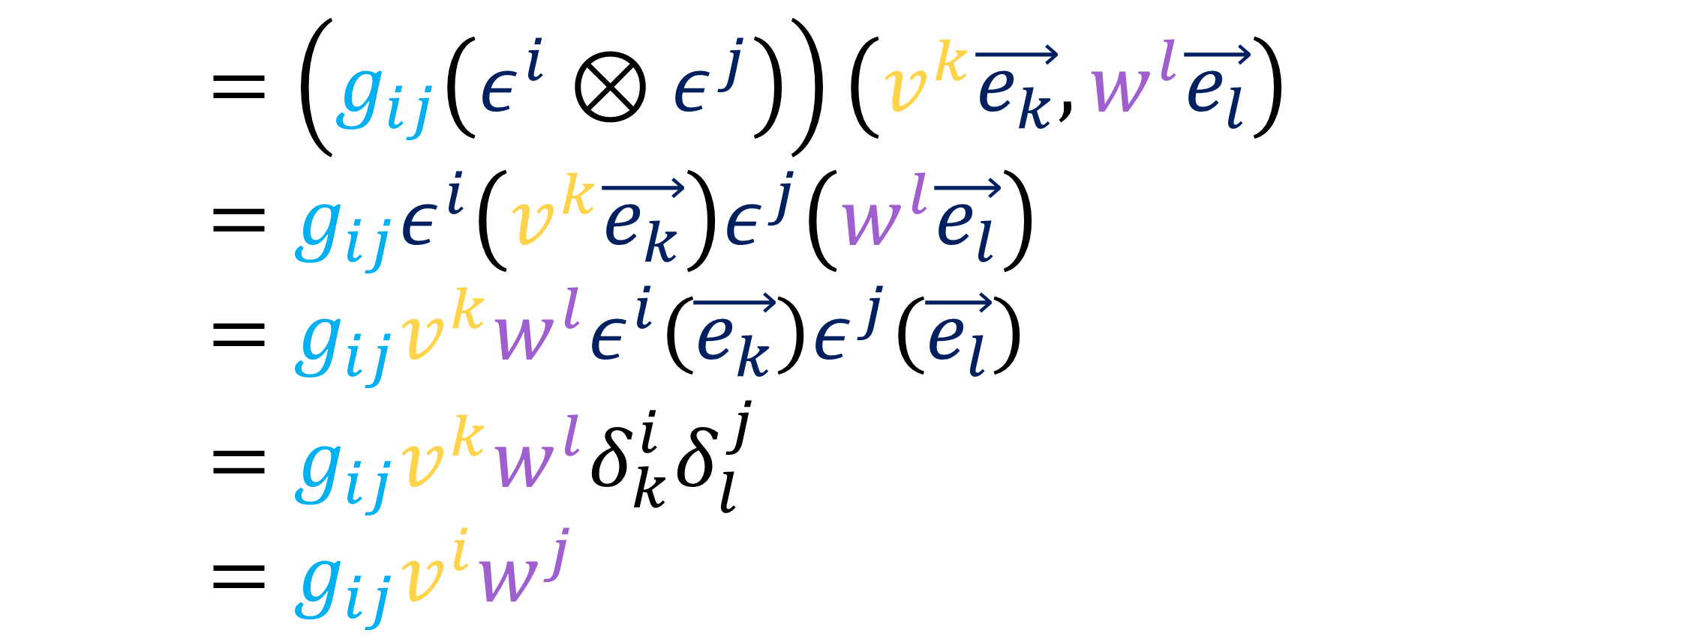
$$\vec{v}⋅\vec{w}=g\left(\vec{v},\vec{w}\right)$$
$$\vec{v}⋅__=\left(g_{ij}\left(ε^{i}⊗ε^{j}\right)\right)\left(v^{k}\vec{e_{k}},w^{l}\vec{e_{l}}\right)$$
$$\vec{v}⋅__=g_{ij}ε^{i}\left(v^{k}\vec{e_{k}}\right)ε^{j}\left(w^{l}\vec{e_{l}}\right)$$
$$\vec{v}⋅__=g_{ij}v^{k}w^{l}ε^{i}\left(\vec{e_{k}}\right)ε^{j}\left(\vec{e_{l}}\right)$$
$$\vec{v}⋅__=g_{ij}v^{k}w^{l}δ_{k}^{i}δ_{l}^{j}$$
$$\vec{v}⋅__=g_{ij}v^{i}w^{j}$$

Slide 17
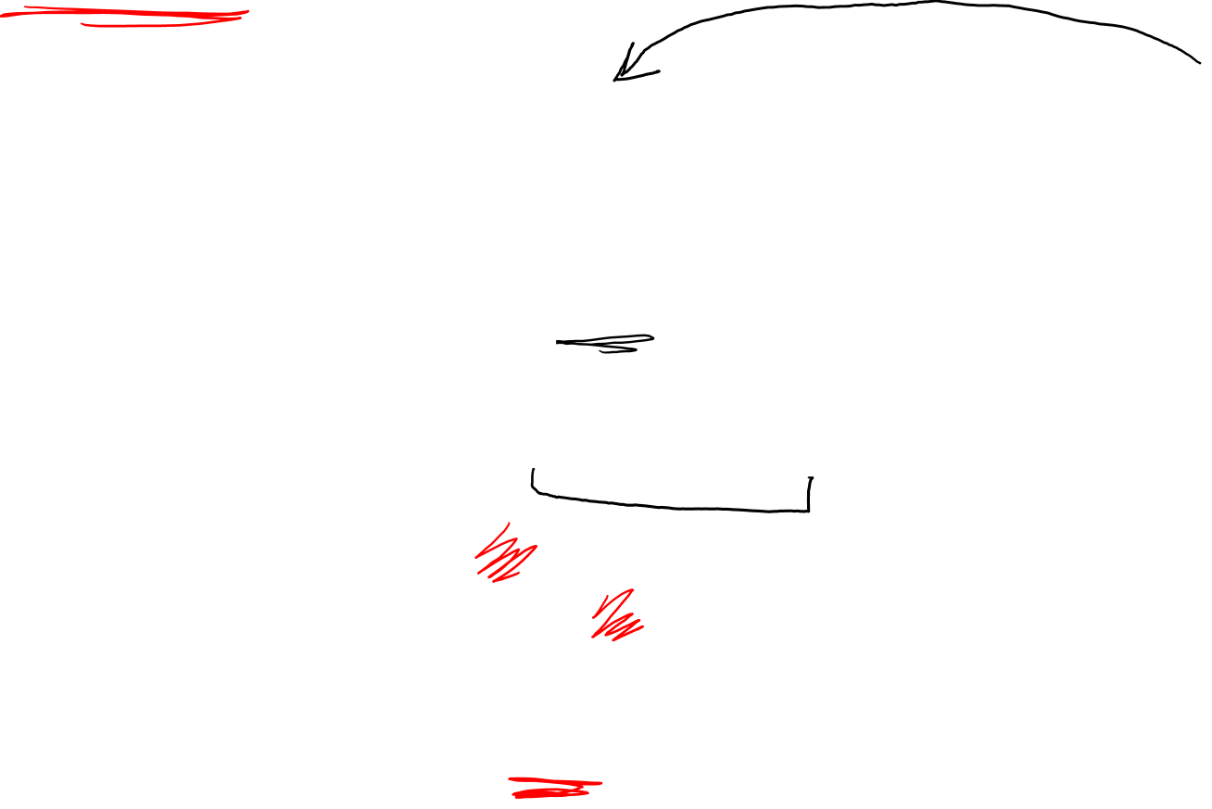
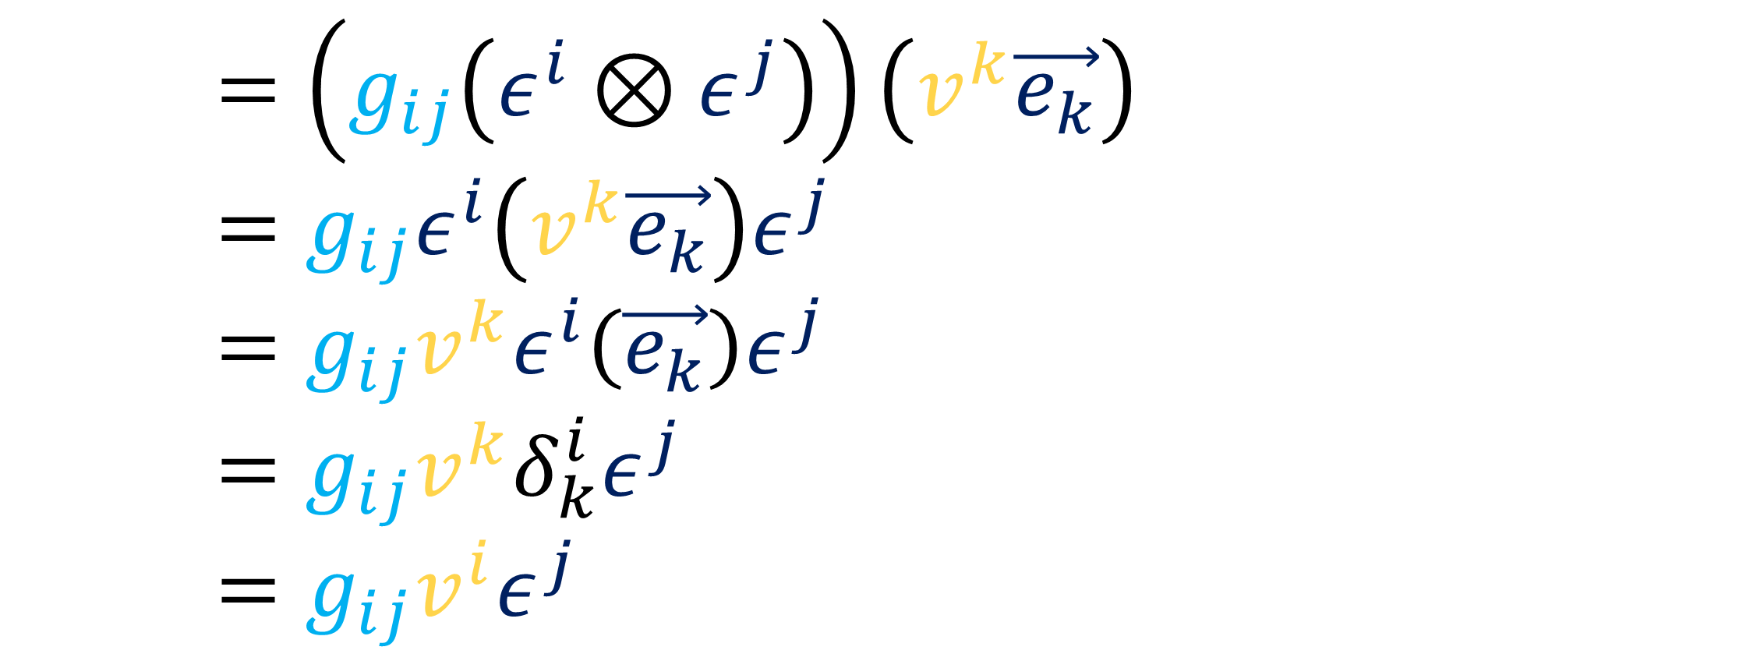
$$\vec{v}⋅__=g\left(\vec{v},__\right)$$
$$\vec{v}⋅__=\left(g_{ij}\left(ε^{i}⊗ε^{j}\right)\right)\left(v^{k}\vec{e_{k}}\right)$$
$$\vec{v}⋅__=g_{ij}ε^{i}\left(v^{k}\vec{e_{k}}\right)ε^{j}$$
$$\vec{v}⋅__=g_{ij}v^{k}ε^{i}\left(\vec{e_{k}}\right)ε^{j}$$
$$\vec{v}⋅__=g_{ij}v^{k}δ_{k}^{i}ε^{j}$$
$$\vec{v}⋅__=g_{ij}v^{i}ε^{j}$$

Slide 18
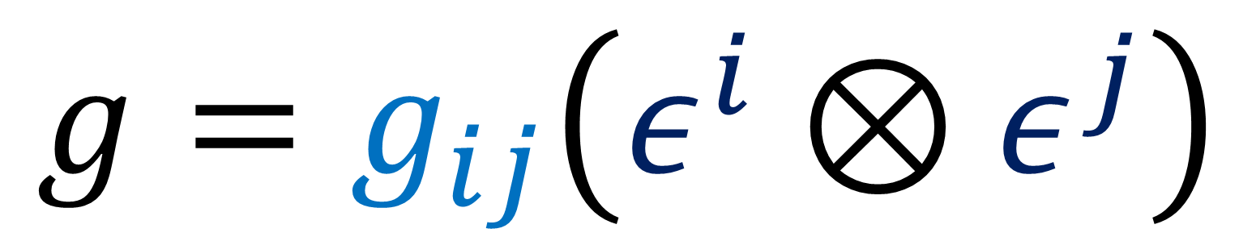

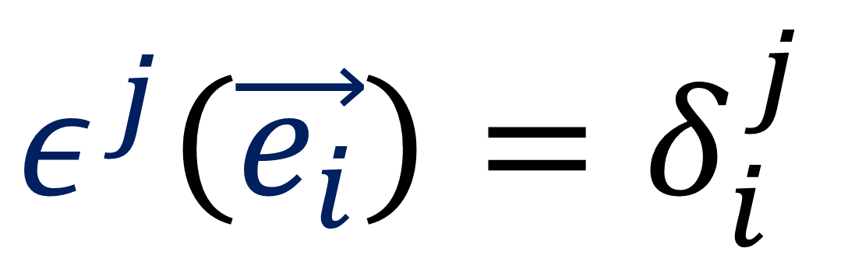
$$g=g_{ij}\left(ε^{i}⊗ε^{j}\right)$$
$$ε^{j}\left(\vec{e_{i}}\right)=δ_{i}^{j}$$

Slide 19
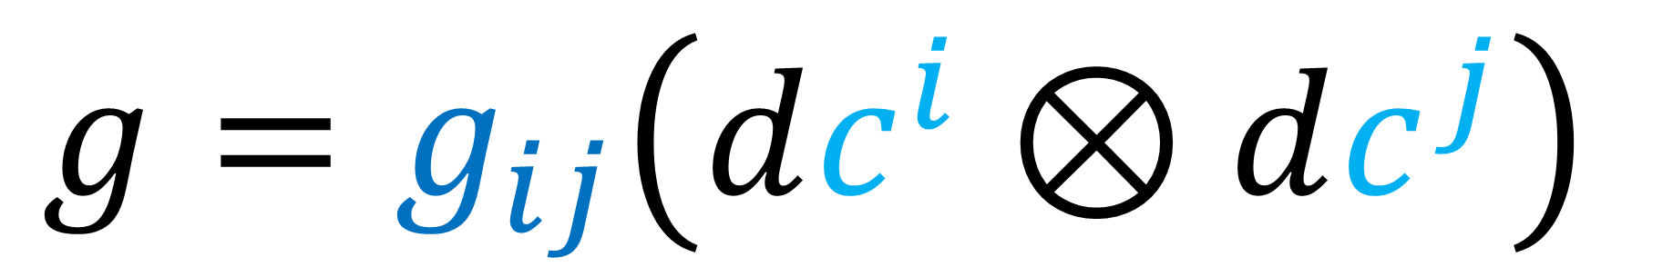
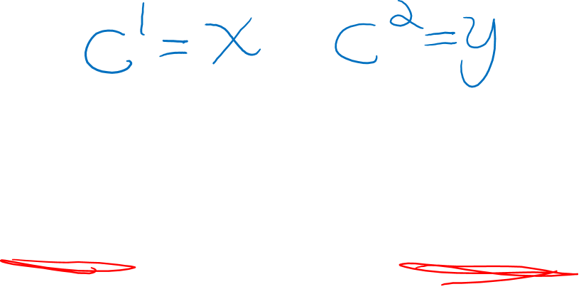
$$g=g_{ij}\left(dc^{i}⊗dc^{j}\right)$$
$$ε^{j}\left(\vec{e_{i}}\right)=δ_{i}^{j}$$

Slide 20


$$g=g_{ij}\left(dc^{i}⊗dc^{j}\right)$$
$dc^{j}\left(\frac{∂}{∂c^{i}}\right)=δ_{i}^{j}$

Slide 21
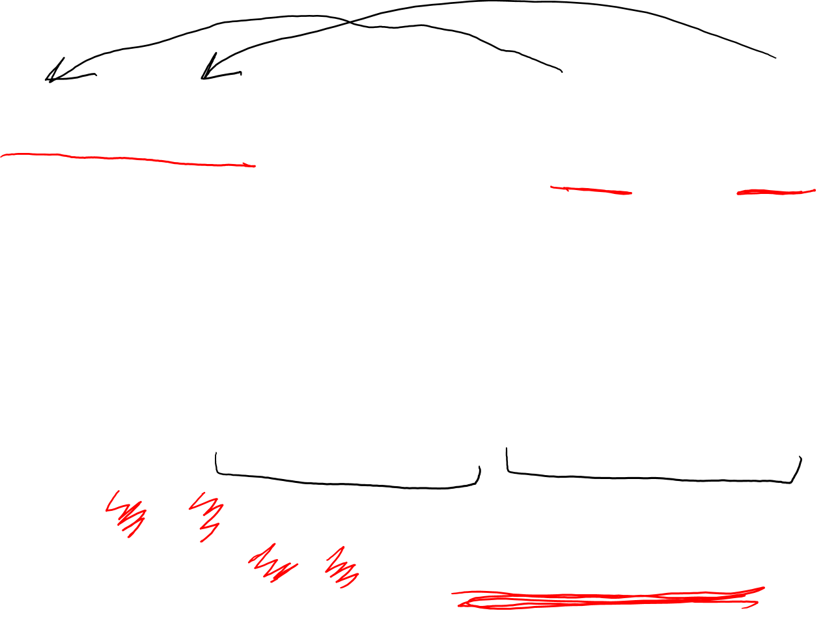
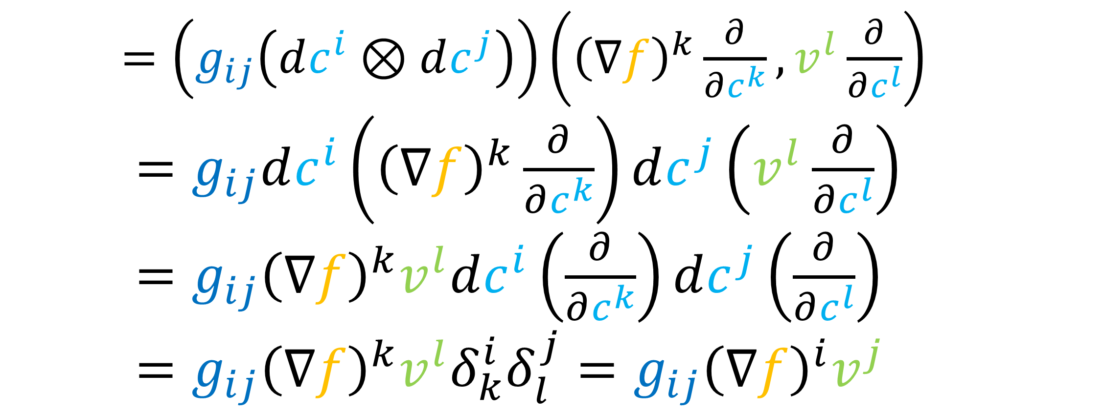
$$∇f⋅\vec{v}=g\left(∇f,\vec{v}\right)$$
$\vec{v}⋅__=\left(g_{ij}\left(dc^{i}⊗dc^{j}\right)\right)\left({\left(∇f\right)}^{k}\frac{∂}{∂c^{k}},v^{l}\frac{∂}{∂c^{l}}\right)$
$\vec{v}⋅__=g_{ij}dc^{i}\left({\left(∇f\right)}^{k}\frac{∂}{∂c^{k}}\right)dc^{j}\left(v^{l}\frac{∂}{∂c^{l}}\right)$
$\vec{v}⋅__=g_{ij}{\left(∇f\right)}^{k}v^{l}dc^{i}\left(\frac{∂}{∂c^{k}}\right)dc^{j}\left(\frac{∂}{∂c^{l}}\right)$
$$\vec{v}⋅__=g_{ij}{\left(∇f\right)}^{k}v^{l}δ_{k}^{i}δ_{l}^{j}=g_{ij}{\left(∇f\right)}^{i}v^{j}$$

Slide 22
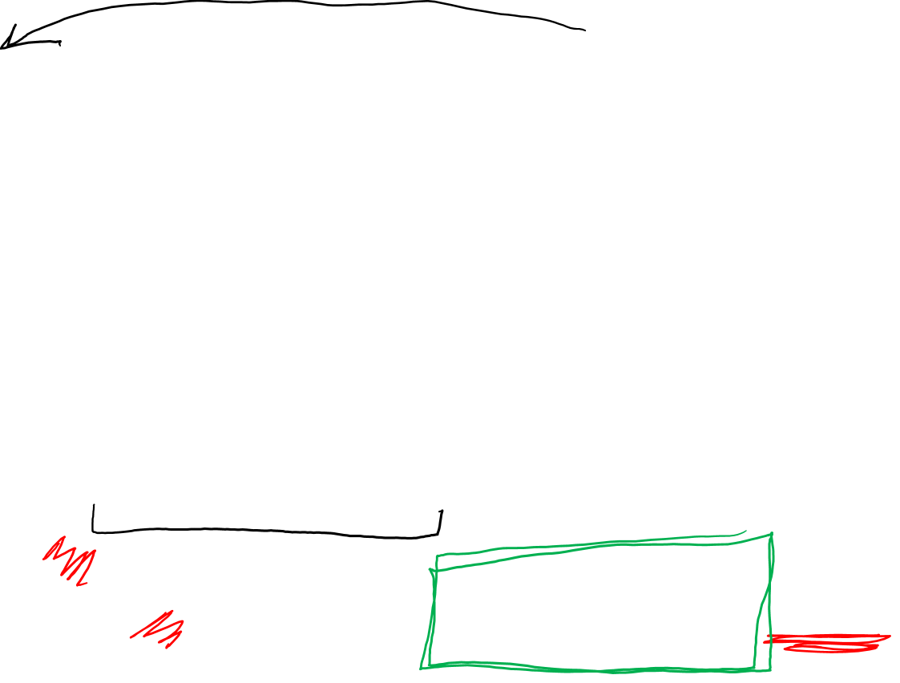
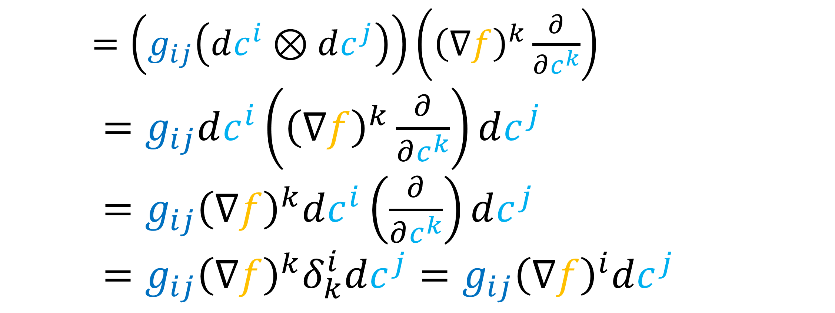
$$∇f⋅__=g\left(∇f,__\right)$$
$\vec{v}⋅__=\left(g_{ij}\left(dc^{i}⊗dc^{j}\right)\right)\left({\left(∇f\right)}^{k}\frac{∂}{∂c^{k}}\right)$
$\vec{v}⋅__=g_{ij}dc^{i}\left({\left(∇f\right)}^{k}\frac{∂}{∂c^{k}}\right)dc^{j}$
$\vec{v}⋅__=g_{ij}{\left(∇f\right)}^{k}dc^{i}\left(\frac{∂}{∂c^{k}}\right)dc^{j}$
$$\vec{v}⋅__=g_{ij}{\left(∇f\right)}^{k}δ_{k}^{i}dc^{j}=g_{ij}{\left(∇f\right)}^{i}dc^{j}$$

Slide 23

This Video:
Proof of
$$df\left(\vec{v}\right)=∇f⋅__=g_{ij}{\left(∇f\right)}^{i}dc^{j}$$
and examples of computing $∇f$.

Slide 24
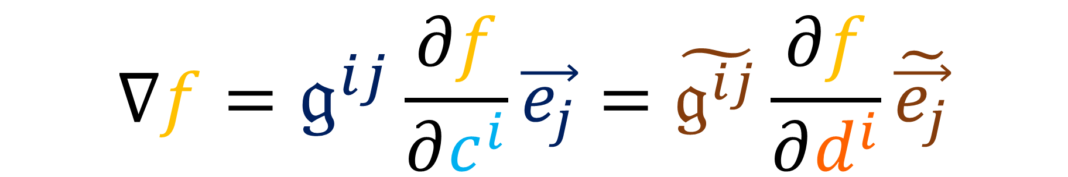

2. An Example
$$∇f=𝔤^{ij}\frac{∂f}{∂c^{i}}\vec{e_{j}}=\tilde{𝔤^{ij}}\frac{∂f}{∂d^{i}}\tilde{\vec{e_{j}}}$$

Slide 25
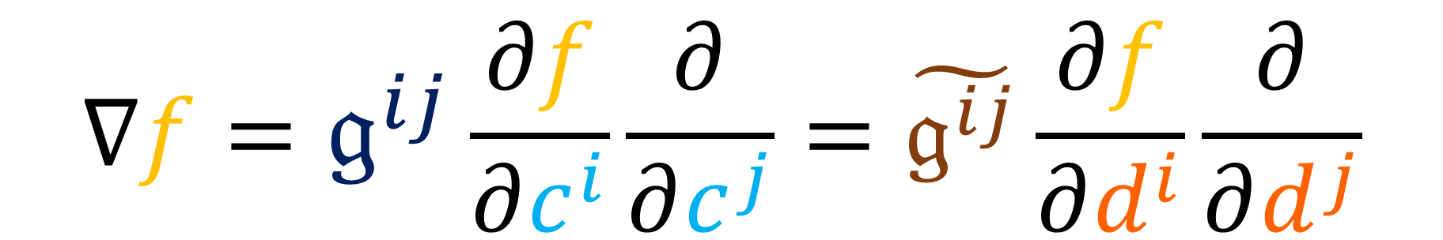
2. An Example
$$∇f=𝔤^{ij}\frac{∂f}{∂c^{i}}\frac{∂}{∂c^{j}}=\tilde{𝔤^{ij}}\frac{∂f}{∂d^{i}}\frac{∂}{∂d^{j}}$$

Slide 26


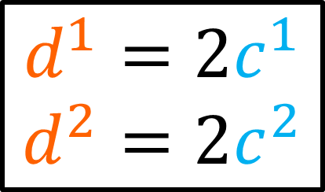
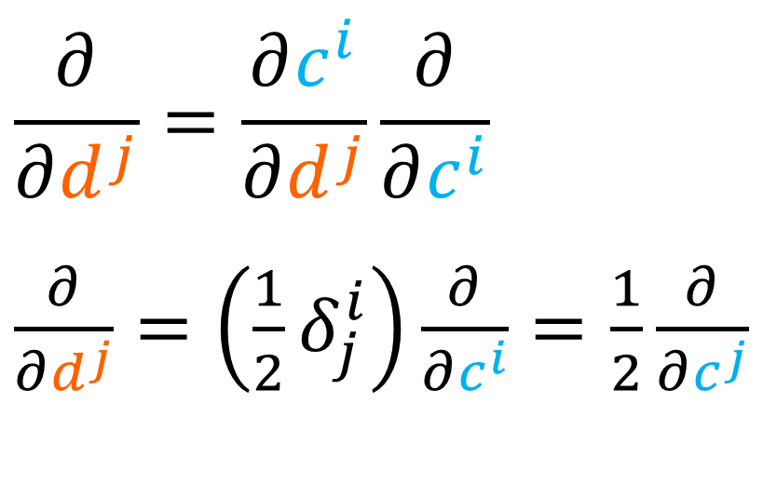


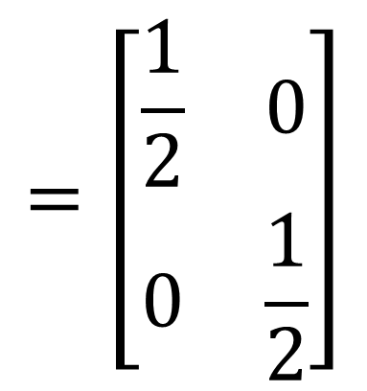
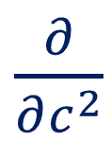






$$c^{2}$$
$$d^{1}=2c^{1}$$
$$d^{2}=2c^{2}$$
$$d^{2}$$
$\frac{∂}{∂c^{2}}$
$c^{1}=\frac{1}{2}d^{1}$
$c^{2}=\frac{1}{2}d^{2}$
$\frac{∂}{∂d^{2}}$
$\frac{∂}{∂c^{1}}$
$\frac{∂}{∂d^{1}}$
$$c^{1}$$
$$d^{2}$$
$$\left[\begin{matrix}\frac{∂c^{1}}{∂d^{1}} & \frac{∂c^{1}}{∂d^{2}} \\ \frac{∂c^{2}}{∂d^{1}} & \frac{∂c^{2}}{∂d^{2}}\end{matrix}\right]$$
$$=\left[\begin{matrix}\frac{1}{2} & 0 \\ 0 & \frac{1}{2}\end{matrix}\right]$$
$$\frac{∂}{∂d^{j}}=\frac{∂c^{i}}{∂d^{j}}\frac{∂}{∂c^{i}}$$
$\frac{∂}{∂d^{j}}=\left(\frac{1}{2}δ_{j}^{i}\right)\frac{∂}{∂c^{i}}=\frac{1}{2}\frac{∂}{∂c^{j}}$

Slide 27



$$c^{2}$$
$$d^{1}=2c^{1}$$
$$d^{2}=2c^{2}$$
$$d^{2}$$
$\frac{∂}{∂c^{2}}$
$c^{1}=\frac{1}{2}d^{1}$
$c^{2}=\frac{1}{2}d^{2}$
$\frac{∂}{∂d^{2}}$
$\frac{∂}{∂c^{1}}$
$\frac{∂}{∂d^{1}}$
$$c^{1}$$
$$d^{2}$$
$$\frac{∂}{∂c^{j}}=\frac{∂d^{i}}{∂c^{j}}\frac{∂}{∂d^{i}}$$
$\frac{∂}{∂c^{j}}=\left(2δ_{j}^{i}\right)\frac{∂}{∂d^{i}}=2\frac{∂}{∂d^{i}}$
$$\left[\begin{matrix}\frac{∂d^{1}}{∂c^{1}} & \frac{∂d^{1}}{∂c^{2}} \\ \frac{∂d^{2}}{∂c^{1}} & \frac{∂d^{2}}{∂c^{2}}\end{matrix}\right]$$
$$=\left[\begin{matrix}2 & 0 \\ 0 & 2\end{matrix}\right]$$

Slide 28


$$c^{2}$$
$$d^{1}=2c^{1}$$
$$d^{2}=2c^{2}$$
$$d^{2}$$
$\frac{∂}{∂c^{2}}$
$c^{1}=\frac{1}{2}d^{1}$
$c^{2}=\frac{1}{2}d^{2}$
$\frac{∂}{∂d^{2}}$
$\frac{∂}{∂c^{1}}$
$\frac{∂}{∂d^{1}}$
$$c^{1}$$
$$d^{2}$$
$\left[\begin{matrix}\frac{∂}{∂c^{1}}⋅\frac{∂}{∂c^{1}} & \frac{∂}{∂c^{2}}⋅\frac{∂}{∂c^{1}} \\ \frac{∂}{∂c^{1}}⋅\frac{∂}{∂c^{2}} & \frac{∂}{∂c^{2}}⋅\frac{∂}{∂c^{2}}\end{matrix}\right]$ $=\left[\begin{matrix}1 & 0 \\ 0 & 1\end{matrix}\right]$

Slide 29


$$c^{2}$$
$$d^{1}=2c^{1}$$
$$d^{2}=2c^{2}$$
$$d^{2}$$
$\frac{∂}{∂c^{2}}$
$c^{1}=\frac{1}{2}d^{1}$
$c^{2}=\frac{1}{2}d^{2}$
$\frac{∂}{∂d^{2}}$
$\frac{∂}{∂c^{1}}$
$\frac{∂}{∂d^{1}}$
$$c^{1}$$
$$d^{2}$$
$\frac{∂}{∂c^{i}}⋅\frac{∂}{∂c^{j}}=g_{ij}=δ_{ij}$

Slide 30



$$c^{2}$$
$$d^{1}=2c^{1}$$
$$d^{2}=2c^{2}$$
$$d^{2}$$
$\frac{∂}{∂c^{2}}$
$c^{1}=\frac{1}{2}d^{1}$
$c^{2}=\frac{1}{2}d^{2}$
$\frac{∂}{∂d^{2}}$
$\frac{∂}{∂c^{1}}$
$\frac{∂}{∂d^{1}}$
$$c^{1}$$
$$d^{2}$$
$$\left[\begin{matrix}1/4 & 0 \\ 0 & 1/4\end{matrix}\right]$$
$\tilde{g_{ij}}=\frac{∂}{∂d^{i}}⋅\frac{∂}{∂d^{j}}=\left(\frac{1}{2}\frac{∂}{∂c^{i}}\right)⋅\left(\frac{1}{2}\frac{∂}{∂c^{j}}\right)$
$\frac{∂}{∂d^{i}}⋅\frac{∂}{∂d^{j}}=\frac{1}{4}\left(\frac{∂}{∂c^{i}}⋅\frac{∂}{∂c^{j}}\right)=\frac{1}{4}g_{ij}=\frac{1}{4}δ_{ij}$

Slide 31




$$c^{2}$$
$$d^{1}=2c^{1}$$
$$d^{2}=2c^{2}$$
$$d^{2}$$
$\frac{∂}{∂c^{2}}$
$c^{1}=\frac{1}{2}d^{1}$
$c^{2}=\frac{1}{2}d^{2}$
$\frac{∂}{∂d^{2}}$
$\frac{∂}{∂c^{1}}$
$\frac{∂}{∂d^{1}}$
$$c^{1}$$
$$d^{2}$$
$$g_{ij}= δ_{ij}⇒𝔤^{ij}= δ^{ij}$$
$$\left[\begin{matrix}1 & 0 \\ 0 & 1\end{matrix}\right]$$
$\tilde{g_{ij}}={\frac{1}{4}δ}_{ij}⇒\tilde{𝔤^{ij}}=4δ^{ij}$
$$\left[\begin{matrix}4 & 0 \\ 0 & 4\end{matrix}\right]$$

Slide 32



$$c^{2}$$
$$d^{1}=2c^{1}$$
$$d^{2}=2c^{2}$$
$$d^{2}$$
$\frac{∂}{∂c^{2}}$
$c^{1}=\frac{1}{2}d^{1}$
$c^{2}=\frac{1}{2}d^{2}$
$\frac{∂}{∂d^{2}}$
$\frac{∂}{∂c^{1}}$
$\frac{∂}{∂d^{1}}$
$$c^{1}$$
$$d^{2}$$
$$f(c^{1},c^{2})=c^{1}+2c^{2}−2$$
$f(d^{1},d^{2})=\left(\frac{1}{2}d^{1}\right)+2\left(\frac{1}{2}d^{2}\right)−2$

Slide 33


$$c^{2}$$
$$d^{1}=2c^{1}$$
$$d^{2}=2c^{2}$$
$$d^{2}$$
$\frac{∂}{∂c^{2}}$
$c^{1}=\frac{1}{2}d^{1}$
$c^{2}=\frac{1}{2}d^{2}$
$\frac{∂}{∂d^{2}}$
$\frac{∂}{∂c^{1}}$
$\frac{∂}{∂d^{1}}$
$$c^{1}$$
$$d^{2}$$
$$f=c^{1}+2c^{2}−2$$
$f=\frac{1}{2}d^{1}+d^{2}−2$
$\frac{∂f}{∂c^{1}}=1$ $\frac{∂f}{∂c^{2}}=2$
$\frac{∂f}{∂d^{1}}=\frac{1}{2}$ $\frac{∂f}{∂d^{2}}=1$

Slide 34




$∇f=𝔤^{ij}\frac{∂f}{∂c^{i}}\frac{∂}{∂c^{j}}$
$∇f=δ^{ij}\frac{∂f}{∂c^{i}}\frac{∂}{∂c^{j}}$
$∇f=\frac{∂f}{∂c^{i}}\frac{∂}{∂c^{i}}$
$∇f=\frac{∂f}{∂c^{1}}\frac{∂}{∂c^{1}}+\frac{∂f}{∂c^{2}}\frac{∂}{∂c^{2}}$
$∇f=1\frac{∂}{∂c^{1}}+2\frac{∂}{∂c^{2}}$
$$∇f=1\vec{e_{1}}+2\vec{e_{2}}$$
$$𝔤^{ij}= δ^{ij}$$
$$\tilde{𝔤^{ij}}=4δ^{ij}$$
$\frac{∂f}{∂c^{1}}=1$ $\frac{∂f}{∂c^{2}}=2$
$\frac{∂f}{∂d^{1}}=\frac{1}{2}$ $\frac{∂f}{∂d^{2}}=1$

Slide 35



$∇f=\tilde{𝔤^{ij}}\frac{∂f}{∂d^{i}}\frac{∂}{∂d^{j}}$
$∇f=4δ^{ij}\frac{∂f}{∂d^{i}}\frac{∂}{∂d^{j}}$
$∇f=4\frac{∂f}{∂d^{i}}\frac{∂}{∂d^{i}}$
$∇f=4\frac{∂f}{∂d^{1}}\frac{∂}{∂d^{1}}+4\frac{∂f}{∂d^{2}}\frac{∂}{∂d^{2}}$
$∇f=4\left(\frac{1}{2}\right)\frac{∂}{∂d^{1}}+4(1)\frac{∂}{∂d^{2}}$
$∇f=2\frac{∂}{∂d^{1}}+4\frac{∂}{∂d^{2}}$
$$𝔤^{ij}= δ^{ij}$$
$$\tilde{𝔤^{ij}}=4δ^{ij}$$
$\frac{∂f}{∂c^{1}}=1$ $\frac{∂f}{∂c^{2}}=2$
$\frac{∂f}{∂d^{1}}=\frac{1}{2}$ $\frac{∂f}{∂d^{2}}=1$
$$2\tilde{\vec{e_{1}}}+4\tilde{\vec{e_{2}}}=$$

Slide 36






$$c^{2}$$
$∇f=1\frac{∂}{∂c^{1}}+2\frac{∂}{∂c^{2}}$
$∇f=2\frac{∂}{∂d^{1}}+4\frac{∂}{∂d^{2}}$
$\frac{∂}{∂c^{2}}$
$\frac{∂}{∂c^{1}}$
$$c^{1}$$
$$d^{2}$$
$∇f=𝔤^{ij}\frac{∂f}{∂c^{i}}\frac{∂}{∂c^{j}}$
$∇f=\tilde{𝔤^{ij}}\frac{∂f}{∂d^{i}}\frac{∂}{∂d^{j}}$
$\frac{∂}{∂d^{2}}$
$\frac{∂}{∂d^{1}}$
$$d^{2}$$

Slide 37


Cylindrical
$∇f=\frac{∂f}{∂ρ}\vec{e_{ρ}}+\frac{1}{ρ^{2}}\frac{∂f}{∂φ}\vec{e_{φ}}+$ $\frac{∂f}{∂z}\vec{e_{z}}$
Spherical
$∇f=\frac{∂f}{∂r}\vec{e_{r}}+\frac{1}{r^{2}}\frac{∂f}{∂θ}\vec{e_{θ}}+$ $\frac{1}{r^{2}{\left(\sin{θ}\right)}^{2}}$ $\frac{∂f}{∂φ}\vec{e_{φ}}$

Slide 38




$∇ =\left[\begin{aligned}\frac{∂f}{∂x} \\ \frac{∂f}{∂y}\end{aligned}\right]$
$∇f=\frac{∂f}{∂x}\vec{e_{x}}+\frac{∂f}{∂y}\vec{e_{y}}$
Cartesian Only!!
$$∇f=𝔤^{ij}\frac{∂f}{∂c^{i}}\vec{e_{j}}$$
True formula:

