Slide 1
Geodesics Examples
(First see Video 15 on “Geodesics and Christoffel Symbols)
(Link is in the description!)

Slide 2

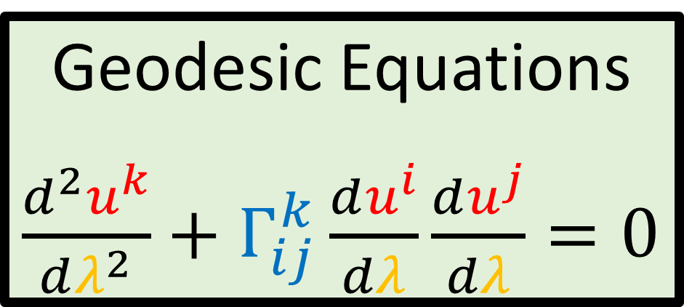
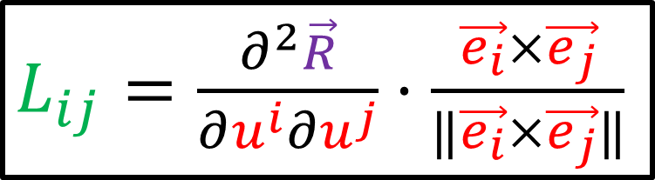
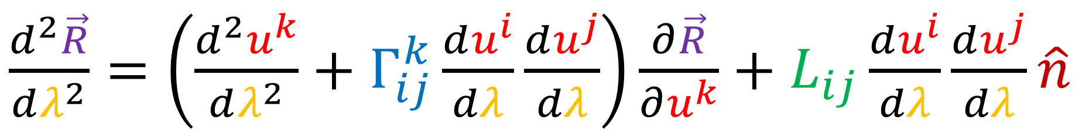
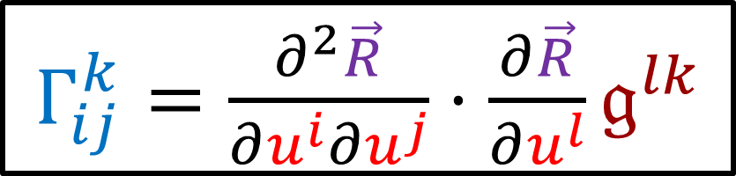
Summary
Geodesic = straightest possible path
in a curved surface/space.
A Geodesic curve has zero tangential acceleration when we travel along it at constant speed.
$\frac{d^{2}\vec{R}}{dλ^{2}}=\left(\frac{d^{2}u^{k}}{dλ^{2}}+Γ_{ij}^{k}\frac{du^{i}}{dλ}\frac{du^{j}}{dλ}\right)\frac{∂\vec{R}}{∂u^{k}}+L_{ij}\frac{du^{i}}{dλ}\frac{du^{j}}{dλ}\hat{n}$
$Γ_{ij}^{k}=\frac{∂^{2}\vec{R}}{∂u^{i}∂u^{j}}⋅\frac{∂\vec{R}}{∂u^{l}}𝔤^{lk}$
Geodesic Equations
$\frac{d^{2}u^{k}}{dλ^{2}}+Γ_{ij}^{k}\frac{du^{i}}{dλ}\frac{du^{j}}{dλ}=0$
$L_{ij}=\frac{∂^{2}\vec{R}}{∂u^{i}∂u^{j}}⋅\frac{\vec{e_{i}}×\vec{e_{j}}}{‖\vec{e_{i}}×\vec{e_{j}}‖}$

Slide 3
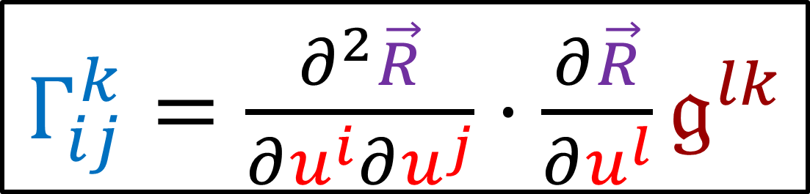
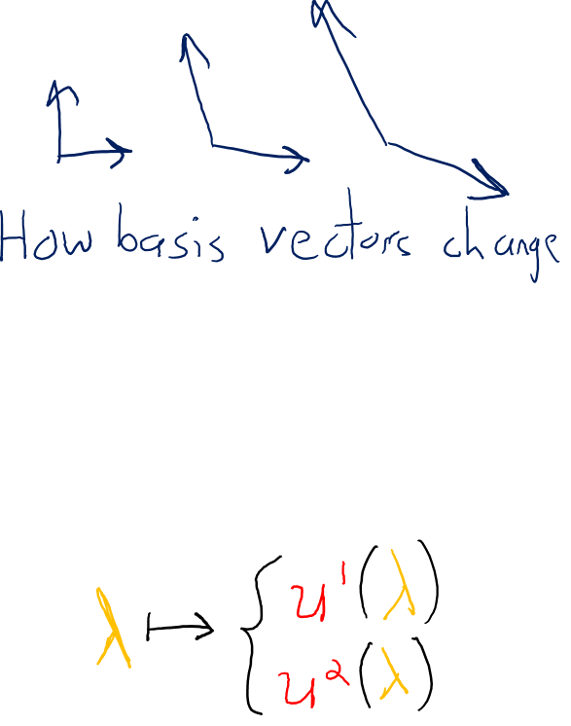
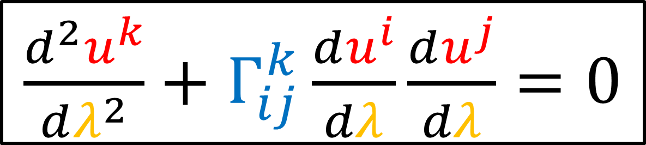
The Plan: To compute geodesics on a surface…
1. Compute Christoffel Symbols
$Γ_{ij}^{k}=\frac{∂^{2}\vec{R}}{∂u^{i}∂u^{j}}⋅\frac{∂\vec{R}}{∂u^{l}}𝔤^{lk}$
2. Solve Geodesic Equations
$\frac{d^{2}u^{k}}{dλ^{2}}+Γ_{ij}^{k}\frac{du^{i}}{dλ}\frac{du^{j}}{dλ}=0$

Slide 4
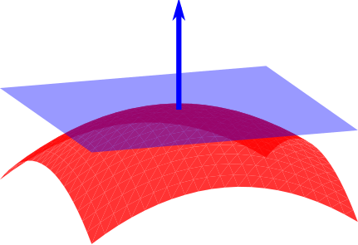

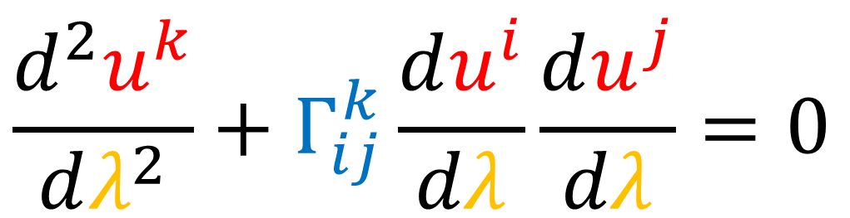



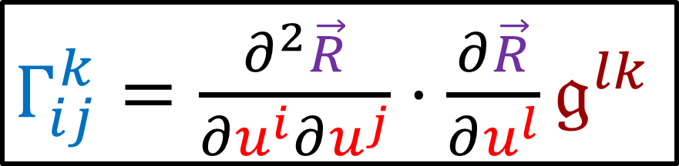

$$\frac{d^{2}u^{k}}{dλ^{2}}+Γ_{ij}^{k}\frac{du^{i}}{dλ}\frac{du^{j}}{dλ}=0$$
$Γ_{ij}^{k}=\frac{∂^{2}\vec{R}}{∂u^{i}∂u^{j}}⋅\frac{∂\vec{R}}{∂u^{l}}𝔤^{lk}$
$$\hat{n}$$
$\frac{∂\vec{R}}{∂u^{1}}=\frac{∂\vec{R}}{∂u}=\vec{e_{u}}$
$\frac{∂\vec{R}}{∂u^{2}}=\frac{∂\vec{R}}{∂v}=\vec{e_{v}}$
$\frac{∂\vec{R}}{∂u^{2}}$
$\frac{∂\vec{R}}{∂u^{1}}$

Slide 5
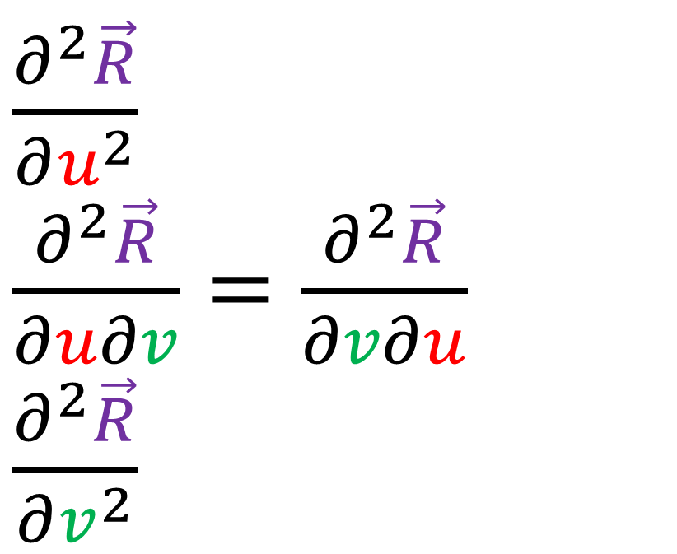
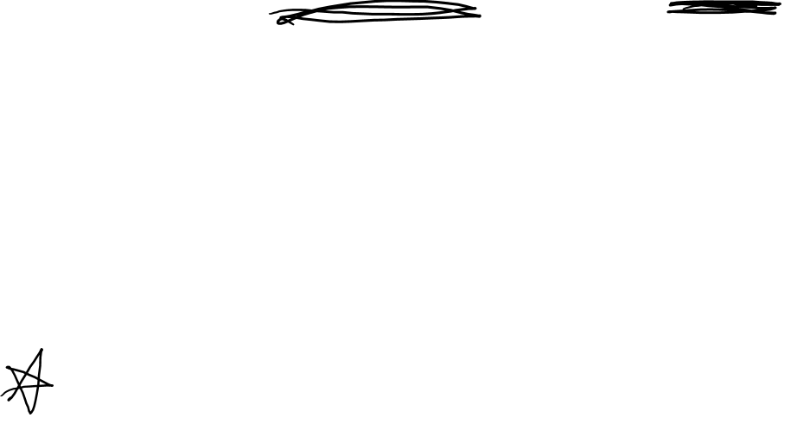
$$\frac{d^{2}u^{k}}{dλ^{2}}+Γ_{ij}^{k}\frac{du^{i}}{dλ}\frac{du^{j}}{dλ}=0$$
$Γ_{ij}^{k}=\frac{∂^{2}\vec{R}}{∂u^{i}∂u^{j}}⋅\frac{∂\vec{R}}{∂u^{l}}𝔤^{lk}$
$\frac{∂^{2}\vec{R}}{∂u^{2}}$
$\frac{∂^{2}\vec{R}}{∂u∂v}=\frac{∂^{2}\vec{R}}{∂v∂u}$
$\frac{∂^{2}\vec{R}}{∂v^{2}}$
$\frac{∂\vec{R}}{∂u^{1}}=\frac{∂\vec{R}}{∂u}=\vec{e_{u}}$
$\frac{∂\vec{R}}{∂u^{2}}=\frac{∂\vec{R}}{∂v}=\vec{e_{v}}$

Slide 6
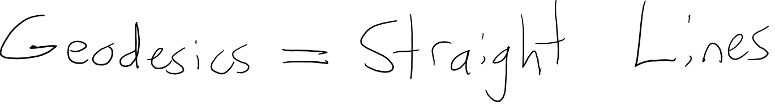
Example:
The Flat Plane

Slide 7

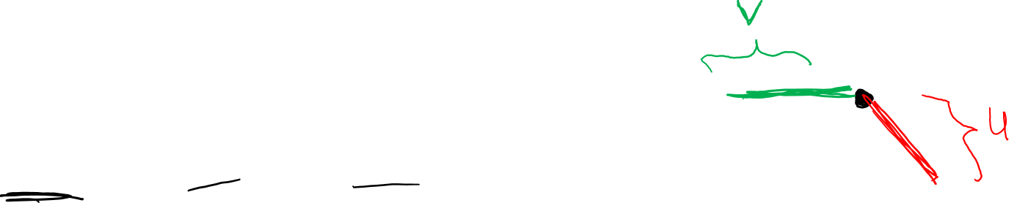
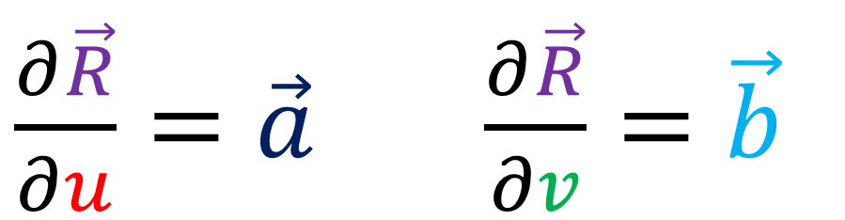





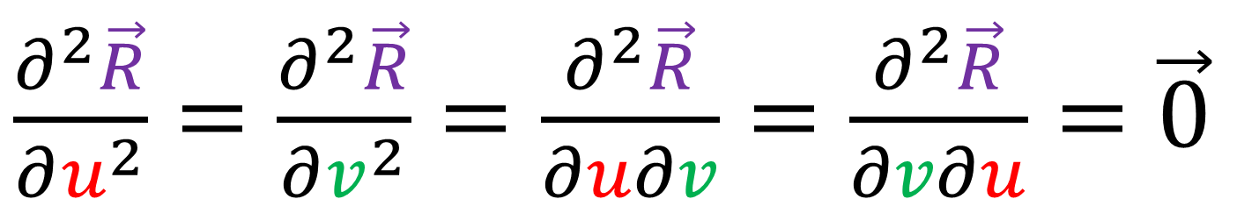
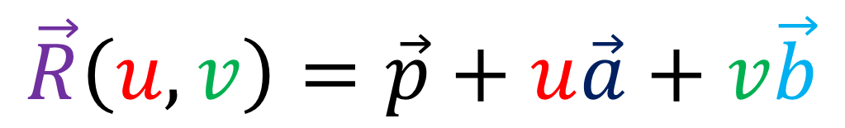
Equation of a 2D plane:
$$\vec{R}\left(u,v\right)=\vec{p}+u\vec{a}+v\vec{b}$$
$$\vec{a}$$
$$Z$$
$$Y$$
$$\vec{b}$$
$\frac{∂\vec{R}}{∂u}=\vec{a}$ $\frac{∂\vec{R}}{∂v}=\vec{b}$
$$\vec{p}$$
$$X$$
$\frac{∂^{2}\vec{R}}{∂u^{2}}=\frac{∂^{2}\vec{R}}{∂v^{2}}=\frac{∂^{2}\vec{R}}{∂u∂v}=\frac{∂^{2}\vec{R}}{∂v∂u}=\vec{0}$

Slide 8
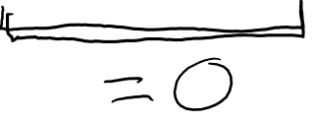

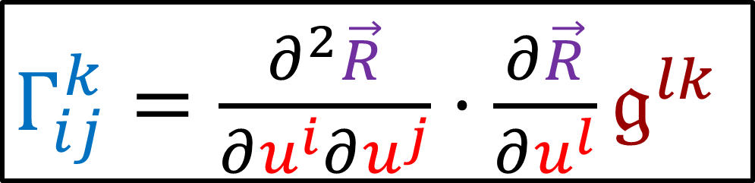
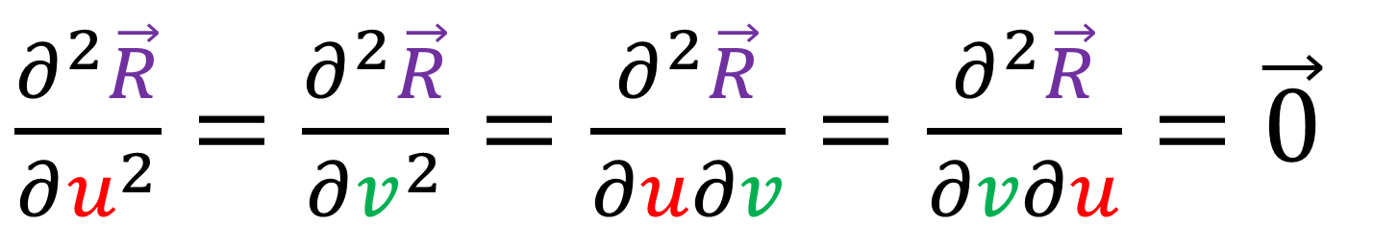
Equation of a 2D plane:
$$\vec{R}\left(u,v\right)=\vec{p}+u\vec{a}+v\vec{b}$$
$\frac{∂^{2}\vec{R}}{∂u^{2}}=\frac{∂^{2}\vec{R}}{∂v^{2}}=\frac{∂^{2}\vec{R}}{∂u∂v}=\frac{∂^{2}\vec{R}}{∂v∂u}=\vec{0}$
$$Γ_{ij}^{k}=0$$
$Γ_{ij}^{k}=\frac{∂^{2}\vec{R}}{∂u^{i}∂u^{j}}⋅\frac{∂\vec{R}}{∂u^{l}}𝔤^{lk}$

Slide 9
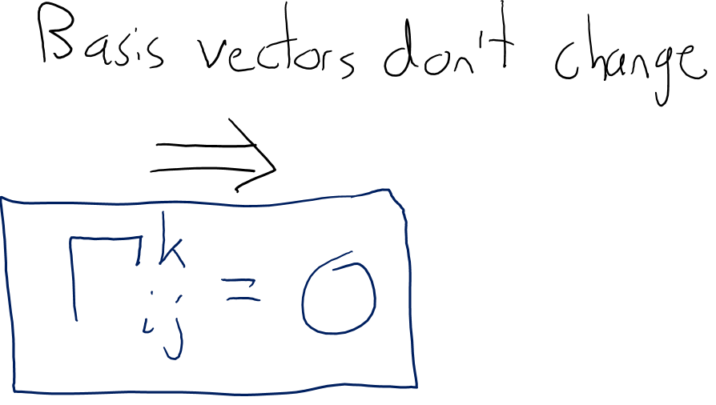
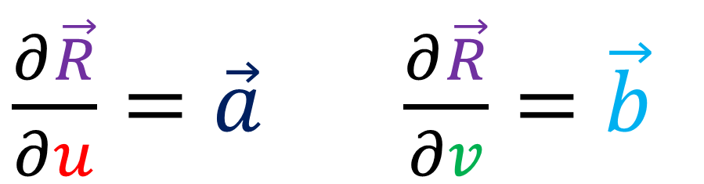

$$\vec{R}\left(u,v\right)=\vec{p}+u\vec{a}+v\vec{b}$$
$\frac{∂\vec{R}}{∂u}=\vec{a}$ $\frac{∂\vec{R}}{∂v}=\vec{b}$
$$\vec{a}$$
$$\vec{a}$$
$$\vec{b}$$
$$Z$$
$$Y$$
$$\vec{a}$$
$$\vec{b}$$
$$\vec{p}$$
$$\vec{b}$$
$$X$$

Slide 10


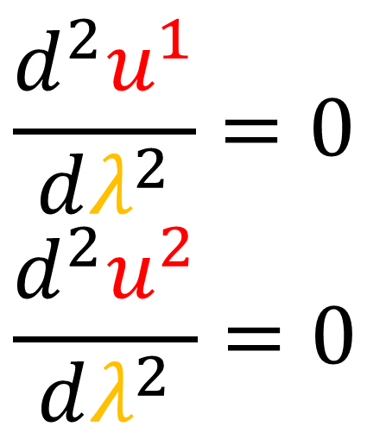
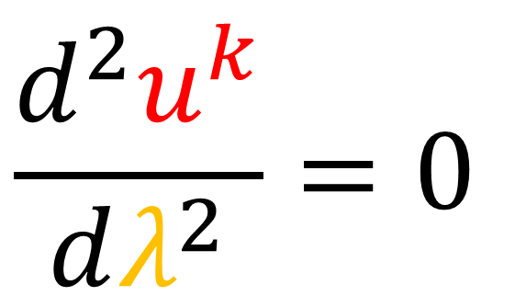

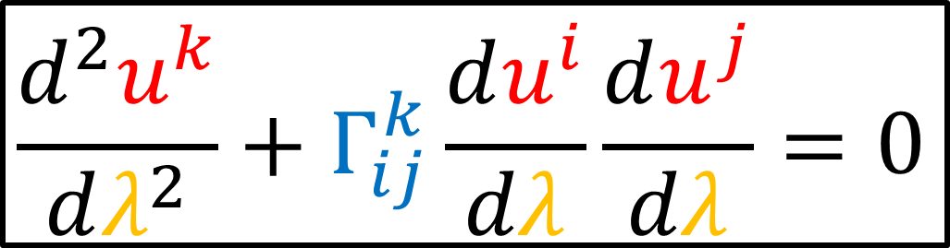
Geodesics in a 2D plane:
$$\frac{d^{2}u^{k}}{dλ^{2}}+Γ_{ij}^{k}\frac{du^{i}}{dλ}\frac{du^{j}}{dλ}=0$$
$$Γ_{ij}^{k}=0$$
$$\frac{d^{2}u^{1}}{dλ^{2}}=0$$
$$\frac{d^{2}u^{2}}{dλ^{2}}=0$$
$$\frac{d^{2}u^{k}}{dλ^{2}}=0$$

Slide 11
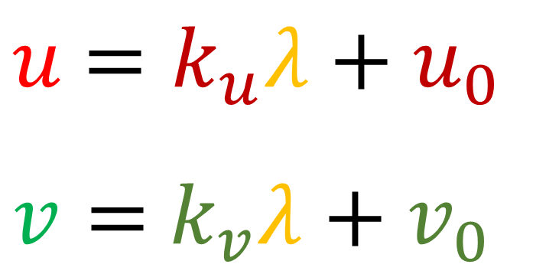
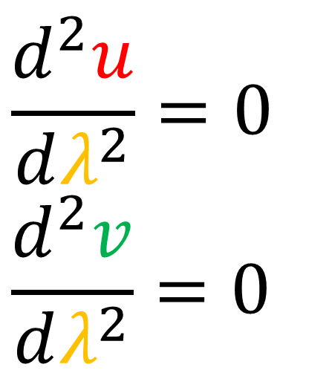

Geodesics in a 2D plane:
$$\frac{d^{2}u^{k}}{dλ^{2}}+Γ_{ij}^{k}\frac{du^{i}}{dλ}\frac{du^{j}}{dλ}=0$$
$$Γ_{ij}^{k}=0$$
$$\frac{d^{2}u}{dλ^{2}}=0$$
$$\frac{d^{2}v}{dλ^{2}}=0$$
$$\frac{d^{2}u^{k}}{dλ^{2}}=0$$
$u$ $=k_{u}λ+u_{0}$
$v=$ $k_{v}λ+v_{0}$

Slide 12
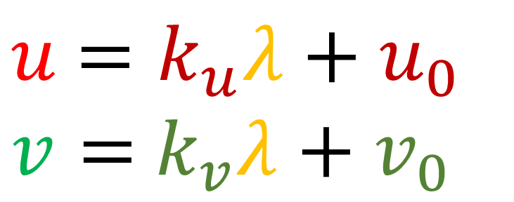
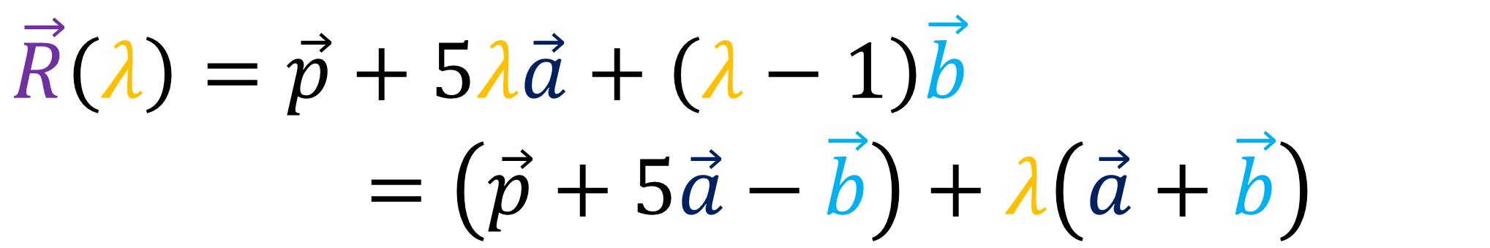
Geodesics in a 2D plane… are straight lines
$u$ $=k_{u}λ+u_{0}$
$v=$ $k_{v}λ+v_{0}$
$$\vec{R}\left(u,v\right)=\vec{p}+u\vec{a}+v\vec{b}$$
$$\vec{R}\left(λ\right)=\vec{p}+\left(k_{u}λ+u_{0}\right)\vec{a}+\left(k_{v}λ+v_{0}\right)\vec{b}$$
$\vec{R}\left(λ\right)=\vec{p}+5λ\vec{a}+\left(λ−1\right)\vec{b}$
$$\vec{R}\left(λ\right)=\left(\vec{p}+5\vec{a}−\vec{b}\right)+λ\left(\vec{a}+\vec{b}\right)$$

Slide 13
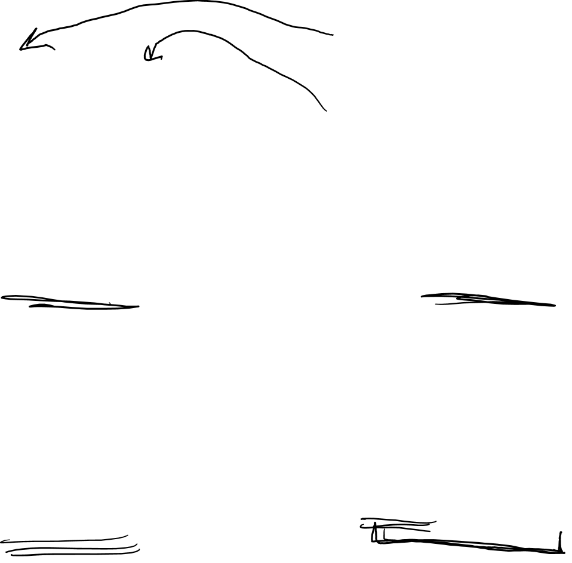
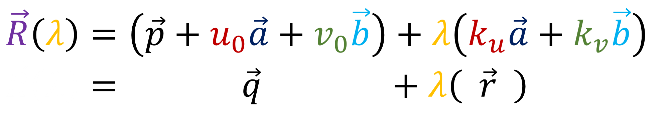
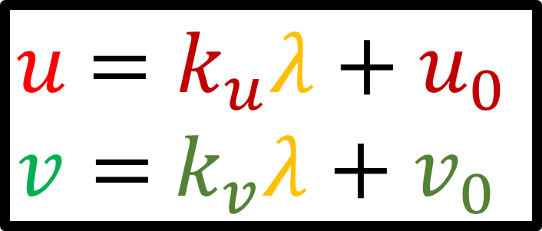
Geodesics in a 2D plane… are straight lines
$u$ $=k_{u}λ+u_{0}$
$v=$ $k_{v}λ+v_{0}$
$$\vec{R}\left(u,v\right)=\vec{p}+u\vec{a}+v\vec{b}$$
$$\vec{R}\left(λ\right)=\vec{p}+\left(k_{u}λ+u_{0}\right)\vec{a}+\left(k_{v}λ+v_{0}\right)\vec{b}$$
$$\vec{R}\left(λ\right)=\left(\vec{p}+u_{0}\vec{a}+v_{0}\vec{b}\right)+λ\left(k_{u}\vec{a}+k_{v}\vec{b}\right)$$
$$\vec{R}\left(λ\right)= \vec{q} +λ\left( \vec{r} \right)$$

Slide 14

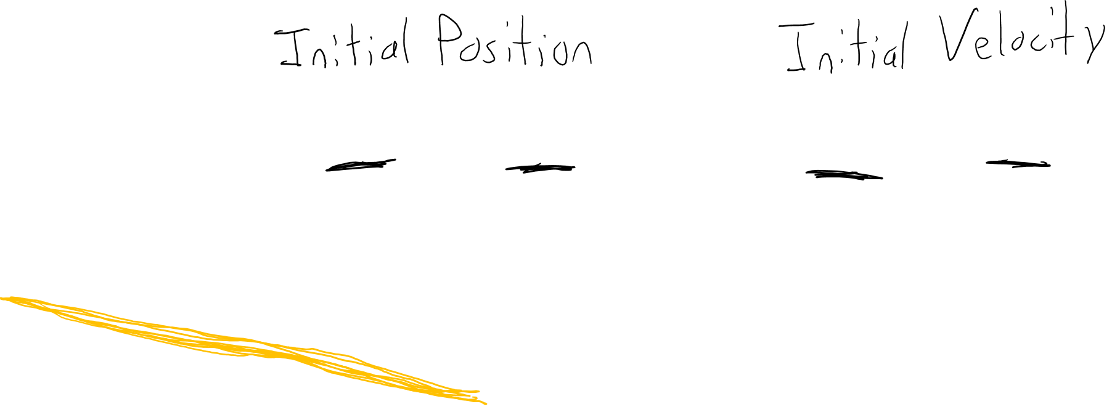
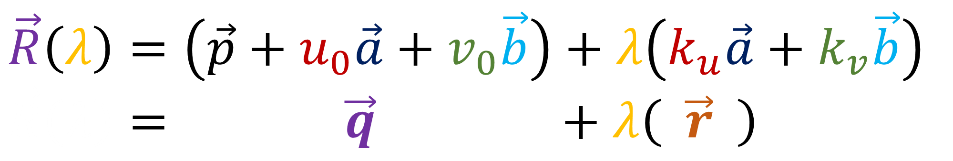







Geodesics in a 2D plane… are straight lines
$$\vec{R}\left(λ\right)=\left(\vec{p}+u_{0}\vec{a}+v_{0}\vec{b}\right)+λ\left(k_{u}\vec{a}+k_{v}\vec{b}\right)$$
$$\vec{R}\left(λ\right)= \vec{q} +λ\left( \vec{r} \right)$$
$$\vec{r}$$
$$\vec{q}$$
$$\vec{a}$$
$$Z$$
$$Y$$
$$\vec{b}$$
$$\vec{p}$$
$$X$$

Slide 15
Example:
The Sphere

Slide 16
The Plan: To compute geodesics on a surface…
1. Compute Christoffel Symbols
$Γ_{ij}^{k}=\frac{∂^{2}\vec{R}}{∂u^{i}∂u^{j}}⋅\frac{∂\vec{R}}{∂u^{l}}𝔤^{lk}$
2. Solve Geodesic Equations
$\frac{d^{2}u^{k}}{dλ^{2}}+Γ_{ij}^{k}\frac{du^{i}}{dλ}\frac{du^{j}}{dλ}=0$

Slide 17
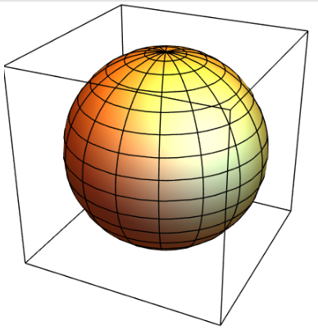
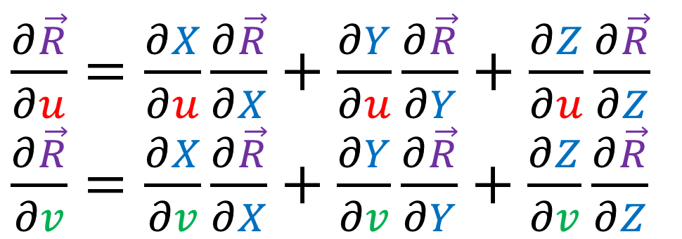



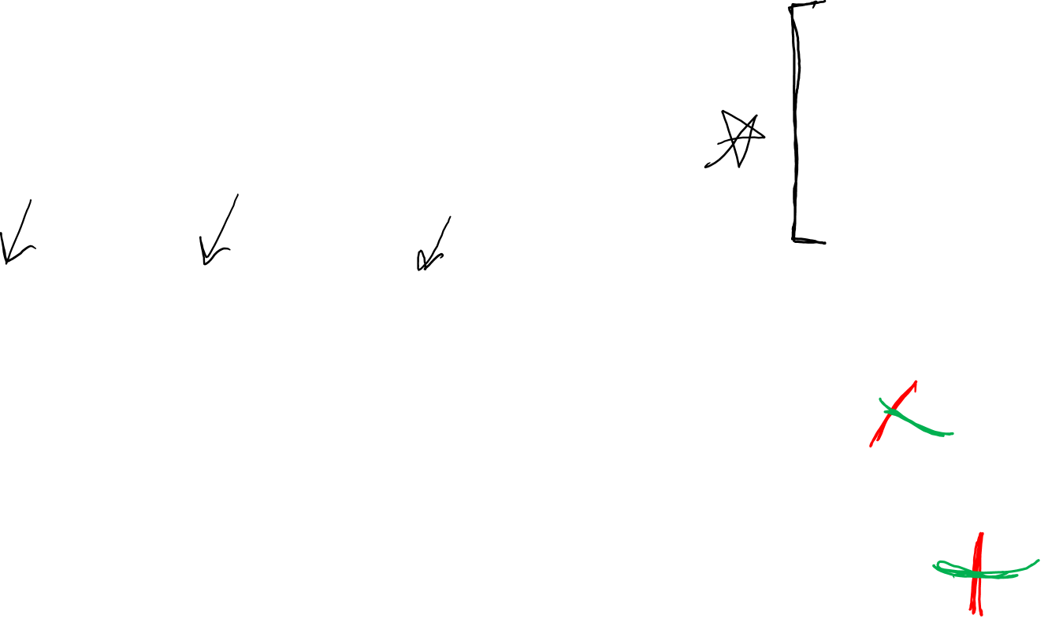
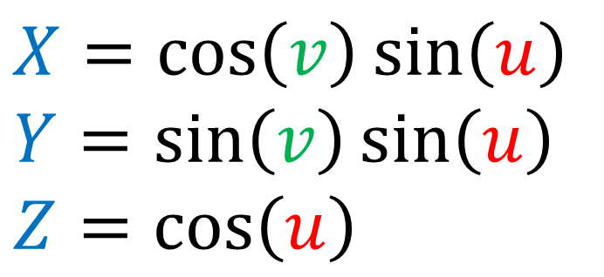

From Tensor Calculus Video #12:
$$X=\cos\left(v\right)\sin\left(u\right)$$
$$Y=\sin\left(v\right)\sin\left(u\right)$$
$$Z=\cos\left(u\right)$$
$\frac{∂\vec{R}}{∂u}=\frac{∂X}{∂u}\frac{∂\vec{R}}{∂X}+\frac{∂Y}{∂u}\frac{∂\vec{R}}{∂Y}+\frac{∂Z}{∂u}\frac{∂\vec{R}}{∂Z}$
$\frac{∂\vec{R}}{∂v}=\frac{∂X}{∂v}\frac{∂\vec{R}}{∂X}+\frac{∂Y}{∂v}\frac{∂\vec{R}}{∂Y}+\frac{∂Z}{∂v}\frac{∂\vec{R}}{∂Z}$
$$\vec{e_{v}}$$
$$\vec{e_{v}}$$
$$\vec{e_{u}}$$
$$\vec{e_{u}}$$

Slide 18
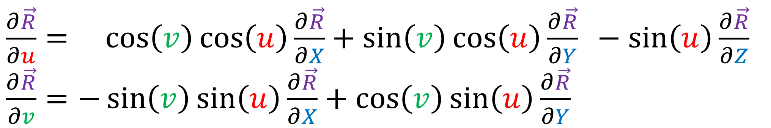


From Tensor Calculus Video #12:
$$X=\cos\left(v\right)\sin\left(u\right)$$
$$Y=\sin\left(v\right)\sin\left(u\right)$$
$$Z=\cos\left(u\right)$$
$\frac{∂\vec{R}}{∂u}= \cos\left(v\right)\cos\left(u\right)\frac{∂\vec{R}}{∂X}+\sin\left(v\right)\cos\left(u\right)\frac{∂\vec{R}}{∂Y} −\sin\left(u\right)\frac{∂\vec{R}}{∂Z}$
$\frac{∂\vec{R}}{∂v}=−\sin\left(v\right)\sin\left(u\right)\frac{∂\vec{R}}{∂X}+\cos\left(v\right)\sin\left(u\right)\frac{∂\vec{R}}{∂Y}$
$g_{ij}→\left[\begin{matrix}\frac{∂\vec{R}}{∂u}⋅\frac{∂\vec{R}}{∂u} & \frac{∂\vec{R}}{∂u}⋅\frac{∂\vec{R}}{∂v} \\ \frac{∂\vec{R}}{∂v}⋅\frac{∂\vec{R}}{∂u} & \frac{∂\vec{R}}{∂v}⋅\frac{∂\vec{R}}{∂v}\end{matrix}\right]=\left[\begin{matrix}1 & 0 \\ 0 & {\left(\sin\left(u\right)\right)}^{2}\end{matrix}\right]$

Slide 19



$\frac{∂\vec{R}}{∂u}= \cos\left(v\right)\cos\left(u\right)\frac{∂\vec{R}}{∂X}+\sin\left(v\right)\cos\left(u\right)\frac{∂\vec{R}}{∂Y} −\sin\left(u\right)\frac{∂\vec{R}}{∂Z}$
$\frac{∂\vec{R}}{∂v}=−\sin\left(v\right)\sin\left(u\right)\frac{∂\vec{R}}{∂X}+\cos\left(v\right)\sin\left(u\right)\frac{∂\vec{R}}{∂Y}$
$\frac{∂}{∂u}\left(\frac{∂\vec{R}}{∂u}\right)=−\cos\left(v\right)\sin\left(u\right)\frac{∂\vec{R}}{∂X}−\sin\left(v\right)\sin\left(u\right)\frac{∂\vec{R}}{∂Y} −\cos\left(u\right)\frac{∂\vec{R}}{∂Z}$
$\frac{∂}{∂v}\left(\frac{∂\vec{R}}{∂v}\right)=−\cos\left(v\right)\sin\left(u\right)\frac{∂\vec{R}}{∂X}−\sin\left(v\right)\sin\left(u\right)\frac{∂\vec{R}}{∂Y}$
$\frac{∂}{∂u}\left(\frac{∂\vec{R}}{∂v}\right)=\frac{∂}{∂v}\left(\frac{∂\vec{R}}{∂u}\right)=−\sin\left(v\right)\cos\left(u\right)\frac{∂\vec{R}}{∂X}+\cos\left(v\right)\cos\left(u\right)\frac{∂\vec{R}}{∂Y}$

Slide 20



$\frac{∂\vec{R}}{∂u}= \cos\left(v\right)\cos\left(u\right)\frac{∂\vec{R}}{∂X}+\sin\left(v\right)\cos\left(u\right)\frac{∂\vec{R}}{∂Y} −\sin\left(u\right)\frac{∂\vec{R}}{∂Z}$
$\frac{∂\vec{R}}{∂v}=−\sin\left(v\right)\sin\left(u\right)\frac{∂\vec{R}}{∂X}+\cos\left(v\right)\sin\left(u\right)\frac{∂\vec{R}}{∂Y}$
$\frac{∂^{2}\vec{R}}{∂u^{2}}=−\cos\left(v\right)\sin\left(u\right)\frac{∂\vec{R}}{∂X}−\sin\left(v\right)\sin\left(u\right)\frac{∂\vec{R}}{∂Y} −\cos\left(u\right)\frac{∂\vec{R}}{∂Z}$
$\frac{∂^{2}\vec{R}}{∂v^{2}}=−\cos\left(v\right)\sin\left(u\right)\frac{∂\vec{R}}{∂X}−\sin\left(v\right)\sin\left(u\right)\frac{∂\vec{R}}{∂Y}$
$\frac{∂^{2}\vec{R}}{∂u∂v}=\frac{∂^{2}\vec{R}}{∂v∂u}=−\sin\left(v\right)\cos\left(u\right)\frac{∂\vec{R}}{∂X}+\cos\left(v\right)\cos\left(u\right)\frac{∂\vec{R}}{∂Y}$
$g_{ij}→\left[\begin{matrix}1 & 0 \\ 0 & {\left(\sin\left(u\right)\right)}^{2}\end{matrix}\right]$
$𝔤^{ij}→\left[\begin{matrix}1 & 0 \\ 0 & {1/\left(\sin\left(u\right)\right)}^{2}\end{matrix}\right]$

Slide 21



$Γ_{ij}^{k}=\frac{∂^{2}\vec{R}}{∂u^{i}∂u^{j}}⋅\frac{∂\vec{R}}{∂u^{l}}𝔤^{lk}$
$Γ_{ij}^{1}=\frac{∂^{2}\vec{R}}{∂u^{i}∂u^{j}}⋅\frac{∂\vec{R}}{∂u^{l}}𝔤^{l1}$

Slide 22




$𝔤^{ij}→\left[\begin{matrix}1 & 0 \\ 0 & {1/\left(\sin\left(u\right)\right)}^{2}\end{matrix}\right]$
$Γ_{ij}^{k}=\frac{∂^{2}\vec{R}}{∂u^{i}∂u^{j}}⋅\frac{∂\vec{R}}{∂u^{l}}𝔤^{lk}$
$$𝔤^{12}=𝔤^{21}=0$$
$Γ_{ij}^{1}=\frac{∂^{2}\vec{R}}{∂u^{i}∂u^{j}}⋅\frac{∂\vec{R}}{∂u^{1}}𝔤^{11}+\frac{∂^{2}\vec{R}}{∂u^{i}∂u^{j}}⋅\frac{∂\vec{R}}{∂u^{2}}𝔤^{21}$
$Γ_{ij}^{2}=\frac{∂^{2}\vec{R}}{∂u^{i}∂u^{j}}⋅\frac{∂\vec{R}}{∂u^{1}}𝔤^{12}+\frac{∂^{2}\vec{R}}{∂u^{i}∂u^{j}}⋅\frac{∂\vec{R}}{∂u^{2}}𝔤^{22}$

Slide 23


$𝔤^{ij}→\left[\begin{matrix}1 & 0 \\ 0 & {1/\left(\sin\left(u\right)\right)}^{2}\end{matrix}\right]$
$Γ_{ij}^{k}=\frac{∂^{2}\vec{R}}{∂u^{i}∂u^{j}}⋅\frac{∂\vec{R}}{∂u^{l}}𝔤^{lk}$
$$𝔤^{12}=𝔤^{21}=0$$
$Γ_{ij}^{1}=\frac{∂^{2}\vec{R}}{∂u^{i}∂u^{j}}⋅\frac{∂\vec{R}}{∂u^{1}}$
$Γ_{ij}^{2}=\frac{∂^{2}\vec{R}}{∂u^{i}∂u^{j}}⋅\frac{∂\vec{R}}{∂u^{2}}\frac{1}{{\left(\sin\left(u\right)\right)}^{2}}$

Slide 24


$$\vec{a}⋅\vec{b}=\left(a^{X}\vec{e_{X}}+a^{Y}\vec{e_{Y}}+a^{Z}\vec{e_{Z}}\right)⋅\left(b^{X}\vec{e_{X}}+b^{Y}\vec{e_{Y}}+b^{Z}\vec{e_{Z}}\right)$$
$$\vec{a}⋅\vec{b} =a^{X}b^{X}\left(\vec{e_{X}}⋅\vec{e_{X}}\right)+a^{X}b^{Y}\left(\vec{e_{X}}⋅\vec{e_{Y}}\right)+a^{X}b^{Z}\left(\vec{e_{X}}⋅\vec{e_{Z}}\right)$$
$+ a^{Y}b^{X}\left(\vec{e_{Y}}⋅\vec{e_{X}}\right)+a^{Y}b^{Y}\left(\vec{e_{Y}}⋅\vec{e_{Y}}\right)+a^{Y}b^{Z}\left(\vec{e_{Y}}⋅\vec{e_{Z}}\right)$
$+ a^{Z}b^{X}\left(\vec{e_{Z}}⋅\vec{e_{X}}\right)+a^{Z}b^{Y}\left(\vec{e_{Z}}⋅\vec{e_{Y}}\right)+a^{Z}b^{Z}\left(\vec{e_{Z}}⋅\vec{e_{Z}}\right)$
$$\vec{a}⋅=a^{X}b^{X}+a^{Y}b^{Y}+a^{Z}b^{Z}$$
Cartesian Basis Only!!

Slide 25


$$\frac{∂\vec{R}}{∂u}⋅\frac{∂^{2}\vec{R}}{∂u^{2}}=\left[\begin{aligned}\cos\left(v\right)\cos\left(u\right) \\ \sin\left(v\right)\cos\left(u\right) \\ −\sin\left(u\right)\end{aligned}\right]⋅\left[\begin{aligned}−\cos\left(v\right)\sin\left(u\right) \\ −\sin\left(v\right)\sin\left(u\right) \\ −\cos\left(u\right)\end{aligned}\right]$$
$$=−{\left(\cos\left(v\right)\right)}^{2}\cos\left(u\right)\sin\left(u\right)$$
$$=−{\left(\sin\left(v\right)\right)}^{2}\cos\left(u\right)\sin\left(u\right)$$
$$=+\cos\left(u\right)\sin\left(u\right)$$
$$=−\left[{\left(\cos\left(v\right)\right)}^{2}+{\left(\sin\left(v\right)\right)}^{2}\right]\cos\left(u\right)\sin\left(u\right)+\cos\left(u\right)\sin\left(u\right)$$
$$=−\cos\left(u\right)\sin\left(u\right)+\cos\left(u\right)\sin\left(u\right)$$
$$=0$$

Slide 26


$$\frac{∂\vec{R}}{∂u}⋅\frac{∂^{2}\vec{R}}{∂v^{2}}=\left[\begin{aligned}\cos\left(v\right)\cos\left(u\right) \\ \sin\left(v\right)\cos\left(u\right) \\ −\sin\left(u\right)\end{aligned}\right]⋅\left[\begin{aligned}−\cos\left(v\right)\sin\left(u\right) \\ −\sin\left(v\right)\sin\left(u\right) \\ 0\end{aligned}\right]$$
$$=−{\left(\cos\left(v\right)\right)}^{2}\cos\left(u\right)\sin\left(u\right)$$
$$=−{\left(\sin\left(v\right)\right)}^{2}\cos\left(u\right)\sin\left(u\right)$$
$$=−\left[{\left(\cos\left(v\right)\right)}^{2}+{\left(\sin\left(v\right)\right)}^{2}\right]\cos\left(u\right)\sin\left(u\right)$$
$$=−\cos\left(u\right)\sin\left(u\right)$$

Slide 27



$$\frac{∂\vec{R}}{∂u}⋅\frac{∂^{2}\vec{R}}{∂u∂v}=\left[\begin{aligned}\cos\left(v\right)\cos\left(u\right) \\ \sin\left(v\right)\cos\left(u\right) \\ −\sin\left(u\right)\end{aligned}\right]⋅\left[\begin{aligned}−\sin\left(v\right)\cos\left(u\right) \\ \cos\left(v\right)\cos\left(u\right) \\ 0\end{aligned}\right]$$
$$=−{\left(\cos\left(u\right)\right)}^{2}\cos\left(v\right)\sin\left(v\right) \\ =+{\left(\cos\left(u\right)\right)}^{2}\cos\left(v\right)\sin\left(v\right)$$
$$=+0$$
$$=0$$
$$=\frac{∂\vec{R}}{∂u}⋅\frac{∂^{2}\vec{R}}{∂v∂u}$$

Slide 28


$$\frac{∂\vec{R}}{∂v}⋅\frac{∂^{2}\vec{R}}{∂u^{2}}=\left[\begin{aligned}−\sin\left(v\right)\sin\left(u\right) \\ \cos\left(v\right)\sin\left(u\right) \\ 0\end{aligned}\right]⋅\left[\begin{aligned}−\cos\left(v\right)\sin\left(u\right) \\ −\sin\left(v\right)\sin\left(u\right) \\ −\cos\left(u\right)\end{aligned}\right]$$
$$={\left(\sin\left(u\right)\right)}^{2}\cos\left(v\right)\sin\left(v\right) \\ =−{\left(\sin\left(u\right)\right)}^{2}\cos\left(v\right)\sin\left(v\right)$$
$$=+0$$
$$=0$$

Slide 29


$$\frac{∂\vec{R}}{∂v}⋅\frac{∂^{2}\vec{R}}{∂v^{2}}=\left[\begin{aligned}−\sin\left(v\right)\sin\left(u\right) \\ \cos\left(v\right)\sin\left(u\right) \\ 0\end{aligned}\right]⋅\left[\begin{aligned}−\cos\left(v\right)\sin\left(u\right) \\ −\sin\left(v\right)\sin\left(u\right) \\ 0\end{aligned}\right]$$
$$=−{\left(\sin\left(u\right)\right)}^{2}\cos\left(v\right)\sin\left(v\right) \\ =+{\left(\sin\left(u\right)\right)}^{2}\cos\left(v\right)\sin\left(v\right)$$
$$=+0$$
$$=0$$

Slide 30



$$\frac{∂\vec{R}}{∂v}⋅\frac{∂^{2}\vec{R}}{∂u∂v}=\left[\begin{aligned}−\sin\left(v\right)\sin\left(u\right) \\ \cos\left(v\right)\sin\left(u\right) \\ 0\end{aligned}\right]⋅\left[\begin{aligned}−\sin\left(v\right)\cos\left(u\right) \\ \cos\left(v\right)\cos\left(u\right) \\ 0\end{aligned}\right]$$
$$= {\left(\sin\left(v\right)\right)}^{2}\cos\left(u\right)\sin\left(u\right) \\ =+{\left(\cos\left(v\right)\right)}^{2}\cos\left(u\right)\sin\left(u\right)$$
$$=+0$$
$$=\left[{\left(\sin\left(v\right)\right)}^{2}+{\left(\cos\left(v\right)\right)}^{2}\right]\cos\left(u\right)\sin\left(u\right)$$
$$=\cos\left(u\right)\sin\left(u\right)$$
$$=\frac{∂\vec{R}}{∂v}⋅\frac{∂^{2}\vec{R}}{∂v∂u}$$

Slide 31


$$\frac{d^{2}u^{k}}{dλ^{2}}+Γ_{ij}^{k}\frac{du^{i}}{dλ}\frac{du^{j}}{dλ}=0$$
$Γ_{ij}^{k}=\frac{∂^{2}\vec{R}}{∂u^{i}∂u^{j}}⋅\frac{∂\vec{R}}{∂u^{l}}𝔤^{lk}$
$\frac{∂^{2}\vec{R}}{∂v^{2}}⋅\frac{∂\vec{R}}{∂u}=−\cos\left(u\right)\sin\left(u\right)=\frac{∂^{2}\vec{R}}{∂u^{2}∂u^{2}}⋅\frac{∂\vec{R}}{∂u^{1}}$
$\frac{∂^{2}\vec{R}}{∂u∂v}⋅\frac{∂\vec{R}}{∂v}=\cos\left(u\right)\sin\left(u\right) =\frac{∂^{2}\vec{R}}{∂u^{1}∂u^{2}}⋅\frac{∂\vec{R}}{∂u^{2}}$

Slide 32






$𝔤^{ij}→\left[\begin{matrix}1 & 0 \\ 0 & {1/\left(\sin\left(u\right)\right)}^{2}\end{matrix}\right]$
$Γ_{ij}^{k}=\frac{∂^{2}\vec{R}}{∂u^{i}∂u^{j}}⋅\frac{∂\vec{R}}{∂u^{l}}𝔤^{lk}$
$$𝔤^{12}=𝔤^{21}=0$$
$Γ_{ij}^{1}=\frac{∂^{2}\vec{R}}{∂u^{i}∂u^{j}}⋅\frac{∂\vec{R}}{∂u^{1}}$
$Γ_{ij}^{2}=\frac{∂^{2}\vec{R}}{∂u^{i}∂u^{j}}⋅\frac{∂\vec{R}}{∂u^{2}}\frac{1}{{\left(\sin\left(u\right)\right)}^{2}}$
$$\frac{∂^{2}\vec{R}}{∂u^{2}∂u^{2}}⋅\frac{∂\vec{R}}{∂u^{1}}=−\cos\left(u\right)\sin\left(u\right)$$
$$\frac{∂^{2}\vec{R}}{∂u^{1}∂u^{2}}⋅\frac{∂\vec{R}}{∂u^{2}}=\cos\left(u\right)\sin\left(u\right)$$
$Γ_{22}^{1}=\frac{∂^{2}\vec{R}}{∂u^{2}∂u^{2}}⋅\frac{∂\vec{R}}{∂u^{1}}=−\cos\left(u\right)\sin\left(u\right)$
$$Γ_{12}^{2}=\frac{∂^{2}\vec{R}}{∂u^{1}∂u^{2}}⋅\frac{∂\vec{R}}{∂u^{2}}\frac{1}{{\left(\sin\left(u\right)\right)}^{2}}=\frac{\cos\left(u\right)\sin\left(u\right)}{{\left(\sin\left(u\right)\right)}^{2}}=\frac{\cos\left(u\right)}{\sin\left(u\right)}$$

Slide 33



$$\frac{d^{2}u^{k}}{dλ^{2}}+Γ_{ij}^{k}\frac{du^{i}}{dλ}\frac{du^{j}}{dλ}=0$$
$Γ_{22}^{1}=−\cos\left(u\right)\sin\left(u\right)$
$$Γ_{12}^{2}=\frac{\cos\left(u\right)}{\sin\left(u\right)}$$
$$\frac{d^{2}u^{1}}{dλ^{2}}+Γ_{22}^{1}\frac{du^{2}}{dλ}\frac{du^{2}}{dλ}=0$$
$$\frac{d^{2}u^{2}}{dλ^{2}}+Γ_{12}^{2}\frac{du^{1}}{dλ}\frac{du^{2}}{dλ}=0$$

Slide 34

$$\frac{d^{2}u^{k}}{dλ^{2}}+Γ_{ij}^{k}\frac{du^{i}}{dλ}\frac{du^{j}}{dλ}=0$$
$Γ_{22}^{1}=−\cos\left(u\right)\sin\left(u\right)$
$$Γ_{12}^{2}=\frac{\cos\left(u\right)}{\sin\left(u\right)}$$
$$\frac{d^{2}u^{1}}{dλ^{2}}−\cos\left(u\right)\sin\left(u\right)\frac{du^{2}}{dλ}\frac{du^{2}}{dλ}=0$$
$$\frac{d^{2}u^{2}}{dλ^{2}}+\frac{\cos\left(u\right)}{\sin\left(u\right)}\frac{du^{1}}{dλ}\frac{du^{2}}{dλ}=0$$

Slide 35

$$\frac{d^{2}u^{k}}{dλ^{2}}+Γ_{ij}^{k}\frac{du^{i}}{dλ}\frac{du^{j}}{dλ}=0$$
$Γ_{22}^{1}=−\cos\left(u\right)\sin\left(u\right)$
$$Γ_{12}^{2}=\frac{\cos\left(u\right)}{\sin\left(u\right)}$$
$$\frac{d^{2}u}{dλ^{2}}−\cos\left(u\right)\sin\left(u\right)\frac{dv}{dλ}\frac{dv}{dλ}=0$$
$$\frac{d^{2}v}{dλ^{2}}+\frac{\cos\left(u\right)}{\sin\left(u\right)}\frac{du}{dλ}\frac{dv}{dλ}=0$$

Slide 36


$$\frac{d^{2}u^{k}}{dλ^{2}}+Γ_{ij}^{k}\frac{du^{i}}{dλ}\frac{du^{j}}{dλ}=0$$
$Γ_{22}^{1}=−\cos\left(u\right)\sin\left(u\right)$
$$Γ_{12}^{2}=\frac{\cos\left(u\right)}{\sin\left(u\right)}$$
$$\frac{d^{2}u}{dλ^{2}}−\cos\left(u\right)\sin\left(u\right)\frac{dv}{dλ}\frac{dv}{dλ}=0$$
$$\frac{d^{2}v}{dλ^{2}}+\cot\left(u\right)\frac{du}{dλ}\frac{dv}{dλ}=0$$

Slide 37





These Equations are hard to solve in general…
$$\frac{d^{2}u}{dλ^{2}}−\cos\left(u\right)\sin\left(u\right)\frac{dv}{dλ}\frac{dv}{dλ}=0$$
$$\frac{d^{2}v}{dλ^{2}}+\cot\left(u\right)\frac{du}{dλ}\frac{dv}{dλ}=0$$
Try a circle of latitude:
$\frac{du}{dλ}=0$
$\frac{dv}{dλ}=k$
$\frac{d^{2}u}{dλ^{2}}=0$
$\frac{d^{2}v}{dλ^{2}}=0$
$$u=θ_{0}$$
$$v=kλ$$

Slide 38



These Equations are hard to solve in general…
$$0−\cos\left(θ_{0}\right)\sin\left(θ_{0}\right)k^{2}=0$$
$$0+\cot\left(θ_{0}\right)(0)(k)=0$$
Try a circle of latitude:
$\frac{du}{dλ}=0$
$\frac{dv}{dλ}=k$
$\frac{d^{2}u}{dλ^{2}}=0$
$\frac{d^{2}v}{dλ^{2}}=0$
$$u=θ_{0}$$
$$v=kλ$$

Slide 39


These Equations are hard to solve in general…
$$\cos\left(θ_{0}\right)\sin\left(θ_{0}\right)k^{2}=0$$
$k=0→$ single point $(u=θ_{0},v=kλ=0)$
$θ_{0}=0, θ_{0}=π→$ single points at north/south pole
$θ_{0}=\frac{π}{2}→$ curve around the equator
Try a circle of latitude:
$\frac{du}{dλ}=0$
$\frac{dv}{dλ}=k$
$\frac{d^{2}u}{dλ^{2}}=0$
$\frac{d^{2}v}{dλ^{2}}=0$
$$u=θ_{0}$$
$$v=kλ$$

Slide 40



The Equator is a geodesic curve
$$u=π/2$$
$$v=kλ$$
Other circles of latitude are not geodesics
$$u≠π/2$$
$$v=kλ$$

Slide 41




The Equator is a geodesic curve
$$Z$$
$$u=π/2$$
$$v=kλ$$
$$Y$$
Other circles of latitude are not geodesics
$$X$$
$$u≠π/2$$
$$v=kλ$$

Slide 42

The Equator is a geodesic curve
$$u=π/2$$
$$v=kλ$$
By rotational symmetry,
all great circles are
geodesics.

Slide 43
Summary: To compute geodesics on a surface…
1. Compute Christoffel Symbols
$Γ_{ij}^{k}=\frac{∂^{2}\vec{R}}{∂u^{i}∂u^{j}}⋅\frac{∂\vec{R}}{∂u^{l}}𝔤^{lk}$
2. Solve Geodesic Equations
$\frac{d^{2}u^{k}}{dλ^{2}}+Γ_{ij}^{k}\frac{du^{i}}{dλ}\frac{du^{j}}{dλ}=0$

Slide 44
extra notes
https://web.archive.org/web/20180826214416/http://www.maths.manchester.ac.uk/~khudian/Teaching/Geometry/GeomRim13/solutions7.pdf
https://www.youtube.com/watch?v=0teZOk5Xo-s
Tensor Calculus 8d: The Christoffel Symbol on the Sphere of Radius R

