Slide 1

Video 17.5: Covariant Derivative (Component Definition/ Engineering Definition)
(Follow-up to Video 17: Flat Space Definition)
(Links in the description)

Slide 2
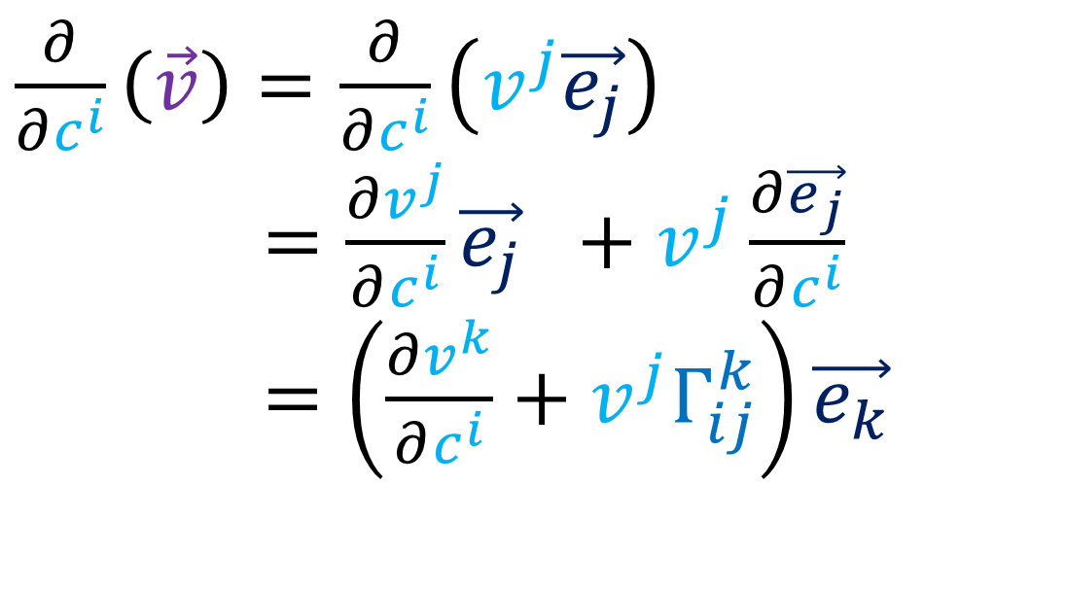
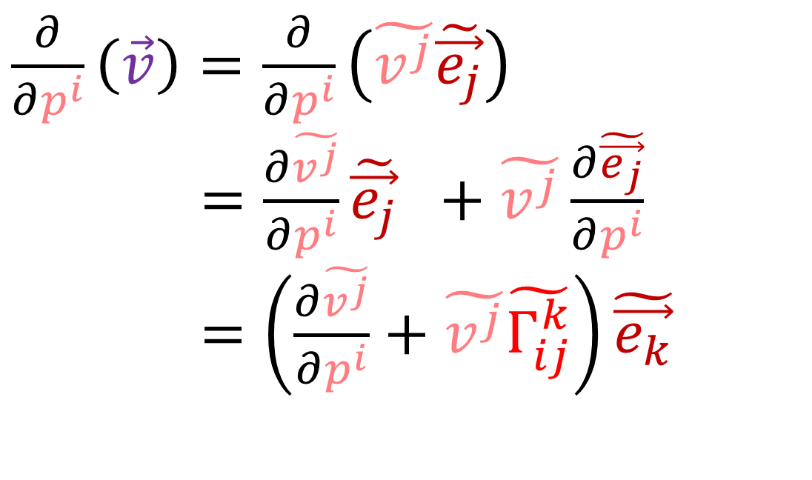
Covariant Derivative Summary
In flat space, the Covariant Derivative of a vector field…
is just the ordinary derivative
we make sure to differentiate both the vector components and the basis vectors.
$\frac{∂}{∂c^{i}}\left(\vec{v}\right)=\frac{∂}{∂c^{i}}\left(v^{j}\vec{e_{j}}\right)$
$\frac{∂}{∂u^{i}}\left(\vec{v}\right)=\frac{∂v^{j}}{∂c^{i}}\vec{e_{j}} +v^{j}\frac{∂\vec{e_{j}}}{∂c^{i}}$
$\frac{∂}{∂u^{i}}\left(\vec{v}\right)=\left(\frac{∂v^{k}}{∂c^{i}}+v^{j}Γ_{ij}^{k}\right)\vec{e_{k}}$
$\frac{∂}{∂p^{i}}\left(\vec{v}\right)=\frac{∂}{∂p^{i}}\left(\tilde{v^{j}}\tilde{\vec{e_{j}}}\right)$
$\frac{∂}{∂u^{i}}\left(\vec{v}\right)=\frac{∂\tilde{v^{j}}}{∂p^{i}}\tilde{\vec{e_{j}}} +\tilde{v^{j}}\frac{∂\tilde{\vec{e_{j}}}}{∂p^{i}}$
$\frac{∂}{∂u^{i}}\left(\vec{v}\right)=\left(\frac{∂\tilde{v^{j}}}{∂p^{i}}+\tilde{v^{j}}\tilde{Γ_{ij}^{k}}\right)\tilde{\vec{e_{k}}}$

Slide 3
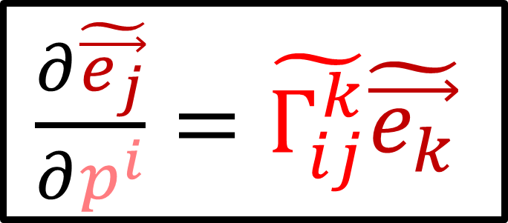

Covariant Derivative Summary
$\frac{∂\vec{e_{j}}}{∂c^{i}}=Γ_{ij}^{k}\vec{e_{k}}$
$\frac{∂\tilde{\vec{e_{j}}}}{∂p^{i}}=\tilde{Γ_{ij}^{k}}\tilde{\vec{e_{k}}}$
$\frac{∂}{∂c^{i}}\left(\vec{v}\right)=\frac{∂}{∂c^{i}}\left(v^{j}\vec{e_{j}}\right)$
$\frac{∂}{∂u^{i}}\left(\vec{v}\right)=\frac{∂v^{j}}{∂c^{i}}\vec{e_{j}} +v^{j}\frac{∂\vec{e_{j}}}{∂c^{i}}$
$\frac{∂}{∂u^{i}}\left(\vec{v}\right)=\left(\frac{∂v^{k}}{∂c^{i}}+v^{j}Γ_{ij}^{k}\right)\vec{e_{k}}$
$\frac{∂}{∂p^{i}}\left(\vec{v}\right)=\frac{∂}{∂p^{i}}\left(\tilde{v^{j}}\tilde{\vec{e_{j}}}\right)$
$\frac{∂}{∂u^{i}}\left(\vec{v}\right)=\frac{∂\tilde{v^{j}}}{∂p^{i}}\tilde{\vec{e_{j}}} +\tilde{v^{j}}\frac{∂\tilde{\vec{e_{j}}}}{∂p^{i}}$
$\frac{∂}{∂u^{i}}\left(\vec{v}\right)=\left(\frac{∂\tilde{v^{j}}}{∂p^{i}}+\tilde{v^{j}}\tilde{Γ_{ij}^{k}}\right)\tilde{\vec{e_{k}}}$

Slide 4
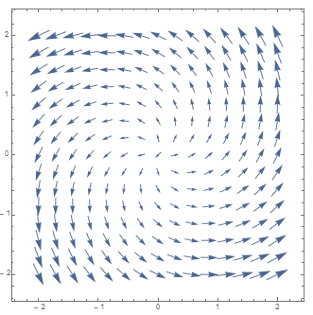
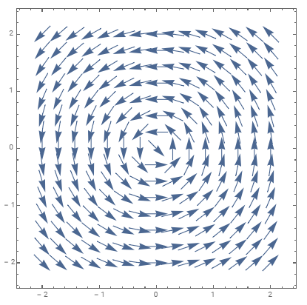
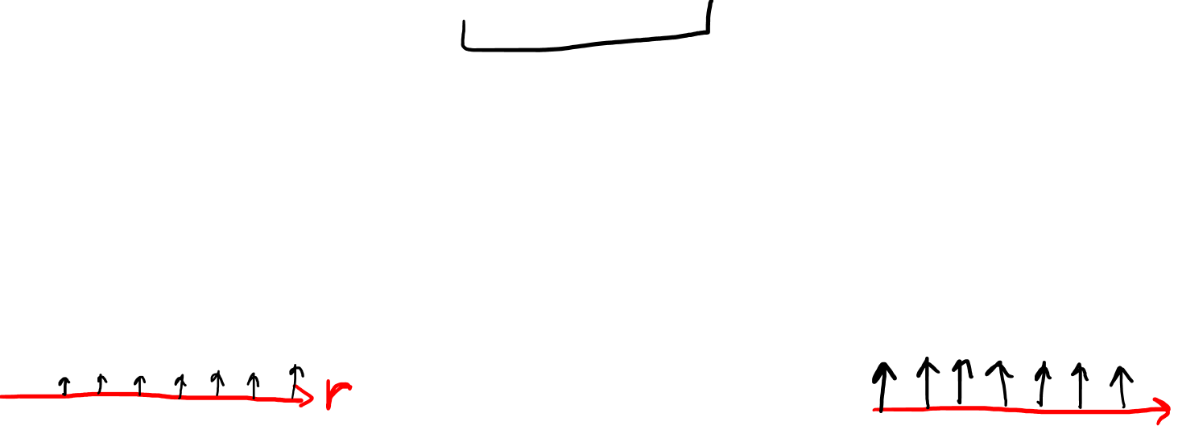
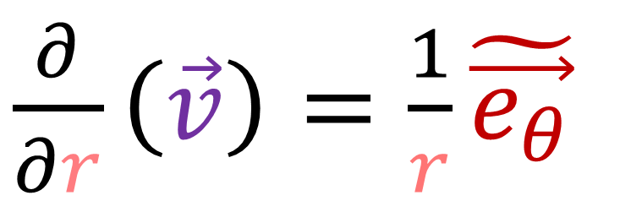
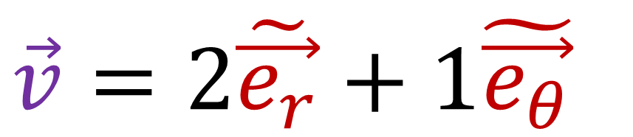
$\frac{∂}{∂r}\left(\vec{v}\right)=\frac{1}{r}\tilde{\vec{e_{θ}}}$
$\vec{v}=2\tilde{\vec{e_{r}}}+1\tilde{\vec{e_{θ}}}$

Slide 5
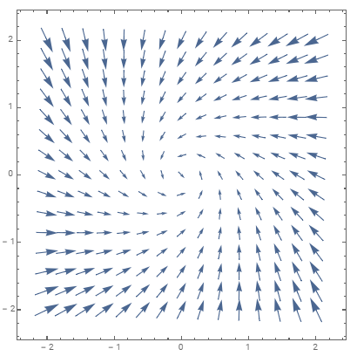

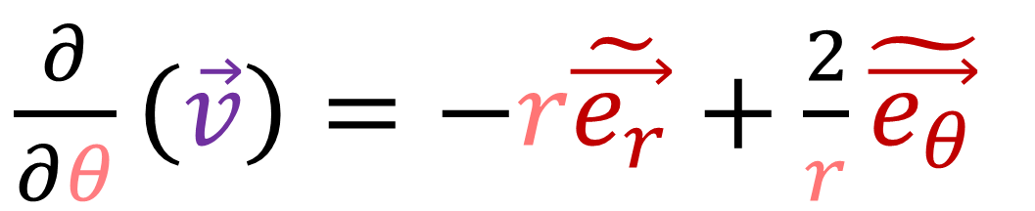
$\vec{v}=2\tilde{\vec{e_{r}}}+1\tilde{\vec{e_{θ}}}$
$\frac{∂}{∂θ}\left(\vec{v}\right)=−r\tilde{\vec{e_{r}}}+\frac{2}{r}\tilde{\vec{e_{θ}}}$

Slide 6
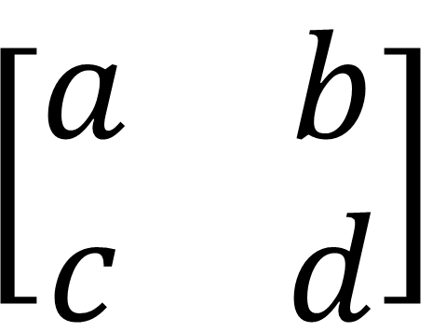
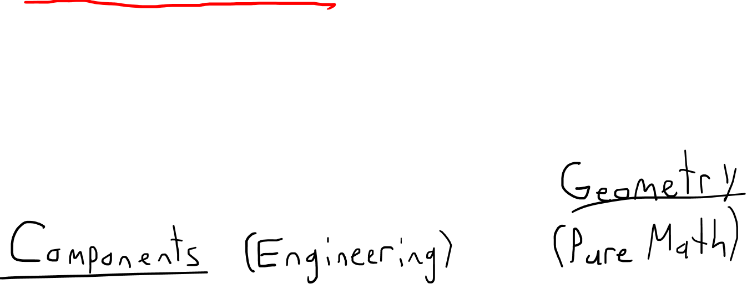
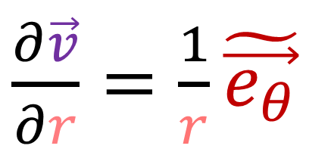
One viewer pointed out…
The covariant derivative is a Vector Field?
The covariant derivative is a rank-2 tensor?
$$\left[\begin{matrix}a & b \\ c & d\end{matrix}\right]$$
$\frac{∂\vec{v}}{∂r}=\frac{1}{r}\tilde{\vec{e_{θ}}}$

Slide 7
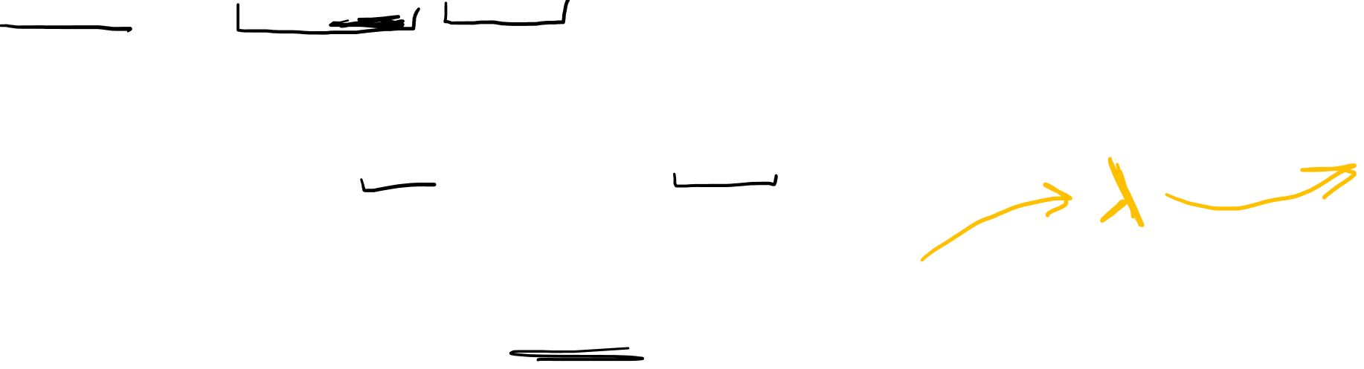
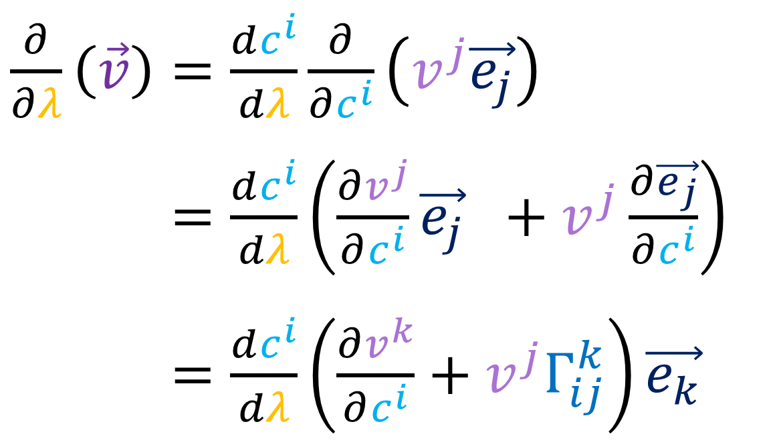

$$\vec{v}$$
$\frac{∂}{∂λ}\left(\vec{v}\right)=\frac{dc^{i}}{dλ}\frac{∂}{∂c^{i}}\left(v^{j}\vec{e_{j}}\right)$
$\frac{∂}{∂λ}\left(\vec{v}\right)=\frac{dc^{i}}{dλ}\left(\frac{∂v^{j}}{∂c^{i}}\vec{e_{j}} +v^{j}\frac{∂\vec{e_{j}}}{∂c^{i}}\right)$
$\frac{∂}{∂λ}\left(\vec{v}\right)=\frac{dc^{i}}{dλ}\left(\frac{∂v^{k}}{∂c^{i}}+v^{j}Γ_{ij}^{k}\right)\vec{e_{k}}$

Slide 8
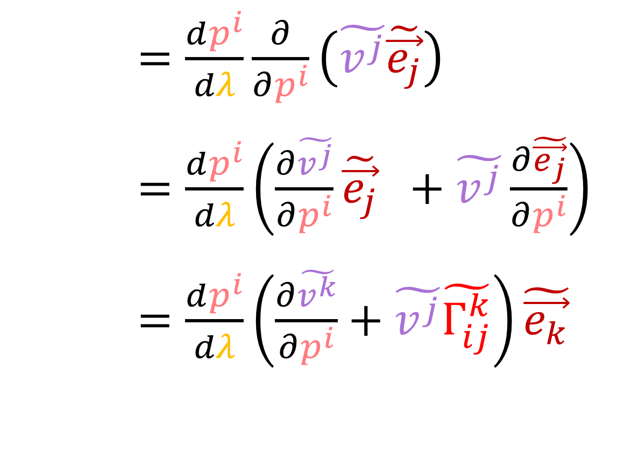
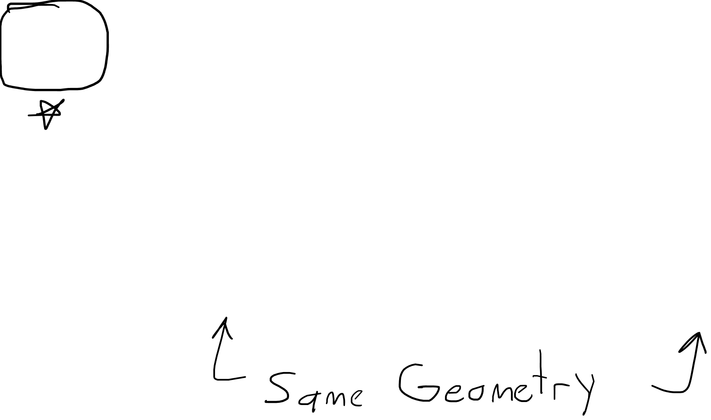
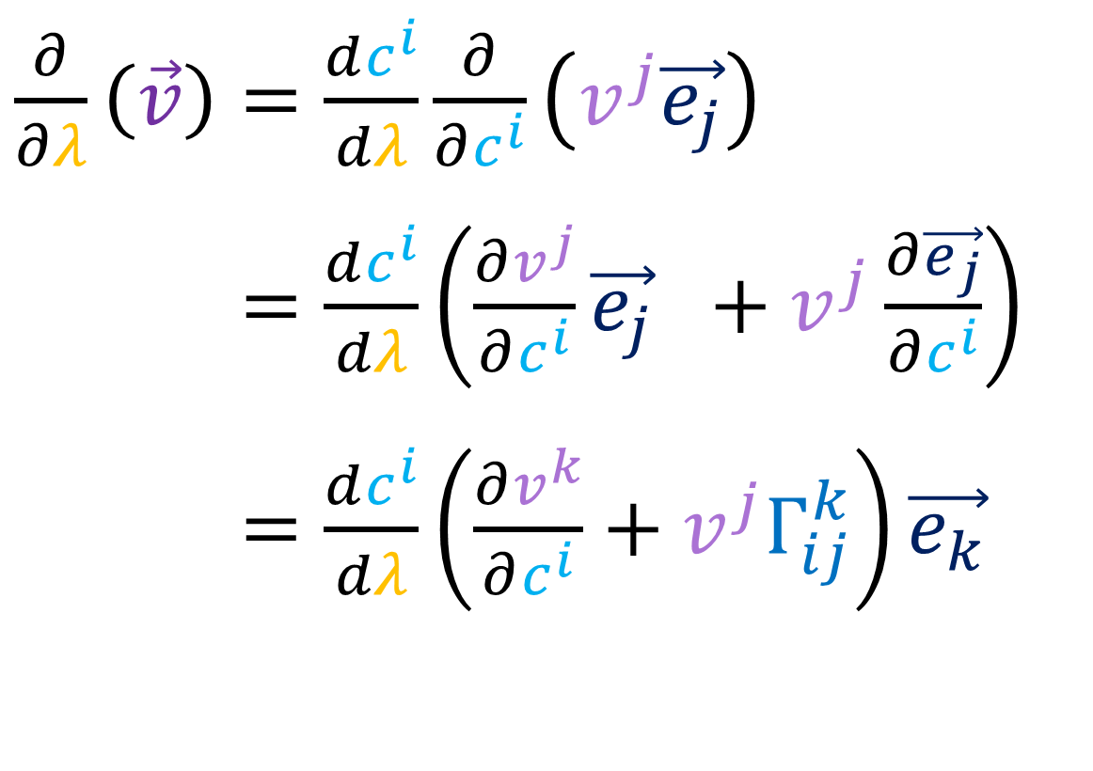
$\frac{∂}{∂λ}\left(\vec{v}\right)=\frac{dp^{i}}{dλ}\frac{∂}{∂p^{i}}\left(\tilde{v^{j}}\tilde{\vec{e_{j}}}\right)$
$\frac{∂}{∂λ}\left(\vec{v}\right)=\frac{dp^{i}}{dλ}\left(\frac{∂\tilde{v^{j}}}{∂p^{i}}\tilde{\vec{e_{j}}} +\tilde{v^{j}}\frac{∂\tilde{\vec{e_{j}}}}{∂p^{i}}\right)$
$\frac{∂}{∂λ}\left(\vec{v}\right)=\frac{dp^{i}}{dλ}\left(\frac{∂\tilde{v^{k}}}{∂p^{i}}+\tilde{v^{j}}\tilde{Γ_{ij}^{k}}\right)\tilde{\vec{e_{k}}}$
$\frac{∂}{∂λ}\left(\vec{v}\right)=\frac{dc^{i}}{dλ}\frac{∂}{∂c^{i}}\left(v^{j}\vec{e_{j}}\right)$
$\frac{∂}{∂λ}\left(\vec{v}\right)=\frac{dc^{i}}{dλ}\left(\frac{∂v^{j}}{∂c^{i}}\vec{e_{j}} +v^{j}\frac{∂\vec{e_{j}}}{∂c^{i}}\right)$
$\frac{∂}{∂λ}\left(\vec{v}\right)=\frac{dc^{i}}{dλ}\left(\frac{∂v^{k}}{∂c^{i}}+v^{j}Γ_{ij}^{k}\right)\vec{e_{k}}$

Slide 9
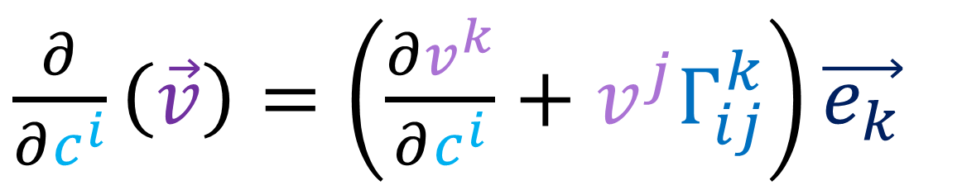

$\frac{∂}{∂c^{i}}\left(\vec{v}\right)=\left(\frac{∂v^{k}}{∂c^{i}}+v^{j}Γ_{ij}^{k}\right)\vec{e_{k}}$

Slide 10
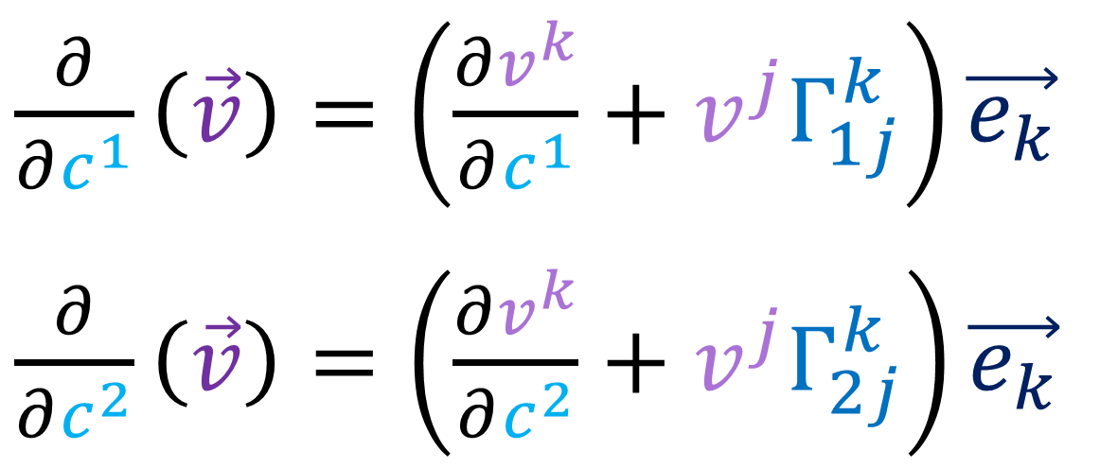
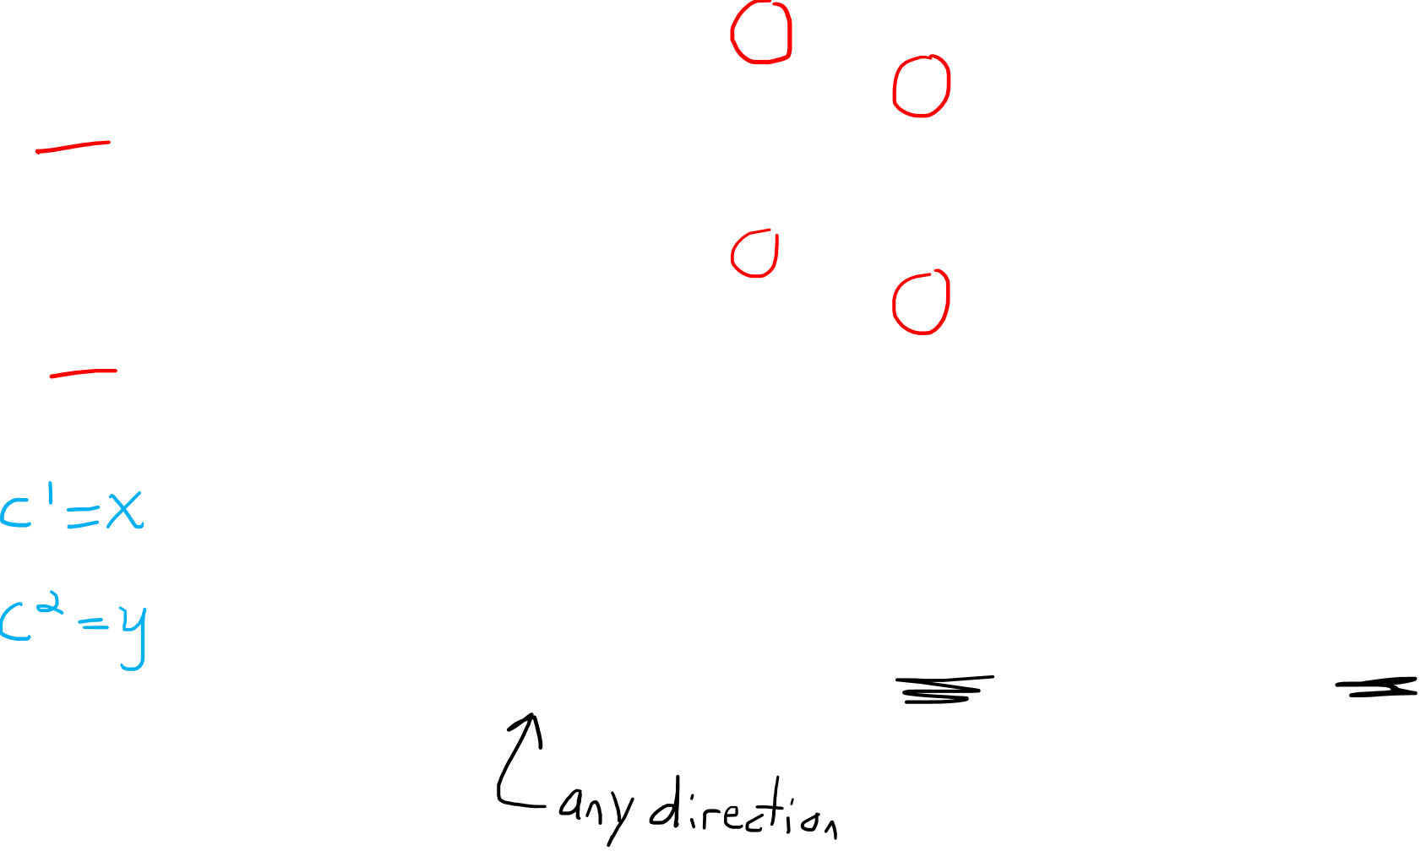
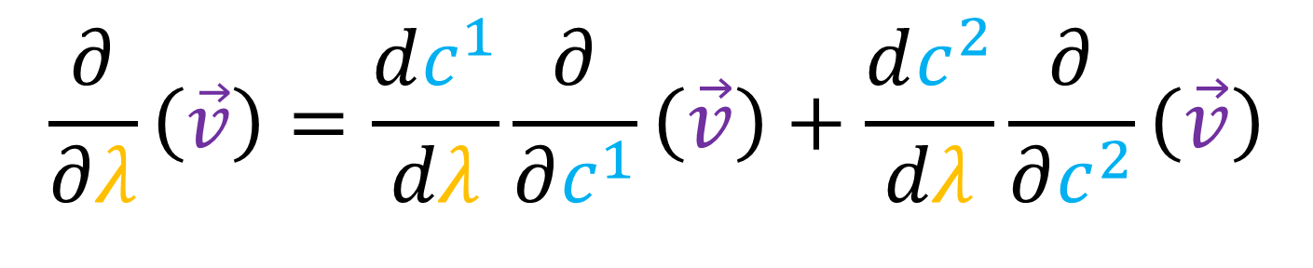
$\frac{∂}{∂c^{1}}\left(\vec{v}\right)=\left(\frac{∂v^{k}}{∂c^{1}}+v^{j}Γ_{1j}^{k}\right)\vec{e_{k}}$
$\frac{∂}{∂c^{2}}\left(\vec{v}\right)=\left(\frac{∂v^{k}}{∂c^{2}}+v^{j}Γ_{2j}^{k}\right)\vec{e_{k}}$
$$\frac{∂}{∂λ}\left(\vec{v}\right)=\frac{dc^{1}}{dλ}\frac{∂}{∂c^{1}}\left(\vec{v}\right)+\frac{dc^{2}}{dλ}\frac{∂}{∂c^{2}}\left(\vec{v}\right)$$

Slide 11
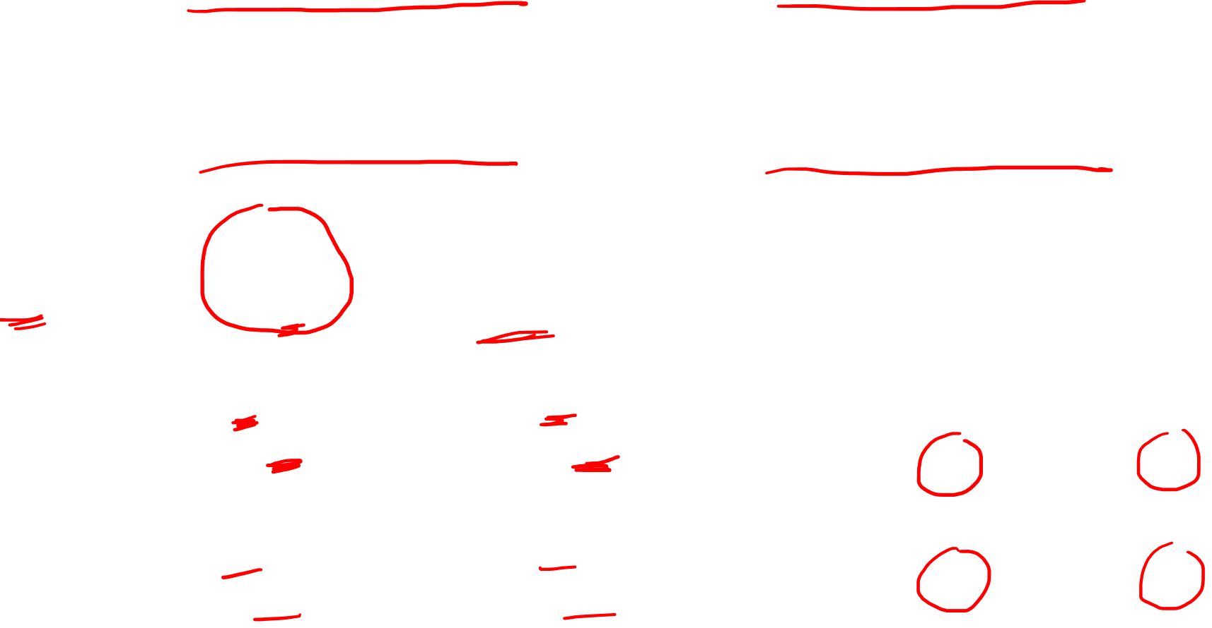
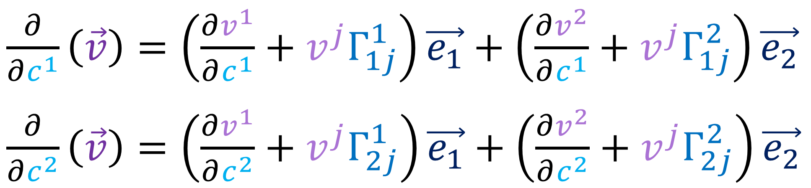
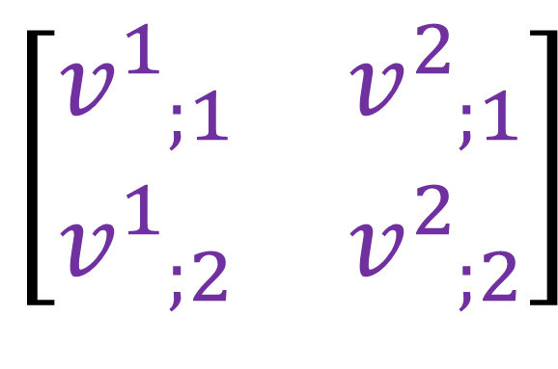
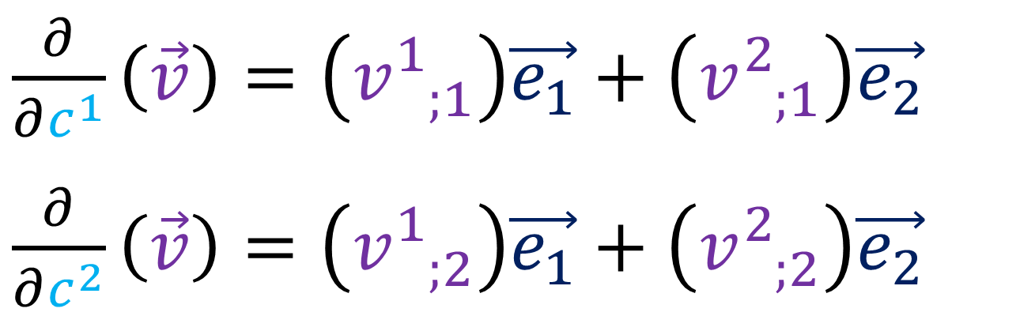

$\frac{∂}{∂c^{1}}\left(\vec{v}\right)=\left(\frac{∂v^{1}}{∂c^{1}}+v^{j}Γ_{1j}^{1}\right)\vec{e_{1}}+\left(\frac{∂v^{2}}{∂c^{1}}+v^{j}Γ_{1j}^{2}\right)\vec{e_{2}}$
$\frac{∂}{∂c^{2}}\left(\vec{v}\right)=\left(\frac{∂v^{1}}{∂c^{2}}+v^{j}Γ_{2j}^{1}\right)\vec{e_{1}}+\left(\frac{∂v^{2}}{∂c^{2}}+v^{j}Γ_{2j}^{2}\right)\vec{e_{2}}$
Engineering Covariant Derivative
$∇_{i}v^{k}=v_{ ;i}^{k}=\left(\frac{∂v^{k}}{∂c^{i}}+v^{j}Γ_{ij}^{k}\right)$
$\frac{∂}{∂c^{1}}\left(\vec{v}\right)=\left(v_{ ;1}^{1}\right)\vec{e_{1}}+\left(v_{ ;1}^{2}\right)\vec{e_{2}}$
$\frac{∂}{∂c^{2}}\left(\vec{v}\right)=\left(v_{ ;2}^{1}\right)\vec{e_{1}}+\left(v_{ ;2}^{2}\right)\vec{e_{2}}$
$$\left[\begin{matrix}v_{ ;1}^{1} & v_{ ;1}^{2} \\ v_{ ;2}^{1} & v_{ ;2}^{2}\end{matrix}\right]$$

Slide 12
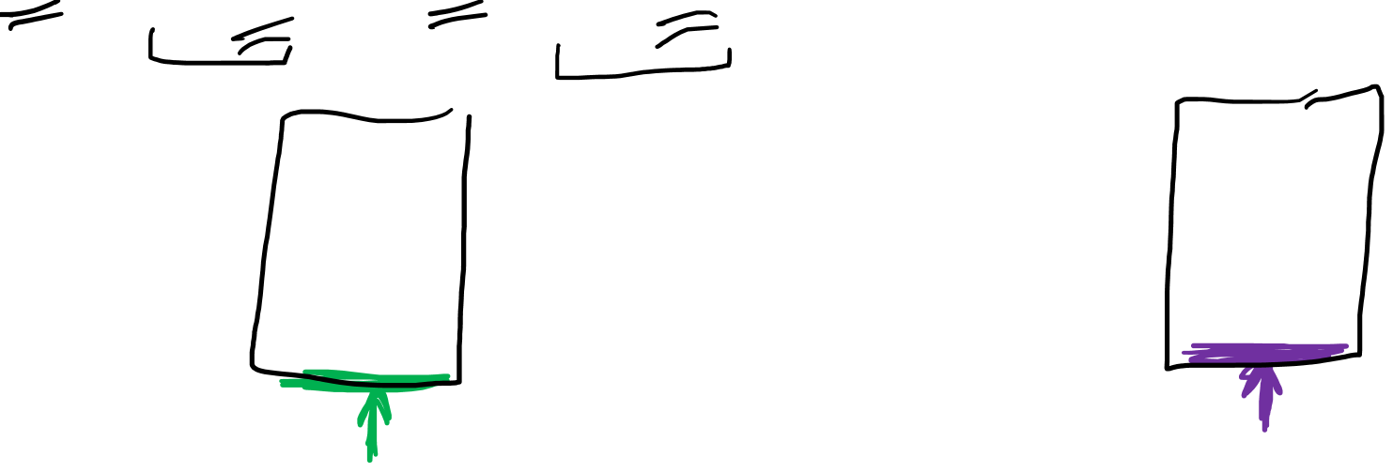
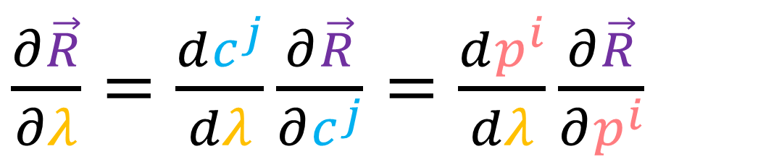
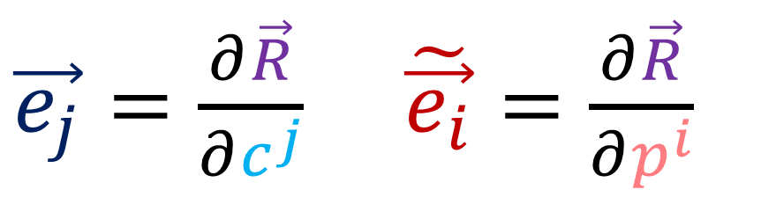
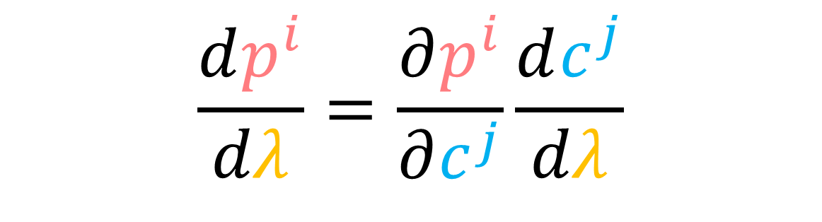
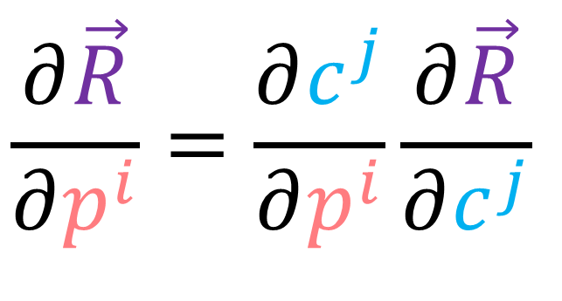
Basis Vector = Covariant
Vector Components = Contravariant
$\vec{e_{j}}=\frac{∂\vec{R}}{∂c^{j}}$ $\tilde{\vec{e_{i}}}=\frac{∂\vec{R}}{∂p^{i}}$
$\frac{∂\vec{R}}{∂λ}=\frac{dc^{j}}{dλ}\frac{∂\vec{R}}{∂c^{j}}=\frac{dp^{i}}{dλ}\frac{∂\vec{R}}{∂p^{i}}$
$$\frac{∂\vec{R}}{∂p^{i}}=\frac{∂c^{j}}{∂p^{i}}\frac{∂\vec{R}}{∂c^{j}}$$
$$\frac{dp^{i}}{dλ}=\frac{∂p^{i}}{∂c^{j}}\frac{dc^{j}}{dλ}$$
Inverse Jacobian Matrix
Jacobian Matrix

Slide 13
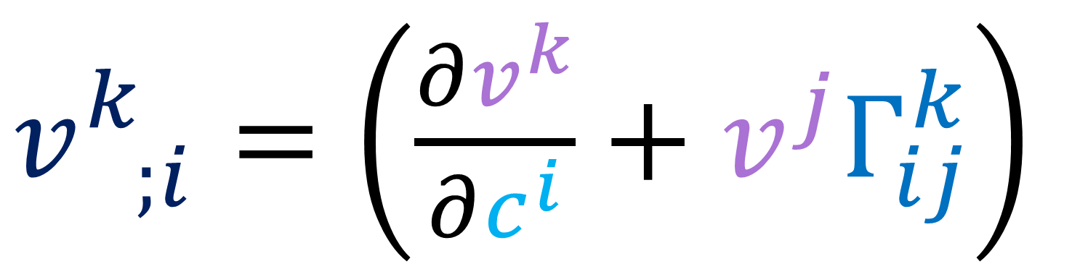
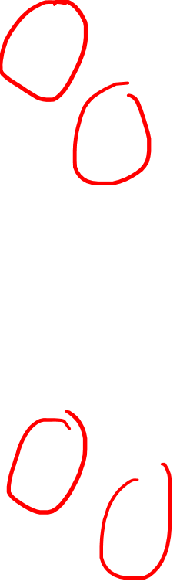
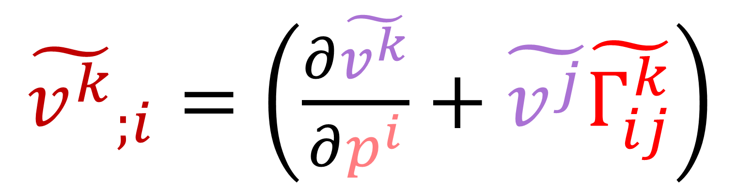
$v_{ ;i}^{k}=\left(\frac{∂v^{k}}{∂c^{i}}+v^{j}Γ_{ij}^{k}\right)$
${\tilde{v^{k}}}_{;i}=\left(\frac{∂\tilde{v^{k}}}{∂p^{i}}+\tilde{v^{j}}\tilde{Γ_{ij}^{k}}\right)$

Slide 14


$\frac{∂c^{i}}{∂p^{a}}\frac{∂p^{n}}{∂c^{i}} \frac{∂\vec{v}}{∂c^{i}}=\frac{∂c^{i}}{∂p^{a}}\left(\frac{∂v^{k}}{∂c^{i}}+v^{j}Γ_{ij}^{k}\right)\vec{e_{k}}$

Slide 15
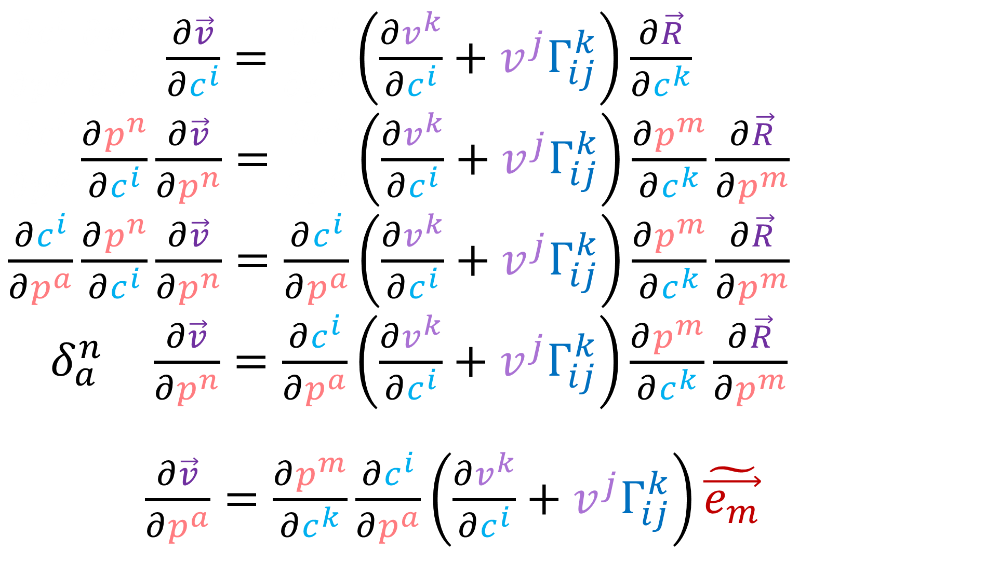
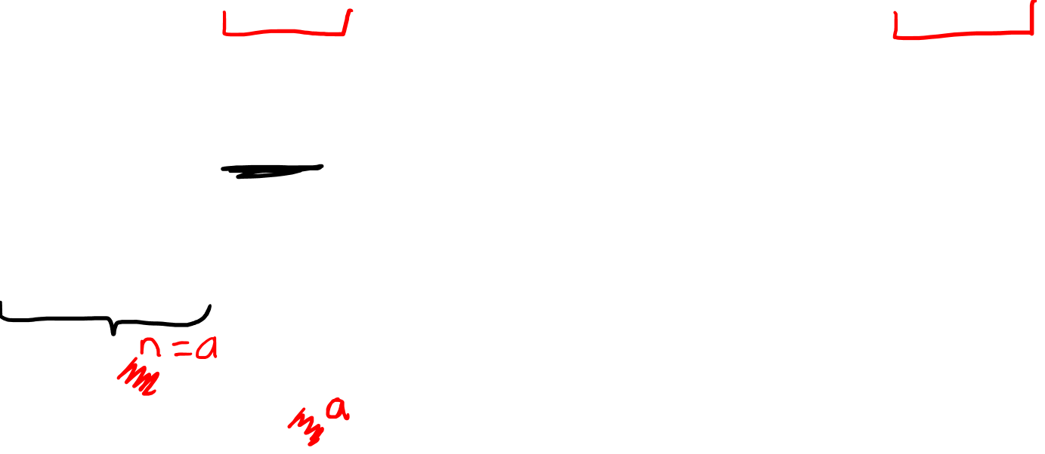
$\frac{∂c^{i}}{∂p^{a}}\frac{∂p^{n}}{∂c^{i}} \frac{∂\vec{v}}{∂c^{i}}=\frac{∂c^{i}}{∂p^{a}}\left(\frac{∂v^{k}}{∂c^{i}}+v^{j}Γ_{ij}^{k}\right)\frac{∂\vec{R}}{∂c^{k}}$
$\frac{∂c^{i}}{∂p^{a}}\frac{∂p^{n}}{∂c^{i}}\frac{∂\vec{v}}{∂p^{n}}=\frac{∂c^{i}}{∂p^{a}}\left(\frac{∂v^{k}}{∂c^{i}}+v^{j}Γ_{ij}^{k}\right)\frac{∂p^{m}}{∂c^{k}}\frac{∂\vec{R}}{∂p^{m}}$
$\frac{∂c^{i}}{∂p^{a}}\frac{∂p^{n}}{∂c^{i}}\frac{∂\vec{v}}{∂p^{n}}=\frac{∂c^{i}}{∂p^{a}}\left(\frac{∂v^{k}}{∂c^{i}}+v^{j}Γ_{ij}^{k}\right)\frac{∂p^{m}}{∂c^{k}}\frac{∂\vec{R}}{∂p^{m}}$
$δ_{a}^{n} \frac{∂\vec{v}}{∂p^{n}}=\frac{∂c^{i}}{∂p^{a}}\left(\frac{∂v^{k}}{∂c^{i}}+v^{j}Γ_{ij}^{k}\right)\frac{∂p^{m}}{∂c^{k}}\frac{∂\vec{R}}{∂p^{m}}$
$\frac{∂\vec{v}}{∂p^{a}}=\frac{∂p^{m}}{∂c^{k}}\frac{∂c^{i}}{∂p^{a}}\left(\frac{∂v^{k}}{∂c^{i}}+v^{j}Γ_{ij}^{k}\right)\tilde{\vec{e_{m}}}$

Slide 16
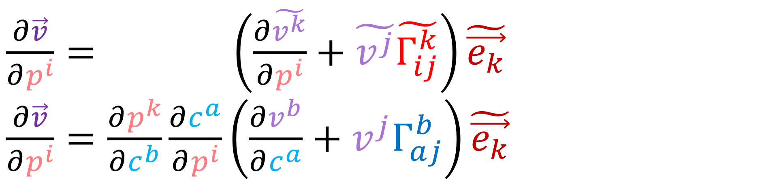
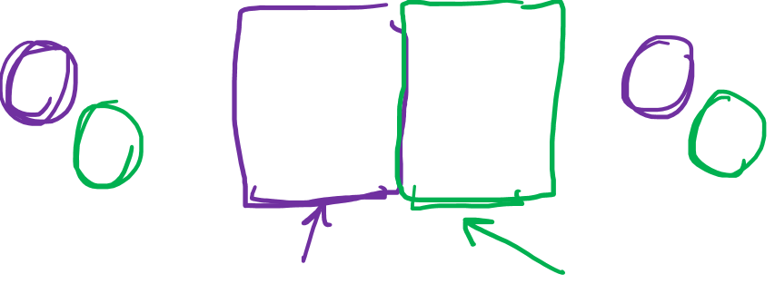

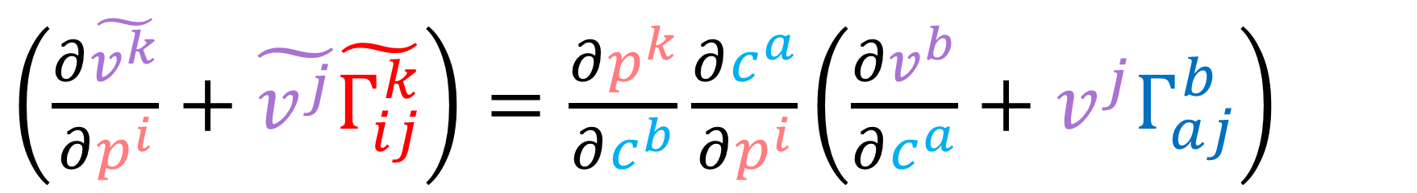
$\frac{∂\vec{v}}{∂p^{i}}= \left(\frac{∂\tilde{v^{k}}}{∂p^{i}}+\tilde{v^{j}}\tilde{Γ_{ij}^{k}}\right)\tilde{\vec{e_{k}}}$
$\frac{∂\vec{v}}{∂p^{i}}=\frac{∂p^{k}}{∂c^{b}}\frac{∂c^{a}}{∂p^{i}}\left(\frac{∂v^{b}}{∂c^{a}}+v^{j}Γ_{aj}^{b}\right)\tilde{\vec{e_{k}}}$
$\left(\frac{∂\tilde{v^{k}}}{∂p^{i}}+\tilde{v^{j}}\tilde{Γ_{ij}^{k}}\right)=\frac{∂p^{k}}{∂c^{b}}\frac{∂c^{a}}{∂p^{i}}\left(\frac{∂v^{b}}{∂c^{a}}+v^{j}Γ_{aj}^{b}\right)$
$\left({\tilde{v^{k}}}_{;i}\right)=\frac{∂p^{k}}{∂c^{b}}\frac{∂c^{a}}{∂p^{i}}\left(v_{ ;a}^{b}\right)$
Inverse Jacobian Matrix
Jacobian Matrix

Slide 17
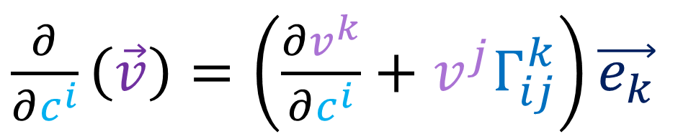
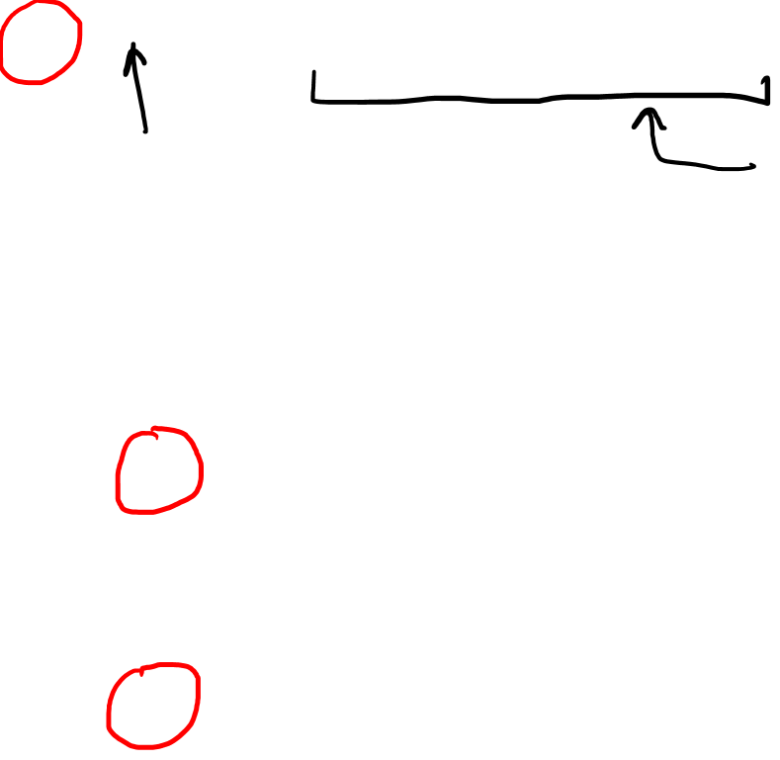
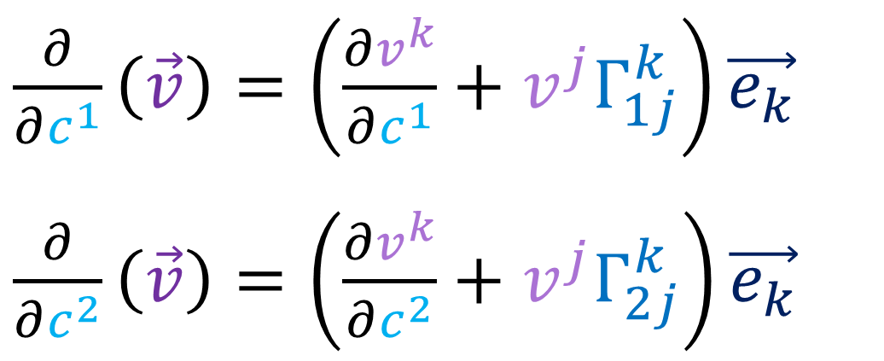
Summary
$\frac{∂}{∂c^{i}}\left(\vec{v}\right)=\left(\frac{∂v^{k}}{∂c^{i}}+v^{j}Γ_{ij}^{k}\right)\vec{e_{k}}$
Vector Field
New Vector Field
$\frac{∂}{∂c^{1}}\left(\vec{v}\right)=\left(\frac{∂v^{k}}{∂c^{1}}+v^{j}Γ_{1j}^{k}\right)\vec{e_{k}}$
$\frac{∂}{∂c^{2}}\left(\vec{v}\right)=\left(\frac{∂v^{k}}{∂c^{2}}+v^{j}Γ_{2j}^{k}\right)\vec{e_{k}}$

Slide 18
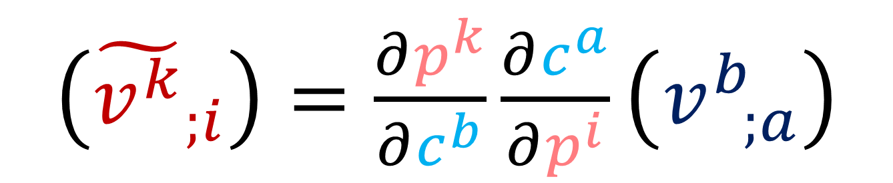
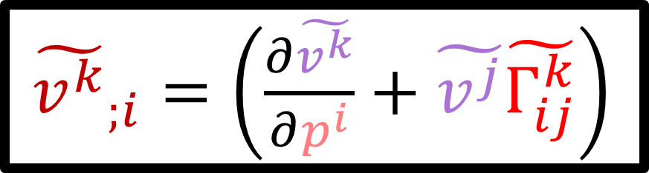
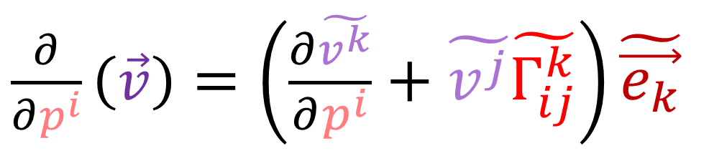
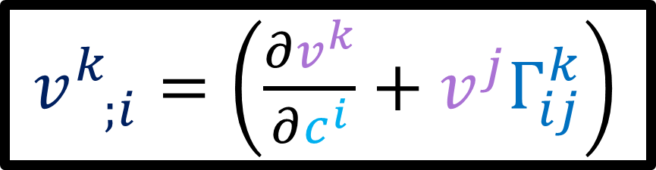
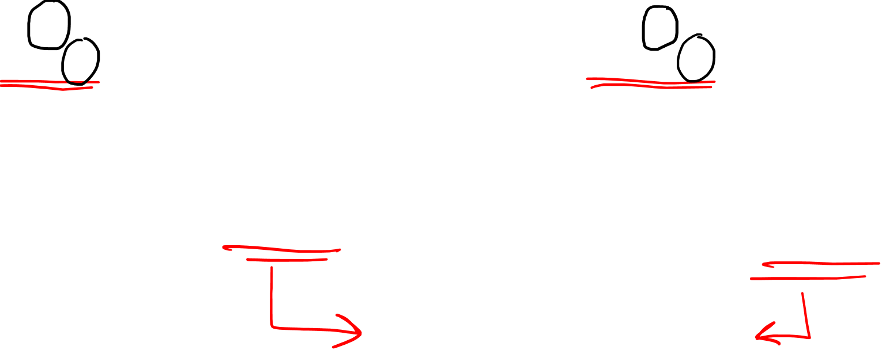
Summary
$\frac{∂}{∂c^{i}}\left(\vec{v}\right)=\left(\frac{∂v^{k}}{∂c^{i}}+v^{j}Γ_{ij}^{k}\right)\vec{e_{k}}$
$\frac{∂}{∂p^{i}}\left(\vec{v}\right)=\left(\frac{∂\tilde{v^{k}}}{∂p^{i}}+\tilde{v^{j}}\tilde{Γ_{ij}^{k}}\right)\tilde{\vec{e_{k}}}$
$v_{ ;i}^{k}=\left(\frac{∂v^{k}}{∂c^{i}}+v^{j}Γ_{ij}^{k}\right)$
${\tilde{v^{k}}}_{;i}=\left(\frac{∂\tilde{v^{k}}}{∂p^{i}}+\tilde{v^{j}}\tilde{Γ_{ij}^{k}}\right)$
$\left({\tilde{v^{k}}}_{;i}\right)=\frac{∂p^{k}}{∂c^{b}}\frac{∂c^{a}}{∂p^{i}}\left(v_{ ;a}^{b}\right)$
(1,1)-Tensor

Slide 19
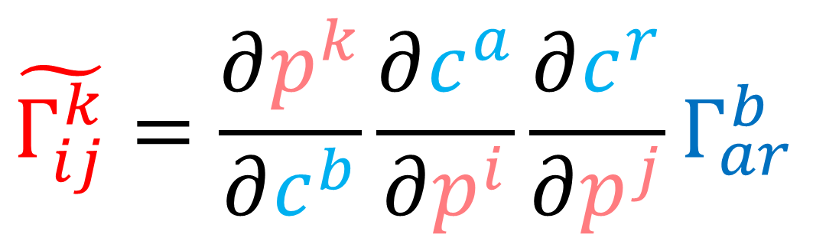
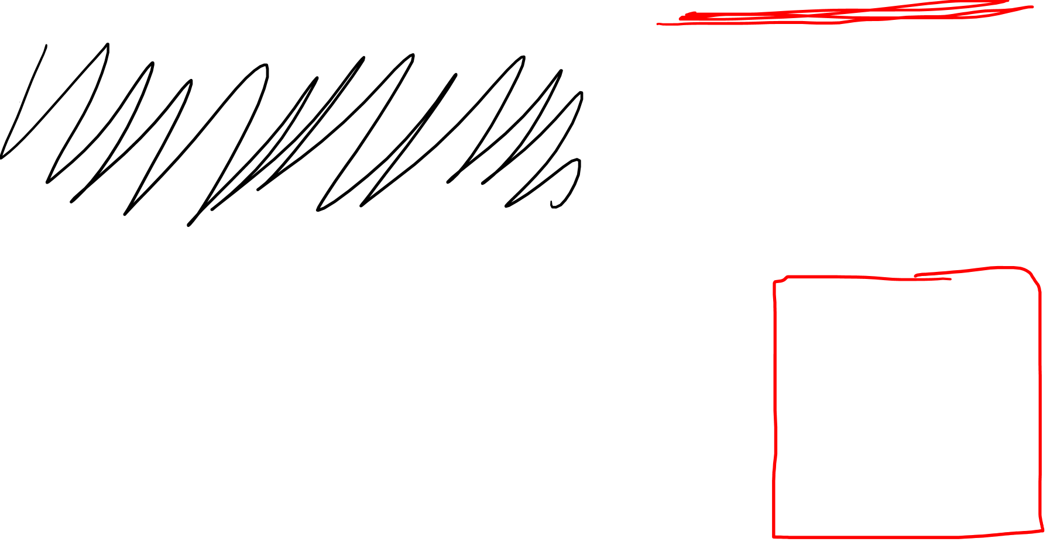
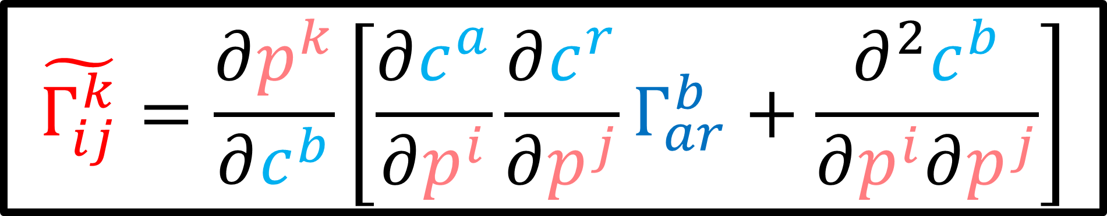

Christoffel Symbols are NOT Tensors!!!
$$\tilde{Γ_{ij}^{k}}=\frac{∂p^{k}}{∂c^{b}}\frac{∂c^{a}}{∂p^{i}}\frac{∂c^{r}}{∂p^{j}}Γ_{ar}^{b}$$
$←$ Not true!
$$\tilde{Γ_{ij}^{k}}=\frac{∂p^{k}}{∂c^{b}}\left[\frac{∂c^{a}}{∂p^{i}}\frac{∂c^{r}}{∂p^{j}}Γ_{ar}^{b}+\frac{∂^{2}c^{b}}{∂p^{i}∂p^{j}}\right]$$

Slide 20



$\frac{∂\vec{v}}{∂p^{i}}= \frac{∂p^{k}}{∂c^{b}}\frac{∂c^{a}}{∂p^{i}}\left( v_{ ;a}^{b} \right) \tilde{\vec{e_{k}}} =\left( {\tilde{v^{k}}}_{;i} \right)\tilde{\vec{e_{k}}}$
$\frac{∂\vec{v}}{∂p^{i}}=\frac{∂p^{k}}{∂c^{b}}\frac{∂c^{a}}{∂p^{i}}\left(\frac{∂}{∂c^{a}}v^{b}+v^{j}Γ_{aj}^{b}\right)\tilde{\vec{e_{k}}}=\left(\frac{∂}{∂p^{i}}\tilde{v^{k}}+\tilde{v^{j}}\tilde{Γ_{ij}^{k}}\right)\tilde{\vec{e_{k}}}$
$\frac{∂p^{k}}{∂c^{b}}\frac{∂c^{a}}{∂p^{i}}\left(\frac{∂}{∂c^{a}}v^{b}+v^{j}Γ_{aj}^{b}\right)$
$\frac{∂p^{k}}{∂c^{b}}\frac{∂c^{a}}{∂p^{i}}\left(\frac{∂p^{m}}{∂c^{a}}\frac{∂}{∂p^{m}}\left(\frac{∂c^{b}}{∂p^{n}}\tilde{v^{n}}\right)+\frac{∂c^{j}}{∂p^{r}}\tilde{v^{r}}Γ_{aj}^{b}\right)$
$$\tilde{v^{m}}=\frac{∂p^{m}}{∂c^{n}}v^{n}$$
$$v^{m}=\frac{∂c^{m}}{∂p^{n}}\tilde{v^{n}}$$
Contravariant

Slide 21


$\frac{∂p^{k}}{∂c^{b}}\frac{∂c^{a}}{∂p^{i}}\left(\frac{∂p^{m}}{∂c^{a}}\frac{∂}{∂p^{m}}\left(\frac{∂c^{b}}{∂p^{n}}\tilde{v^{n}}\right)+\frac{∂c^{j}}{∂p^{r}}\tilde{v^{r}}Γ_{aj}^{b}\right)$
$\frac{∂p^{k}}{∂c^{b}}\frac{∂c^{a}}{∂p^{i}}\left(\frac{∂p^{m}}{∂c^{a}}\left[\frac{∂^{2}c^{b}}{∂p^{m}∂p^{n}}\tilde{v^{n}}+\frac{∂c^{b}}{∂p^{n}}\frac{∂\tilde{v^{n}}}{∂p^{m}}\right]+\frac{∂c^{j}}{∂p^{r}}\tilde{v^{r}}Γ_{aj}^{b}\right)$
$\frac{∂p^{k}}{∂c^{b}}\left(\frac{∂c^{a}}{∂p^{i}}\frac{∂p^{m}}{∂c^{a}}\left[\frac{∂^{2}c^{b}}{∂p^{m}∂p^{n}}\tilde{v^{n}}+\frac{∂c^{b}}{∂p^{n}}\frac{∂\tilde{v^{n}}}{∂p^{m}}\right]+\frac{∂c^{a}}{∂p^{i}}\frac{∂c^{j}}{∂p^{r}}\tilde{v^{r}}Γ_{aj}^{b}\right)$
$\frac{∂p^{k}}{∂c^{b}}\left(δ_{i}^{m}\left[\frac{∂^{2}c^{b}}{∂p^{m}∂p^{n}}\tilde{v^{n}}+\frac{∂c^{b}}{∂p^{n}}\frac{∂\tilde{v^{n}}}{∂p^{m}}\right]+\frac{∂c^{a}}{∂p^{i}}\frac{∂c^{j}}{∂p^{r}}\tilde{v^{r}}Γ_{aj}^{b}\right)$
$\frac{∂p^{k}}{∂c^{b}}\left(\left[\frac{∂^{2}c^{b}}{∂p^{i}∂p^{n}}\tilde{v^{n}}+\frac{∂c^{b}}{∂p^{n}}\frac{∂\tilde{v^{n}}}{∂p^{i}}\right]+\frac{∂c^{a}}{∂p^{i}}\frac{∂c^{j}}{∂p^{r}}\tilde{v^{r}}Γ_{aj}^{b}\right)$

Slide 22


$\frac{∂p^{k}}{∂c^{b}}\left(\left[\frac{∂^{2}c^{b}}{∂p^{i}∂p^{n}}\tilde{v^{n}}+\frac{∂c^{b}}{∂p^{n}}\frac{∂\tilde{v^{n}}}{∂p^{i}}\right]+\frac{∂c^{a}}{∂p^{i}}\frac{∂c^{j}}{∂p^{r}}\tilde{v^{r}}Γ_{aj}^{b}\right)$
$\left(\frac{∂p^{k}}{∂c^{b}}\frac{∂^{2}c^{b}}{∂p^{i}∂p^{n}}\tilde{v^{n}}+\frac{∂p^{k}}{∂c^{b}}\frac{∂c^{b}}{∂p^{n}}\frac{∂\tilde{v^{n}}}{∂p^{i}}+\frac{∂p^{k}}{∂c^{b}}\frac{∂c^{a}}{∂p^{i}}\frac{∂c^{j}}{∂p^{r}}\tilde{v^{r}}Γ_{aj}^{b}\right)$
$\left(\frac{∂p^{k}}{∂c^{b}}\frac{∂^{2}c^{b}}{∂p^{i}∂p^{n}}\tilde{v^{n}}+δ_{n}^{k}\frac{∂\tilde{v^{n}}}{∂p^{i}}+\frac{∂p^{k}}{∂c^{b}}\frac{∂c^{a}}{∂p^{i}}\frac{∂c^{j}}{∂p^{r}}\tilde{v^{r}}Γ_{aj}^{b}\right)$
$\left(\frac{∂p^{k}}{∂c^{b}}\frac{∂^{2}c^{b}}{∂p^{i}∂p^{r}}\tilde{v^{r}}+\frac{∂\tilde{v^{k}}}{∂p^{i}}+\frac{∂p^{k}}{∂c^{b}}\frac{∂c^{a}}{∂p^{i}}\frac{∂c^{j}}{∂p^{r}}\tilde{v^{r}}Γ_{aj}^{b}\right)$
$\left(\frac{∂\tilde{v^{k}}}{∂p^{i}}+\tilde{v^{r}}\frac{∂p^{k}}{∂c^{b}}\left[\frac{∂c^{a}}{∂p^{i}}\frac{∂c^{j}}{∂p^{r}}Γ_{aj}^{b}+\frac{∂^{2}c^{b}}{∂p^{i}∂p^{r}}\right]\right)$

Slide 23



$\frac{∂\vec{v}}{∂p^{i}}=\frac{∂p^{k}}{∂c^{b}}\frac{∂c^{a}}{∂p^{i}}\left( v_{ ;a}^{b} \right)\tilde{\vec{e_{k}}}=\left( {\tilde{v^{k}}}_{;i} \right)\tilde{\vec{e_{k}}}$
$\frac{∂p^{k}}{∂c^{b}}\frac{∂c^{a}}{∂p^{i}}\left(\frac{∂v^{b}}{∂c^{a}}+v^{j}Γ_{aj}^{b}\right)\tilde{\vec{e_{k}}}=\left(\frac{∂\tilde{v^{k}}}{∂p^{i}}+\tilde{v^{j}}\tilde{Γ_{ij}^{k}}\right)\tilde{\vec{e_{k}}}$
$\left(\frac{∂\tilde{v^{k}}}{∂p^{i}}+\tilde{v^{r}}\frac{∂p^{k}}{∂c^{b}}\left[\frac{∂c^{a}}{∂p^{i}}\frac{∂c^{j}}{∂p^{r}}Γ_{aj}^{b}+\frac{∂^{2}c^{b}}{∂p^{i}∂p^{r}}\right]\right)\tilde{\vec{e_{k}}}=\left(\frac{∂\tilde{v^{k}}}{∂p^{i}}+\tilde{v^{j}}\tilde{Γ_{ij}^{k}}\right)\tilde{\vec{e_{k}}}$
$\left(\frac{∂\tilde{v^{k}}}{∂p^{i}}+\tilde{v^{j}}\frac{∂p^{k}}{∂c^{b}}\left[\frac{∂c^{a}}{∂p^{i}}\frac{∂c^{r}}{∂p^{j}}Γ_{ar}^{b}+\frac{∂^{2}c^{b}}{∂p^{i}∂p^{j}}\right]\right)\tilde{\vec{e_{k}}}=\left(\frac{∂\tilde{v^{k}}}{∂p^{i}}+\tilde{v^{j}}\tilde{Γ_{ij}^{k}}\right)\tilde{\vec{e_{k}}}$
$$\tilde{Γ_{ij}^{k}}=\frac{∂p^{k}}{∂c^{b}}\left[\frac{∂c^{a}}{∂p^{i}}\frac{∂c^{r}}{∂p^{j}}Γ_{ar}^{b}+\frac{∂^{2}c^{b}}{∂p^{i}∂p^{j}}\right]$$

Slide 24



$$\tilde{Γ_{ij}^{k}}=\frac{∂p^{k}}{∂c^{b}}\left[\frac{∂c^{a}}{∂p^{i}}\frac{∂c^{r}}{∂p^{j}}Γ_{ar}^{b}+\frac{∂^{2}c^{b}}{∂p^{i}∂p^{j}}\right]$$
$$\tilde{Γ_{ij}^{k}}=\frac{∂p^{k}}{∂c^{b}}\frac{∂c^{a}}{∂p^{i}}\frac{∂c^{r}}{∂p^{j}}Γ_{ar}^{b}+\frac{∂p^{k}}{∂c^{b}}\frac{∂^{2}c^{b}}{∂p^{i}∂p^{j}}$$
$Γ≠Γ_{ar}^{b}$ $\left(\vec{e_{b}}⊗ε^{a}⊗ε^{r}\right)≠\tilde{Γ_{ij}^{k}}$ $\left(\tilde{\vec{e_{b}}}⊗\tilde{ε^{a}}⊗\tilde{ε^{r}}\right)$

Slide 25



Summary
$\frac{∂}{∂c^{i}}\left(\vec{v}\right)=\left(\frac{∂v^{k}}{∂c^{i}}+v^{j}Γ_{ij}^{k}\right)\vec{e_{k}}$
$\frac{∂}{∂p^{i}}\left(\vec{v}\right)=\left(\frac{∂\tilde{v^{k}}}{∂p^{i}}+\tilde{v^{j}}\tilde{Γ_{ij}^{k}}\right)\tilde{\vec{e_{k}}}$
$v_{ ;i}^{k}=\left(\frac{∂v^{k}}{∂c^{i}}+v^{j}Γ_{ij}^{k}\right)$
${\tilde{v^{k}}}_{;i}=\left(\frac{∂\tilde{v^{k}}}{∂p^{i}}+\tilde{v^{j}}\tilde{Γ_{ij}^{k}}\right)$
$\left({\tilde{v^{k}}}_{;i}\right)=\frac{∂p^{k}}{∂c^{b}}\frac{∂c^{a}}{∂p^{i}}\left(v_{ ;a}^{b}\right)$
$\tilde{Γ_{ij}^{k}}=\frac{∂p^{k}}{∂c^{b}}\left[\frac{∂c^{a}}{∂p^{i}}\frac{∂c^{r}}{∂p^{j}}Γ_{ar}^{b}+\frac{∂^{2}c^{b}}{∂p^{i}∂p^{j}}\right]$

