Slide 1
Covariant Derivative (Flat Space Definition)
(Also see: Videos 15 & 16 on Geodesics)
(Links in the description)

Slide 2
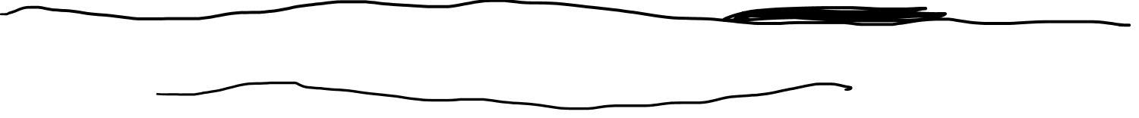
One-Sentence Definition
Covariant Derivative = understanding the rate of change of vector (tensor) fields that takes changing basis vectors into account
Problem: different sources define the covariant derivative in different ways

Slide 3
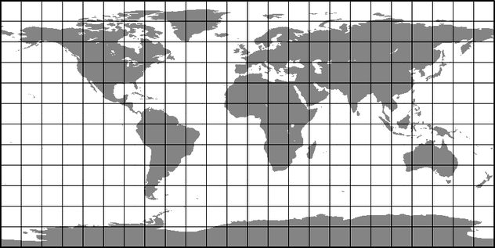




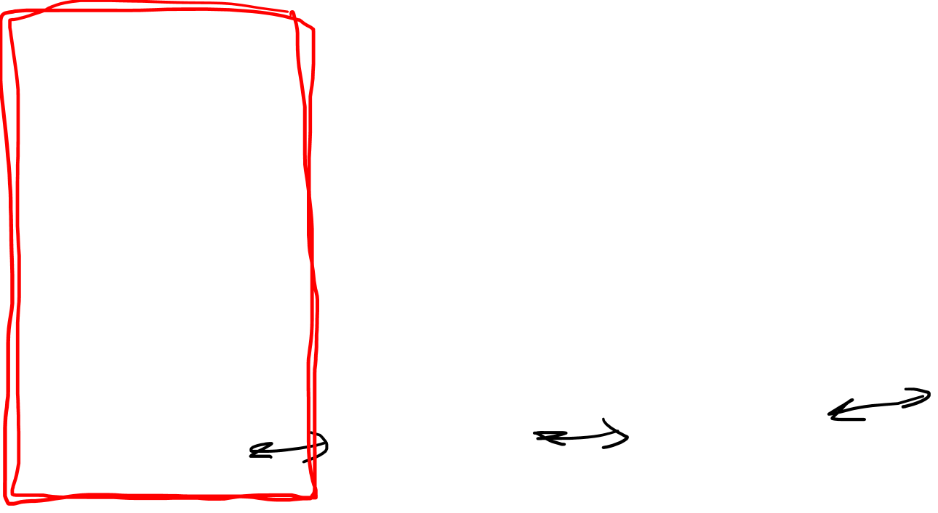
Definitions of Covariant Derivative
$$∇_{\vec{w}}\vec{v}$$
Abstract Definition
$$y$$
Curved-Space (Intrinsic) Definition
$$x$$
Curved-Space (Extrinsic)
Definition
Flat-Space Definition
Easiest
(Least Powerful)
Hardest
(Most Powerful)

Slide 4



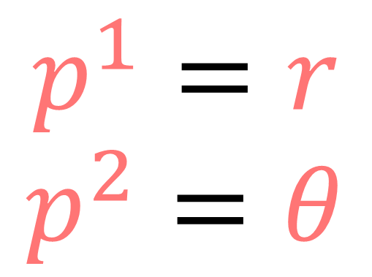
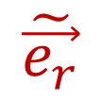



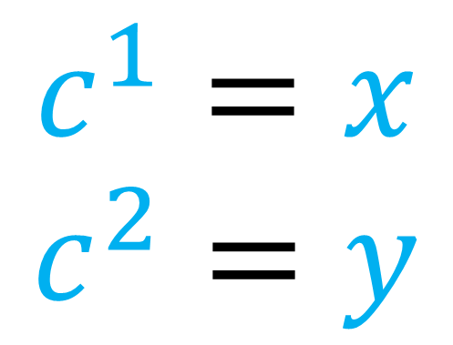

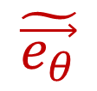

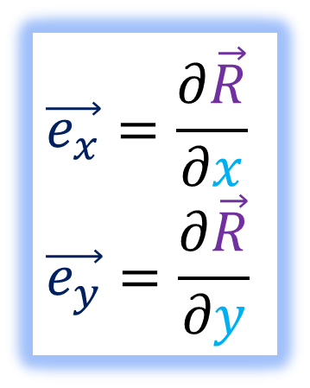



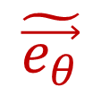
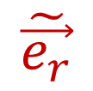


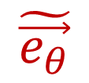
$$y$$
$$\vec{e_{y}}$$
$$\tilde{\vec{e_{r}}}$$
$$\vec{e_{x}}=\frac{∂\vec{R}}{∂x}$$
$$\vec{e_{y}}=\frac{∂\vec{R}}{∂y}$$
$$\tilde{\vec{e_{θ}}}$$
$$\vec{e_{x}}$$
$$\tilde{\vec{e_{r}}}=\frac{∂\vec{R}}{∂r}$$
$$\tilde{\vec{e_{θ}}}=\frac{∂\vec{R}}{∂θ}$$
$$\vec{e_{y}}$$
$$θ$$
$$\vec{e_{x}}$$
$$\vec{e_{y}}$$
$$\tilde{\vec{e_{r}}}$$
$$x$$
$$\tilde{\vec{e_{θ}}}$$
$$r$$
$$\vec{e_{x}}$$
$$\tilde{\vec{e_{θ}}}$$
$$\tilde{\vec{e_{r}}}$$
$$c^{1}=x$$
$$c^{2}=y$$
$$p^{1}=r$$
$$p^{2}=θ$$

Slide 5
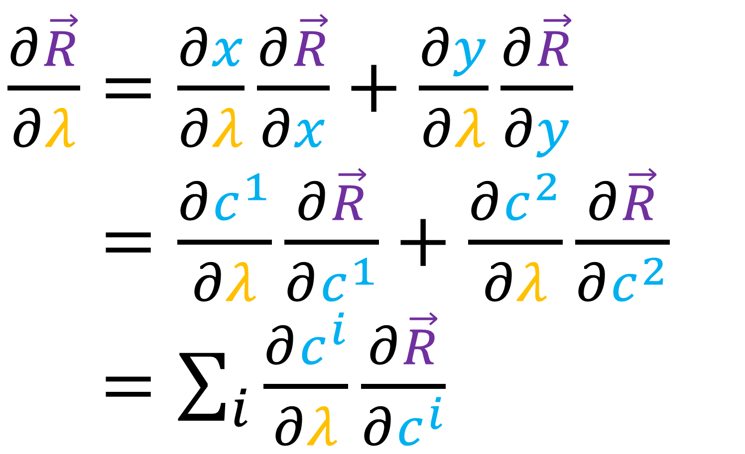
$\frac{∂\vec{R}}{∂λ}=\frac{∂x}{∂λ}\frac{∂\vec{R}}{∂x}+\frac{∂y}{∂λ}\frac{∂\vec{R}}{∂y}$
$\frac{∂\vec{R}}{∂λ}=\frac{∂c^{1}}{∂λ}\frac{∂\vec{R}}{∂c^{1}}+\frac{∂c^{2}}{∂λ}\frac{∂\vec{R}}{∂c^{2}}$
$\frac{∂\vec{R}}{∂λ}=\sum_{i}{\frac{∂c^{i}}{∂λ}\frac{∂\vec{R}}{∂c^{i}}}$

Slide 6
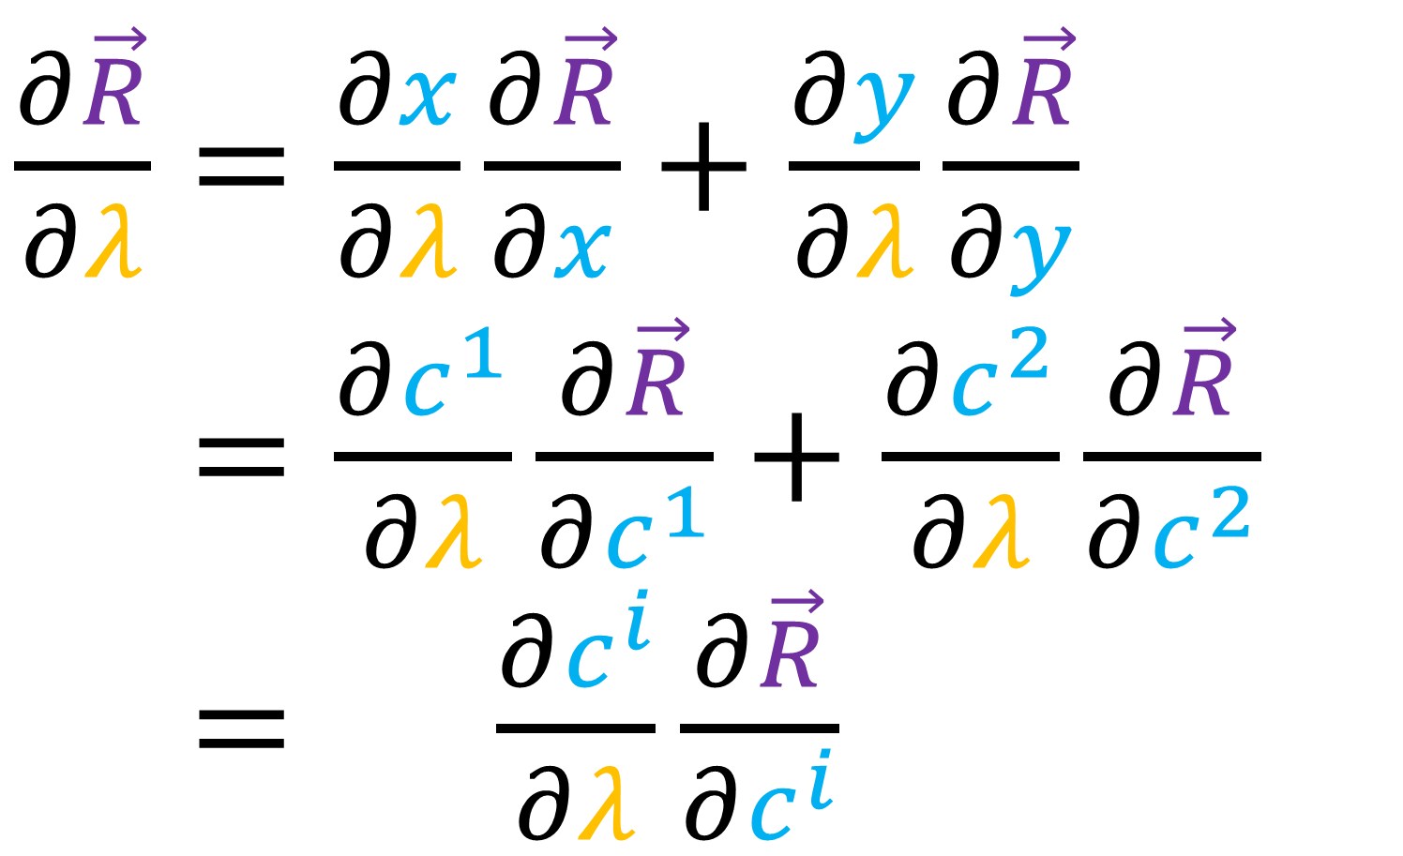

$\frac{∂\vec{R}}{∂λ}=\frac{∂x}{∂λ}\frac{∂\vec{R}}{∂x}+\frac{∂y}{∂λ}\frac{∂\vec{R}}{∂y}$
$\frac{∂\vec{R}}{∂λ}=\frac{∂c^{1}}{∂λ}\frac{∂\vec{R}}{∂c^{1}}+\frac{∂c^{2}}{∂λ}\frac{∂\vec{R}}{∂c^{2}}$
$\frac{∂\vec{R}}{∂λ}=\sum_{i}{\frac{∂c^{i}}{∂λ}\frac{∂\vec{R}}{∂c^{i}}}$

Slide 7
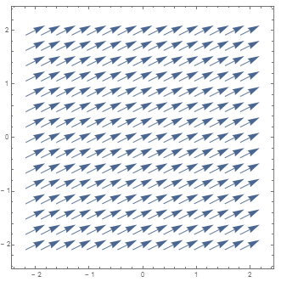
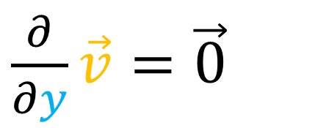
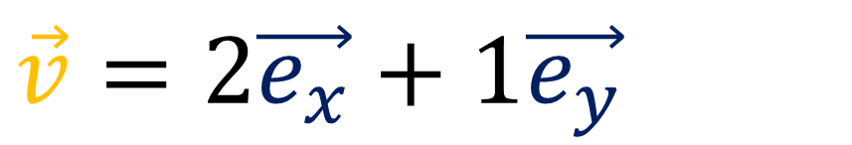
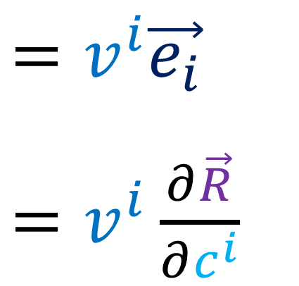
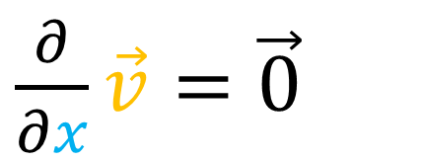
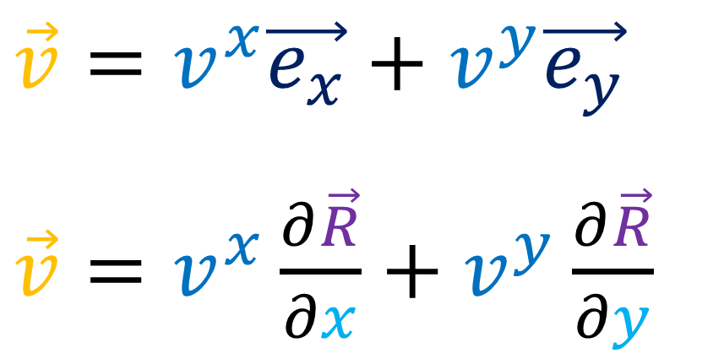
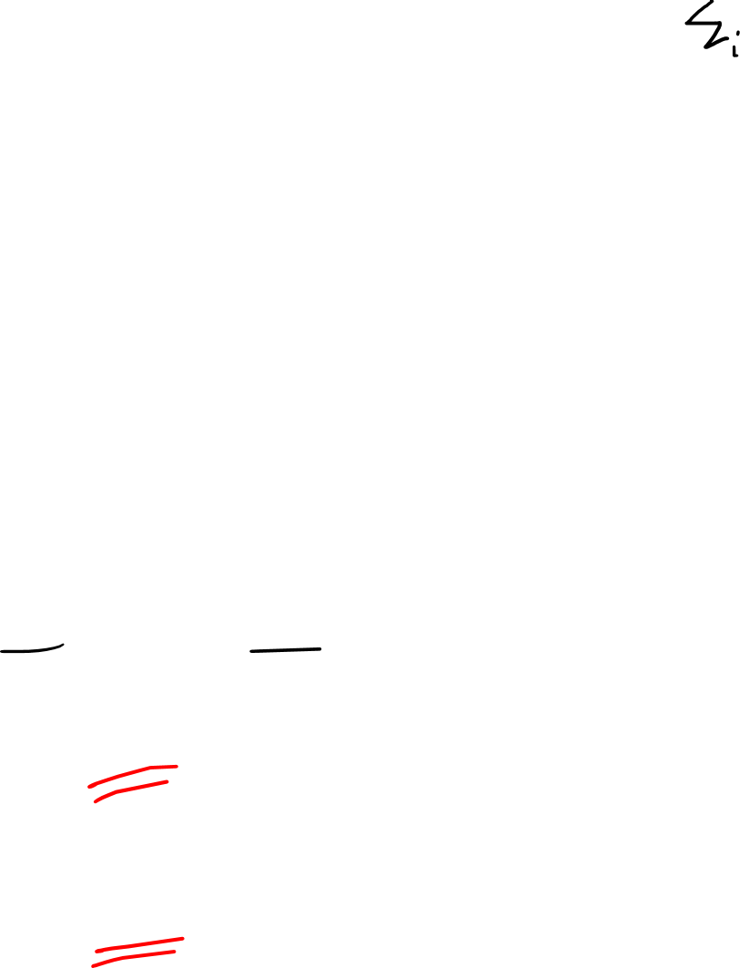
$$y$$
$$\vec{e_{y}}$$
$$\vec{v}=v^{x}\vec{e_{x}}+v^{y}\vec{e_{y}}$$
$\vec{v}=v^{x}\frac{∂\vec{R}}{∂x}+v^{y}\frac{∂\vec{R}}{∂y}$
$$=v^{i}\vec{e_{i}}$$
$=v^{i}\frac{∂\vec{R}}{∂c^{i}}$
$$\vec{e_{y}}$$
$$\vec{e_{x}}$$
$$\vec{e_{x}}$$
$$\vec{e_{y}}$$
$$x$$
$$\vec{e_{x}}$$
$$\vec{v}=2\vec{e_{x}}+1\vec{e_{y}}$$
$\frac{∂}{∂x}\vec{v}=\vec{0}$
$\frac{∂}{∂y}\vec{v}=\vec{0}$

Slide 8
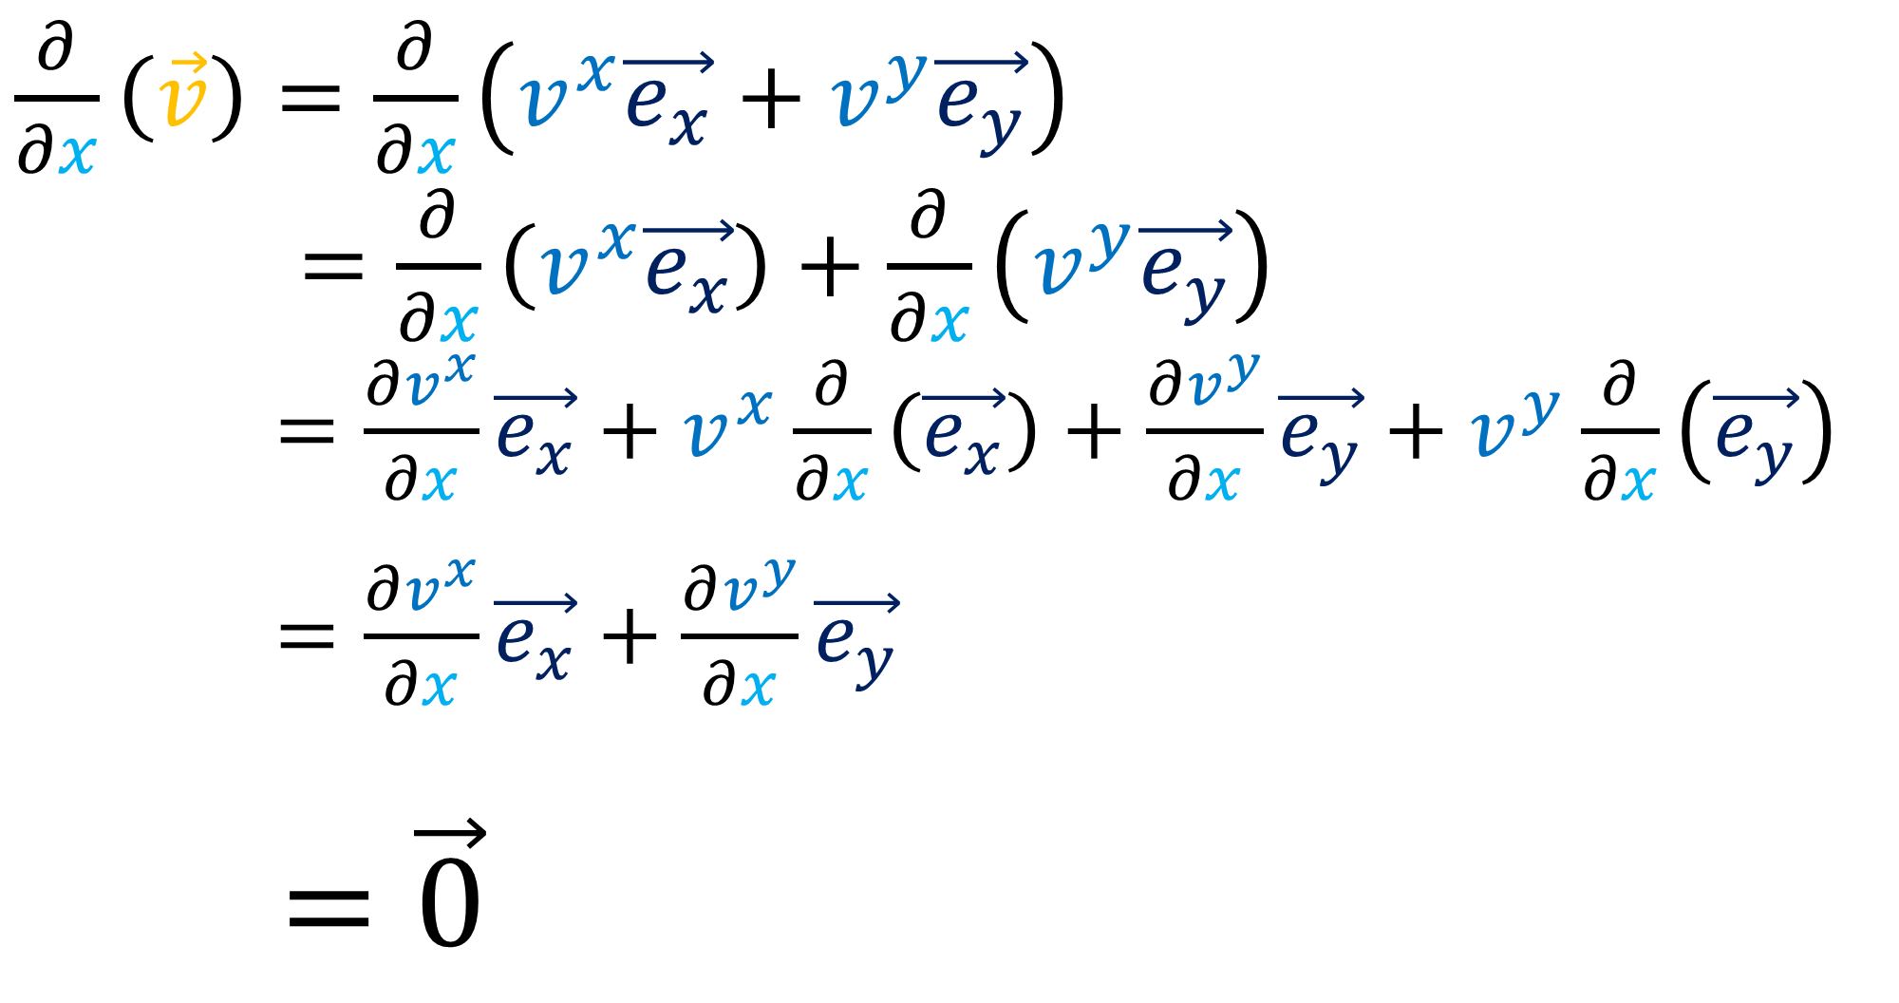





$$y$$
$$\vec{e_{y}}$$
$\frac{∂}{∂x}\left(\vec{v}\right)=\frac{∂}{∂x}\left(v^{x}\vec{e_{x}}+v^{y}\vec{e_{y}}\right)$
$\frac{d}{dθ}\left(\vec{w}\right)=\frac{∂}{∂x}\left(v^{x}\vec{e_{x}}\right)+\frac{∂}{∂x}\left(v^{y}\vec{e_{y}}\right)$
$\frac{d}{dθ}\left(\vec{w}\right)=\frac{∂v^{x}}{∂x}\vec{e_{x}}+v^{x}\frac{∂}{∂x}\left(\vec{e_{x}}\right)+\frac{∂v^{y}}{∂x}\vec{e_{y}}+v^{y}\frac{∂}{∂x}\left(\vec{e_{y}}\right)$
$\frac{d}{dθ}\left(\vec{w}\right)=\frac{∂v^{x}}{∂x}\vec{e_{x}}+\frac{∂v^{y}}{∂x}\vec{e_{y}}$
$\frac{d}{dθ}\left(\vec{w}\right)$ $=\vec{0}$
$$\vec{e_{y}}$$
$$\vec{e_{x}}$$
$$\vec{e_{x}}$$
$$\vec{e_{y}}$$
$$x$$
$$\vec{e_{x}}$$
$$\vec{v}=2\vec{e_{x}}+1\vec{e_{y}}$$
$v^{x}$ $=2$
$v^{y}$ $=1$

Slide 9
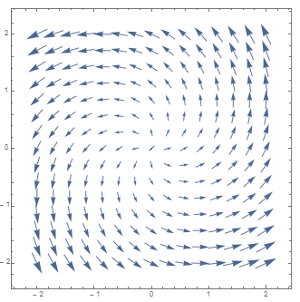

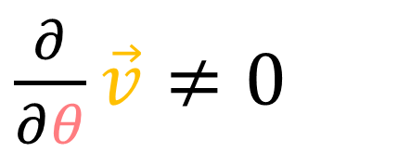
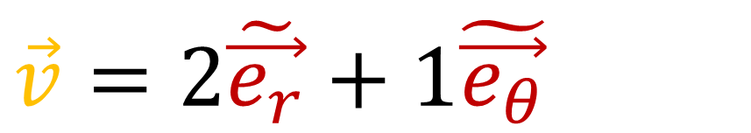
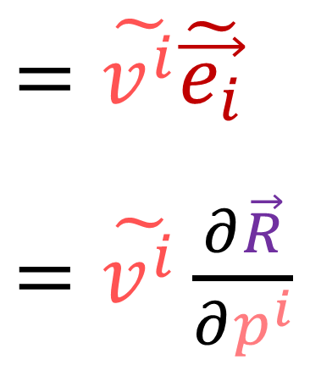
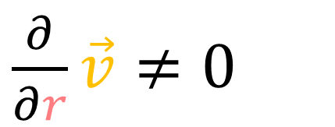
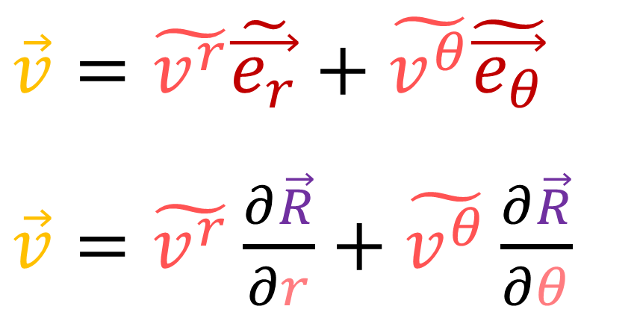
$$\vec{v}=\tilde{v^{r}}\tilde{\vec{e_{r}}}+\tilde{v^{θ}}\tilde{\vec{e_{θ}}}$$
$\vec{v}=\tilde{v^{r}}\frac{∂\vec{R}}{∂r}+\tilde{v^{θ}}\frac{∂\vec{R}}{∂θ}$
$$=\tilde{v^{i}}\tilde{\vec{e_{i}}}$$
$=\tilde{v^{i}}\frac{∂\vec{R}}{∂p^{i}}$
$$\tilde{\vec{e_{r}}}$$
$$\tilde{\vec{e_{θ}}}$$
$$θ$$
$$\tilde{\vec{e_{r}}}$$
$$\tilde{\vec{e_{θ}}}$$
$$r$$
$$\tilde{\vec{e_{θ}}}$$
$$\tilde{\vec{e_{r}}}$$
$\vec{v}=2\tilde{\vec{e_{r}}}+1\tilde{\vec{e_{θ}}}$
$\frac{∂}{∂r}\vec{v}≠0$
$\frac{∂}{∂θ}\vec{v}≠0$

Slide 10
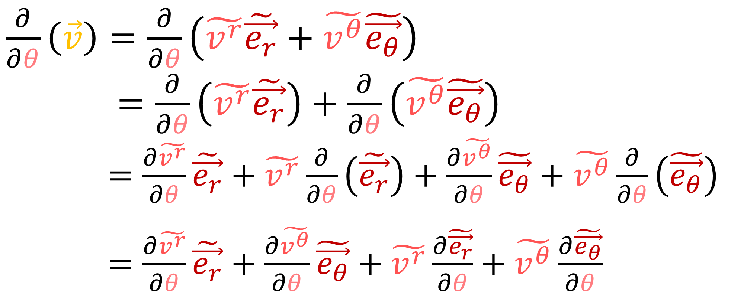

$$\tilde{\vec{e_{r}}}$$
$$\tilde{\vec{e_{θ}}}$$
$\frac{∂}{∂θ}\left(\vec{v}\right)=\frac{∂}{∂θ}\left(\tilde{v^{r}}\tilde{\vec{e_{r}}}+\tilde{v^{θ}}\tilde{\vec{e_{θ}}}\right)$
$\frac{d}{dθ}\left(\vec{w}\right)=\frac{∂}{∂θ}\left(\tilde{v^{r}}\tilde{\vec{e_{r}}}\right)+\frac{∂}{∂θ}\left(\tilde{v^{θ}}\tilde{\vec{e_{θ}}}\right)$
$\frac{d}{dθ}\left(\vec{w}\right)=\frac{∂\tilde{v^{r}}}{∂θ}\tilde{\vec{e_{r}}}+\tilde{v^{r}}\frac{∂}{∂θ}\left(\tilde{\vec{e_{r}}}\right)+\frac{∂\tilde{v^{θ}}}{∂θ}\tilde{\vec{e_{θ}}}+\tilde{v^{θ}}\frac{∂}{∂θ}\left(\tilde{\vec{e_{θ}}}\right)$
$\frac{d}{dθ}\left(\vec{w}\right)=\frac{∂\tilde{v^{r}}}{∂θ}\tilde{\vec{e_{r}}}+\frac{∂\tilde{v^{θ}}}{∂θ}\tilde{\vec{e_{θ}}}+\tilde{v^{r}}\frac{∂\tilde{\vec{e_{r}}}}{∂θ}+\tilde{v^{θ}}\frac{∂\tilde{\vec{e_{θ}}}}{∂θ}$
$$θ$$
$$\tilde{\vec{e_{r}}}$$
$$\tilde{\vec{e_{θ}}}$$
$$r$$
$$\tilde{\vec{e_{θ}}}$$
$$\tilde{\vec{e_{r}}}$$

Slide 11
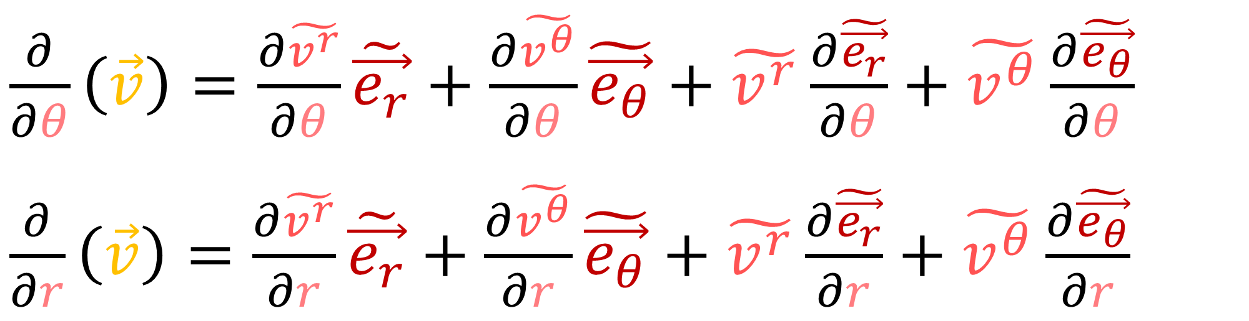

$\frac{∂}{∂θ}\left(\vec{v}\right)=\frac{∂\tilde{v^{r}}}{∂θ}\tilde{\vec{e_{r}}}+\frac{∂\tilde{v^{θ}}}{∂θ}\tilde{\vec{e_{θ}}}+\tilde{v^{r}}\frac{∂\tilde{\vec{e_{r}}}}{∂θ}+\tilde{v^{θ}}\frac{∂\tilde{\vec{e_{θ}}}}{∂θ}$
$\frac{∂}{∂r}\left(\vec{v}\right)=\frac{∂\tilde{v^{r}}}{∂r}\tilde{\vec{e_{r}}}+\frac{∂\tilde{v^{θ}}}{∂r}\tilde{\vec{e_{θ}}}+\tilde{v^{r}}\frac{∂\tilde{\vec{e_{r}}}}{∂r}+\tilde{v^{θ}}\frac{∂\tilde{\vec{e_{θ}}}}{∂r}$

Slide 12


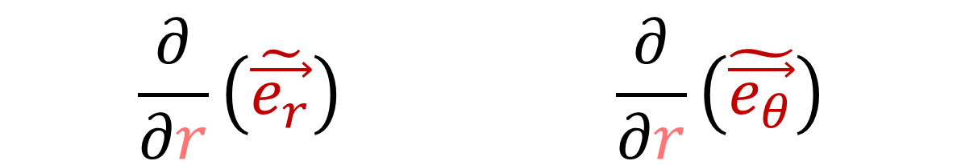








$$\frac{∂}{∂r}\left(\tilde{\vec{e_{r}}}\right)$$ | $$\frac{∂}{∂r}\left(\tilde{\vec{e_{θ}}}\right)$$
$$\vec{e_{θ}}$$
$$\vec{e_{θ}}$$
$$θ$$
$$\vec{e_{θ}}$$
$$\vec{e_{θ}}$$
$$r$$
$$\vec{e_{r}}$$
$$\vec{e_{r}}$$
$$\vec{e_{r}}$$
$$\vec{e_{r}}$$

Slide 13


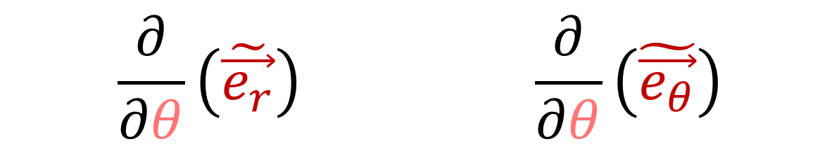



$$\frac{∂}{∂θ}\left(\tilde{\vec{e_{r}}}\right)$$ | $$\frac{∂}{∂θ}\left(\tilde{\vec{e_{θ}}}\right)$$
$$\vec{e_{θ}}$$
$$θ$$
$$\vec{e_{θ}}$$
$$\vec{e_{r}}$$
$$r$$
$$\vec{e_{r}}$$

Slide 14
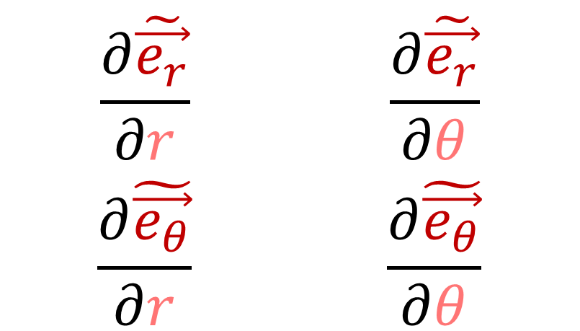
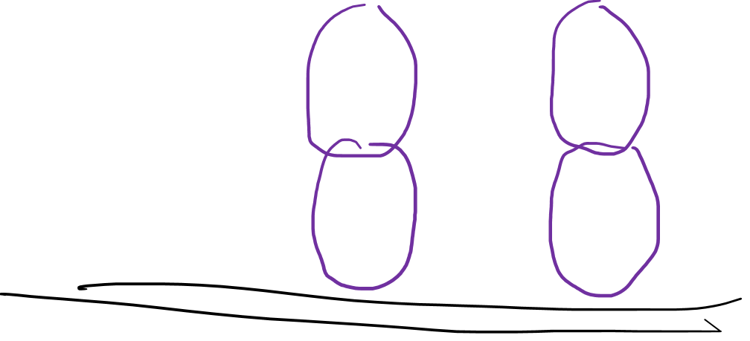
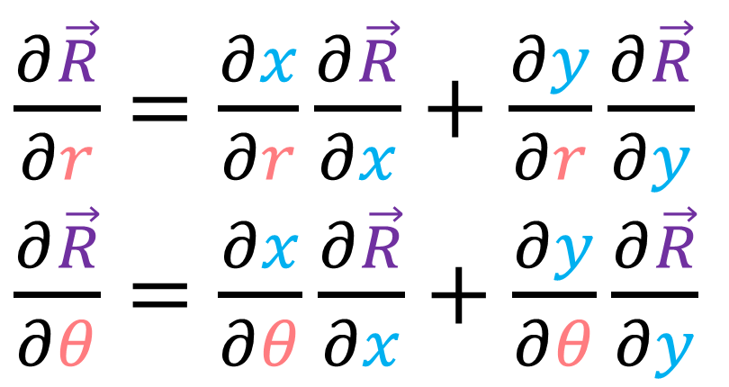
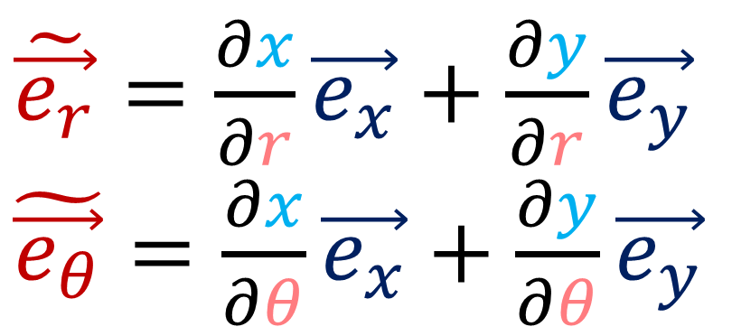
$$\frac{∂\tilde{\vec{e_{r}}}}{∂r}$$ | $$\frac{∂\tilde{\vec{e_{r}}}}{∂θ}$$
$$\frac{∂\tilde{\vec{e_{θ}}}}{∂r}$$ | $$\frac{∂\tilde{\vec{e_{θ}}}}{∂θ}$$
$\frac{∂\vec{R}}{∂r}=\frac{∂x}{∂r}\frac{∂\vec{R}}{∂x}+\frac{∂y}{∂r}\frac{∂\vec{R}}{∂y}$
$\frac{∂\vec{R}}{∂θ}=\frac{∂x}{∂θ}\frac{∂\vec{R}}{∂x}+\frac{∂y}{∂θ}\frac{∂\vec{R}}{∂y}$
$\tilde{\vec{e_{r}}}=\frac{∂x}{∂r}\vec{e_{x}}+\frac{∂y}{∂r}\vec{e_{y}}$
$\tilde{\vec{e_{θ}}}=\frac{∂x}{∂θ}\vec{e_{x}}+\frac{∂y}{∂θ}\vec{e_{y}}$

Slide 15





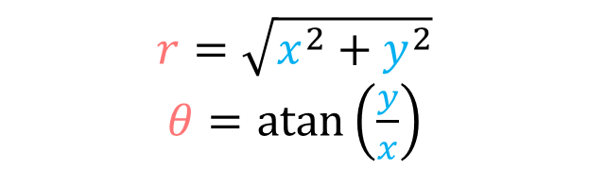
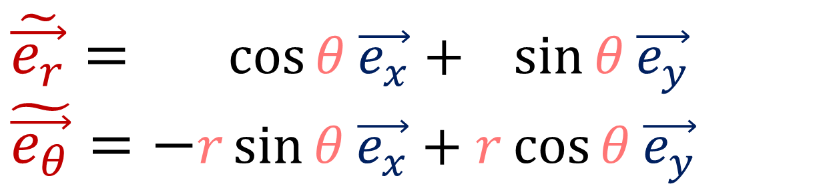
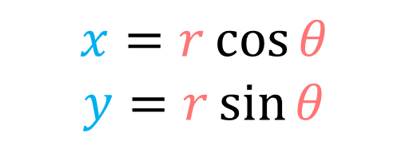



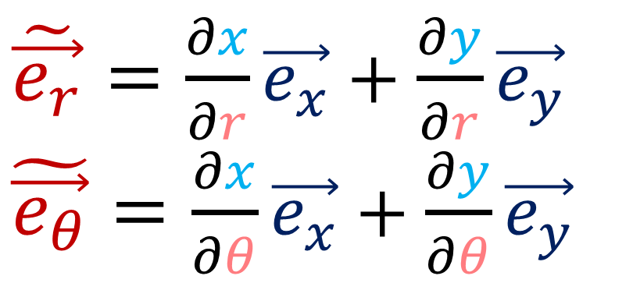







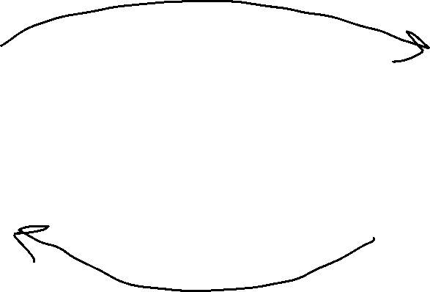
$$y$$
$$r=\sqrt{x^{2}+y^{2}}$$
$θ=atan\left(\frac{y}{x}\right)$
$$θ$$
$$\vec{e_{y}}$$
$$r$$
$$y$$
$$r$$
$$y$$
$$θ$$
$$x$$
$$θ$$
$$x$$
$$\vec{e_{x}}$$
$$x$$
$$r$$
$$x=r\cos{θ}$$
$$y=r\sin{θ}$$
$\tilde{\vec{e_{r}}}=\frac{∂x}{∂r}\vec{e_{x}}+\frac{∂y}{∂r}\vec{e_{y}}$
$\tilde{\vec{e_{θ}}}=\frac{∂x}{∂θ}\vec{e_{x}}+\frac{∂y}{∂θ}\vec{e_{y}}$
$\tilde{\vec{e_{r}}}= \cos{θ}\vec{e_{x}}+ \sin{θ}\vec{e_{y}}$
$\tilde{\vec{e_{θ}}}=−r\sin{θ}\vec{e_{x}}+r\cos{θ}\vec{e_{y}}$

Slide 16
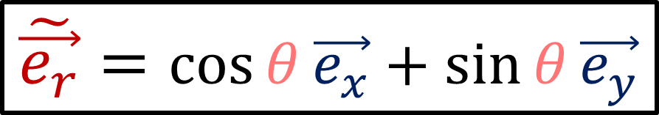
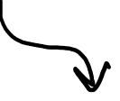
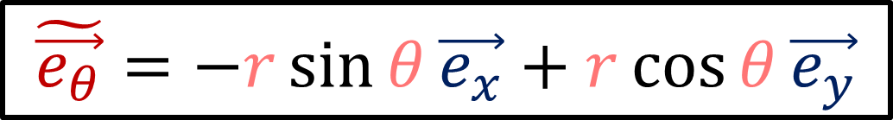
$$\tilde{\vec{e_{r}}}=\cos{θ}\vec{e_{x}}+\sin{θ}\vec{e_{y}}$$
$$\tilde{\vec{e_{θ}}}=−r\sin{θ}\vec{e_{x}}+r\cos{θ}\vec{e_{y}}$$
$\frac{∂}{∂r}\left(\tilde{\vec{e_{r}}}\right)$

Slide 17
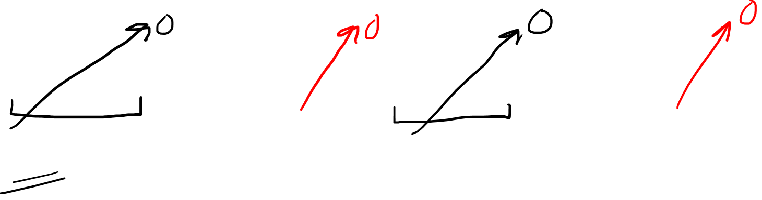
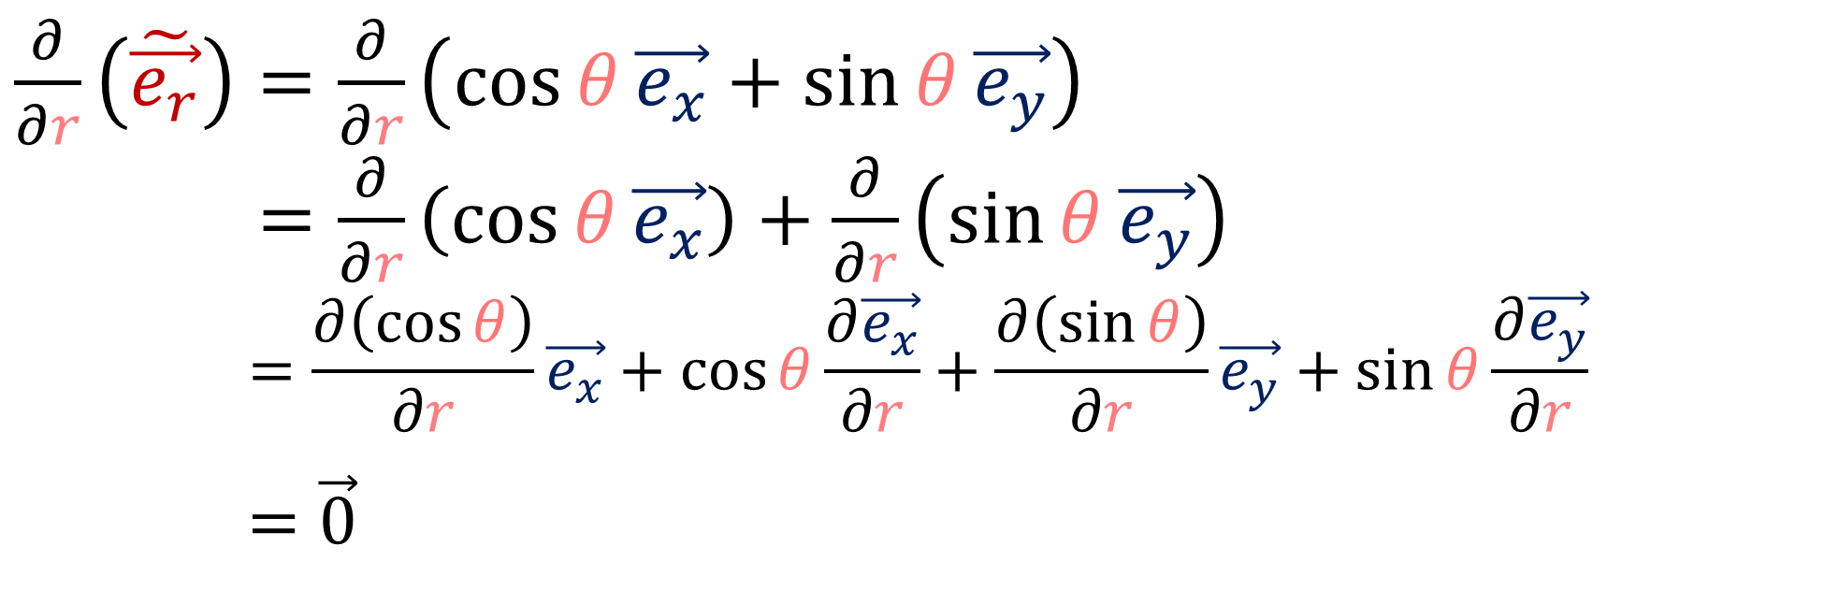
$$\tilde{\vec{e_{r}}}=\cos{θ}\vec{e_{x}}+\sin{θ}\vec{e_{y}}$$
$$\tilde{\vec{e_{θ}}}=−r\sin{θ}\vec{e_{x}}+r\cos{θ}\vec{e_{y}}$$
$\frac{∂}{∂r}\left(\tilde{\vec{e_{r}}}\right)=\frac{∂}{∂r}\left(\cos{θ}\vec{e_{x}}+\sin{θ}\vec{e_{y}}\right)$
$\frac{∂}{∂r}\left(\tilde{\vec{e_{r}}}\right)=\frac{∂}{∂r}\left(\cos{θ}\vec{e_{x}}\right)+\frac{∂}{∂r}\left(\sin{θ}\vec{e_{y}}\right)$
$$\frac{∂}{∂r}\left(\tilde{\vec{e_{r}}}\right) =\frac{∂\left(\cos{θ}\right)}{∂r}\vec{e_{x}}+\cos{θ}\frac{∂\vec{e_{x}}}{∂r}+\frac{∂\left(\sin{θ}\right)}{∂r}\vec{e_{y}}+\sin{θ}\frac{∂\vec{e_{y}}}{∂r}$$
$$\frac{∂}{∂r}\left(\tilde{\vec{e_{r}}}\right)=\vec{0}$$

Slide 18
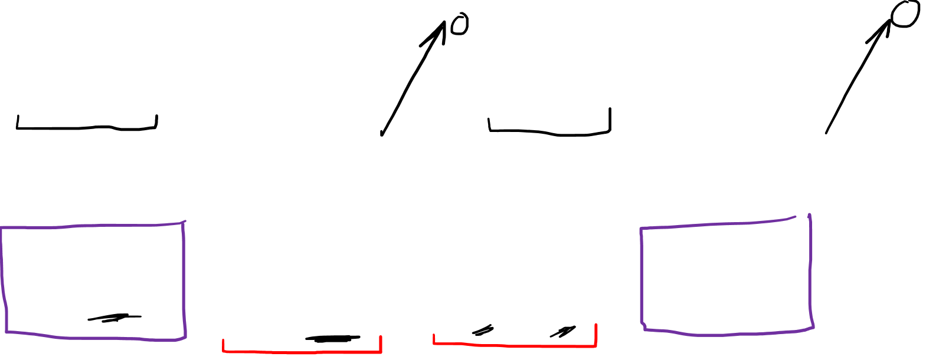


$$\tilde{\vec{e_{r}}}=\cos{θ}\vec{e_{x}}+\sin{θ}\vec{e_{y}}$$
$$\tilde{\vec{e_{θ}}}=−r\sin{θ}\vec{e_{x}}+r\cos{θ}\vec{e_{y}}$$
$\frac{∂}{∂θ}\left(\tilde{\vec{e_{r}}}\right)=\frac{∂}{∂θ}\left(\cos{θ}\vec{e_{x}}+\sin{θ}\vec{e_{y}}\right)$
$\frac{∂}{∂θ}\left(\tilde{\vec{e_{θ}}}\right)=\frac{∂}{∂θ}\left(\cos{θ}\vec{e_{x}}\right)+\frac{∂}{∂θ}\left(\sin{θ}\vec{e_{y}}\right)$
$$\frac{∂}{∂θ}\left(\tilde{\vec{e_{θ}}}\right) =\frac{∂\left(\cos{θ}\right)}{∂θ}\vec{e_{x}}++\cos{θ}\frac{∂\vec{e_{x}}}{∂θ}+\frac{∂\left(\sin{θ}\right)}{∂θ}\vec{e_{y}}+\sin{θ}\frac{∂\vec{e_{y}}}{∂θ}$$
$$\frac{∂}{∂θ}\left(\tilde{\vec{e_{θ}}}\right)=−\sin{θ}\vec{e_{x}}+\cos{θ}\vec{e_{y}}$$
$=\frac{∂}{∂θ}\left(\tilde{\vec{e_{r}}}\right)=\frac{∂}{∂θ}\left(\frac{∂\vec{R}}{∂r}\right)=\frac{∂}{∂r}\left(\frac{∂\vec{R}}{∂θ}\right)=\frac{∂}{∂r}\left(\tilde{\vec{e_{θ}}}\right)$

Slide 19

$$\tilde{\vec{e_{r}}}=\cos{θ}\vec{e_{x}}+\sin{θ}\vec{e_{y}}$$
$$\tilde{\vec{e_{θ}}}=−r\sin{θ}\vec{e_{x}}+r\cos{θ}\vec{e_{y}}$$
$\frac{∂}{∂θ}\left(\tilde{\vec{e_{θ}}}\right)=\frac{∂}{∂θ}\left(−r\sin{θ}\vec{e_{x}}+r\cos{θ}\vec{e_{y}}\right)$
$\frac{∂}{∂θ}\left(\tilde{\vec{e_{θ}}}\right)=\frac{∂}{∂θ}\left(−r\sin{θ}\vec{e_{x}}\right)+\frac{∂}{∂θ}\left(r\cos{θ}\vec{e_{y}}\right)$
$\frac{∂}{∂θ}\left(\tilde{\vec{e_{θ}}}\right)=\frac{∂\left(−r\sin{θ}\right)}{∂θ}\vec{e_{x}}−r\sin{θ}\frac{∂\vec{e_{x}}}{∂θ}+\frac{∂\left(r\cos{θ}\right)}{∂θ}\vec{e_{y}}+r\cos{θ}\frac{∂\vec{e_{y}}}{∂θ}$
$$\frac{∂}{∂θ}\left(\tilde{\vec{e_{θ}}}\right)=−r\cos{θ}\vec{e_{x}}−r\sin{θ}\vec{e_{y}}$$

Slide 20


$$\tilde{\vec{e_{r}}}=\cos{θ}\vec{e_{x}}+\sin{θ}\vec{e_{y}}$$
$$\tilde{\vec{e_{θ}}}=−r\sin{θ}\vec{e_{x}}+r\cos{θ}\vec{e_{y}}$$
$$\frac{∂\tilde{\vec{e_{r}}}}{∂r} =0$$
$$\frac{∂\tilde{\vec{e_{r}}}}{∂θ}=\frac{∂\tilde{\vec{e_{θ}}}}{∂r}=−\sin{θ}\vec{e_{x}}+\cos{θ}\vec{e_{y}}$$
$$\frac{∂\tilde{\vec{e_{θ}}}}{∂θ} =−r\cos{θ}\vec{e_{x}}−r\sin{θ}\vec{e_{y}}$$

Slide 21






$$y$$
$$r=\sqrt{x^{2}+y^{2}}$$
$θ=atan\left(\frac{y}{x}\right)$
$$θ$$
$$\vec{e_{y}}$$
$$r$$
$$y$$
$$r$$
$$y$$
$$θ$$
$$x$$
$$θ$$
$$x$$
$$\vec{e_{x}}$$
$$x$$
$$r$$
$$x=r\cos{θ}$$
$$y=r\sin{θ}$$
$\vec{e_{x}}=\left(\frac{x}{\sqrt{x^{2}+y^{2}}}\right)\tilde{\vec{e_{r}}}+\left(−\frac{y}{x^{2}+y^{2}}\right)\tilde{\vec{e_{θ}}}$
$\vec{e_{y}}=\left(\frac{y}{\sqrt{x^{2}+y^{2}}}\right)\tilde{\vec{e_{r}}}+\left(\frac{x}{x^{2}+y^{2}}\right)\tilde{\vec{e_{θ}}}$
$\vec{e_{x}}=\frac{∂r}{∂x}\tilde{\vec{e_{r}}}+\frac{∂r}{∂x}\tilde{\vec{e_{θ}}}$
$\vec{e_{y}}=\frac{∂r}{∂y}\tilde{\vec{e_{r}}}+\frac{∂θ}{∂y}\tilde{\vec{e_{θ}}}$

Slide 22


$$y$$
$$r=\sqrt{x^{2}+y^{2}}$$
$θ=atan\left(\frac{y}{x}\right)$
$$θ$$
$$\vec{e_{y}}$$
$$r$$
$$y$$
$$r$$
$$y$$
$$θ$$
$$x$$
$$θ$$
$$x$$
$$\vec{e_{x}}$$
$$x$$
$$r$$
$$x=r\cos{θ}$$
$$y=r\sin{θ}$$
$\vec{e_{x}}=\left(\frac{x}{r}\right)\tilde{\vec{e_{r}}}+\left(−\frac{y}{r^{2}}\right)\tilde{\vec{e_{θ}}}$
$\vec{e_{y}}=\left(\frac{y}{r}\right)\tilde{\vec{e_{r}}}+\left(\frac{x}{r^{2}}\right)\tilde{\vec{e_{θ}}}$
$\vec{e_{x}}=\frac{∂r}{∂x}\tilde{\vec{e_{r}}}+\frac{∂r}{∂x}\tilde{\vec{e_{θ}}}$
$\vec{e_{y}}=\frac{∂r}{∂y}\tilde{\vec{e_{r}}}+\frac{∂θ}{∂y}\tilde{\vec{e_{θ}}}$

Slide 23


$$y$$
$$r=\sqrt{x^{2}+y^{2}}$$
$θ=atan\left(\frac{y}{x}\right)$
$$θ$$
$$\vec{e_{y}}$$
$$r$$
$$y$$
$$r$$
$$y$$
$$θ$$
$$x$$
$$θ$$
$$x$$
$$\vec{e_{x}}$$
$$x$$
$$r$$
$$x=r\cos{θ}$$
$$y=r\sin{θ}$$
$\vec{e_{x}}=\frac{∂r}{∂x}\tilde{\vec{e_{r}}}+\frac{∂r}{∂x}\tilde{\vec{e_{θ}}}$
$\vec{e_{y}}=\frac{∂r}{∂y}\tilde{\vec{e_{r}}}+\frac{∂θ}{∂y}\tilde{\vec{e_{θ}}}$
$\vec{e_{x}}=\left(\frac{r\cos{θ}}{r}\right)\tilde{\vec{e_{r}}}+\left(−\frac{r\sin{θ}}{r^{2}}\right)\tilde{\vec{e_{θ}}}$
$\vec{e_{y}}=\left(\frac{r\sin{θ}}{r}\right)\tilde{\vec{e_{r}}}+\left(\frac{r\cos{θ}}{r^{2}}\right)\tilde{\vec{e_{θ}}}$

Slide 24

$$y$$
$$r=\sqrt{x^{2}+y^{2}}$$
$θ=atan\left(\frac{y}{x}\right)$
$$θ$$
$$\vec{e_{y}}$$
$$r$$
$$y$$
$$r$$
$$y$$
$$θ$$
$$x$$
$$θ$$
$$x$$
$$\vec{e_{x}}$$
$$x$$
$$r$$
$$x=r\cos{θ}$$
$$y=r\sin{θ}$$
$\vec{e_{x}}=\frac{∂r}{∂x}\tilde{\vec{e_{r}}}+\frac{∂r}{∂x}\tilde{\vec{e_{θ}}}$
$\vec{e_{y}}=\frac{∂r}{∂y}\tilde{\vec{e_{r}}}+\frac{∂θ}{∂y}\tilde{\vec{e_{θ}}}$
$\vec{e_{x}}=\left(\cos{θ}\right)\tilde{\vec{e_{r}}}+\left(−\frac{\sin{θ}}{r}\right)\tilde{\vec{e_{θ}}}$
$\vec{e_{y}}=\left(\sin{θ}\right)\tilde{\vec{e_{r}}}+\left(\frac{\cos{θ}}{r}\right)\tilde{\vec{e_{θ}}}$

Slide 25



$\vec{e_{x}}=\cos{θ}\tilde{\vec{e_{r}}}−\left(\frac{\sin{θ}}{r}\right)\tilde{\vec{e_{θ}}}$
$\vec{e_{y}}=\sin{θ}\tilde{\vec{e_{r}}}+\left(\frac{\cos{θ}}{r}\right)\tilde{\vec{e_{θ}}}$
$$\frac{∂\tilde{\vec{e_{r}}}}{∂r} =0$$
$$\frac{∂\tilde{\vec{e_{r}}}}{∂θ}=\frac{∂\tilde{\vec{e_{θ}}}}{∂r}=−\sin{θ}\vec{e_{x}}+\cos{θ}\vec{e_{y}}$$
$$\frac{∂\tilde{\vec{e_{θ}}}}{∂θ} =−r\cos{θ}\vec{e_{x}}−r\sin{θ}\vec{e_{y}}$$

Slide 26


$\vec{e_{x}}=\cos{θ}\tilde{\vec{e_{r}}}−\left(\frac{\sin{θ}}{r}\right)\tilde{\vec{e_{θ}}}$
$\vec{e_{y}}=\sin{θ}\tilde{\vec{e_{r}}}+\left(\frac{\cos{θ}}{r}\right)\tilde{\vec{e_{θ}}}$
$\frac{∂\tilde{\vec{e_{r}}}}{∂r} =0$
$\frac{∂\tilde{\vec{e_{r}}}}{∂θ}=\frac{∂\tilde{\vec{e_{θ}}}}{∂r} =−\sin{θ}\left(\cos{θ}\tilde{\vec{e_{r}}}−\left(\frac{\sin{θ}}{r}\right)\tilde{\vec{e_{θ}}}\right)+ \cos{θ}\left(\sin{θ}\tilde{\vec{e_{r}}}+\left(\frac{\cos{θ}}{r}\right)\tilde{\vec{e_{θ}}}\right)$
$\frac{∂\tilde{\vec{e_{θ}}}}{∂θ} =−r\cos{θ}\left(−\left(\frac{\sin{θ}}{r}\right)\tilde{\vec{e_{θ}}}+\cos{θ}\tilde{\vec{e_{r}}}\right)$
$−r\sin{θ}\left( \left(\frac{\cos{θ}}{r}\right)\tilde{\vec{e_{θ}}}+\sin{θ}\tilde{\vec{e_{r}}}\right)$

Slide 27


$\vec{e_{x}}=\cos{θ}\tilde{\vec{e_{r}}}−\left(\frac{\sin{θ}}{r}\right)\tilde{\vec{e_{θ}}}$
$\vec{e_{y}}=\sin{θ}\tilde{\vec{e_{r}}}+\left(\frac{\cos{θ}}{r}\right)\tilde{\vec{e_{θ}}}$
$\frac{∂\tilde{\vec{e_{r}}}}{∂r} =0$
$\frac{∂\tilde{\vec{e_{r}}}}{∂θ}=\frac{∂\tilde{\vec{e_{θ}}}}{∂r} =\left(\frac{{\left(\sin{θ}\right)}^{2}}{r}+\frac{{\left(\cos{θ}\right)}^{2}}{r}\right)\tilde{\vec{e_{θ}}}$
$\frac{∂\tilde{\vec{e_{θ}}}}{∂θ} =−r\cos{θ}\left(−\left(\frac{\sin{θ}}{r}\right)\tilde{\vec{e_{θ}}}+\cos{θ}\tilde{\vec{e_{r}}}\right)$
$−r\sin{θ}\left( \left(\frac{\cos{θ}}{r}\right)\tilde{\vec{e_{θ}}}+\sin{θ}\tilde{\vec{e_{r}}}\right)$

Slide 28


$\vec{e_{x}}=\cos{θ}\tilde{\vec{e_{r}}}−\left(\frac{\sin{θ}}{r}\right)\tilde{\vec{e_{θ}}}$
$\vec{e_{y}}=\sin{θ}\tilde{\vec{e_{r}}}+\left(\frac{\cos{θ}}{r}\right)\tilde{\vec{e_{θ}}}$
$\frac{∂\tilde{\vec{e_{r}}}}{∂r} =0$
$\frac{∂\tilde{\vec{e_{r}}}}{∂θ}=\frac{∂\tilde{\vec{e_{θ}}}}{∂r} =\left(\frac{{\left(\sin{θ}\right)}^{2}}{r}+\frac{{\left(\cos{θ}\right)}^{2}}{r}\right)\tilde{\vec{e_{θ}}}$
$\frac{∂\tilde{\vec{e_{θ}}}}{∂θ} =\left({−r\left(\cos{θ}\right)}^{2}+{−r\left(\sin{θ}\right)}^{2}\right)\tilde{\vec{e_{r}}}$

Slide 29


$\vec{e_{x}}=\cos{θ}\tilde{\vec{e_{r}}}−\left(\frac{\sin{θ}}{r}\right)\tilde{\vec{e_{θ}}}$
$\vec{e_{y}}=\sin{θ}\tilde{\vec{e_{r}}}+\left(\frac{\cos{θ}}{r}\right)\tilde{\vec{e_{θ}}}$
$\frac{∂\tilde{\vec{e_{r}}}}{∂r} =0$
$\frac{∂\tilde{\vec{e_{r}}}}{∂θ}=\frac{∂\tilde{\vec{e_{θ}}}}{∂r} =\frac{1}{r}\left({\left(\sin{θ}\right)}^{2}+{\left(\cos{θ}\right)}^{2}\right)\tilde{\vec{e_{θ}}}$
$\frac{∂\tilde{\vec{e_{θ}}}}{∂θ} =\left({−r\left(\cos{θ}\right)}^{2}+{−r\left(\sin{θ}\right)}^{2}\right)\tilde{\vec{e_{r}}}$

Slide 30


$\vec{e_{x}}=\cos{θ}\tilde{\vec{e_{r}}}−\left(\frac{\sin{θ}}{r}\right)\tilde{\vec{e_{θ}}}$
$\vec{e_{y}}=\sin{θ}\tilde{\vec{e_{r}}}+\left(\frac{\cos{θ}}{r}\right)\tilde{\vec{e_{θ}}}$
$\frac{∂\tilde{\vec{e_{r}}}}{∂r} =0$
$\frac{∂\tilde{\vec{e_{r}}}}{∂θ}=\frac{∂\tilde{\vec{e_{θ}}}}{∂r} =\frac{1}{r}\left({\left(\sin{θ}\right)}^{2}+{\left(\cos{θ}\right)}^{2}\right)\tilde{\vec{e_{θ}}}$
$\frac{∂\tilde{\vec{e_{θ}}}}{∂θ} =−r\left({\left(\cos{θ}\right)}^{2}+{\left(\sin{θ}\right)}^{2}\right)\tilde{\vec{e_{r}}}$

Slide 31

$\vec{e_{x}}=\cos{θ}\tilde{\vec{e_{r}}}−\left(\frac{\sin{θ}}{r}\right)\tilde{\vec{e_{θ}}}$
$\vec{e_{y}}=\sin{θ}\tilde{\vec{e_{r}}}+\left(\frac{\cos{θ}}{r}\right)\tilde{\vec{e_{θ}}}$
$\frac{∂\tilde{\vec{e_{r}}}}{∂r} =0$
$\frac{∂\tilde{\vec{e_{r}}}}{∂θ}=\frac{∂\tilde{\vec{e_{θ}}}}{∂r} =\frac{1}{r}\tilde{\vec{e_{θ}}}$
$\frac{∂\tilde{\vec{e_{θ}}}}{∂θ} =−r\tilde{\vec{e_{r}}}$

Slide 32

$\frac{∂\tilde{\vec{e_{r}}}}{∂r}=0$ | $\frac{∂\tilde{\vec{e_{r}}}}{∂θ}=\frac{1}{r}\tilde{\vec{e_{θ}}}$
$\frac{∂\tilde{\vec{e_{θ}}}}{∂r}=\frac{1}{r}\tilde{\vec{e_{θ}}}$ | $\frac{∂\tilde{\vec{e_{θ}}}}{∂θ}=−r\tilde{\vec{e_{r}}}$

Slide 33






$\frac{∂\tilde{\vec{e_{r}}}}{∂r}=0$ | $\frac{∂\tilde{\vec{e_{θ}}}}{∂r}=\frac{1}{r}\tilde{\vec{e_{θ}}}$
$$\vec{e_{θ}}$$
$$\vec{e_{θ}}$$
$$θ$$
$$\vec{e_{θ}}$$
$$\vec{e_{θ}}$$
$$r$$
$$\vec{e_{r}}$$
$$\vec{e_{r}}$$
$$\vec{e_{r}}$$
$$\vec{e_{r}}$$

Slide 34

$\frac{∂\tilde{\vec{e_{r}}}}{∂r}=0$ | $\frac{∂\tilde{\vec{e_{θ}}}}{∂r}=\frac{1}{r}\tilde{\vec{e_{θ}}}$
$$\vec{e_{θ}}$$
$$\vec{e_{θ}}$$
$$θ$$
$$\vec{e_{θ}}$$
$$\vec{e_{θ}}$$
$$r$$
$$\vec{e_{r}}$$
$$\vec{e_{r}}$$
$$\vec{e_{r}}$$
$$\vec{e_{r}}$$

Slide 35


$\frac{∂\tilde{\vec{e_{r}}}}{∂θ}=\frac{1}{r}\tilde{\vec{e_{θ}}}$ | $\frac{∂\tilde{\vec{e_{θ}}}}{∂θ}=−r\tilde{\vec{e_{r}}}$
$$\vec{e_{θ}}$$
$$θ$$
$$\vec{e_{θ}}$$
$$\vec{e_{r}}$$
$$r$$
$$\vec{e_{r}}$$

Slide 36

$\frac{∂\tilde{\vec{e_{r}}}}{∂θ}=\frac{1}{r}\tilde{\vec{e_{θ}}}$ | $\frac{∂\tilde{\vec{e_{θ}}}}{∂θ}=−r\tilde{\vec{e_{r}}}$
$$\vec{e_{θ}}$$
$$θ$$
$$\vec{e_{θ}}$$
$$\vec{e_{r}}$$
$$r$$
$$\vec{e_{r}}$$

Slide 37




$\frac{∂}{∂r}\left(\vec{v}\right)=\frac{∂\tilde{v^{r}}}{∂r}\tilde{\vec{e_{r}}}+\frac{∂\tilde{v^{θ}}}{∂r}\tilde{\vec{e_{θ}}}+\tilde{v^{r}}\frac{∂\tilde{\vec{e_{r}}}}{∂r}+\tilde{v^{θ}}\frac{∂\tilde{\vec{e_{θ}}}}{∂r}$
$\frac{∂}{∂θ}\left(\vec{v}\right)=\frac{∂\tilde{v^{r}}}{∂θ}\tilde{\vec{e_{r}}}+\frac{∂\tilde{v^{θ}}}{∂θ}\tilde{\vec{e_{θ}}}+\tilde{v^{r}}\frac{∂\tilde{\vec{e_{r}}}}{∂θ}+\tilde{v^{θ}}\frac{∂\tilde{\vec{e_{θ}}}}{∂θ}$
$\frac{∂\tilde{\vec{e_{r}}}}{∂r}=0$ $\frac{∂\tilde{\vec{e_{θ}}}}{∂r}=\frac{∂\tilde{\vec{e_{r}}}}{∂θ}=\frac{1}{r}\tilde{\vec{e_{θ}}}$ $\frac{∂\tilde{\vec{e_{θ}}}}{∂θ}=−r\tilde{\vec{e_{r}}}$
$\frac{∂}{∂r}\left(\vec{v}\right)=\frac{∂\tilde{v^{r}}}{∂r}\tilde{\vec{e_{r}}}+\frac{∂\tilde{v^{θ}}}{∂r}\tilde{\vec{e_{θ}}}+ 0 +\tilde{v^{θ}}\frac{1}{r}\tilde{\vec{e_{θ}}}$
$\frac{∂}{∂θ}\left(\vec{v}\right)=\frac{∂\tilde{v^{r}}}{∂θ}\tilde{\vec{e_{r}}}+\frac{∂\tilde{v^{θ}}}{∂θ}\tilde{\vec{e_{θ}}}+\tilde{v^{r}}\frac{1}{r}\tilde{\vec{e_{θ}}}+\tilde{v^{θ}}(−r\tilde{\vec{e_{r}}})$

Slide 38



$\frac{∂}{∂r}\left(\vec{v}\right)= \frac{∂\tilde{v^{r}}}{∂r} \tilde{\vec{e_{r}}}+\left(\frac{∂\tilde{v^{θ}}}{∂r}+\tilde{v^{θ}}\frac{1}{r}\right)\tilde{\vec{e_{θ}}}$
$\frac{∂}{∂θ}\left(\vec{v}\right)=\left(\frac{∂\tilde{v^{r}}}{∂θ}−r\tilde{v^{θ}}\right)\tilde{\vec{e_{r}}}+\left(\frac{∂\tilde{v^{θ}}}{∂θ}+\tilde{v^{r}}\frac{1}{r}\right)\tilde{\vec{e_{θ}}}$
$\frac{∂}{∂r}\left(\vec{v}\right)⇒\left[\begin{aligned}\frac{∂\tilde{v^{r}}}{∂r} \\ \frac{∂\tilde{v^{θ}}}{∂r}+\tilde{v^{θ}}\frac{1}{r}\end{aligned}\right]$ $\frac{∂}{∂θ}\left(\vec{v}\right)⇒\left[\begin{aligned}\frac{∂\tilde{v^{r}}}{∂θ}−r\tilde{v^{θ}} \\ \frac{∂\tilde{v^{θ}}}{∂θ}+\tilde{v^{r}}\frac{1}{r}\end{aligned}\right]$

Slide 39





$\vec{v}=2\tilde{\vec{e_{r}}}+1\tilde{\vec{e_{θ}}}$
$\frac{∂}{∂r}\left(\vec{v}\right)= \frac{∂\tilde{v^{r}}}{∂r} \tilde{\vec{e_{r}}}+\left(\frac{∂\tilde{v^{θ}}}{∂r}+\tilde{v^{θ}}\frac{1}{r}\right)\tilde{\vec{e_{θ}}}$
$\frac{∂}{∂θ}\left(\vec{v}\right)=\left(\frac{∂\tilde{v^{r}}}{∂θ}−r\tilde{v^{θ}}\right)\tilde{\vec{e_{r}}}+\left(\frac{∂\tilde{v^{θ}}}{∂θ}+\tilde{v^{r}}\frac{1}{r}\right)\tilde{\vec{e_{θ}}}$
$\frac{∂}{∂r}\left(\vec{v}\right)=\frac{1}{r}\tilde{\vec{e_{θ}}}$
$\frac{∂}{∂θ}\left(\vec{v}\right)=−r\tilde{\vec{e_{r}}}+\frac{2}{r}\tilde{\vec{e_{θ}}}$
Constant Components
$$≠$$
Constant Vector Field

Slide 40



$\frac{∂}{∂c^{i}}\left(\vec{v}\right)=\frac{∂}{∂c^{i}}\left(v^{j}\vec{e_{j}}\right)$
$\frac{∂}{∂u^{i}}\left(\vec{v}\right)=\frac{∂v^{j}}{∂c^{i}}\vec{e_{j}} +v^{j}\frac{∂\vec{e_{j}}}{∂c^{i}}$
$\frac{∂}{∂p^{i}}\left(\vec{v}\right)=\frac{∂}{∂p^{i}}\left(\tilde{v^{j}}\tilde{\vec{e_{j}}}\right)$
$\frac{∂}{∂u^{i}}\left(\vec{v}\right)=\frac{∂\tilde{v^{j}}}{∂p^{i}}\tilde{\vec{e_{j}}} +\tilde{v^{j}}\frac{∂\tilde{\vec{e_{j}}}}{∂p^{i}}$
In flat space, the Covariant Derivative of a vector field…
is just the ordinary derivative
we make sure to differentiate both the vector components and the basis vectors.

Slide 41



$\frac{∂}{∂c^{i}}\left(\vec{v}\right)=\frac{∂}{∂c^{i}}\left(v^{j}\vec{e_{j}}\right)$
$\frac{∂}{∂u^{i}}\left(\vec{v}\right)=\frac{∂v^{j}}{∂c^{i}}\vec{e_{j}} +v^{j}\frac{∂\vec{e_{j}}}{∂c^{i}}$
$$\frac{∂\vec{e_{j}}}{∂c^{i}}=Γ_{ij}^{1}\vec{e_{1}}+Γ_{ij}^{2}\vec{e_{2}}$$

Slide 42



$\frac{∂}{∂c^{i}}\left(\vec{v}\right)=\frac{∂}{∂c^{i}}\left(v^{j}\vec{e_{j}}\right)$
$\frac{∂}{∂u^{i}}\left(\vec{v}\right)=\frac{∂v^{j}}{∂c^{i}}\vec{e_{j}} +v^{j}\frac{∂\vec{e_{j}}}{∂c^{i}}$
$\frac{∂}{∂u^{i}}\left(\vec{v}\right)=\frac{∂v^{j}}{∂c^{i}}\vec{e_{j}}+v^{j}Γ_{ij}^{k}\vec{e_{k}}$
$\left(\vec{v}\right) =\left(\frac{∂v^{k}}{∂c^{i}}+v^{j}Γ_{ij}^{k}\right)\vec{e_{k}}$
$$\frac{∂\vec{e_{j}}}{∂c^{i}}=Γ_{ij}^{k}\vec{e_{k}}$$

Slide 43

$\frac{∂}{∂c^{i}}\left(\vec{v}\right)=\frac{∂}{∂c^{i}}\left(v^{j}\vec{e_{j}}\right)$
$\frac{∂}{∂u^{i}}\left(\vec{v}\right)=\frac{∂v^{j}}{∂c^{i}}\vec{e_{j}} +v^{j}\frac{∂\vec{e_{j}}}{∂c^{i}}$
$\frac{∂}{∂u^{i}}\left(\vec{v}\right)=\frac{∂v^{j}}{∂c^{i}}\vec{e_{j}}+v^{j}Γ_{ij}^{k}\vec{e_{k}}$
$\left(\vec{v}\right) =\left(\frac{∂v^{k}}{∂c^{i}}+v^{j}Γ_{ij}^{k}\right)\vec{e_{k}}$
Flat space,
Cartesian Coordinates:
$$Γ_{ij}^{k}=0$$
$$\frac{∂\vec{e_{j}}}{∂c^{i}}=Γ_{ij}^{k}\vec{e_{k}}$$

Slide 44







$\frac{∂\tilde{\vec{e_{r}}}}{∂r}=0$
$\frac{∂\tilde{\vec{e_{θ}}}}{∂θ}=−r\tilde{\vec{e_{r}}}$
$\frac{∂\tilde{\vec{e_{r}}}}{∂θ}=\frac{∂\tilde{\vec{e_{θ}}}}{∂r}=\frac{1}{r}\tilde{\vec{e_{θ}}}$
$\frac{∂}{∂p^{i}}\left(\vec{v}\right)=\frac{∂}{∂p^{i}}\left(\tilde{v^{j}}\tilde{\vec{e_{j}}}\right)$
$\frac{∂}{∂u^{i}}\left(\vec{v}\right)=\frac{∂\tilde{v^{j}}}{∂p^{i}}\tilde{\vec{e_{j}}} +\tilde{v^{j}}\frac{∂\tilde{\vec{e_{j}}}}{∂p^{i}}$
$\frac{∂}{∂u^{i}}\left(\vec{v}\right)=\left(\frac{∂\tilde{v^{j}}}{∂p^{i}}+\tilde{v^{j}}\tilde{Γ_{ij}^{k}}\right)\tilde{\vec{e_{k}}}$
$\tilde{Γ_{rr}^{r}}=0$ $\tilde{Γ_{rr}^{θ}}=0$
$$\tilde{Γ_{θθ}^{r}}=−r \tilde{Γ_{θθ}^{θ}}=0$$
$$\frac{∂\tilde{\vec{e_{j}}}}{∂p^{i}}=\tilde{Γ_{ij}^{k}}\tilde{\vec{e_{k}}}$$
$\tilde{Γ_{rθ}^{r}}=0$ $\tilde{Γ_{rθ}^{θ}}=\frac{1}{r}$
$\tilde{Γ_{θr}^{r}}=0$ $\tilde{Γ_{θr}^{θ}}=\frac{1}{r}$

Slide 45


$\frac{∂}{∂p^{i}}\left(\vec{v}\right)=\frac{∂}{∂p^{i}}\left(\tilde{v^{j}}\tilde{\vec{e_{j}}}\right)$
$\frac{∂}{∂u^{i}}\left(\vec{v}\right)=\frac{∂\tilde{v^{j}}}{∂p^{i}}\tilde{\vec{e_{j}}} +\tilde{v^{j}}\frac{∂\tilde{\vec{e_{j}}}}{∂p^{i}}$
$\frac{∂}{∂u^{i}}\left(\vec{v}\right)=\left(\frac{∂\tilde{v^{j}}}{∂p^{i}}+\tilde{v^{j}}\tilde{Γ_{ij}^{k}}\right)\tilde{\vec{e_{k}}}$
Flat space,
Polar Coordinates:
$\tilde{Γ_{rr}^{r}}=0$ $\tilde{Γ_{rr}^{θ}}=0$
$\tilde{Γ_{rθ}^{r}}=0$ $\tilde{Γ_{rθ}^{θ}}=\frac{1}{r}$
$\tilde{Γ_{θr}^{r}}=0$ $\tilde{Γ_{θr}^{θ}}=\frac{1}{r}$
$$\tilde{Γ_{θθ}^{r}}=−r \tilde{Γ_{θθ}^{θ}}=0$$
$$\frac{∂\tilde{\vec{e_{j}}}}{∂p^{i}}=\tilde{Γ_{ij}^{k}}\tilde{\vec{e_{k}}}$$

Slide 46



Covariant Derivative Summary
In flat space, the Covariant Derivative of a vector field…
is just the ordinary derivative
we make sure to differentiate both the vector components and the basis vectors.
$\frac{∂}{∂c^{i}}\left(\vec{v}\right)=\frac{∂}{∂c^{i}}\left(v^{j}\vec{e_{j}}\right)$
$\frac{∂}{∂u^{i}}\left(\vec{v}\right)=\frac{∂v^{j}}{∂c^{i}}\vec{e_{j}} +v^{j}\frac{∂\vec{e_{j}}}{∂c^{i}}$
$\frac{∂}{∂u^{i}}\left(\vec{v}\right)=\left(\frac{∂v^{k}}{∂c^{i}}+v^{j}Γ_{ij}^{k}\right)\vec{e_{k}}$
$\frac{∂}{∂p^{i}}\left(\vec{v}\right)=\frac{∂}{∂p^{i}}\left(\tilde{v^{j}}\tilde{\vec{e_{j}}}\right)$
$\frac{∂}{∂u^{i}}\left(\vec{v}\right)=\frac{∂\tilde{v^{j}}}{∂p^{i}}\tilde{\vec{e_{j}}} +\tilde{v^{j}}\frac{∂\tilde{\vec{e_{j}}}}{∂p^{i}}$
$\frac{∂}{∂u^{i}}\left(\vec{v}\right)=\left(\frac{∂\tilde{v^{j}}}{∂p^{i}}+\tilde{v^{j}}\tilde{Γ_{ij}^{k}}\right)\tilde{\vec{e_{k}}}$

Slide 47

Next Video: Covariant Derivative on curved surfaces
+ Parallel transport

