Slide 1
The Jacobian
(Forward & Backward
Transformations Redux)

Slide 2

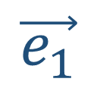
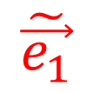
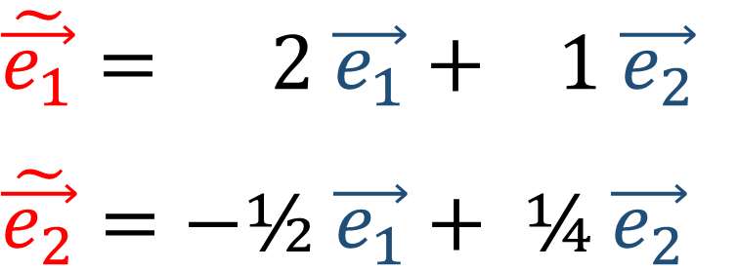

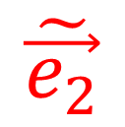

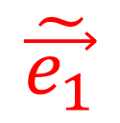
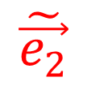
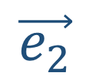

See Video “Tensors for Beginners:
Forward & Backward Transformations”
$$\vec{e_{2}}$$
$$\tilde{\vec{e_{1}}}$$
Old Basis
$$\tilde{\vec{e_{2}}}$$
New Basis
$$\vec{e_{1}}$$
$$\tilde{\vec{e_{1}}}= 2 \vec{e_{1}}+ 1 \vec{e_{2}}$$
$$\tilde{\vec{e_{2}}}=−\text{½} \vec{e_{1}}+ \text{¼} \vec{e_{2}}$$
$$\vec{e_{2}}$$
$$\tilde{\vec{e_{1}}}$$
$$\tilde{\vec{e_{2}}}$$
$$\vec{e_{1}}$$

Slide 3
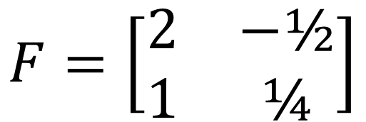
See Video “Tensors for Beginners:
Forward & Backward Transformations”
$$\vec{e_{2}}$$
$$\tilde{\vec{e_{1}}}$$
Old Basis
$$\tilde{\vec{e_{2}}}$$
New Basis
$$\vec{e_{1}}$$
$$\tilde{\vec{e_{1}}}= 2 \vec{e_{1}}+ 1 \vec{e_{2}}$$
$$\tilde{\vec{e_{2}}}=−\text{½} \vec{e_{1}}+ \text{¼} \vec{e_{2}}$$
$$\vec{e_{2}}$$
$$\tilde{\vec{e_{1}}}$$
$$\tilde{\vec{e_{2}}}$$
$$F=\left[\begin{matrix}2 & −\text{½} \\ 1 & \text{¼}\end{matrix}\right]$$
$$\vec{e_{1}}$$

Slide 4


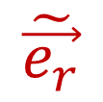
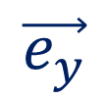

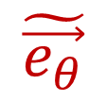
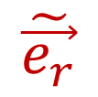
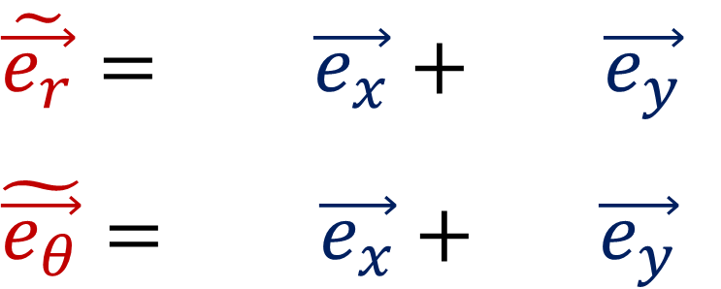



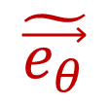




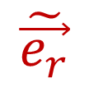

$$y$$
$$\vec{e_{y}}$$
$$\tilde{\vec{e_{θ}}}$$
$$\tilde{\vec{e_{r}}}$$
$$\vec{e_{x}}$$
$$\vec{e_{y}}$$
$$θ$$
$$\tilde{\vec{e_{r}}}$$
$$\vec{e_{x}}$$
$$\vec{e_{y}}$$
$$x$$
$$\tilde{\vec{e_{θ}}}$$
$$r$$
$$\vec{e_{x}}$$
$$\tilde{\vec{e_{θ}}}$$
$$\tilde{\vec{e_{r}}}$$
$$\tilde{\vec{e_{r}}}= 2\vec{e_{x}}+ 1\vec{e_{y}}$$
$$\tilde{\vec{e_{θ}}}=−\text{½}\vec{e_{x}}+ \text{¼} \vec{e_{y}}$$

Slide 5

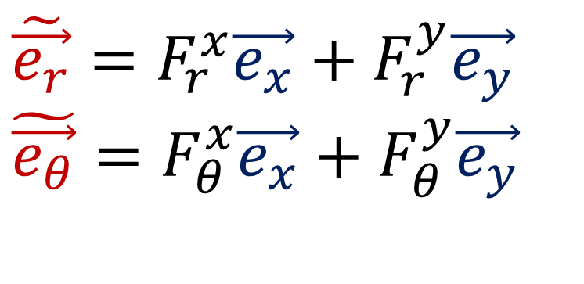
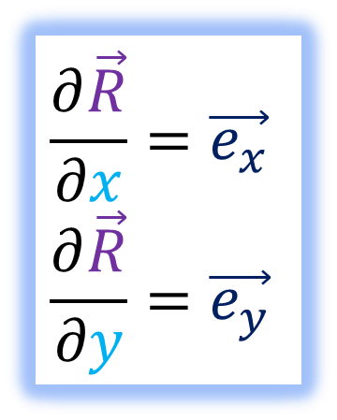
Basis Vectors = Partial Derivatives
$$\frac{∂\vec{R}}{∂x}=\vec{e_{x}}$$
$$\frac{∂\vec{R}}{∂y}=\vec{e_{y}}$$
$$\frac{∂\vec{R}}{∂r}=\tilde{\vec{e_{r}}}$$
$$\frac{∂\vec{R}}{∂θ}=\tilde{\vec{e_{θ}}}$$
$$\tilde{\vec{e_{r}}}=F_{r}^{x}\vec{e_{x}}+F_{r}^{y}\vec{e_{y}}$$
$$\tilde{\vec{e_{θ}}}=F_{θ}^{x}\vec{e_{x}}+F_{θ}^{y}\vec{e_{y}}$$
$$y$$
$$\vec{e_{y}}$$
$$\tilde{\vec{e_{θ}}}$$
$$\tilde{\vec{e_{r}}}$$
$$\vec{e_{x}}$$
$$θ$$
$$\vec{e_{y}}$$
$$\tilde{\vec{e_{r}}}$$
$$\vec{e_{x}}$$
$$\vec{e_{y}}$$
$$x$$
$$\tilde{\vec{e_{θ}}}$$
$$r$$
$$\vec{e_{x}}$$
$$\tilde{\vec{e_{θ}}}$$
$$\tilde{\vec{e_{r}}}$$

Slide 6


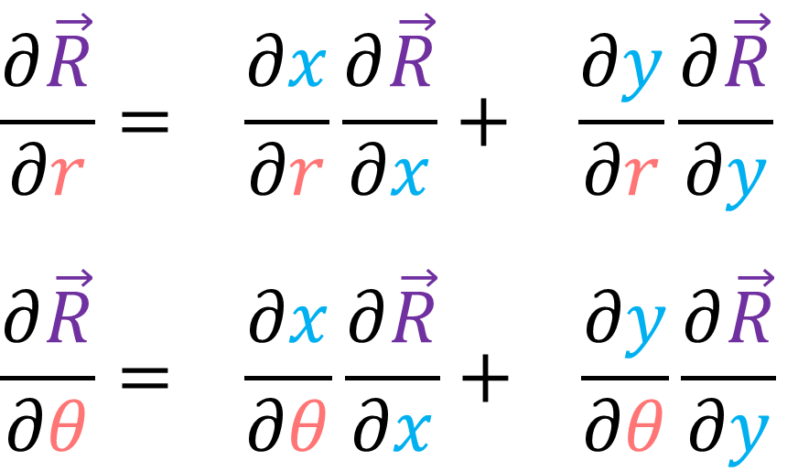
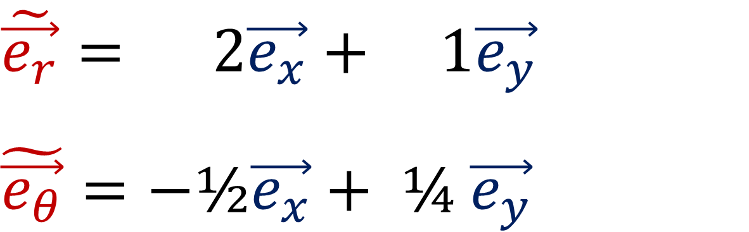
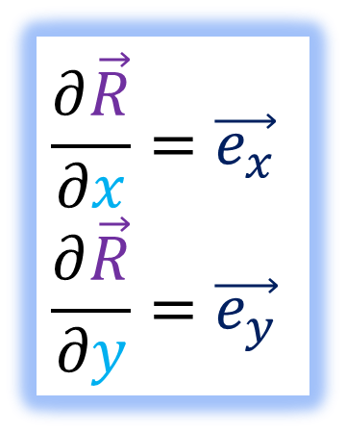
$$\tilde{\vec{e_{r}}}= 2\vec{e_{x}}+ 1\vec{e_{y}}$$
$$\tilde{\vec{e_{θ}}}=−\text{½}\vec{e_{x}}+ \text{¼} \vec{e_{y}}$$
$$\frac{∂\vec{R}}{∂x}=\vec{e_{x}}$$
$$\frac{∂\vec{R}}{∂y}=\vec{e_{y}}$$
$$\frac{∂\vec{R}}{∂r}=\tilde{\vec{e_{r}}}$$
$$\frac{∂\vec{R}}{∂θ}=\tilde{\vec{e_{θ}}}$$
$$\frac{∂\vec{R}}{∂r}= \frac{∂x}{∂r}\frac{∂\vec{R}}{∂x}+ \frac{∂y}{∂r}\frac{∂\vec{R}}{∂y}$$
$$\frac{∂\vec{R}}{∂θ}= \frac{∂x}{∂θ}\frac{∂\vec{R}}{∂x}+ \frac{∂y}{∂θ}\frac{∂\vec{R}}{∂y}$$

Slide 7
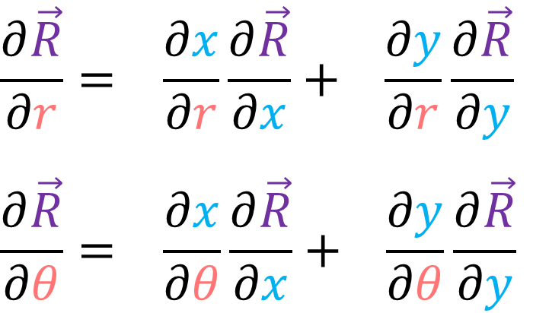

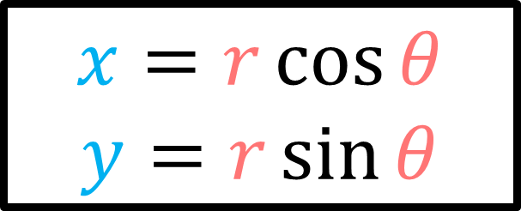
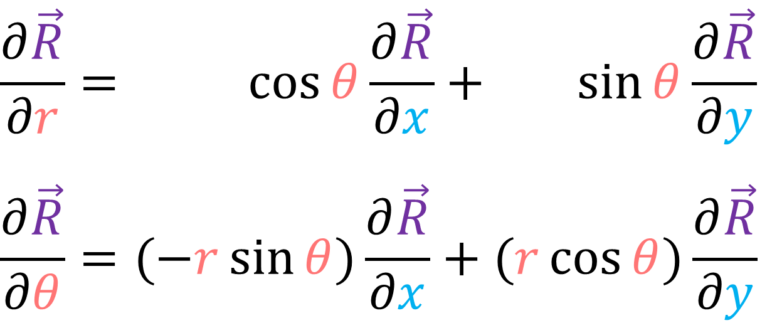
$$\frac{∂\vec{R}}{∂r}= \frac{∂x}{∂r}\frac{∂\vec{R}}{∂x}+ \frac{∂y}{∂r}\frac{∂\vec{R}}{∂y}$$
$$\frac{∂\vec{R}}{∂θ}= \frac{∂x}{∂θ}\frac{∂\vec{R}}{∂x}+ \frac{∂y}{∂θ}\frac{∂\vec{R}}{∂y}$$
$$x=r\cos{θ}$$
$$y=r\sin{θ}$$
$$\frac{∂\vec{R}}{∂r}= \cos{θ}\frac{∂\vec{R}}{∂x}+ \sin{θ}\frac{∂\vec{R}}{∂y}$$
$$\frac{∂\vec{R}}{∂θ}=(−r\sin{θ})\frac{∂\vec{R}}{∂x}+(r\cos{θ})\frac{∂\vec{R}}{∂y}$$

Slide 8
$$\frac{∂\vec{R}}{∂r}= \frac{∂x}{∂r}\frac{∂\vec{R}}{∂x}+ \frac{∂y}{∂r}\frac{∂\vec{R}}{∂y}$$
$$\frac{∂\vec{R}}{∂θ}= \frac{∂x}{∂θ}\frac{∂\vec{R}}{∂x}+ \frac{∂y}{∂θ}\frac{∂\vec{R}}{∂y}$$
$$x=r\cos{θ}$$
$$y=r\sin{θ}$$
$$\frac{∂\vec{R}}{∂r}= \cos{θ}\frac{∂\vec{R}}{∂x}+ \sin{θ}\frac{∂\vec{R}}{∂y}$$
$$\frac{∂\vec{R}}{∂θ}=(−r\sin{θ})\frac{∂\vec{R}}{∂x}+(r\cos{θ})\frac{∂\vec{R}}{∂y}$$

Slide 9
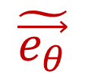
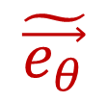


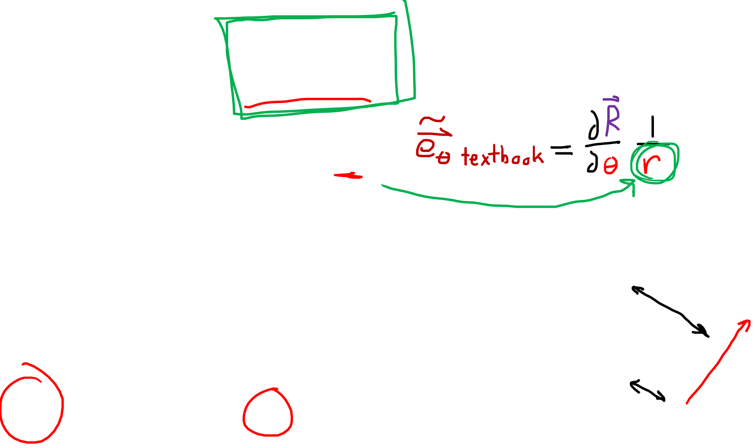
Recall my definition of $\tilde{\vec{e_{θ}}}=\frac{∂\vec{R}}{∂θ}$ is NOT NORMALIZED.
So we end up with factors of $r$
$$\frac{∂\vec{R}}{∂r}= \cos{θ}\frac{∂\vec{R}}{∂x}+ \sin{θ}\frac{∂\vec{R}}{∂y}$$
$$\frac{∂\vec{R}}{∂θ}=(−r\sin{θ})\frac{∂\vec{R}}{∂x}+(r\cos{θ})\frac{∂\vec{R}}{∂y}$$
$$\tilde{\vec{e_{θ}}}$$
$$\tilde{\vec{e_{θ}}}$$
$$r$$

Slide 10
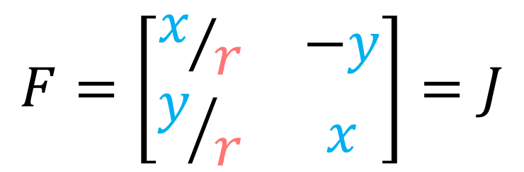
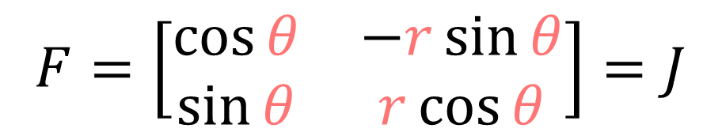
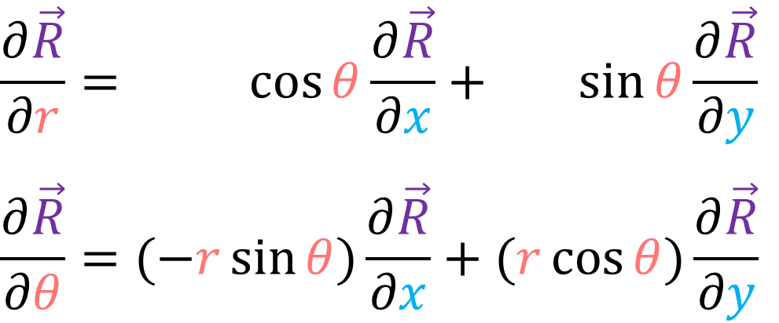
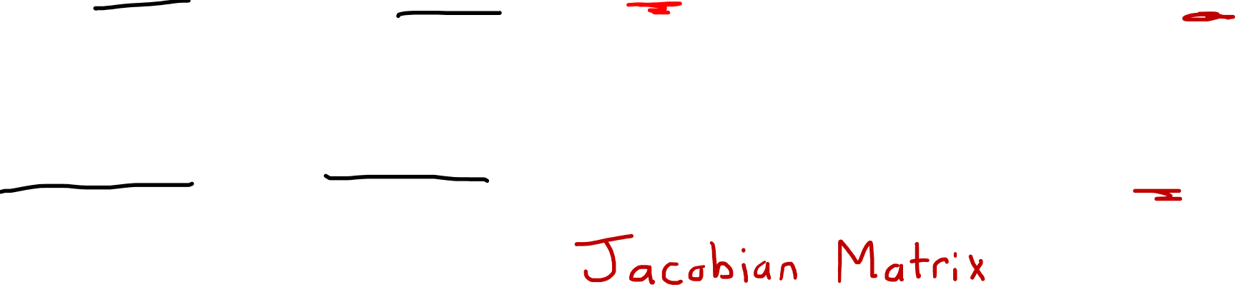
$$\frac{∂\vec{R}}{∂r}= \frac{∂x}{∂r}\frac{∂\vec{R}}{∂x}+ \frac{∂y}{∂r}\frac{∂\vec{R}}{∂y}$$
$$\frac{∂\vec{R}}{∂θ}= \frac{∂x}{∂θ}\frac{∂\vec{R}}{∂x}+ \frac{∂y}{∂θ}\frac{∂\vec{R}}{∂y}$$
$$x=r\cos{θ}$$
$$y=r\sin{θ}$$
$$\frac{∂\vec{R}}{∂r}= \cos{θ}\frac{∂\vec{R}}{∂x}+ \sin{θ}\frac{∂\vec{R}}{∂y}$$
$$\frac{∂\vec{R}}{∂θ}=(−r\sin{θ})\frac{∂\vec{R}}{∂x}+(r\cos{θ})\frac{∂\vec{R}}{∂y}$$
$$F=\left[\begin{matrix}\cos{θ} & −r\sin{θ} \\ \sin{θ} & r\cos{θ}\end{matrix}\right]=J$$
$$F=\left[\begin{matrix}x/r & −y \\ y/r & x\end{matrix}\right]=J$$

Slide 11
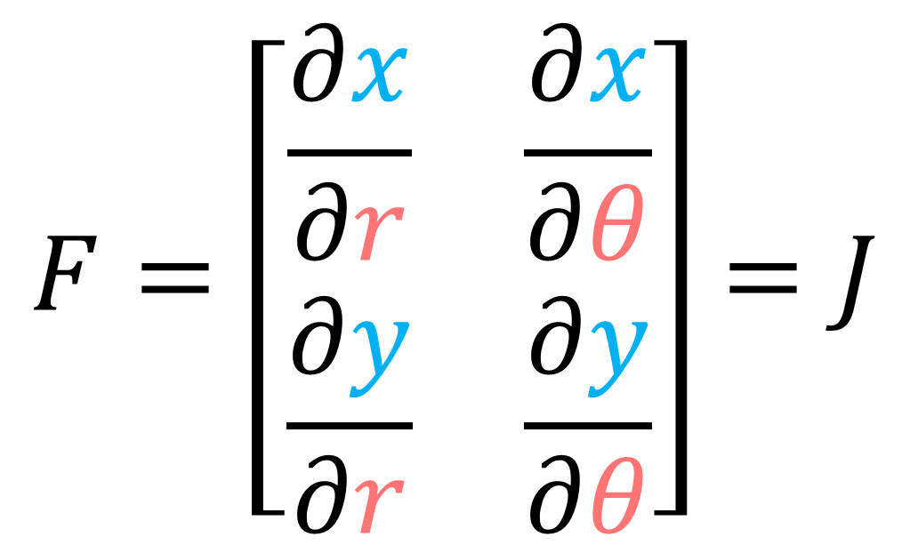

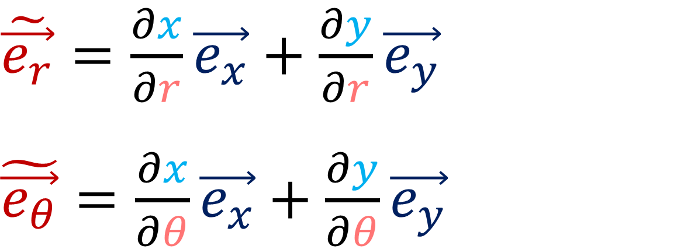
The Jacobian Matrix (aka “Forward Transform”)
$$F=\left[\begin{matrix}\frac{∂x}{∂r} & \frac{∂x}{∂θ} \\ \frac{∂y}{∂r} & \frac{∂y}{∂θ}\end{matrix}\right]=J$$
$\tilde{\vec{e_{r}}}=\frac{∂x}{∂r}\vec{e_{x}}+\frac{∂y}{∂r}\vec{e_{y}}$
$\tilde{\vec{e_{θ}}}=\frac{∂x}{∂θ}\vec{e_{x}}+\frac{∂y}{∂θ}\vec{e_{y}}$

Slide 12










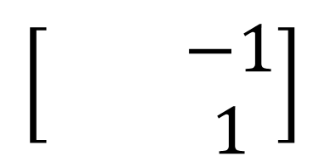
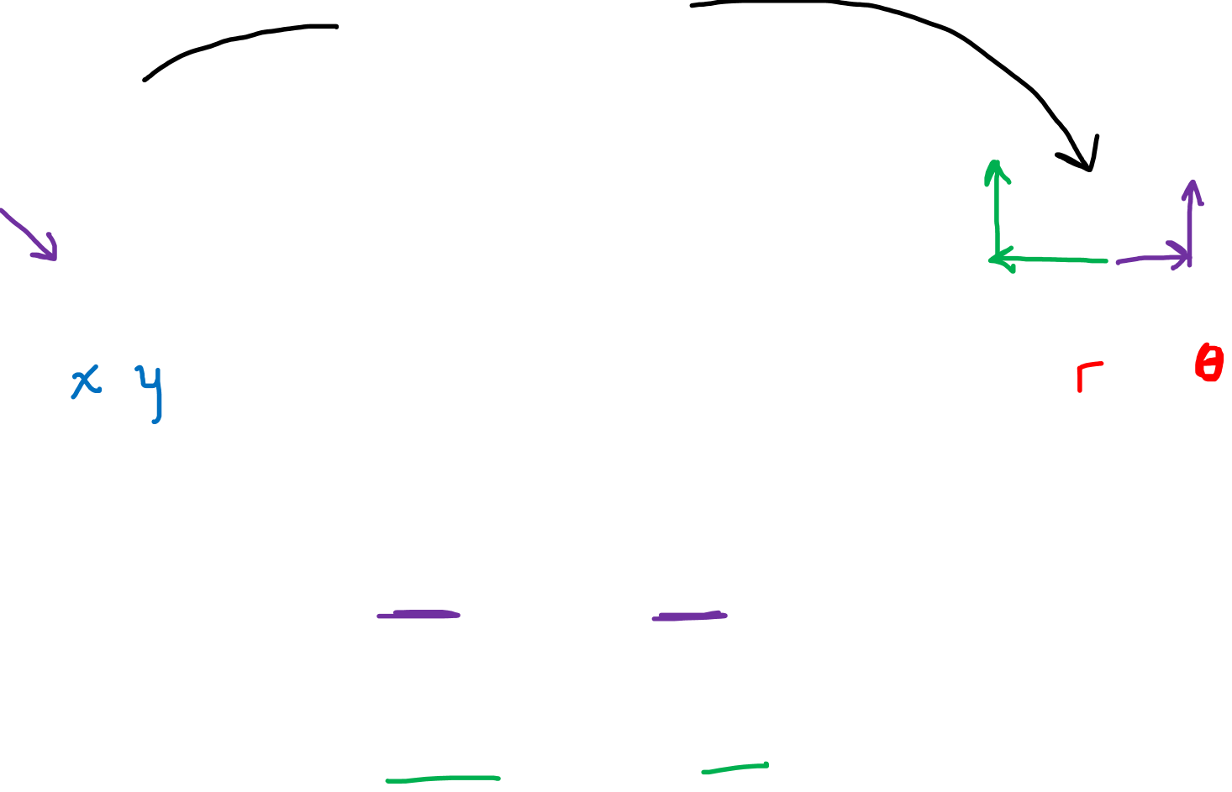



$$\left[\begin{matrix} & −1 \\ & 1\end{matrix}\right]$$
$$1/{\sqrt{2}}$$
$$y$$
$$\vec{e_{y}}$$
$$\tilde{\vec{e_{θ}}}$$
$$1/{\sqrt{2}}$$
$$θ$$
$$\tilde{\vec{e_{r}}}$$
$$\vec{e_{x}}$$
$\left(\sqrt{2},\frac{π}{4}\right)$
$$\left(1,1\right)$$
$$x$$
$$r$$
$$F=\left[\begin{matrix}x/r & −y \\ y/r & x\end{matrix}\right]=J$$

Slide 13

$$\left[\begin{matrix} & −1 \\ & 1\end{matrix}\right]$$
$$1/{\sqrt{2}}$$
$$y$$
$$\vec{e_{y}}$$
$$\tilde{\vec{e_{θ}}}$$
$$1/{\sqrt{2}}$$
$$θ$$
$$\tilde{\vec{e_{r}}}$$
$$\vec{e_{x}}$$
$\left(\sqrt{2},\frac{π}{4}\right)$
$$\left(1,1\right)$$
$$x$$
$$r$$
$\tilde{\vec{e_{r}}}=\frac{1}{\sqrt{2}}\vec{e_{x}}+\frac{1}{\sqrt{2}}\vec{e_{y}}$
$$\tilde{\vec{e_{θ}}}=(−1)\vec{e_{x}}+\text{1}\vec{e_{y}}$$
$$F=\left[\begin{matrix}x/r & −y \\ y/r & x\end{matrix}\right]=J$$

Slide 14

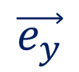




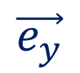
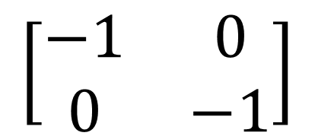
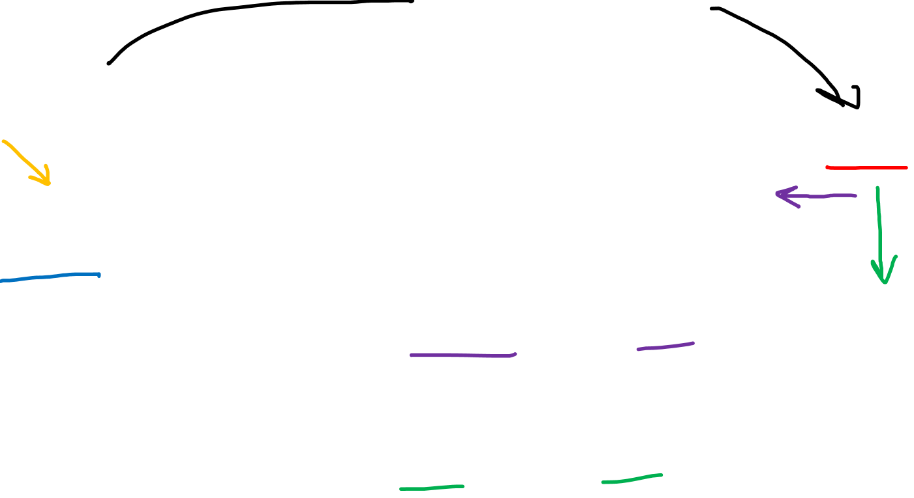

$$y$$
$$\left[\begin{matrix}−1 & 0 \\ 0 & −1\end{matrix}\right]$$
$$θ$$
$$\vec{e_{y}}$$
$$\vec{e_{y}}$$
$\left(1,π\right)$
$$\vec{e_{x}}$$
$$\vec{e_{x}}$$
$$x$$
$$\tilde{\vec{e_{r}}}$$
$$r$$
$$\left(−1,0\right)$$
$$\tilde{\vec{e_{θ}}}$$
$$F=\left[\begin{matrix}x/r & −y \\ y/r & x\end{matrix}\right]=J$$

Slide 15
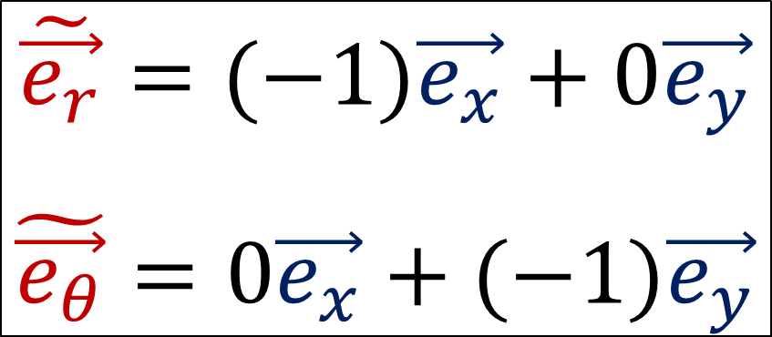
$$y$$
$$\left[\begin{matrix}−1 & 0 \\ 0 & −1\end{matrix}\right]$$
$$θ$$
$$\vec{e_{y}}$$
$$\vec{e_{y}}$$
$\left(1,π\right)$
$$\vec{e_{x}}$$
$$\vec{e_{x}}$$
$$x$$
$$\tilde{\vec{e_{r}}}$$
$$r$$
$$\left(−1,0\right)$$
$\tilde{\vec{e_{r}}}=(−1)\vec{e_{x}}+0\vec{e_{y}}$
$$\tilde{\vec{e_{θ}}}=0\vec{e_{x}}+(−1)\vec{e_{y}}$$
$$\tilde{\vec{e_{θ}}}$$
$$F=\left[\begin{matrix}x/r & −y \\ y/r & x\end{matrix}\right]=J$$

Slide 16



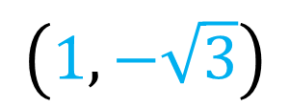









$\tilde{\vec{e_{r}}}=1/2\vec{e_{x}}+(−{\sqrt{3}}/2)\vec{e_{y}}$
$$\tilde{\vec{e_{θ}}}=\sqrt{3}\vec{e_{x}}+1\vec{e_{y}}$$
$$y$$
$$θ$$
$$x$$
$$r$$
$$\left[\begin{matrix} & \sqrt{3} \\ & 1\end{matrix}\right]$$
$$1/2$$
$$\vec{e_{y}}$$
$$−{\sqrt{3}}/2$$
$\left(2,\frac{π}{3}\right)$
$$\tilde{\vec{e_{θ}}}$$
$$\vec{e_{x}}$$
$$F=\left[\begin{matrix}x/r & −y \\ y/r & x\end{matrix}\right]=J$$
$$\left(1,−\sqrt{3}\right)$$
$$\tilde{\vec{e_{r}}}$$

Slide 17













$$\left[\begin{matrix} & −1 \\ & 1\end{matrix}\right]$$
$$1/{\sqrt{2}}$$
$$y$$
$$1/{\sqrt{2}}$$
$$\tilde{\vec{e_{θ}}}$$
$$\vec{e_{y}}$$
$$θ$$
$$\vec{e_{y}}$$
$$\tilde{\vec{e_{r}}}$$
$$\vec{e_{x}}$$
$$\left[\begin{matrix}−1 & 0 \\ 0 & −1\end{matrix}\right]$$
$$\vec{e_{x}}$$
$$\tilde{\vec{e_{r}}}$$
$$x$$
$$r$$
$$\vec{e_{y}}$$
$$\tilde{\vec{e_{θ}}}$$
$$\tilde{\vec{e_{θ}}}$$
$$\vec{e_{x}}$$
$$\left[\begin{matrix} & \sqrt{3} \\ & 1\end{matrix}\right]$$
$$1/2$$
$$\tilde{\vec{e_{r}}}$$
$$F=\left[\begin{matrix}x/r & −y \\ y/r & x\end{matrix}\right]=J$$
$$−{\sqrt{3}}/2$$

Slide 18



$$\vec{e_{x}}= 2\tilde{\vec{e_{r}}}+ 1\tilde{\vec{e_{θ}}}$$
$$\vec{e_{y}}=−\text{½}\tilde{\vec{e_{r}}}+ \text{¼} \tilde{\vec{e_{θ}}}$$
$$\frac{∂\vec{R}}{∂x}=\vec{e_{x}}$$
$$\frac{∂\vec{R}}{∂y}=\vec{e_{y}}$$
$$\frac{∂\vec{R}}{∂r}=\tilde{\vec{e_{r}}}$$
$$\frac{∂\vec{R}}{∂θ}=\tilde{\vec{e_{θ}}}$$
$$\frac{∂\vec{R}}{∂x}= \frac{∂r}{∂x}\frac{∂\vec{R}}{∂r}+ \frac{∂θ}{∂x}\frac{∂\vec{R}}{∂θ}$$
$$\frac{∂\vec{R}}{∂y}= \frac{∂r}{∂y}\frac{∂\vec{R}}{∂r}+ \frac{∂θ}{∂y}\frac{∂\vec{R}}{∂θ}$$

Slide 19



$$\frac{∂\vec{R}}{∂x}= \frac{∂r}{∂x}\frac{∂\vec{R}}{∂r}+ \frac{∂θ}{∂x}\frac{∂\vec{R}}{∂θ}$$
$$\frac{∂\vec{R}}{∂y}= \frac{∂r}{∂y}\frac{∂\vec{R}}{∂r}+ \frac{∂θ}{∂y}\frac{∂\vec{R}}{∂θ}$$
$$r=\sqrt{x^{2}+y^{2}}$$
$θ=atan\left(\frac{y}{x}\right)$
$$\frac{∂\vec{R}}{∂x}=\left(\frac{x}{\sqrt{x^{2}+y^{2}}}\right)\frac{∂\vec{R}}{∂r}+\left(\frac{y}{\sqrt{x^{2}+y^{2}}}\right)\frac{∂\vec{R}}{∂θ}$$
$$\frac{∂\vec{R}}{∂y}=\left(−\frac{y}{x^{2}+y^{2}}\right)\frac{∂\vec{R}}{∂r}+ \left(\frac{x}{x^{2}+y^{2}}\right)\frac{∂\vec{R}}{∂θ}$$

Slide 20




$$\frac{∂\vec{R}}{∂x}= \frac{∂r}{∂x}\frac{∂\vec{R}}{∂r}+ \frac{∂θ}{∂x}\frac{∂\vec{R}}{∂θ}$$
$$\frac{∂\vec{R}}{∂y}= \frac{∂r}{∂y}\frac{∂\vec{R}}{∂r}+ \frac{∂θ}{∂y}\frac{∂\vec{R}}{∂θ}$$
$$r=\sqrt{x^{2}+y^{2}}$$ $θ=atan\left(\frac{y}{x}\right)$
$$\frac{∂\vec{R}}{∂x}= \left(\frac{x}{r}\right) \frac{∂\vec{R}}{∂r}+ \left(−\frac{y}{r^{2}}\right) \frac{∂\vec{R}}{∂θ}$$
$$\frac{∂\vec{R}}{∂y}= \left(\frac{y}{r}\right) \frac{∂\vec{R}}{∂r}+ \left(\frac{x}{r^{2}}\right) \frac{∂\vec{R}}{∂θ}$$
$$B=\left[\begin{matrix}\frac{x}{r} & \frac{y}{r} \\ −\frac{y}{r^{2}} & \frac{x}{r^{2}}\end{matrix}\right]=J^{−1}$$

Slide 21



The Inverse Jacobian Matrix (aka “Backward Transform”)
$$B=\left[\begin{matrix}\frac{∂r}{∂x} & \frac{∂r}{∂y} \\ \frac{∂θ}{∂x} & \frac{∂θ}{∂y}\end{matrix}\right]=J^{−1}$$
$$\vec{e_{x}}=\frac{∂r}{∂x}\tilde{\vec{e_{r}}}+\frac{∂θ}{∂x}\tilde{\vec{e_{θ}}}$$
$$\vec{e_{y}}=\frac{∂r}{∂y}\tilde{\vec{e_{r}}}+\frac{∂θ}{∂y}\tilde{\vec{e_{θ}}}$$

Slide 22












$$\left[\begin{matrix}1/{\sqrt{2}} & −1/2 \\ 1/{\sqrt{2}} & 1/2\end{matrix}\right]$$
$$y$$
$$\vec{e_{θ}}$$
$$\vec{e_{y}}$$
$$θ$$
$$\vec{e_{y}}$$
$$\vec{e_{r}}$$
$$\vec{e_{x}}$$
$$\left[\begin{matrix}−1 & 0 \\ 0 & −1\end{matrix}\right]$$
$$\vec{e_{x}}$$
$$\vec{e_{r}}$$
$$x$$
$$r$$
$$\vec{e_{y}}$$
$$\vec{e_{θ}}$$
$$\vec{e_{θ}}$$
$$\vec{e_{x}}$$
$$\left(1,−\sqrt{3}\right)$$
$$\left[\begin{matrix}1/2 & −{\sqrt{3}}/2 \\ {\sqrt{3}}/4 & 1/4\end{matrix}\right]$$
$$\vec{e_{r}}$$
$$B=\left[\begin{matrix}x/r & y/r \\ −y/{r^{2}} & x/{r^{2}}\end{matrix}\right]=J^{−1}$$

Slide 23




Forward
Backward
$$\frac{∂\vec{R}}{∂r}=\frac{∂x}{∂r}\frac{∂\vec{R}}{∂x}+\frac{∂y}{∂r}\frac{∂\vec{R}}{∂y}$$
$$\frac{∂\vec{R}}{∂θ}=\frac{∂x}{∂θ}\frac{∂\vec{R}}{∂x}+\frac{∂y}{∂θ}\frac{∂\vec{R}}{∂y}$$
$$\frac{∂\vec{R}}{∂x}=\frac{∂r}{∂x}\frac{∂\vec{R}}{∂r}+\frac{∂θ}{∂x}\frac{∂\vec{R}}{∂θ}$$
$$\frac{∂\vec{R}}{∂y}=\frac{∂r}{∂y}\frac{∂\vec{R}}{∂r}+\frac{∂θ}{∂y}\frac{∂\vec{R}}{∂θ}$$
$$\tilde{\vec{e_{r}}}=\frac{∂x}{∂r}\vec{e_{x}}+\frac{∂y}{∂r}\vec{e_{y}}$$
$$\tilde{\vec{e_{θ}}}=\frac{∂x}{∂θ}\vec{e_{x}}+\frac{∂y}{∂θ}\vec{e_{y}}$$
$$\vec{e_{x}}=\frac{∂r}{∂x}\vec{e_{r}}+\frac{∂θ}{∂x}\vec{e_{θ}}$$
$$\vec{e_{y}}=\frac{∂r}{∂y}\vec{e_{r}}+\frac{∂θ}{∂y}\vec{e_{θ}}$$

Slide 24






$$\frac{∂\vec{R}}{∂r}=\frac{∂x}{∂r}\frac{∂\vec{R}}{∂x}+\frac{∂y}{∂r}\frac{∂\vec{R}}{∂y}$$
$$\frac{∂\vec{R}}{∂θ}=\frac{∂x}{∂θ}\frac{∂\vec{R}}{∂x}+\frac{∂y}{∂θ}\frac{∂\vec{R}}{∂y}$$
$$\frac{∂\vec{R}}{∂x}=\frac{∂r}{∂x}\frac{∂\vec{R}}{∂r}+\frac{∂θ}{∂x}\frac{∂\vec{R}}{∂θ}$$
$$\frac{∂\vec{R}}{∂y}=\frac{∂r}{∂y}\frac{∂\vec{R}}{∂r}+\frac{∂θ}{∂y}\frac{∂\vec{R}}{∂θ}$$
$$\tilde{\vec{e_{r}}}=\frac{∂x}{∂r}\vec{e_{x}}+\frac{∂y}{∂r}\vec{e_{y}}$$
$$\tilde{\vec{e_{θ}}}=\frac{∂x}{∂θ}\vec{e_{x}}+\frac{∂y}{∂θ}\vec{e_{y}}$$
$$\vec{e_{x}}=\frac{∂r}{∂x}\tilde{\vec{e_{r}}}+\frac{∂θ}{∂x}\tilde{\vec{e_{θ}}}$$
$$\vec{e_{y}}=\frac{∂r}{∂y}\tilde{\vec{e_{r}}}+\frac{∂θ}{∂y}\tilde{\vec{e_{θ}}}$$
$$B=\left[\begin{matrix}\frac{∂r}{∂x} & \frac{∂r}{∂y} \\ \frac{∂θ}{∂x} & \frac{∂θ}{∂y}\end{matrix}\right]=J^{−1}$$
$$F=\left[\begin{matrix}\frac{∂x}{∂r} & \frac{∂x}{∂θ} \\ \frac{∂y}{∂r} & \frac{∂y}{∂θ}\end{matrix}\right]=J$$

Slide 25



$$\left[\begin{matrix}\frac{∂x}{∂r} & \frac{∂x}{∂θ} \\ \frac{∂y}{∂r} & \frac{∂y}{∂θ}\end{matrix}\right]\left[\begin{matrix}\frac{∂r}{∂x} & \frac{∂r}{∂y} \\ \frac{∂θ}{∂x} & \frac{∂θ}{∂y}\end{matrix}\right]=\left[\begin{matrix}\frac{∂x}{∂r}\frac{∂r}{∂x}+\frac{∂x}{∂θ}\frac{∂θ}{∂x} & \frac{∂x}{∂r}\frac{∂r}{∂y}+\frac{∂x}{∂θ}\frac{∂θ}{∂y} \\ \frac{∂y}{∂r}\frac{∂r}{∂x}+\frac{∂y}{∂θ}\frac{∂θ}{∂x} & \frac{∂y}{∂r}\frac{∂r}{∂y}+\frac{∂y}{∂θ}\frac{∂θ}{∂y}\end{matrix}\right]$$
$$\frac{df}{dx}=\frac{∂f}{∂r}\frac{∂r}{∂x}+\frac{∂f}{∂θ}\frac{∂θ}{∂x}$$
$$\frac{dx}{dx}=\frac{∂x}{∂r}\frac{∂r}{∂x}+\frac{∂x}{∂θ}\frac{∂θ}{∂x}$$

Slide 26
$$\left[\begin{matrix}\frac{∂x}{∂r} & \frac{∂x}{∂θ} \\ \frac{∂y}{∂r} & \frac{∂y}{∂θ}\end{matrix}\right]\left[\begin{matrix}\frac{∂r}{∂x} & \frac{∂r}{∂y} \\ \frac{∂θ}{∂x} & \frac{∂θ}{∂y}\end{matrix}\right]=\left[\begin{matrix}\frac{∂x}{∂r}\frac{∂r}{∂x}+\frac{∂x}{∂θ}\frac{∂θ}{∂x} & \frac{∂x}{∂r}\frac{∂r}{∂y}+\frac{∂x}{∂θ}\frac{∂θ}{∂y} \\ \frac{∂y}{∂r}\frac{∂r}{∂x}+\frac{∂y}{∂θ}\frac{∂θ}{∂x} & \frac{∂y}{∂r}\frac{∂r}{∂y}+\frac{∂y}{∂θ}\frac{∂θ}{∂y}\end{matrix}\right]$$
$$\frac{df}{dx}=\frac{∂f}{∂r}\frac{∂r}{∂x}+\frac{∂f}{∂θ}\frac{∂θ}{∂x}$$
$$\frac{dx}{dx}=\frac{∂x}{∂r}\frac{∂r}{∂x}+\frac{∂x}{∂θ}\frac{∂θ}{∂x}$$

Slide 27


$$\left[\begin{matrix}\frac{∂x}{∂r} & \frac{∂x}{∂θ} \\ \frac{∂y}{∂r} & \frac{∂y}{∂θ}\end{matrix}\right]\left[\begin{matrix}\frac{∂r}{∂x} & \frac{∂r}{∂y} \\ \frac{∂θ}{∂x} & \frac{∂θ}{∂y}\end{matrix}\right]=\left[\begin{matrix}\frac{∂x}{∂r}\frac{∂r}{∂x}+\frac{∂x}{∂θ}\frac{∂θ}{∂x} & \frac{∂x}{∂r}\frac{∂r}{∂y}+\frac{∂x}{∂θ}\frac{∂θ}{∂y} \\ \frac{∂y}{∂r}\frac{∂r}{∂x}+\frac{∂y}{∂θ}\frac{∂θ}{∂x} & \frac{∂y}{∂r}\frac{∂r}{∂y}+\frac{∂y}{∂θ}\frac{∂θ}{∂y}\end{matrix}\right]$$
$$=\left[\begin{matrix}\frac{dx}{dx} & \frac{dx}{dy} \\ \frac{dy}{dx} & \frac{dy}{dy}\end{matrix}\right]=\left[\begin{matrix}1 & 0 \\ 0 & 1\end{matrix}\right]$$

Slide 28



$$\left[\begin{matrix}\frac{∂x}{∂r} & \frac{∂x}{∂θ} \\ \frac{∂y}{∂r} & \frac{∂y}{∂θ}\end{matrix}\right]\left[\begin{matrix}\frac{∂r}{∂x} & \frac{∂r}{∂y} \\ \frac{∂θ}{∂x} & \frac{∂θ}{∂y}\end{matrix}\right]=\left[\begin{matrix}\frac{∂c_{1}}{∂p_{1}} & \frac{∂c_{1}}{∂p_{2}} \\ \frac{∂c_{2}}{∂p_{1}} & \frac{∂c_{2}}{∂p_{2}}\end{matrix}\right]\left[\begin{matrix}\frac{∂p_{1}}{∂c_{1}} & \frac{∂p_{1}}{∂c_{2}} \\ \frac{∂p_{2}}{∂c_{1}} & \frac{∂p_{2}}{∂c_{2}}\end{matrix}\right]$$
$$\frac{∂c_{i}}{∂p_{j}}\frac{∂p_{j}}{∂c_{k}}=\frac{dc_{i}}{dc_{k}}=\left\{\begin{aligned}0 if i≠k \\ 1if i=k\end{aligned}\right.=δ_{k}^{i}$$
Chain Rule: $\frac{df}{dz}=\frac{∂f}{∂q_{j}}\frac{∂q_{j}}{∂z}$

Slide 29



$$c^{1}=x c^{2}=y$$
$$p^{1}=r p^{2}=θ$$

Slide 30

$$\left[\begin{matrix}\frac{∂x}{∂r} & \frac{∂x}{∂θ} \\ \frac{∂y}{∂r} & \frac{∂y}{∂θ}\end{matrix}\right]\left[\begin{matrix}\frac{∂r}{∂x} & \frac{∂r}{∂y} \\ \frac{∂θ}{∂x} & \frac{∂θ}{∂y}\end{matrix}\right]=\left[\begin{matrix}\frac{∂c_{1}}{∂p_{1}} & \frac{∂c_{1}}{∂p_{2}} \\ \frac{∂c_{2}}{∂p_{1}} & \frac{∂c_{2}}{∂p_{2}}\end{matrix}\right]\left[\begin{matrix}\frac{∂p_{1}}{∂c_{1}} & \frac{∂p_{1}}{∂c_{2}} \\ \frac{∂p_{2}}{∂c_{1}} & \frac{∂p_{2}}{∂c_{2}}\end{matrix}\right]$$
$$\frac{∂c_{i}}{∂p_{j}}\frac{∂p_{j}}{∂c_{k}}=\frac{dc_{i}}{dc_{k}}=\left\{\begin{aligned}0 if i≠k \\ 1if i=k\end{aligned}\right.=δ_{k}^{i}$$
Chain Rule: $\frac{df}{dz}=\frac{∂f}{∂q_{j}}\frac{∂q_{j}}{∂z}$

Slide 31
























$$y$$
$$\vec{e_{y}}$$
$$\vec{e_{2}}$$
$$\tilde{\vec{e_{θ}}}$$
$$\tilde{\vec{e_{r}}}$$
$$\vec{e_{x}}$$
$$θ$$
$$\vec{e_{y}}$$
$$\tilde{\vec{e_{1}}}$$
$$\tilde{\vec{e_{2}}}$$
$$\tilde{\vec{e_{r}}}$$
$$\vec{e_{x}}$$
$$\vec{e_{y}}$$
$$x$$
$$r$$
$$\vec{e_{x}}$$
$$\tilde{\vec{e_{θ}}}$$
$$\tilde{\vec{e_{θ}}}$$
$$\vec{e_{1}}$$
$$\tilde{\vec{e_{r}}}$$
$$\frac{∂\vec{R}}{∂r}=\frac{∂x}{∂r}\frac{∂\vec{R}}{∂x}+\frac{∂y}{∂r}\frac{∂\vec{R}}{∂y}$$
$$\frac{∂\vec{R}}{∂θ}=\frac{∂x}{∂θ}\frac{∂\vec{R}}{∂x}+\frac{∂y}{∂θ}\frac{∂\vec{R}}{∂y}$$
$$\tilde{\vec{e_{1}}}=F_{1}^{1}\vec{e_{1}}+F_{1}^{2}\vec{e_{2}}$$
$$\tilde{\vec{e_{2}}}=F_{2}^{1}\vec{e_{1}}+F_{2}^{2}\vec{e_{2}}$$
$$\vec{e_{1}}=B_{1}^{1}\tilde{\vec{e_{1}}}+B_{1}^{2}\tilde{\vec{e_{2}}}$$
$$\vec{e_{2}}=B_{2}^{1}\tilde{\vec{e_{1}}}+B_{2}^{2}\tilde{\vec{e_{2}}}$$
$$\frac{∂\vec{R}}{∂x}=\frac{∂r}{∂x}\frac{∂\vec{R}}{∂r}+\frac{∂θ}{∂x}\frac{∂\vec{R}}{∂θ}$$
$$\frac{∂\vec{R}}{∂y}=\frac{∂r}{∂y}\frac{∂\vec{R}}{∂r}+\frac{∂θ}{∂y}\frac{∂\vec{R}}{∂θ}$$

Slide 32


$$y$$
$$\vec{e_{y}}$$
$$\vec{e_{2}}$$
$$\tilde{\vec{e_{θ}}}$$
$$\tilde{\vec{e_{r}}}$$
$$\vec{e_{x}}$$
$$θ$$
$$\vec{e_{y}}$$
$$\tilde{\vec{e_{1}}}$$
$$\tilde{\vec{e_{2}}}$$
$$\tilde{\vec{e_{r}}}$$
$$\vec{e_{x}}$$
$$\vec{e_{y}}$$
$$x$$
$$r$$
$$\vec{e_{x}}$$
$$\tilde{\vec{e_{θ}}}$$
$$\tilde{\vec{e_{θ}}}$$
$$\vec{e_{1}}$$
$$\tilde{\vec{e_{r}}}$$
$$\tilde{\vec{e_{r}}}=\frac{∂x}{∂r}\vec{e_{x}}+\frac{∂y}{∂r}\vec{e_{y}}$$
$$\tilde{\vec{e_{θ}}}=\frac{∂x}{∂θ}\vec{e_{x}}+\frac{∂y}{∂θ}\vec{e_{y}}$$
$$\tilde{\vec{e_{1}}}=F_{1}^{1}\vec{e_{1}}+F_{1}^{2}\vec{e_{2}}$$
$$\tilde{\vec{e_{2}}}=F_{2}^{1}\vec{e_{1}}+F_{2}^{2}\vec{e_{2}}$$
$$\vec{e_{1}}=B_{1}^{1}\tilde{\vec{e_{1}}}+B_{1}^{2}\tilde{\vec{e_{2}}}$$
$$\vec{e_{2}}=B_{2}^{1}\tilde{\vec{e_{1}}}+B_{2}^{2}\tilde{\vec{e_{2}}}$$
$$\vec{e_{x}}=\frac{∂r}{∂x}\tilde{\vec{e_{r}}}+\frac{∂θ}{∂x}\tilde{\vec{e_{θ}}}$$
$$\vec{e_{y}}=\frac{∂r}{∂y}\tilde{\vec{e_{r}}}+\frac{∂θ}{∂y}\tilde{\vec{e_{θ}}}$$

Slide 33




$$y$$
$$\vec{e_{y}}$$
$$\vec{e_{2}}$$
$$\tilde{\vec{e_{θ}}}$$
$$\tilde{\vec{e_{r}}}$$
$$\vec{e_{x}}$$
$$θ$$
$$\vec{e_{y}}$$
$$\tilde{\vec{e_{1}}}$$
$$\tilde{\vec{e_{2}}}$$
$$\tilde{\vec{e_{r}}}$$
$$\vec{e_{x}}$$
$$\vec{e_{y}}$$
$$x$$
$$r$$
$$\vec{e_{x}}$$
$$\tilde{\vec{e_{θ}}}$$
$$\tilde{\vec{e_{θ}}}$$
$$\vec{e_{1}}$$
$$\tilde{\vec{e_{r}}}$$
$$F=\left[\begin{matrix}{∂x}/{∂r} & {∂x}/{∂θ} \\ {∂y}/{∂r} & {∂y}/{∂θ}\end{matrix}\right]=J$$
$$F=\left[\begin{matrix}F_{1}^{1} & F_{2}^{1} \\ F_{1}^{2} & F_{2}^{2}\end{matrix}\right]$$
$$B=\left[\begin{matrix}B_{1}^{1} & B_{2}^{1} \\ B_{1}^{2} & B_{2}^{2}\end{matrix}\right]$$
$$B=\left[\begin{matrix}{∂r}/{∂x} & {∂r}/{∂y} \\ {∂θ}/{∂x} & {∂θ}/{∂y}\end{matrix}\right]=J^{−1}$$

Slide 34


$$y$$
$$\vec{e_{y}}$$
$$\vec{e_{2}}$$
$$\tilde{\vec{e_{θ}}}$$
$$\tilde{\vec{e_{r}}}$$
$$\vec{e_{x}}$$
$$θ$$
$$\vec{e_{y}}$$
$$\tilde{\vec{e_{1}}}$$
$$\tilde{\vec{e_{2}}}$$
$$\tilde{\vec{e_{r}}}$$
$$\vec{e_{x}}$$
$$\vec{e_{y}}$$
$$x$$
$$r$$
$$\vec{e_{x}}$$
$$\tilde{\vec{e_{θ}}}$$
$$\tilde{\vec{e_{θ}}}$$
$$\vec{e_{1}}$$
$$\tilde{\vec{e_{r}}}$$
$$\tilde{\vec{e_{i}}}=F_{i}^{j}\vec{e_{j}}$$
$$\vec{e_{i}}=B_{i}^{j}\tilde{\vec{e_{j}}}$$
$$F_{k}^{i}B_{j}^{k}=δ_{j}^{i}$$

Slide 35


$$y$$
$$\vec{e_{y}}$$
$$\vec{e_{2}}$$
$$\tilde{\vec{e_{θ}}}$$
$$\tilde{\vec{e_{r}}}$$
$$\vec{e_{x}}$$
$$θ$$
$$\vec{e_{y}}$$
$$\tilde{\vec{e_{1}}}$$
$$\tilde{\vec{e_{2}}}$$
$$\tilde{\vec{e_{r}}}$$
$$\vec{e_{x}}$$
$$\vec{e_{y}}$$
$$x$$
$$r$$
$$\vec{e_{x}}$$
$$\tilde{\vec{e_{θ}}}$$
$$\tilde{\vec{e_{θ}}}$$
$$\vec{e_{1}}$$
$$\tilde{\vec{e_{r}}}$$
$$\frac{∂\vec{R}}{∂p^{i}}=\frac{∂c^{j}}{∂p^{i}}\frac{∂\vec{R}}{∂c^{j}}=F_{i}^{j}\frac{∂\vec{R}}{∂c^{j}}$$
$$\frac{∂\vec{R}}{∂c^{i}}=\frac{∂p^{j}}{∂c^{i}}\frac{∂\vec{R}}{∂p^{j}}=B_{i}^{j}\frac{∂\vec{R}}{∂p^{j}}$$
$$\tilde{\vec{e_{i}}}=F_{i}^{j}\vec{e_{j}}$$
$$\vec{e_{i}}=B_{i}^{j}\tilde{\vec{e_{j}}}$$
$$\frac{∂c^{i}}{∂p^{k}}\frac{∂p^{k}}{∂c^{j}}=F_{k}^{i}B_{j}^{k}=δ_{j}^{i}$$
$$F_{k}^{i}B_{j}^{k}=δ_{j}^{i}$$

Slide 36

$$y$$
$$\vec{e_{y}}$$
$$\vec{e_{2}}$$
$$\tilde{\vec{e_{θ}}}$$
$$\tilde{\vec{e_{r}}}$$
$$\vec{e_{x}}$$
$$θ$$
$$\vec{e_{y}}$$
$$\tilde{\vec{e_{1}}}$$
$$\tilde{\vec{e_{2}}}$$
$$\tilde{\vec{e_{r}}}$$
$$\vec{e_{x}}$$
$$\vec{e_{y}}$$
$$x$$
$$r$$
$$\vec{e_{x}}$$
$$\tilde{\vec{e_{θ}}}$$
$$\tilde{\vec{e_{θ}}}$$
$$\vec{e_{1}}$$
$$\tilde{\vec{e_{r}}}$$
$$\tilde{\vec{e_{i}}}=\frac{∂c^{j}}{∂p^{i}}\vec{e_{j}}=F_{i}^{j}\vec{e_{j}}$$
$$\vec{e_{i}}=\frac{∂p^{j}}{∂c^{i}}\tilde{\vec{e_{j}}}=B_{i}^{j}\tilde{\vec{e_{j}}}$$
$$\tilde{\vec{e_{i}}}=F_{i}^{j}\vec{e_{j}}$$
$$\vec{e_{i}}=B_{i}^{j}\tilde{\vec{e_{j}}}$$
$$\frac{∂c^{i}}{∂p^{k}}\frac{∂p^{k}}{∂c^{j}}=F_{k}^{i}B_{j}^{k}=δ_{j}^{i}$$
$$F_{k}^{i}B_{j}^{k}=δ_{j}^{i}$$

Slide 37



Main Take-Aways:
$$F=J =\left[\begin{matrix}\frac{∂p_{1}}{∂c_{1}} & \frac{∂p_{1}}{∂c_{2}} \\ \frac{∂p_{2}}{∂c_{1}} & \frac{∂p_{2}}{∂c_{2}}\end{matrix}\right]$$
$$\frac{∂\vec{R}}{∂p^{i}}=\frac{∂c^{j}}{∂p^{i}}\frac{∂\vec{R}}{∂c^{j}}$$
$$\frac{∂\vec{R}}{∂c^{i}}=\frac{∂p^{j}}{∂c^{i}}\frac{∂\vec{R}}{∂p^{j}}$$
$$B=J^{−1}=\left[\begin{matrix}\frac{∂c_{1}}{∂p_{1}} & \frac{∂c_{1}}{∂p_{2}} \\ \frac{∂c_{2}}{∂p_{1}} & \frac{∂c_{2}}{∂p_{2}}\end{matrix}\right]$$

Slide 38

$$\vec{v} = v^{1} \vec{e_{1}} + v^{2} \vec{e_{2}}$$
$$\frac{d}{dλ}=\frac{∂q_{1}}{∂λ}\frac{∂}{∂q_{1}}+\frac{∂q_{2}}{∂λ}\frac{∂}{∂q_{2}}$$

